Slide 1
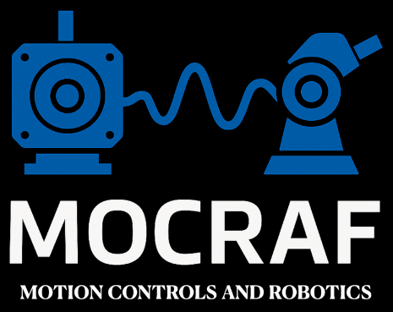
Maintenance & Operation Support
Xavier Serra-Gallifa, Electronics
21/09/2025

Slide 2
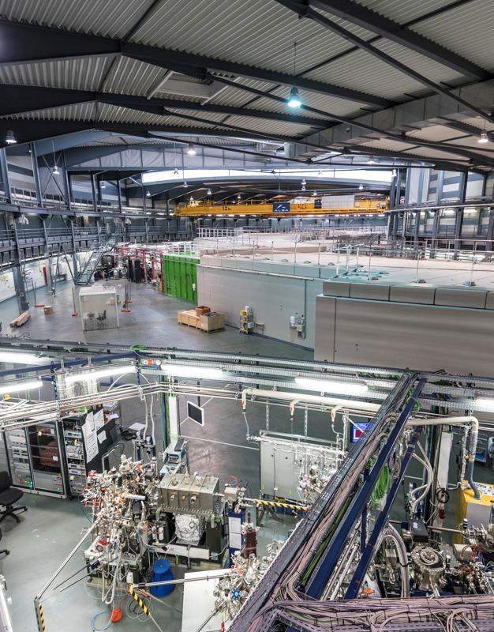
Strategy of Operation Support
Maintenance is applied on the mechanics, but not in the Controllers neither the motors
So strategy to ensure operation is fast resolution of incidents
ALBA has a 24-hour On-Call service during operation which should be able to solve the incident
The issues detected on the controllers are mainly due to some action like sudden stop, powercut, collision, wire cut, mistake on connections.

Slide 3
How optimize the incident resolution
Understand the origin of the problem
· Documentation of past incidents
Locate what is failing
· Documentation of the equipment
Replace the damaged components
· Stock of the components
· Use Standard components
· Management of configurations

Slide 4
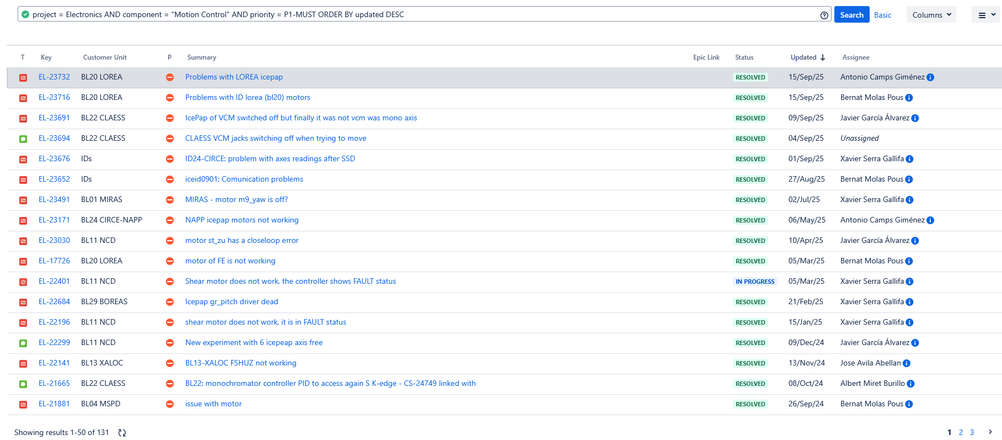
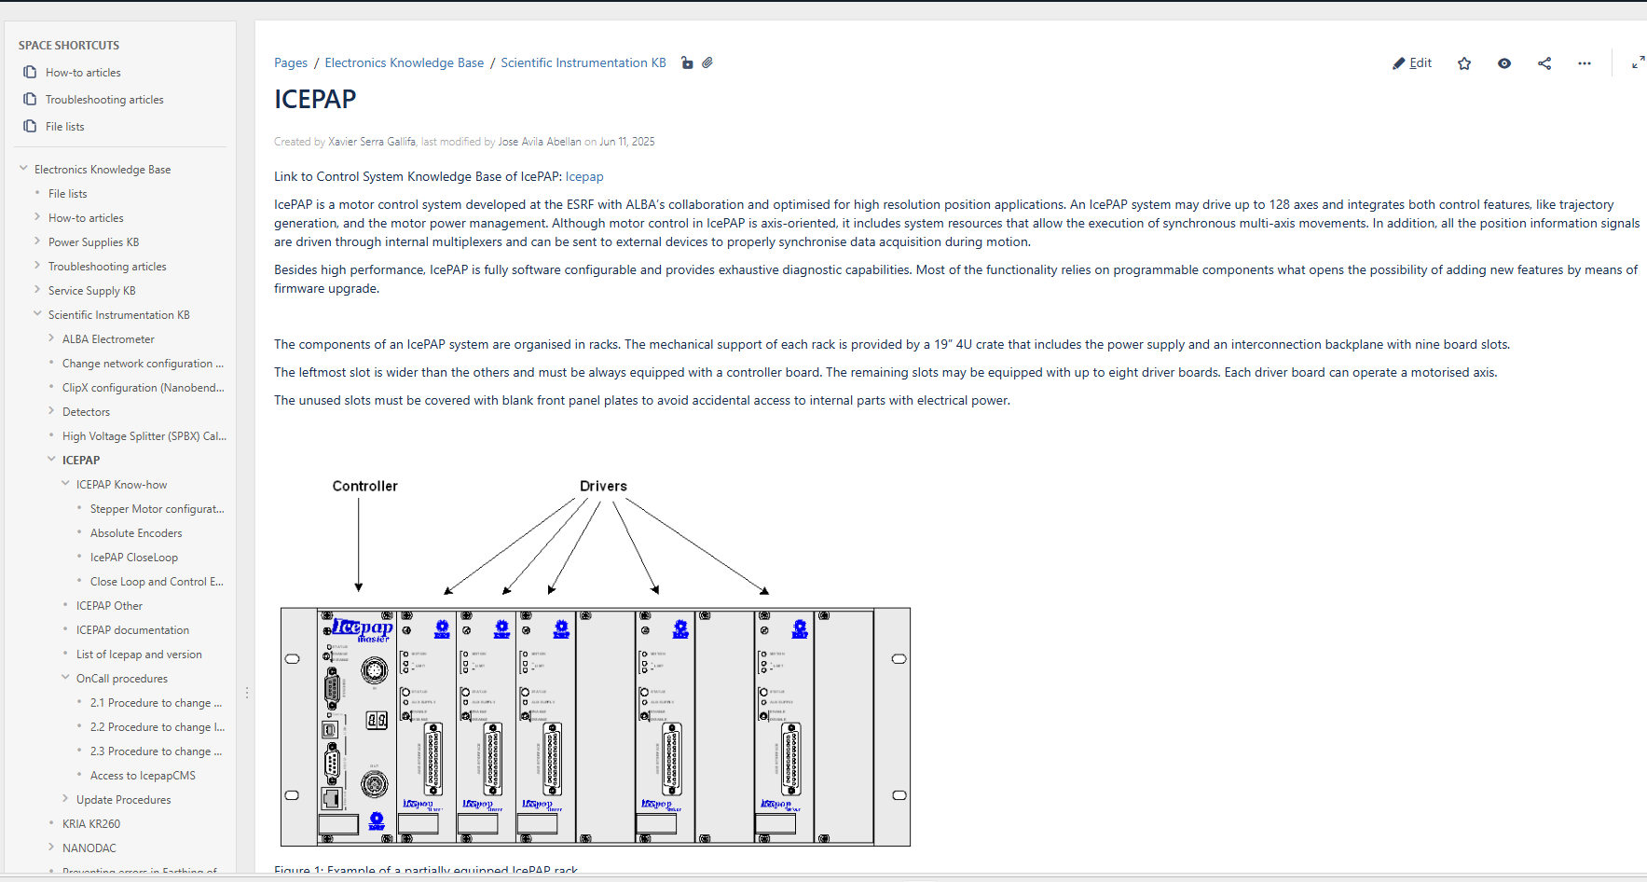
How optimize the incident resolution: Understand
Documentation of basic procedures or the most probable for problem solving: Confluence knowledge base
Look for past incidents to find similar issues

Slide 5
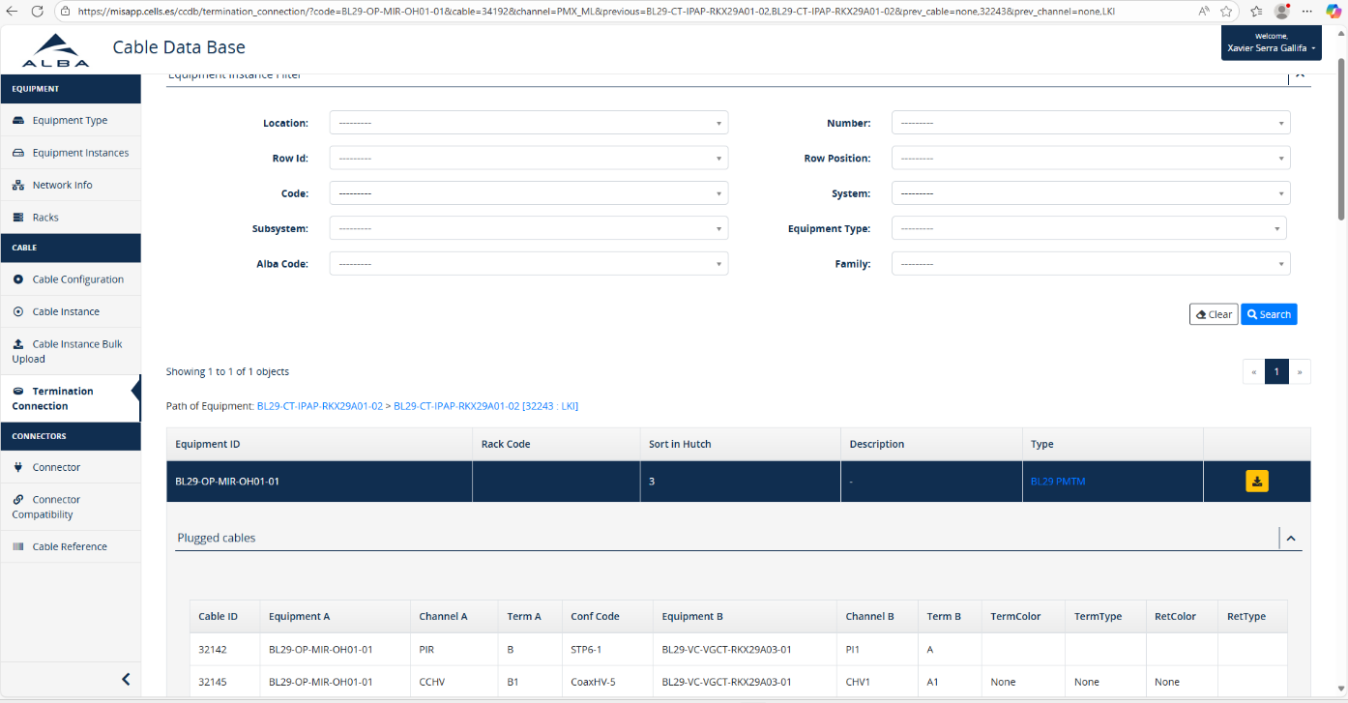
How optimize the incident resolution: Locate
Documentation of the equipment and cabling to locate the failing element: Cable database

Slide 6
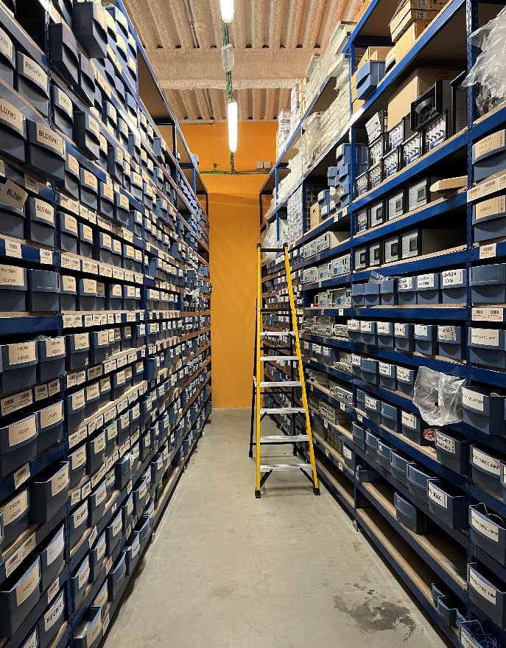
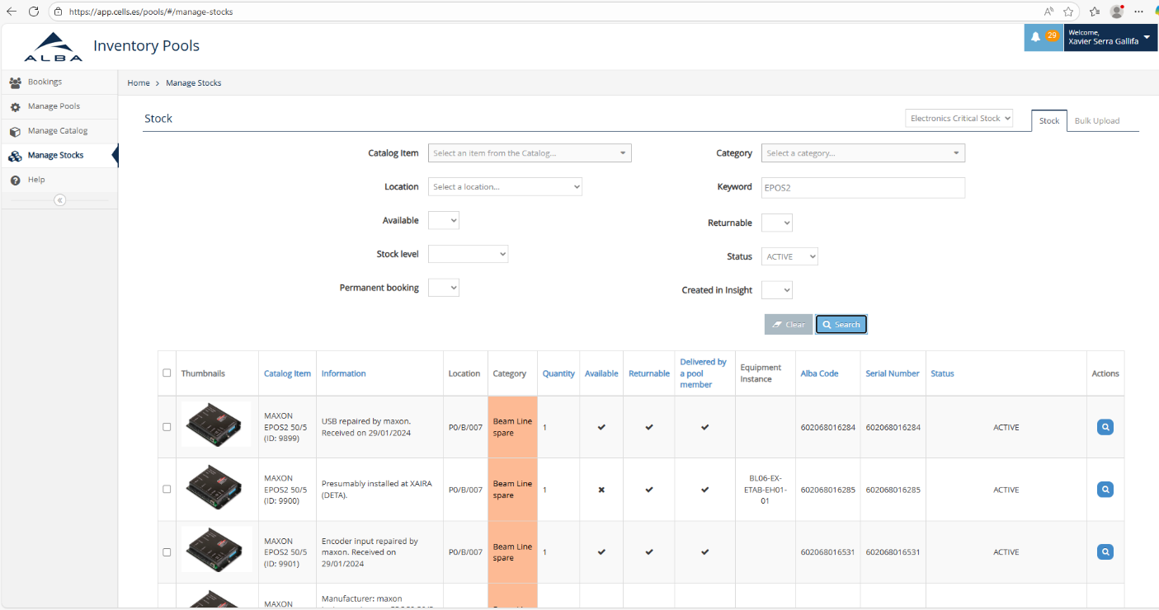
How optimize the incident resolution: Replacement
Stocks management tool: Inventory pool
Easy location of spare units
Tidy warehouse
ITEM SEARCH
LOCATION ON WAREHOUSE

Slide 7
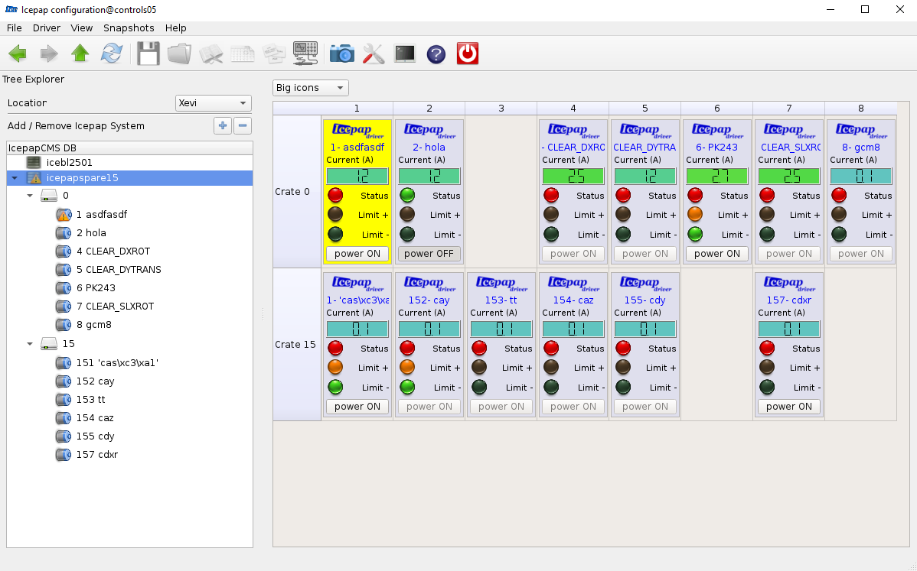
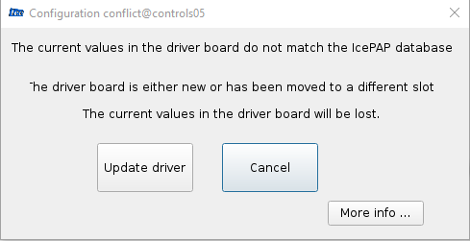
How optimize the incident resolution: Replacement
Controllers Configuration upload
Configuration on the cable database
Configuration on IcepapCMS
Icepap is the standard motor controller in ALBA
IcepapCMS alows also parameters tracking

Slide 8
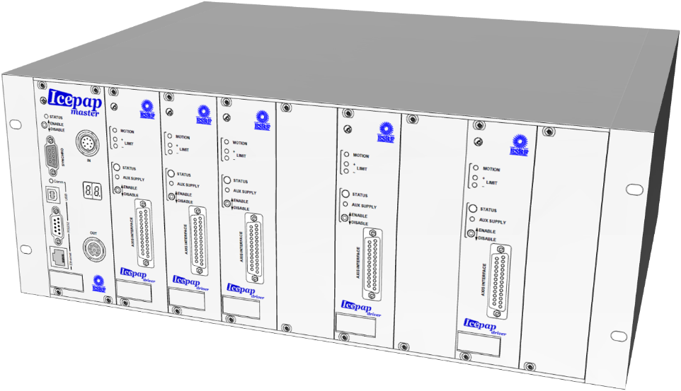
How optimize the incident resolution and stock: Use of standards
This strategy requires to have spare of all the equipment installed.
This is told to users on the project design stages
Budget for spares
Icepap is the standard controller for steper motors and covers more than 90% of motion controllers in ALBA.
ICEPAP is a collaboration project between ESRF ALBA and MAXIV
IcepapCMS allows an easy replacement
IcepapCMS tracks parameter changes

Slide 9
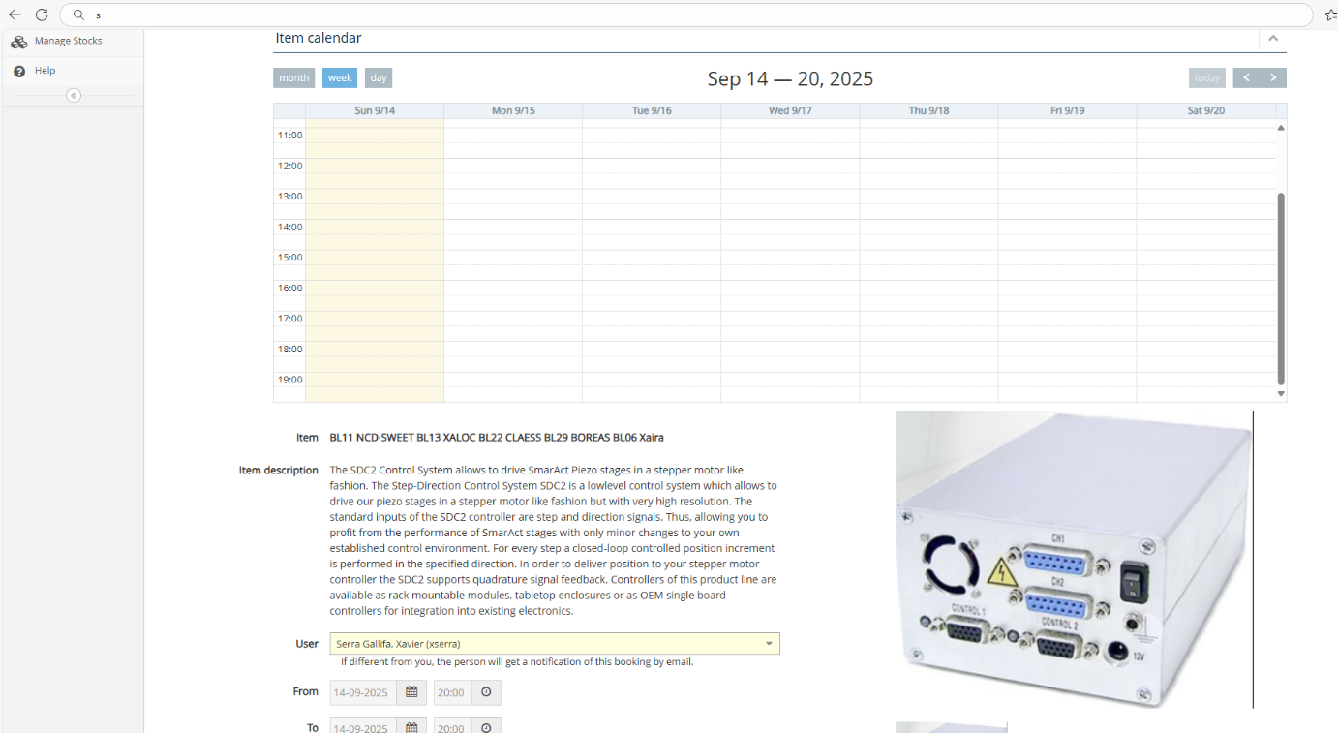
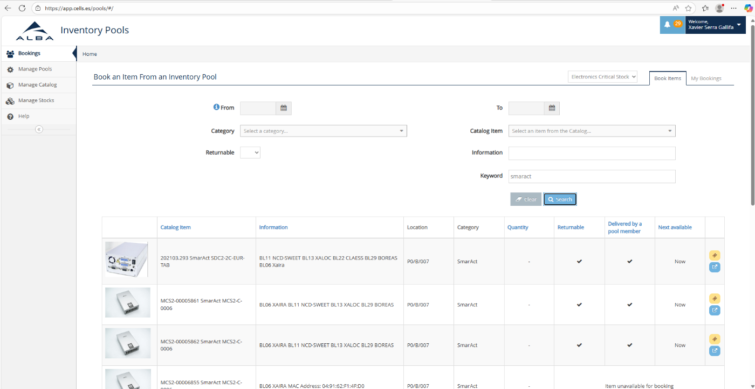
Keep Inventory as tidy as Warehouse
Report all temporal & permanent bookings
Remove equipment that is not working
Withdraw equipment indicating the installation location
Introduce repared and new equipment

Slide 10
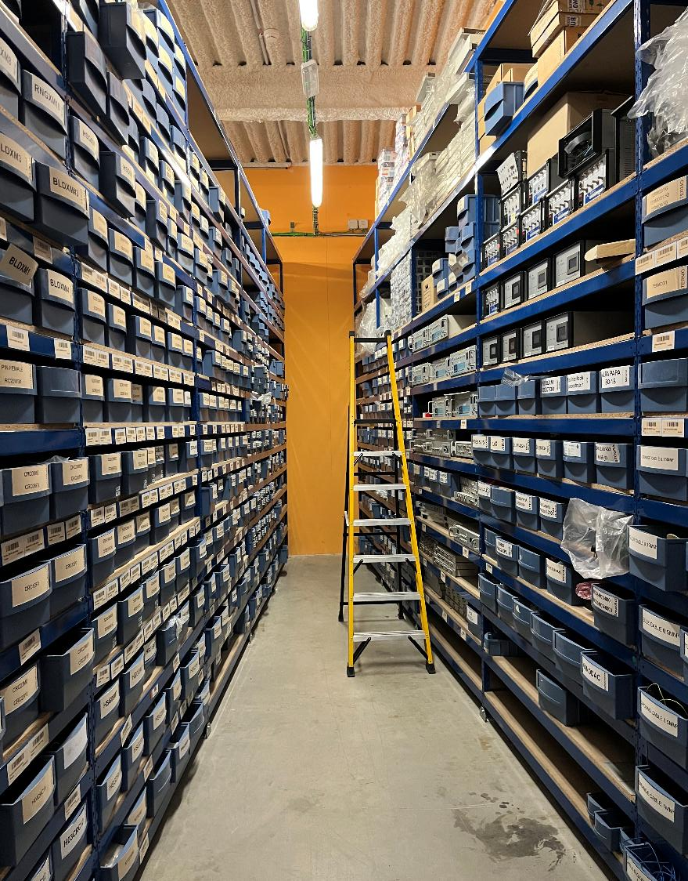
Inventory tool not only for equipment also for consumables like connectors, wires,
The Inventory pool application and cableDB are used to keep a control of the needed stocks and spares

Slide 11
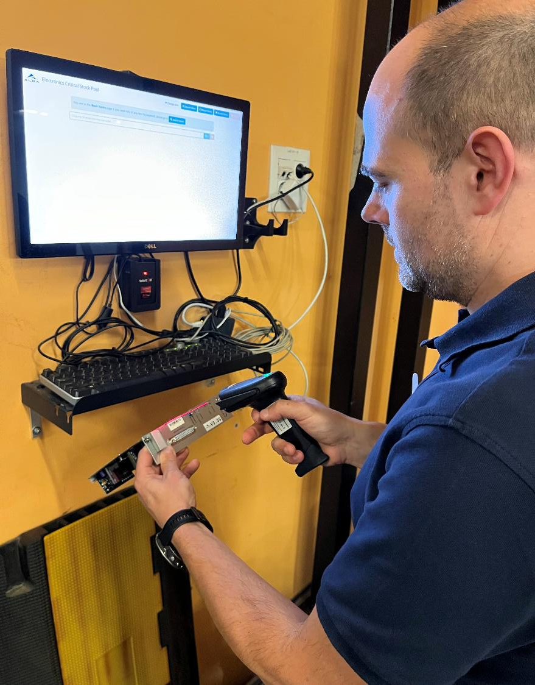
Ease Stock withdraw
Stock management terminal on the store
All spares with a code bar for easy management

Slide 13
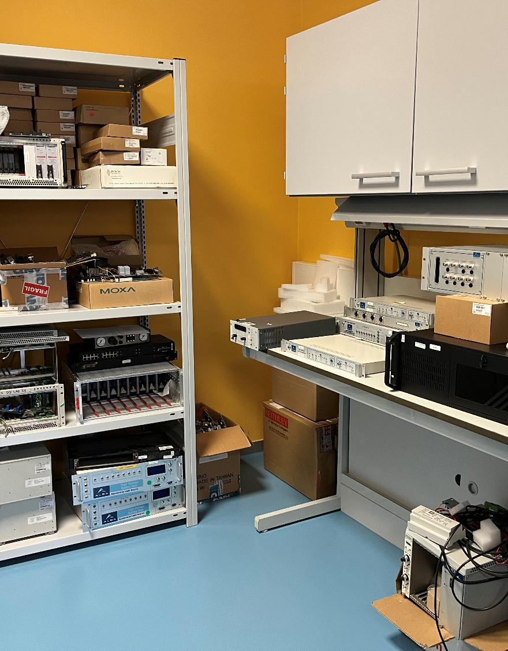
The Repair Corner

Slide 14
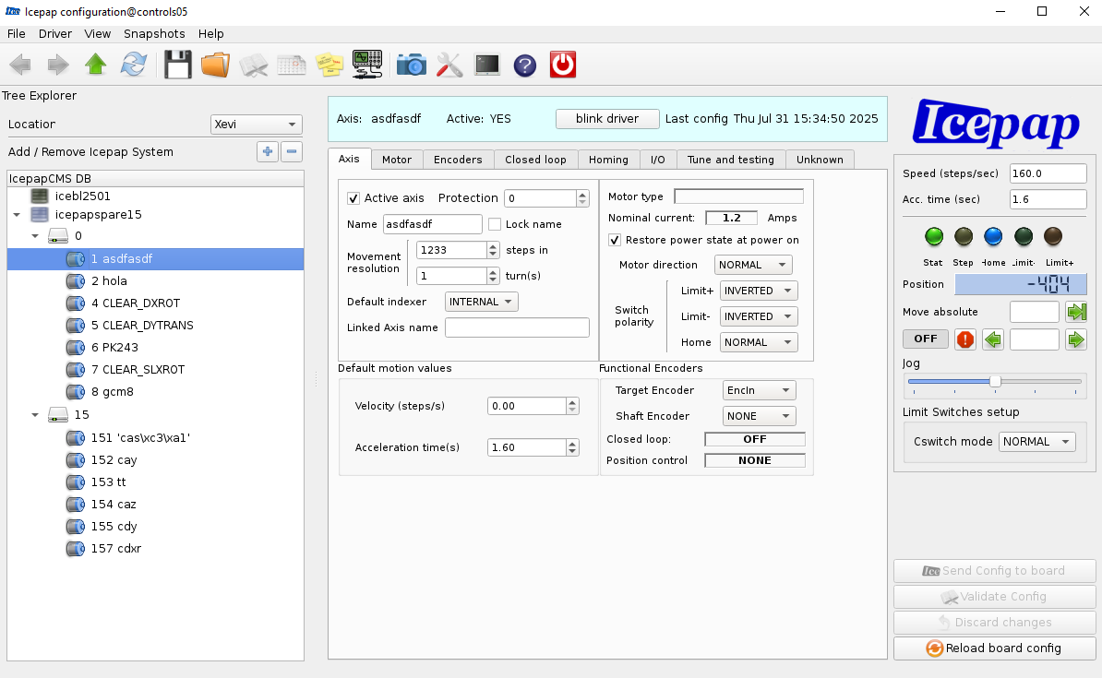
How optimize the incident resolution: Replacement
Controllers Configuration upload:
Configuration on the cable database
Configuration on IcepapCMS

