Slide 1
Open source EtherCAT motion control, ECMC, at PSI
Anders Sandström
22.09.25
Notes:
Hello, my name is Anders Sandström from PSI.
Today will talk about ECMC platform and how we uses it at PSI

Slide 2
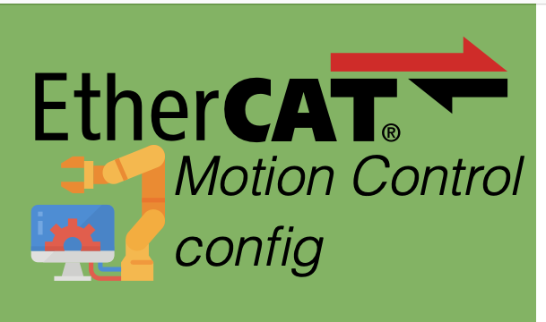
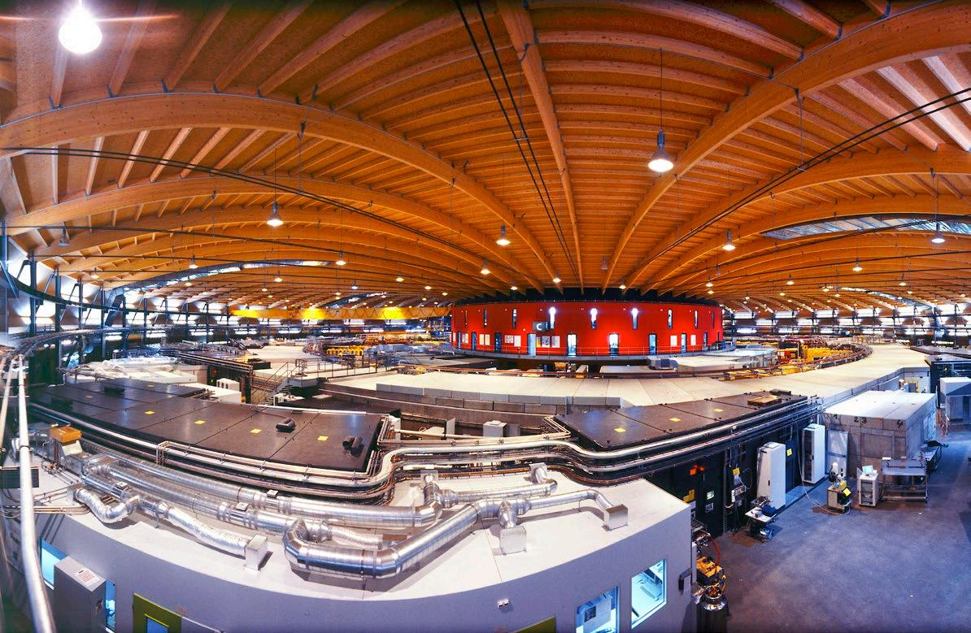

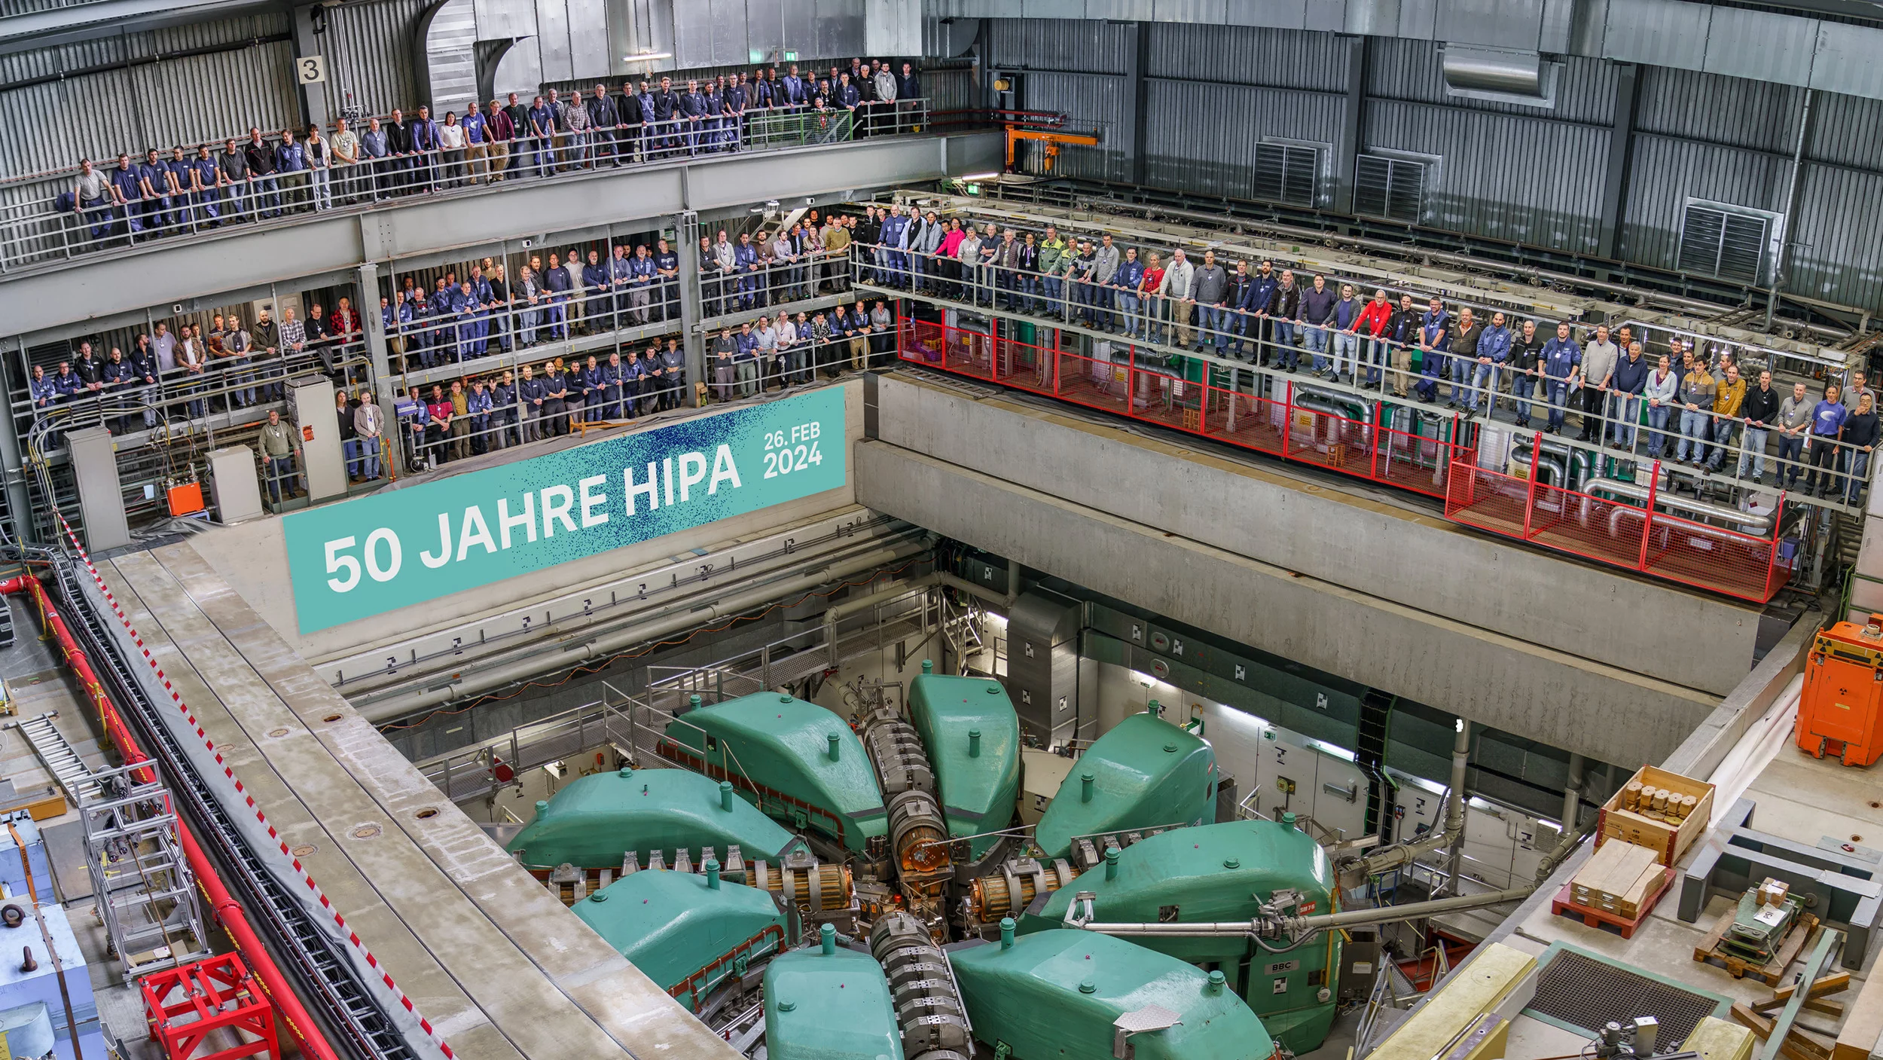
Introduction
ECMC = open-source motion control framework for EtherCAT hardware integrated in EPICS
Provides motion control, DAQ, soft-PLC scripting, plugin support
Several ongoing projects:
SLS 2.0 scope approx. 2000 axes
HIPA upgrade, HIPA IMPACT
Currently deployed on 650+ axes and growing fast, mainly in SLS, but also in HIPA, and SwissFEL
Main challenges at PSI: scale, flexibility, and combining motion + DAQ
www.beckhoff.com
SLS
SwissFEL
HIPA
Notes:
First a quick overview. ECMC is an open-source control framework for EtherCAT hardware integrated in EPICS Main functionality is motion control, data acquisition, soft-PLC scripting, and a plugin system which can be used for extensions.
Several ongoing projects, right now SLS2.0 and some HIPA projects in startup.
We are already running more than 650 axes in production, mainly at SLS, but also at HIPA and SwissFEL. And with SLS 2.0, this number will increase dramatically in the near future.
So the challenge is clear: we need a system that scales, that stays flexible, and that can combine motion control with data acquisition.

Slide 3
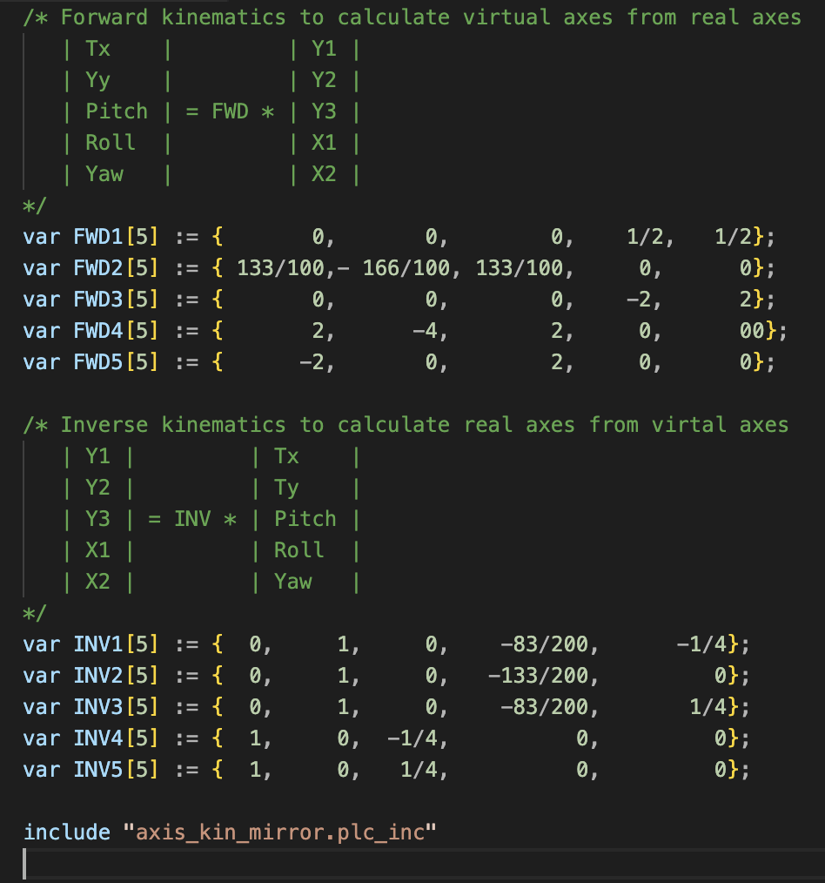
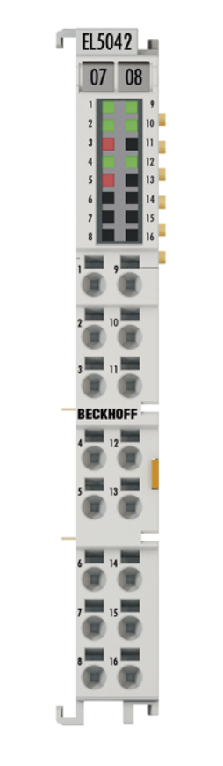
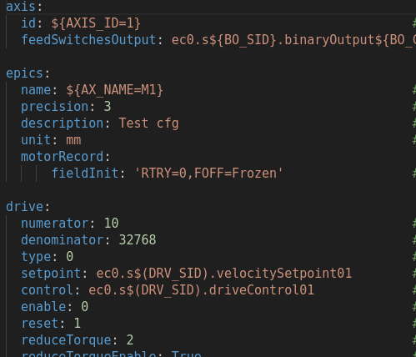
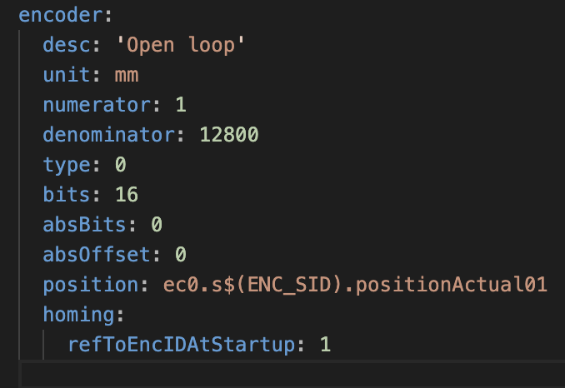
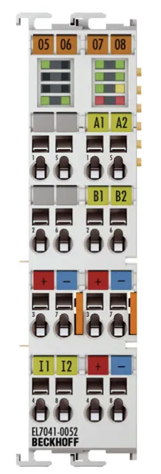
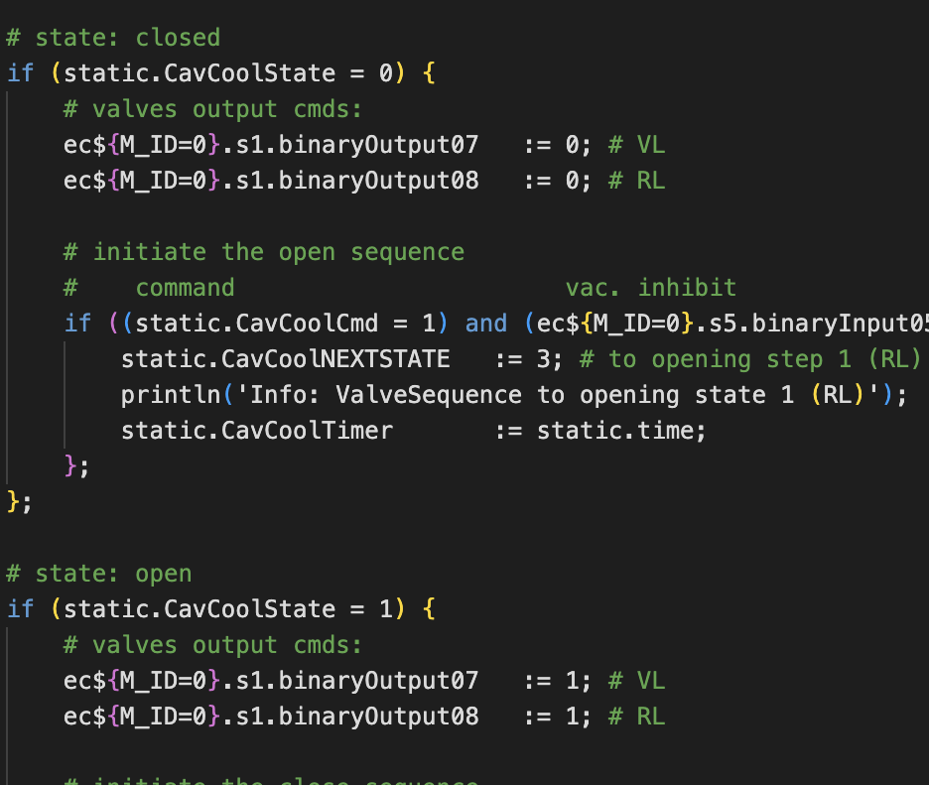
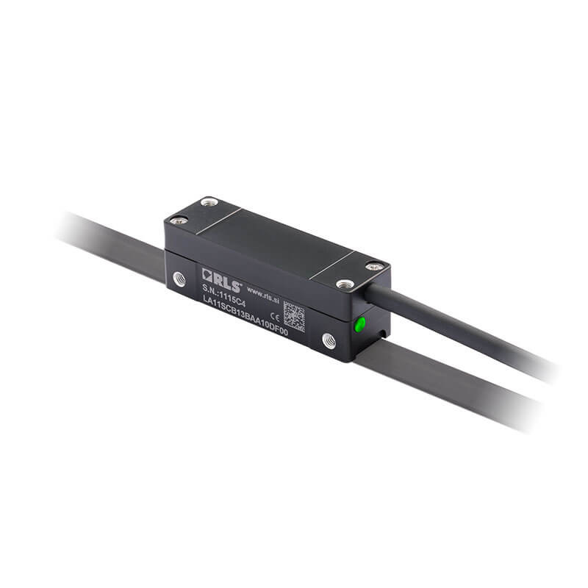
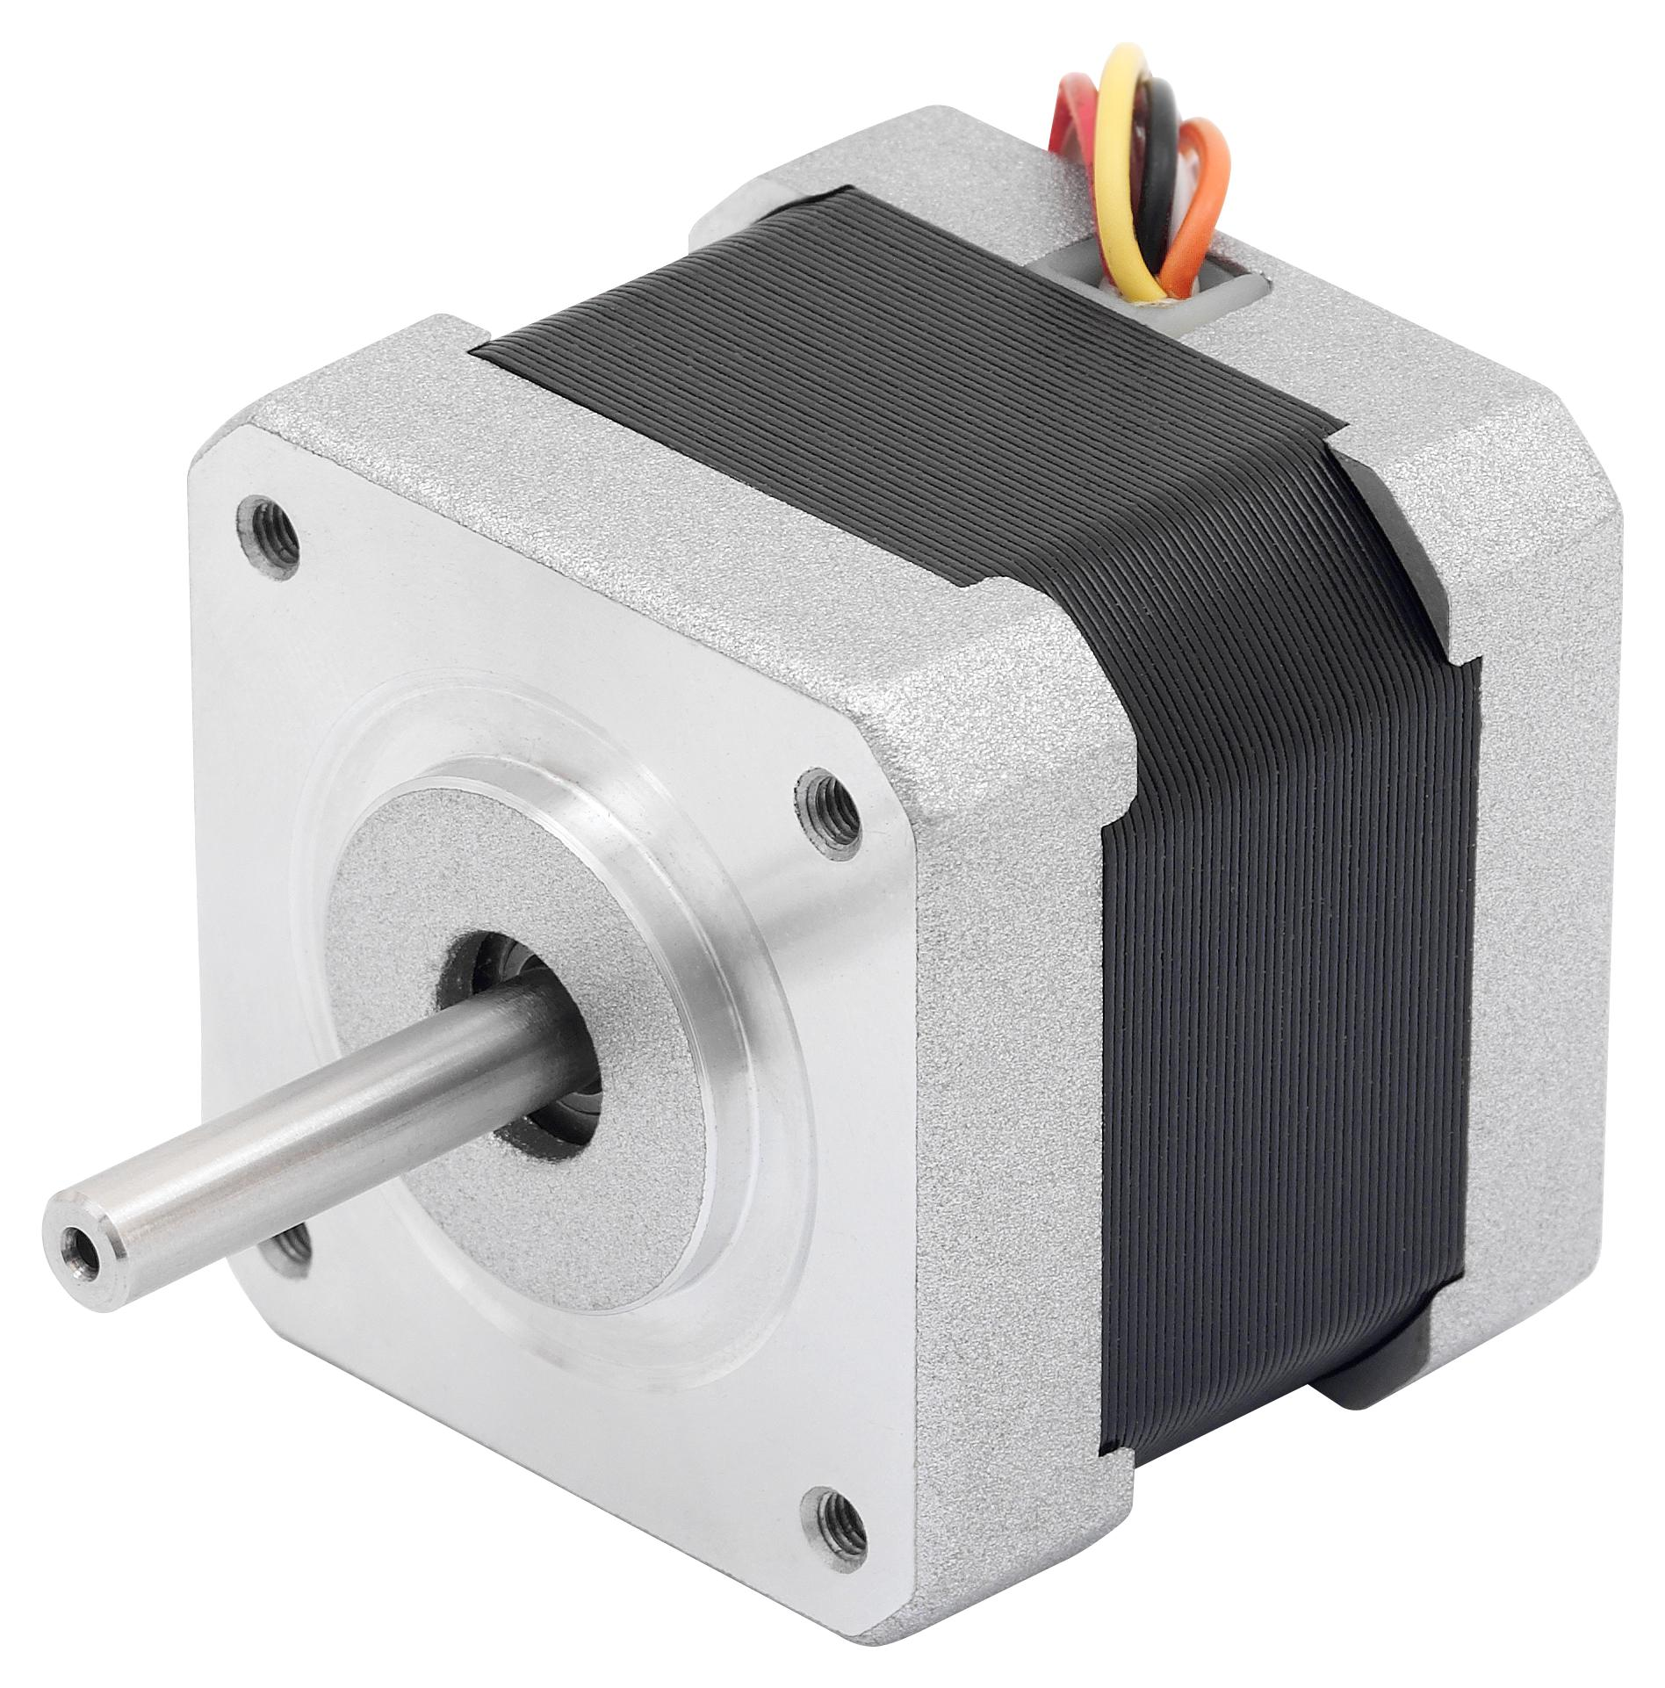
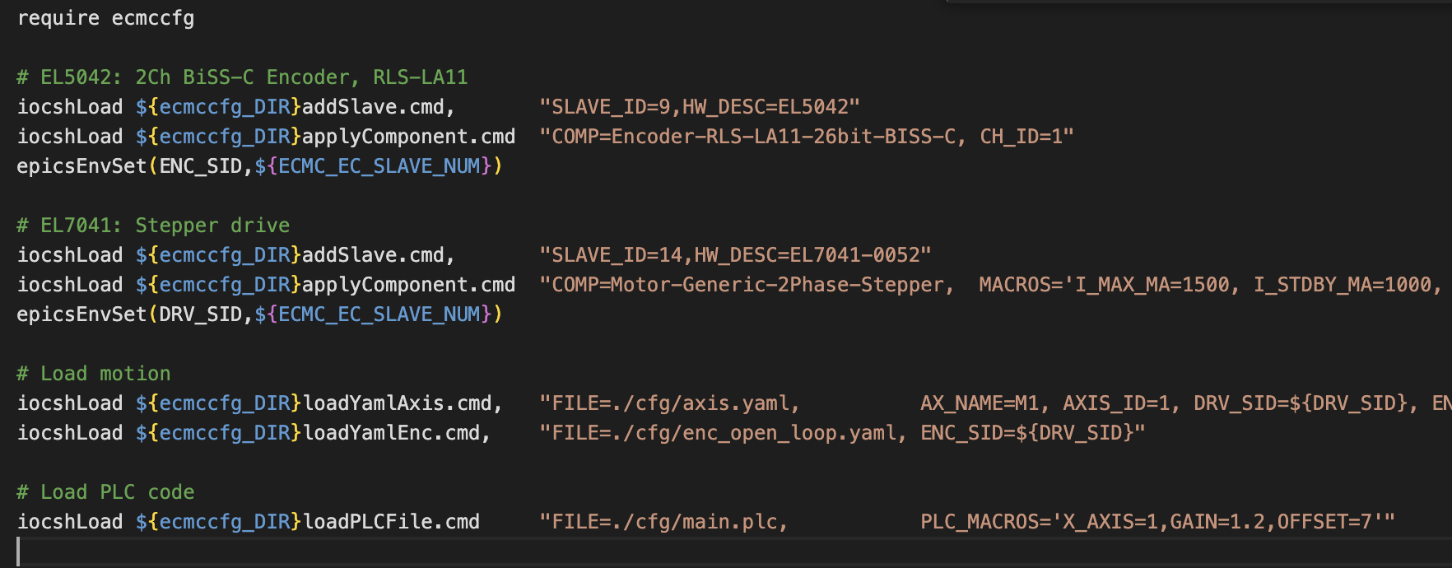
Streamlined Configuration
All configurations in EPICS startup script
No need for vendor specific applications or projects
Notes:
The high axes and system count resulted in that we put a lot of focus on configuration.
In an ECMC system, all configurations are defined in an EPICS startup script, using YAML files and standardized component blocks.
There’s no need for vendor specific applications or projects
.
This is our base structure, lets see how it looks when applied to real usecase

Slide 4
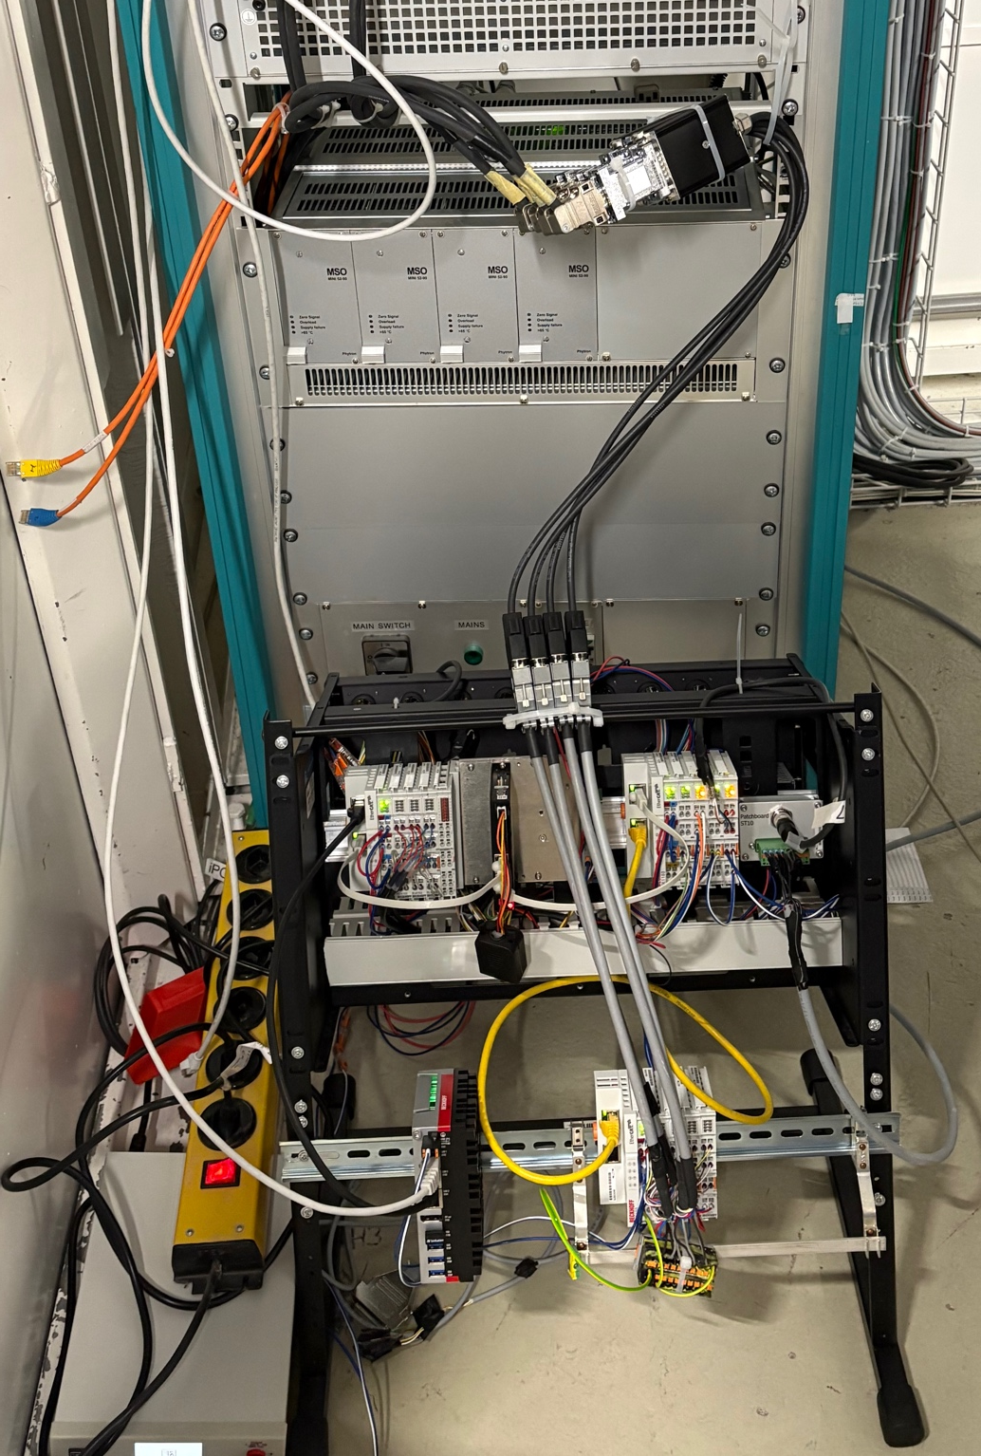
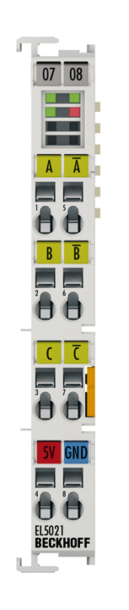
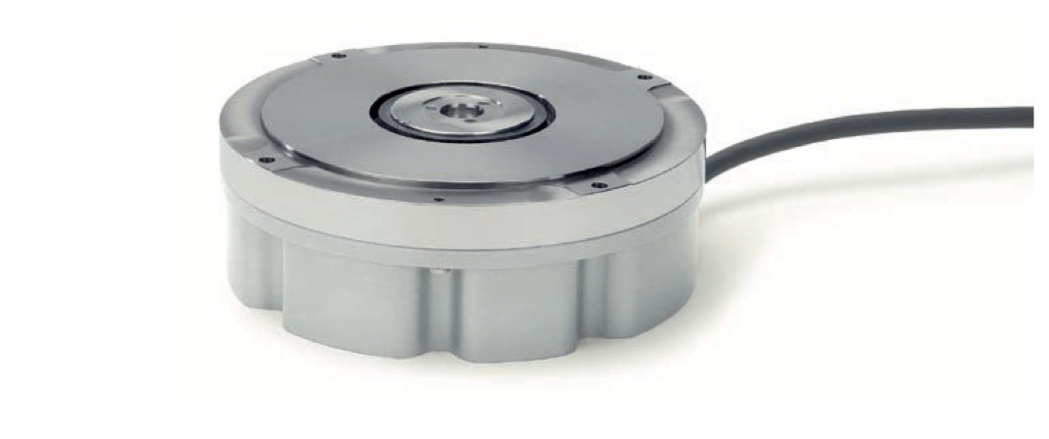
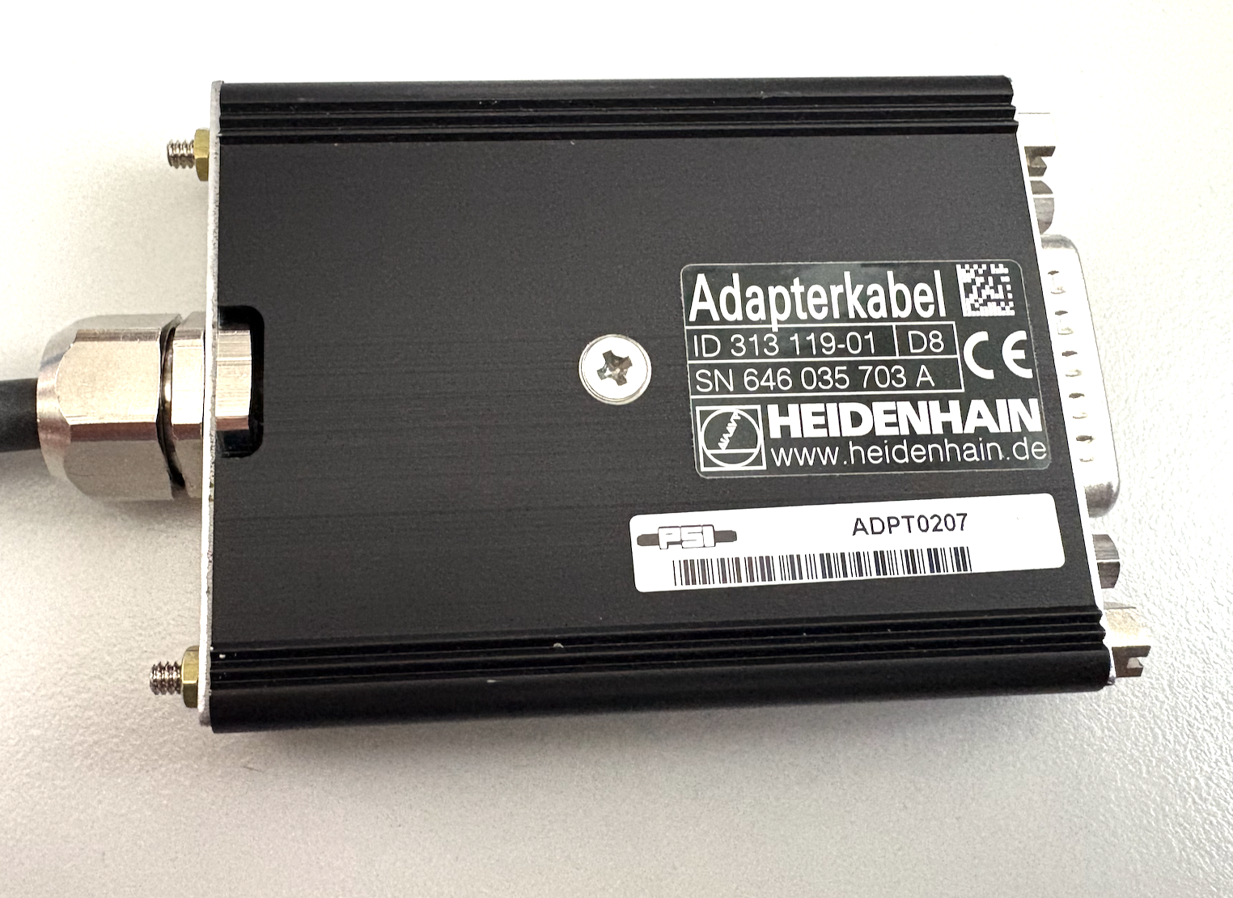
Hardware Integration Example: RON905 Encoder
High-accuracy rotary encoder (Heidenhain RON905)
Equipped with four analog sin/cos reading heads, offset by 90°.
Analog signals converted and then interfaced by 1 Vpp sin/cos module, EL5021, from Beckhoff
Positions from the 4 heads averaged to achieve maximum accuracy.
Calibration curves applied individually to each reading head to correct systematic amplitude and phase errors in analog signals.
Test setup
www.heidenhain.com
www.beckhoff.com
Notes:
Here is an example: the Heidenhain RON905 rotary encoder.
It uses four angular reading heads with analog sin/cos signals, which are converted and then read by a Beckhoff EL5021 module.
The signals from the 4 reading heads needs individual calibration curves and then to be averaged to achieve best accuracy
Let's look at the configuration.

Slide 5
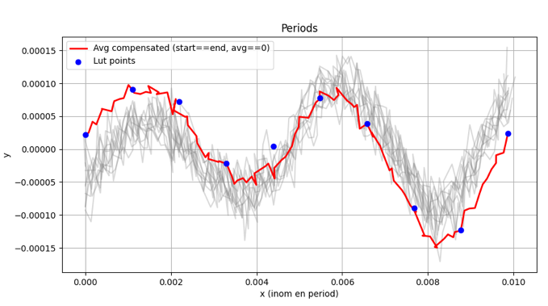
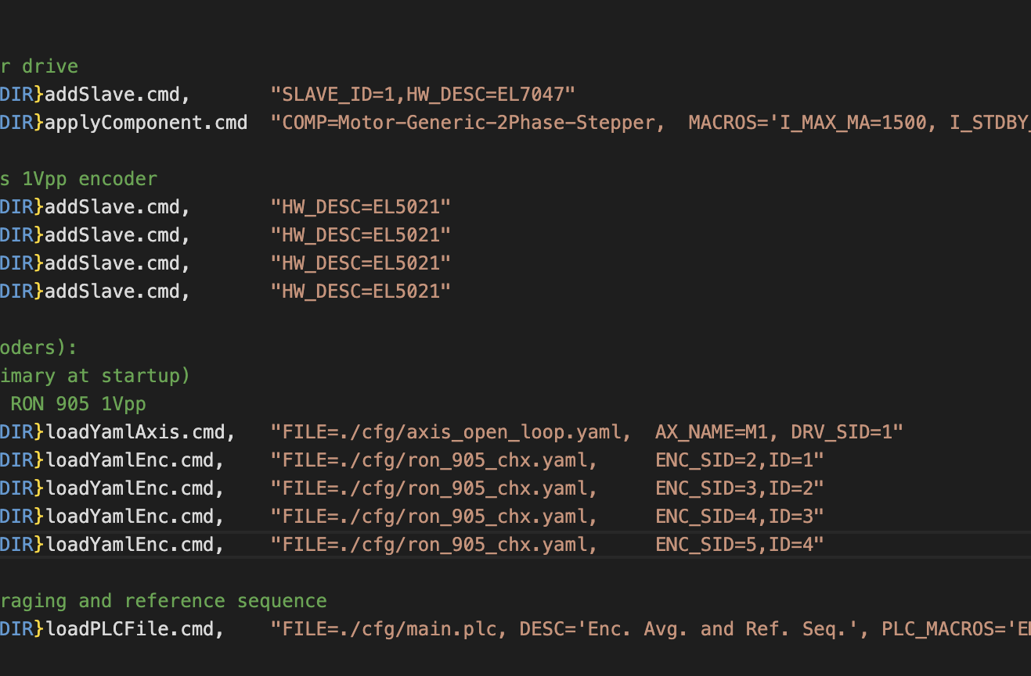
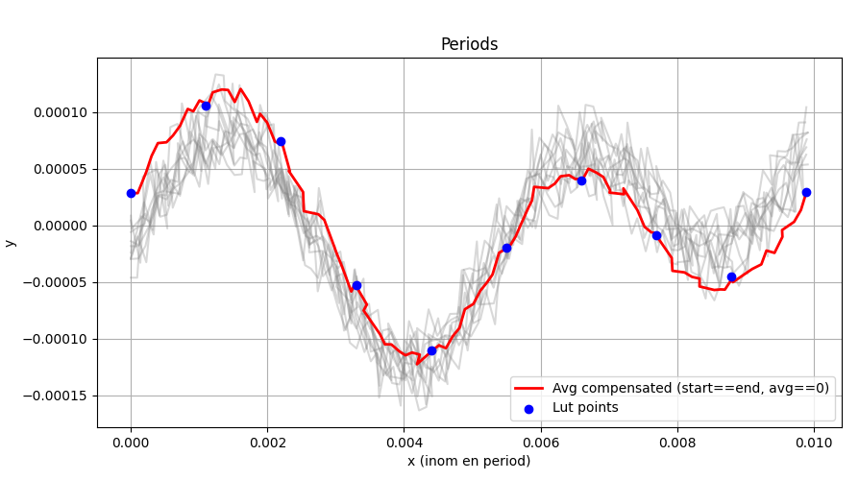
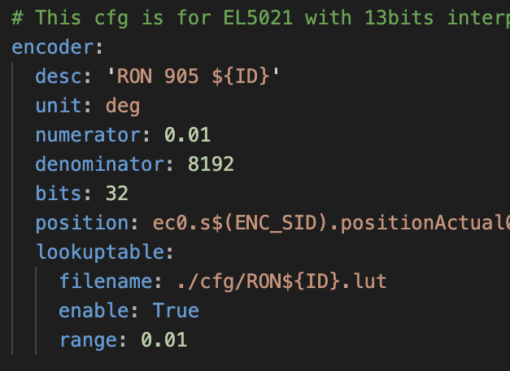
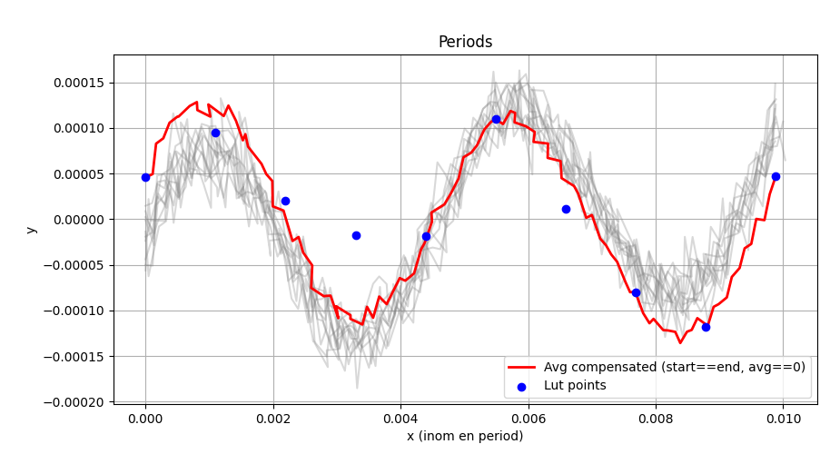
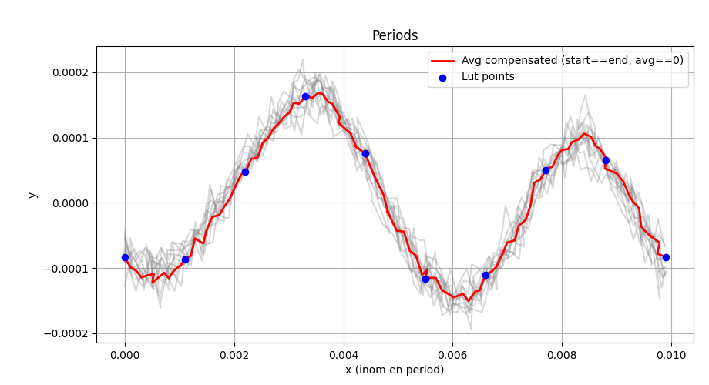
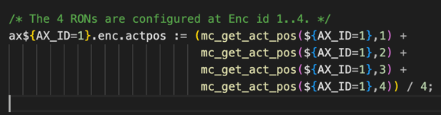
Hardware Integration Example: RON905 Encoder
Notes:
The startup file would look like this:
* Stepper
* Then the 4 encoder readers.
* Motion axis (linking the encoders with the drive)
* The 4 ecmc encoder configurations, note the calibration tables.
* And the averaging of the values are made in softPLC code.
And during fist tests it seems we get high accuracy,
As you can see the ECMC configurations are very flexible but at the same time consistent.
Another area of great importance for us is complex motion like synchronization and custom trajectories.

Slide 6
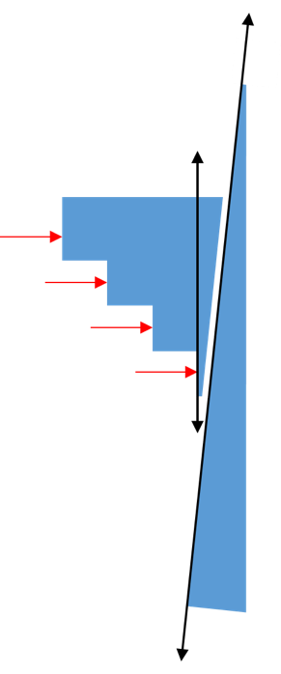
Virtual Commissioning
Virtual axes and PLC code enable early testing of kinematics, interlocks, and custom logic.
Reduces commissioning pressure, identifies mechanical limitations early, smooth transition to hardware.
Example: Front End filter system:
Beam attenuation with two retractable filters one staircase and one wedge
Virtual axes emulate both positioners and total thickness axis with closed-loop feedback.
Pre-commissioned logic, validated control models, commissioning focused on motor tuning instead of troubleshooting.
Notes:
We also started experimenting with virtual commissioning for some complex systems.
Not always access to the final hardware, start preparing configurations basedn
Example:
Filter system, one with discrete steps and one for fine adjustment.
Virtual axes for both filters and for the total thickness, in closed loop control.
By using virtual commissioning with ECMC, we can validate complex motion systems early, avoid surprises, and make hardware commissioning faster and smoother.

Slide 7
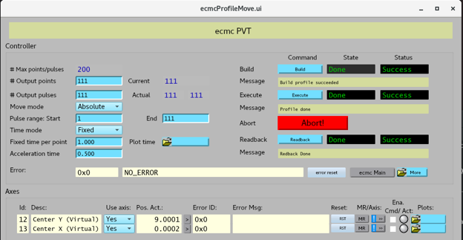
Complex motion: Position-Velocity-Time trajectories
Trajectory defined by array of positions, velocities and times.
Any ECMC axis can be configured with a PVT trajectory
Hardware / software triggers
Notes:
This is where position–velocity–time, or PVT trajectories, come in.
In ECMC, any axis can follow a PVT profile, which is simply an array of positions, velocities, and times.
This is a complement to trajectories defined by equations.
Both triggering over hardware and software is possible.
That means we can perform complex scans, for example area scans, while keeping everything synchronized.

Slide 8
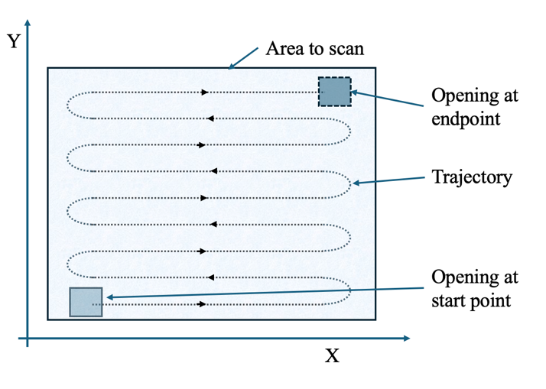
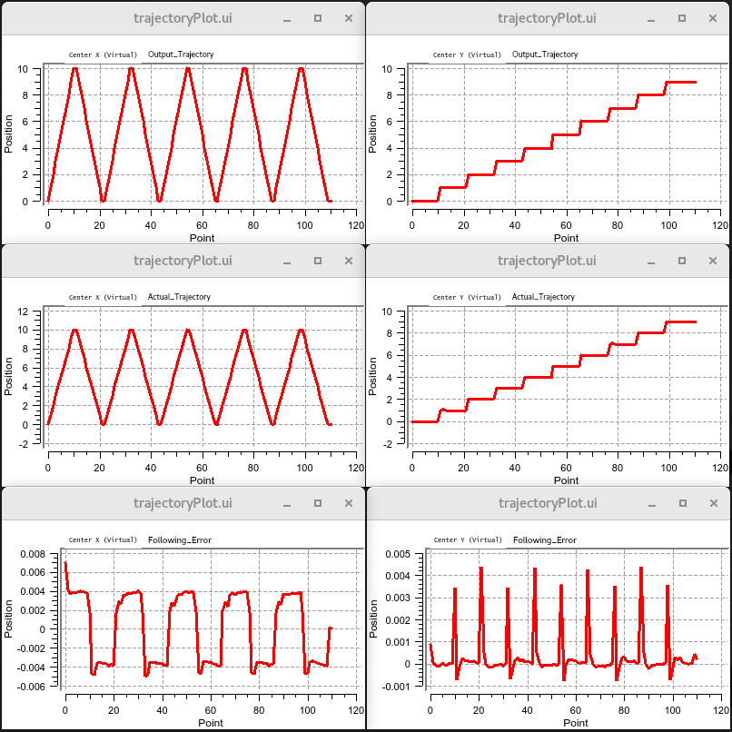
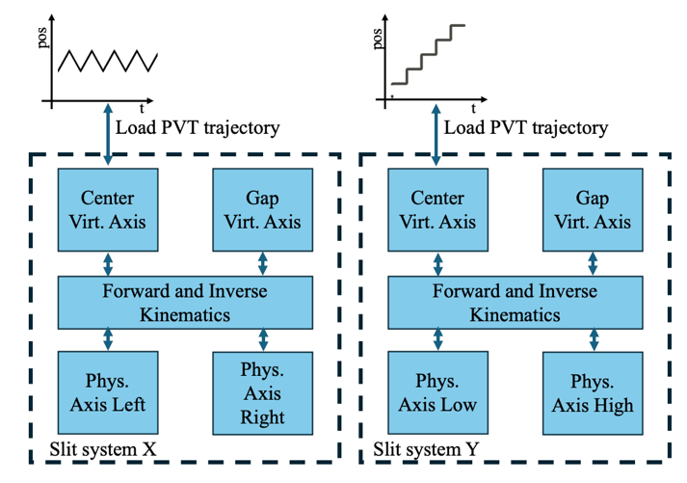
Example: PVT Area Scan
Notes:
In this example, two slit assemblies define an opening in X and Y. In ECMC, the blades are modelled as physical axes, while virtual axes define the center point and the gap. Kinematics link them together.
An area scan is then straightforward: a sawtooth trajectory in X and a staircase trajectory in Y. The PVT trajectories are transformed into the correct blade motions automatically.
What you see on the right are the resulting paths, actual values, and trigger points.

Slide 9
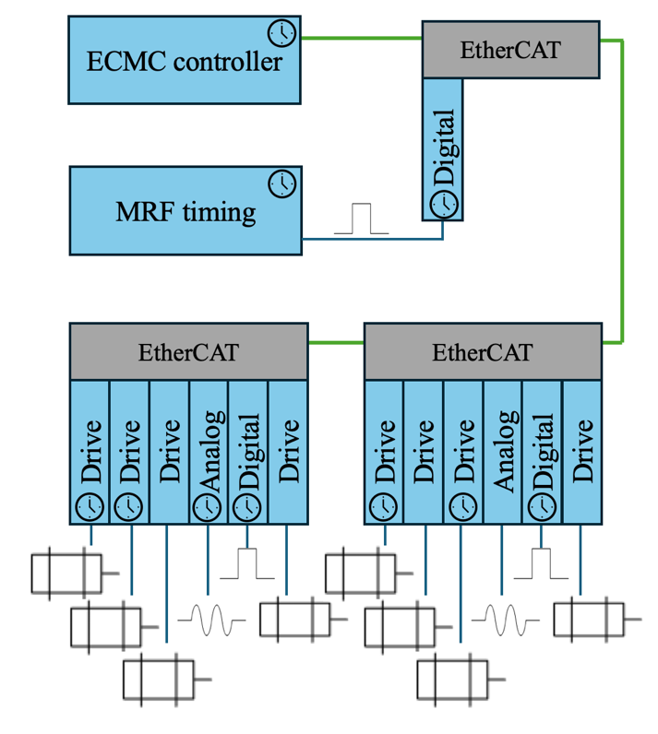
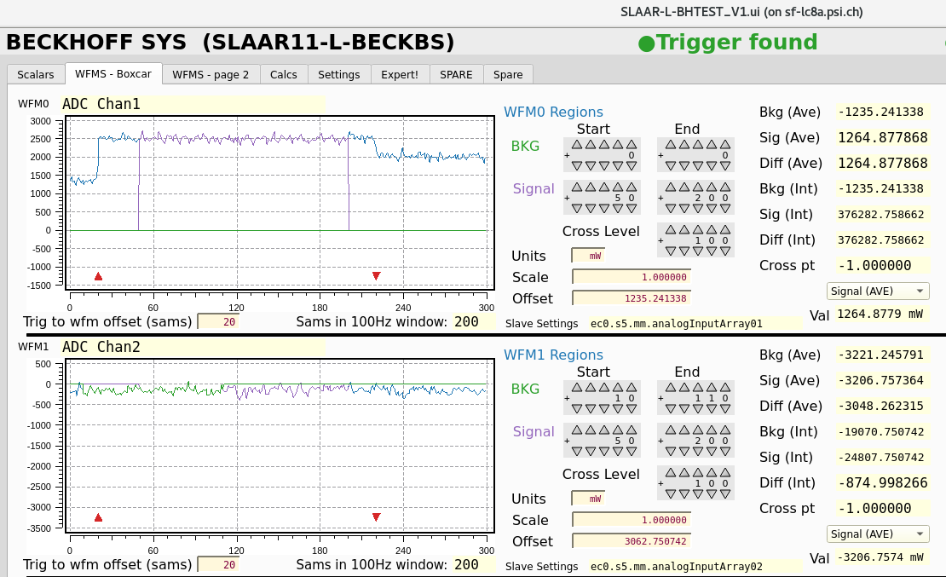
DAQ and Beam Sync. DAQ
Motion and DAQ integrated in ECMC
Sampling in kHz range (up to 100 kHz, defined by hardware)
Plugins for FFT and DAQ with timestamps
SwissFEL: beam-synch. DAQ by MRF timing system trigger to time stamped digital input.
Notes:
ECMC can also be used for DAQ of both motion related parameters as well as hardware signals.
We can sample at kilohertz rates, up to 100Khz defined by hardware
With hardware timestamps, we reach an accuracy of around 10 microseconds.
This gives us confidence that motion and measurements are truly synchronized.
So with ECMC we can unify motion and data in a single process, rather than stitching together separate systems. And when we look at the big picture, here are the key takeaways.”
sample-and-hold detector triggered at 100Hz.

Slide 10
Conclusion
ECMC is now being rolled out– approx. 650 axes today, increasing rapidly with SLS 2.0.
Streamlined configuration → fast, consistent commissioning
Virtual commissioning → reduce pressure at commissioning
PVT motion → complex, synchronized scans
DAQ, incl. beam-synchronous at SwissFEL → motion + data in one framework.
Open source & plugins → easy to adapt, extend, and interface with diverse hardware
Notes:
ECMC being rolled out
Working continuously to improve the system for instance:
streamlining configuration
Testing new ways of commissioning
Adding new features like PVT and beam sync DAQ
Basically, what made this possible is that it’s open source, we can add features as we want.

Slide 11
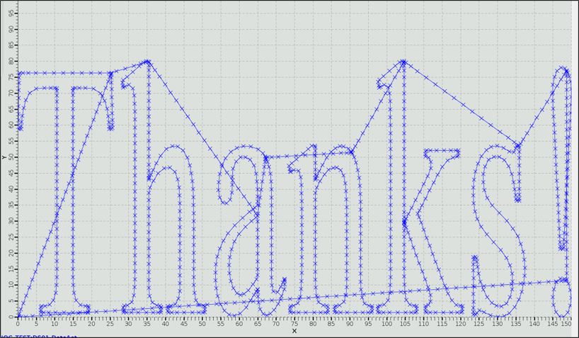
Thanks for listening!
Thanks to:
Felix Maier
Istvan Mohacsi
Alvin Acerbo
Xiaoqiang Wang
Tine Celcer
Edwin Divall
XY-stage, “Thanks” by CNC G-Code: https://git.psi.ch/motion/ecmc_plugin_grbl

Slide 12
References
[1] EtherCAT organization: https://www.ethercat.org
[2] Etherlab open source EtherCAT master: https://etherlab.org
[3] EPICS: https://epics-controls.org
[4] EPICS motor: https://epics.anl.gov/bcda/synApps/motor/index.html
[5] MRF, Micro Research Finland: www.mrf.fi
[6] ecmc_plugin_daq: https://github.com/paulscherrerinstitute/ecmc_plugin_daq
[7] Beckhoff Automation: https://www.beckhoff.com/
[8] Heidenhain: www.heidenhain.com

