Slide 1
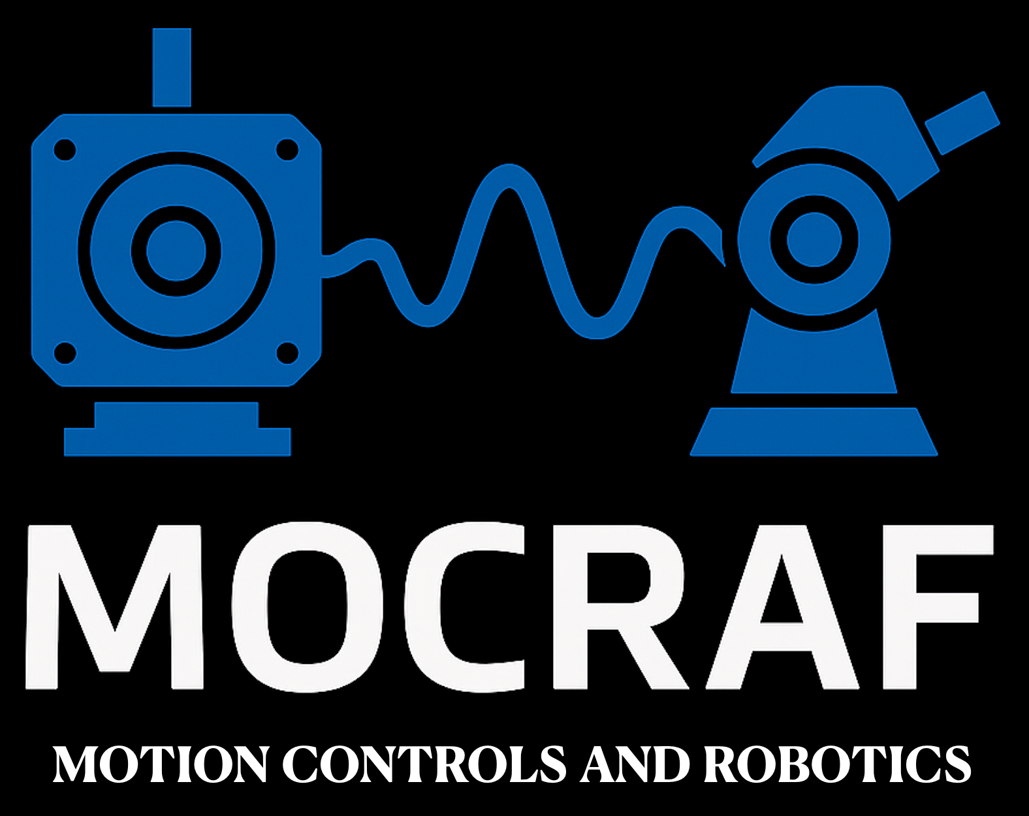

Obsolescence and upgrades of Diamond Motion Systems
ICALEPCS’25 CHICAGO

Slide 2
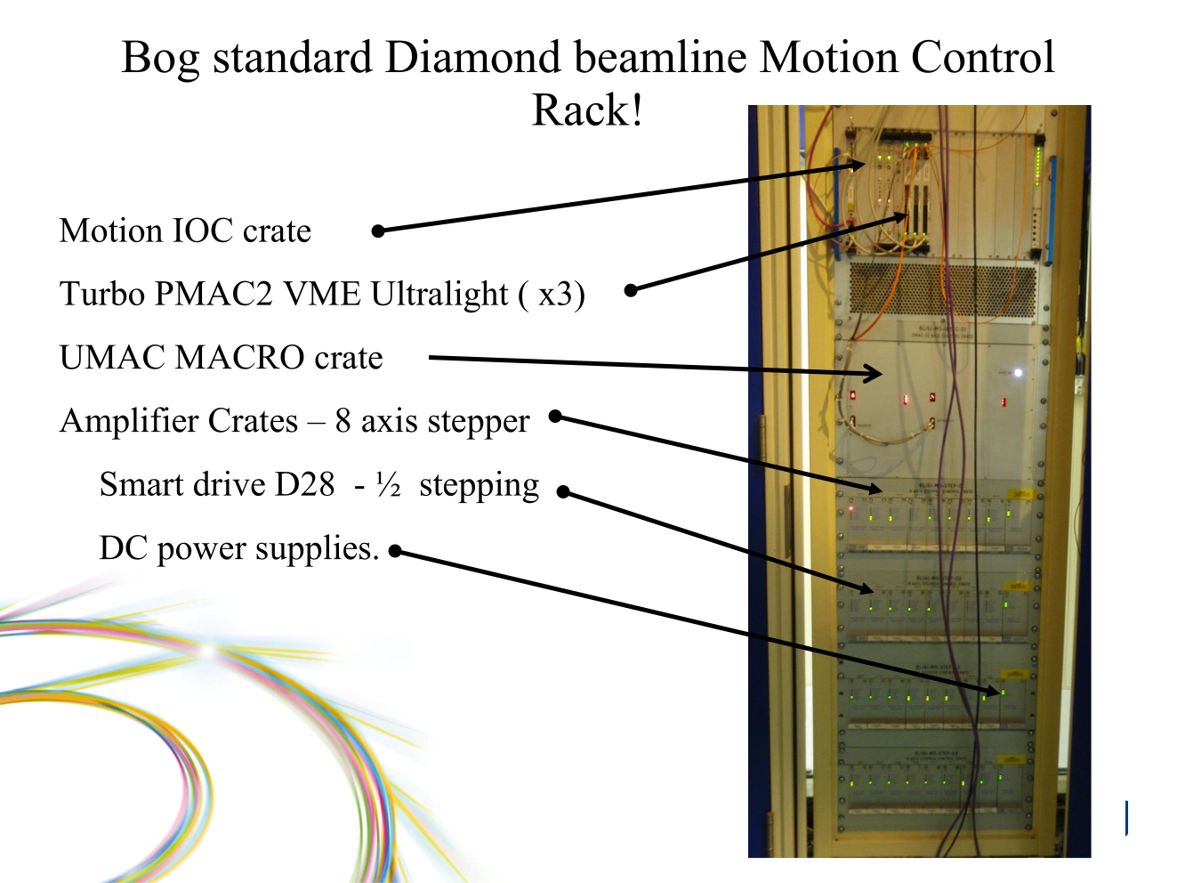
Phase-1 standard Diamond beamline Motion Control Rack!
November 2006.
Beamline I16 completes first pass motion commissioning.
Controls engineer Pete Dennison
Commissioning effort supplied by Micromech since Aug 2006
Bog standard Diamond beamline Motion Control Rack?

Slide 3
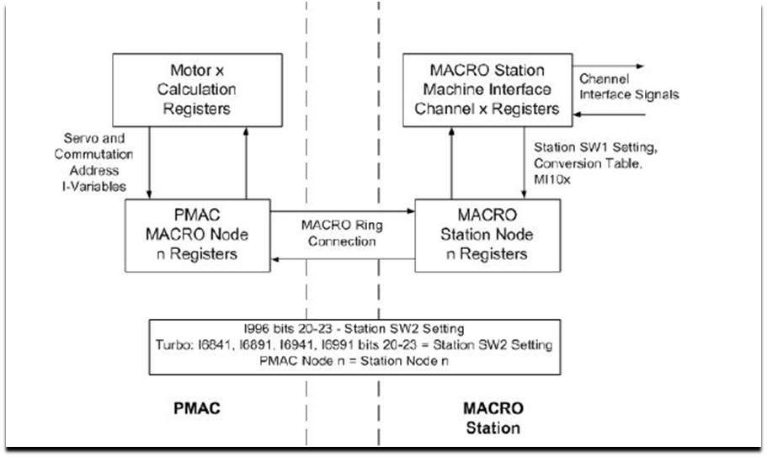
UMAC MACRO CRATE
16 Axis UMAC MACRO expansion card
3U high Eurocard allows PMAC to control remote amplifiers via fibre optic interface up to 3Km distant
ACC 24 and ACC11 expansion cards
Acc 24 E2-x . Motor control accessory card
-S version provides step and direction output for 4 steppers
-A version provides +/- 10v demand output for 2 or 4 servos
Both provide 1 channel of quadrature encoder input per axis
Both provide 4 user inputs per channel – Plim Nlim Home User
-A provides relay output for amp enable signal
Acc 11 E Digital i/o card
provides 24 digital inputs & 24 Digital outputs opto coupled
16 out reserved for amplifier enable in stepper crates
16 in reserved for amplifier healthy signal

Slide 4
Phase-1 standard Diamond beamline Motion Control Rack!
Amplifier crates
Two version- 8 axis crate each amplifier has it’s own front plate, and 16 axis crate with one combined front plate.
16 axis crate has two power supplies to allow for different bus voltages ( 32Vdc up to 160 Vdc)
SMART DRIVE D28 full/half step amplifers ( 8 axis crate only). Some few have microstepping . Same amplifier as used on front ends.
STOGRA ST: Range of amplifiers giving from 2A to 16A each with up to 1/5 step as standard (1000 step per rev from a standard 1.8° motor) Options include microstepping up to 128000 per rev, and vacuum versions with 10% standby current (usually 50%). Available in 8 or 16 axis versions.
Stitching it all together
32 axis motion 16 axis stepper based UMAC crate + … Options of 12 stepper + 2 - 4 servo ; 8 stepper +2, 4 or 6 servo
SUSTAINABILITY / MAINTENANCE
Allowed us to create standard control.pmc files that required only minor adjustment prior to the commissioning process.
Creating a standard Mapping file for first 24 axis significantly reduced fault finding effort.
Standard cabling broken down into groups of 4 axes for motor demand, motor control, Limit switch feedback.

Slide 5
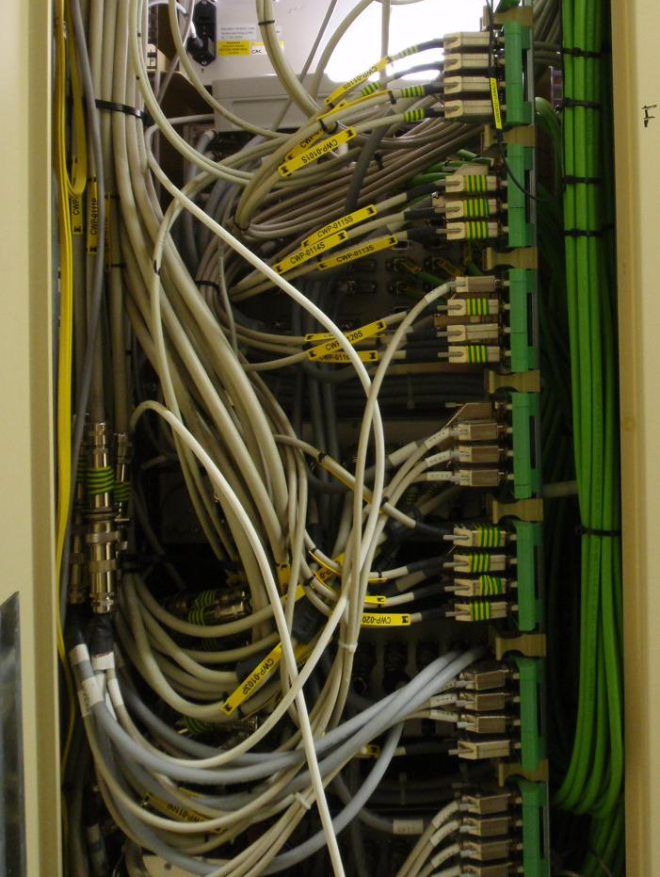
Drivers for change
Cost of Implementation
Average cost per axis approaching £1600
VME Bottlenecks
VME driver only allows for single channel read write. Ethernet allows for multiple read write access.
Installation Nightmare
Crowded racks are virtually impossible to work in.
Limit PIMs on rack sides encourage poor wring practice.

Slide 6
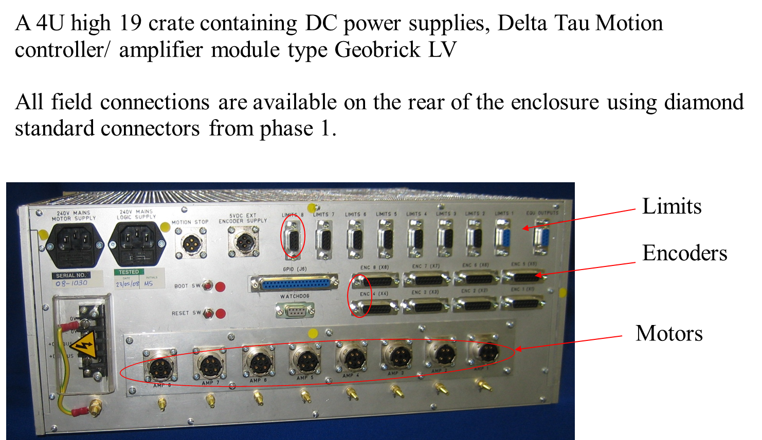
GeoBrick-LV-IMS

Slide 7
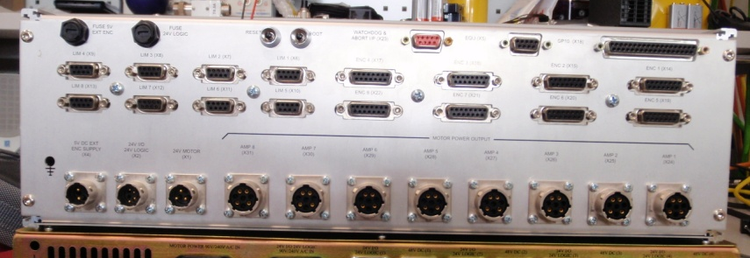
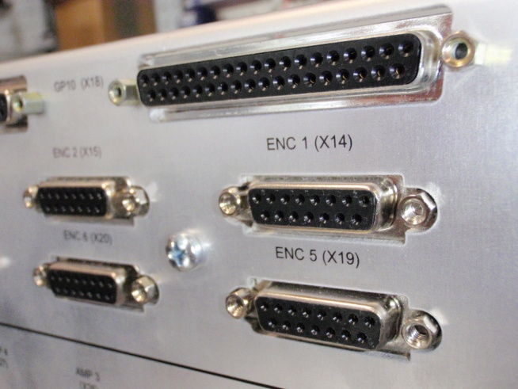
GEOBRICK –LV-IMS-II Maintain the same Connector interface
The LV-IMS-II keeps the same connectors as our existing LV-IMS design
Motion-STOP and WATCHDOG connectors are integrated into 1 connector
Limits connectors moved from top row to middle, same orientation as encoder axes
DC input connectors use different UTO types to prevent cross connection

Slide 8

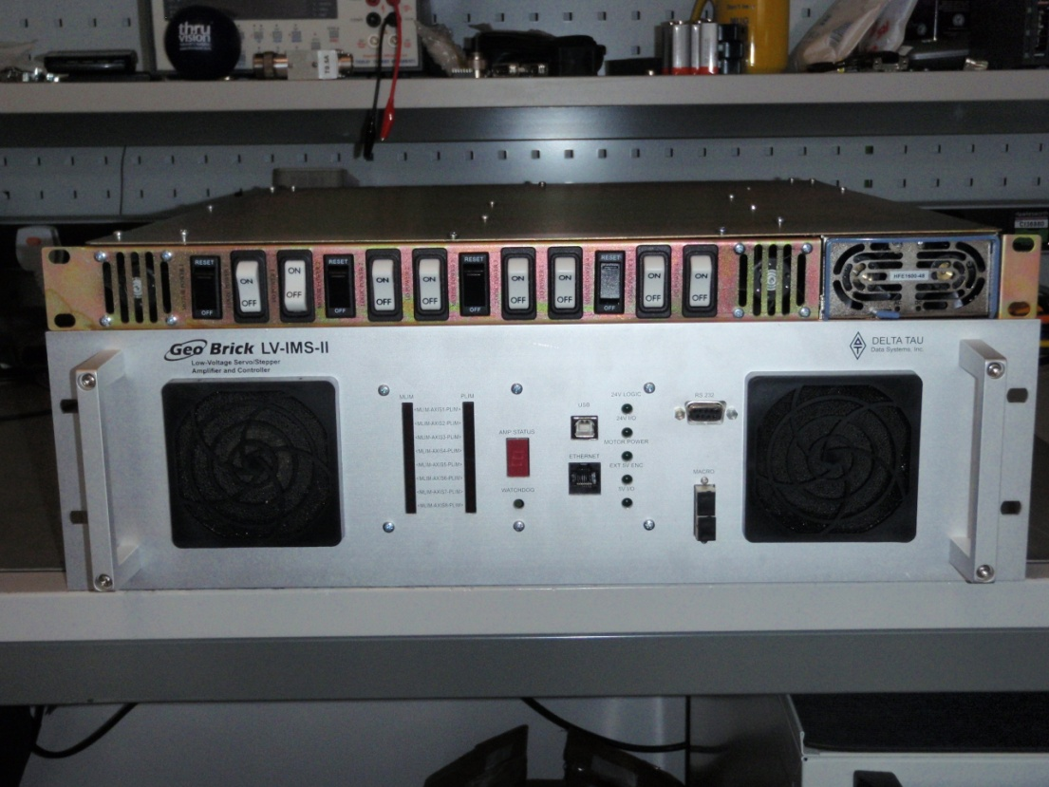
A new power supply
A single 1500VA or 500VA switch mode supply so supply 4 motion crates with motor power
TWO 24V DC supplies to provide logic power and i/o power. In the event of an external i/o fault, controller will not lose their control supply. Both supplies are fed through a single seriou connector
Individual switches for motor logic and i/o supply for each motion crate
TWO AC input connectors with same connectors as existing GeoBrick LV IMS to maintain logic and motor power separation in motion rack
1 U high crate means the new 3 U LV-IMS-II and new supply can occupy the same space as the old 4U LV-IMS design

Slide 9
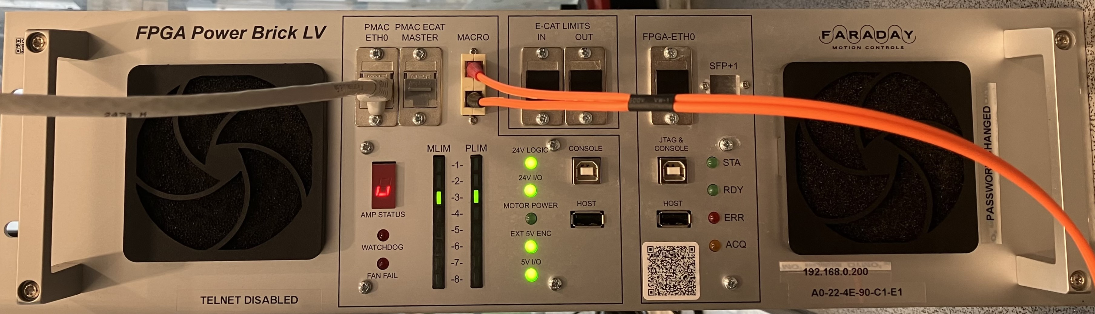
Diamond-2 Beamline Motion Controller:-PowerBrick-LV-IMS

Slide 10







^{FPGA PowerBRICK LV IMS} ^{“No,} look ^{in front of you!”}
Ethernet Communication port
Internal etherCAT loop for limit interlocking.
Fibre Optic MACRO ring connector ( up to 32 axes)
EtherCAT master for I/O plus 8 axes of synchronous motion. (Tested OMRON, Beckhoff and RTA drives)
AMP status indicator. Healthy is. Mimic available on DLS-motor-control.py
CONSOLE USB provides serial port into powerBrick.
HOST USB for peripherals and memory sticks.
Limit switch mimics. Light is ON then limit is healthy. If light is ON and s/w says limit is violated, then check for interlock status.
Power supply indicators. Very useful ‘at a glance’ diagnostics
Watchdog and Fan Fail are BAD call motion team!

Slide 11
Why Change Phase 1 systems?
Some hardware was purchased in 2006 –nearly 20 years old
Whilst only 2 VME PMAC ULTRALIGHT have failed the last failure could not be recovered using spares “off the shelf”, which are at least 10-15 years old.
The failed unit was replaced by a GeoBrick-LV-IMS2 ‘floor mounted’ in the optics hutch. This has since been relocated to a new rack in the CIA
VX Works the real time operating system of the IOC computer systems need to be replaced. Upgrade these systems to RTEMS or completely replace the old motion hardware ?
Most of the stepper drives are only 1000 steps per rev ( assuming 1.8° full step)

Slide 12
Original Choice - Fit multiple PowerBrick-LV’s
The diamond-2 standard beamline motion controller
Base Cost £10,000 per 8 axis of control (nearly 2K more than base product)
Replace all old hardware..
ONLY 32 axes per rack ( some beamlines have 48 )
Engineering effort to redesign racks estimated as 6 weeks per rack + 2 weeks to build, no internal resource available
All encoder cables need re-terminating. Limit and motor cables re-used if long enough, potential radiation damage to cables???

Slide 13
Replacing the Obsolete Phase1 motion Control in Numbers
16: There are 16 beamlines still relying in part on the original system.
105: To replace them all will require 105 PowerBrick-LV controllers
40: This will require 40 modified racks and potentially cabling
600: The estimate to build 40 racks is 600 workshop days
1302: Design office estimates1302 designer days to redraw everything (checking as built accuracy)
1050000: The estimated hardware cost for motion controllers, racks and PSU is £1,050,000
2357250: Including sub-contract design effort, the total estimated cost to replace is £2,357,250
0: there is no resource for design and contractors are not an option ( all doing Diamond-2 upgrade)

Slide 14
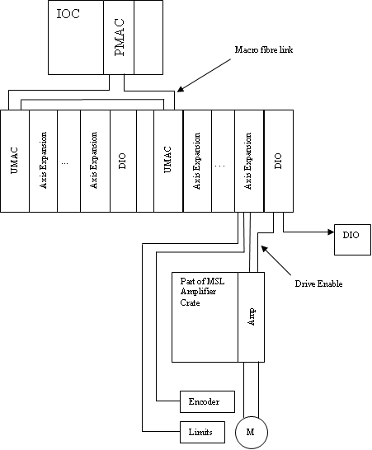
Delta Tau PMAC – UMAC MACRO Solution
A Quick Comparison
32 axis pmac ultralight still available and proven reliable.
16 axes UMAC ( macro expansion card)
4 axis motion cards
24 in 24 out digital
16 (or 8) amplifier crate
Discrete specialist amps
MX add on amplifier

Slide 15
Option 2- Switch VME to PowerUMAC Ultra Chassis
Replace VME crate with Ultra Chasis containing PowerUMAC controllers and Acc5E3 MACRO controllers
Base Cost £6883 per 32 axis of control (£11,000 for 64; £13,500 for 96 axes)
Utilises the existing Fibre optic MACRO network
No plant cables need changing, limited design effort required.
STOGRA amplifiers still available
Smart Drive (at risk and obsolete) amplifier replacement sourced.

Slide 16
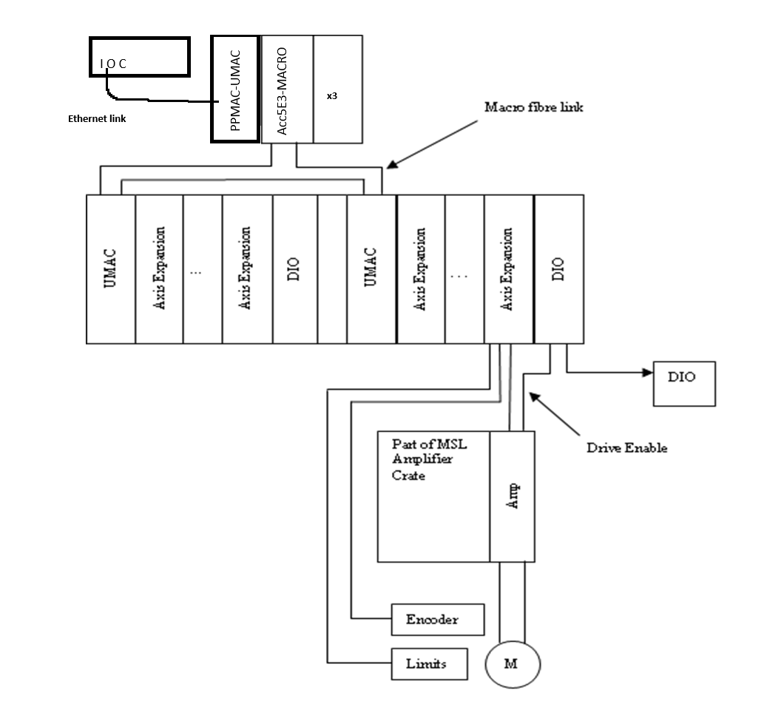
Option 2 at a glance : Power UMAC Ultralight Chassis– UMAC MACRO Solution
A Quick Comparison
32 axis PowerPMAC with Acc5E3 MACRO master
16 axes UMAC ( macro expansion card)
4 axis motion cards
24 in 24 out digital
16 (or 8) amplifier crate
Discrete specialist amps
MX add on amplifier
+ 3U crate per 1 –> 3 PPMAC UMAC set

Slide 17
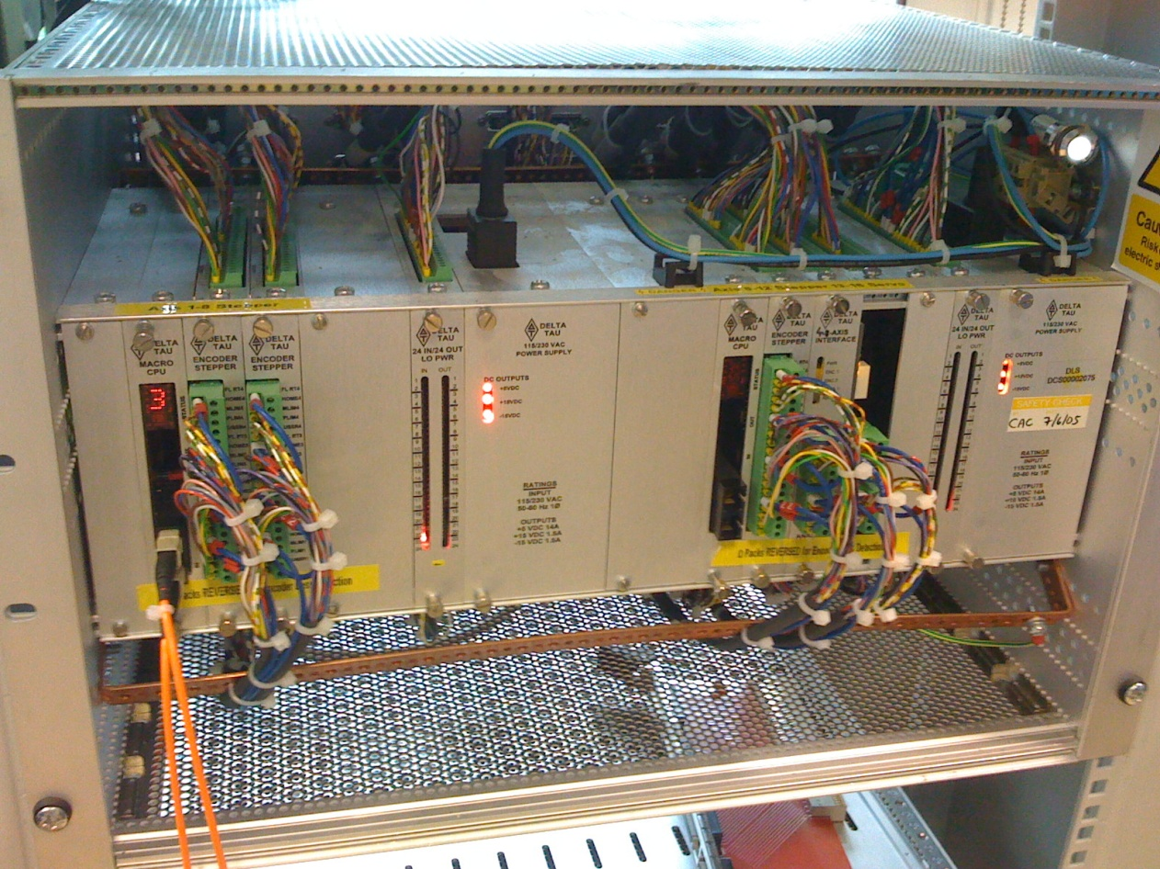
Option 3- Replace 16Axis MACRO- with PowerUMAC
Replace 16 axis MACRO cards in expansion crate with PowerUMAC controllers.
Base Cost £2,800 per 16 axis of control
Removes need for fibre optic network.
Very little design effort per rack.
Every Acc-24E2S will need to be removed from crate to change addressing.
Estimate 4 hours per crate with attendant risk of damaging cables/connectors.
STOGRA amplifiers still available
Smart Drive amplifier replacement sourced.

Slide 18
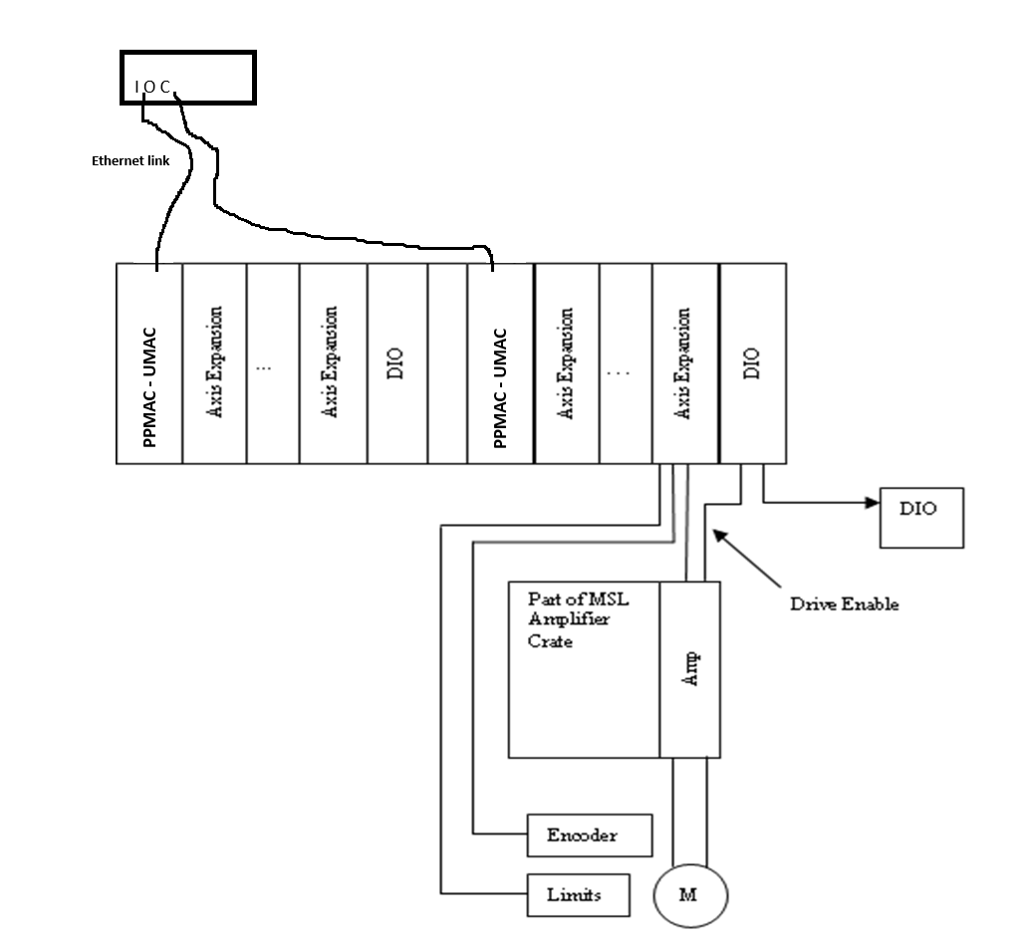
Delta Tau PPMAC – UMAC controller in axis interface crate
A Quick Comparison
16 axes PPMAC – UMAC controller card. 1 per original UMAC
4 axis motion cards
24 in 24 out digital
16 (or 8) amplifier crate
Discrete specialist amps
MX add on amplifier- not possible

Slide 19
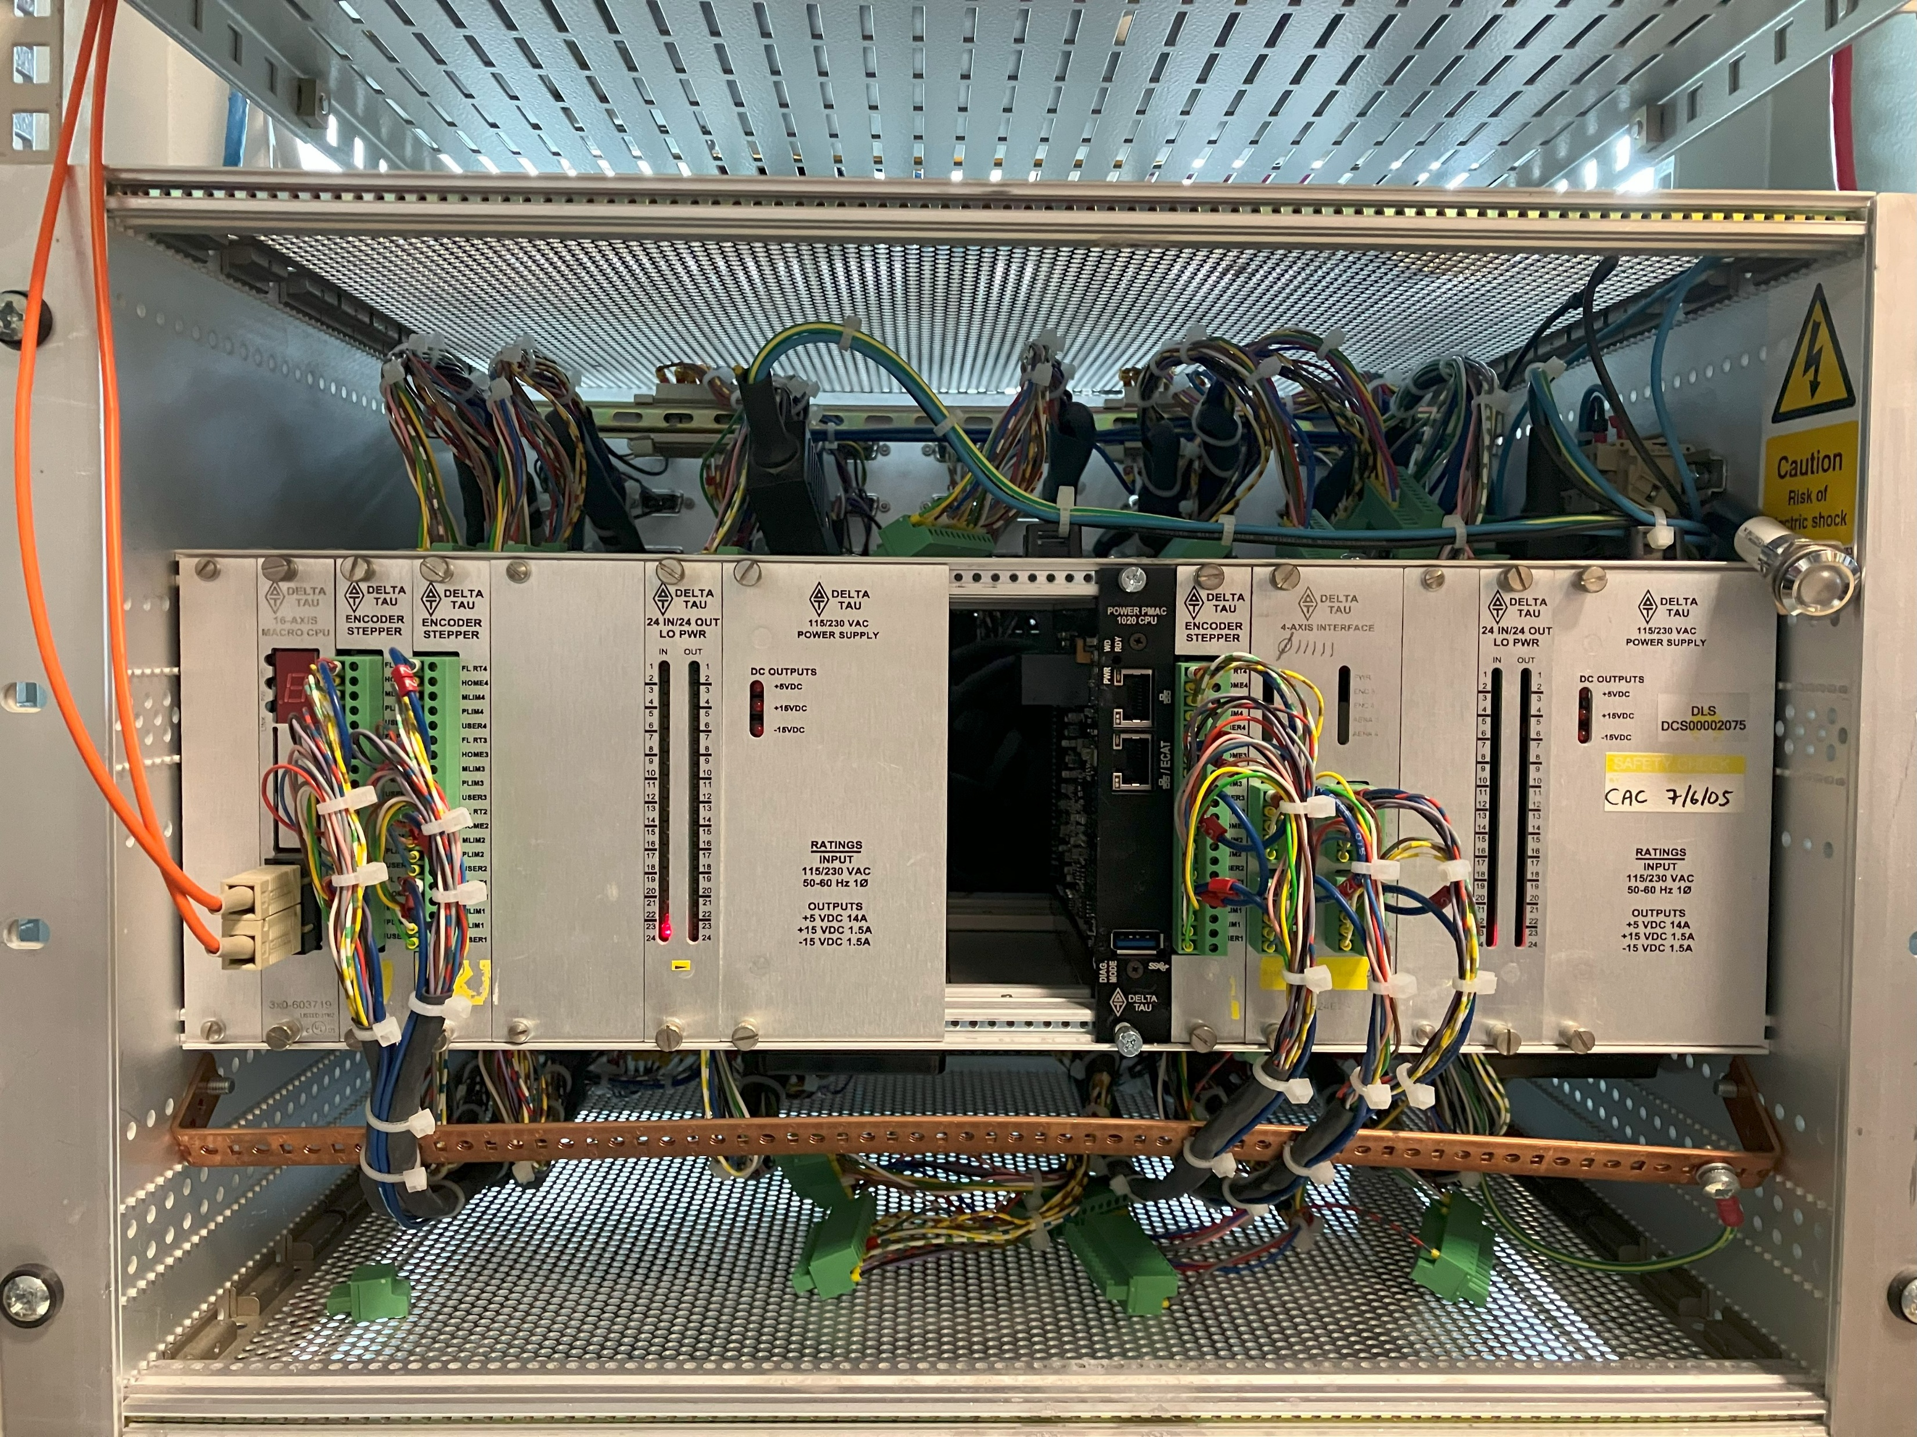
Delta Tau PPMAC – UMAC controller in axis interface crate
Every Acc-24E2S will need to be removed from crate to change addressing.
Estimate 4 hours per crate with attendant risk of damaging cables/connectors

Slide 20
Option 4- PowerBrickLV with MACRO output per 32 axis control
Replace VME crate with 3U crate containing PowerPMAC controller with on board MACRO master output
Base Cost £10,000 per 32 axis of control.
Utilises the existing Fibre optic MACRO network
No plant cables need changing.
Additional 8 axes of control per PowerBrick. ( new plant cabling required)
Very little design effort per rack.
STOGRA amplifiers still available
Smart Drive amplifier replacement sourced.
Needs 1 off 3U crate per Axis expansion crate

Slide 21
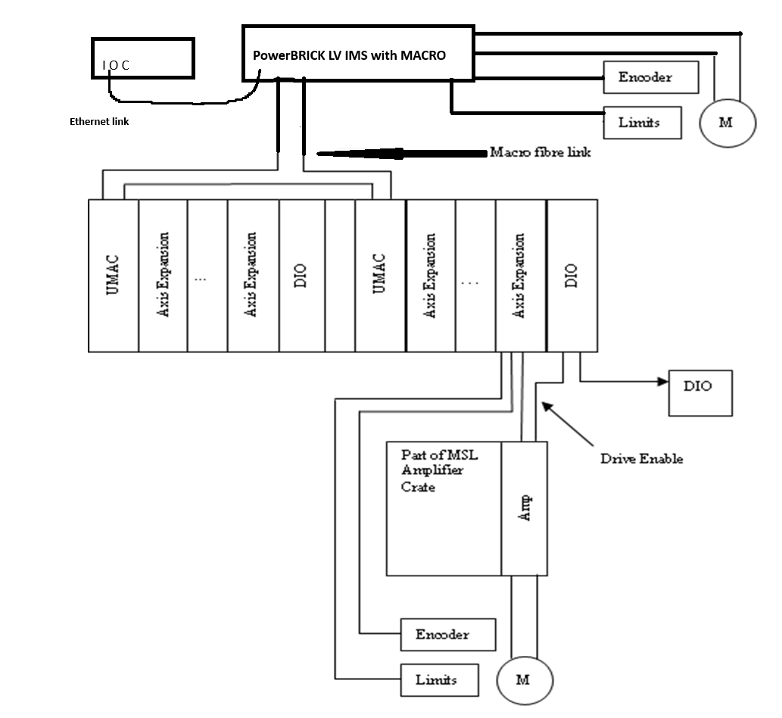
Power UMAC Ultralight Chassis– UMAC MACRO Solution
A Quick Comparison
32 MACRO axis per PowerBrick LV with MACRO master
16 axes UMAC ( macro expansion card)
4 axis motion cards
24 in 24 out digital
16 (or 8) amplifier crate
Discrete specialist amps
MX add on amplifier
+ 8 axes per PowerBrick
+3U crate per PowerBrick

Slide 22
And the winner is…
Option 2; replace VME Ultralight with 3U crate containing up to 3 PPMAC UMAC cards with MACRO expansion.
First system due in time for October Shutdown.
Perform test upgrade on 1 willing beamline. If successful plan roll out for remaining beamlines between now and dark period. Motion subcontractors may be required.
Confirm time estimates for recommissioning ( August S/D we recommissioned 21 axes onto PowerBrick-LV in I15)
Outline configuration files already constructed and tested against spares stock of UMAC MACRO crates. Test published conversion factors to establish if gains are acceptable.

Slide 23
Questions?
Don’t forget
Exercise your mechanics slowly; end to end to keep them well lubricated and prevent build up of grime mid travel.
Stick-Slip piezos have limited life. Our well-known brand lasts less than 5 years.
Anything that ‘slips’ is not ideal for high resolution imaging applications.

