Slide 1

Low Noise Linear Amplifier Development For Sub-Nanometre Positioning Tony Jacobs

Slide 2
The Idea
The project began following a discussion at Diamond Light Source
Diamond are developing systems that require sub-nanometre positioning for the Diamond-II upgrade
Modelling and tests suggested that amplifier noise was limiting the positional stability of existing systems
Faraday decided to accept the challenge of designing a low noise linear amplifier

Slide 3
The Mechanical System
Credit: Diamond Light Source

Slide 4
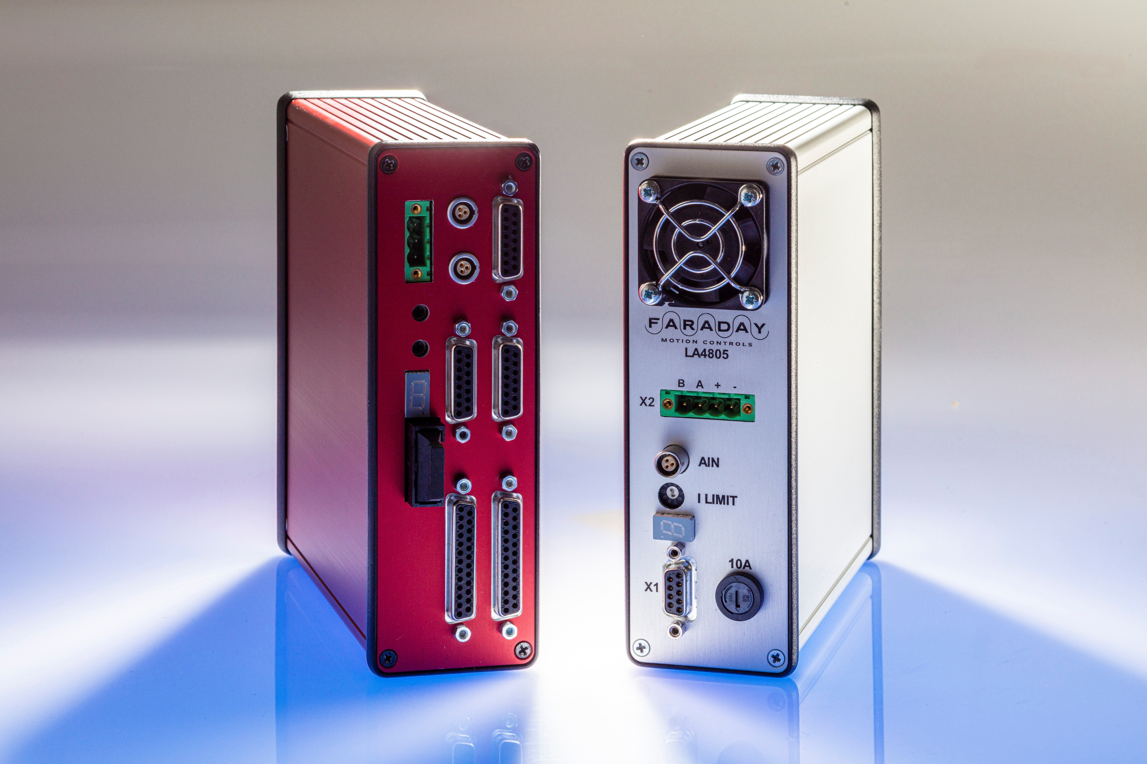
Standalone Linear Amplifier
LA48-05 Amplifier
and
20-bit DAC

Slide 5
DAC + Amplifier
PSU
PSU
Motor
Controller
DAC
AMP

Slide 6
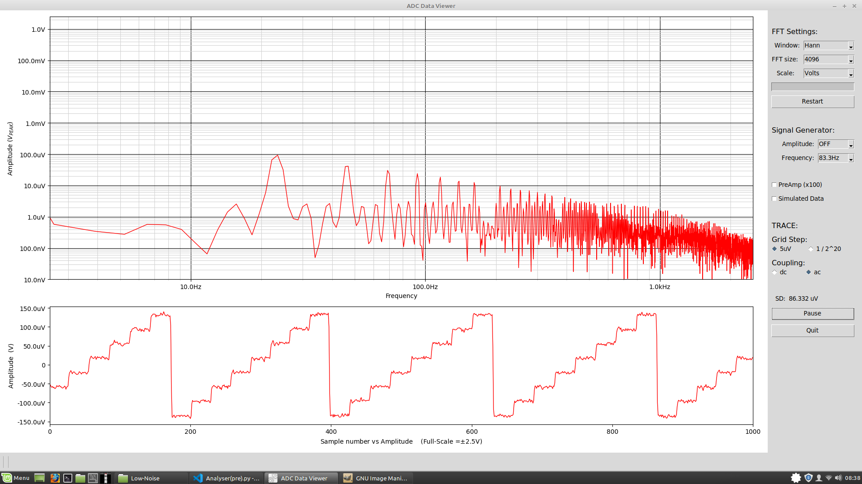
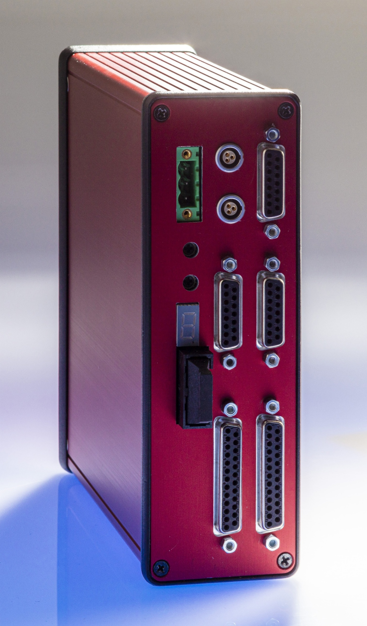
Low Noise, 20-bit DAC
Faraday low noise, 20-bit DAC.
8 step ramp of single DAC bits.

Slide 7
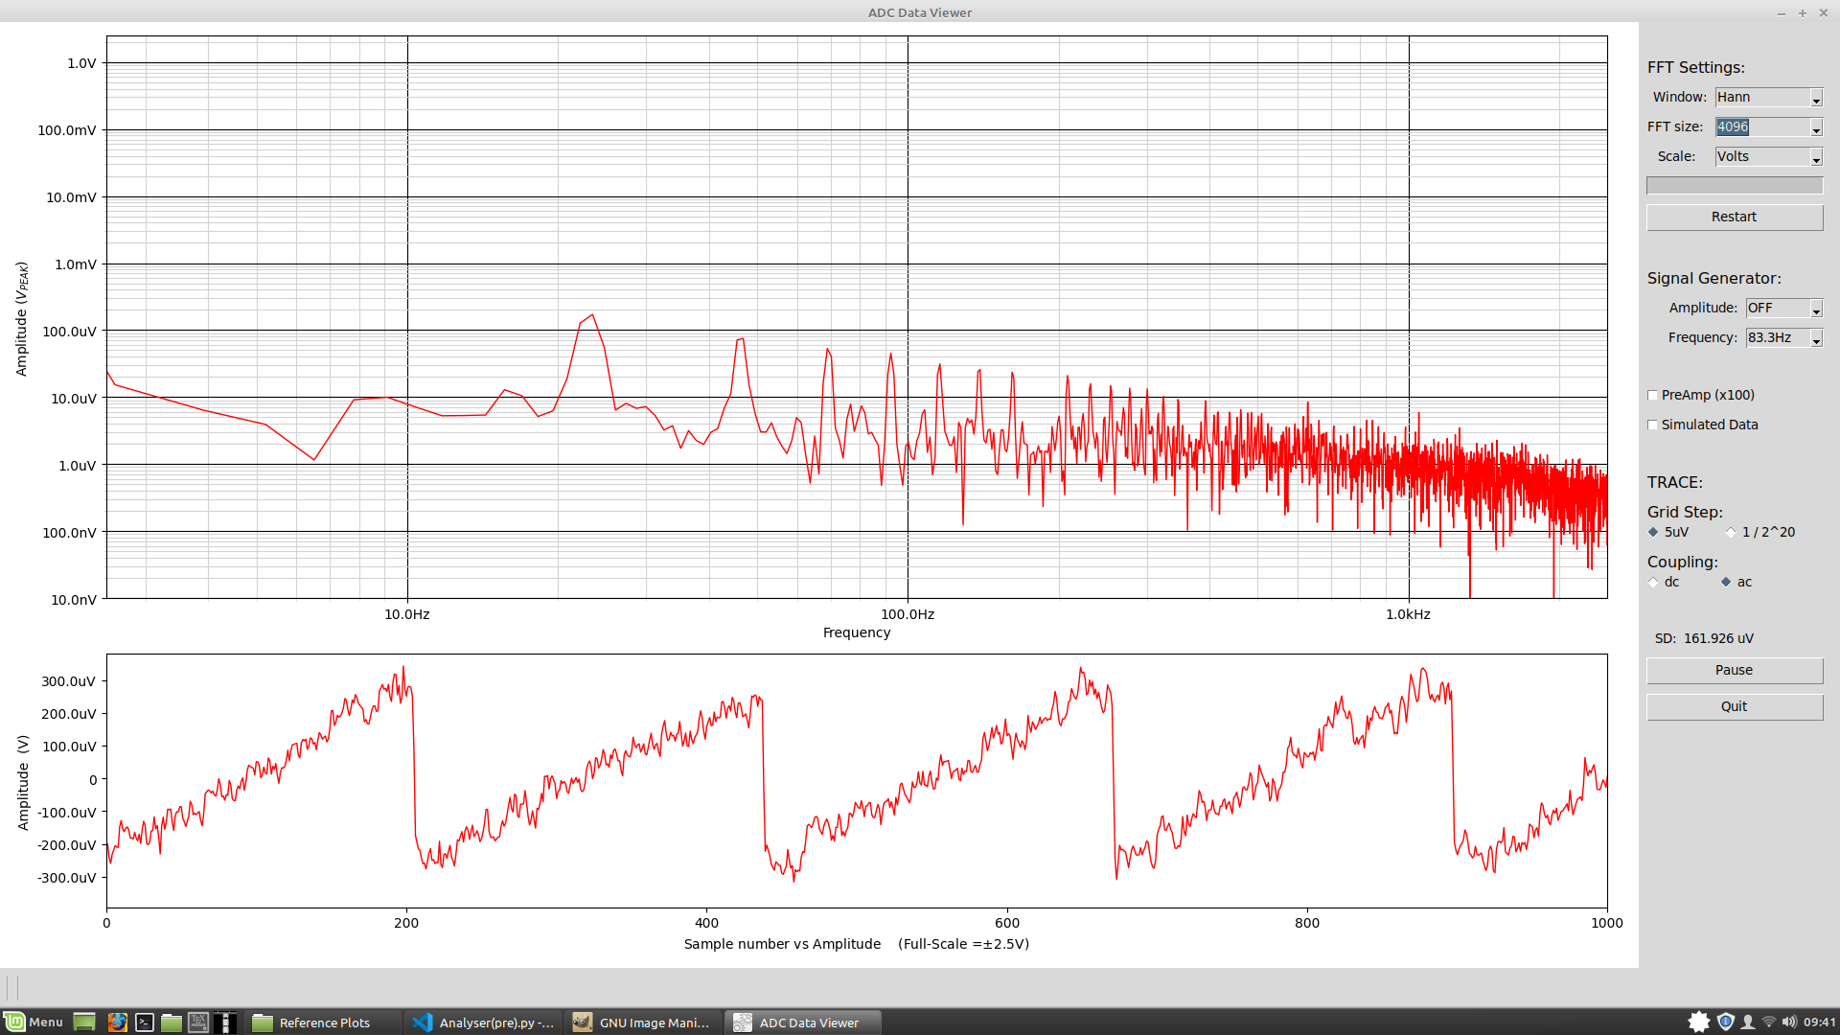
LA48-05 Amplifier Output
Noise in Faraday LA48-05
8 Step ramp. Single DAC bits

Slide 8
Where does the noise come from?
External Sources:
Cabling. The 20-bit DAC is quiet but the signal needs to be transferred to the amplifier.
Electrical noise can be picked up by the cables.
Most ordinary cables are microphonic. The effect is measurable on even specialist microphone cable.
Power supply noise.
Amplifier internal noise sources:
Microphonic components e.g. particularly ceramic capacitors.
Resister thermal noise.
Capacitive coupling from driver transistors to the case/heatsink.
Electrical noise in the internal feedback loop.
Fan noise, both mechanical and electrical.

Slide 9
How did we avoid the problem?
Controlling external Noise Sources
We combined the DAC and amplifier into a single package with an internal power supply. This eliminates much external cabling.
Galvanic isolation of incoming digital signals from the motion controller.
Controlling internal noise sources
Careful choice of components. Borrowed ideas from high-end audio.
Standard complimentary pair output transistors controlled by modern ultra-low noise, high-performance op-amps for feedback.
Screening between the case/heatsink and the output transistors.
Isolation of external power using an internal DC-DC converter with filtering and further regulation.

Slide 10
DAC-Amp
External PSU
PSU + Filtering
Motor
Controller
DAC
AMP
Galvanic
Isolation

Slide 11
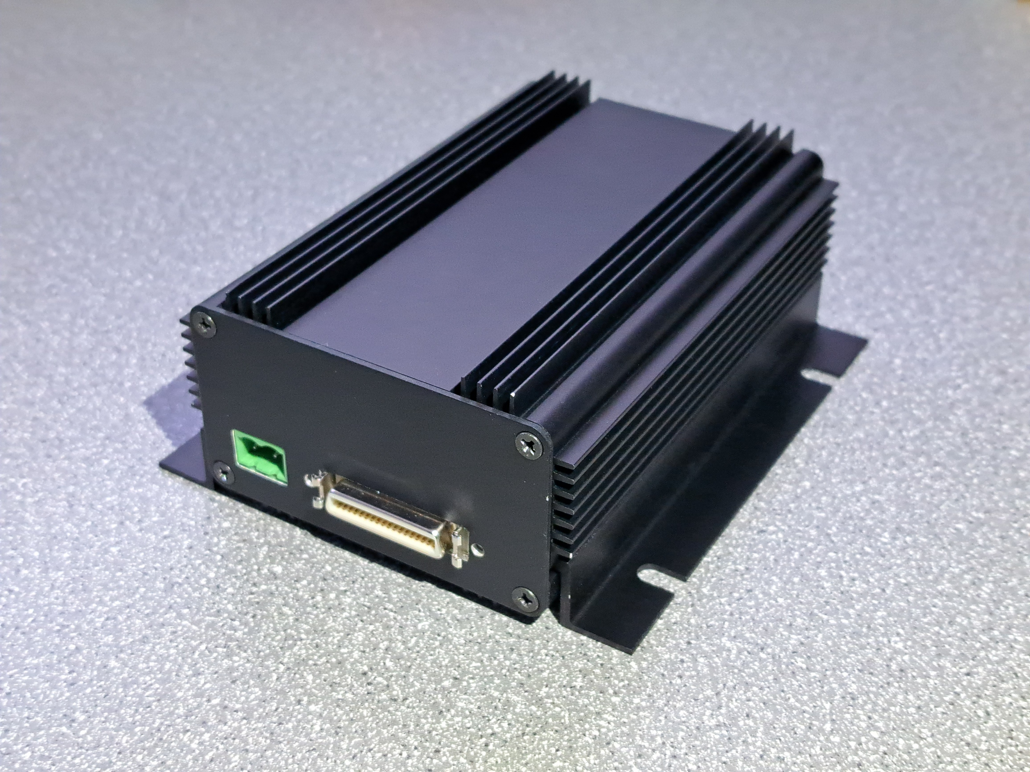
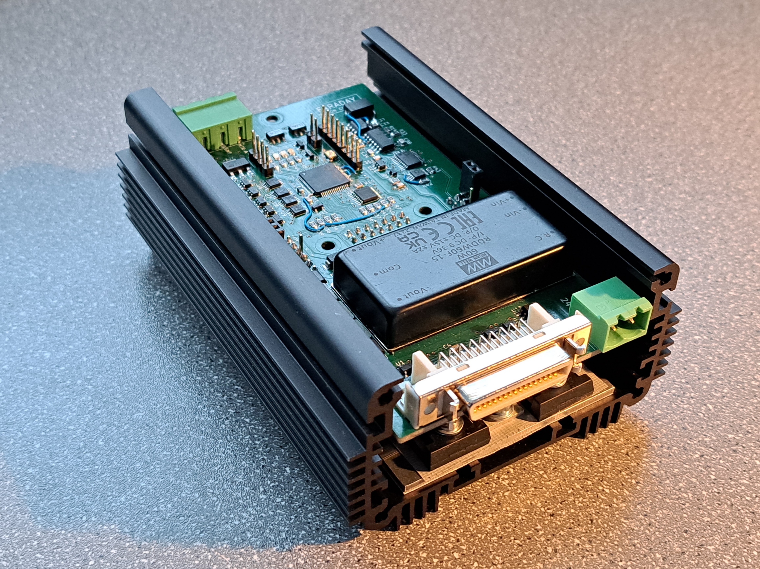
DAC-Amp

Slide 12
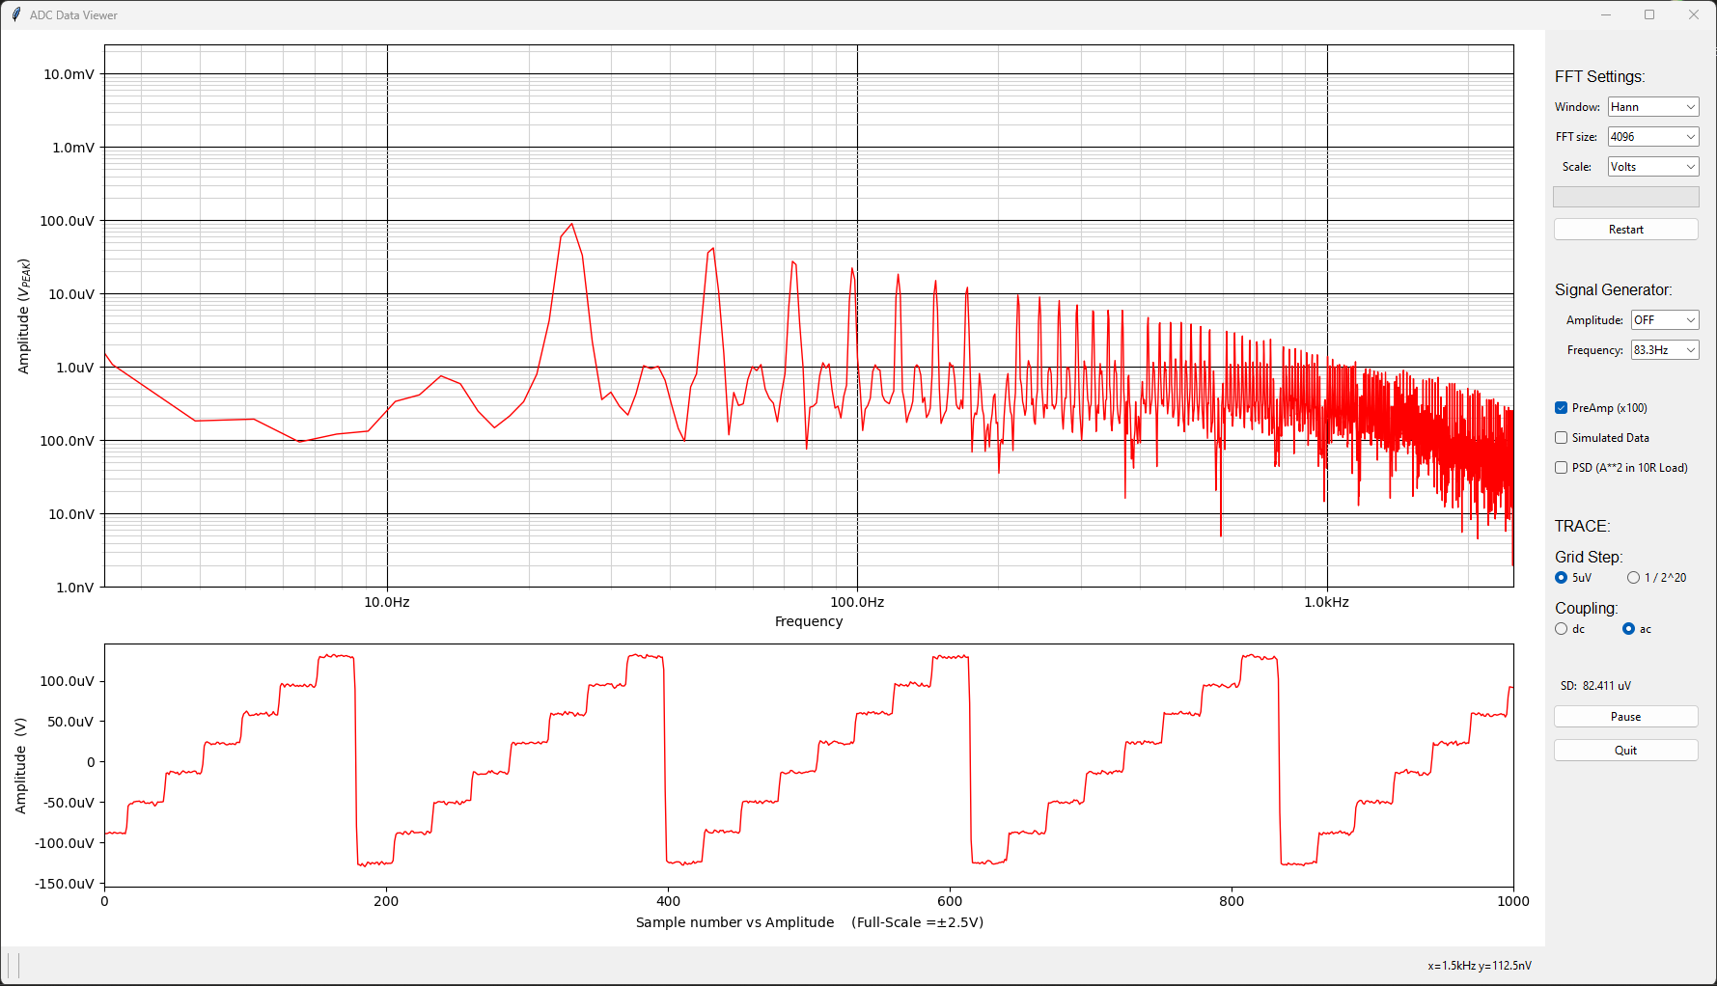
Results
2A into 10 Ohm with a staircase superimposed on it.
Noise is lower than the original 20-bit DAC!

Slide 13

First Test At Diamond
Disaster! Results on Diamond stage were not good enough!
Stability was only around +/-2-3nm. We need sub-nanometre.
No better than previous amplifier.
Why?
Tests with a locked stage showed that the noise from the Attocube interferometer was too high. The servo loop reacted to the noise to try to “correct” the position.

Slide 14

Second Test At Diamond
The Attocube interferometer was replaced with a Qudis.
This time the results were much better.

Slide 15
Second Test At Diamond
Stable to better than +/-700pm.
Speaking produces 3nm spikes.

Slide 16
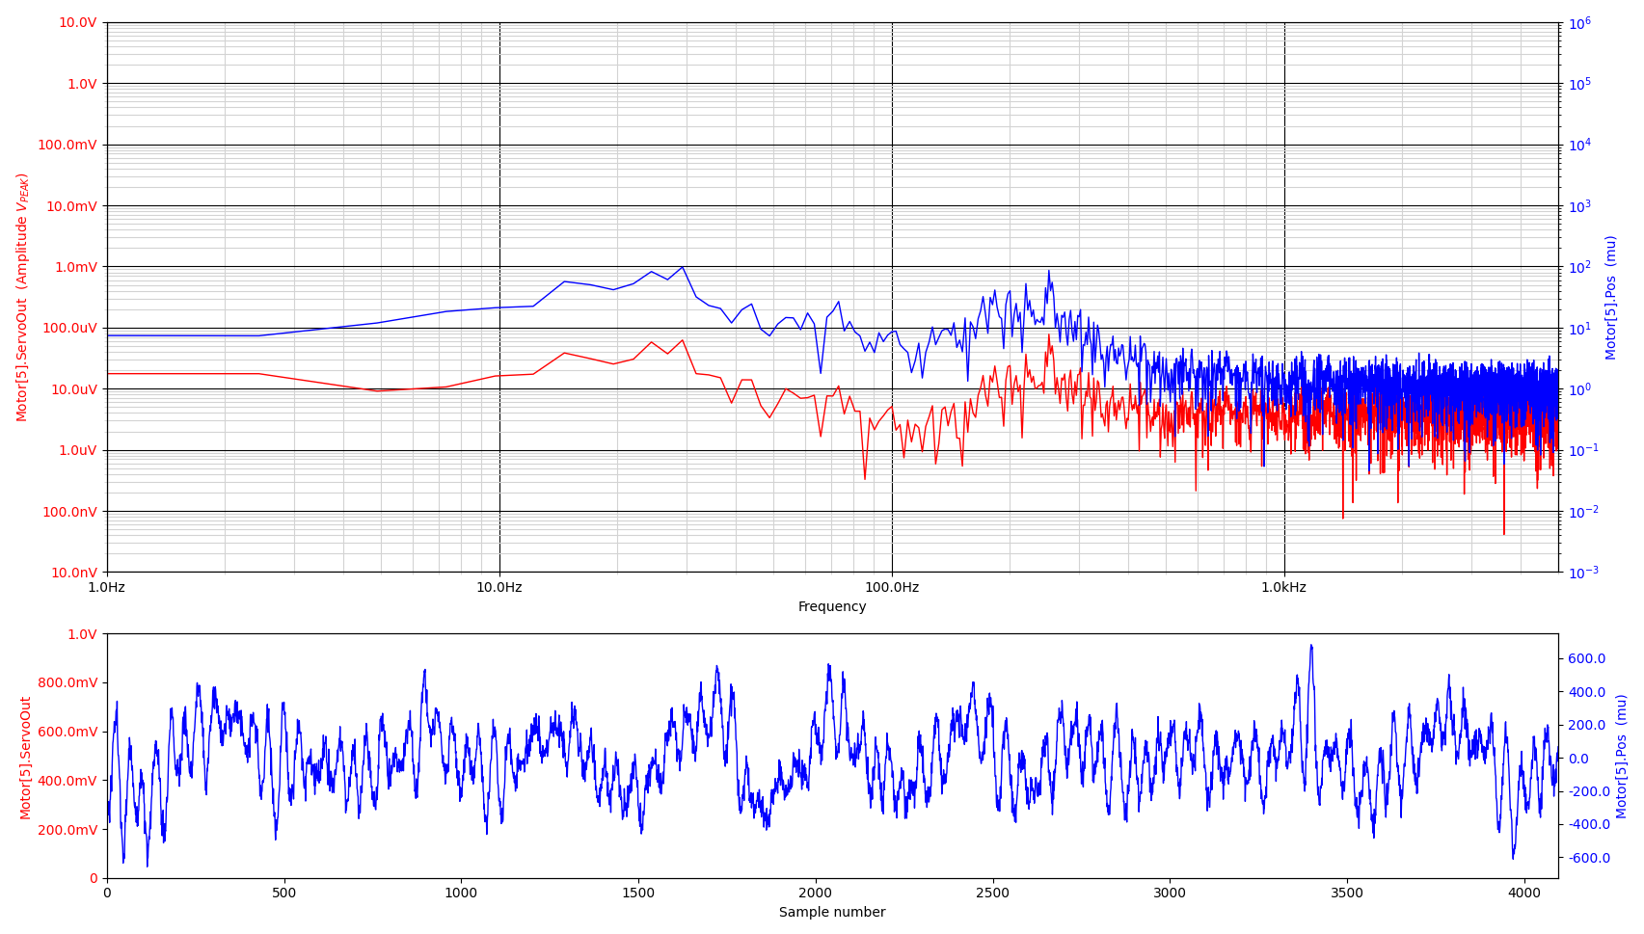
7mm Interferometer Path Length
Closed loop
Holding position within +/-600pm.

Slide 17
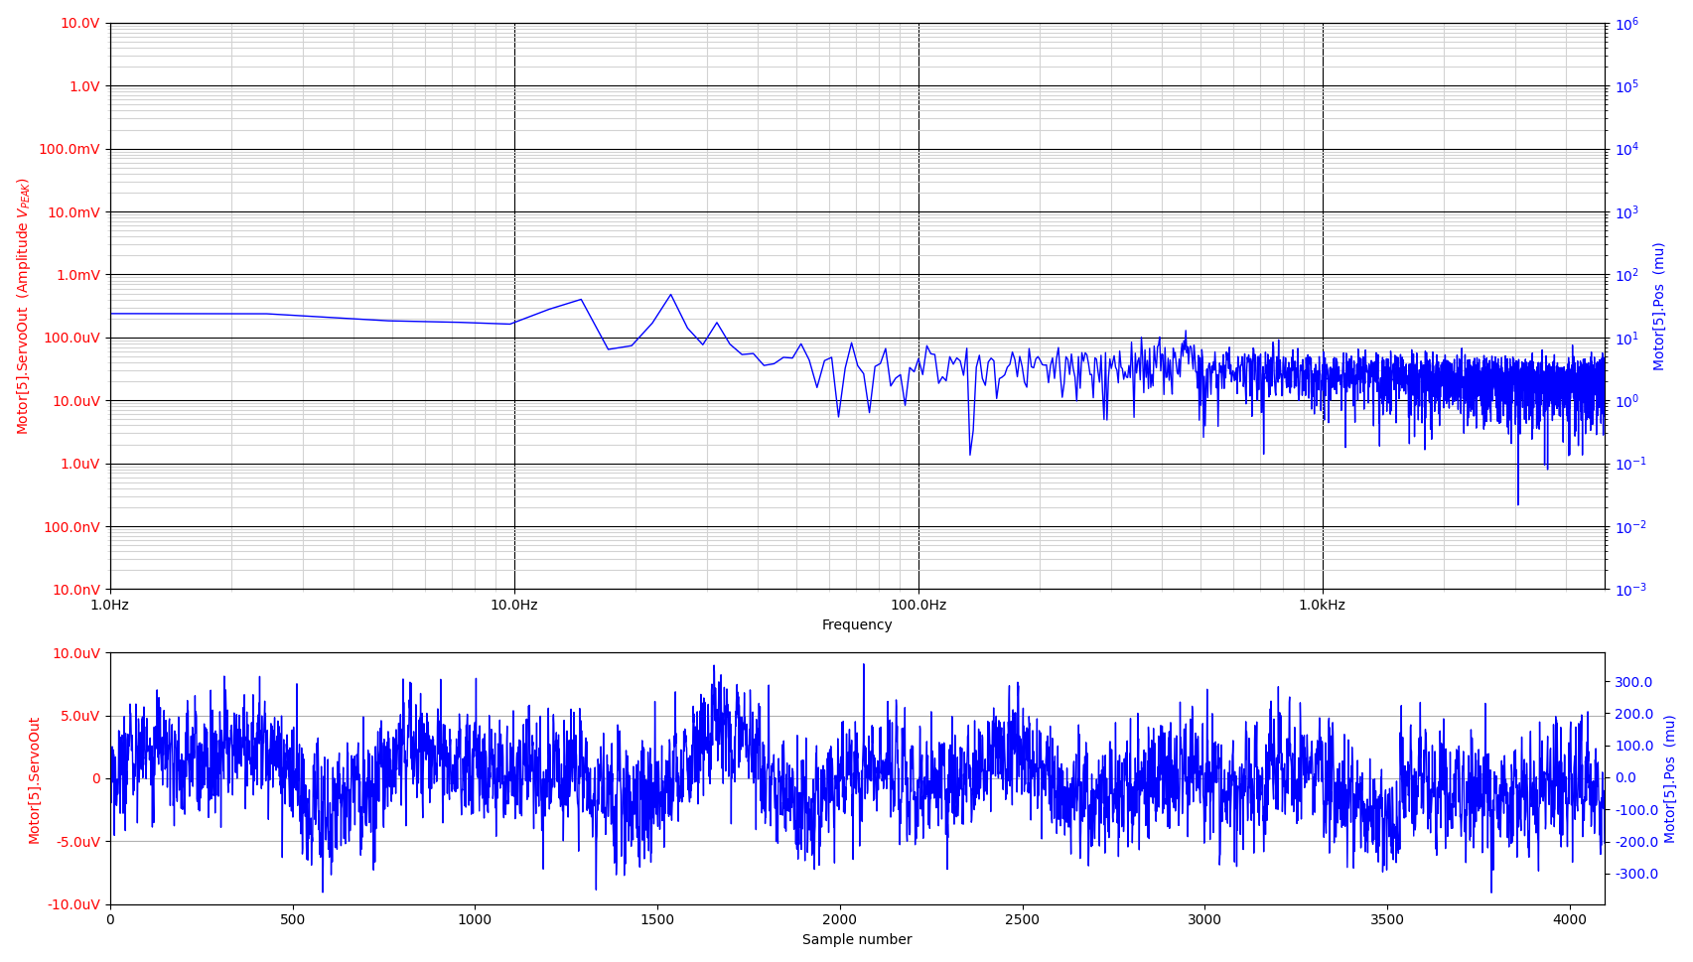
Locked Stage
With the stage locked the noise from the interferometer is still +/-300pm.
We need better position feedback.

Slide 18
Conclusion
The amplifier output required to hold the position was lower than the noise coming from the original amplifier.
Diamond’s modelling was proved correct. Amplifier noise does limit the positional stability for sub-nanometre applications.
Better, less noisy feedback should allow even better results.

