Slide 1


ICALEPCS’25 CHICAGO
9th workshop dedicated to
Motion Control and Robotic Applications in large Facilities
Yves-Marie ABIVEN (SOLEIL), Nicola Coppola (EuXFEL); Mario Di Castro (CERN); Xavier Serra Gallifa (Alba); Brian Nutter( Diamond); Maxim Brendike (HZB); Thomas DEHAEZE (ESRF)

Slide 2
ICALEPCS’25 CHICAGO
Why?
Who?
What?
How?

Slide 3

MOCRAF Workshop
Who?
How?
Why?
What?
Motion control and Robotics are key element ,which enable high level of performance at scientific facilities
A long tradition now with 8 previous MOCRAF Workshop
(2011 in SOLEIL, 2012 in Diamond, 2013 ICALEPCS San Francisco, 2015 ICALEPCS Melbourne, 2017 ICALEPCS Barcelona, 2019 ICALEPCS New York, 2021 ICALEPCS Shanghai, 2023 ICALEPCS Cape Town)
ICALEPCS 2025 in CHICAGO is an ideal place for the 9th WS, …
…meeting new friends
… Sharing expertise, methods, tools,
… Exchanging experience, solutions, lessons learned
…Initiating collaboration

Slide 4
MOCRAF Workshop
Who?
How?
Why?
What?
Challenges in our Diverse Facilities Share with your workhsop colleagues what new challenges we are facing, or solutions we are implementing. Share our application experiences with sub-micron positioning, complex sample stages and synchronous motion control and detectors acquisition.
Automation, Mechatroincs and Robotics How this field is changing in our facilites. What are we developing. What are the challenges of customisation for integration. And how do we determine the cost vs benefits analysis. Share our experiences with industrial robot arms, implementations and integration into our control systems (EPICS/ TANGO). Explore experiences with metrology, how we characterise our stages, how we integrate new sensors
Maintenance strategies: Preventive, corrective, predictive As our facilities age what strategies do we employ to maintain our actuators and machines at peak performance. What tools do we employ, condition monitoring, predictive maintenance and any diagnostic tools for data driven insights for reliability improvements. How does the control impact the maintenance and lifetime of our devices?
New Technologies Share your experiences in digital twins, Simulation Driven Design and Machine learning for Controls tuning. Explore experiences with integrated smart actuators, Brushless DC motors with FOC and collaborative robots and actuators. What are we considering regarding Embedded and edge intelligence.

Slide 5

Who?
How?
Why?
What?
MOCRAF Workshop
41 attendees
11 countries
19 Institutes
4 trading companies
https://www.google.com/maps/d/edit?hl=en&mid=1IJHQnihWT_Sk_-aLoR_gkVmAY2g&ll=5.108998801646877%2C0&z=2

Slide 6
Who?
How?
Why?
What?
MOCRAF Workshop
Workshop sessions
Update of the status and challenges at each facilities
Tracks related presentation will feature talks followed by 30-45 min round table discussion in groups
Round up from the groups in the summary session
Please respect the speaking time

Slide 7
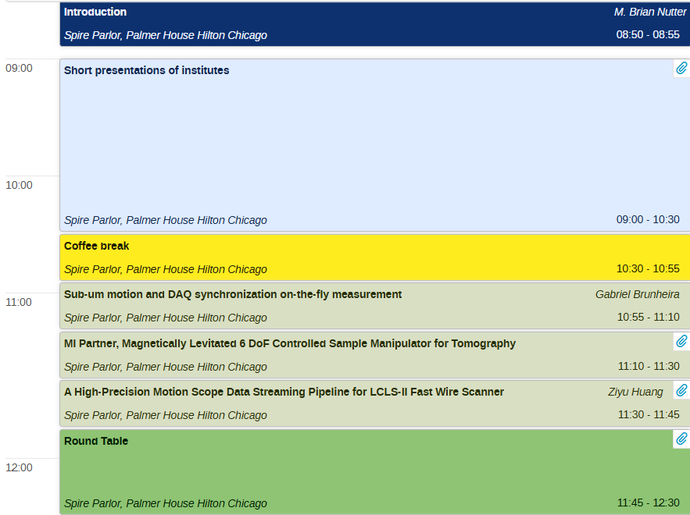
Who?
How?
Why?
What?
MOCRAF Workshop
ALBA
ANL/APS
BNL/NSLS2
CERN
CLS
DLS
ESRF
JCNS
HZB
MaxIV
PSI
SLAC
Soleil
Spring-8
Tekniker
XFEL

Slide 8
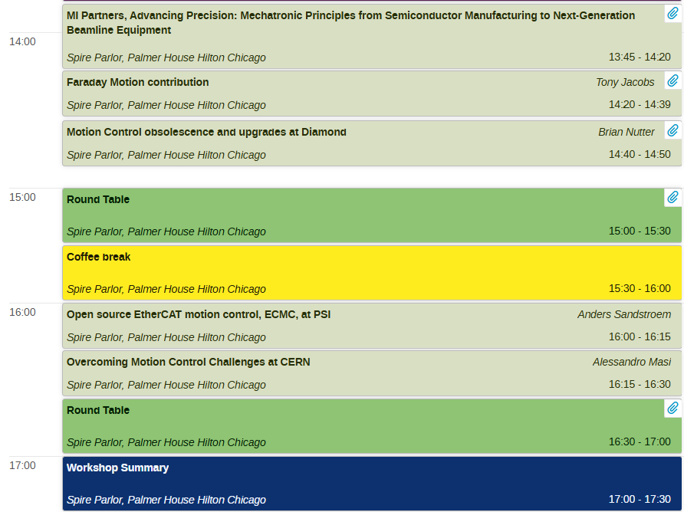
Who?
How?
Why?
What?
MOCRAF Workshop

Slide 9
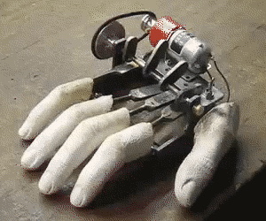
Contribute to this collaborative atmosphere
Thanks for your contribution and participation!
Enjoy the workshop !

