Slide 1
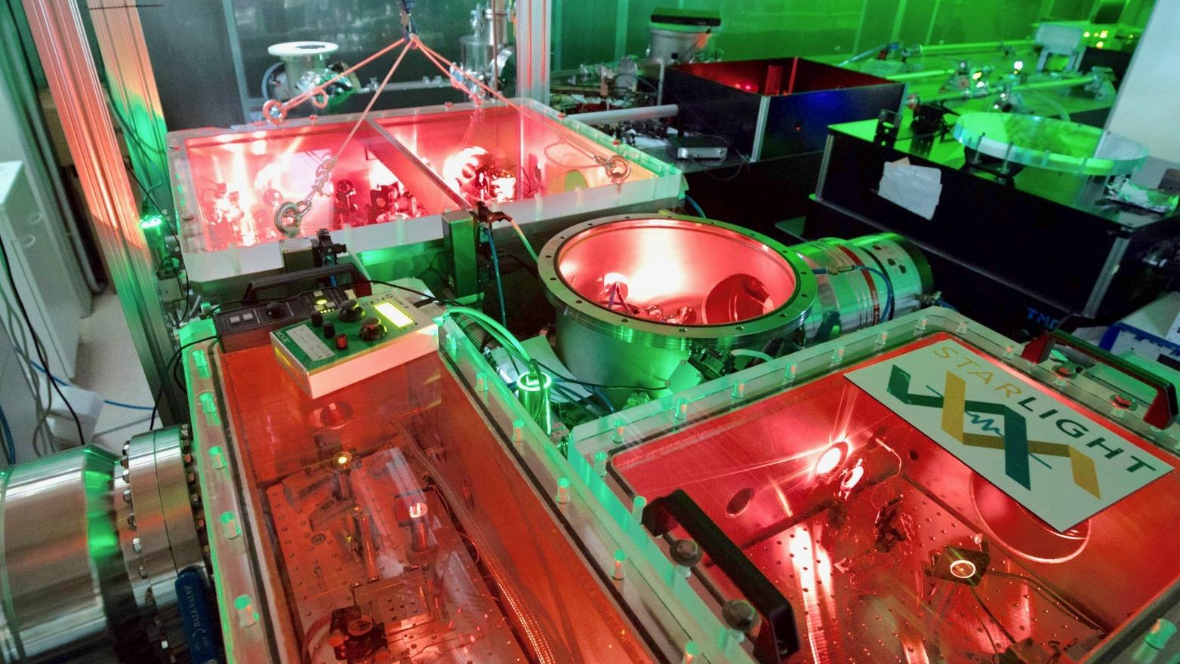




Real-Time Tracking of the intramolecular vibrational dynamics of liquid water
Oliviero Cannelli
09.03.2026, ELIXIR-2026, Synchrotron Soleil

Slide 2
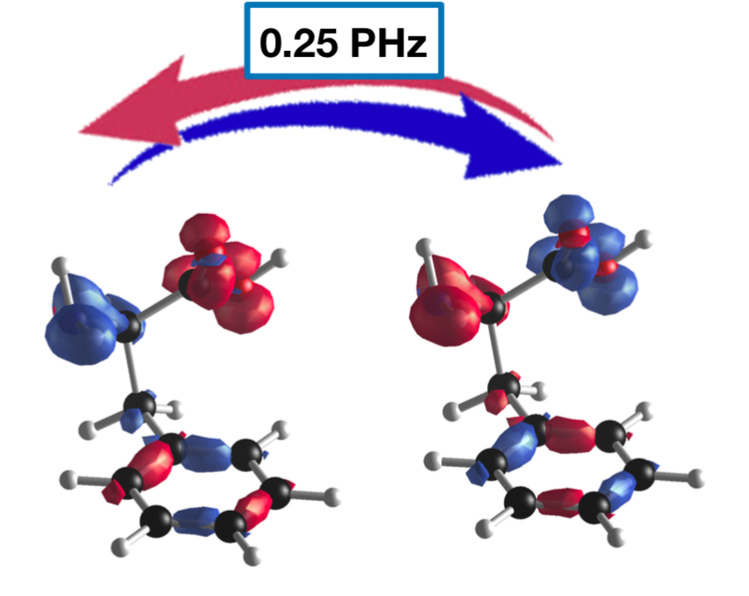
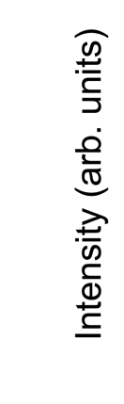
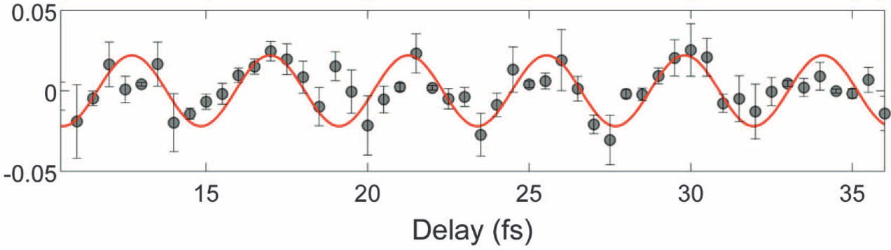
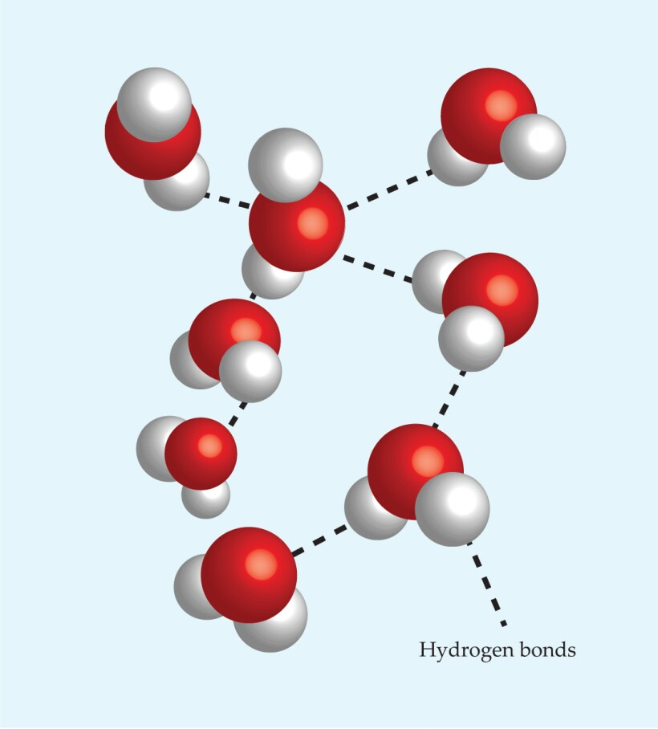
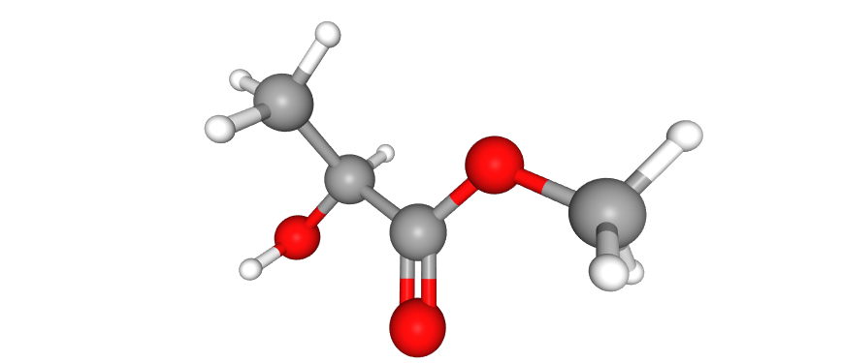
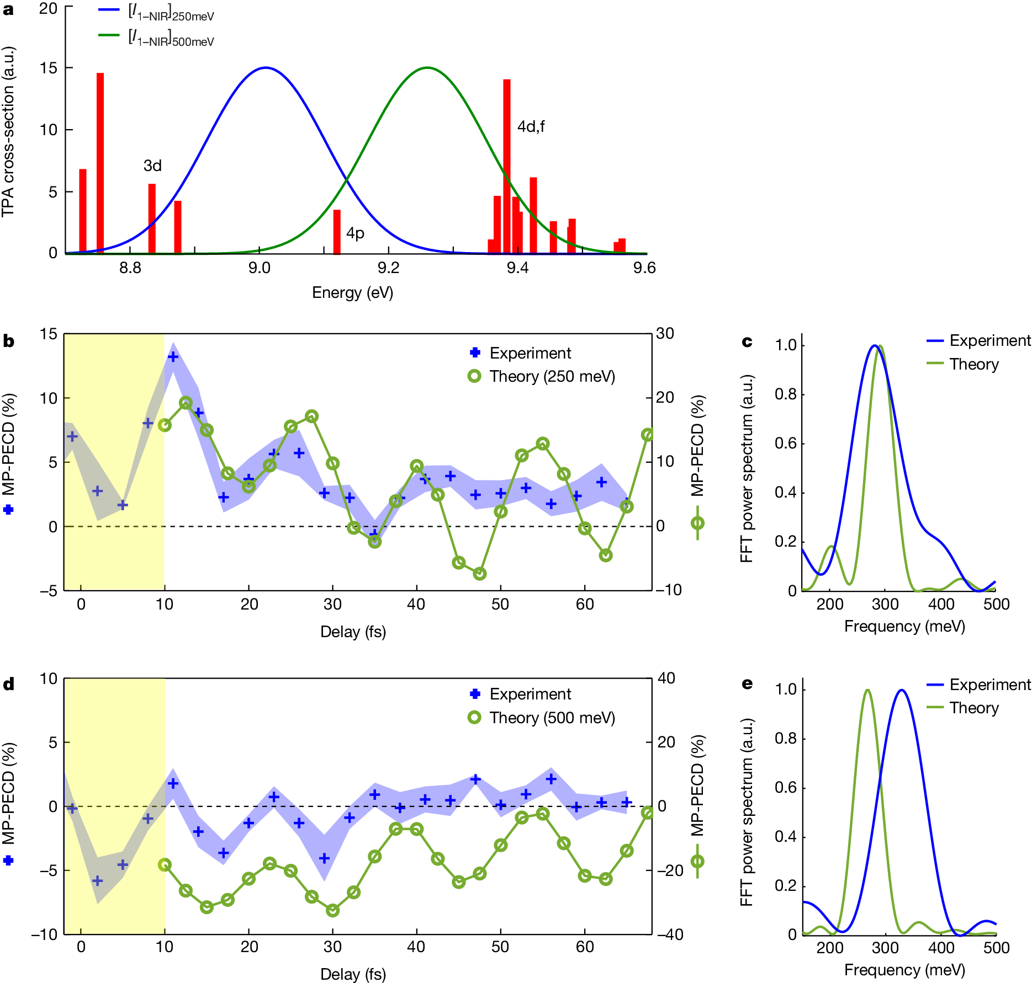
Ultrafast spectroscopy at extreme time scales
Charge migration
Extension to condensed phase
Phenylalanine
F. Calegari et al., Science346.6207 (2014): 336-339.
Chiral current driven by electronic coherences
Image by Mischa Flór, EPFL.
Methyl lactate
Vibrational delocalization and energy dissipation in water
V. Wanie et al., Nature 630.8015 (2024): 109-115.

Slide 3
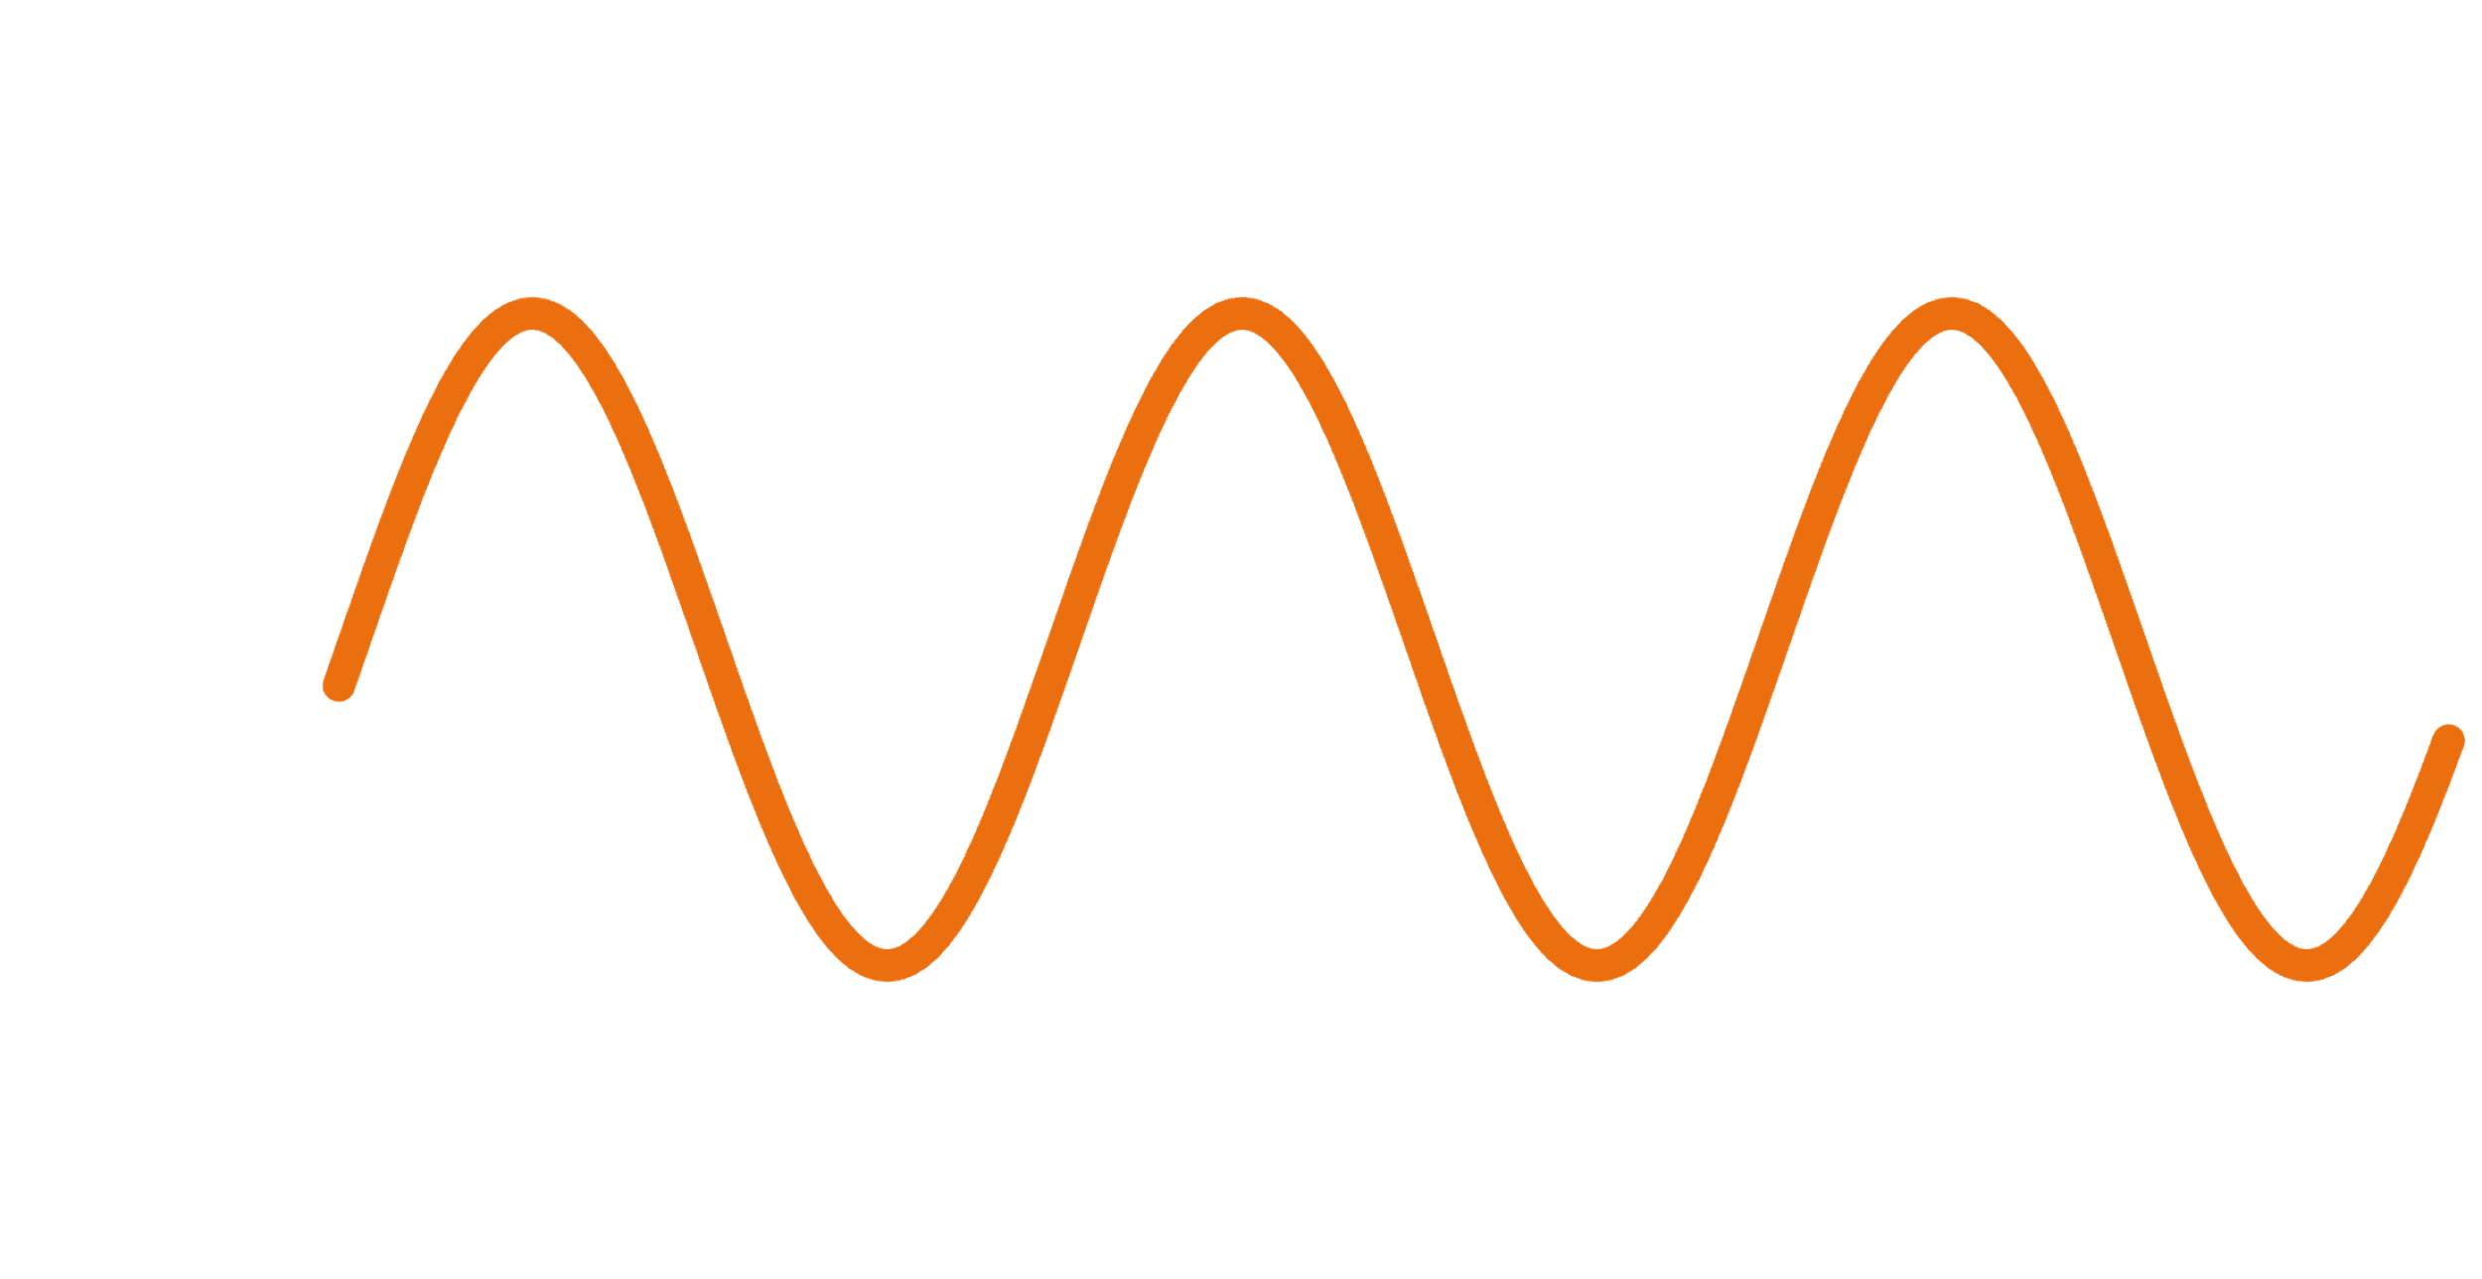
Coherent wavepacket dynamics
Resonant
excitation
Nuclear wavepacket dynamics
ħω
ΔE ~ 100 meV
period ~40 fs
nuclear coordinate
Impulsive stimulated Raman scattering (ISRS)
probe
Δt
ħω
CMOS detector
sample
nuclear coordinate
pump
Impulsive laser excitation
Coherent modulation of refractive index

Slide 4
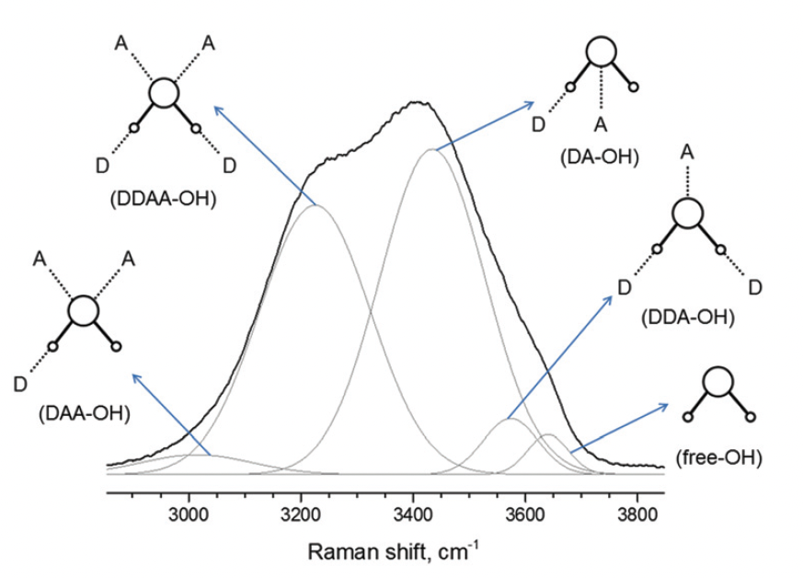
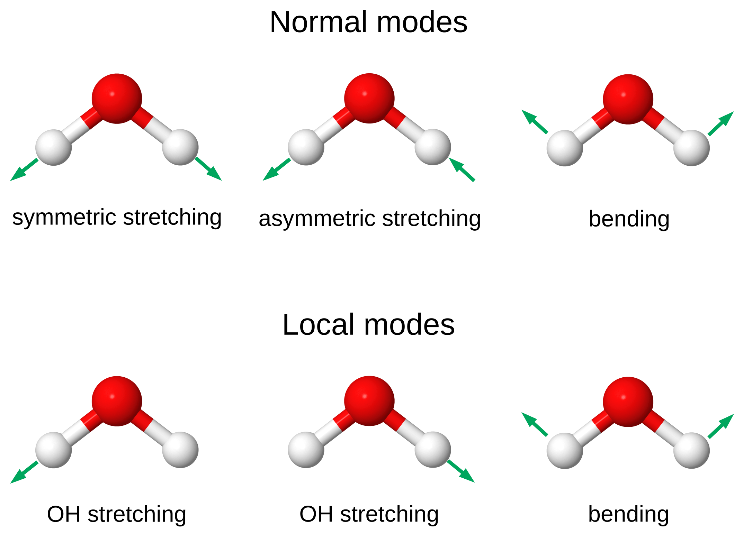
Practical requirements for coherent wavepacket spectroscopy
Define relevant time scales:
Generate pulses with appropriate duration
Pump: established technology in NIR-Vis: hollow core fiber <5 fs
Probe: possibly non-degenerate, generally UV <2 fs
Preserve temporal duration
Avoid dispersive materials, reflection geometry (no transmission), avoid air: vacuum
Sample interaction region: vacuum + liquid + thin: liquid jet technology
<9 fs
symmetric stretching
asymmetric stretching
bending
C. Choe, et al. Analyst 141.22 (2016): 6329-6337.
M. Nisoli, et al. Applied Physics Letters 68.20 (1996): 2793-2795.
M. Galli, et al. Optics letters 44.6 (2019): 1308-1311.
J.C. Travers, et al. Nature Photonics 13.8 (2019): 547-554.

Slide 5
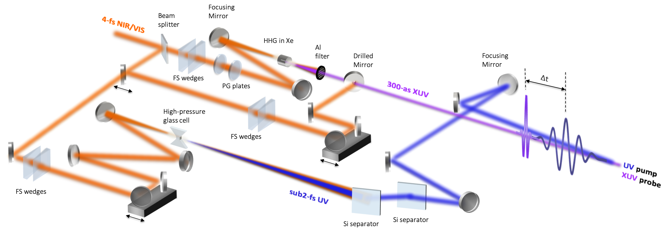
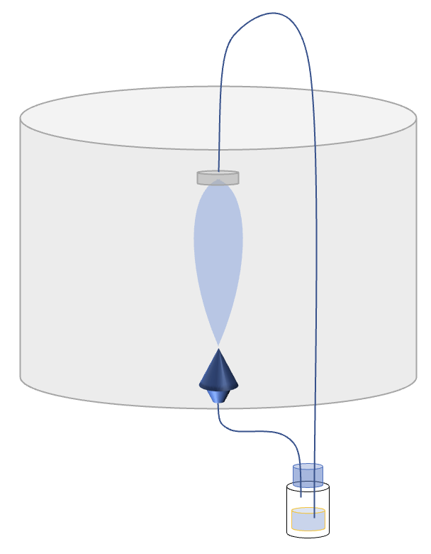
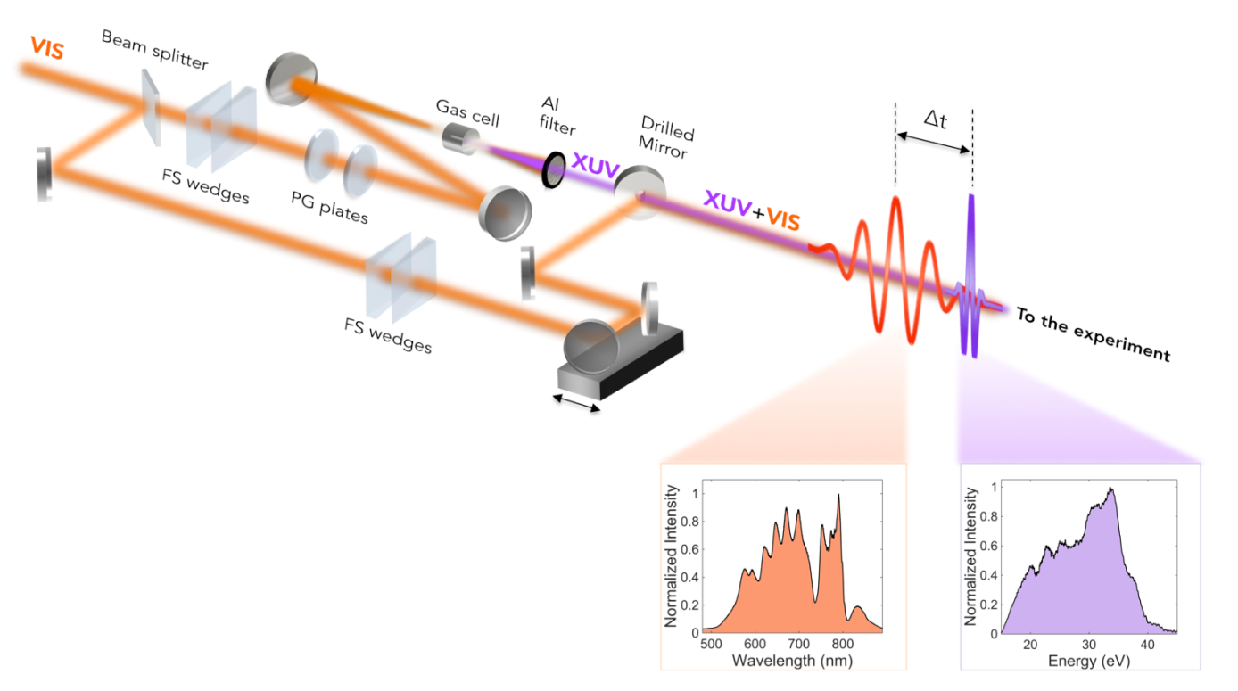
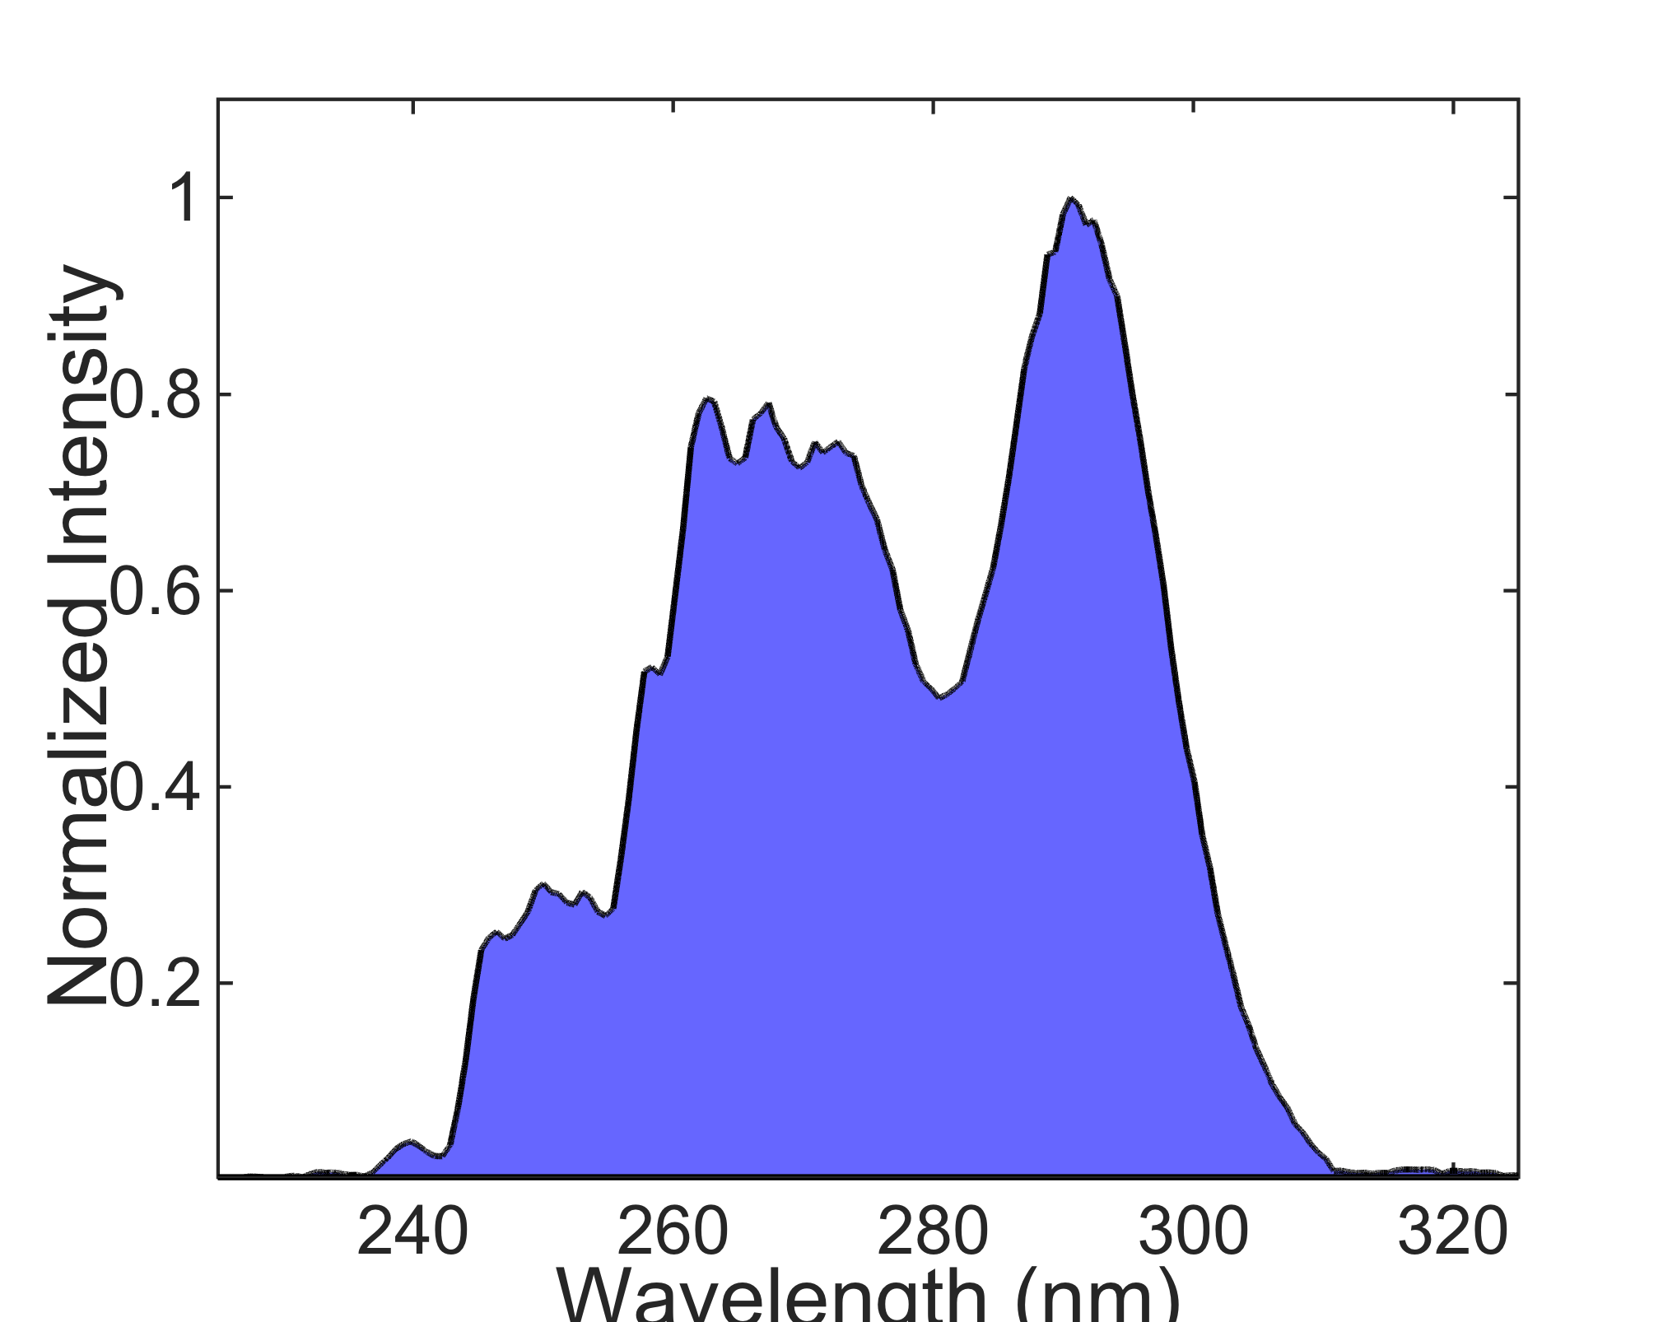
Starlight setup for NIR-Vis-UV-XUV spectroscopy
Liquid jet
IR pump
UV probe

Slide 6
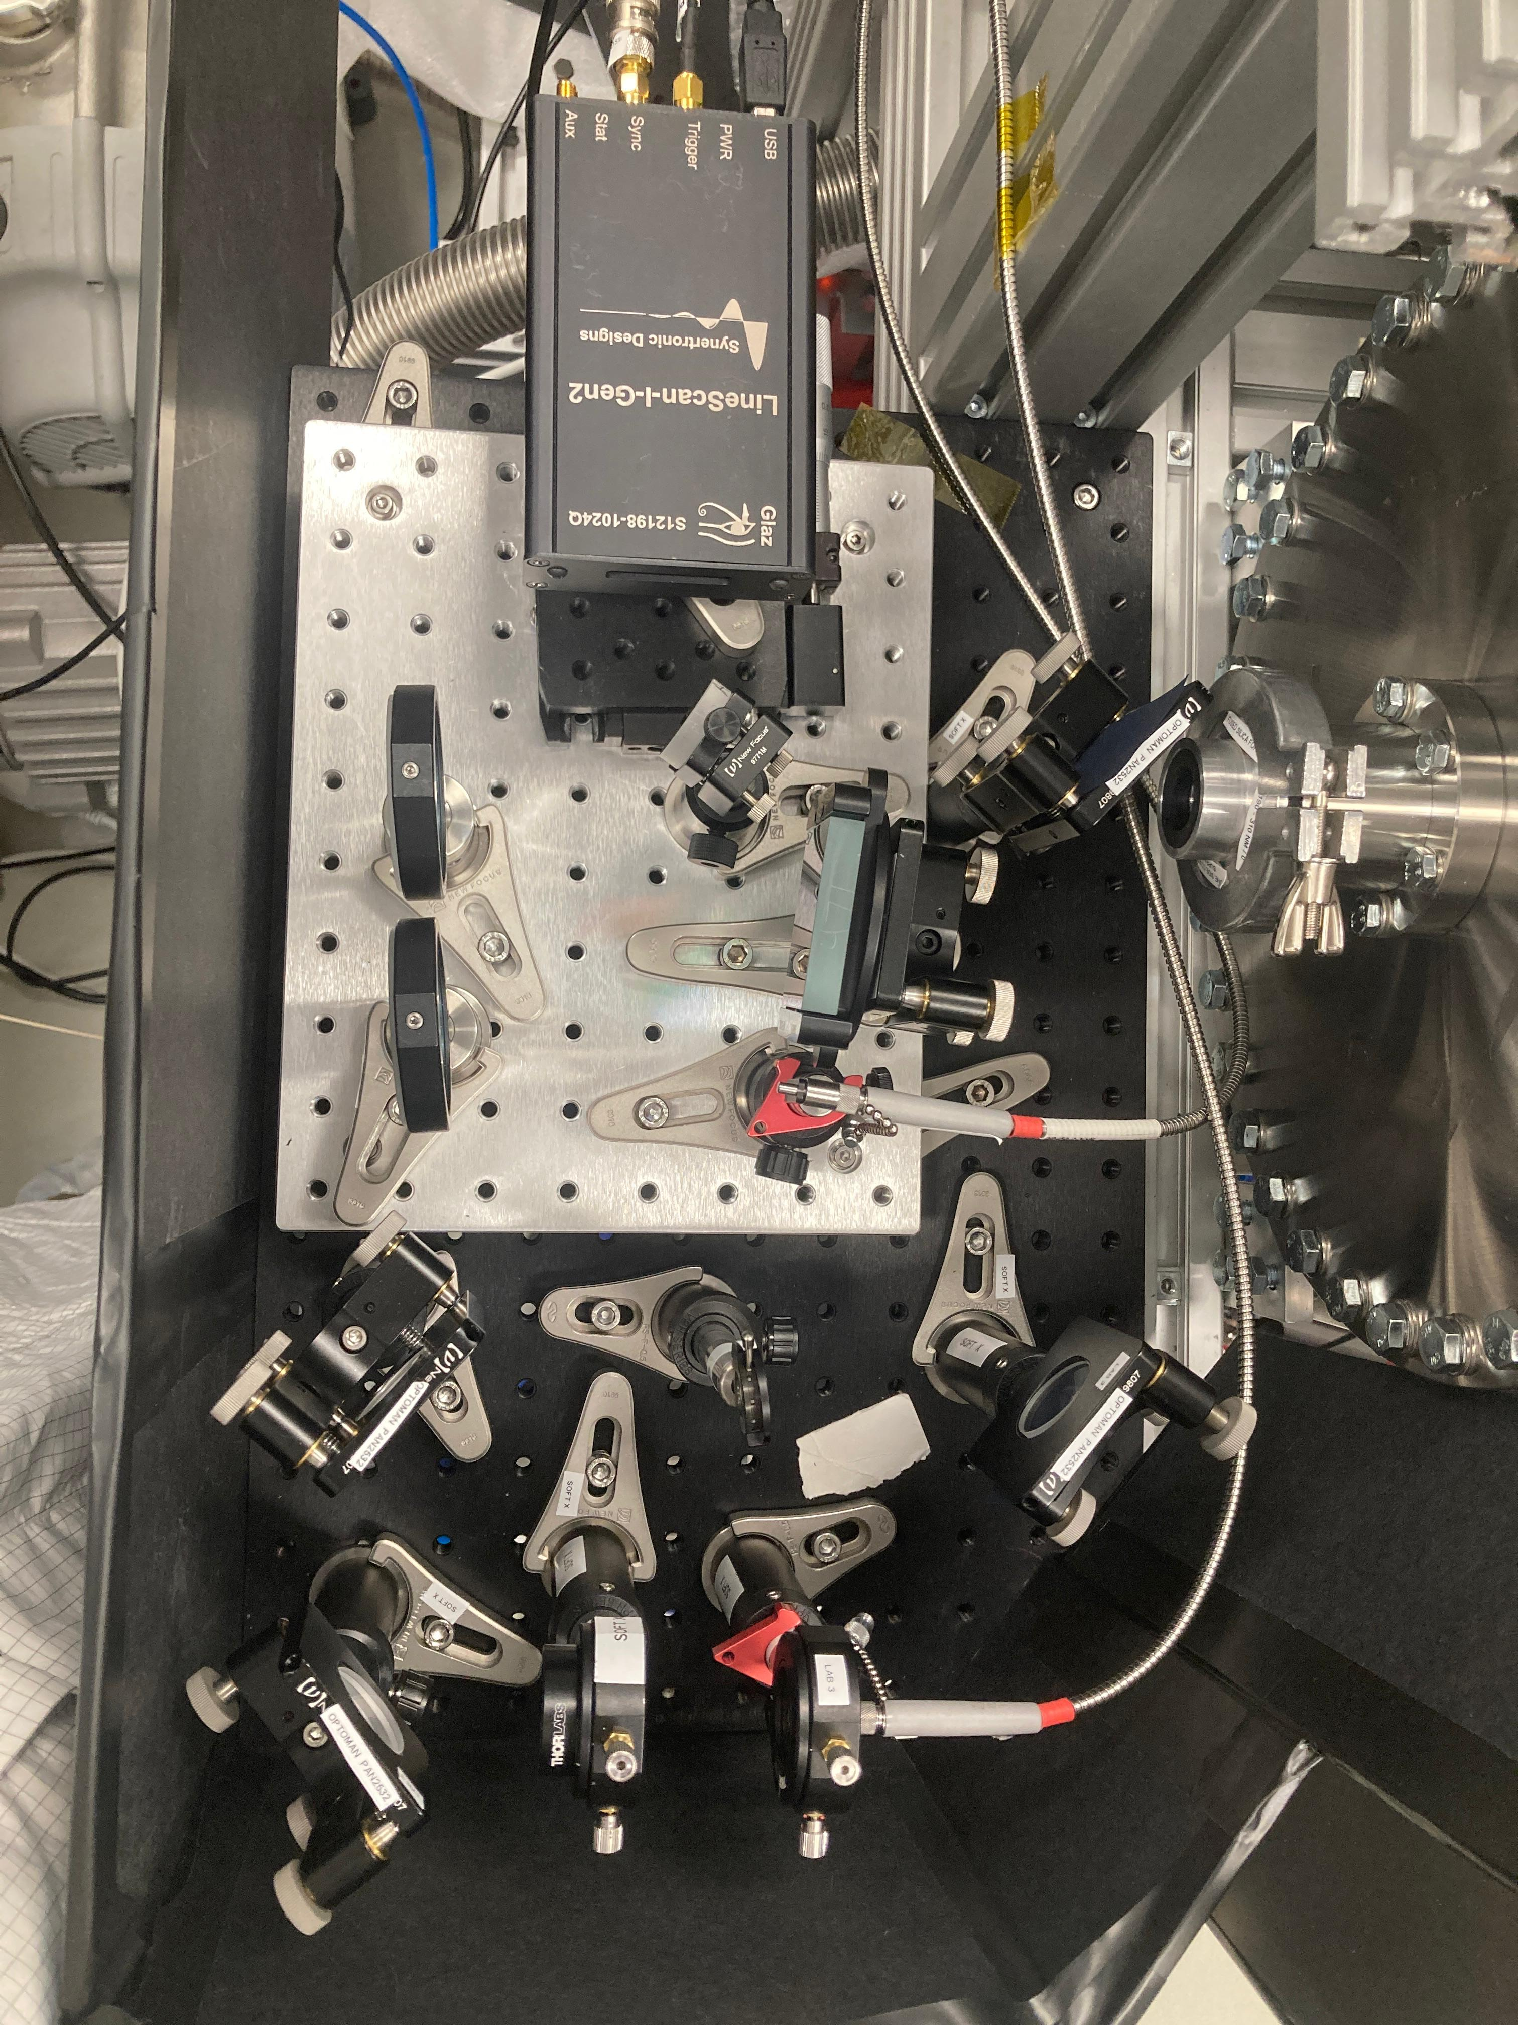
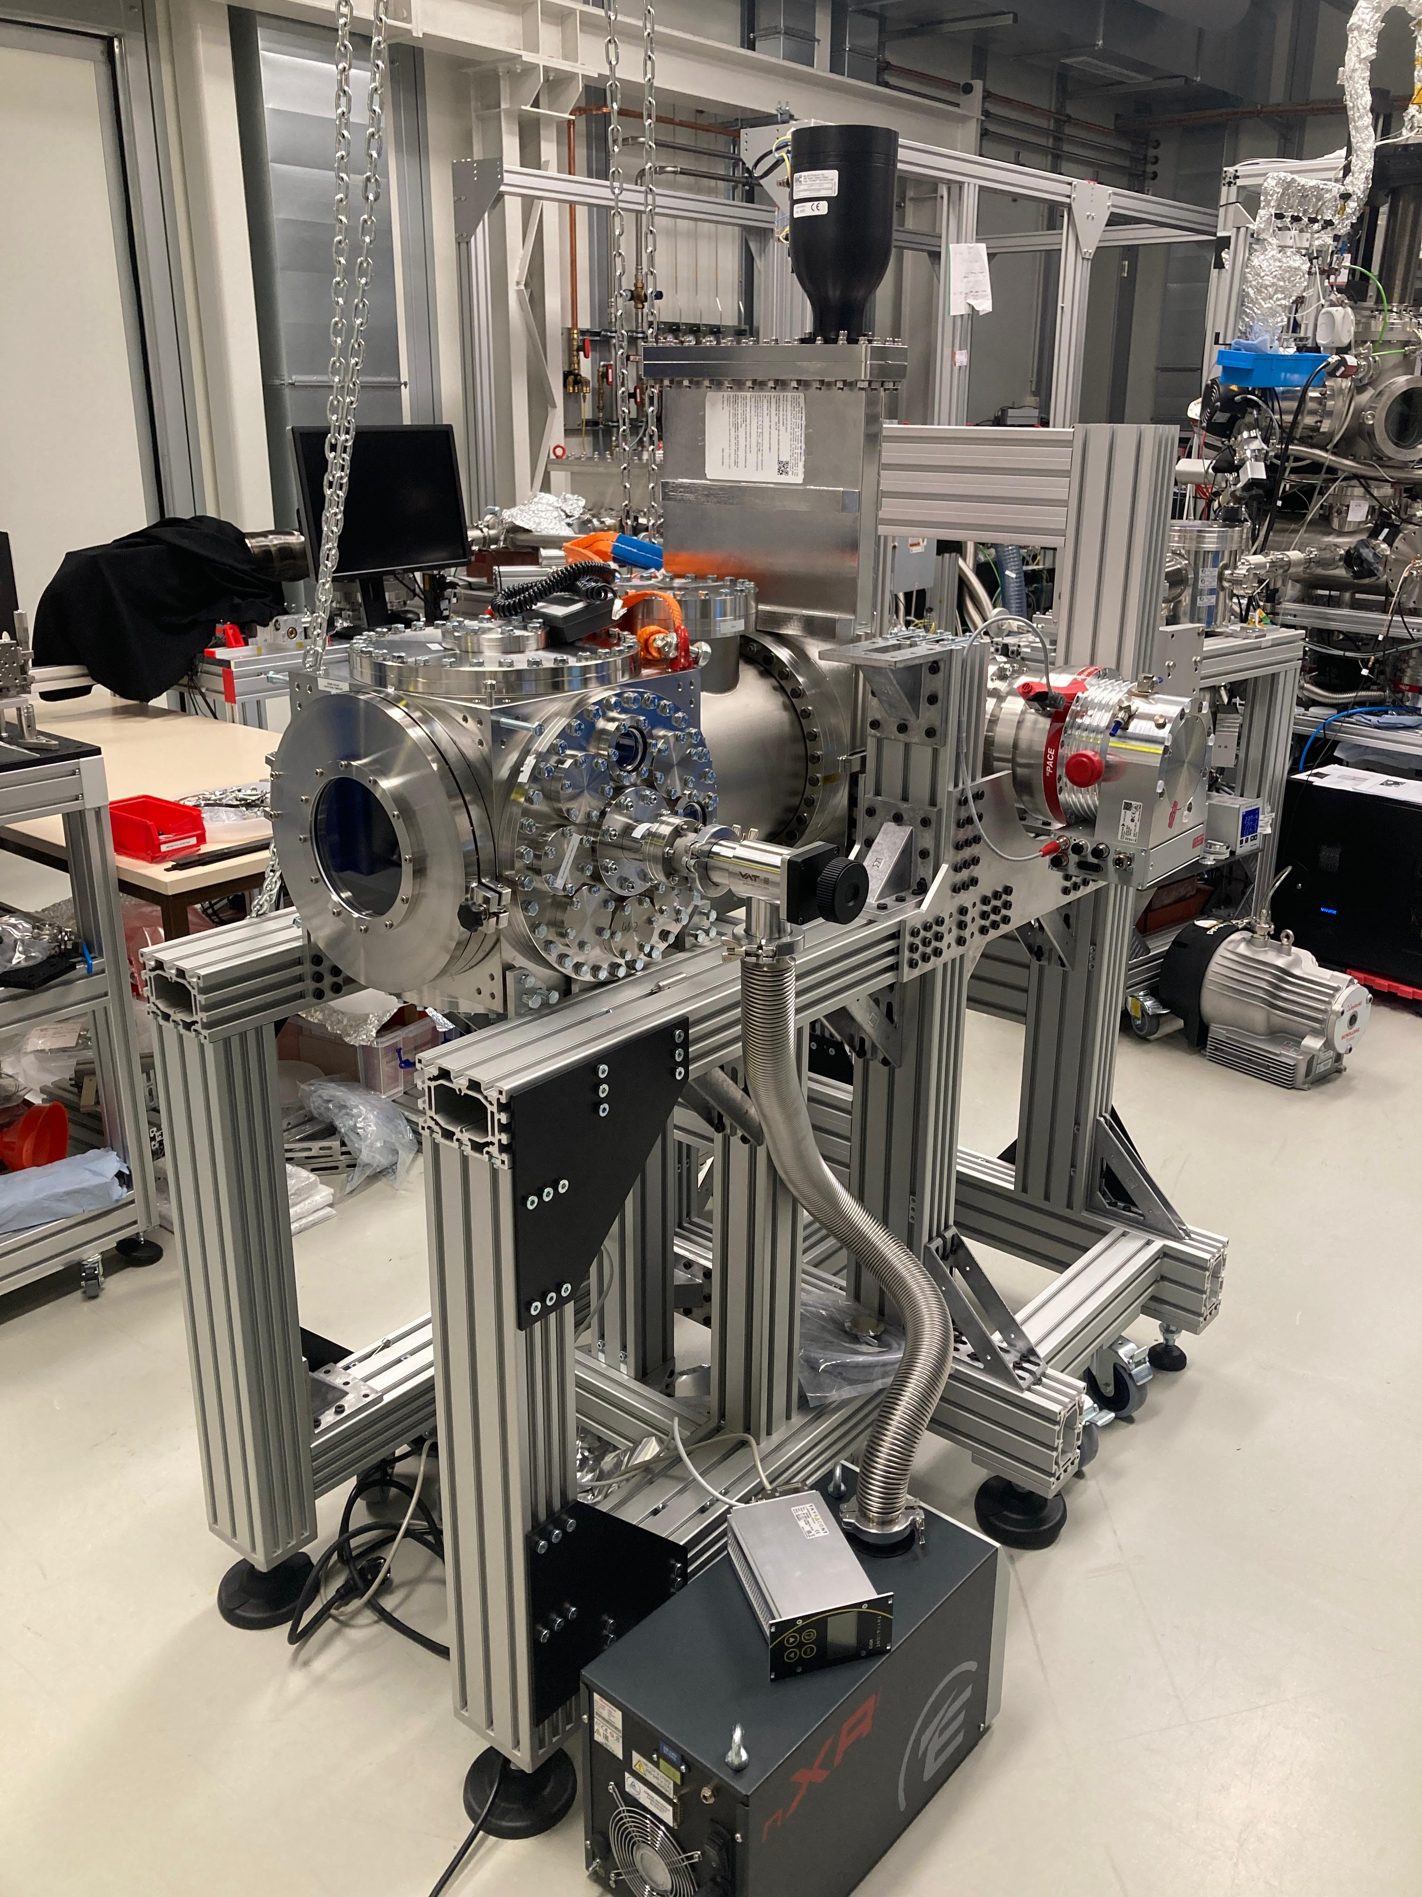

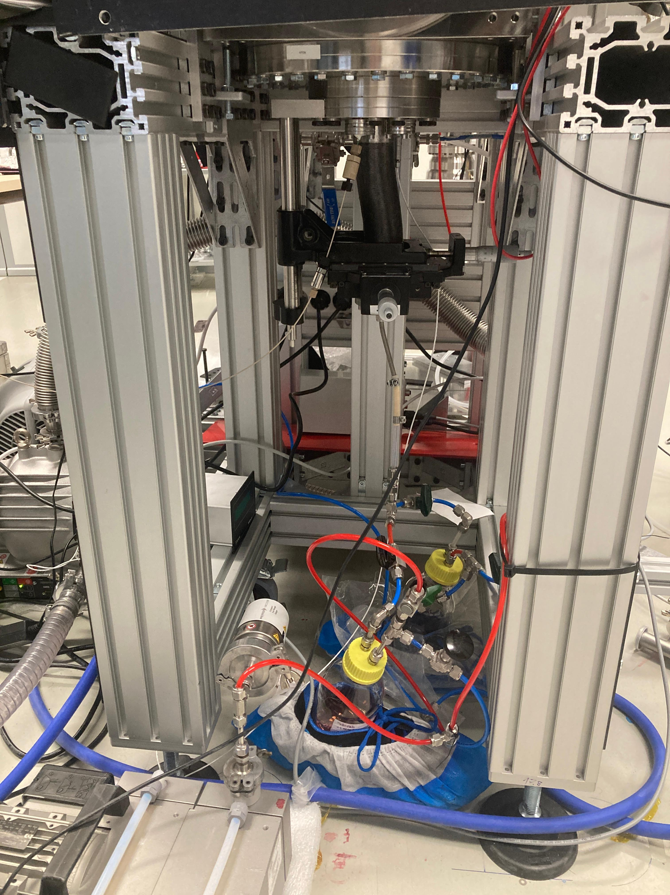
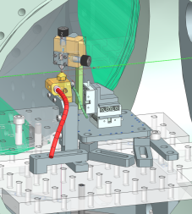
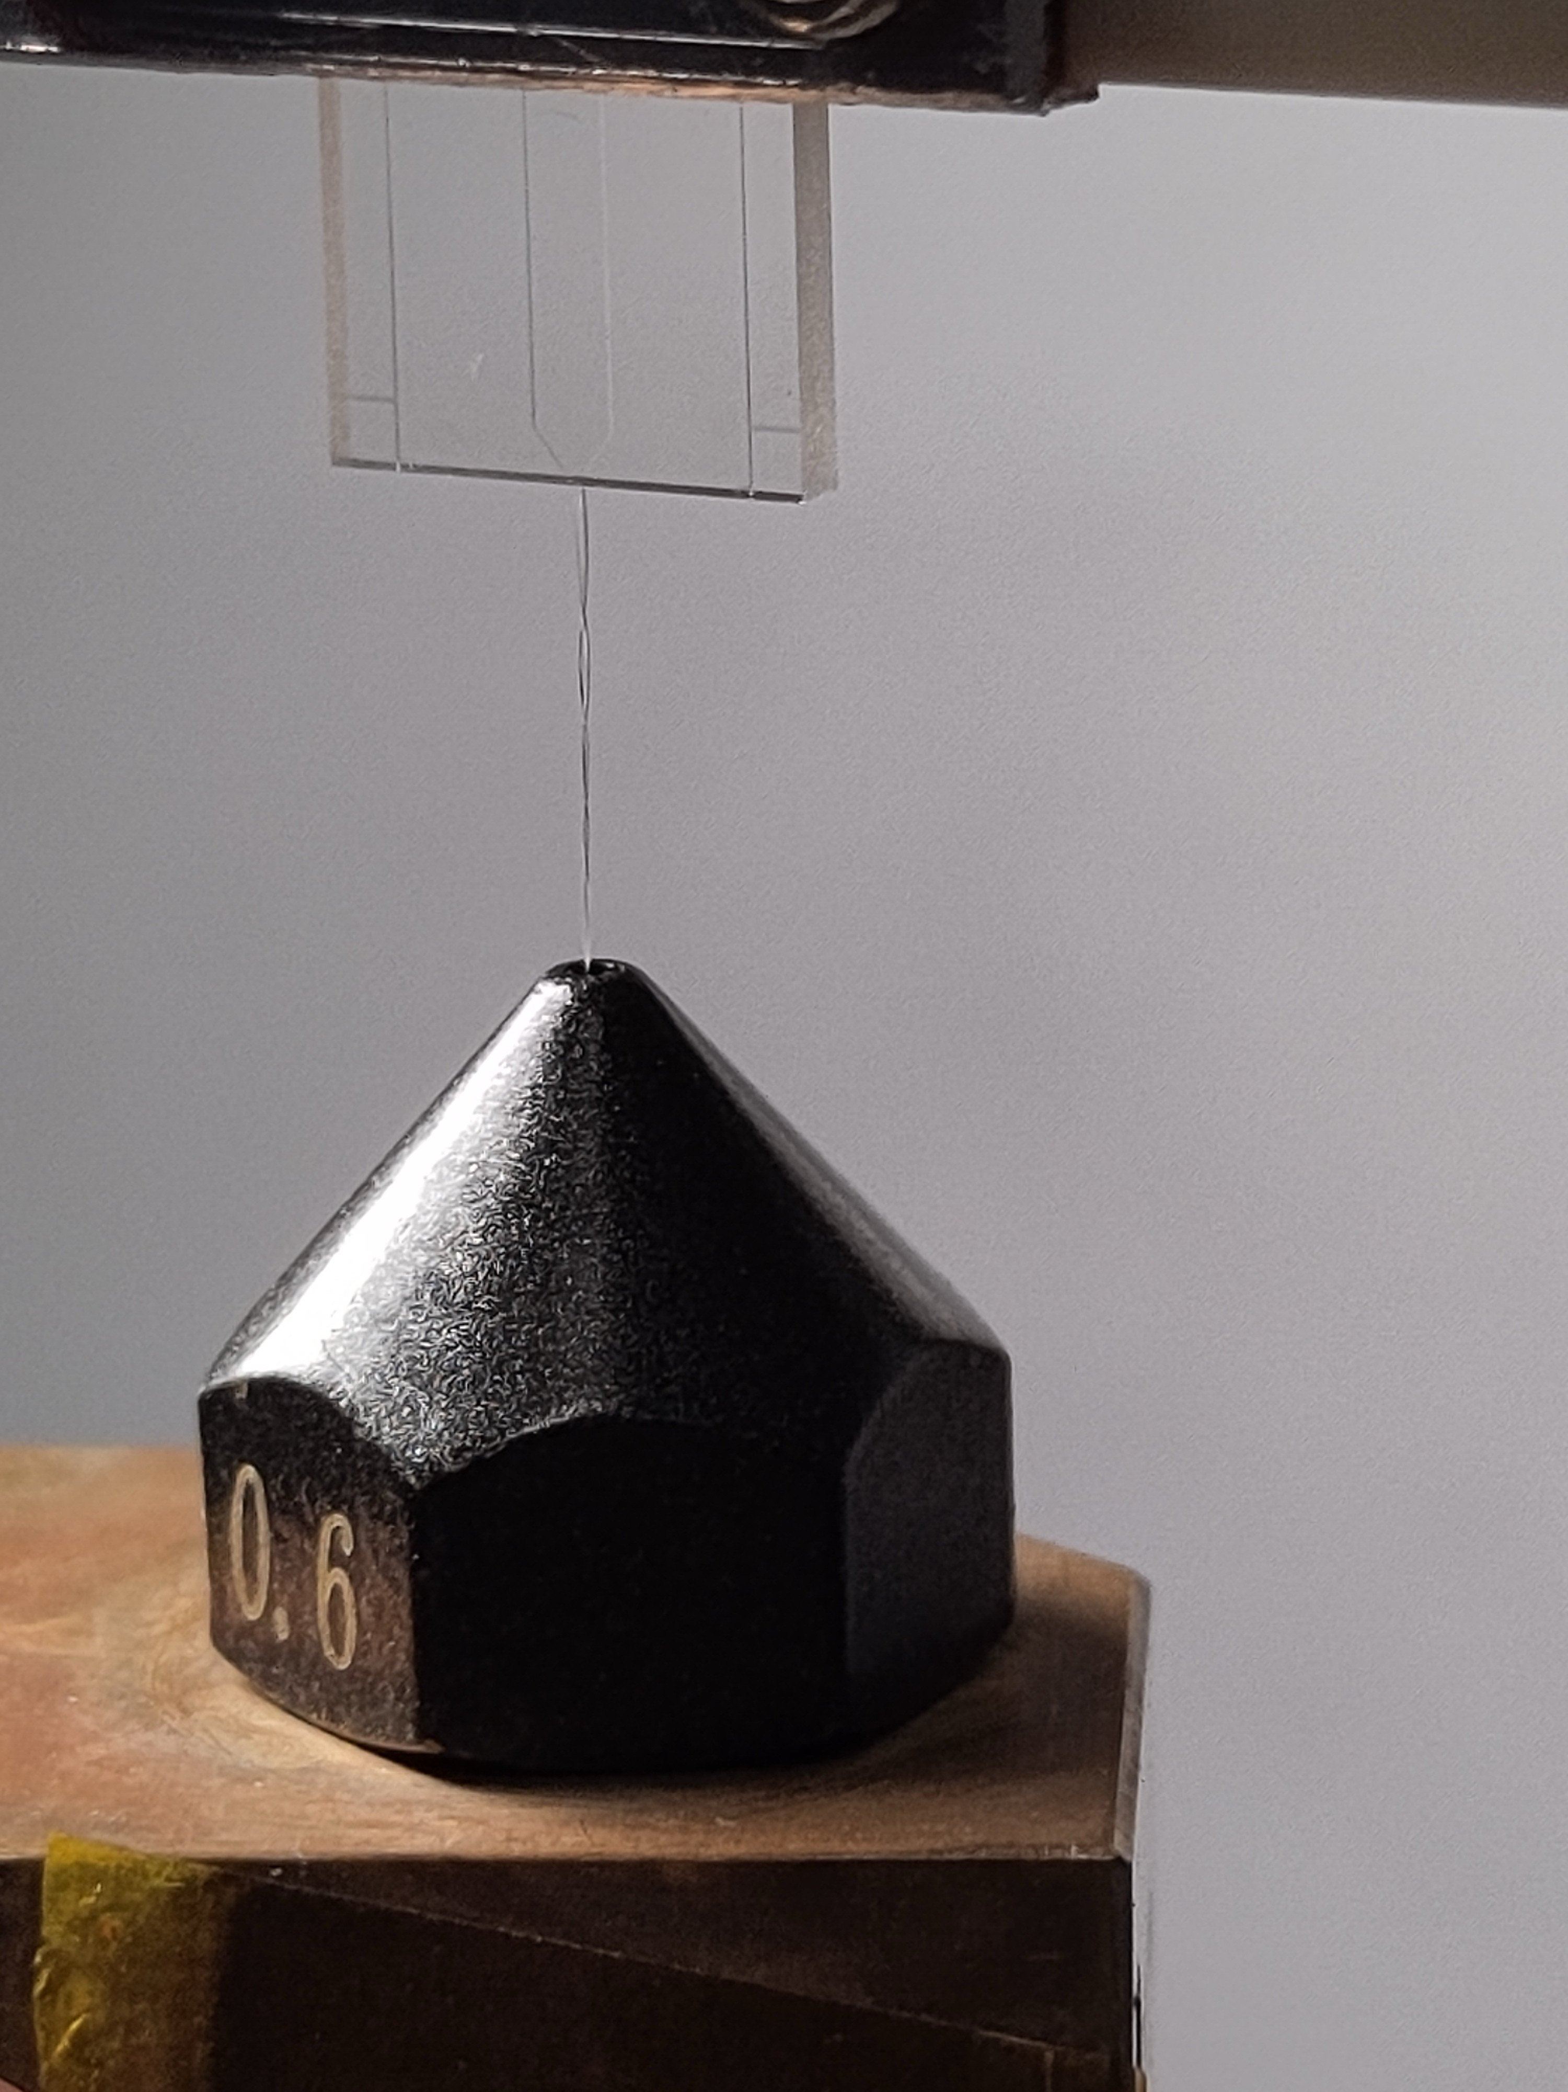
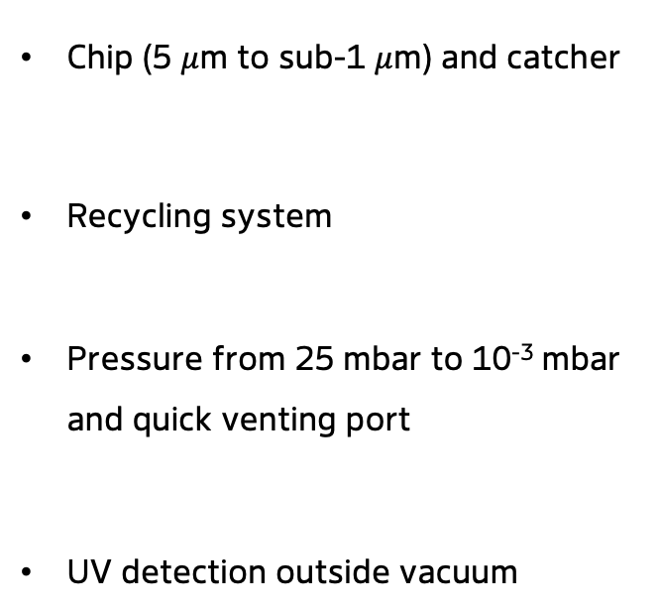
Liquid jet setup
Chip (5 $μ$m to sub-1 $μ$m) and catcher
Recycling system
Pressure from 25 mbar to 10⁻³ mbar and quick venting port
UV detection outside vacuum

Slide 7
Experimental scheme
NIR-Vis pump (< 5 fs)
Ultrabroadband UV probe (< 2 fs)
ISRS of water
Nuclear wavepacket dynamics

Slide 8
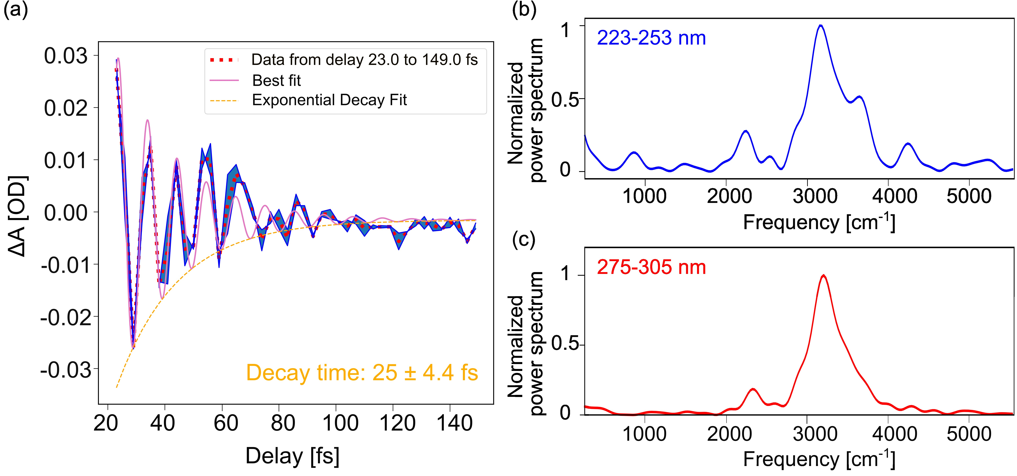
Real-time water stretching
Coherent oscillation dominated by the O-H stretching mode
Dephasing due to intermolecular coupling
G. Giovannetti, et al. Commun. Chem. 9.57 (2026)
C. Choe, et al. Analyst 141.22 (2016): 6329-6337.

Slide 9
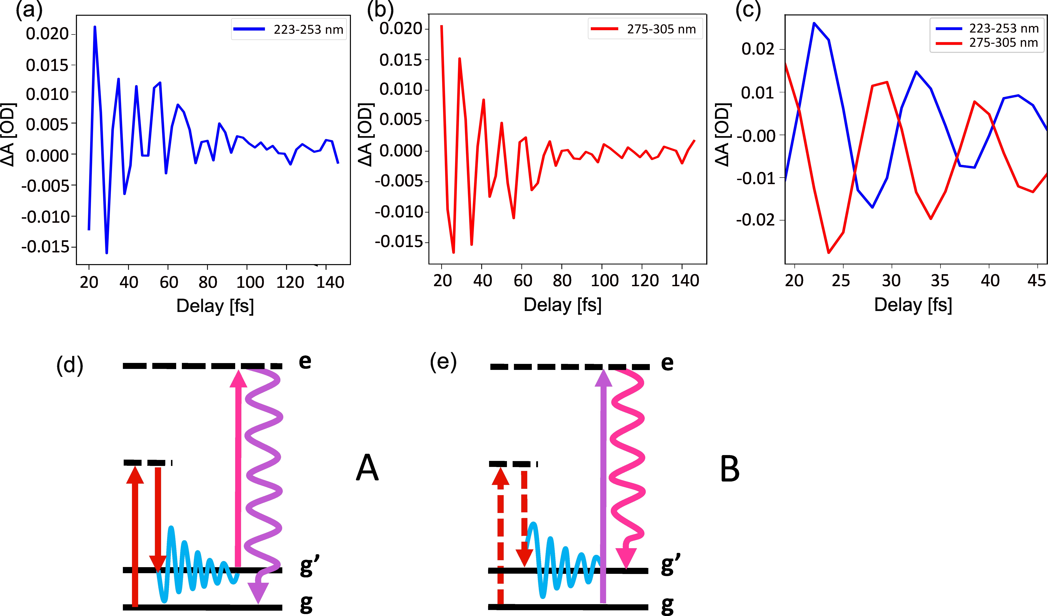
Antiphase oscillation
Node at 260 nm (and 305 nm)

Slide 10
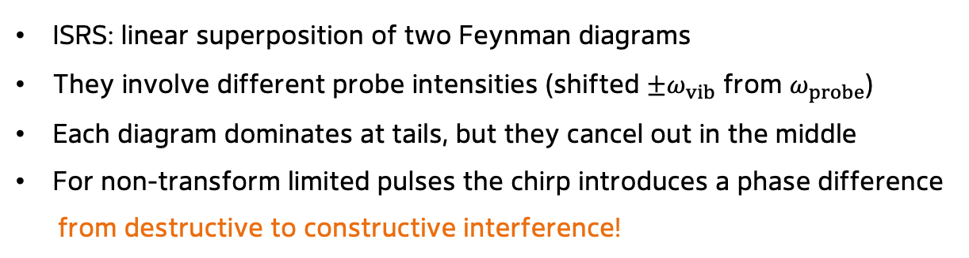
Diagrammatic description of ISRS
ISRS: linear superposition of two Feynman diagrams
They involve different probe intensities (shifted $±ω_{vib}$ from $ω_{probe}$)
Each diagram dominates at tails, but they cancel out in the middle
For non-transform limited pulses the chirp introduces a phase difference
from destructive to constructive interference!
L. Monacelli, et al. JPCL 8.5 (2017): 966-974.

Slide 11
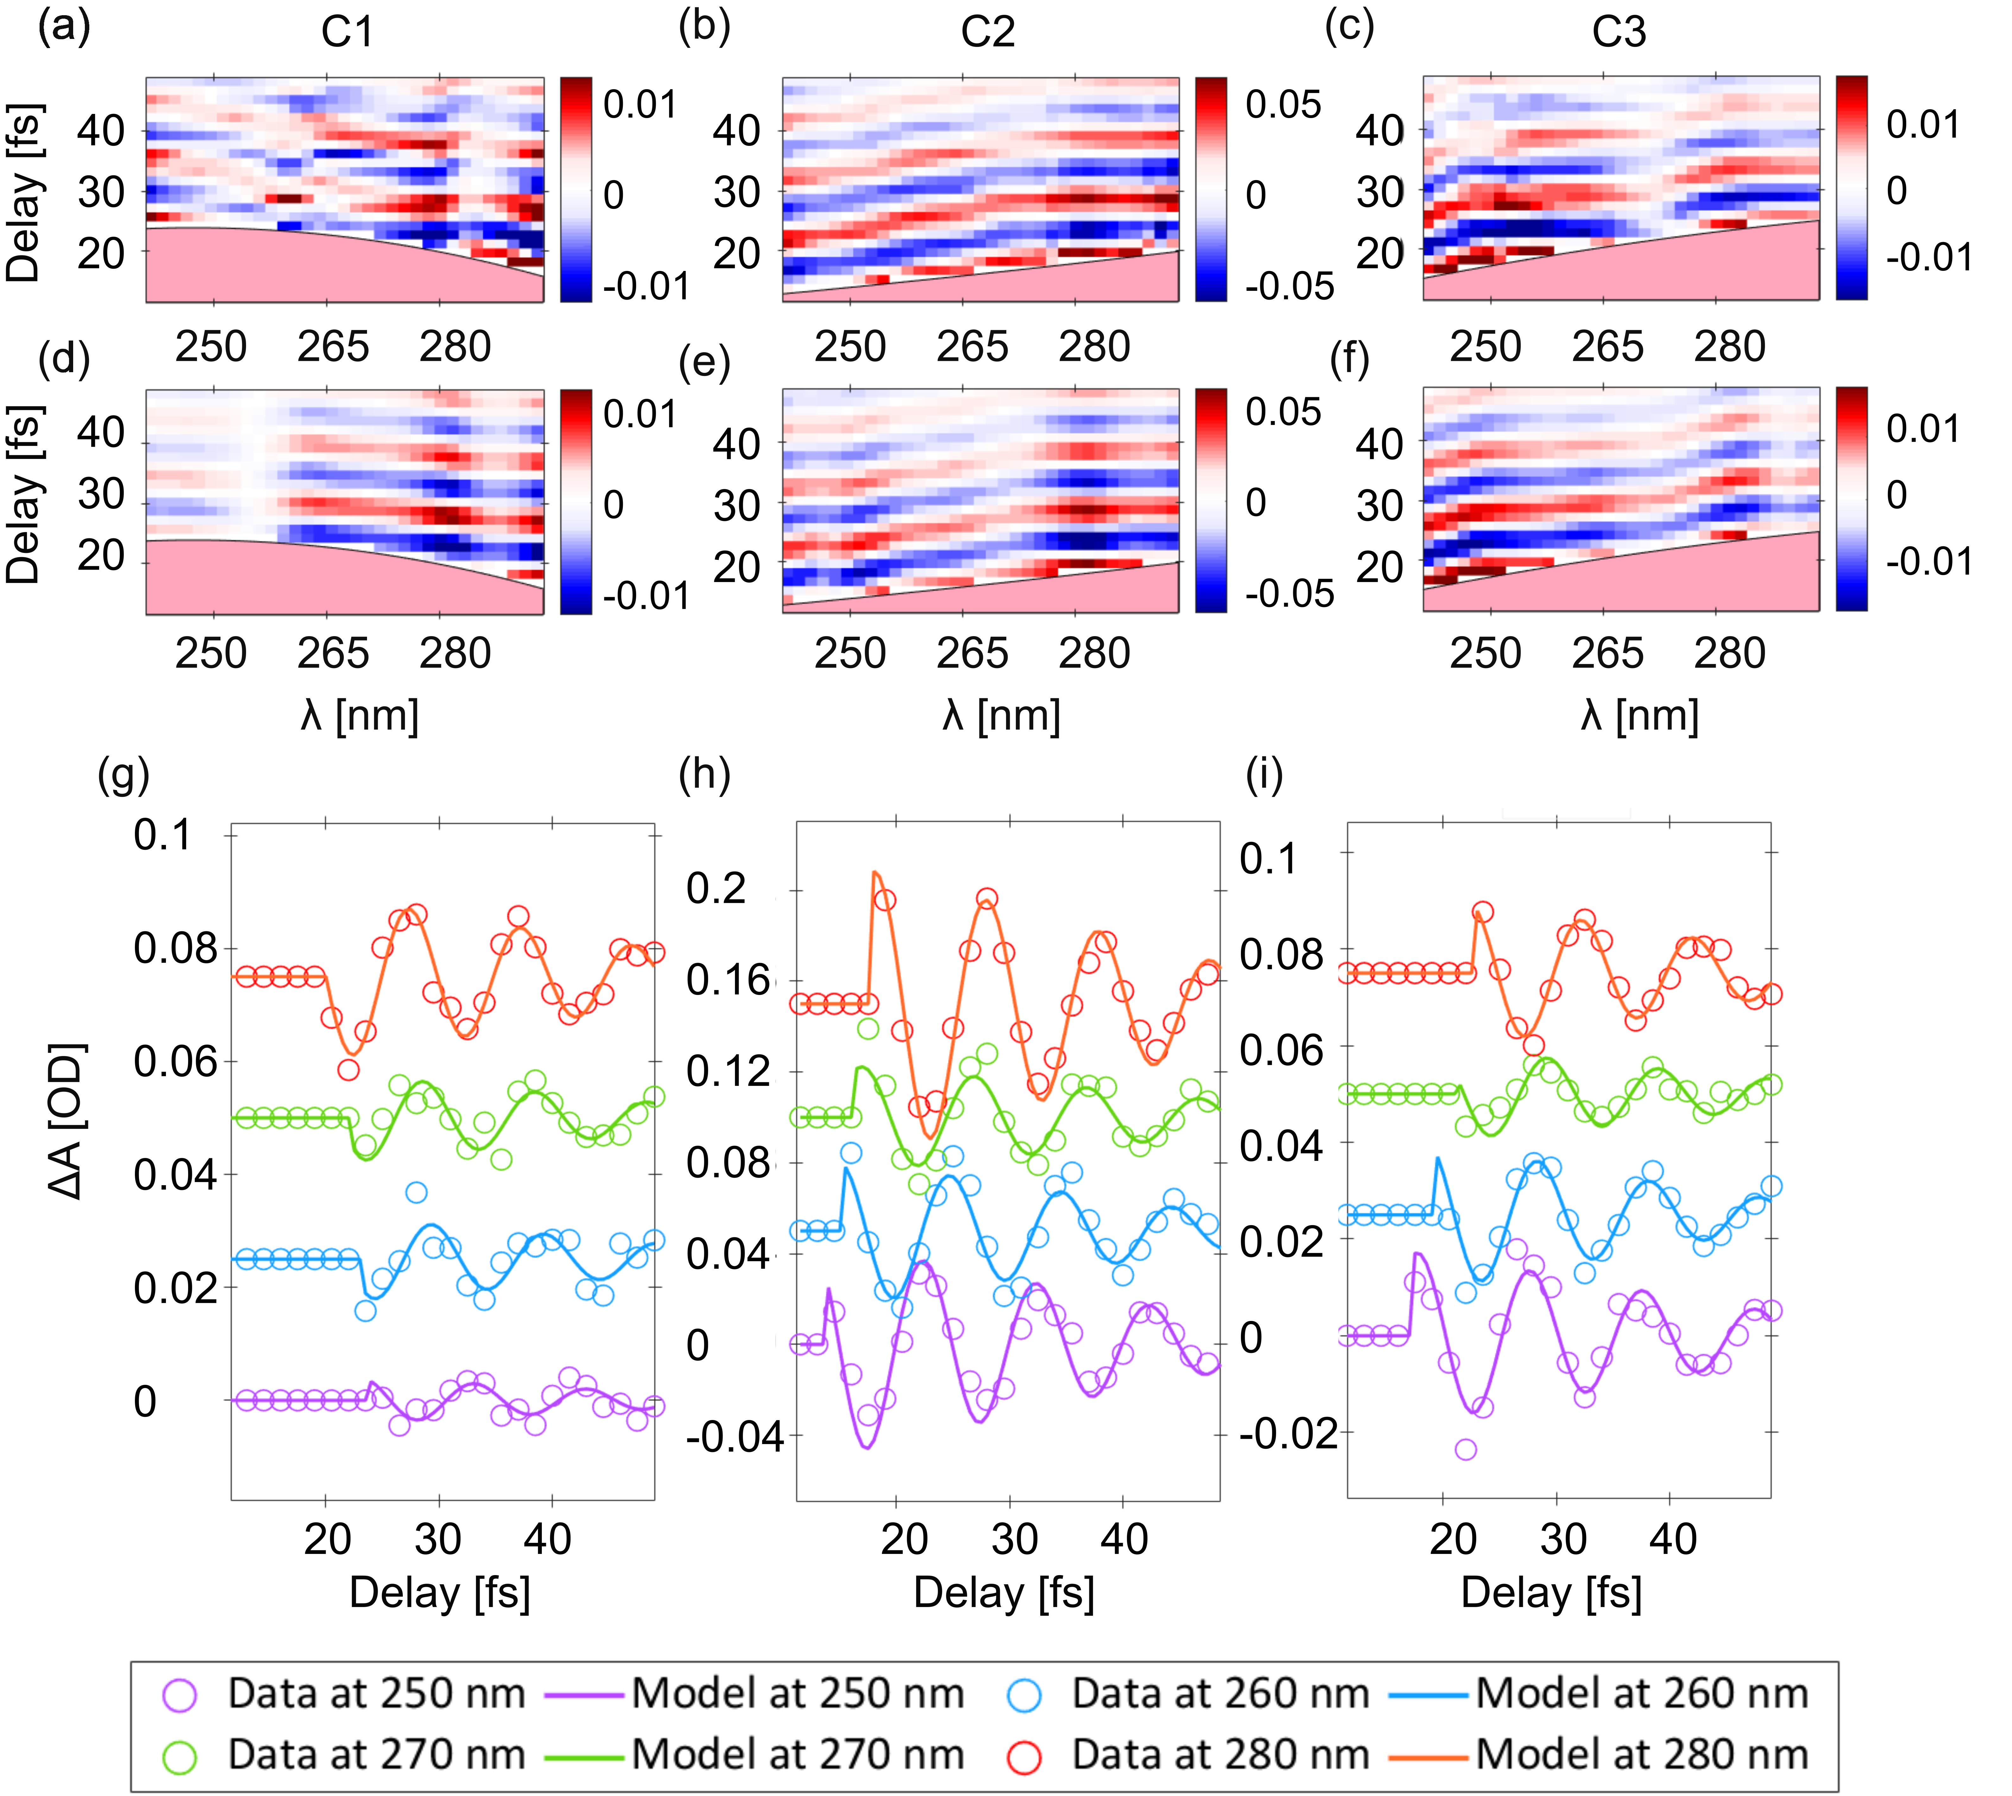
Chirp-dependence of ISRS
Experiment
Model
Excellent agreement in modelling the chirp-dependence of the ISRS process
G. Giovannetti, et al. Commun. Chem. 9.57 (2026)

Slide 12
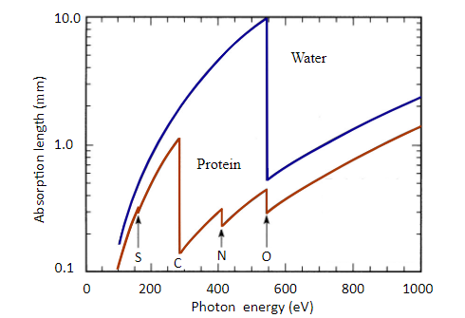
Conclusions and perspectives
Demonstrating real-time tracking of liquid water vibrational dynamics enables extending few-fs wavepacket dynamics in solution phase

Slide 13
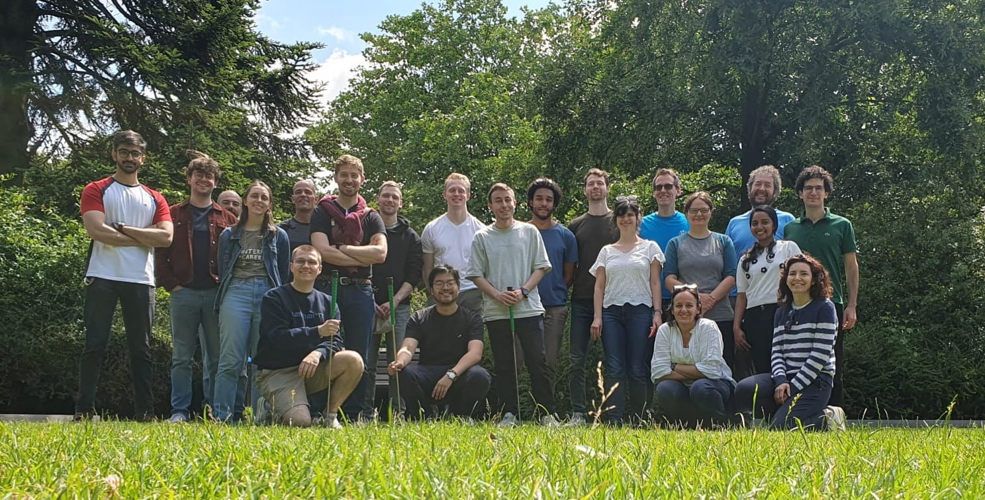
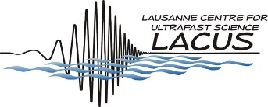




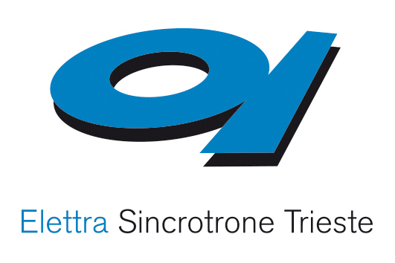






Acknowledgements
Gaia Giovannetti
Sabine Rockenstein
Sergey Ryabchuk
Ammar Bin Wahid
Aurelien Sanchez
Kate Robertson
Kai-Fu Wong
Agata Azzolin
Linda Oberti
Oliviero Cannelli
Erik P. Månsson
Terry Mullins
Andrea Trabattoni
Vincent Wanie
Francesca Calegari
Ofer Neufeld
Angel Rubio
Emanuele Mai
Giovanni Batignani
Tullio Scopigno
Hui-Yuan Chen
Sebastian Jackson
Cristian Soncini
Majed Chergui
Geoffrey Carneiro Gabriele Crippa
Hugo Marroux

Slide 15
Chirp-dependence and modelling

Slide 16
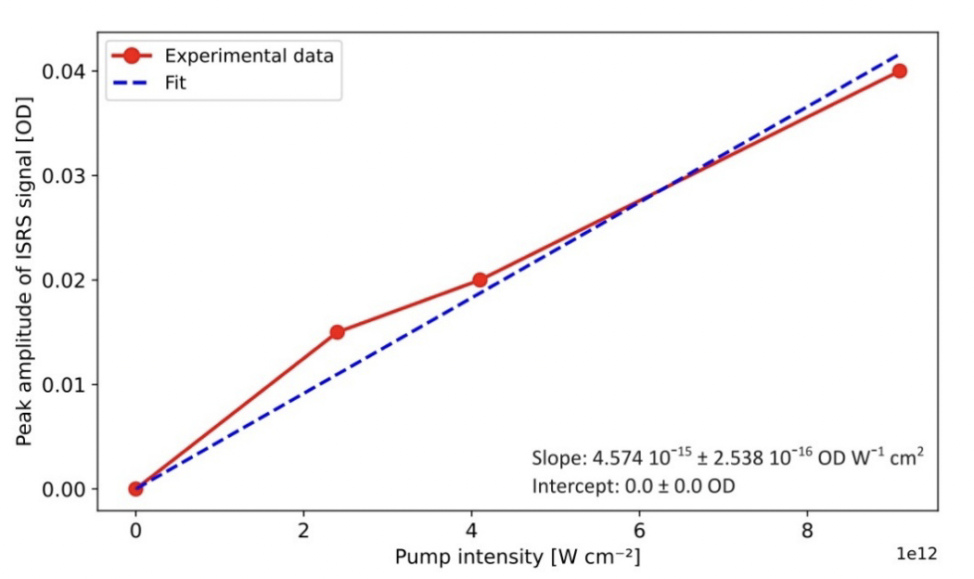
ISRS fluence dependence

Slide 17
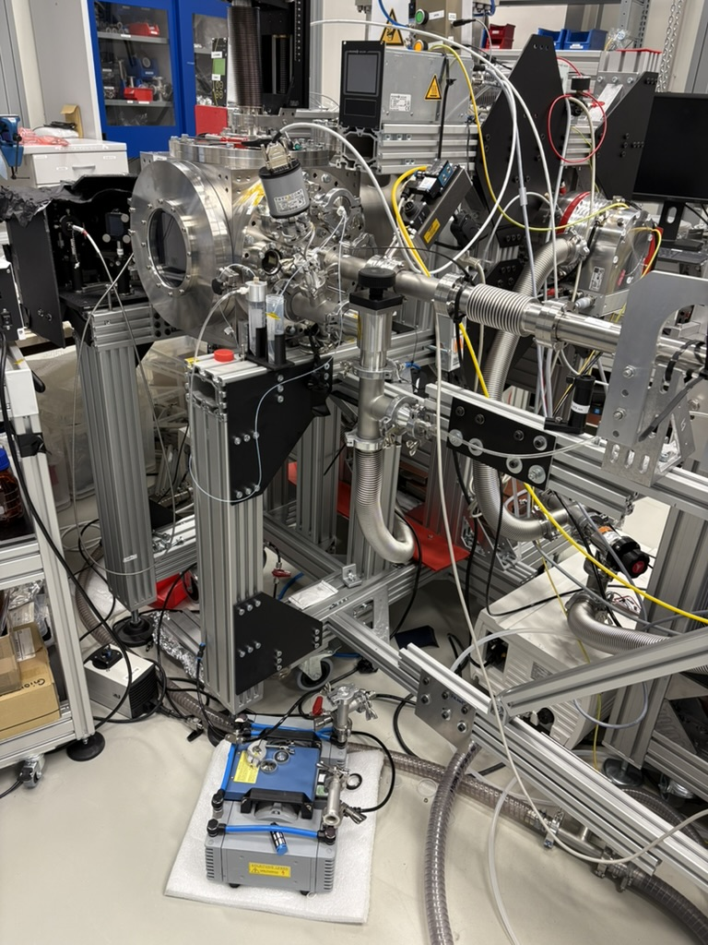
Current status fo the liquid jet

Slide 18
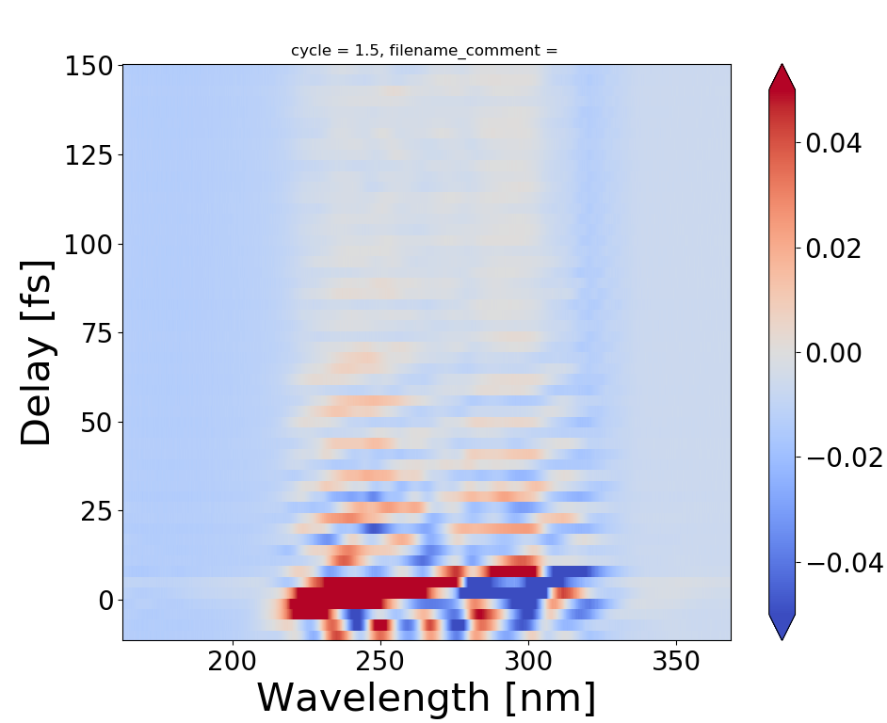
Transient signal at t₀

Slide 20
Generic slide with
Something
Something else
Reference
Question and some text bold

Slide 21
Understanding the properties of aqueous solutions is a key first step in determining the effects of the liquid environment on the chemical reactions occurring in biological systems. For this reason vibrational relaxation and therefore energy dissipation in liquid water have been intensely investigated [1].
Many of the unique properties of water originate from the hydrogen bond network of water, which results from the strong intermolecular interactions between water molecules. For instance, the water H-bond network allows for rapid delocalization and dissipation of excess energy following chemical reactions, thereby making reactions irreversible.
For water, different O-H stretch modes are known to be very strongly coupled both within and between water molecules, leading to ultrafast dissipation and delocalization of vibrational energy [2].

