Slide 1
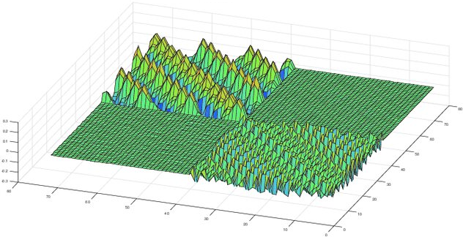

PyAML software architecture
python accelerator middle layer
Joint technology platform for design, commissioning and operation of particle accelerators.
https://github.com/python-accelerator-middle-layer/pyaml
Jean Luc Pons

Slide 2
SOFTWARE REQUIREMENTS
PyAML is designed to be 100% control system agnostic
No control system related code in PyAML
Tango external bindings (tango-pyaml)
OphydAsync external bindings for Tango and Epics (pyaml-cs-oa)
PyAML is designed to allow external plugins
Custom tuning tools
Custom measurement tools
Custom magnet models
etc…
PyAML is a young project
Tune response measurement / Tune correction
Orbit response measurement / Orbit correction (using pySC)
Dispersion measurement (using pySC)
Chromaticity measurement

Slide 3
MAIN SOFTWARE OVERVIEW
User space
Scripts / High level applications / Servers
PyAML
Measurement tools
Tuning tools
ORM
Chroma.
Disp.
Tune Resp.
…
Orbit Corr.
Tune Corr.
…
Magnets
BPM
RF
Betatron
Tune
…
Model
Model
Control System Backends
Accelerator
Toolbox
PyAML provides a unified interface for accessing a control system or a simulator

Slide 4
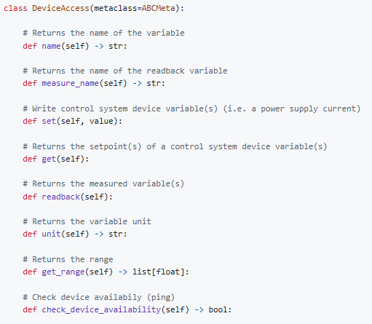
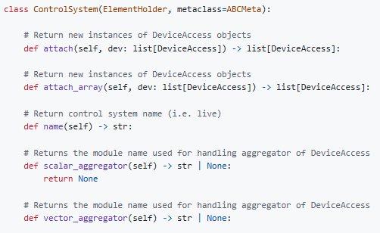
CONTROL SYSTEM ABSTRACTION
PyAML defines 2 abstract classes to be implemented in CS backends
The attach methods are not connection method. The CS backend is in charge of returning DeviceAccess objects attached to a given CS instance (i.e. different TANGO_HOST, different PV prefix, etc…).
The pydantic configuration models associated to a ControlSystem or a DeviceAccess are not a part of PyAML but of the backend

Slide 5



CONTROL SYSTEM ABSTRACTION
External CS backends
PyAML
tango-pyaml
(native tango backend)
DeviceAccess2
(Abstract)
DeviceAccess
(Abstract)
tests/dummy_cs/tango-pyaml
(mocking CS for unit test)
ControlSystem2
(Abstract)
ControlSystem
(Abstract)
pyaml-cs-oa
(OphydAsynch backend)
Tango/Epics
OphydAsynch needs the explicit type of the CS variable (not the native tango backend). This kind of discrepancy should be handled in the CS backend implementation
Change of PyAML abstract interfaces can be handled by overriding DeviceAccess and ControlSystem classes to avoid breaking backward compatibility. CS backends can be updated later to get new features
Implementation of new CS backend has to be clearly documented

Slide 6
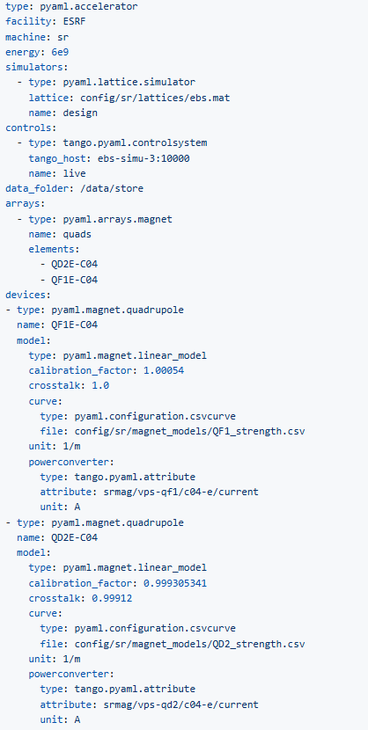
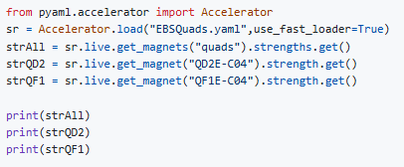

ACCELERATOR CONFIGURATION
Top level configuration
A simple example with 2 quads
outputs
Python attributes can be automatically added (if magnet naming style is good in the config) to allow:
sr.live.quads.strengths.get()
In order to closely fulfill the specification document.

Slide 7
MAGNETS
Supported magnets
Normal and skew multipole components are separated to allow the syntax: mag.strength.set(value)
HCorrector / VCorrector
Quadrupole / SkewQuad
Sextupole / SkewSext
Octupole / SkewOctu
Complex combined function magnets and “virtual” magnets
When multipoles are not separated at the hardware level, the underlying magnet model needs all strength setpoints to compute coil currents. Virtual magnets act exactly as simple magnets and can be added in arrays.
PyAML is in charge of sending PS setpoints without overlap.
HCorrector
Combined
Function
Magnet
Power
Supply
VCorrector
Power
Supply
Power
Supply
SkewQuad
Power
Supply
Model
Power
Supply
Sextupole

Slide 8
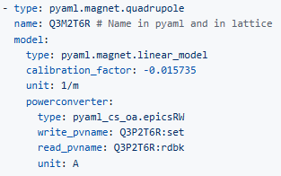
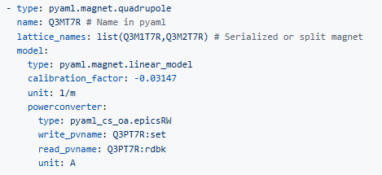
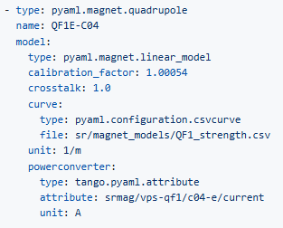
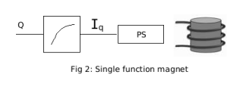
MAGNETS CONFIGURATION
Simple magnet configuration
The type field refers to a python module. It is dynamically imported when the configuration is loaded.
lattice_names : str or None, optional
The name(s) of the associated element(s) in the lattice. By default,
the PyAML element name is used. lattice_names accept the following
syntax:
- list(name,[name]) : Element names
- [name]@idx[,idx] : Element indices in the subset formed by name.
- [name]#start_idx..end_idx : Element range in the subset formed by name.
In the above syntax, if the name is not specified, the whole set
of lattice element is used for indexing.

Slide 9
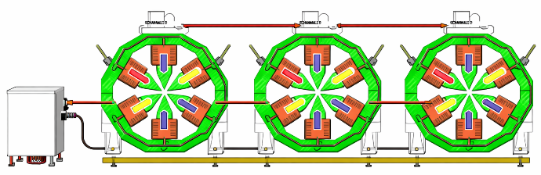
MAGNETS CONFIGURATION
Magnets in series configuration
1 power supply for several magnets
Serie of magnets
Strength
Current
Models
PS
Setting the strength on one magnet computes the required current for that magnet and then applies this current to all magnets.
All magnet can have the same calibration curve, or a specific curve can be applied to each magnet.
- type: pyaml.magnet.serialized_magnet name: mySeriesOfMagnets function: B1 elements: - QF8B-C04 - QF8D-C04 - QD5D-C04 - QF6D-C04 - QF4D-C04 model: type: pyaml.magnet.linear_serialized_model calibration_factors: 1.00504 calibration_offsets: 0.0 unit: m-1 curves: sr/magnet_models/quadcurve.yaml powerconverter: type: tango.pyaml.attribute attribute: srmag/ps-corr-sh1/c01-a-ch1/current unit: A
type: pyaml.magnet.serialized_magnet name: mySeriesOfMagnets function: B1 elements: - QF8B-C04 - QF8D-C04 - QD5D-C04 - QF6D-C04 - QF4D-C04 model: type: pyaml.magnet.linear_serialized_model calibration_factors: [1.00504, 1.00504, 1.00504, 1.00504, 1.00504] calibration_offsets: [0.0, 0.0, 0.0, 0.0, 0.0] unit: m-1 curves: - sr/magnet_models/quadcurve1.yaml - sr/magnet_models/quadcurve2.yaml - sr/magnet_models/quadcurve3.yaml - sr/magnet_models/quadcurve4.yaml - sr/magnet_models/quadcurve5.yaml powerconverter: type: tango.pyaml.attribute attribute: srmag/ps-corr-sh1/c01-a-ch1/current unit: A
sr: Accelerator = Accelerator.load(sr_file) magnets = [ sr.design.get_element("QF8B-C04"), sr.design.get_element("QF8B-C04"), sr.design.get_element("QD5D-C04"), sr.design.get_element("QF6D-C04"), sr.design.get_element("QF4D-C04"), ] magnets[3].strength.set(0.6) # Strengths may not all be equal, depending on the magnet calibration parameters strengths = [magnet.strength.get() for magnet in magnets] # All currents must be equal; this is what binds the magnets together.
currents = [magnet.hardware.get() for magnet in magnets]

Slide 10
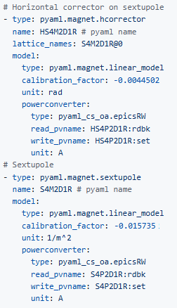
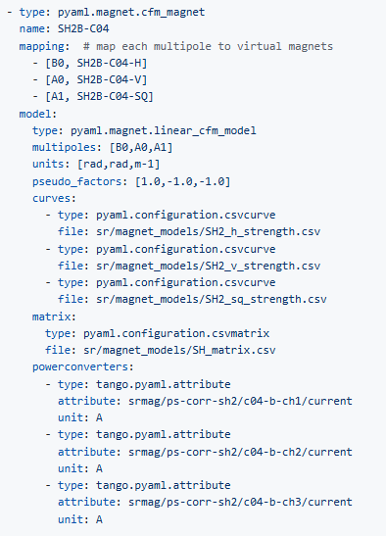

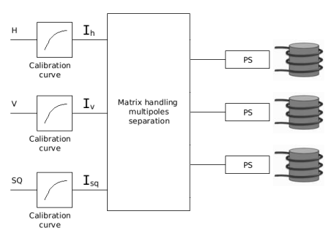
MAGNETS CONFIGURATION
Combined function magnet configuration
Complex HCorrector + VCorrector + SkewQuad with 3 PS and a multipole separation matrix. On the side of the PyAML development, hcorr is a `virtual` magnet.
Simple HCorrector + Sextupole
with 2 independent PS that control
each multipole
@ESRF, we call I_{h}, I_{v} and I_{sq} pseudo currents.

Slide 11
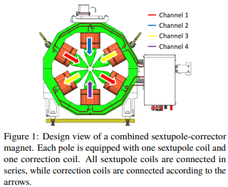
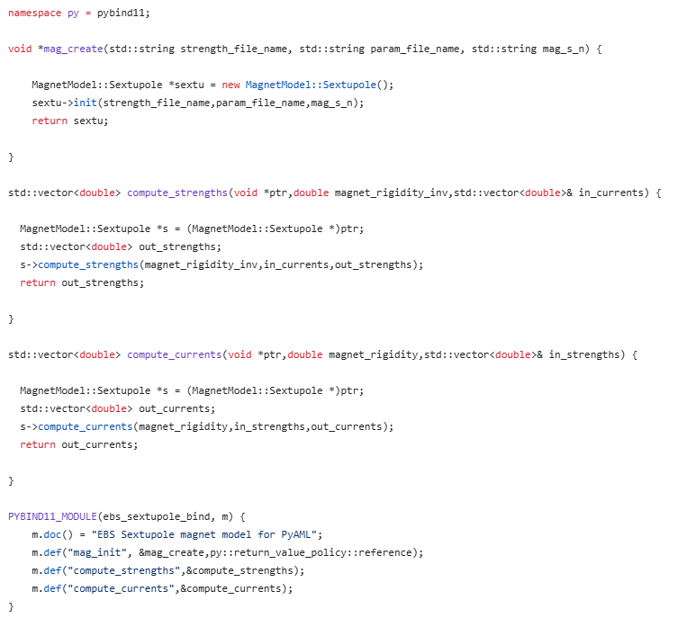
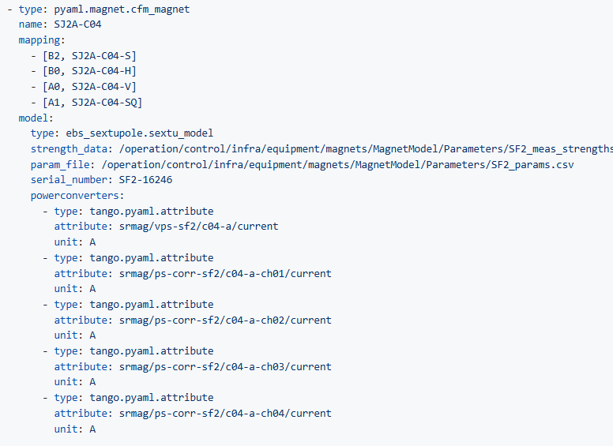
MAGNETS CONFIGURATION
External magnet model (example EBS Sextupole model)
Design and C++ code by G. Le Bec, https://proceedings.jacow.org/ipac2021/papers/tupab369.pdf
https://github.com/python-accelerator-middle-layer/ebs_sextupole
External module

Slide 12
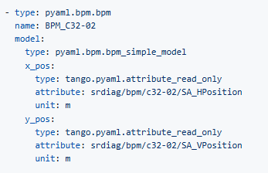
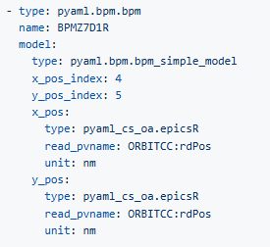

BPM CONFIGURATION
BPM configuration
A simple BPM with 2 distinct Tango attributes for H & V positions.
A simple indexed BPM with 1 Epics PV for the whole H & V orbit
BPM offsets and tilt are handled in the same way

Slide 13
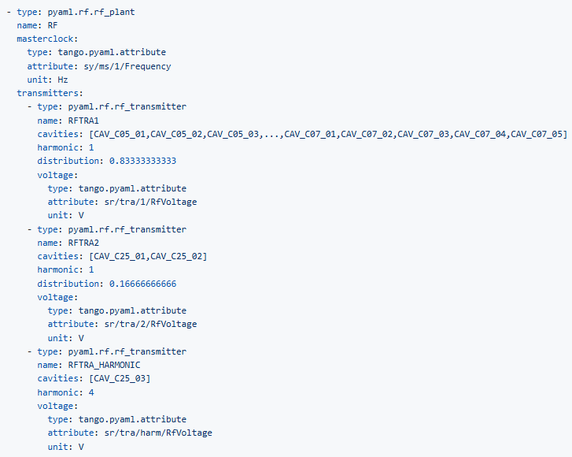

RF CONFIGURATION
RF configuration
RF transmitters definition is optional.
When RF transmitters are not defined, PyAML default to AT set_rf_frequency() and set_rf_voltage() methods for the design, setting of RF voltage on the live is no longer possible.

Slide 14
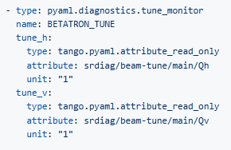

TUNE MONITOR CONFIGURATION
Tune monitor configuration
A simple transverse tune monitor with 2 distinct Tango attributes for H & V tunes.

Slide 15
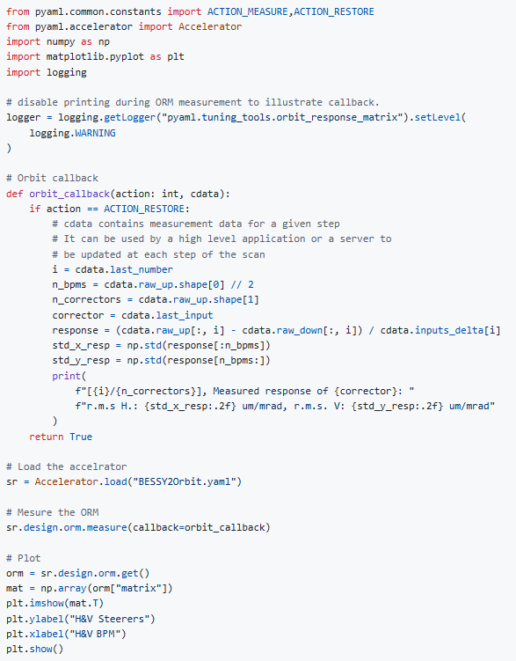
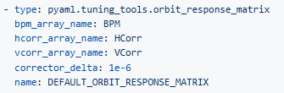
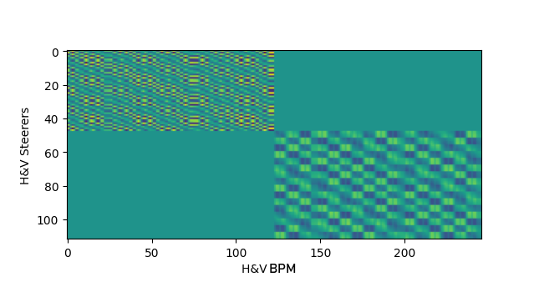
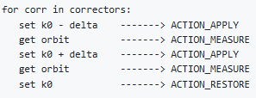

ORM MEASUREMENT TOOL
ORM measurement
Configuration
Callback workflow
Callback is optional

Slide 16
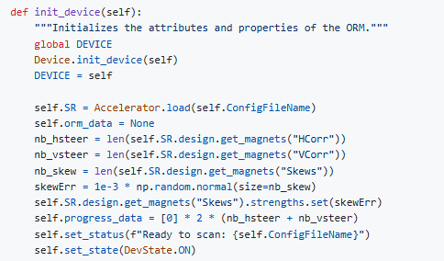
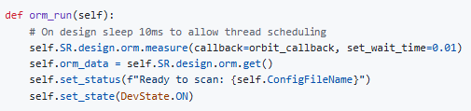
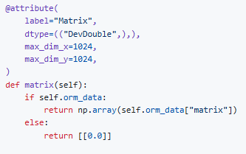
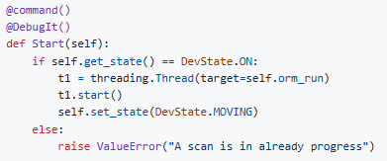
ORM MEASUREMENT TOOL in Tango SERVER
Run measurement tool in a Tango Server
pyTango server interface is rather simple
Allow to plug PyAML based servers to existing (ATK or Taurus) applications
Initialization
(SkewQuad error has been added to add a bit of coupling)
ORM thread
Matrix attribute
Start command

Slide 17
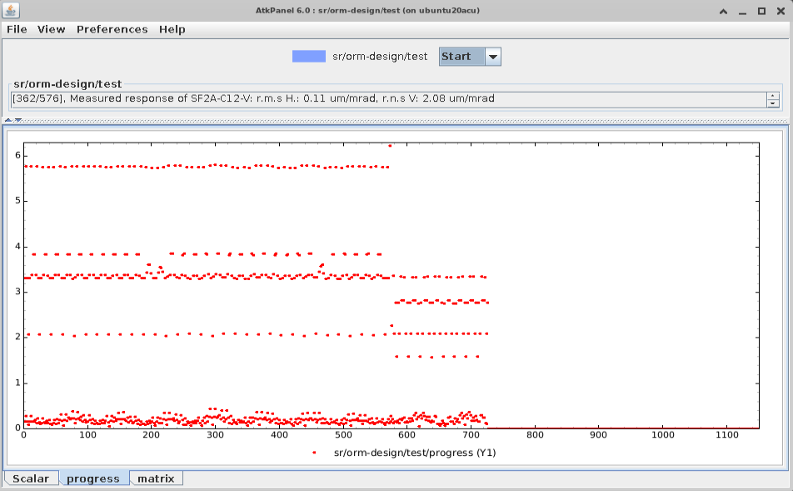
ORM MEASUREMENT TOOL in Tango SERVER
Generic Tango client (ATKPanel) showing the scan progress.
Orbit h,v rms is plotted sequentially for each steerer. The effect of the beta function can be seen on top and the coupling on bottom.

Slide 18
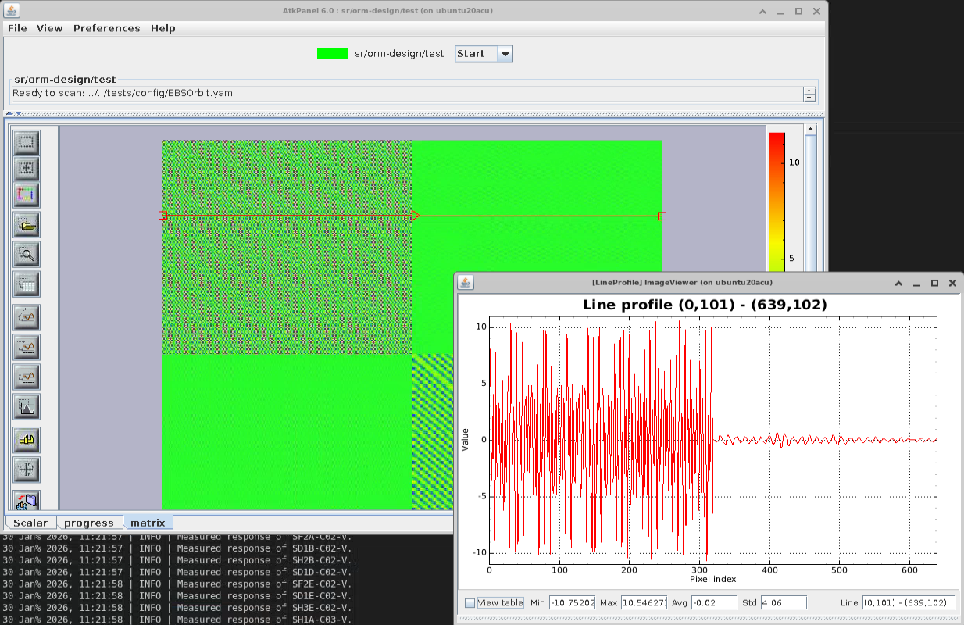
ORM MEASUREMENT TOOL in Tango SERVER
Generic Tango client (ATKPanel) showing the ORM

Slide 19
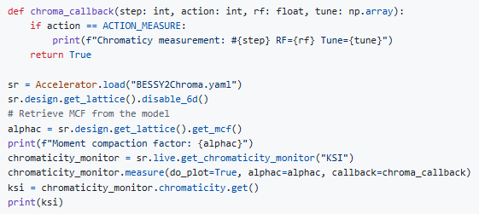
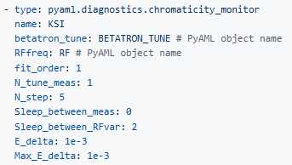
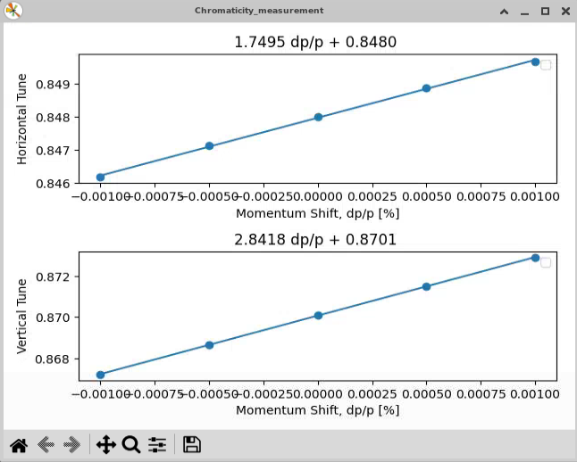
CHROMATICITY MEASUREMENT TOOL
Chromaticity measurement configuration
Configuration

Slide 20

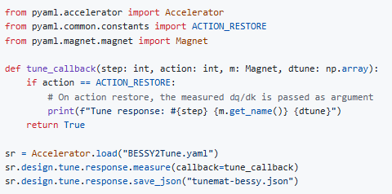
TUNE RESPONSE MEASUREMENT TOOL
Tune response measurement
Configuration

Slide 21
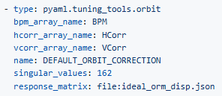

ORBIT TUNING TOOL
Orbit correction
Successfully tested on EBS
Beam lost at 250 singular values (It was expected but PyAML should have check corrector strengths before applying, setpoint check has been added recently)
Configuration
Usage

Slide 22
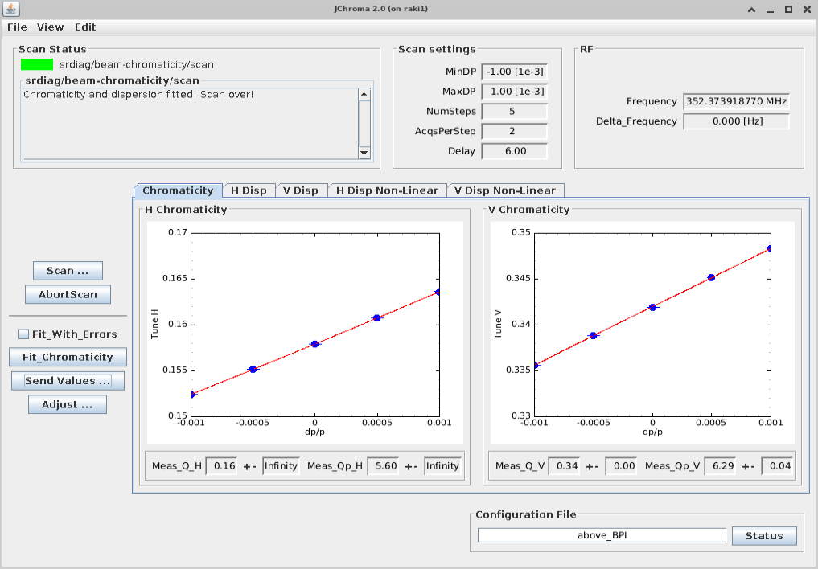
NEXT OBJECTIVE FOR THE NEXT WORKSHOP ?
TODO List and challenge
Unit conversion (pint ?)
Logging
DOOCS bindings
Dynamic generated API for Accelerator creation by code
Unify measurement tools (interface, metadata, …)
Chromaticity adjustment (+ first high level application on top of a Tango server)
BBA
LOCO
…
pyTango Server
PyAML

Slide 23
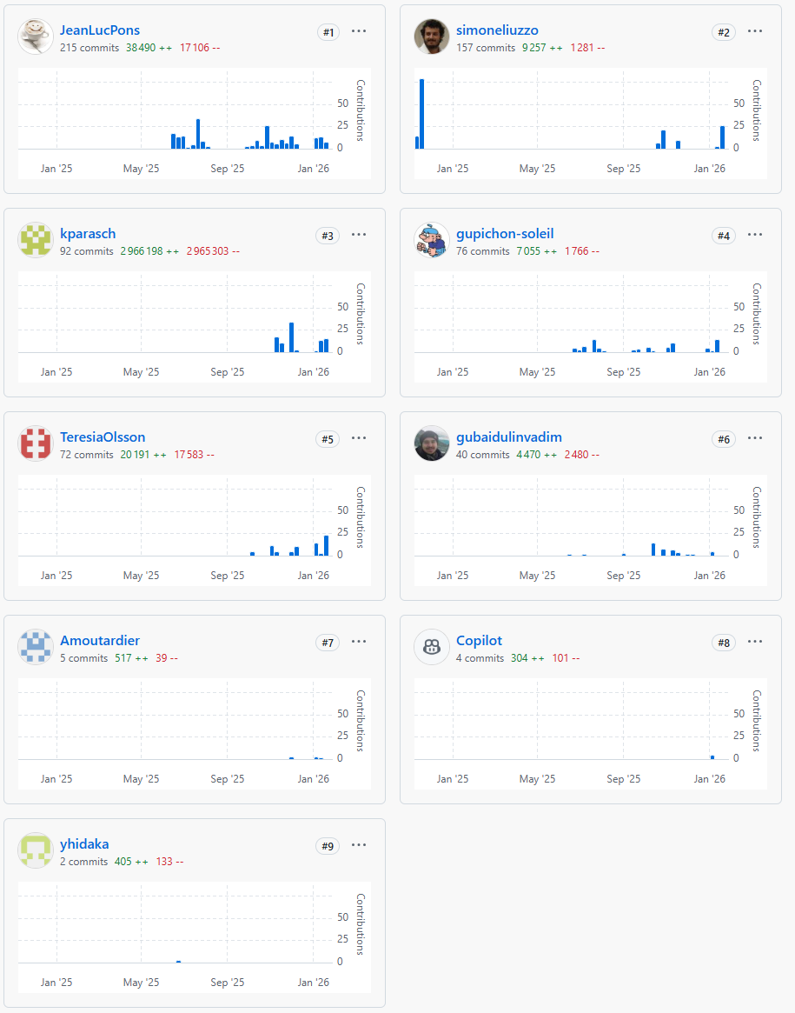
THANK You
Special thanks to all who contributed actively to the PyAML project
Kostas
@DESY
(pySC, PyAML)
Teresia
@HZB
(PyAML)
Yoshi
@BNL
(Epics, Tango, OphydAsync, PyAML)
Guillaume @SOLEIL
(Tango, PyAML)
Vadim
@SOLEIL
(PyAML)
Simone @ESRF
(PyAML)
Alexandre
@SOLEIL
(PyAML)

