Slide 1
3rd Python Accelerator Middle Layer Workshop
pyAML 2026
Local Organization Committee
GUBAIDULIN Vadim (Chair)
PODGORNY Sabine
IORIO Deborah
GAMELIN Alexis
MADELA Patrick
MOUTARDIER Alexandre
NADOLSKI Laurent S.
PICHON Guillaume
February 2-4, 2026 • Synchrotron SOLEIL, France

Slide 2
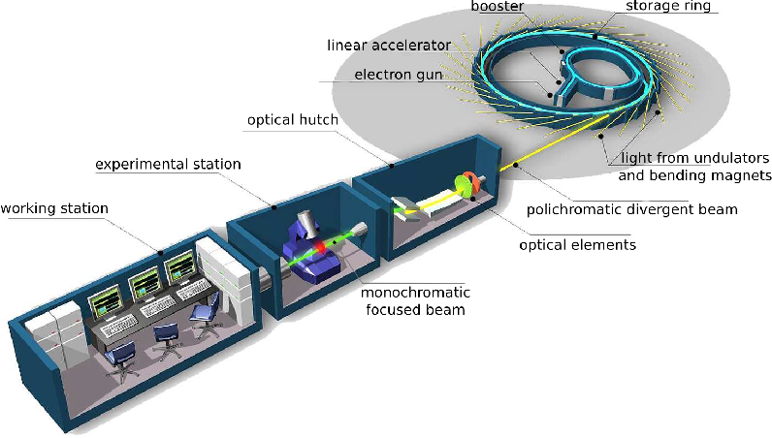
Contents
SR: 354 m
Booster: 157 m
Welcome to SOLEIL
Safety Rules
Introduction to SOLEIL and SOLEIL II
Workshop Opening
11 km South of Paris, France
heart of the Paris-Saclay
university and technology park
29 beamlines
1 cryo-EM

Slide 3
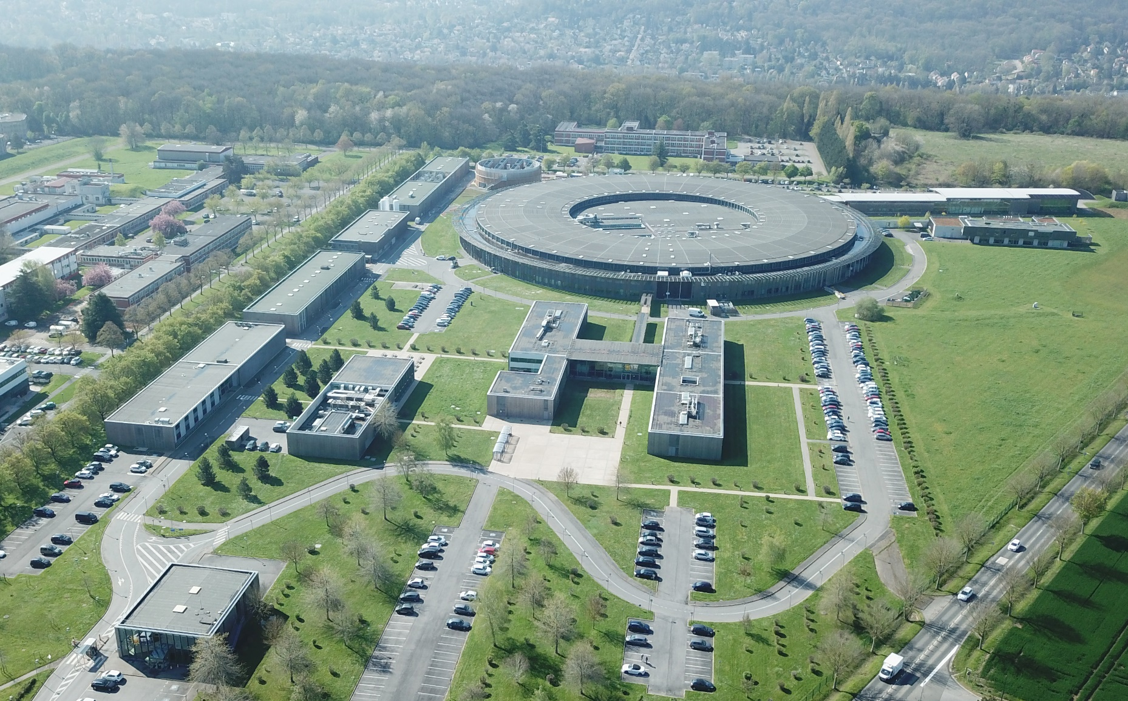
The Synchrotron SOLEIL
Source Optimisée de Lumière d’Energie Intermédiaire du LURE *
2005
First LINAC
BOOSTER beams
2006
Commissioning of the Storage ring
* Laboratoire d’Utilisation de Rayonnement Electromagnétique

Slide 4
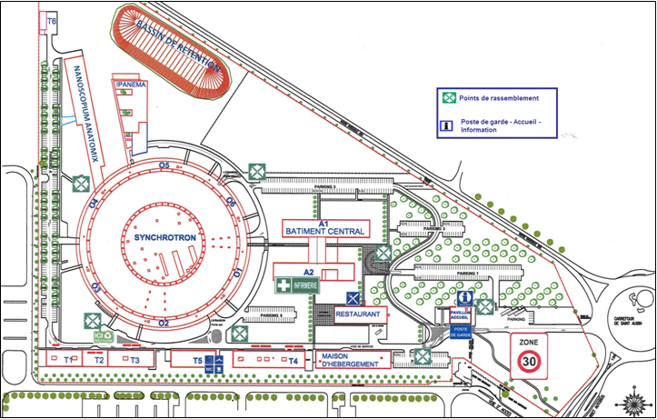
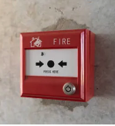
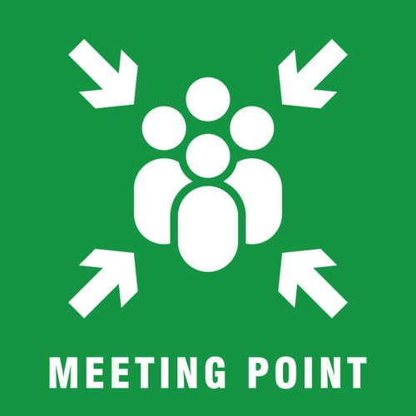
Safety Rules
EVACUATION PROCEDURE
Facility Tour: Safety
People with electronic devices that could affect their health (pacemakers, insulin pumps, neurostimulators for epileptic seizures, etc.) are not allowed to enter due to the presence of powerful magnets. Please note that cochlear implants are allowed, even though the magnetic fields may cause harmless crackling noises. The particle accelerator tunnels have narrow, confined passages that are not accessible to people with reduced mobility (PRMs). The floor of the accelerator tunnels is covered with grates, so it is strongly advised not to wear shoes with heels that could get stuck in them.
Control room
24h a day
(Don’t hang up first)
18
01 69 35 98 40

Slide 5
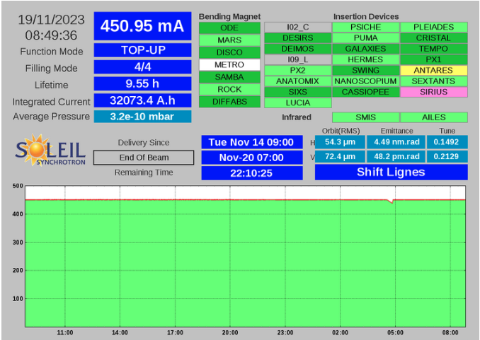
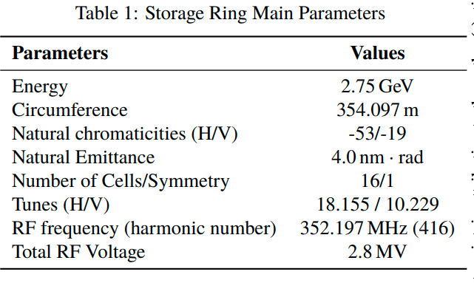
Third Generation Light Source
ε_{x0} = 4.0 nm•rad @ 2.75 GeV
Location: France, 11 km South of Paris
Circumference: 354 m
DBA + distributed dispersion
24 straight sections
SDL: 4 x 12 m
SDM: 12 x 7 m
SDC: 8 x 3.6 m
29 beamlines
2 IR
7 on bending magnets
20 on insertion devices
(variable lengths)
1 CRYO-EM microscope
SDL-SDM
SDC-SDM-SDC
Top-up Injection
In all modes of operation
5

Slide 6
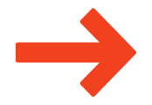
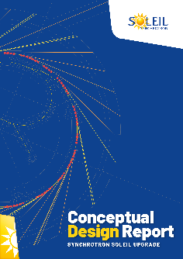
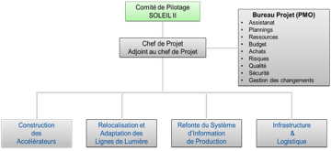
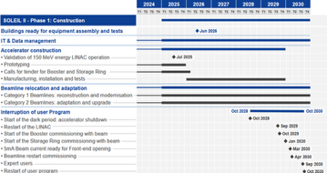
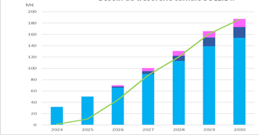
Chronology and Structuration of SOLEIL II Project
LPR
94 M€
Machine shutdown + restart + commissioning = 24 months
External users come back: October 2030
Dark period
2020
2021
2022
2023
2024
2025
2026
2027
2028
2029
2030
2031
2032
2033
2034
2035
CDR
(Conceptual Design report)
TDR
(Technical Design Review)
STAGE 1 :
CONSTRUCTION
STAGE 2 :
TOWARDS FULL PERFORMANCE
Shutdown and dismantling of the existing machine
Commissioning of the new booster and storage ring
Adaptation and restart of the beamlines
Information System Overhaul
Modernization of the support labs
R&D program on instrumentation
Complete Modernization of the beamlines
Full performance of the accelerators
Modernization of the support labs
R&D program on instrumentation
Evolution towards innovative analysis techniques
STAGE 1 (6 years) : ~ 186 M€
SOLEIL II Budget
~ 309 M€
(includes 8% contingency)
STAGE 2 (5 years) : ~ 123 M€
Notes:
Premiers financements de la Loi de Programmation de la Recherche
Message très fort de soutien -> Débuter sereinement la réalisation du projet avec le lacement des premiers appels d’offre et commandes.

Slide 7
SOLEIL II Project Stage 1 Organization
Steering Committee
SOLEIL II
Project Management Office
Administrative support
Planning
Resources
Budget
Purchasing
Risks
Quality
Safety
Change Management
1. SOLEIL II Project Phase 1
Project Leader: Amor Nadji
Deputy: Javier Perez
Hélène Rozelot
1.1 Construction
of
Accelerators
1.2 Relocation and adaptation of Beamlines
1.3 Overhaul of the information system
1.4 Infrastructure
&
Logistics
Laurent Nadolski
Patrick Alexandre
Kewin Desjardins
Stephanie Blanchandin
Yves-Marie Abiven
Emiliano Fonda
Christian Herbeaux Mohamed Nouna
3rd Python Accelerator Middle Layer Workshop | Feb. 2-4 2026 | SOLEIL | L. S. Nadolski

Slide 8
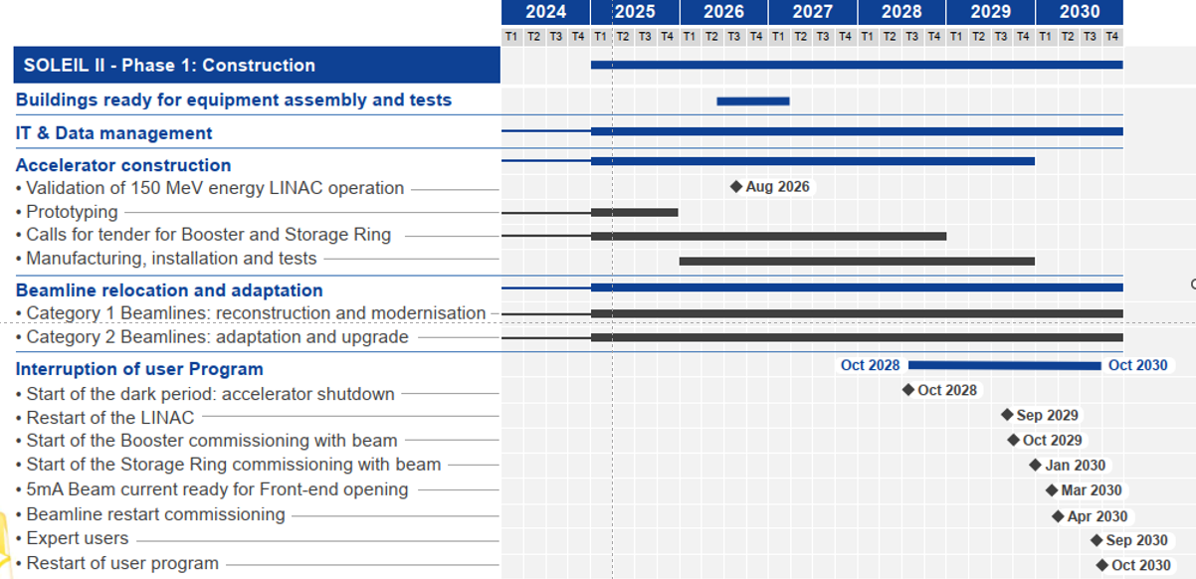
Master Planning (Stage1)

Slide 9
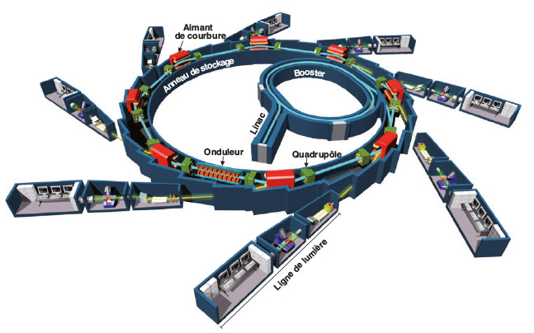
Perimeter of the Program CONTACCT
3 accelerators et 28(9) Front-ends (FE)
Injectors: LINAC + TL1 + Booster (156 m) + TL2
Anneau de stockage (354 m)
FEs : 9 (+2) from dipoles, 19 from insertions, [+3 Machine Dedicated]
1
2
3
4
5
6
7
8
9
Specifications
Construction
Equipment qualification | test on beam
LINAC & TL1 refurbishment @ 150 MeV
A brand-new booster ring
A brand-new storage ring
Photons Sources and FE adaptations
Reaching the Performance
Back to users’ operation
For the accelerators
For the beamlines

Slide 10
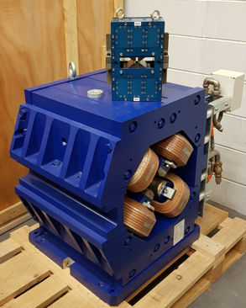
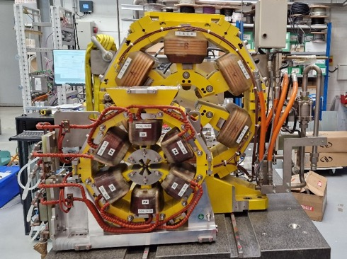
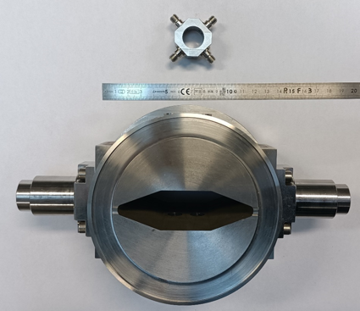
SOLEIL II Storage Ring Key Features
Non-standard MBA lattice: 12 x 7BA + 8 x 4BA / 2.75 GeV / 354 m / 500 mA
~90 pm.rad (~54 pm.rad round beam as ultimate goal).
22 straight sections (7 different lengths).
Large photon spectrum (far IR to hard X-rays).
NEG coated very small vacuum chamber diameter (12 mm)
Extensive use of permanent magnets (all dipoles, RB and main quadrupoles).
Miniaturization.
Off-axis injection.
High performance Multipole Injection Kicker (MIK).
Energy savings and reduced energy footprint.
LINAC upgrade
New low-emittance Booster
Innovative Insertion Devices
+
An Ambitious Project
+
Strong Expertise
=
Pushing the Limit of Science
and Technology
Quadrupole SOLEIL/SOLEIL II
Sextupole SOLEIL/SOLEIL II
BPM vacuum chamber SOLEIL/SOLEIL II
Notes:
Upgrade linac en avance de phase

Slide 11
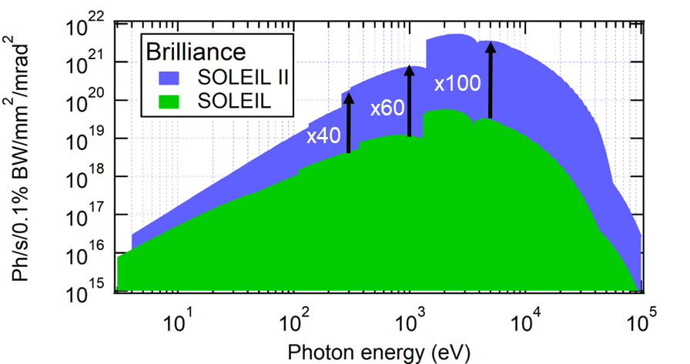
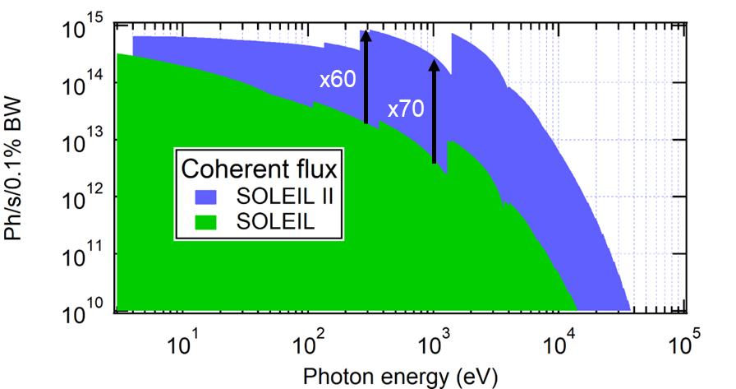
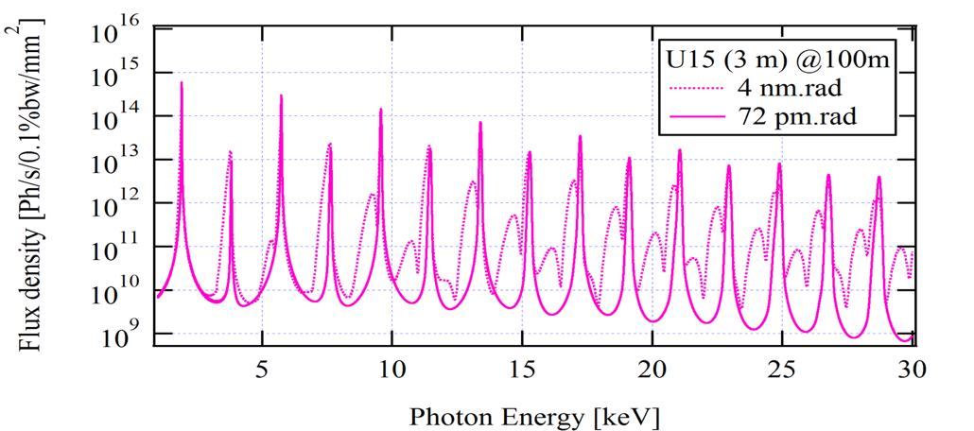
Spectral Performance of SOLEIL II vs SOLEIL
→ Bright beams for nanoprobe based techniques
→ Coherence based imaging techniques
→ Pink beams for broadband imaging or scattering techniques
Gains are not evenly spread across the portfolio of beamlines
Beamlines on bending magnet sources are more impacted (source points are moved upstream)
Unparalleled performance between 1 keV and 3 keV
5-30 keV range: very competitive
Superbend (3T) sources
Round beam (ultimate goal for ID point sources)
Preserves uniqueness of SOLEIL in VUV and IR methods

Slide 12
Deliverables for SOLEIL II Stage 1 Project
Upgrade of LINAC and TL1 @150 MeV before shutdown.
Construction of a new low-emittance Booster.
Construction of a new ultra-low emittance Storage Ring (SR).
Construction of the first three new Insertion Devices.
Relocation of 6 Beamlines (4 IDs + 2 BM).
Adaptation and alignment of other Beamlines.
Modernization of IT systems.
Installation of the necessary infrastructure and buildings.
Commissioning of accelerators: restart of the LINAC, commissioning of the new Booster and the new Storage Ring.
Commissioning of ready beamlines and restart of laboratories.
Opening of beamlines to users.

Slide 13
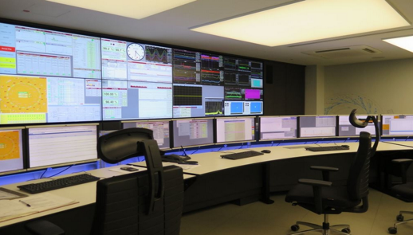
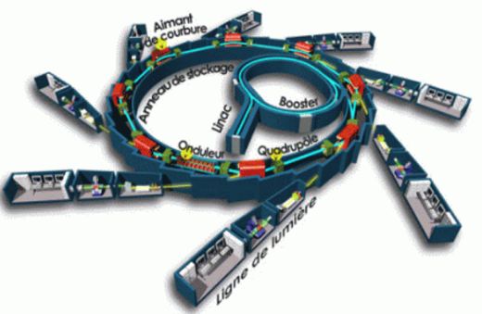
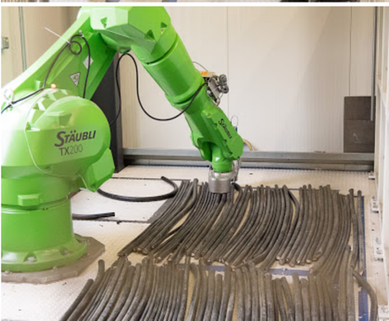
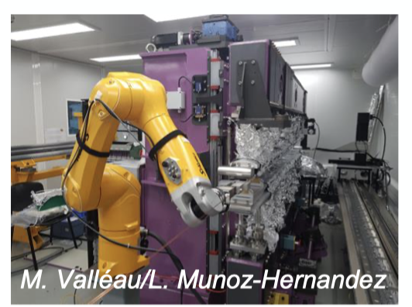
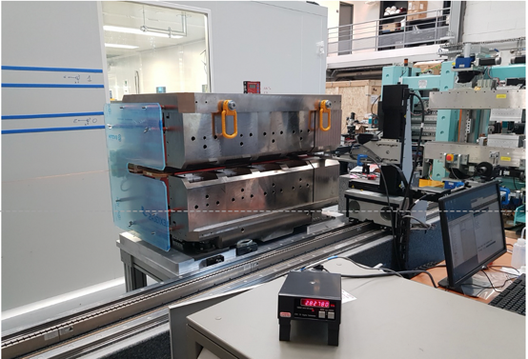
IT for Accelerators
Higher number of equipment
Higher complexity
Higher data flow
Higher storage capacity
Fast meas. techniques
Fast feedbacks
Start to end ID control
A storage ring
A booster ring
28(9) BLs
Laboratories
Meas. benches
Towards 4.0 accelerators
Robotics and Automation
For Radiation Safety Measurements
Benches for Magnet and ID assembly and magnetic measurements

Slide 14


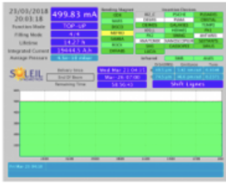
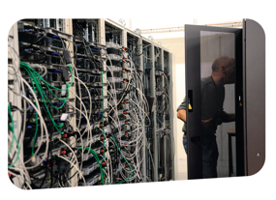
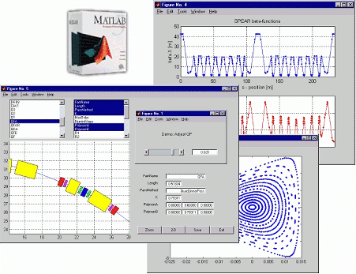
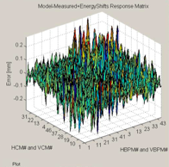
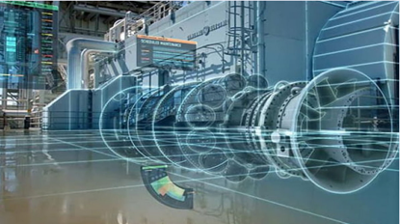
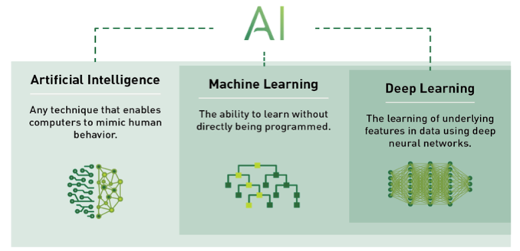
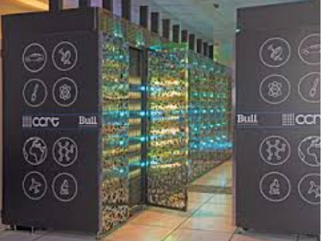
IT Support for Accelerators
Computerization of our jobs
Collaborative and agile developments
Common platform for development and production
Choice of support software, APIs, GUIs
Web-based user interfaces
HW and SW standardization when possible
Digital
Twins
IT infrastructure evolution
Increased connected equipment
Low latency networks
Remote access, IT support, operation
Cybersecurity
Simulation and online optimization
Data driven approach
Reliability-Centered Maintenance
Augmented operation (automation, AI-aided operation)
Data historization, storage and databases
HPC needs for simulation
and analysis
Notes:
Computerization of workflows
• Collaborative and agile development
• Common platform for development and production
• Unified software tools: APIs, GUIs, frameworks
• Web-based user interfaces
• HW/SW standardization when possible

Slide 15
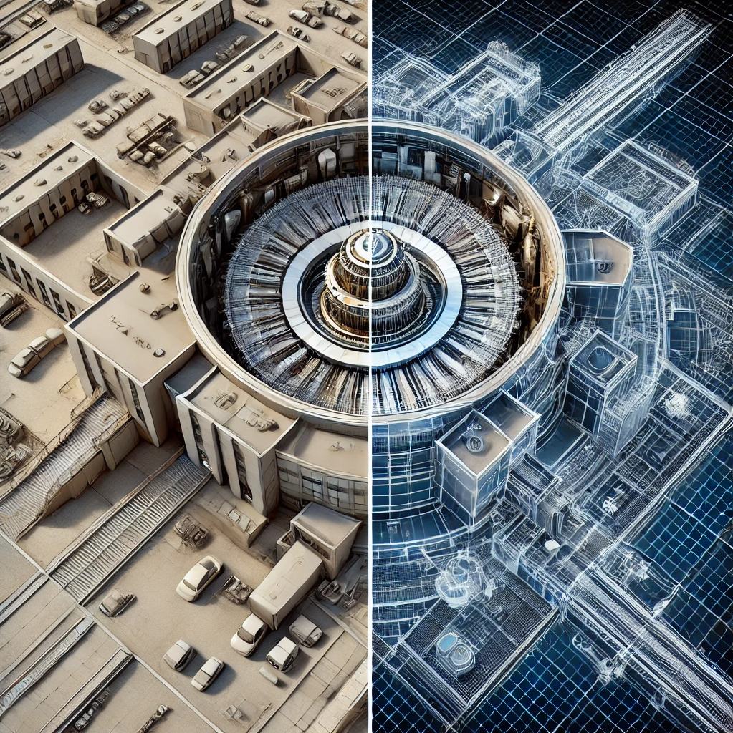
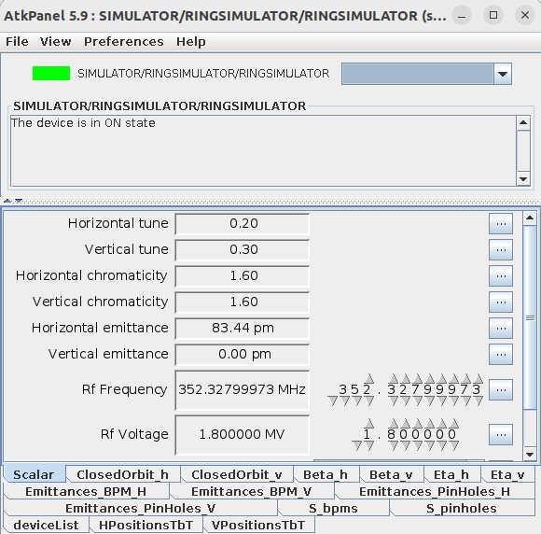
Digital Twins for SOLEIL II Accelerators
Objectives of the Digital Twin (DT) for SOLEIL II:
Full replication of the future SOLEIL II accelerators control system wired to simulations (of the beam, of some key items, ...) instead of the real hardware.
Must allow for the design and testing of most of the control system (high-level devices and graphical interfaces, middle layer, commissioning tools) before the commissioning period.
After commissioning, it is expected to be a fundamental tool for the control group to test new software before being deployed to the real system.
It can also be used to prepare machine sessions and as a post-mortem diagnostic tool based on archived data (digital shadow).
Current status​:
Proof of concept (POC) digital twin experiment started in July 2024:​
Team mixing software engineers and machine physicists​.
Gain experience in the design and usage of DTs​.
DT now runs with SOLEIL II lattice in a separate environment from SOLEIL control system (integrated in the software factory of the control group):​
Modified version from ESRF-EBS DT to meet the needs of our POC.
More than >1300 magnets simulated and controlled in the DT​.
Beam physics and diagnostics correctly modelled and accessible from the control system​.
Automated procedure to generate a DT from a given lattice and nomenclature​.
The DT is being used to write and test the new accelerator middle layer to control the SOLEIL II accelerators (pyAML)

Slide 16
Welcome to the 3rd Edition of the pyAML Workshop!
What is pyAML?
1st Workshop
Python Accelerator Middle Layer - A collaborative technology platform (replacing 20+ year of Matlab Middle Layer Platform)
19-21 June 2024 • DESY, Hamburg Kick-off & vision
2nd Workshop
Unified interface for accelerator control and physics
Hardware abstraction - works with any control system
Physics applications - orbit correction, optics matching, BBA...
Standardized API for multi-facility deployment...
12-14 February 2025 • Berlin, Germany Architecture & specs
SOLEIL is pleased to host
An international collaboration of accelerator facilities
A common goal: developing tomorrow's tools
3 days of collaborative work and expertise sharing

Slide 17
Workshop Participation
Key Features of pyAML
30 participants (23 in-person)
Control System Agnostic
EPICS, TANGO, DOOCS - any control system
Modular Design
Plugin architecture for flexibility
Modern Python
Leveraging latest ecosystem tools, AI-enable..
Open Development
GitHub, community-driven evolution

Slide 18
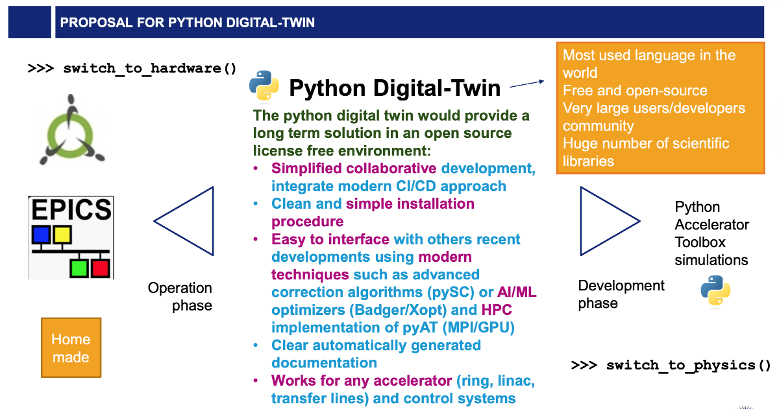
Python Middle Layer (pyAML)
AT: https://github.com/atcollab/at
pySC: https://github.com/lmalina/pySC

Slide 19
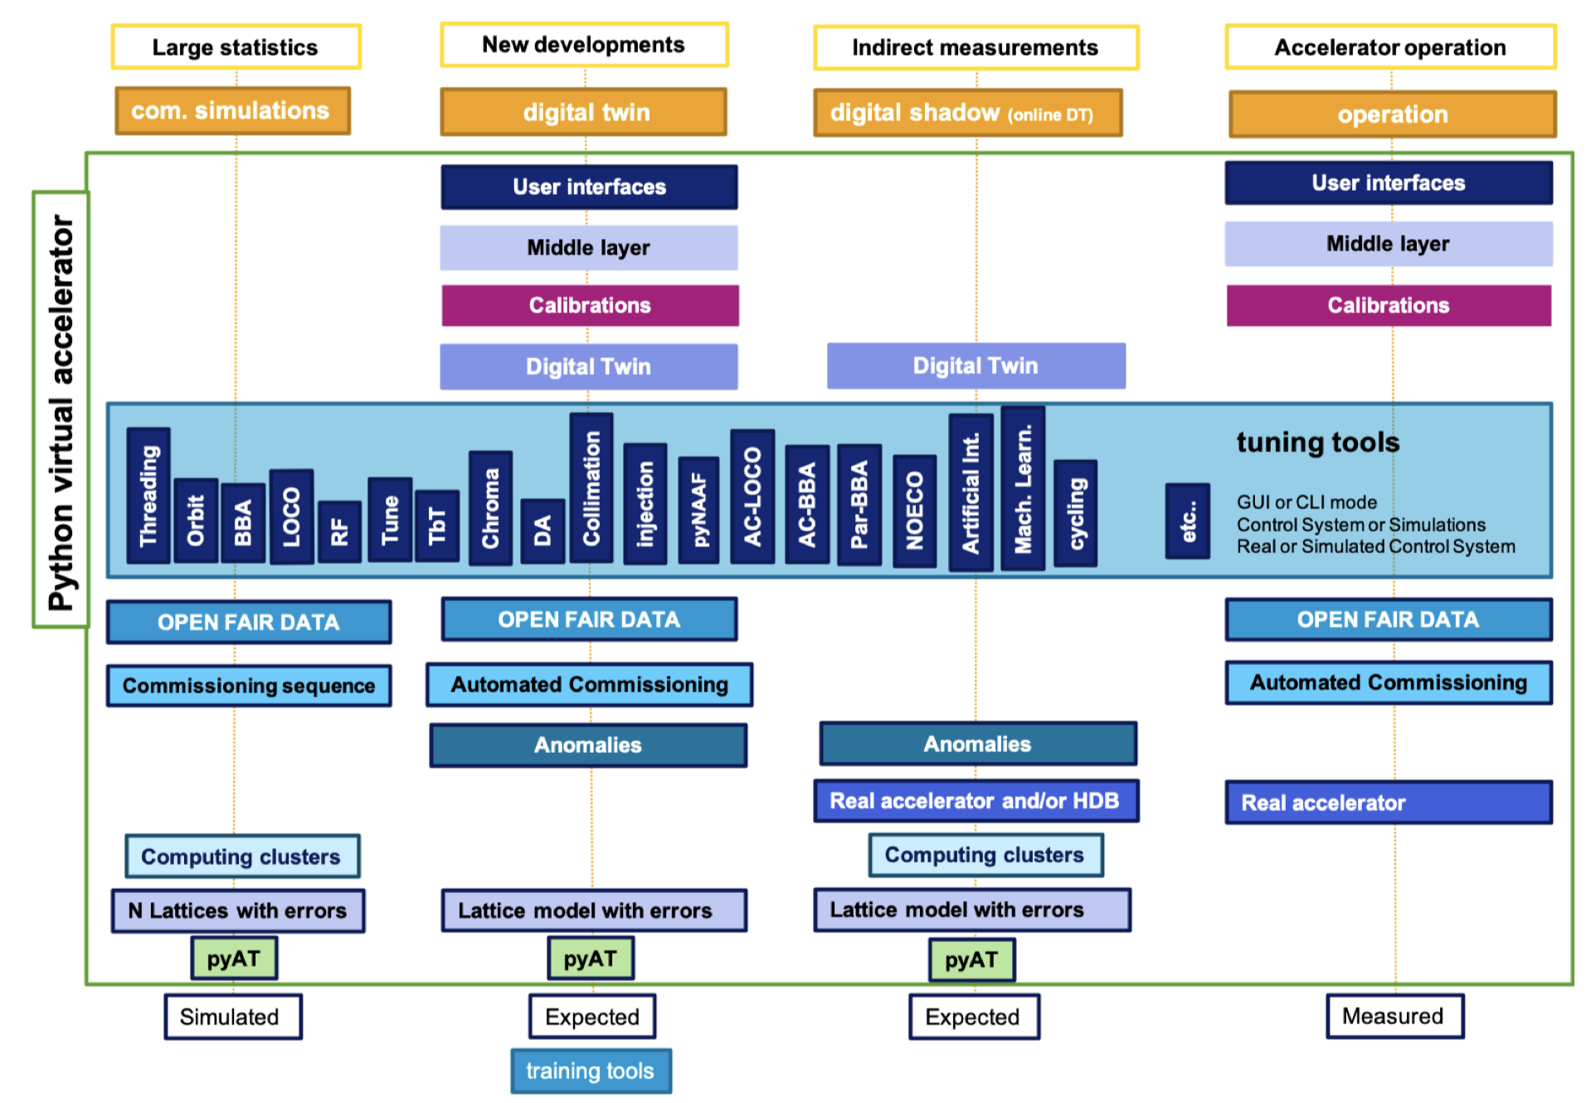
Python Middle Layer (pyAML)
No fancy Application Packages
No high-level applications
Focus on the definition of a Middle Layer

Slide 20
Workshop Objectives
Team Synergy: Maximizing Feature Potential and Core pyAML Consolidation
The primary focus is to synchronize development efforts to enhance pyAML's feature set while fortifying its core architecture.
Key Presentations
Teresia OLSSON: pyAML Project Status Report. A comprehensive update on the progress made since the Berlin workshop, specifically regarding specification documentation and the evolution of the pyAML product.
Jean-Luc PONS: Prototype Development Progress. An in-depth look at the pyaml-repository, highlighting the implementation of control system interfaces via the dedicated tango-pyaml and pyaml-cs-oa repositories.
Waheedullah Sulaiman KHAIL: accml-repository Development. An update on the technical milestones reached within the AccML framework.
Konstantinos PARASCHOU: Python Simulated Commissioning (pySC). A status report on the pySC project and its integration within the broader ecosystem.

Slide 21
Workshop Objectives
Afternoon Session Training / hackathon preparation
Setup of the tools
Working group composition
Practical information and objectives
Life demonstration in SOLEIL control room
Glimpse on Prototypes and workshop dinner
Visit: SOLEIL II prototypes
Workshop dinner

Slide 22

🚀 HACKATHON-FOCUSED WORKSHOP
3 Days of Hands-On Development
Code together - collaborative implementation
Test prototypes - real accelerator use cases
Share expertise - cross-facility learning
Notes:
Beam-Based Alignment (BBA) - automated quadrupole centering
Orbit Correction - global and local feedback systems
Optics Measurements - beta function and dispersion
Machine Learning Integration - anomaly detection

Slide 23
Key Deliverables and Strategic Milestones
Operational Prototypes: Successfully addressing core use cases to demonstrate viability.
API Validation: Ensuring robustness through real-world implementation and field testing.
Comprehensive Documentation: Delivery of detailed user guides and practical examples to streamline onboarding.
2026 Deployment Roadmap: A finalized strategic plan, backed by the formal commitment of all project contributors to ensure long-term scalability and development.

Slide 24
Enjoy the Workshop!
Let's collaborate to build the future of accelerators
indico.synchrotron-soleil.fr/event/125/

