Slide 1
Developments in pySC and tests in ESRF EBS
Konstantinos Paraschou, Elaf Musa, Ilya Agapov,
DESY
Simone Liuzzo, Simon White, Jean-Luc Pons, N. Carmignani
ESRF
Previous contributors to pySC: Lukas Malina, Simone Liuzzo, Thorsten Hellert,
Lina Hoummi, Sebastien Joly, Bianca Veglia
Based on the “SC -Toolkit for Simulated Commissioning” by Thorsten Hellert
3rd Python Accelerator Middle Layer workshop
2nd February 2026

Slide 2
Simulated Commissioning
Main components of pySC/SC:
A kind of middle-layer between user and simulator
  Field calibration errors
  Alignment errors (including supporting structures)
  Injection errors (Static or random)
  BPM reading errors (offsets, noise, calibration)
  Cavity errors
  …
Routines to perform measurements and apply corrections:
  First-turn steering
  Beam-based alignment of BPMs to quadrupoles
  Orbit correction
  Tune correction
  Orbit response matrix measurement (also ideal ORM)
  Dispersion measurement
  Interface to a “LOCO” code for optics corrections
  …
“set k1 = 1”
“get k1” → 1
pySC/SC
k1 = 1.05
Accelerator Toolbox

Slide 3
Development of pySC and goals
Development of pySC driven by PETRA IV project at DESY.
Short-term goals of development:
  Commissioning simulations for the PETRA IV upgrade.
  Provide tools that can also benefit operation.
  Maximize compatibility with pyAML.
  Design heavily influenced by pyAML User Interface Specification
  document and associated discussions.
  Latest development focused on flexibility → no new physics compared to previous versions or SC:
  Make simulator look like a real accelerator with a control system.
    K0 = SC.magnet_settings.get(“SD1B_A1S2/B1L”)
    SC.magnet_settings.set(“SD1B_A1S2/B1L”, K0 + 1e-5)
  Separate “tuning tools” from the “pySC simulator”. (pySC.apps)
    (For reuse in real accelerators, pyAML, other simulators, …)
    Also allows testing in real accelerators. (ESRF-EBS tests in 10/11/2025, 26/1/2026)
    Configuration (registration of errors) through yaml file.
    At the moment only (py)Accelerator Toolbox, expanding into XSuite and OCELOT.
pySC is in active and intense development.

Slide 4
pySC.apps
pySC configuration and simulated commissioning
pyLOCO
virtual pySC

Slide 5
pySC.apps
pySC configuration and simulated commissioning
pyLOCO
virtual pySC

Slide 6
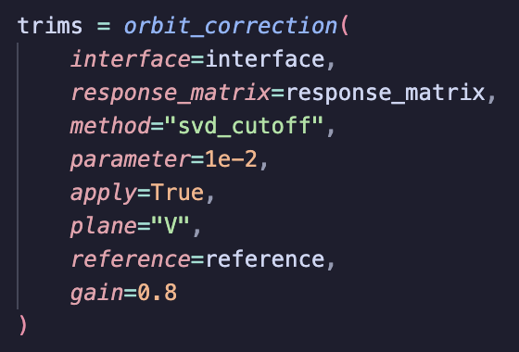
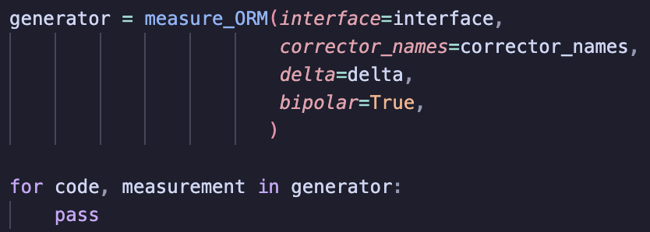
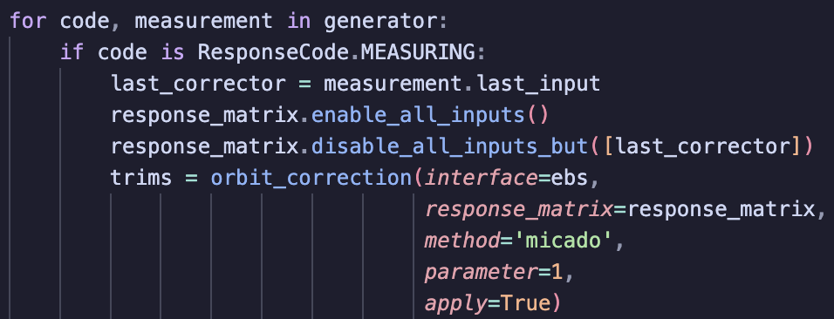
pySC.apps
Multi-step measurements implemented with Python Generators
Orbit correction is simple
→ implemented as function
What you would do in simulation:
In real synchrotrons you may want to correct orbit at each step.
    pySC.apps: measurement methods independent of simulator/models. (Orbit correction, ORM, dispersion, BBA)
    Apps are structured to work with an “interface”.

Slide 7
# pySC sim:
class pySCOrbitInterface:
SC: SimulatedCommissioning
def get_orbit(self):
return self.SC.bpm_system.capture_orbit()
def get(self, name: str):
return self.SC.magnet_settings.get(name)
...
# pyAML:
class pySCInterface:
…
def get_orbit(self):
pos = self.bpm_array.positions.get()
return pos [:, 0], pos [:, 1]
def get(self, name: str):
magnet = self.element_holder.get_magnet(name=name)
return magnet.strength.get()
…
pySC.apps: interface
    pySC.apps: measurement methods independent of
    simulator/models. (Orbit correction, ORM, dispersion, BBA)
    Apps are structured to work with an interface.
# ESRF-EBS tango:
class Interface:
…
def get_orbit(self):
time.sleep(self.orbit_wait_time)
orb_h = HBPM.read().value
orb_v = VBPM.read().value
return orb_h, orb_v
def get(self, name: str):
mag = AttributeProxy(name+'/Strength')
mag_SetPoint = mag.read().w_value
return mag_SetPoint
....
Interface is an object whose class has functions:
get_orbit()
get(name)
set(name, value)
get_many(name_list)
set_many(names_val_dict)
get_rf_main_frequency()
set_rf_main_frequency(frf)

Slide 8
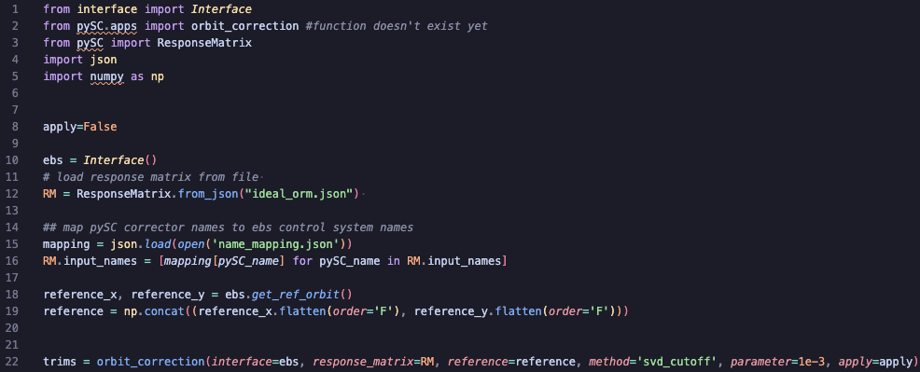
pySC.apps: orbit correction in ESRF-EBS
Instantiate EBS tango interface
Load response matrix from file
Replace names
(pySC → Tango)
as ORM was
calculated in pySC.
Get reference to correct to from Tango.
Do orbit correction.

Slide 9
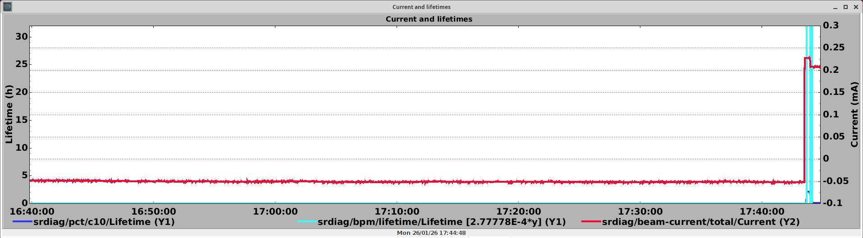
pySC.apps: tests in ESRF-EBS
Tested in ESRF-EBS (ESRF-EBS tests in 10/11/2025, 26/1/2026) :
✅ Orbit correction
✅ First-turn steering
✅ Measurement of dispersion
✅ Measurement of Orbit Response Matrix
✅ Measurement of BPM noise
✅ Beam-based alignment (BPM to quad.)
From zero corrections in magnets → accumulating beam
✅ pyLOCO → optics corrections

Slide 10
pySC.apps
pySC configuration and simulated commissioning
pyLOCO
virtual pySC

Slide 11
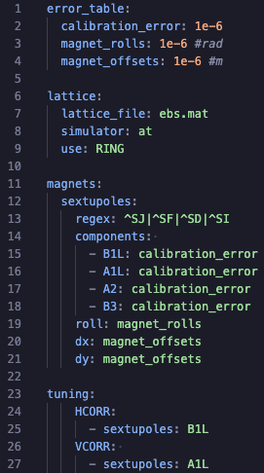
pySC configuration file (yaml)
Numbers defined in one place. Assigned by name in the file later.
Many more options!
Lattice file and simulator conf.
Name of your magnet array (not related to name in simulator)
Regular expression to find magnets by name in lattice.
Which error to put on which component.
B1L is integrated normal dip. normalized strength
A2 is (not integrated) skew quad. normalized strength.
Specify which components of which magnet family to be used for (default) orbit correction.

Slide 12
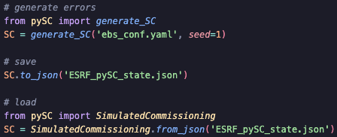

pySC simulated commissioning
SimulatedCommissioning object holds all information. Provides functions to do actions. E.g.
SC.bpm_system.capture_orbit()
SC.tuning.correct_injection()
SC.tuning.correct_orbit()
SC.tuning.do_parallel_orbit_bba()
One of the first steps is usually first-turn steering
At some point you do beam-based alignment:

Slide 13
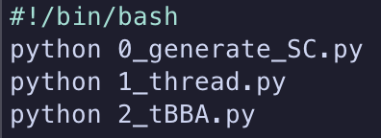
pySC simulated commissioning
Workflow is script-based. pySC leaves the user to submit into a cluster.
PETRA IV
Commissioning simulation steps:
First-turn steering (beam threading)
Trajectory-based BBA
Multipole ramp-up
Tune scan
Orbit + tune correction
Orbit-based BBA
Optics correction (pyLOCO)
Aim of pySC is to provide a platform to:
Study different types of errors.
Develop tuning tools and study their performance when different errors are included.
…

Slide 14
pySC.apps
pySC configuration and simulated commissioning
pyLOCO
virtual pySC

Slide 15
pyLOCO
LOCO is complex!!
Development of pyLOCO by Elaf Musa driven by PETRA IV project at DESY.
pyLOCO:
  Library to perform a LOCO (Linear Optics from Closed Orbits) fit in Python.
  Similar features to the Matlab LOCO program.
  Uses Accelerator Toolbox (Python)
  Is being developed and tested with PETRA IV, ESRF-EBS, SOLEIL II, FCC-ee in mind.
  Work in progress.
    Significant benchmarking against Matlab LOCO.
    Successfully corrected optics at ESRF-EBS,
    as good as ESRF’s operational tools.
AT
EBS
pySC
simulator
Operational
optics corrections
Example:
Commissioning Simulations
AT
pyLOCO
pySC.apps
? ? ?
Measure Orbit Response Matrix
Measure Dispersion
Measure BPM noise

Slide 16
pySC.apps
pySC configuration and simulated commissioning
pyLOCO
virtual pySC

Slide 17
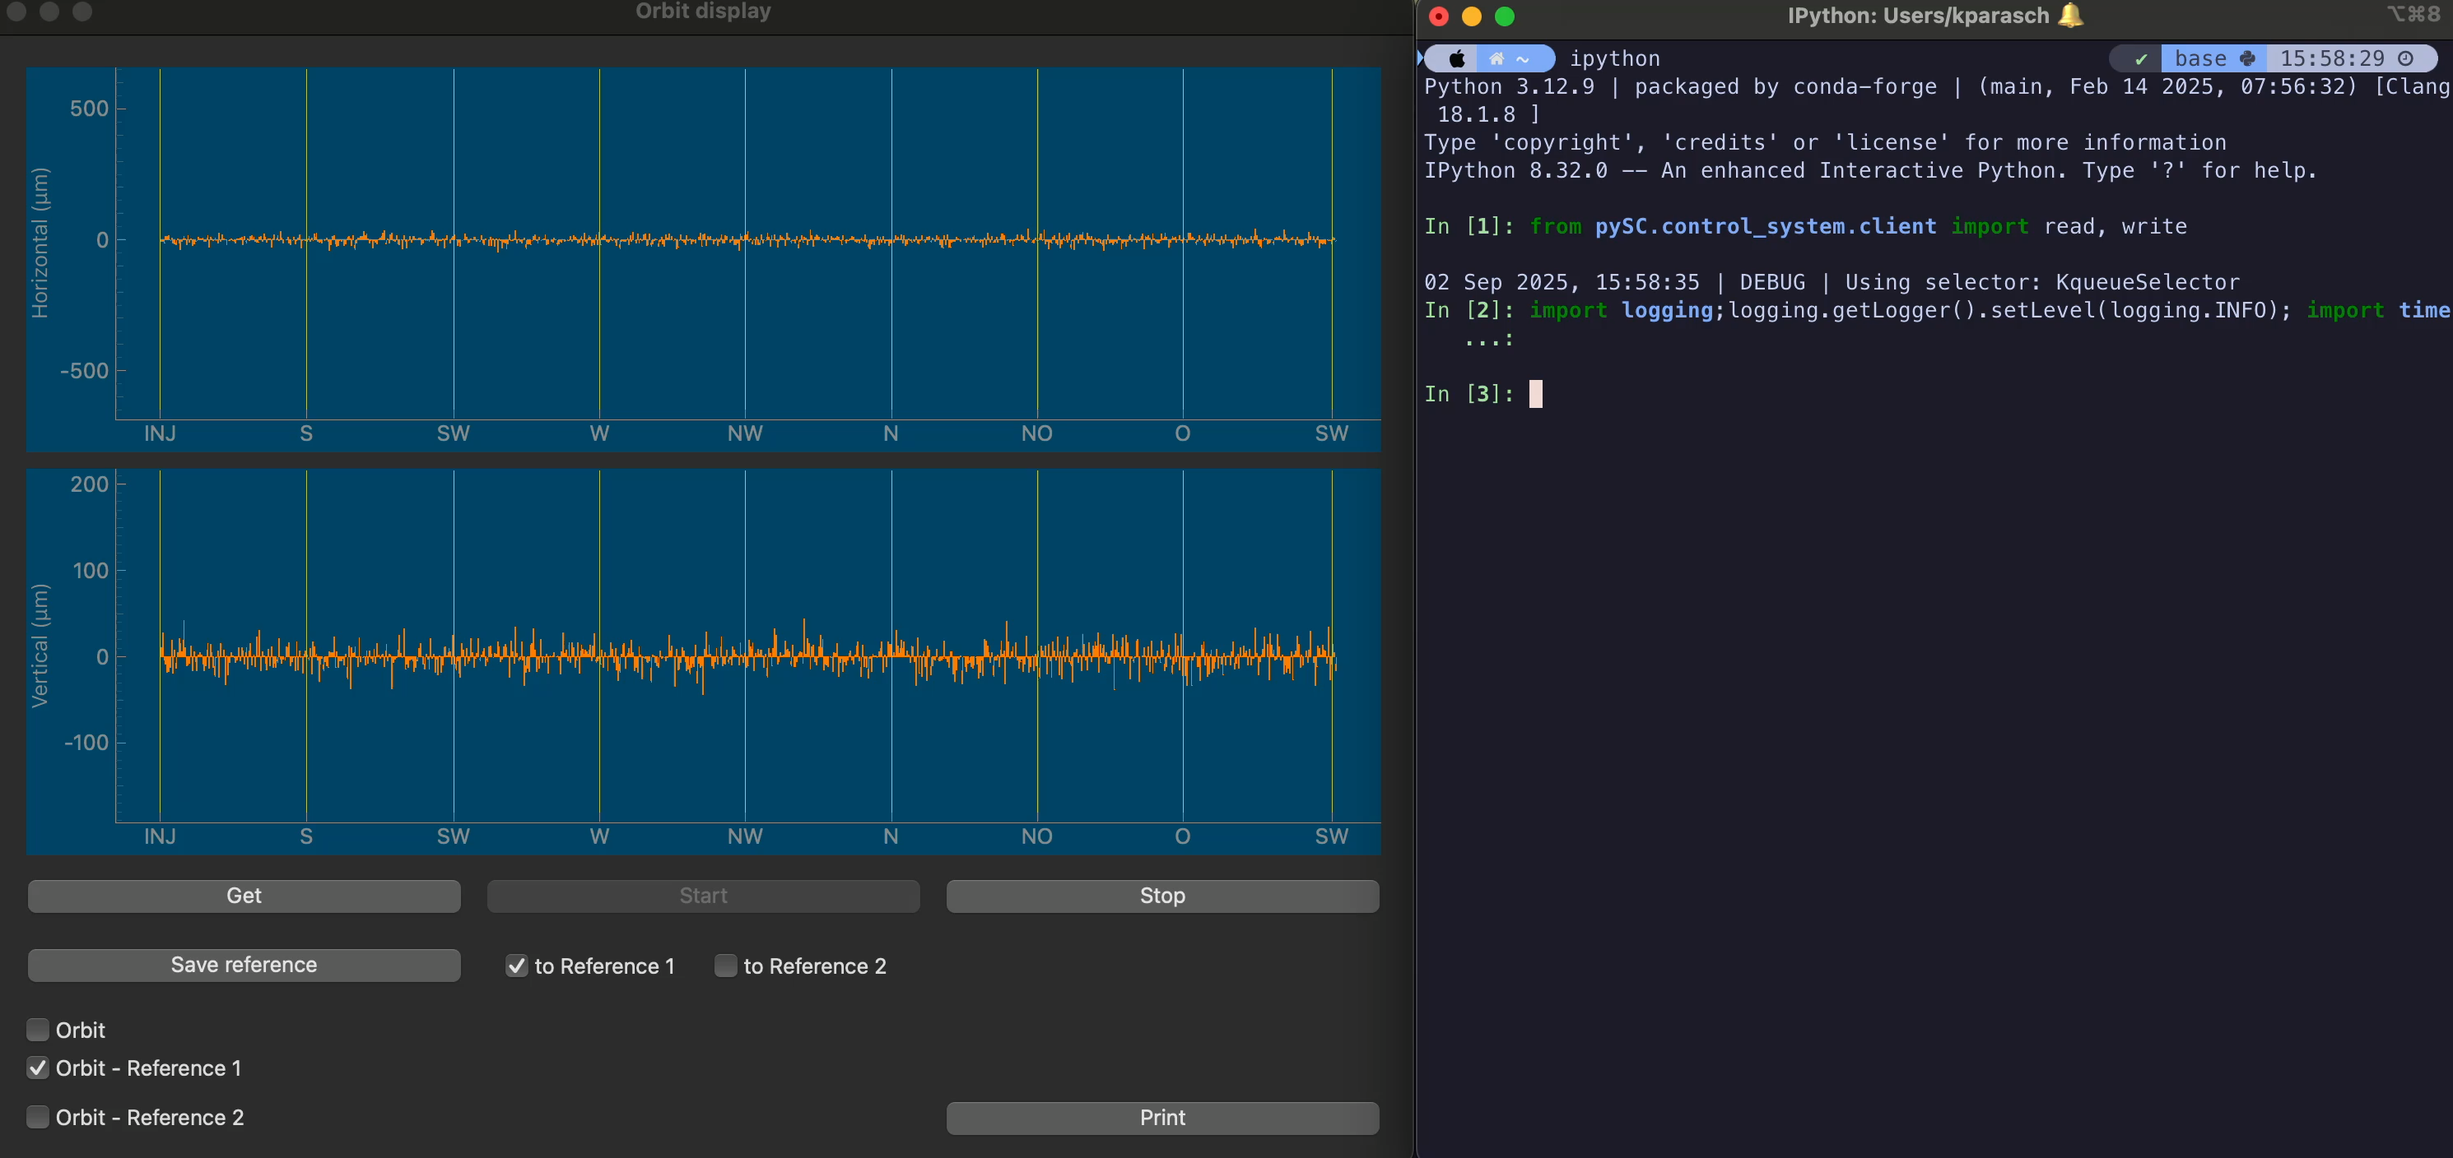
Virtual pySC
SC.start_server(port=13131, timeout=0.6)

Slide 18
Conclusion
pySC and pyLOCO codes actively being developed.
  https://github.com/kparasch/pySC/ → “pip install accelerator-commissioning”
  https://github.com/elafmusa/pyloco
Latest developments in pySC expose tuning tools:
  Successfully used in ESRF with tango,
  Presently interfaced with pyAML → Orbit correction, dispersion, ORM.
  Useful shortcut to allow focusing on configuration of these objects.
Commissioning simulations with pySC:
  Can be configured with a yaml file for normal use
  Flexible infrastructure behind to support pyAML compatibility
  pySC also provides a minimal ‘virtual accelerator’ mode.
    Can potentially be used in pyAML for CI/CD to test features
    unrelated to EPICS/TANGO/DOOCS/ophyd e.t.c.
    Happy to support anyone who would like to use pySC.
Thank you for your attention!
Konstantinos Paraschou

Slide 19
pySC magnets, controls, links
Control: Variable with a setpoint that may be changed by the user/app
(e.g. ‘SD1B_A1S2/B1L’ or ‘54/B1L’)
Link: Transforms setpoint (puts error) and assigns to a component of a magnet.
Magnet: Holds all information to be passed to AT
(e.g. ‘SD1B_A1S2’ or ‘54’)
Individually powered magnets
pySC
AT
Magnet
Control
Link
Magnet
X
A1
B1
Magnets in series
B2
pySC
X
Control
Link
Magnet
AT
Magnet
B2 = a X + b
X
B2
X
B2
X
B2 = a X + b
B2
B2

Slide 20

pySC support system
Magnets
Girders
Hierarchical support system to define arbitrary number of layers of supporting structure.
Tunnel
Magnets
Girders
Tunnel

