Slide 1
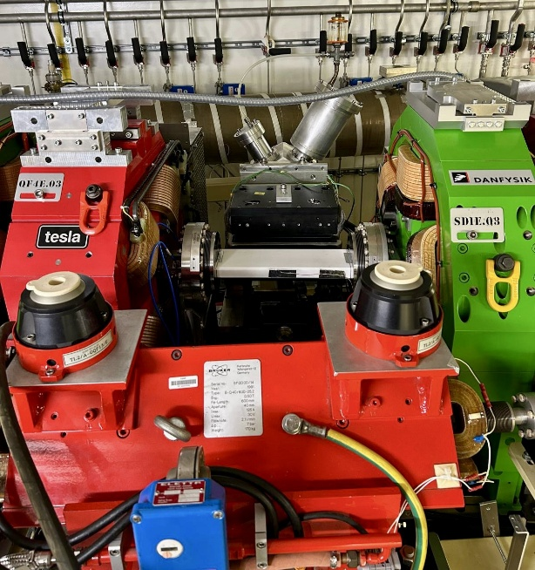

33rd European Synchrotron Light Source Workshop
Synchrotron SOLEIL
29th-31st October 2025
Accelerator operation
Jean-Luc Revol, Nicola Carmignani
On behalf of the EBS Accelerator Team
Statistics and failures
Shutdown activities
Beam parameters
Projects and development

Slide 2
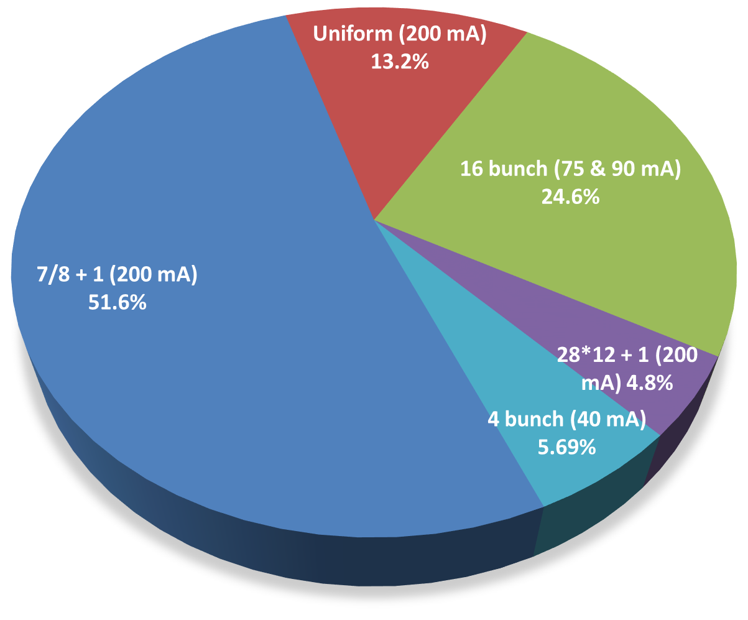
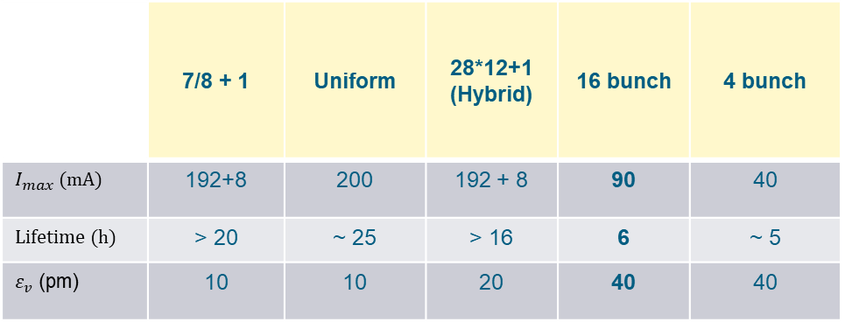
beam delivery October 2024 ➔ October 2025
 | 7/8 + 1 | Uniform | 28*12+1 (Hybrid) | 16 bunch | 4 bunch
$I_{max}$ (mA) | 192+8 | 200 | 192 + 8 | 90 | 40
Lifetime (h) | > 20 | ~ 25 | > 16 | 6 | ~ 5
$ε_{v}$ (pm) | 10 | 10 | 20 | 40 | 40
* Vertical emittance artificially increased from 1 pm rad to get an operational lifetime
* All timing modes delivered with a purity of 10⁻⁹ with cleaning process in the booster
All beam modes delivered since last MAC
16 Bunch achieved at nominal current (90 mA) in January 2025 (delivered at 75 mA before)

Slide 3
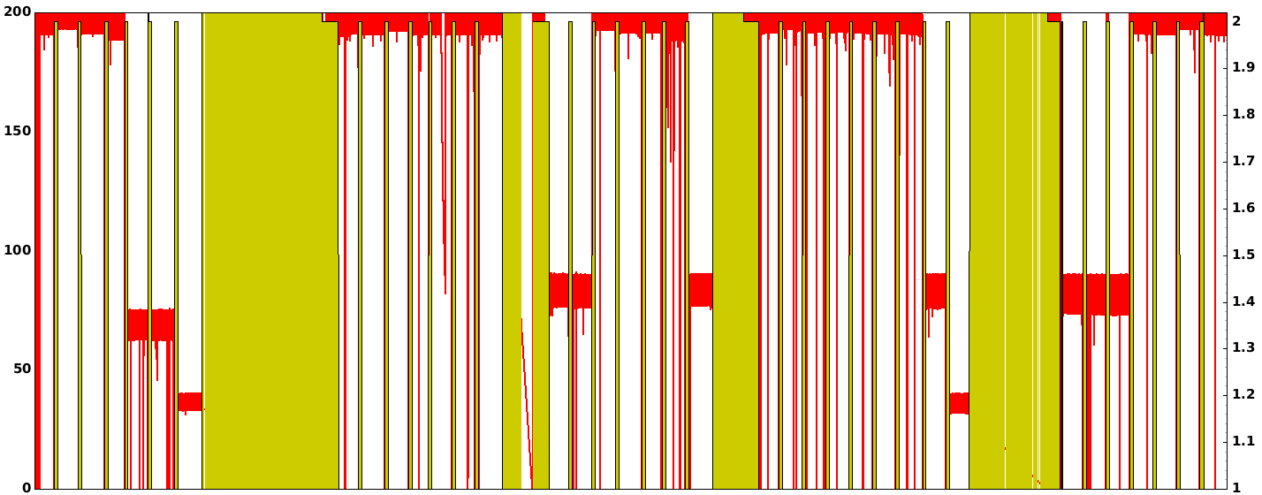
Beam current October 2024 ➔ October 2025
Uniform
Hybrid
Uniform
Hybrid
Uniform
Uniform
Uniform
16 b
16 b
16 b
16 b
16 b
4 b
4 b
12 Failures
4 Failures
9 Failures
14 Failures
7 Failures
5 0 0 0 3 4 0
1 0 0 1 0 1 1
0 2 1 0 2 3 1
4 2 4 1 1 0 2 0 0
0 4 1 1 0 0 1
Oct
Nov
Dec
Jan
Feb
March
Apr
May
June
July
Aug
Sept
Oct
Run 2024-5
Run 2025-1
Run 2025-2
Run 2025-3
Run 2025-4
Non labelled weeks are delivered in 7/8+1
Green is MDT day or shutdown1

Slide 4
Statistics October 2024 ➔ October 2025
Bad run, mostly RF failures
Not a single RF fault ! Beamline, flowmeters, vacuum
Long power outage & RF failures
Very good despite a long failure of the injector
Bad run, mostly RF and flow meters
Due to 1 long failure of injector
Due to injection kicker, timing and RIPS control

Slide 5
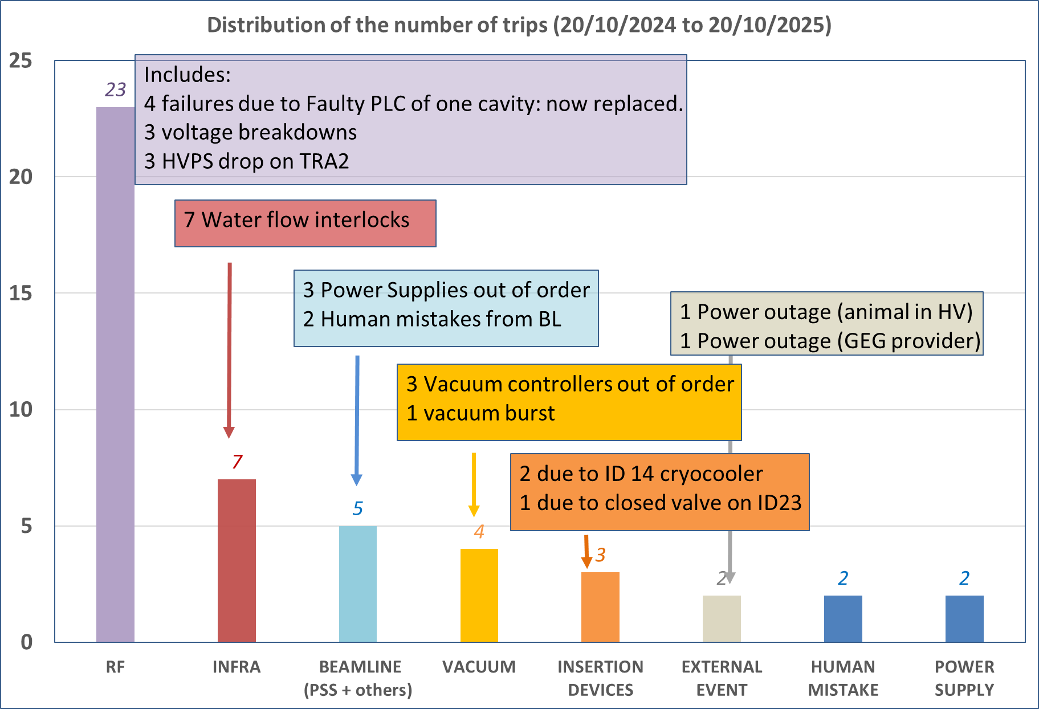
Distribution of number of trips from 20/10/2024 to 20/10/2025
No failure during full Run 2025-2
All in Run 2025 2&3
➔Total black out
* All failures counted as a single failure

Slide 6
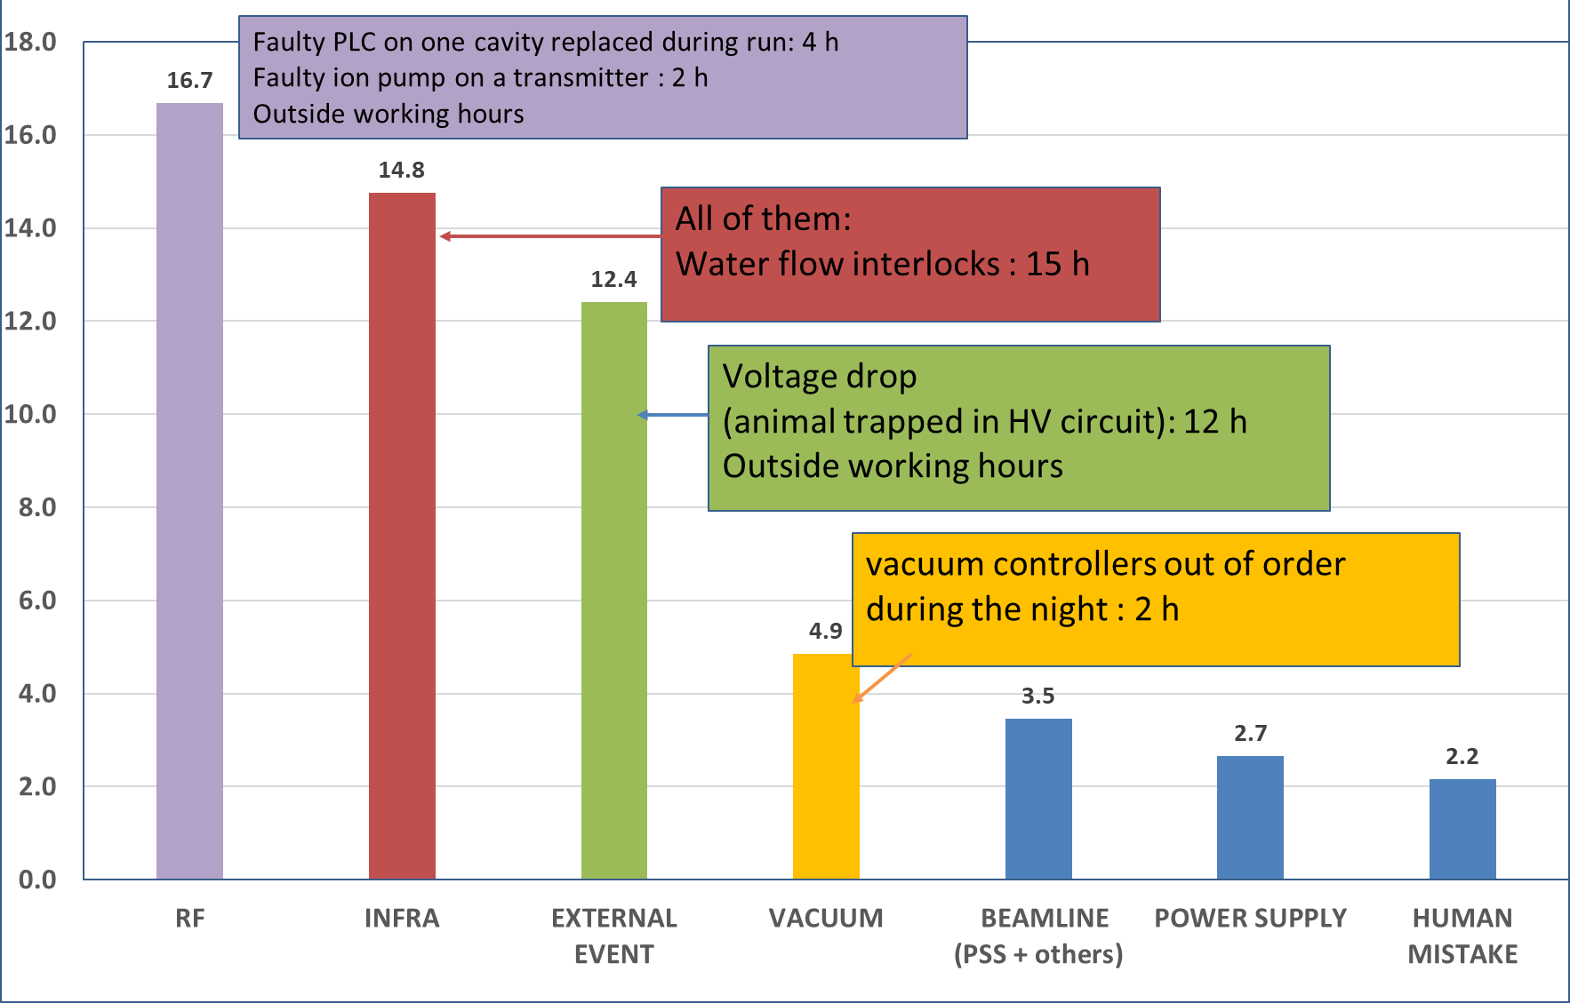
Distribution of amount of time lost from 20/10/2024 to 20/10/2025
➔ 1 Total black out

Slide 7
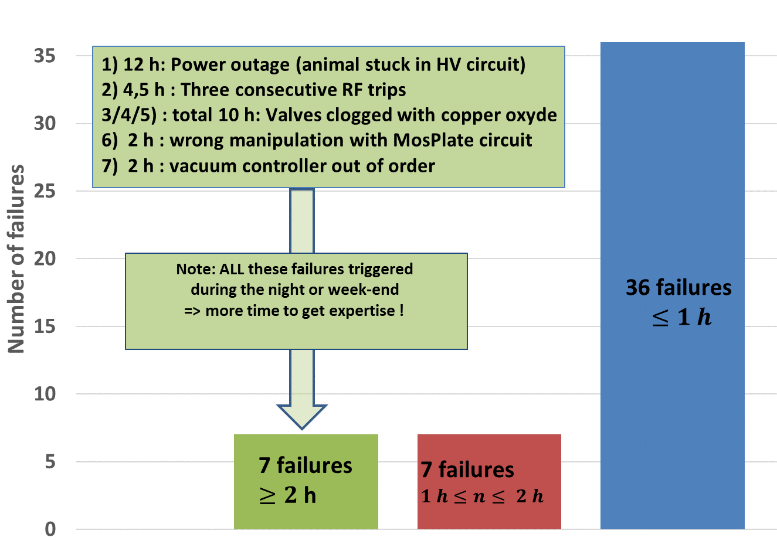
DISTRIBUTION of failures vs duration
* All failures counted as a single failures

Slide 8
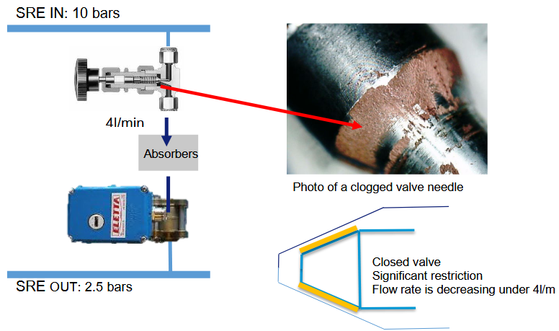
Cooling issue during run 2055-2 and 2025-3
Needle valves are installed on the cooling circuits of :
The absorbers ( 4 valves / cell – 1 valve / girder )
And
The room temperature in-vacuum insertion devices water cooling
In June 2021, we suffered from 2 beam trips due to clogging of the absorbers’ needle valves.
=> All of the absorbers’ needle valves were fully open in order to avoid new beam trip and to take time to understand the problem and react.
In May 2023, the absorbers’ needle valves in ¼ of the SR were tuned @ nominal flow rate (~ 5l/mn).
In August 2023, All the absorbers’ needle valves were tuned @ nominal flow rate.
➔ Since then no specific cooling issues.

Slide 9
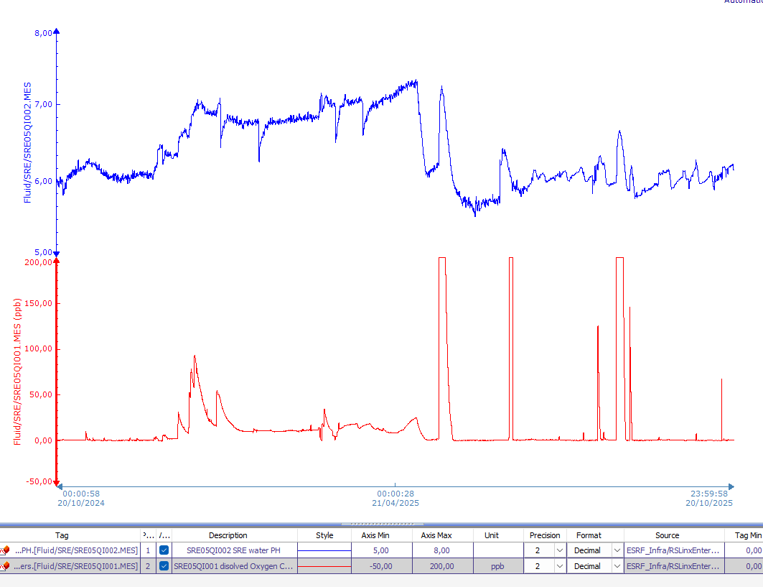
Cooling issue during run 2025-2 and 2025-3
Monday 28/04/2025 (MDT) : 11 alarms ➔ Decision to fully open All the absorbers’ needle valves during MDT
Then water flow interlock in Cell 9, cooling of the straight section. ➔ flow was set to nominal flow by opening the valve
Then on 1 May at 17:33 beam lost on cooling cell 16
Observation of a regular decrease of the flow for a few days.
Intervention during MDT to check all flow in straight sections and
Check and correct PH and low O₂ level
PH
Serious problem of solid copper deposit due to an abnormally high level of O₂ in the circuit (despite the 1 μm filters in each cell and 0.1 μm in PGUT)
7
6
5
PH carefully monitored and corrected at 6, but slow process
(Risk of erosion of cooper (dissolved copper if Low PH) instead of solid copper (High PH))
O₂
➔ The situation is now stable with no flowmeter issues but requires a careful follow up during shutdowns (and sometime MDT).

Slide 10
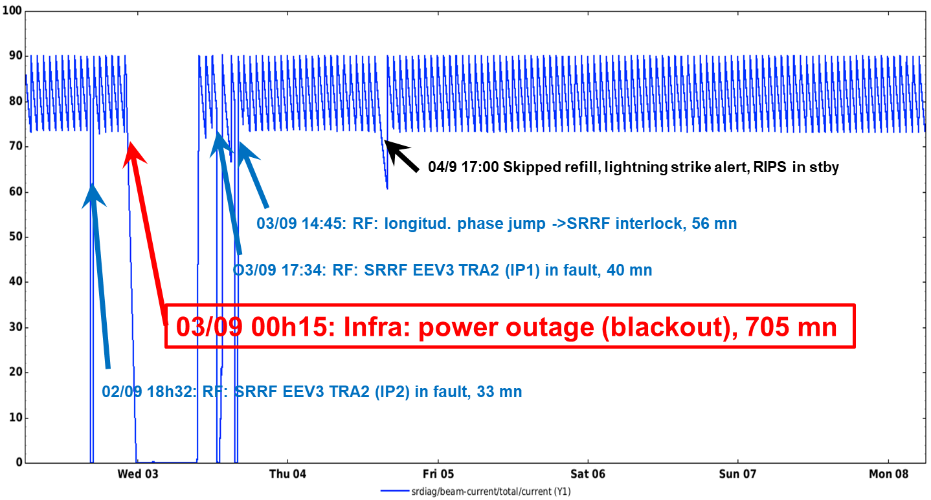
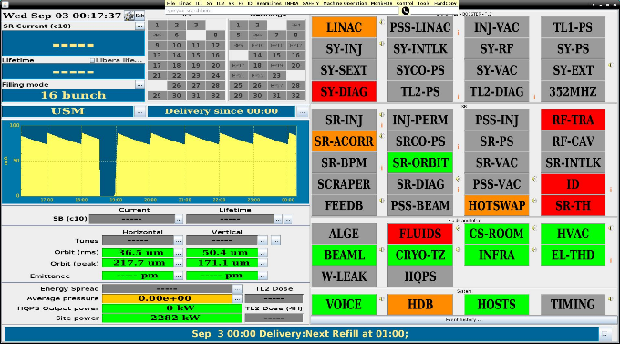
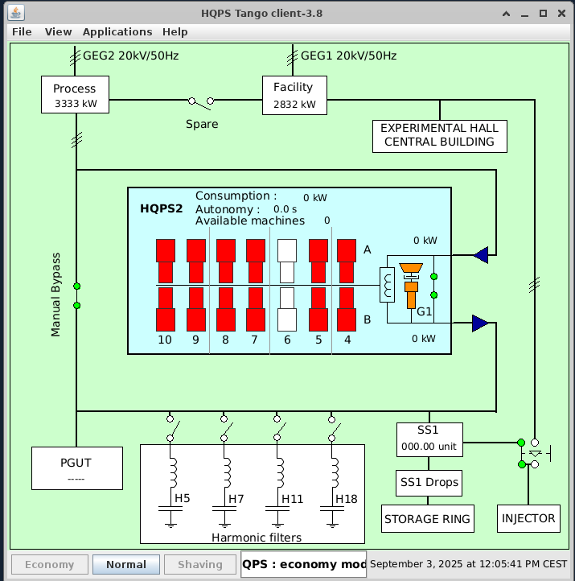
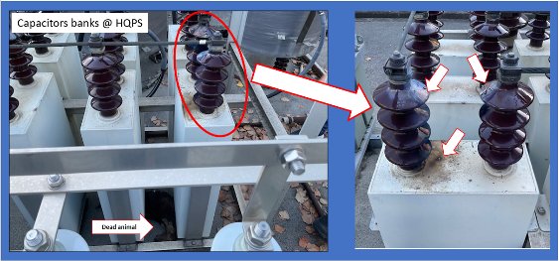
BLack out on 3 September
A similar black out occurred last year on 1st September due to the feeding line
Lessons learned:
All standbys on site to restart the equipment of the accelerators
As usual, it is difficult to restart after a complete black out. Some equipment is broken, some settings are not correct, a few pieces of equipment hidden… Need time …..
➔ situation has improved but some procedures still needed concerning control restart
Detailed restart in back-up slide
CPMUs cryo-coolers this time kept cooled up after the power outage
➔ No problem this time thanks to the new dual powering system
Diesel engineer repaired
➔ But of no use due to the origin of the black out
Short circuit in the 20 kV harmonic filters due to an animal, downstream HQPS
Single mailing list for information diffusion (address to be contacted done but single list still not done)

Slide 11
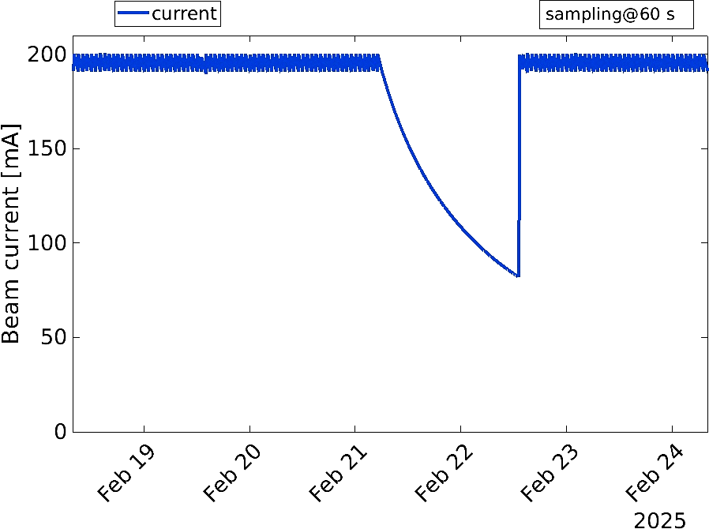
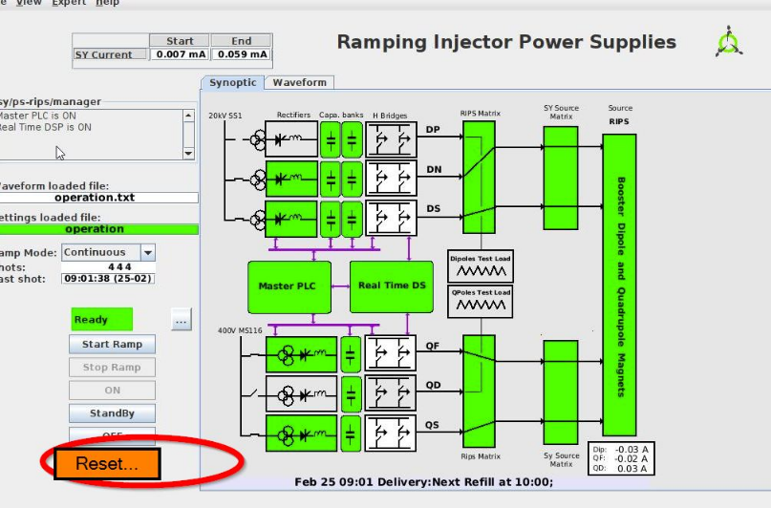
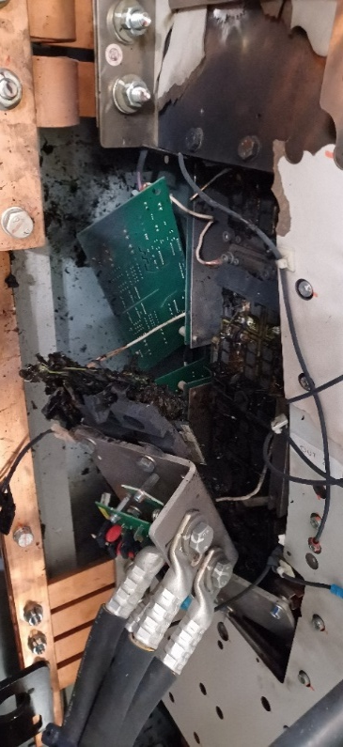
Run 2025-01: fifth week: 31 Skipped refills
A smooth decay of 31 hours (31 skipped refills) ….which was comfortable for some users who take out attenuators!
Linac modulators in fault
2016 Commissioning of RIPS
2016-2024:
Running smoothly since 2018 after fixing minor design issues
About 20 millions cycles accumulated
July 2024: installation of a NEW spare IGBT stack in DP H-Bridge… … exploded after only 2.3 million cycles / 6 months’ operation on 21/02 at 06:00
Replaced by spare power supply after careful checks
Procurement and repair took 5 months without operational spares
Use of RIPS was a constraint during this period to minimize the operation risk. In particular, 16 bunch mode was delivered at 40 pm.rad instead of 20 in order to gain in lifetime.
Back to operation on 15/07

Slide 12
EBS operation record
5372 hours of beam delivered in 2024 out of 5486 hours scheduled
Overall availability in 2024: 97.92 %, with MTBF = 72 hrs and MDF = 1.59 hrs
In 2025, 4358.7 hours of beam delivered in 2025 out of 4409 scheduled [in progress]
Overall availability 2025: 98.86 % [in progress]
ECO mode in USM operation maintained

Slide 13
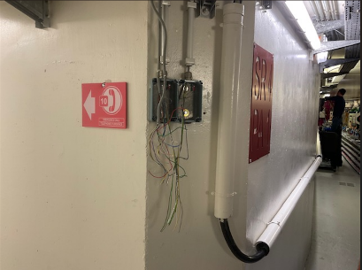
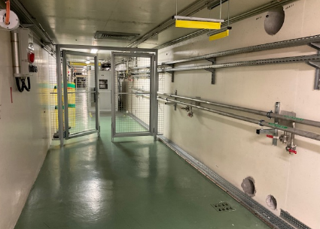
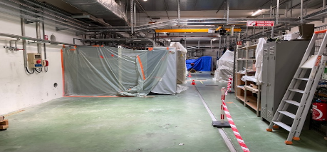
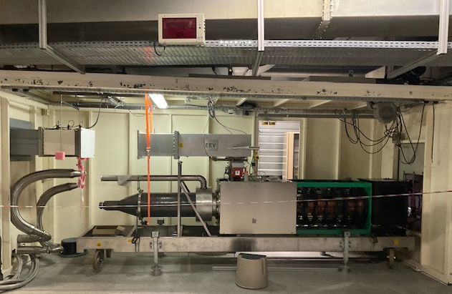
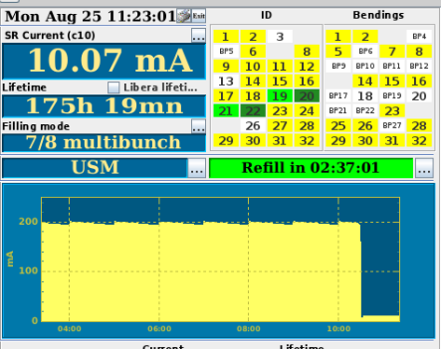
Main interventions during shutdowns
Detailed list in back-up slide
Winter shutdown 2025
SRTU : refurbishment of search button cables of the PSS
TZ04-8-HSC04 : Sext/Octu Mopslate installation
CELL03-arc : K1 Friatec vessel against Solcera vessel
CELL28-SS : 2 room temp in vacs
March shutdown 2025
LINAC : Extension of the SRE network
CELL28-SS : phase shifter middle SS
May shutdown 2025
RIPS: Removal of the broken IGBT stack (DP H-bridge)
Cell08-SS CV2300/6mm in downstream position (prototype AL vessel)
Cell23-SS Replacement of the CV5000 (canted straight section)
Cel24-SS: New revolver upstream position + phase shifter civil work
Summer shutdown 2025
Linac: Preparatory works (civil works, cabling, cooling, wave guide network, …)
SRRF : TRA2 klystron replacement : EEV5 ➔ EEV-3
CELL29-SS Removal of the cryogenic in vacuum device – IVU in the middle
CELL13-SS : cryogenic in vacuum device installation middle position
CELL24-SS : New revolver - Downstream position
Cell08-SS Replacement of the CV2300/6 by the CV2300 coming from CELL13-SS
CELL17-CELL21: Partial re-alignment of girders
October shutdown 2025
SYTU : replacement of QF28 & QF29
CELL01-SS : room temp in vacuum device
Al PS are now covered by hot swap system
new fence doors
Partial realignment of Cell 17 to Cell 21 during summer shutdown (See David’s talk). No specific issues at restart and for the beamlines
Every shutdown:
SRTU &SYTU: Flow meter maintenance
FE maintenance
Benefit for the machine will only be seen when the total realignment is performed

Slide 14
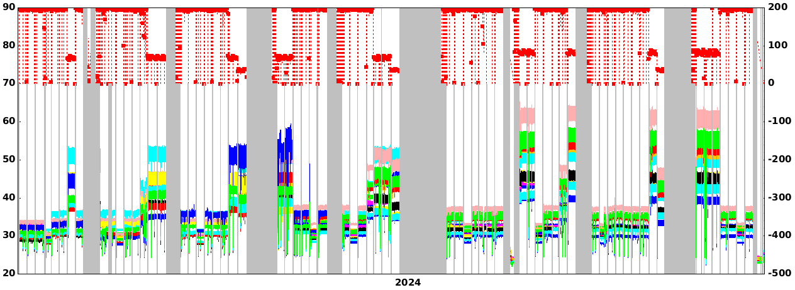
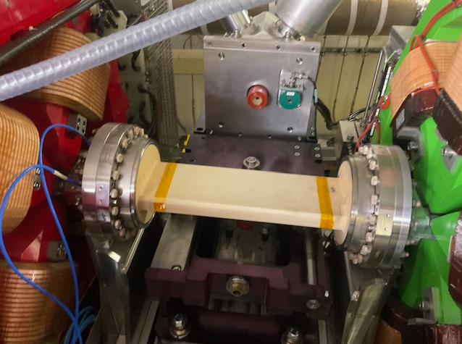
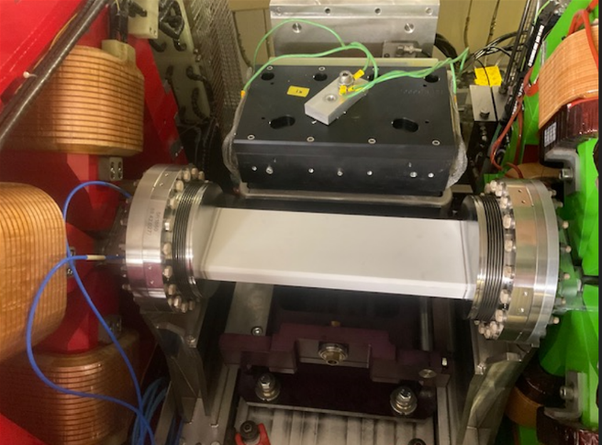
Cell03-arc : replacement of the last friatec ceramic vessel
Year 2024
Year 2025
Temperatures
K2 K3 summer SD
K4 october SD
K1 winter SD
Jan
Jan
Oct
K1 replaced during the 2024 winter shutdown, was the last step allowing 90 mA in 16 bunch.
Temperatures at expected values (less coating, higher in the middle) and stable
All 4 Solcera chambers behave well in all beam modes and 90 mA has been reached since January 2025.

Slide 15
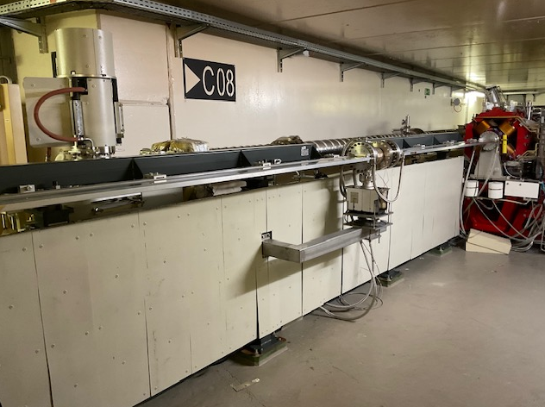
Cell08-SS : CV2300 (8 x 10mm) replaced by cv2300 (6 x 8mm)
Prototype AL CV2300 6mm inner aperture installed downstream in cell8
Equivalent to an in vacuum undulator closed at 5.8 mm
In place during the whole of Run2025-03
No stopping issue encountered (nevertheless small reduction of injection efficiency &, larger activation)
Use for beamline to be evaluated

Slide 16
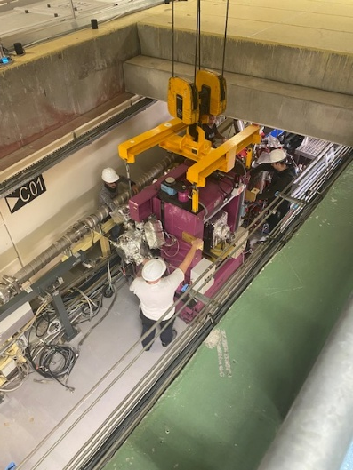
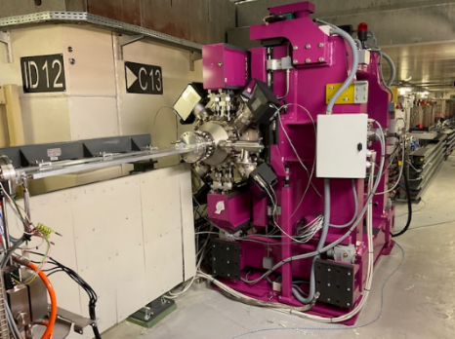
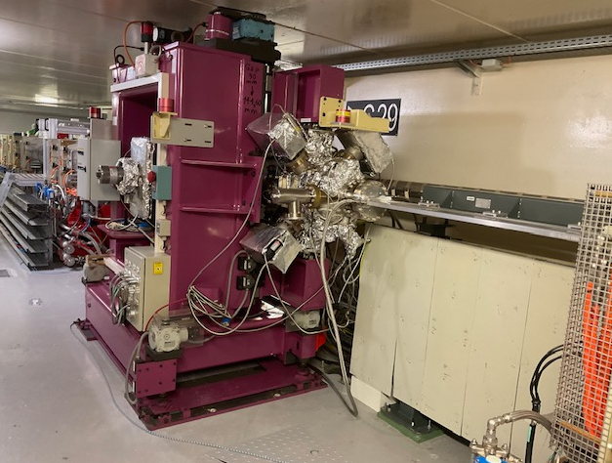
Location of the in-vacuum devices
 | Position
 | Upstream | Middle | Downstream
CELL01 |  |  | XXXXX uncooled
CELL03 |  | CPMU16.4/2
CELL06 | CPMU18/1
CELL09 | ppi23/1 |  | ppi17/1
CELL11 | CPMU18/2 |  | hpi22/1
CELL13 |  | CPMU16-4b
CELL14 | CPMU18.6/1
CELL15 | CPMU18/3 |  | hpi20/1
CELL16 | CPMU20.5/1
CELL22 |  | hpi26/1
CELL27 |  | CPMU18/4
CELL28 | hpi22/2 |  | hpi13.3/1 uncooled
CELL29 |  | ppi21/1
CELL31 |  | CPMU14.4/1
Total | 7 | 6 | 5
Installed during October 2025 shutdown,
Removed this week-end
Cell13-ss : cryo-invac coming from id29 in middle position
Cell29-SS : IVU shifted in middle position
9 Cryogenic in-vacuum devices
7 Room temperature in-vacuum devices (IVU) water cooled
2 1 Room temperature in-vacuum devices uncooled

Slide 17
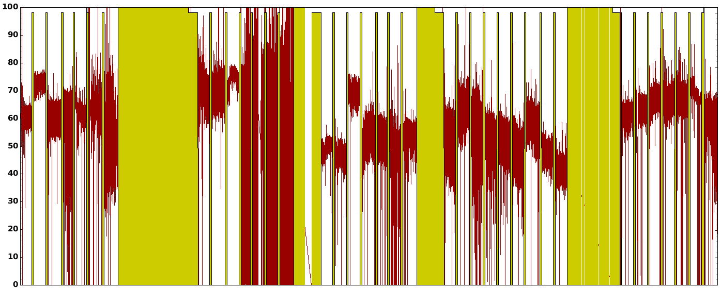
Injection efficiency October 2024 ➔ October 2025
Uniform
Hybrid
Uniform
Uniform
Uniform
Uniform
Hybrid
16 b
16 b
16 b
16 b
16 b
4 b
4 b
ID08 6mm ID chamber
Oct
Nov
Dec
Jan
Feb
March
Apr
May
June
July
Aug
Sept
Oct
Average during the period: 65%, upgrade of the injector is a key issue to improve injection efficiency.
Injection efficiency re-optimized at each restart (manual +badger) and regularly by operators
10% reduction observed since March, but difficult to recover, not well understood, some ideas under investigation
7/8+1 affected by saturation on single bunch for a long time (linked to impedance effect, study with simulation and MDT)

Slide 18
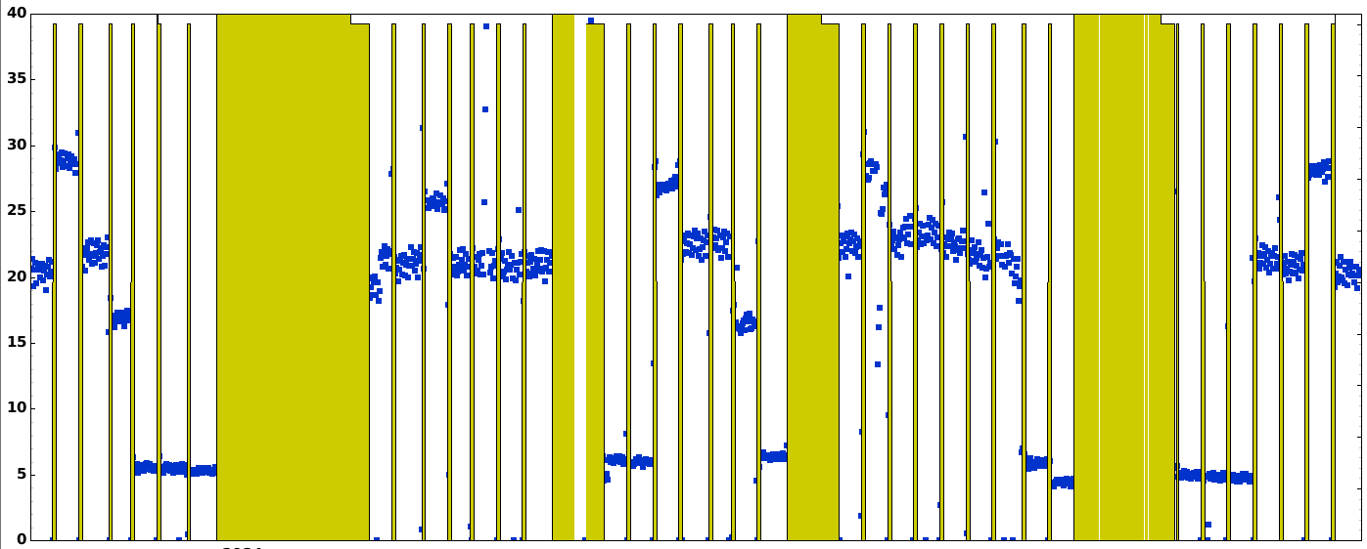
Lifetime October 2024 ➔ October 2025
Uniform
Hybrid
Uniform
Uniform
Hybrid
Uniform
Uniform
16 b
4 b
16 b
16 b
16 b
4 b
16 b
Oct
Nov
Dec
Jan
Feb
March
Apr
May
June
July
Aug
Sept
Oct
Average beam mode maintained compared to previous years
Lifetime re-optimized at each restart (manual +badger)
Collimators retuned at each change of beam mode (set at 7% reduction gap open)
Lifetime increased in 16 bunch run 2025-2&3 to protect RIPS

Slide 19
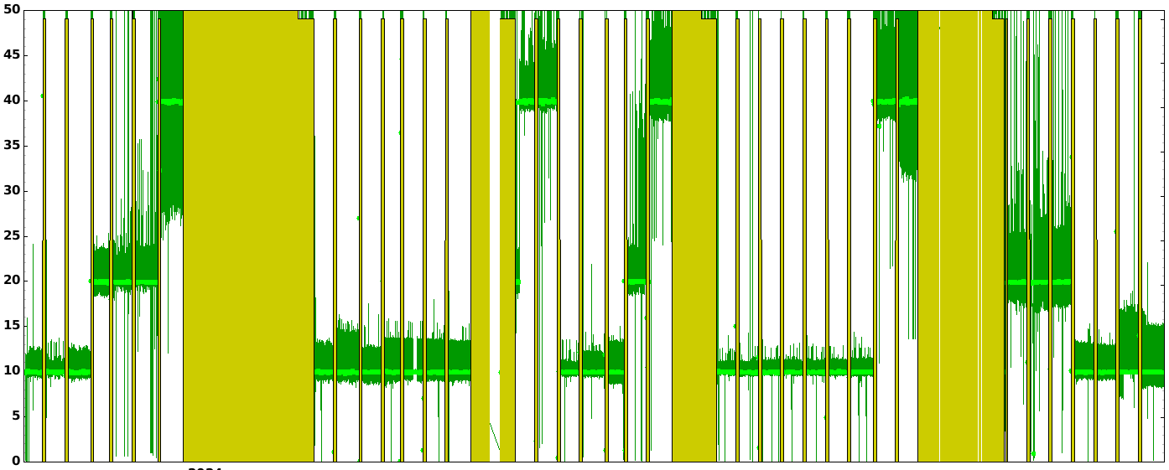
Vertical emittance October 2024 ➔ October 2025
Hybrid
Hybrid
4 b
16 b
16 b
16 b
4 b
Uniform
Uniform
Uniform
Uniform
Uniform
16 b
16 b
Oct
Nov
Dec
Jan
Feb
March
Apr
May
June
July
Aug
Sept
Oct
Vertical emittance increased from 1 to 10, 20 or 4 pm.rad to maintain lifetime
Vertical emittance increased from 20 to 40 pm in 16 bunch run 2025-2&3 to protect RIPS
Less than 5 pm blow-up at injection in multibunch mode

Slide 20
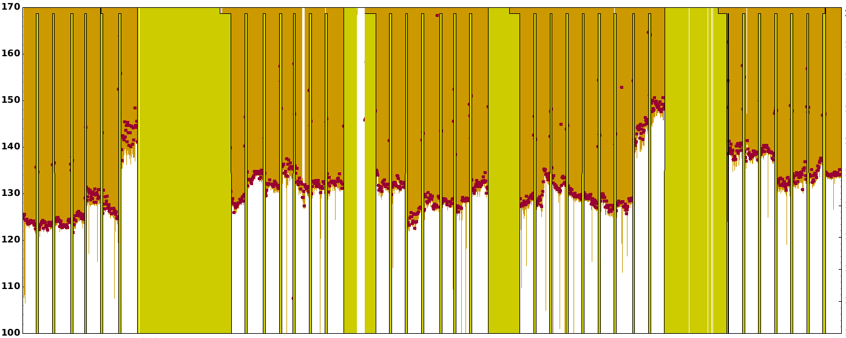
Horizontal emittance October 2024 ➔ October 2025
Hybrid
Uniform
Hybrid
Uniform
Uniform
Uniform
4 b
16 b
16 b
4 b
Uniform
16 b
16 b
16 b
Oct
Nov
Dec
Jan
Feb
March
Apr
May
June
July
Aug
Sept
Oct
Horizontal emittance in average of 128 pm
A few pm variation with ID gap variation (ID power of 100kW in average at 200 mA)

Slide 21
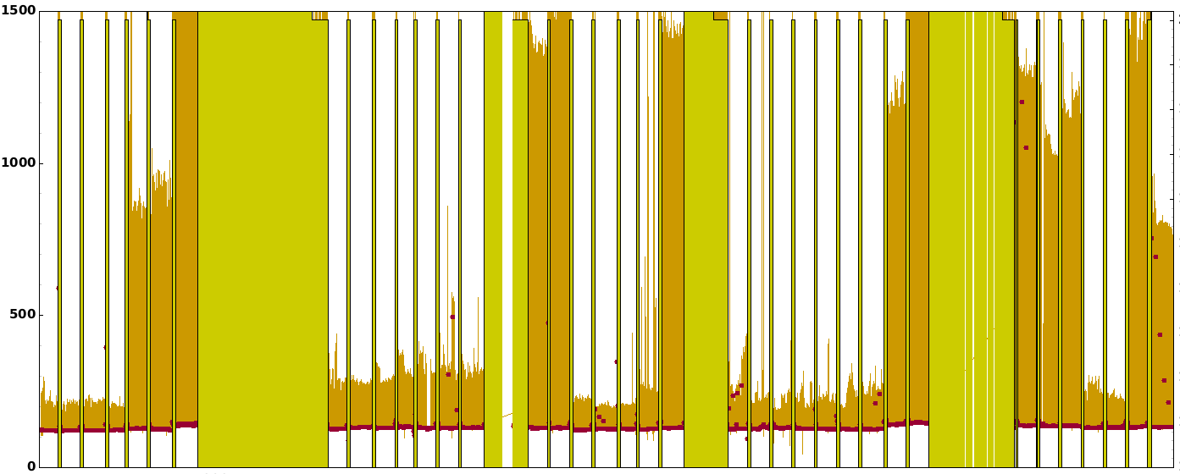
Horizontal emittance (injection perturbation) Oct 2024 ➔ Oct 2025
HybridD
4 b
16 b
16 b
4 b
Uniform
Uniform
16 b
Uniform
Uniform
16 b
Uniform
16 b
Oct
Nov
Dec
Jan
Feb
March
Apr
May
June
July
Aug
Sept
Oct
Less than 200 pm blow-up at injection in multi-bunch mode when the compensation system and the optics (tune) are well tuned (the most sensitive beamlines do not take data during refill)
Compensation system not working in 16 and 4 bunch mode
No complaints from users even when the system is not perfectly tuned (like the large perturbation in the uniform of last run, most probably due to compensation system not well tuned to the injection settings)

Slide 22
Medium term scientific programs
Accelerator programs in next 5 years
High reliability, availability, stability and sustainability of USM operation
SSAs for RF system @ storage ring – consolidate the storage ring operation
ID constructions, ID controls – provide more light sources, better control, and explore the potential of EBS
Energy saving (ECO mode) maintained in USM operation
Injector upgrade (linac refurbishment & booster light upgrade)
Improvement of beam delivery and performance
Injection improvement – injection efficiency promotion, transparent injection
4th harmonic cavity – improve the beam performance @ timing modes – Higher brightness & coherence, future upgrade
Low-gap IDs, other new type IDs (HTS) – under investigation
New linac (COLD) – Increased linac energy, test facility for new technology of linac structure
Courtesy Q Qin

Slide 23
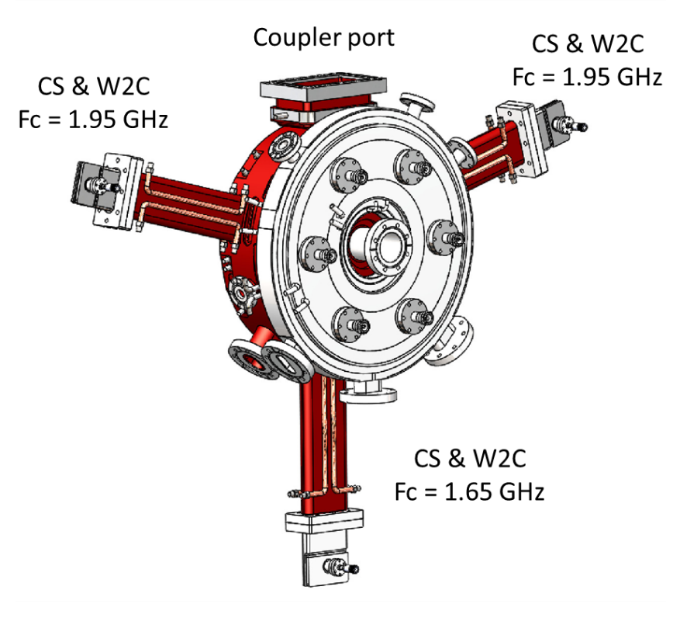
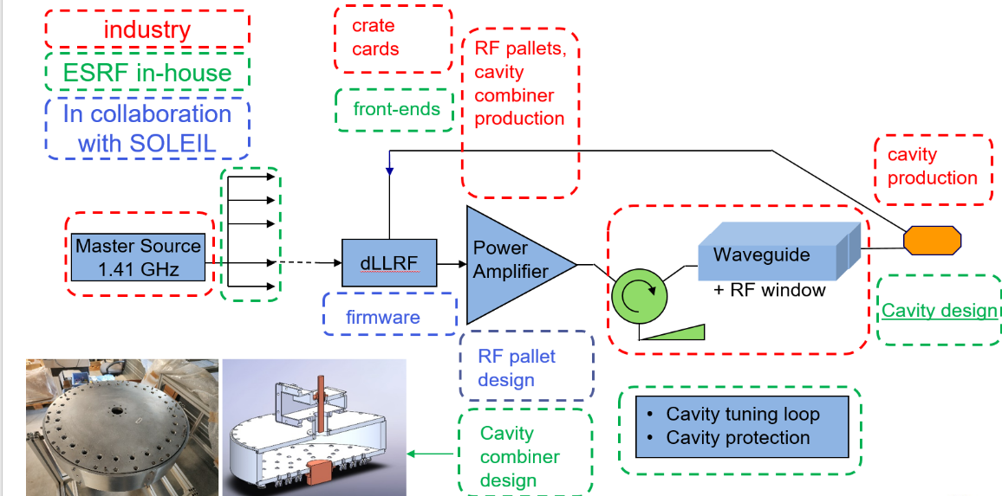
4th harmonic cavity
The ESRF is providing the complete cavity design to SOLEIL II within a collaboration contract
Close design project relaunched in 2025 for ESRF
Active NC single cell
Courtesy P Boroviec

Slide 24
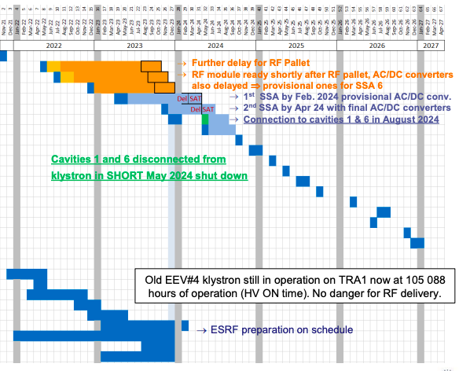
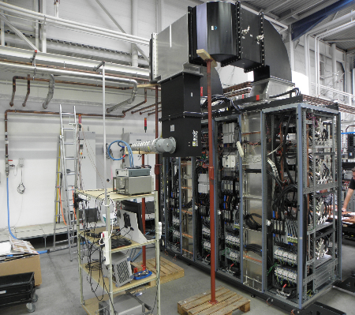
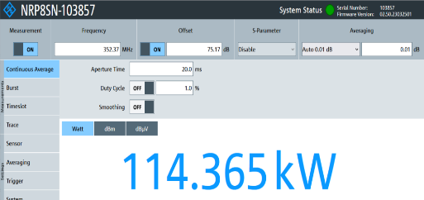
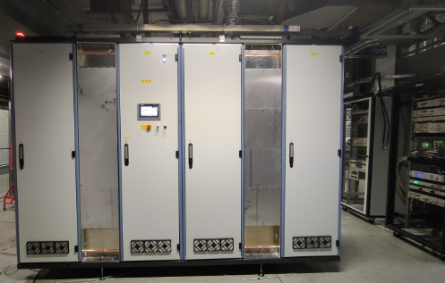
medium term strategy programs – RF projects (SSA)
Original plan
SSA0, a prototype of tech-
nical verification at JEMA
SSA0, test at the ESRF
Solid State Amplifiers situation
An amendment was signed in April 2024, to have an SSA0 to be the technical validation for JEMA
SSA0 delivered in on 18th Oct, 2024, but SAT not yet fulfilled due to a series technical issues. The scheduled 1000 hrs test even not yet started.
SSA2, as the milestone 2, scheduled to finished in June 2025, tests failed until 20th Oct.
The contract to JEMA France most probably to be terminated, due to these uncompleted milestones.
Courtesy P Boroviec

Slide 25
medium term strategy programs – ID
ID construction
ID synchrotronization
Courtesy G LeBec

Slide 26
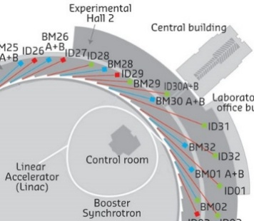
Injector upgrade programme
Mid-term
Long-term
Injectors
upgrade
SR Injection section
improvement
Booster
refurbishment
Linac
refurbishment
NEW
Linac
COLD
Started
5 M€
Replace existing injectors with a full energy injector linac
Higher injection efficiency, lower injection perturbation, enable/facilitate future SR upgrades
6GeV + margin
> 600 pC (single bunch)
< 1 nm.rad at SR injection
< 0.1 % energy spread
< 1 mm bunch length
> 4 Hz repetition rate
Bunch spacing 2.8ns (in the SR)
Fits on site (maximum 180m)
As low energy consumption as possible
User facility grade :
Reliability
Reproducibility Maintainability
In construction
3 M€
Non-linear injector kicker
Transparent injections
Maintain injection efficiency
Advanced
Design & procurement
Procurement
0.5 M€
1.5 M€
Lower natural emittance
Higher injection efficiency in SR
Higher extraction efficiency
More reliability
Modernization
Short term

Slide 27
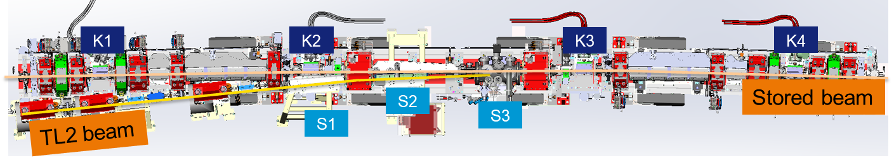
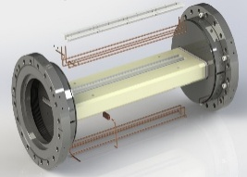
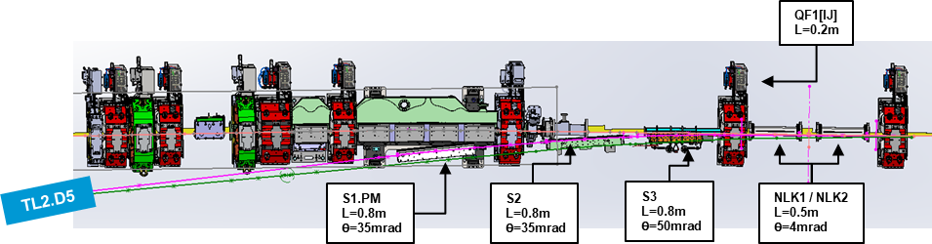
medium-term scientific programs – injection improvement
S3 & related TL2 shifted 5mm towards storage ring – done in 2024
Nonlinear kicker scheme
Courtesy A Sauret
Insertion of the coil inside the ceramic chamber.
/NLK3
Assembly end 2025 of the NLK, same procedure as SOLEIL
Installation in May 2026 in the ID8 test section for test and validation
Installation in 2029 in the injection section of 3 NLK for a total angle of 12.2 mrad.

Slide 28
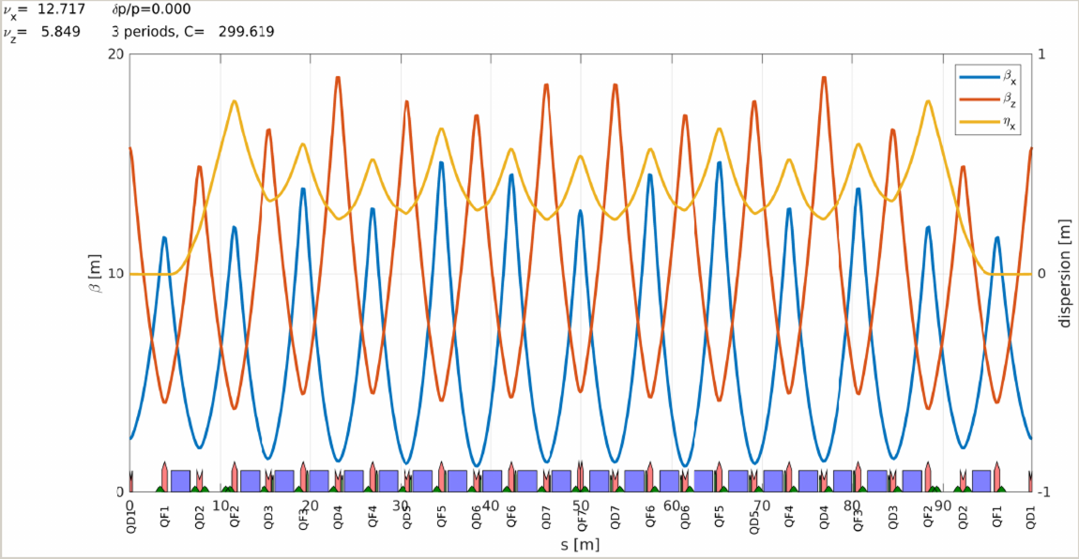
Booster light upgrade
Basic idea: increase the number of quadrupole families from 2 to more (4, 5 or 6) to reduce horizontal emittance. The 3 additional QF families will be powered by the same booster power supply (RIPS), but the 18 magnets will be shorter in order to have a smaller gradient.
Present lattice
2 quad families
The new magnets are: QFA, QFB, and QFC
39 QD, 39 QF
ε_{x} = 83.1 nm
BL = 22.6 mm
New lattice
5 quad families
39 QD, 21 QF,
6 QFA, 6 QFB, 6 QFC
ε_{x} = 59.6 nm
BL = 19.9 mm
The installation in the booster should be during the winter shutdown 2027/2028.
Courtesy N Carmignani

Slide 29
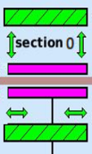
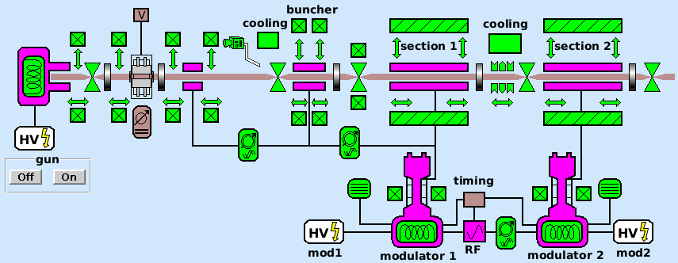
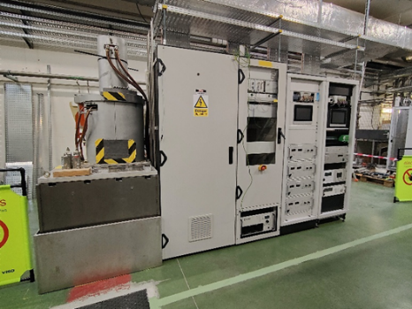
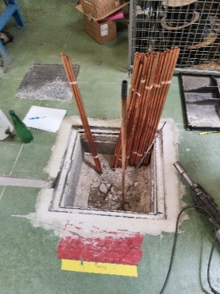
Linac – Refurbisment
Implemented actions:
Modulator #3 moved to a new position to provide the RF for:
Section #1 in the Linac
Spare accelerating section during conditioning
Spare accelerating section -> CFT awarded by RI GmbH
All cavities have been machined
Brazing and tuning in November
Delayed delivery due to lead time of ceramic for the RF window (input splitter)
Solid state RF Unit -> CFT awarded by ScandiNova
Canon klystron has been selected
FAT accepted.
SAT in November
Purchase of vacuum chamber to replace any section -> delivered
Modulator S3
(backup for Mod. #1)
December 2025
New RF Unit #0
(backup for Mod. 2)
Linac, beam dynamic simulations by BD Group.
Existing Linac is modelized
Preparation work in progress
Courtesy P Boroviec
new fence doors

Slide 30
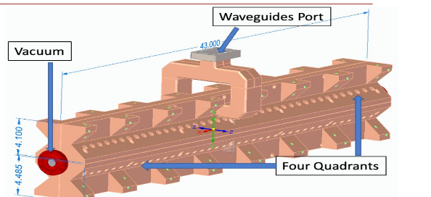
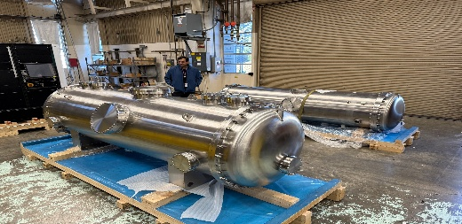

COLD project
SLAC distributed coupling standing wave cryogenic accelerating strucutres and cryomodule
C^{2 cold copper}
Operation
Linac
Demonstrator
high gradient (135MV/m peak field)
Low breakdown rates at 77K
A demonstrator to prove
high gradient cryogenic accelerating structures(about 80 MeV/m energy gain)
for users facility grade operation
at low repetition rate.
The pre-injector of a new 6GeV linac.
Courtesy S Liuzzo

Slide 31




Installation in the tunnel
Present situation (2/3 of linac tunnel empty
High power RF test of C³ accelerating structure
2027
2025
Phase 0
2028
Beam in section 0 (TBC)
High power RF test of spare accelerating structure and new modulator (S0)
135 MeV
2026
Photo Gun available in 2028
Beam in C³ acc. structures.
2029
170 MeV
Phase 1
Take decision to continue or not toward 6GeV linac

Slide 32




Installation in the tunnel
2030
(option) Proposed to install an undulator → WP12
Phase 3
2031
Beam to ESRF booster and old linac as spare
Phase 2
6GeV Linac construction during shutdowns and commissioning during USM
2032-35(?)
2030
2 cryomodules (1 from SLAC and 1 ESRF)
Fits on ESRF site
6.159 GeV in 131m, 21 x 5.93m modules
80+4 accelerating C³ structures
5.6mm.mrad, ~500pmrad@6GeV
0.18% energy spread
0.5mm bunch length
2035 (?)
2 month shutdown to install new Transfer line linac to SR and commission new injection

Slide 33
Overview of EBS operation and conclusion
 | Units | ESRF | ESRF-EBS
Energy | GeV | 6 | 6
Circumference | m | 844.4 | 844
Lattice |  | DBA | HMBA
Current | mA | 200 | 200
Lifetime | h | 50 | 25
Emittance H | pm.rad | 4000 | 133
Emittance V | pm.rad | 4 | 1 to 40
EBS fully operational at nominal parameters.
➔ 90 mA current routinely delivered in 16 bunch
Reliability, reproducibility and tuning of the machine are very good.
➔However injection efficiency is an issue
Injection perturbation (imposing 1h topping up) is still an issue despite the efforts to reduce it
➔ New injection scheme is in development
Statistics are better for 2025 with fewer failures and very few long beam interruptions.
➔ securing the SR RF system is mandatory (SSA)
Maintaining and improving lifetime
➔ 4th harmonic cavity project restarted
Upgrade of the injector
➔ Linac upgrade programme is ongoing
 | 2018 | 2024 | 2025*
Availability (%) | 98.47 | 97.92 | 98.86
Number of failures | 53 | 72 | 34
Mean Time Between Failures (hrs) | 104.30 | 76.2 | 129.7
Mean Duration per Failure (hrs) | 1.60 | 1.6 | 1.5
* statistics until 14th October for 2025
Two failures occurring in less than 1 hour counted as a single long failure
Failures affecting a single beamline are not counted

Slide 34


Many thanks for your attention

Slide 35
EBS 5-year operation since 25/08/2020
 | 2020 (4 months) | 2021 | 2022 | 2023 | 2024 | 2025 (4 runs)
Scheduled beam time (hrs) | 1609 | 3616 | 5490 | 5492 | 5486 | 4409
Delivered beam time (hrs) | 1545.90 | 3547.27 | 5438 | 5374 | 5372 | 4358.7
Availability | 96.1% | 96.35% | 99.06% | 97.85% | 97.92% | 98.86%
Number of failures | 35 | 70 | 62 | 52 | 72 | 34
Mean time between failures (hrs) | 46.0 | 66.4 | 88.5 | 105.6 | 76.2 | 129.7
Mean duration of a failure (hrs) | 1.8 | 1.32 | 0.83 | 2.27 | 1.59 | 1.48

Slide 36

Overview of the restart after black out
00:15:
Process power lost
Injector back
11.75 hours
Control back
Intervention for BM8 FE
Process power back
RF back
Beam back to users
RIPS on spare
Magnets back
Vacuum back
All IDs back
HQPS protection back
PSS back
The automatic switch from Machine to facilities of the cryo-coolers in TZ ran extremely well: No PB

Slide 37
Main interventions during shutdowns
New installations | Preventive maintenance
Winter shutdown 2025
Booster-sector1: 20 buttons vacuum vessel installation | SY-RF / SR-RF : Greasing and check of tuners
TL2-correctors : New power supplies | SRTU : refurbishment of search button cables
TZ04-8-HSC04 : Sext/Octu Mopslate installation | CELL04-G0 : Refurbishment of S2 cooling system
CELL03-arc : K1 Friatec vessel against Solcera vessel | TL1-QD3 : brazing of a leaky water copper box
CELL06-BPM7 : Clamp installed | CELL06-SS : Re-installation of cryogenic invacuum device
CELL14-SS : Phase shifter installation | CELL30-SS : New carriage on upstream mechanic (taper)
CELL28-SS : 2 room temp invac devices* + phase shifter support | FE maintenance
March shutdown 2025
LINAC : Extension of the SRE network | SRTU &SYTU: Flow meter maintenance
CELL15-BM15 : New CV990 Al NEG coated | TL2-G0 : vertical re-alignment mainly S2
CELL28-SS : phase shifter installation middle SS | CELL14-ch7 : Replacement of the ch07 RF finger
CELL32-BPM4 : clamp installation | FE maintenance
May shutdown 2025
RIPS: Removal of the broken IGBT stack (DP H-bridge) | SRTU &SYTU: Flow meter maintenance
Cell08-SS CV2300/6mm installation in downstream position (prototype AL vessel) | Cell30-FE-ID30: Motorization stage replacement
Cell23-SS Replacement of the CV5000 (canted straight section) | FE maintenance
Cel24-SS: New revolver upstream position + phase shifter civil work
Summer shutdown 2025
Linac: Preparatory works for new section (civil works, cabling, cooling, wave guide network, …) | SRTU &SYTU: Flow meter maintenance
SRRF : TRA2 klystron replacement : EEV5 ➔ EEV-3 | CELL17-CELL21: Partial re-alignment of girders
CELL29-SS Removal of the cryogenic invacuum device – IVU in the middle | ID03& ID13 : Slits upgrade/motorization stages & fast shutter replacement
CELL13-SS : Cryogenic trench & cryogenic invacuum device installation middle position | TZ14 : cryo-cooler replacement
CELL24-SS : New revolver - Downstream position | False floor repair in TZ
Cell08-SS Replacement of the CV2300/6 by the CV2300 coming from CELL13-SS | FE maintenance
October shutdown 2025
SYTU : replacement of QF28 & QF29 | MTBN / MTBS / PINJ concrete doors check
CELL01-SS : room temp invacuum device installation | TZ14 : cryo-cooler intervention
 | CELL15-arc : AL ch07 : New RF finger
 | Roof C5-7RF : Installation of grids on the air cooling circuits of the couplers
 | FE maintenance

Slide 38
No beam is a problem but what concern other Beam parameters?
 | Consequences | Report/complain to operation | Comment
Failures | No beam | Yes
Skipped refill | 20 mn or more delay of injection | No
Injection perturbation | Position & emittance increase | No | But the most sensitive cannot work in any case
Longer refill |  | No | Due to lower injEff & beam mode
Lifetime drop/reduction | Faster decay | No
Purity | > 10⁻⁹ | Yes | ID14
Larger V emittance | Stabilized from 1 to 10&20&40 pm.rad | No | Could be reduced (7 pm.rad at least in multi)
H emittance stability | 20 pm. variation beam mode& gap closure | N0
Beam position |  | Yes | Small bump from CTRM when BL needed
Beam stability/fast motion |  | Some | Mostly ID24
Filling pattern flatness |  | No | Could be reduced
Bunch length | Factor 4 with beam mode | No | Depending optics, current/bunch RF voltage
Energy spread | Factor 2 with beam mode | No | Depending optics, current/bunch

Slide 39
Master planning and shutdown schedule (Summary)
Del. | Date | Instrument added to the installation | Beam achievements | project
Del. 1 | 2025-October SD | ModS3 RF-unit displacement |  | Linac refurbishment
Del. 1 | 2025-October SD | ModS0 RF-unit (SAT) |  | Linac refurbishment
Del. 1 | 2025-December SD | 6m section (RF Cond) |  | Linac refurbishment
Del. 2 | 2025-2026 | Thermo-ionic gun assembly in test-stand |  | Linac refurbishment
Del. 4 | 2026-December SD | ModS4- RF-unit (SAT) |  | COLD
Del. 2 | 2026-December SD | Thermoionic gun in tunnel |  | Linac refurbishment
Del. 2 | 2026-DecemberSD | Diag and beam dump in tunnel |  | Linac refurbishment
Del. 2 | 2027-April |  | 135MeV Beam | Linac refurbishment
Del. 3 | 2027-May SD | First C-band RF-unit |  | COLD
Del. 3 | 2027-Aout SD | First C-band acc. Struct. |  | COLD
Del. 4 | 2028-May SD | S-band photo-gun + laser | 7MeV photogun beam | COLD
Del. 4 | 2028-May SD | Diag and beam dump upgrade |  | COLD
Del. 4 | 2029-January |  | 170MeV beam | COLD
Del. 5 | 2029-August SD | Undulator + 170MeV beam | Xray beam | COLD
Del. 6 | 2029-December SD | Second C-band RF-unit and acc.struct |  | COLD phase 2
Del. 6 | 2030-September |  | 325MeV beam | COLD phase 2
Del. 7 | 2031-August SD | TL1upgrade and inject in booster | 325MeV beam to booster | COLD phase 2

