Slide 1
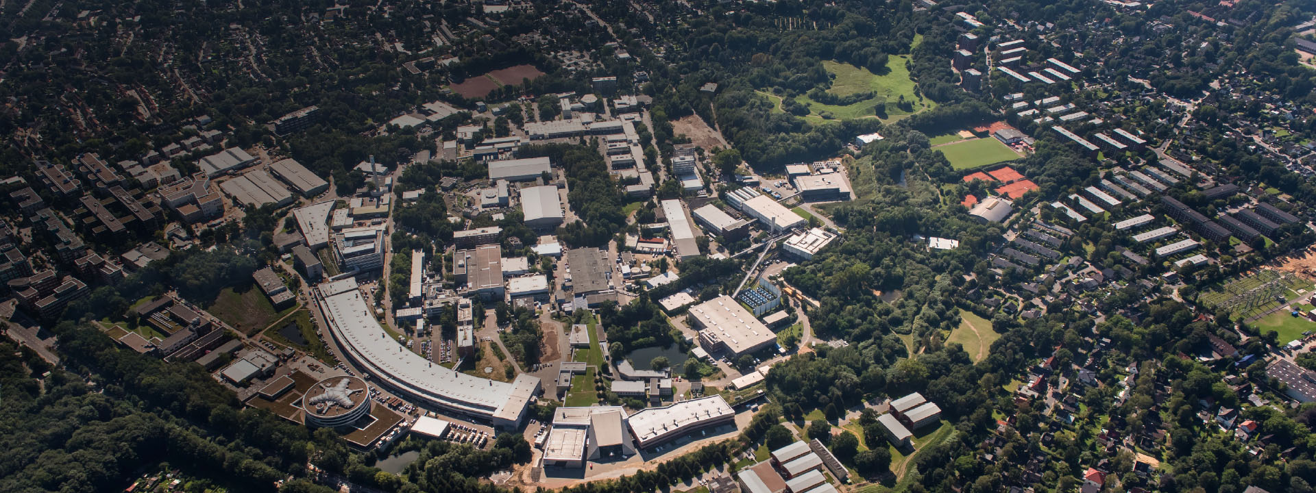
PETRA III Operation & PETRA IV Status
ESLS Workshop 2025
SOLEIL, 30.10.2025
Michaela Schaumann
on behalf of the PETRA III Operations Team
PETRA III Operations Team: J. Keil, G. Sahoo, M. Schaumann, R. Wanzenberg
PETRA IV Project Team: R. Bartolini, H. Reichert et al.

Slide 2
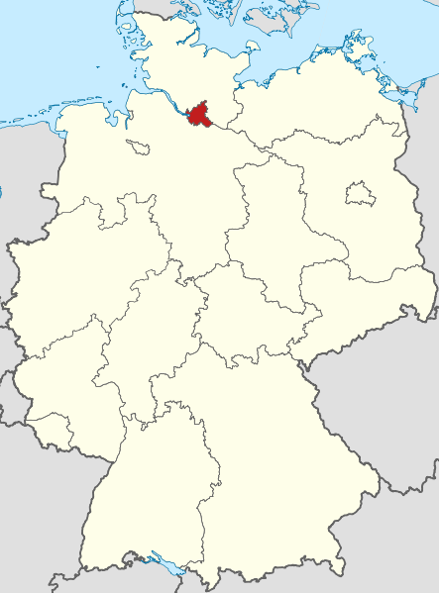
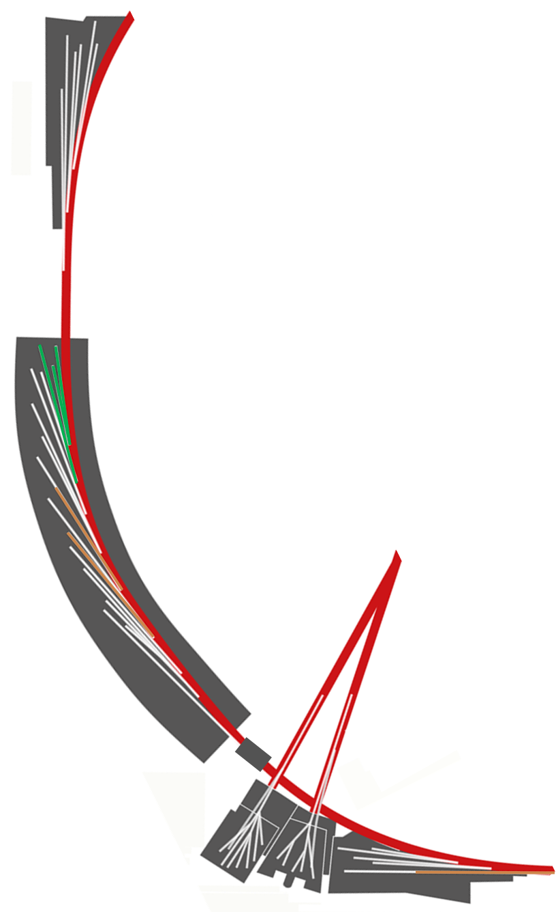
Ada Yonath Hall
Extension Hall East
PETRA III
is one of DESY’s core facilities
@ DESY, Hamburg, Germany
Max von Laue Hall
Hall „Ada Yonath“
BLs P21…P25
Paul P. Ewald Hall
Extension Hall North
Sweden
EMBL
HZG
The world’s biggest storage ring light source
Hall „Max von Laue“
Beamlines P01-P14
24 Beamlines are in operation
+ 1 in commissioning
+ 1 in preparation
Parameter | PETRA III
Energy / GeV | 6
Circumference /m | 2304
Emittance (horz. / vert.) /nm | 1.3 / 0.013
Number of bunches | 40 or 480
Total current / mA | 100 or 120
More than 50 experiments covering most relevant methods
FLASH 1&2
P66
Hall „Paul Peter Ewald“
BLs P61 … P65

Slide 3
Content
PETRA III Operation in 2025
Plans for the Long Shutdown from Sept. 2026
Status of the PETRA IV Project

Slide 4
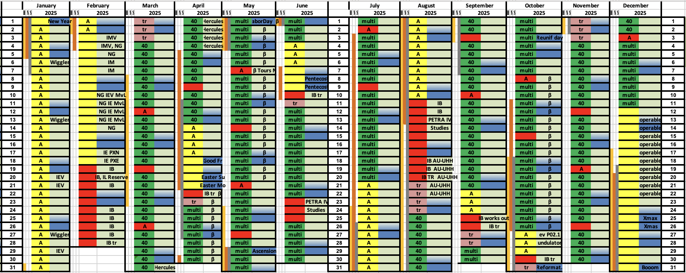
4656 user hours are scheduled for 2025
Two-week “operable” period in December to support energy management at DESY
TODAY
Shutdown
Studies / Machine Development
Test Run
User Run

Slide 5
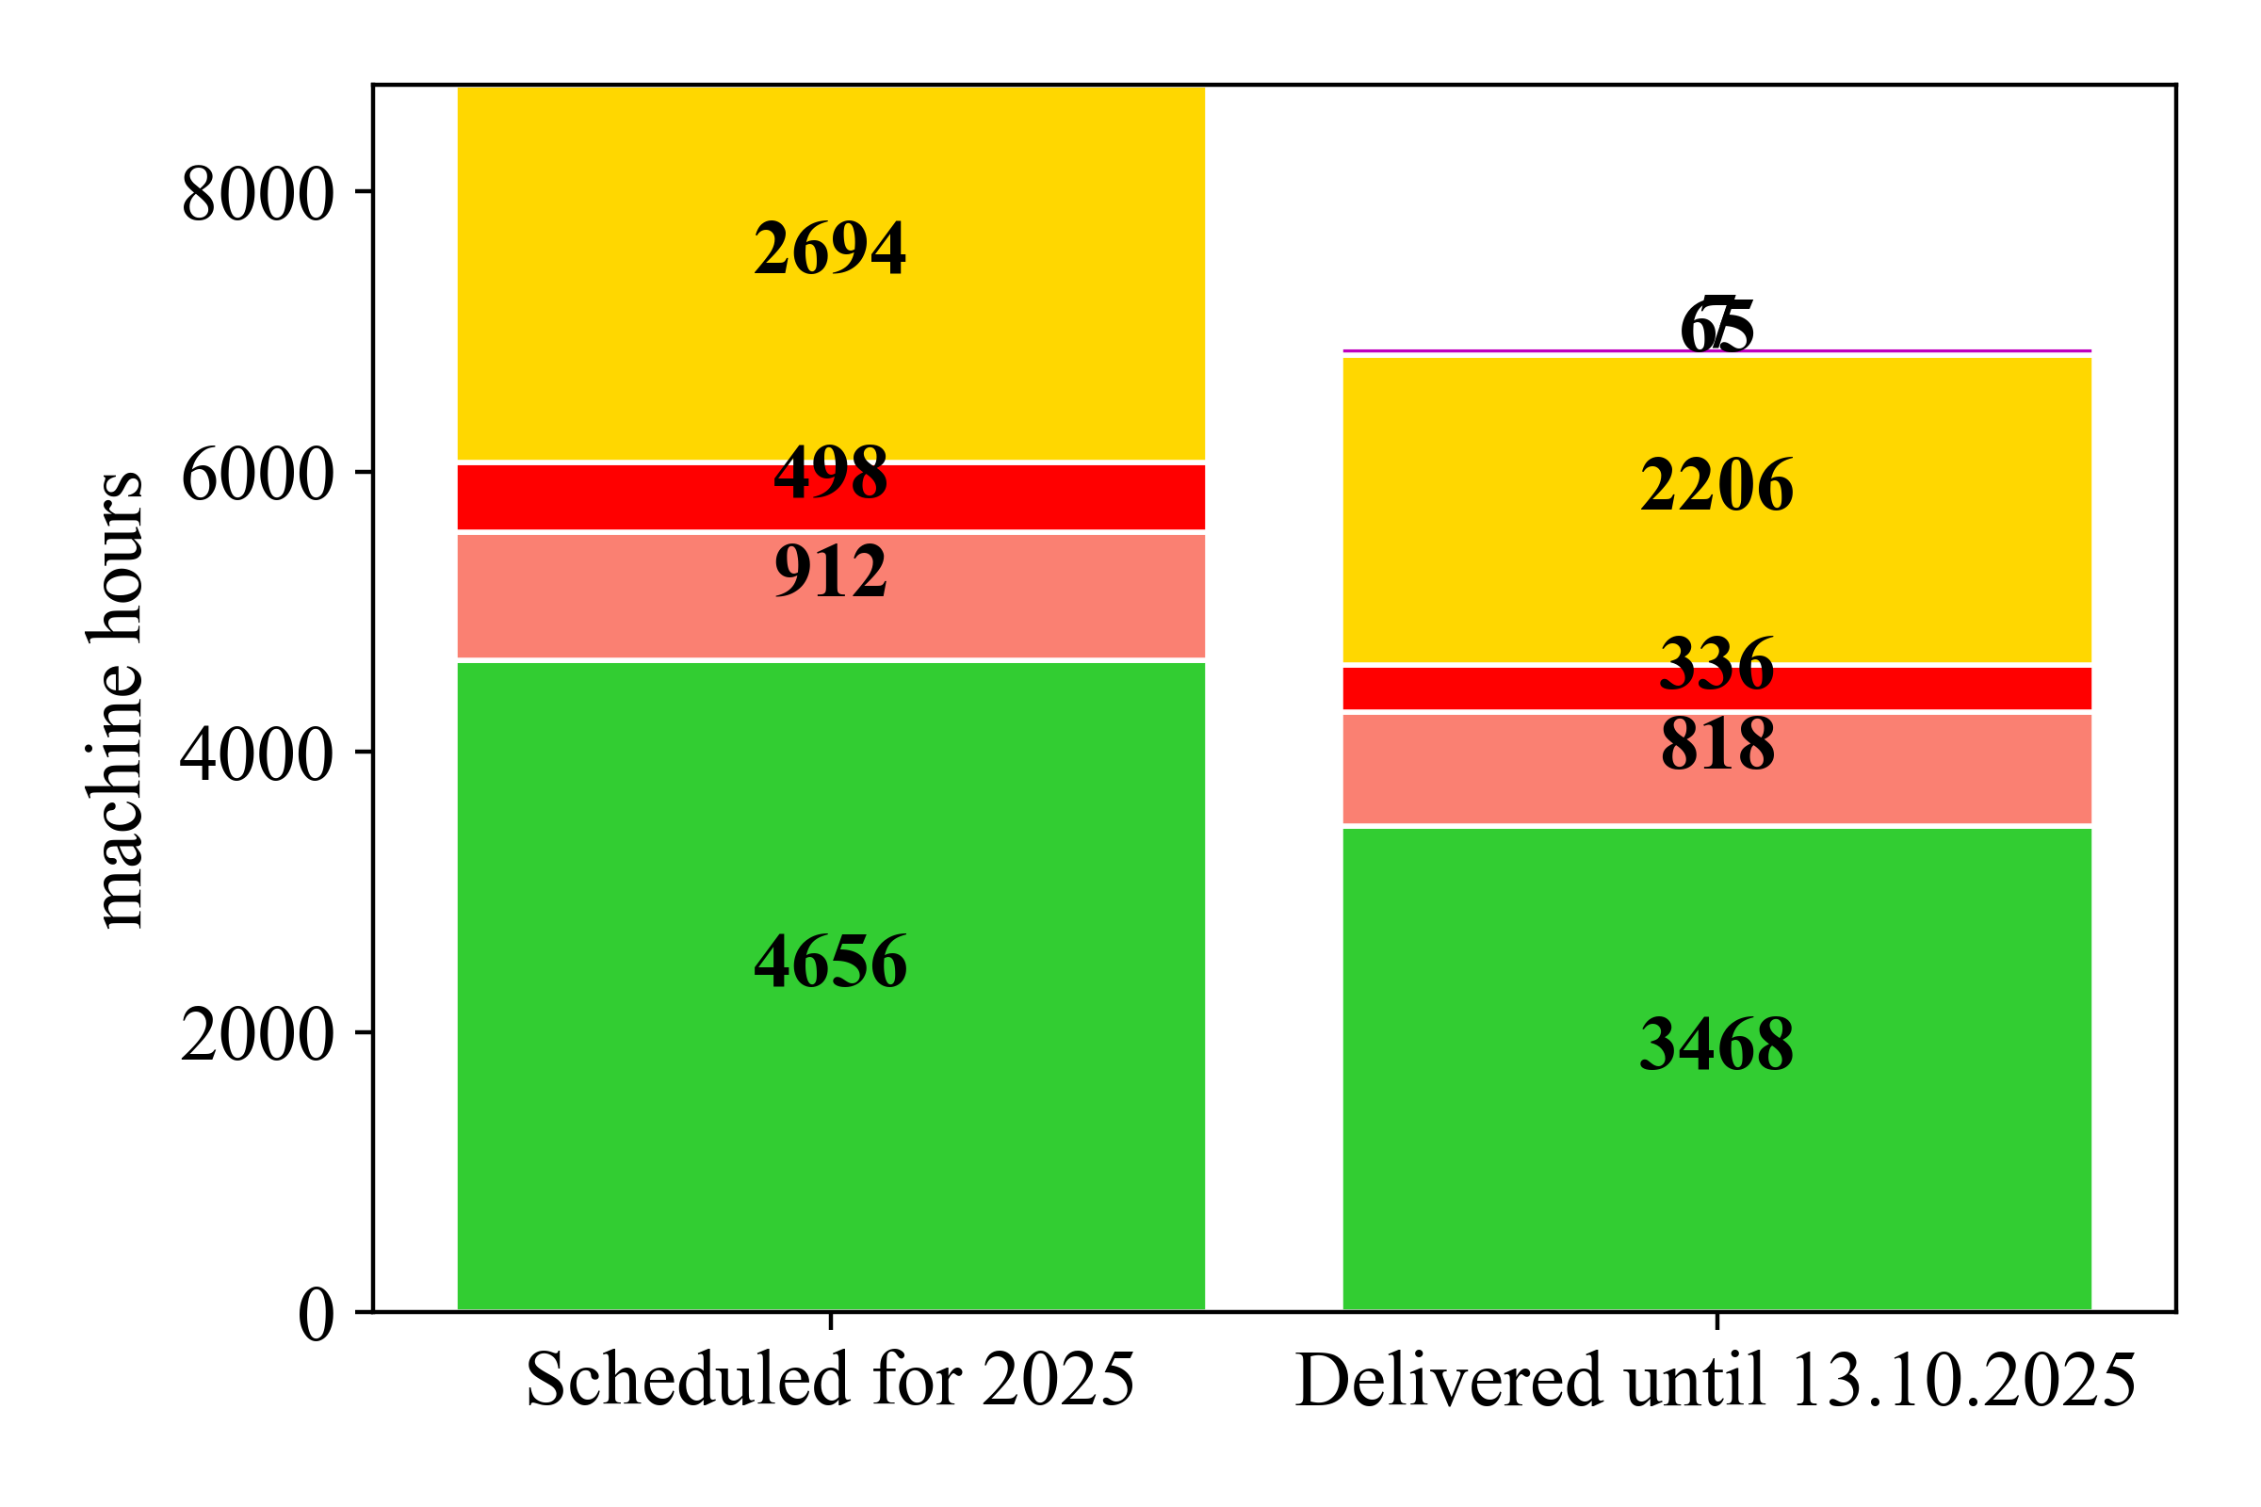
Already delivered 75% of user time scheduled for 2025 with 98.2% availability
MTBF of ~65h thanks to low general fault rate – in total 54 faults during user run
Machine Time Distribution in 2025 (as of 13.10.2025)
Fault in Test Run (7h)
Fault in User Run (65h)
65+7
Shutdown/
Maintenance
Machine Development
Test Run
User Run
 | Done | Target
Availability | 98.2% | 98%
MTBF | 65 h | 60 h
MTTR | 1.2 h | -
Notes:
2023

Slide 6
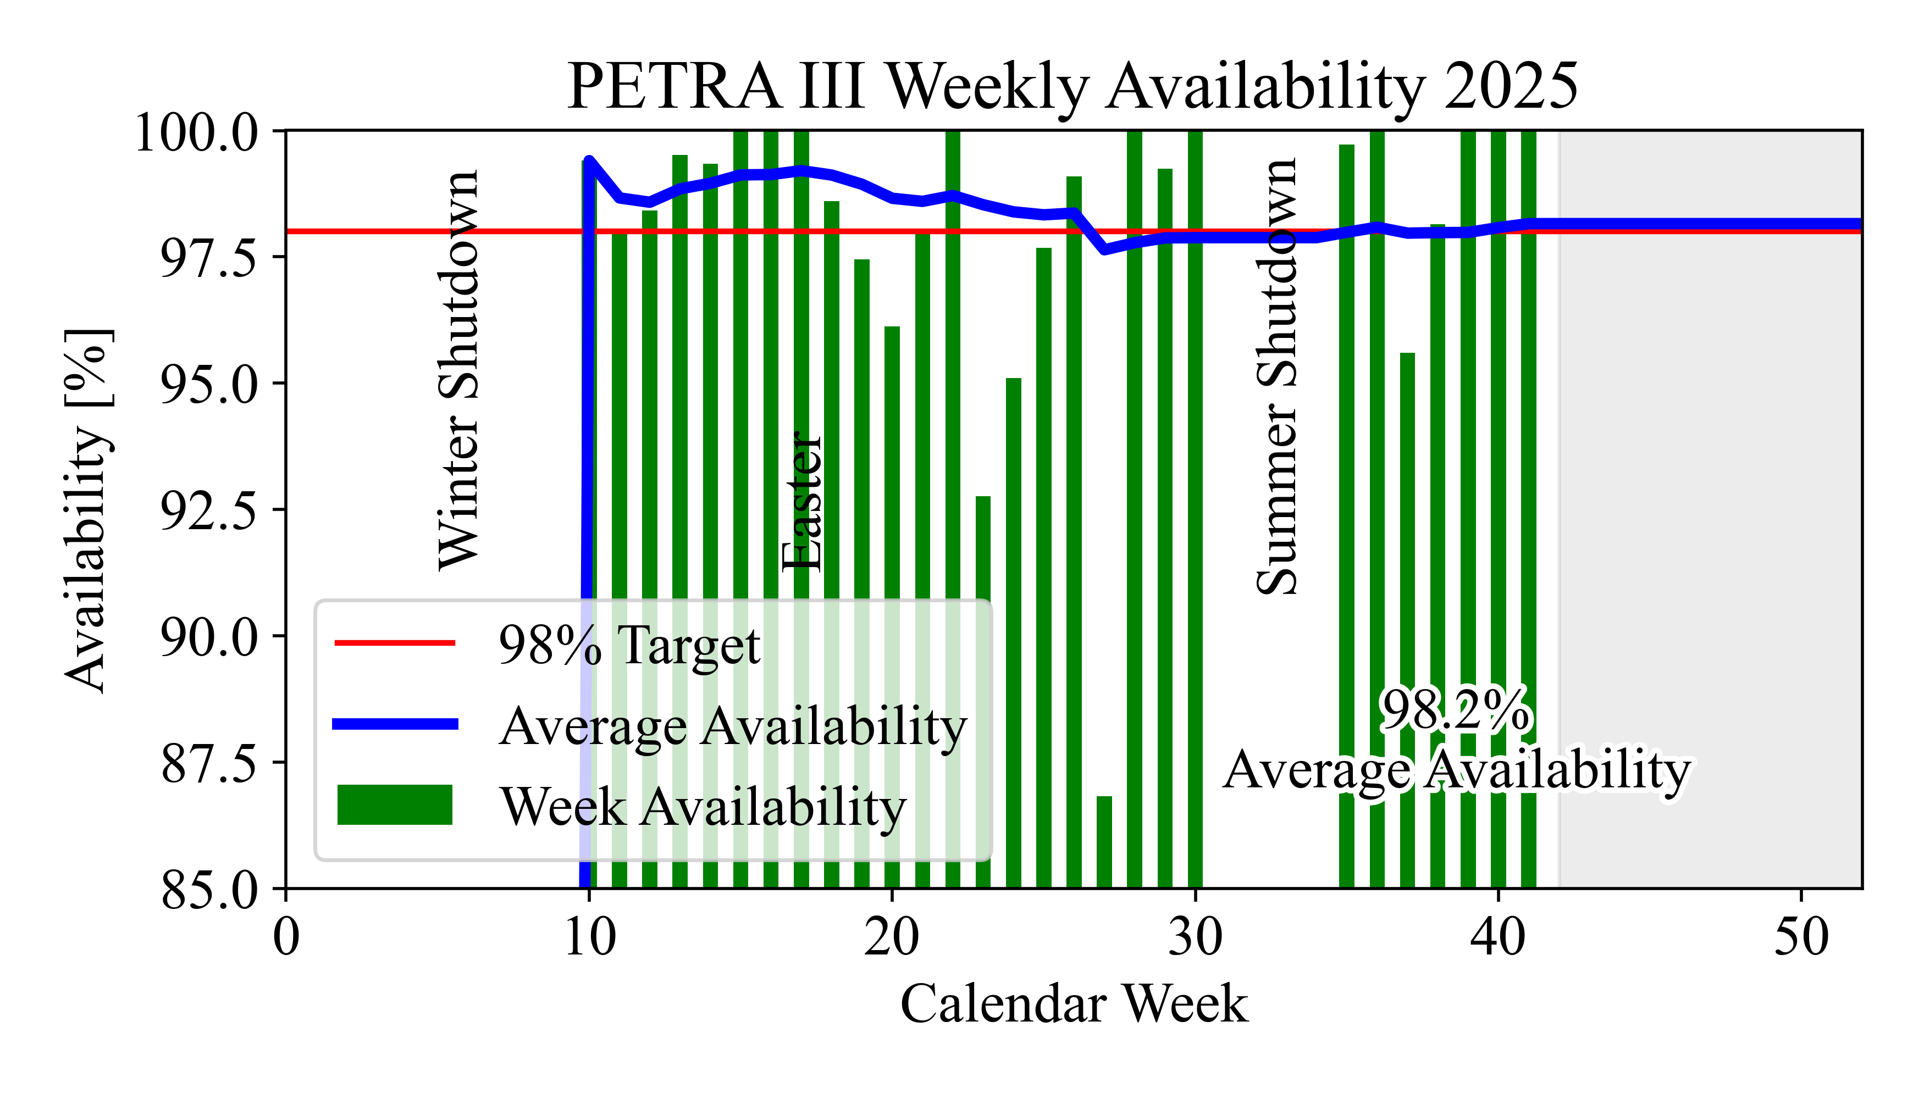
Stable availability around 98%
Major source of faults in 2025 were issues around the cooling water infrastructure
KW20/23/24
3 punctured water hoses of the same type
KW27
defect water filter polluted cooling water system around the whole ring
KW37
radiation damaged temperature sensor caused frequent beam dumps

Slide 7
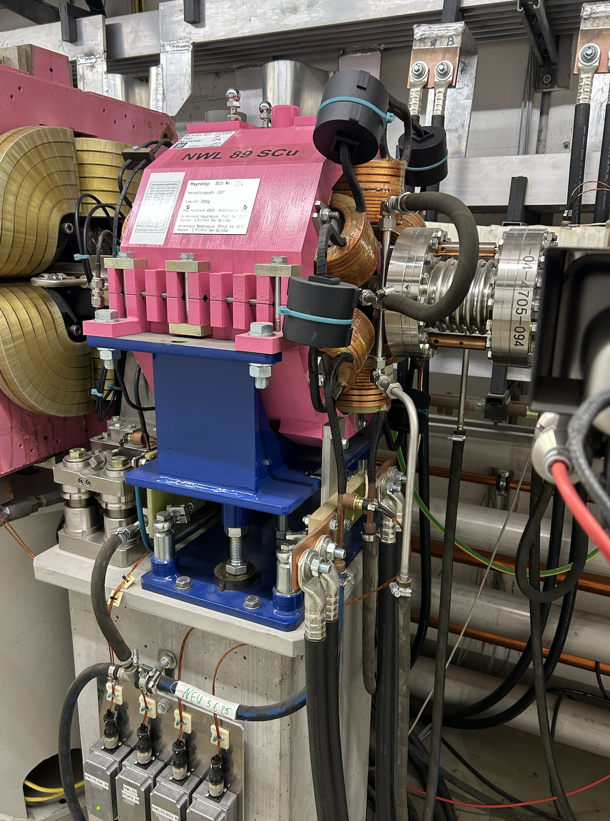
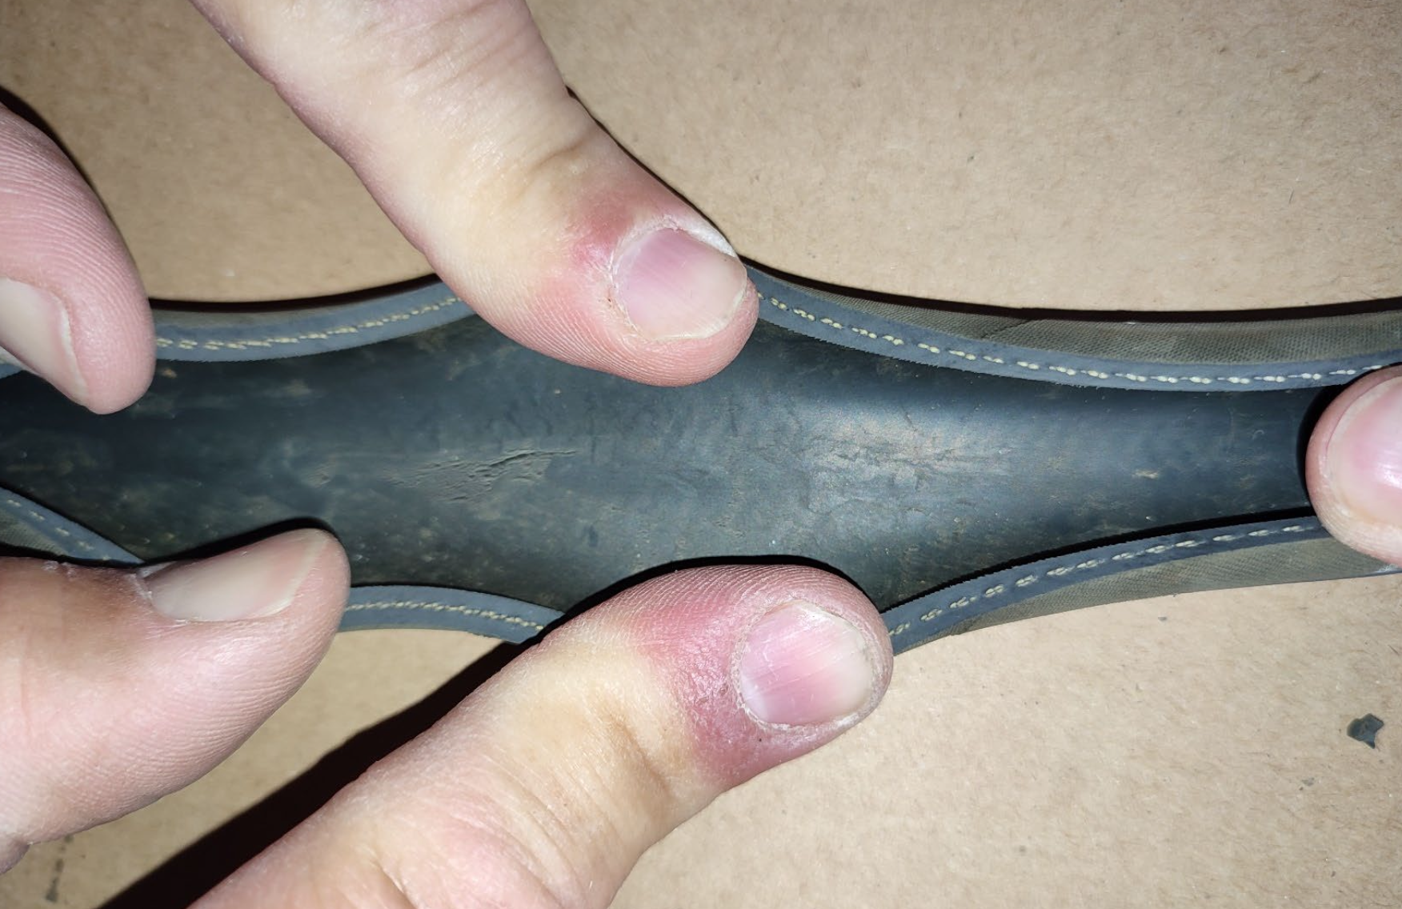
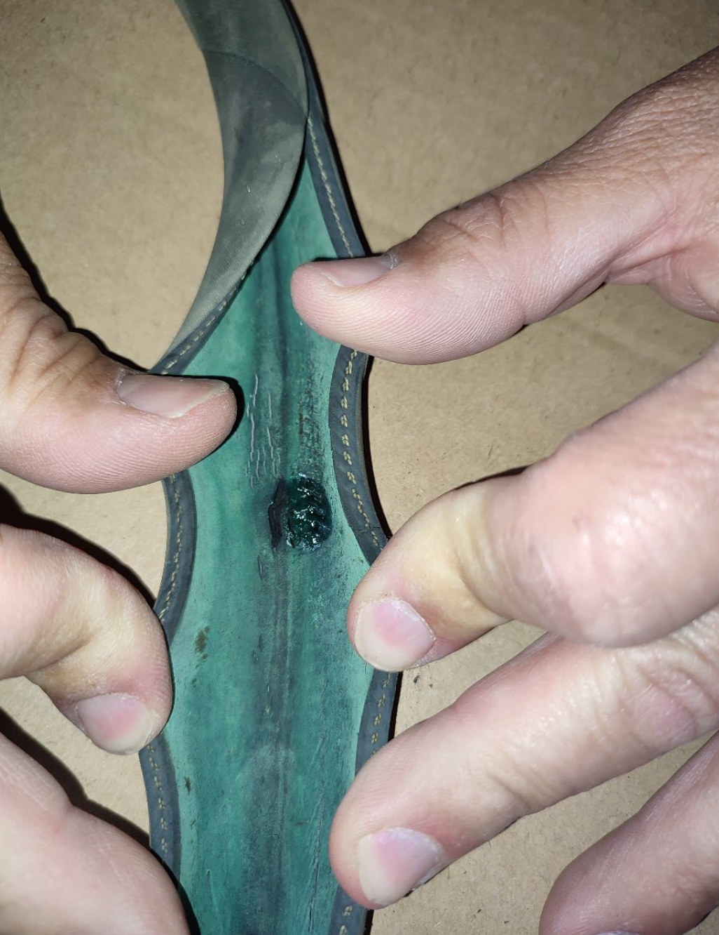
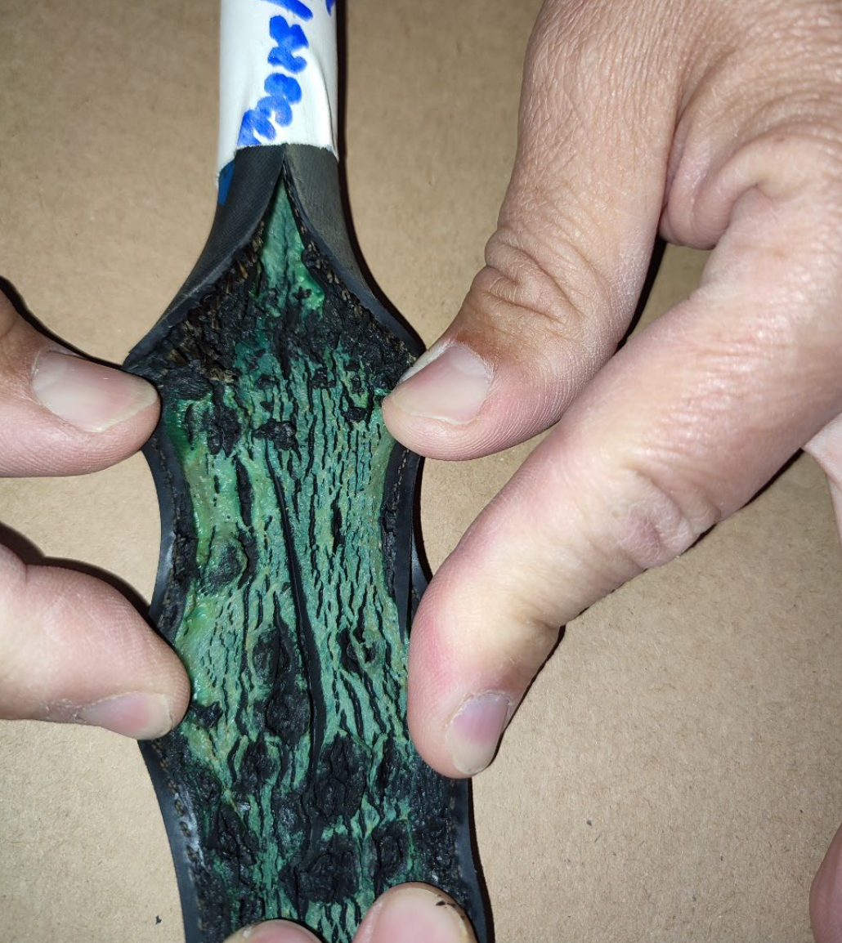
Series of broken water hoses – faster ageing due to higher water temperature
Water hoses on a particular position at all sextupoles in the copper-water circuit have been exchanged
3x water leaks during user run
All hoses of this position exchanged during summer shutdown
Most found to have the same symptoms
How it should look like
Inside covered by copper rust, point-like holes and cracked defects
Sextupoles of SCu type are operated at higher current
higher water temperature
higher stress on material
Samples of other locations on “hose tree” of SCu and SAl show good condition.
Always same piece of hose connecting the sextupole coils to the Cu-water circuit.

Slide 8
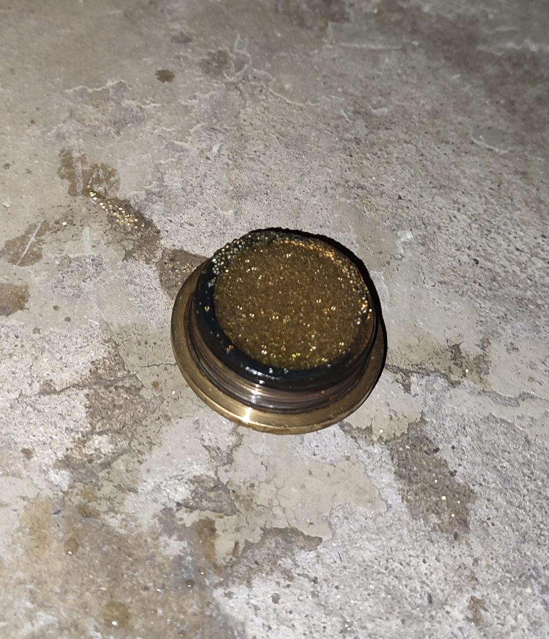
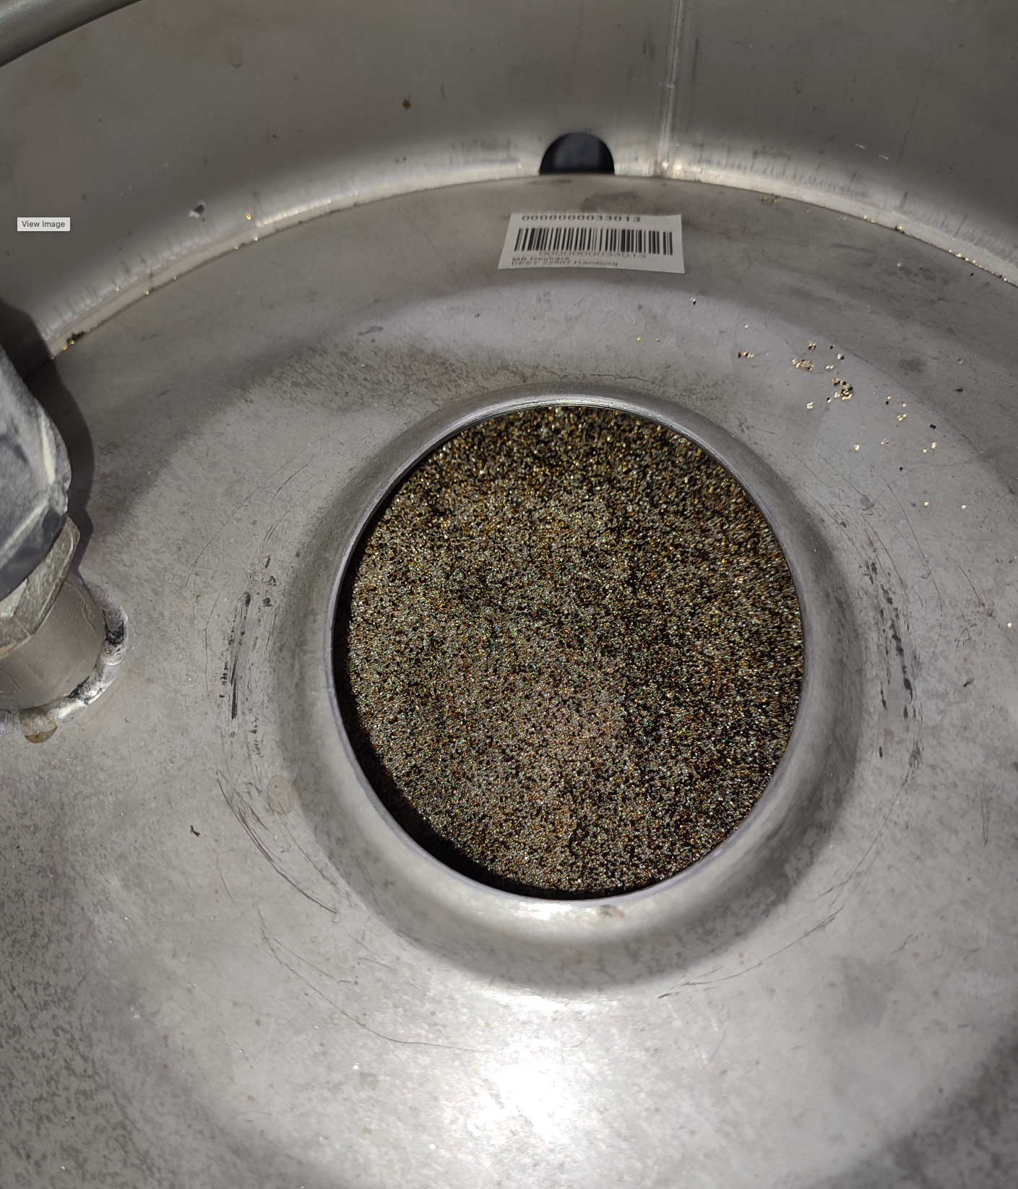
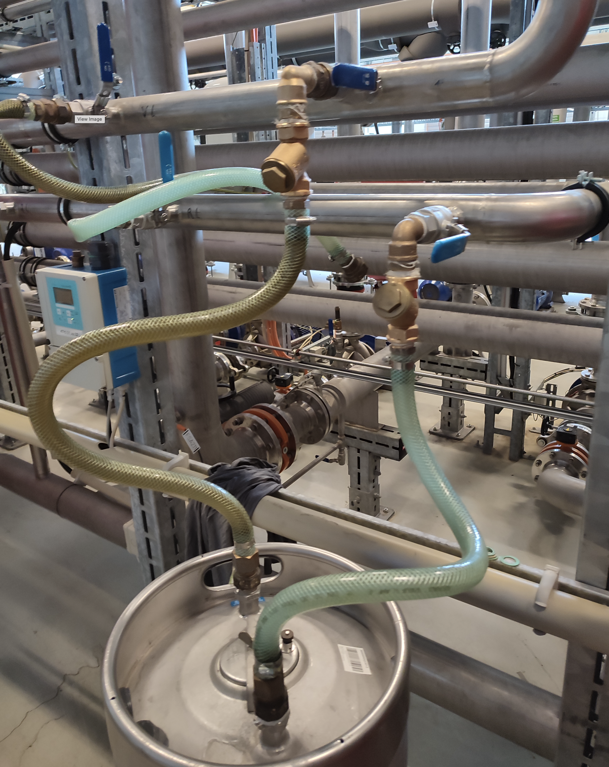
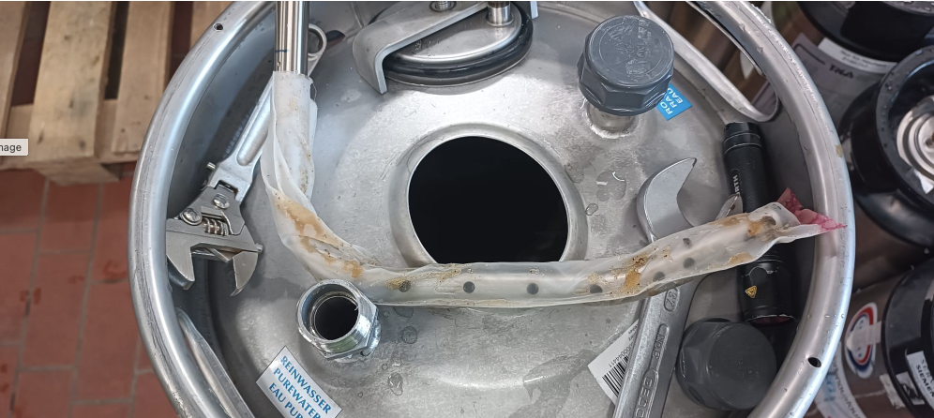
Broken water filter distributed resin particles over the full copper-water circuit
529 dirt traps had to be cleaned before machine operation could continue
Cleaning of all dirt traps in the tunnel and the power supplies that are connected to the Cu water circuit.
Filter exchanged.
Root cause analysis showed that mesh keeping the particles inside the filter had detached.
Installation of dirt traps on connections to filter.
Triggered further discussions on dirt trap concept for PETRA IV

Slide 9
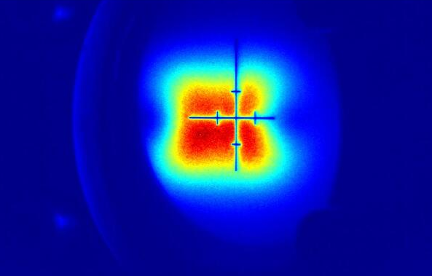
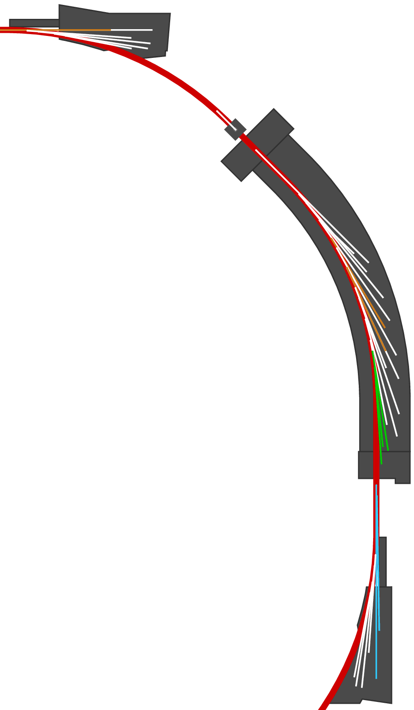
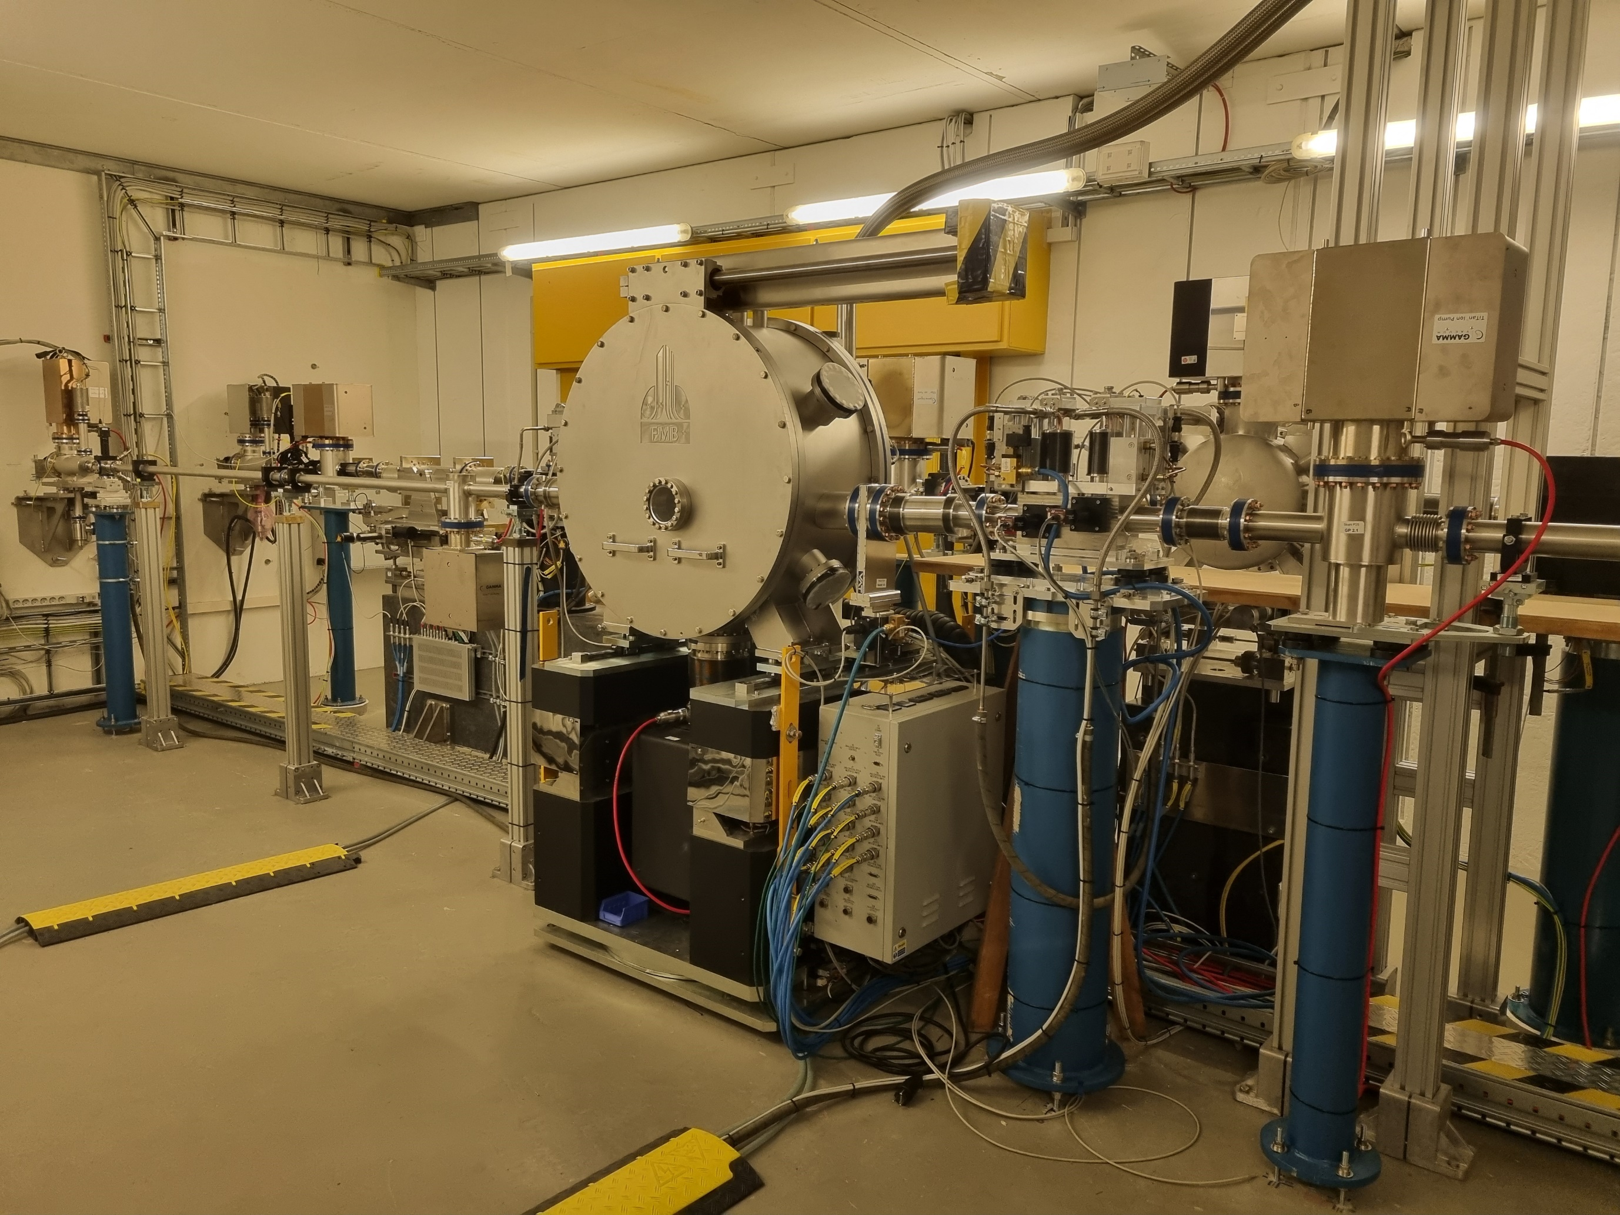
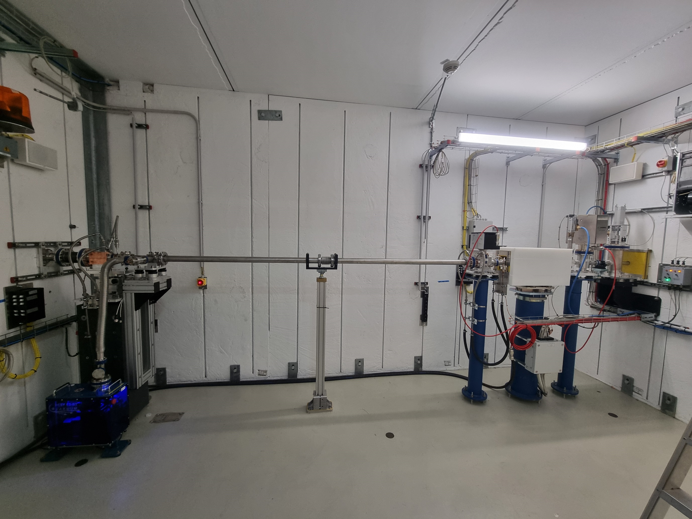

First light from PU25 undulator
The commissioning of the PU25 Undulator is finished – Beamline P25 is getting ready for first light
Partnership of industry and DESY Innovation and Technology Transfer (ITT) & Photon Science
Beamline for Applied Bio-Medical Imaging, Powder Diffraction and Innovation
P25
Optics Hutch 1:
P25 Double Crystal Monochromator (DCM)
Optics Hutch 2:
White– and mono-beam test station
<number>

Slide 10
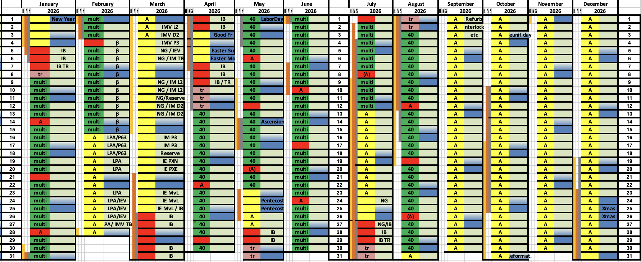
Approved schedule for 2026 with long shutdown and 3144 h user run
Many external boundary conditions influenced the scheduling
Main tasks during the shutdown:
Campus west: 110kV cable works
PIA renovation
Interlock renovation LINAC, DESY, PETRA
Urgent renovations in PETRA complex – mainly injectors
Wiggler section realignment
Re-routing of cables in PETRA North (prep. for PETRA IV)
LPA connection to LINAC II
Shutdown
Studies / Machine Development
Test Run
User Run

Slide 11
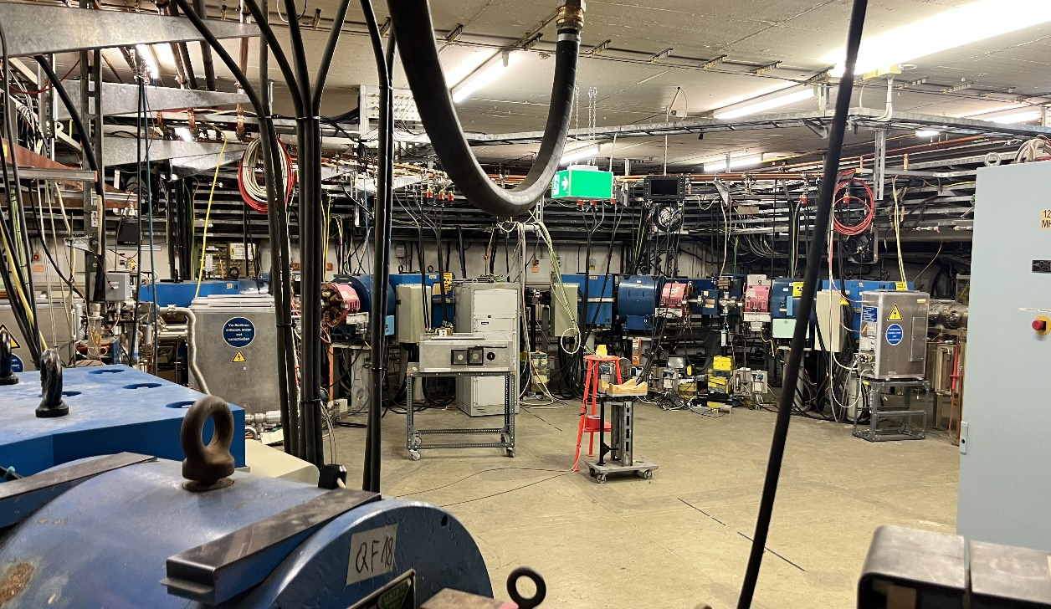
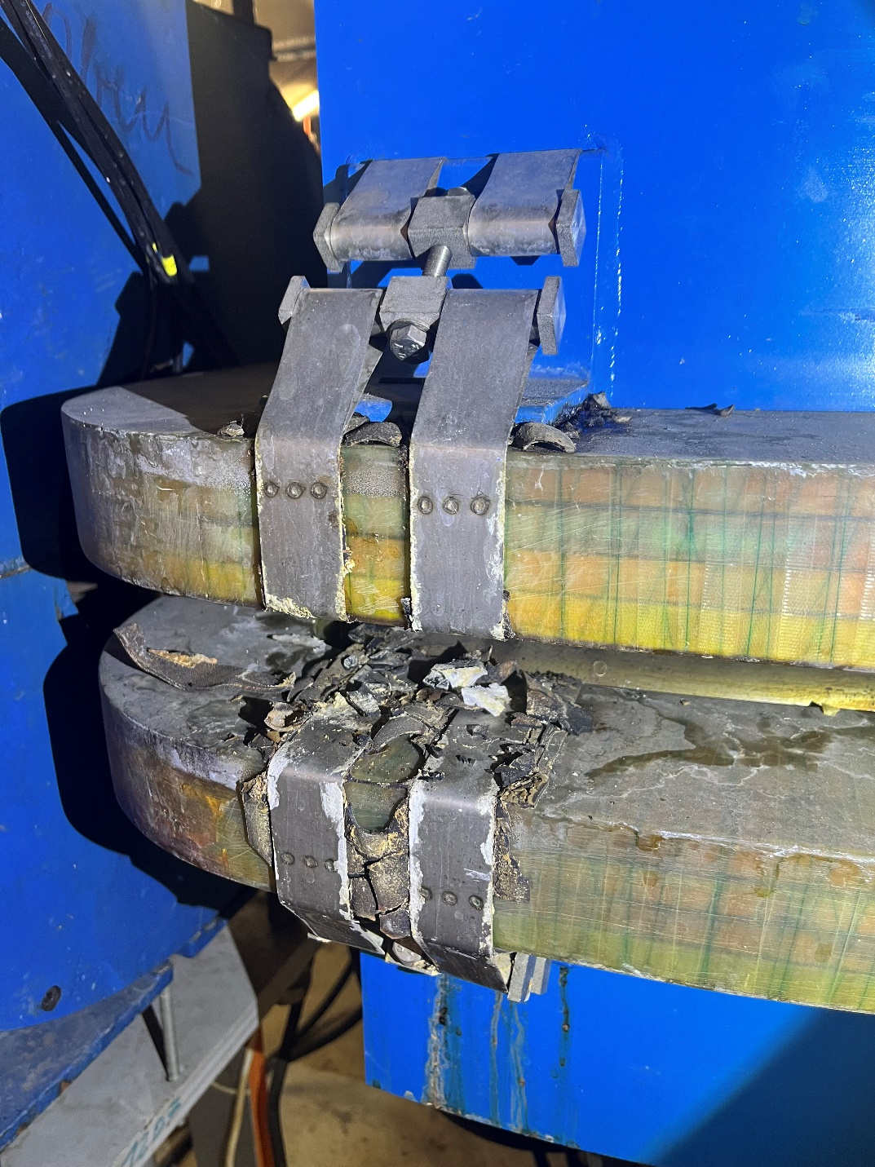
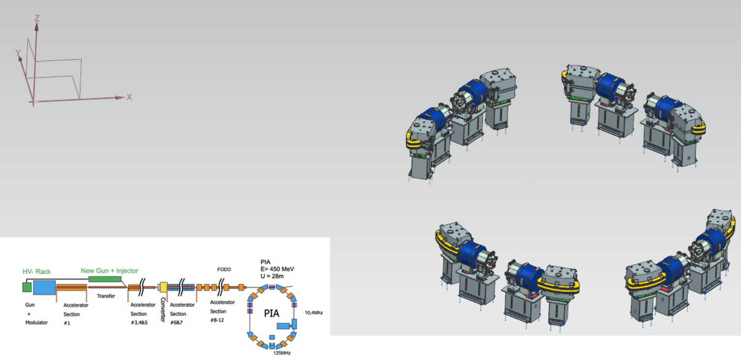
PIA refurbishment in long shutdown from Sept. 2026
Project long due, but delayed due to delivery issues
Core items to be renewed
New sextupoles and quadrupoles
Dipoles will be equipped with new coils
New BPM electronics
New vacuum chambers
General refurbishment of the hall

Slide 12
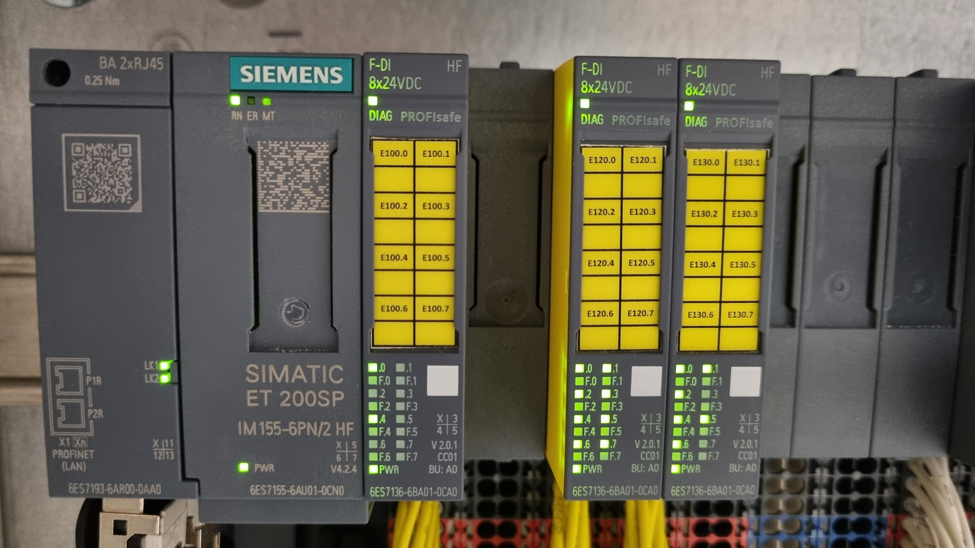
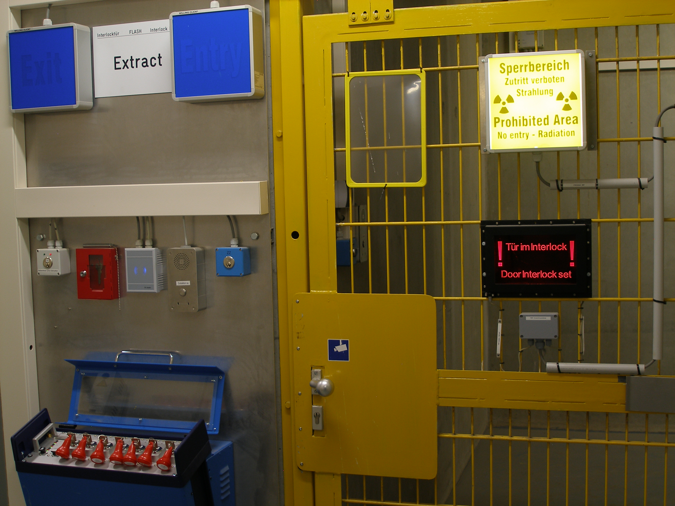
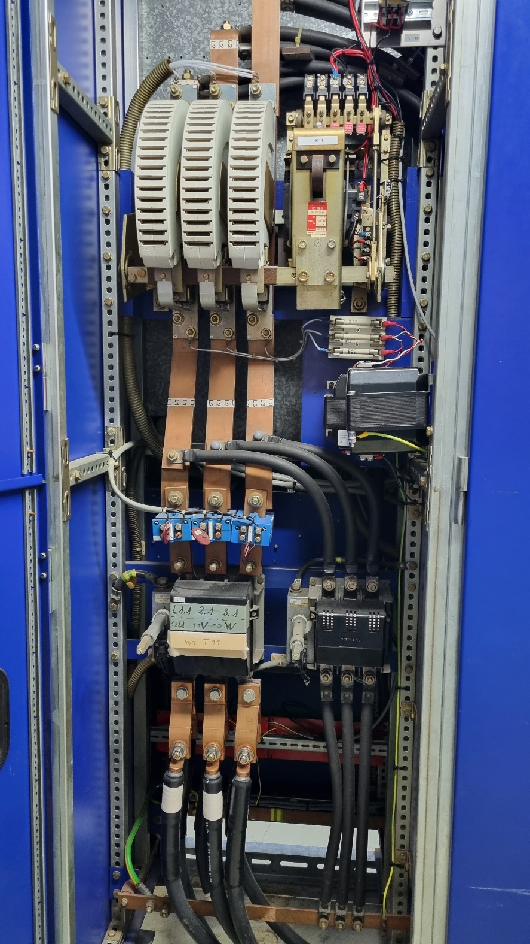
Refurbishment of the interlock system from Sept. 2026
Ensure continued safe operation of the PETRA III complex in compliance with current standards
Key safety components reach end of 20-year mission time in 2027
Demand to continue operation of PETRA III and the pre-accelerators until 2029
The personnel safety systems (PSS) at LINAC II, DESY II and RF safety interlock at PETRA III will undergo a comprehensive refurbishment.
Safety Interlock System
Ensuring fast switching off of the hazard source (electron beam, RF) in emergency situations.

Slide 13


Slide 14

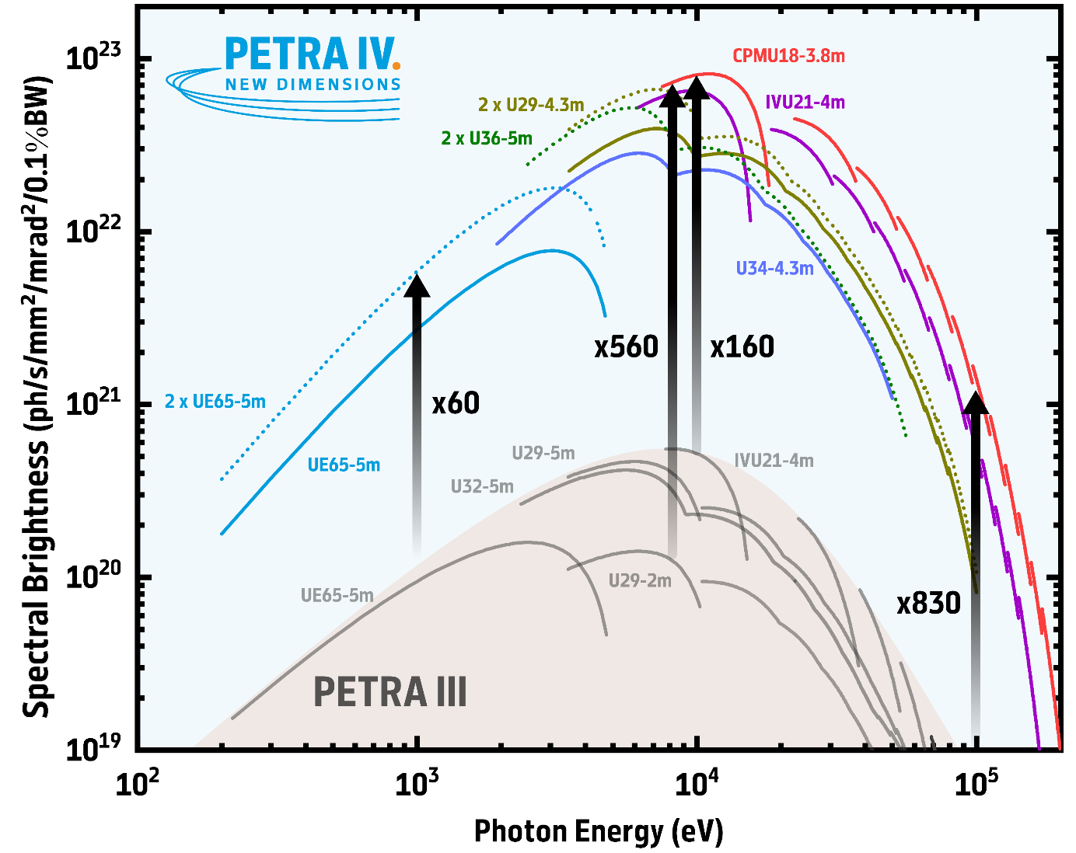

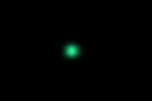
High-energy x-rays will be up to 800x brighter than at PETRA III
PETRA IV will run with round beams in full coupling operation
1 keV
10 keV
100 keV
PIII today
PIV
Photon source size – ideal imaging capabilities
Standard operation: full coupling
12 x 12 (pm.rad)² emittance
5 x 5 μm² source size
2.4 x 2.4 μrad² source divergence
PETRA IV brightness mode
1900 bunches , 4 ns spacing, 200 mA (1 nC per bunch)
PETRA IV brightness at 100 keV
higher than for 10 keV at PETRA III today!!
Courtesy of H. Reichert

Slide 15
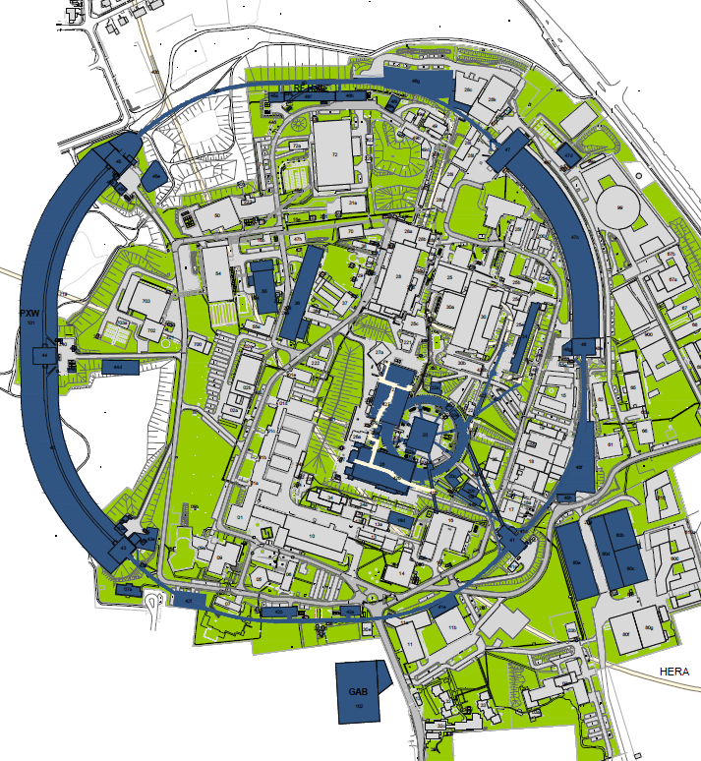
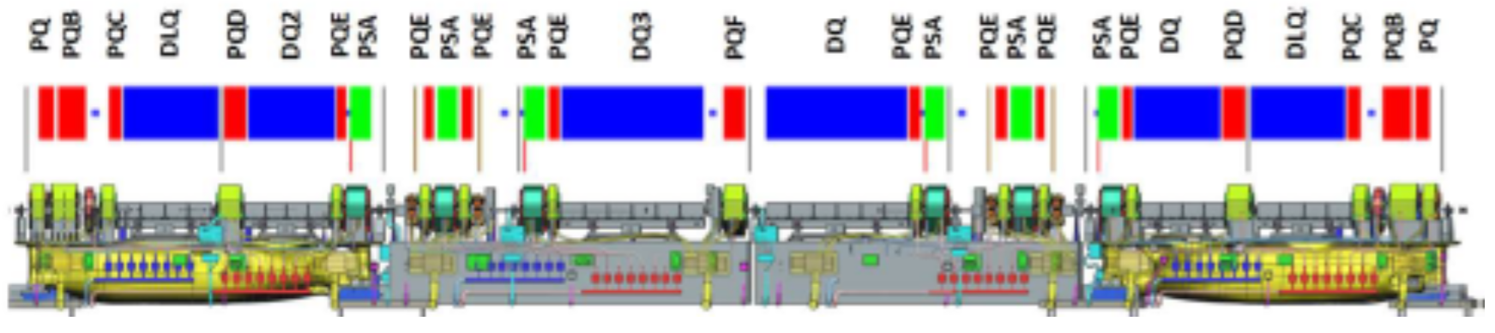
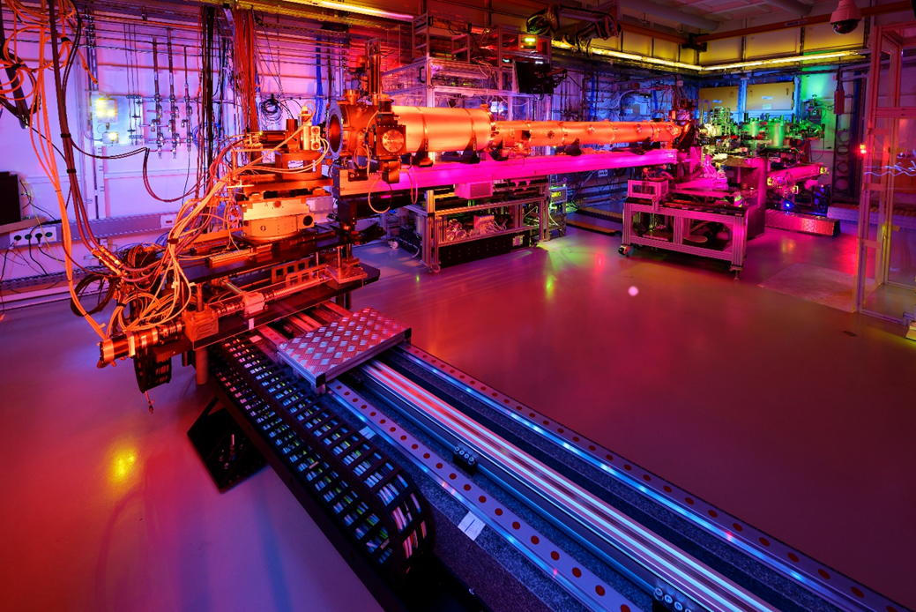
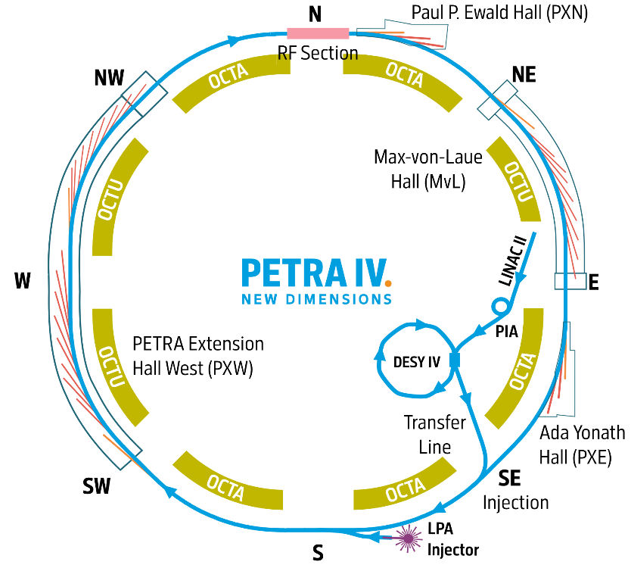
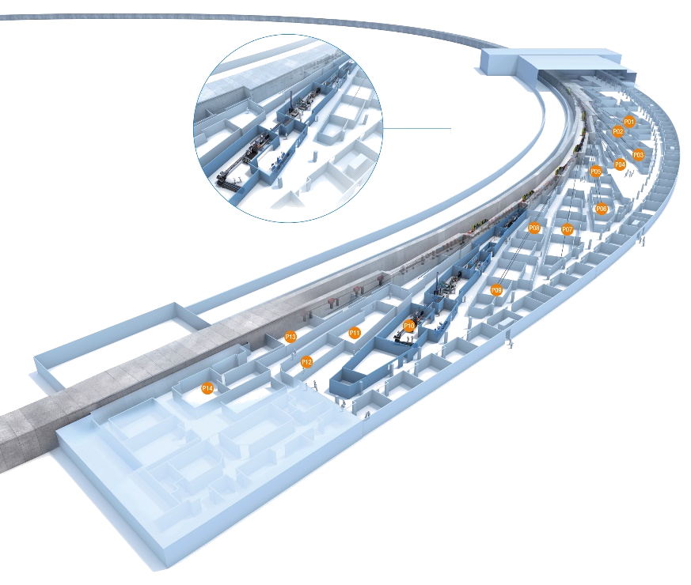
A new accelerator complex in an extended & refurbished infrastructure
Project pillars are the civil construction, accelerator complex and experimental facilities
Civil Construction and Infrastructure
Accelerator Complex
Experimental Facilities
Decommissioning of PETRA III
Construction of 2.3 km storage ring
Decommissioning of DESY II
Construction of DESY IV
New Laser-Plasma Injector
New RF System in the North
Demolition of 28 buildings
Construction of 49 buildings/structures
Refurbishment of 11 buildings
Extended/advanced technical infrastructure
31 new photon beamlines
60 new/refurb. endstations
62 new/refurb. laboratories
Courtesy of H. Reichert

Slide 16
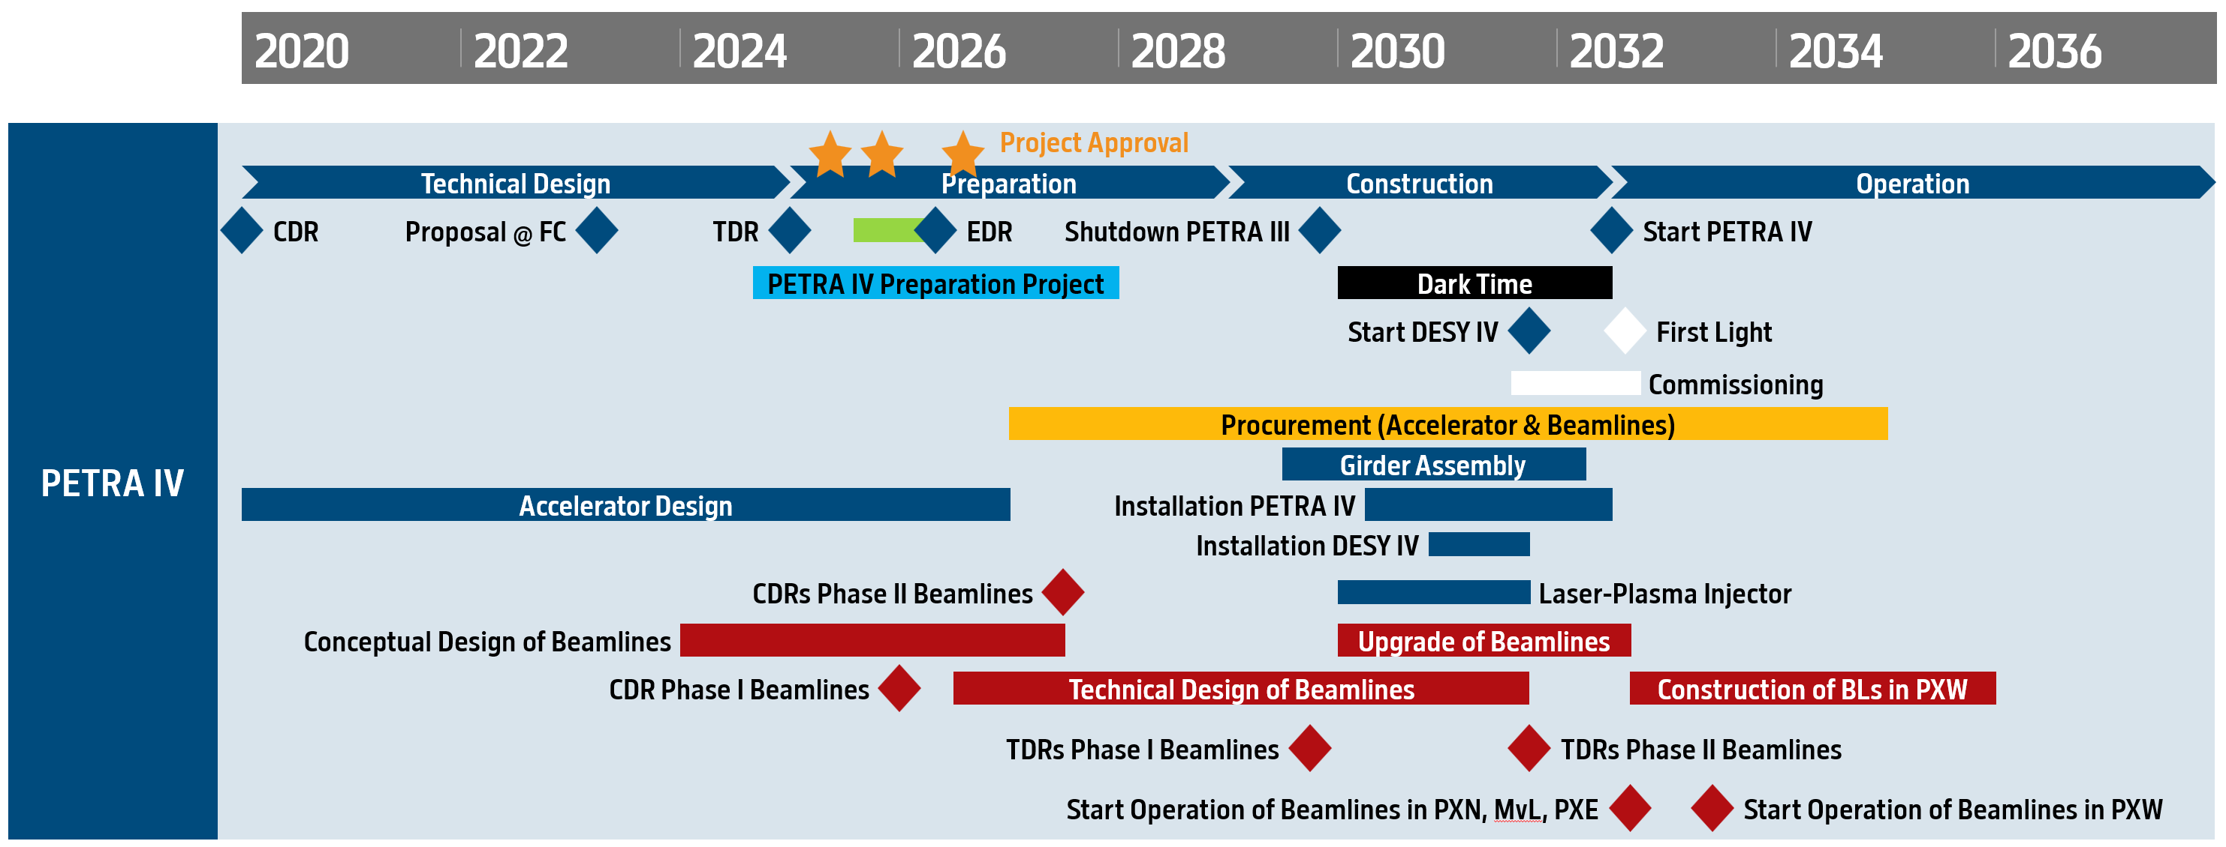
Project timeline fixed by (external) boundary conditions
July 2025: PETRA IV was classified as ”Research Infrastructure of National Importance"
PETRA IV put on roadmap priority list for large-scale research infrastructures in Germany
Project evaluation for final funding approval 2./3. Dec 2025
Shutdown max.
2.5 year (2030-32)
Start of operation 7/2032
with 19 beamlines
Today
Pre-project funding
44.4 M€
Courtesy of H. Reichert

Slide 17
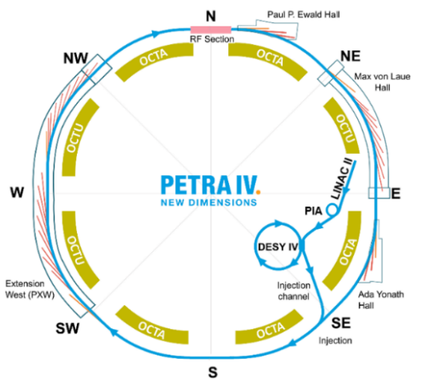
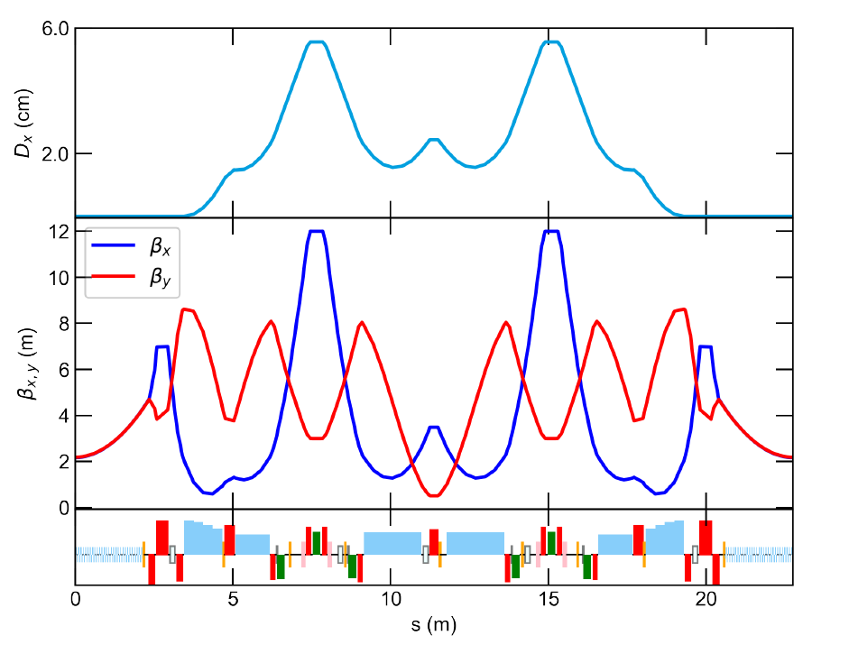
Fully symmetric 8-fold H6BA cell structure with 72 cells over 2.3km
Dynamic aperture sufficient for off axis injection (~8mm with errors – 6mm at injection point)
Momentum aperture sufficient for beam lifetime >10h (brightness mode)
Courtesy of R. Bartolini

Slide 18
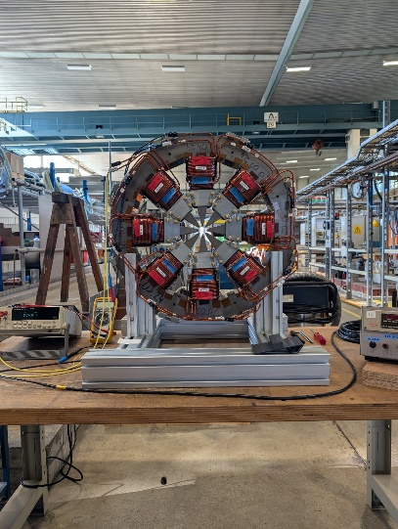
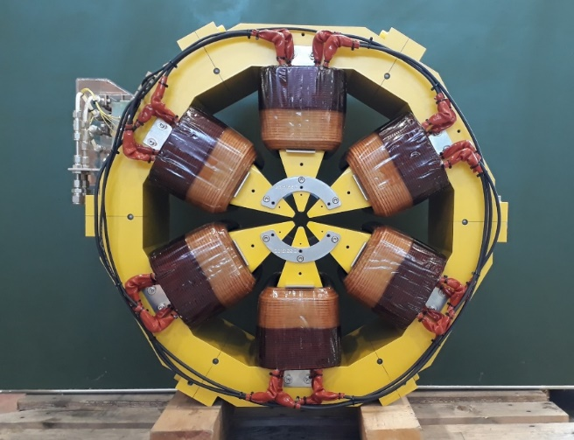
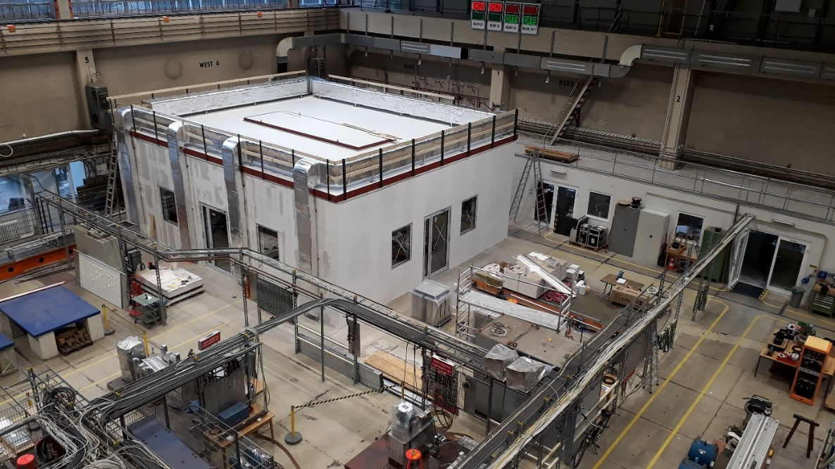
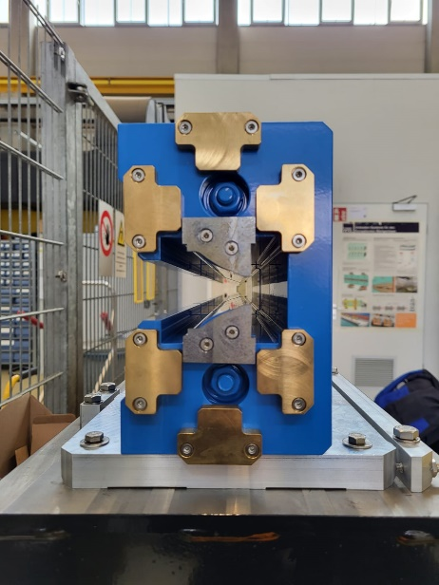
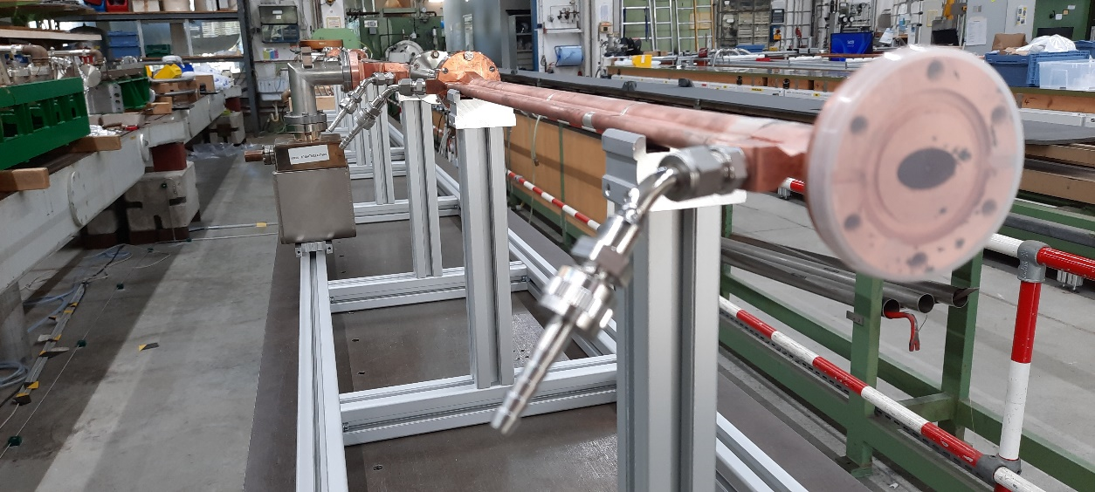
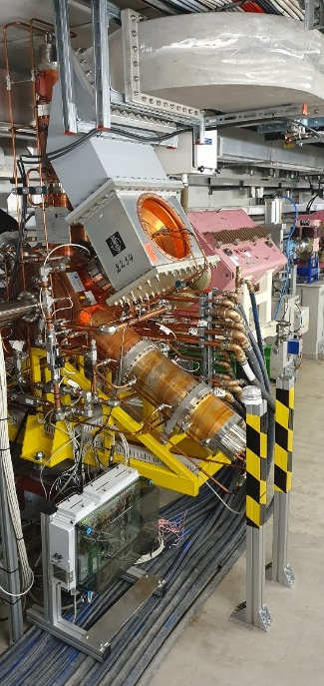
Prototypes for the main critical components are on site
A mock-up girder is been assembled with prototypes and dummy magnets
corrector
Sextupole
DLQ
RF: 3rd HC
Climatic cabin for magnetic measurements
RF: 500 MHz
Vacuum chamber for mock up girder
Courtesy of R. Bartolini

Slide 19
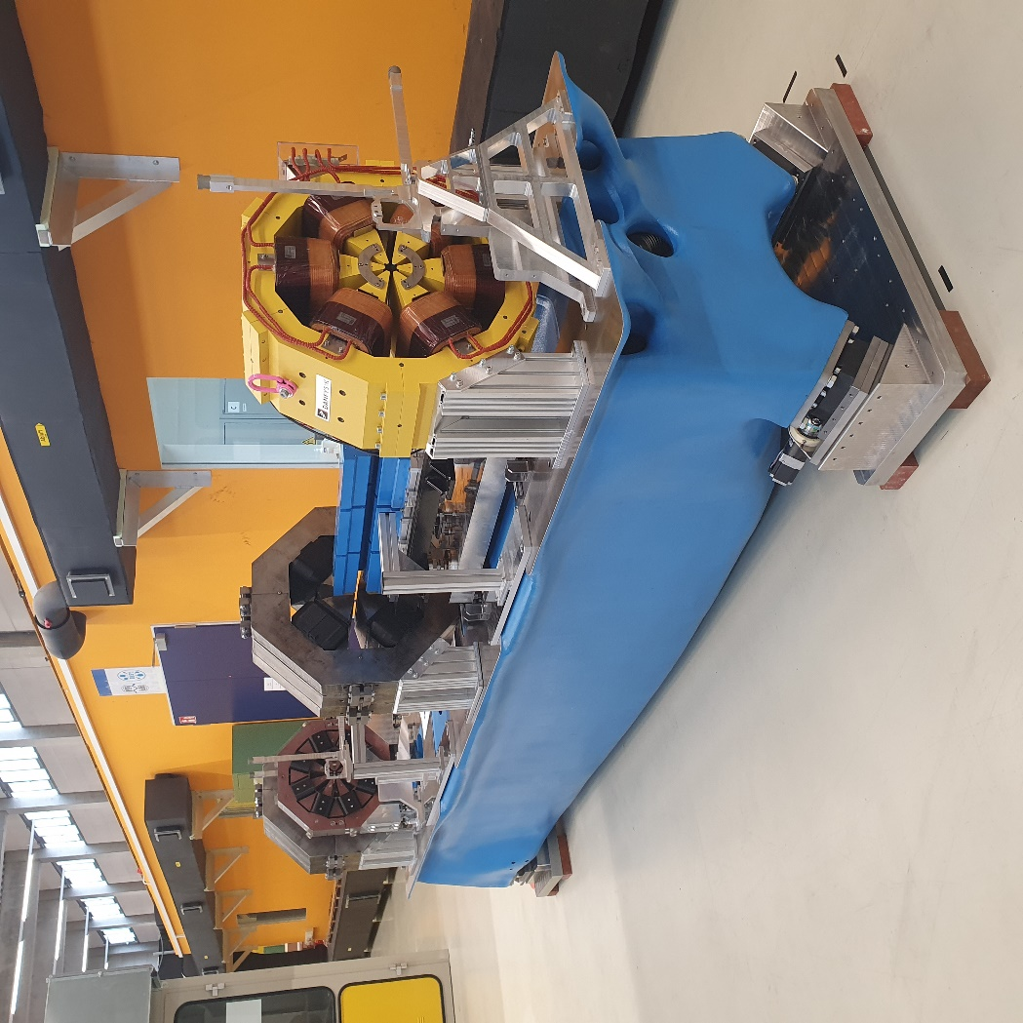
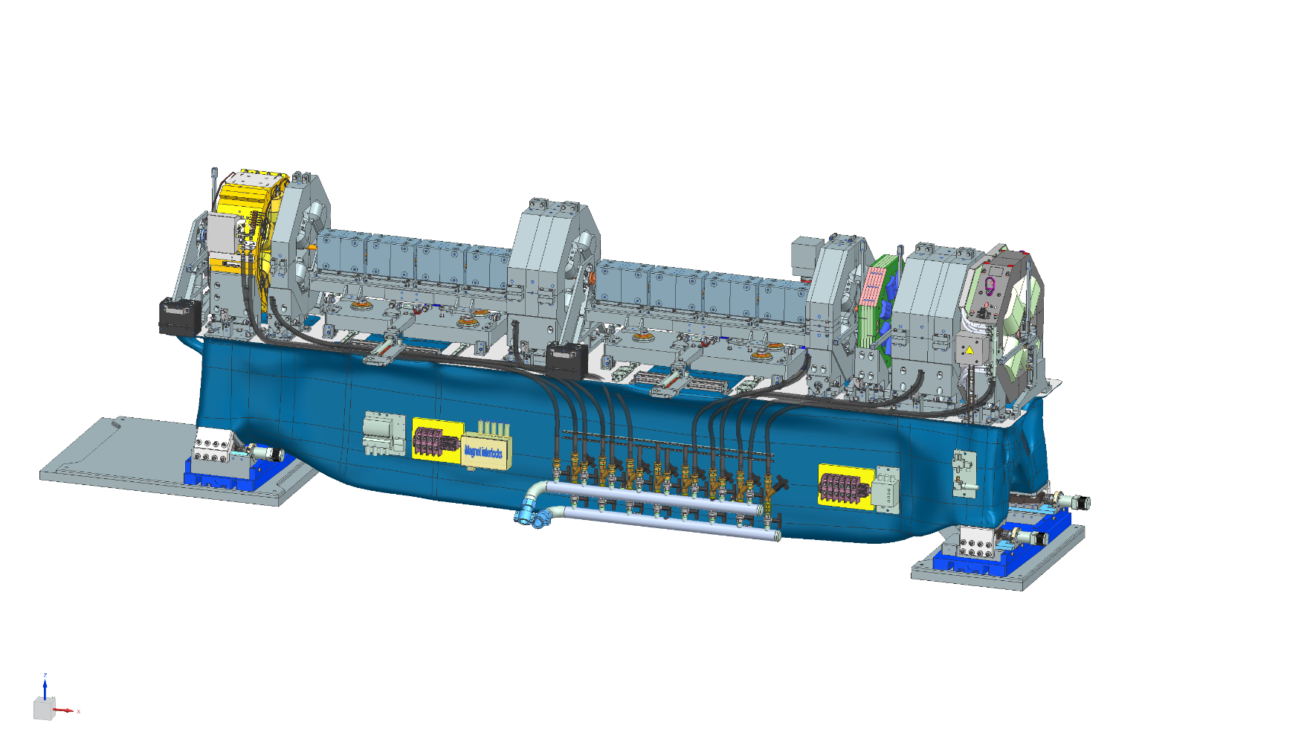
Mock-up girder is been assembled with prototypes and dummy magnets
Prototype girder is now in the testing phase
Magnets, vacuum equipment, diagnostics will be assembled, aligned and tested on girders
PETRA IV will have 288 girders
Courtesy of R. Bartolini

Slide 20
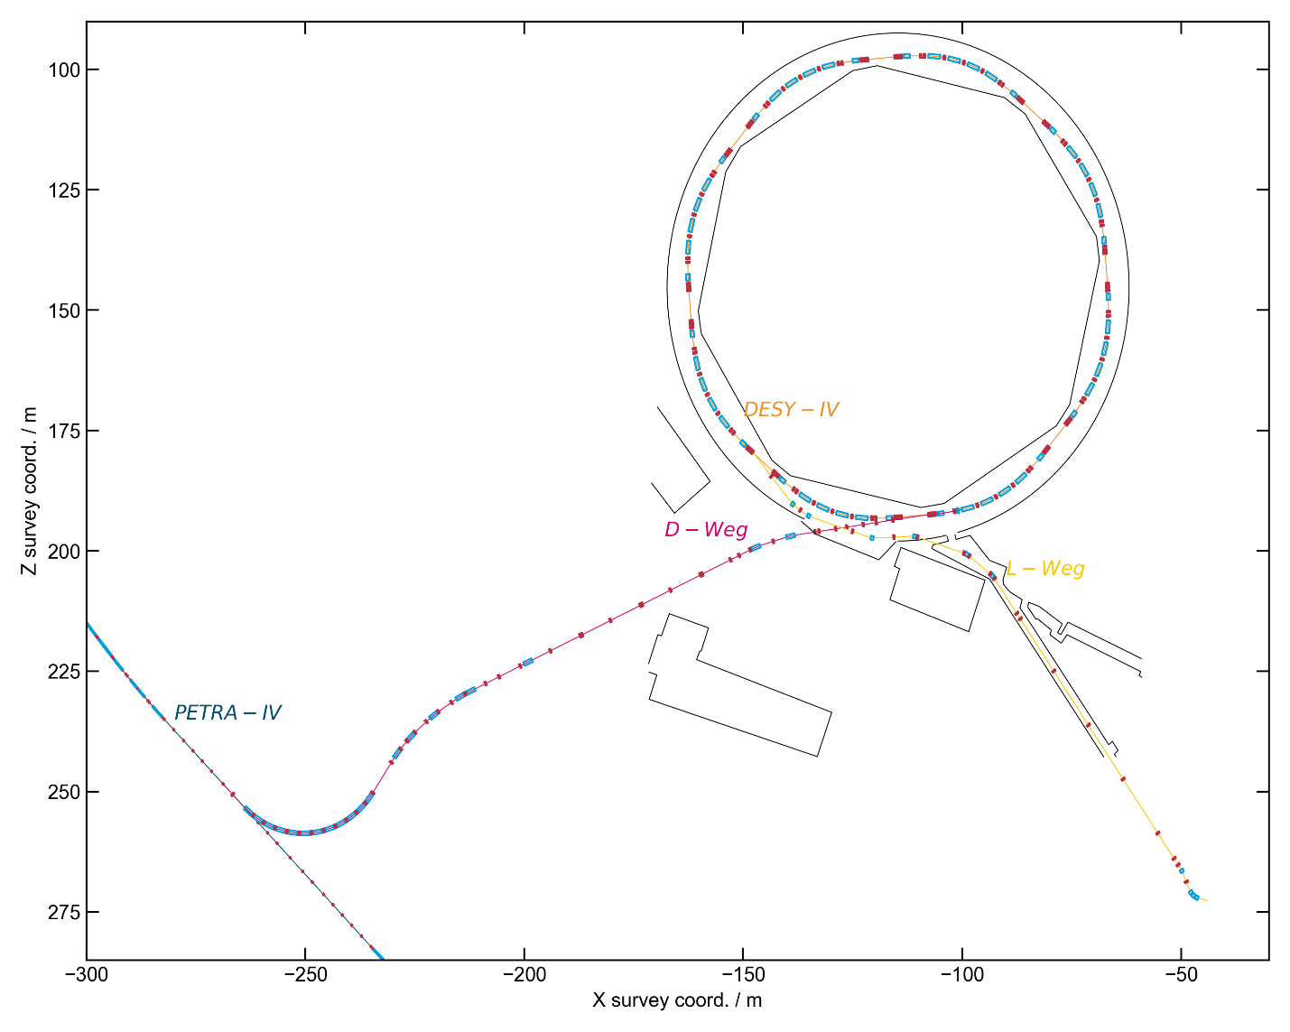
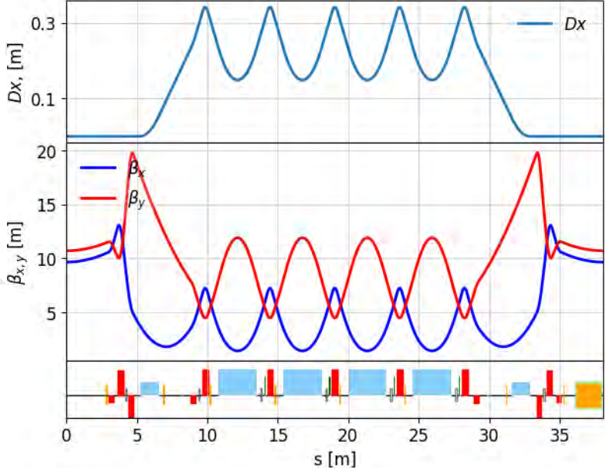
Injector baseline: construction of a new booster - DESY IV
with lower emittance than the existing DESY II (from 335 nm to 20 nm)
b35
b17
Courtesy of R. Bartolini

Slide 21
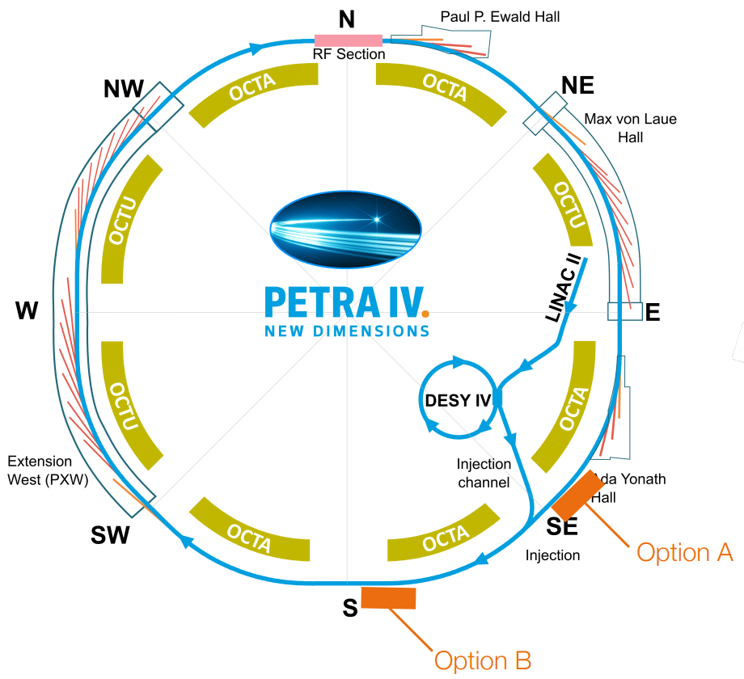
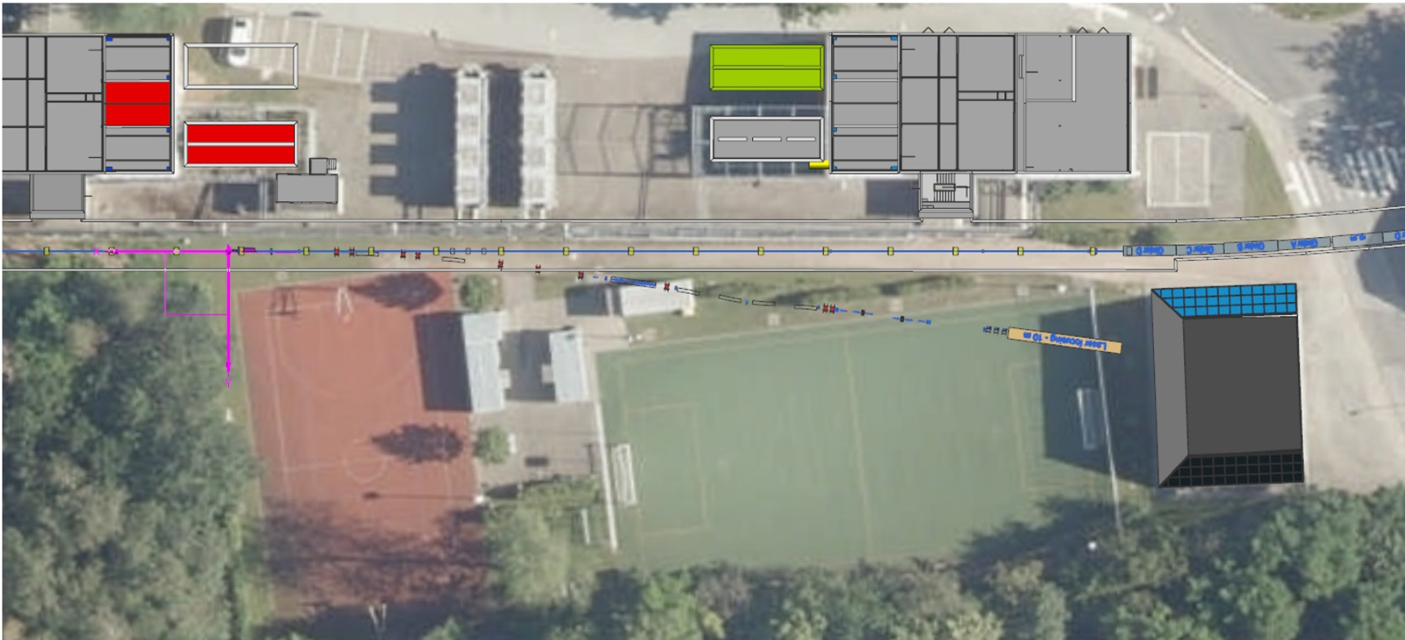
Laser Plasma Accelerator (LPA) as alternative injector option
Integration of the LPA into the storage ring straight sections is been studied
The LPA injector can sustain filling the ring and top-up operation with a charge of 250 pC at 10 Hz rep rate
Bird view of Option B
Courtesy of R. Bartolini

Slide 22
Conclusion
The PETRA III complex operates with an availability of 98%, while aging effects become more and more noticeable.
A 6-month long shutdown is planned to start in September 2026, with the major task to refurbish PIA and the interlock system in the injector chain.
PETRA IV got accepted for the national roadmap priority list
Evaluation for final funding approval in December 2025
Project start 2027 – with 2.5 years of dark time in 2030-2032

Slide 23
Thank you for your attention

Slide 24
Full Coupling: new PETRA IV standard operating mode
PETRA IV brightness mode
1900 bunches 4 ns spacing 200 mA (1 nC per bunch)
standard mode: emittance 20 pm; 20% coupling (17pm/3pm); energy spread 0.1 %
 | β_{x} (m) | β_{y} (m) | σ_{x} (μm) | σ_{x}‘ (μrad) | σ_{y} (μm) | σ_{y}‘ (μrad)
Standard straights | 2.2 | 2.2 | 6.1 | 2.8 | 2.7 | 1.2
Long straights | 4.0 | 4.0 | 8.2 | 2.0 | 3.7 | 0.9
Long straight north | 5.0 | 5.0 | 9.1 | 1.8 | 4.1 | 0.8
All other optics functions are zero: α_{x} = α_{y} = D_{x} = D_{x}’ = D_{y} = D_{y}’ = 0
full coupling mode: emittance 20 pm; 100% coupling (12pm/12pm); energy spread 0.1 %
 | β_{x} (m) | β_{y} (m) | σ_{x} (μm) | σ_{x}‘ (μrad) | σ_{y} (μm) | σ_{y}‘ (μrad)
Standard straights | 2.2 | 2.2 | 5.1 | 2.3 | 5.1 | 2.3
Long straights | 4.0 | 4.0 | 6.9 | 1.7 | 6.9 | 1.7
Long straight north | 5.0 | 5.0 | 7.7 | 1.5 | 7.7 | 1.5

Slide 25
Michaela Schaumann
MPE
Michaela.Schaumann@desy.de
0049 40 8998 1769

