Slide 1
Status of Diamond Light Source and the Diamond-II Upgrade
Richard Fielder
on behalf of the Diamond team
33rd European Synchrotron Light Source Workshop
30/10/2025

Slide 2
Talk Outline
Diamond Status:
  Operations summary
  SLED operation
  IDs
  Solar installation
Diamond-II Status:
  Project status
  Vacuum
  Magnets
  Stripline testing
  Beam abort system
  IDs
  Diagnostics
  Lattice optimisation
Conclusions
R. Fielder, Diamond Update, ESLS 2025, 30/10/2025

Slide 3
Diamond Operations
R. Fielder, Diamond Update, ESLS 2025, 30/10/2025

Slide 4
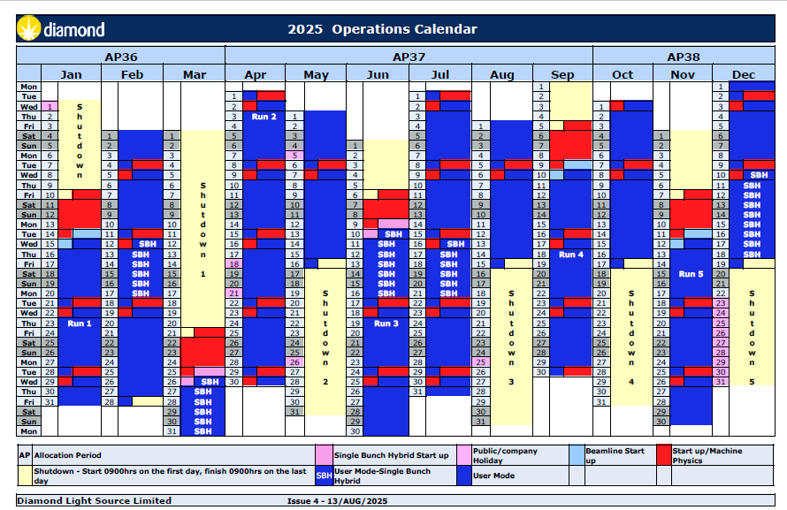
Diamond Operations
Diamond is UK’s national synchrotron radiation facility
Operational since January 2007
Several operational modes on offer, only standard and hybrid requested by beamlines in last year:
Standard Fill (900 bunch)
Hybrid mode (686+1 bunch)
156 bunch mode (timing)
THz low-alpha
Short-pulse low alpha
R. Fielder, Diamond Update, ESLS 2025, 30/10/2025

Slide 5
Diamond Operational Statistics
From Run 5 2024 – Run 4 2025 inclusive
Three trip free weeks (machine day to machine day). 6 Uptimes >100 h.
24 uptime periods >72 hours (ignoring MD and SD)
Longest Uptimes: 410 h, 382 h, 323 h and 291 h at end of Run 4, 2025.
MTBF on downward trend due to RF issues, mixture of aging equipment faults and D-II preparation work.
Courtesy V. Winter
R. Fielder, Diamond Update, ESLS 2025, 30/10/2025

Slide 6
Diamond Operational Statistics
Courtesy V. Winter
R. Fielder, Diamond Update, ESLS 2025, 30/10/2025

Slide 7
Diamond Operational Statistics
Major events affecting downtime in last year:
Impact | Summary | Downtime (hrs)
Beam trip | Master oscillator failure | 8.1
Beam trip | Beam instability – vertical instability in high charge hybrid bunch | 5.1
Beam trip | K11 major water leak in optics hutch | 4.8
Beam trip + beamtime delay | BOBL (PSS) failure, recovery delayed due to RF conditioning | 4.7
Beam trip | MPS PLC failure | 4.3
Beam trip | Valve crate failure | 4.1
Beam trip | Cavity 3 vacuum trip | 3.4
General Category | Total Downtime /h | # Trips | # Delays
SRRF CAVITY | 34.81 | 22 | 2
TMBF / Instability / SETUP | 11.65 | 1 | 4
PLC | 11.35 | 4 | 0
IOT | 11.23 | 7 | 0
Master Oscillator^{[1]} | 10.78 | 2 | 0
^{[1]} Master Oscillator may be responsible for some inconclusive RF faults.
R. Fielder, Diamond Update, ESLS 2025, 30/10/2025
Courtesy V. Winter

Slide 8
Diamond Operational Statistics
Run 5 2023 – Run 4 2025
01/11/24 – Running on SCC 2 & 3, NCC 15 &16 (higher total voltage, reduced power on SCC). Cavity 18 tested at moderate voltages.
300mA dropped to 250mA near start run 5 following multiple cavity trips. Trip rate significantly improved following cavity 2 partial warm-up. Start Run 1 back to 300mA on 4 cavities
From 11th February, cavity 16 off due to required soft start spares failure.
From April 25 – RF conditioning Every MD and shorter preventative conditioning on most trips implemented with partial warm-up mid-way through run. Improvement seen in statistics from Run 2 2025
From Run 3, non-RF issues dominated.
R. Fielder, Diamond Update, ESLS 2025, 30/10/2025
Courtesy V. Winter

Slide 9
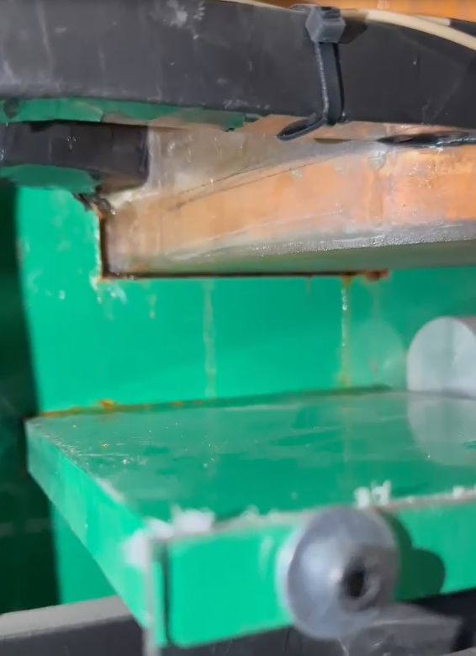
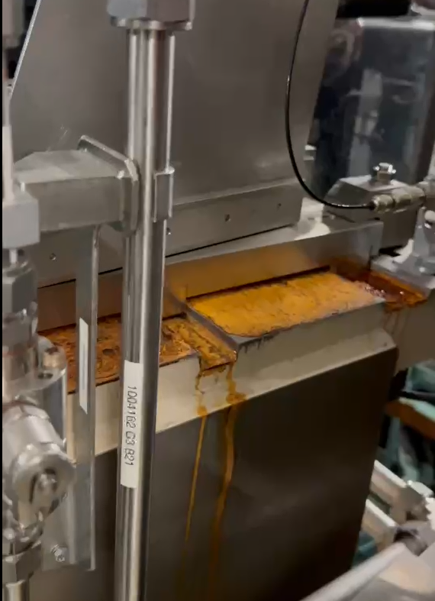
Dipole Leak
March 2025 - Leak in coil of dipole in cell 17, dipole 2
Easier to replace dipole with spare than to swap girder
Difficult to remove dipole shims – partly rust, but also just wedged
Ultimately repaired in place with rubber tape
R. Fielder, Diamond Update, ESLS 2025, 30/10/2025

Slide 10
SLED Cavity Operation
SLED pulse compressor installed in linac
Compress output from klystron to increase peak power
Waveguide layout changed to accommodate SLED
Operate both linac accelerating structures from one klystron
  Improved resilience
Before
After
Courtesy A. Tropp
R. Fielder, Diamond Update, ESLS 2025, 30/10/2025

Slide 11
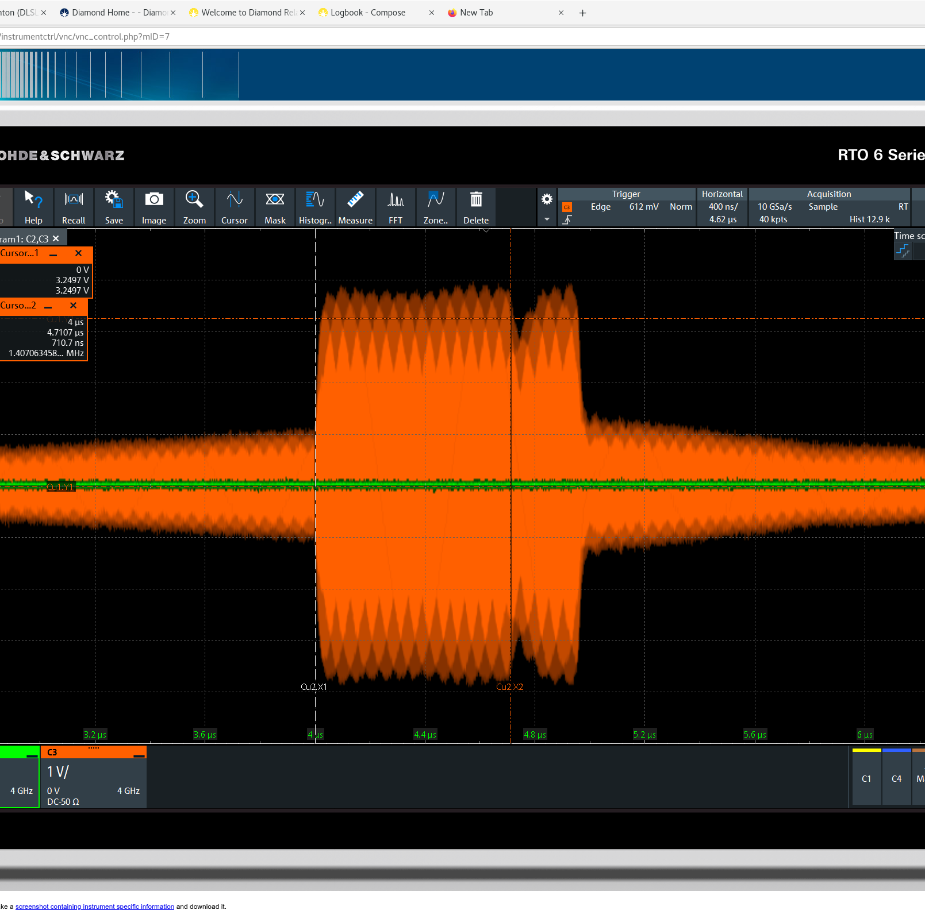
SLED Cavity Operation
Amplitude modulation to shape flat top
Operation since April 2025
Multibunch possible, but requires careful shaping of pulse
Only just long enough to fit 120 bunch train
Theoretical
Real
With modulation
Courtesy A. Tropp
R. Fielder, Diamond Update, ESLS 2025, 30/10/2025

Slide 12
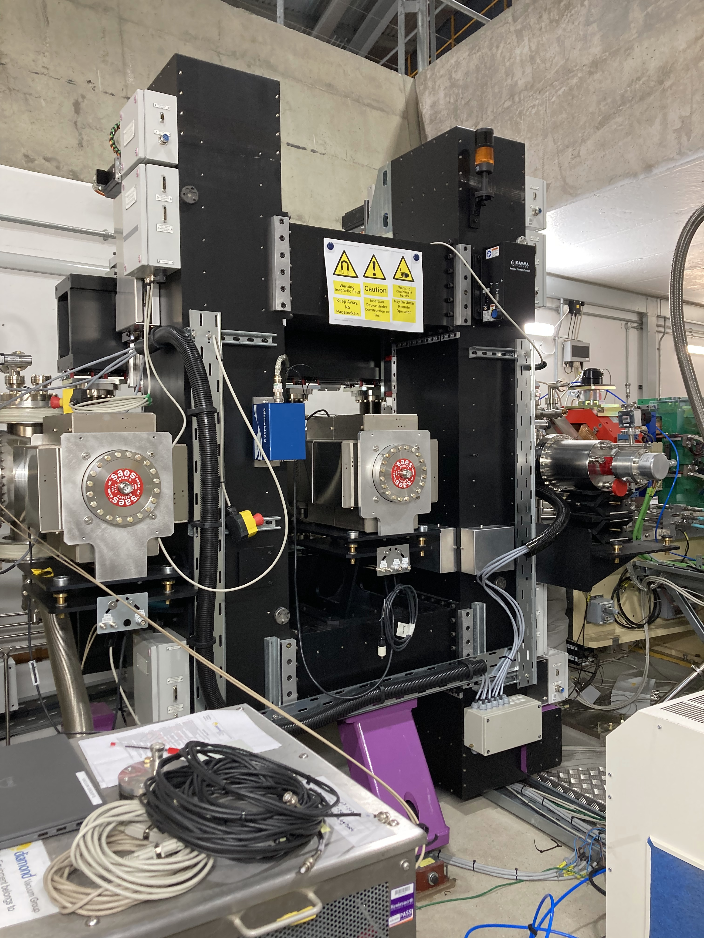
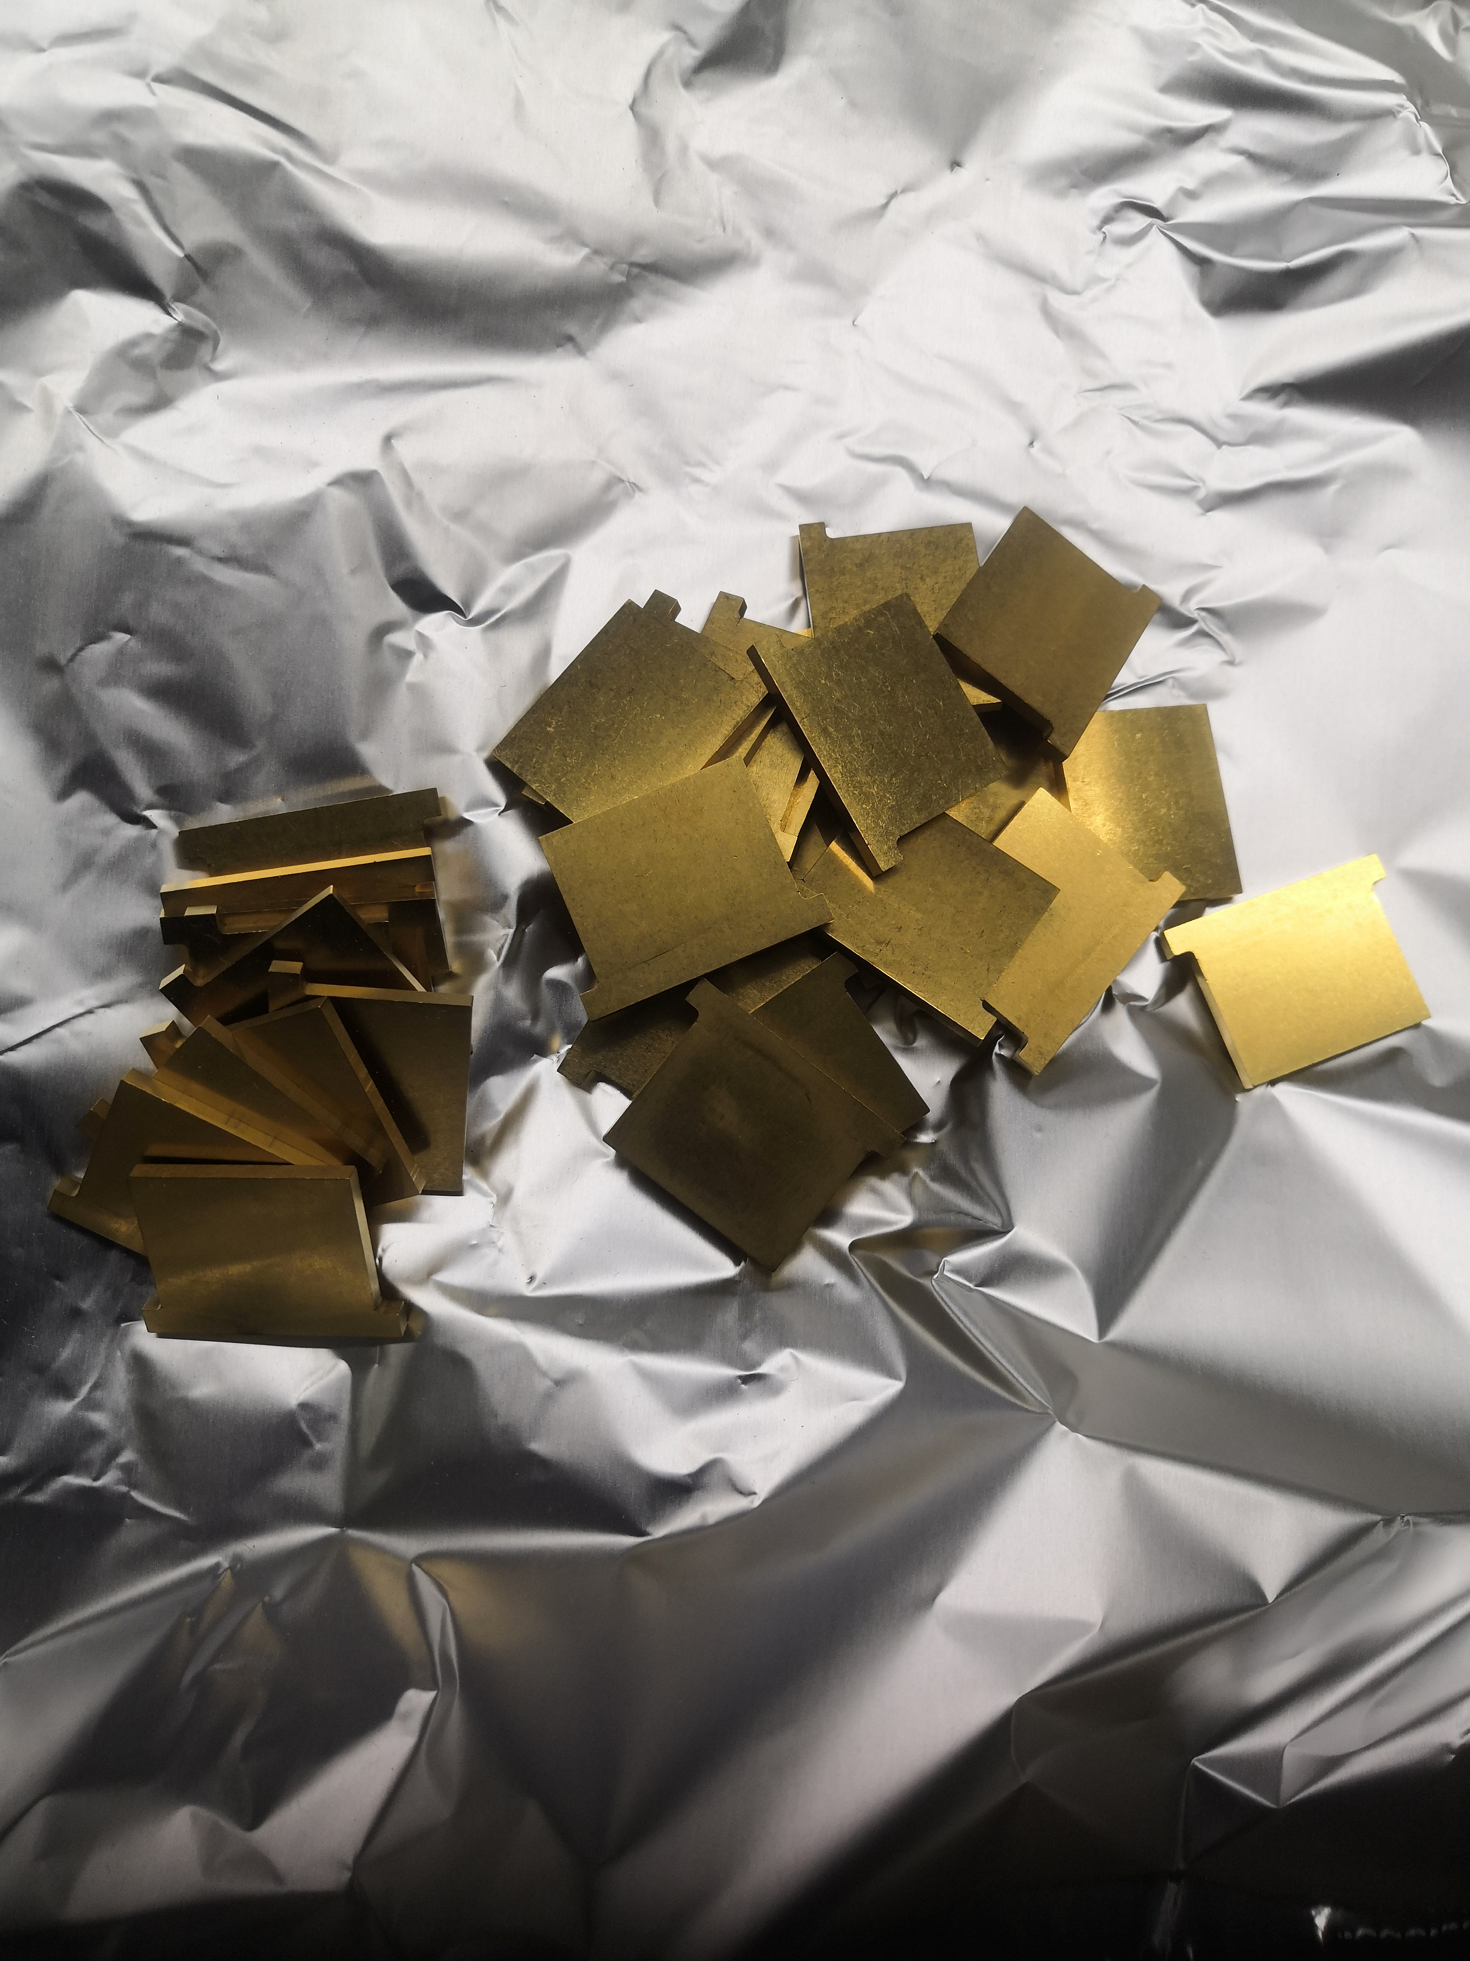
Insertion Devices Summary
One CPMU installed Oct ‘24 in the DDBA straight
Recommission of ID lab following 1 year shutdown (Jan ’24 to Jan ‘25)
for building works
CPMU re-work ongoing. 2 devices suffered with a Cu-Ni foil buckling
issue. First device is at the cold testing stage after:
  Full strip-down & clean after smoke contamination from a fire in the building
  Poles coated with TiN
  Pole height set flush
  to magnets, full shimming performed
  Foil pre-tensioned and reduced in
  width (50 mm -> 35 mm)
Spare wiggler has arrived at site.
Preparing for SAT
CPMU-5 Oct ‘24
TiN coated CPMU poles
Courtesy Z. Patel
R. Fielder, Diamond Update, ESLS 2025, 30/10/2025

Slide 13
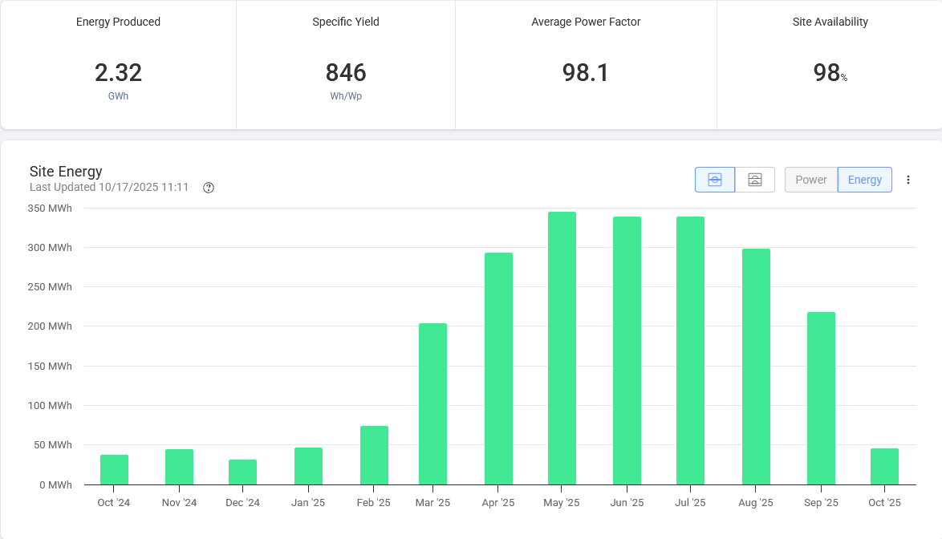
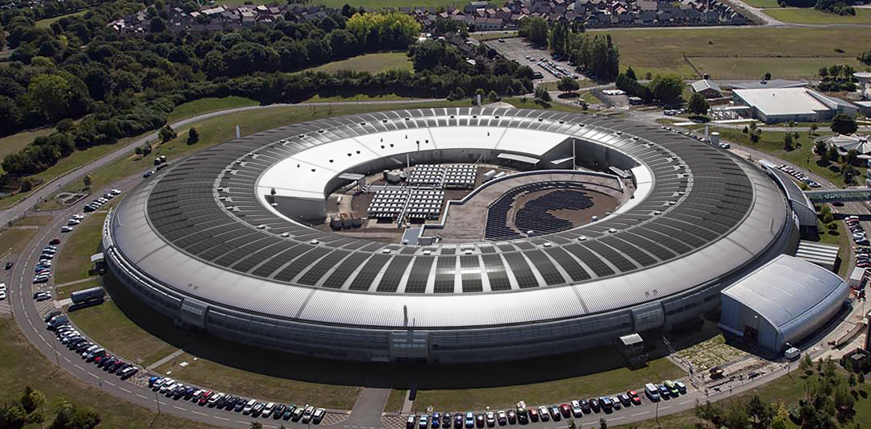
Solar Installation
Final stage of synchrotron building solar installation energised summer 2024
2.7 MWp capacity - predicted output 2.3 GWh/yr
Actual output in the last year = 2.32 GWh
R. Fielder, Diamond Update, ESLS 2025, 30/10/2025

Slide 14
Diamond-II Updates
R. Fielder, Diamond Update, ESLS 2025, 30/10/2025

Slide 15
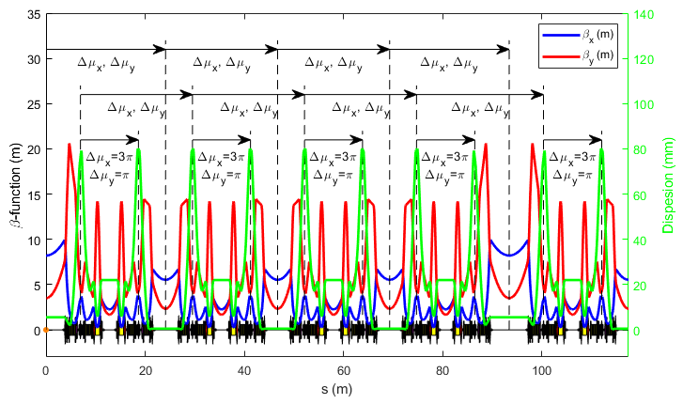
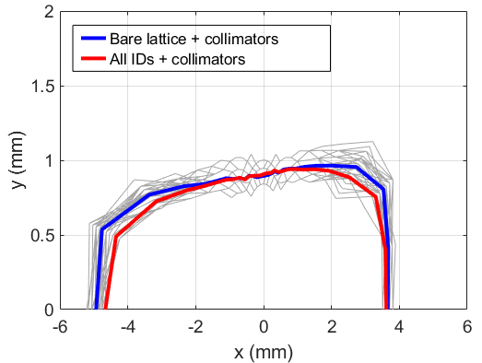
Diamond-II
Modified Hybrid 6-Bend Achromat (M-H6BA) for low emittance
Number of insertion straights increased from 24 to 48
Off-axis injection for beam accumulation, top-up using kick-and-cancel (aperture sharing) double kick with striplines
Passive SC harmonic cavity for lifetime / beam stability / IBS
Development ongoing on options for low beta lattice
Parameter | Units | Diamond | Diamond-II
Energy | GeV | 3.0 | 3.5
Circumference | M | 560.6 | 560.560944
Harmonic Number | - | 936 | 934
RF Frequency | MHz | 499.654 | 499.511
Positive Bending Angle | deg | 360.0 | 374.4
Reverse Bending Angle | deg | 0.0 | 14.4
Total Bending Angle | deg | 360.0 | 388.8
Betatron Tunes | - | [27.21, 12.36] | [54.14, 20.24]
Natural Chromaticity | - | [-79.0, -35.6] | [-68.2, -89.1]
Corrected Chromaticity | - | [1.7, 2.2] | [2.6, 2.6]
Mom. Compaction Factor | ×10⁻⁴ | 1.70 | 1.03
Natural Emittance | pm.rad | 2729 | 162
Energy Spread | % | 0.096 | 0.094
Energy Loss per Turn | MeV | 1.01 | 0.724
Natural Bunch Length | ps | 11.4@2.4 MV | 12.4@1.4 MV
Horizontal Damping Partition | - | 1.00 | 1.88
Horizontal Damping Time | ms | 11.1 | 9.4
Vertical Damping Time | ms | 11.2 | 18.1
Longitudinal Damping Time | ms | 5.6 | 16.1
Courtesy I Martin
R. Fielder, Diamond Update, ESLS 2025, 30/10/2025

Slide 16
Diamond II Project Status
July 2023 Approval for Diamond-II Project and start of funding
Sep 2029 ​
First Phase of beamlines become operational
Dec 2028 ​
Start of storage ring beam commissioning ​​​
Mar 2030 ​​
End of the Diamond-II project ​
Mar 2023
Mar 2024
Mar 2025
Mar 2026
Mar 2027
Mar 2028
Mar 2029
2023/24 FY
2024/25 FY
2025/26 FY
2026/27 FY
2027/28 FY
2028/29 FY
2029/30 FY
Q1 | Q2 | Q3 | Q4
Q1 | Q2 | Q3 | Q4
Q1 | Q2 | Q3 | Q4
Q1 | Q2 | Q3 | Q4
Q1 | Q2 | Q3 | Q4
Q1 | Q2 | Q3 | Q4
Q1 | Q2 | Q3 | Q4
8 month delay against original completion
Oct 2025
Completion of the Diamond Extension Building – not yet handed over ​
Jan 2030
First User on a Flagship Beamline
Mar 2026
Start of main girder assembly​
Dec 2027 ​
Start of the dark period ​​
Mar 2027
Electromagnets main series delivery​
June 2029
End of the dark period; start of regular beamline X-ray commissioning
R. Fielder, Diamond Update, ESLS 2025, 30/10/2025

Slide 17
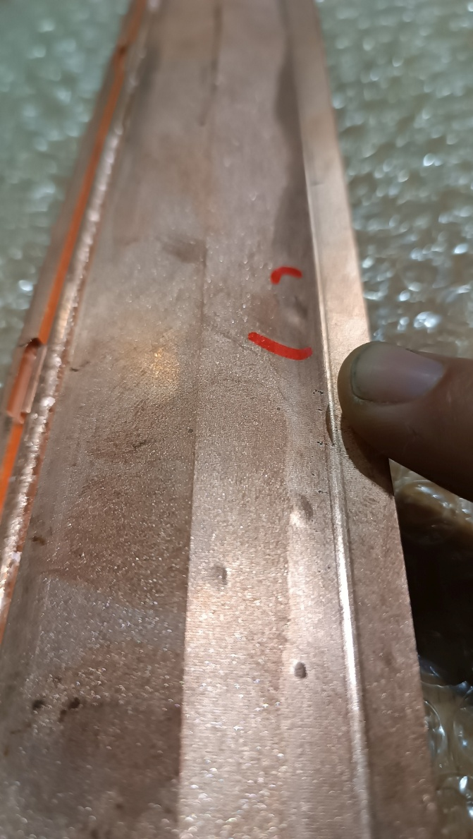
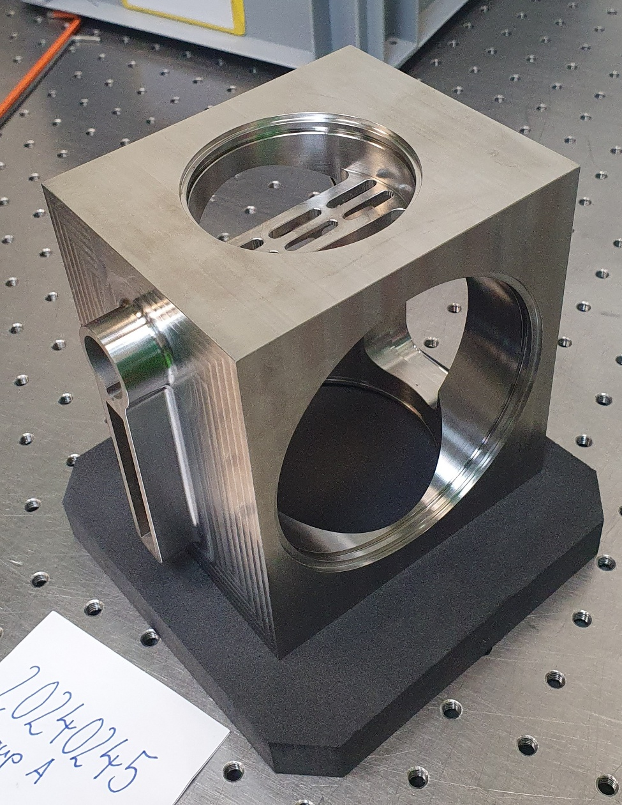
Diamond II Vacuum
Orders placed for main arc vessels
Still to order special vessels, straights, ceramic vessels, injection components
Planning dates
Start of pre-series vacuum string assembly Feb 2026
Start of girder vacuum string assembly Apr 2026
Start of dark period Dec 2027
Issues with blistering on some copper vessels – Cu-OFS oxygen content measured 0.21-0.37%, should be <0.005% !
Vessels to be remade with Cu-OFE
Pumping block pre-series used 316L due to material availability
Could not meet permeability spec
Main series to use 316LN as specified
Courtesy M Cox
R. Fielder, Diamond Update, ESLS 2025, 30/10/2025

Slide 18
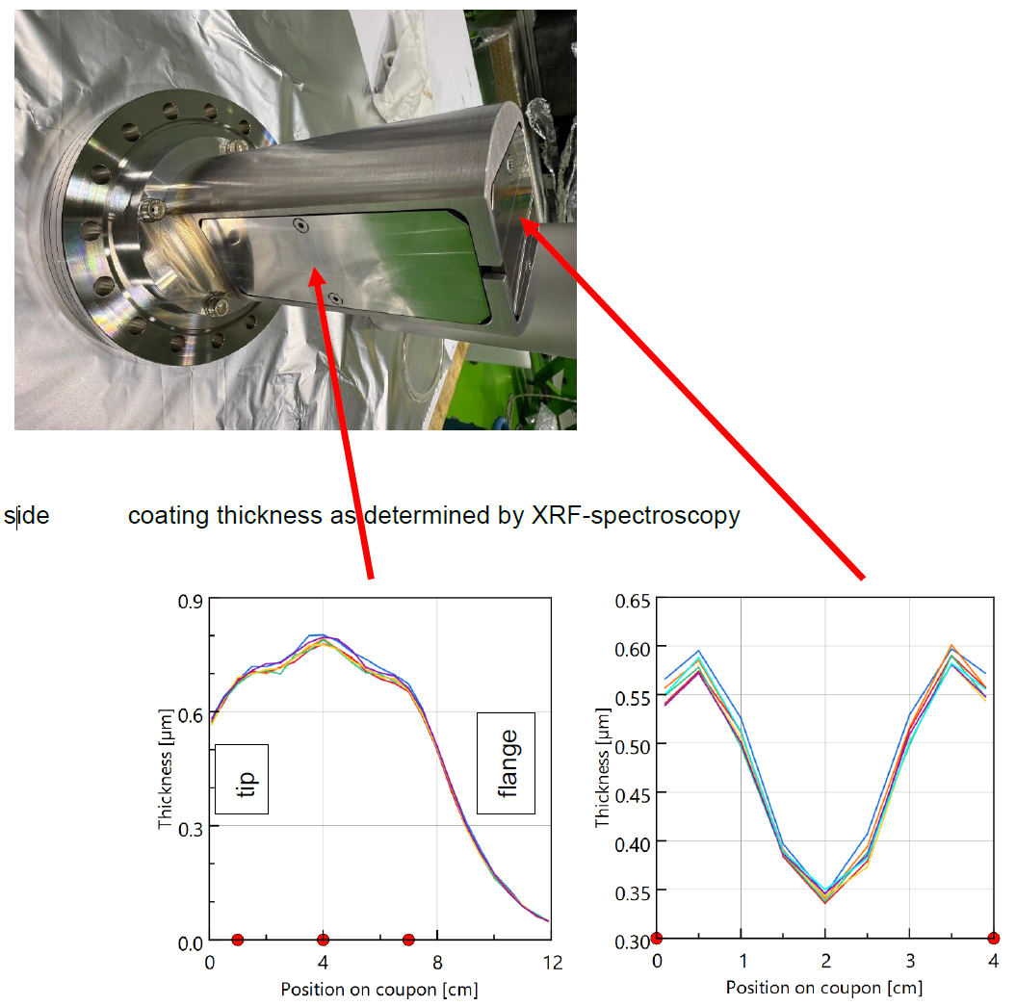
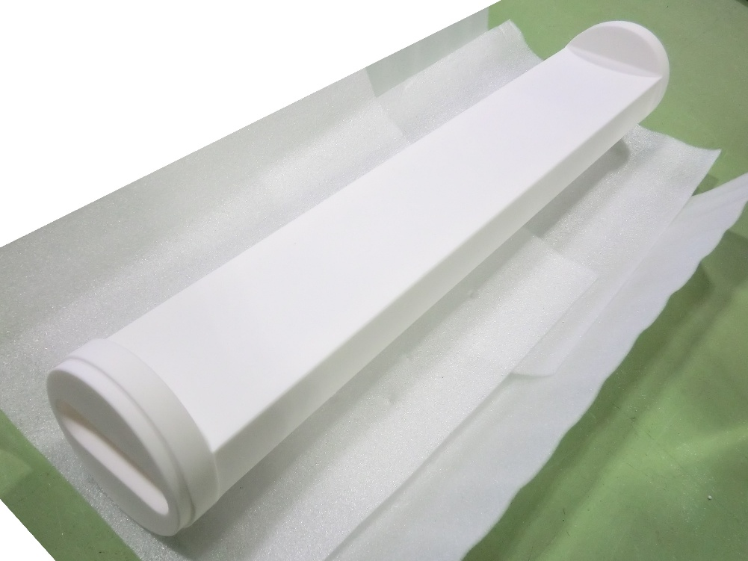
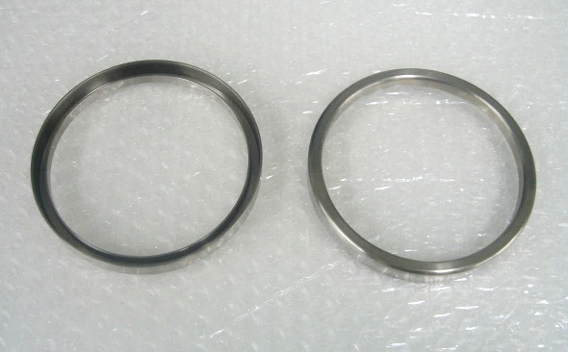
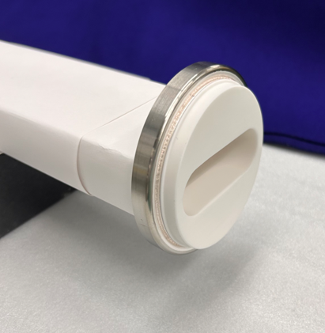
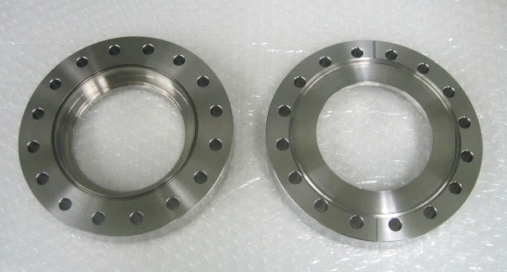
Diamond-II Vacuum
Successful test NEG coating absorber
Prototype ceramic kicker vessel
Ti coating to be done by Polyteknik – coating 4 existing spare vessels as test
Titanium interface rings
Monolithic Al₂O₃ ceramic body
Courtesy M Cox
Ceramic body brazed to interface rings
Titanium end flanges
R. Fielder, Diamond Update, ESLS 2025, 30/10/2025

Slide 19
Diamond-II Magnets
DL assembly in progress – tuning to be done later once DEB is available
DQ – some delay due to difficulty meeting tolerance
  FAT and site witness visit due end October
Quadrupoles – 1 of 4 pre-series failed dimensional testing, new yoke to be machined
  Plan to accept partial batches so assembly can begin as ready
Sextupoles – pre series FAT OK, but toward limit of acceptable range
  Further tests negotiated on examples of each type, any changes only to final machining
Octupoles – FAT on schedule
  Oct/corrector pre-series FAT Jan 2026
  Fast corrector pre-series FAT Feb 2026
Booster magnets all under construction
  Dipole testing at ALBA in November 2025
R. Fielder, Diamond Update, ESLS 2025, 30/10/2025

Slide 20
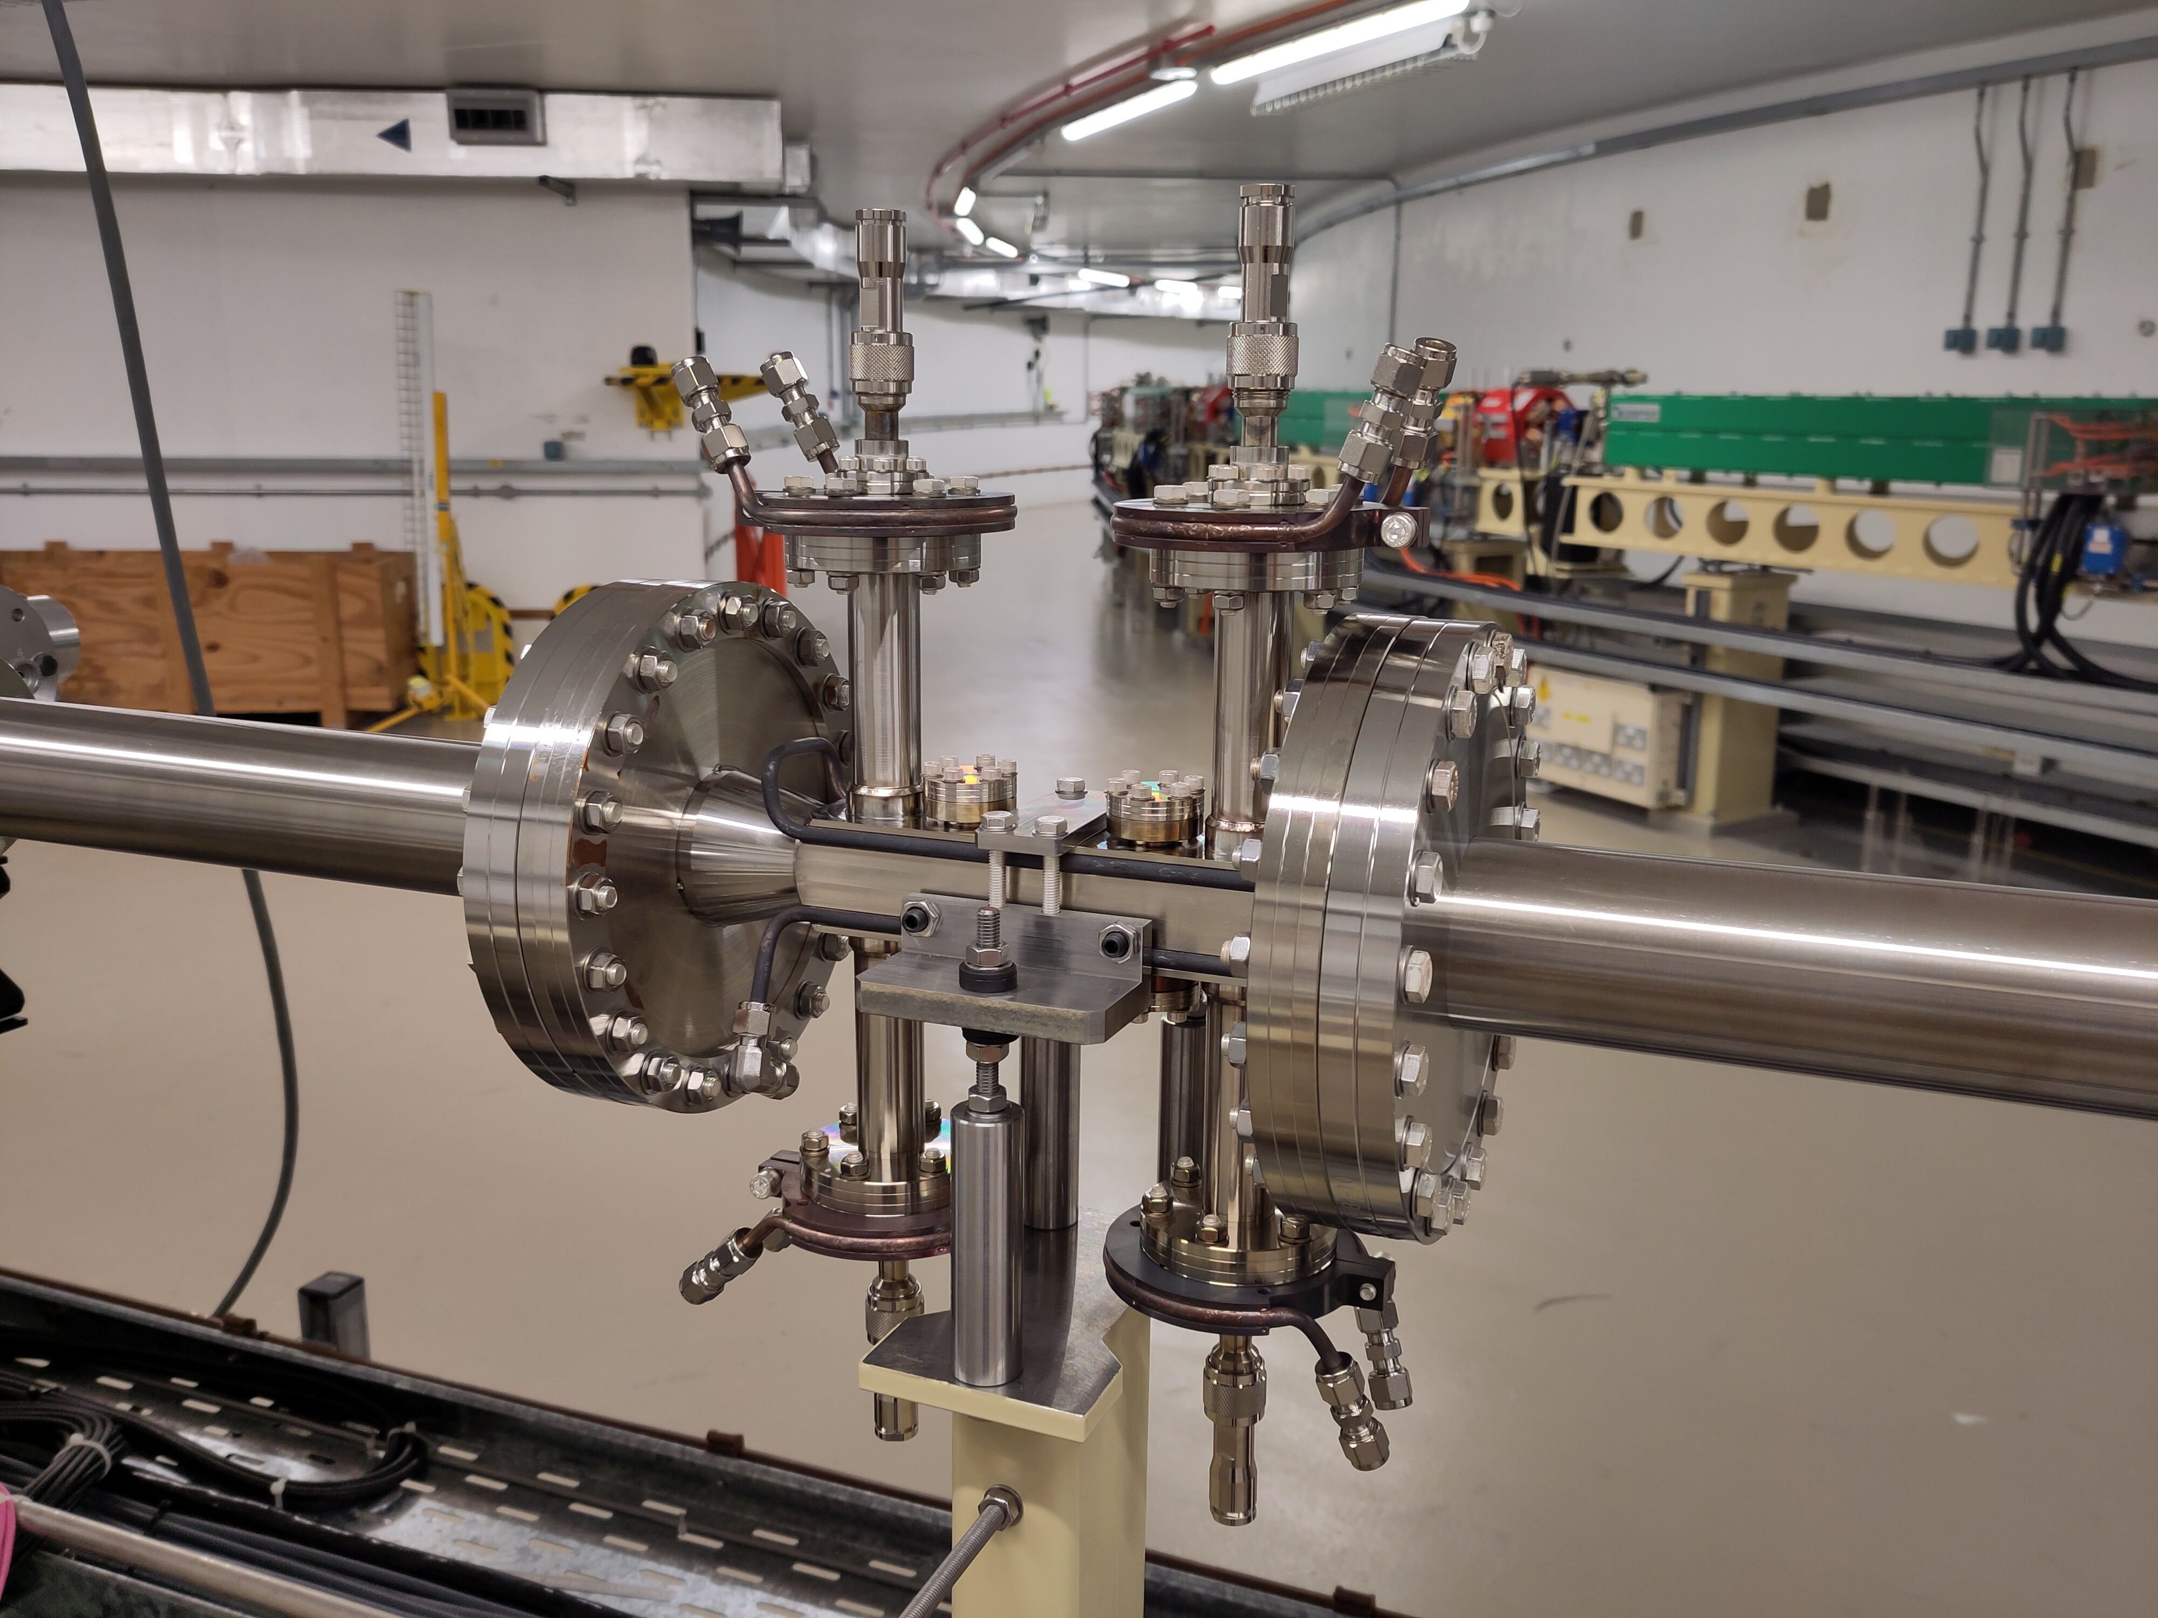
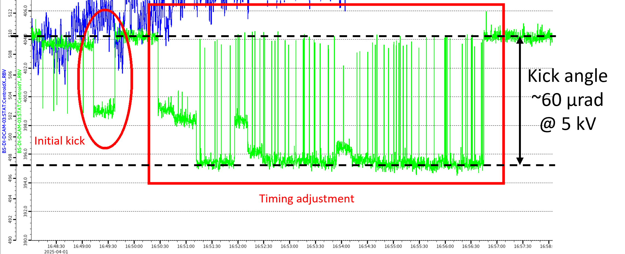
Diamond-II Injection: Striplines
Prototype stripline installed in booster-to-storage ring (BTS) transfer line in March 2025
Tested with low power 5 kV pulser
Amplitude of kick as expected once correct timing found
3 ns
1.5 µs
R. Fielder, Diamond Update, ESLS 2025, 30/10/2025

Slide 21
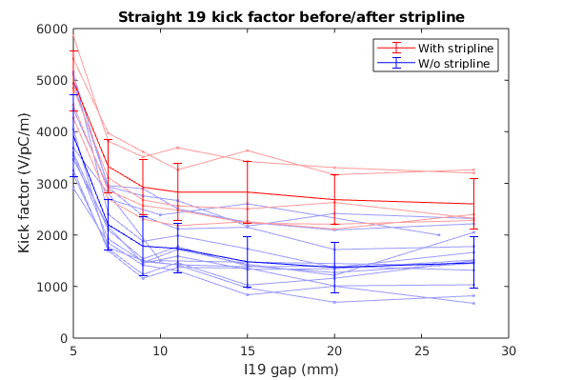
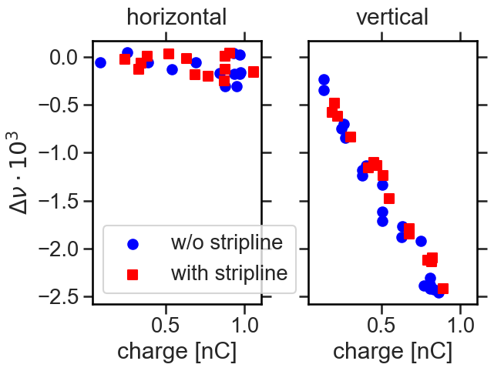

Diamond-II Injection: Striplines
Removed from BTS and installed in storage ring in June 2025
Initial test without pulser to test apertures, beam heating, impedance, etc.
Can’t measure blade temperatures directly, but no problems observed from external monitoring – as long as ports are connected to correctly matched loads!
Kick factor measured larger than expected, but very noisy and inconsistent between measurements
No measurable impact on tune shift, bunch lengthening or microwave instability threshold
Measured $Δk_{y}$ = 1176 V/pC/m
CST model $Δk_{y}$ = 109.1 V/pC/m
IDs closed
IDs closed
3 ns
1.5 µs
Removed to replace feedthroughs with 7/16 type for high power
Full assembly tested with 20 kV pulser last week – to be re-installed in ring this week
R. Fielder, Diamond Update, ESLS 2025, 30/10/2025

Slide 22
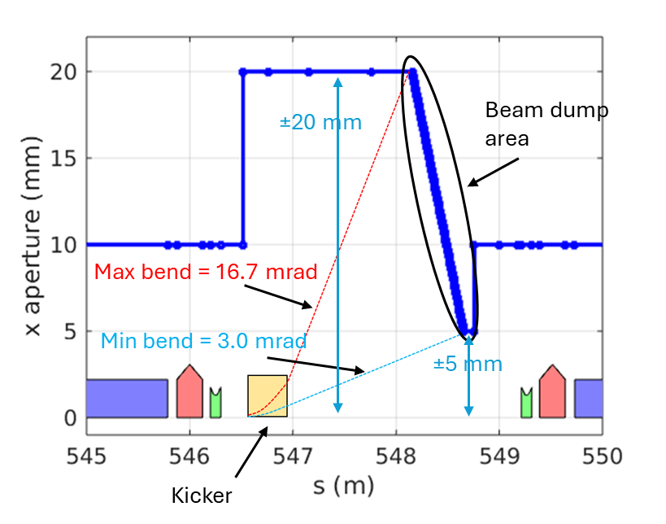
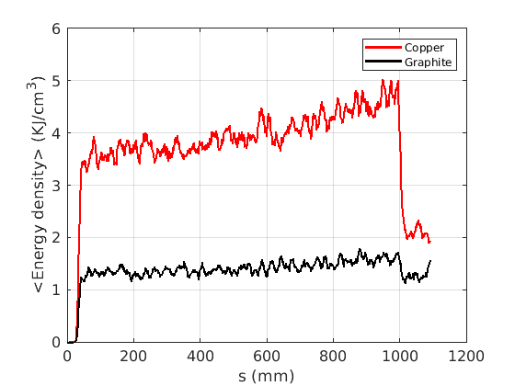
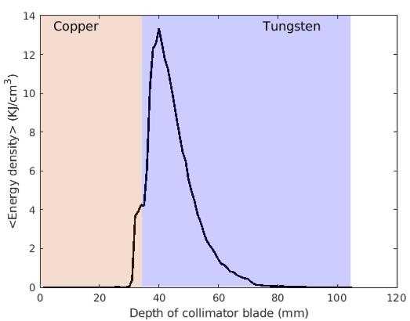
Diamond-II Beam Abort System
Dedicated beam dump system required to prevent damage to machine on beam loss
Preferred solution with kicker in K23 straight, tapered beam dumps in K23 and K24
Based on SLS-II method
Space for two kickers for redundancy, maybe vertical decoherence kicker
Copper beam dump: peak energy density = 5.0 kJ/cm³ (likely to melt)
Graphite beam dump: peak energy density = 1.7 kJ/cm³
Copper section of the collimator is also likely to melt:
  Copper section = 4.3 KJ/cm³
  Tungsten section = 13.1 KJ/cm³ (below melting point)
Using linear pulse shape for kicker and spreading beam vertically should bring energy density within safe limits on beam dump and collimators (still WIP)
Fixed vac. vessel
R. Fielder, Diamond Update, ESLS 2025, 30/10/2025

Slide 23
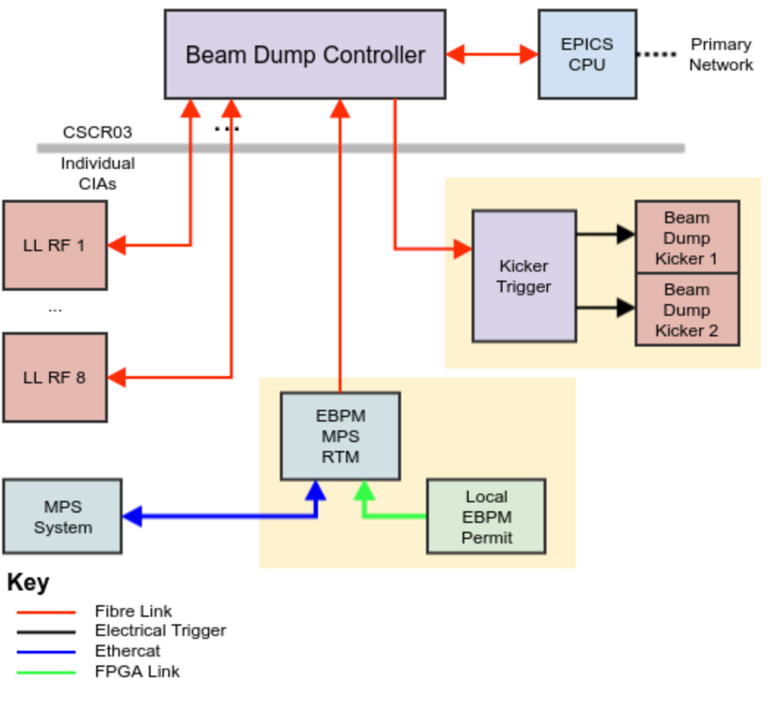
Diamond-II Beam Abort System
Diamond-II Beam Abort System
Time budget is set by need to kill the beam before it starts to hit the collimator
  RF trip: <90 turns (~170 µs)
  Outside orbit interlock: <~115 µs (TBC – step change of slow corrector)
Three response times for the BDC:
  Fast: (<15 µs) direct fibre links to 8 LLRF systems
  Medium: (<115 µs) orbit interlock from EBPMs in local CIA
  Slow: (<400 µs) PSS triggers RF+PSU power down, triggering MPS
Source | Delay
RF decision | 0.5 µs
Fibre Delay | 1.8 µs
BDC FPGA | 0.4 µs
Fibre Delay | 1.8 µs
PSU Realisation | 5-10 µs
Kicker Pulse | 2 µs
Total | 11.5-16.5 µs
R. Fielder, Diamond Update, ESLS 2025, 30/10/2025

Slide 24
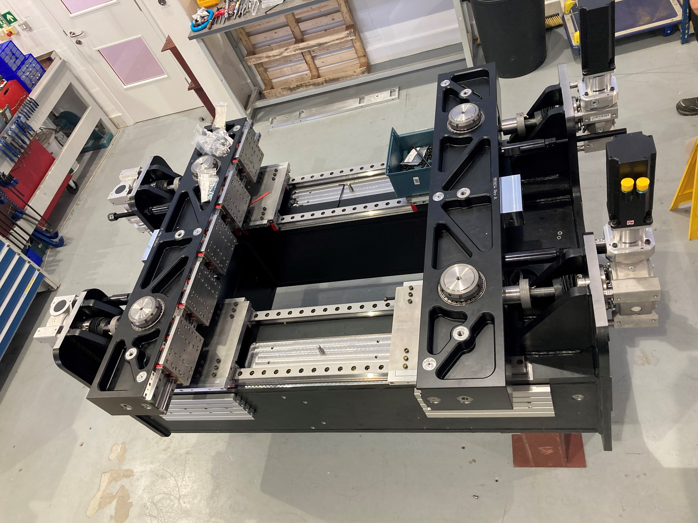
Diamond-II IDs
New IDs for Diamond-II are a mix of in-house development and procurement from industry:
  1 CPMU, 2 HPMUs, 5 APPLE-IIs, 1 APPLE-KNOT, 1 EMPHU, 1 vertically-canted 3PW, 1 MPW
Large engineering effort made to simplify and stiffen the ID structures going forward
CPMU: 17.6 mm period, 1.5 long
Currently being built in-house
Magnets delivered by HPMG
Controls commissioning and magnet mounting due to start imminently
2 x HPMUs: 18.7 mm period, 1.5 m long
Contract awarded to Kyma
FDR to complete in next few weeks
EMPHU: 56 mm period, 1.75 m long
Based on Soleil’s design
Magnetic design validated, engineering design ongoing
Stainless steel vessel to be used to avoid eddy currents
New CPMU structure
Courtesy Z. Patel
R. Fielder, Diamond Update, ESLS 2025, 30/10/2025

Slide 25
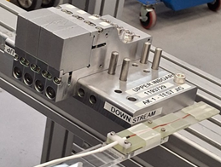
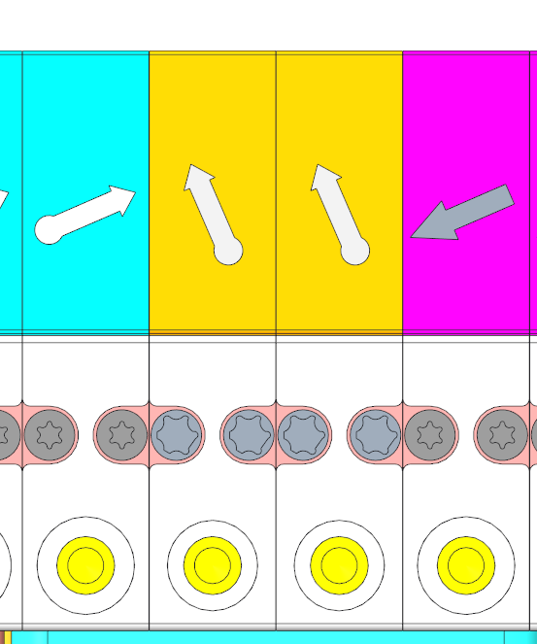
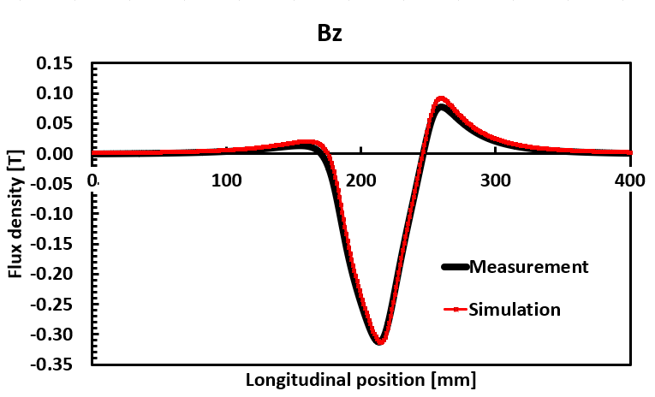
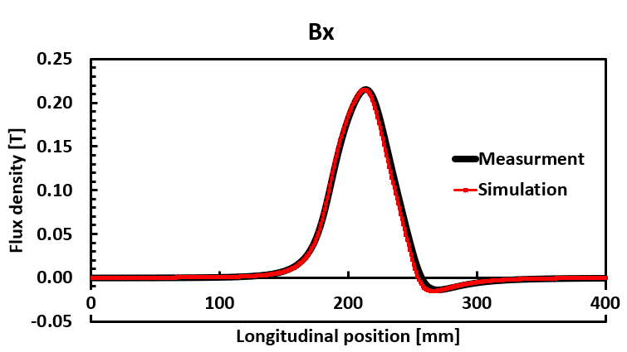
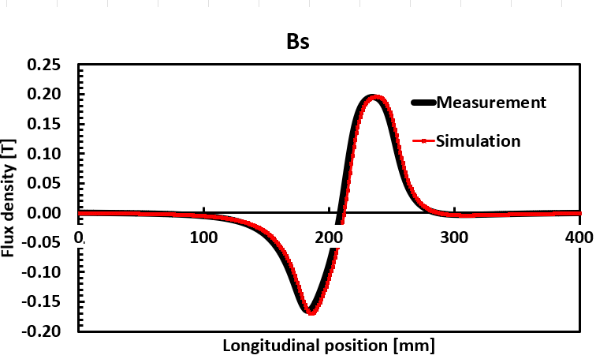
Diamond-II IDs
APPLE Knot: 140 mm period, 5 m long
Magnets delivered from HPMG
  QA ongoing
Final prototype parts due end Oct.
Small section of sample magnets measured on Hall probe bench match prediction from magnet model in Radia
1 x APPLE-II: 52 mm period, 5 m long
Magnetic design ongoing
1 x APPLE-II: 64 mm period, 1.8 m long
1 x MPW: 116 mm period, 0.7 m long
Procurement specifications started
2 x APPLE-IIs: 56 mm period, 2 m long
1 x APPLE-II: 56 mm period, 4 m long
3PW: 1.4 T main radiator
Procurement specifications almost complete
Courtesy Z. Patel
R. Fielder, Diamond Update, ESLS 2025, 30/10/2025

Slide 26
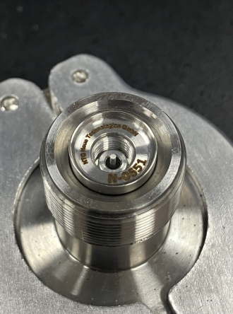
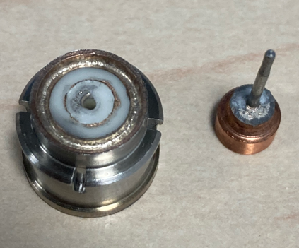
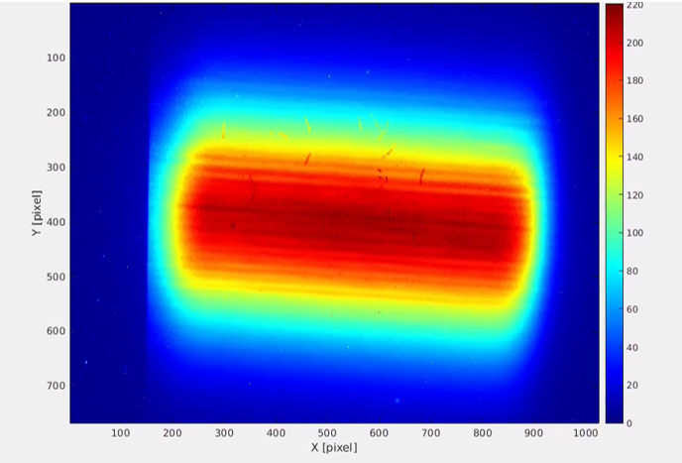

Diamond-II Diagnostics
Received 1000/2000 BPM buttons
Successful FAT and SAT tests (visual, dimensional, leak, capacitance)
One failed button during handling/welding – joint intact but ceramic broke
X-ray beam extraction location to avoid fringe fields have been identified for all the pinhole cameras.
Extraction window made of aluminium creates filamentation patterns, seen at Diamond, ESRF, HEPS and Soleil. Different solutions on overcoming this problem for Diamond-II are being investigated.
New supplier for manufacturing a C-D shaped assembly out of tungsten
Tungsten blades and chemically etched shims
C-D design with machined aperture
R. Fielder, Diamond Update, ESLS 2025, 30/10/2025

Slide 27
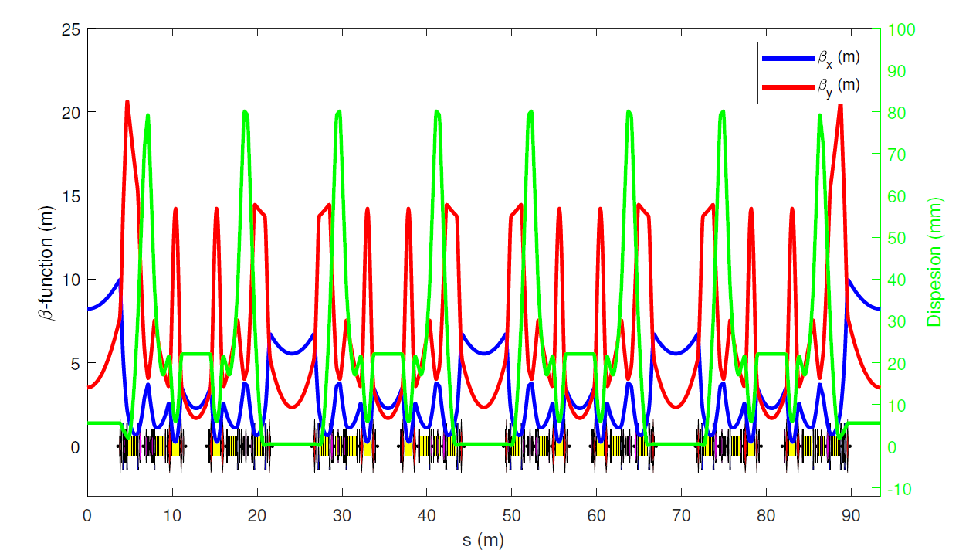
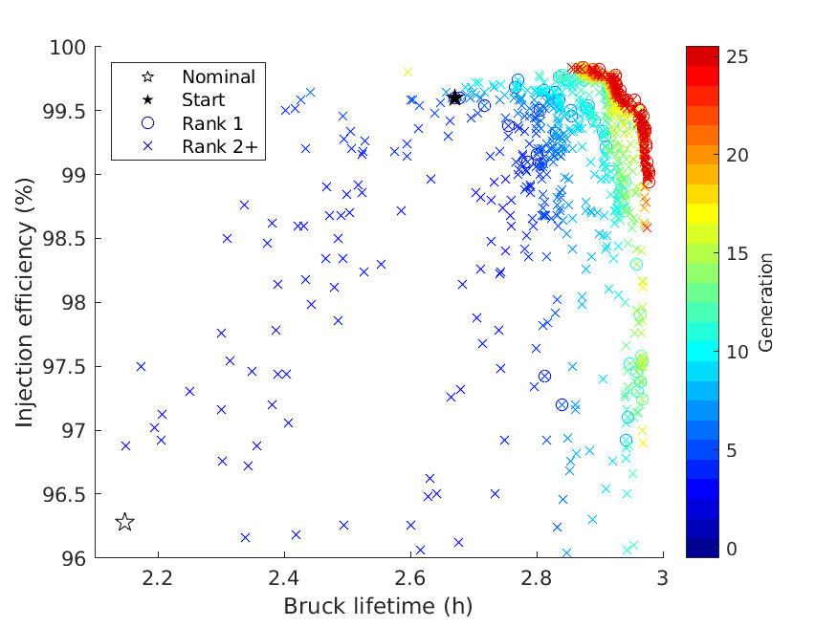
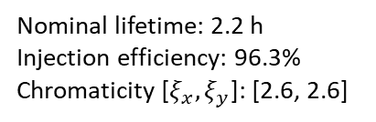
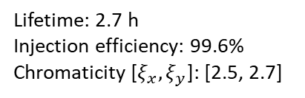
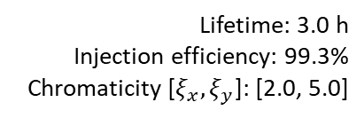
Diamond-II Lattice Update
Ongoing optimisation of lattice (MOGA, AT)
Introduce additional sextupole families where optics differ near long / standard straights
Lifetime: 2.7 h
Injection efficiency: 99.6%
Chromaticity [$ξ_{x},ξ_{y}$]: [2.5, 2.7]
Lifetime: 3.0 h
Injection efficiency: 99.3%
Chromaticity [$ξ_{x},ξ_{y}$]: [2.0, 5.0]
S1XL
S2AL
S3AL
S4AL
S5X
S6X
S6X
S5X
S4AS
S3AS
S2AS
S1XS
Nominal lifetime: 2.2 h
Injection efficiency: 96.3%
Chromaticity [$ξ_{x},ξ_{y}$]: [2.6, 2.6]
Significant improvement in lifetime, although less with IDs closed
Further improvement with higher RF voltage due to increased momentum aperture
Lifetimes shown without 3HC – should have gain >*3 depending on fill pattern
L
M
S
R. Fielder, Diamond Update, ESLS 2025, 30/10/2025

Slide 28
Conclusions
Diamond
Focus on supporting operations – improve resilience
Rolling updates to IDs, RF and controls systems as part of Diamond-II preparations
Testbed for Diamond-II – stripline prototype, accelerator commissioning, virtual accelerator…
Diamond-II
Many major contracts placed, others following at pace
Prototyping and pre-series testing underway on vacuum and magnet systems
Beam abort system a concern, but design is progressing
Hardware frozen, but optics optimisation still ongoing
Some delays, absorbed by contingency in planning – still on target for Dec 2027 start to dark period
R. Fielder, Diamond Update, ESLS 2025, 30/10/2025

Slide 29
Acknowledgements
AP
I Martin, N Blaskovic Kraljevic, H-C Chao, H Ghasem, D Rabusov, B Singh
Diagnostics and Controls
L Bobb, M Abbott, S Banerjee, G Cook, C Houghton, H Malik, A Morgan, N Vitoratou, M Zeeshan
RF
A Kaftoosian, P Gu, S Pande, A Tropp
IDs
S Milward, A Ramezani Moghaddam, Z Patel, S Tripathi
Magnets
C Bailey, A Shahveh, S Ahamad
Others
A. Amiri, M Cox, P Vivian, R Walker, V Winter, V Zhiltsov
R. Fielder, Diamond Update, ESLS 2025, 30/10/2025

Slide 30
Extra Slides
R. Fielder, Diamond Update, ESLS 2025, 30/10/2025

Slide 31
Diamond II Project Status
Contingency in plan –still on schedule for Dec 2027 start to dark period
  3 month contingency still kept before start of commissioning in case of further delays
Regular internal and external reviews:
  MAC – machine
  SAC – science and beamlines
  SSAC – software and controls
Project Assurance Reviews in Sept. 2025, 2027, 2029
  Rated Amber-Green – no critical issues, some risks which are understood
Bi-annual internal readiness reviews in run-up to dark period, first in Dec 2025
£79.1m contingency funds to cover risks
  £10m released so far
    5th RF cavity, 8th RF amplifier
    1MW data centre
    Additional data storage, UPS
    Apple knot ID
R. Fielder, Diamond Update, ESLS 2025, 30/10/2025

Slide 32
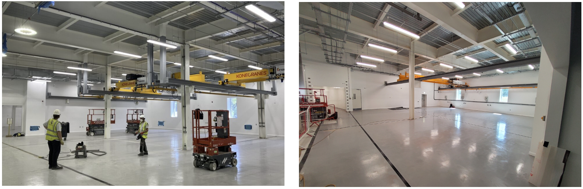
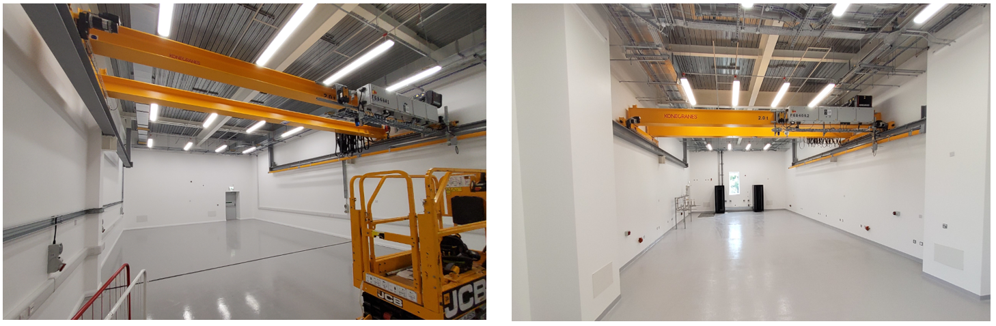
DEB
Diamond II Project Status
Girder Assembly Vacuum Bake-out
Magnet Assembly Beamline Assembly
R. Fielder, Diamond Update, ESLS 2025, 30/10/2025

Slide 33
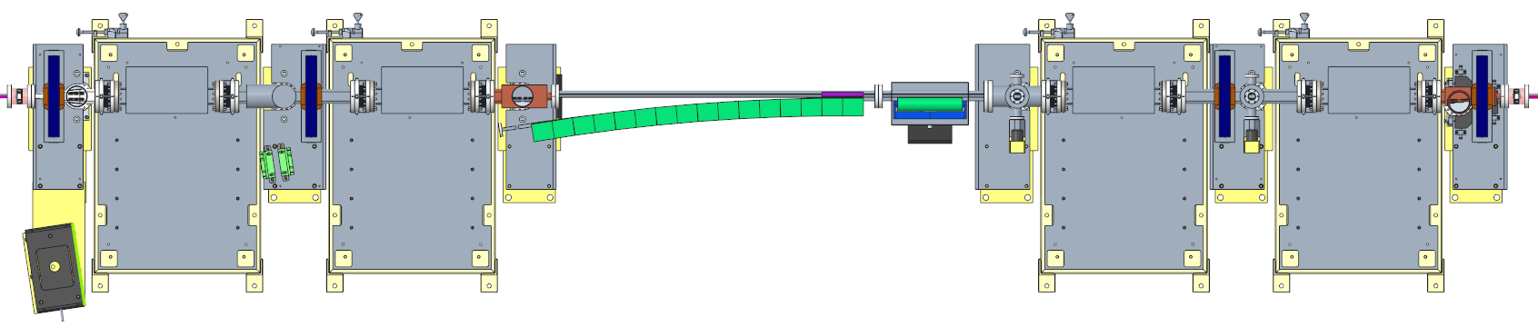
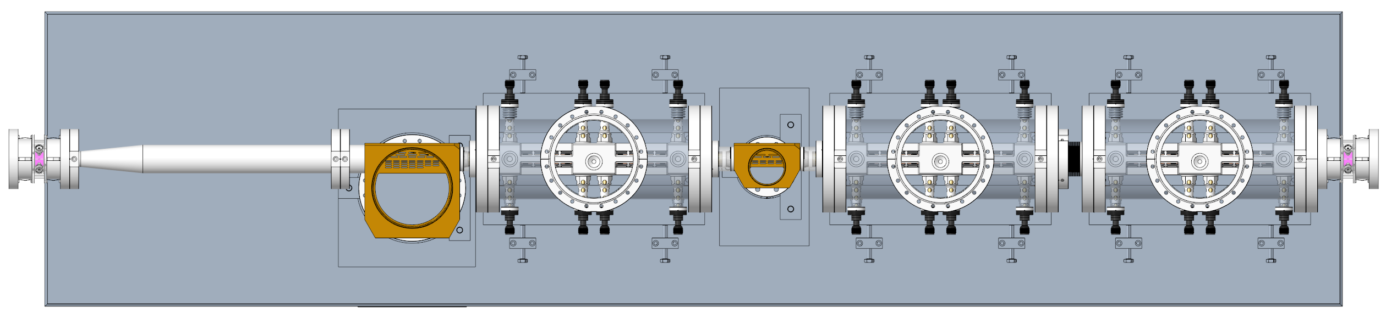
Diamond-II Injection
Two injection schemes
1) Standard four kicker bump (SB or MB)
Robust, proven technology
Stage 1: single shot, on-axis injection
Stage 2: off-axis accumulation with non-closed bump (improved capture efficiency)
Stage 3: off-axis accumulation with closed orbit bump (improved transparency)
2) Fast stripline kickers (SB only)
Pseudo-transparent injection
Stage 4: top-up injection only
Pulsed dipole kicker magnet
DC chicane magnet
I01 Injection Straight
400
PM thick septum
Pulsed thin septum
K01 Injection Straight
Vacuum pump
Photon absorber
Module containing two pairs of stripline kickers
Courtesy V Zhiltsov
R. Fielder, Diamond Update, ESLS 2025, 30/10/2025

Slide 34
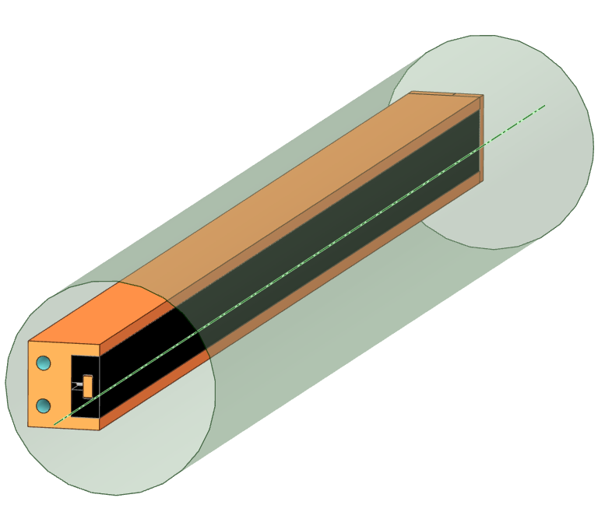
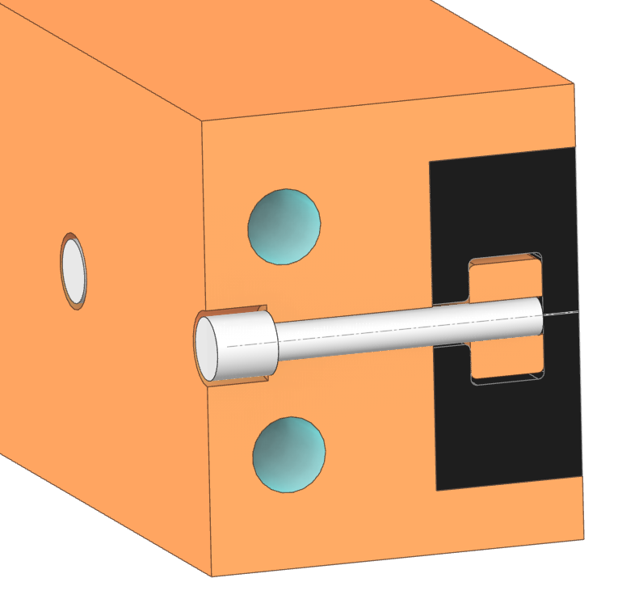
Beam Dump Options
Two options being considered for the beam dump:
Graphite beam dump (preferred)
High thermal shock resistance, high melting point
Brittle material: likely to crack rather than melt
Lower stopping power / extra shielding required
Designed to be failure-free (would need replacing if damage occurs)
Copper beam dump
Ductile material, tolerant to cracks
Simpler design, replacement and manufacturability
Higher stopping power / integrated shielding
Lower melting point
Designed to be tolerant to damage (functionality may degrade over time)
Graphite Beam Dump Concept
Isotropic graphite to minimize thermal shock and improve manufacturability
Copper holder to provide shielding
Bolted joint to minimize thermal stress from synchrotron radiation
Beam dump separated from vacuum vessel
Beam
Isotropic graphite
Copper nut
Copper matrix
M3 SS bolt
Cooling channels
Courtesy I. Martin
R. Fielder, Diamond Update, ESLS 2025, 30/10/2025

Slide 35
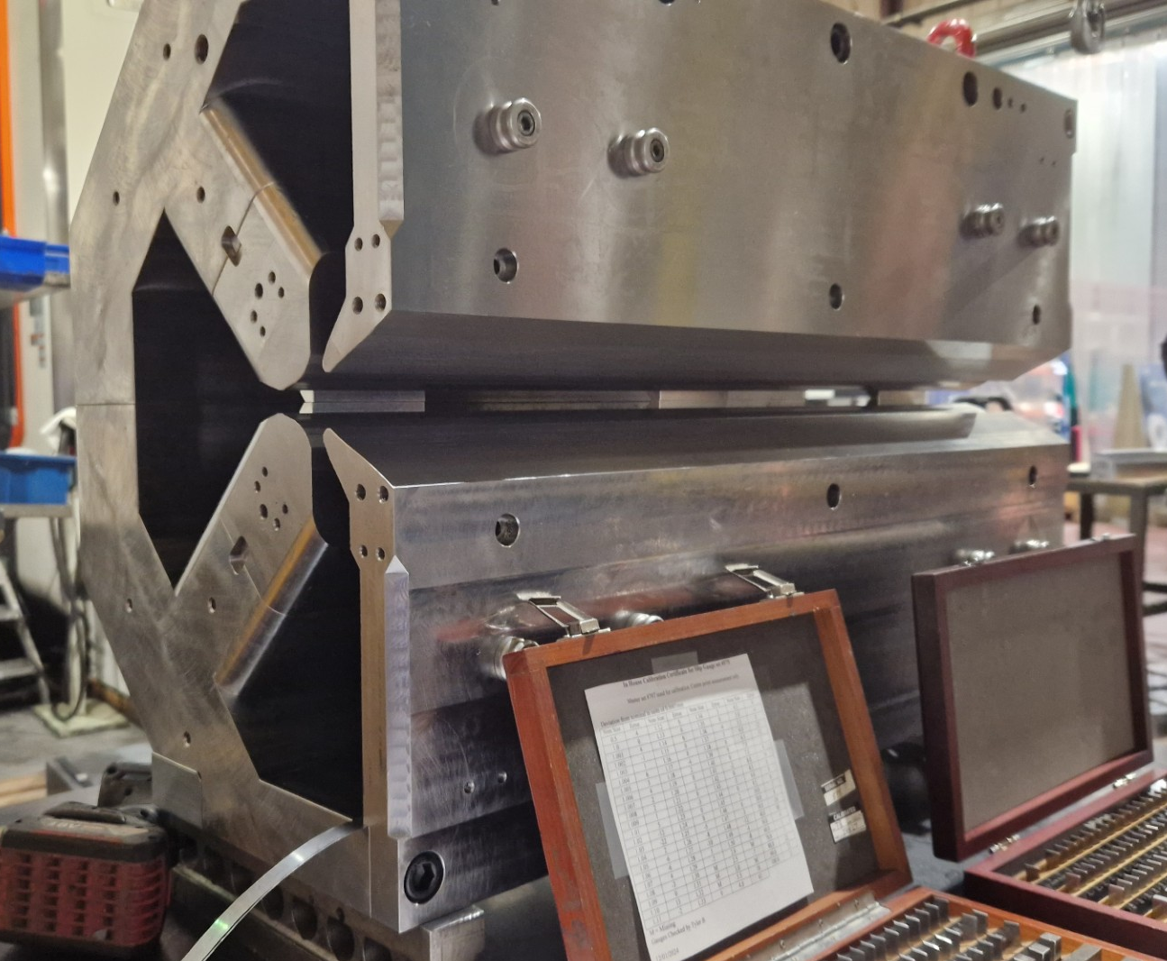
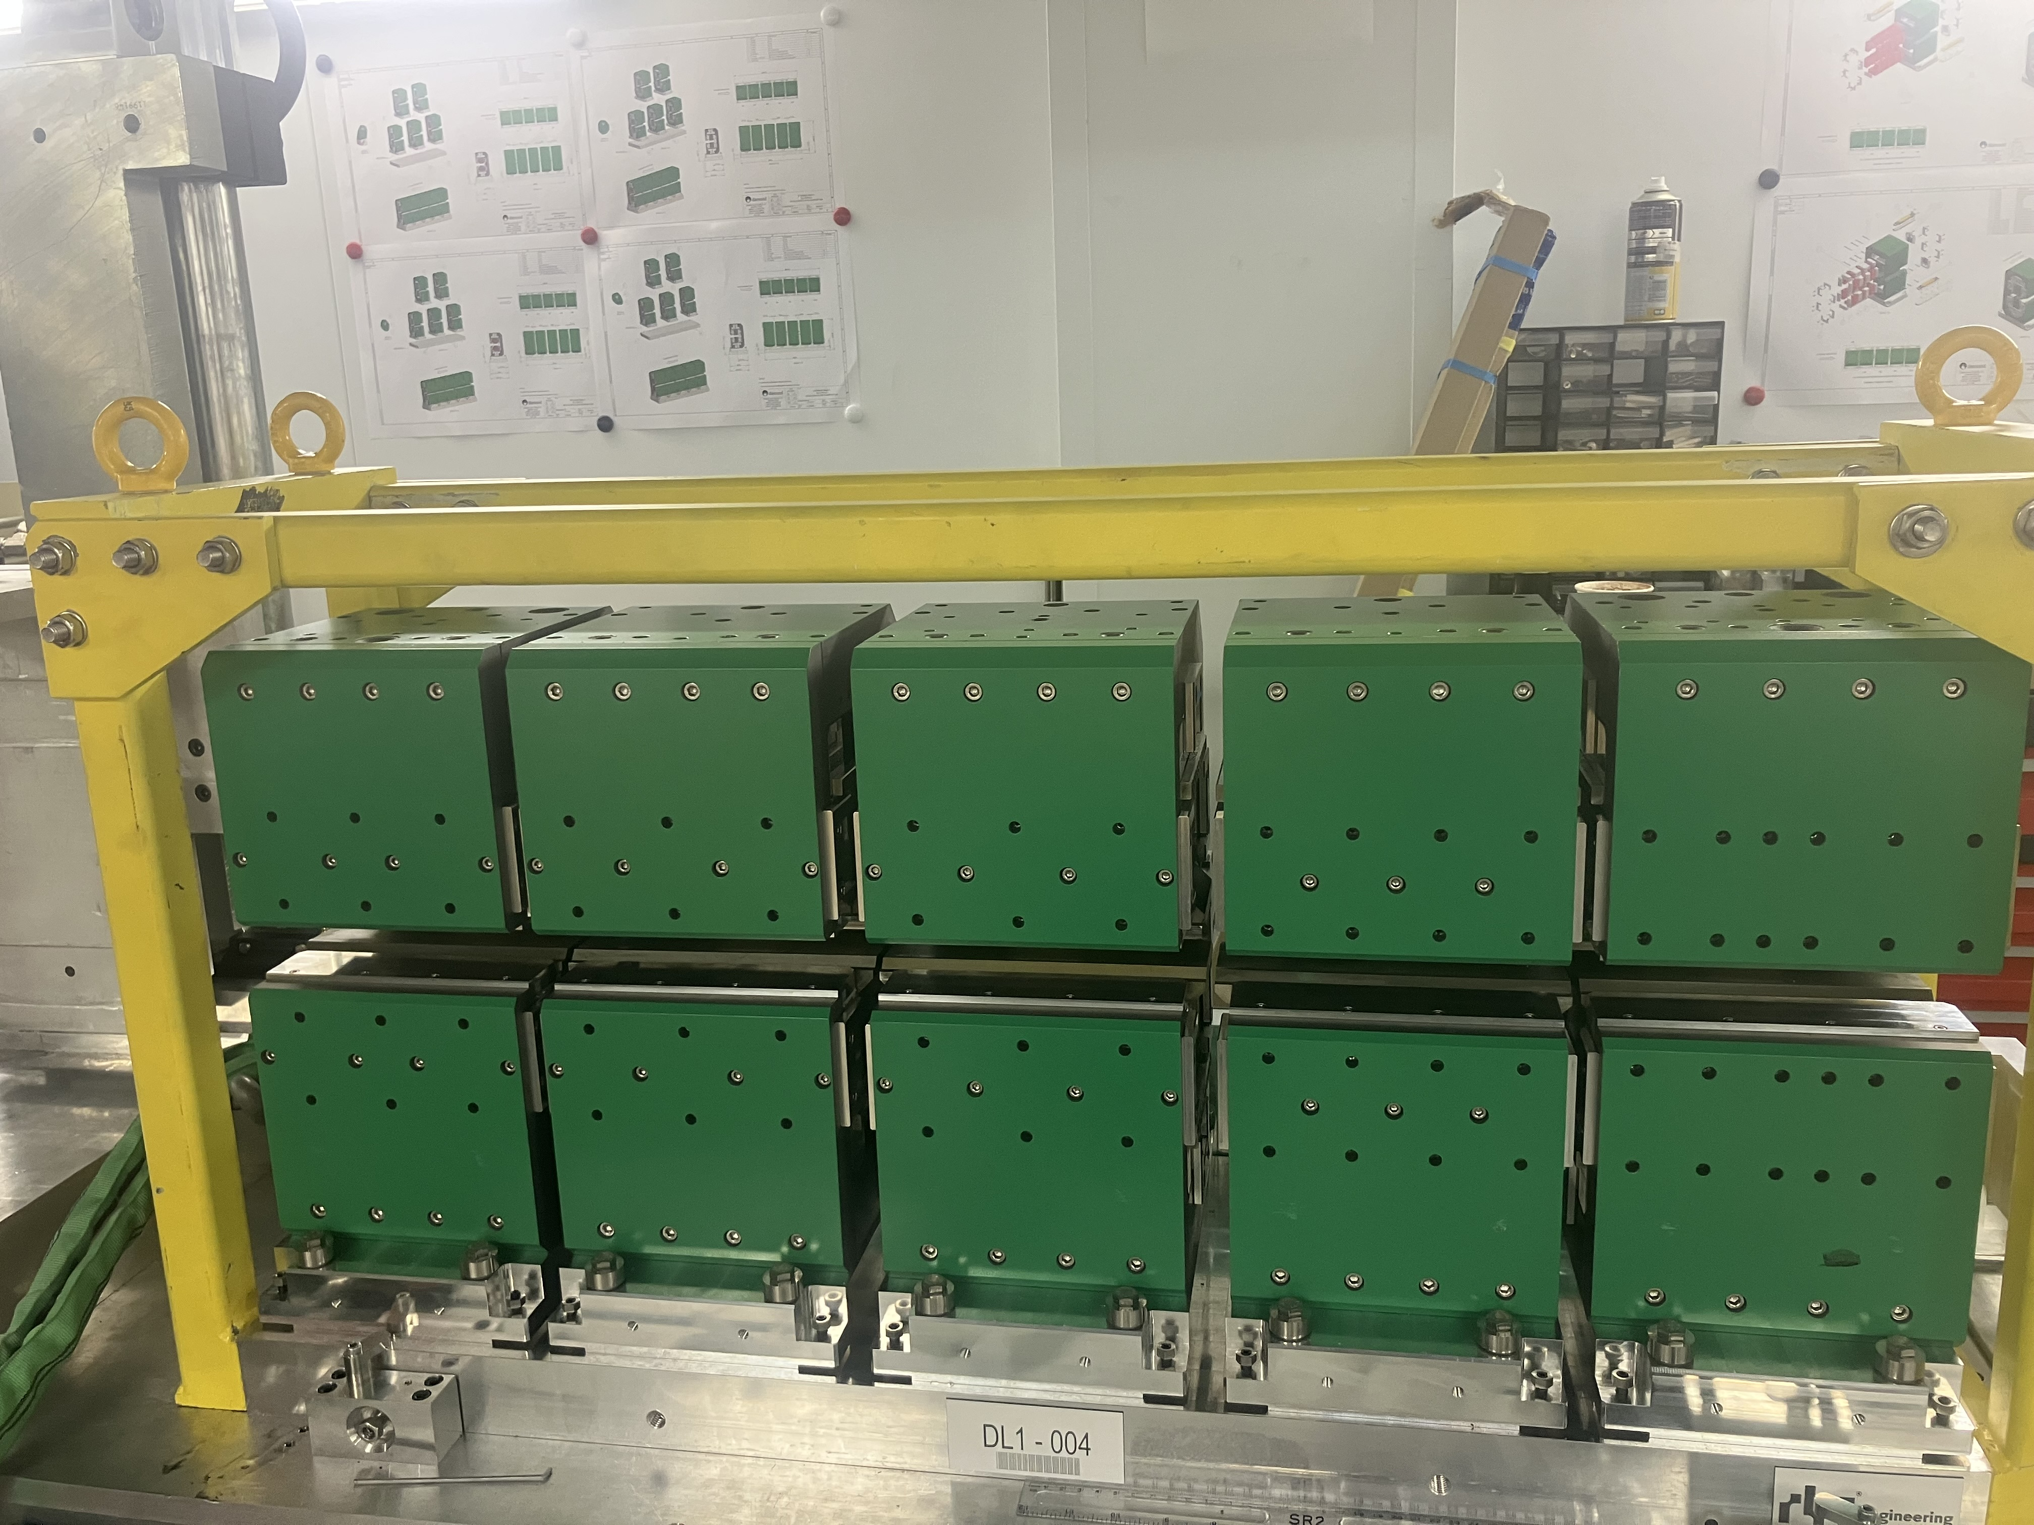
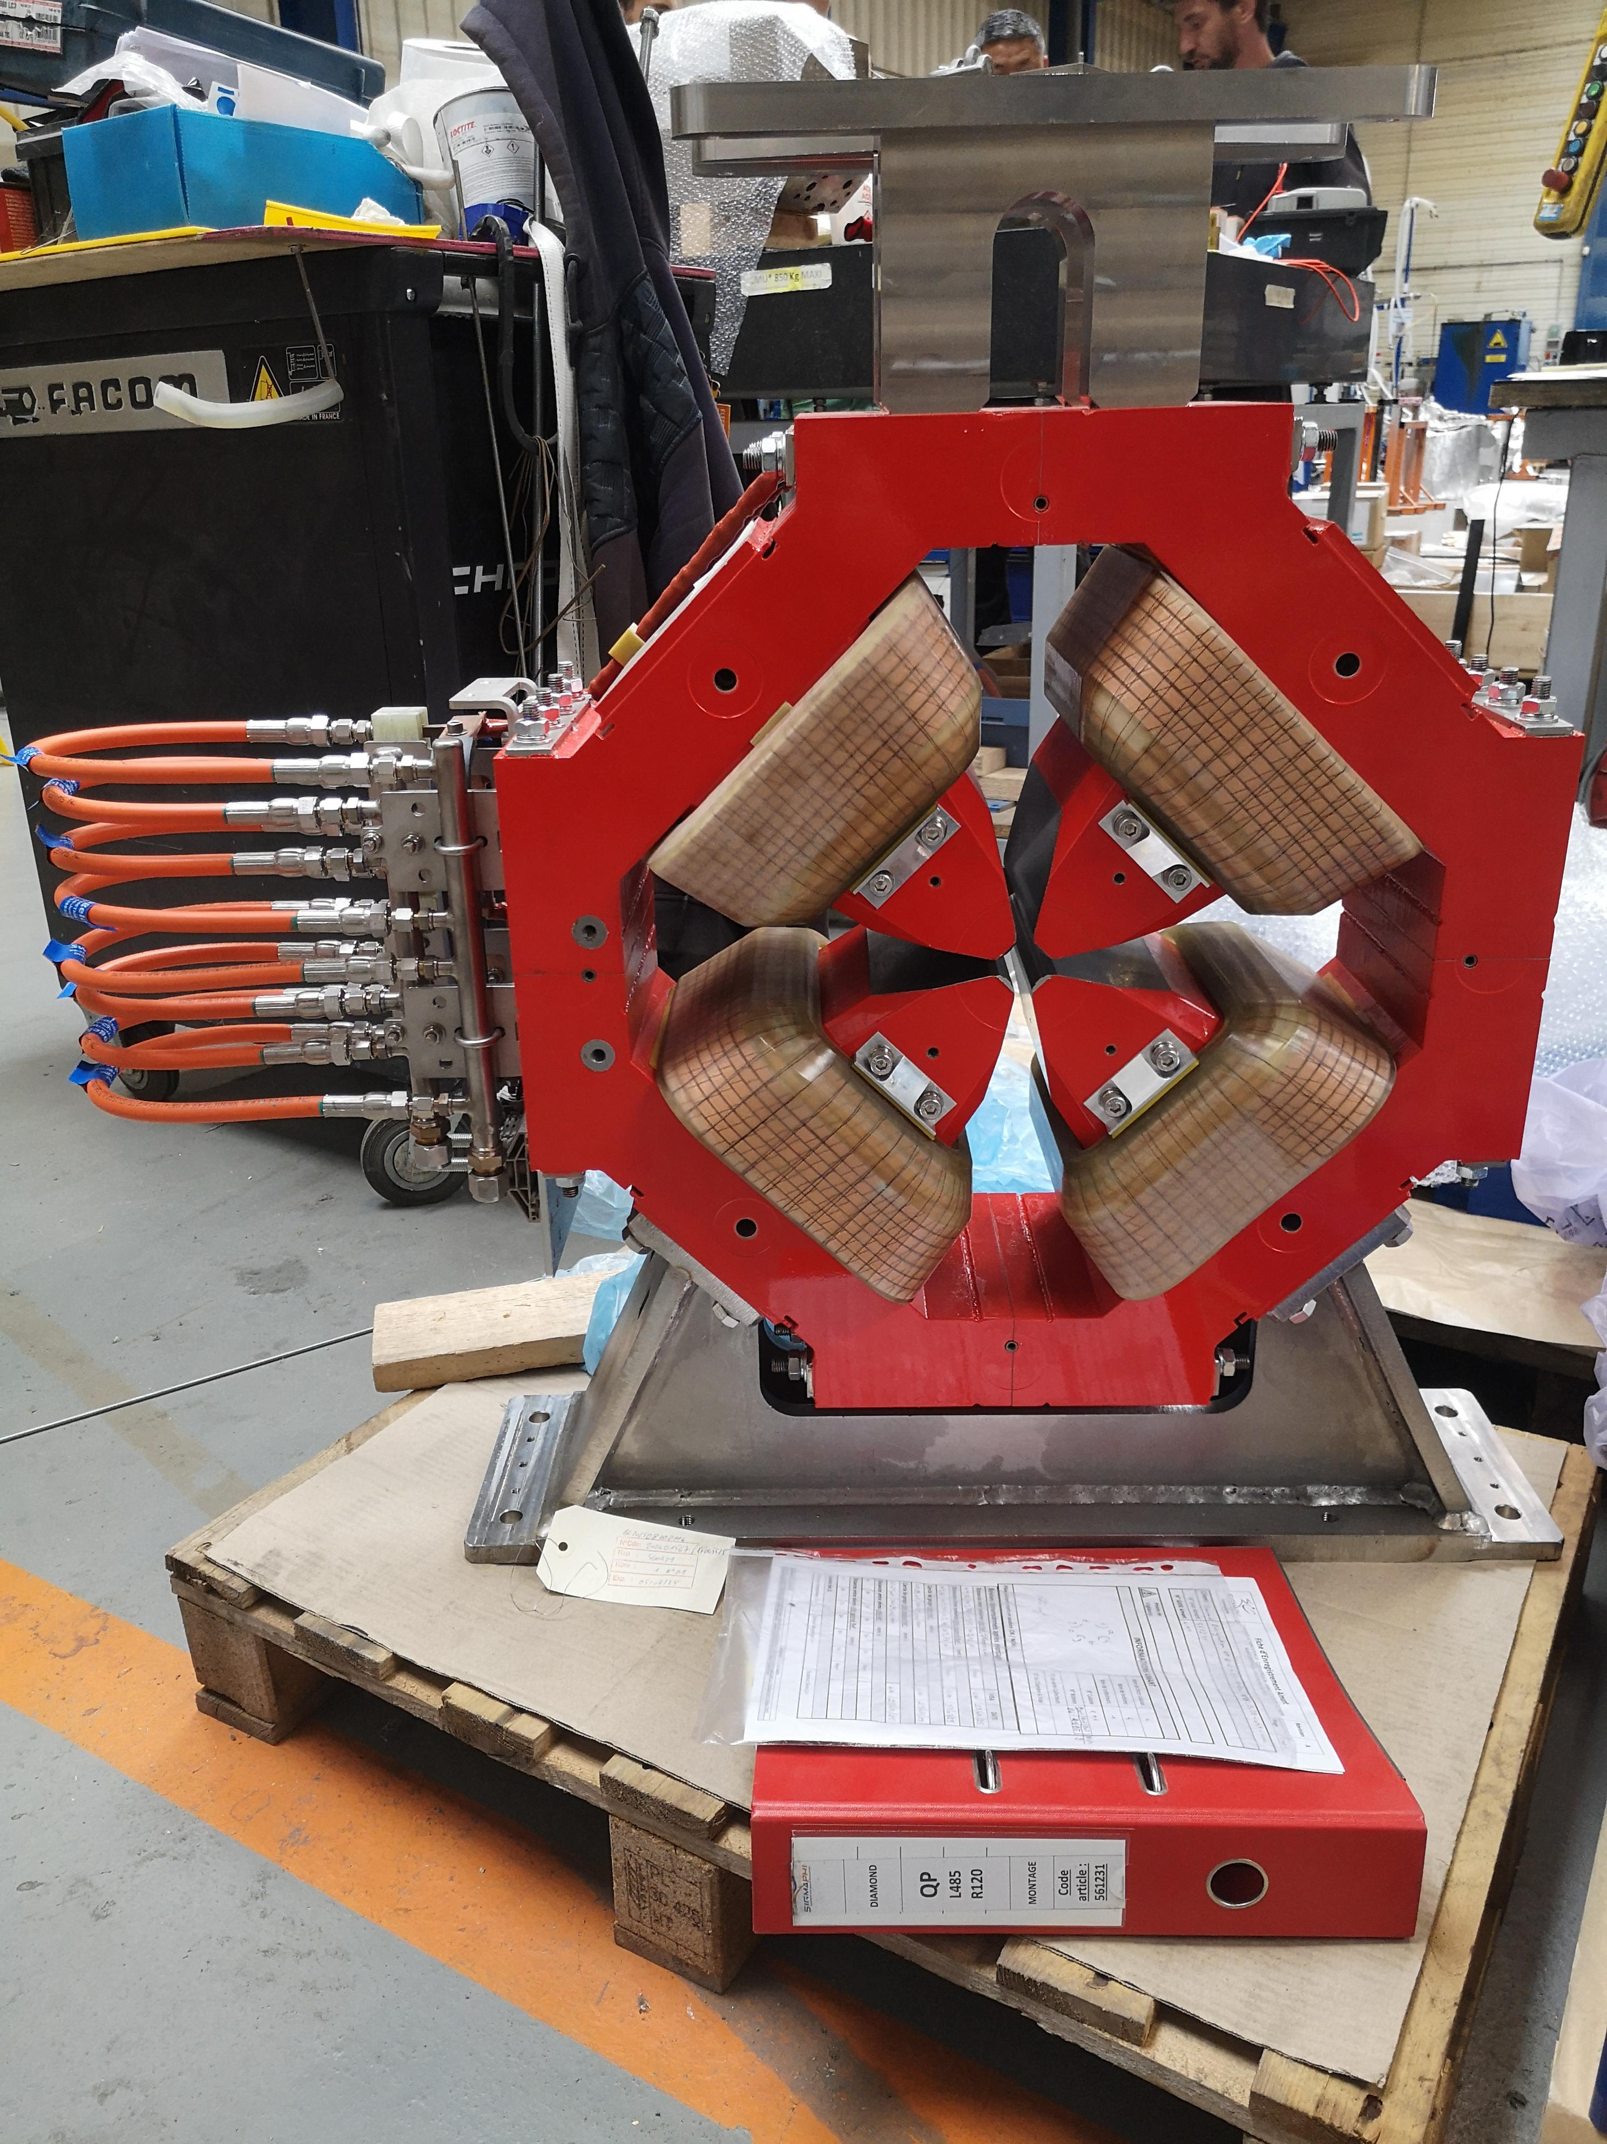
Diamond-II Magnets
DQ
DL
Quadrupole
Courtesy C Bailey
R. Fielder, Diamond Update, ESLS 2025, 30/10/2025

Slide 36
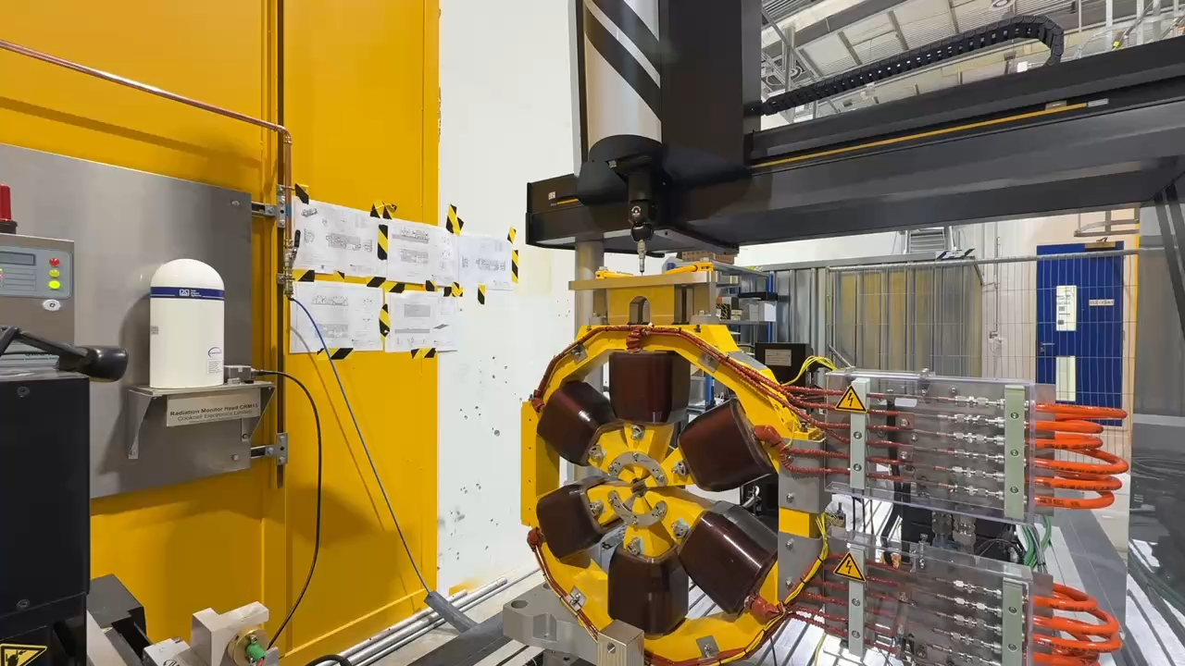
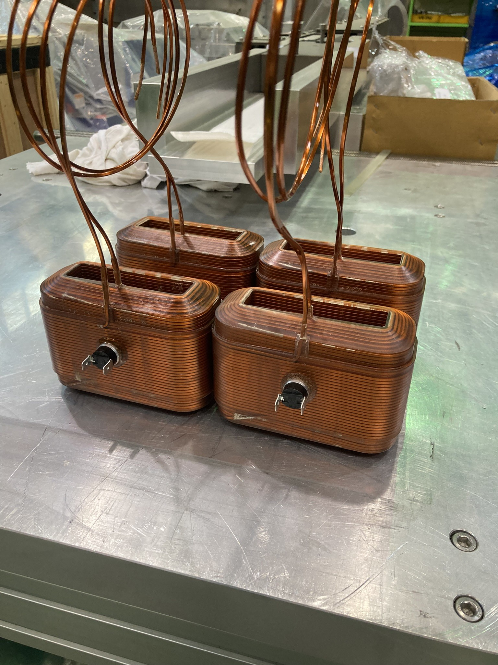

Diamond-II Magnets
Sextupole
Octupole
Courtesy C Bailey
R. Fielder, Diamond Update, ESLS 2025, 30/10/2025

Slide 37




Diamond-II Booster Magnets
Courtesy C Bailey
R. Fielder, Diamond Update, ESLS 2025, 30/10/2025

