Slide 1

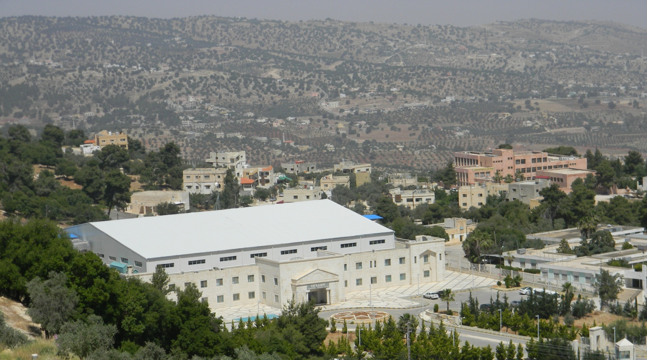
SESAME Report
Maher Attal
On behalf of SESAME team
M. Attal, ESLS33 Meeting, SOLEIL, Oct 29 - 31, 2025

Slide 2
Outline
O Introduction
O Machine performance
O Machine upgrades
O Major incidents
O Energy sustainability
M. Attal, ESLS33 Meeting, SOLEIL, Oct 29 - 31, 2025

Slide 3
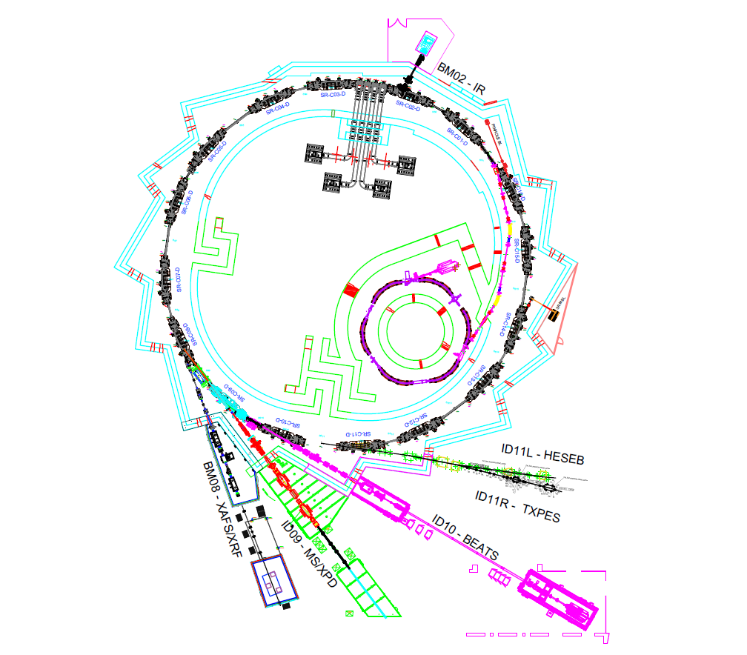
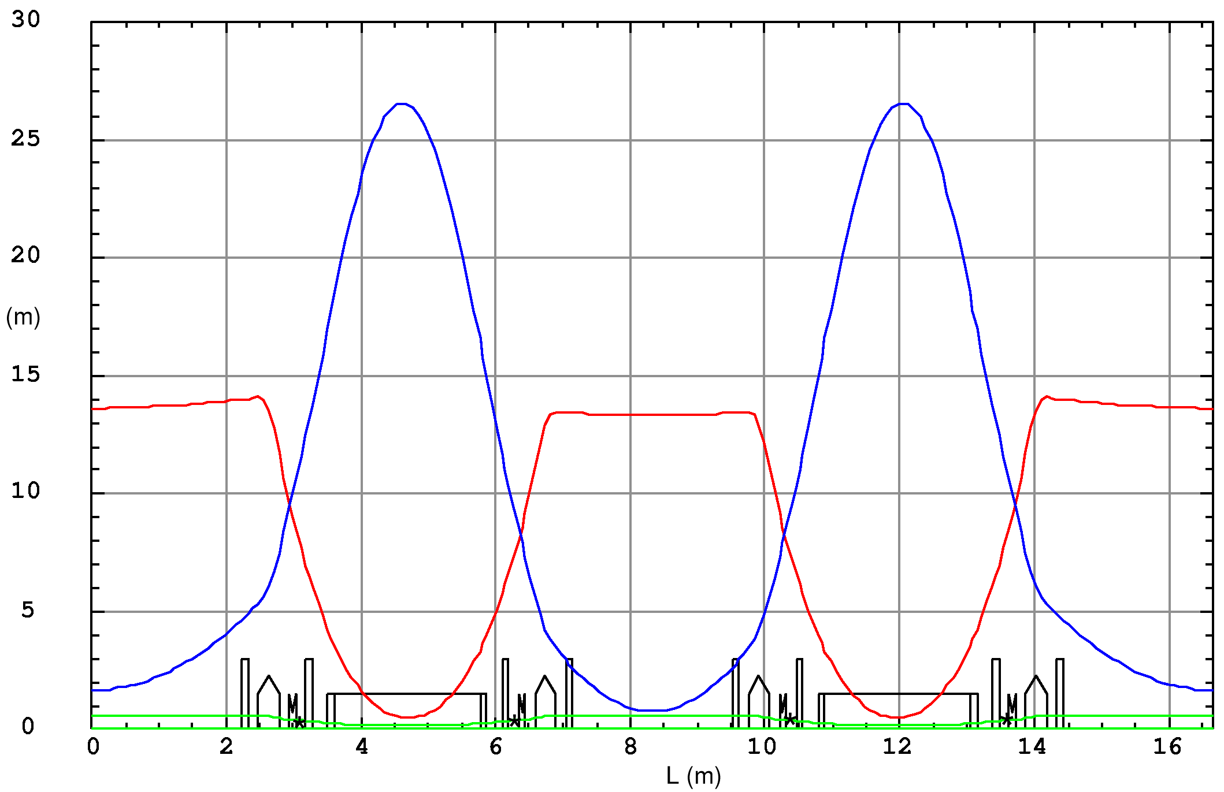
SESAME Structure
100kW Elettra cavities
IR (0.001-3 eV)
(source: BM (includes Edge Radiation))
2.5GeV Storge Ring
C =133.2m
ε_{x} = 26 nm.rad
Simple DBA lattice, dispersive sections
16 cells & 16 S.S. (8x4.2m + 8x2.2m)
I = 300mA (design value: 400mA)
RF: 500MHz, 1.7MV
20MeV Microtron
Ch= 16-24nC, pulse = 2µs
80kW, 500MHz SSAs
800MeV booster
I = up to 12 mA, pulse = 110 ns
β_{y}
β_{x}
Soft X-ray (70 -1800 eV)
(source: Apple II Undulator)
η_{x}
Tomography (5 -100 keV)
(source: 2.9T 3PW)
Hard X-ray (4.7-30 keV)
(source: 1.455T BM)
Hard X-ray (5 -25 keV)
(source: 1.38T MW)
M. Attal, ESLS33 Meeting, SOLEIL, Oct 29 - 31, 2025

Slide 4
Machine Operation Management
Two operator shifts / day: 8:00 – 15:00 and 15:00 – 22:00
Staff are on call in the period 17:00 – 22:00
The machine is not attended in the period 22:00 – 8:00
If the beam is lost after 22:00, recovery will take place next morning
The machine was running in a “Free Mode” over the weekends
(recently it is running at injection energy)
M. Attal, ESLS33 Meeting, SOLEIL, Oct 29 - 31, 2025

Slide 5
Machine Performance
M. Attal, ESLS33 Meeting, SOLEIL, Oct 29 - 31, 2025

Slide 6
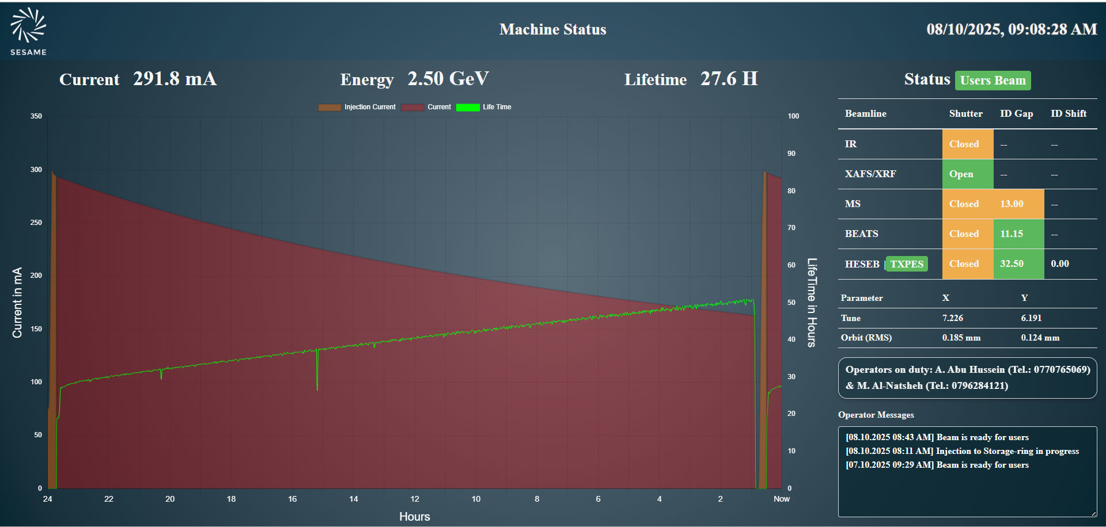
Machine Performance
Good beam lifetime, hence one injection / day

Slide 7
Beam lifetime in 2025 (Feb – Oct)
250mA
300mA
M. Attal, ESLS33 Meeting, SOLEIL, Oct 29 - 31, 2025

Slide 8
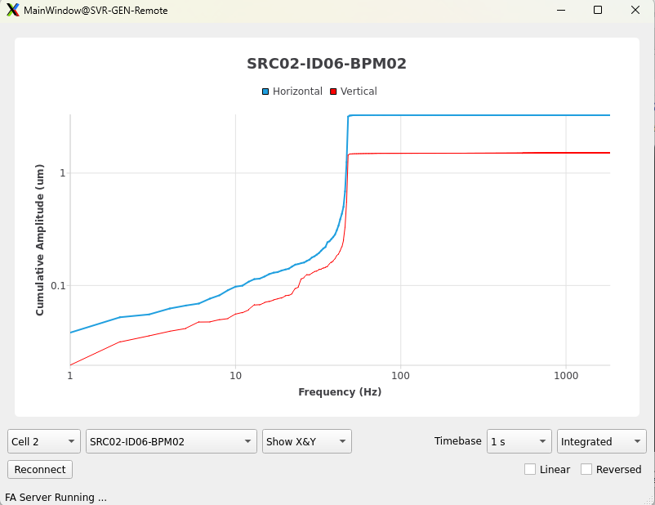
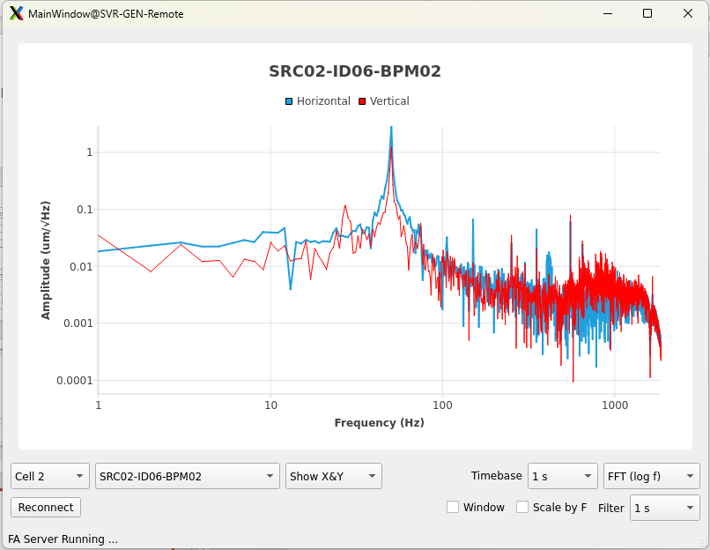
Orbit stability and Orbit Feed Back Systems
RMS in 1-100Hz |  | Horizontal (% of the beam size) |  |  | Vertical (% of beam size)
 |  | Long Straight | Short Straight | Dipole | Long Straight | Short Straight | Dipole
Beam int. Position (μm) | Tolerance | 82.59 (10%) | 82.08 (10%) | 23.23 (10%) | 2.08 (10%) | 1.42 (10%) | 8.1 (10%)
 | Measured | 9.3 (1.12%) | 9.23 (1.12%) | 5.9(2.54%) | 1.4 (6.73%) | 0.8 (5.63%) | 2.57(3.17%)
Beam orbit is corrected by SOFB at 2Hz rate.
Correction rate to be improved to 10Hz
IDs’ orbit distortion is sufficiently compensated
using Feed Forward Tables (FFTs).
No need for FOFB is foreseen at this stage.
M. Attal, ESLS33 Meeting, SOLEIL, Oct 29 - 31, 2025

Slide 9
Machine Performance in 2025 (until Oct 9)
Overall Performance
Including power grid failure
BA = 97.7 %
MTBF = 122.7 h
MTTR = 1.6 h
Excluding power grid failure
BA = 98.2 %
MTBF = 185.0 h
MTTR = 1.5 h
NOTE: machine is not attended in the 3rd shift (22:00-8:00)
M. Attal, ESLS33 Meeting, SOLEIL, Oct 29 - 31, 2025

Slide 10
Machine Performance in 2025 (until Oct 9)
Performance/ Run
Beam Availability
MTBF
MTTR: 1.6h
MTTR: 2.4h
MTTR: 0.8h
MTTR: 0.4h
M. Attal, ESLS33 Meeting, SOLEIL, Oct 29 - 31, 2025

Slide 11
Machine downtime & failures in 2025 (until Oct 9)
Total machine downtime = 59.2 h & Total number of failures = 54
21.5%
Number of failures
Machine downtime
15.4%
14.7%
13.6%
12.6%
12.2%
2.4%
1.5%
1.5%
1.4%
0.9%
0.8%
0.5%
0.5%
0.3%
M. Attal, ESLS33 Meeting, SOLEIL, Oct 29 - 31, 2025

Slide 12
Machine Statistics over last years
Including power grid failure
Beam Availability
MTBF
BMS of cooling
system upgraded to PLC (Aug 2024)
Configuration of RF LLEs improved (Sep 2024)
Exceptional year of power grid instability
M. Attal, ESLS33 Meeting, SOLEIL, Oct 29 - 31, 2025

Slide 13
Performance of cooling and RF systems in 2024 versus 2025
 | The system’s contribution to machine downtime
 | 2024 (Feb – October) | 2025 (Feb – October)
Cooling system | 15.5 h (62% due to BMS) | 6.6 h (0% due to the PLC)
RF system | 79.8 h (88% due to LLE) | 0.5 h
M. Attal, ESLS33 Meeting, SOLEIL, Oct 29 - 31, 2025

Slide 14
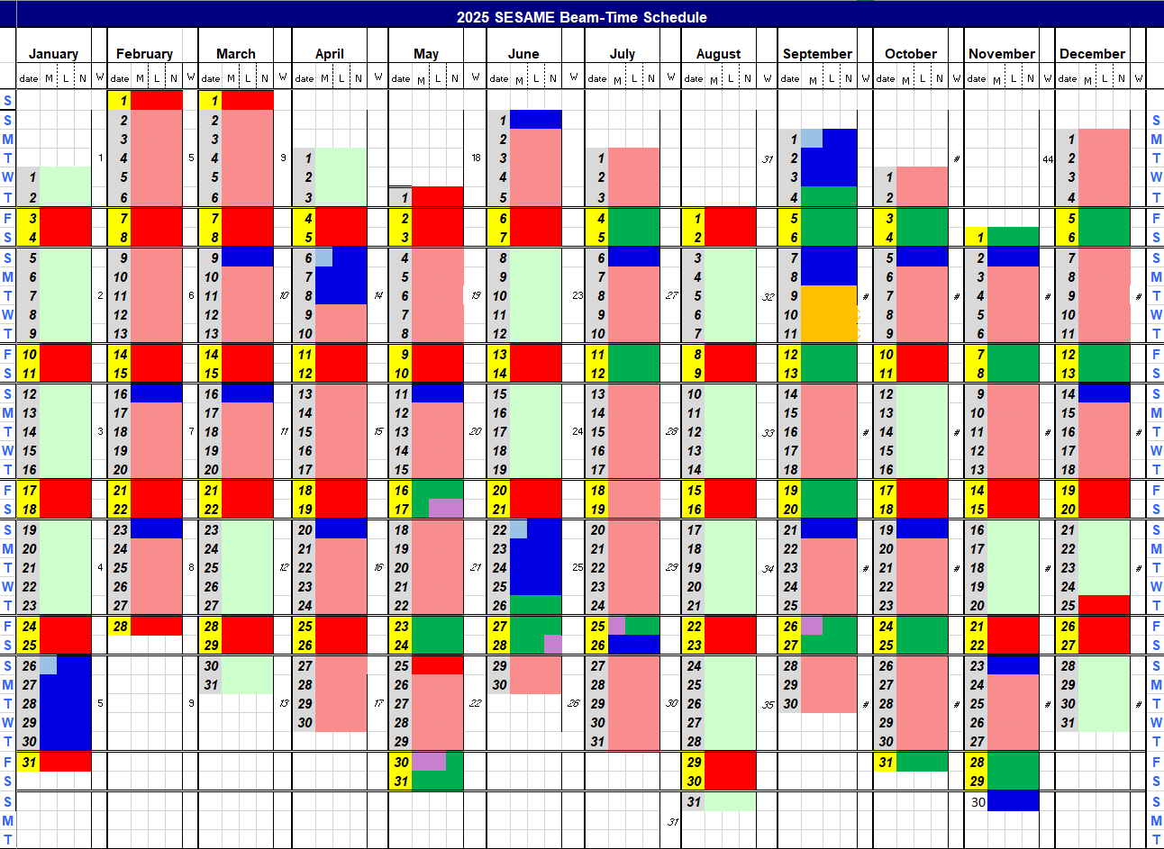
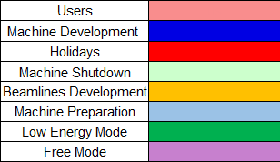
Machine calendar 2025
Total shifts: 4392h
=================
User time : 3528h (80.3%)
Machine dev.: 760h (17.3%)
Beamline dev. : 72h (1.64%)
Machine pre. : 32h (0.73%)
Free mode: 56h
Low energy mode: 832h

Slide 15
Major Upgrades on the Machine
M. Attal, ESLS33 Meeting, SOLEIL, Oct 29 - 31, 2025

Slide 16
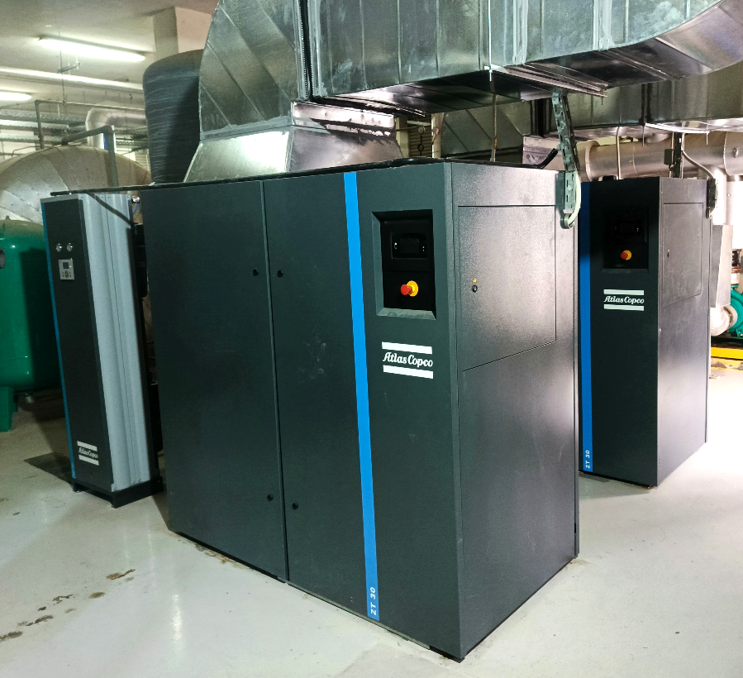
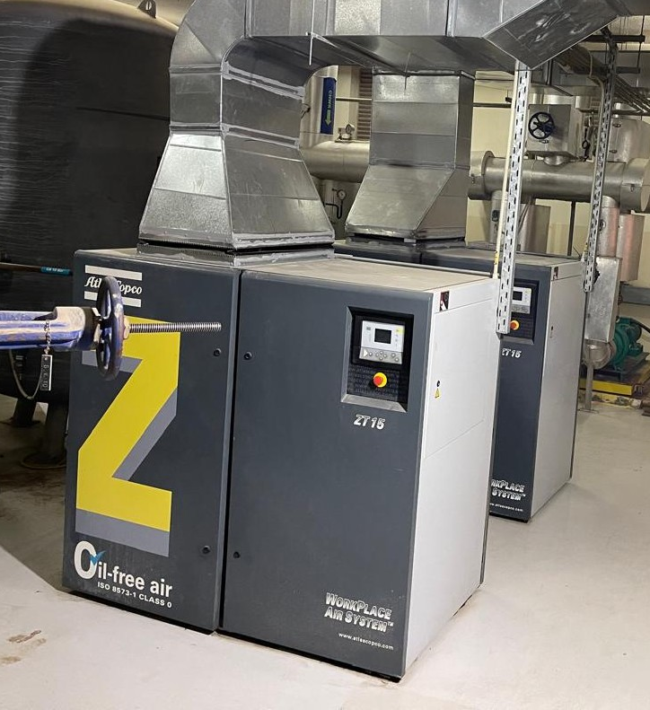
Upgrade on compressed air system (Aug 2025)
Two air compressors (ZT15) (31.1 L/s each):
Running under risky conditions
(exceeded their overhaul time).
One compressor can’t run the machine
(machine load ~ 45 L/s).
A single point of failure for the machine
Two new compressors (ZT30) (70.4 L/s each).
The condition “one compressor running, one on standby” is achieved.
The system isn’t critical anymore
Upgraded to
Fully funded by PSI
Many thanks

Slide 17
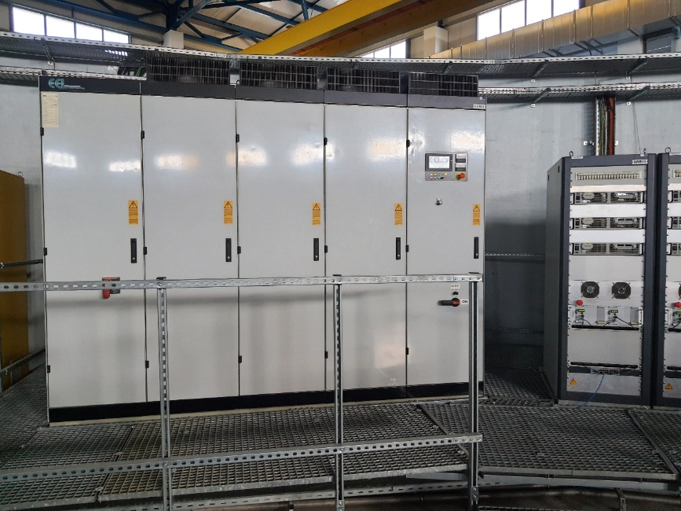
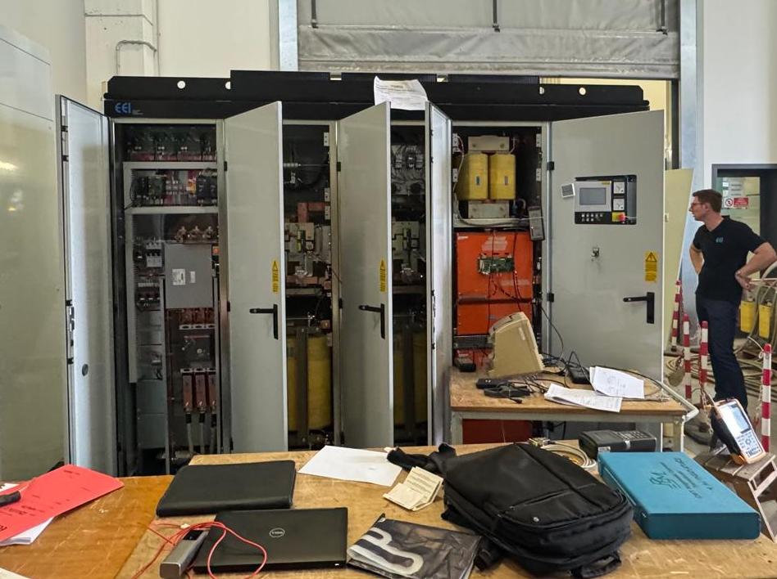
A spare power supply for storage ring dipoles
SR dipoles’ PS is a big and complicated system
Any failure takes several days of troubleshooting and repair
A single point of failure for the machine
A spare one has been manufactured by EEI company
Shipment in Nov 2025 & installation in Jan 2026
(The planned fast switching between the two PSs will reduce a lot the MTTR)
Dipole PS
Funded mainly by PSI
Many thanks
Partial fund from SESAME

Slide 18
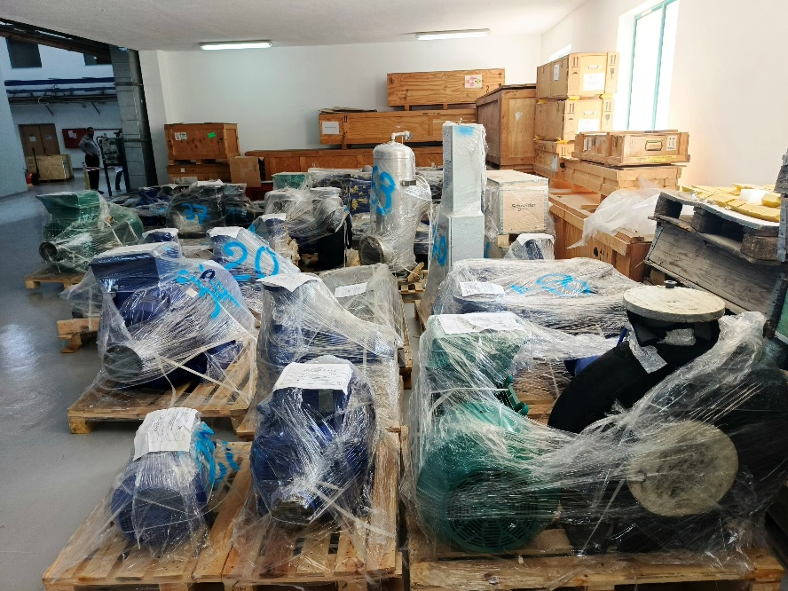
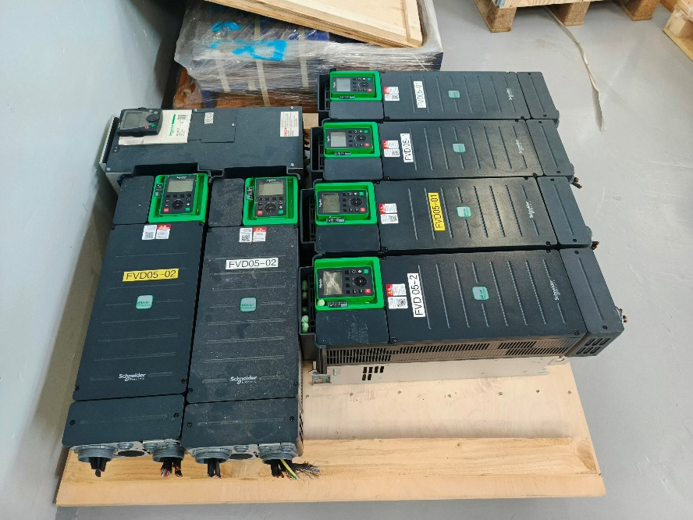
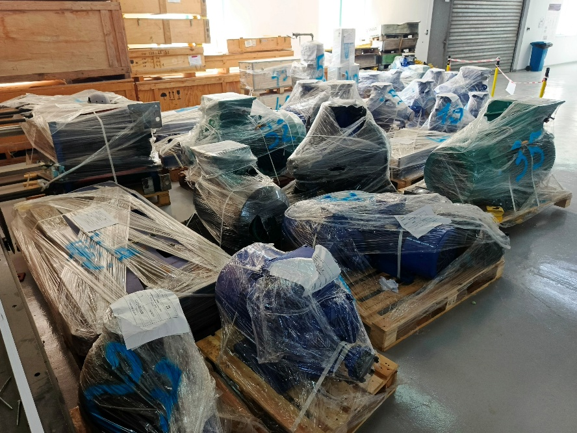
Further upgrades on the cooling system soon
Cooling parts donated by SOLEIL arrived at SESAME
Further upgrades on SESAME cooling system are planned starting January 2026
(main SR pumps, heat exchanger, DI water feeding unit, …..)
Many thanks

Slide 19
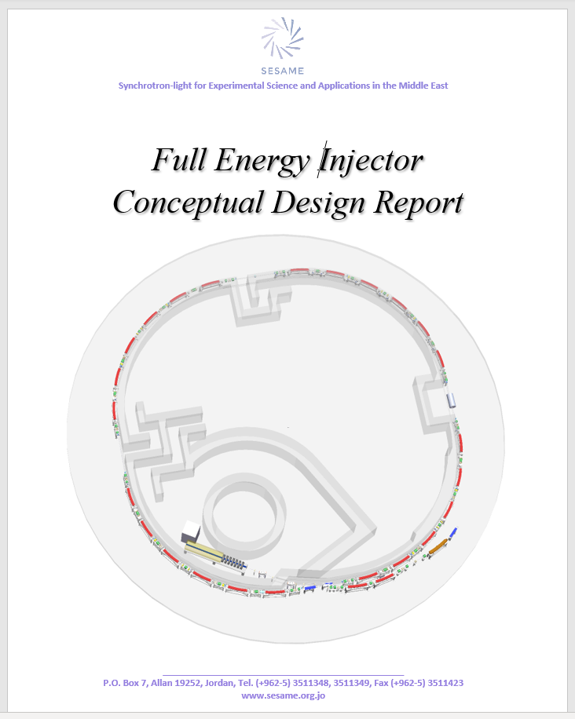
The future full energy injector
The draft CDR is finished (under review by the MAC)
Main features:
A compact 100MeV linac (8.2 – 8.6 m)
It uses one HG accelerating section (27 – 30 MV/m)
(adopting the design of FERMI HG structure)
A 30 nm.rad, 118.2 m, 2.5 GeV booster
(attached to the inner of SR tunnel)
The project is to be done in two phases, keeping
the microtron as a standby pre-injector in phase I.
M. Attal, ESLS33 Meeting, SOLEIL, Oct 29 - 31, 2025

Slide 20
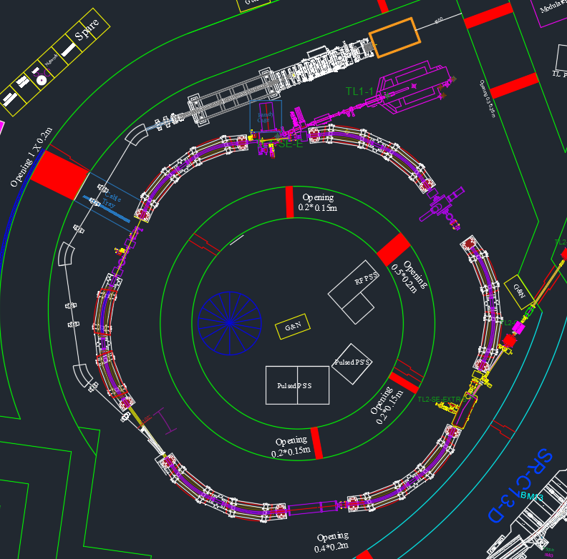
The future full energy injector
Why a compact 100MeV linac (8.2 – 8.6m):
Fits the space available in booster tunnel
Lower cost (no new bunker is needed)
Space effective solution
Less efforts (no construction work required)
No dark period is needed (installation &
commissioning can be done during user’s time
& normal shutdowns)
Phase I:
The linac installed parallel to Microtron with injection
at different section into the 800MeV booster.
The microtron will be kept as a standby pre-injector until reliability of the linac is approved
and good experience is obtained in the new system.
Injection septum
Injection/ extraction kicker
M. Attal, ESLS33 Meeting, SOLEIL, Oct 29 - 31, 2025

Slide 21
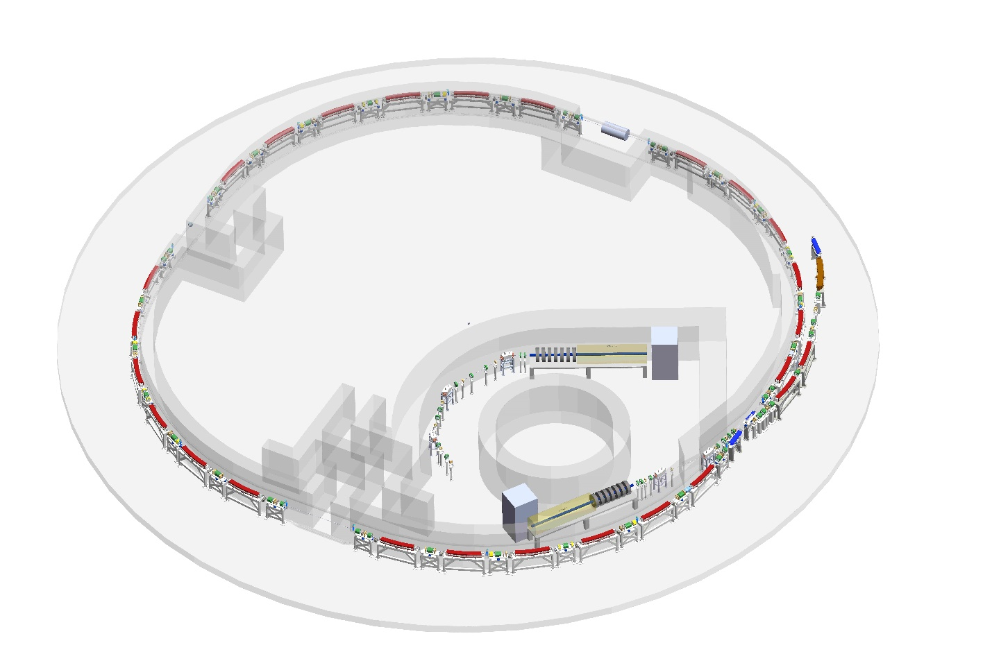
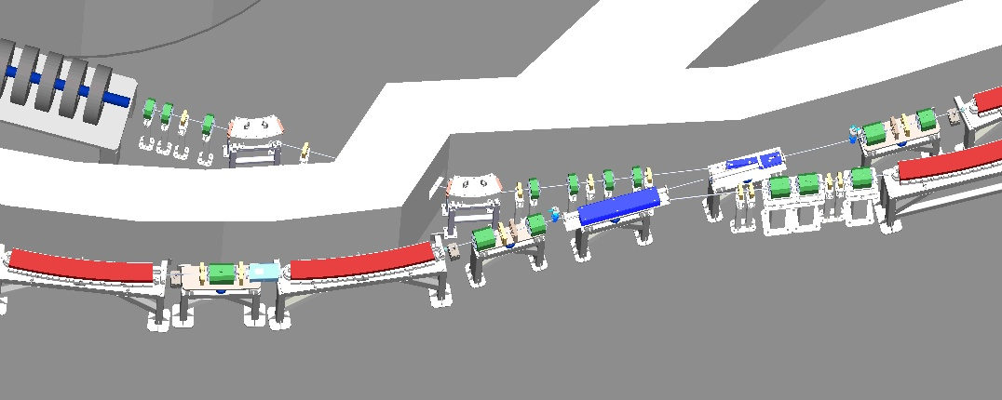
The future full energy injector
Phase 2
When the full energy booster
becomes available.
Linac to be moved to its final
location closer to the FEB.
The 800MeV booster will be dismantled
Phase 1
Phase 2
M. Attal, ESLS33 Meeting, SOLEIL, Oct 29 - 31, 2025
Injection/extraction section

Slide 22
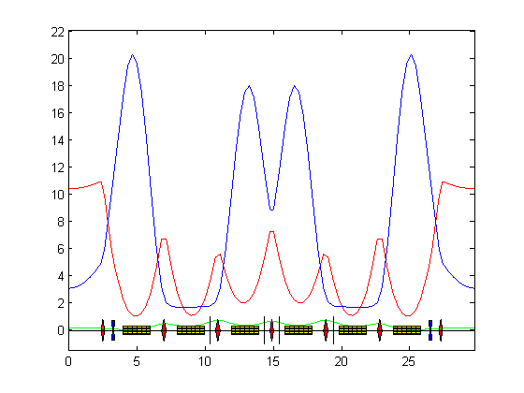
Main parameters of the full energy booster
Parameter | Unit | Value
Inj. / ext. energy | GeV | 0.1 / 2.5
C | m | 118.2
Nat. emittance | nm.rad | 30
Qx, Qy |  | 6.77, 4.83
Nat. ξ x, y |  | -8.52, -11.8
Energy spread | % | 0.1503
Energy loss/turn | keV | 452.7
τ_{x}, τ_{y}, τ_{s} (@100MeV) | s | 27.2, 68.4, 141.3
τ_{x}, τ_{y}, τ_{s} (@2.5GeV) | ms | 1.74, 4.38, 9.05
α | % | 1.521
I max | mA | 10
Repetition rate | Hz | 3
RF frequency | MHz | 500
Harmonic number |  | 197
Peak RF voltage | MV | 0.650
β_{y}
β_{x}
η_{x}
M. Attal, ESLS33 Meeting, SOLEIL, Oct 29 - 31, 2025

Slide 23
Major Incidents
M. Attal, ESLS33 Meeting, SOLEIL, Oct 29 - 31, 2025

Slide 24
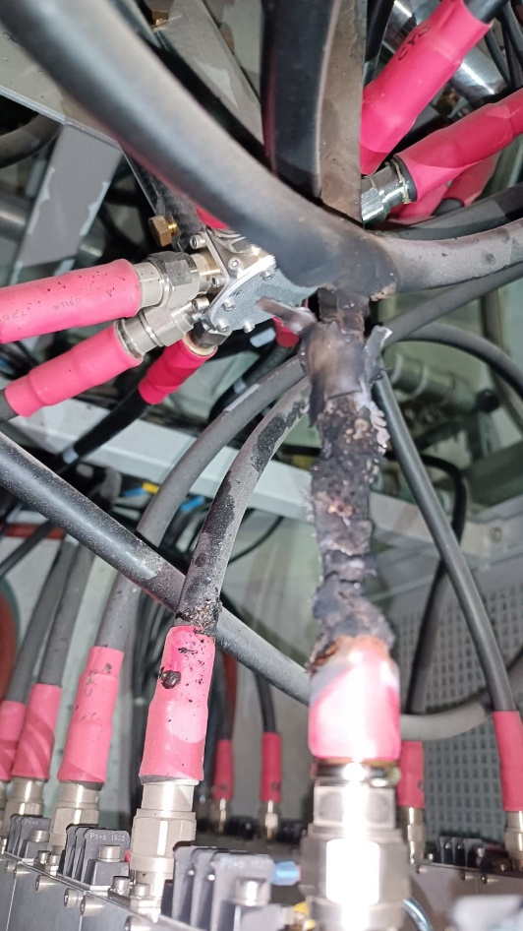
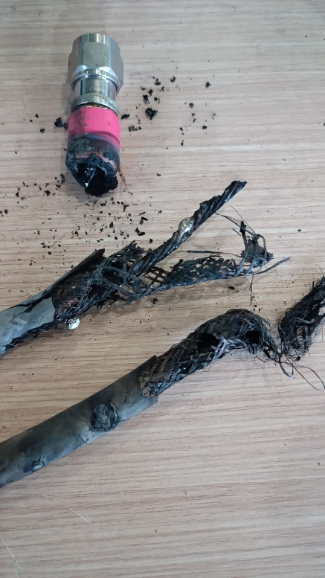
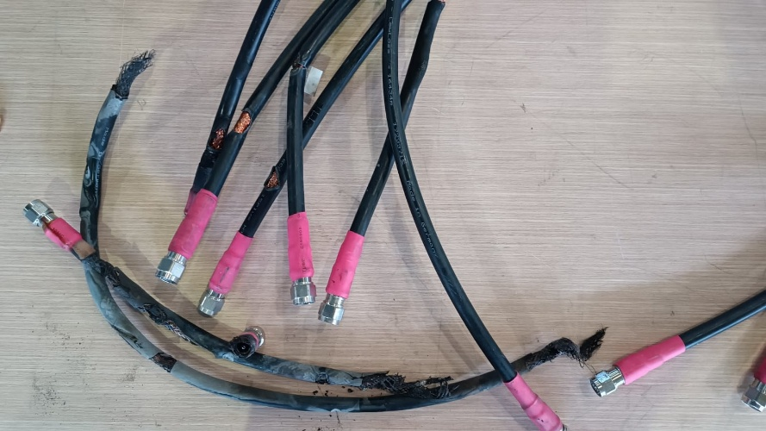
High-voltage cable burned
Incident: A high-power coaxial cable burned in RF SSA1
Date: September, 2024
Reason: A connection loose
Impact:
4.5h of machine downtime (it was a machine day).
The burned cable caused partial damage to 6 other
cables located below it.
Action:
All damaged cables were replaced.
Tightness of other cables was verified
Cable tightness and thermal inspections (thermal camera)
have been scheduled as part of periodic preventive
maintenance.

Slide 25
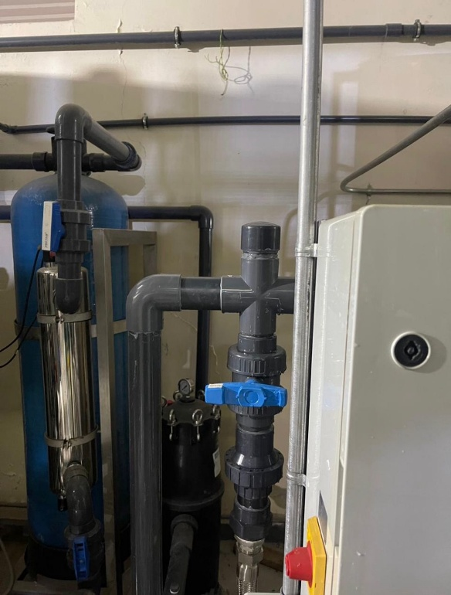
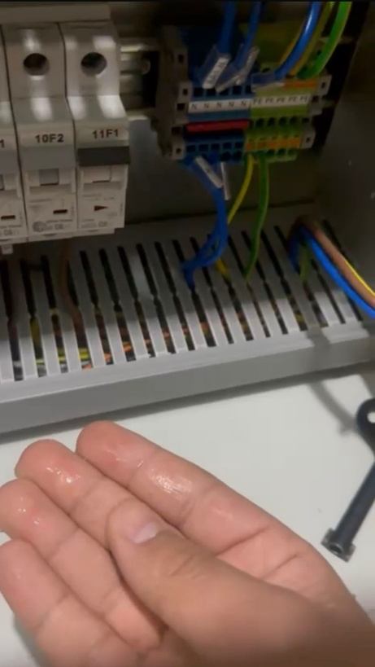
A strong water leak in the DI water unit
Incident: Strong water leak in DI water unit which sprayed water
on the PLC control panel.
Date: May, 2025
Reason: A crack in the PVC elbow (manufacturing fault ?)
Impact:
A short circuit in the control panel which disturbed the PLC operation
Incorrect operation of the SR and RF circuits’ 3-way valves.
Action:
The PLC panel was dried well and returned to normal operation
The elbow was replaced temporarily
(later, it was replaced with stainless steel one)
M. Attal, ESLS33 Meeting, SOLEIL, Oct 29 - 31, 2025

Slide 26
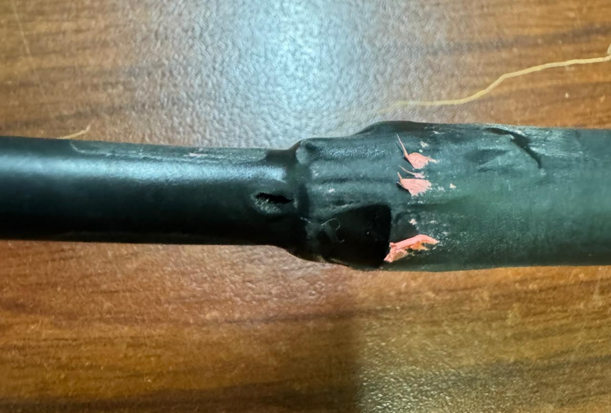
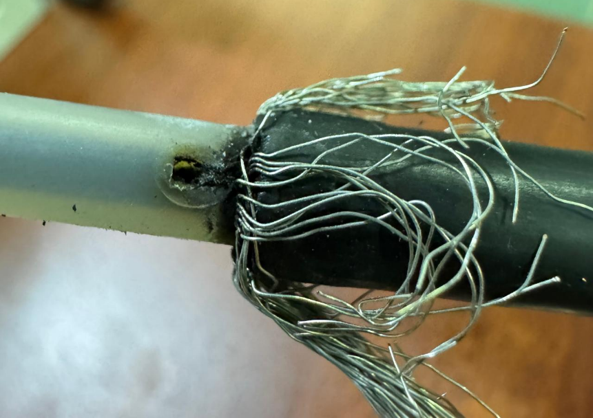
High-voltage cable of extraction kicker burned
Incident: Short circuit in the high-voltage coaxial cable of
booster extraction kicker’s PFL.
Date: October, 2025
Reason: Unknow (Insulation problem ?)
Impact: Disabled the extraction kicker & stopped injection
(during the machine time)
Action:
The cable repaired and its insulation improved
An industrial high voltage connector to be used
A scheduled periodic inspection of high-voltage connections
M. Attal, ESLS33 Meeting, SOLEIL, Oct 29 - 31, 2025

Slide 27
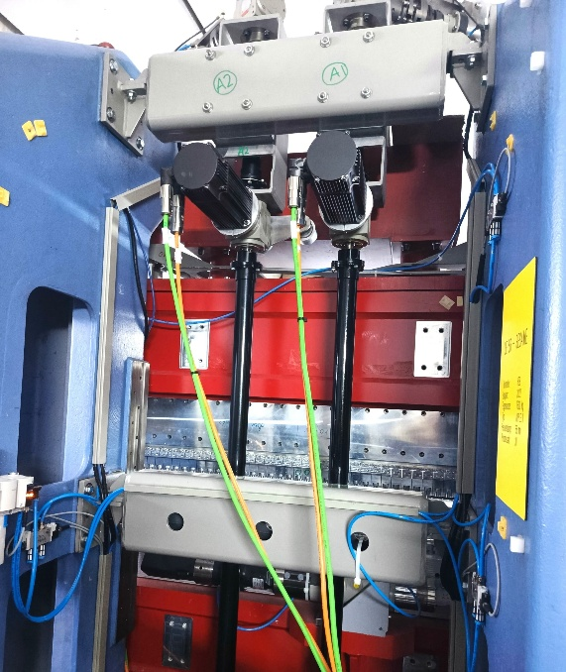
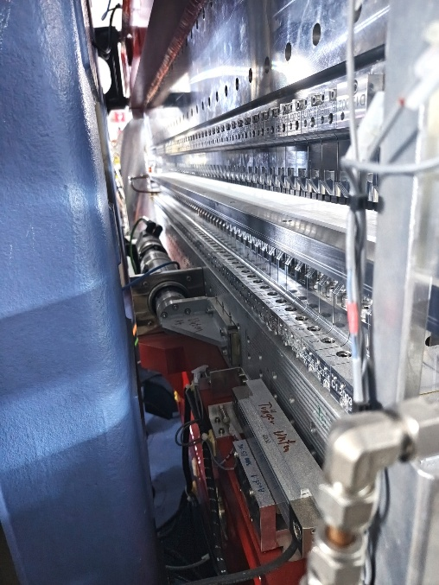
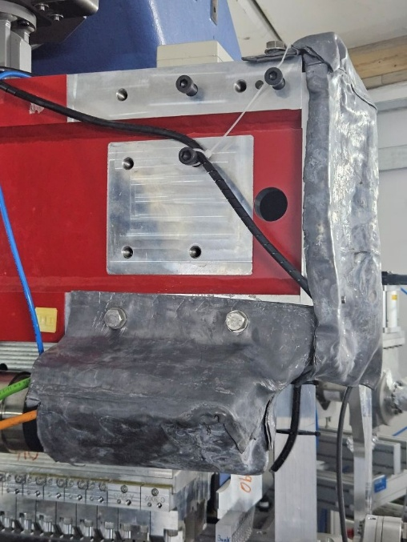
Failures in Apple II undulator’s motors
Gap motor
Phase shift motor
Incident: 3 failures in undulator’s motors in 3 years
(gap motor (once) and phase shift motor (twice))
Date: June 2022, Nov. 2024, Oct. 2025
Reason: Unknown (power dip/outage? or radiation?)
Impact: Disabling the undulator’s motion.
Action:
The motors were replaced
Temporary lead shielding installed (recently).
Shielded housings for motors and encoders
(lead + polyethylene) to be fabricated and
installed next shutdown.
Motor & encoder
shielded with lead sheets
M. Attal, ESLS33 Meeting, SOLEIL, Oct 29 - 31, 2025

Slide 28
Energy Sustainability
M. Attal, ESLS33 Meeting, SOLEIL, Oct 29 - 31, 2025

Slide 29
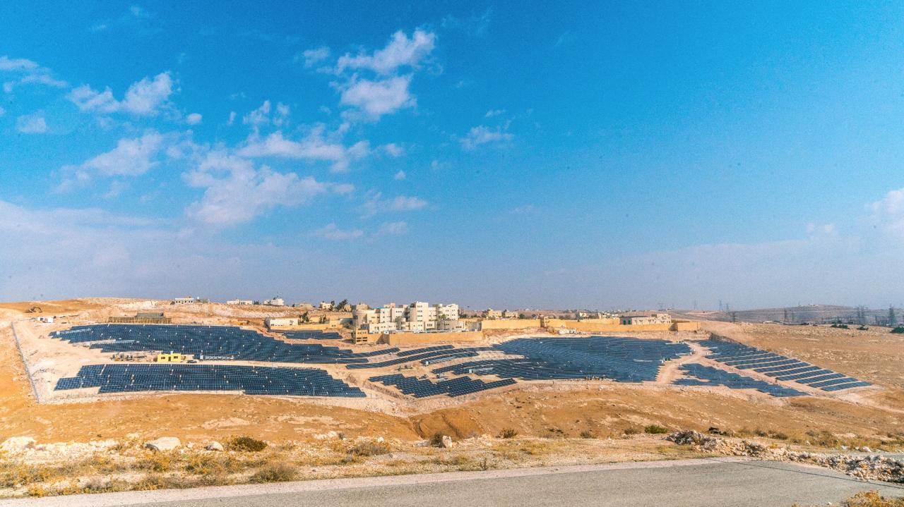

SESAME is powered by sun
6.5MW Solar Power Plant.
Funded by EU ($ 7.34 M)
Many thanks to EU
Start of operation:
Feb 28, 2019
40km far from SESAME
Supplies SESAME with power through a “Wheeling System”
SESAME became a signatory of the UN Climate Neutral Now initiative

Slide 30
Solar power plant (SPP) comparison chart of 2023-2025

Slide 31
Electrical energy budget (2019-2025)
Year | Production (kWh) | Consumption (kWh) | Cost (US$) |  | Savings (US$) | Saved CO₂ (Ton)
 |  |  | With SPP | Without SPP
2019 | 9,541,970 | 7,127,380 | 112,041 | 2,677,801 | 2,565,760 | 6,233
2020 | 9,318,793 | 5,676,520 | 108,182 | 2,132,704 | 2,024,522 | 6,087
2021 | 11,529,373 | 9,726,160 | 137,238 | 3,654,179 | 3,516,941 | 7,531
2022 | 10,812,209 | 8,318,220 | 127,778 | 3,125,207 | 2,997,429 | 7,062
2023 | 10,747,999 | 10,743,270 | 295,274 | 4,036,313 | 3,741,039 | 7,021
2024 | 10,921,502 | 11,596,700 | 353,219 | 4,356,952 | 4,003,733 | 7,134
2025 Jan-Jun | 4,888,385 | 4,955,620 | 169,403 | 1,861,857 | 1,692,454 | 3,193
Total | 67,760,231 | 58,143,870 | 1,303,137 | 21,845,013 | 20,541,877 | 44,260

Slide 32
Reducing machine energy consumption
The machine’s energy consumption was getting closer to SPP’s production.
Unplanned requests by Jordan Electric Power Company to stop the SPP
during the weekends in March & April, 2025. Another similar
requests are potential in the future.
Actions taken:
Running the machine at injection energy (low energy mode) during weekends.
Reducing total machine operation time by ~ 14% in 2025 with respect to 2024
(4392h instead of 5088h) (user time reduced by 14% & machine time reduced by 20%)
M. Attal, ESLS33 Meeting, SOLEIL, Oct 29 - 31, 2025

Slide 33
Machine calendar
2025
Low energy mode
during the weekends
starting May 2025.

Slide 34
Thank you

