Slide 1

Metrology Light Source Status, Upgrade and SSMB activities
Carsten Mai on behalf of the MLS team
30 October 2025
ESLS 2025 SOLEIL

Slide 2
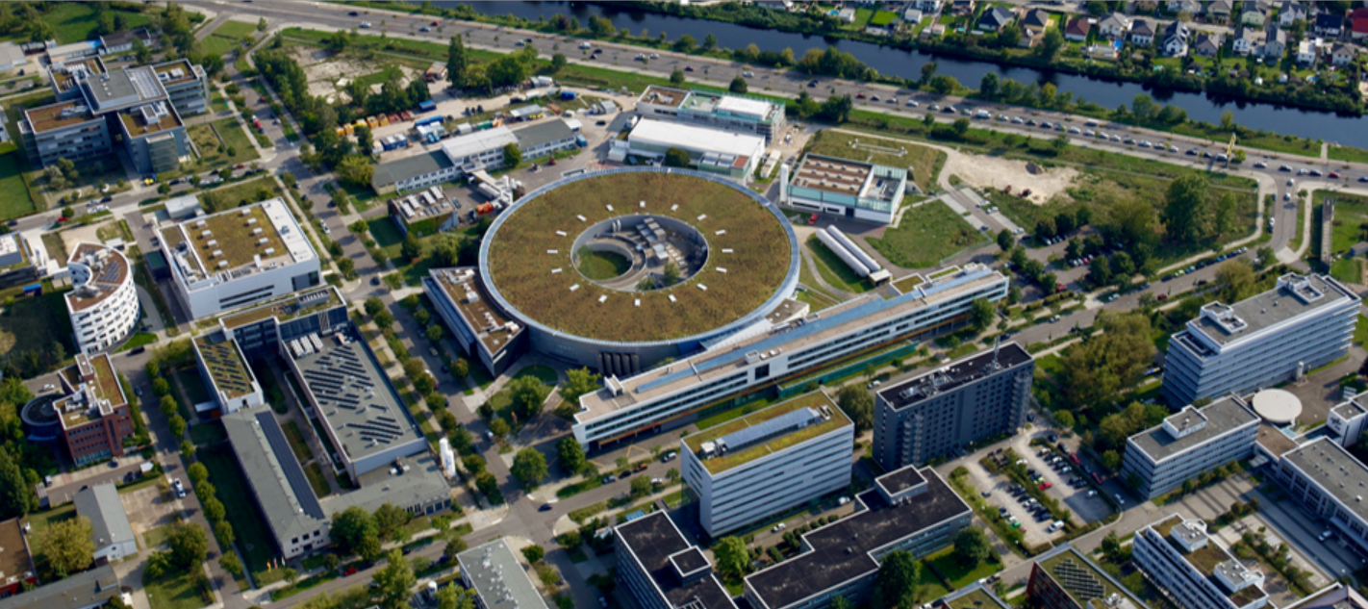
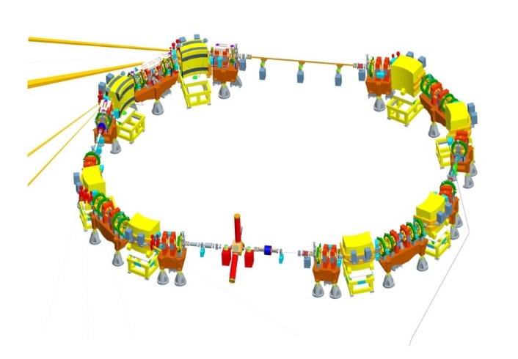
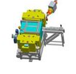
Overview
MLS
BESSY II
The Metrology Light Source
U125 undulator
RF cavity, HOM damped
500 kV@ 500 MHz, h=80
Circumference Revolution time | 48 m 160 ns = 1/6.25MHz
Injection Energy Operational Energy | 105 MeV 50 MeV to 630 MeV
Beam Current | 1pA (1e-) – 200mA
Momentum Compaction Factor | -0.05 < α < 0.05
Emittances at 630 MeV | 120 nm*rad (standard user) 25 nm*rad (low emittance) 250 nm*rad (low alpha)
Typical lifetimes in frequently used operation modes | standard user 6h @ 150 mA, 350 h @ 10µA low emittance 2h @ 150 mA low alpha 10h @ 150 mA
Microtron
Owned by Physikalisch-Technische Bundesanstalt (PTB)
Operated and maintained by HZB
First storage ring optimized for low alpha operation (short bunch operation → coherent THz emission)

Slide 3
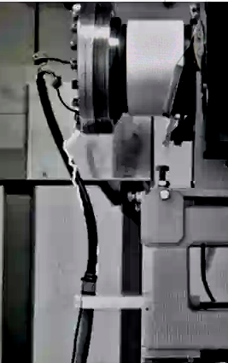
Overview
MLS OPERATION STATUS
in general: very reliable machine operation with few interruptions
interruptions mostly caused by: RF, Microtron
damaged HV connector slightly reduced injection rate
multiple power outages
outage of 1 (redundant) main cooler without effect on user operation
2-week shutdown in July
improvements for steady-state microbunching setup
integration of new laser
specially EUV reflectometry under very high demand at PTB

Slide 4
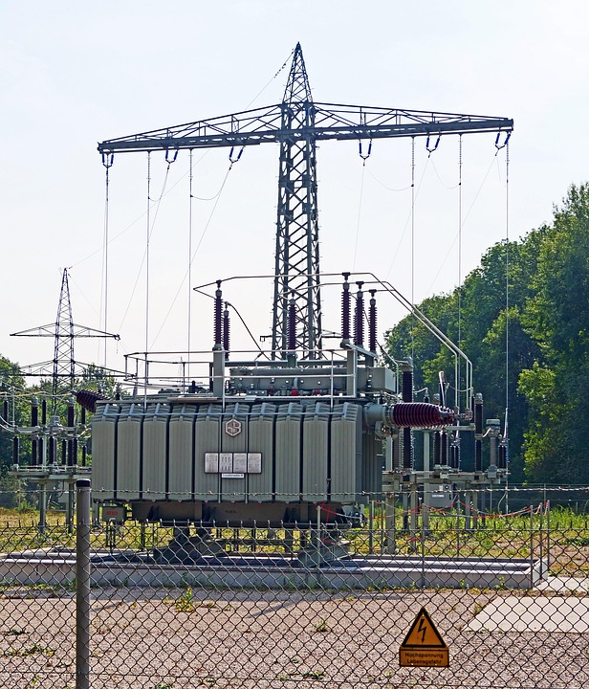
Overview
Power OUTAGEs
3 power outages
buffered, but outage too long
damage of 2 BPM electronics
scheduled outage for UPS maintenance
again damage of BPM electronics
attack on power distribution system of neighboring city districts
attack:
fire at overhead-to-underground transition of HV cables
September 9, 05:09 → September 11, 16:33
meanwhile 50000 people without electricity
letter of confession was published
attack aimed at indirectly warfare-related industry & research
→ under investigation

Slide 5
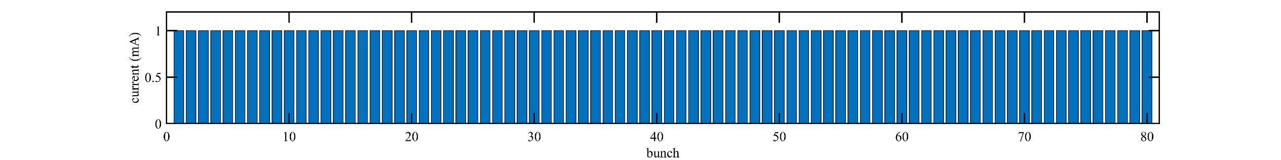
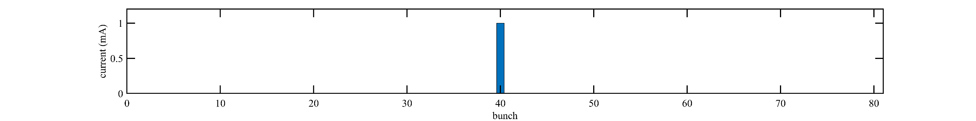
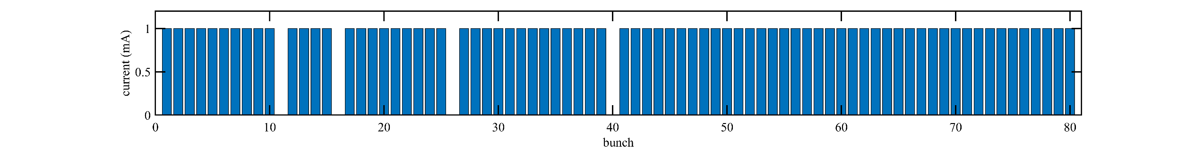
Overview
SINGLE BUNCH OPERATION
special user request: single bunch operation
machine not optimized for single bunch
vacuum conditions
single bunch → single user
solution:
“inverse” single bunch
bunch-cleaning of h/2, h/3, h/5, h/7
deconvolution of detector response under test and fill pattern

Slide 6
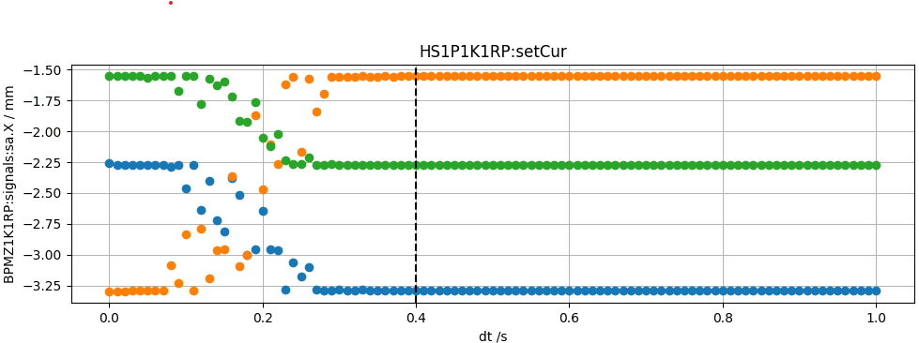
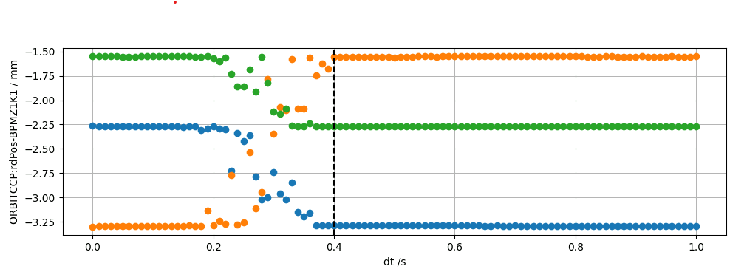
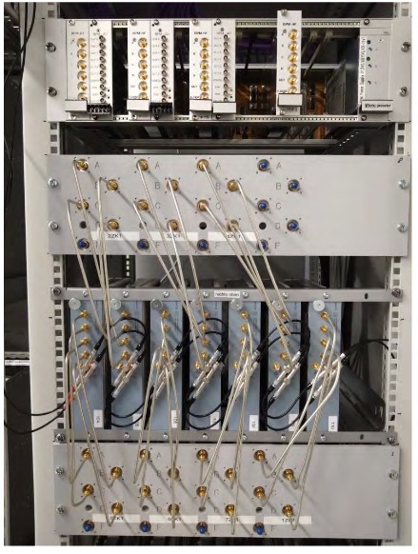
improvements
TURN-BY-TURN ORBIT DATA
commissioning of Libera Spark BPM electronics started in 2024
stable operation
improvement of readout speed:
0.5 Hz → 10 Hz for slow acquisition + 6.25 MHz
speed of beam-based alignment improved (~ 8 minutes / BPM)
speed test / reaction test of all main power supplies
backwards-compatibility of orbit-feedback code
rewiring of BPM polarity in shutdown

Slide 7
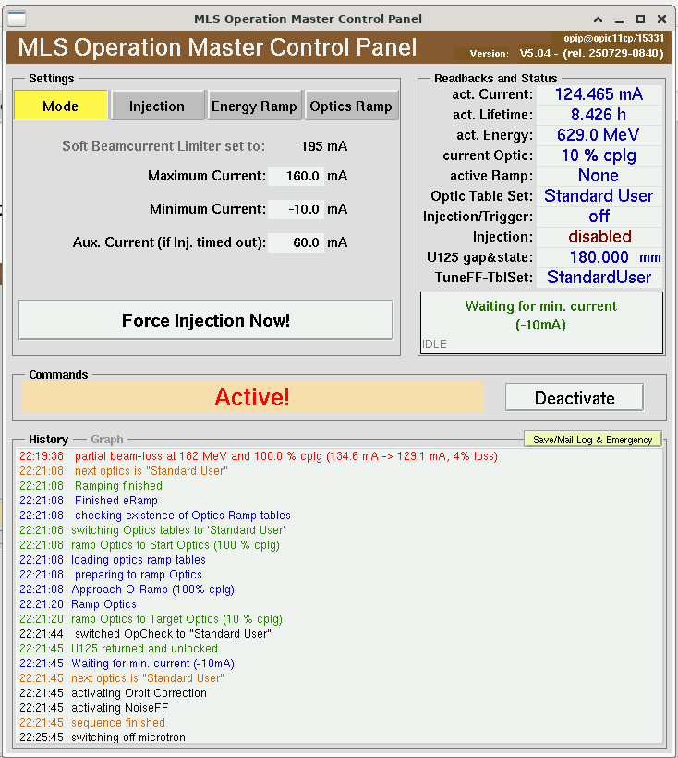
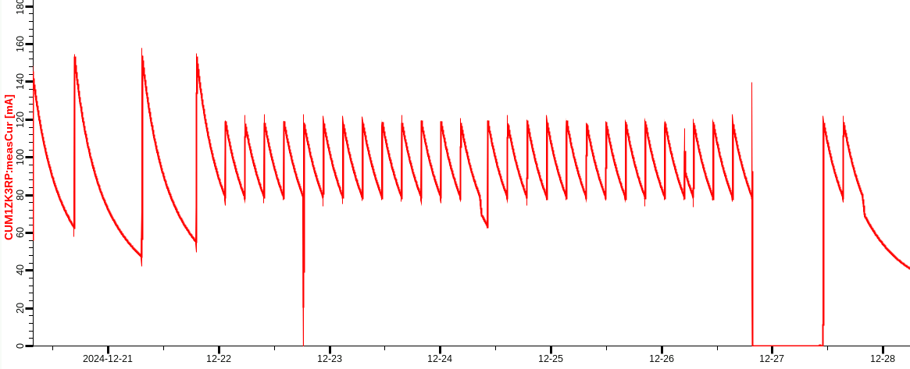
Improvements
AUTOMATIC energy RAMP Optimization
ramped operation: injection at 105 MeV → 629 MeV
operation is based on “master” program relying on ramp tables
any unwanted setup change will be gone after next injection
very steady operation with little necessity of expert knowledge during shift
tune optimization needed at interval of 3-4 weeks
Operation during christmas 2024

Slide 8
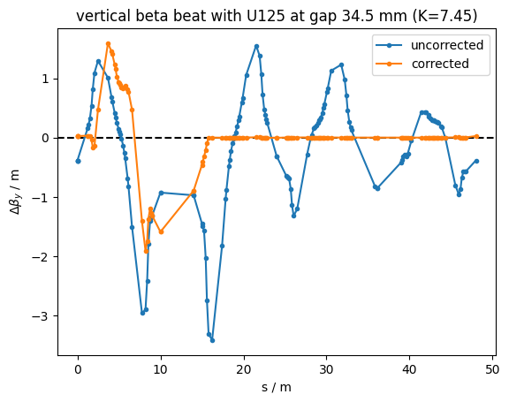
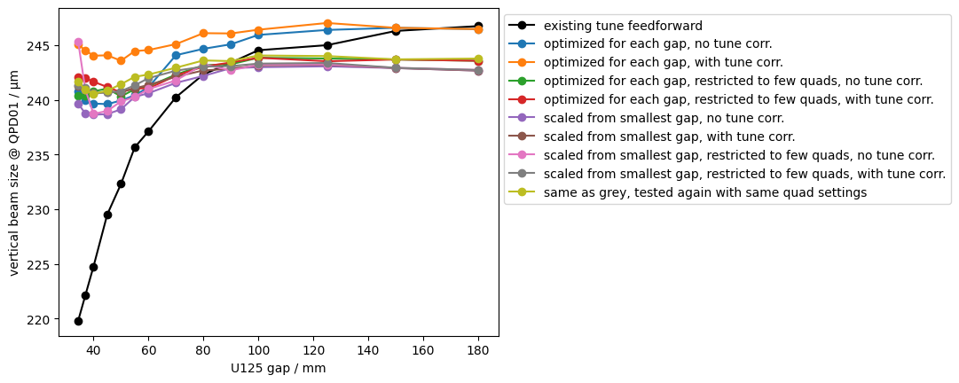
Improvements
U125 undulator
Beta-beat correction for U125
QPD01 source point imaging system
At small gaps (wiggler mode), U125 introduces strong vertical focusing leading to beta-beat
So far only symmetric quadrupole-feedforward to maintain tunes
Establish beta-beat correction using quads in front of U125 (simulation with elegant WIGGLER element, then tune correction on real machine)
Quads (de-) excited for beta-beat correction
beamlines
QPD01
Results for vertical beam size at QPD01:
(Different variations of beta-beat correction in color, original tune-feedforward in black)
U125

Slide 9
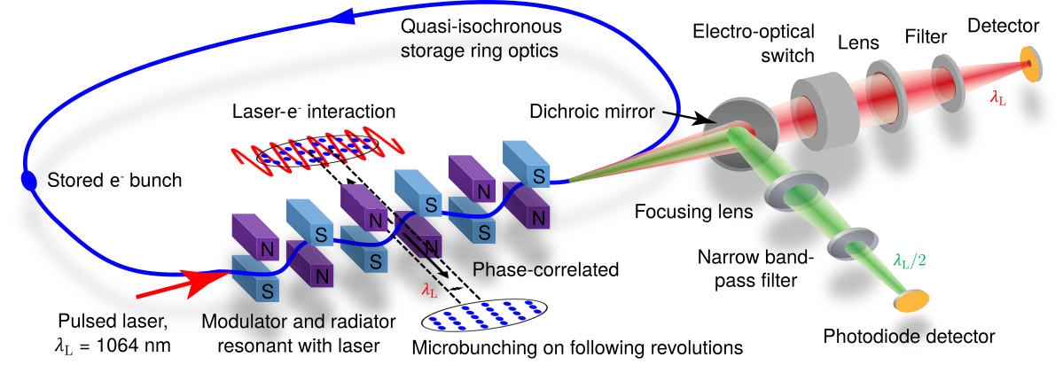
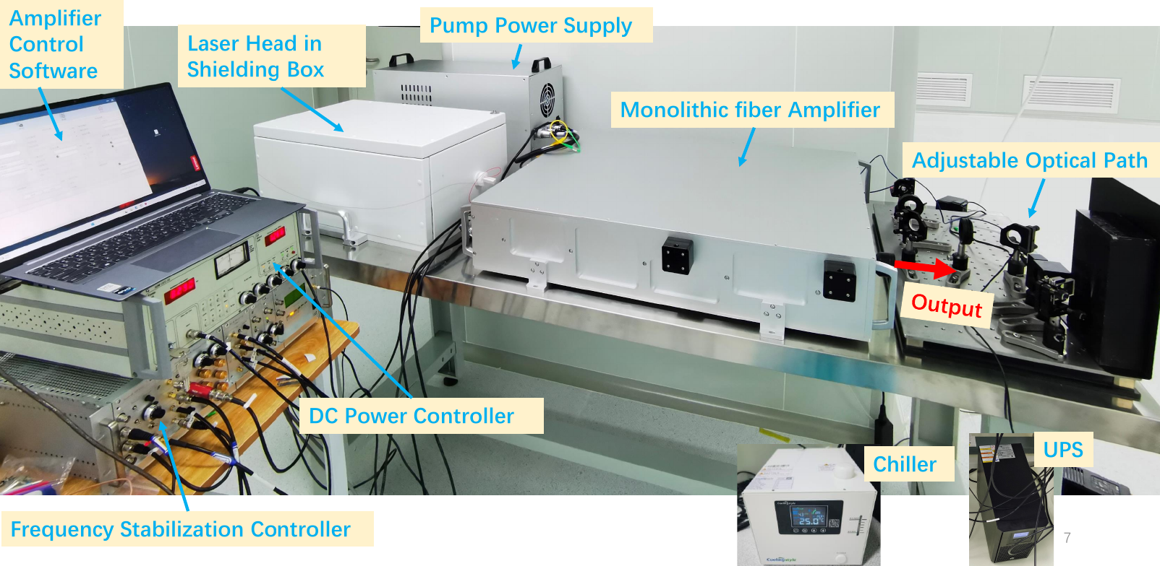
Preparing Phase II of the SSMB POP Experiment
Steady-State Microbunching
Phase I experiments concluded in 2024
Goal of phase II: Show persistent microbunching over 1000 revolutions with synchrotron oscillations in microbuckets
New laser for turn-by turn modulation is installed in MLS bunker, first experiments planned November 2025
 | Phase I laser | Phase II laser
Wavelength | 1064 nm | 1064 nm
Pulse length | 5 ns FWHM | 0.5 ns FWHM
Peak power | ~ 20 MW | ~ 20 kW
Repetition rate | 1.25 Hz | 6.25 MHz
X. Deng et al., Nature 590, 576‒579 (2021).
A. Kruschinski et al., Communications Physics 7, 160 (2024)

Slide 10
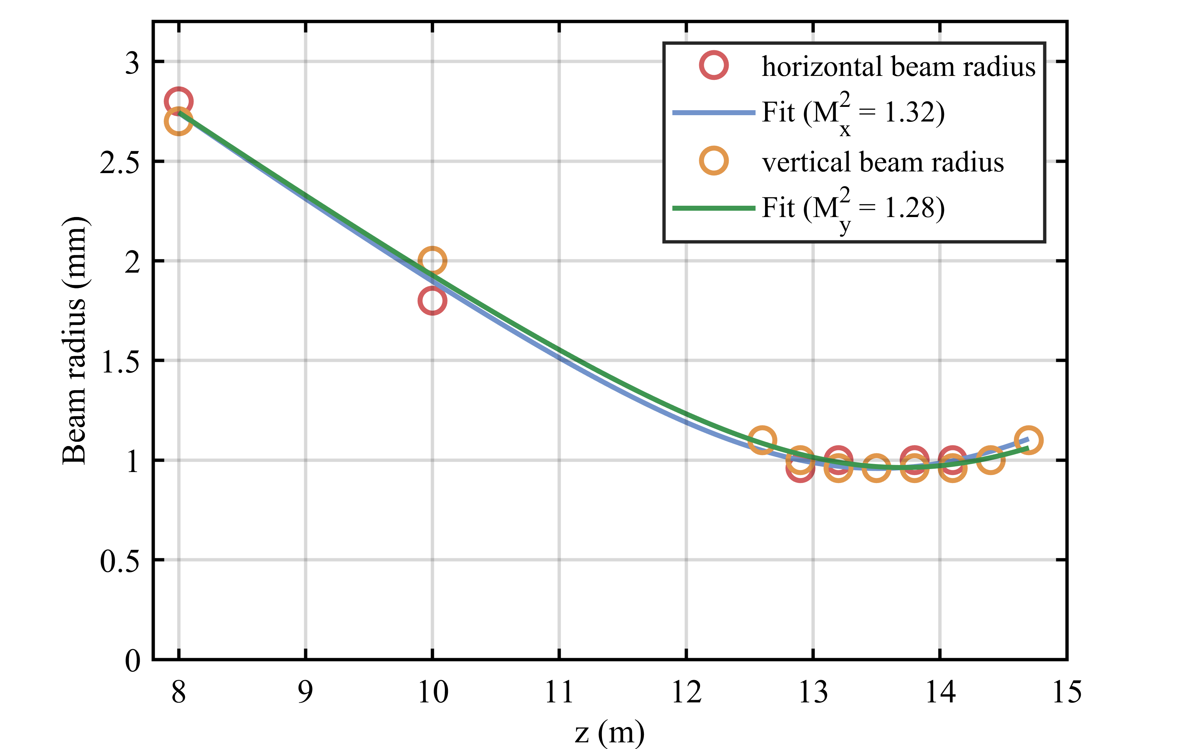
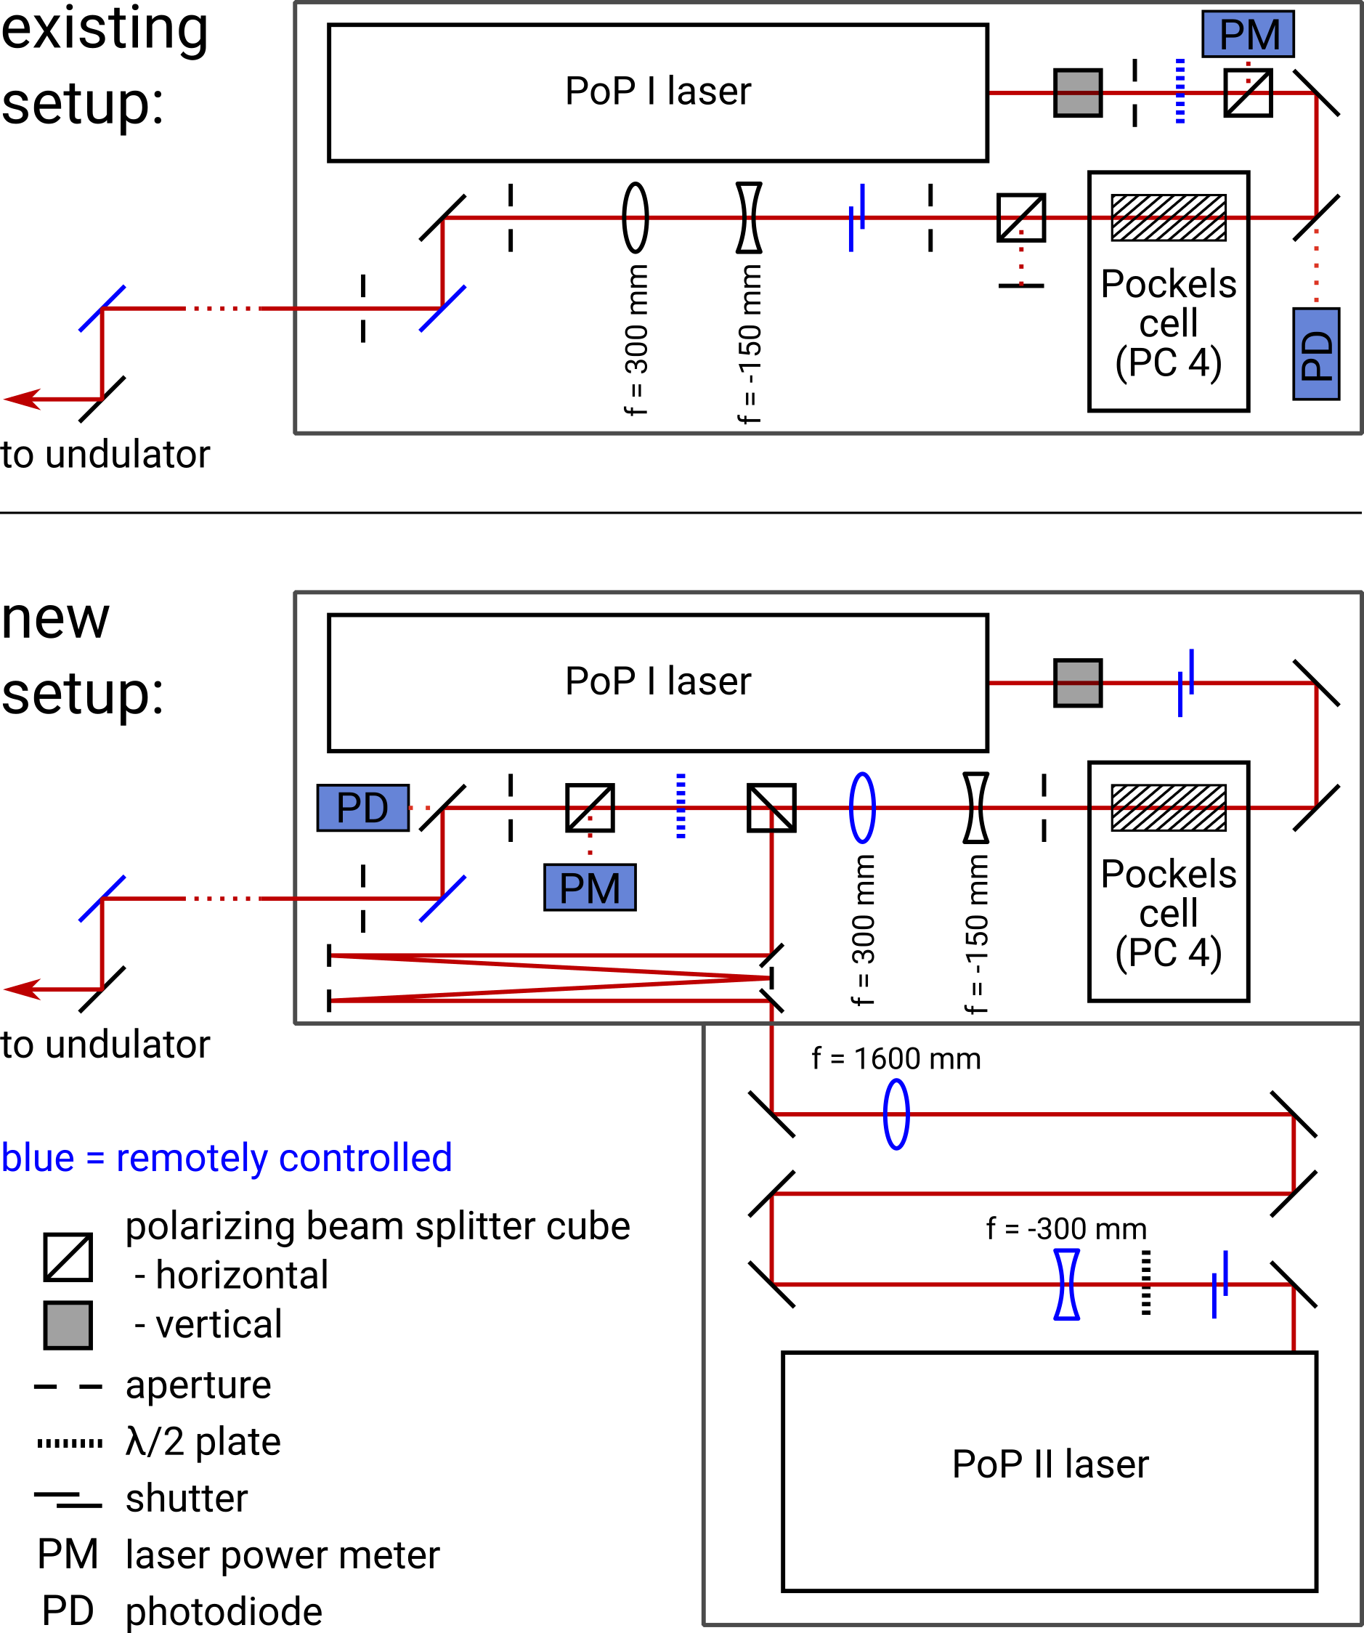
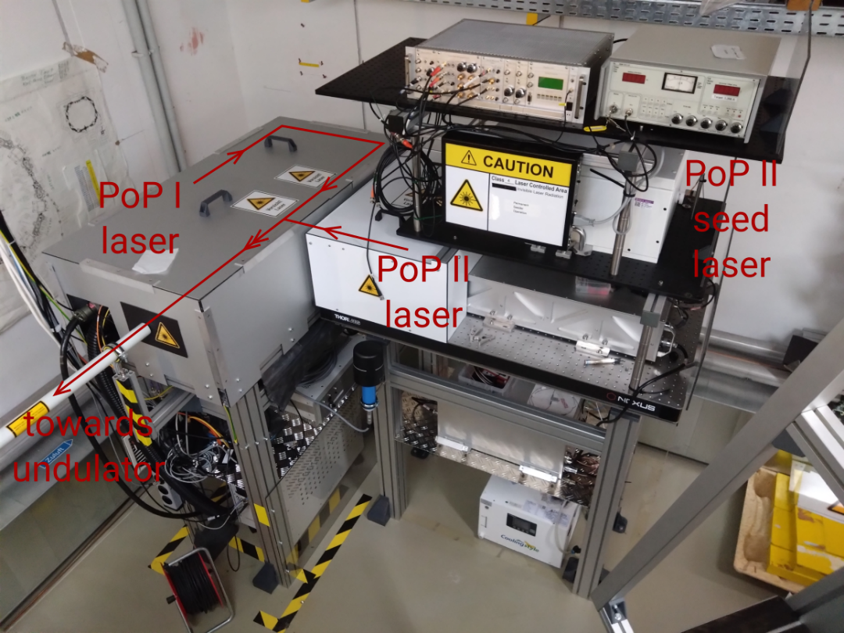
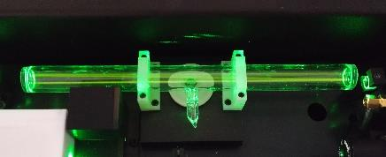
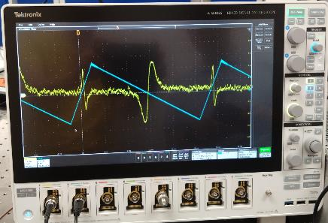
Commissioning and integration of POP II laser
Steady-State Microbunching
Commissioning in laser lab at MLS: test laser performance and frequency-locking of seed laser, design and test telescope
Laser setup in the bunker: Install PoP II laser in parallel to existing PoP I laser, facilitating operation of both systems

Slide 11
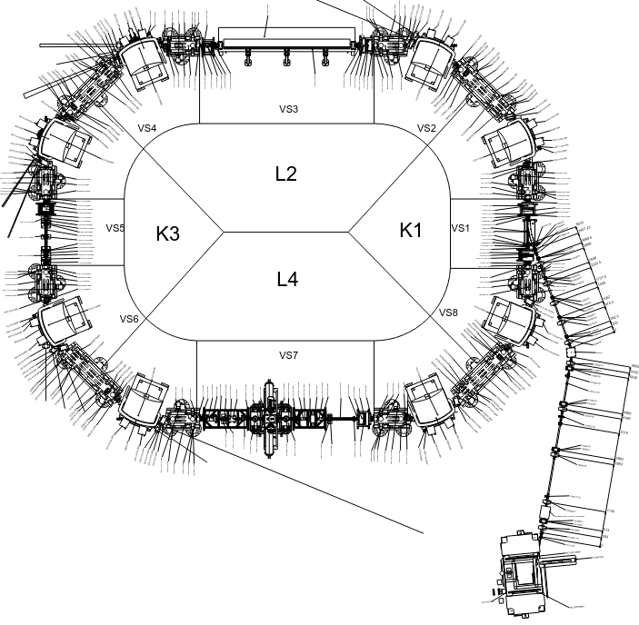
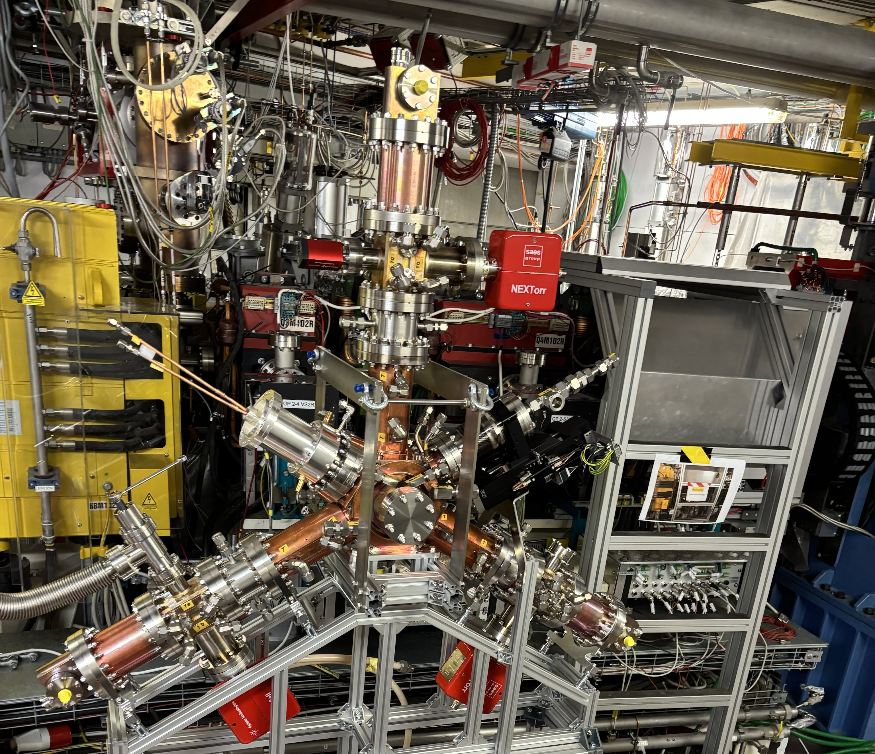
upgrades
Harmonic Cavity
1.5 GHz Cavity delivered
waveguide installed
LLRF system (Dimtel) delivered
installation:
short shutdown in January 2027

Slide 12
upgrades
MLS+
U125 undulator
study for machine “MLS2” completed
800 MeV, green-field
full-energy injector linac
keeping an upgraded MLS alive is preferred, instead
instead focus on
keeping high availability and reliability
installation of 2nd undulator and replacement of U125
injection: non-linear kicker instead of 4-kicker bump
magnet renovation
extend building to house additional beamlines
status of MLS+
agreement between PTB and HZB expected to be reached in Nov 2025
2-year phase for CDR development
3-year phase for TDR development
RF cavity, HOM damped
500 kV@ 500 MHz, h=80
Microtron

Slide 13
SUMMARY
operation very stable
great improvement: new BPM electronics!
SSMB
successful completion of phase I
2-year project, phase II: increased repetition rate
energy modulation possible with reduced peak power
next week: joint measurements with colleagues from Tsinghua University
MLS+
work on design reports will start in 2026

