Slide 1
Elettra Report on behalf of the Elettra team

Slide 2
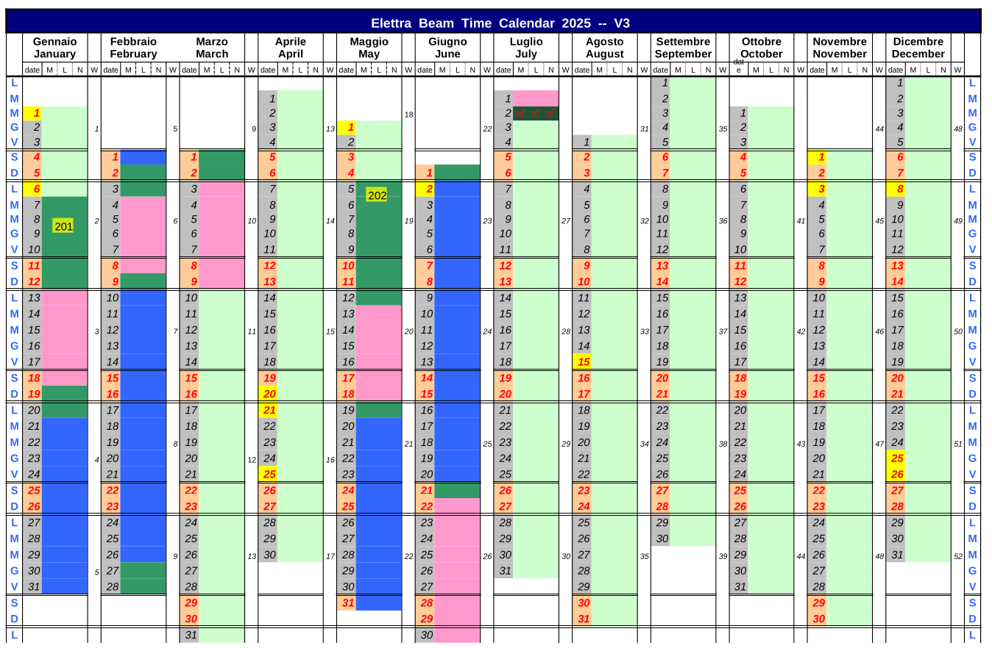
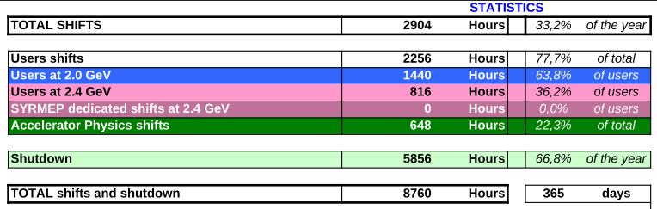
Operation schedule 2025
Even with the required preparation work for the dark period, the same % of user hours as in previous 2 years was provided in a single semester. For 2023 and 2024 the user operation time was reduced by 40% due to energy cost increase.
Notes:
I will start the talk by discussing the last semester of Elettra’s operation, and then I will update you on the progress of the work for the new Elettra 2.0 machine.
The dark period started on July 2nd, 2025. Despite the extensive preparation activities for this dark period — such as the early decommissioning of four beamlines and the clearing of areas for the temporary storage of materials coming from the dismantling of Elettra 1 — we managed to provide the same amount of beam time to users as in previous years, reaching almost 2500 user hours in the first semester.

Slide 3
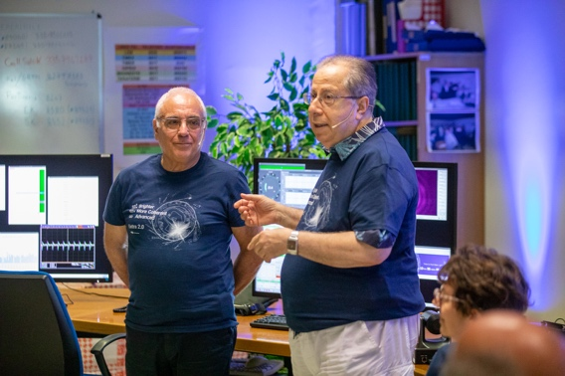
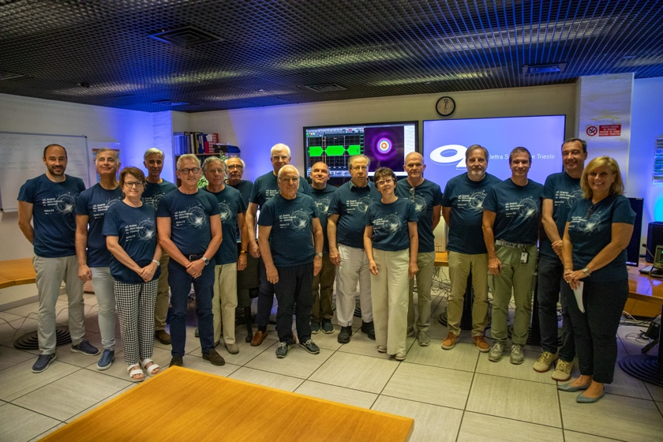
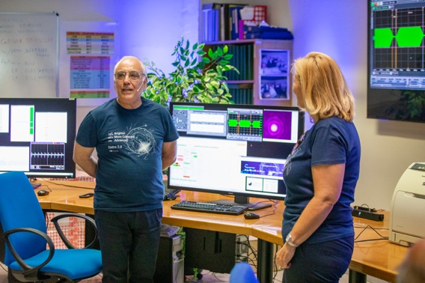
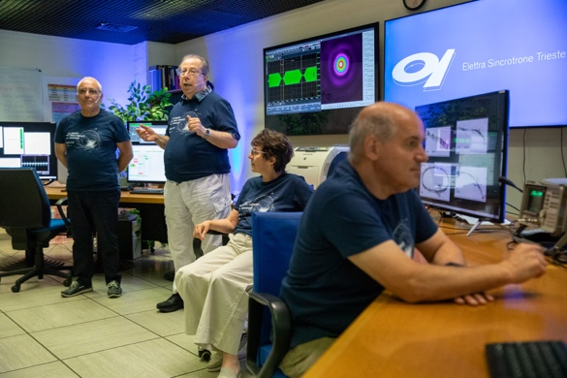
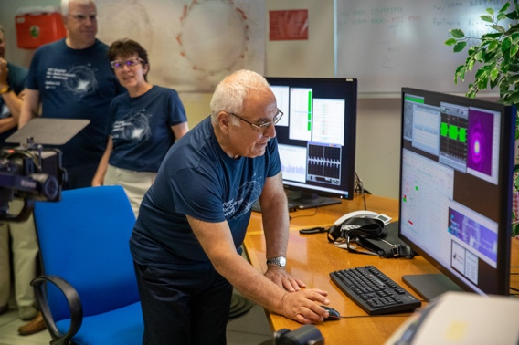
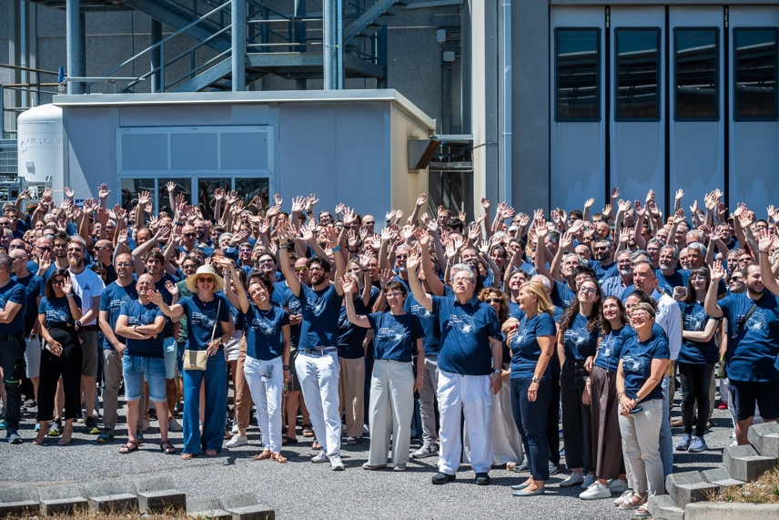
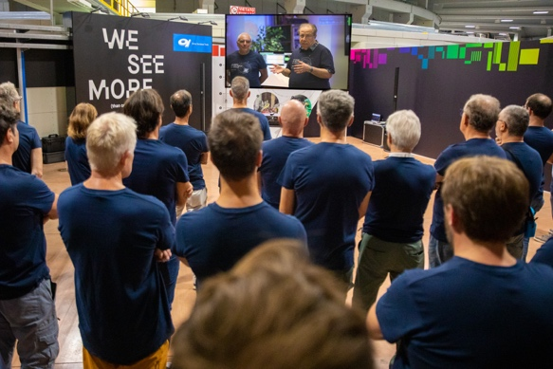
End user mode on 2/7/2025 at 12:30 with a ceremony. The dark period started immediately after as programmed, first task the removal of the old machine
Notes:
On July 2nd, 2025, the last beam dump of Elettra 1 was carried out, marked by a ceremony involving the entire institute.

Slide 4
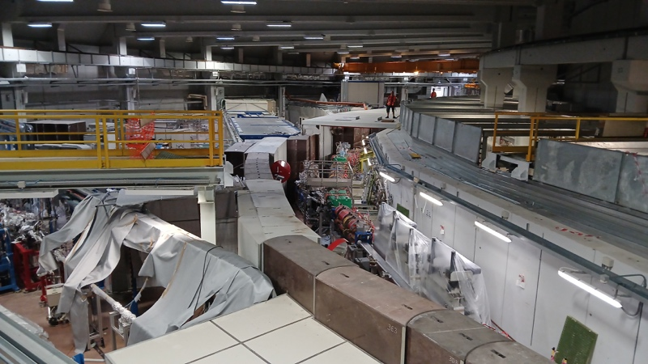
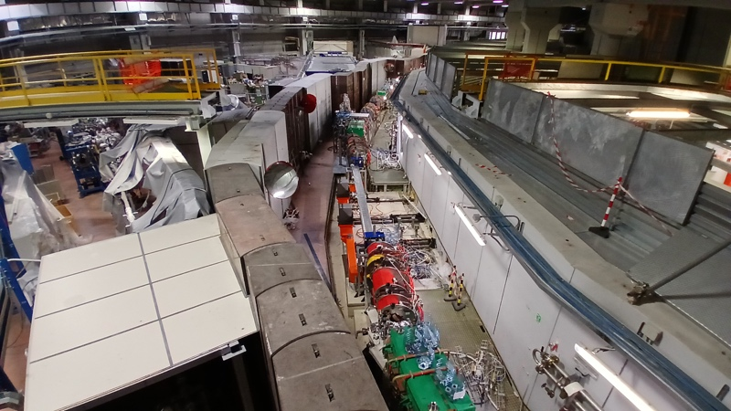
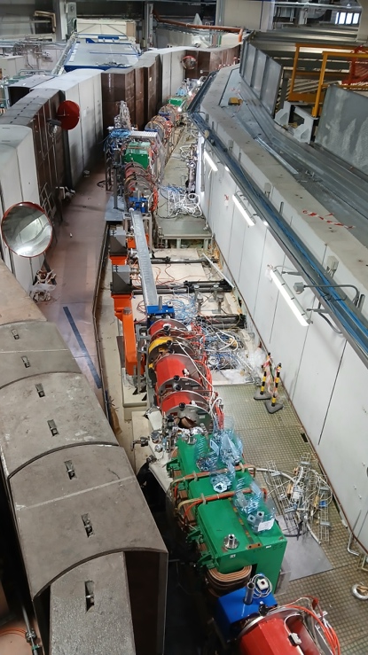
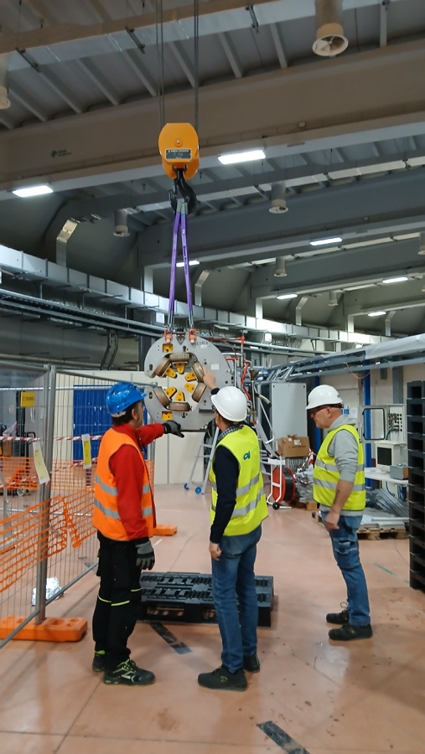
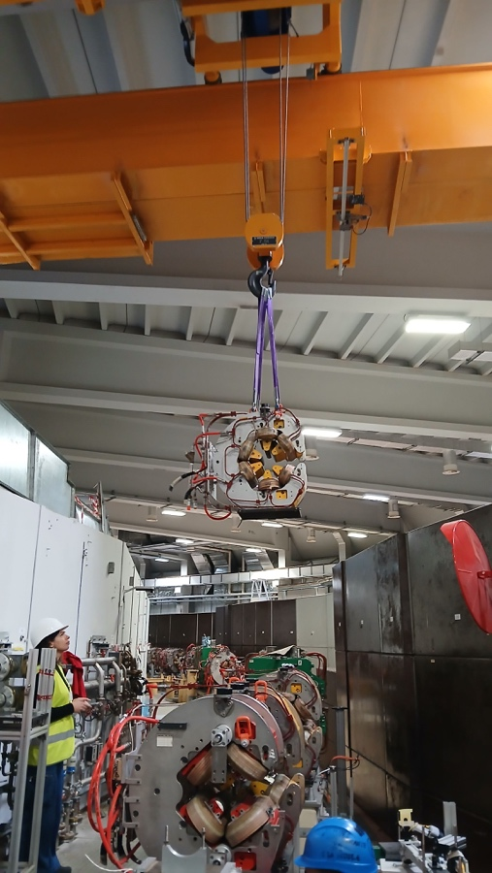
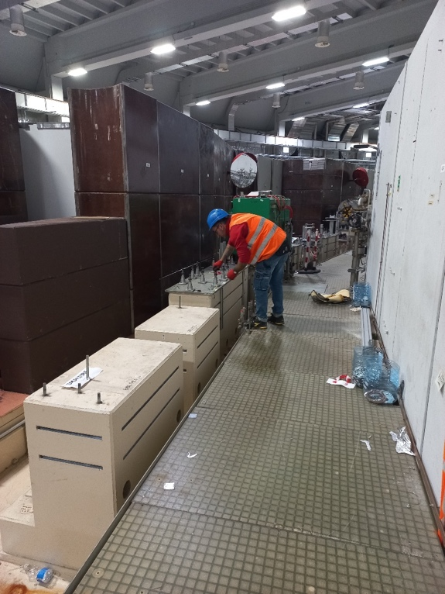
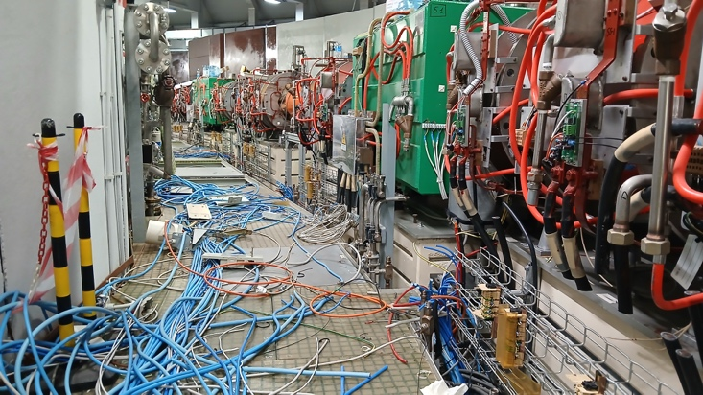
Dark period activities highlights
Storage ring removal
Notes:
Some images from the machine tunnel dismantling phase.

Slide 5
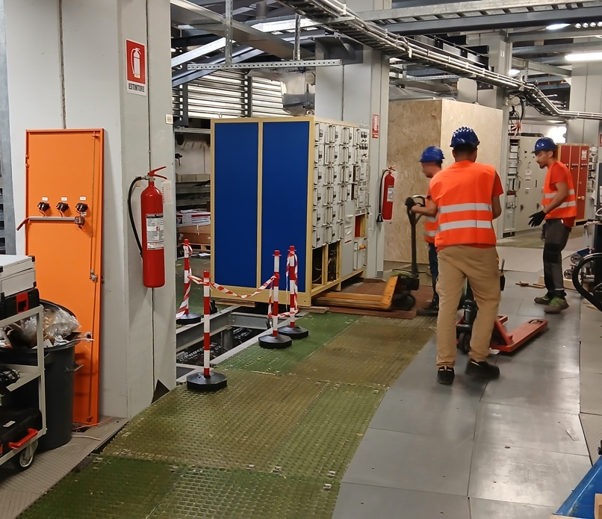
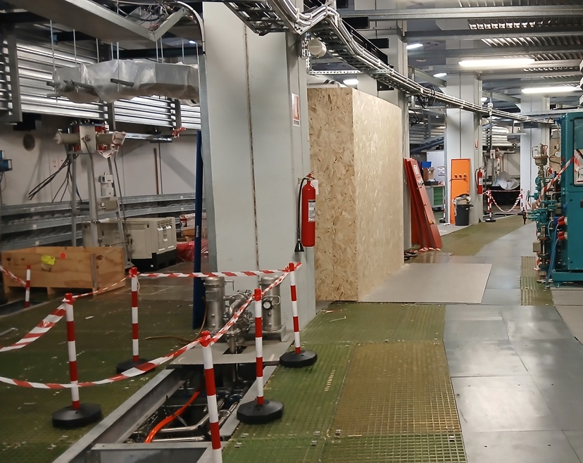
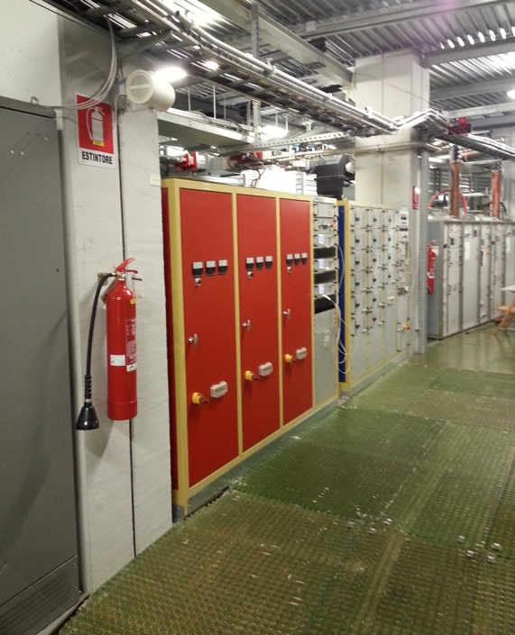
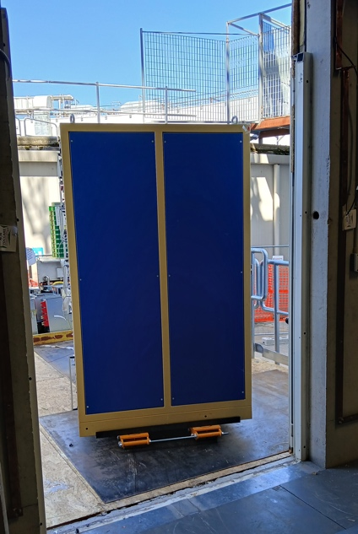
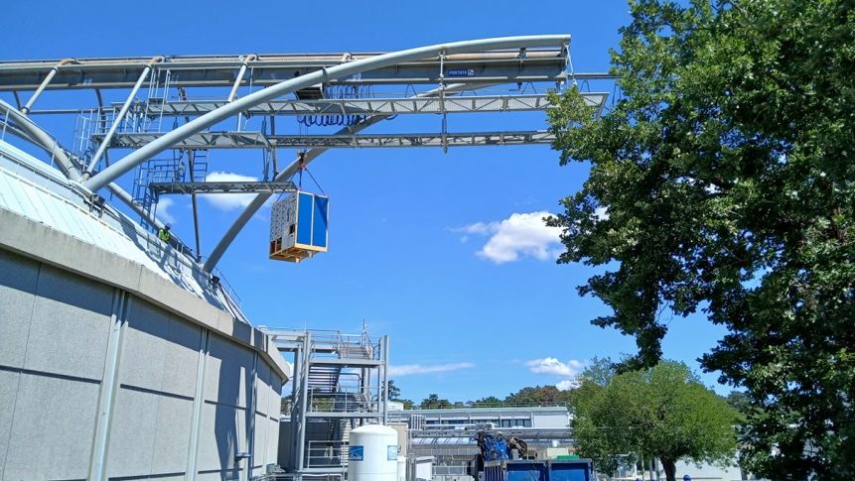
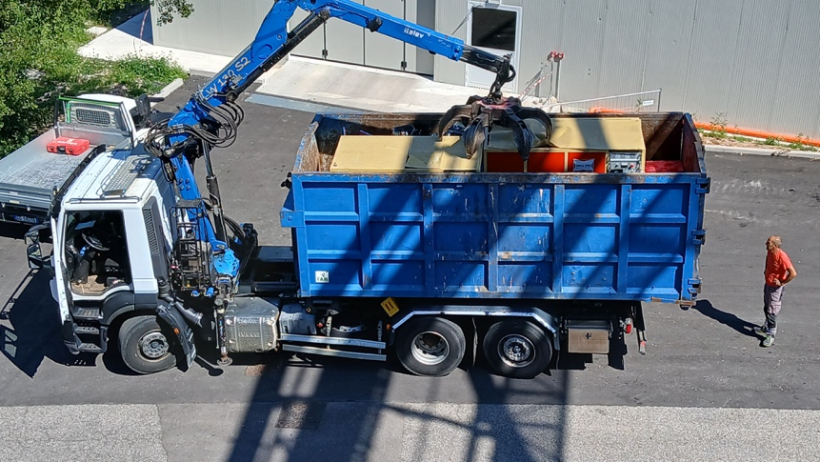
Dark period activities highlights
Service area removal
Notes:
E dell’area servizi

Slide 6
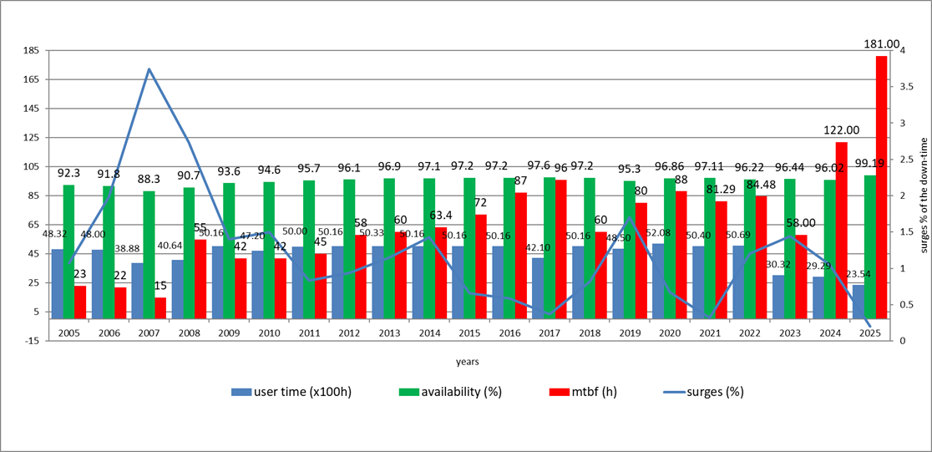
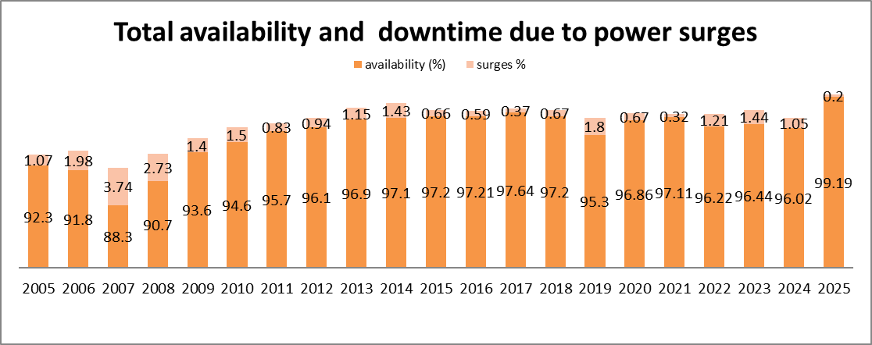
Elettra has been a very successful and stable storage ring
1993-2025, 32 years of operations with 5000 hours/year most of the time for users and a total of 35545 Ah
Topup enabled
The 2025 was … the best year in the entire Elettra history
Beam availability of 99.19 %.
MTBF of 181 hours.
Notes:
Elettra has been operating for 32 years, and 2025 was its best year in terms of performance statistics. In fact, we achieved an uptime of 99.19% and a Mean Time Between Failures (MTBF) of 180 hours.
In 2009, we entered stable top-up operation mode with a current variation (ΔI) of 1 mA. This transition significantly improved both the average machine uptime and, especially, the MTBF — which increased from an average of about 30 hours to consistently above 60 hours.

Slide 7
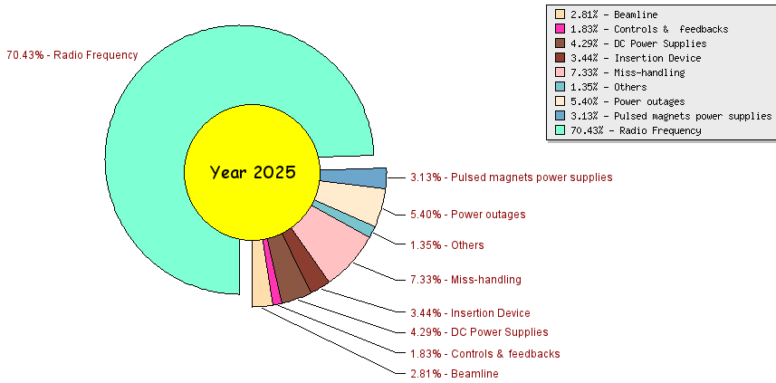
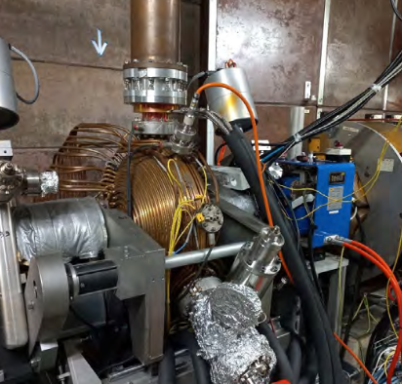
2025 faults
Major fault of 65h due to the failure of the cavity #3 feed-through, during machine physics studies in an unstable beam condition.
Only two downtimes due to system upgrades related to the Elettra 2.0 project.
Short, consecutive beam interruptions due to a commissioning script executed on the machine instead of on the simulator
Air-to-vacuum leak occurred the day before the last startup due to incorrect operation during frontend removal
Minor fault due to water leaks on steerers and RF cavity.
Last RUN with one RF cavity operated at limited power, due to reduced cooling.
Notes:
The main source of downtime was the failure of the RF cavity 3 feedthrough, which resulted in 65 hours of downtime. The fault occurred during machine physics studies, so the machine stop had only a minimal impact on user availability.
Only two downtimes were related to the Elettra 2 upgrade activities:
* short, consecutive…….
* air-to-vacuum …. which was also completely transparent to users.
There were also some minor issues with the cooling circuits — small leaks in some correctors, which were promptly fixed when necessary, and in the cooling circuit of RF cavity 8, whose power was consequently reduced.

Slide 8
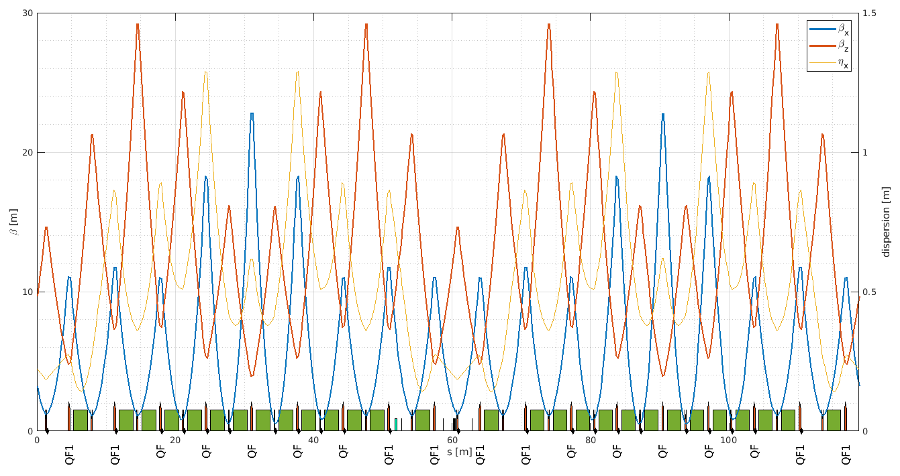
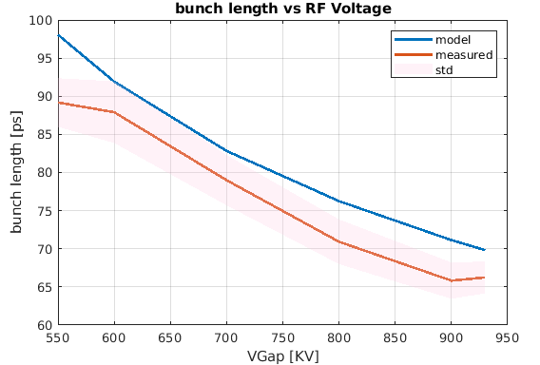
Injector preparation
Booster
  Increased RF power from 0.6 MV to 1 MV → the bunch length reduces from 27 mm to 20 mm (InjEff +5%)
  Changed Booster optics, reducing the hor emittance from 230 nmrad down to 160 nmrad
  In Jan ’26, an additional PS QF2 family will be introduced to reduce the horizontal emittance to 130 nmrad, increasing InjEff from 65% to >77%.
  Using the emittance exchange by crossing a coupling resonance InjEff: 77% → >97%
Notes:
During the machine physics days, we successfully tested the new electronics for the BPMs with the pilot-on function to ensure maximum long-term stability, completed the upgrade of the GlobalOrbitFeedback, but most importantly, we focused on improving the performance of the injector.
The RF voltage of the booster was increased from 0.6 to 1 MV in order to reduce the bunch length.
According to simulations, this improvement enhances the injection efficiency. The bunch length of the extracted beam from the booster was also measured, and the result is consistent with the simulated values.
The booster tune working point was adjusted, reducing the emittance from 230 to 160 nm·rad.
In January 2026, an additional PS family of QF quadrupoles will be implemented, allowing for a new optics configuration with an emittance of 130 nm·rad and an injection efficiency (IE) of 77%. This value can be further increased, up to 97%, by applying the emittance swap technique, which we are already capable of performing.

Slide 9
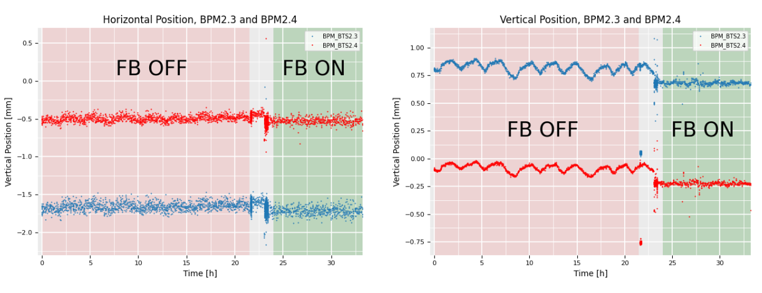
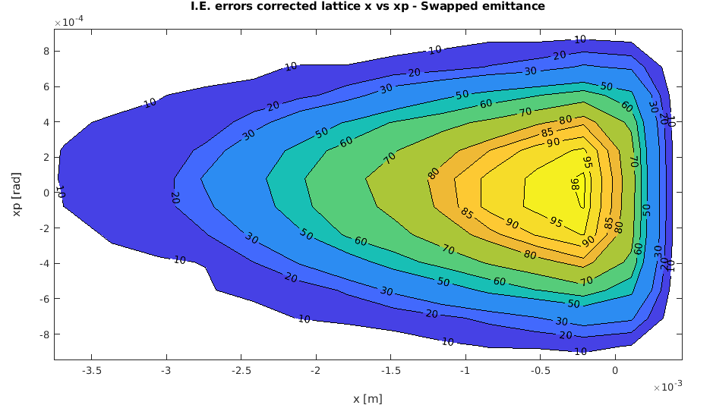
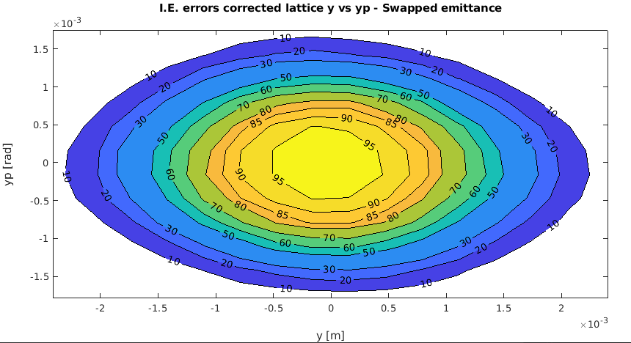
Injector preparation
Booster To Storage ring
  Implemented the Trajectory feedback along BTS to compensate the slow drifts
    Good regults in vertical plane
    Slight improvement in horizontal plane mainly due to bad PS stability during ramping (400 mA) → the Booster PS of quads and bends will be replaced in early 2026
In order to archive an injection efficiency > 95 %, the trajectory stability of the injected beam must be within x±250 um y±500 um
Notes:
A trajectory feedback system was implemented in the BTS (Booster-to-Storage ring transfer line).
The achieved stability is consistent with the beam stability specifications required for Elettra 2.0

Slide 10
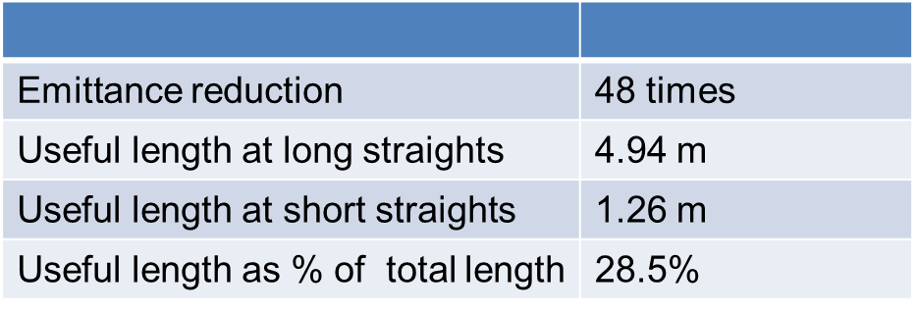
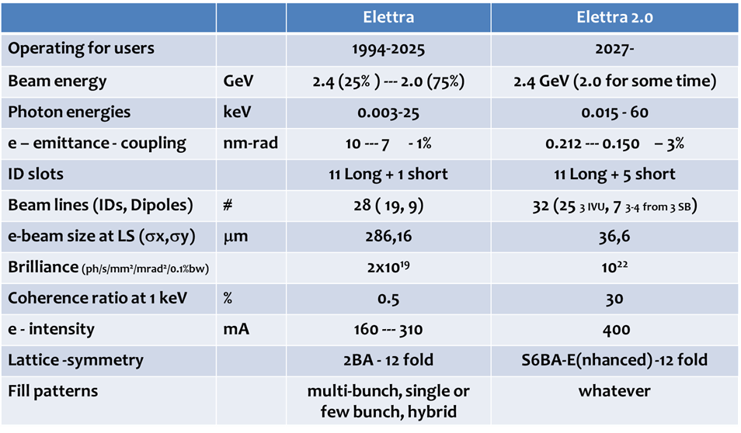
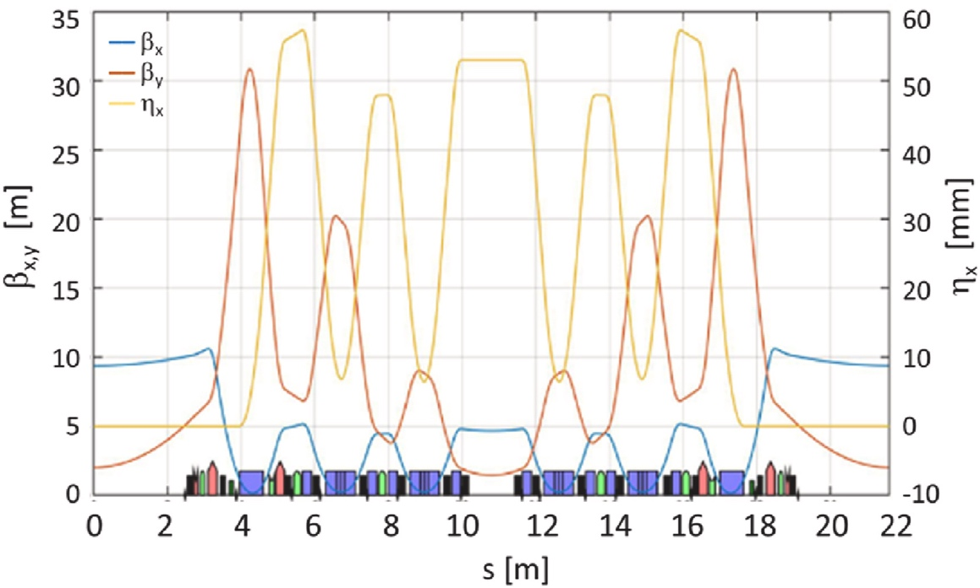
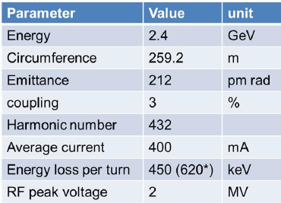
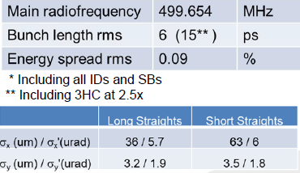
Elettra 2.0
Elettra 2.0 will operate mostly at 2.4 GeV with a bare emittance of 212 pm-rad.
The brilliance will increase by more than 2 orders of magnitude at 10 keV, 36 times at 1 keV.
The coherence level will increase by a factor of 60 at 1 keV.
Main operating energy 2.4 GeV
Possibility for installing bunch deflection scheme
Inclusion of super-bends and in-vacuum-undulators
Increase of the number of slots available for insertion devices
Contraints:
Keep same building, injector and ring circumference
Keep same source point and length for long straight sections

Slide 11
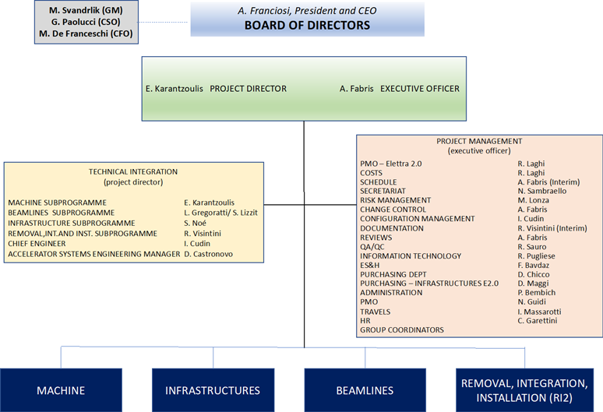
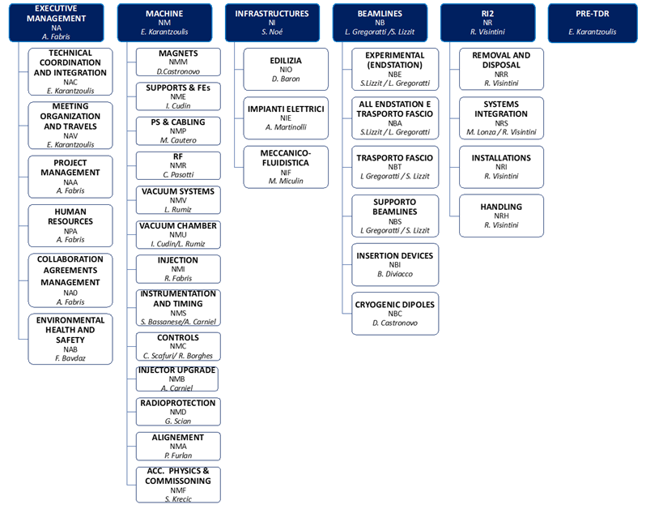
Project organization

Slide 12
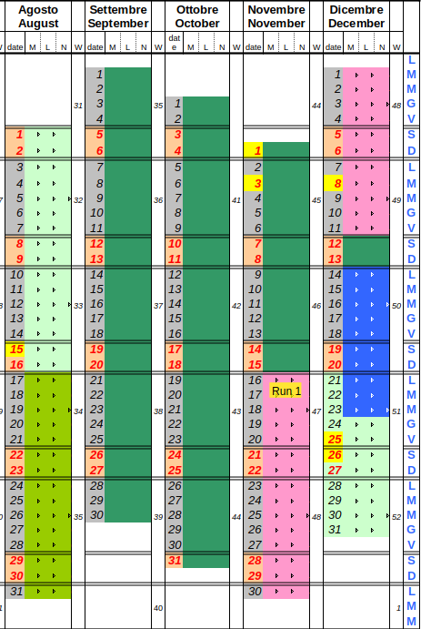
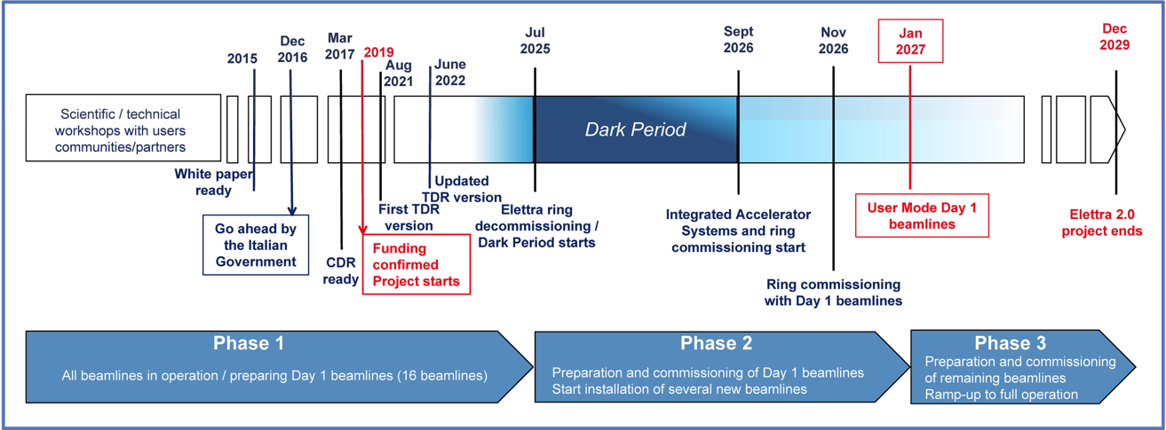
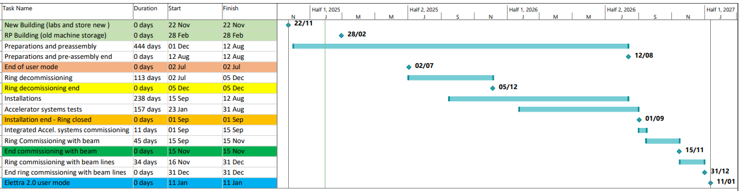
Schedule
Temporary buildings
The schedule baseline remains unchanged at present
decommissioning
commissioning
Friendly users
Installations and tests
Notes:
Our program for the dark period
We are currently in the full decommissioning phase.
From the updated schedule, you can see that some installation activities have already started — these are related to the installation works for the Booster.
There have been a few setbacks — essentially, in the experimental hall we have two overhead cranes, and one of them was out of service for about a month. The failure occurred one week after the start of the dark period.
Although this did not cause any actual delays, it required us to revise the work plan. Since each crane covers half of the storage ring, we focused our efforts first on one half of the ring and then on the other.
The actual commissioning schedule...

Slide 13
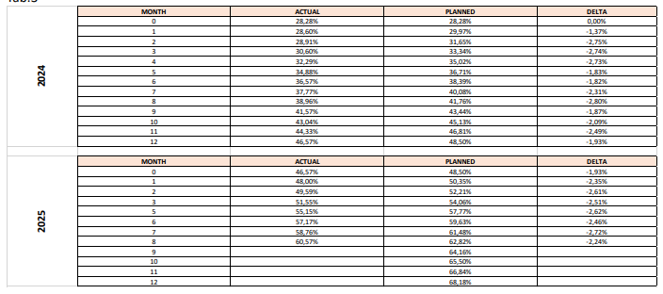
Project progression
Ref: A. Fabris
100
%
90
%
80
%
70
%
60
%
50
%
40
%
Actual 2024
Actual 2025
Planned
30
%
Percent Complete at the end of September 2025: 62,30 % (64.16% planned)
20
%
10
%
0
%
Percent complete= (value of work performed)/(budget approved at completion)*100
2023-01-01
2024-01-01
2025-01-01
2026-01-01
2027-01-01
2028-01-01
2029-01-01
2030-01-01
Project management tools are in place and actively used to monitor the project. They include:
Work Breakdown Structure, Project Management Plan, Configuration Management Plan, Change Control Process, Risk Management Plan, Risk Registry, Schedule and budget control.
Spending overview
Total Value (Planned)
172,25 M€
Total Value (Committed)
149,93 M€ (87,0 %)
Total Value (To be committed)
22,32 M€ (13,0 %)
All values VAT included
All values updated to September 30, 2025

Slide 14
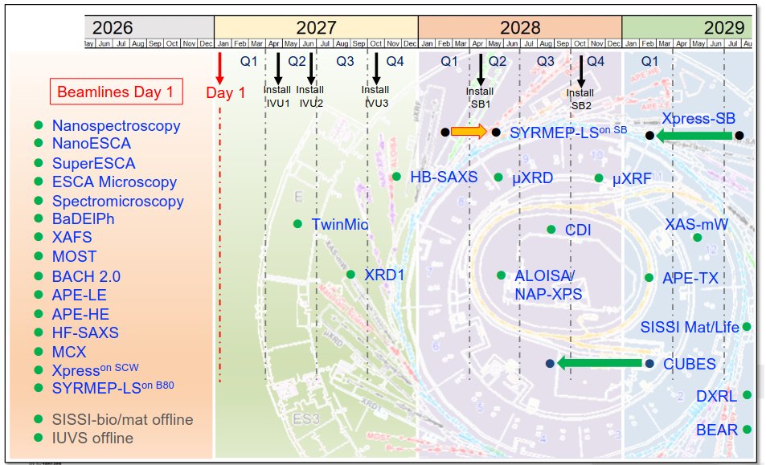
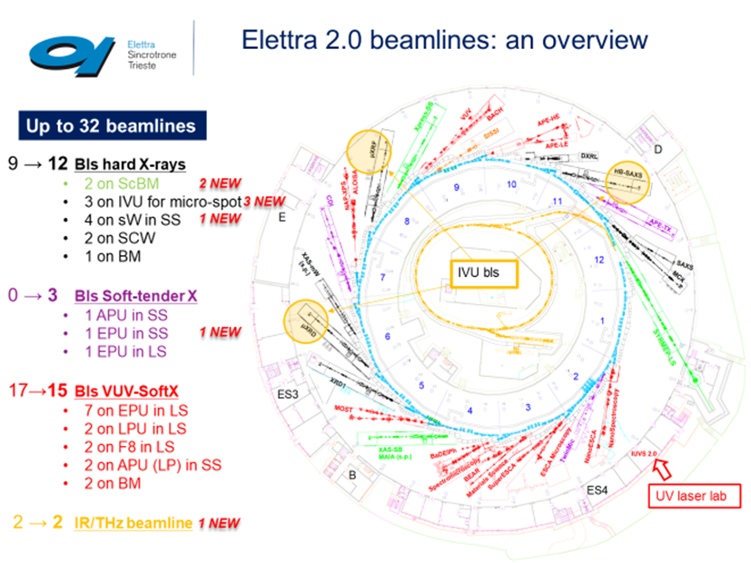
Beam lines
Increased # of beam lines from 28 to 32 Also 5 in the short straights
Shift towards tender and hard x-rays (65% proposals for hard x rays)
Day 1 with 15 beam lines
  13 from Insertion Device
  2 from Bending
Short section:
  4 for RF cavity
  3 for diagnostics instrumentation
  5 for beam lines
8 beam lines are removed
9 beam lines keep the same position (IDs)
8 new beam lines
Notes:
The number of beamlines will increase from 28 to 32, and the short sections have also been used to host beamlines.
From day one, 13 insertion device (ID) beamlines and 2 bending magnet beamlines will be operational.
The ID beamlines available from the start will use the same insertion devices that were already in operation at Elettra 1.
The current plan foresees completing all beamline upgrades by 2030.

Slide 15
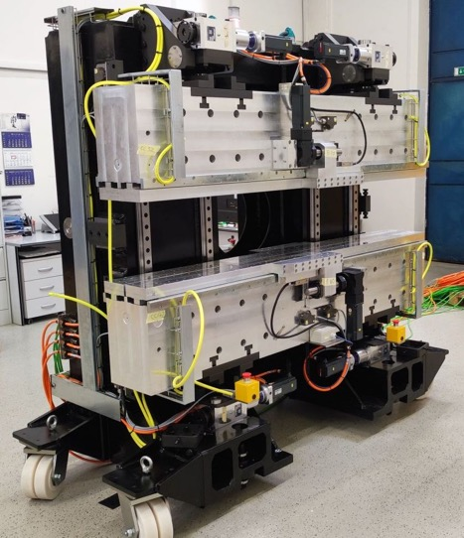
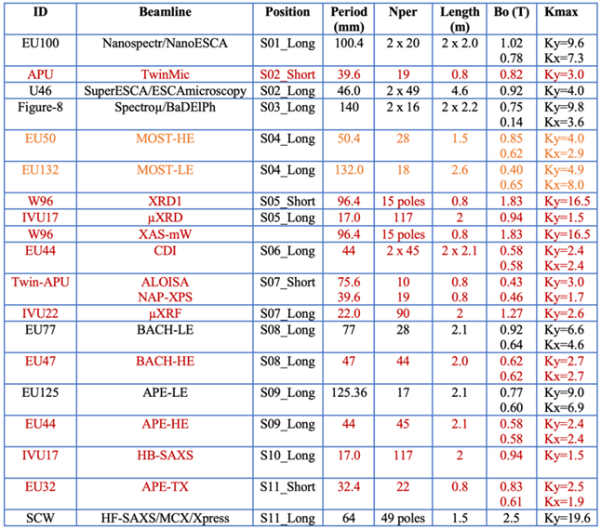
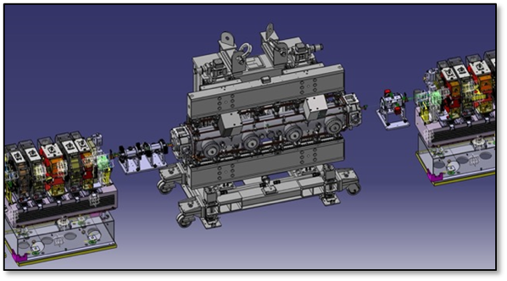
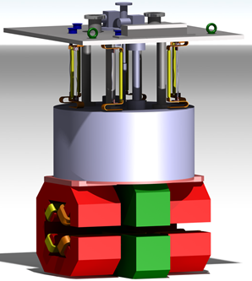
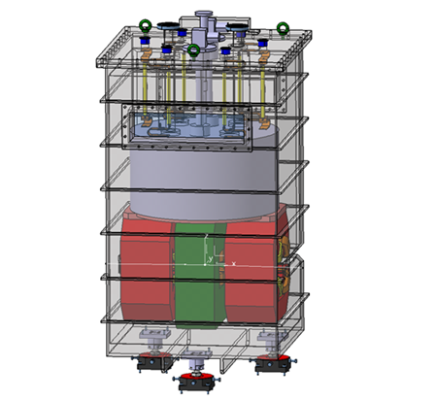
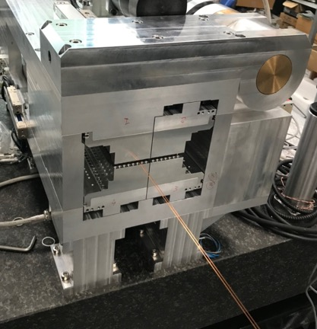



SC magnets and IDs
Ref. B. Diviacco
Two super-conducting 6 T dipoles (60 – 140 keV)
Short-period in-vacuum LPUs will be used to extend the photon energy range into the hard X-ray regime, reaching up to 18 keV (period 17.2-22 mm).
Four APPLE-II Undulator – outsourced to KYMA)
One of the requirements for the new lattice is to extend the number of beamlines. In fact five out of the twelve short straight sections are dedicated to the beam lines and due to space limitations compact undulators and wigglers are developed with a useful length of only 80 cm. Already 4 short Ids are built in-house.
Ref. D. Castronovo, M. Modica, EK
EU32: compact EPU for the APE-TX beamline
Notes:
Some images of the insertion devices currently under development,
And the list of the IDs being reused from Elettra 1 and those that will be newly manufactured.
The installation of the three IVUs is scheduled to begin at the end of 2027, while the SuperBends are planned for 2028.

Slide 16







Magnets and power supplies
Ref. D. Castronovo
MAGNETS
First girder assembled
All quadrupoles magnets delivered
Sextupoles and octupoles magnets:
  4 out of 6 deliveries completed
  Last delivery: scheduled early Jan. ‘26
Bending magnets:
  First of Series measured
  In production
  Last delivery scheduled mid Jan. ‘26
POWER SUPPLIES
All dipoles PS delivered
All multipolar magnets PS delivered
Corrector PS:
  450 out of 700 built
  Completion foreseen mid Nov. ‘25
Contract for racks’ assembly effective
Multipolar magnets P.S. in storage
Ref. M Cautero
Notes:
We are making good progress with the magnet delivery. The first girder has been completed, and the setup of the measurement benches — of which we will have three — has been finalized, so we are now starting the magnetic measurements.
Great attention has been paid to the accuracy of the measurements, especially on the reverse bends and the effects of the combined-function coils. For example, from the initial measurements, we observed that the hysteresis introduced by the use of embedded correctors in the sextupoles modifies a dipole component within the sextupole. This is an effect that we will need to take into account during the BBA of the BPMs.
We expect to have the first cross-talk measurements by the end of the year.
Measurements are being performed with a stretched wire, while a Hall probe mapping for more detailed characterization will be conducted subsequently.

Slide 17





Chambers and vacuum systems
Ion pumps and NEG pumps: delivered
Vacuum gauges: delivered
Vacuum valves: in production, First batch received, last scheduled in March ‘26
Vacuum chambers:
  Under construction
  Dipole chamber prototyope under SAT.
  Deliveries in batches. Last item scheduled in Aug. ‘26
Other vacuum components (bellows, aborbers, tapers, etc): under construction, to be completed in Spring 26
Ref. L. Rumiz
Ref. G. Scrimali
Dipole vacuum chamber tests
It’s crucial to closely follow the production and validation process, including frequent visits to the manufacturers. Many issues were corrected during these stages, thereby preventing potential problems.
Photon absorbers
Mask
Notes:
For the vacuum chambers and systems as well, we are on schedule.
We have noticed how crucial it is to closely follow the production and validation process, including frequent visits to the manufacturers. Many issues were corrected during these stages, thereby preventing potential problems.

Slide 18






Supports, BPMs and Injection
8 granite slabs per achromat for the multipoles (1.5x0.6x0.3 m) + 6 for the dipoles in total 168 girders.
item | status
BPM electronics | All delivered – 8 already installed in Elettra
BPM feedthroughs | Delivery expected to be completed in Feb. 2026
Kickers: Design phase from the contractor (Danfysik) completed. Delivery expected within June 2026.
Septum: Design phase from the contractor (Research Instruments) close to completion
Ceramic Chambers: Contract signed on January 2025 (Kyocera) . Delivery expected in Jan – Feb 2026
Dump kicker: The Contractor (Reasearch Instuments) received the invitation letter.
Delivery expected in Jan 2027
Girders and mechanical supports for injection, all received
Notes:
So far, there are no delays concerning the supports, and BPMs. The schedule is very tight for the delivery of the septum.
On day one, the dump kicker for stopping the beam within 1 turn on the collimator will not be available. In the meantime, we will stop the beam using the RF system, which still concentrates the losses on the collimator.

Slide 19






Storage space
Two buildings have been constructed 700m². These are used as laboratories for magnetic measurements, for vacuum systems, and for the storage of incoming and outgoing materials.
BUT space it is never enough!
RP building
Storage space , vacuum lab, and magnet measurements lab
Mainly old machine

Slide 20
Conclusions
Elettra has been a very successful storage ring for 32 years
Elettra’s performance has not been affected by the Elettra 2.0 project
We are now concentrated on the completion of procurement of the remaining components and services, needed to ensure the start of the facility commissioning according to plan
The schedule is continuously monitored, mitigation strategies are in place for possible delays, however at present we do not consider schedule baseline changes
According to the schedule, the new ring will be completed for commissioning in September 2026
Thank you for your attention

