Slide 1
ALBA Status and Upgrade
33rd ESLS workshop – 30th October 2025, Soleil
Ferran Fernandez, on behalf of the Accelerators team

Slide 2
2025 Operation

Slide 3

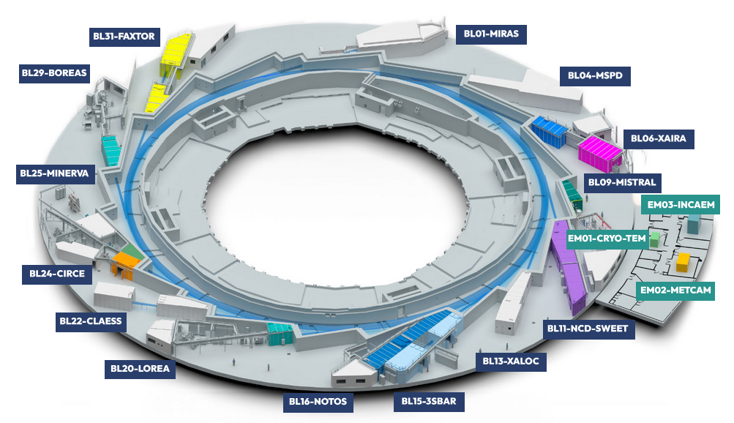
ALBA Synchrotron Light Source
Linac → 0.1 GeV
Booster → 0.1-3.0 GeV
Storage Ring → 3.0 GeV
268.8 m
4.5 nm·rad
250 mA in Top-Up

Slide 4
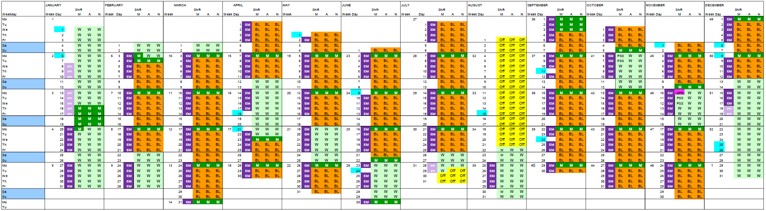
Operation Calendar 2025
SR Bending magnets PS incident
 | Hours
M | 1.152
BL | 4.512
Total | 5.664
4
4

Slide 5
Statistics
73% 84%

Slide 6
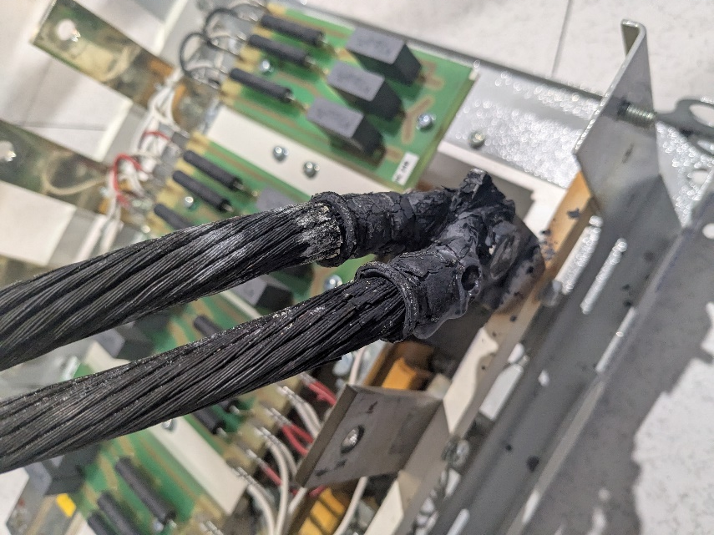
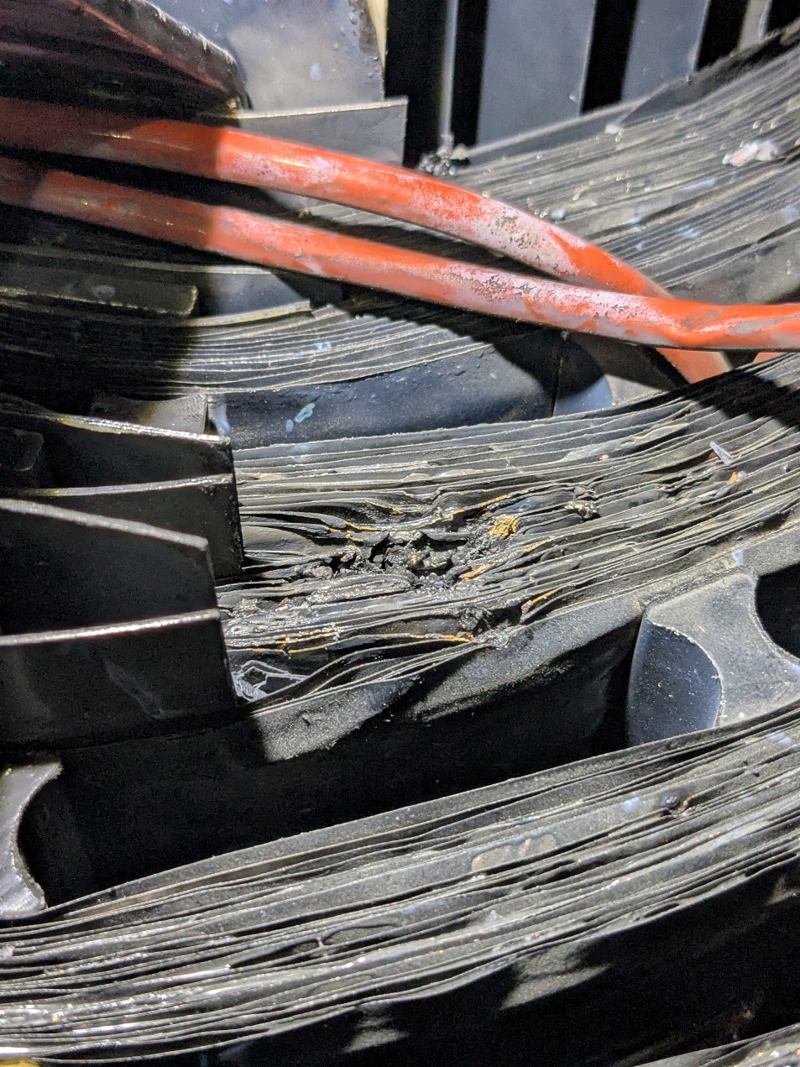
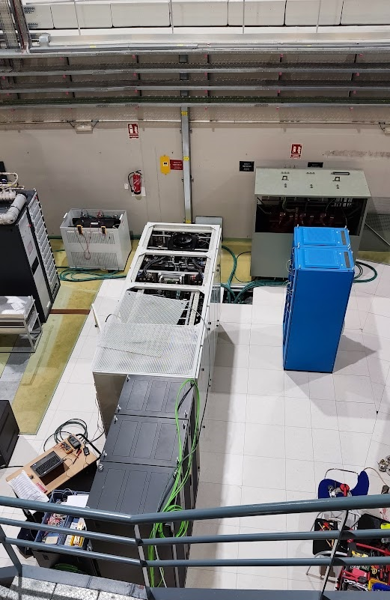
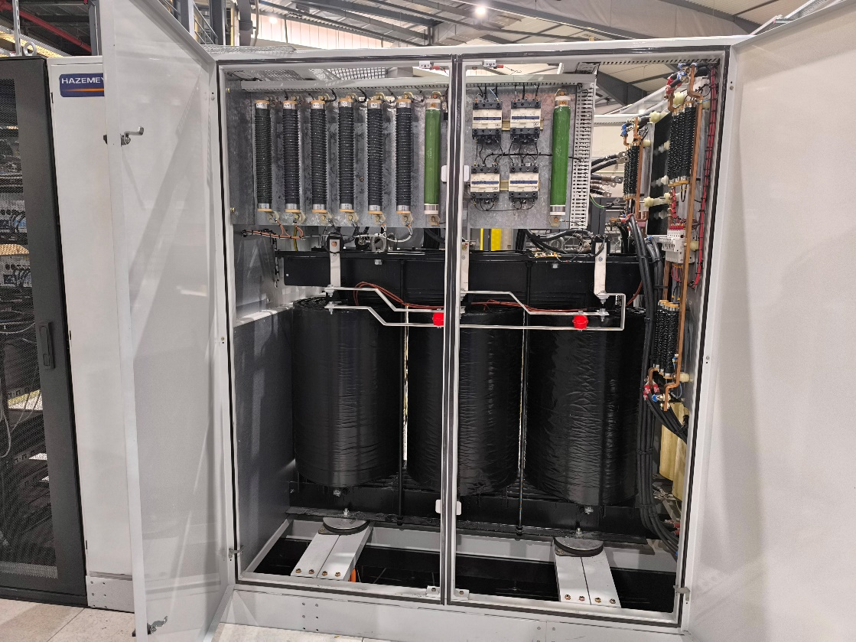
SR-Bending Magnets Power Converter incident
6

Slide 7

SR-Bending Magnets Power Converter incident
SR PS tested after Winter Shutdown (1 week before start operation)
SR PS worked during first 4 M days
Failure the day before start with Beamlines
Temporary solution: rent two transformers from a Belgium company (not same voltage)
New transformers bought and installed following shutdown
Operations calendar 2025 modified to recover the 13 BL days lost
7

Slide 8
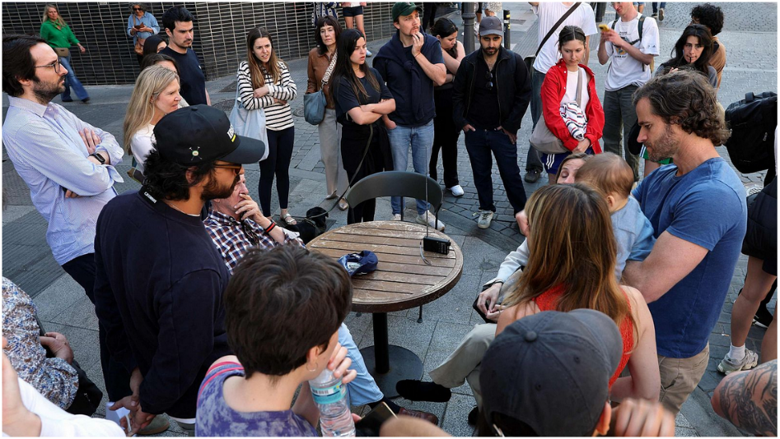
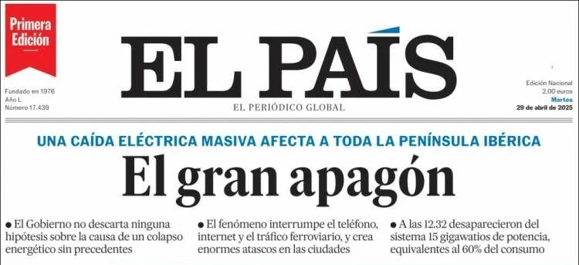

Peninsula blackout
28th April 12h30 a general blackout affected the whole country (ALBA machine day)
ALBA UPS and diesel generators worked as expected
Critical equipment kept running: data servers, internet, vacuum system, SCW cryocoolers, …
Some equipment status secured for a safe restart
Afternoon and night shifts cancelled. All the staff required for the recovery to meet early next morning
The following day (beam for users) it took 8h to recover
Turn on transformers, power up SA racks, turn on water cooling…
Some lessons learnt → CRISIS COMMITTEE working in procedures/checklists
8

Slide 9
ALBA Accelerator Developments

Slide 10
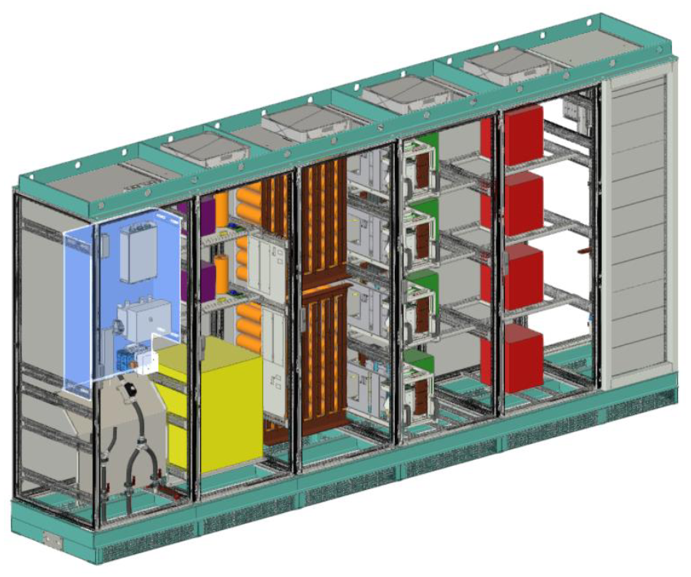
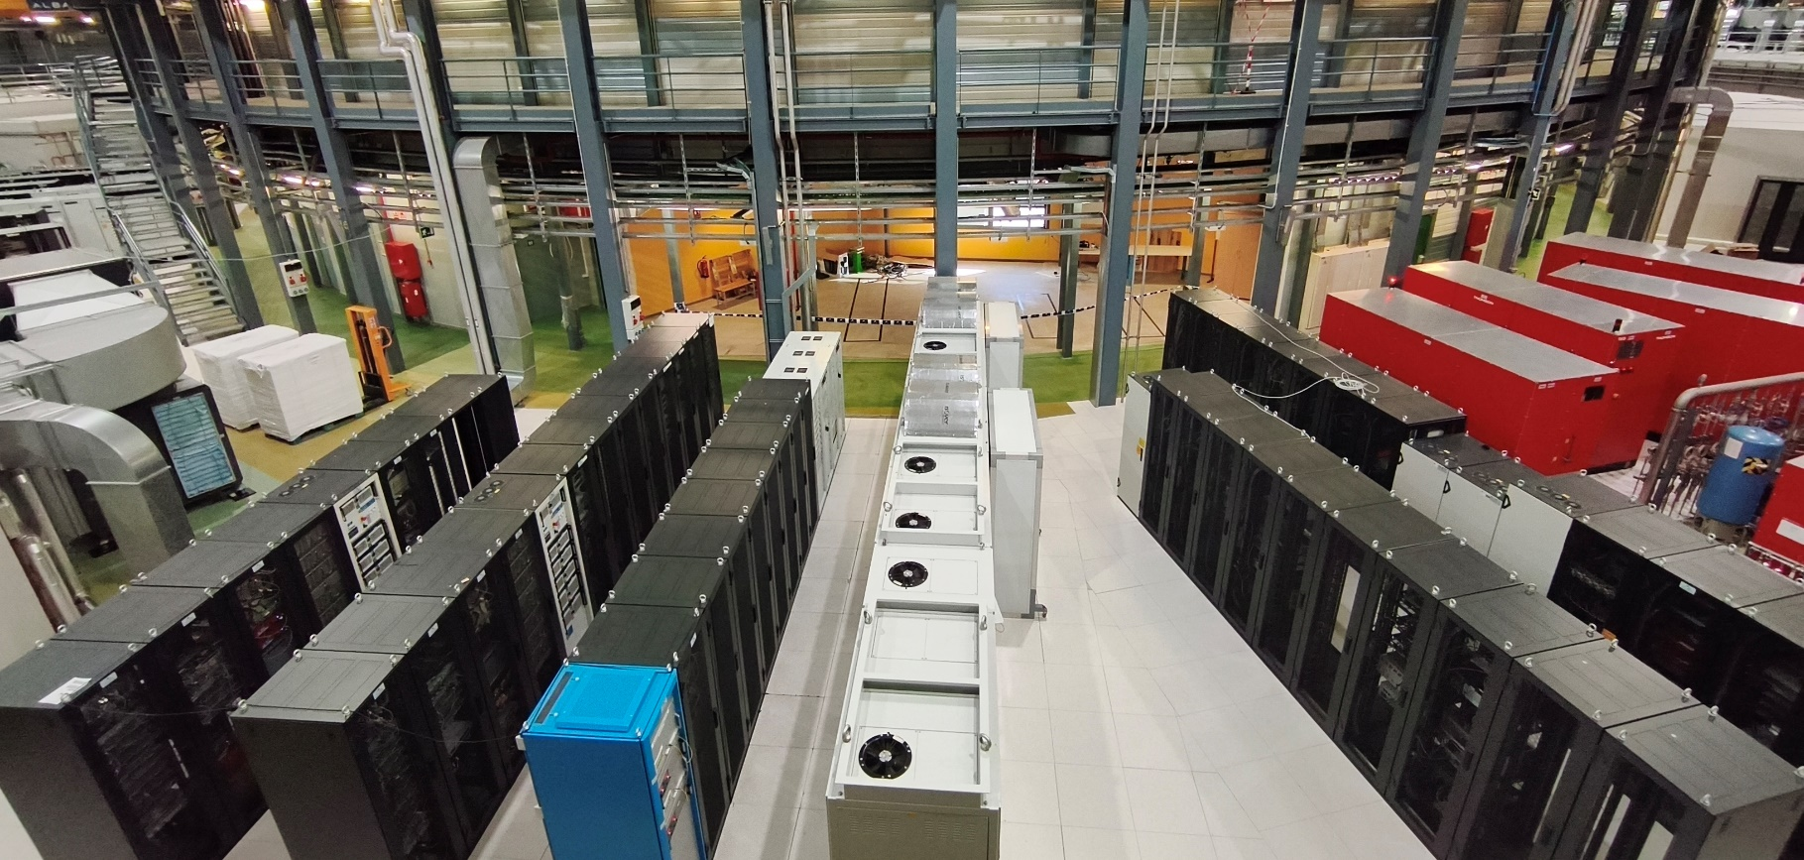
New Booster Power Supplies
Install Easter 2026 → SAT Summer 2026
Both present and new PS operative → switch rack
Switch
New PS
Present PS

Slide 11
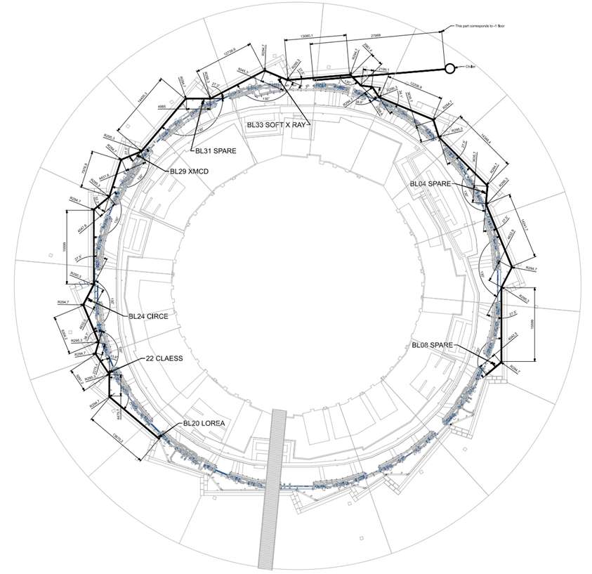
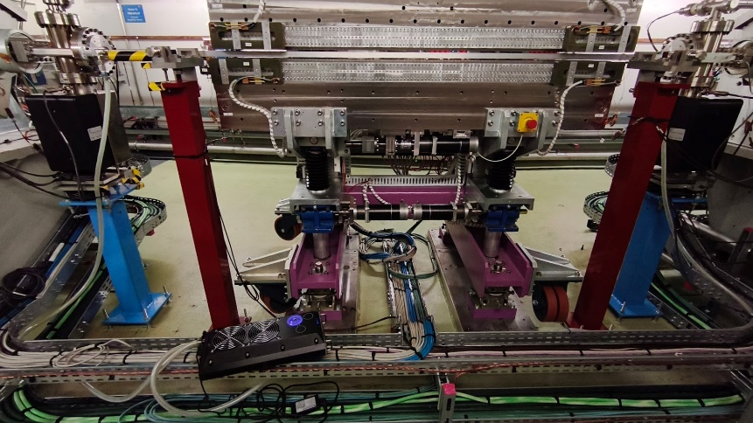
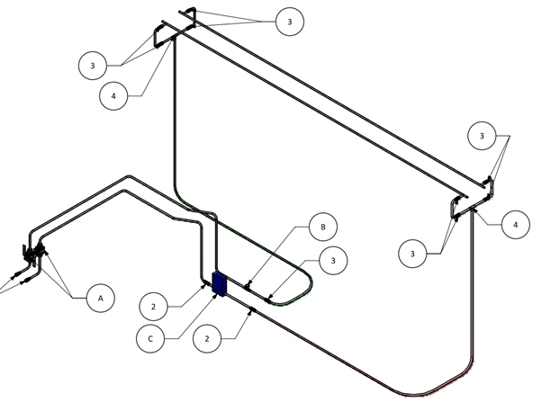
Aluminum cooling water circuit
Dedicated water cooling circuit for aluminum chambers cooling

Slide 12
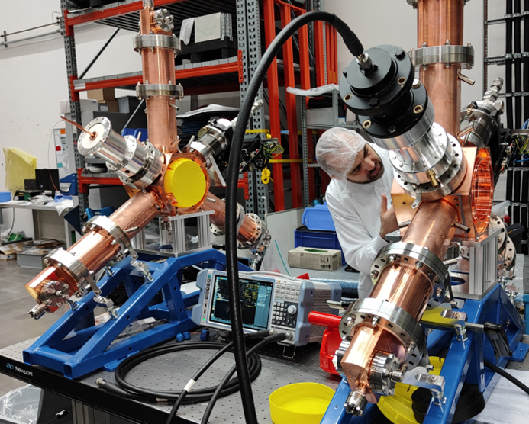
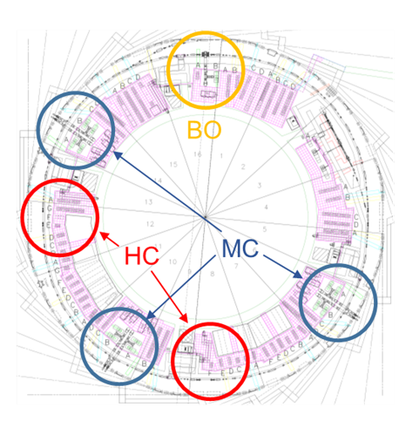
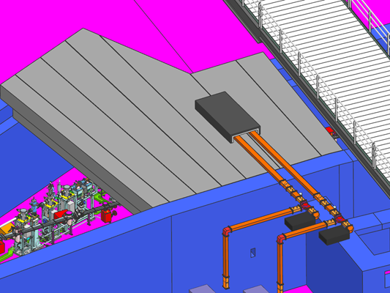

3rd Order Harmonic Cavities
Installation of 4 harmonic RF systems in ALBA SR
Planned to be in operation by the end 2026
2 cavities in long straight sections: S08 & S12

Slide 13
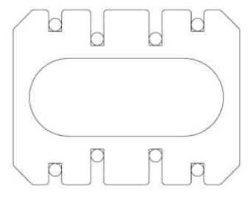
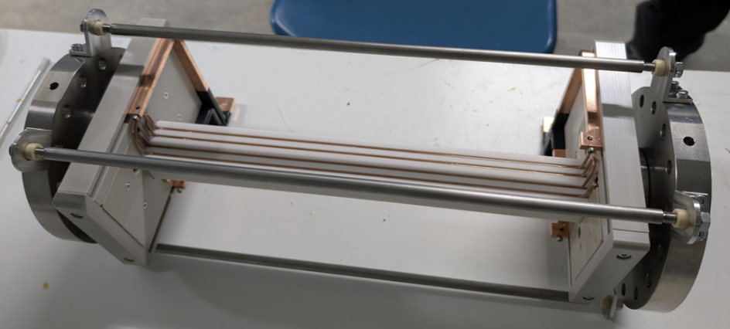
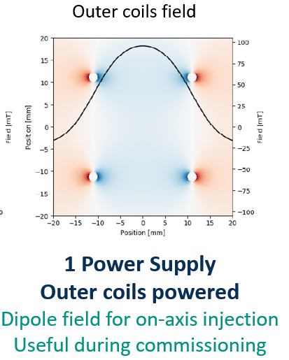
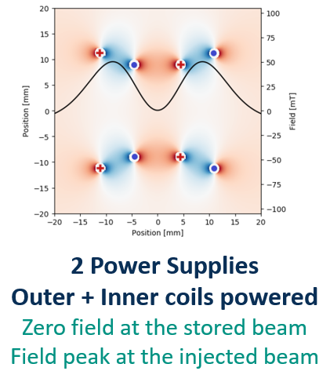
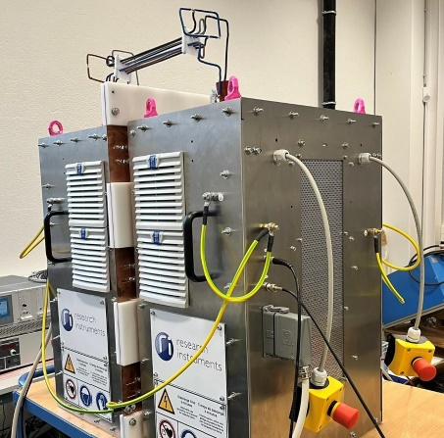
Double Dipole Kicker
Installation of DDK in ALBA SR this winter shutdown

Slide 14
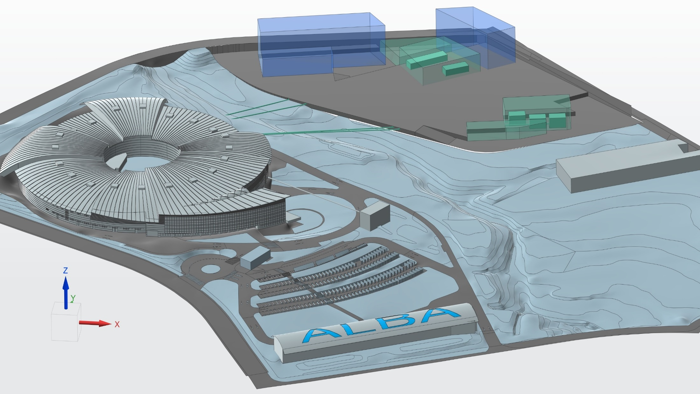




ALBA II Upgrade
14

Slide 15
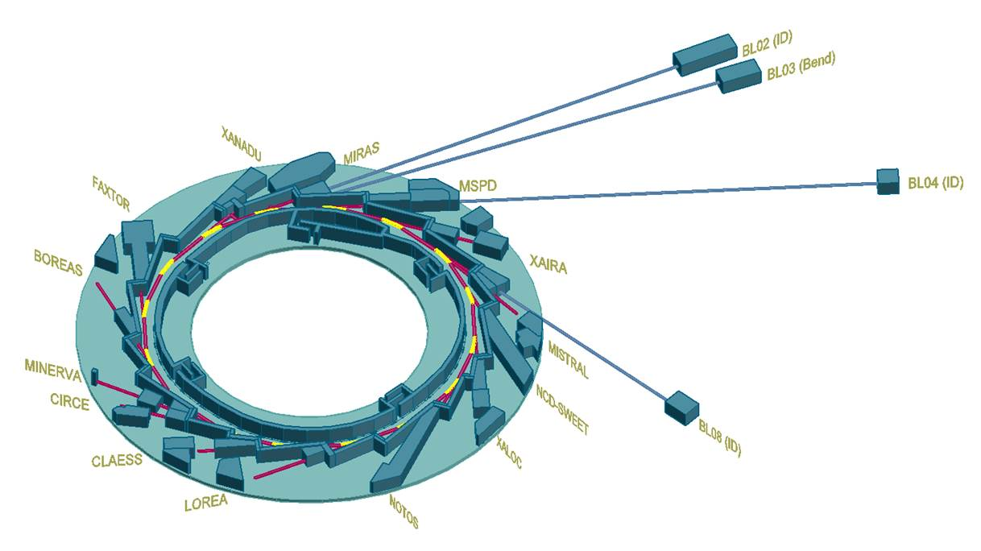

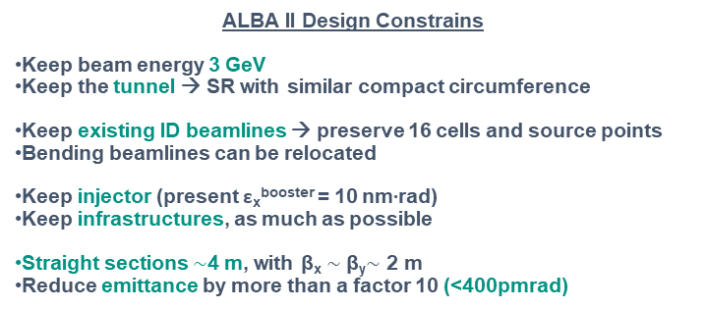
ALBA II Objectives
Replace the Storage ring Accelerator of ALBA
Upgrade the existing beamlines
Build new long beamlines
ALBA II Design Constrains
Keep beam energy 3 GeV
Keep the tunnel → SR with similar compact circumference
Keep existing ID beamlines → preserve 16 cells and source points
Bending beamlines can be relocated
Keep injector (present ε_{x}^{booster} = 10 nm∙rad)
Keep infrastructures, as much as possible
Straight sections $\sim$4 m, with β_{x} $\sim$β_{y}$\sim$ 2 m
Reduce emittance by more than a factor 10 (<400pmrad)

Slide 16
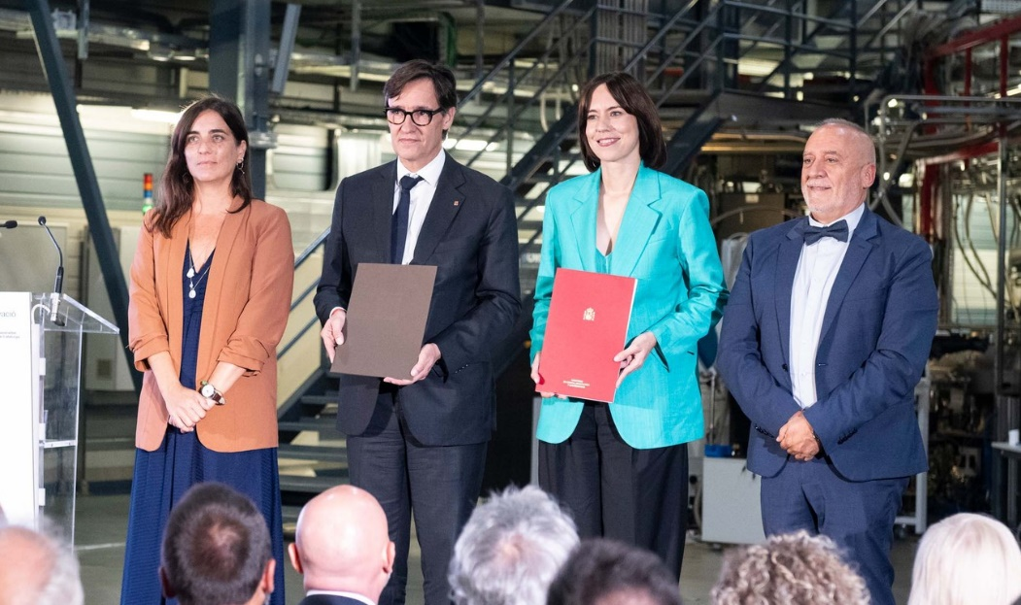
ALBA II Main Dates
September 2025
Starting the design
Presenting to funding agencies the ‘pre-White Paper’
ALBA II included in 2021-2024 ALBA Strategy Plan
First funding for prototyping (ALBA01) – 7.5 M€
Funding for 1st ALBA II BL (ALBA05) – 10 M€
New plots assigned for Long BLs extension - 16 M€
White Paper published
Decision on long BLs
Government approval long-term budget (2024-2038)
Define project work packages
Prototyping
Design
Production + Assembly
Dark period
Operation
2020 2021 2022 2023 2024 2025 2026 2027 2028 2029 2030 2031 2032 2033

Slide 17
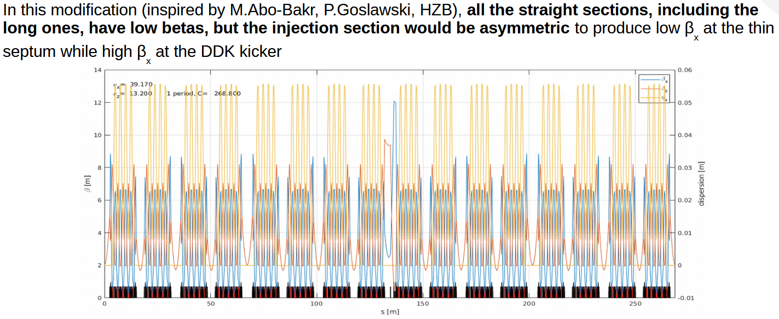
ALBA II Lattice Design
October 2024 5BA with octupoles (ESLS’24)
September 2025 Alpha lattice

Slide 18
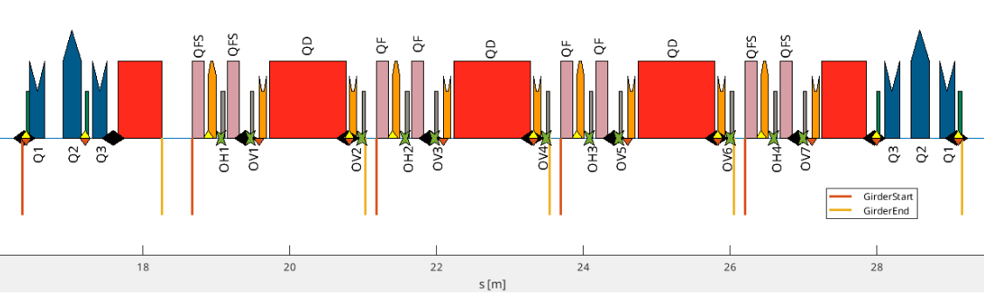
ALBA II Correction Scheme
11 BPM
11 HCM (7 in Sext, 4 in SS)
11 VCM (7 in Sext, 4 in SS)
16 quadrupole gradients
11 SKCOR in octupoles

Slide 19
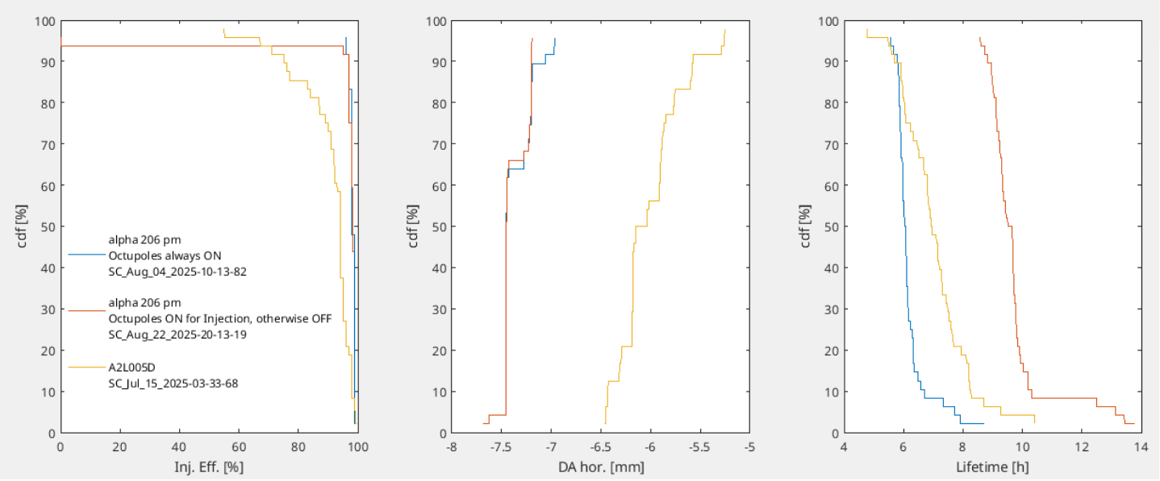
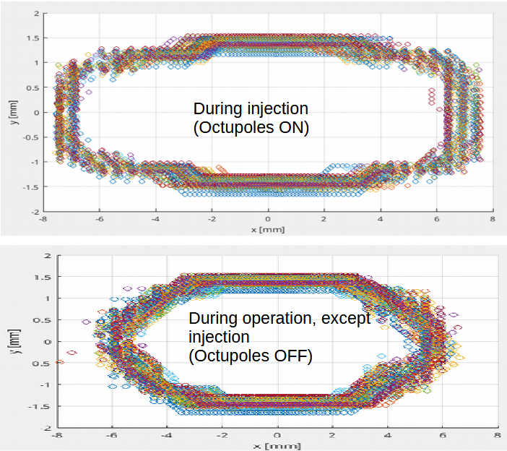
ALBA II Lattice Design
Octupoles ON only during injection? → improve lifetime

Slide 20
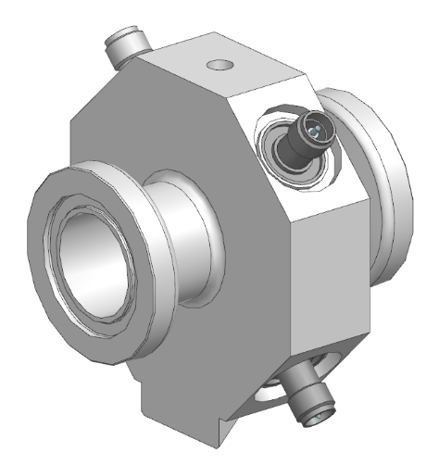
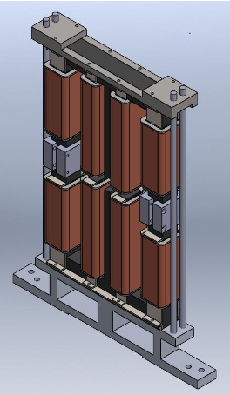
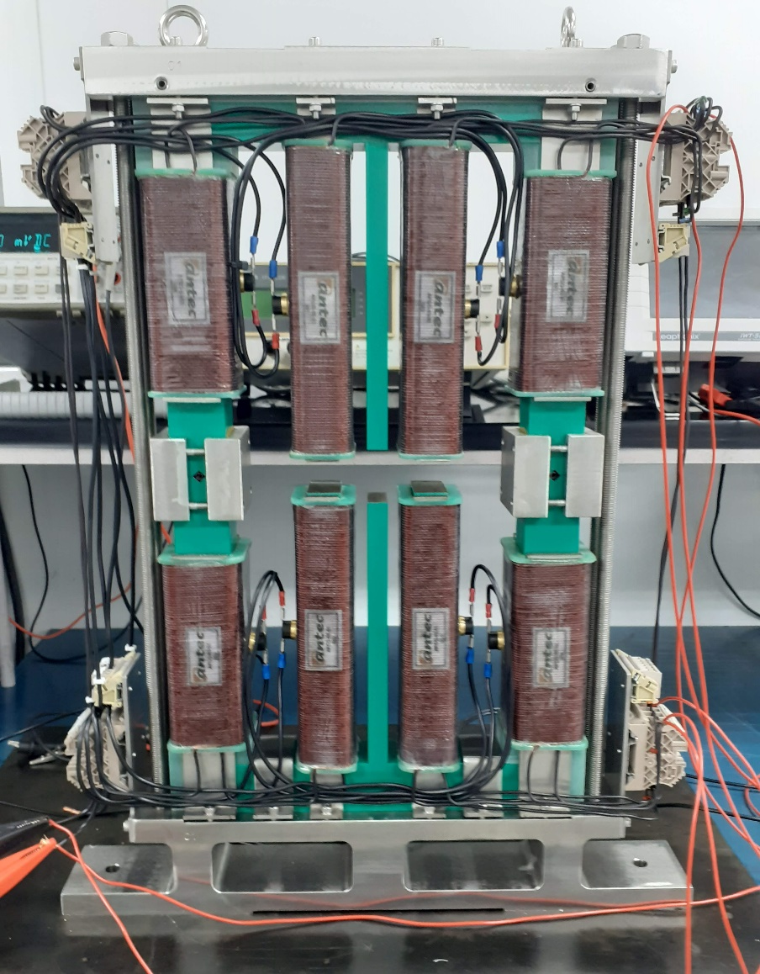
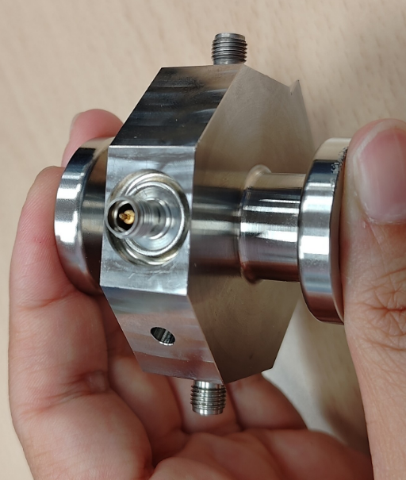
ALBA II Prototyping
Straight Section SR corrector
BPM test chamber and buttons

Slide 21
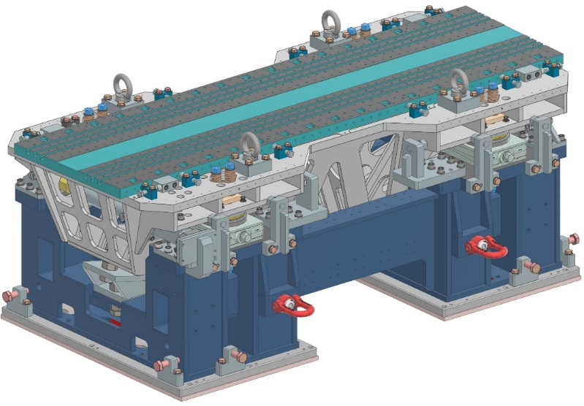
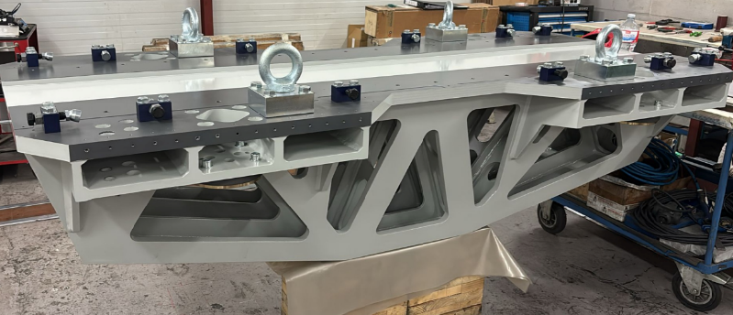
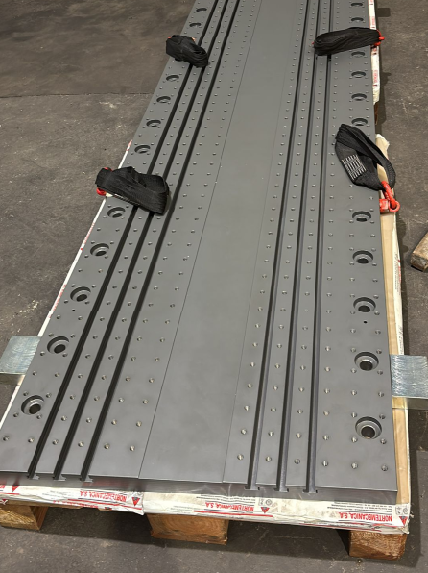
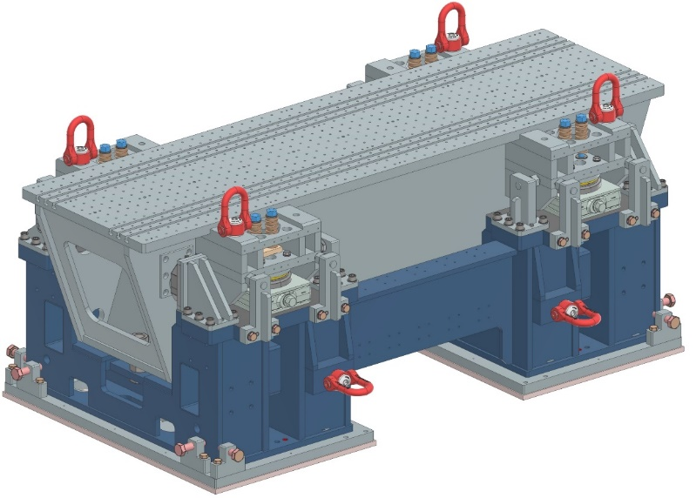
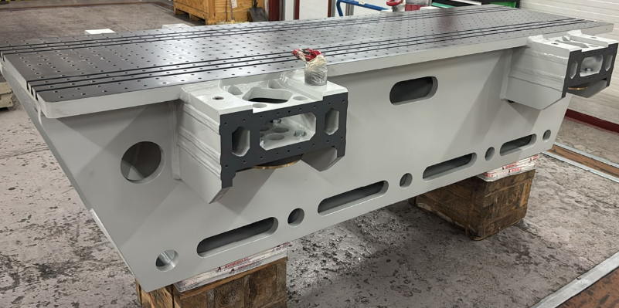
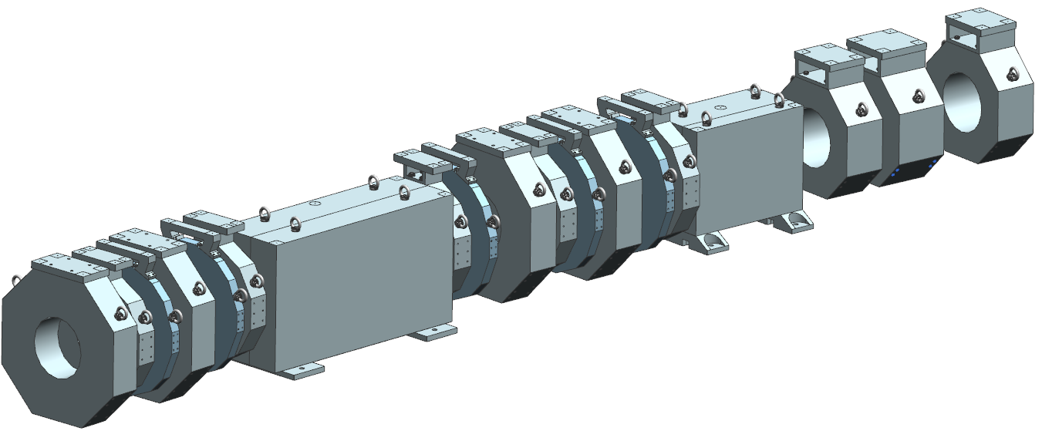
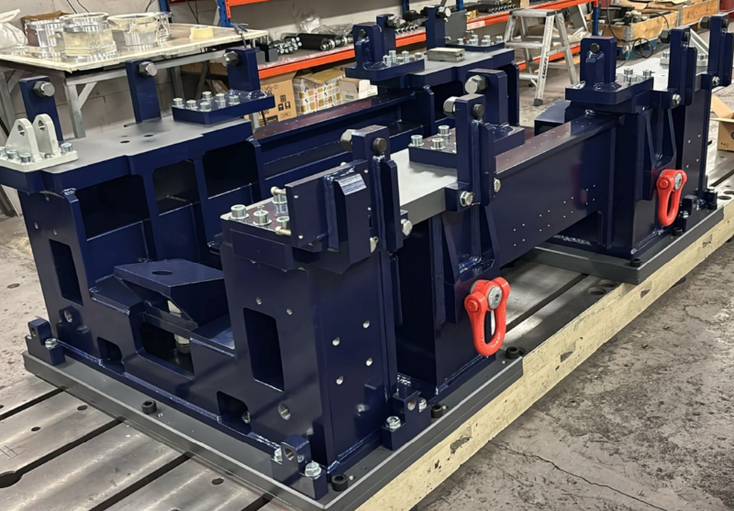
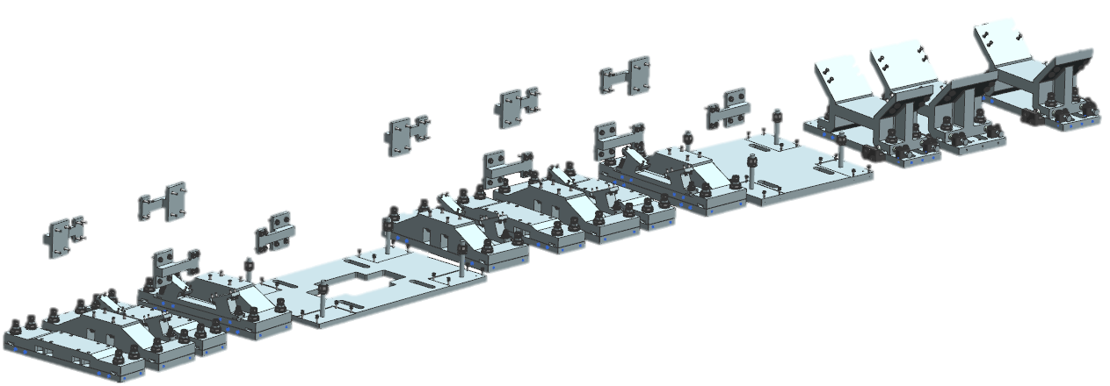
ALBA II Prototyping
Magnet dummies to test Girder

Slide 22
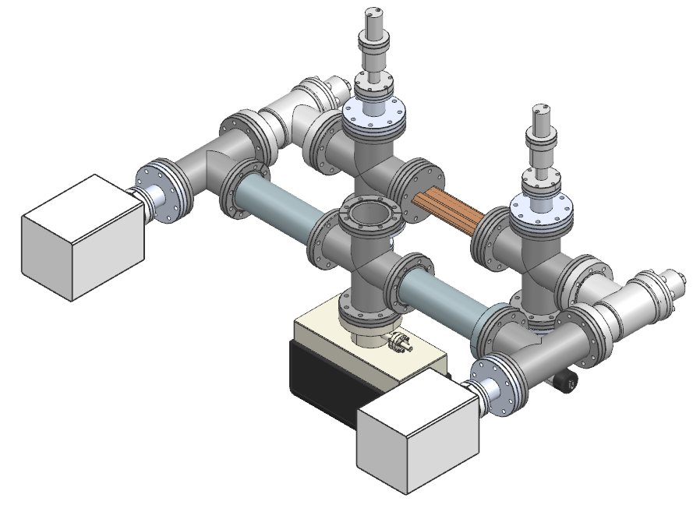
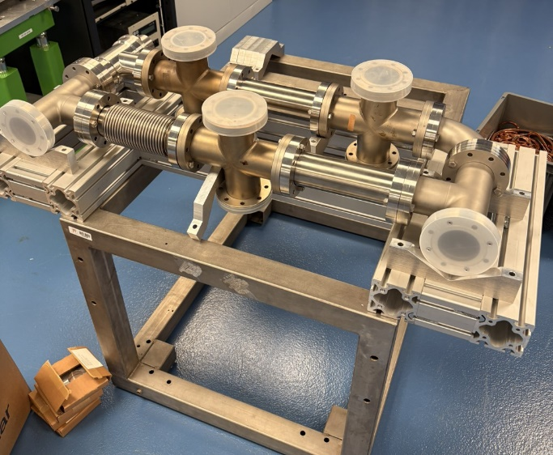
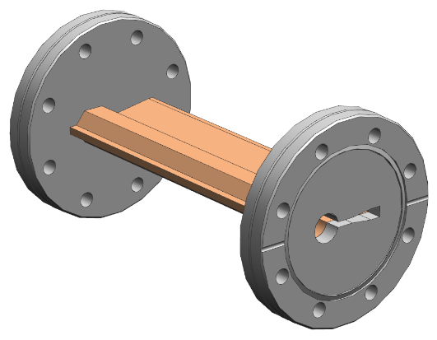
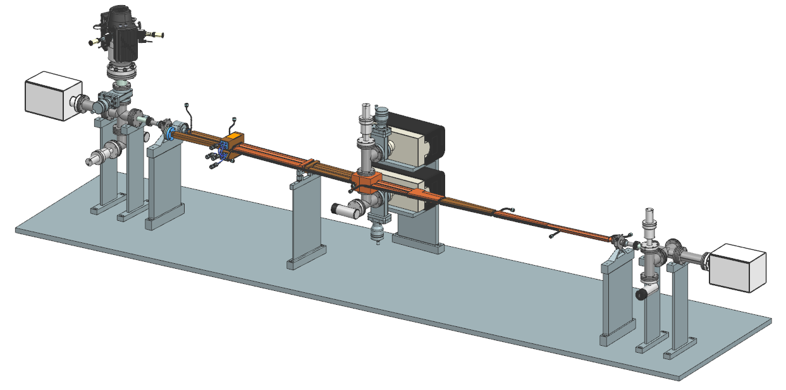
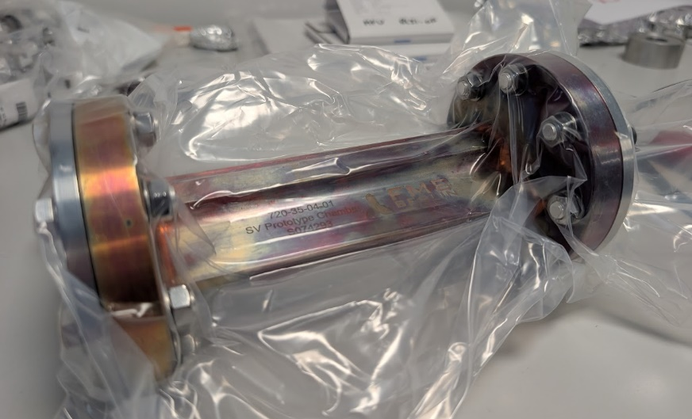
ALBA II Prototyping
Vacuum test bench
CuCrZr chamber

Slide 23
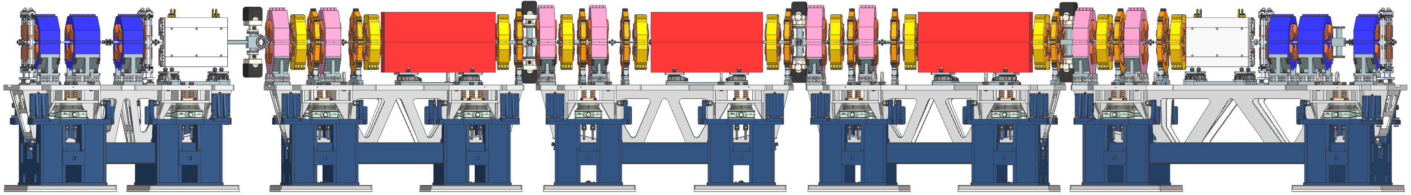
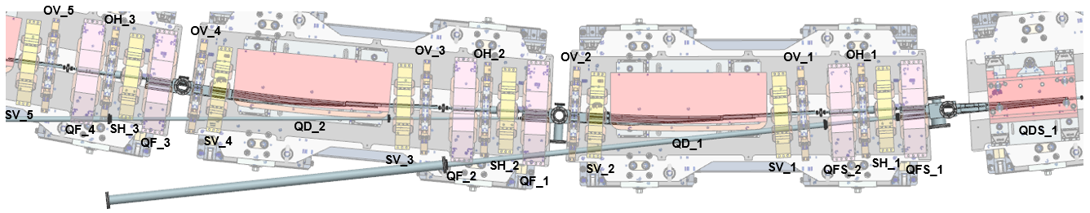
ALBA II Eng. design
Light extraction → magnets modifications

Slide 24
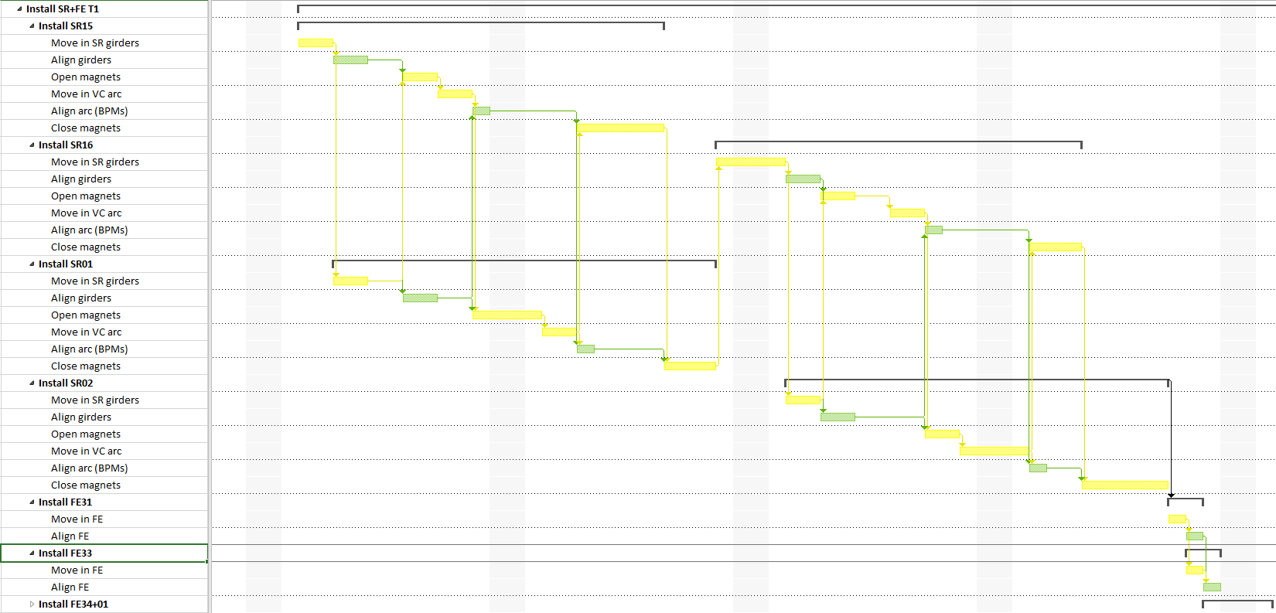
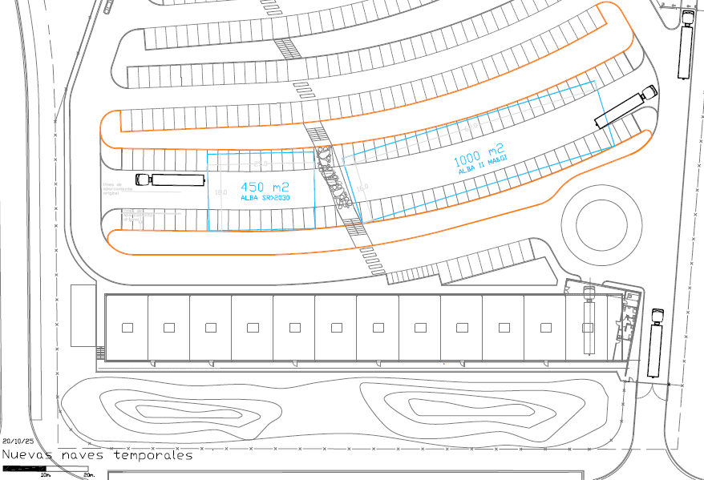

ALBA II Implementation program
Tunnel Removal and Installation plan
Required spaces for storage and assembly

Slide 25
On behalf of the Accelerator Division
and the ALBA II team,
Thanks for your attention

