Slide 1
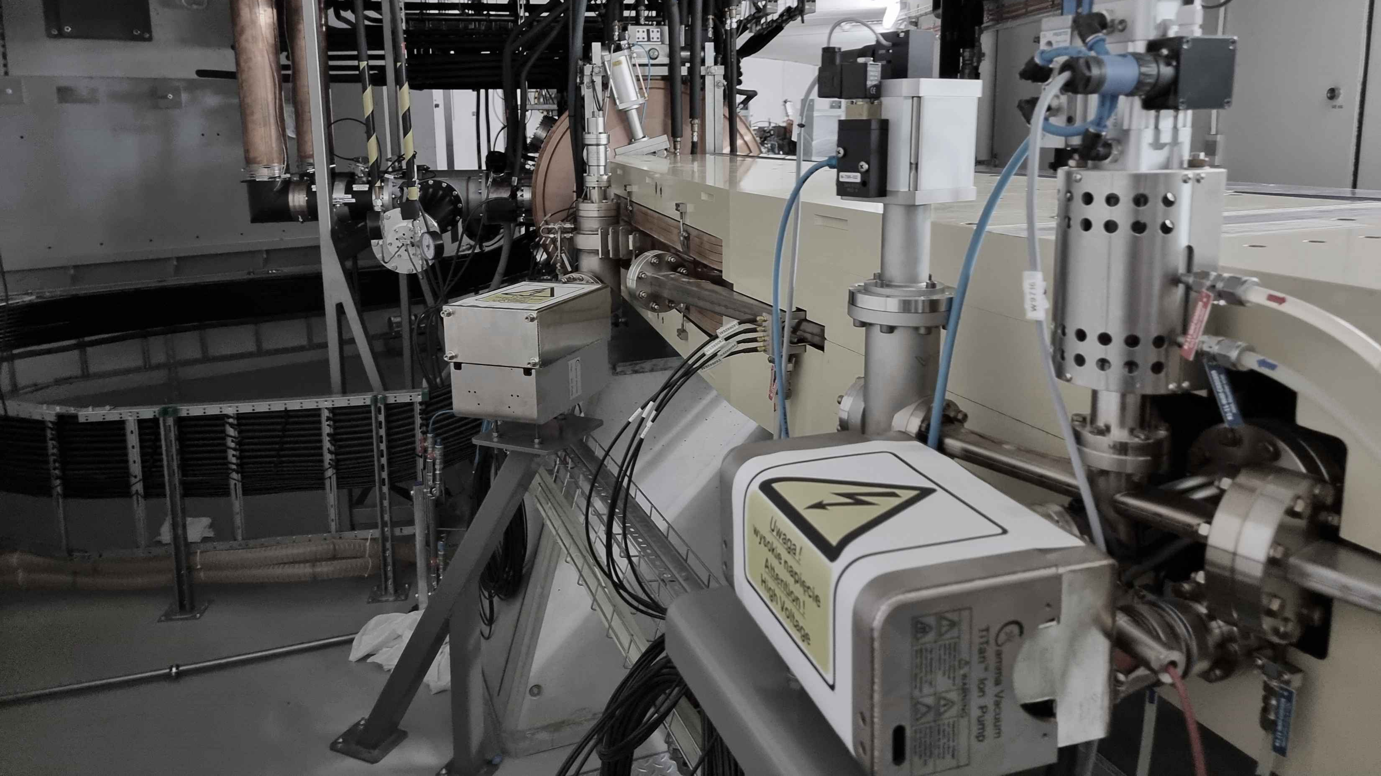
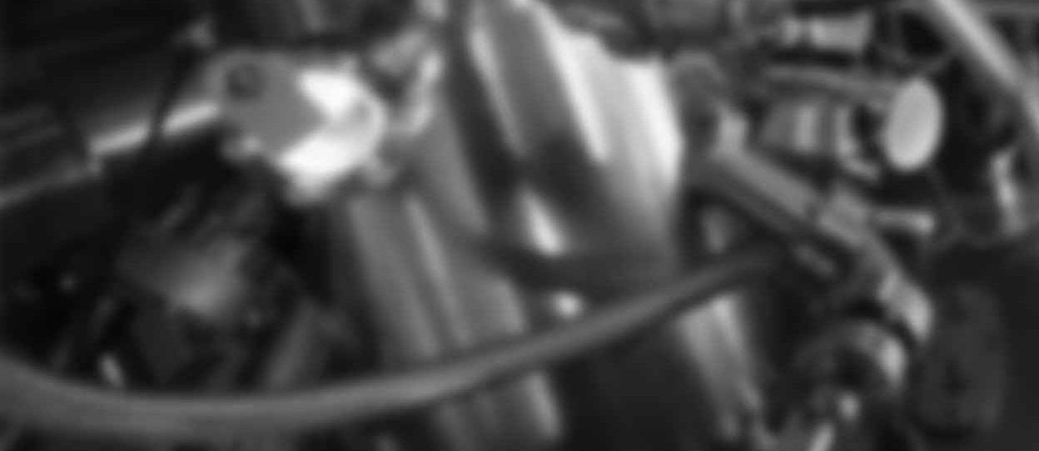

Status of Accelerators
Adriana Wawrzyniak, Roman Panaś
On behalf of Accelerators Department
ESLS, 29-31/10/2025

Slide 2
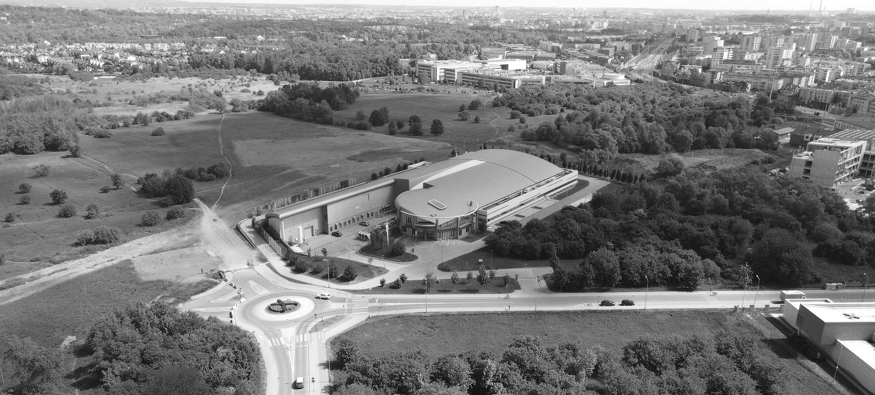

Intorudction to Solaris
KRAKOW
CITY CENTRE
NEW CAMPUS
JAGIELLONIAN UNIVERSITY
SOLARIS

Slide 3
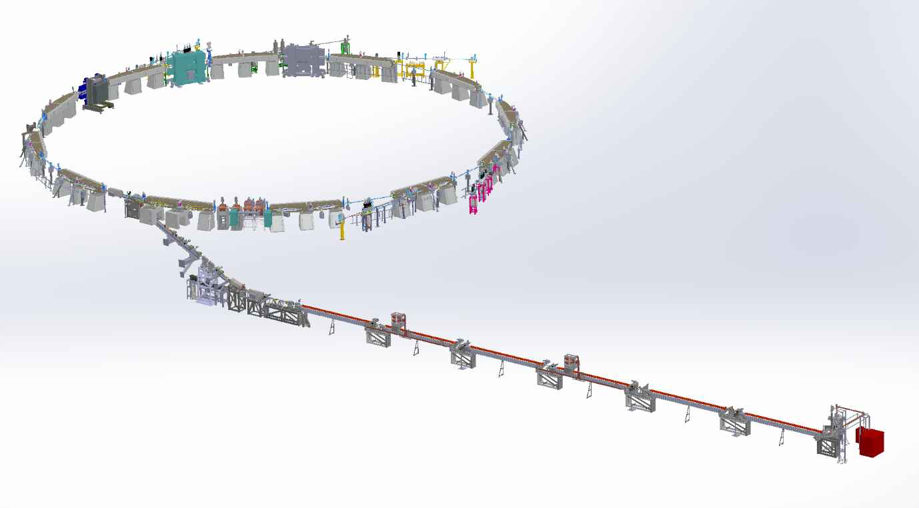
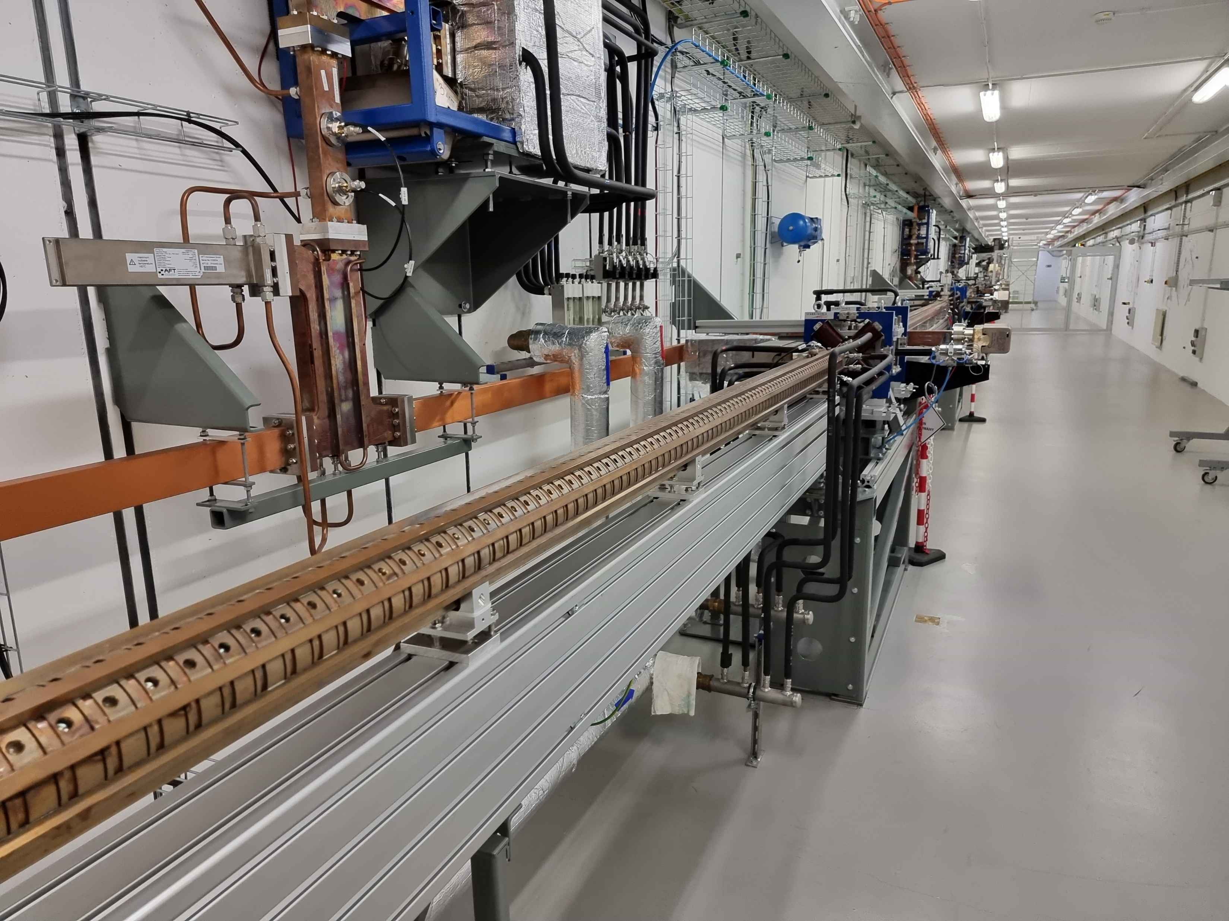
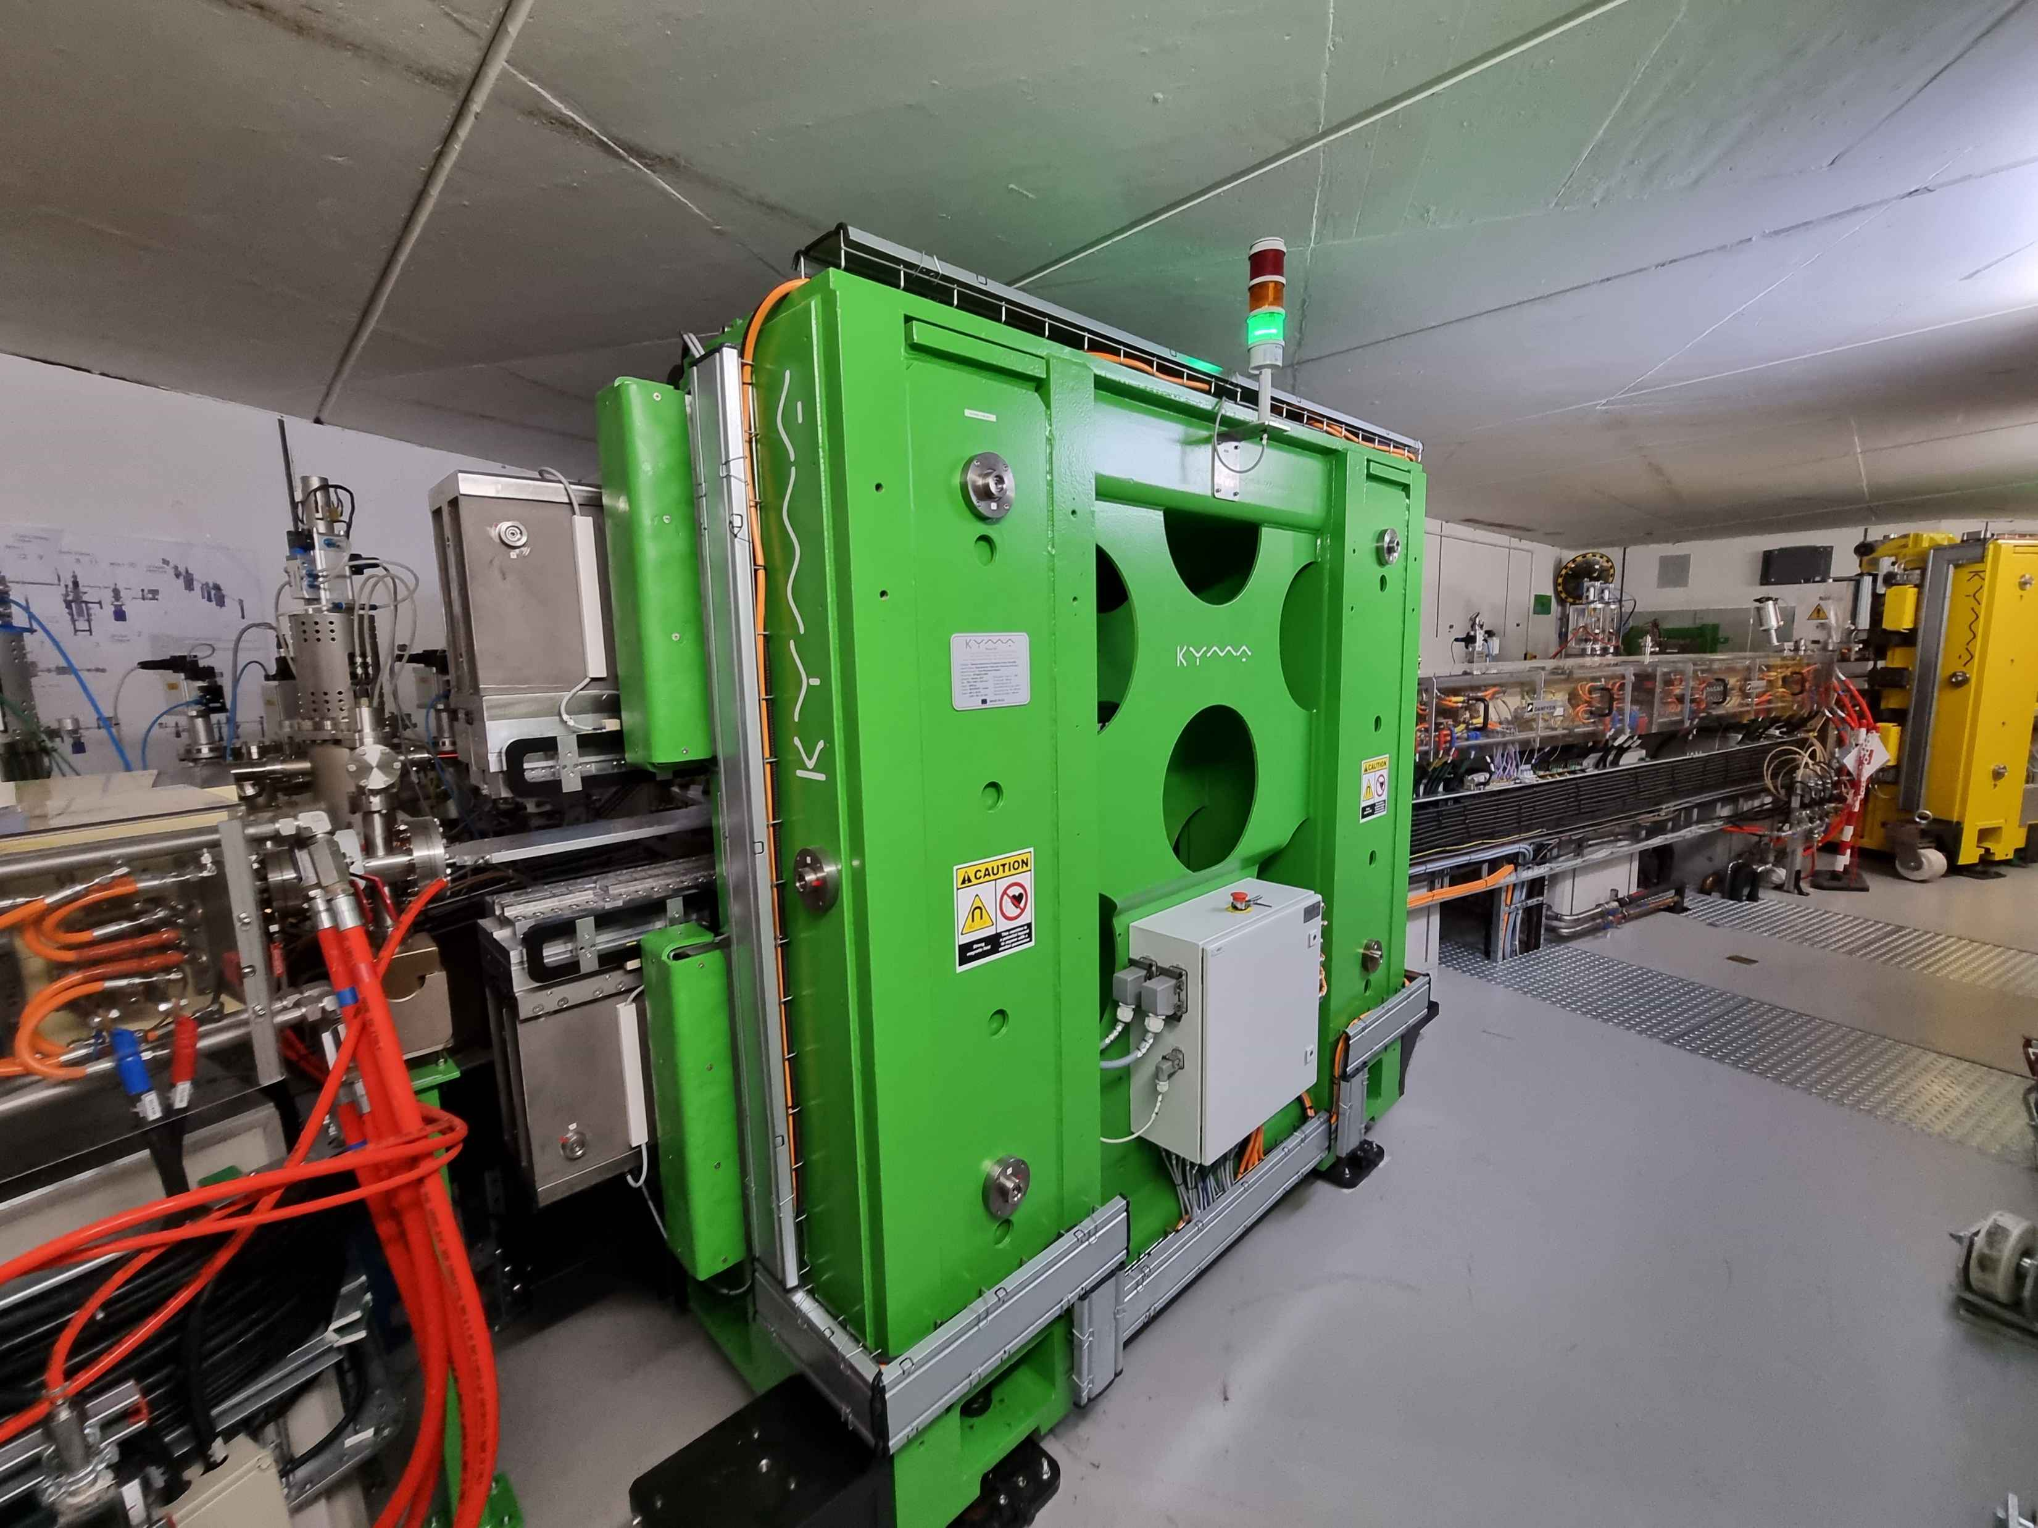
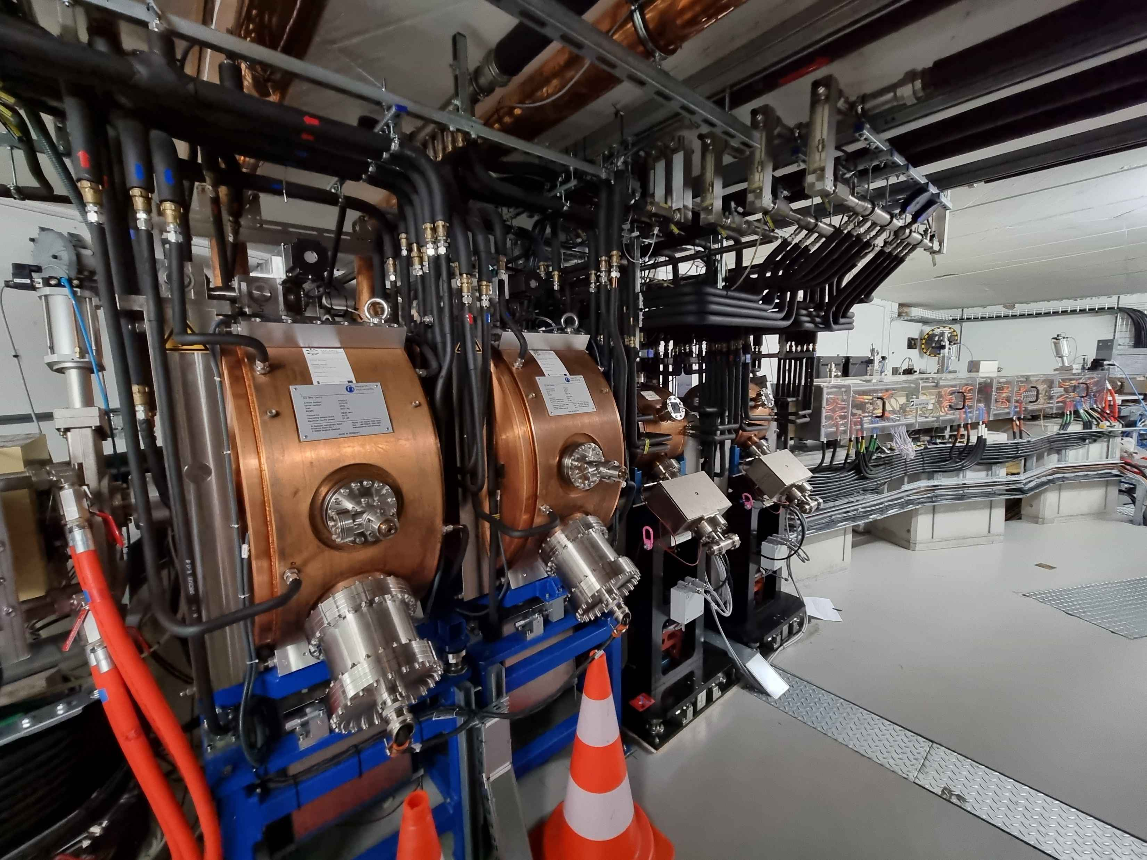
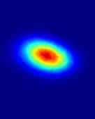
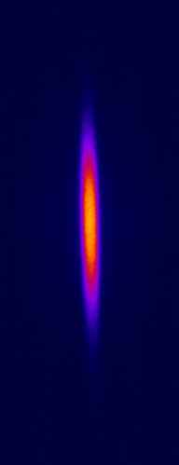

600 MeV Linac
RF Thermionic Gun
6 S-band 2998.5 MHz accelerating
structures
Accelerating gradient 20 MeV/m
3 RF Units & SLED cavities
Dog-leg vertical transfer line
In operation since Dec. 2014
1.5GeV Storage ring
12 DBA Cells – 96 m circumference
Space for ID’s (10 sections) ~ 3.5 m
10 straight sections for IDs
100 MHz RF system
300 MHz Landau Cavities
Injection dipole kicker
Ramping
In operation since May 2015
SOLARIS Accelerators
PINHOLE
LUMOS
Parameter | Value
Energy | 1.5 GeV
Max. current | 500 mA
Harmonic number | 32
Natural emittance | 6 nmrad
Lifetime | 13 h

Slide 4



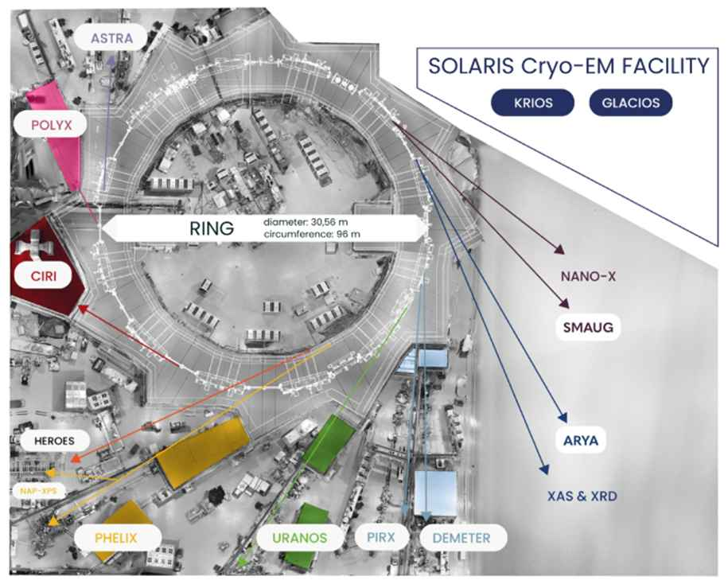














Research Infrastructure
SOLARIS offers research at 7 synchrotron beamlines and at 2 Cryo-TEMs
Instruments available for users (12)
IR microspectroscopy (3)
VUV and soft X-ray spectroscopy at UHV (3)
soft X-ray microscopy (2)
tender & hard X-ray spectroscopy
hard X-ray microscopy & tomography
Cryo TEM (2)
MAVKA
Instruments under construction (5)
X-ray photoemission at near AP
macromocelular crystallography
tender & hard X-ray micro/nano-beam
small angle (hard) X-ray scattering
hard X-ray spectroscopy, diffraction and inelastic scattering
Projects (5)
Hard X-ray photoemission instrument
Surface scattering instrument
Operando RXES beamline
UV-Vis and irradiation laboratory
Next generation Cryo TEM
SMAUG
UV-VIS
HEROES
ARYA
NAP-XPS
XRD & XAS

Slide 5
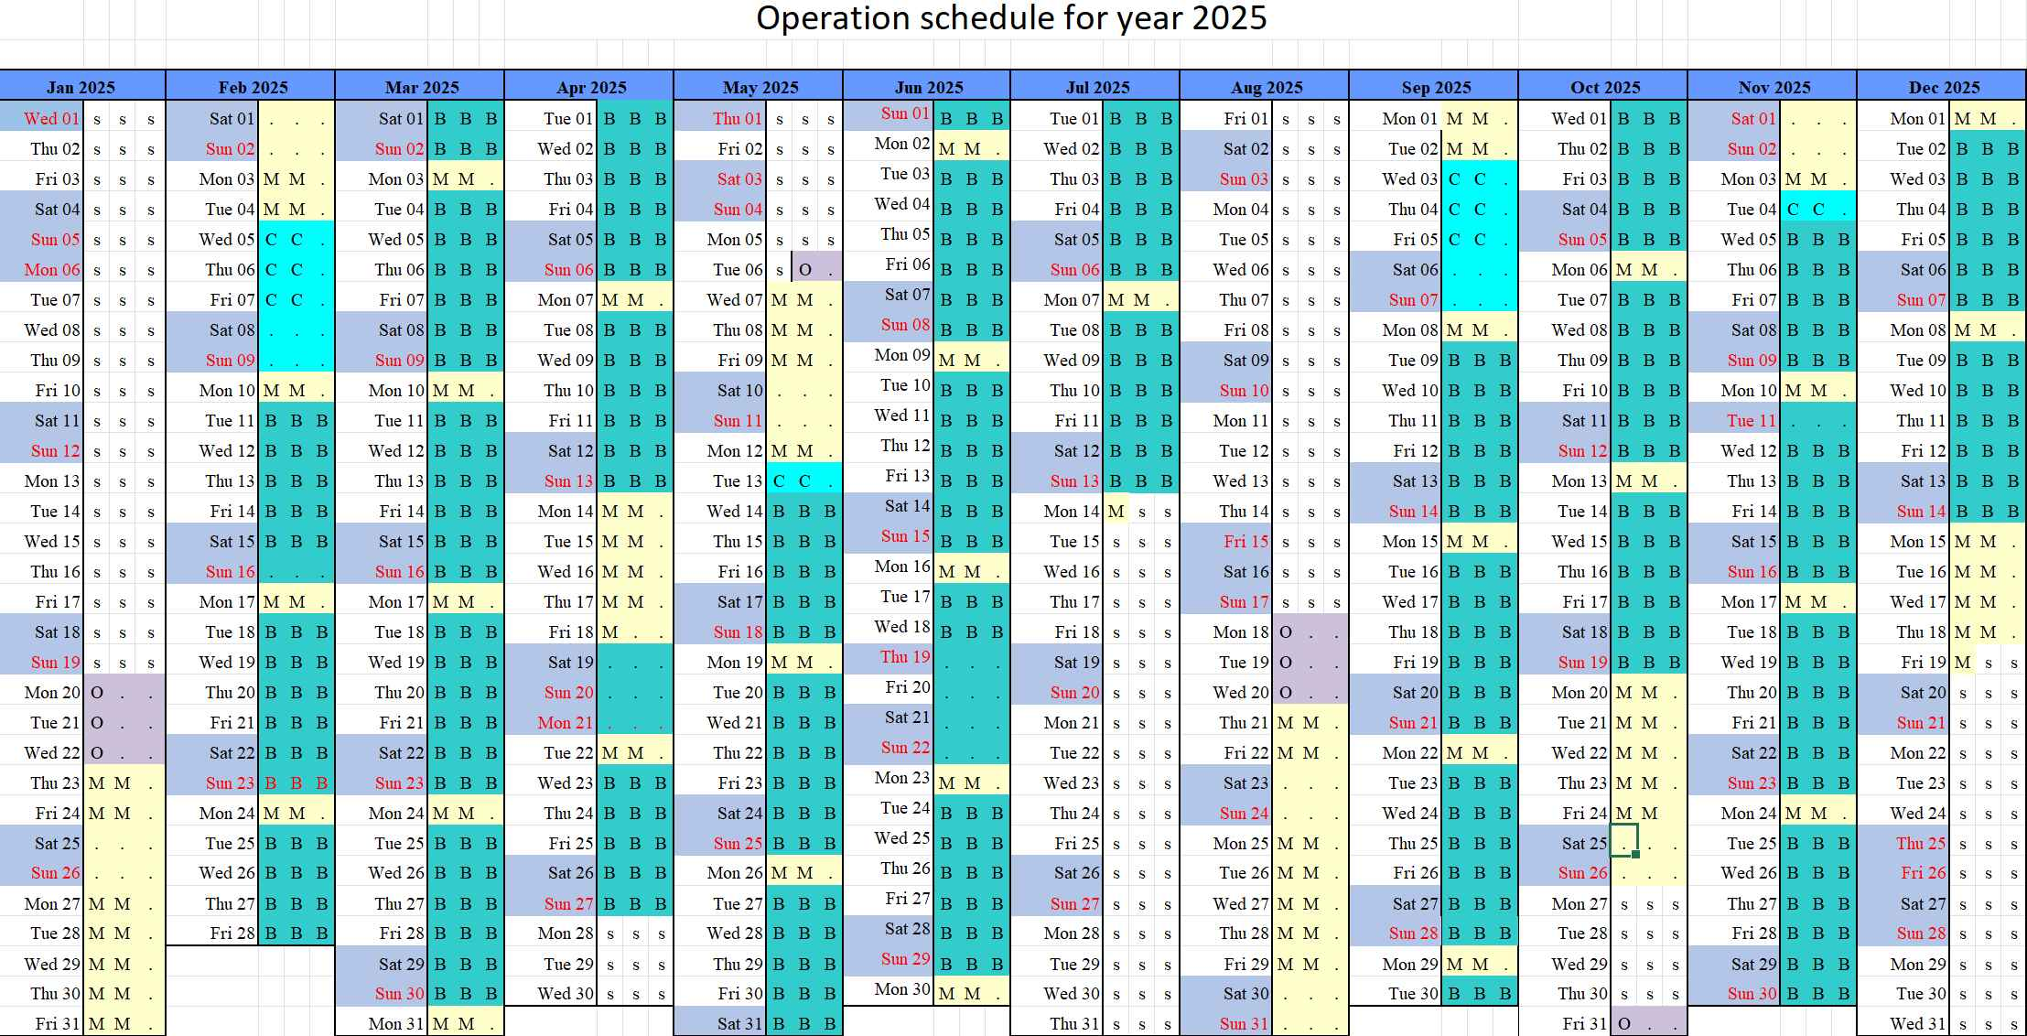

SOLARIS OPERATION: Operation Schedule
STANDRAD OPERATION 24/7 since 2025r.
2 shifts (8:00-16:00; 14:00-22:00),
Mondays (from 8:00 am) for machine studies, developments and maintenance
Tue-Mon (until 8:00 am) –User Operation
On-call duties 22:00-2:00
Operation in decay mode, full filling pattern
2 injections/day
Beam for beamlines/Users
Machine development /maintenance
Shutdown
185 days/year
75 days/year
79 days/year

Slide 6
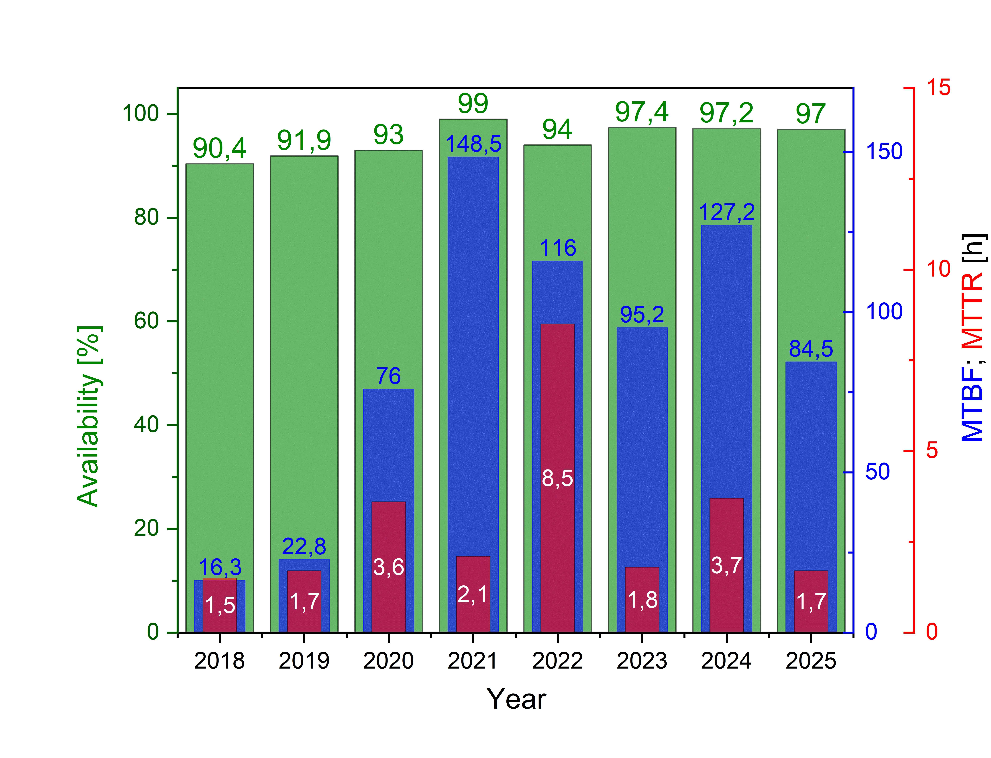
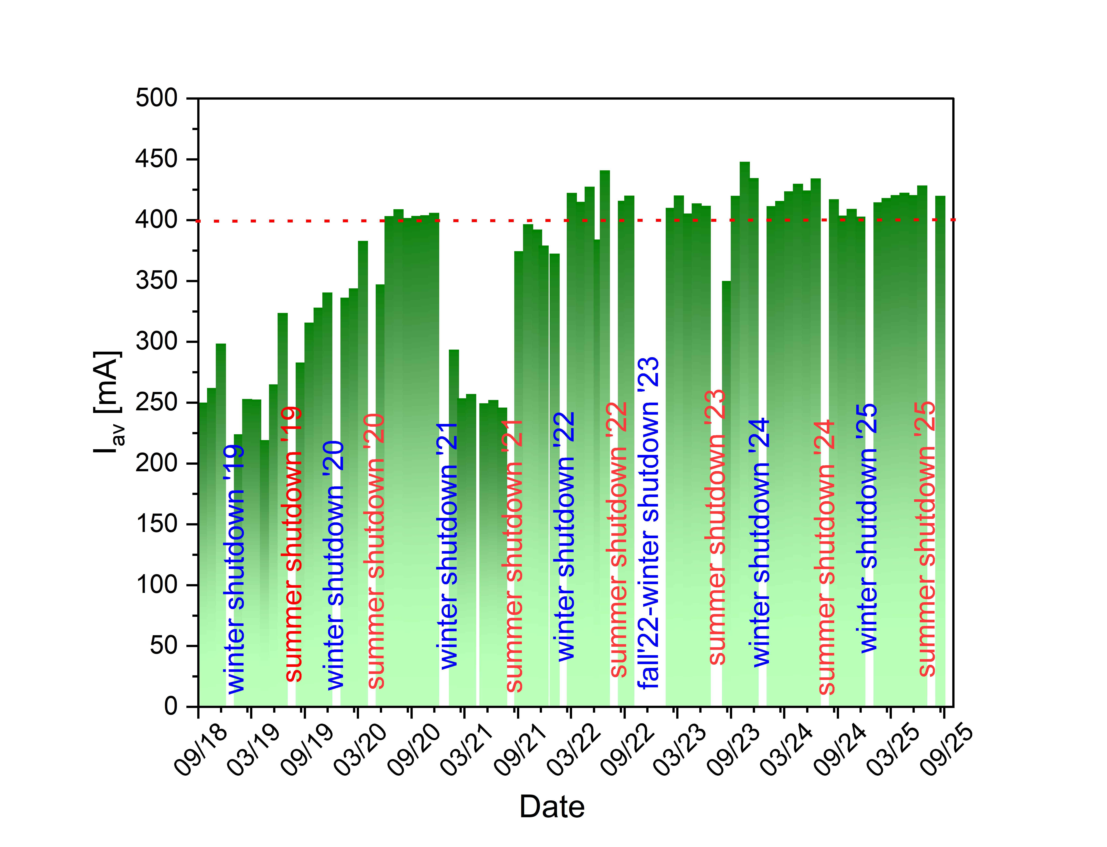
SOLARIS OPERATION: STATISTICS
User time
3970h
MTBF
84.5h
MTTR
1.7h
Availability
97.0%

Slide 7
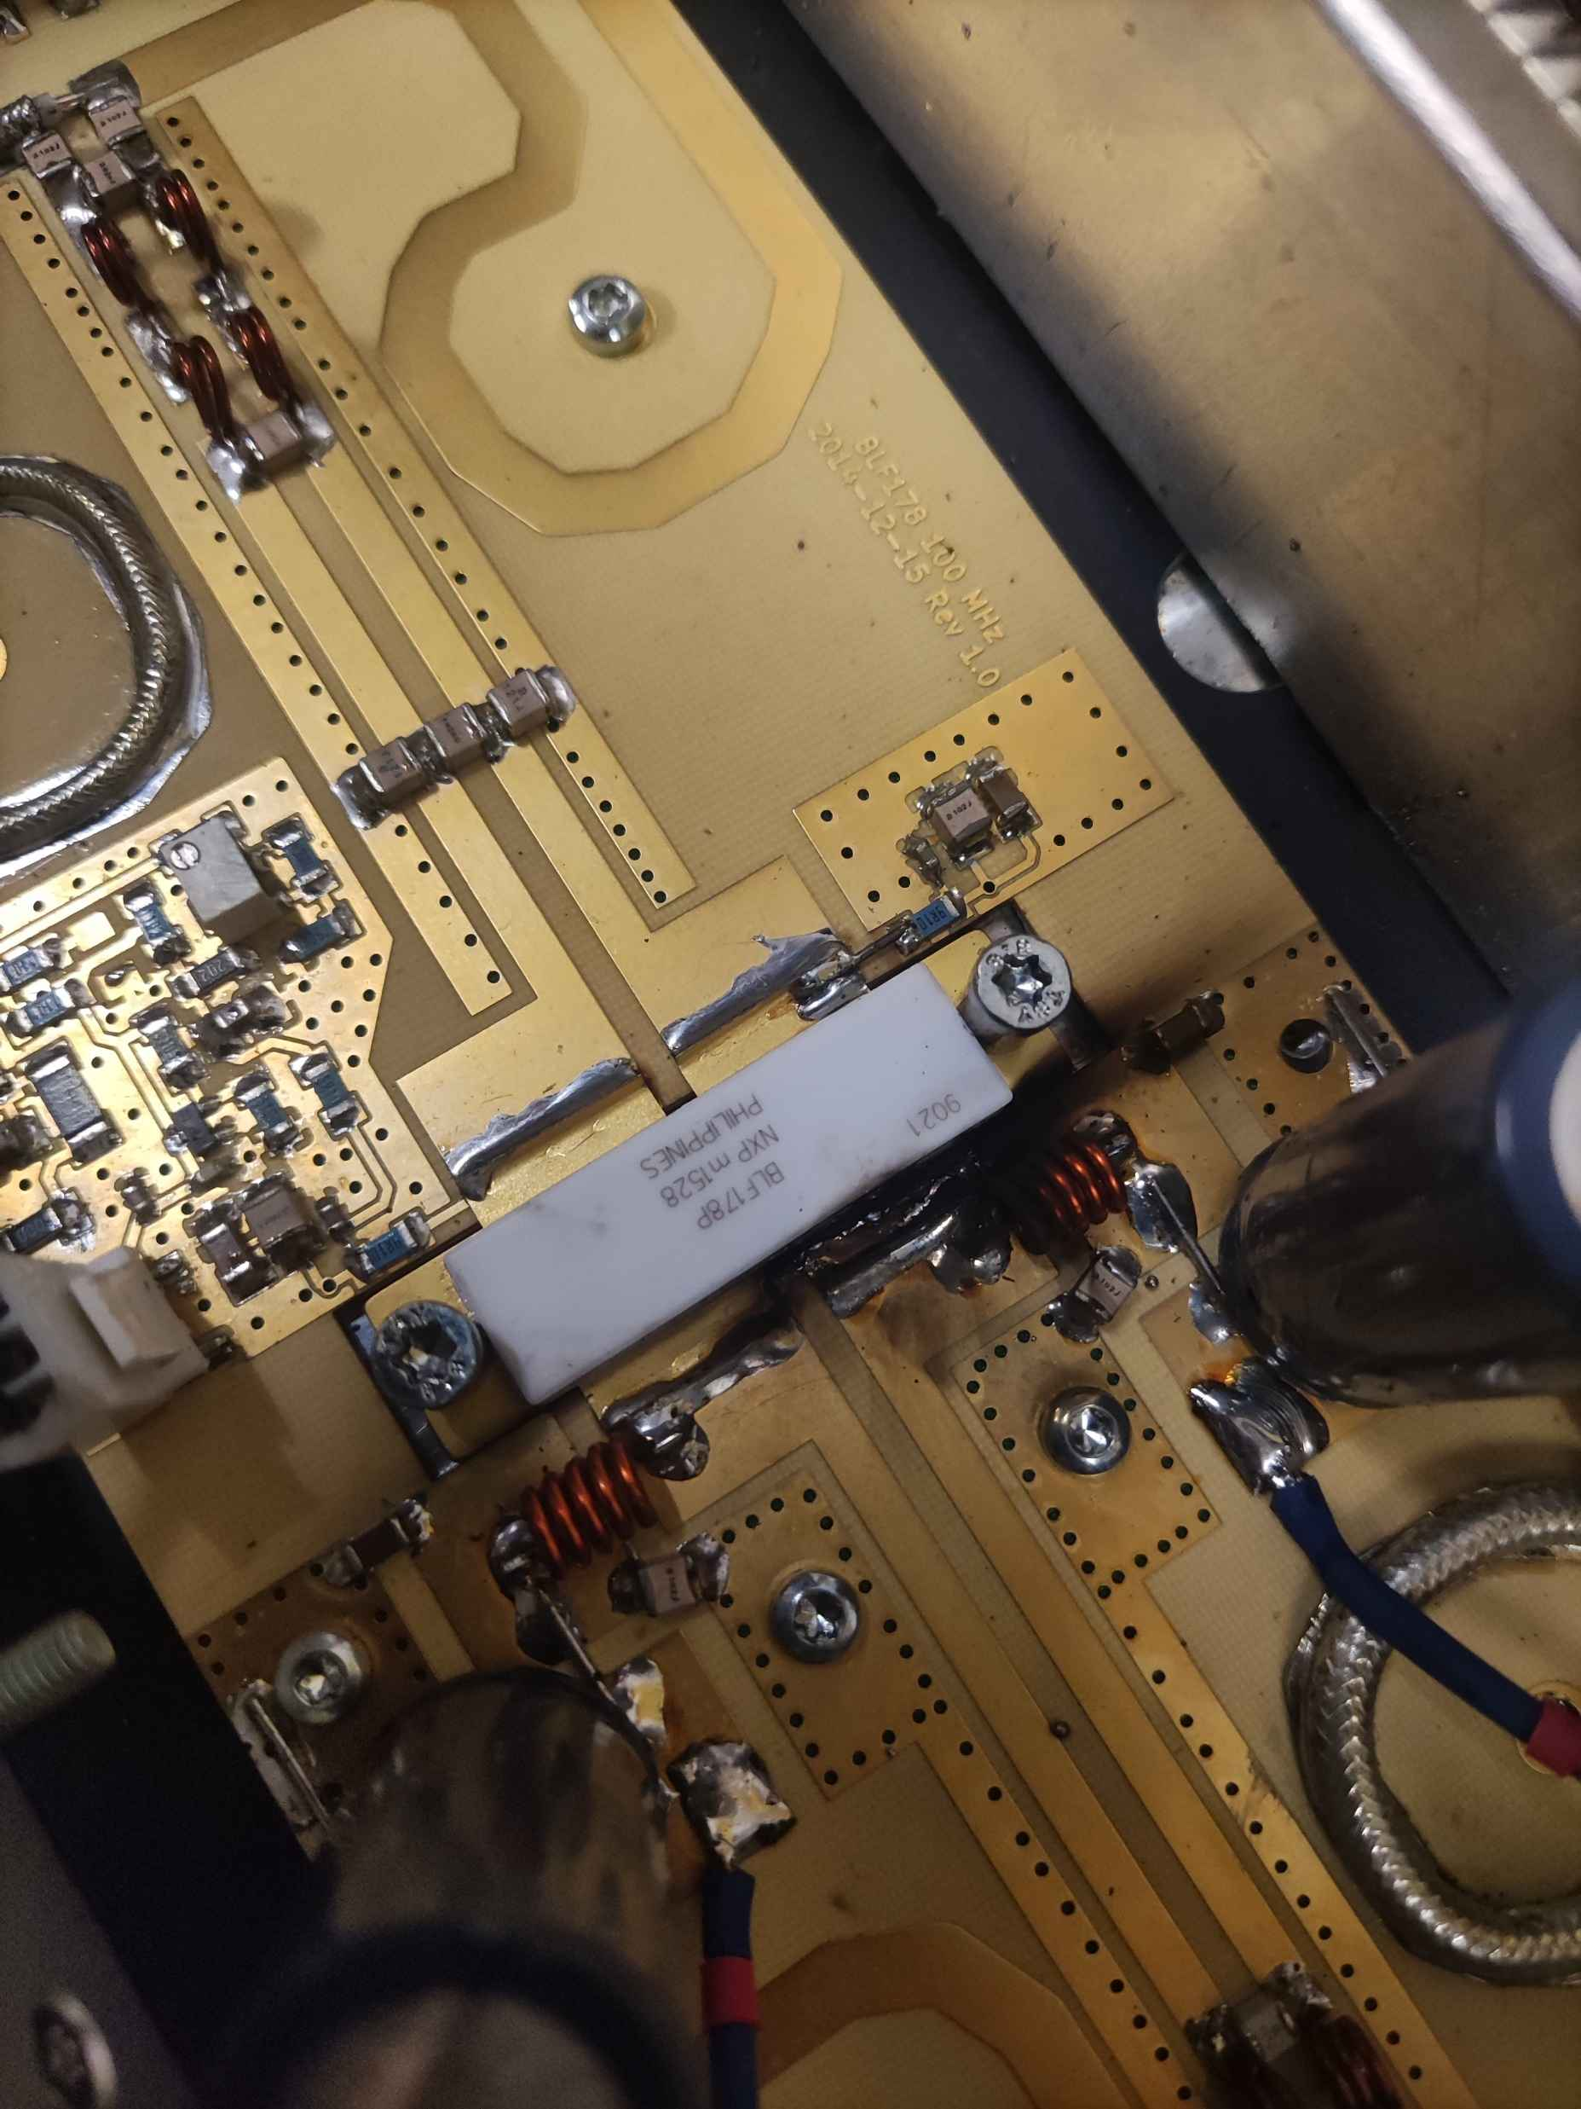
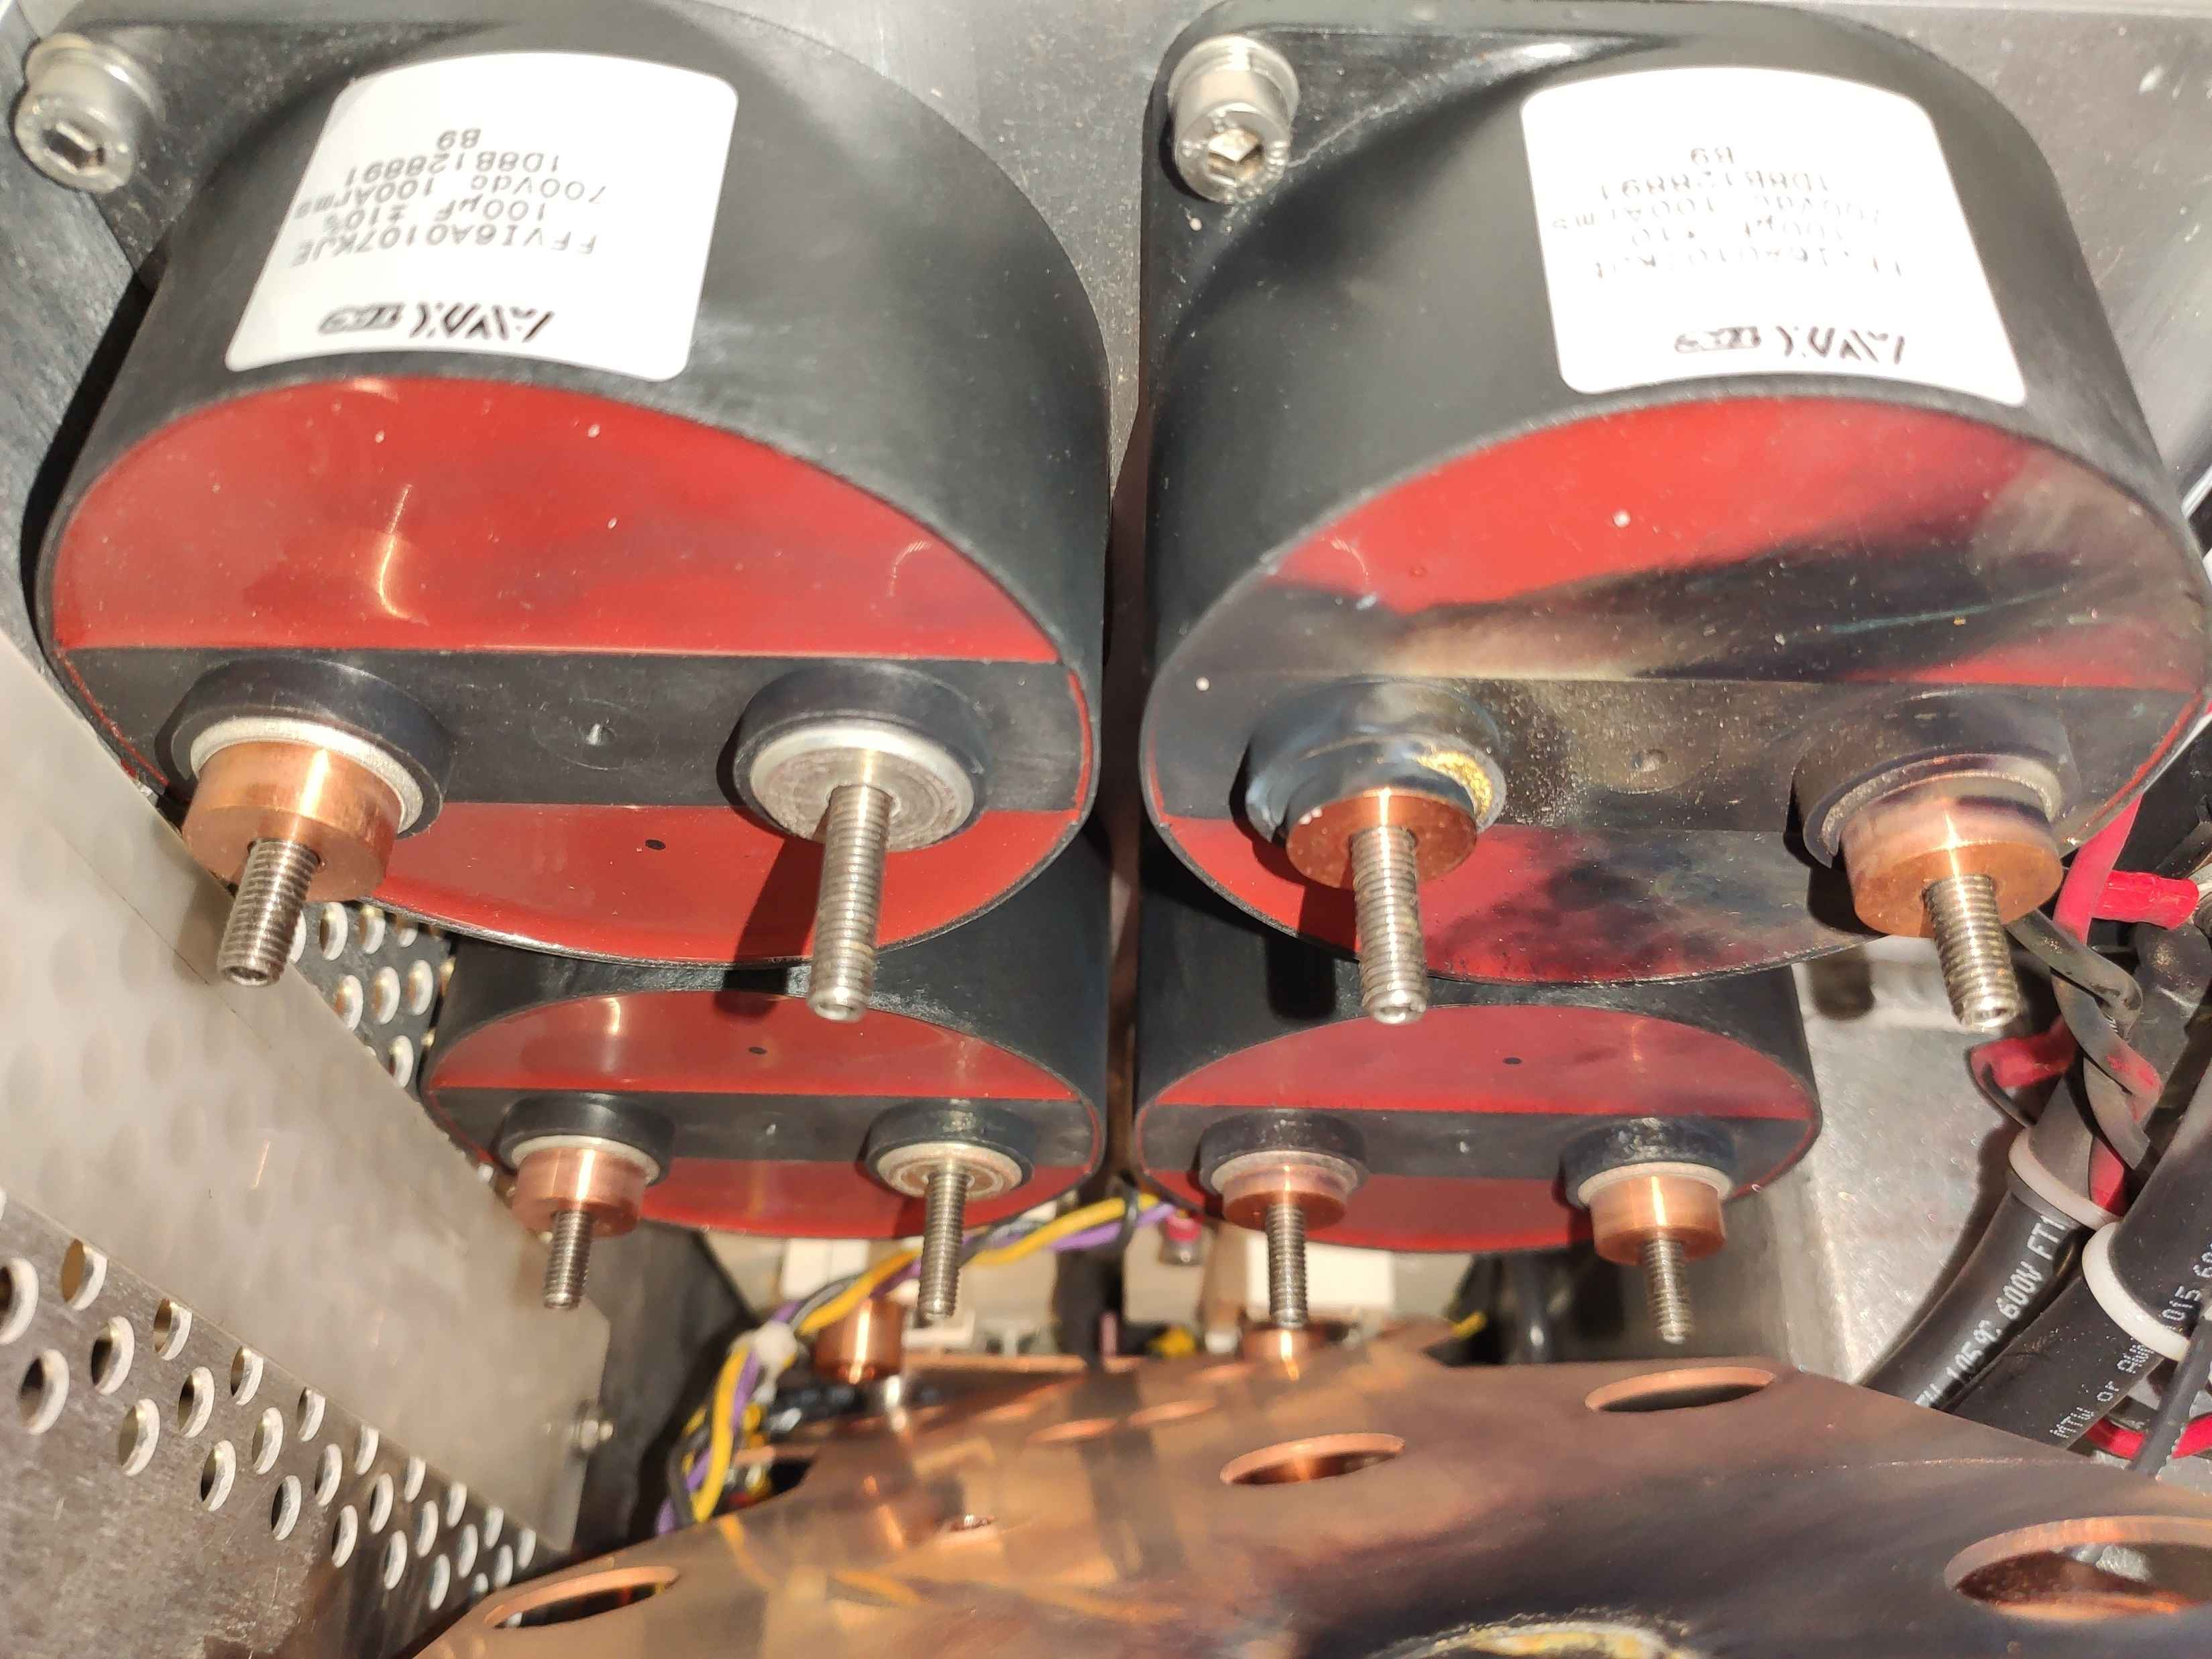
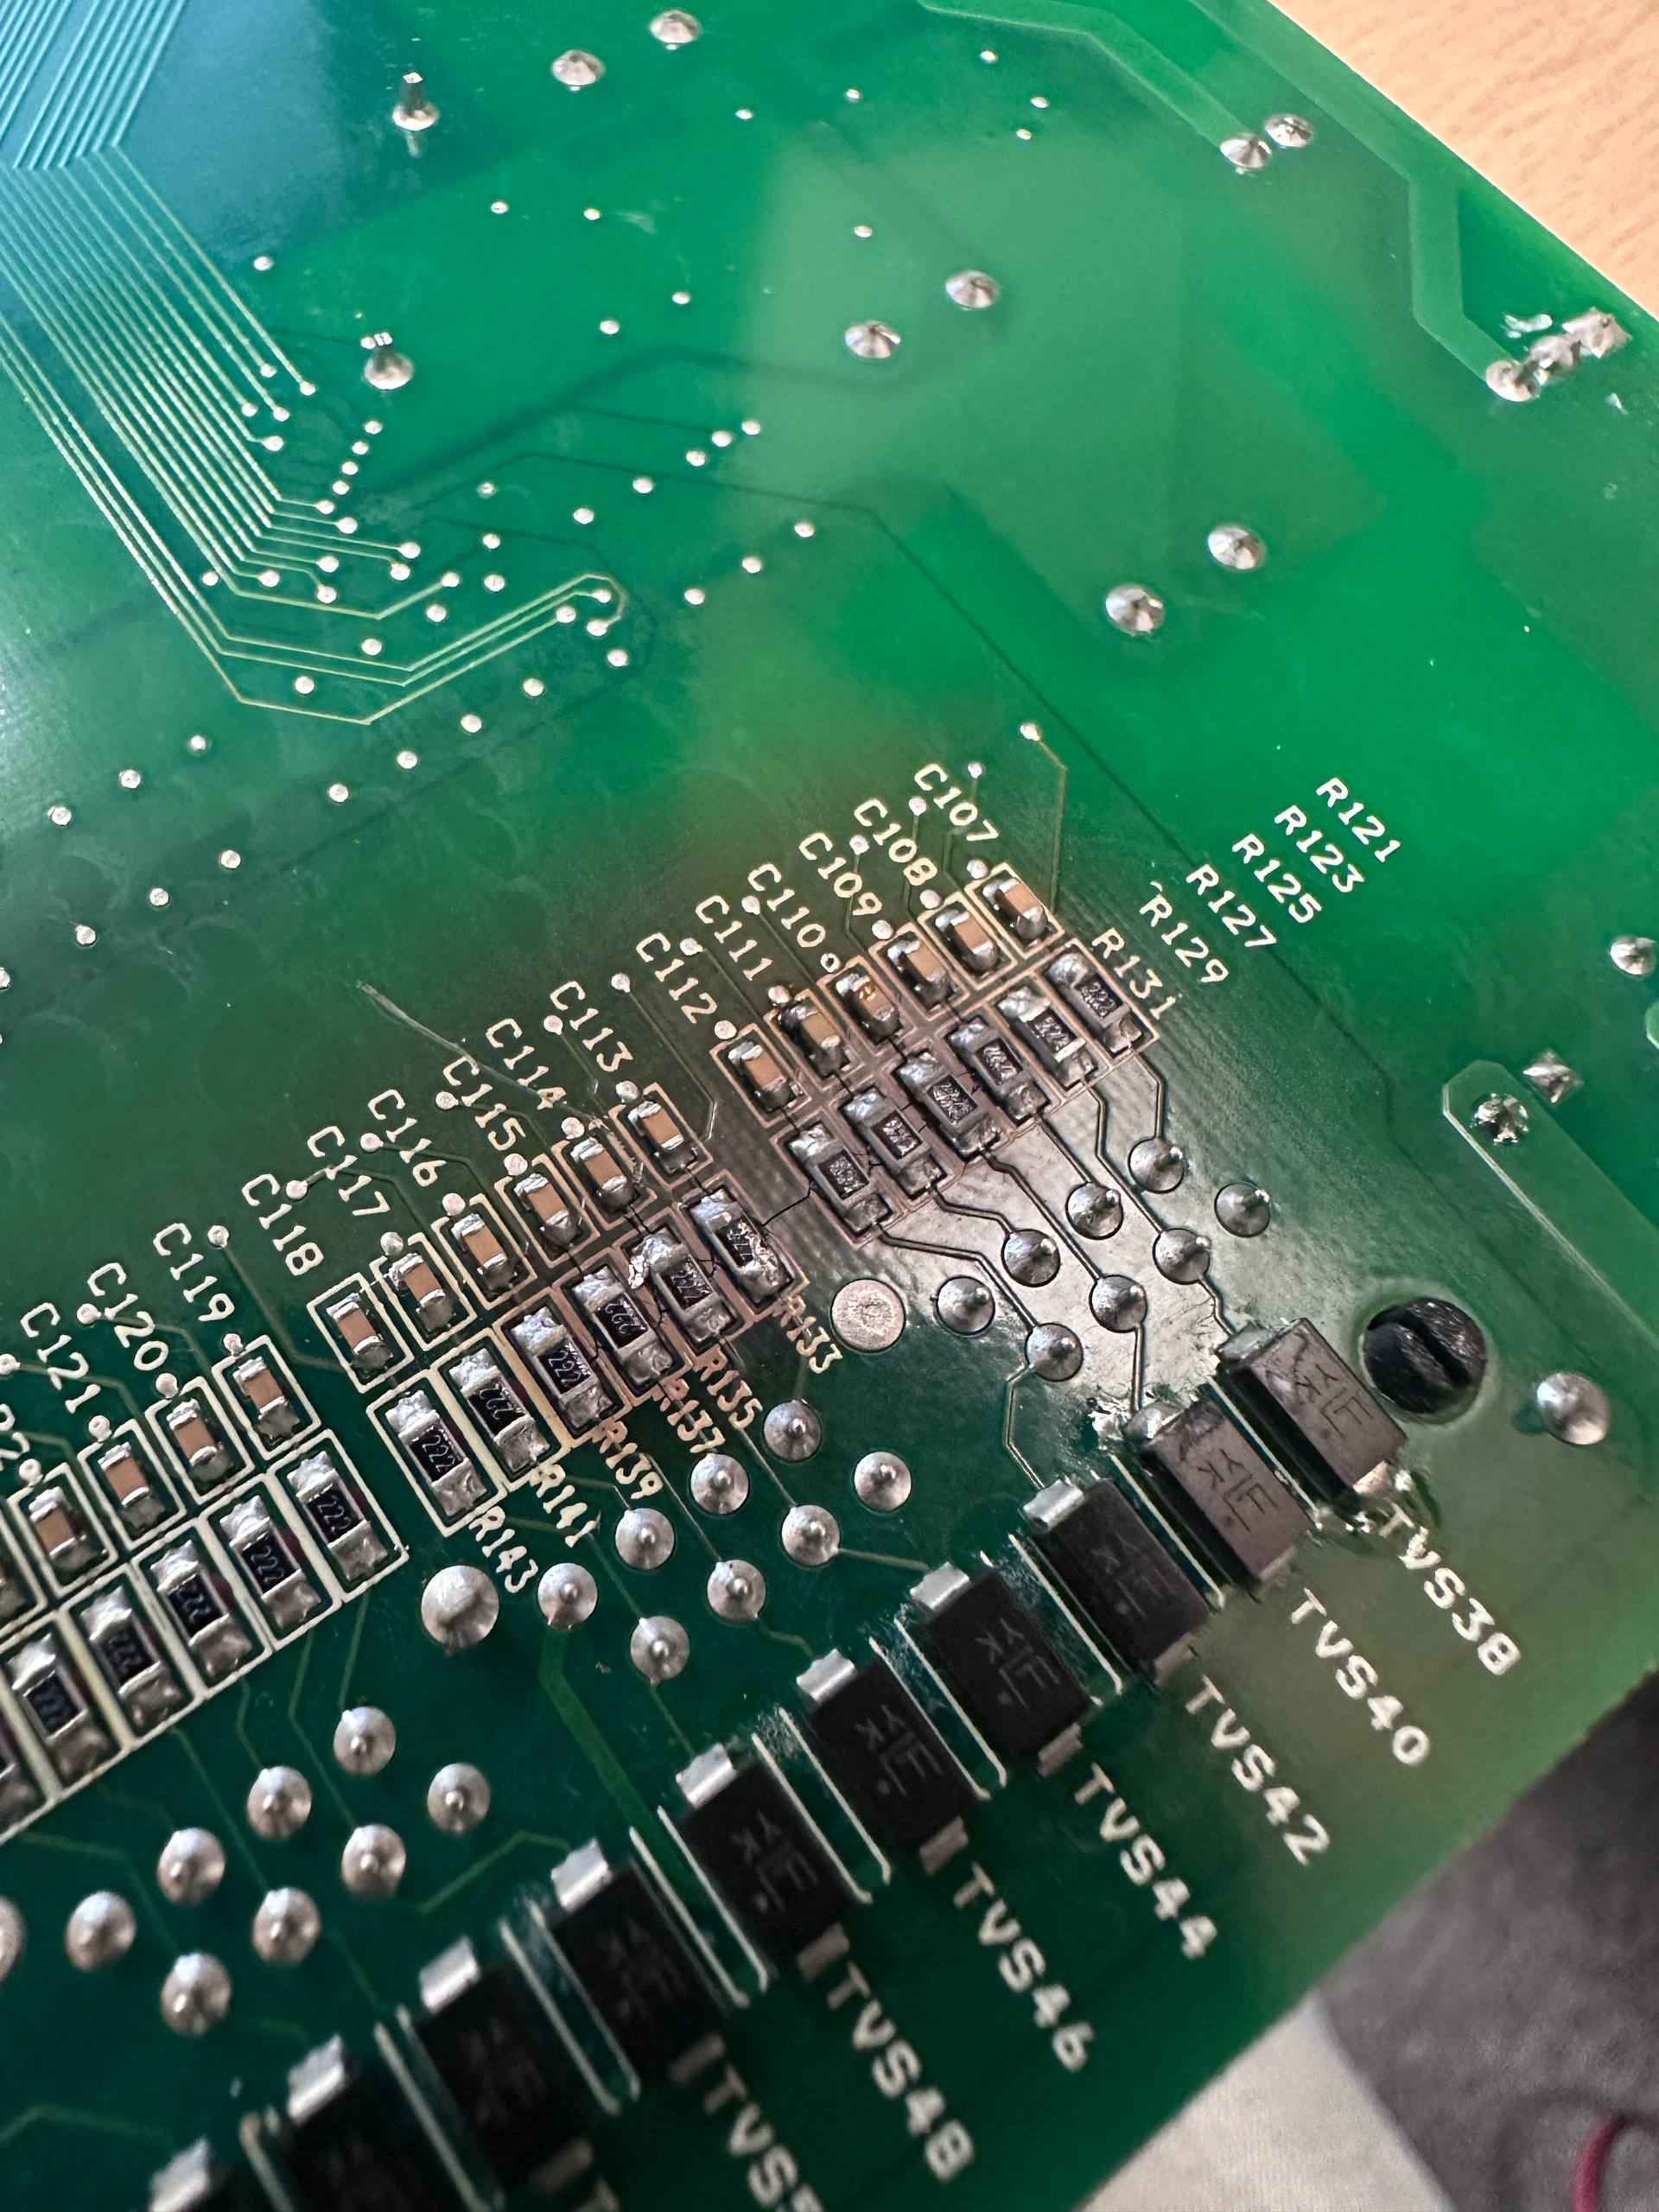
Main Failures
RF Chopper – 100MHz pulsed amplifier failure
High Power Switching Unit (HPSU) for modulators
Timing system: Kontron CP6004 CPU module in CompactPCI form factor
Libera Brilliance RAF modules damage impacting orbit correction system
Water circuit interlocks in storage ring
Water interlocks on main power supplies
At the beginning of 2025, the RF power pulsed amplifier of the 100MHz chopper was damaged, without apparent cause. The LDMOS power transistor burned out. Amplifier and preamplifier modules was repaired and the transistor was replaced.
Several switching modules HPSU in the modulators have been damaged recently. Individual IGBT transistors were failing. The transistors used are no longer manufactured, and we are working on utilizing substitutes with the same parameters.
Several damaged boards. Our approach is to reball Intel i5-3610 chip on PCB. It helps for some time. Next step is to replace chip to another one. New parts are not available.
Around once per 6 months randomly RAF module has failure on internal power lines. Fix is easy and takes half an hour: just replace four 10 uF 0805 capacitors.
Problems with water flow inside the coils of the DBA. Problem solved after installation of the new portable monitoring system (Watson) for temperature detection in critical regions. Design and manufacturing done by Technical Group (PLC Section)
Measurements of the flow in main water circuits and optimisation of their settings, solved the problem.

Slide 8
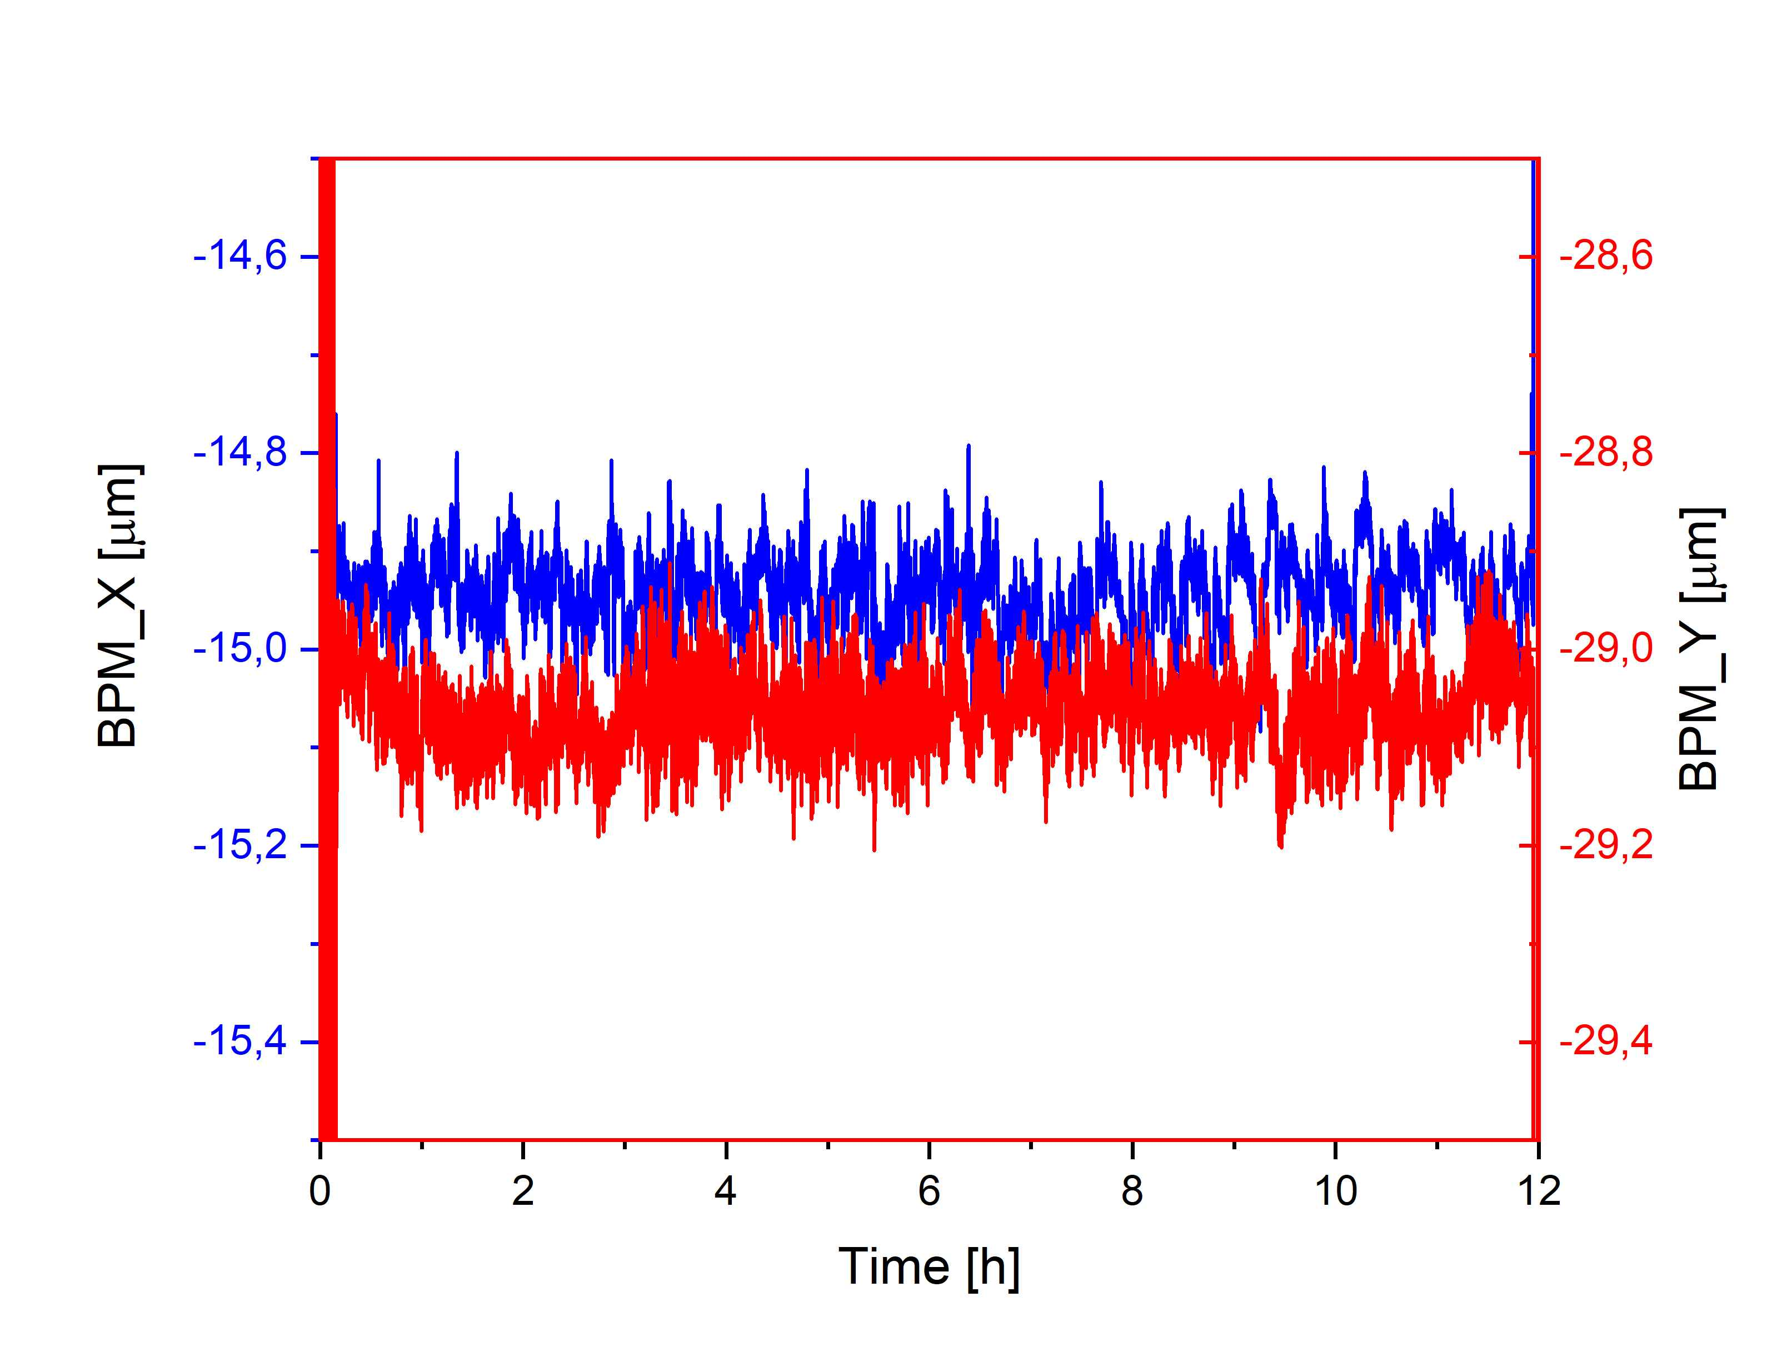
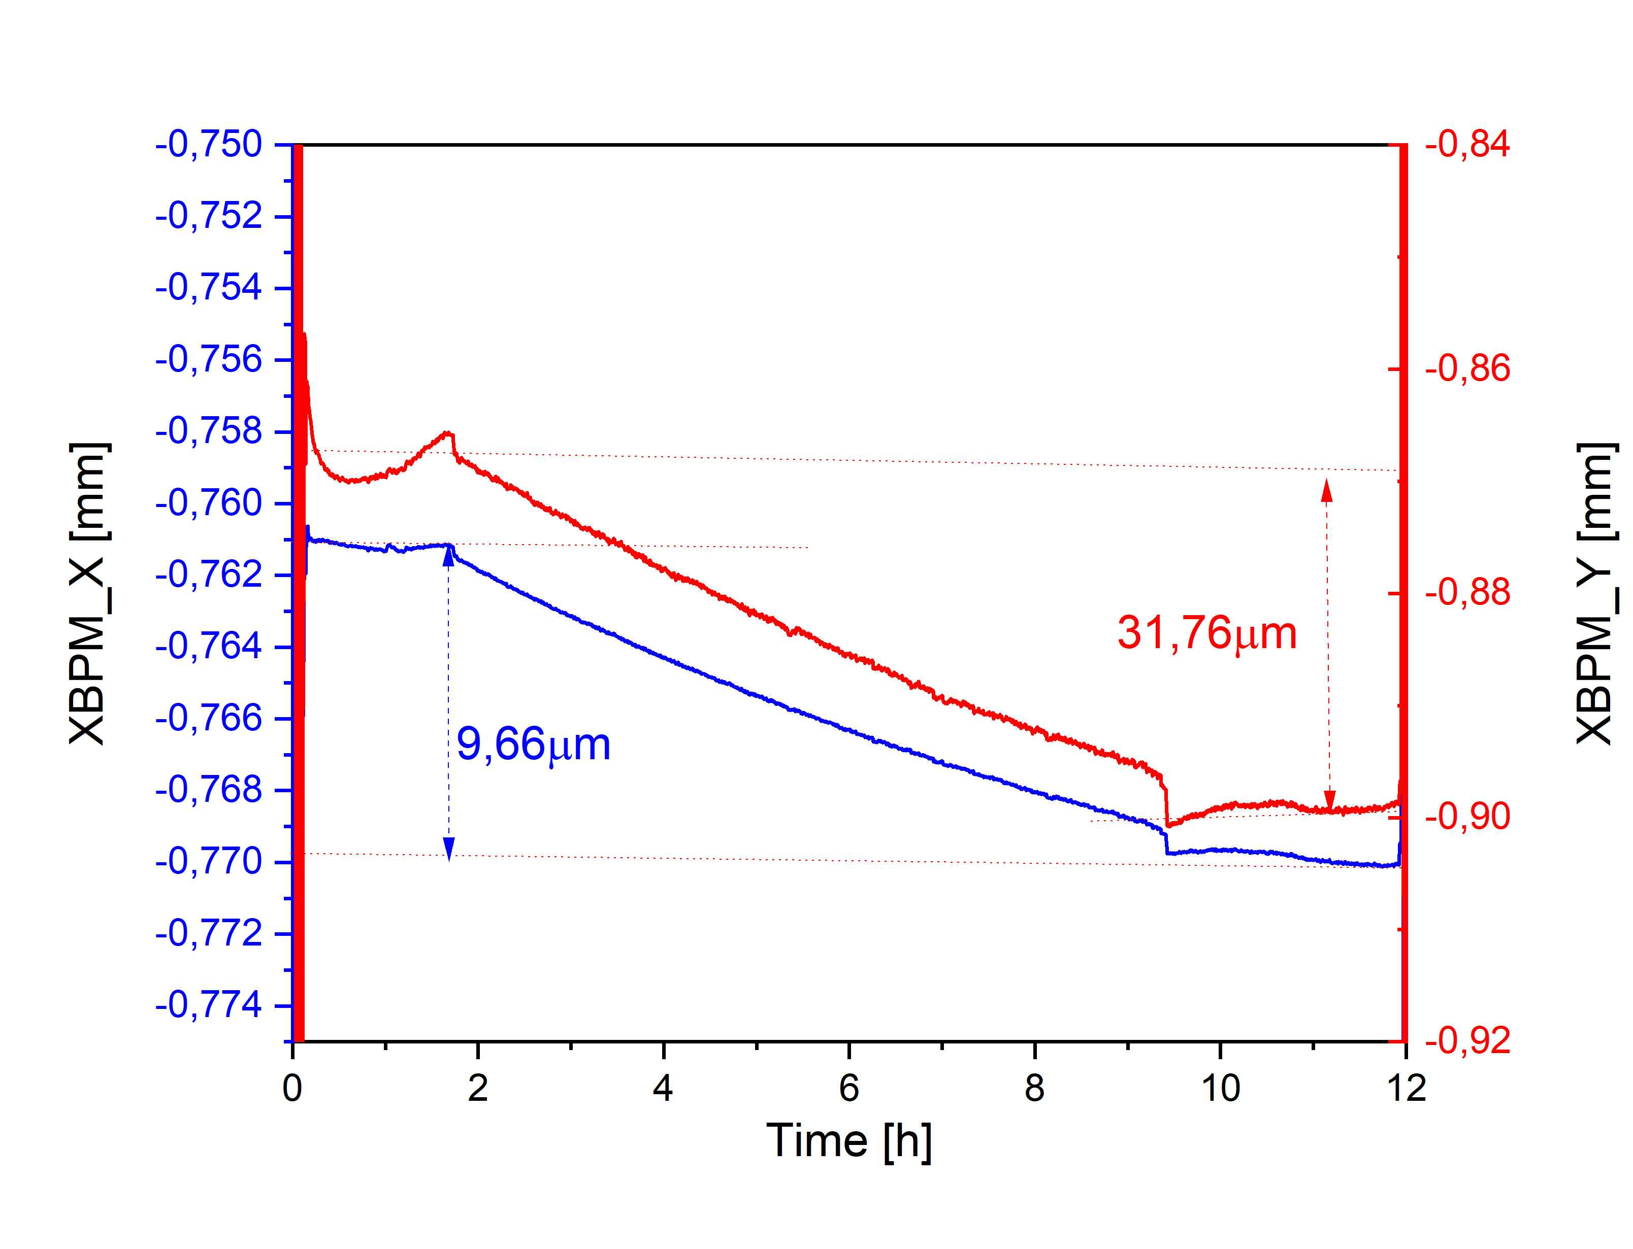
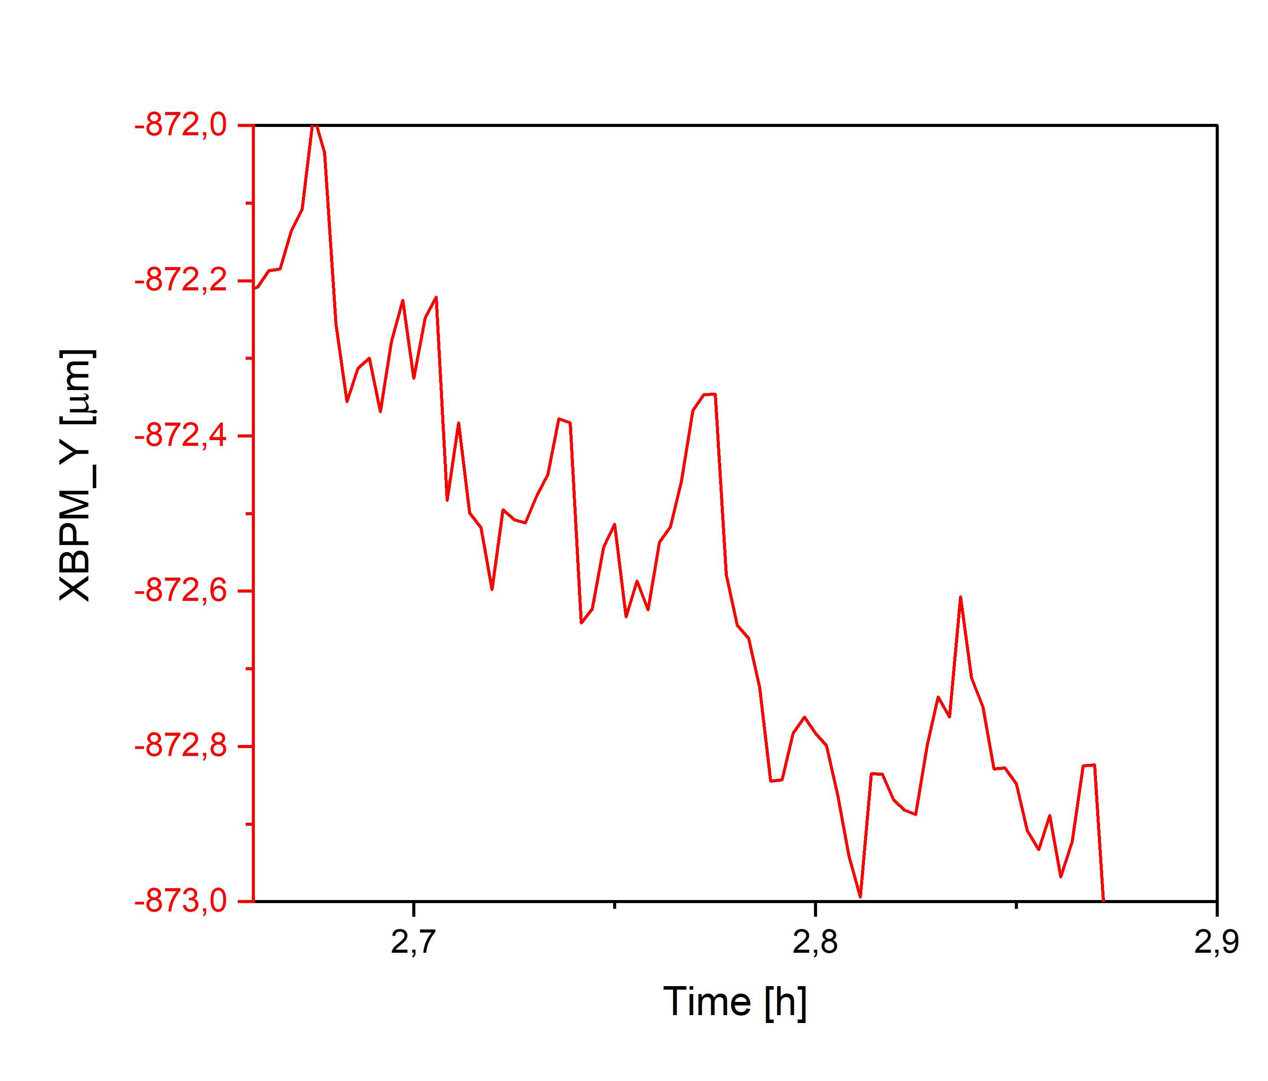
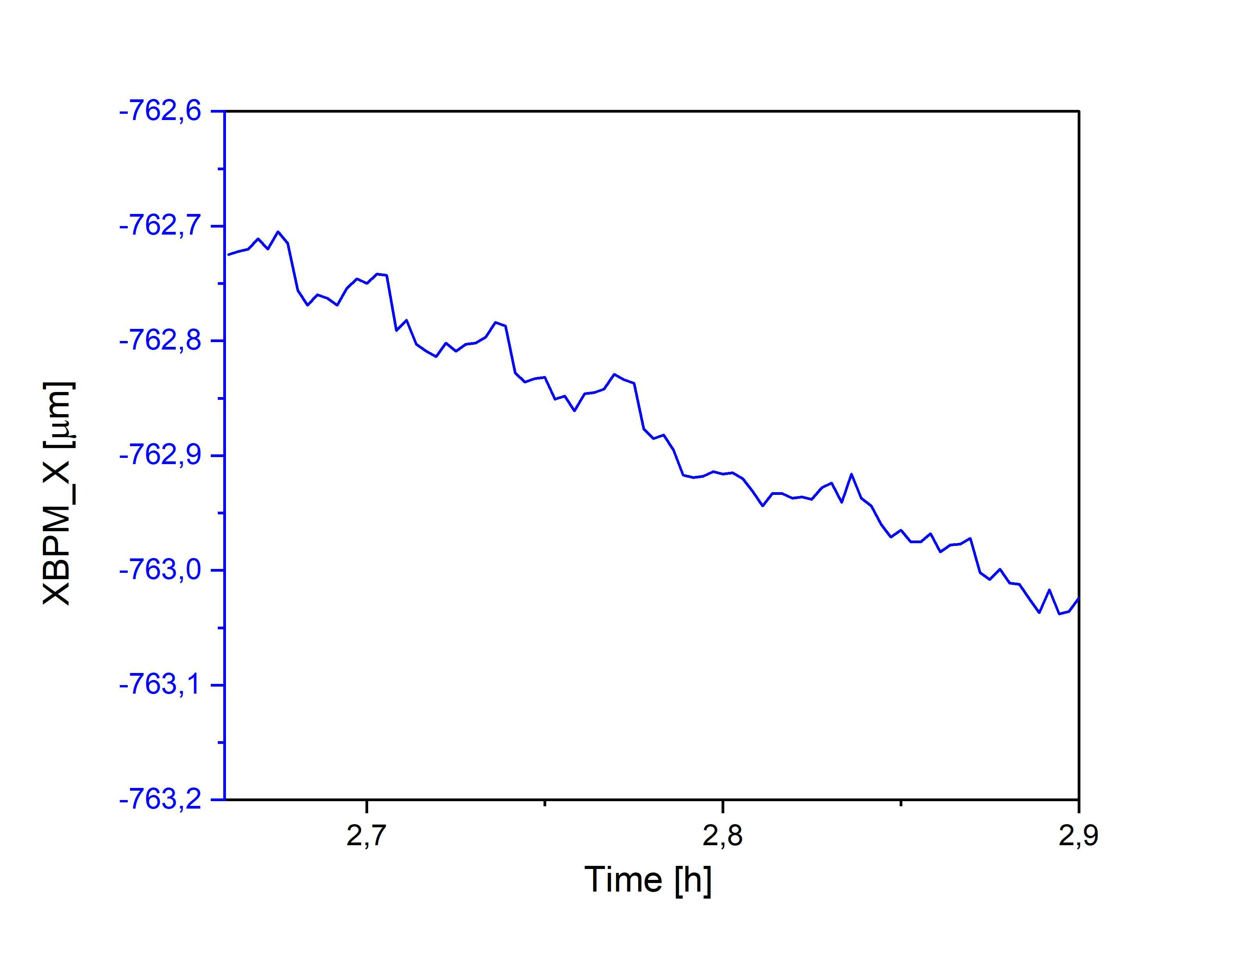
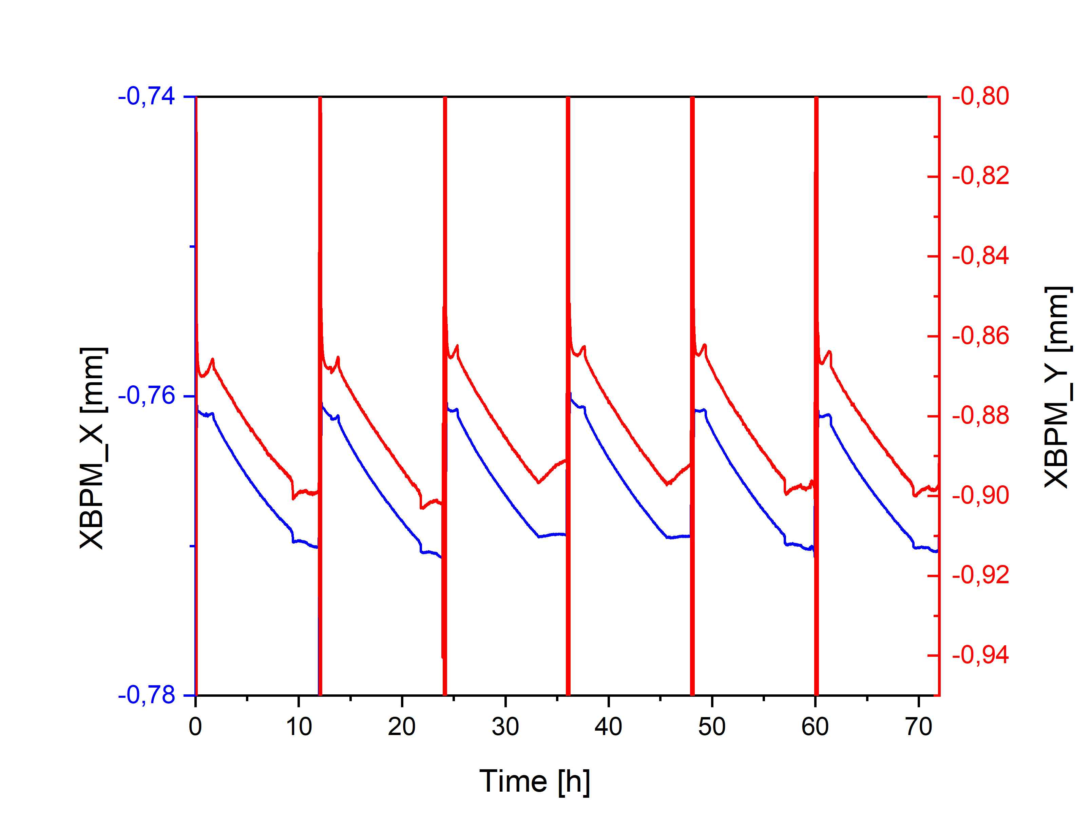
Closed Orbit Stability & Repeatability
Electron beam stability in the sub-micrometer level
Long and short-term stability of the photon beam
Submicron precision in electron beam stability was achieved
Beam position reproducibility is at a good level, but some thermal drift remains in the XBPM readouts.
Repeatability of the injection
8

Slide 9
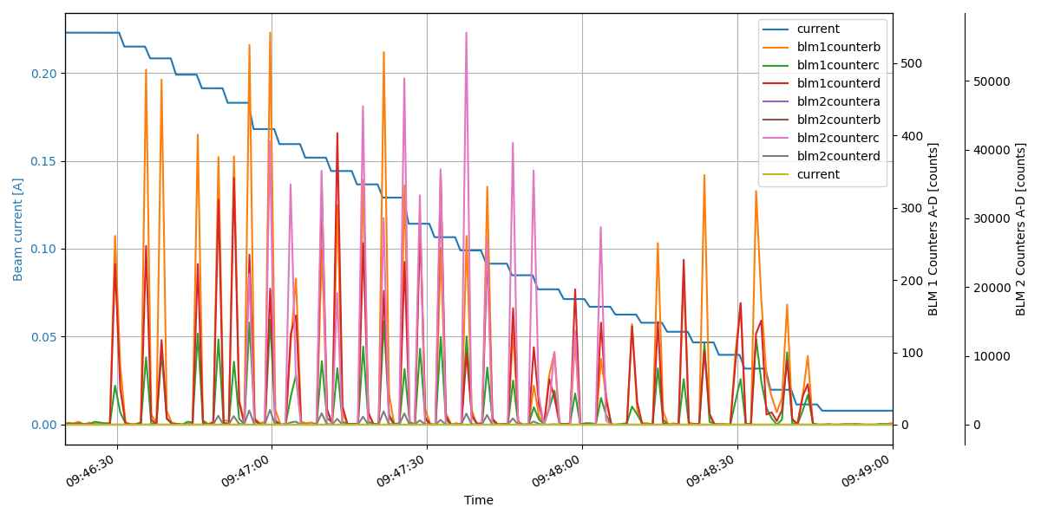
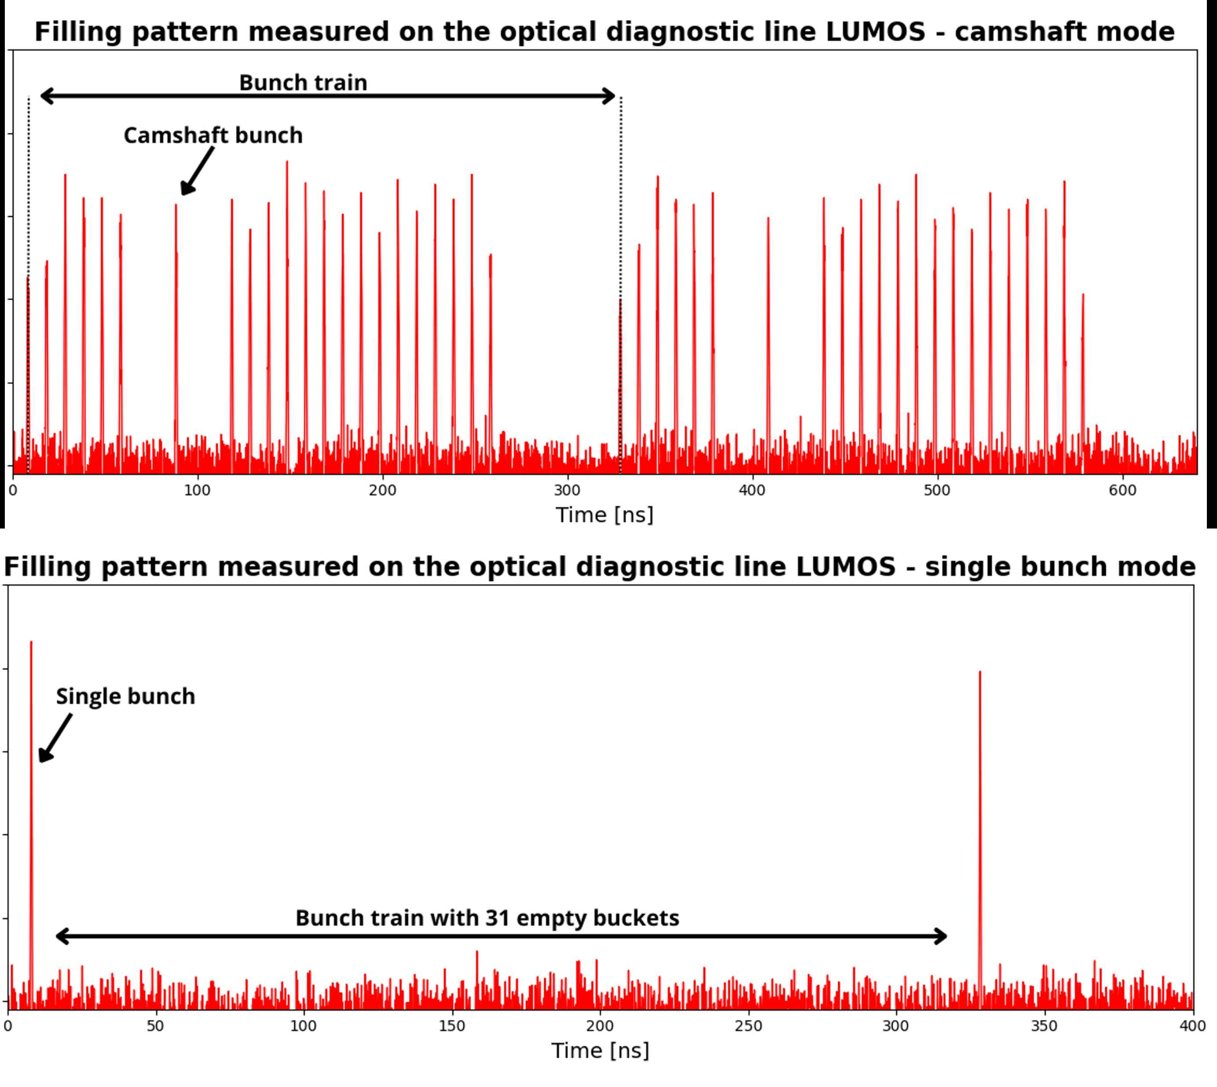
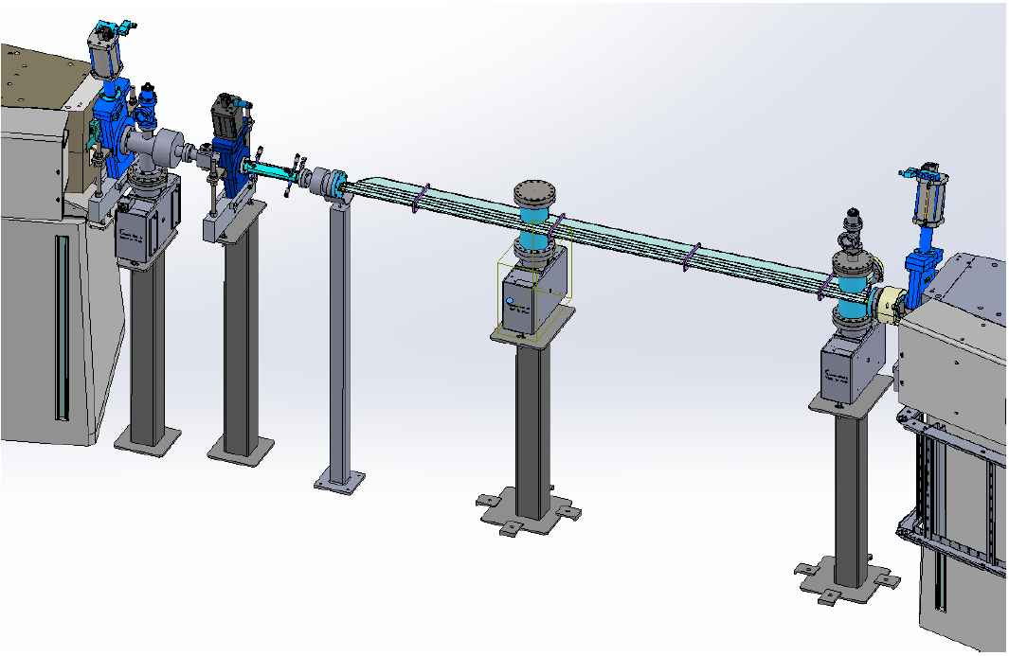
Beam Diagnostics Development
Bunch by bunch feedback system implementation and operation as diagnostic tool for tune measurements, bunch cleaning, transverse beam instabilities suppression etc.
Beam loss monitor signal anomaly detection : Detection of statistical deviations in signals from beam loss monitors (BLM)
Demo GUI based on Taranta BLM & RAD stations: The visual representation of beam loss detectors and radiation measuring stations placement around storage ring, as well as counter readings and interlock state from every BLM device.
Diagnostics of the longitudinal electron beam profile for PolFel: A Martin–Puplett interferometer configuration for Coherent Diffraction Radiation (CDR) signal analysis.
BPM for FCCee (CERN) NCPS. In addition to operating a prototype Base Band Tune (BBQ) system, Solaris will also test Beam Position Monitors (BPM) to support the development of next generation accelerator instrumentation.
Tune Feedback: An automatic tune correction system based on online tune measurements and magnets adjustment in storage ring during ID operation.
Future plans for self adjusting ID correction table: Automation of the construction and updating of feed forward correction tables for insertion devices (IDs)
BPM vacuum chamber (CERN)
Stripline (BBQ)
CDR
e

Slide 10
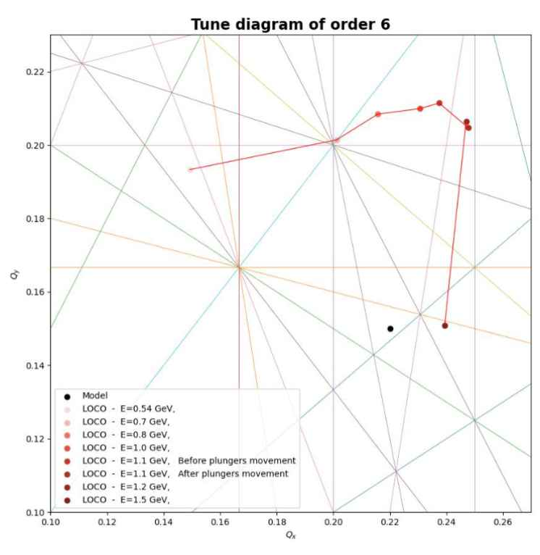
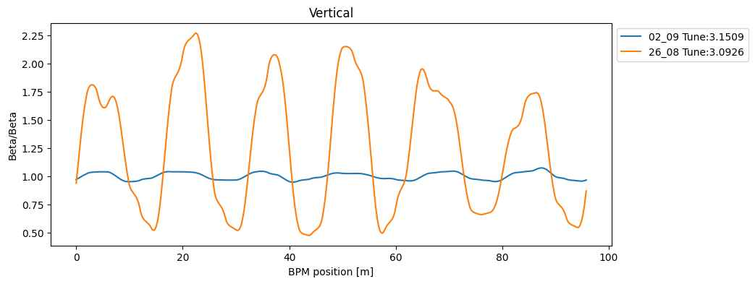
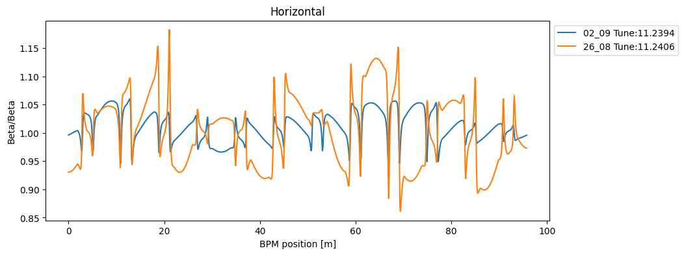
Beam Diagnostics – machine state study
Periodic LOCO (Linear Optics for Closed Orbits) measurements after machine shutdown:
Response matrix measurements
Dispersion measurements
Tune measurements
Quadrupole field gradient measurements
Beta beat measurements.
Ring magnetic lattice warm up visible. Operational conditions achieved after 10 days. (Beating after warm up is ~ 4% in horizontal and vertical plane)
Tune measurements for different energy points. Visible progression of tune in ramping phase.

Slide 11
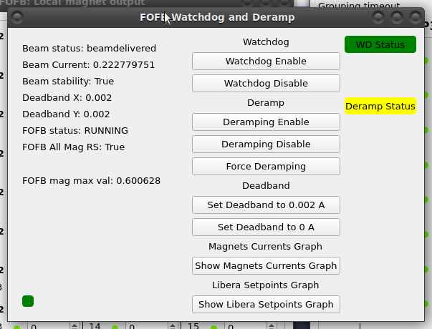
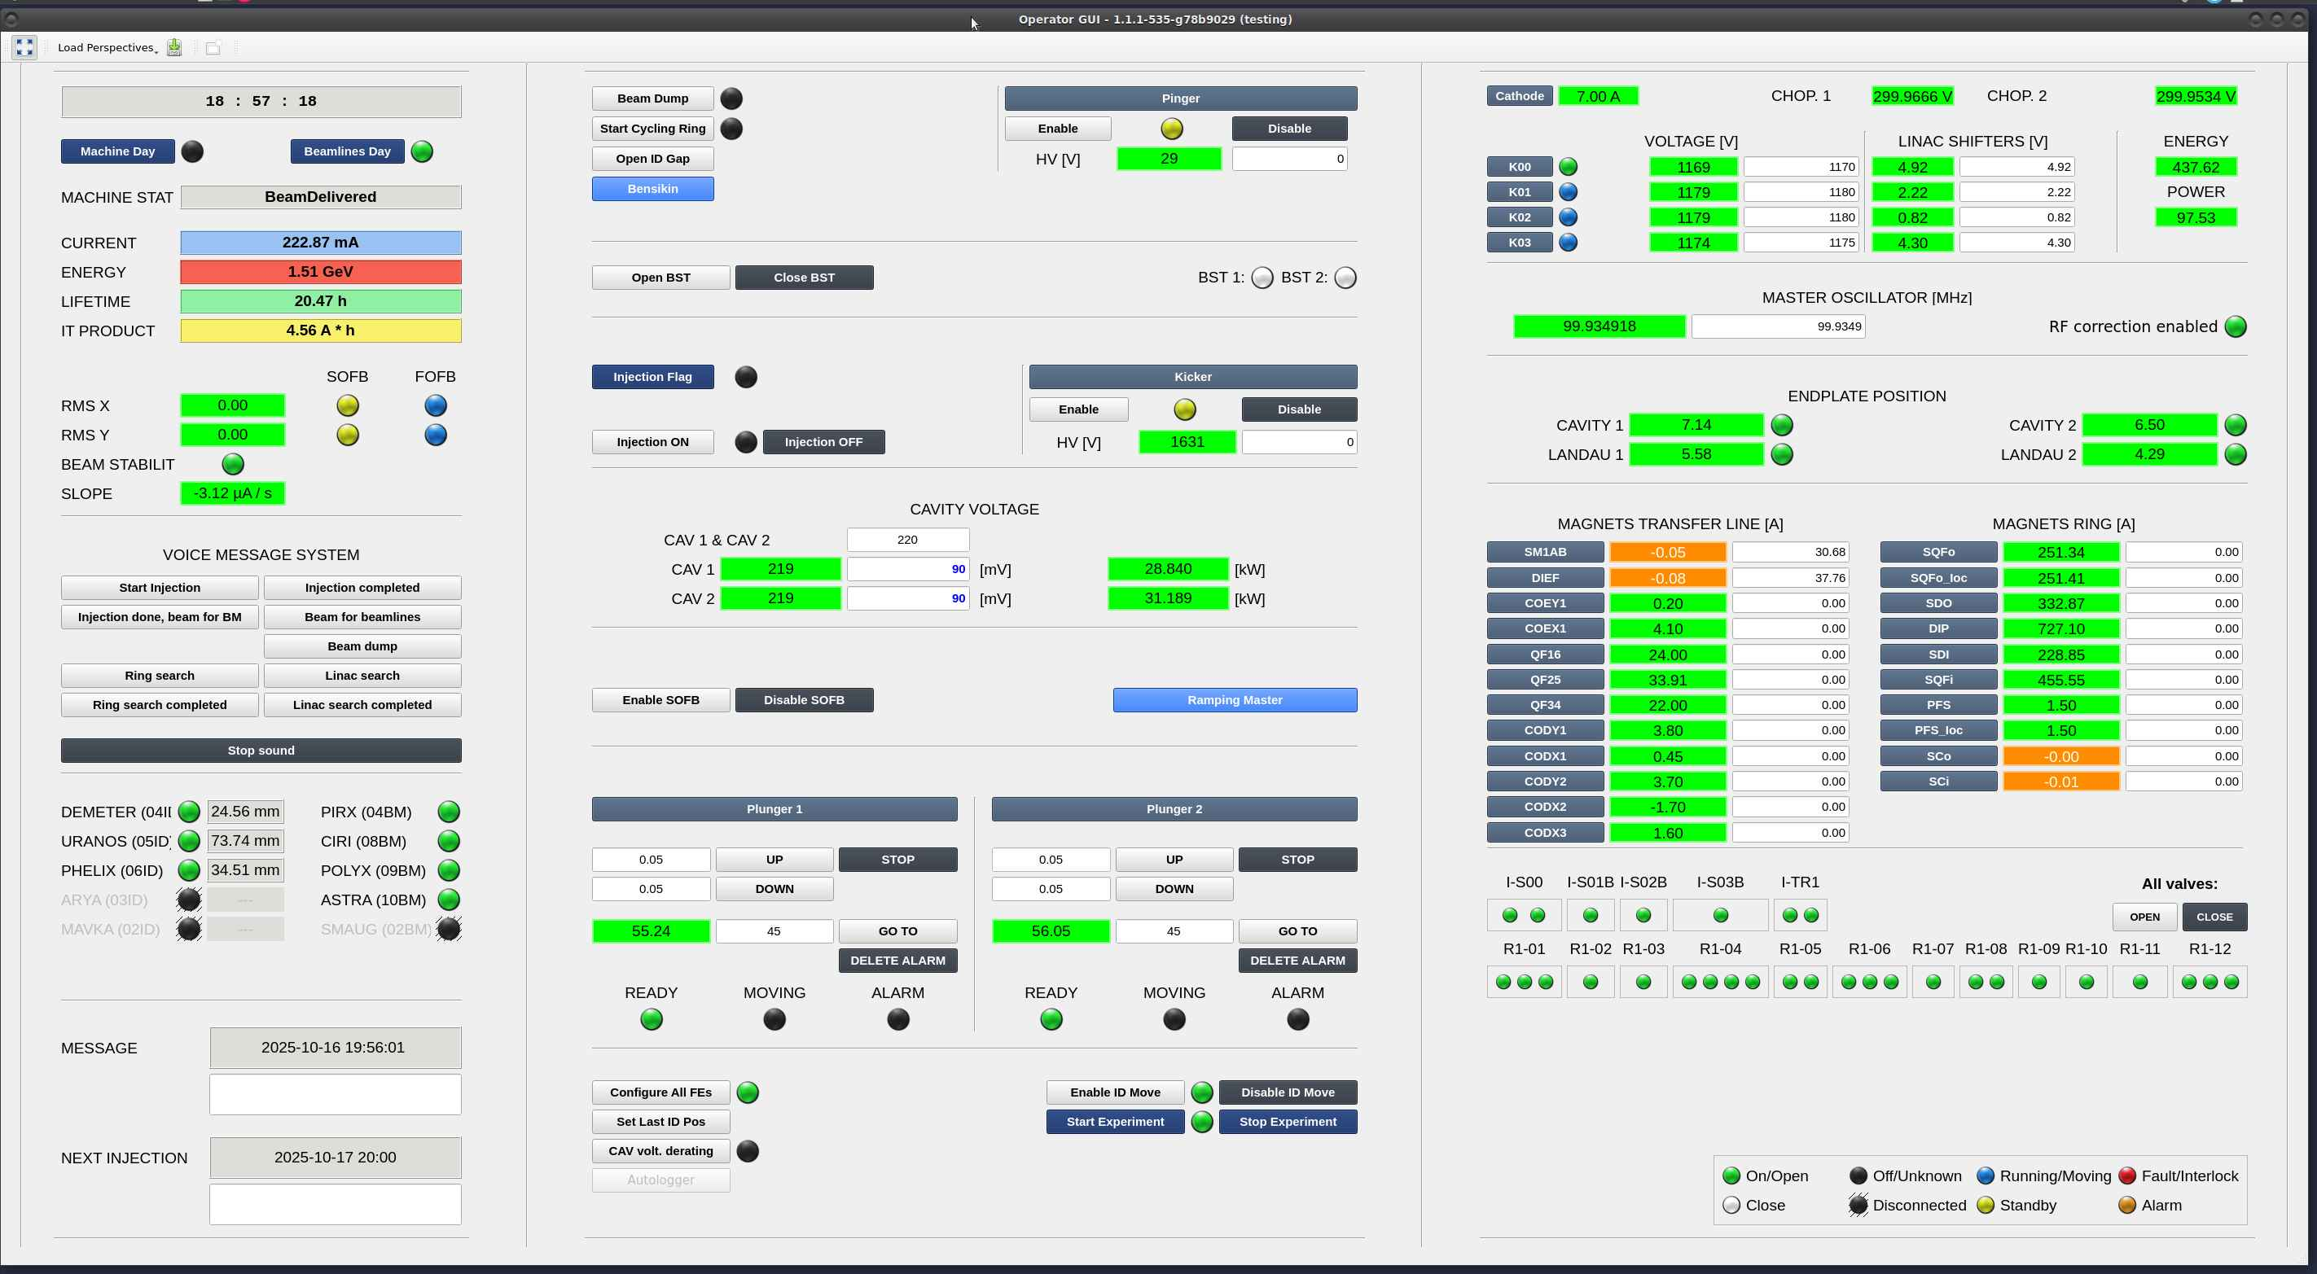
New CR scripts
Watchdog for fast corrector magnet de-ramping in case of current saturation.
All in one, streamlined operator GUI for faster problem diagnostic and simpler injection/dump procedure.

Slide 12
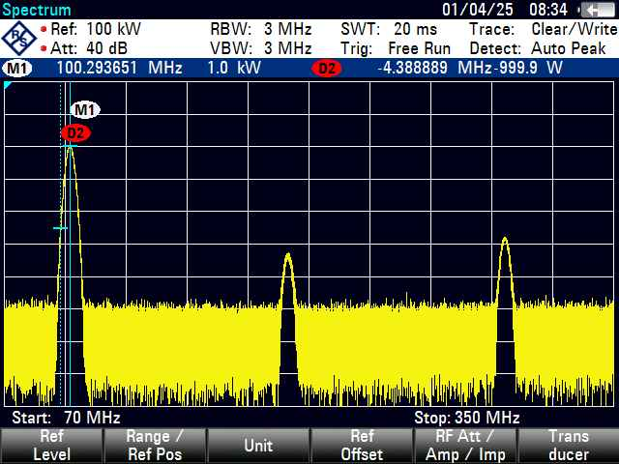
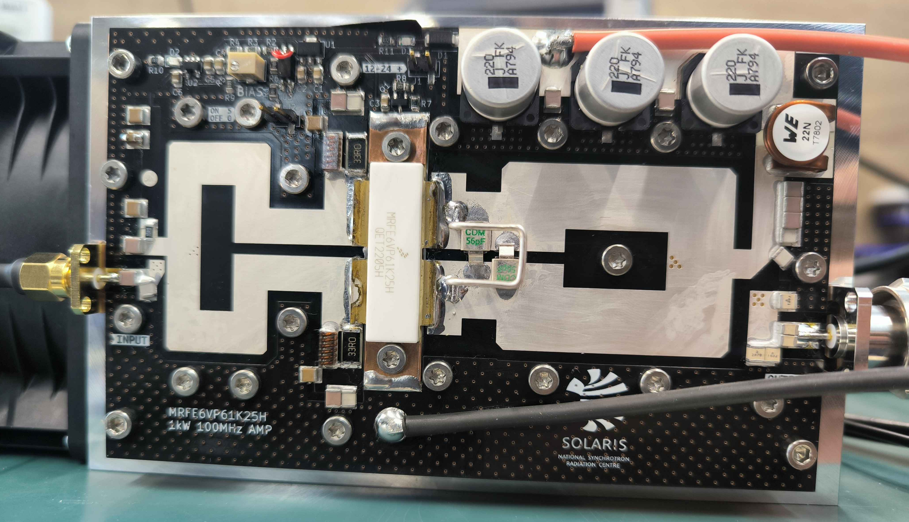
Electronics Development
Color 12 and 20 Mpix cameras project with CSI-2 interface
Our design is based on Sony IMX477 and IMX283 sensors. Except the standard Raspberry HQ Camera features our version has external hardware trigger that triggers directly the sensor without any intermediate processing. Both of the cameras has three power supplies. Digital part is supplied from TLV62568 DC/DC converter and analog and I/O part are supplied from low noise TPS79301 LDOs. Both cameras has 4-lane MIPI interface used for video streaming.
Ring magnets voltage drops monitoring in each section
For Magnets and power supply section we designed 16-channel, precision differential voltage measurement device. Prototype is used in R01 section, but device is designed to communicate wirelessly with other devices to gather data. Each magnet in each bending section can be monitored for potential damages i.e. too high voltage drop. Measurements can be corelated with other machine data.
New 100 MHz 1 kW RF chopper
Once chopper made by MAX IV need to be repaired, a decision was taken to build our own design. Main requirements:
RF transistor in power stage same as used in Storage Ring power amplifiers
one to one replacement of currently used
pulse forward and reflected power stable readings
current monitoring for driver and final stage transistors
well documented whole design process (PCB Gerber files, mechanical drawings, firmware)

Slide 13
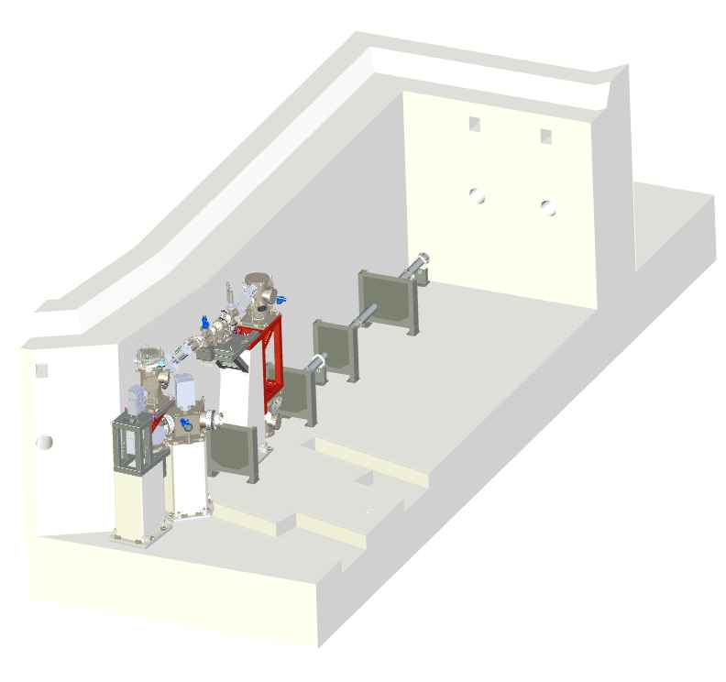
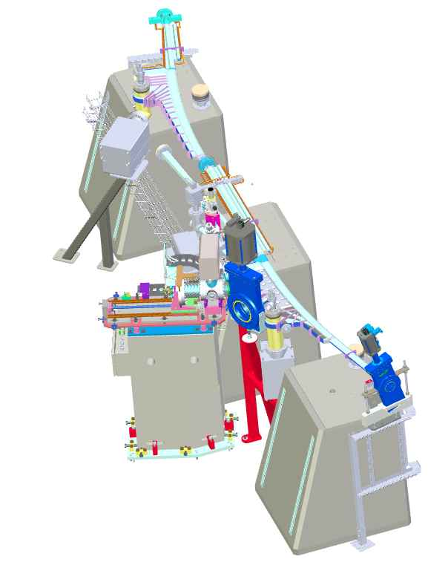
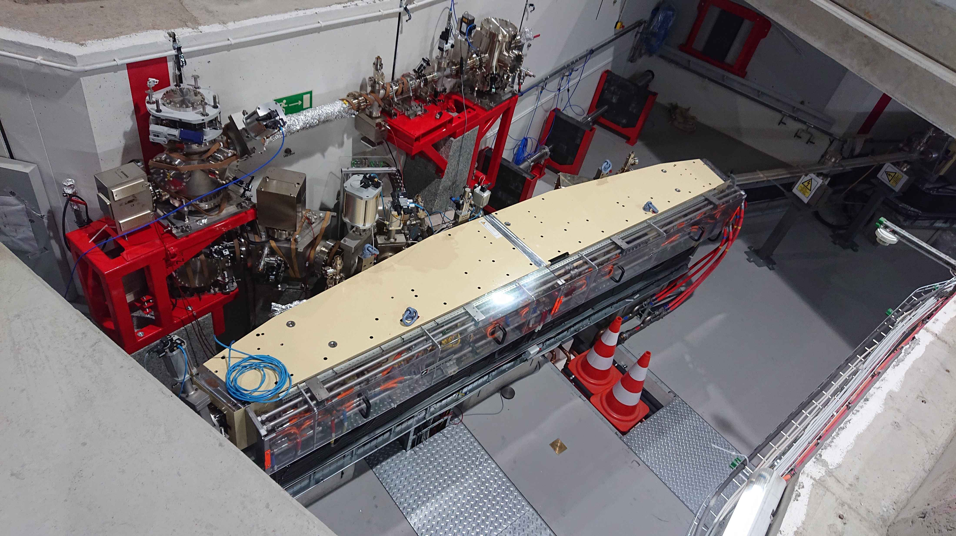
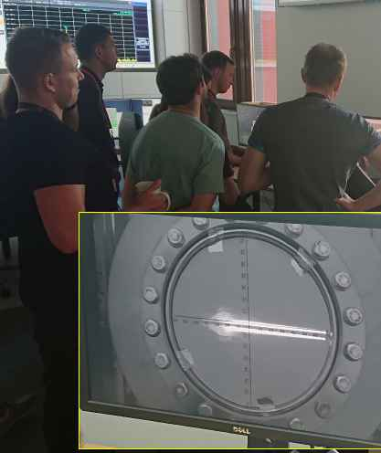
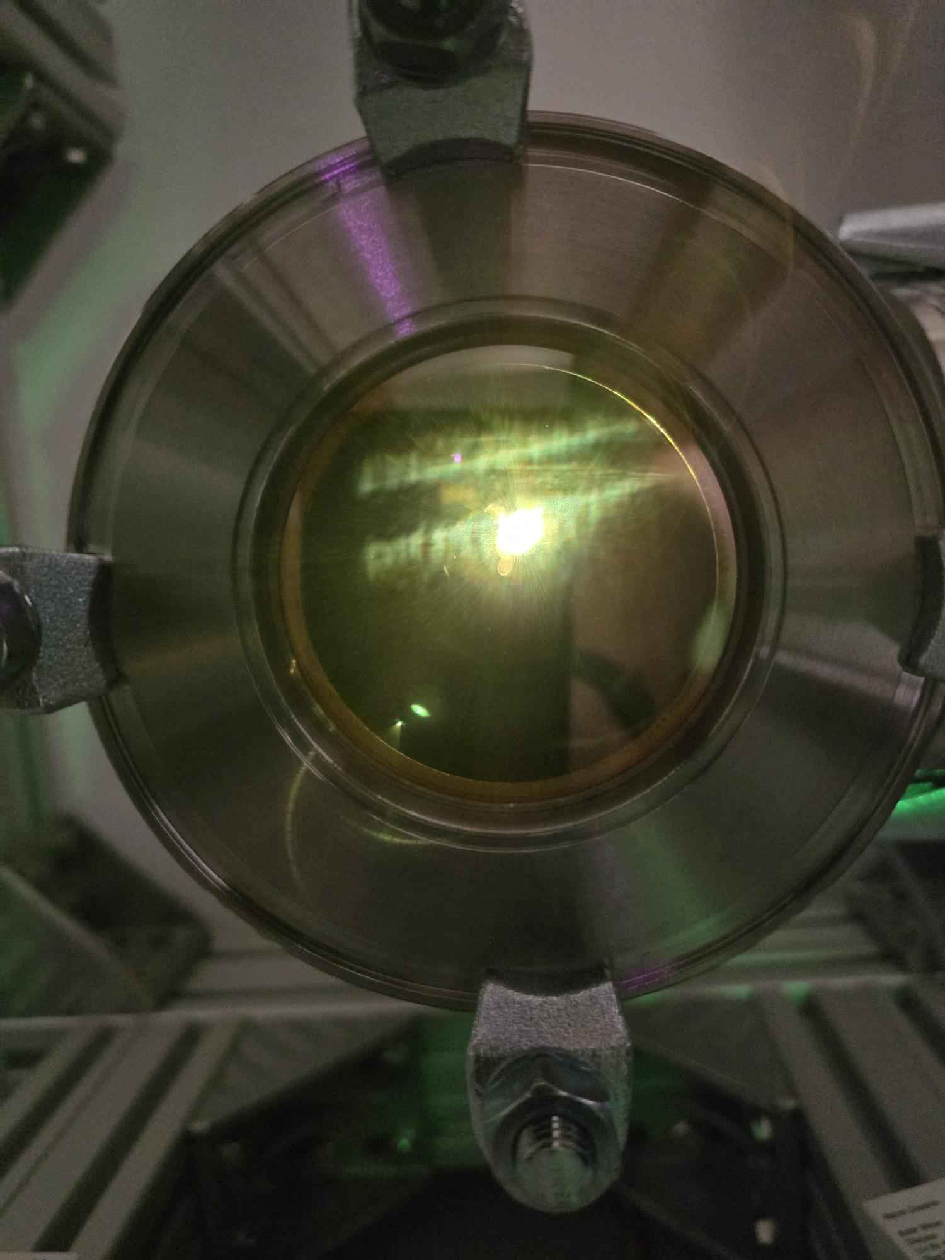
2021 – CDR
2022 – TDR (SOLARIS)
2023 – Manufacture
2024 – Installation & Commissioning
New Beamlines Development: CIRI
Installation and Commissioning of the CIRI Beamline
2018 – CDR
2020 – TDR (FMB)
2021 – Manufacture (FMB)
2023 – Installation & Commissioning
experimental hutch
LV
VK1m
M5
UHV
M1
M4
M6
M3
M2
Photon beam inside experimental hutch

Slide 14
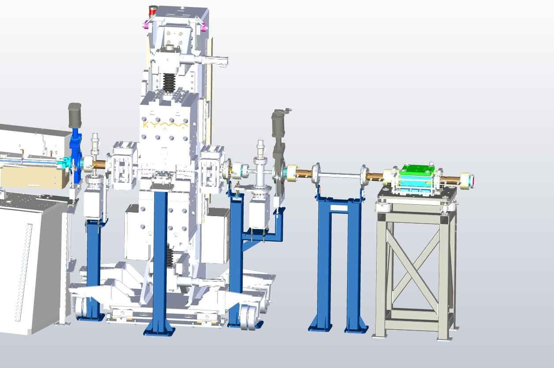
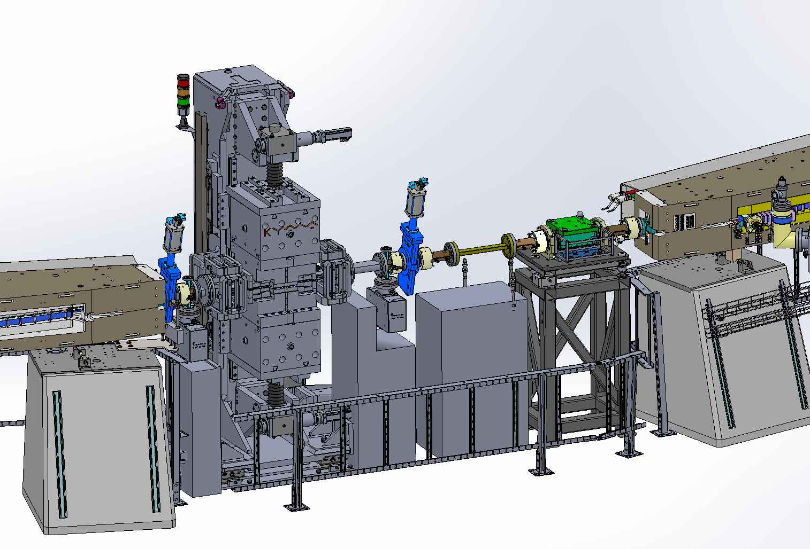
New Beamlines Development: ARYA
Technical Design Report of ARYA Beamline
Saga of ARYA…
2019 – Superconducting Wiggler SCW (Budker Institute of Nuclear Physics)
2021 – SCW - Design Study (FMB) modification of the storage ring
2022 – SCW – Final Design Report (Budker Institute of Nuclear Physics)
2023 – New source 3 Pole Wiggler (3PW) from KYMA ordered
2023 – 3PW - Design Study (FMB) modification of the storage ring straight section
2024 – Straight section Conceptual Design Report (CDR)
2025 –Delivery of the 3PW(KYMA) Straight Section Preliminary Design Review (PDR)
2025 – Straight section (FMB) Final Design Review (FDR)
2026 – FAT, SAT, Delivery of straight section components
FDR
3 Pole Wiggler (ARYA)
Multipole
Injection Kicker
CDR
Kicker
e
R1-03S

Slide 15
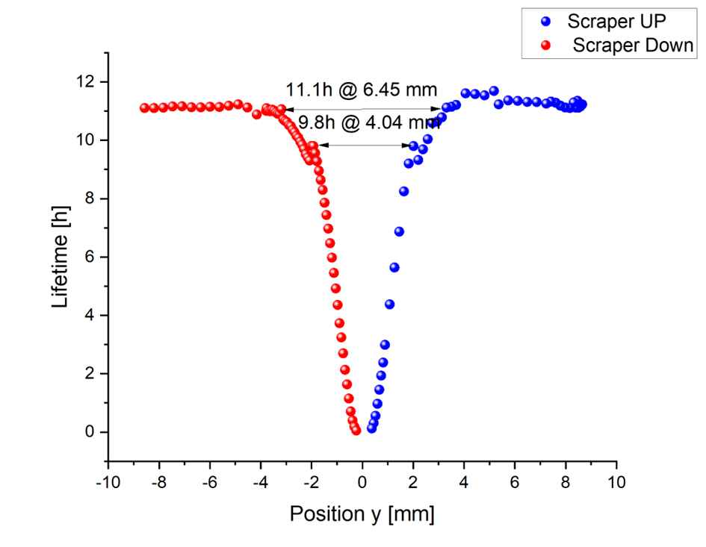
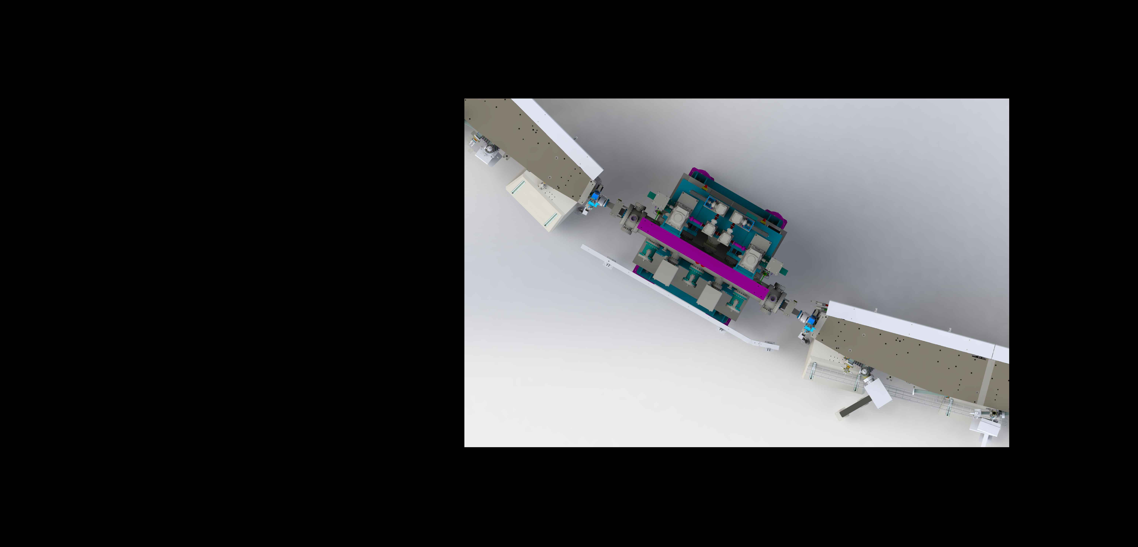
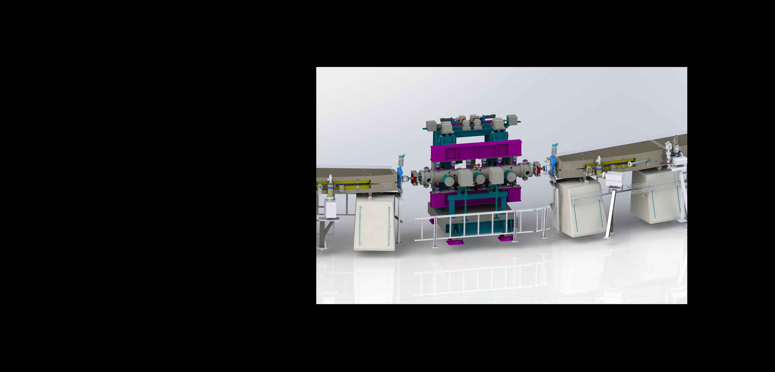
New Beamlines Development: MAVKA
In beam test:
Mimicking MAVKA aperture with upper and lower vertical scraper. Test was done for ~ 400 mA beam current
MAVKA is a in vacuum horizontal undulator, it will be installed in the middle of the 2nd strait section.
Total magnetic length: 1.824 m
Maximum field: 0.9 T at 4.75 mm gap
Periods: 96
Period length: 0.019 m
Minimum gap achieved at 6.45 mm
Wakefield induced on scraper introduces beam instabilities enhancing Tauschek effect. This corresponds to continues beam lifetime degradation.

Slide 16
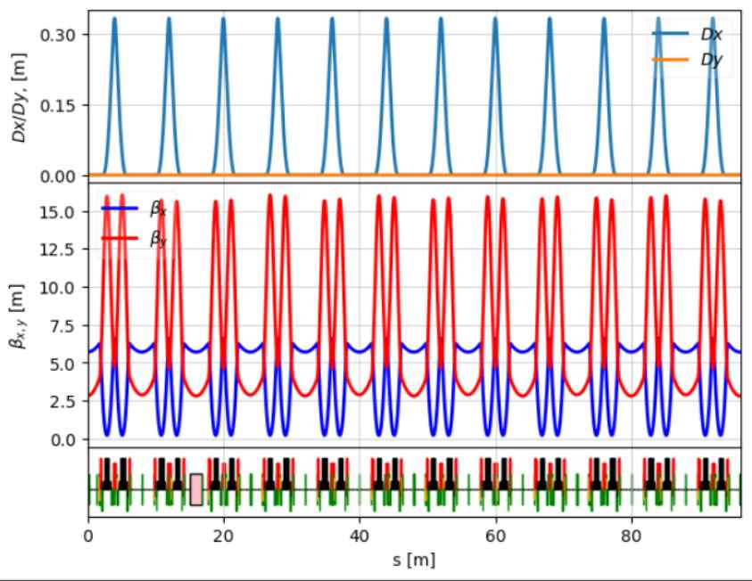
New Beamlines Development: MAVKA
MAVKA is a in vacuum horizontal undulator, it will be installed in the middle of the 2nd strait section.
Total magnetic length: 1.824 m
Maximum field: 0.9 T at 4.75 mm gap
Periods: 96
Period length: 0.019 m
 | Bx/y entrance [m] | Bx/y mid ID [m] | Bx/y exit [m]
Model lattice | beta_x = 5.61 beta_y = 3.13 | beta_x = 5.46 beta_y = 2.84 | beta_x = 5.61 beta_y = 3.13
Actual measured | beta_x = 5.94 beta_y = 2.95 | beta_x = 5.84 beta_y = 2.75 | beta_x = 5.98 beta_y = 3.08
Model with Mavka Ocelot | beta_x = 5.61 beta_y = 3.08 | beta_x = 5.46 beta_y = 2.80 | beta_x = 5.61 beta_y = 3.08
Slight vertical focusing coming from undulator visible (Wakefield not included in calculations)

Slide 17
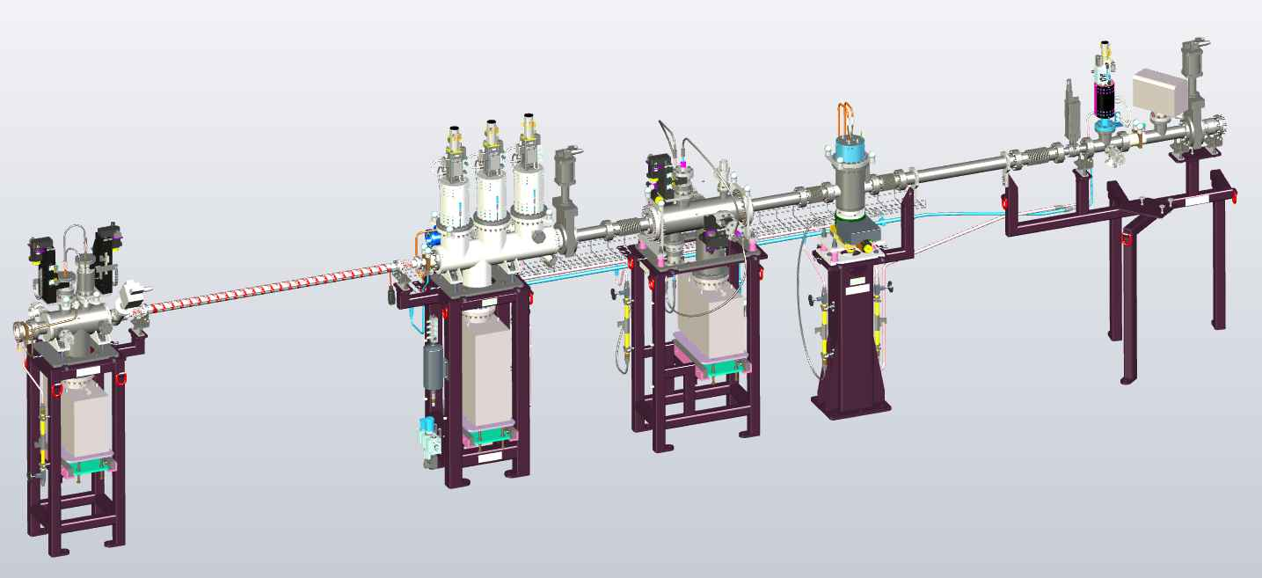
New Beamlines Development
ARYA – Front End & Beamline design
SMAUG – Front end & Beamline design
PHELIX – 2nd Branch design
MAVKA – Insertion device (IVU), straight section, front end design
SMAUG FE, FDR (delivery 21.11.2025)

Slide 18
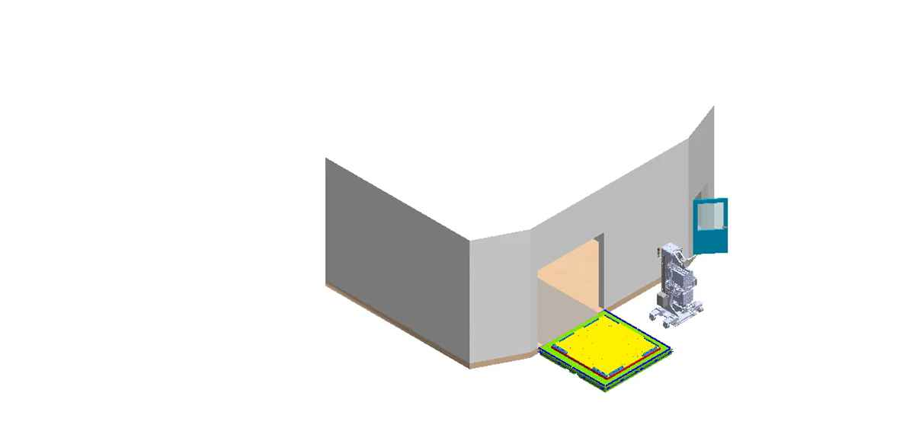
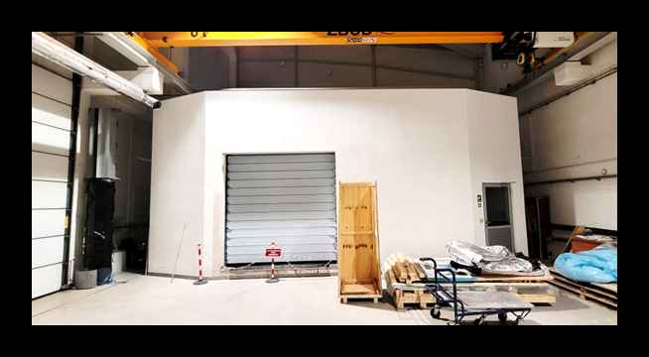
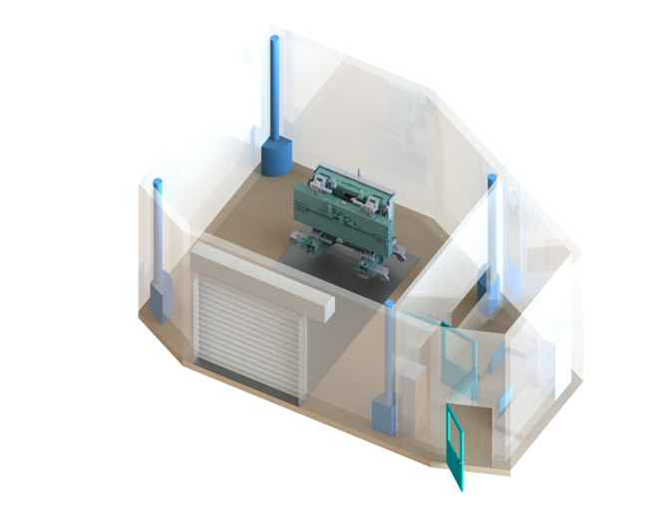
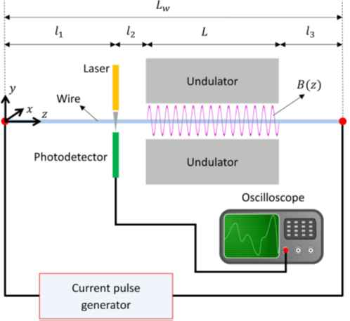
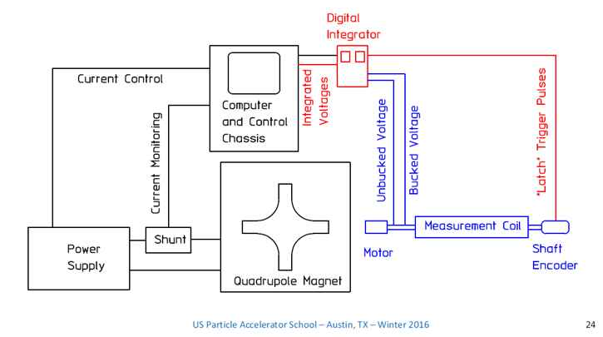
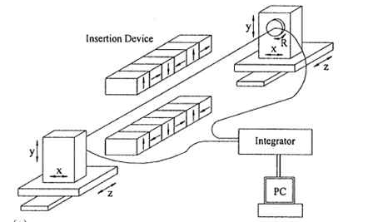
Development of Magnetic Lab
Construction of the magnetic laboratory (in progress)
Adaptation of the available space after removal of the CrioTEM microscope: additional resin surface on the floor, reinforcement of the main communication path for heavy equipment, refreshment of the walls,
Construction of the measuring systems for magnetic measurements (in progress)
Wide spectrum of measurements are foreseen inside the magnetic laboratory:
Rotating coil measurements
Stretched wire measurements
Vibrating wire measurements
Hall probe measurements
All measurements are intended to strengthen Solaris' operational capabilities and lead to reduction of the production costs and, in extreme cases, to the independence of external suppliers.
pulsed wire system
rotating coil system
Stretched wire system

Slide 19
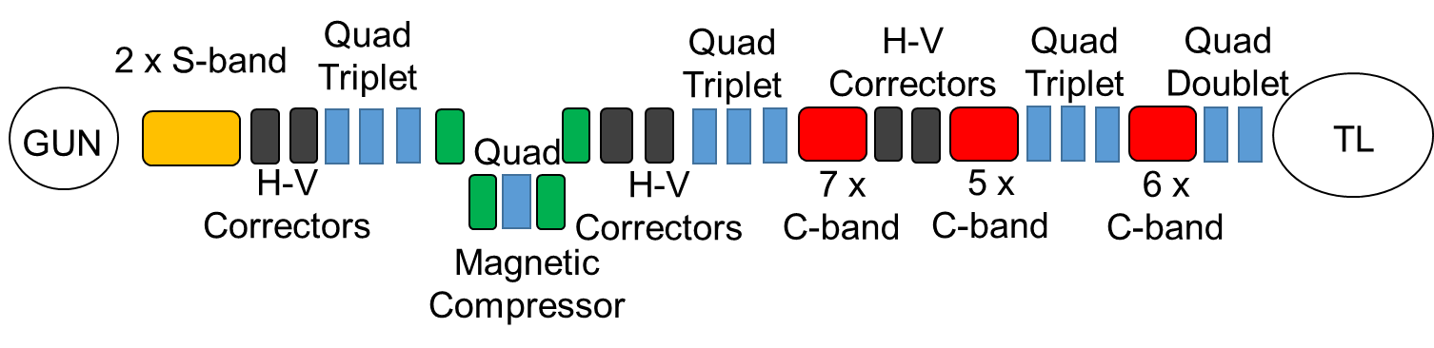
Upgrade plan for LINAC
Hybrid S-band/C-band LINAC with magnetic bunch compressor
Barium oxide thermionic cathode gun and additional laser photocathode gun
Top-up operation, injections every few minutes
2 x S-band and 18 x C-band RF structures
Optics simulations done in Elegant, PyAT and Astra for early stages of acceleration
Parameters of new Linac
Energy [GeV] | 1.5
Accelerating Gradient [MV/m] | 50
RF Frequence [MHz] | 5712
Bunch charge [nC] | 0.2
Hor. Emittance [mm mrad] | 1.69
Ver. Emittance [mm mrad] | 1.43
Rep. rate [Hz] | 10
Bunch lenght on exit [ps] | 0.48
Length [m] | 67
Energy spread [keV] | 794
Parameters of bunch compressor
Energy [GeV] | 0.225
Lenght (with drifts) [m] | 2.54
Lenght (single dipole) [m] | 0.3
Compression rate | 3.373
Deflection angle (single dipole) [rad] | 0.198
Bending field (single dipole) [T] | 0.496
Radius of curvature (single dipole) [m] | 1.515
R56 [m] | -0.048
Bunch lenght on entrance [ps] | 1.69

Slide 20

Challenges
The size of the tunnel is fixed and space is limited it can be demanding to fit all equipment in technological tunnel
Laser lab for the photocathode gun need to be established
Injection scheme with multipole kicker need to be optimised
Radiation protection shielding and beam dump need to be calculated and verified
Although the infrastructure (cooling and electricity) demands are fulfilled, there could be a need to develop new secondary cooling units, or liquid nitrogen cooling linac technology
Developing LLRF system for linac
For the future FEL or SPF the linac tunnel need to be expanded and experimental area need to be foreseen.

Slide 21

SUMMARY
Diagnostics development :
FOFB, BBFB, BLM, Tune FB and BPM system for SOLARIS I FCC ee.
Full energy linac development
Magnet Lab development including magnet diagnostic tools (stability, alignment), ID development
New beamlines development (CIRI, ARYA, SMAUG, MAVKA) and installation
Supporting operation and improving beam stability. High availability.

Slide 22







Acknowledgements
All SOLARIS TEAM
MAX IV TEAM
Marek Gąsior, Thibaut Lefevre, Michał Krupa (CERN)
Dmitry Teytelman
Alessandro Curcio (INFN, Univ. Of Rome)
Dmytro Butt, Rober Nietubyć (NCBJ - POLFEL)
PSI TEAM (Magnet Group, MAVKA BL team)
The project is executed under the provision of the Polish Ministry and Higher Education project “Support for research and development with the use of research infrastructure of the National Synchrotron Radiation Centre SOLARIS” under contract nr 1/SOL/2021/2.

Slide 23



Thank you for your attention!

