Slide 1
BESSY II
status & upgrade
10.30.2025
Meghan McAteer on behalf of the BII machine group
ESLS 2025
SOLEIL

Slide 2
BESSY II Machine Group
Michael Abo-Bakr, Pauline Ahmels, Rebecca Barsotti, Beñat Alberdi Esuain, Terry Atkinson, Yvonne Bergmann, Thomas Birke, Daniel Böhlick, Jörg Borninkhof, Anne Bundels, Robert Burneleit, Natthawut Chaisueb, Nathalie Childs, Matthias Diehn, Marc Dirsat, Olaf Dreßler, Michael Edling, Silvio Ehlert, Dan Eichel, Volker Dürr, Pablo Echevarria, Dennis Engel, Fjodor Falkenstern, Jörg Feikes, Nadine Fischer, Roland Fleischhauer, Andre Frahm, Benjamin Franksen, Holger Glass, Hans-Walter Glock, Felix Glöckner, Anny Gora, Paul Goslawski, Malte Gotz, Ronja Grünke, Mario Haucke, Jochen Heinrich, Stine Heise, Marco Herzog, Sören Heucke, Andreas Heugel, Frank Hoeft, Harry Hoffmann, Falk Hoffmann, Karsten Holldack, Holger Huck, Karsten Janke, Andreas Jankowiak, Sébastien Joly, Christian Jung, Nicole Kaubisch, Christian Kalus, Jens Knobloch, Jörg Kolbe, Arnold Kruschinski, Bernhard Kuner, Jens Kuszynski, Victoria Laux, Sven Lederer, Benjamin Liebe, Melis Löhr, Tobias Loewner, Michael Markert, Aleksandr Matveenko, Meghan McAteer, Andreas Meissner, Marco Marongiu, Ingo Müller, Nicolas Müller, Christian Nass, Ingo Neumann, Teresia Olsson, Volker Oswald, Sylvia Pavlis, Götz Pfeiffer, Fabian Pflocksch, Lutz Pichl, Henry Plötz, Jens Raeder, Günther Rehm, Markus Ries, Stefan Rotterdam, David Rückert, Roswitha Schabardin, Andreas Schälicke, Tobias Schneegans, Günter Schindhelm, Kevin Schemmel, Gregor Schiwietz, Jörg Schleuer, Pierre Schnizer, Bernhard Schriefer, Christoph Schröder, Michael Schuster, Dirk Schüler, Ines Seiler, Nicola Selbach, Liangliang Shi, Irma Shmidt, Hannes Stein, Tom Struppert, Waheedullah Sulaiman Khail, Ervis Suljoti, Fatbardh Tafaj, Yegor Tamashevich, Michael Ulrich, Stefan Wiese, Daniel Wolk, Adolfo Velez, Marie-Louis Venzke, Jens Völker, Antje Vollmer, Sven Wrede, Anna Ziegler, …
and many more

Slide 3
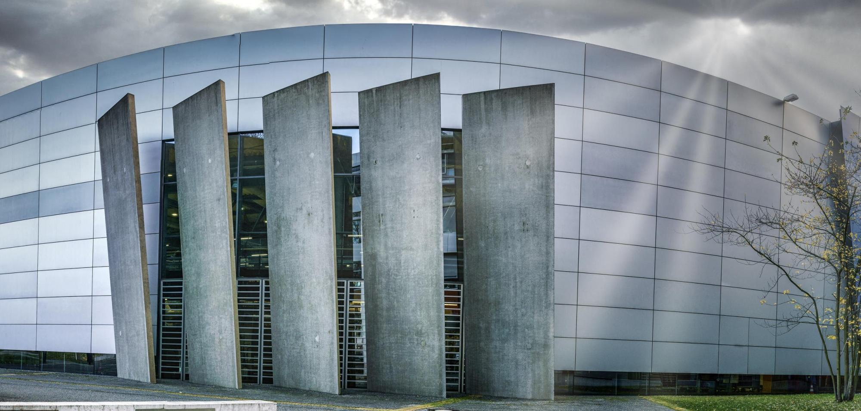
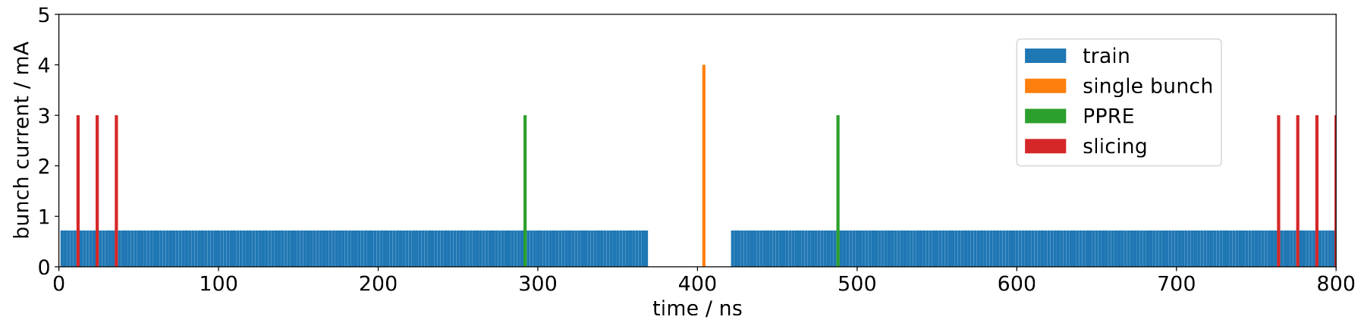
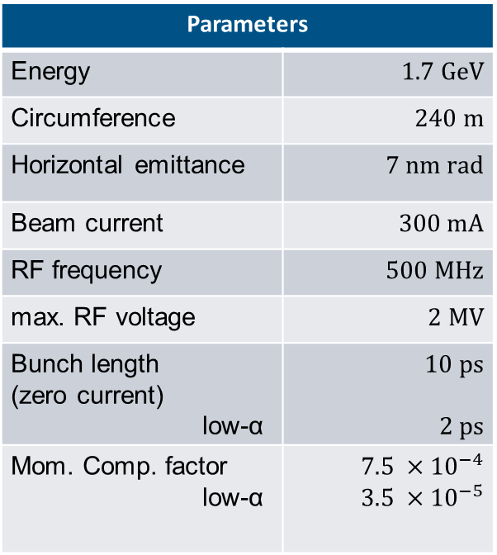
BESSY II, Berlin, Germany
Parameters
Energy | $$1.7 GeV$$
Circumference | $$240 m$$
Horizontal emittance | $$7 nm rad$$
Beam current | $$300 mA$$
RF frequency | $$500 MHz$$
max. RF voltage | $$2 MV$$
Bunch length (zero current) low-α | $$10 ps$$ $$2 ps$$
Mom. Comp. factor low-α | $$7.5 ×{10}^{−4}$$ $$3.5 ×{10}^{−5}$$
in user operation since 1998
diverse user community
offering short x-ray pulses and timing
‘New’ fill-pattern (shorter gap, reduced transients, increased lifetime, more efficient bunch lengthening)

Slide 4
Operation Statistics

Slide 5
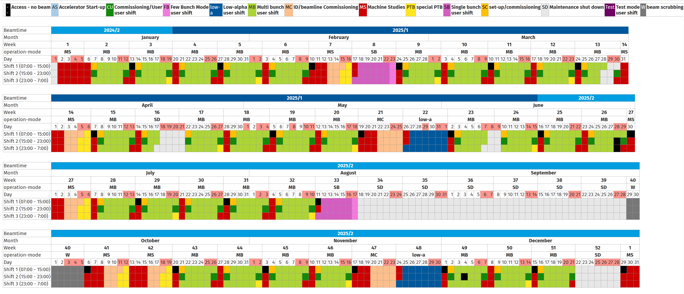
operation schedule for 2025

Slide 6
Availability statistics
Year | Scheduled | Delivered | Downtime | Outages | Availability | MTBF | MTTR
2013 | 4505 h | 4346 h | 159.3 h | 105 | 96.5% | 42.9 h | 1.52 h
2014 | 5408 h | 5024 h | 384.4 h | 136 | 92.9% | 39.8 h | 2.83 h
2015 | 3896 h | 3804 h | 92.5 h | 90 | 97.6% | 43.3 h | 1.03 h
2016 | 4855 h | 4793 h | 61.9 h | 69 | 98.7% | 70.4 h | 0.91 h
2017 | 4299 h | 4050 h | 249.5 h | 62 | 94.2% | 69.3 h | 4.02 h
2018 | 3578 h | 3550 h | 28.3 h | 51 | 99.2% | 70.2 h | 0.56 h
2019 | 4058 h | 3990 h | 67.7 h | 67 | 98.3% | 60.6 h | 1.01 h
2020 | 3455 h | 3404 h | 50.9 h | 49 | 98.5% | 70.5 h | 1.04 h
2021 | 4968 h | 4917 h | 50.6 h | 59 | 99.0% | 84.2 h | 0.86 h
2022 | 3724 h | 3695 h | 29.0 h | 38 | 99.2% | 98.0 h | 0.76 h
2023 | 4587 h | 4528 h | 58.2 h | 48 | 98.7% | 95.6 h | 1.21 h
2024 | 4732 h | 4669 h | 63.4 h | 61 | 98.7% | 77.6 h | 1.04 h
2025* | 3839 h | 3736 h | 103.2 h** | 46 | 97.3% | 76.8 h | 2.06 h
* Until 2025.10.28

Slide 7
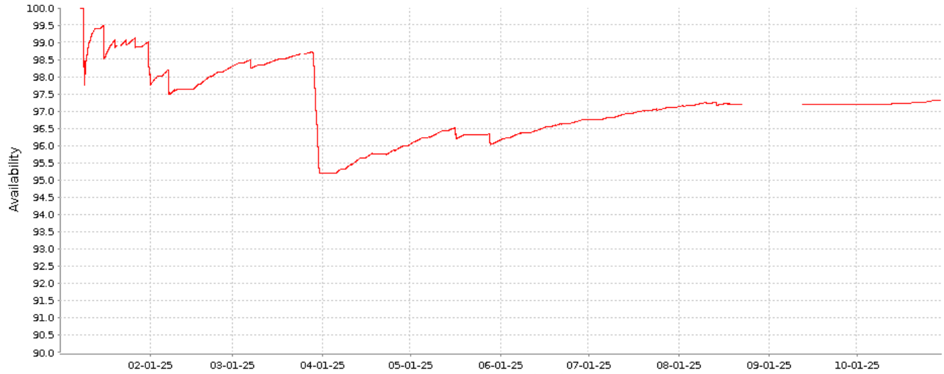
Availability
Vacuum event

Slide 8
number of outages

Slide 9
Duration of outages (total = 128H, of which 80h due to vacuum event)

Slide 10
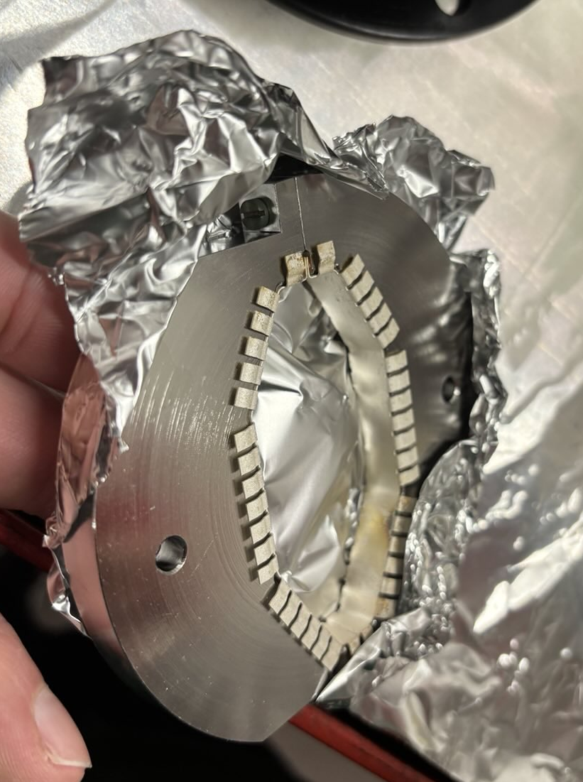
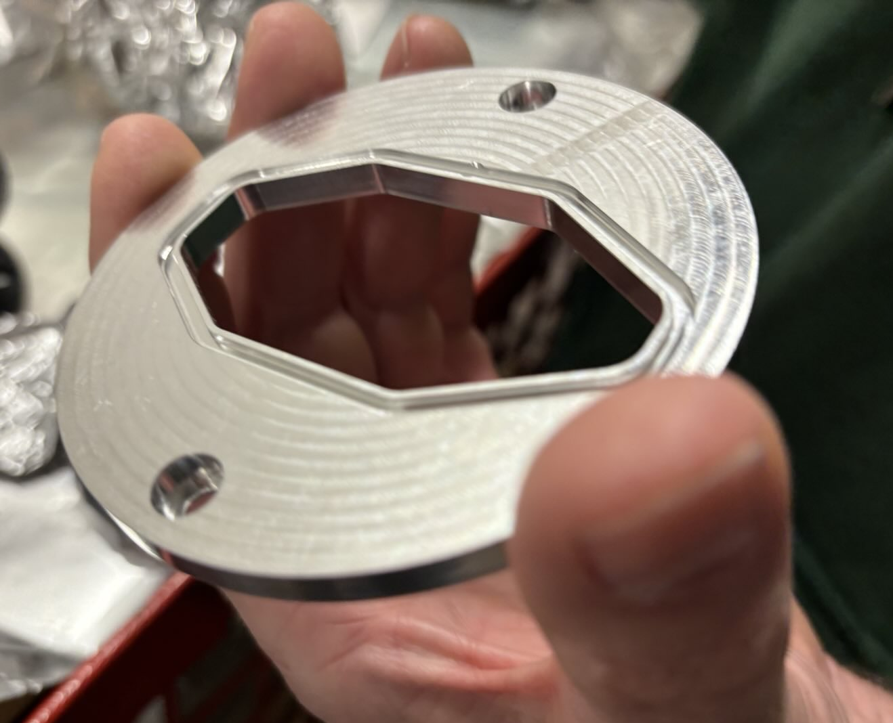
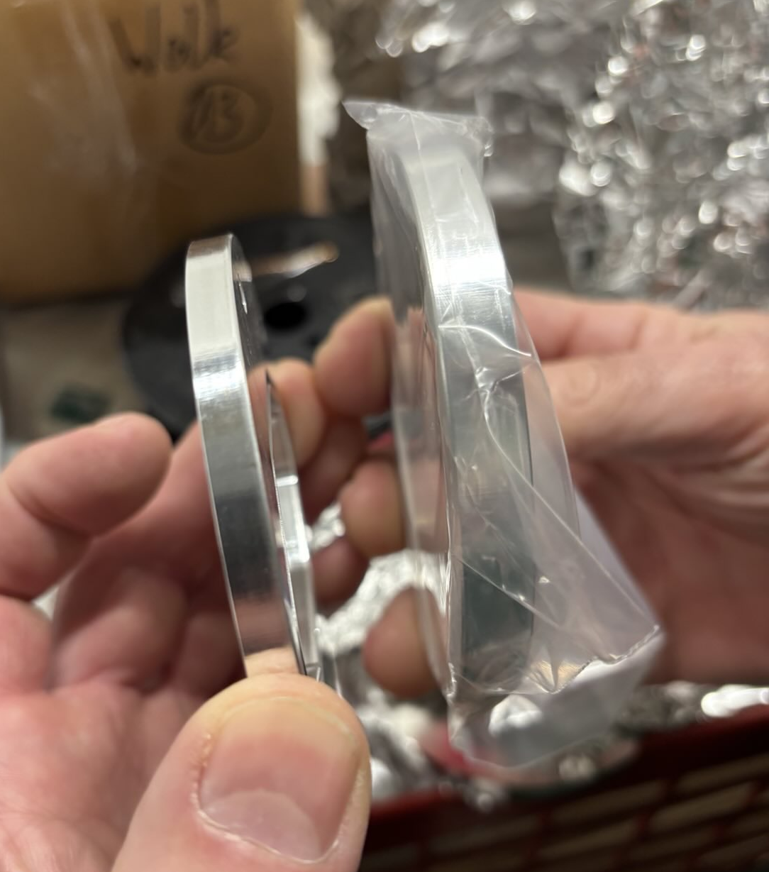
Vacuum intervention (March 2025)
Heating and discharges; couldn’t store 200 mA
Happened on Friday before Machine Commissioning week -> quick decision to break vacuum before weekend to investigate
Found mismatched RF connector (bad fit left a gap)
Beam scrubbing the following week

Slide 11
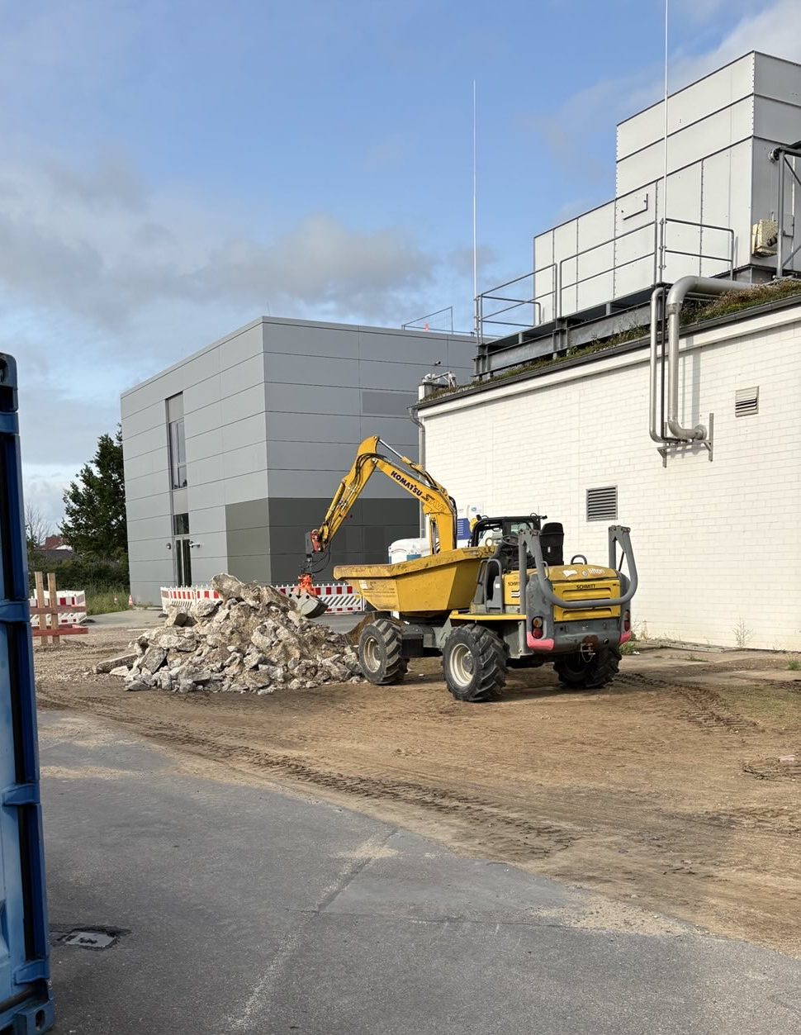
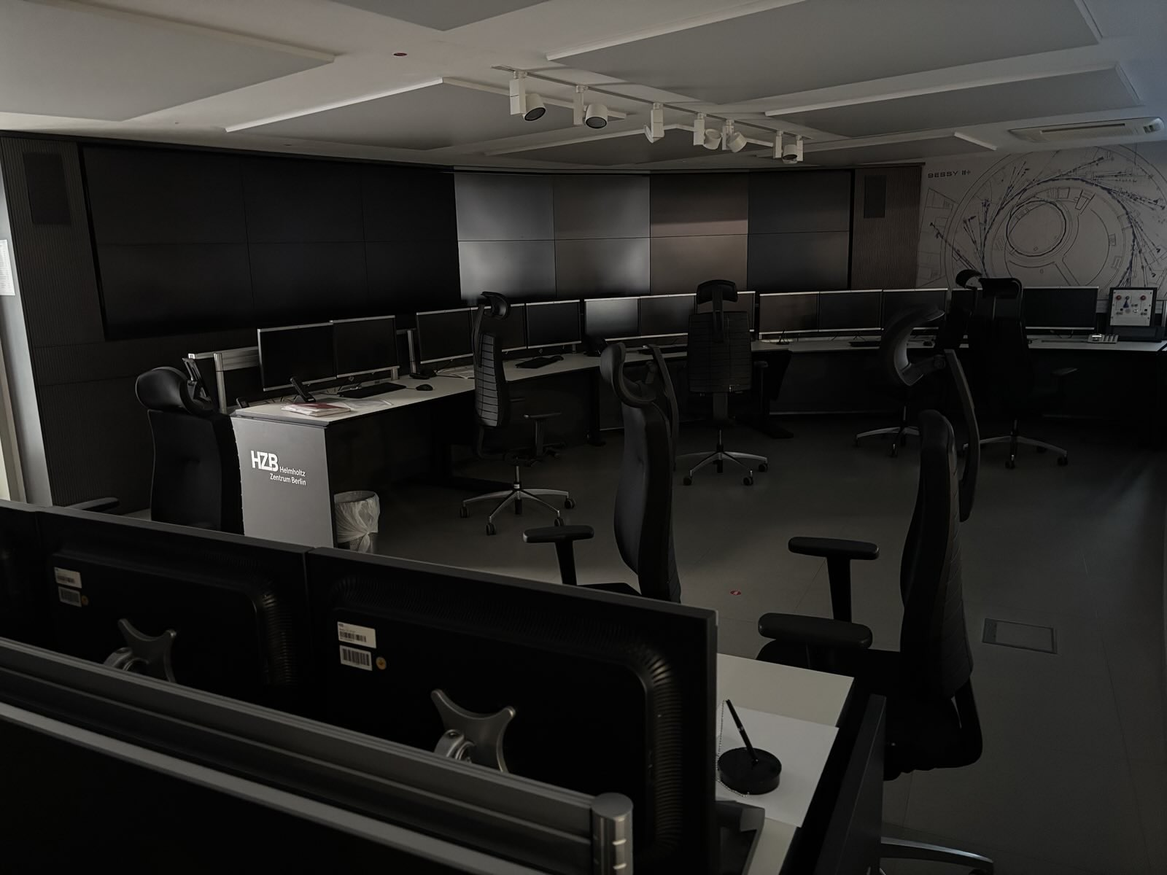
Other disturbances
Lots of construction work and vibrations (two new buildings, new underground electrical infrastructure)
Two significant power outages
Five minutes (during user operation – 6 hrs to get beam back)
Three days (during shutdown)
Network disruption due to failure in server room (luckily no disruption to user operation)

Slide 12
Recent Developments

Slide 13
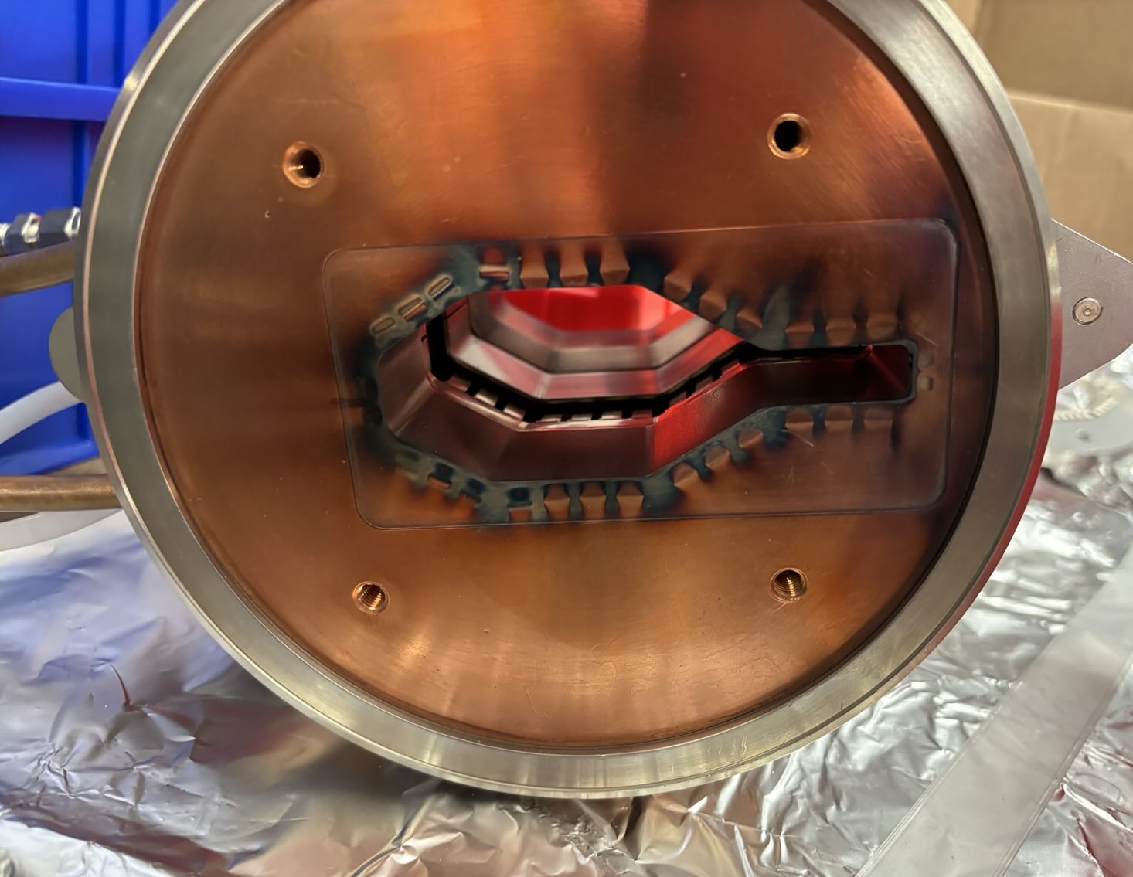
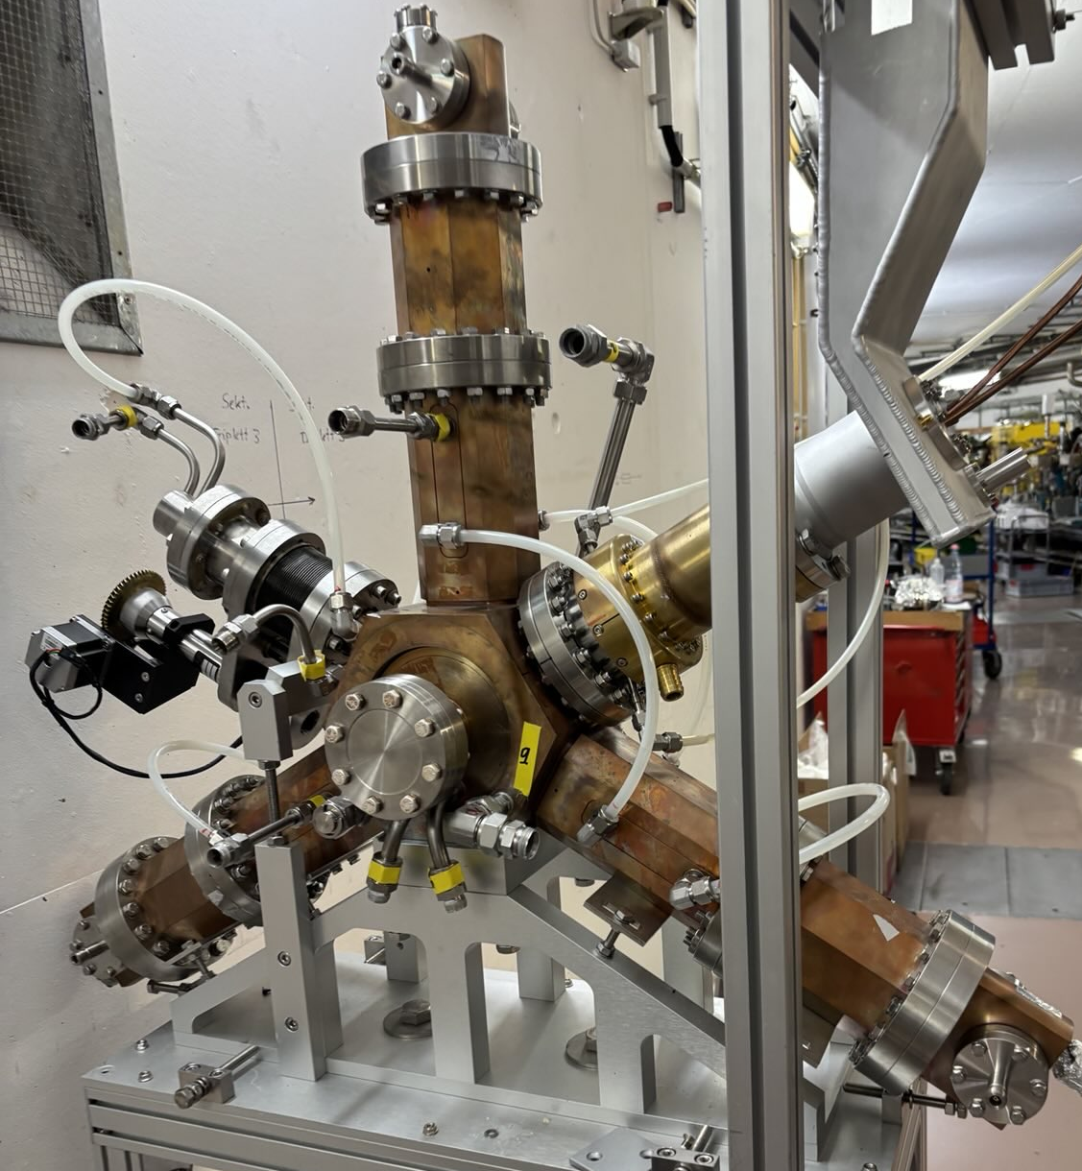
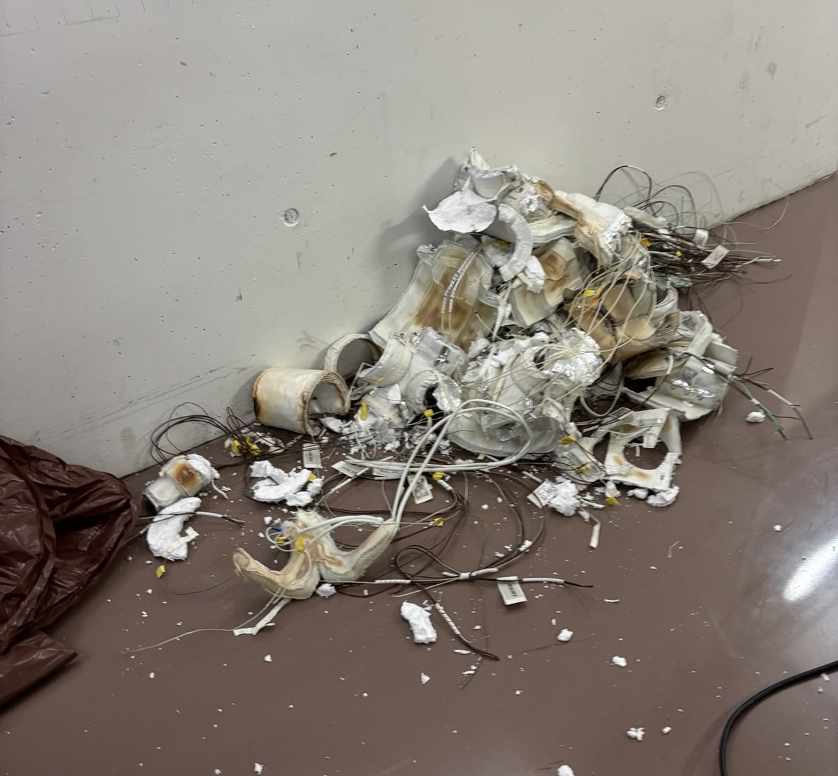
shutdown work 2025
Sections of vacuum chamber replaced
Redesign of magnet feedback loop in Booster dipoles; (attempted) long-term study of magnet stability
Prototype harmonic cavity uninstalled
Extensive surveying campaign
Removal of heating jackets
Much more…

Slide 14
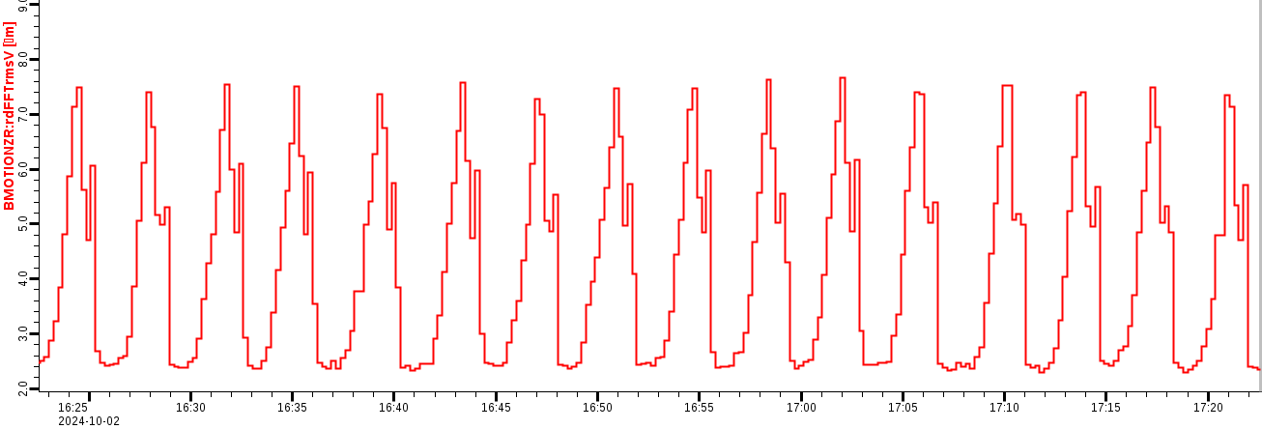
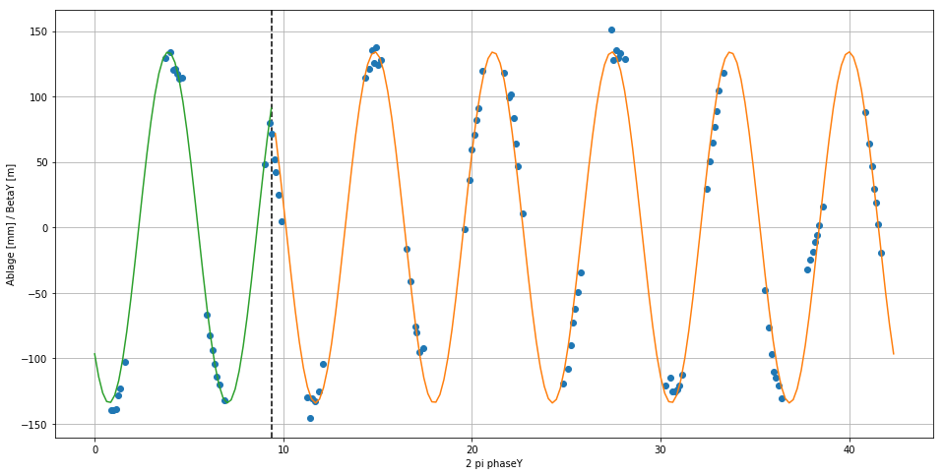
Replacement of vacuum chamber sections
Last year: intermittent low-frequency mystery noise in vertical beam motion

Slide 15
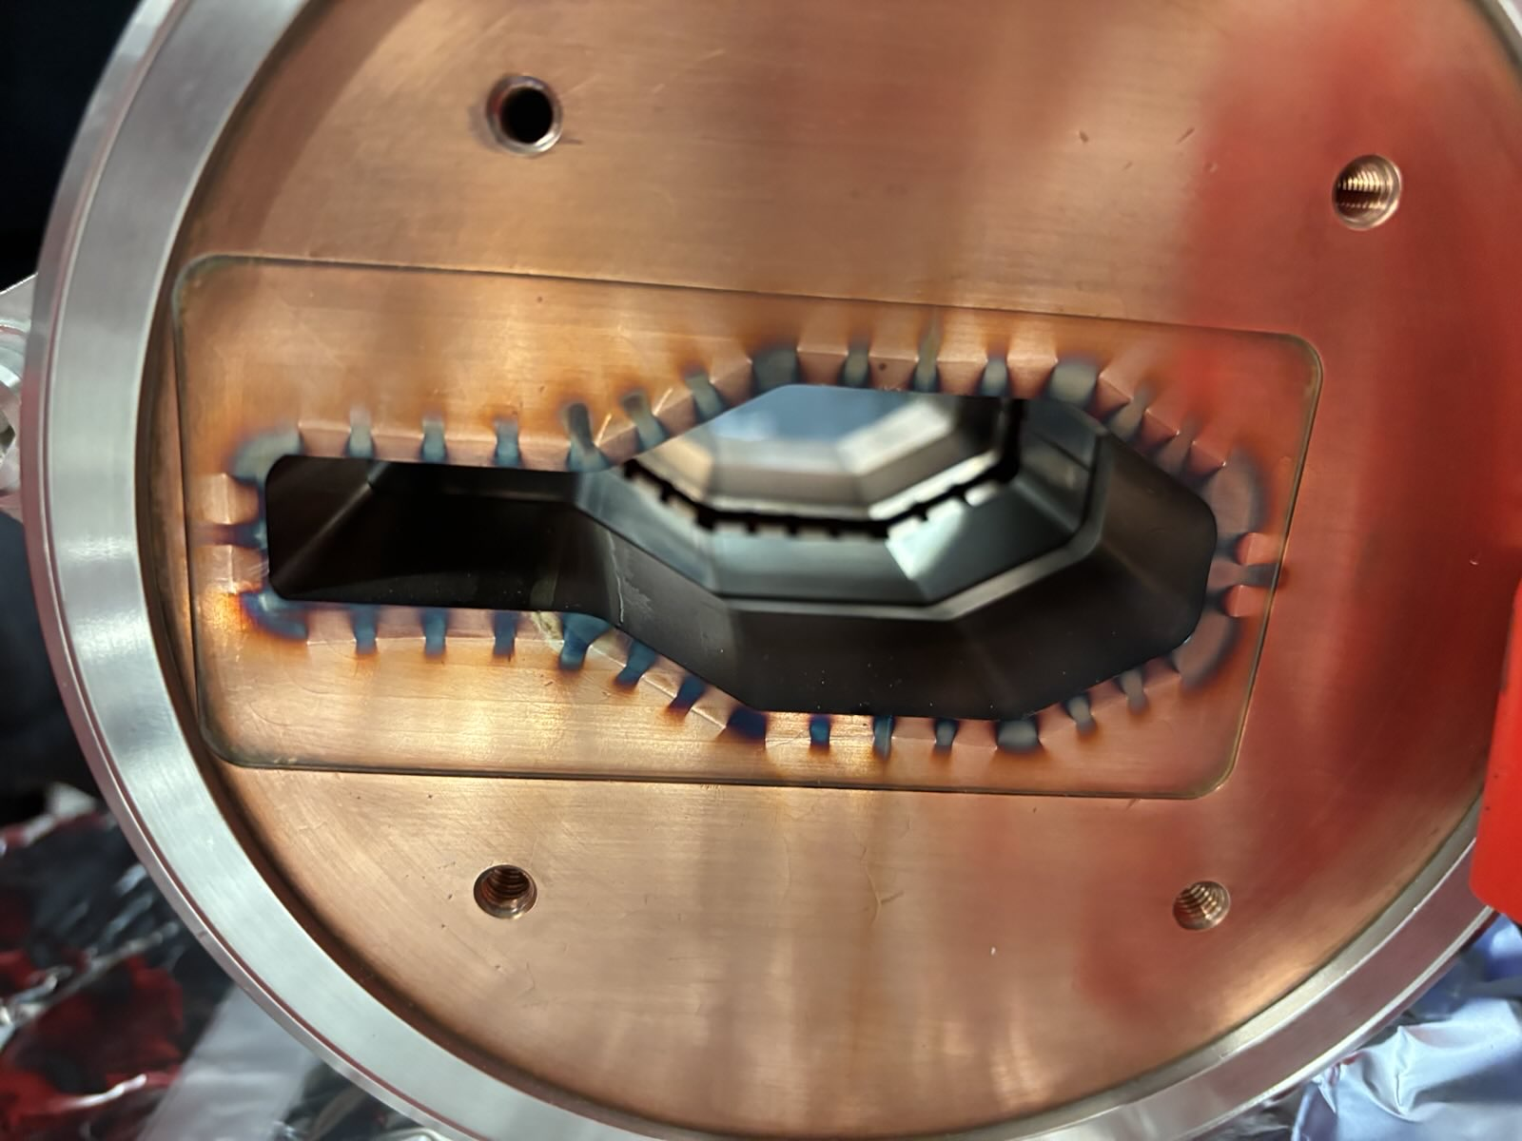
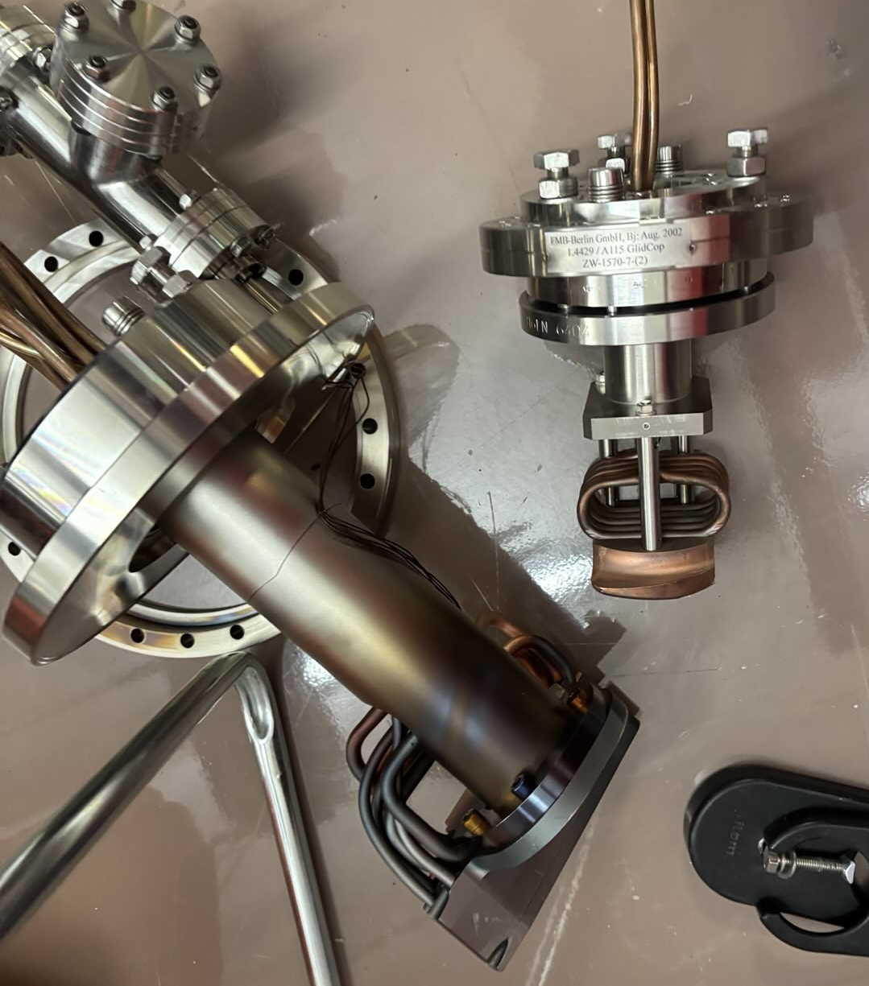
Replacement of vacuum chamber sections
Sections of copper vacuum chamber replaced
Burn marks evident on vacuum chamber, photon absorbers

Slide 16
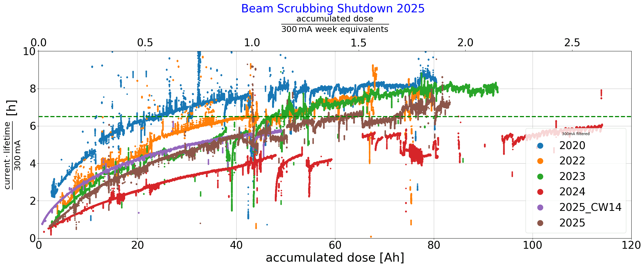
Startup after shutdown 2025:
Beamscrubbing

Slide 17
BII perspectives until 2035
Planned upgrades and developments:
BPM system
Timing system renovation
Vacuum system renovation
Magnet power supply renovation
1.5 GHz cavities, 1.75 GHz cavities, digital LLRF
New WLS
Digital Twin

Slide 18
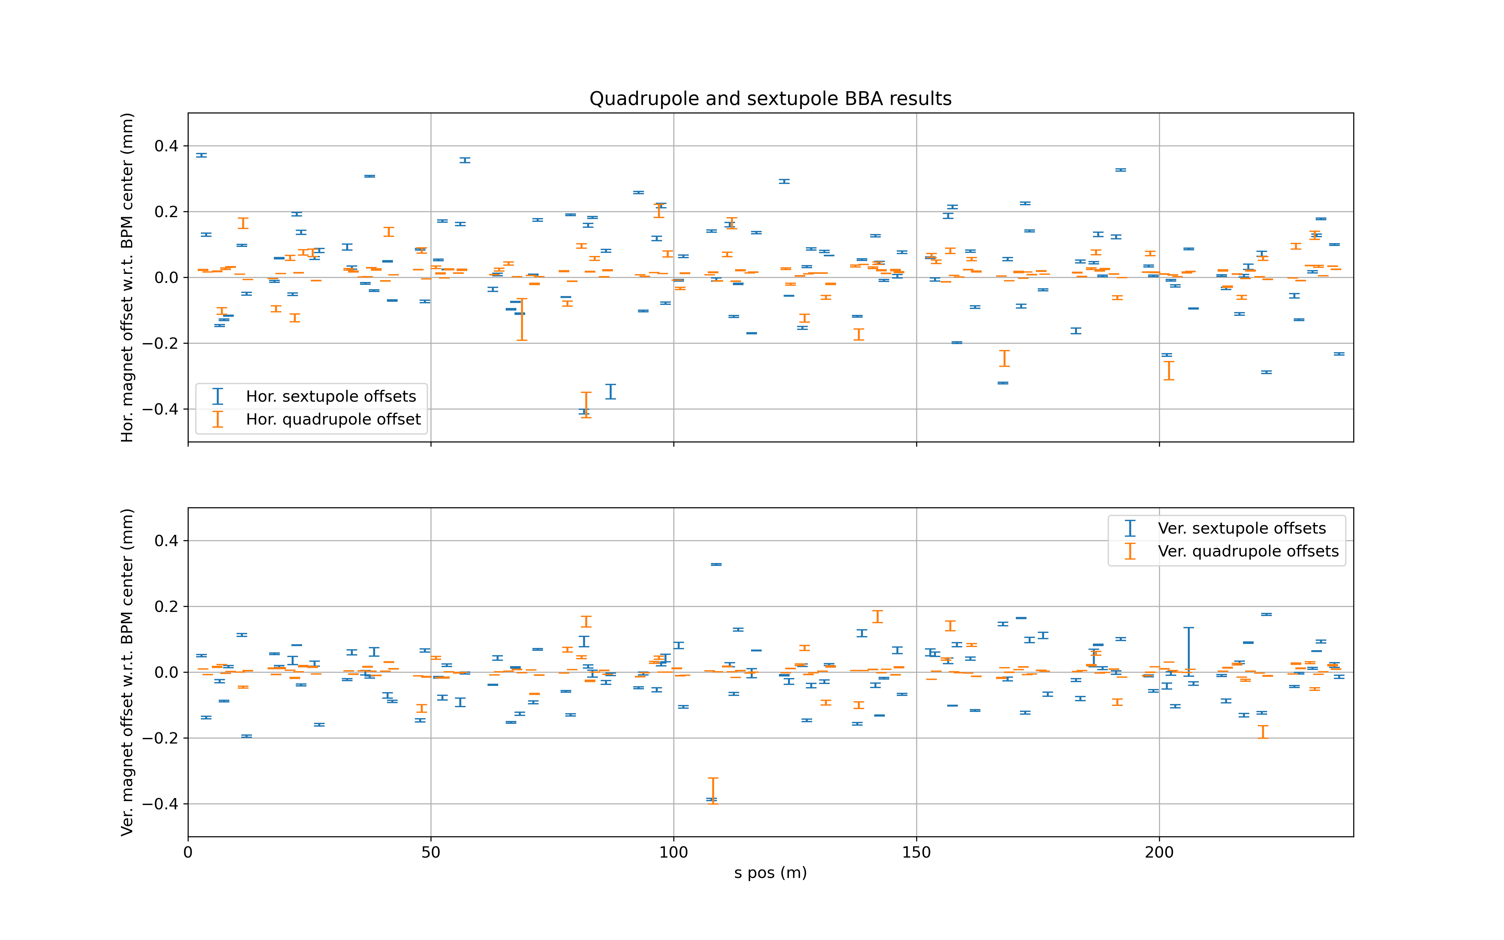
BII perspectives until 2035
Timing system renovation
Vacuum system renovation
Magnet power supply renovation
1.5 GHz cavities, 1.75 GHz cavities, digital LLRF
New WLS
Permanent magnets
Digital Twin
Planned upgrades and developments:
BPM system
Phased installation of Libera Sparks (w/ hybrid orbit correction) completed; full TBT capability
Lots of BBA (of quads and sextupoles)

Slide 19
BII perspectives until 2035
Planned upgrades and developments:
BPM system
Timing system renovation
First components operational; will continue with phased approach
Vacuum system renovation
Magnet power supply renovation
1.5 GHz cavities, 1.75 GHz cavities, digital LLRF
New WLS
Digital Twin

Slide 20
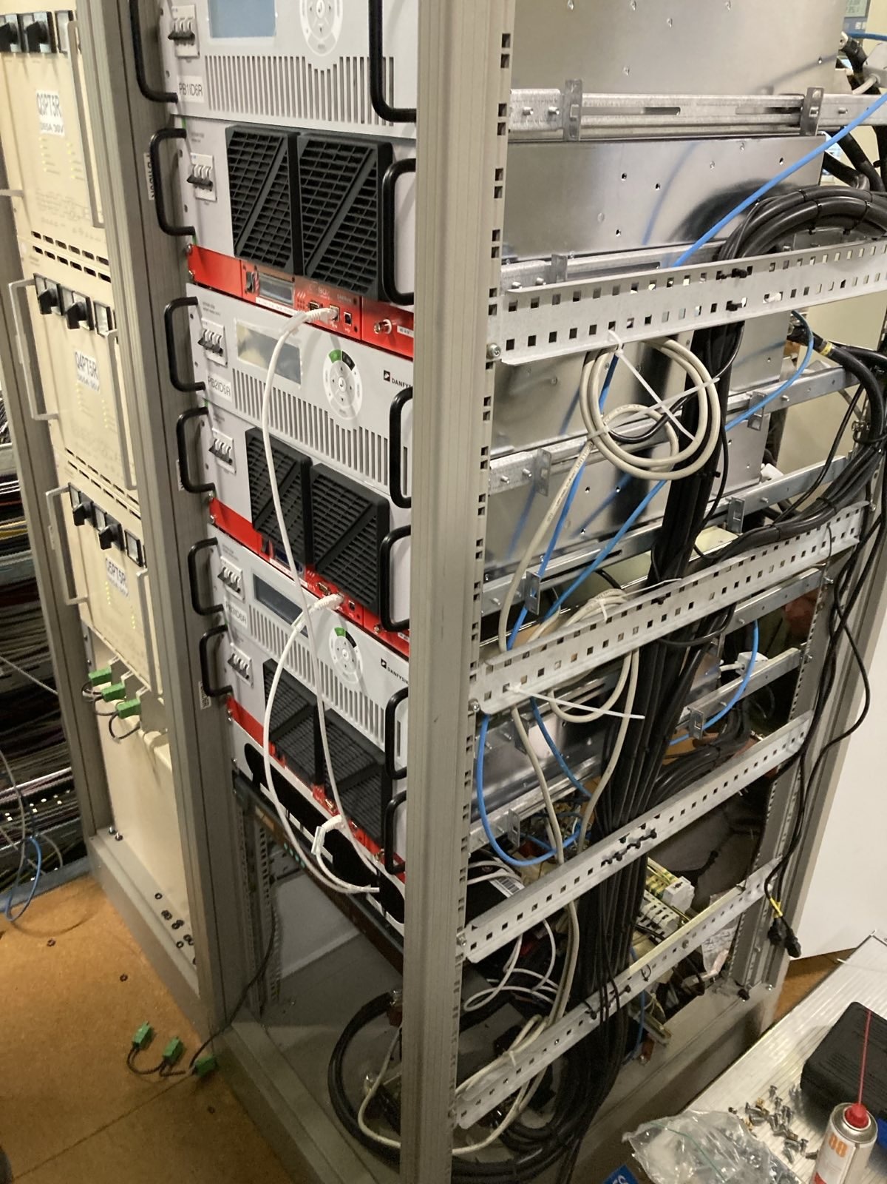
BII perspectives until 2035
Planned upgrades and developments:
BPM system
Timing system renovation
Vacuum system renovation
Magnet power supply renovation
100 power supplies replaced (slicing bends, magnet families in straight sections)
Phased approach (5 per week)
1.5 GHz cavities, 1.75 GHz cavities, digital LLRF
New WLS
Permanent magnets
Digital Twin

Slide 21
BII perspectives until 2035
Planned upgrades and developments:
BPM system
Timing system renovation
Vacuum system renovation
Magnet power supply renovation
1.5 GHz cavities, 1.75 GHz cavities, digital LLRF
New WLS
Digital Twin

Slide 22
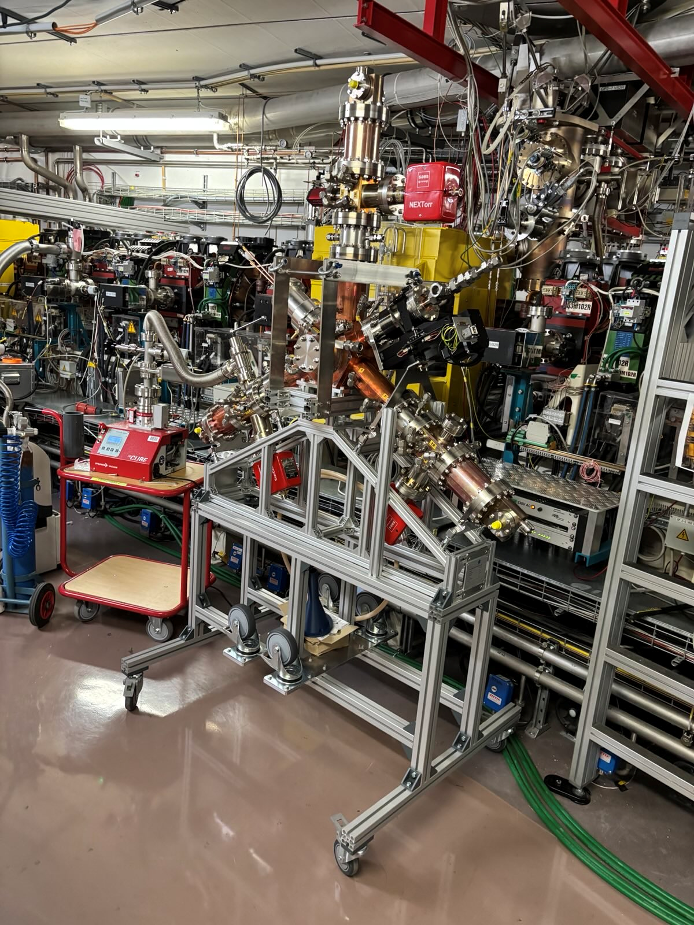
Higher-harmonic cavities and digital LLRF
1.5 GHz cavities (bunch lengthening):
Prototype EU harmonic cavity of Alba design uninstalled
First new cavity received, conditioning started
Remainder arriving before end of year; installation in 2026
1.75 GHz cavities (variable bunch lengthening):
Installation in 2027
Digital LLRF
Replacing LLRF for all frequencies in all rings
Call for tender completed, delivery of first system expected in November, remainder next year
Phased installation, starting with 1.5 GHz cavities in 2026

Slide 23
BII perspectives until 2035
Planned upgrades and developments:
BPM system
Timing system renovation
Vacuum system renovation
Magnet power supply renovation
1.5 GHz cavities, 1.75 GHz cavities, digital LLRF
New WLS
Digital Twin

Slide 24
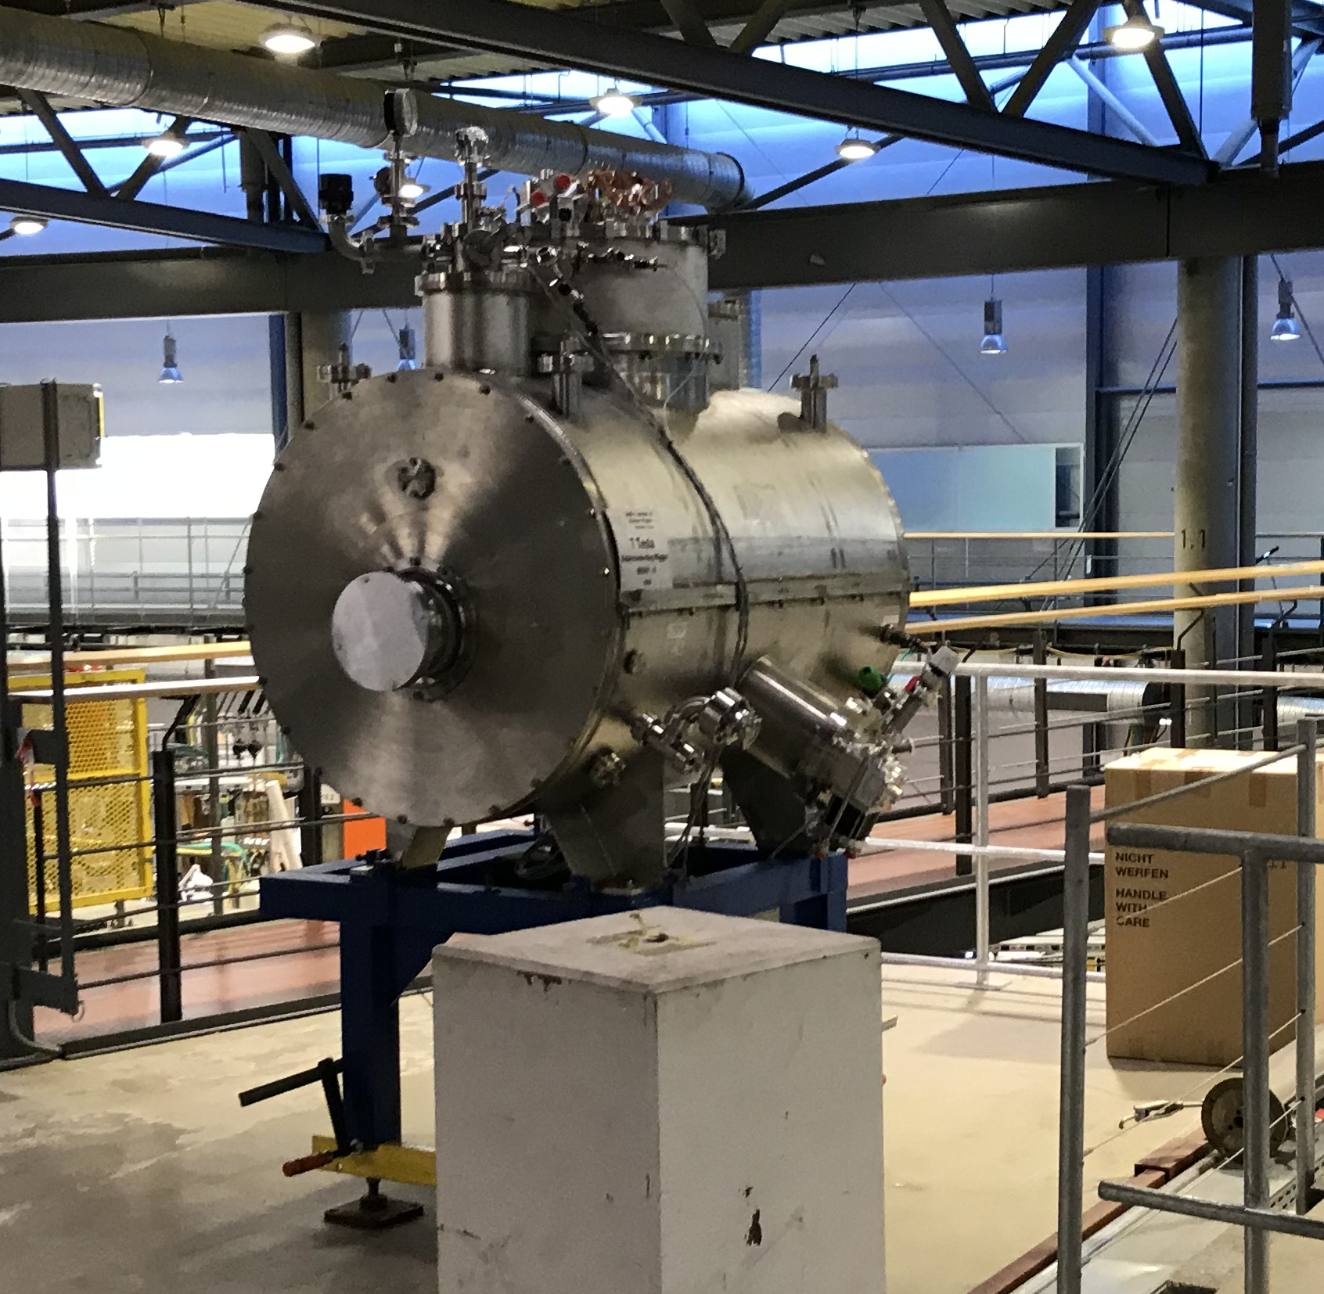
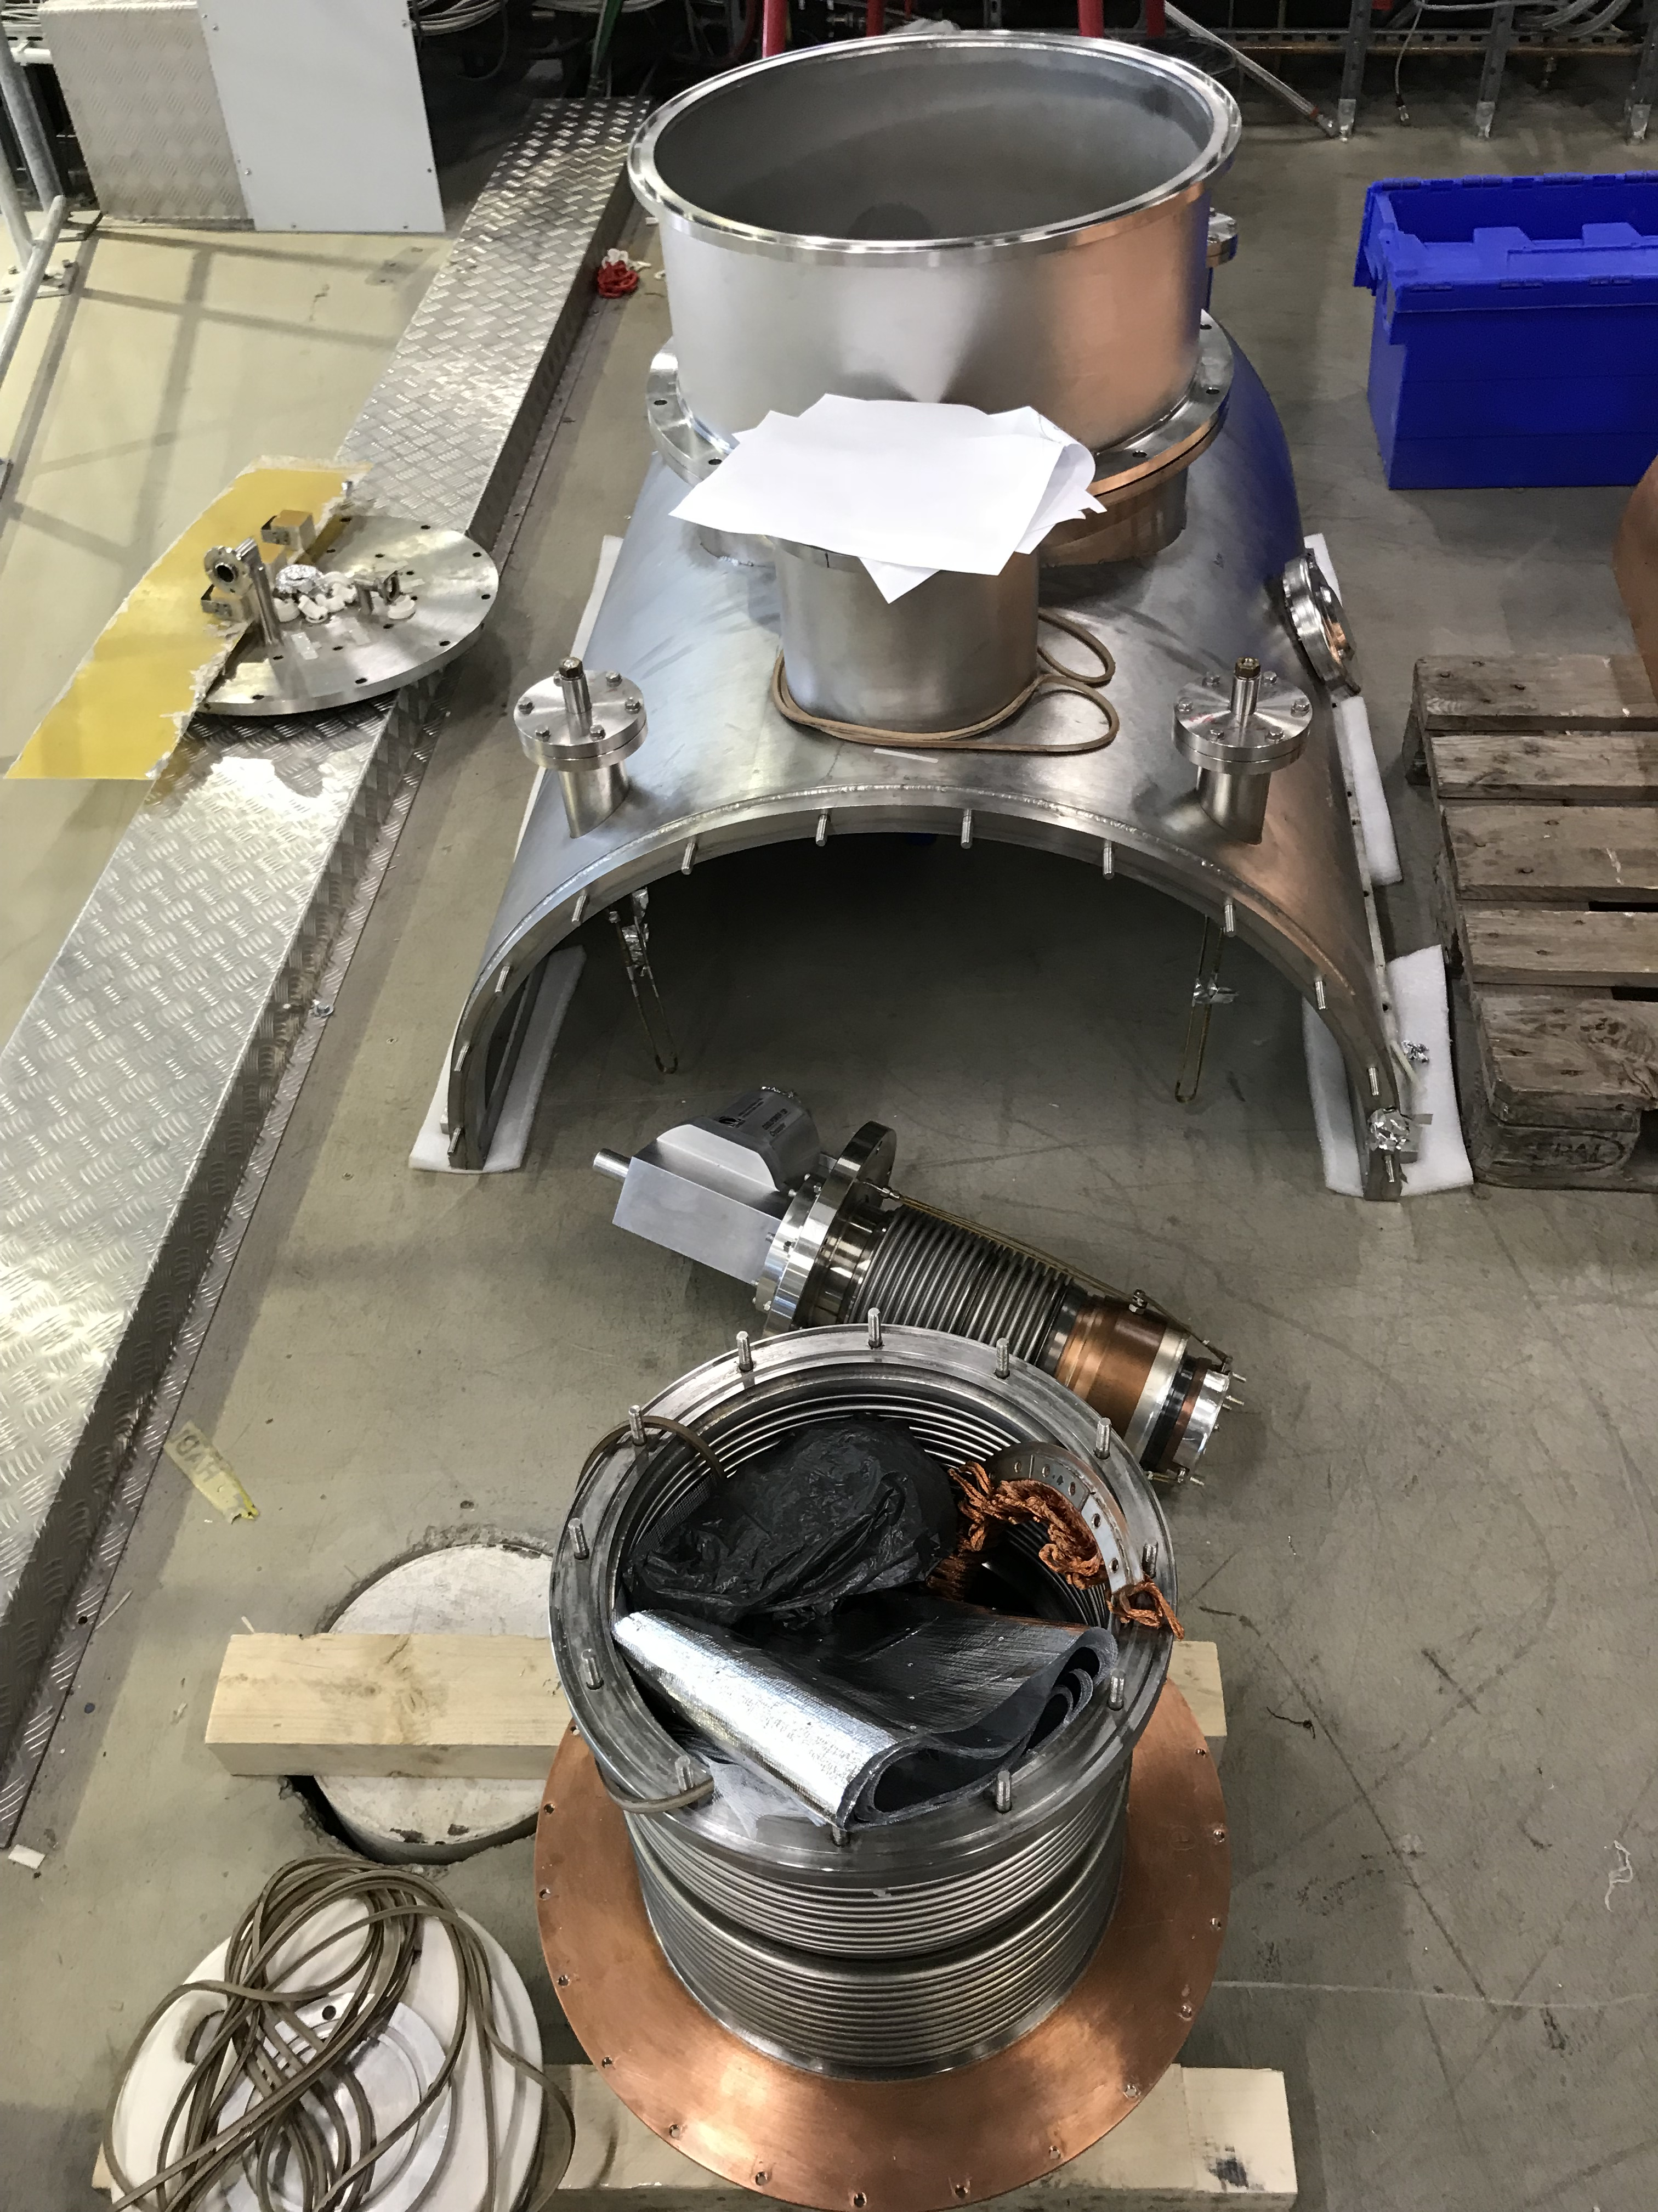
7T wavelength shifter
an established and efficient way to extend the spectral range towards tender x-rays
Existing WLS built by BINP, Novosibirsk, Russia
Maintenance is not available in foreseeable future; reliable but not expected to last until 2035
Replacement project:
Discussions with European manufacturers; call for tender soon
Replicate existing functionality, maybe with design modifications (dry cryostat, smaller vertical gap, maybe 5 SC coils instead of 3)
replacement on site for BESSY II not later than 2029…

Slide 25
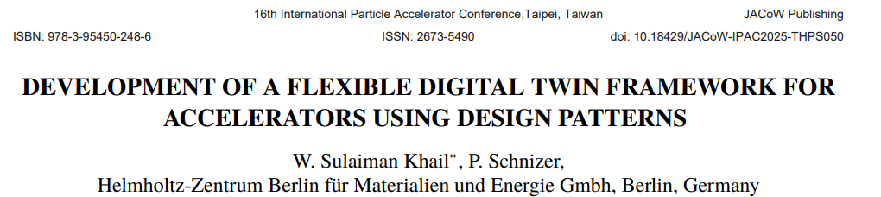
BII perspectives until 2035
Planned upgrades and developments:
BPM system
Timing system renovation
Vacuum system renovation
Magnet power supply renovation
1.5 GHz cavities, 1.75 GHz cavities, digital LLRF
New WLS
Digital Twin
Simulated commissioning / preparing scripts
Details of software architecture:

Slide 26
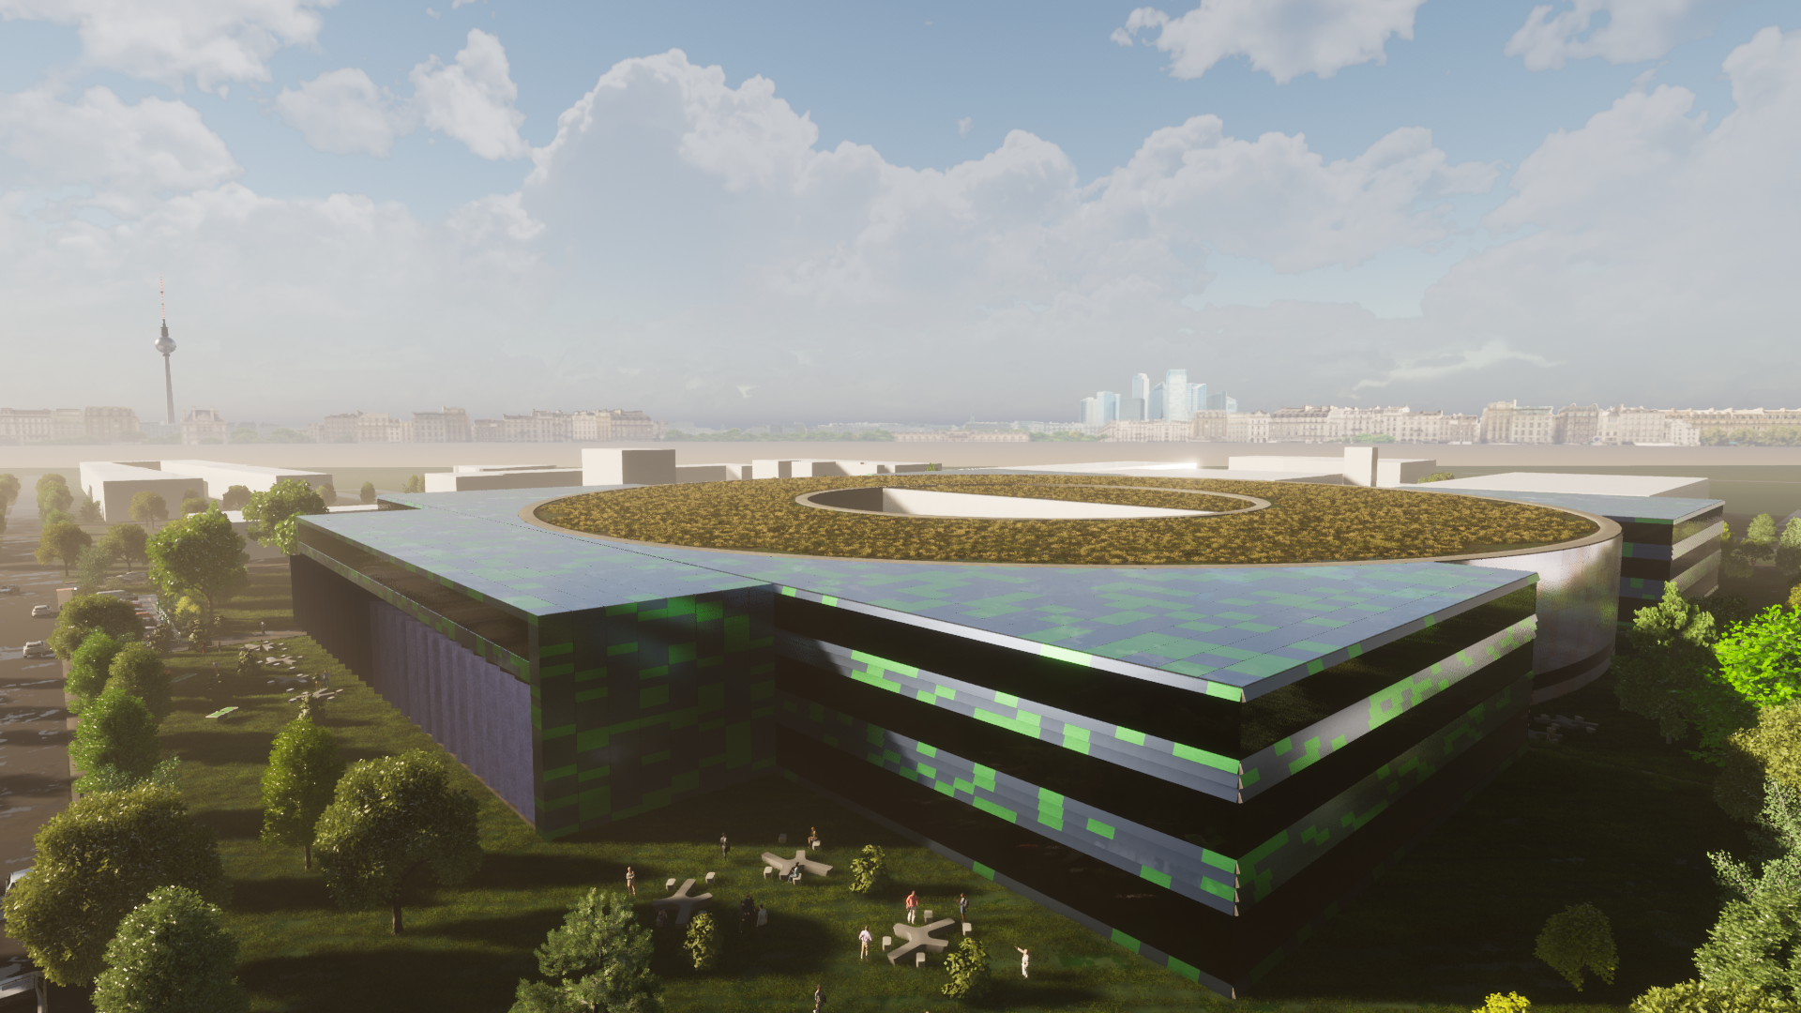
BIII Planning

Slide 27
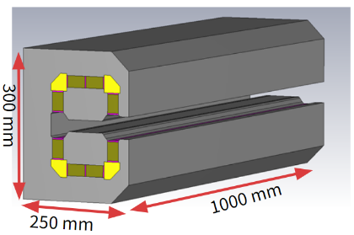

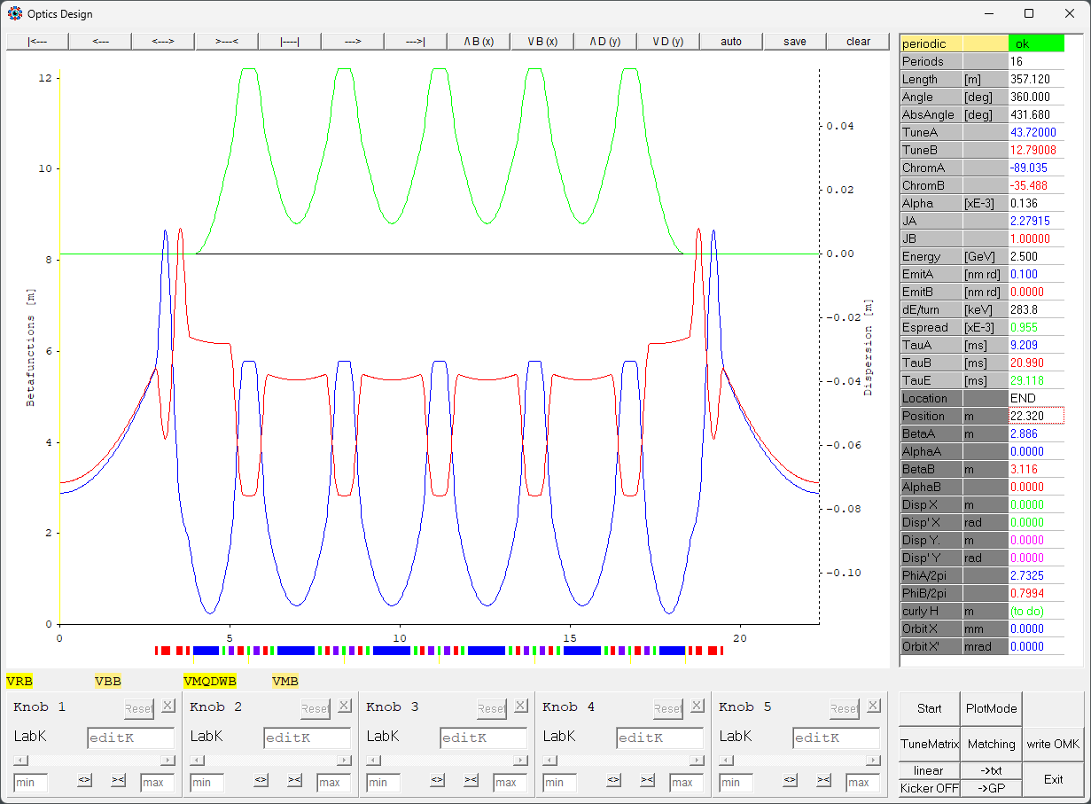
BESSY III Baseline lattice
Slide courtesy of P. Goslawski
A systematic, deterministic lattice approach
stepwise investigation of the MBA lattice basic building blocks! Power and Function of each Component & “Knob” → LEGO approach
with relaxed hardware to minimize the technique risk
not only focusing on emittance, but also on stability & flexibility → Good control of non-linear beam dynamics
6MB-HOA with homogenous metrology bends
100 pm rad emittance @ 2.5 GeV, with 16 straights on 350 m
15µm source size, 10 ps zero current bunch length, lifetime > 5 h
Sustainibility and power consumption
dipoles and quadrupoles mainly build as permanent magnets
power consumption reduce from 1000 kW for electro magnets down to < 200 kW

Slide 28
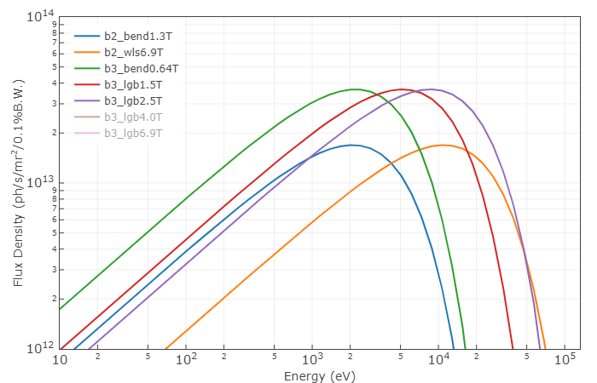

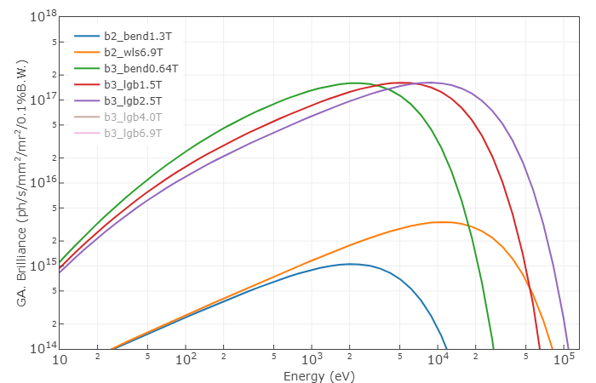
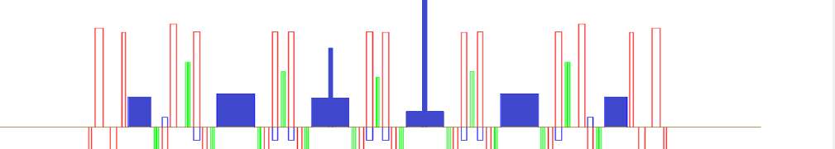
BESSY III Baseline lattice
Slide courtesy of P. Goslawski
BESSY II
ε_{c} = 2.50 keV, B = 1.3 T
ε_{c} = 13.3 keV, B = 6.9 T
Flexibility of bending dipole sources
Extract up to two dipol bending beamlines per 6-MBA arc
The critical photon energy is to some extent adjustable with Longitudinal Gradient Bends (LGBs)
BESSY III
ε_{c} = 2.64 keV, B = 1.5 T
ε_{c} = 6.23 keV, B = 1.5 T
ε_{c} = 10.4 keV, B = 2.5 T
Magnetic Field: 0.64 T 1.5 T 2.5 T
Critical Photon Energy: 2.6 keV 6.2 keV 10.4 keV

Slide 29
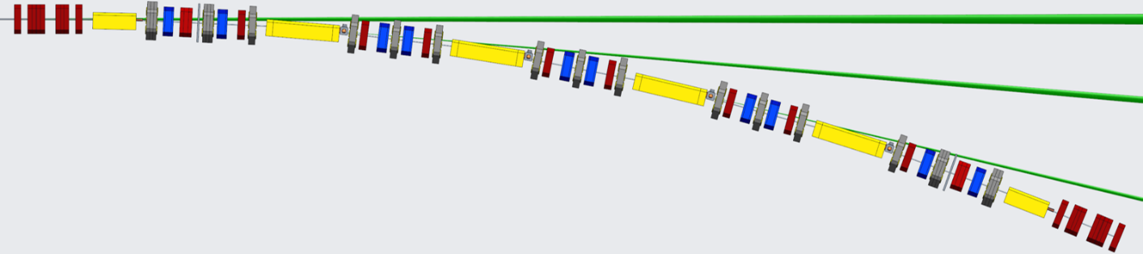
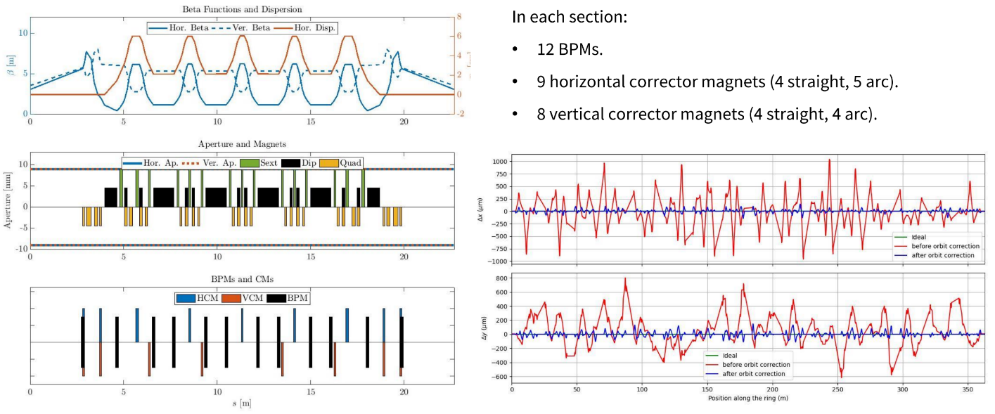
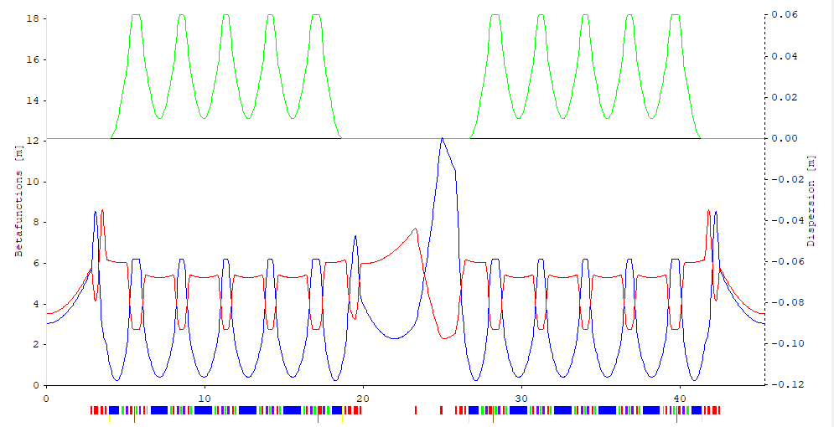
BESSY III Baseline lattice
Slide courtesy of P. Goslawski
Pushing the lattice toward the TDR phase
Technical/engineering adaptions: Absorbers, Front-Ends, Syn.Rad. Extraction
Orbit/Optics etc. Correction Schemes: BPMs, Steerers, etc.
Injection scheme / Injection optics: Lattice adaption for injection dynamics & hardware: septum and non-linear kicker
Non-linear optimization to find the operational sweet spot Operation Schemes
Collective Effects & Bunch Length Manipulation

Slide 30
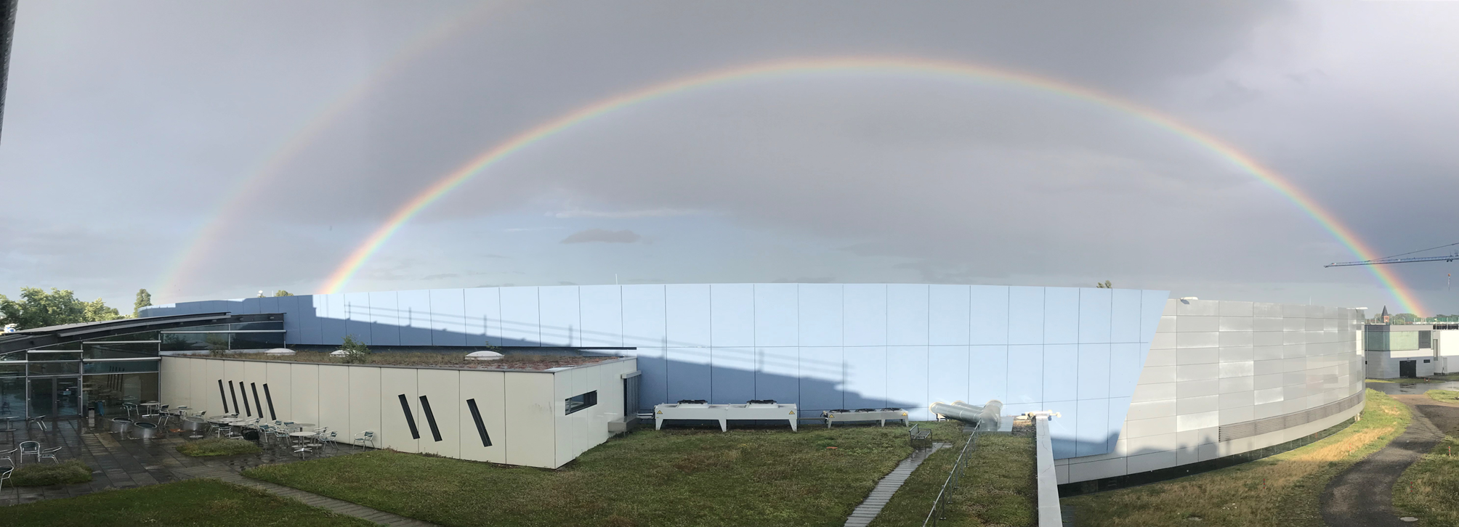
Questions? Comments?
photo A. Vollmer

