Slide 1
Beta function measurement at the SLS 2.0 storage ring
Jesús Ávila Pulido and Jonas Kallestrup
European Synchrotron Light Source Workshop. 31 October 2025

Slide 2
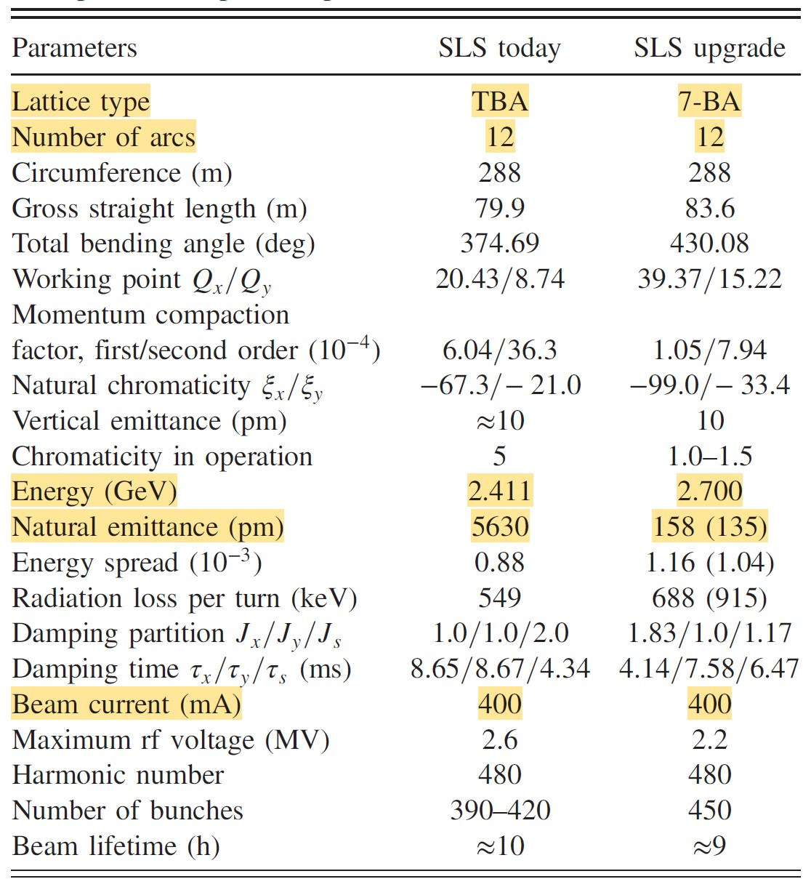
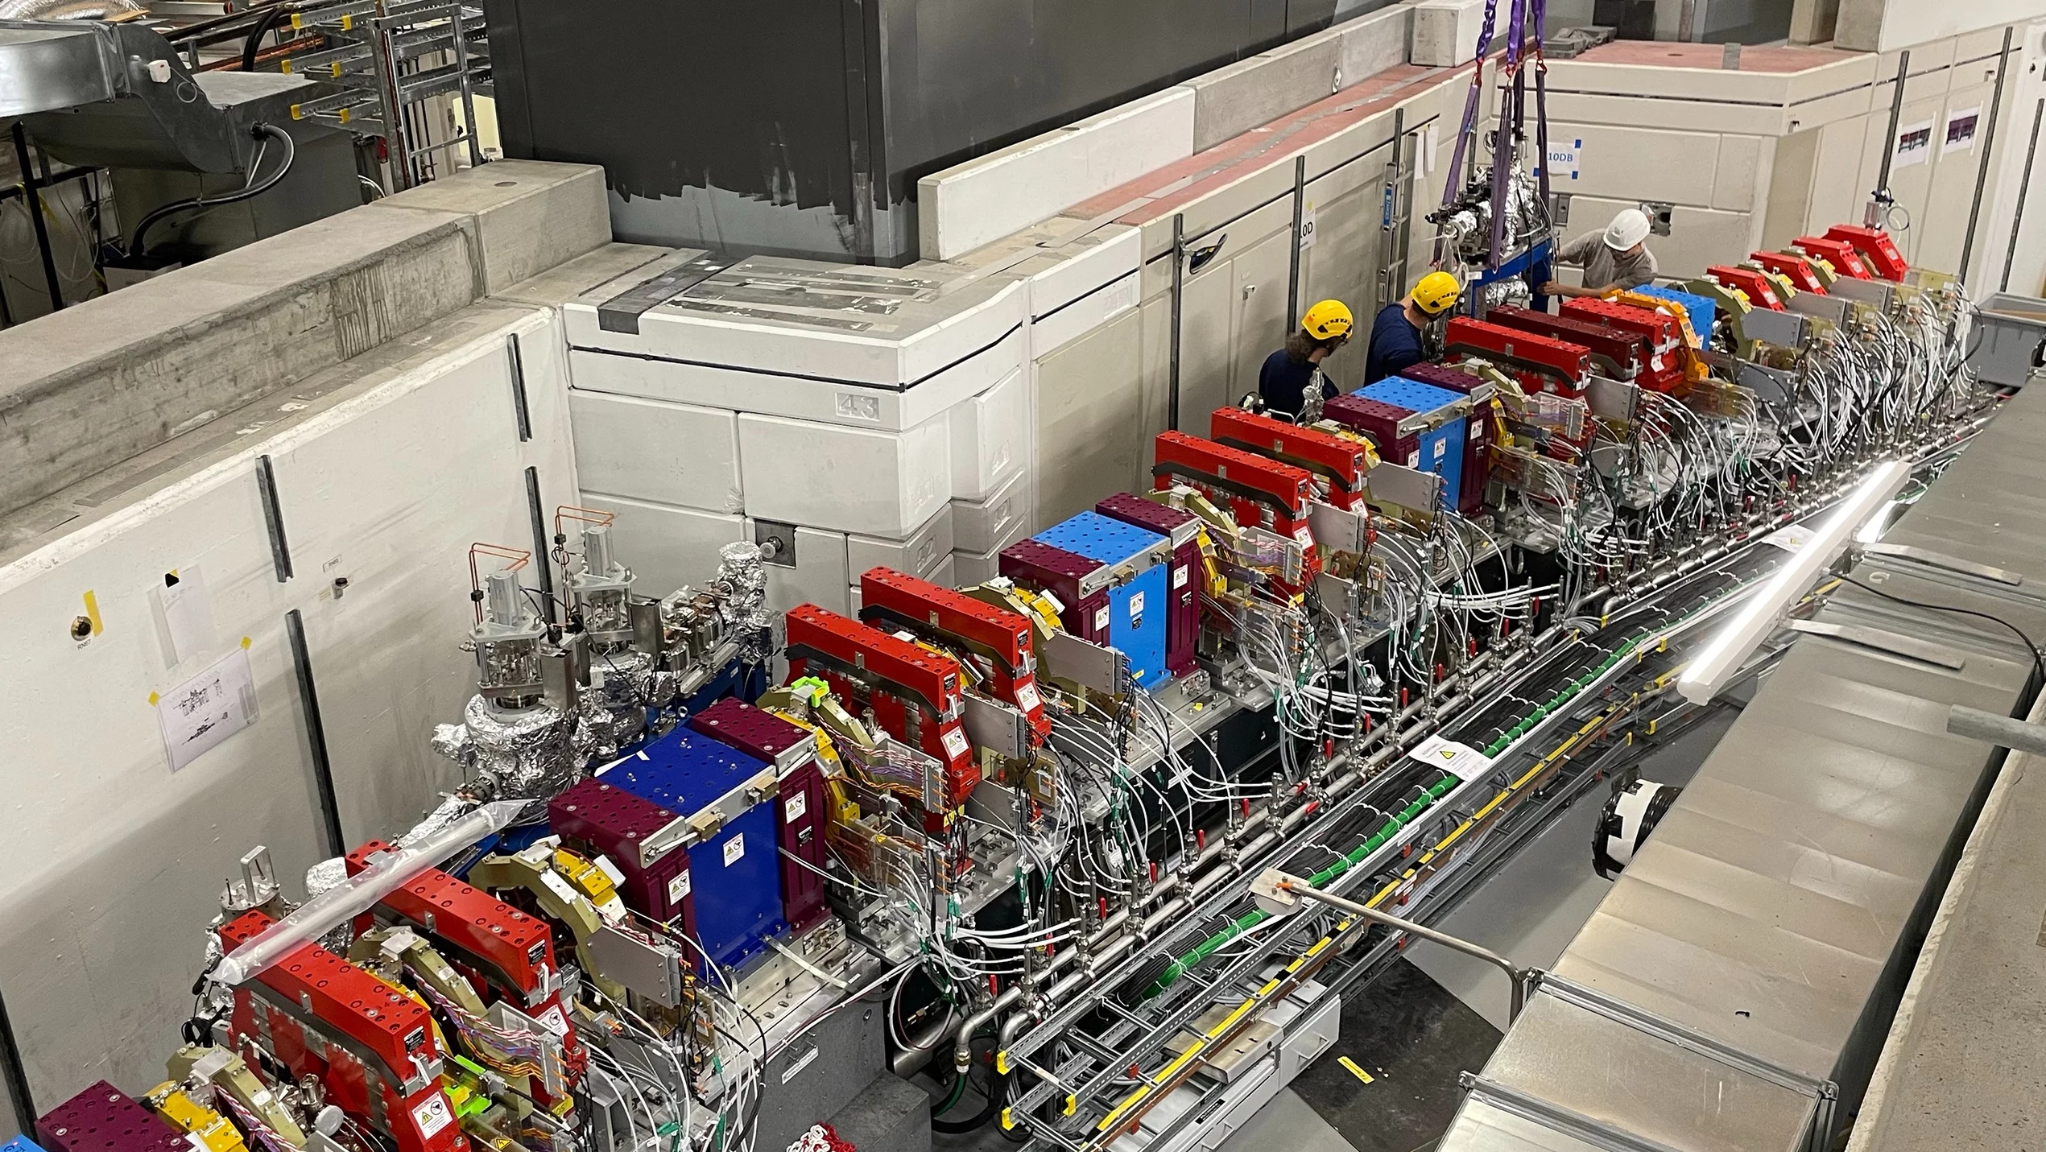
SLS 2.0
SLS
SLS 2.0
[1]
Notes:
1007 Magnets. 388 in SLS

Slide 3
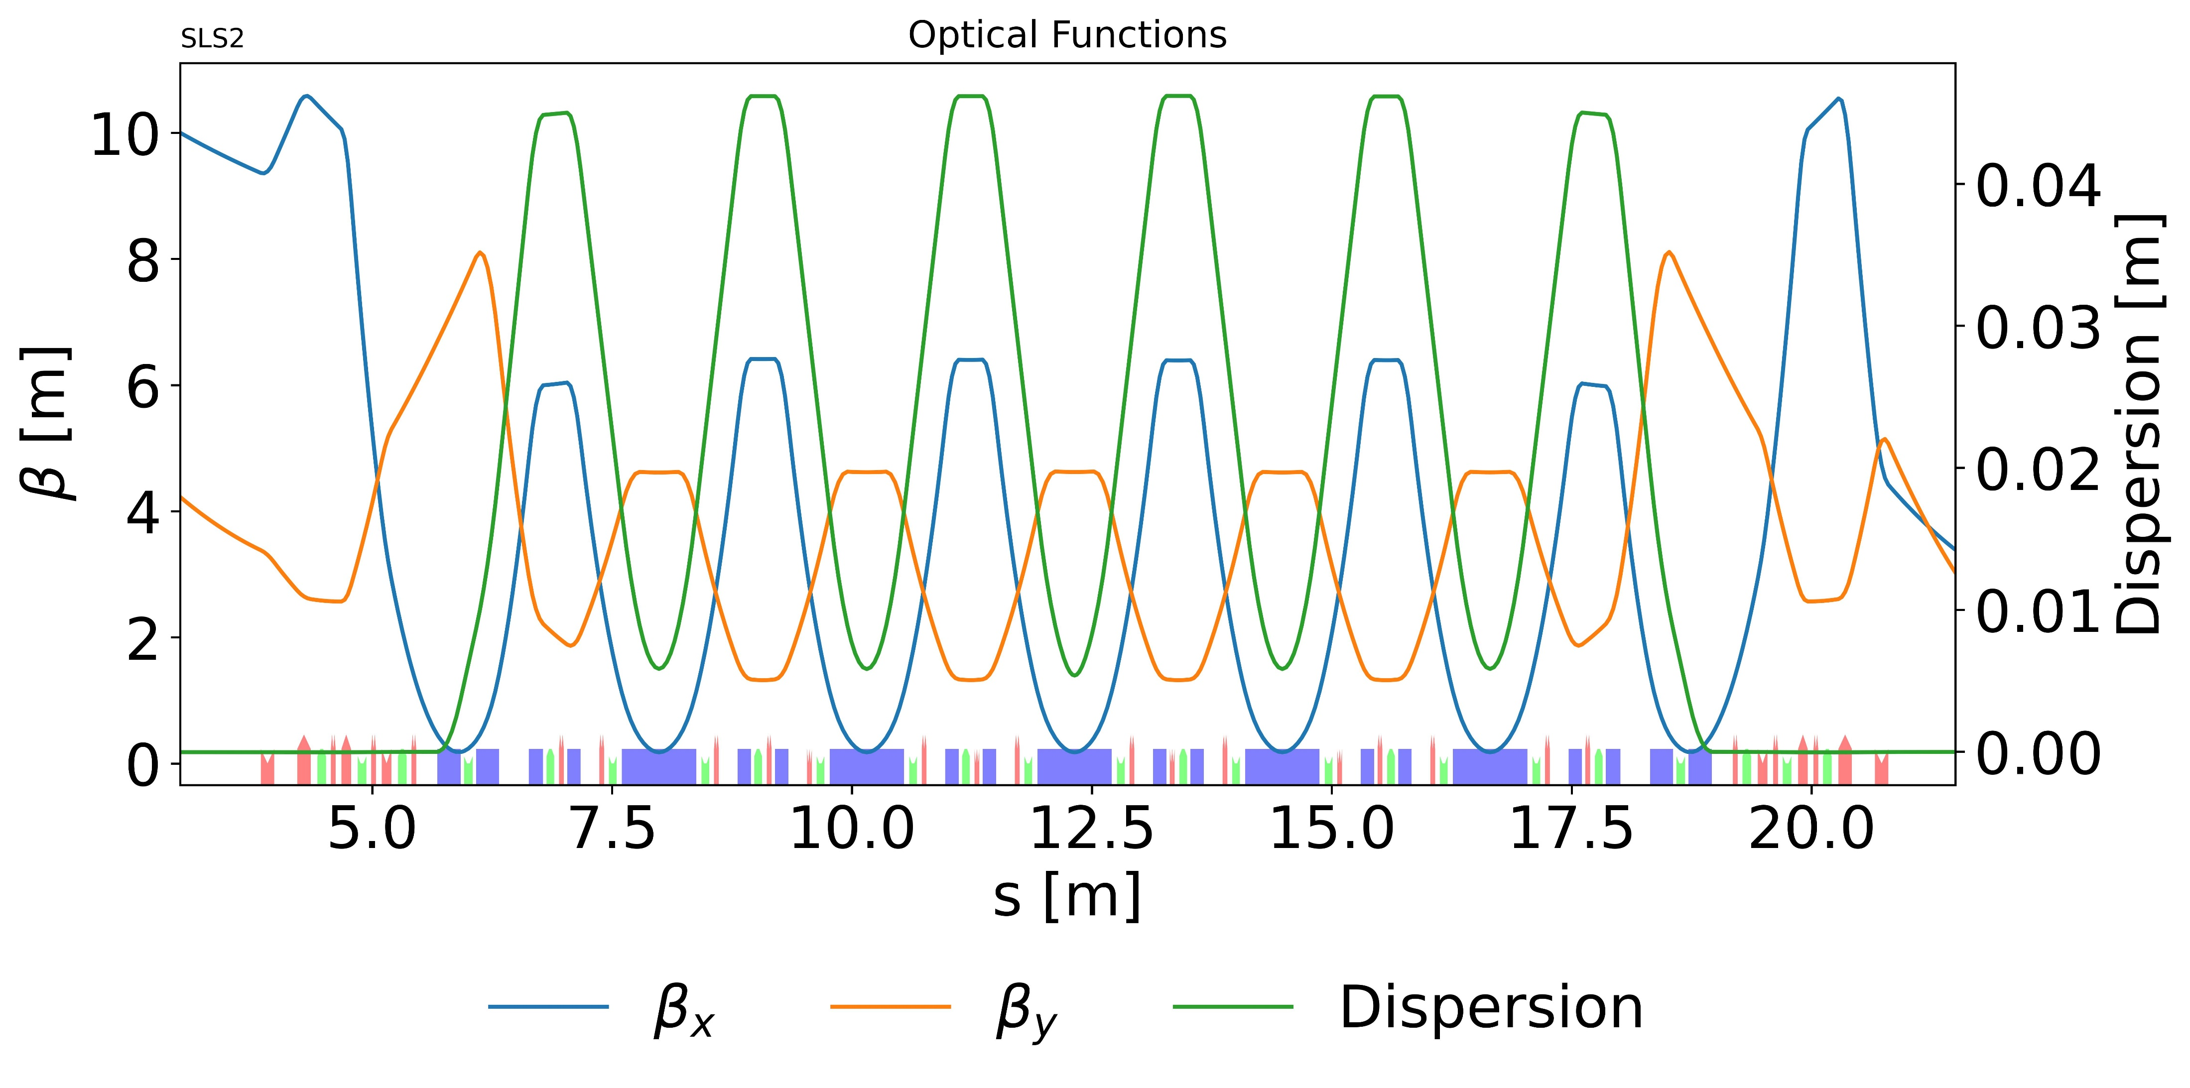
SLS 2.0
SLS
SLS 2.0
[1]
Notes:
1007 Magnets.

Slide 4

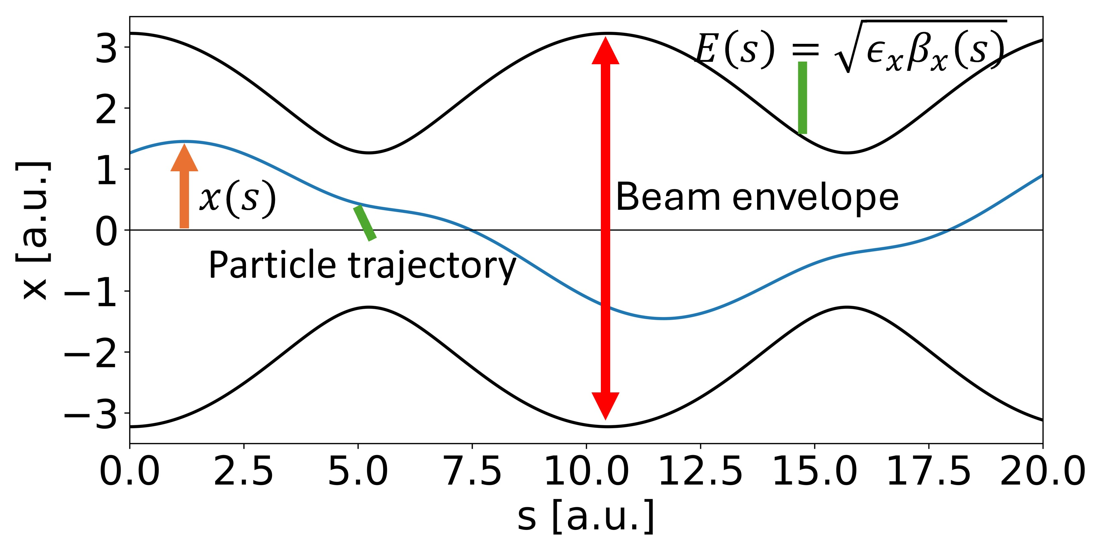
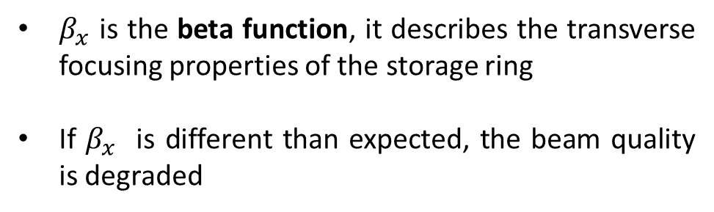
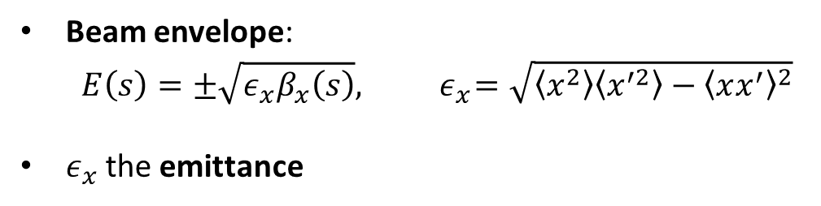

Beta function
Trajectory of a particle in the beam (betatron oscillations):
$$x\left(s\right)=\sqrt{2J_{x}β_{x}(s)}cos⁡[φ\left(s\right) +θ]$$
Beam envelope:
$$E\left(s\right)=±\sqrt{ε_{x}β_{x}\left(s\right)},{ ε}_{x}=\sqrt{\left\langle x^{2}\right\rangle \left\langle x^{′2}\right\rangle −{\left\langle xx^{′}\right\rangle }^{2}}$$
$ε_{x}$ the emittance
$β_{x}$ is the beta function, it describes the transverse focusing properties of the storage ring
If $β_{x}$ is different than expected, the beam quality is degraded
PSI Center for Accelerator Science and Engineering and École Polytechnique Fédérale de Lausanne

Slide 5
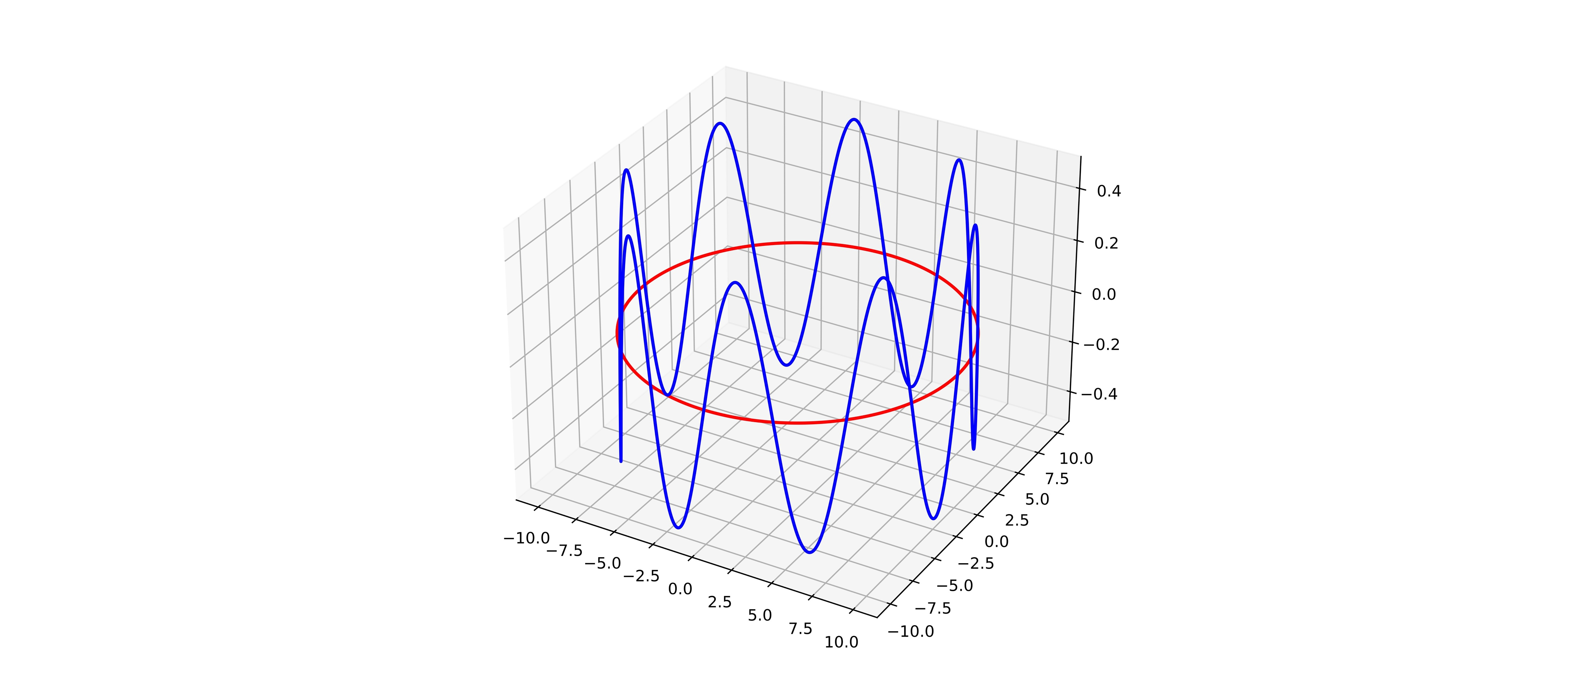
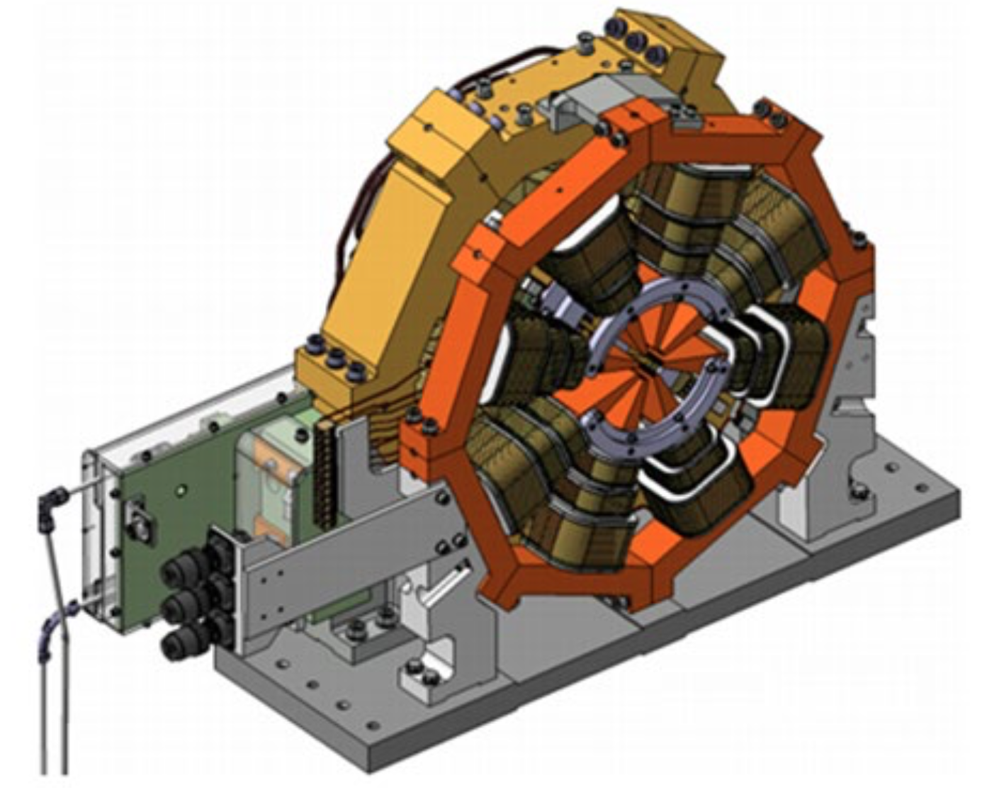
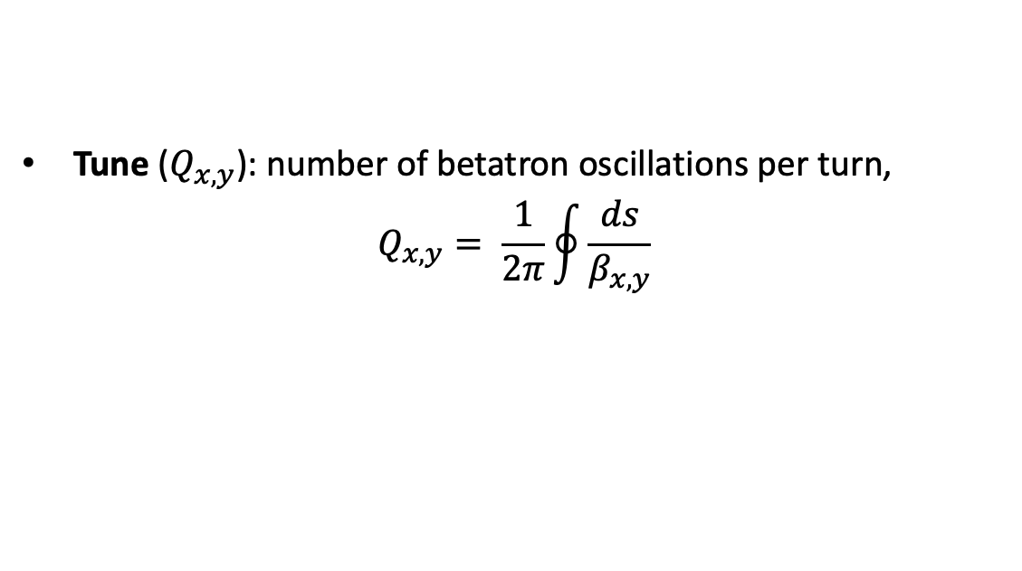
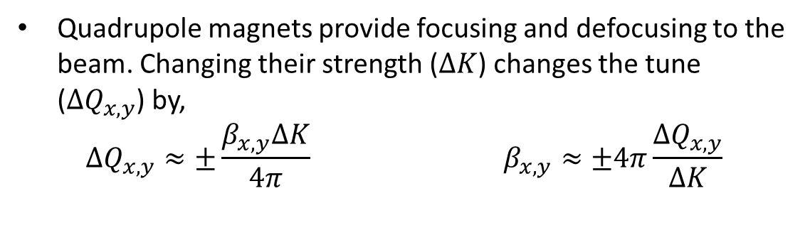
Quadrupole magnets, tune, and beta functions
Tune ($Q_{x,y}$): number of betatron oscillations per turn,
$$Q_{x, y}= \frac{1}{2π}\oint{\frac{ds}{β_{x, y}}}$$
Quadrupole magnets provide focusing and defocusing to the beam. Changing their strength ($∆K$) changes the tune ($∆Q_{x, y}$) by,
$$∆Q_{x, y}≈±\frac{β_{x, y}∆K}{4π} β_{x, y}≈±4π\frac{∆Q_{x, y}}{∆K}$$

Slide 6
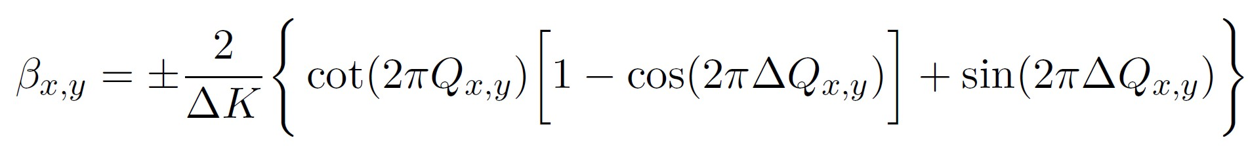
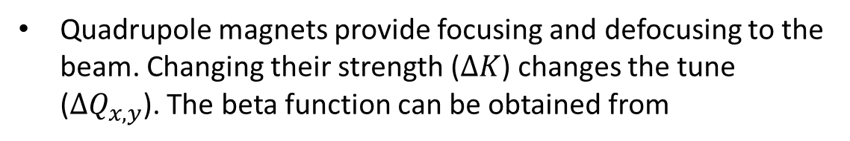
Quadrupole magnets, tune, and beta functions
Tune ($Q_{x,y}$): number of betatron oscillations per turn,
$$Q_{x, y}= \frac{1}{2π}\oint{\frac{ds}{β_{x, y}}}$$
Quadrupole magnets provide focusing and defocusing to the beam. Changing their strength ($∆K$) changes the tune ($∆Q_{x, y}$). The beta function can be obtained from
[2]
This method is known as quadrupole variation (QV). It is a “direct” measurement
SLS 2.0 has 264 quadrupoles and 115 beam position monitors (BPMs)

Slide 7
Measuring tune
Excite the beam
Record the centroid coordinates as a function of the number of turns
Notes:
"C:\Users\avilap_j\Documents\Figs_exam\fft_real_data_plot.py“.

Slide 8
Measuring tune
Excite the beam
Record the centroid coordinates as a function of the number of turns
3. Perform a Fourier Transform*
* Tune was determined using the NAFF (Numerical Analysis of Fundamental Frequencies) method.

Slide 9
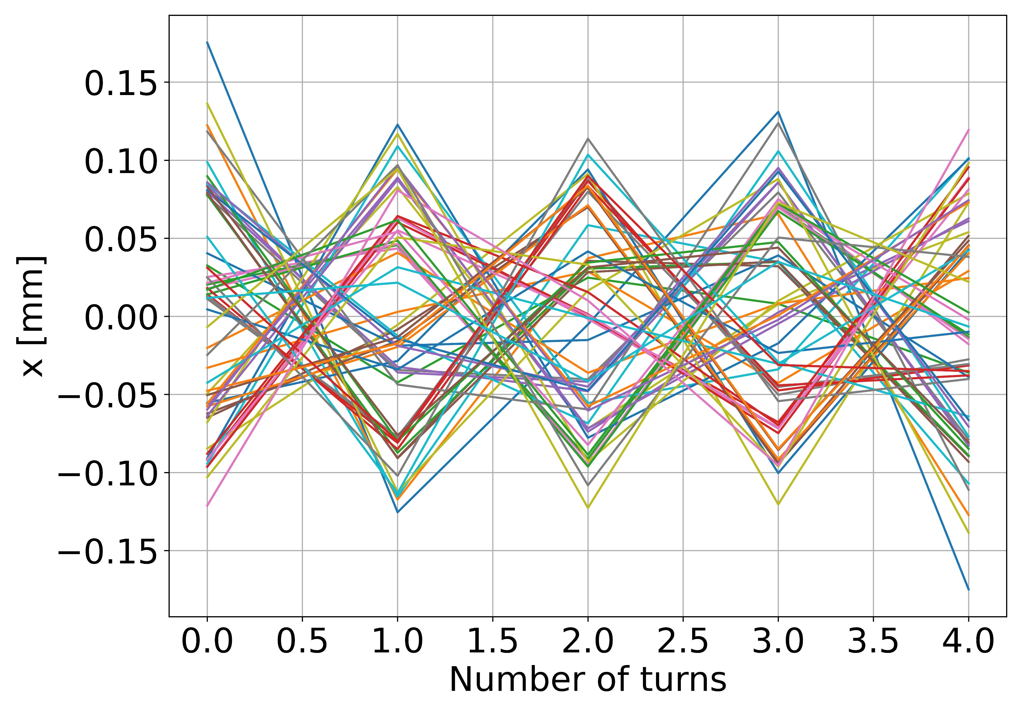
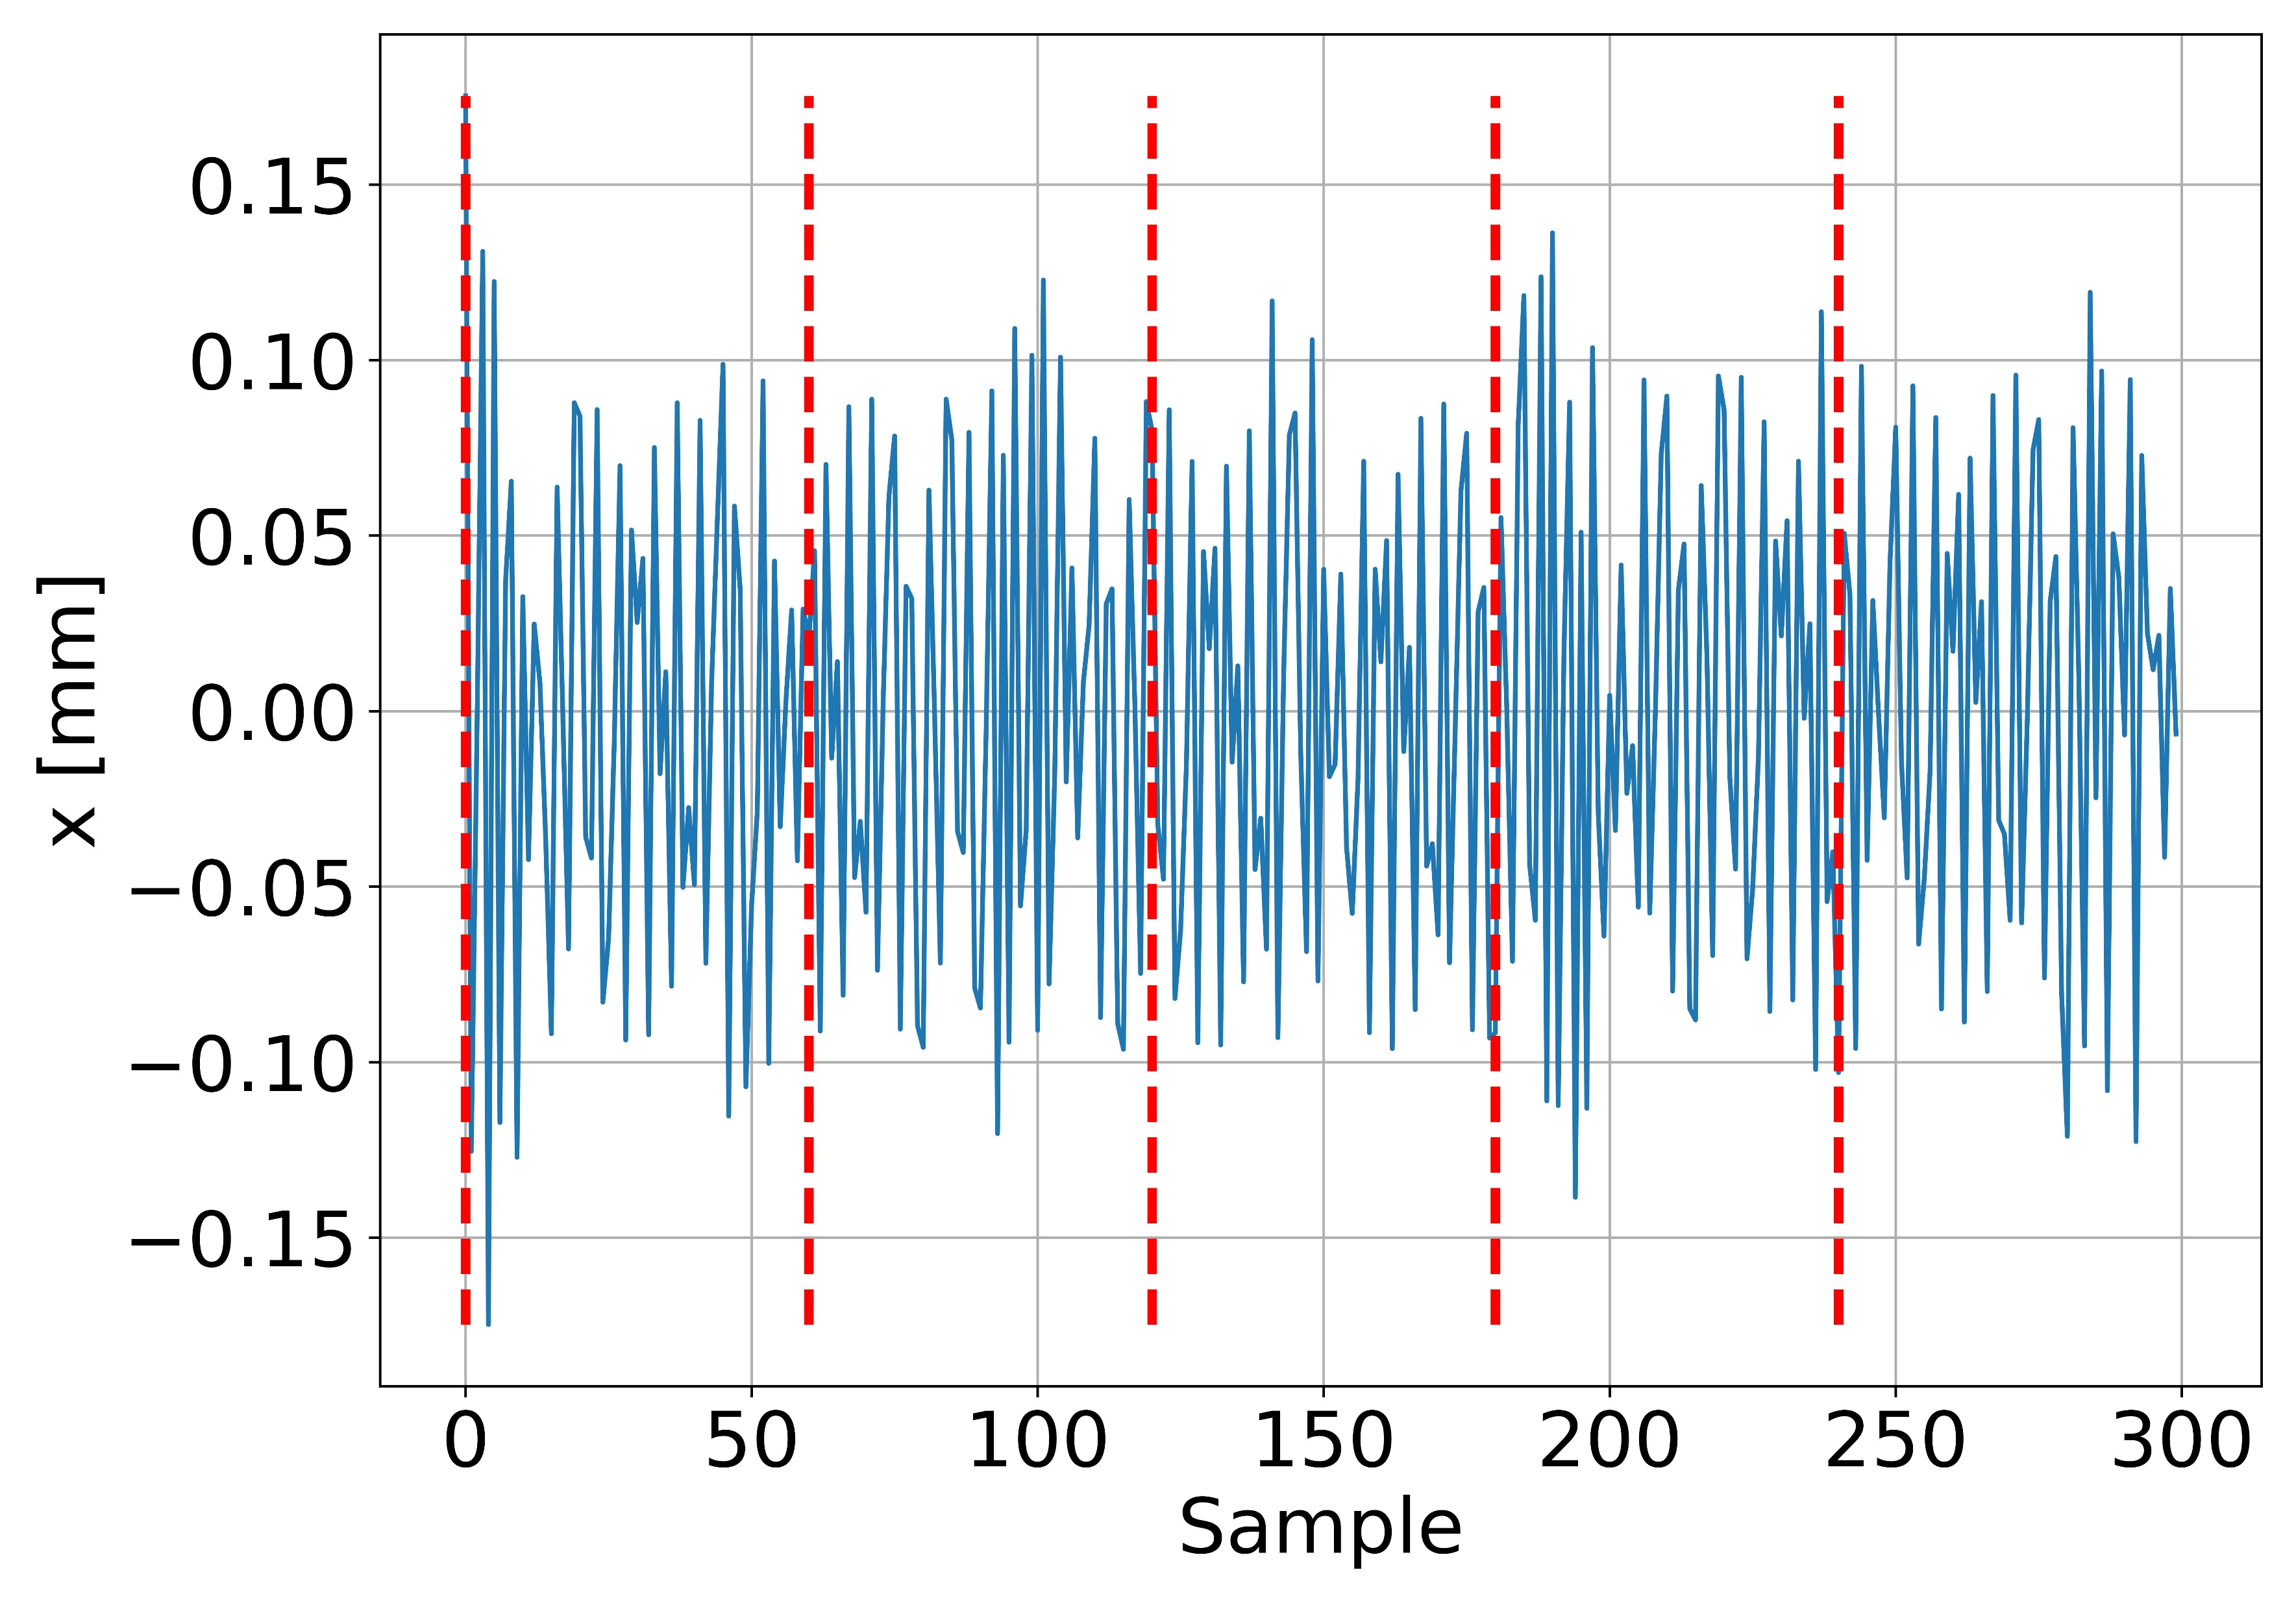
Mixed BPM Method
[3]
Use data of M BPMs for N turns with NAFF method
For 60 BPMs and 5 turns.
PSI Center for Accelerator Science and Engineering and École Polytechnique Fédérale de Lausanne

Slide 10
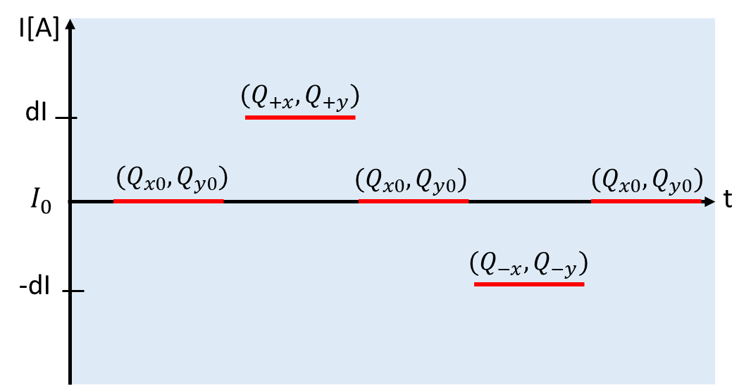
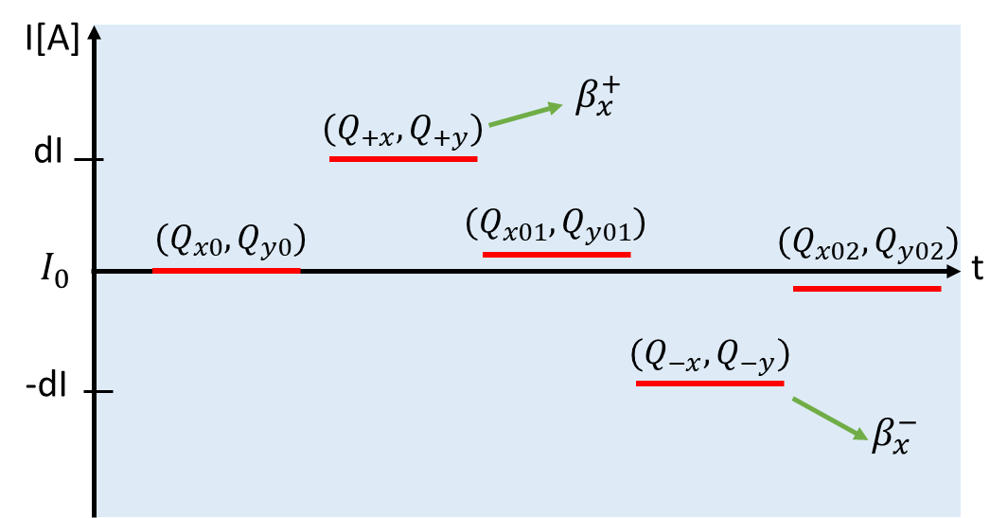
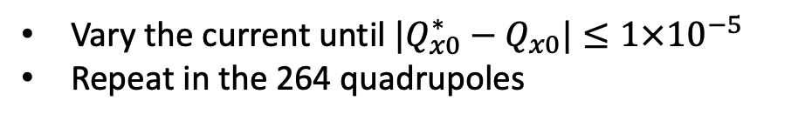
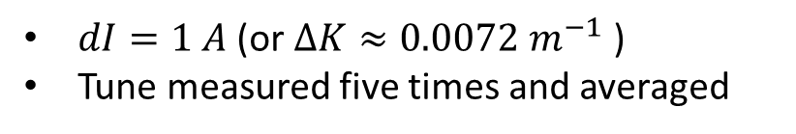


Experimental procedure
$$β_{x}^{+}$$
$$β_{x}^{−}$$
Varying the current of one quadrupole
Not back to the original tune due to hysteresis
$dI=1 A$ (or $∆K≈0.0072 m^{−1}$ )
Tune measured five times and averaged
Vary the current until ${|Q}_{x0}^{∗}−Q_{x0}|≤1×{10}^{−5}$
Repeat in the 264 quadrupoles
PSI Center for Accelerator Science and Engineering and École Polytechnique Fédérale de Lausanne
Notes:
Taking the average helps to compensate for the fact that changing the quadrupoles strength perturbs the optics of the machine.
The tune shifts produced by quadrupole variation should be above the statistical errors, the minimum quadrupole excitation (ΔK) to obtain a tune shift about the statistical error, consider the smallest theoretical β that we want to measure, ΔKx, min is 0.014 A.

Slide 11
Beta function measurement
PSI Center for Accelerator Science and Engineering and École Polytechnique Fédérale de Lausanne

Slide 12
Beta function measurement
PSI Center for Accelerator Science and Engineering and École Polytechnique Fédérale de Lausanne

Slide 13
Tune noise
PSI Center for Accelerator Science and Engineering and École Polytechnique Fédérale de Lausanne
Notes:
The decrease of the tune in both directions indicates that the beam energy is shifting slightly as the machine is warming up. This corresponds to an energy shift of around -0.5 MeV.

Slide 14
Tune noise
PSI Center for Accelerator Science and Engineering and École Polytechnique Fédérale de Lausanne

Slide 15
Beta-beat
Targeted rms beta-beat: <2%
PSI Center for Accelerator Science and Engineering and École Polytechnique Fédérale de Lausanne
Notes:
Results from Run6.
Why below 2%?

Slide 16
Beta-beat
Systematic errors:
Magnet transfer function.
Closed orbit distortions.
PSI Center for Accelerator Science and Engineering and École Polytechnique Fédérale de Lausanne
Notes:
Results from Run6.

Slide 17
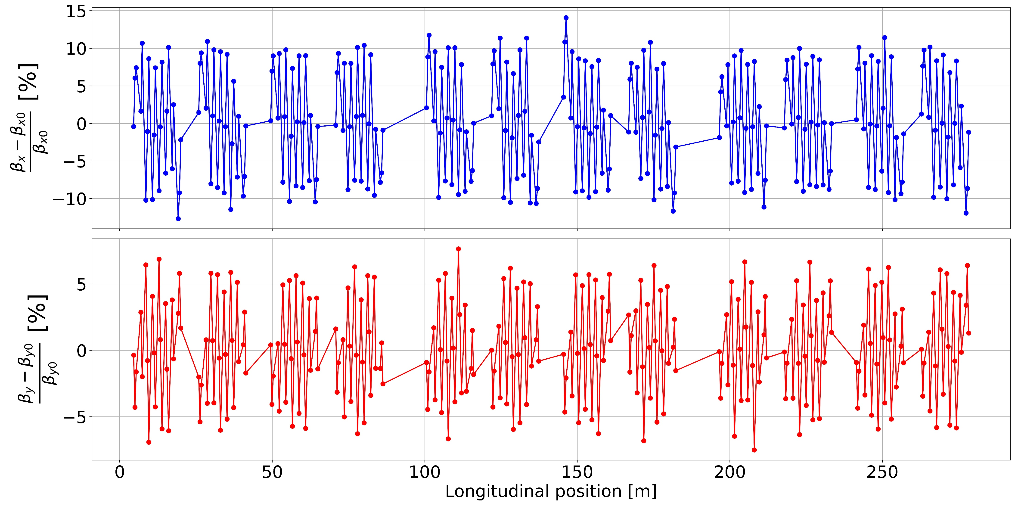
Simulation of beta-beat
PSI Center for Accelerator Science and Engineering and École Polytechnique Fédérale de Lausanne

Slide 18
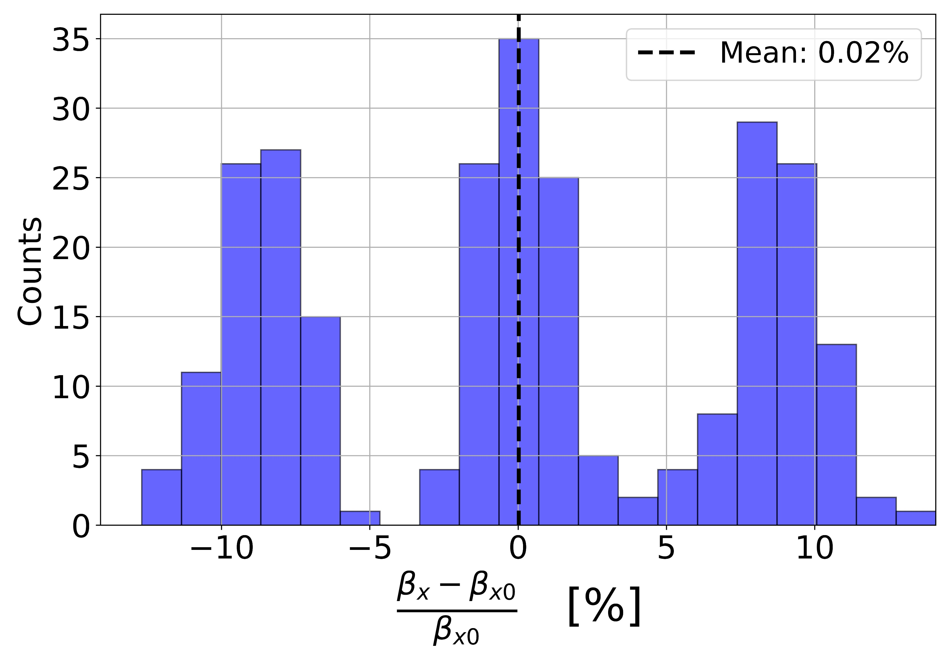
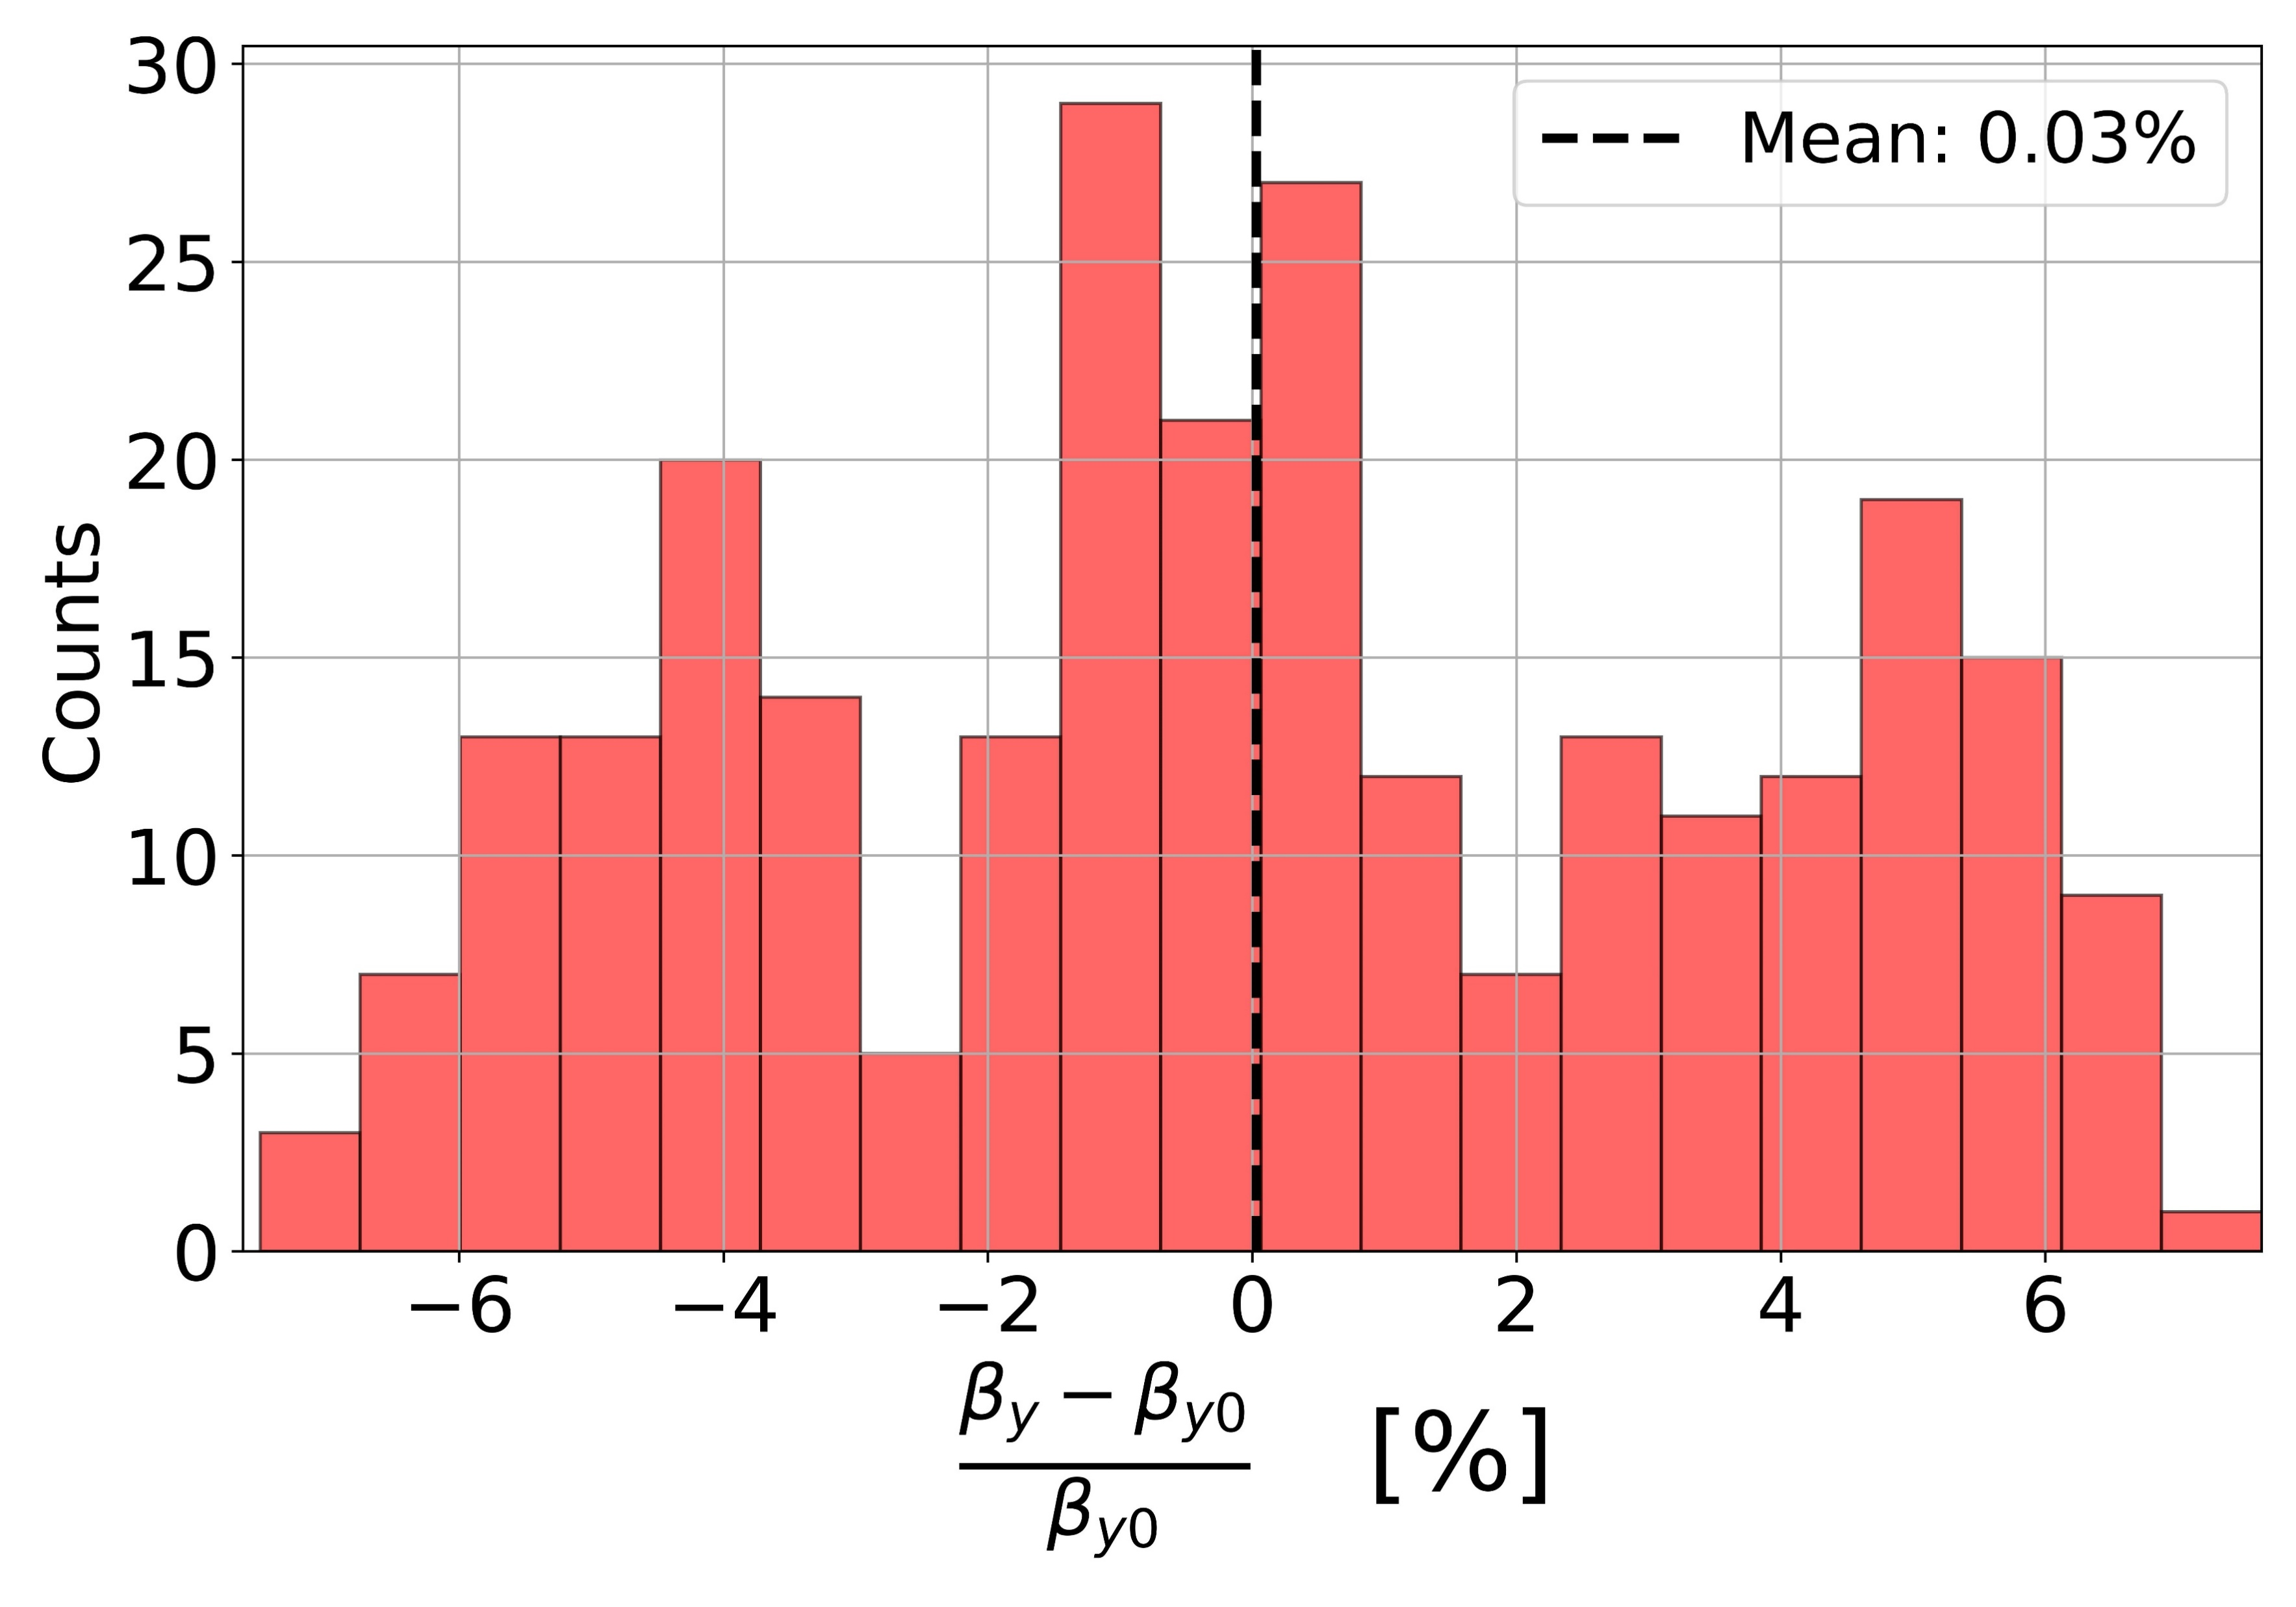
Simulation of beta-beat

Slide 19
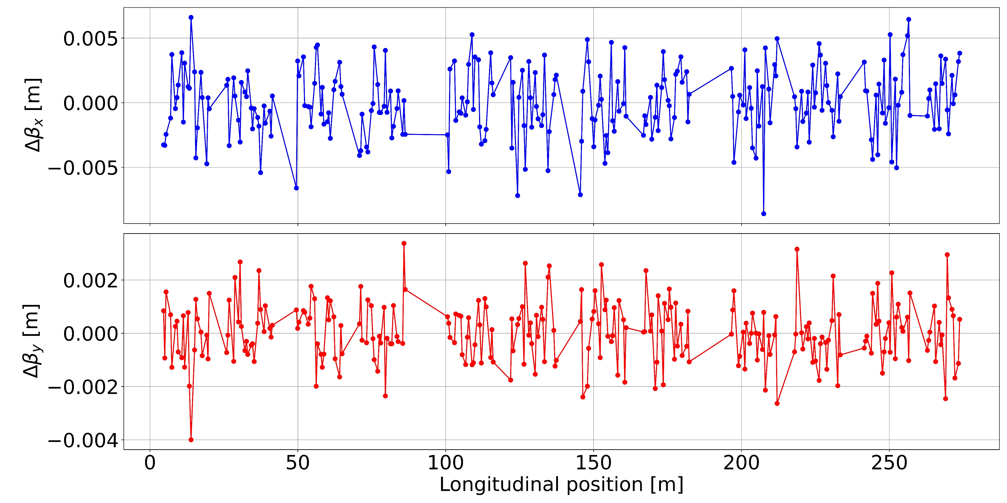
Changes in beta function due to closed orbit distortions
PSI Center for Accelerator Science and Engineering and École Polytechnique Fédérale de Lausanne
Notes:
FOFB running

Slide 20
Reproducibility
PSI Center for Accelerator Science and Engineering and École Polytechnique Fédérale de Lausanne

Slide 21
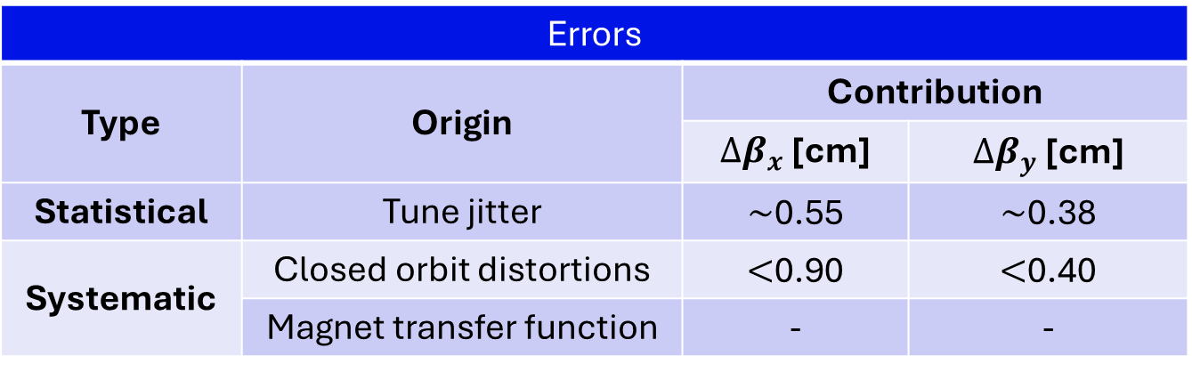
Summary and outlook
Errors
Type | Origin | Contribution
 |  | ${∆β}_{x}$ [cm] | ${∆β}_{y}$ [cm]
Statistical | Tune jitter | $\sim$0.55 | $\sim$0.38
Systematic | Closed orbit distortions | $<$0.90 | $<$0.40
 | Magnet transfer function | - | -
PSI Center for Accelerator Science and Engineering and École Polytechnique Fédérale de Lausanne

Slide 22
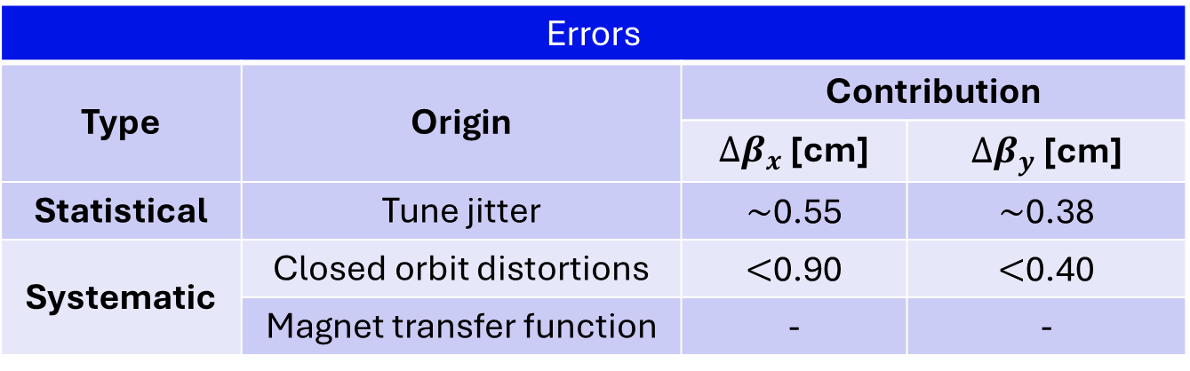
Summary and outlook
Errors
Type | Origin | Contribution
 |  | ${∆β}_{x}$ [cm] | ${∆β}_{y}$ [cm]
Statistical | Tune jitter | $\sim$0.55 | $\sim$0.38
Systematic | Closed orbit distortions | $<$0.90 | $<$0.40
 | Magnet transfer function | - | -
Optics correction
We cannot correct the vertical and horizontal plane independently
Errors contributing to the beta-beat are not necessarily in the quadrupoles
We want to correct the beta-beat without perturbing the dispersion
112 additional quadrupoles to help with the correction
PSI Center for Accelerator Science and Engineering and École Polytechnique Fédérale de Lausanne

Slide 23
Outlook: Sinusoidal QV
QV is lengthy, $\sim$2 hours for the whole ring. Working on a faster version of QV: Sinusoidal QV
Quadrupole strength: $K=A\sin{(2πνt + φ)}$
PSI Center for Accelerator Science and Engineering and École Polytechnique Fédérale de Lausanne

Slide 24
10 consecutive quadrupoles, $A=0.01$, $ν$ from 1 to 10 Hz, $φ=0, K=A\sin{(2πνt + φ)}$
PSI Center for Accelerator Science and Engineering and École Polytechnique Fédérale de Lausanne

Slide 25
References
[1] A. Streun et al. “Swiss Light Source upgrade lattice design.” In: Phys. Rev. Accel. Beams 26 (9 Sept. 2023), p. 091601. doi: 10.1103/PhysRevAccelBeams.26.091601.
[2] G. M. Michiko and F. Zimmermann. Measurement and Control of Charged Particle Beams. Heidelberg: Springer, 2003. DOI: 10.1007/978-3-662-08581-3.
[3] P. Zisopoulos, Y. Papaphilippou, and J. Laskar. “Refined betatron tune measurements by mixing beam position data”. In: Phys. Rev. Accel. Beams 22 (7 July 2019), p. 071002. doi:10.1103 /PhysRevAccelBeams.22.071002.
[4] A. Wolski. Beam Dynamics in High Energy Particle Accelerators. London: Imperial College Press, 2014.
PSI Center for Accelerator Science and Engineering and École Polytechnique Fédérale de Lausanne

Slide 26
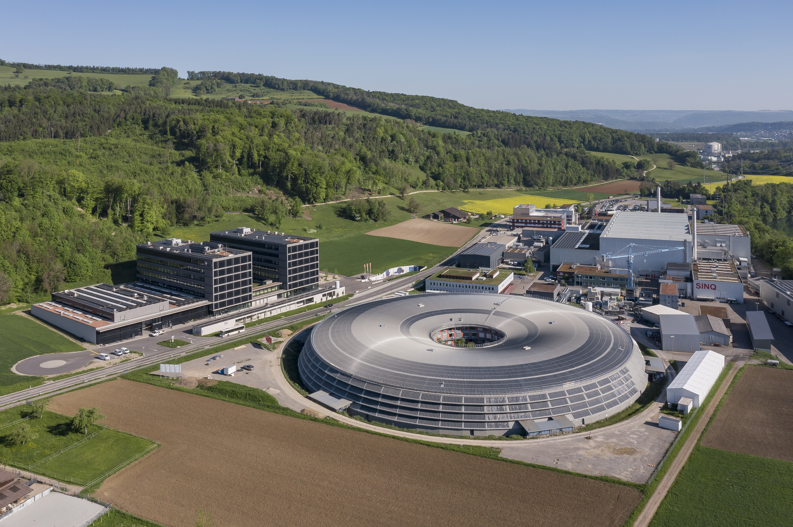
PSI Center for Accelerator Science and Engineering and École Polytechnique Fédérale de Lausanne

Slide 27
Extra slides
PSI Center for Accelerator Science and Engineering and École Polytechnique Fédérale de Lausanne

Slide 28
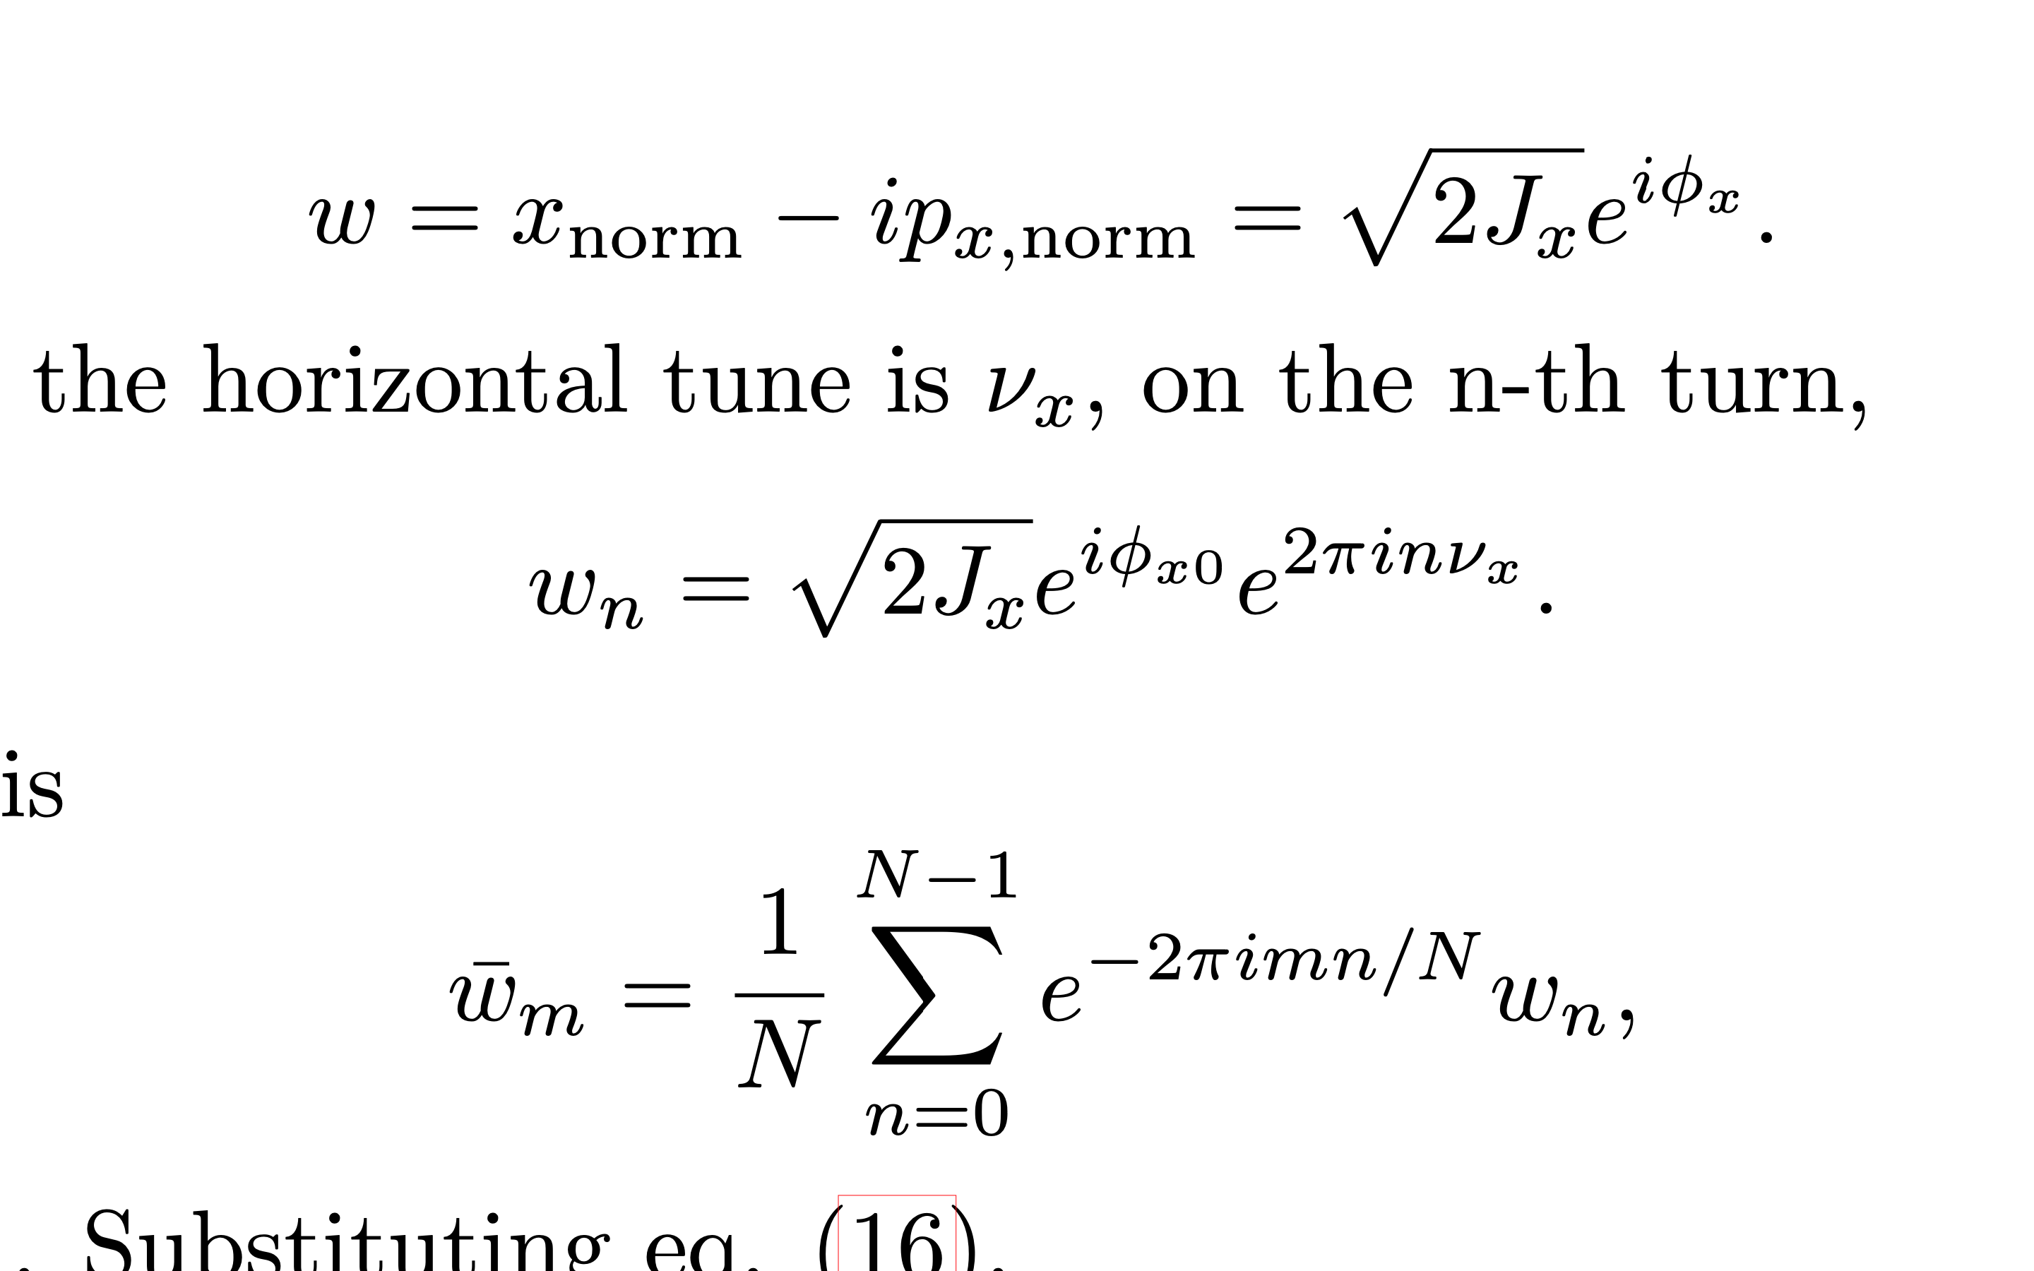
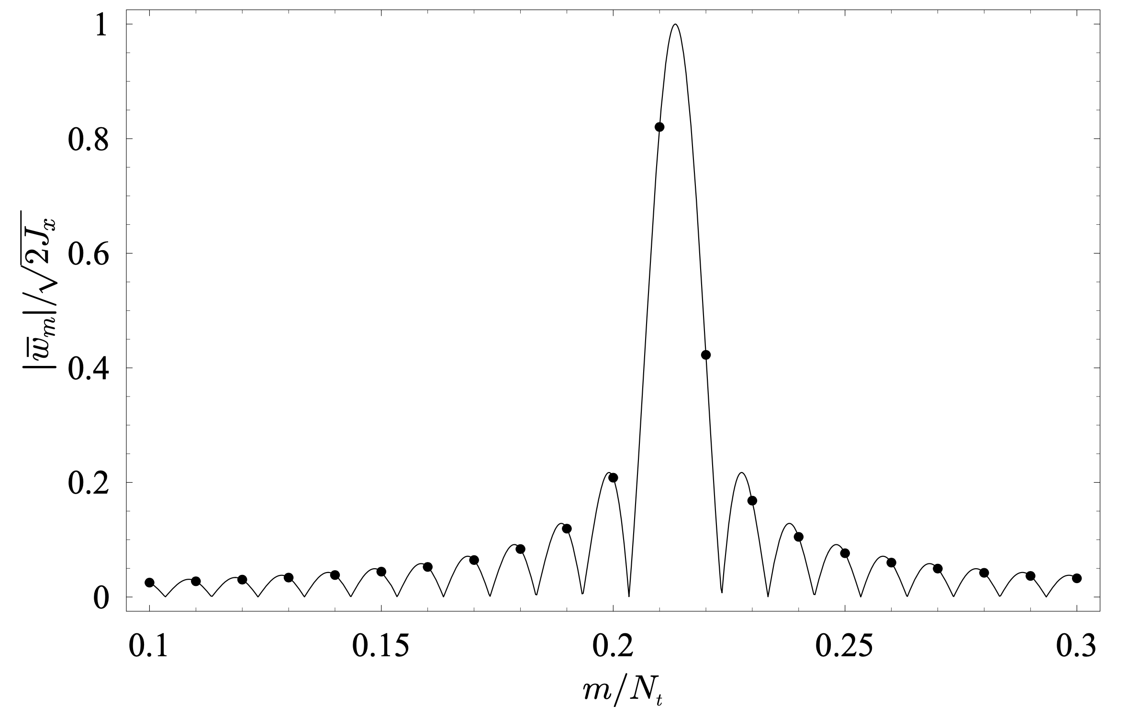
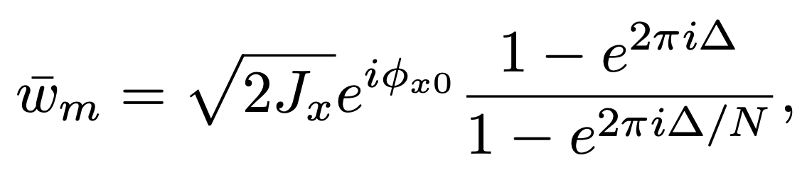




NAFF
Consider the signal
[4]
On the n-th turn,
$$ω_{n}=\sqrt{2J_{x}}e^{iφ_{x0}}e^{2πinQ_{x}}$$
The Fourier transform is,
$$∆=N frac\left(Q_{x}\right)−m$$
Let $m$ be a real number,
$$frac\left(Q_{x}\right)=\frac{\hat{m}}{N}$$
Finding an $m$ that maximizes $|{\overline{ω}}_{m}|$ implies searching for a frequency that gives the maximum overlap between the measured signal and a signal at the given frequency.
PSI Center for Accelerator Science and Engineering and École Polytechnique Fédérale de Lausanne
Notes:
DFT: N turns, N Fourier modes, mode with the highest amplitude is the tune. Precision of 1 / N. In FFT, m is an integer. \bar{w} gas a maximum when \Delta = 0, it is reach only on the very particular case where Nfrac{\nu} is also an integer. In Naff, m can take any value.
A filter can be apply. 1 / N^

Slide 29


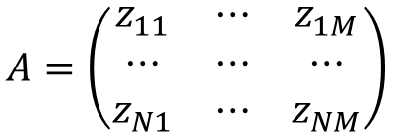
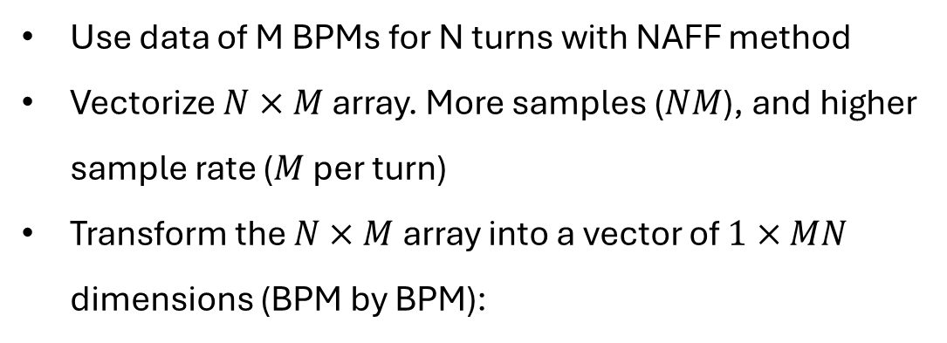
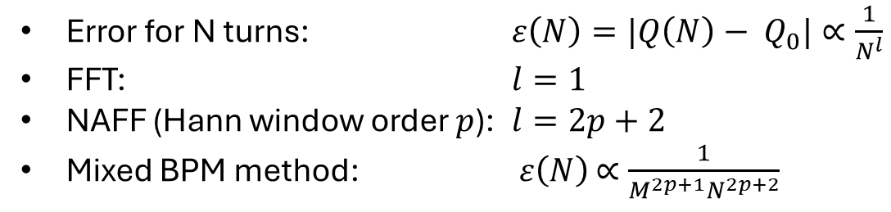
Mixed BPM Method
Use data of M BPMs for N turns with NAFF method
Vectorize $N×M$ array. More samples ($NM$), and higher sample rate ($M$ per turn)
Transform the $N×M$ array into a vector of $1×MN$ dimensions (BPM by BPM):
$$A=\left(\begin{matrix}z_{11} & ⋯ & z_{1M} \\ ⋯ & ⋯ & ⋯ \\ z_{N1} & ⋯ & z_{NM}\end{matrix}\right)$$
$$\tilde{A}=(z_{11}z_{12}⋯z_{NM−1}z_{NM})$$
Error for N turns: $ε\left(N\right)=|Q\left(N\right)− Q_{0}|∝\frac{1}{N^{l}}$
FFT: $l=1$
NAFF (Hann window order $p$): $l=2p+2$
Mixed BPM method: $ε\left(N\right)$ $∝\frac{1}{M^{2p+1}N^{2p+2}}$
[3]
PSI Center for Accelerator Science and Engineering and École Polytechnique Fédérale de Lausanne
Notes:
Error in sampling period since BPMs are not equidistant, error due to BPM-by-BPM modulation of the beta function. Errors are periodic.
Plots: The first 5 turns (top) in 42 BPMS, signal of each BPM with different color. 5 turns, 42 BPMs, 210 samples

Slide 30
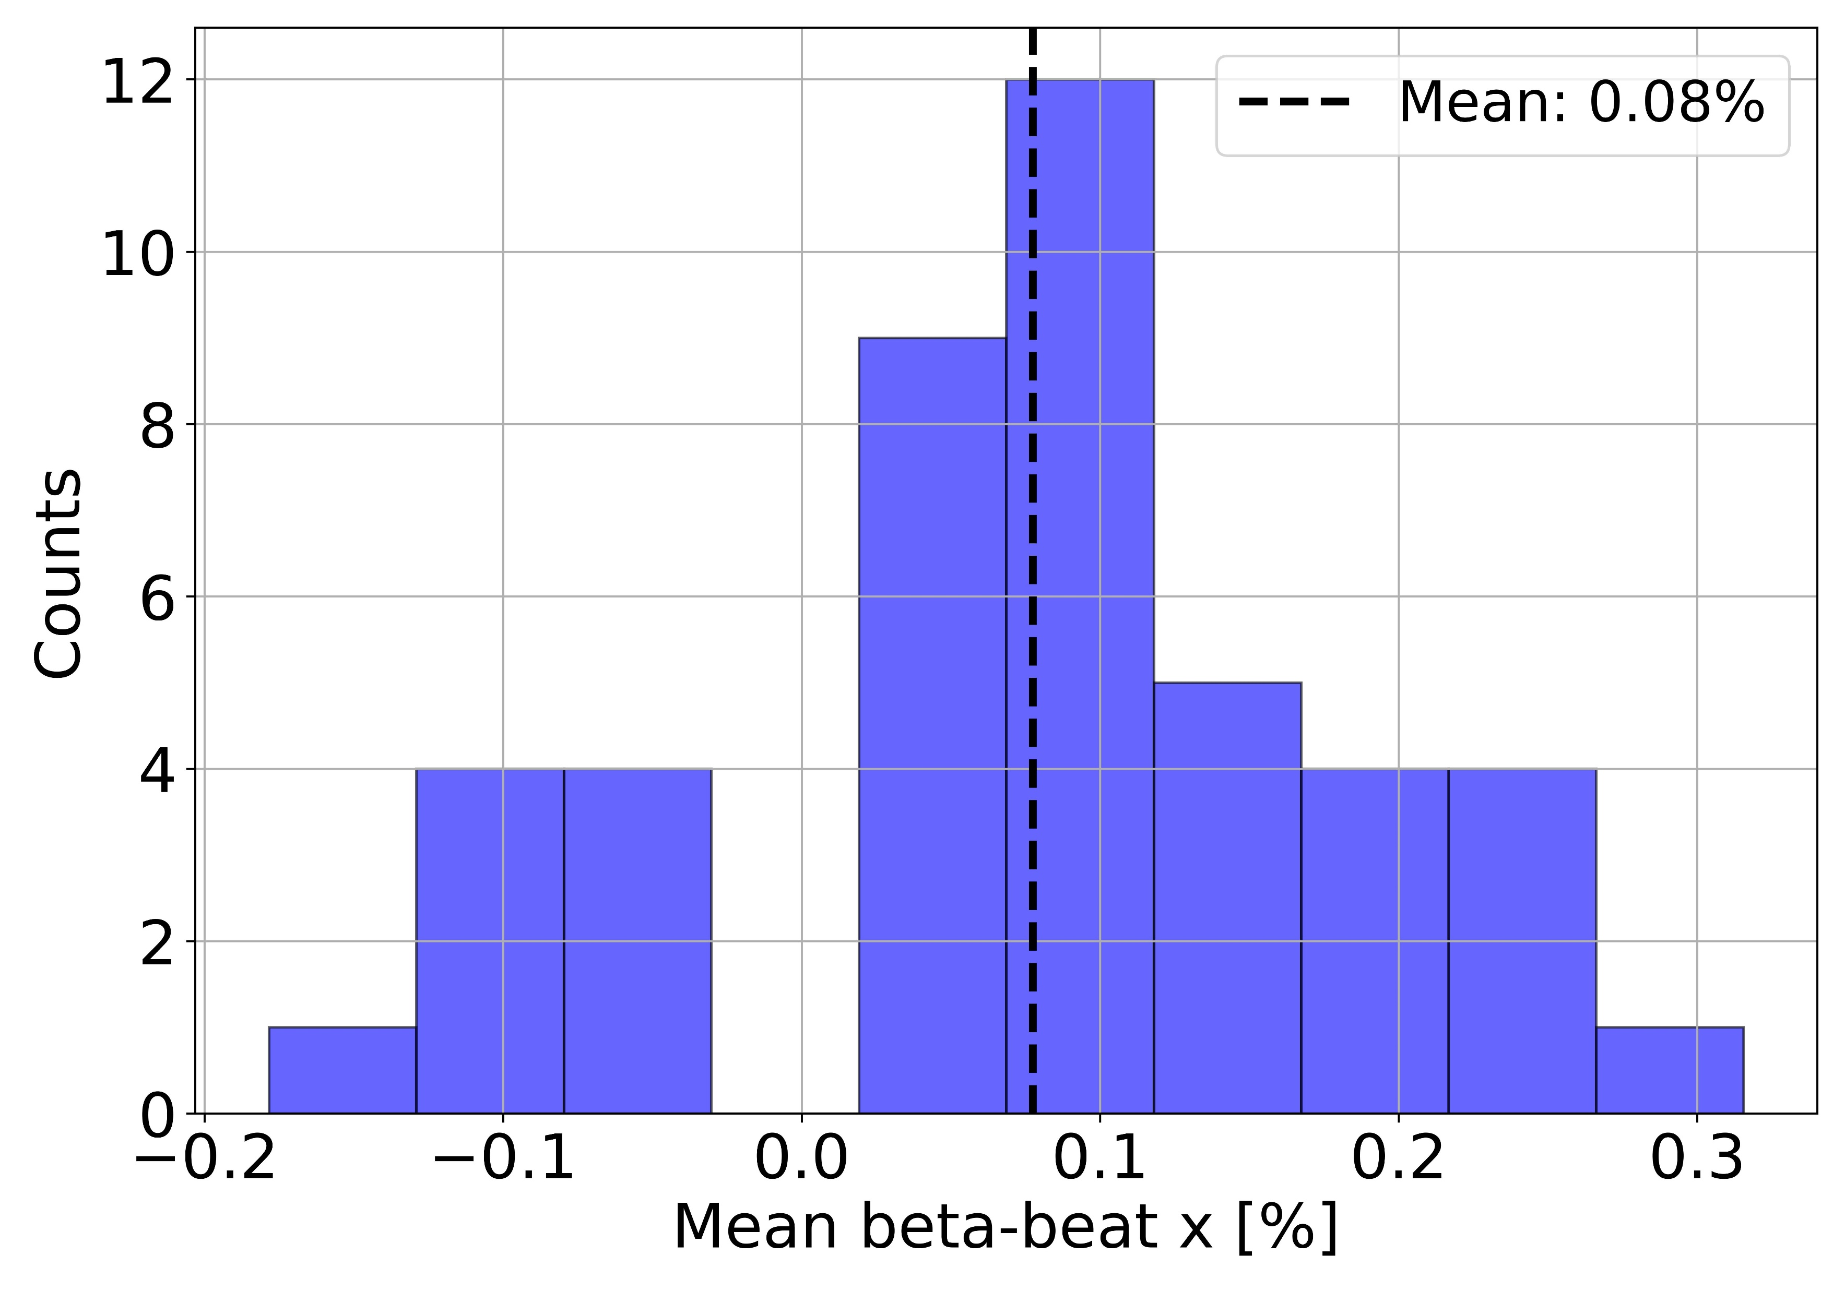
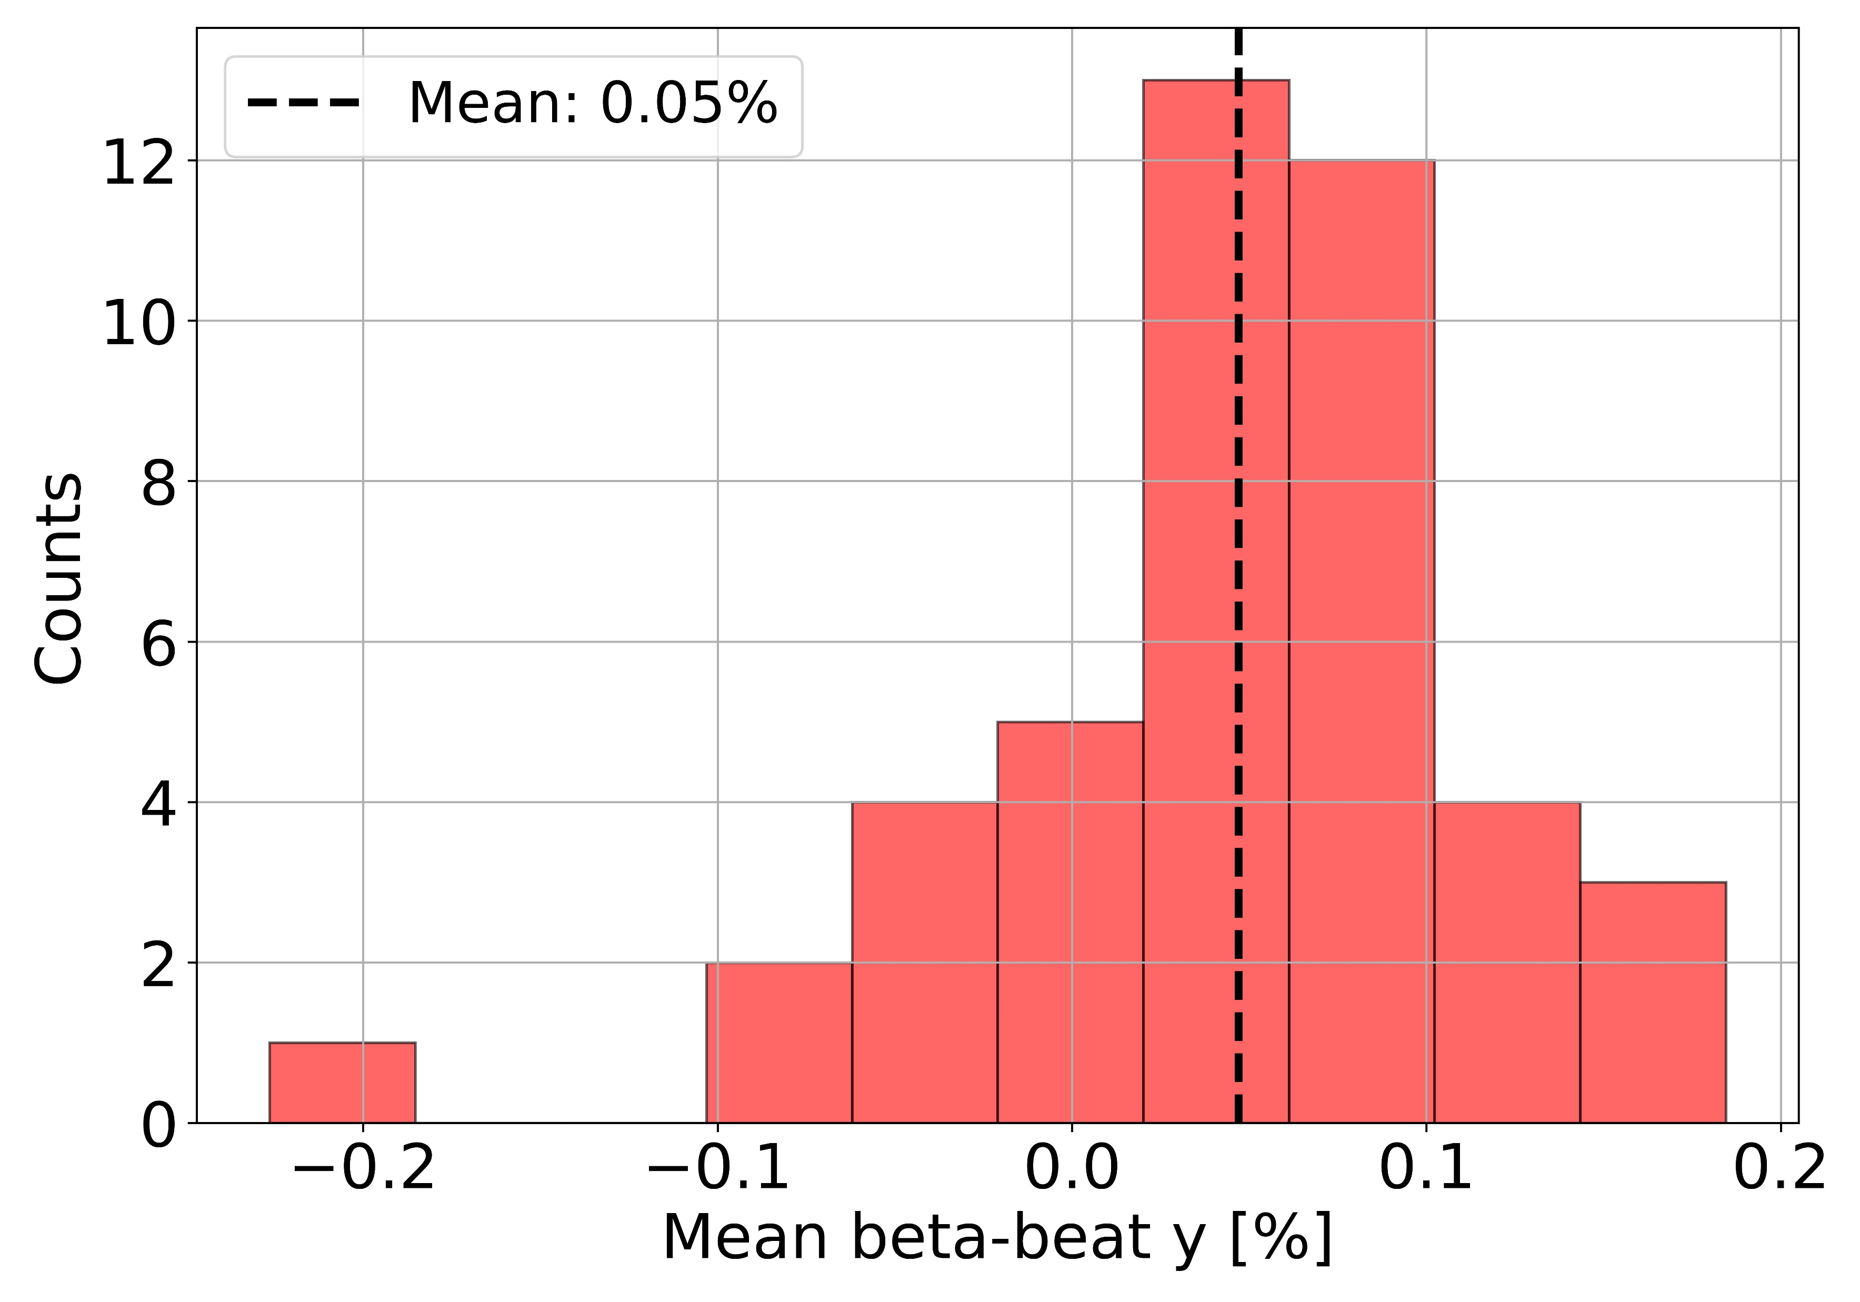
Simulation of beta-beat
Distribution of the mean beta-beat for 44 seeds.

Slide 31
Dispersion
PSI Center for Accelerator Science and Engineering and École Polytechnique Fédérale de Lausanne

Slide 32
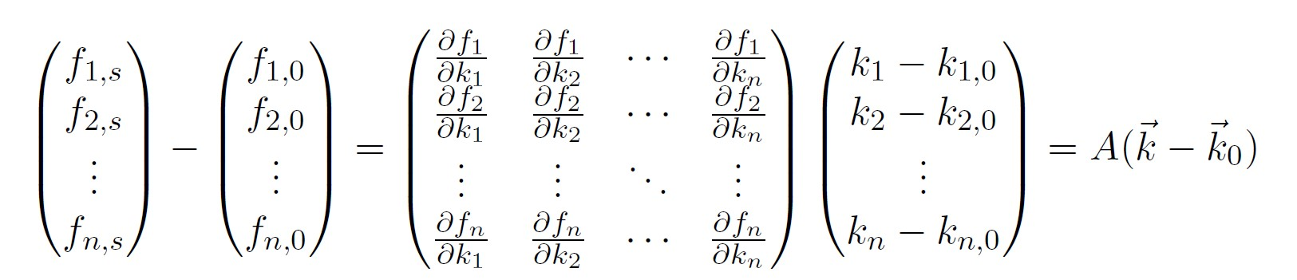
Optics correction
Consider the n optics function $f_{1},f_{2}, …,f_{i},…,f_{n}$ and n quadrupoles with strengths $k_{1},k_{2}, …,k_{i},…,k_{n}.$
$$f_{i}=f_{i}(k_{1},k_{2}, …,k_{i},…,k_{n})$$
We want to reach the ideal values $f_{1, s},f_{2, s}, …, f_{n, s}.$ We have the initial values $f_{1, 0},f_{2, 0}, …, f_{n, 0}$ and $k_{1, 0},k_{2, 0},…,k_{n, 0}$ . We can do a first order expansion,
A is the response matrix.
Unfortunately, we would like match $m$ optics function with only $n$ quadrupoles, $m>n.$
Singular value decomposition
PSI Center for Accelerator Science and Engineering and École Polytechnique Fédérale de Lausanne

Slide 33
Optics correction
Singular value decomposition
SVD cut
Tikhonov regularization
Consider only some singular values
‘Damping’ of singular values
PSI Center for Accelerator Science and Engineering and École Polytechnique Fédérale de Lausanne
Notes:
Filter singular values (s), s / (s^2 + alpha^2)

Slide 34
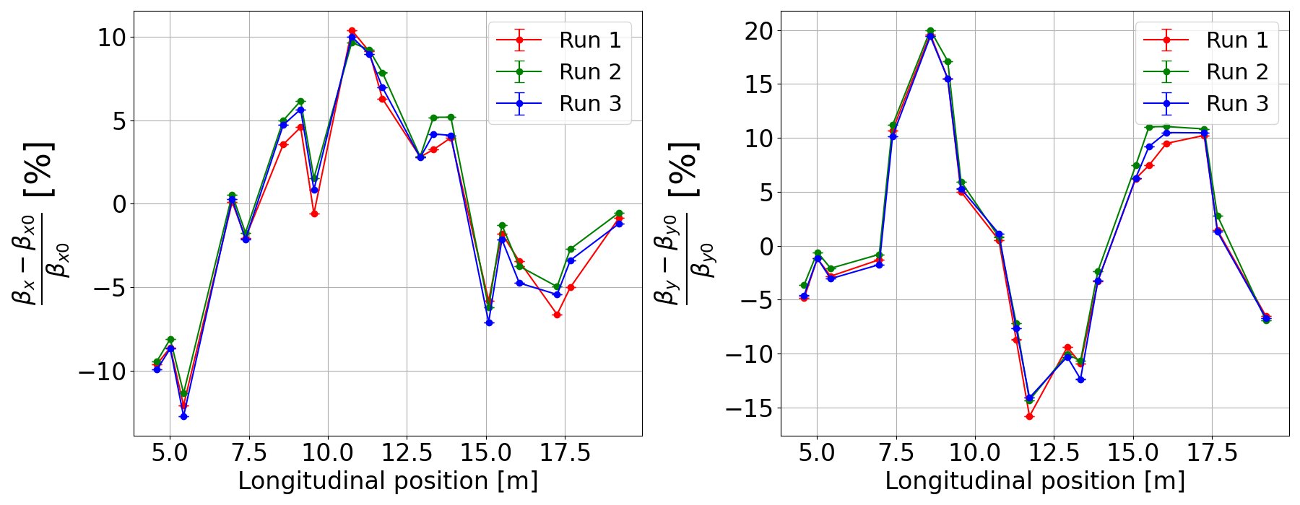
Reproducibility

Slide 35
PSI Center for Accelerator Science and Engineering and École Polytechnique Fédérale de Lausanne

Slide 36
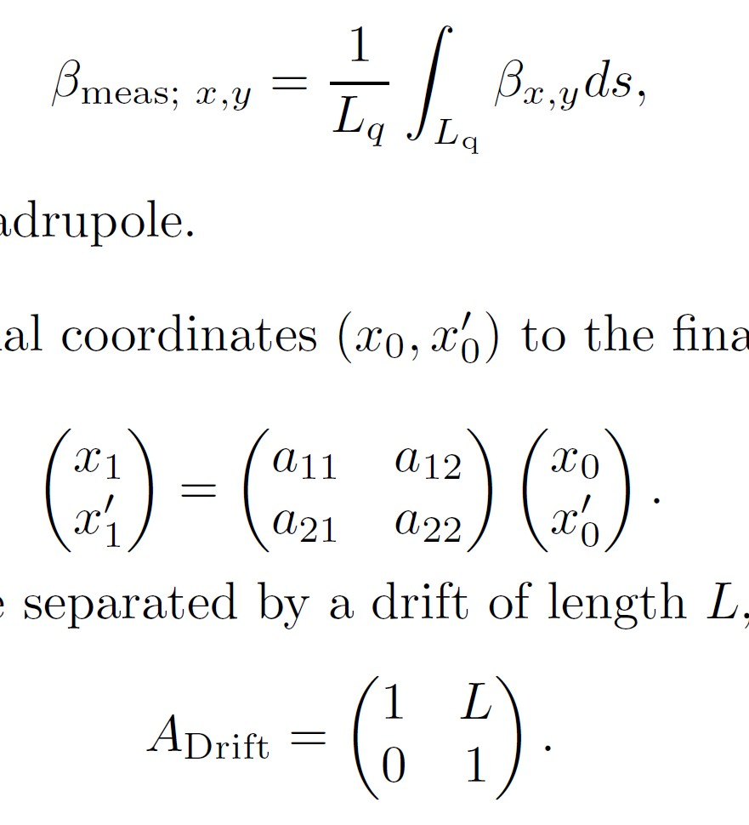
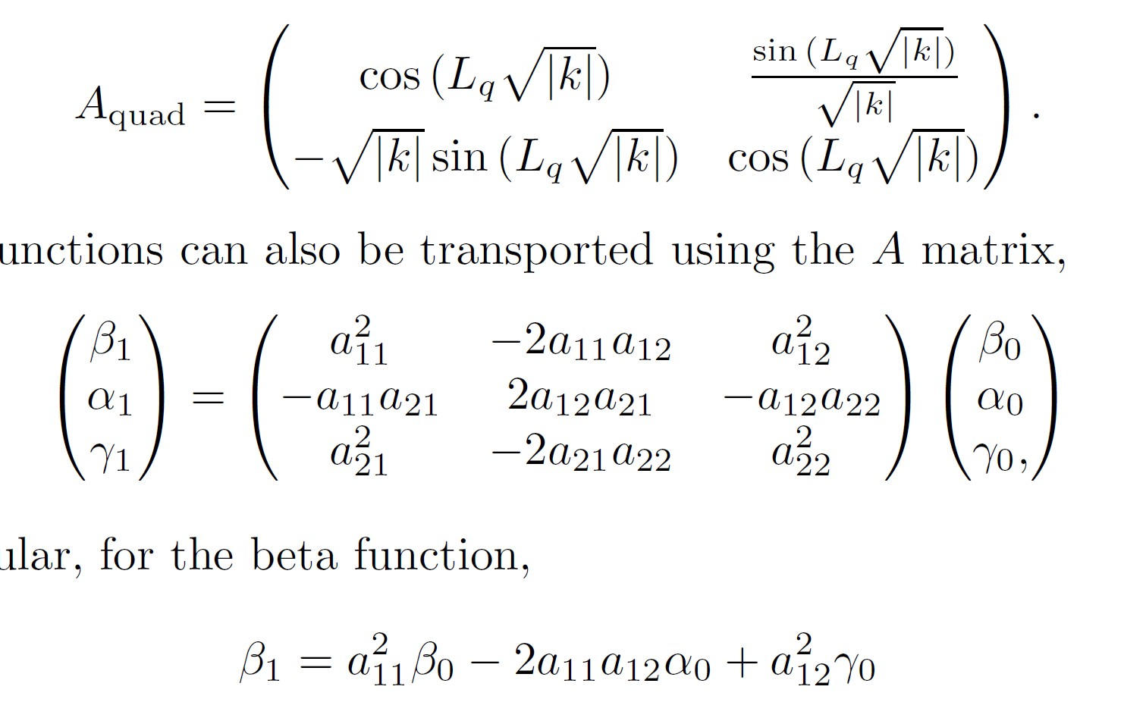
Average beta function
The Twiss parameters can also be transported,
PSI Center for Accelerator Science and Engineering and École Polytechnique Fédérale de Lausanne

Slide 37
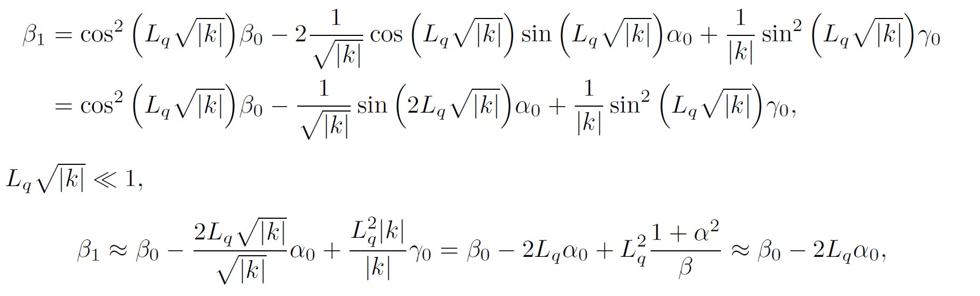
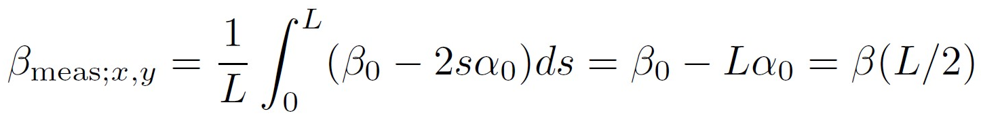
Average beta function
The measured beta function is equivalent to the beta function in the middle of the quadrupole. In SLS 2.0, $L_{q}≈0.0601 m$, and the maximum magnet strength is $K=0.037 m^{−1},L_{q}K=0.047≪1$.
PSI Center for Accelerator Science and Engineering and École Polytechnique Fédérale de Lausanne
Notes:
Maximum \gamma in the horizontal and vertical directions are 10.24 and 3.21, respectively. This means that the term L2qγ0 is at most 0.037 m in x, and 0.01 m in y

Slide 38
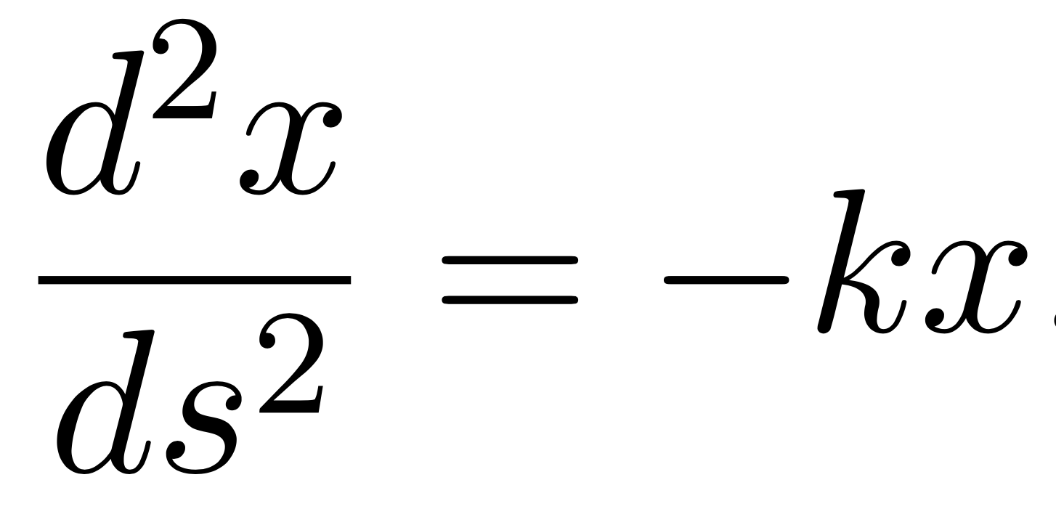
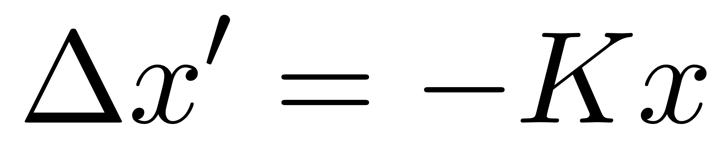
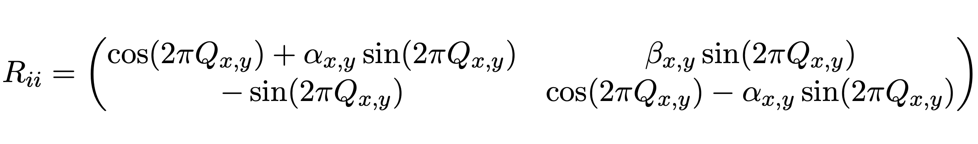
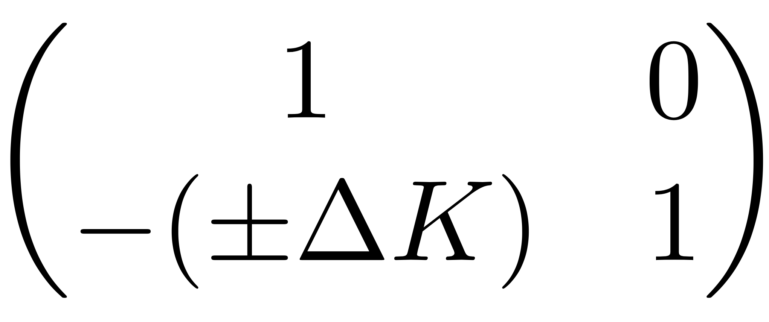
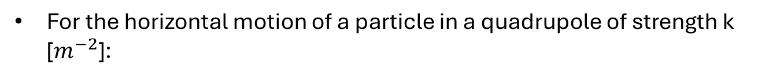


Equation for beta function determination
For the horizontal motion of a particle in a quadrupole of strength k [$m^{−2}$]:
The effect of the quadrupole can be represented by a deflection:
With $K=k l_{q}$ the integrated quadrupole strength in $m^{−1}$.
Recall the one-turn matrix:
$$(1)$$
With trace $2\cos\left(2πQ\right).$
The effect of a change in gradient can be written as:
$$(2)$$
Notes:
+ To the horizontal, - to the vertical plane.

Slide 39
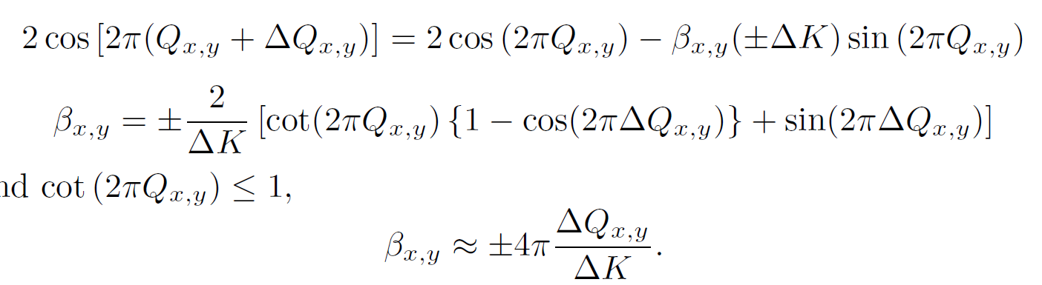

Let ${\overline{Q}}_{x, y}=Q_{x, y}+∆Q_{x, y}$, the new tune after a change in gradient. The trace of the product of (1) and (2) should be equal to $2\cos\left(2π\overline{Q}\right),$
If $2πQ_{x,y}≪1$ and $\cot\left(2πQ_{x,y}\right)≤1,$
Approximation not valid close to integer and half-integer resonances and large $∆K$.

