Slide 1





The ThomX
Compton Source
Nicolas DELERUE (IJCLab, Paris-Saclay University)
on behalf of the ThomX collaboration

Slide 2
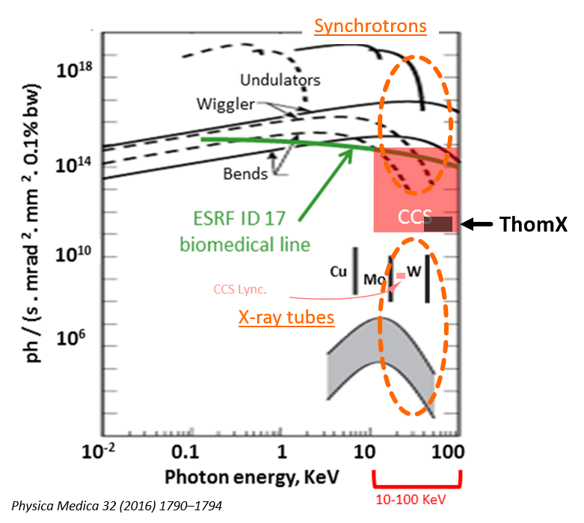
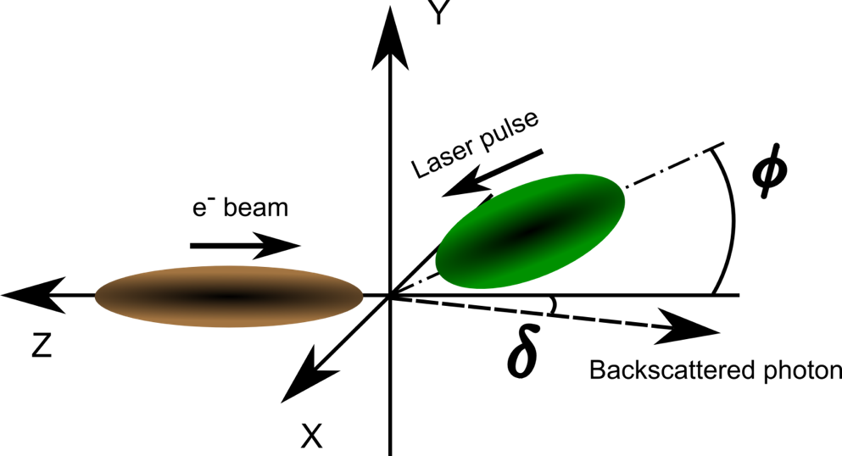
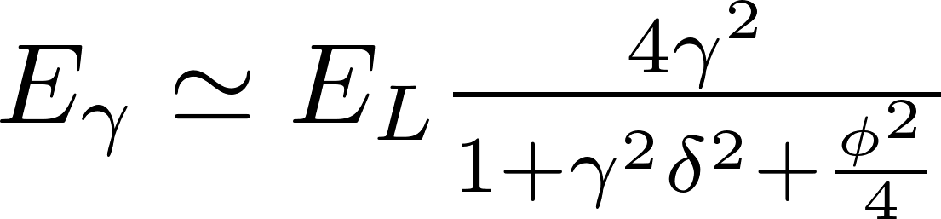
Compact Compton Sources
X-rays produced by Compton interaction
High brightness beam on the laboratory-scale facilities (hospitals, labs, museums…)
Beam is produced in a untypical way
  Compactness (footprint ~ 100 m²)
  Tunable X-ray beam energy
  Large X-ray energy range (keV to MeV)
  High brightness 10¹¹ – 10¹³ ph/(s.mm².mrad²) in 0.1% BW
  Flux 10¹² - 10¹³ ph/s
nominal energy flux brightness
ThomX (Orsay, FR) 45-90 keV 10¹³ ph/s ~ 10¹¹
MuCLS 15-35 keV 10¹⁰ - 10¹¹ ph/s 10⁸ - 10⁹
Lync. Tech (Munich, DE)
*Only 2 “high-flux” Compton sources currently in the world

Slide 3
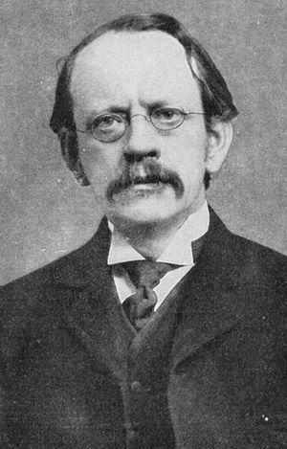
ThomX facility
Thom X
Sir Joseph John Thomson
(1856 –1940)
X-rays
Compact Compton light source

Slide 4
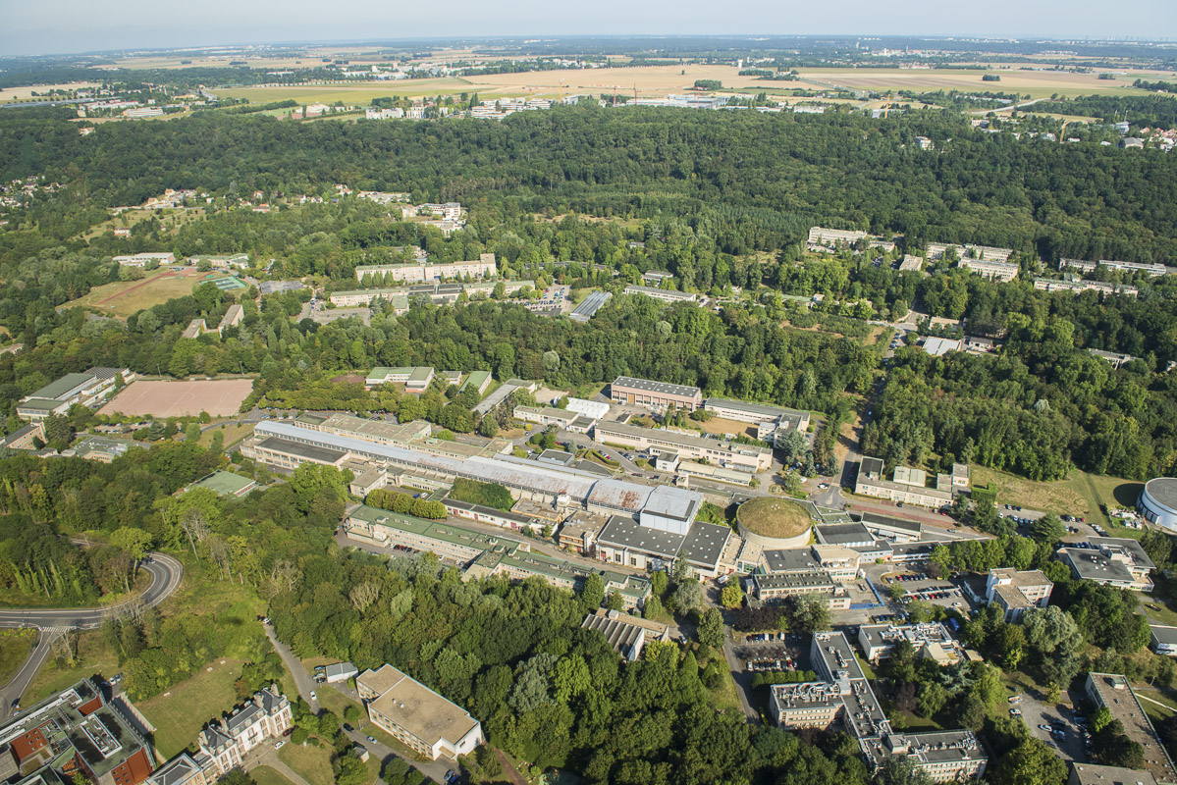


ThomX : on the Orsay campus
SOLEIL
~2km
Using the former LURE DCI building
Orsay Campus with Saclay in the back

Slide 5
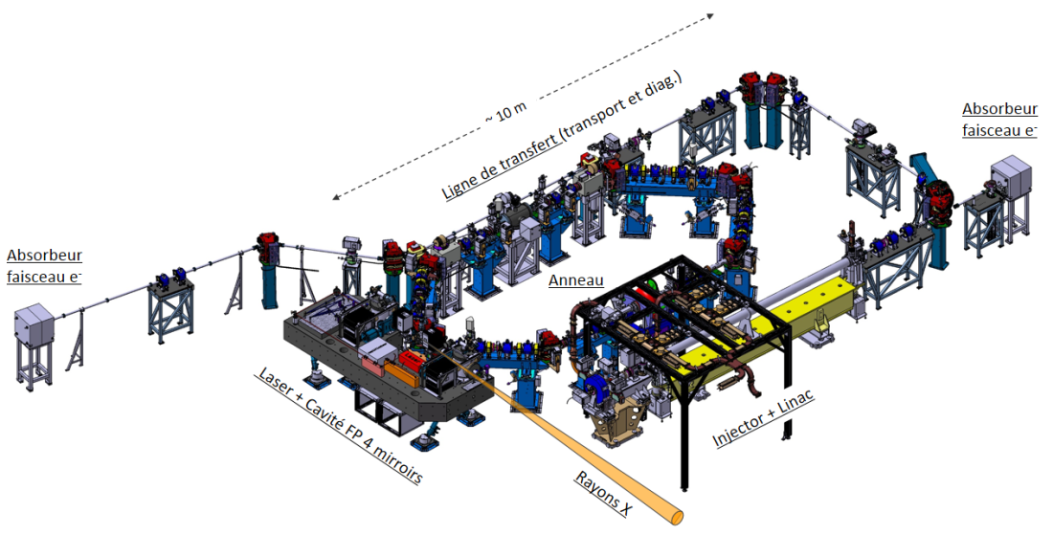
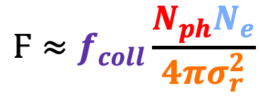
ThomX facility
ThomX target is a high AVERAGE FLUX ➔ many electrons and laser photons colliding in a small volume at high frequency !
$${Ϝ≈f}_{coll}\frac{N_{ph}N_{e}}{4πσ_{r}^{2}}$$
Transfer line (transport & diags.)
e⁻ beam
dump
Maximize collision frequency
Maximize electron bunch charge
Maximize laser pulse power
Minimize source size
e⁻ beam
dump
Ring
Laser + 4 mirrors FP cavity
Injector + Linac
7m
E_{e} = 50 MeV - 70 MeV
Users: cultural heritage, bio-medical and therapy applications, crystallography, X-ray imaging…
X-rays
45 keV - 90 keV
10 mrad /22 keV - 7 mrad / 45 keV
ThomX is a demonstrator
& research platform
X-rays energy scales with 𝛄⁴
Compact X-ray source, affordable for museums, hospitals…

Slide 6

ThomX facility: milestones
Budget : National Research Agency (ANR) /Equipex 12 M€
Installation and operation (2012-2023)
8 French partners :
LAL/IJCLab, SOLEIL, CELIA, LAMS, ESRF, NEEL, INSERM,Thalès
Civil engineering: 2,2 M€
(local Essonne funding)
University Paris-Sud, CNRS/IN2P3,
SESAME, IJCLab : ~ 1 M€

Slide 7
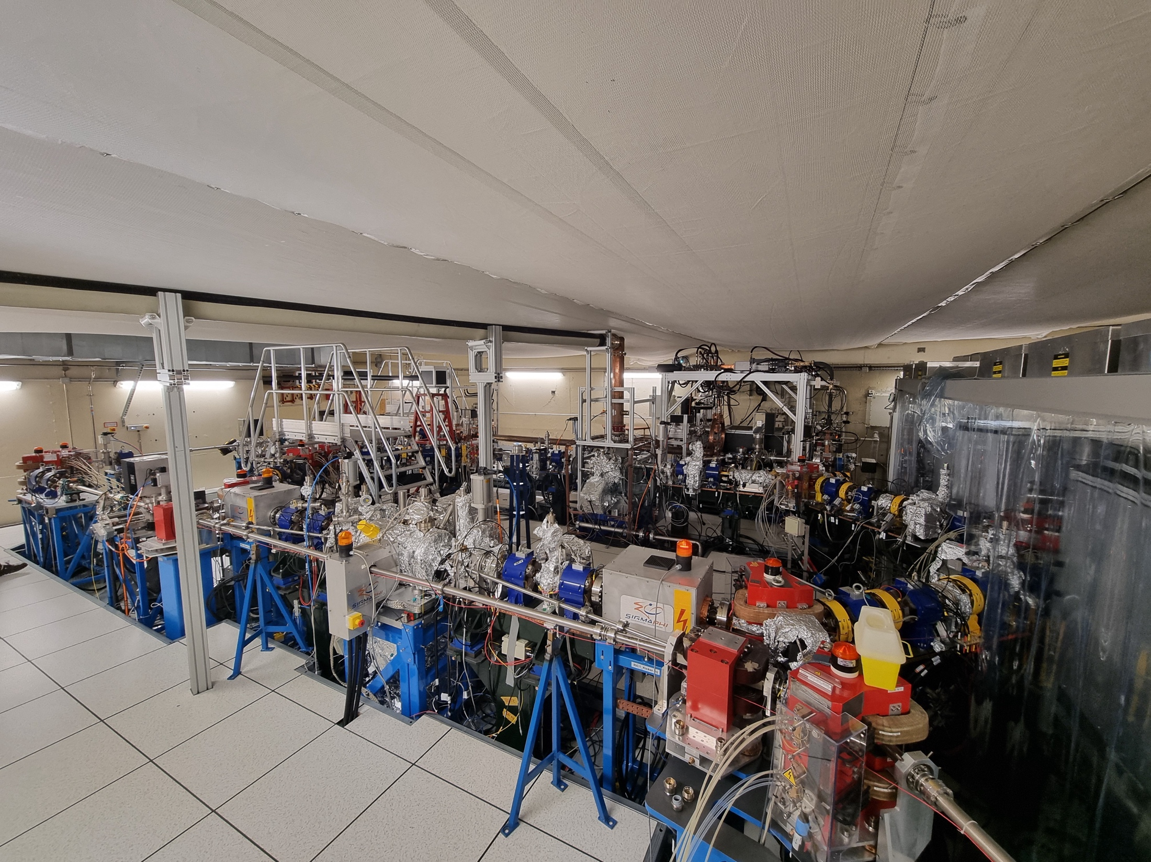
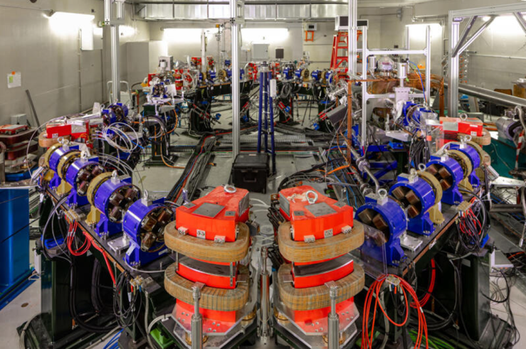
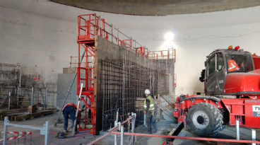
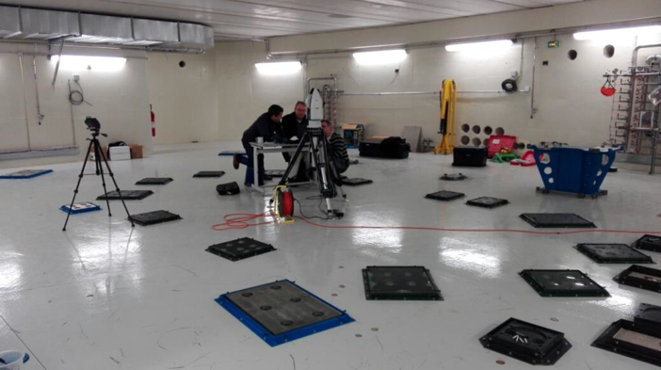
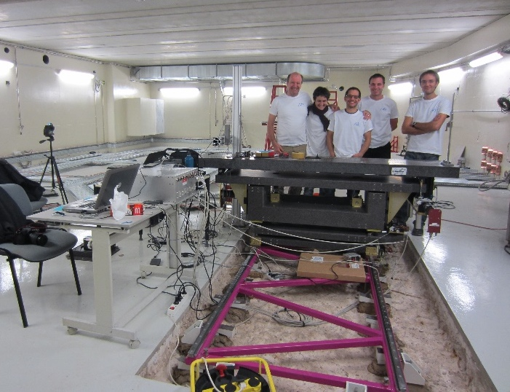
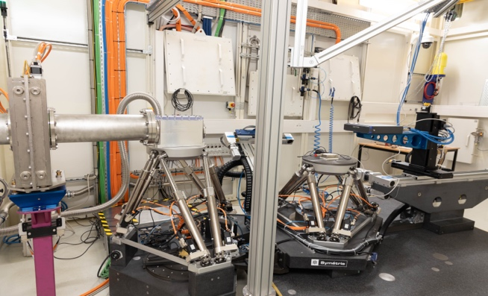
RING
Civil engineering
RING plates alignement
X-LINE
table
Fabry-Perrot cavity
in BUNKER
ThomX facility
April 2025
X-LINE in X-Hutch

Slide 8

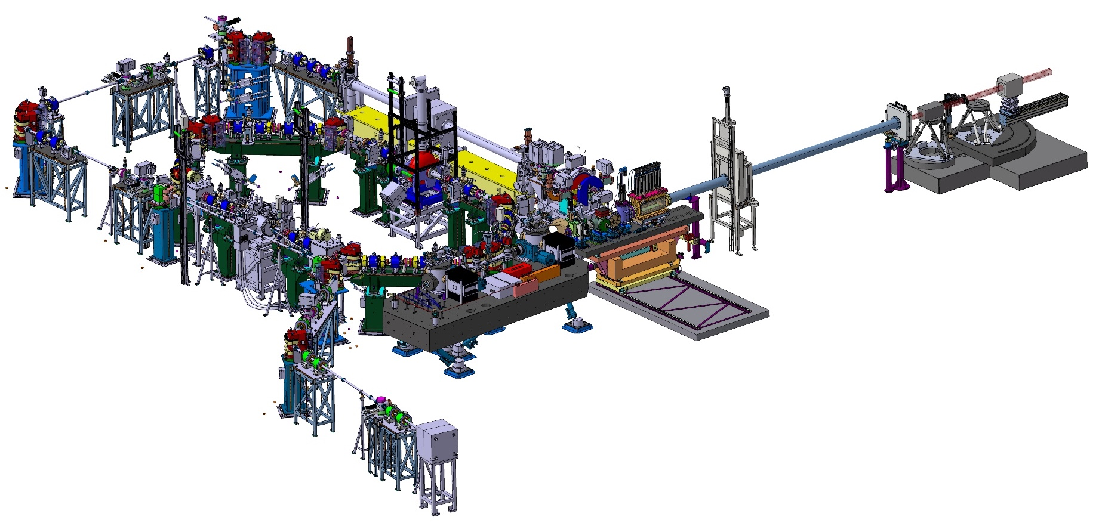
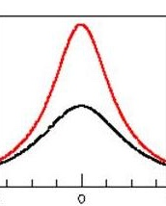
ThomX facility: nominal parameters
Transfer line
(transport & diags.)
Experimental
X-hutch
50-70 MeV, 1nC, 50 Hz
X-ray beam
Flux ~ 10¹³ ph/s
Brightness ~10¹¹ ph/(s.mm².mrad²) in 0.1% BW
σ_{x} ~ 70 μm
On-axis Energy ~ 45 – 90 keV
Injector + Linac
Ring
X-rays
E_{e} = 50 MeV - 70 MeV
Bunker X-line
Electron accelerator
1 nc / bunch @50 Hz
50-70 MeV
Ring, 16 MHz frep
Energy spread < 0.5%
ε_{N} ~ 5-10 mm.mrad
τ_{e} ~ 10-30 ps
σ_{e} ≳ 70 μm
45 keV - 90 keV
Laser +
4 mirrors FP cavity
10 mrad /22 keV - 7 mrad / 45 keV
Extraction line (diags.)
Laser /Cavity system
100 W injected average power
> 0.5 MW stored inside the Fabry-Perrot cavity (~ 15 mJ/pulse)
90
E_{e} = 70 MeV
E_{X} (keV)
45
E_{e} = 50 MeV
-10
10
θ (mrad)

Slide 9
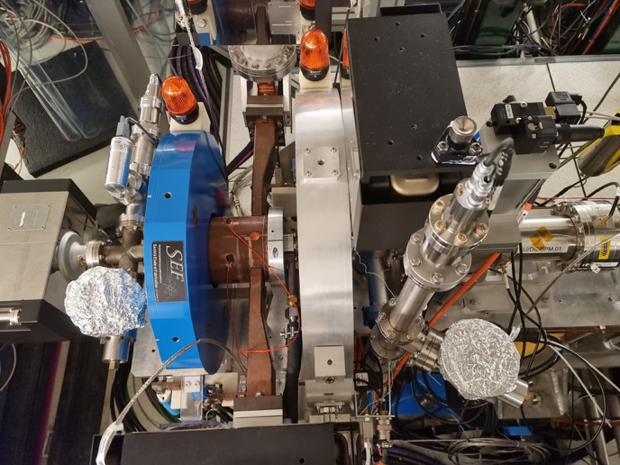
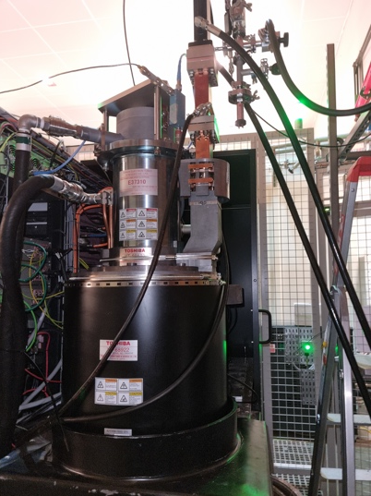
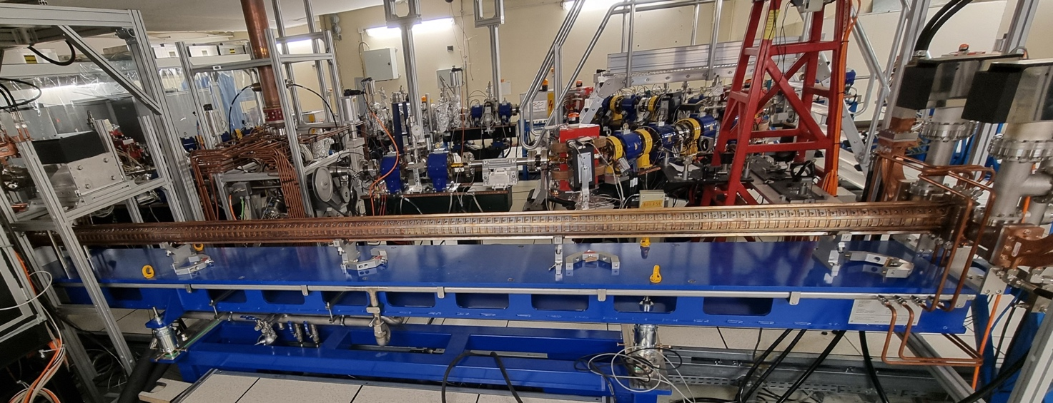
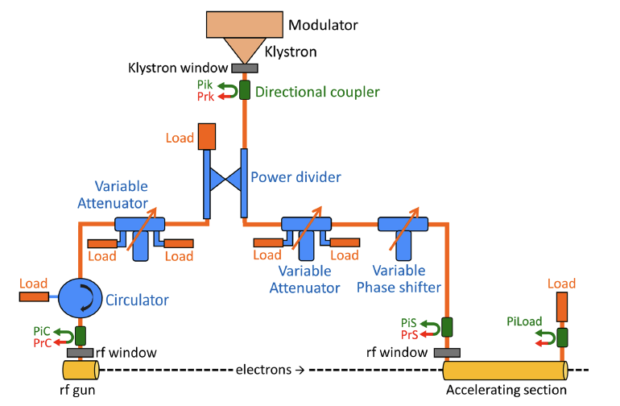
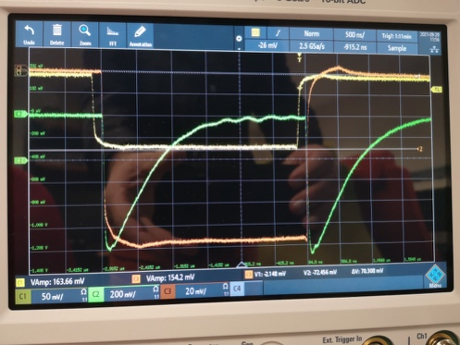
ThomX injector
Photocathode RF gun
Standard design of photoinjector + S-band RF structure + Transfer/Extraction Line
LAL design
made in-house
Injector specification
Parameter | Nom. value | Measured | Units
Energy | 50/70 | 40, 50, 61.5, 70 | MeV
Charge, commissioning/nom. | 0.1/1 | >0.2 | nC
Nb. of bunches per RF pulse | 1 | 1
Energy spread, rms | <1 | 0.08 | %
Emittance (rms, normalized) | <5 | <5 | mm⋅mrad
Bunch length, rms | <5 | 3.9 | ps
Average current | 50 | 1 | nA
Pulse repetition rate | 50 | 10 | Hz
ScandiNova modulator,
3 GHz Toshiba klystron E37310
➜ 2.5-cell photocathode RF gun : Ez = 80 MV/m @ 6 MW to reach E = 5 MeV, Charge 0.1/1 nC
➜ S-band :4.8-meter long accelerating structure (2998.55 MHz) to reach ~45 MeV @ 11 MW
Accelerating structure
Linac RF

Slide 10
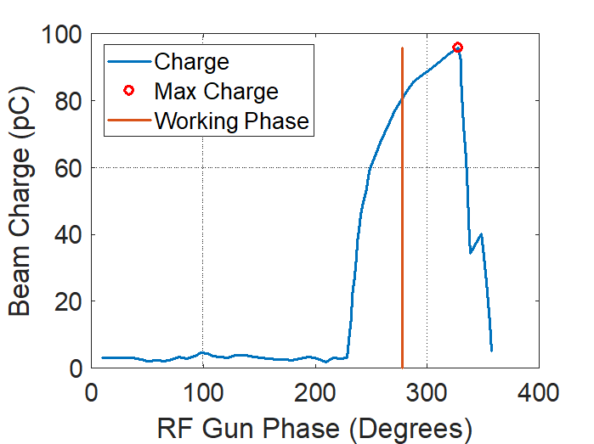
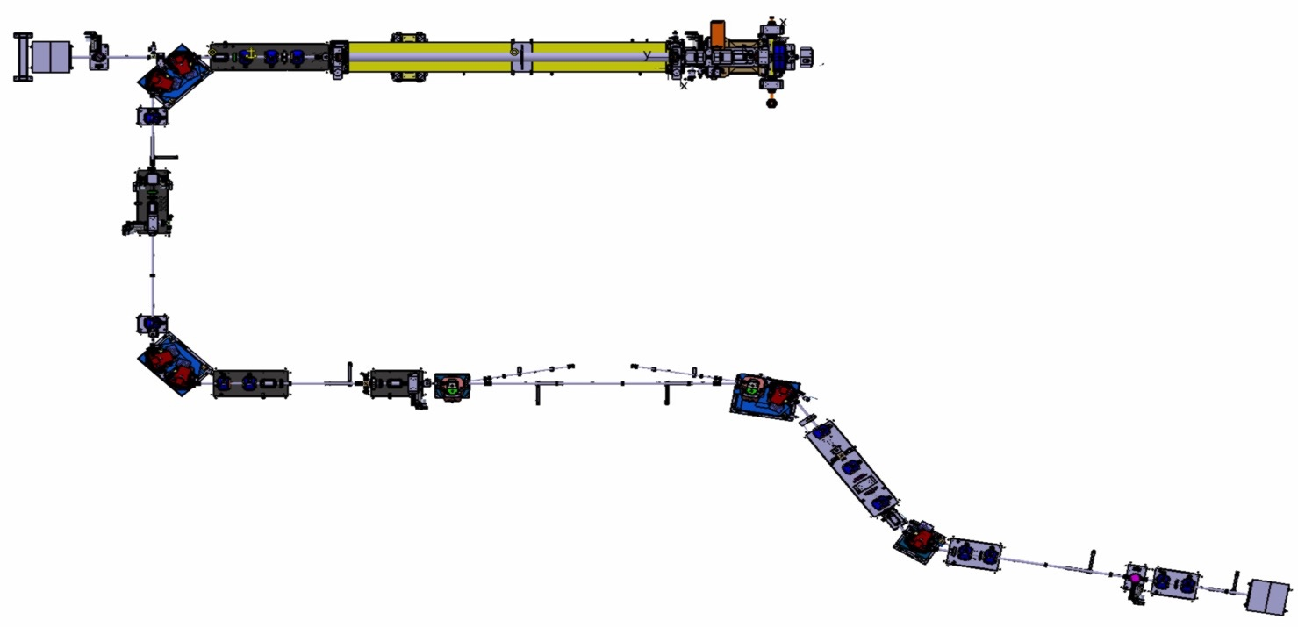
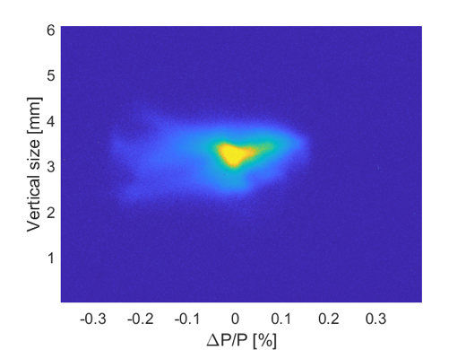
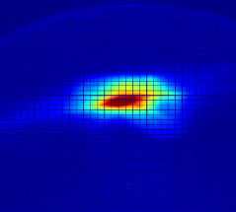
Linac, Transfer Line and Extraction Line
21/03/2025
RF-gun
04/08/2023
Dump
21/03/2025
21/03/2025
04/08/2023
ΔΡ_{rms}/Ρ = 0.08%
6 Dipoles
14 Quadrupoles
2 Dipoles for inj./extr.
8 Correctors
@ I_{sol} = 230 A,
50 MeV
04/08/2023
To ring
System of linear equations for the thick lens approximation is solved c.f. M.C. Ross et al. PAC87
7 BPM
5 Diagnostic stations
3 ICT
2 Faraday Cups
21/03/2025
Dump
04/08/2023
09/12/2022

Slide 11
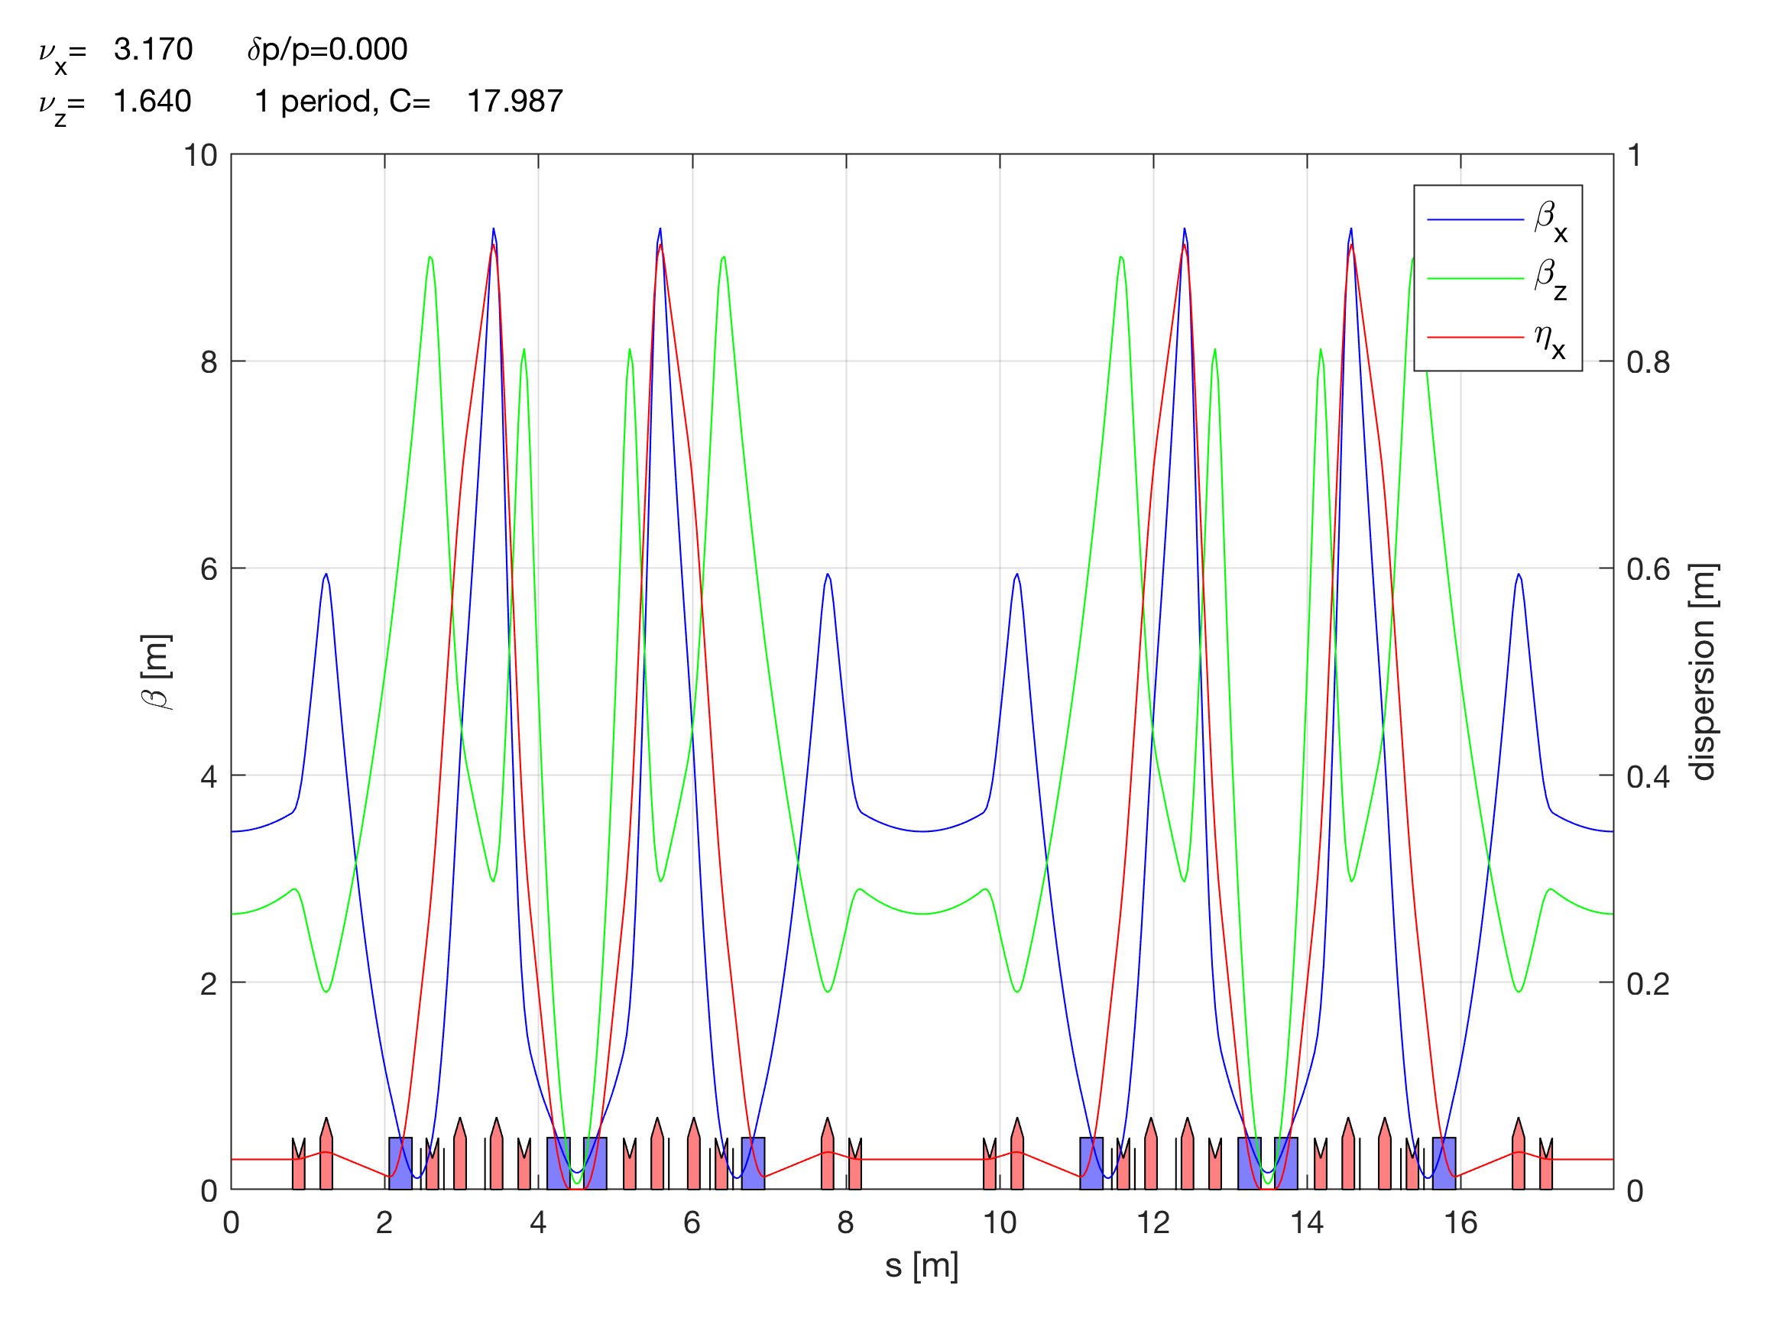
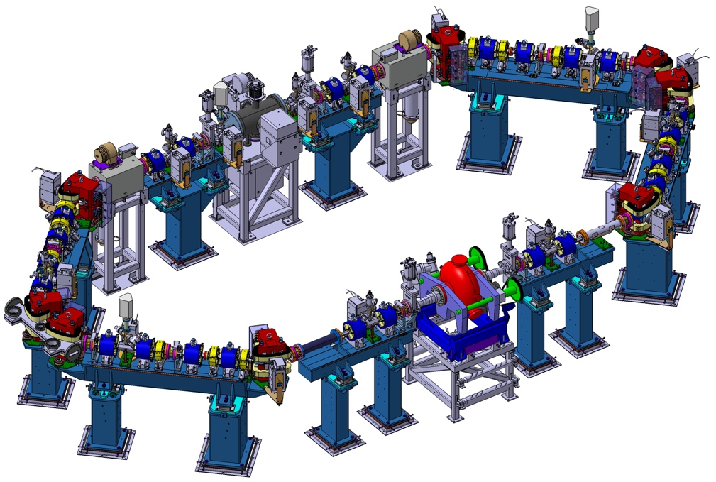
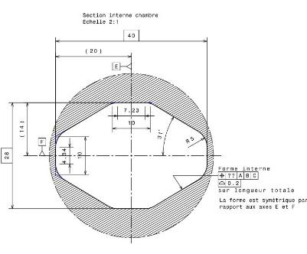
Ring lattice and nominal parameters
Working point 3.17/1.64
8 Dipoles
24 Quadrupoles
12 Sextupoles
2 Kickers
1 Septum
1 RF cavity
12 BPM
12 Correctors
ThomX SR: L = 18 m, T = 60 ns, f_{rep} = 16.7 MHz
Parameter | Value/Units
Beam energy | 50-70 MeV
Bunch Charge | 1 nC
Bunch length (rms) | ~30 ps
Circumference | 18 m
Revolution frequency | 16.7 MHz
Current | 16.7 mA
RF frequency/Harmonics | 500/30 MHz
Momentum compaction | 0.0125 - 0.025
Betatron tunes | 3.17/1.64
Natural chromaticity | -9/-13
Damping time trans./long. | 1.2/0.6 s
Repetition frequency | 50 Hz (20 ms)
Beam size at the IP | ≳70 μm
Nominal RF Voltage/cavity | 300 kV (500 kV max)
Energy loss per turn | 1.57 eV
IP
28x40 mm
IP
11
Very dense integration

Slide 12
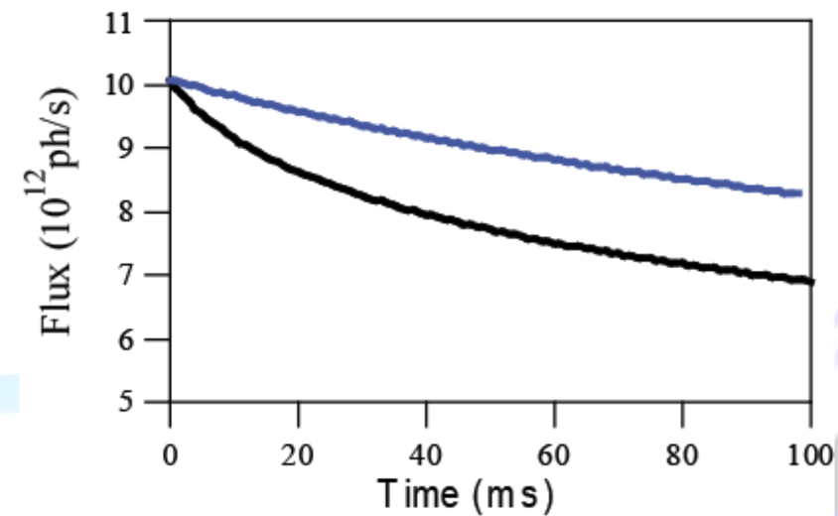
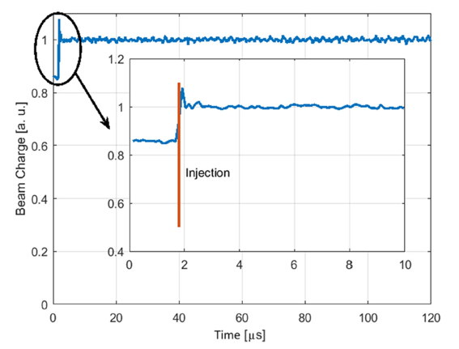
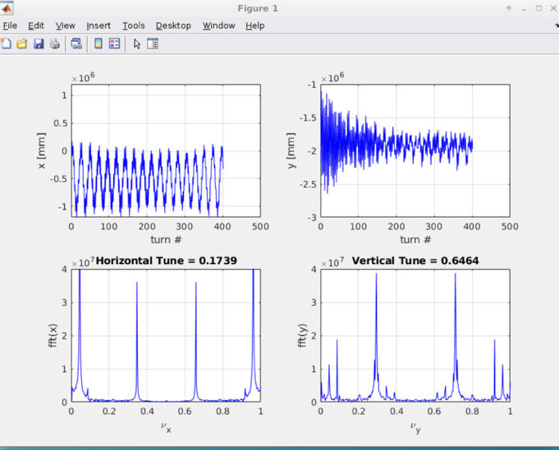
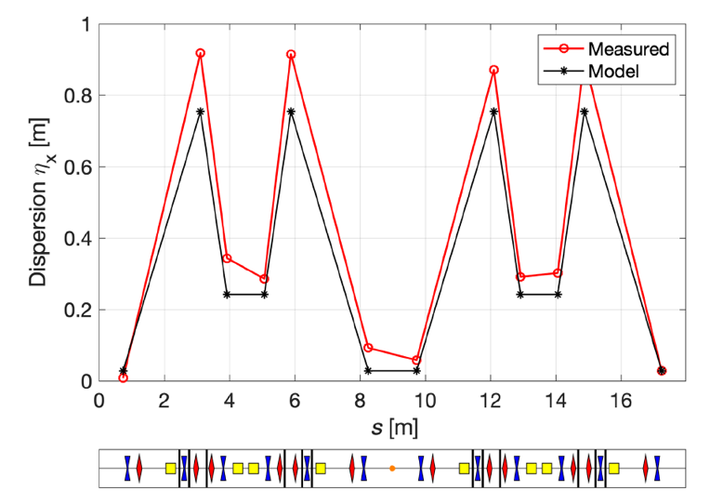
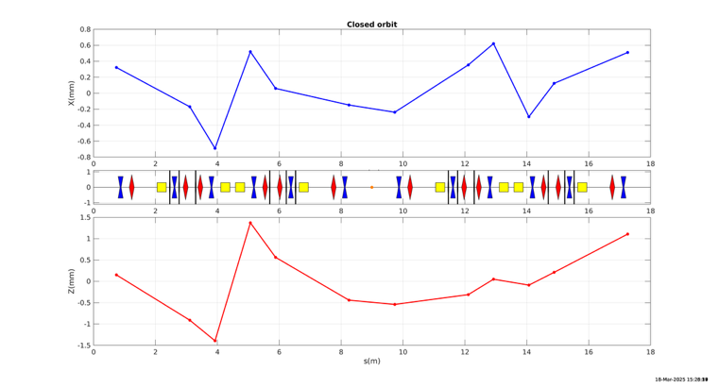
Ring commissioning highlights
1 nC/bunch
IBS only
The Ring operation and its commissioning is a big challenge due to :
high particle density (1 nC/bunch) and low energy operation (50-70 MeV)
mismatched beam injection
absence of the synchrotron damping (stored time << damping time)
strong impact of collective effects (intrabeam and Compton scattering, coherent synchrotron radiation, ion instabilities, etc.)
Beam dynamics is very different from usual dynamics in synchrotrons
IBS + Compton
X-ray flux drops by 30 %
in ~60 s
Tune
Dispersion
Stored charge
≲ 100 pC/bunch
Orbit
ν_{x} = 0.174
ν_{y} = 0.646
Model hor./vert. tune
3.17/1.64
Improvement in beam storage: @10 Hz ~95 %
Physics model vs. real machine: good.
Work in progress!

Slide 13
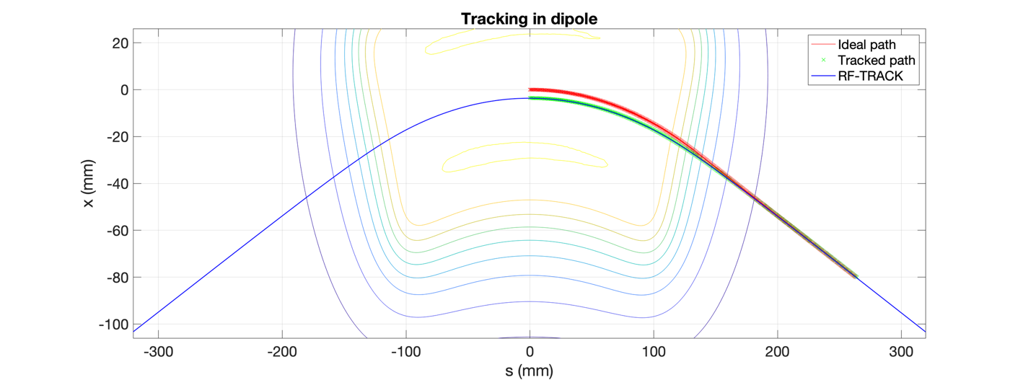

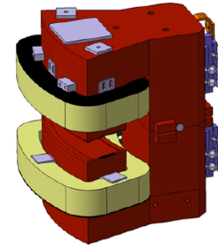
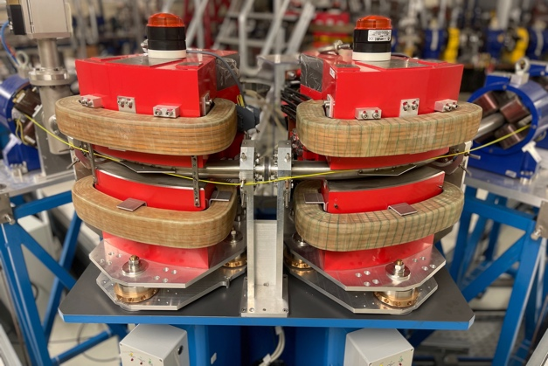
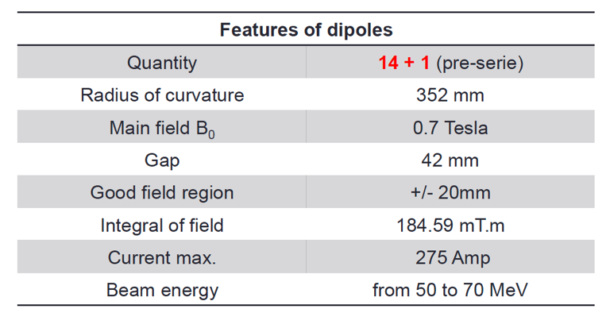
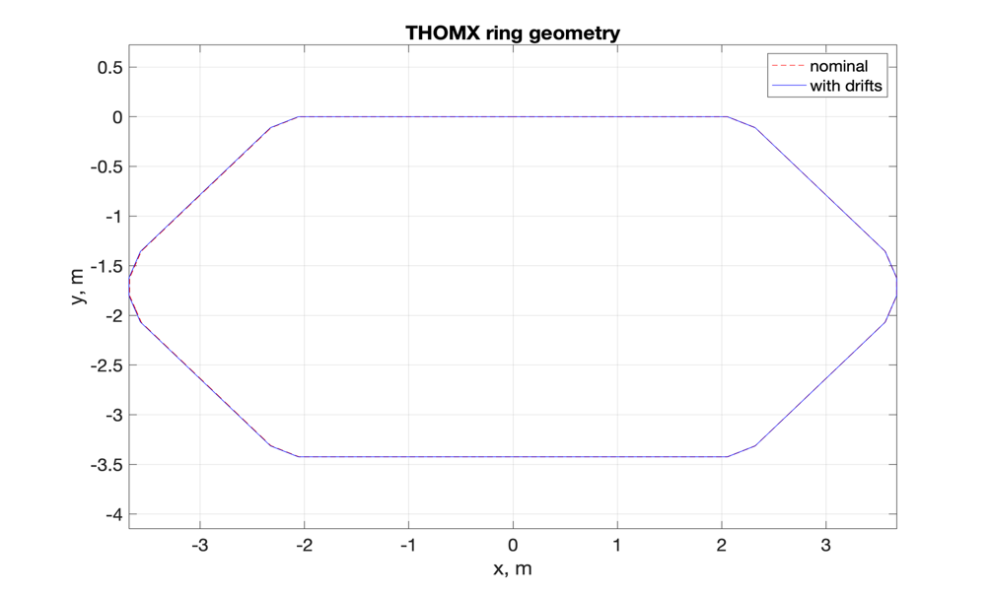
An unexpected find: shorter circumference
EXAMPLE
The RF frequency was found to be ~0.4 MHz higher. A big difficulty for synchronization with the Fabry-Perot cavity laser (limited BW, ≤ 0.25 MHz)
☞ shorter pathlength and
so smaller total circumference
Short and small-radius dipoles
To guarantee the high-intensity X-ray production:
mechanical extension of the ring by ~12 mm
+6mm drifts

Slide 14
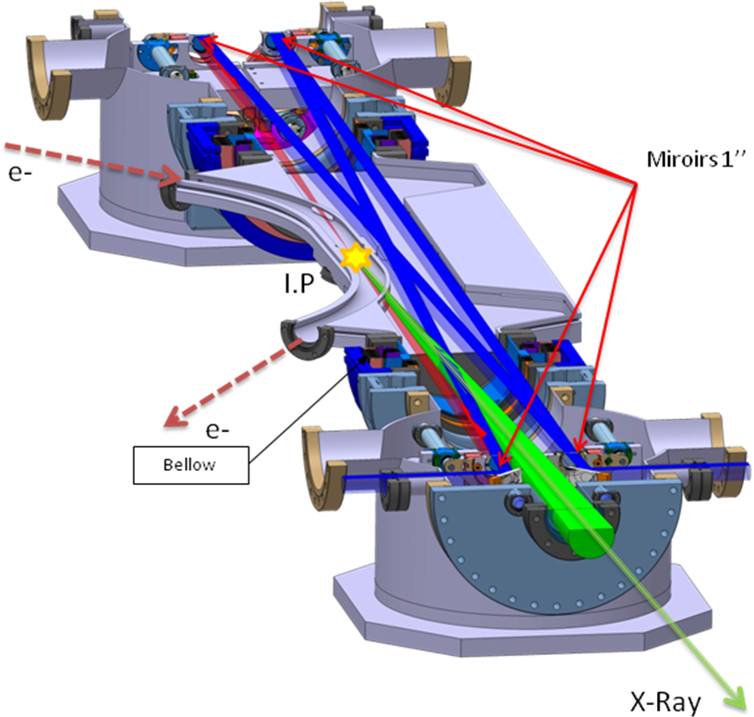
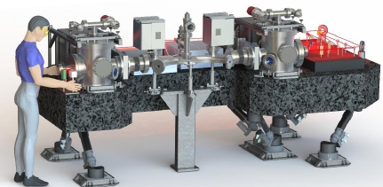
Fabry-Perot cavity @ThomX
Oscil. LASER 40 mW, 33.3 MHz, 10-15 ps, 1031 nm
Optical FIBER AMPLIFICATION
(fibers doped with Ytterbium)
→ 50 - 100 W (1 - 2 μJ/pulse)
Optical CAVITY AMPLIFICATION
4 mirrors planar cavity
2 plan & 2 spherical
Optical path ~ 9 m
Gain 10000
0.5 - 1 MW stored power
Length ~ 10 ps (rms)
Spot size ~ 70 μm (rms)
Optical table is installed on the hexapode (µm precision)

Slide 15
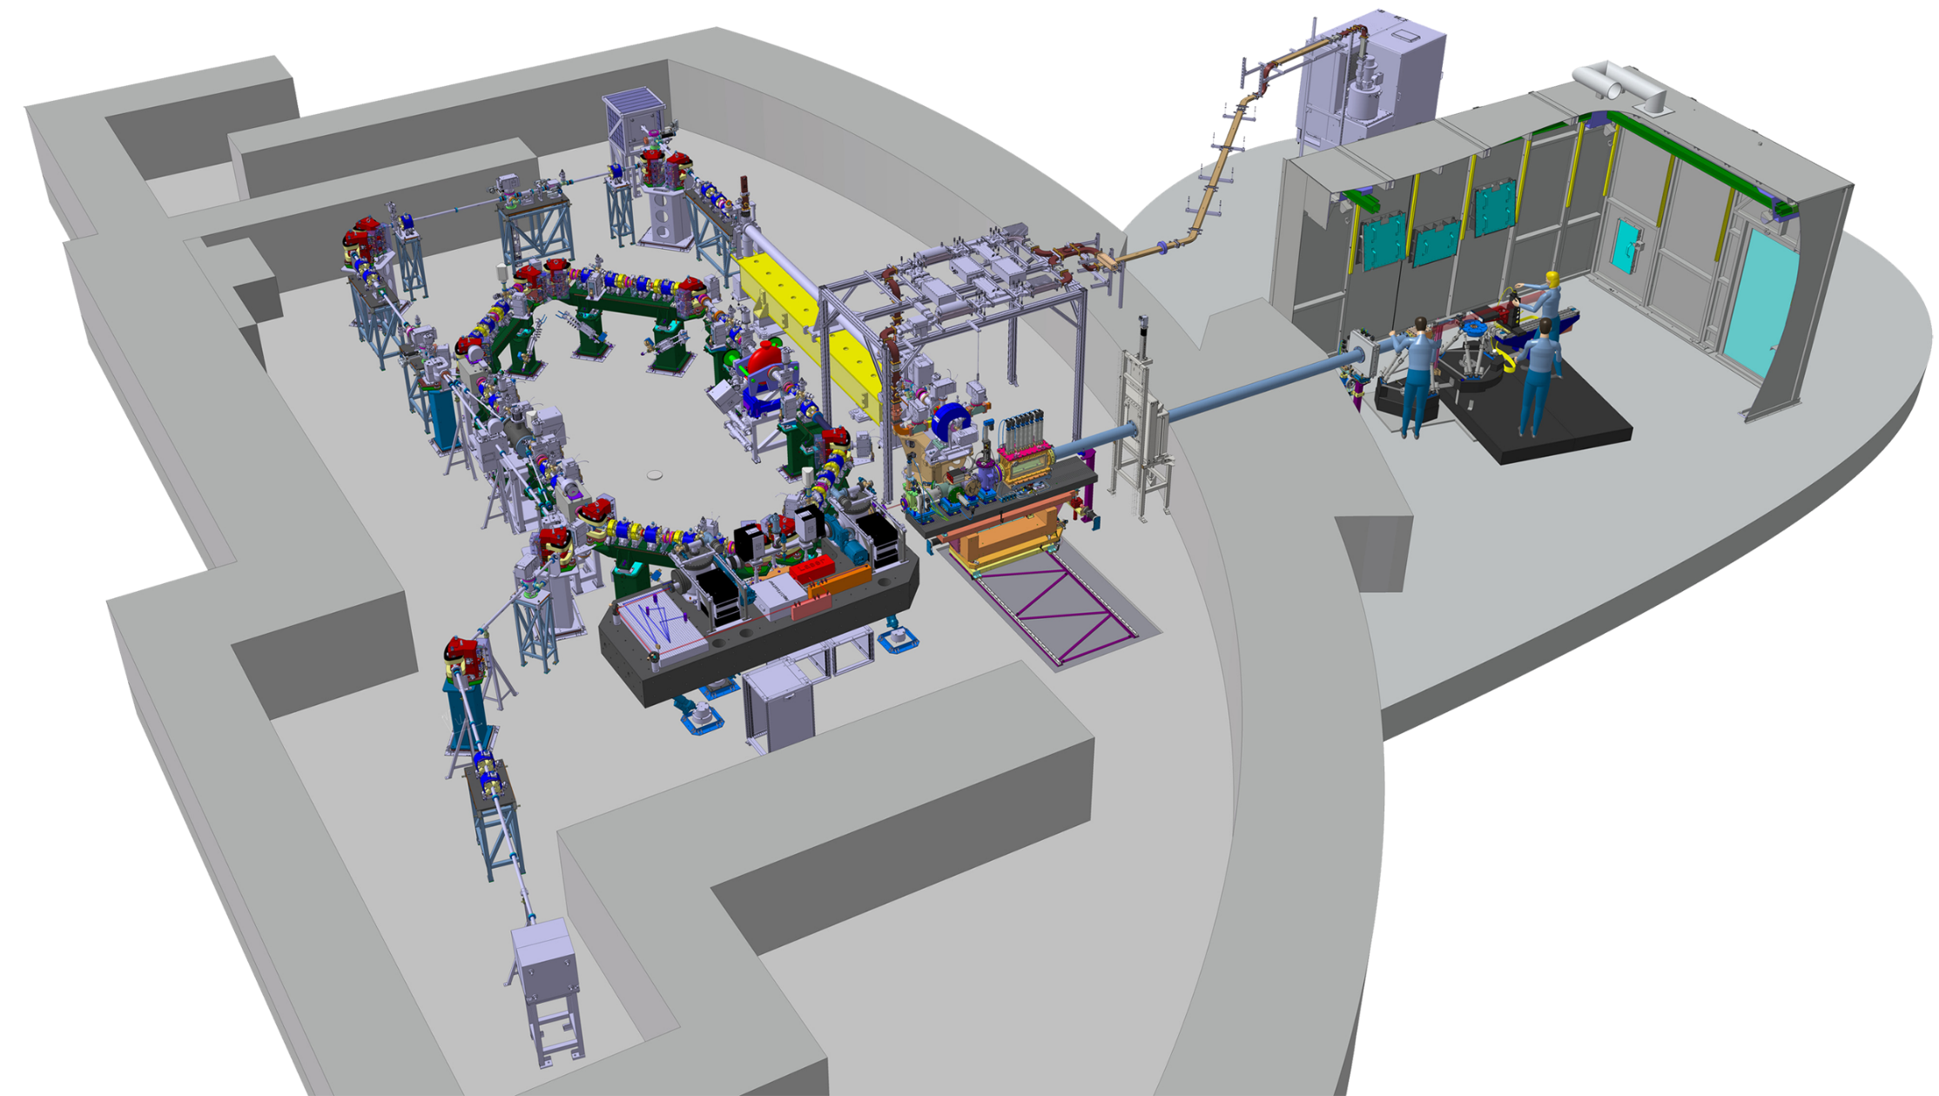
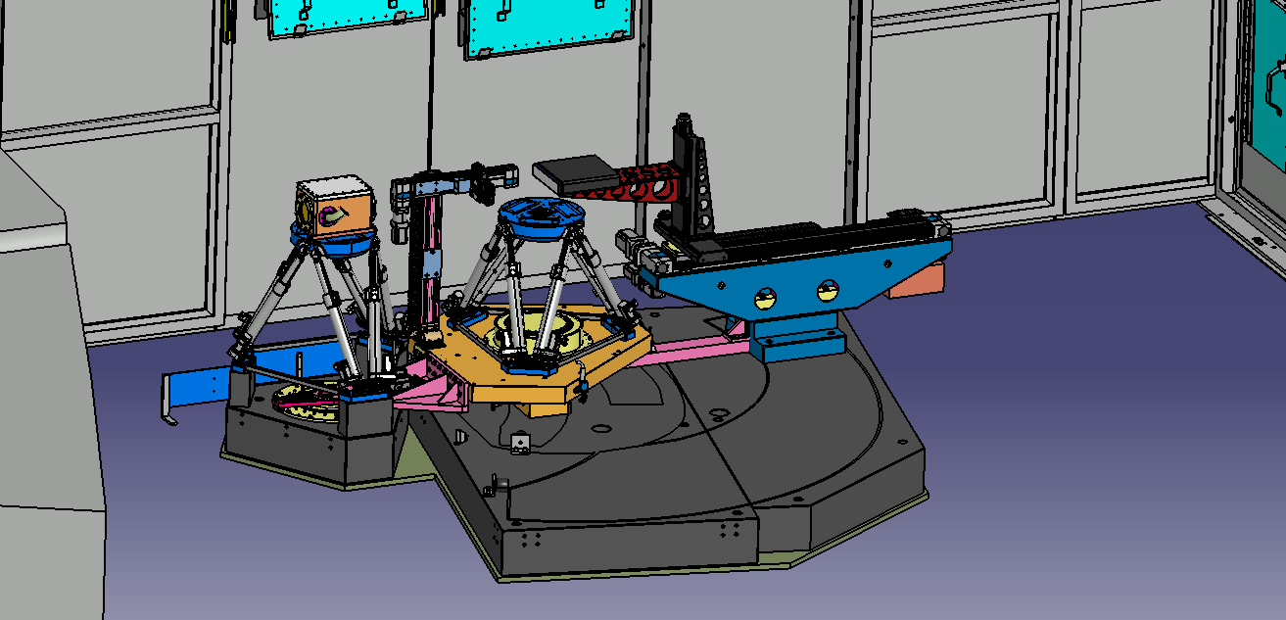
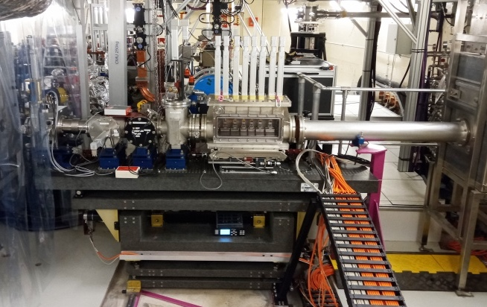

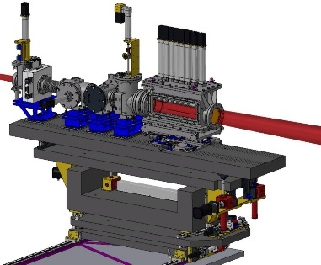
X-line design
BUNKER
Table 2 (hall D1)
Characterization of the X-rays
Monochromator
Experimental set-ups
Detectors (spectrometers, X-ray cameras, etc.)
Experimental
X-hutch
Table 1 (igloo)
Follow the beam line
On-line monitoring of the X-ray beam
BW selection
Collimation et focusing of the X-ray beam (transfocator)
X-LINE elements inside bunker
X-LINE in X-Hutch

Slide 16

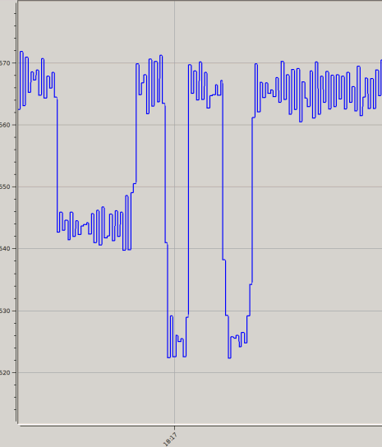
The first X-rays
23 June 2023
Laser LOCKED (~25-30 kW stored)
Measured photodiode signal
570
X-ray flux measurement
X-ray
signal
25 pA
Expected Flux ~ (0.5 - 2)∙10⁷ ph/s
(uncertainty on stored e⁻ bunch charge
and bunch length)
Measured Flux ~10⁷ ph/s
Signal intensity (pA)
e-/laser beams
NOT synchronised
No e- beam
shutter CLOSED
520
Laser
scattering
Background
Laser
DELOCKED
A few minutes scale
M. Jacquet et al. "First production of X-rays at the ThomX high-intensity Compton source."
Eur. Phys. J. Plus 139, 459 (2024)

Slide 17
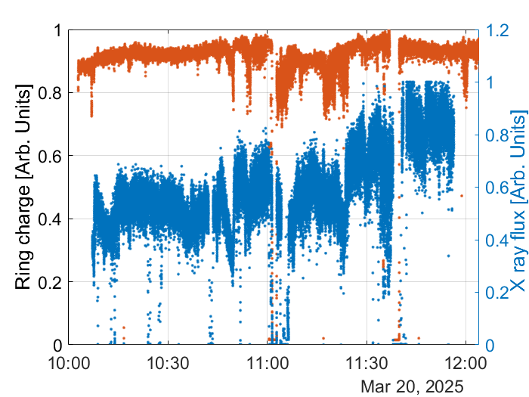
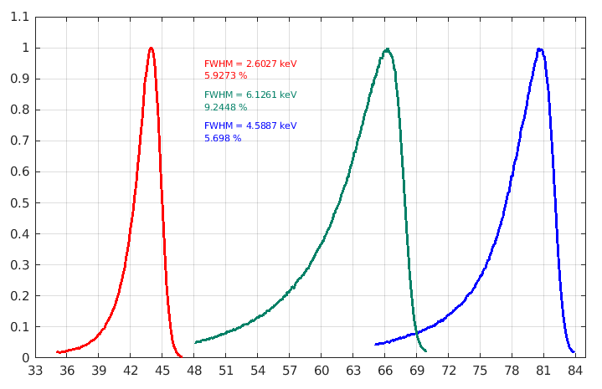
Current X-ray operational performance
ABSOLUTE FLUX measurement in X-Hutch with a calibrated diode
Spectrum
Spectrometer CdTe
Preliminary Results
15 cm
X-rays energy (keV)
for electrons at 50 MeV, 61 MeV and 70 MeV
Total FLUX ~ 3 × 10¹⁰ ph/s
Calibrated Si diode
(Canberra)

Slide 18
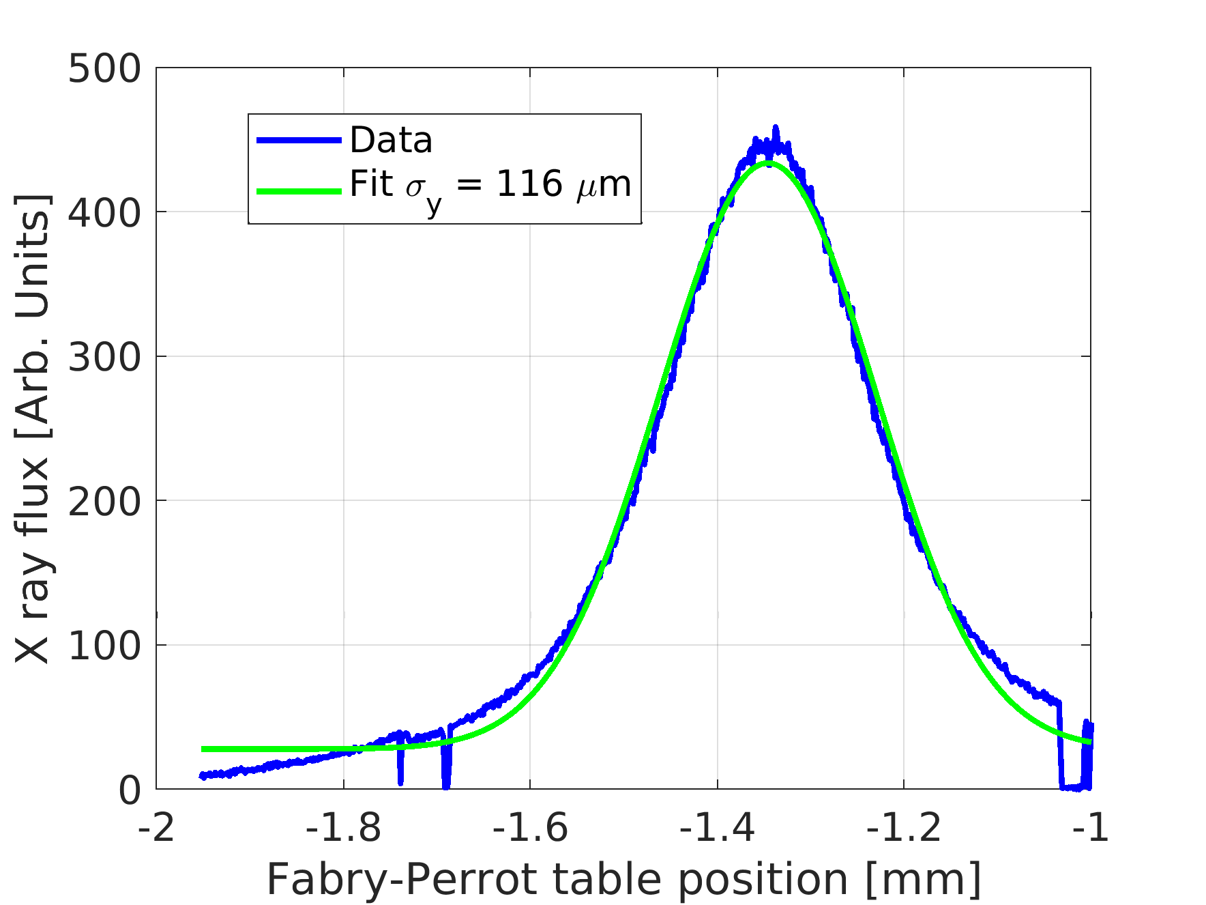
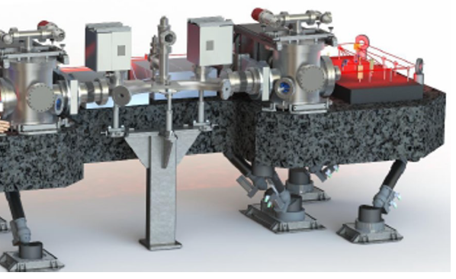
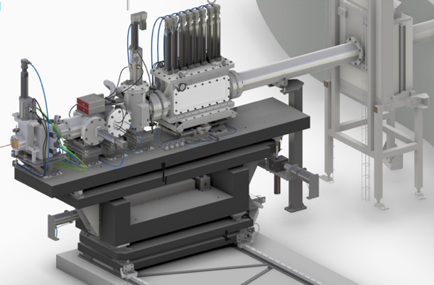


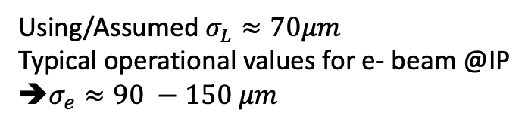
Ring operation highlights
Measurement of the vertical e- beam size @IP
$$\overset{→}{y}$$
@IP
e-
$$σ_{e}≈92 μm$$
$$\overset{→}{z}$$
Laser beam
X-rays
X-ray detector
(fluo screen + pdiode)
$$σ_{scan}=\sqrt{(σ_{e}^{2}+σ_{L}^{2})}$$
Using/Assumed $σ_{L}≈70μm$
Typical operational values for e- beam @IP
➔$σ_{e}≈90 −150 μm$
➔long scan duration (many minutes)
☞ good extraction of electron beam size @IP
From the model and using injector measured emittances
Minimum 𝜎_{𝑒}^{VERT} ≈ 60 – 120 µm (expected)

Slide 19




Source size measurement
Data from 18/03/2025
Preliminary Results
Projections of the edges
$$σ_{source}=\frac{σ_{e}σ_{L}}{\sqrt{σ_{e}^{2}+σ_{L}^{2}}}$$
Using/Assumed $σ_{L}≈70μm$
➔$σ_{e}≈124 μm$ (vert.)
« single shot » online source size measurement:
☞ Electron beam size extraction @IP
☞ X-ray source position estimation
Slit /edge
Detector plan
Blur due to source size
source
X-ray beam
e- vert. beam size is in good agreement
with other measurements and model

Slide 20




Two ways to use the Compton beam
1. Divergent beam in 2D
Biomedical/cultural heritage applications
Conventional Radiography
K-edge subtraction
Phase contrast imaging
RADIOTHERAPY
• Several cm diameter
• Pink beam (few % - 30% )
• Flux ~ 10¹¹ - 10¹³ ph/s
• 40 - 90 keV
IMAGING
→ Measure large samples in a single exposure
(patient, materials …)
2. Beam core
(Cultural heritage, material science, biomedical)
Fluorescence spectroscopy
→Chemical composition
Diffraction
→ Structural analysis
Focalisation = refractive lenses = Transfocator
65 μrad
0.4 mm
• beam: mm down to less than 150 μm
• few % to 0.01 % spectral width with mono.)
• Flux ~ 10⁸ - 10¹⁰ ph/s
• energy 40 - 90 keV

Slide 21
Preliminary analysis: characterization of the X-ray ThomX setup
Bravin¹, P. Coan², L. Franzoni¹, F. Merighi¹ and ThomX collaboration
¹University Milano Bicocca (Milan, Italy)
²Ludwig Maximilians University (Munich, Germany)

Slide 22


Assessment of the spatial resolution
First step: resolution of the taper optics Photonic Science detector
MTF (modulation transfer function)
describes the system response to different spatial frequencies/various sizes
MTF value of 1 at low spatial frequencies ➔ low-frequency (large-scale) details are transferred with full contrast
Smaller MTF (as the spatial frequency increases) ➔ the system is less effective at reproducing finer details
Assessing the 10% MTF value is common method to evaluate the effective spatial resolution of an imaging system
Detector @ThomX: 13–14 line pairs per millimetre (lp/mm)
Should fulfil the requirement of resolving the blur generated @X-ray ThomX setup

Slide 23



Radiography: phase contrast imaging assessment
Wire/fishing line (propagation based) ~ 4,5m
Fishing line has only 1-2% absorption

Slide 24




First Computed Tomography (CT)
Technique for 3D Imaging
Phantom
Sample: Bar Pattern
1000 projections from 0°to 180°
Next Steps:
Volume reconstruction and post-processing

Slide 25

Recent measurements: Prostate biopsy
Prostate biopsy taken from patient exposed to metals

Slide 26
Summary
ThomX is a research platform and demonstrator !
Different from commissioning/operation of a user facility.
X-ray flux of ~3 × 10¹⁰ ph/s is already demonstrated. Several working points available at
40 MeV, 50 MeV, 61.5 MeV and 70 MeV. Characterization of X-rays is in progress.
Currently one of the most advanced Compton source in operation: 10¹¹ − 10¹² ph/s expected in near future !
Recent cathode change (Mg): increase of the e- charge aiming for 1 nC (Mg photocathode) and operation at 50 Hz.
Fabry-Perrot cavity stored power gradually will be increased up to 500 kW. Goal: ~10¹² ph/s
successful first X-ray experiments /commissioning : standard/phase contrast imaging, tomography, fluorescent spectroscopy … to be continued.
The help from SOLEIL’s team has been invaluable to us.
M. Alkadi, et al. "Commissioning of ThomX Compton source subsystems and demonstration of 10¹⁰ x-rays/s."
Phys. Rev. Accel. Beams 28 (2025): 023401

Slide 27


Thank you!

