Slide 1

ESLS33
Information Session
Laurent S. Nadolski
ESLS33 Chairman

Slide 2
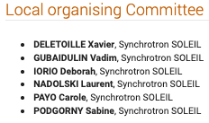
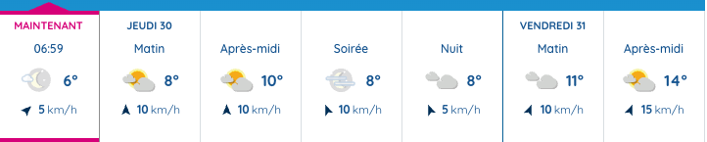
A Warm Welcome to the 33rd European Synchrotron Light Source Workshop
Introduction
Program
Safety Rules

Slide 3
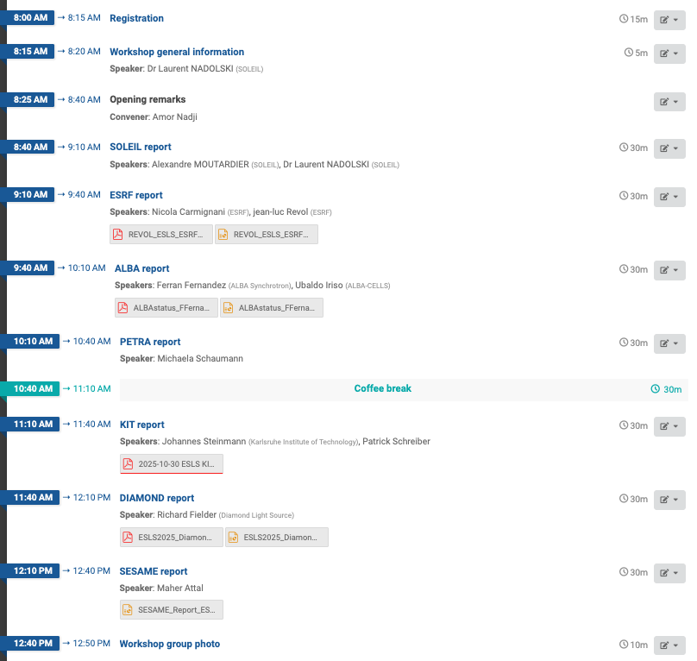
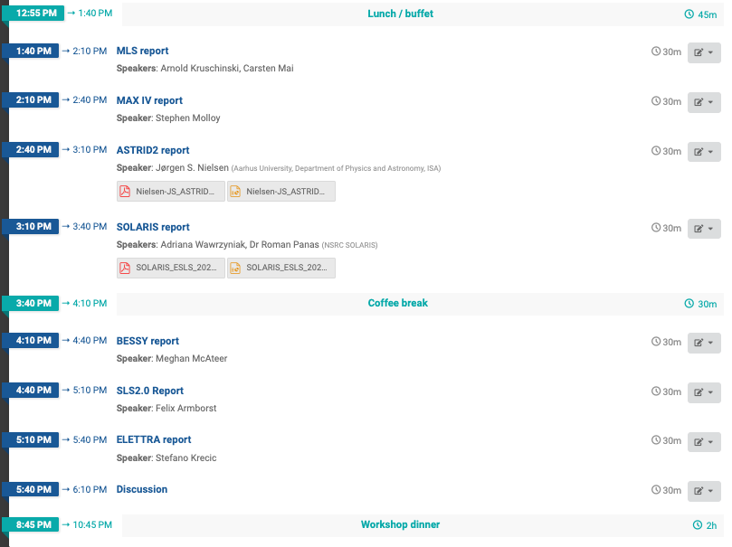
Workshop Schedule
https://indico.synchrotron-soleil.fr/e/esls33

Slide 4
Participants
Laboratory | Country | Number of Participants
SOLEIL | France | 5
Diamond Light Source | United Kingdom | 3
ALBA Synchrotron (CELLS) | Spain | 2
ESRF | France | 2
SOLARIS | Poland | 2
DESY | Germany | 1
Elettra | Italy | 1
PSI (Paul Scherrer Institute) | Switzerland | 1
IJCLab | France | 1
SESAME | Jordan | 1
KIT | Germany | 2
MAX IV | Sweden | 1
Anonymous registrations (not specified) | — | 6
Total participants: 28 (1-2 remotes)
Number of laboratories represented: 12 (+ anonymous)

Slide 5
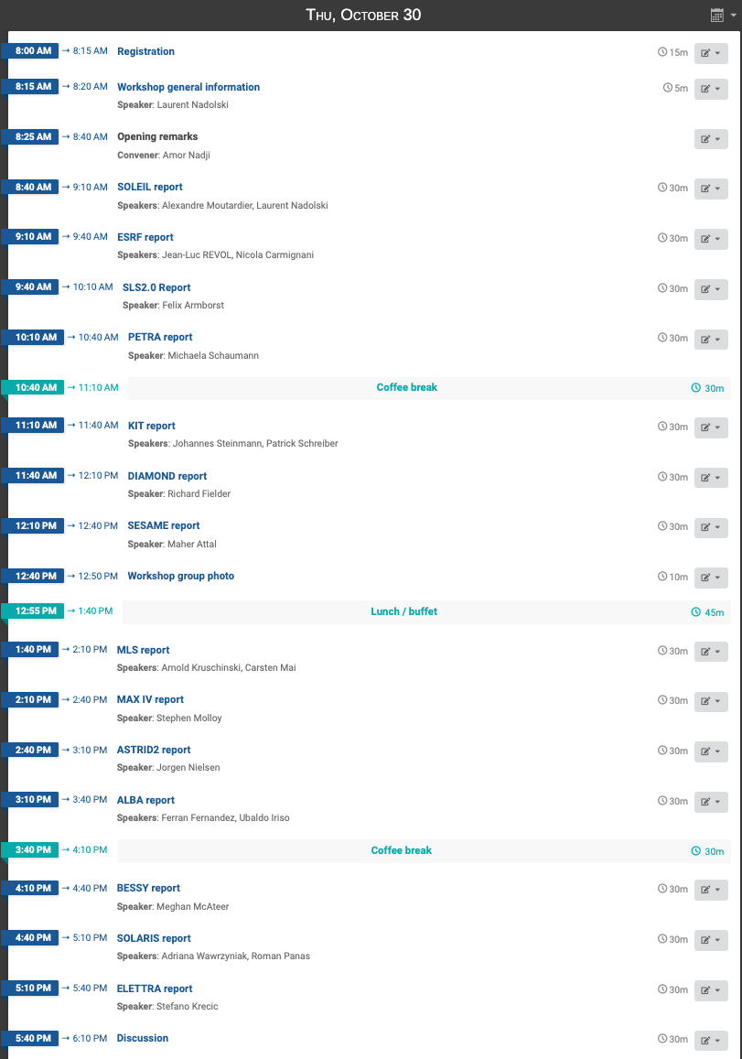
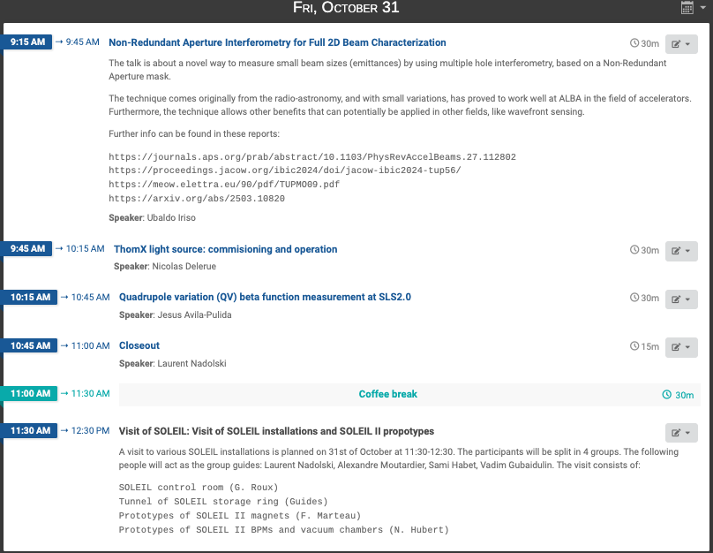
Workshop Program

Slide 6
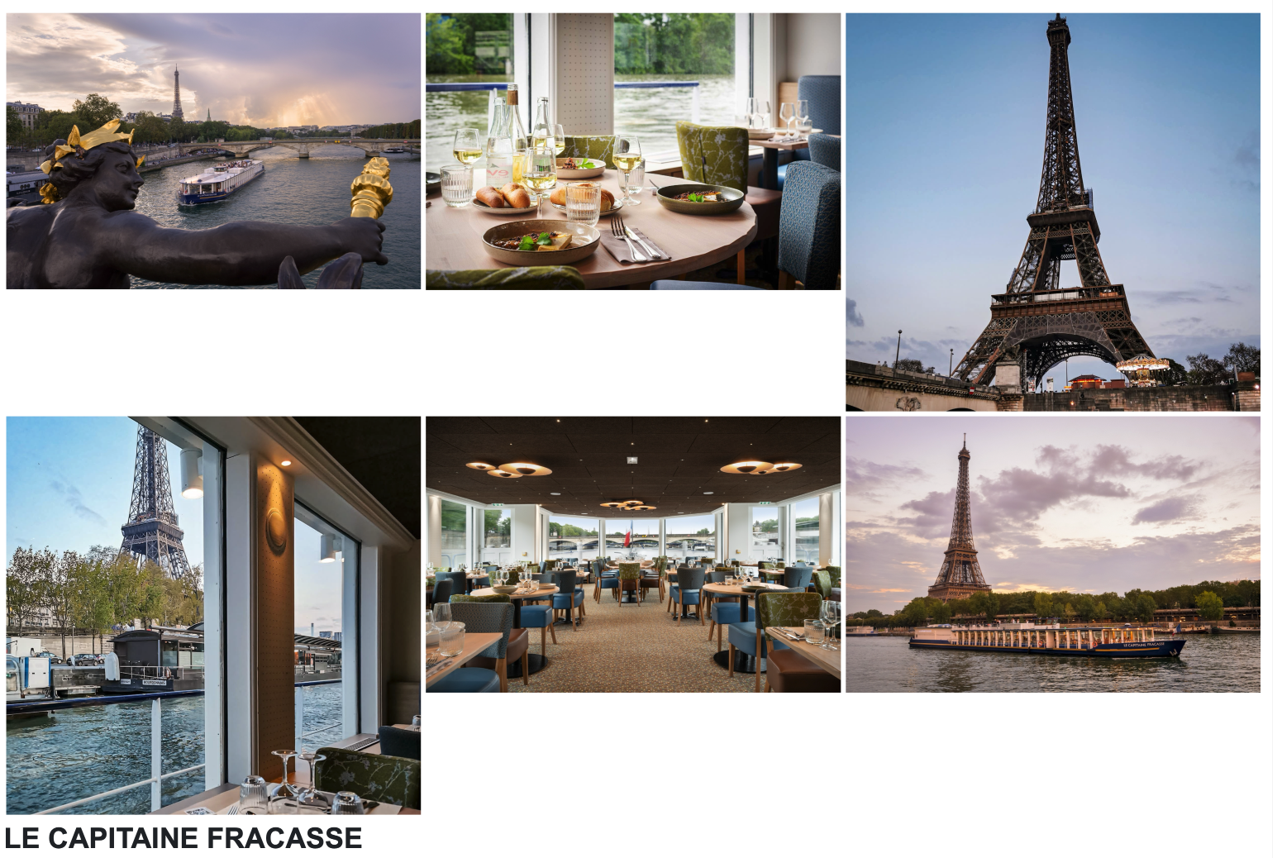
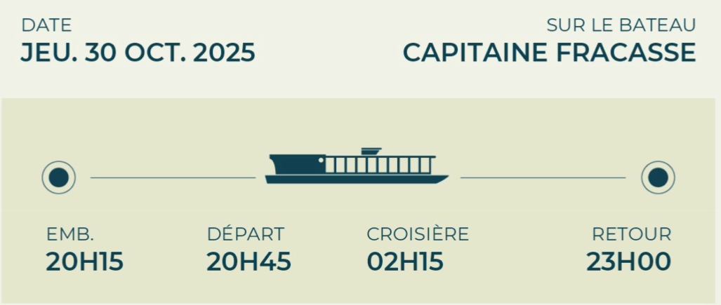
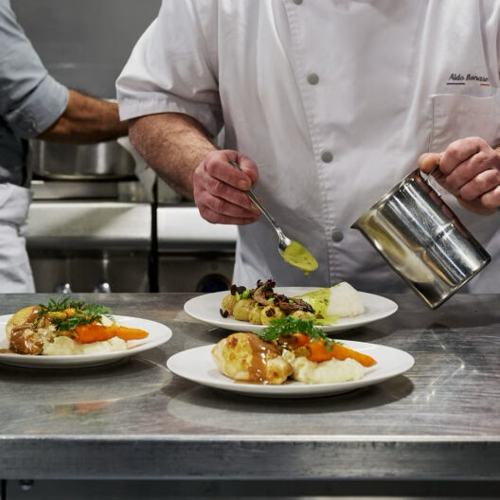
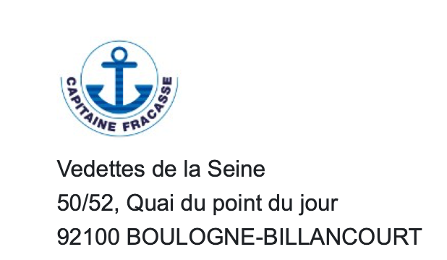
Workshop Dinner: Paris per Bus
Meeting at 18h15

Slide 7
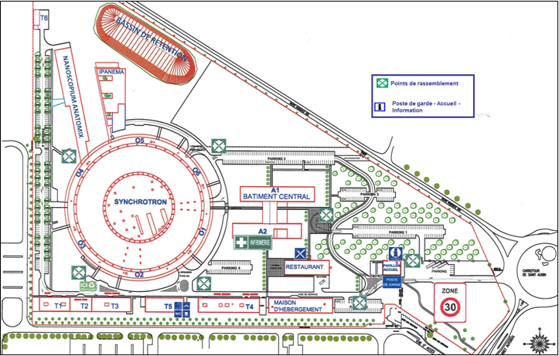
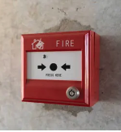

Safety Rules
EVACUATION PROCEDURE
Facility Tour: Safety
People with electronic devices that could affect their health (pacemakers, insulin pumps, neurostimulators for epileptic seizures, etc.) are not allowed to enter due to the presence of powerful magnets. Please note that cochlear implants are allowed, even though the magnetic fields may cause harmless crackling noises. The particle accelerator tunnels have narrow, confined passages that are not accessible to people with reduced mobility (PRMs). The floor of the accelerator tunnels is covered with grates, so it is strongly advised not to wear shoes with heels that could get stuck in them.
Control room
24h a day
(Don’t hang up first)
18
01 69 35 98 40

Slide 8
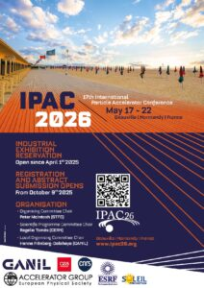
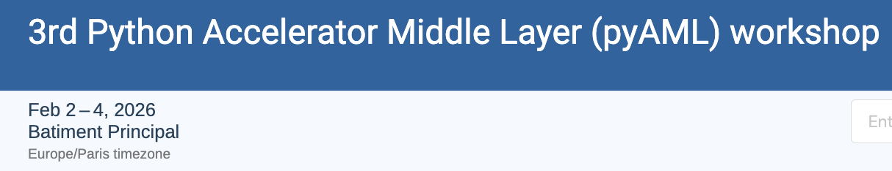
Conference & Workshop
PyAML workshop
IPAC2026
  May 17- 22 2026, Deauville | Normandy | France
Organizer: V. GUBAIDULIN

