Slide 1
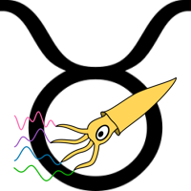
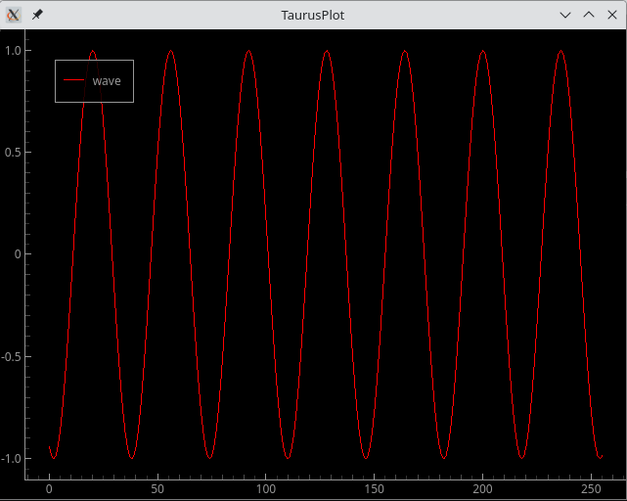

Taurus-PyQtGraph
Emilio Morales
Jose A. Ramos
Zbignew Reszela
Sergi Rubio-Manrique
Oriol Vallcorba

Slide 2
Index
Introduction
Available options
Interesting features
Taurus designer
GUI example using Taurus-PyQtGraph
Some practical use cases
Questions

Slide 3

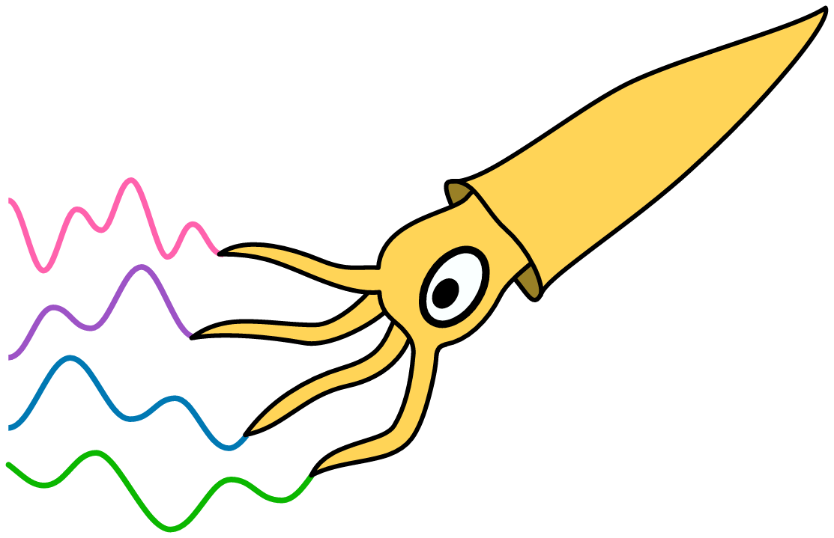
Introduction
Within the Taurus ecosystem, Taurus PyQtGraph acts as a binding layer between pyqtgraph’s high-performance plotting capabilities and Taurus’s data model abstraction, enabling real-time visualization of experimental data with low latency and high flexibility.
This binding allows Taurus to provide:
Real-time signal monitoring.
Control system diagnostics.
Scientific instrumentation dashboards.
High-frequency data streams.

Slide 4
Available options in Taurus-PyQtGraph
Plot
Trend
Image (In progress…)
Trend2d (In progress…)

Slide 5
Taurus Plot
Displays data sets from Taurus models
Designed for static or user-triggered updates
Supports zooming, panning, interactive exploration and second y axis configuration
Built on pyqtgraph for fast rendering
Suitable for analysis, inspection, and comparison of data
CLI Command:
- taurus plot <model>
Key idea:
TaurusPlot focuses on exploring data, rather than continuously streaming it over time.

Slide 6
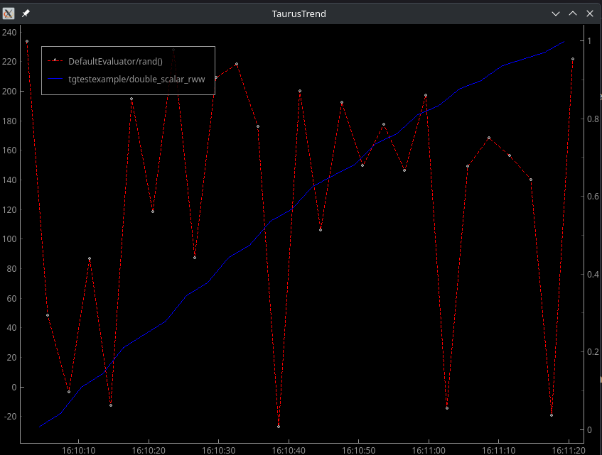
Taurus Trend
Displays live data streams from Taurus models
Optimized for time-based visualization (trending signals)
Supports multiple curves, dynamic updates and second y axis configuration
Ideal for control systems, monitoring, and diagnostics
CLI Command:
- taurus trend <model>
Key idea:
TaurusTrend focuses on streaming data over time, making it the go-to tool for observing how values evolve in real time.

Slide 7
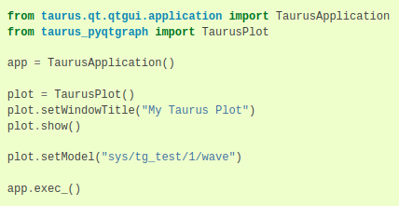
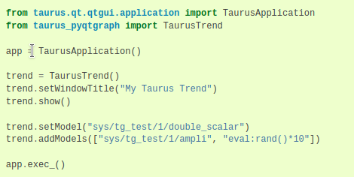
Taurus Plot and trend programmatically

Slide 8
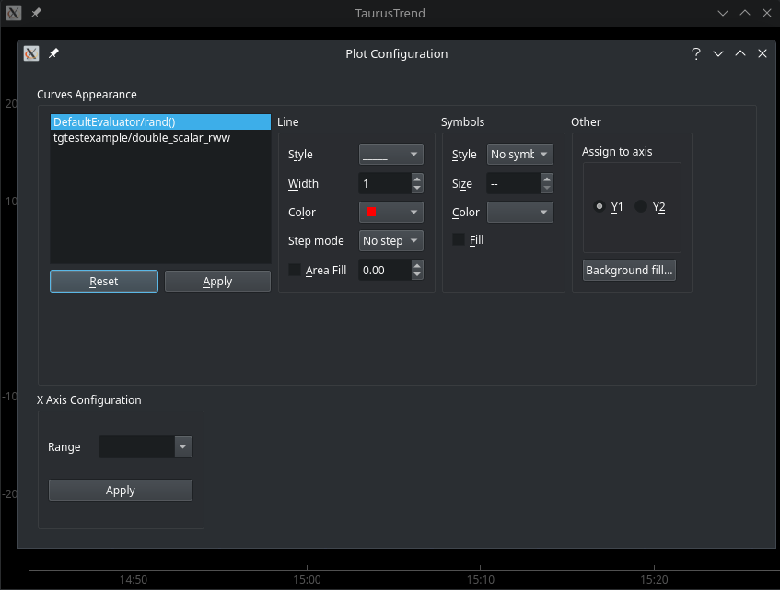
Plot configuration
With the plot configuration menu you can (for each curve):
Change the style, width, color, step mode and the area filling of each curve.
Enable symbol printing for each point of the data received.
Change the Y axis of a given curve.
Modify the Range that you want to view:
In seconds, minutes, hours, days, months or years.

Slide 9
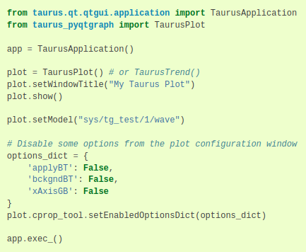
Disable plot configuration options
Giving full functionality to the final user may not be desirable for some of us.
We can configure programmatically which options are disabled for the user in the plot configuration widget.
Those options are:
applyBT
assignToY1BT
assignToY2BT
bckgndBT
curvesLW
dialogEnabled
lineGB
otherGB
resetBT
symbolGB
xAxisGB
Thanks Raphael for suggesting this!

Slide 10
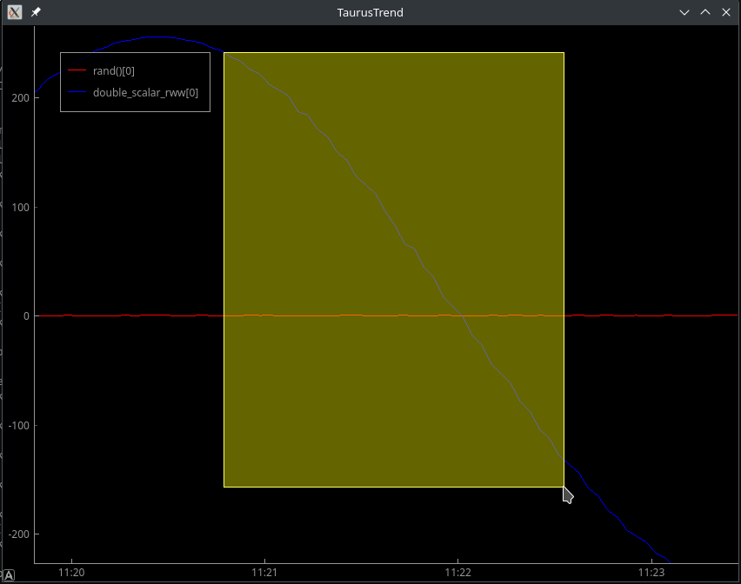
Mouse mode
Like other plotting tools Taurus PyQtGraph allows to change the mouse default behavior.
1 button mode will make the cursor to act as a range selector.
3 button mode:
Left click: drag the axis
Right click: modify axis scale
Wheel: set the zoom level

Slide 11
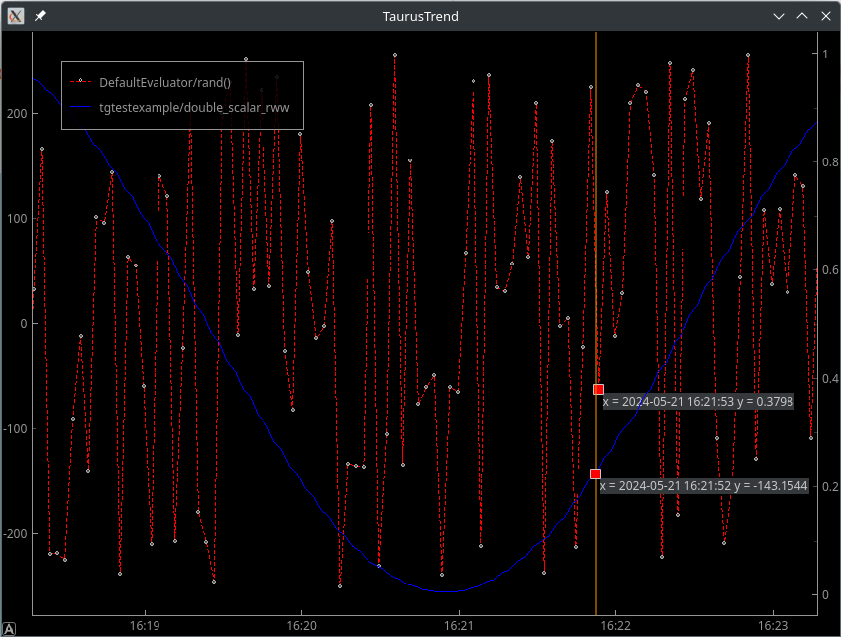
Data inspector
Inspector mode allows to highlight the value of all curves in a given time.
Easy way of comparing two signals in a given time.

Slide 12
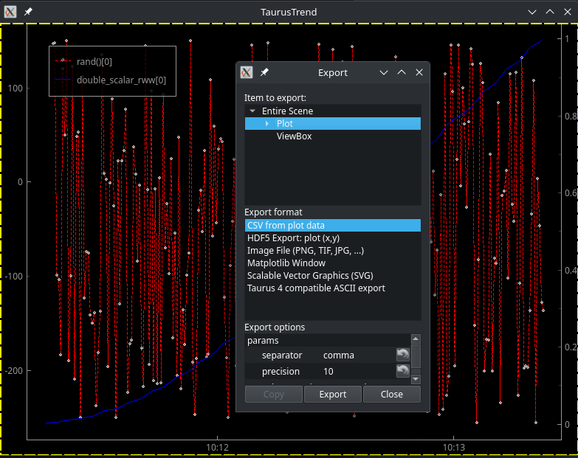
Export mode
The export mode allows us to select a desired output format and save the result of the plot into it.
Available formats:
CSV, TSV
HDF5
Image
Matplotlib Window
SVG
ASCII (same as Taurus 4 format)
It gives the possibility to modify the parameters of each exporting format.

Slide 13
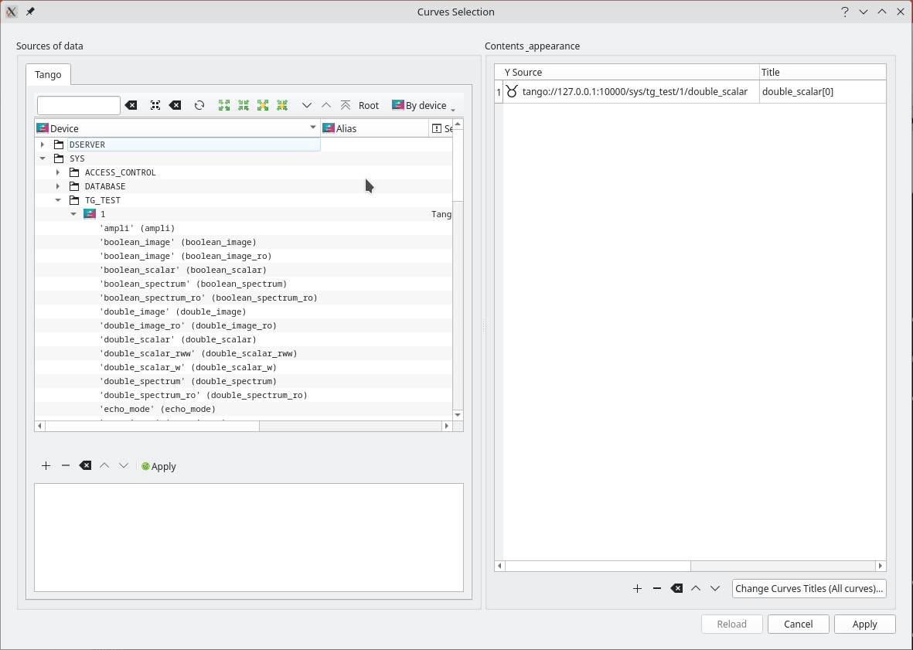
Model Chooser Tool
The Model Chooser is a utility component that allows users to browse and select Taurus models to plot them
Provides a user-friendly interface to explore available models
Selecting attributes for trends and plots
Enables dynamic configuration of plots and widgets
Integrates seamlessly with Taurus-based applications
Simplifies connecting data sources to visualization tools
Key idea:
The Model Chooser bridges the gap between available data and visualization, making it easy to select what to display.

Slide 14
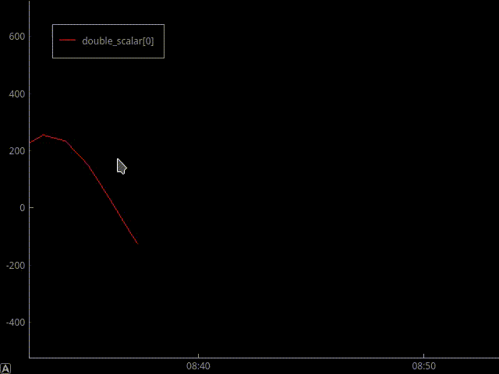
Archiving features
Taurus trend has the possibility to plot archiving data by selecting it on the contextual menu, but this option just appears if you have PyHDB++ installed and configured properly.
PyHDB++?
With this feature we gain the following options:
Autoreload: Loading data by moving trend
Load Once (Ctrl+L)
Decimate and Redraw (Ctrl+R)
Configure decimation
Key Idea:
TaurusTrend enables access to archived data, which allows users to load historical data directly into the trend and apply decimation on demand.

Slide 15
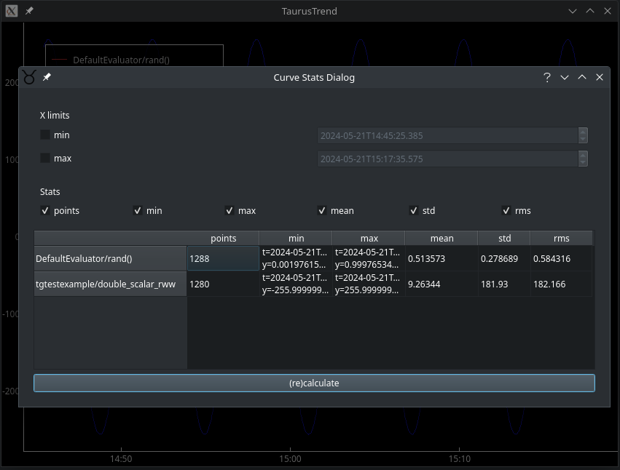
Statistics
Define X limits
Select what stats you want
Num. of points
Min
Max
Mean
Std
RMS

Slide 16
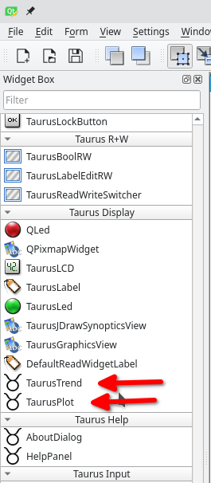
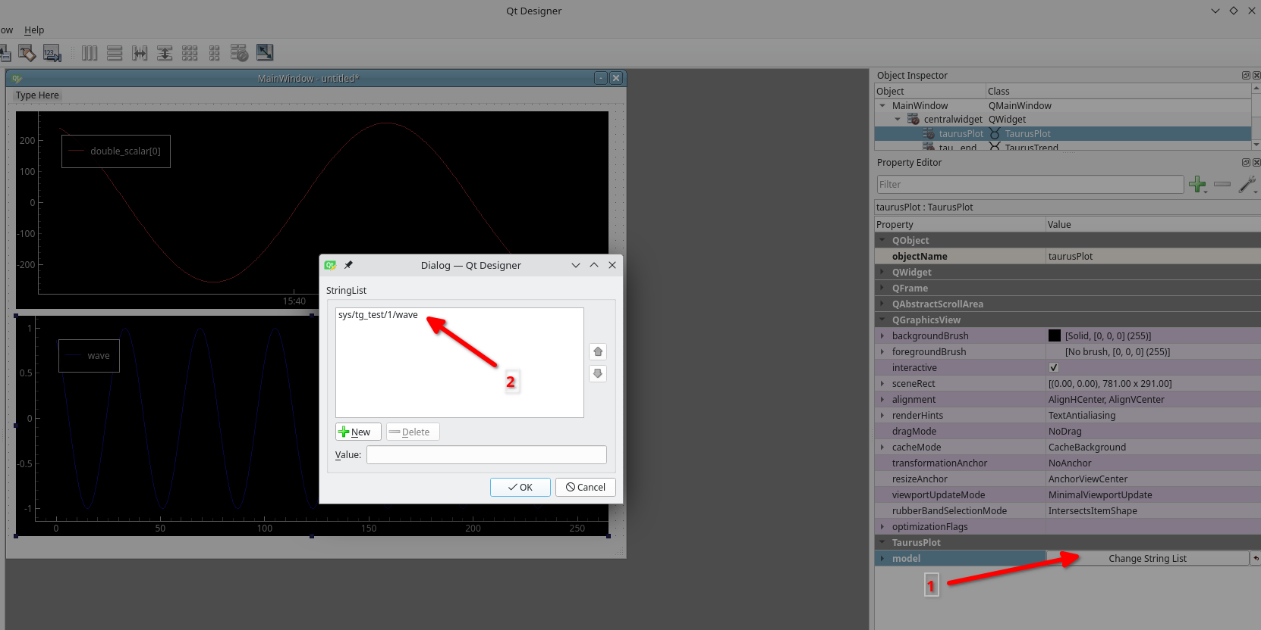
Taurus designer
Like other Taurus widgets, Taurus trends and plots can easily be added via the Taurus Designer for rapid GUI construction.
From the designer you can set the desired models and preview them in real time.

Slide 17
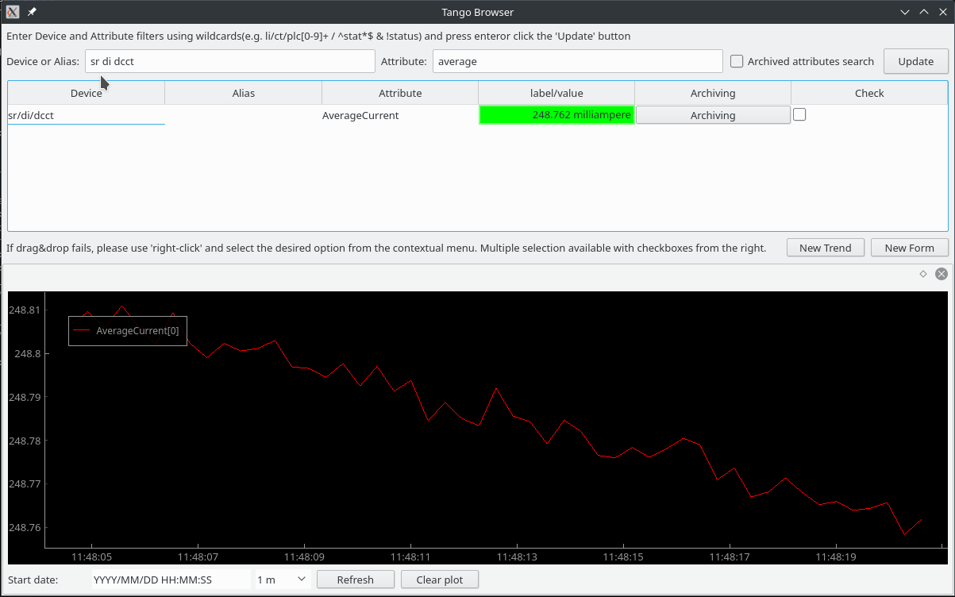
TangoBrowser – A Taurus GUI
TangoBrowser is a tool to search for Tango attributes and display their data, either from live system or if ever archived
Due to the fact that this GUI have been developed using taurus you can drag&drop from the list above to the taurus trend and it will start to plot the attribute.

Slide 18
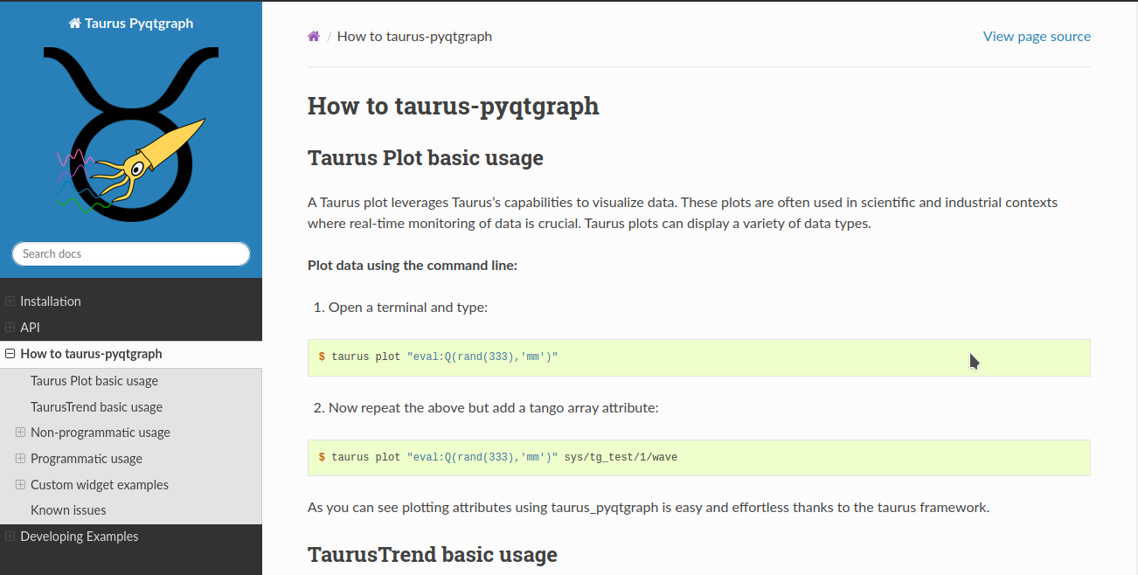
Documentation
You can have a look to the detailed documentation, there all the information from this seminar is updated and expanded.
https://taurus-org.gitlab.io/taurus_pyqtgraph/develop/usage.html

Slide 19
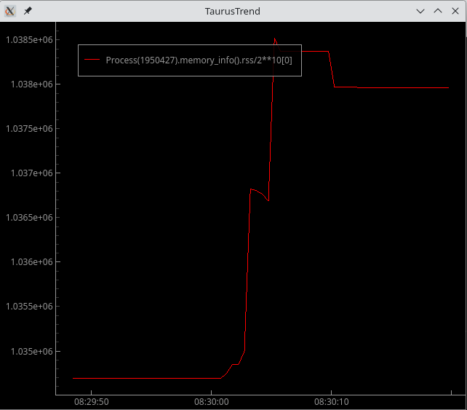
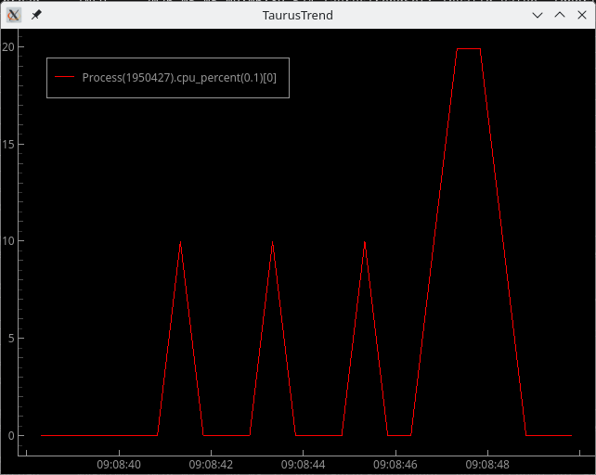
A practical use case
Imagine that you want to track the lifecycle of a process on your system in terms of memory or CPU usage.
taurus trend -r500 "eval:@psutil.*/Process(REPLACE_THIS_BY_PID).memory_info().rss/2**10"
taurus trend -r500 "eval:@psutil.*/Process(REPLACE_THIS_BY_PID).cpu_percent(0.1)"

Slide 20

Questions?
Question mark. Credits: Wikimedia

