Slide 1
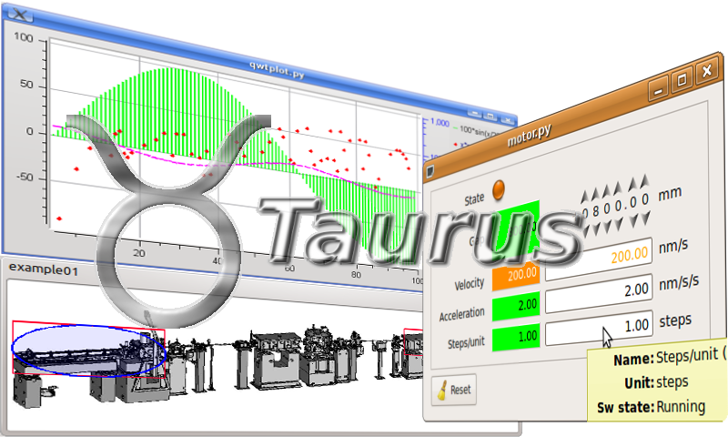

Taurus 2D Plot
Emilio Morales
Jose A. Ramos
Zbignew Reszela
Sergi Rubio-Manrique
Oriol Vallcorba

Slide 2

Index
Introduction
Available widgets
Migration - plotpy
Work in progress
Proposals?
Questions

Slide 3
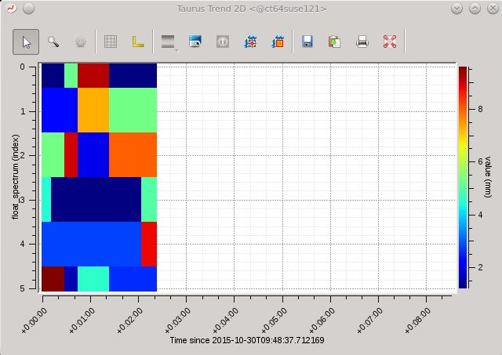
Introduction
Taurus offers a catalog of 2D widgets.
Represent diverse kind of data:
Images
Heatmaps
Spectrograms
…
Using legacy guiqwt Widgets
Not maintained anymore.
Unify plotting tools like taurus-pyqtgraph
TaurusTrend2D. Credits: Taurus

Slide 4
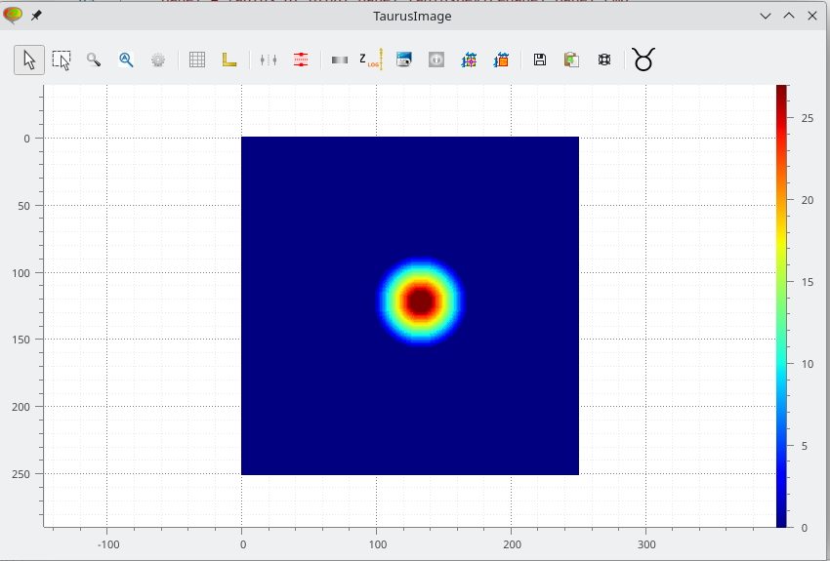
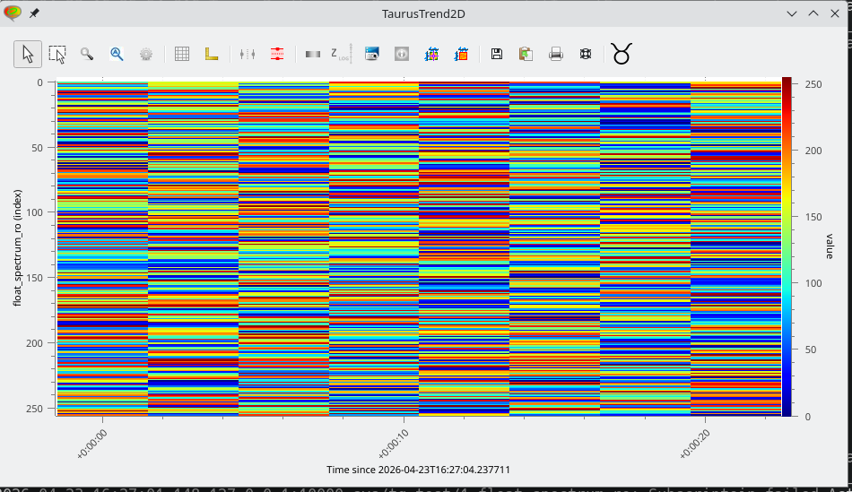
Available Widgets
TaurusImage
TaurusTrend2D

Slide 5
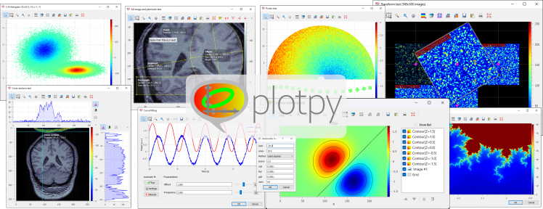
Migration – plotpy
Migrated to plotpy since 5.4.0
“Use the same API”
Not much effort to migrate it.
Offer a maintained alternative to guiqwt library
PlotPy Widgets. Credits: Plotpy

Slide 6
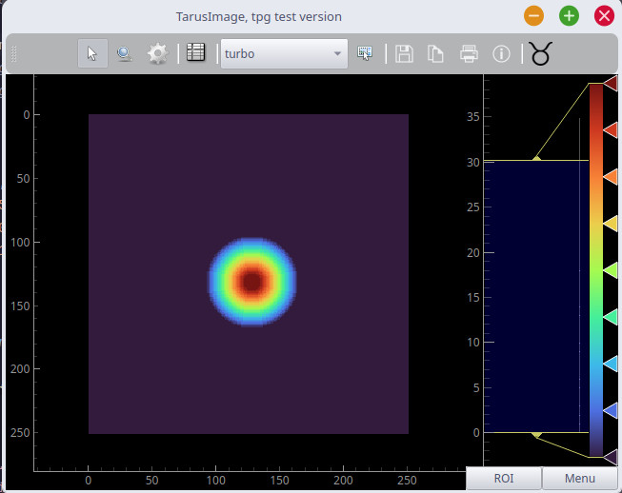
Work in progress
Migrating widgets to taurus-pyqtgraph.
Unify plot catalog.
Use plug-in schema for plot.
Two options:
Deprecate plotpy.
Maintain plotpy widgets as an independent plugin.

Slide 7

Proposals
Question mark. Credits: Wikimedia

Slide 8
Questions
Question mark. Credits: Wikimedia

