Slide 1
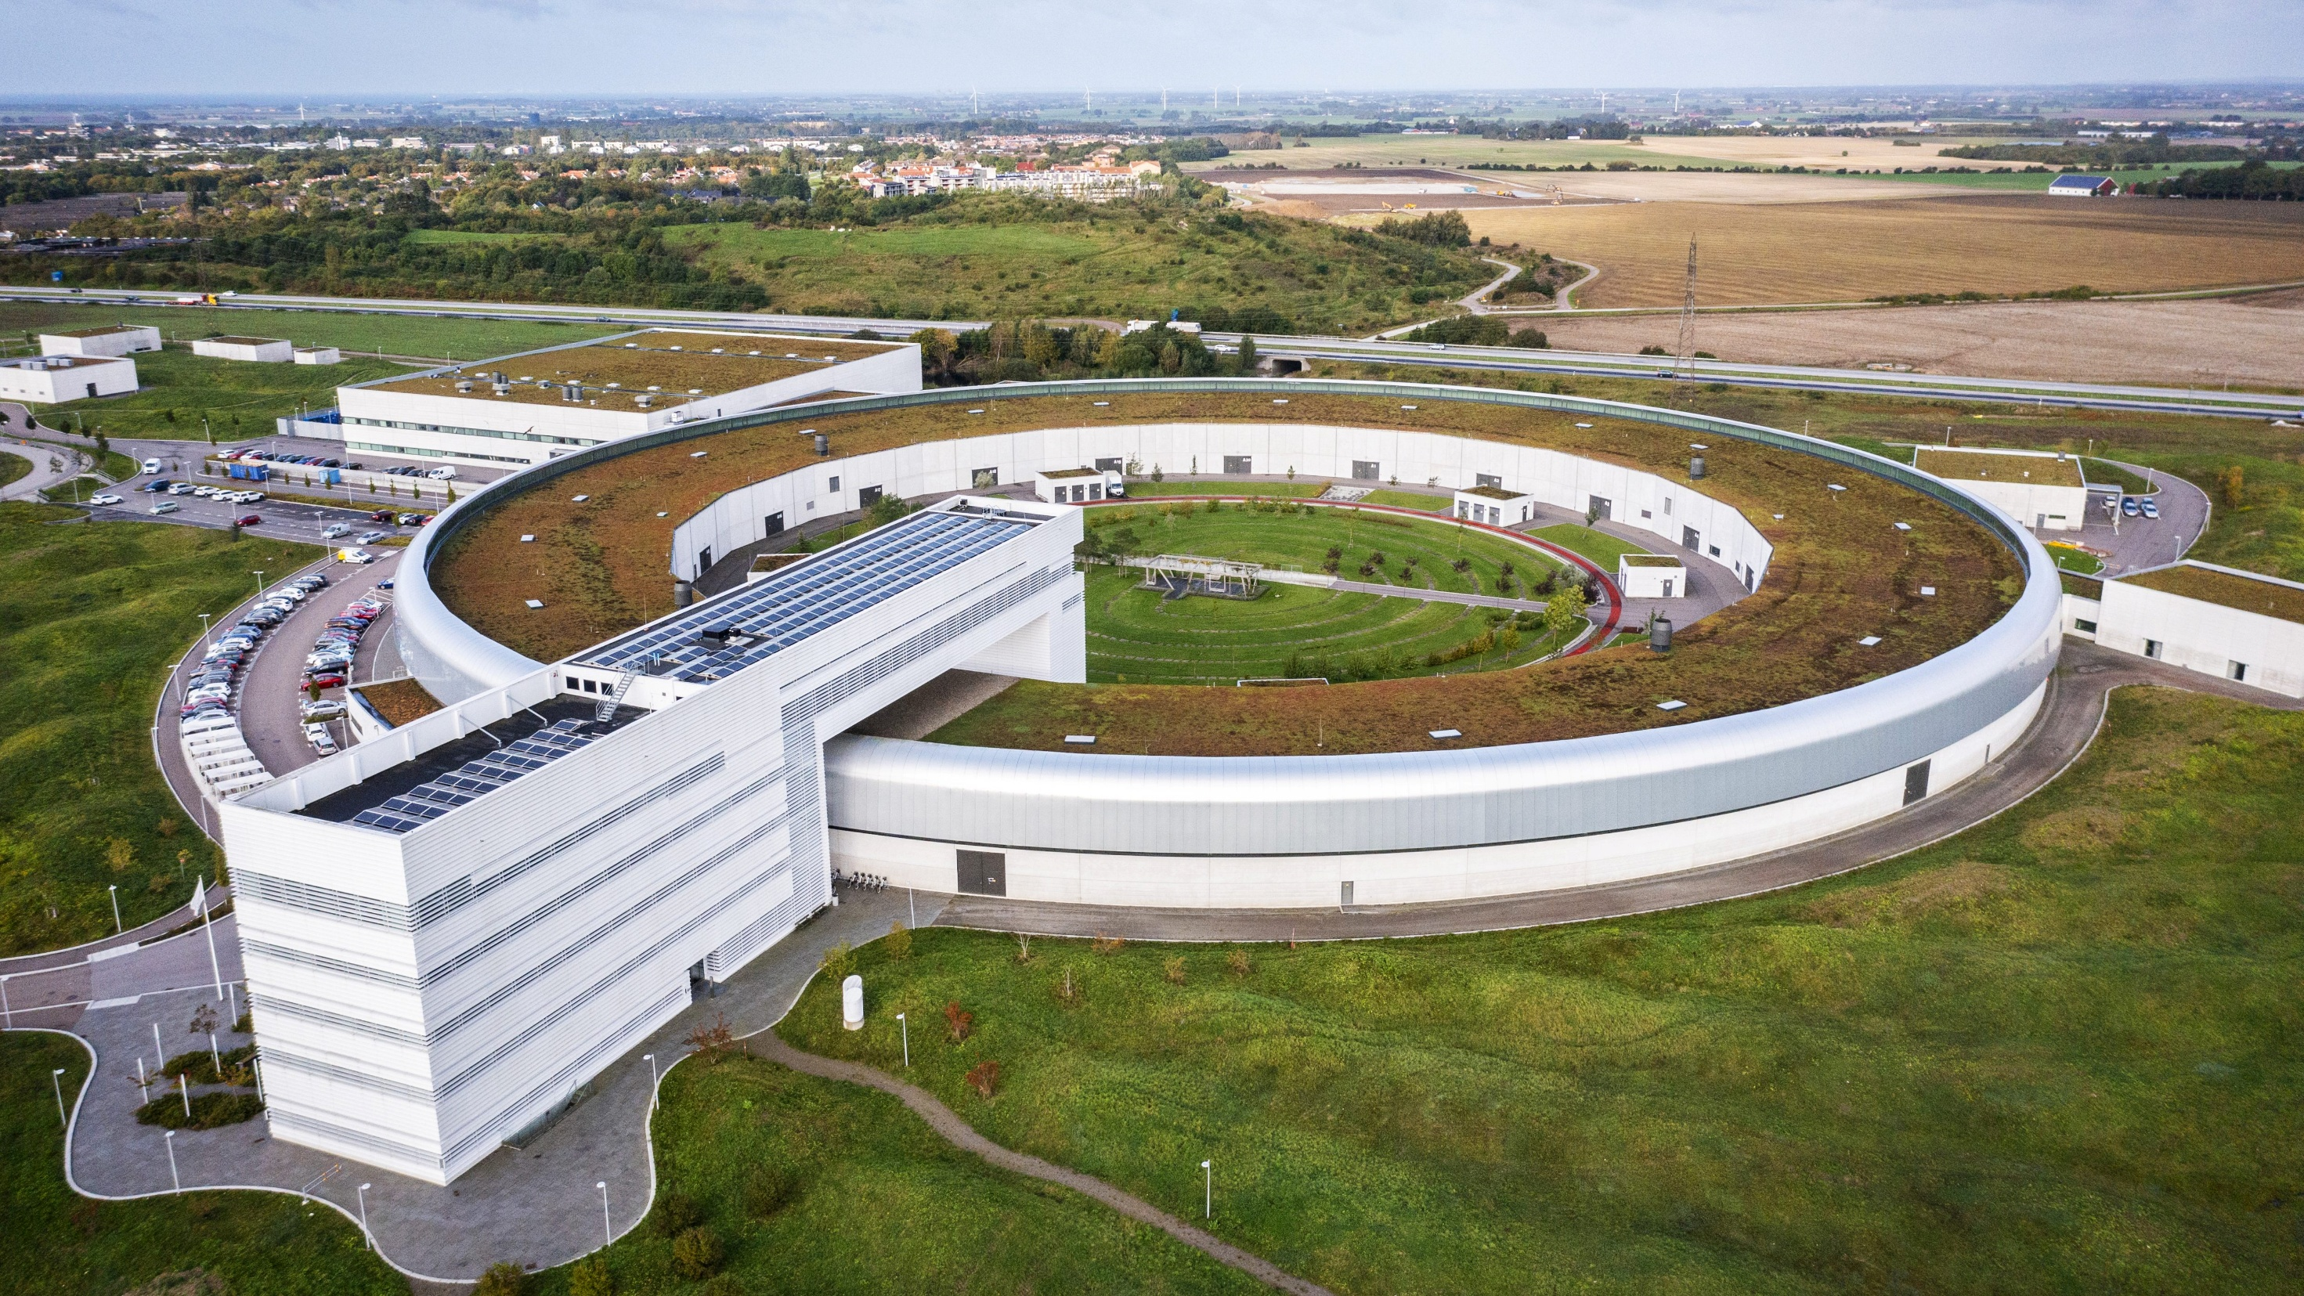
Taurus-based GUIs at Balder beamline
Konstantin Klementiev
MAX IV Laboratory

Slide 2
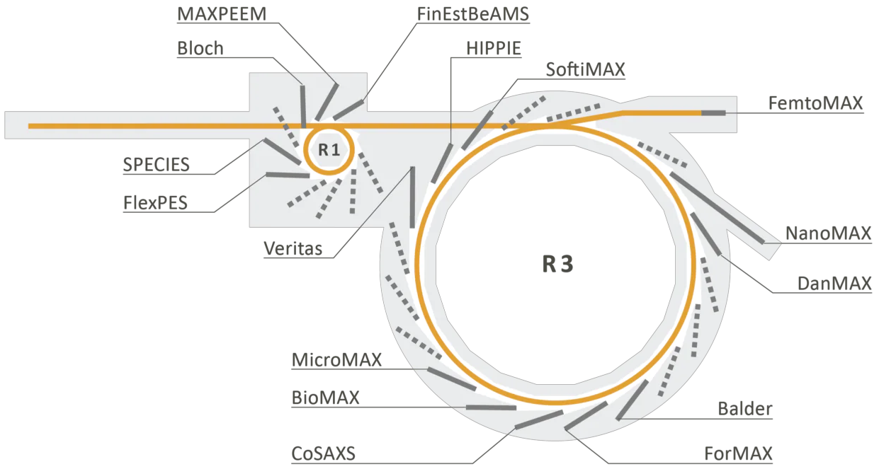
Beamlines at MAX IV
Soft X-ray spectroscopy
Hard X-ray spectroscopy

Slide 3
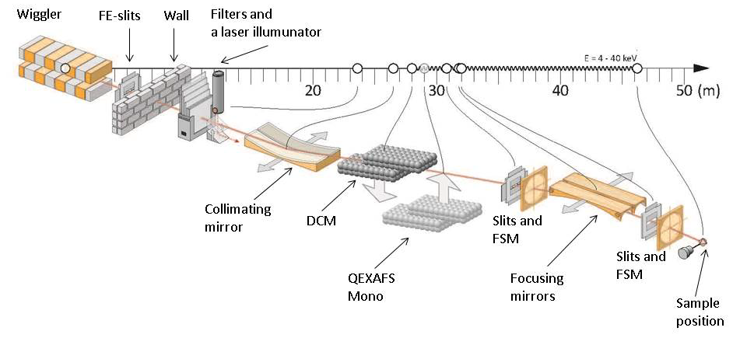

Balder beamline: source and optics
In vacuum wiggler, 10¹³ photons/s, energy range 2.4 – 40 keV (presently from 4 keV)
Focusing down to ~70$×$70 µm², defocusing vertically up to 2 mm
Fast scans: full EXAFS up to 2Hz continuous acquisition, typ. 10-30 s/spectrum

Slide 4
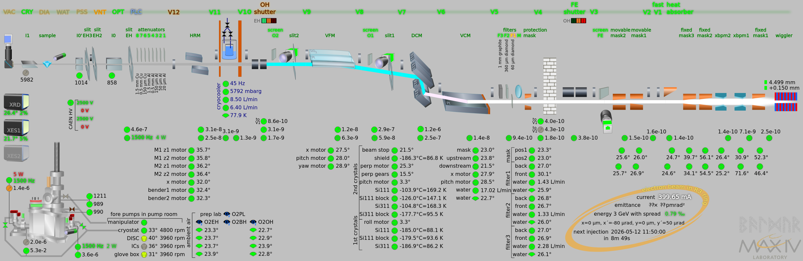
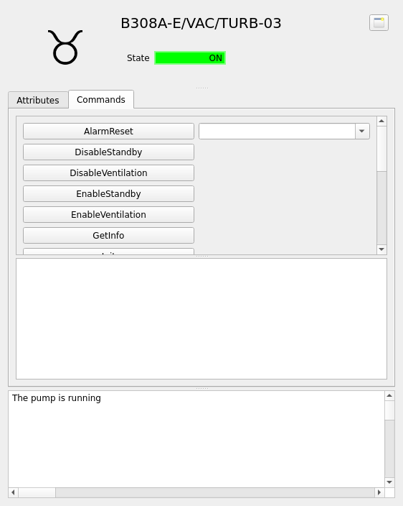
GUI Synoptic

Slide 5
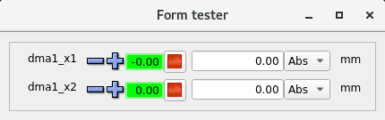
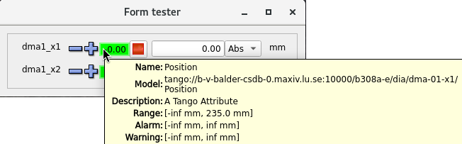
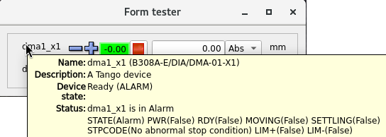
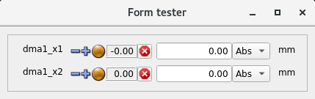
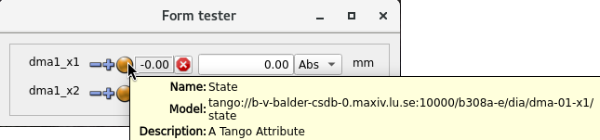
GUI BalderMotors
sardana.taurus.qt.qtgui.extra_pool.PoolMotorTV

Slide 6
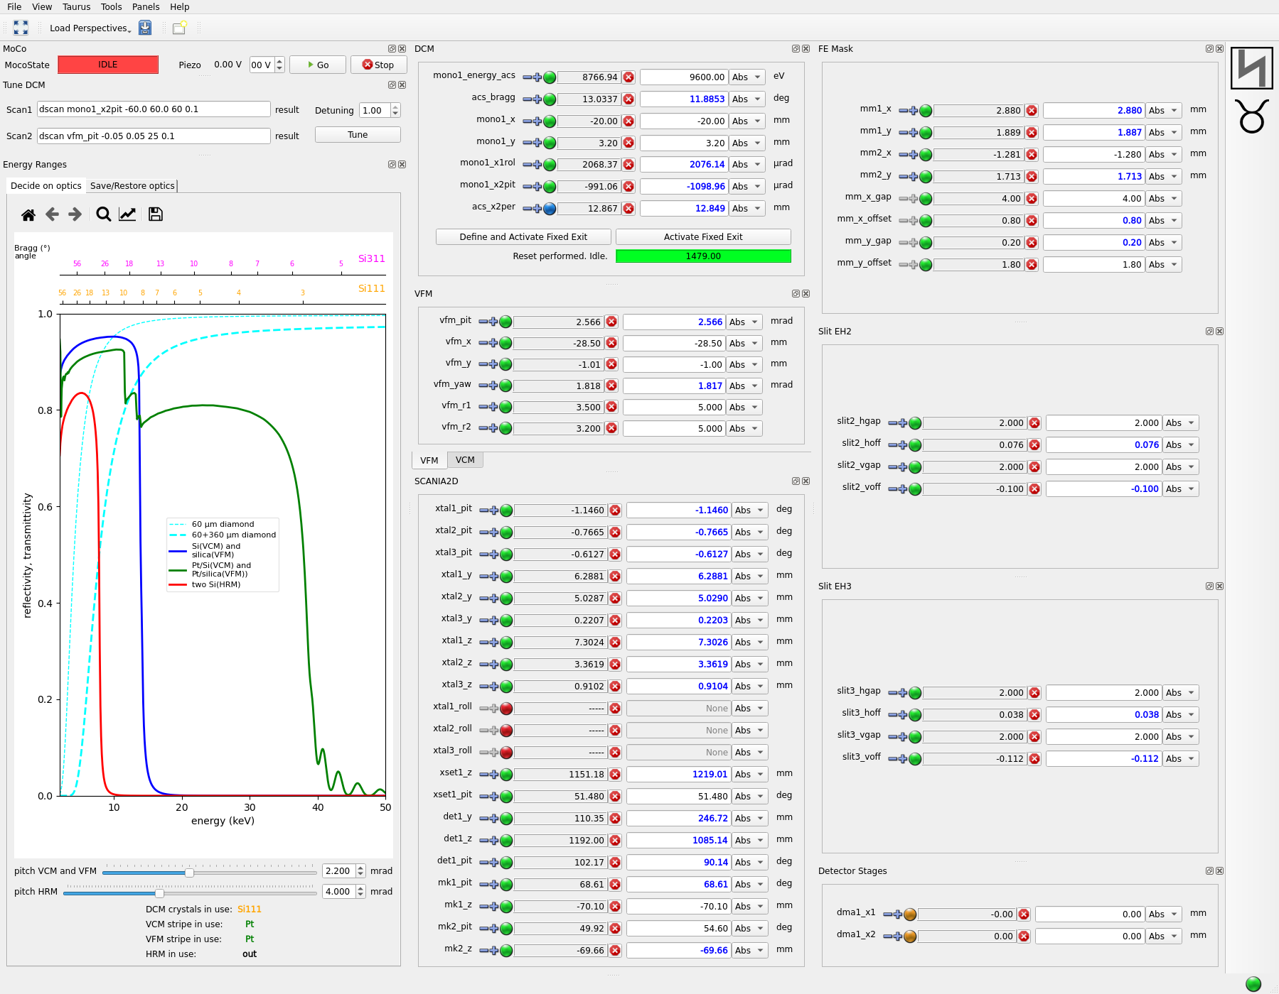
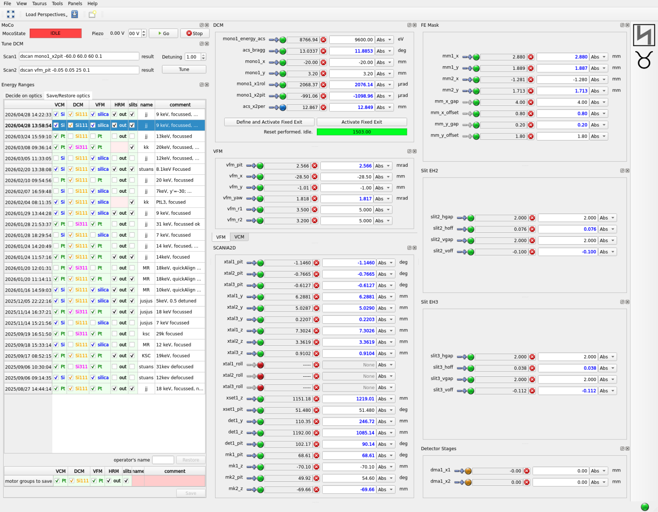
GUI BalderMotors
Store/Restore
motor groups
for specific instruments
The whole Taurus GUI
gets segmentation fault
during start-up
when faulty motors exist

Slide 7
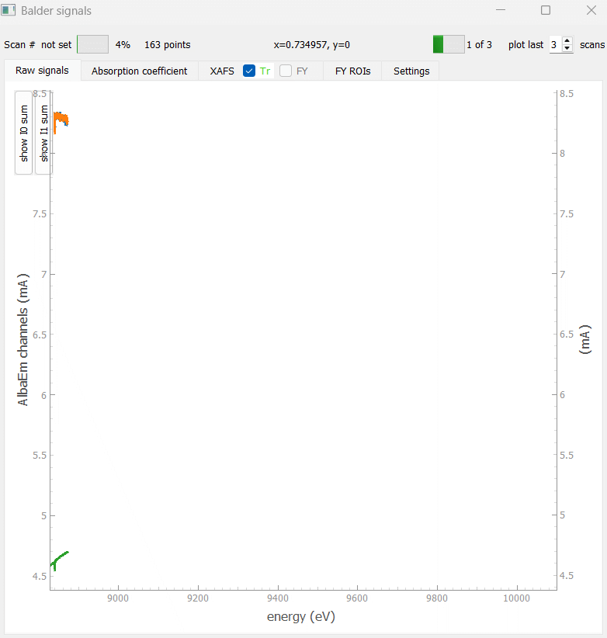
GUI BalderScans

Slide 8
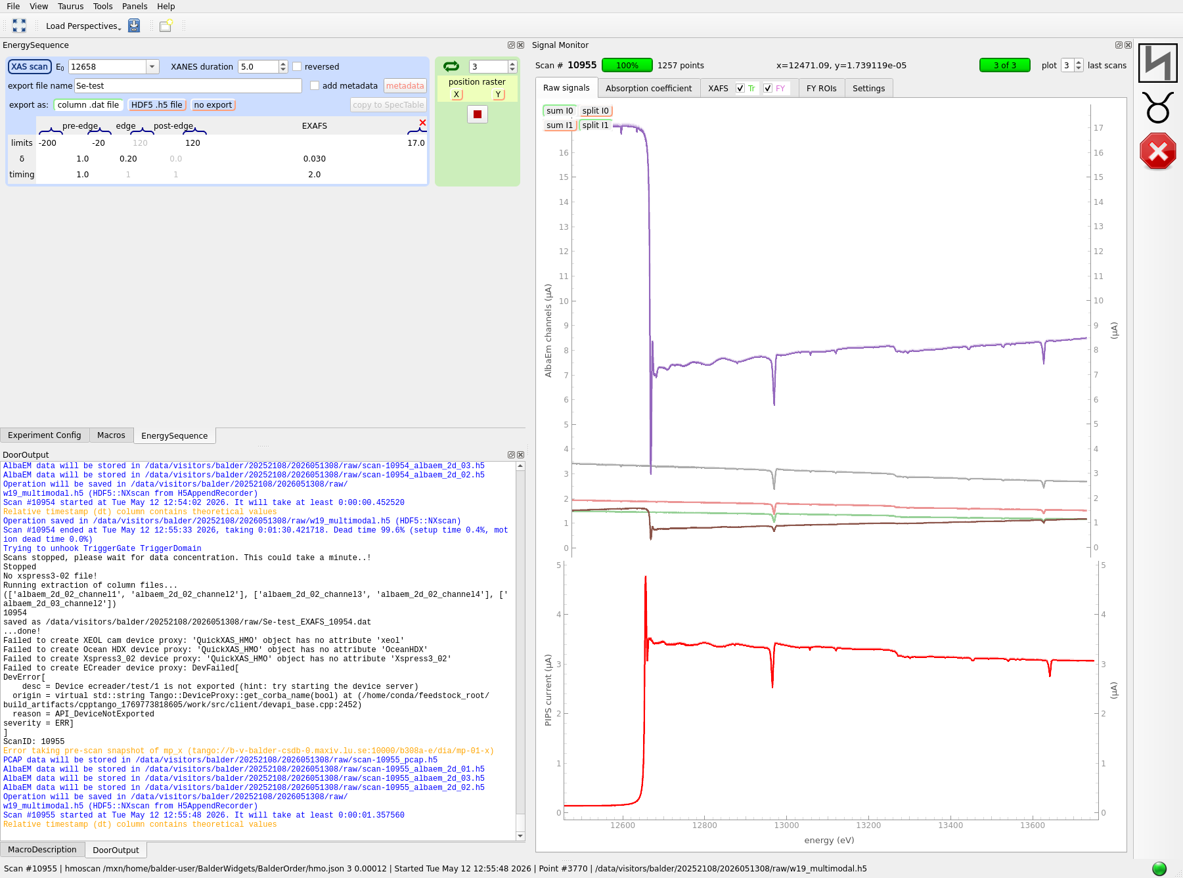
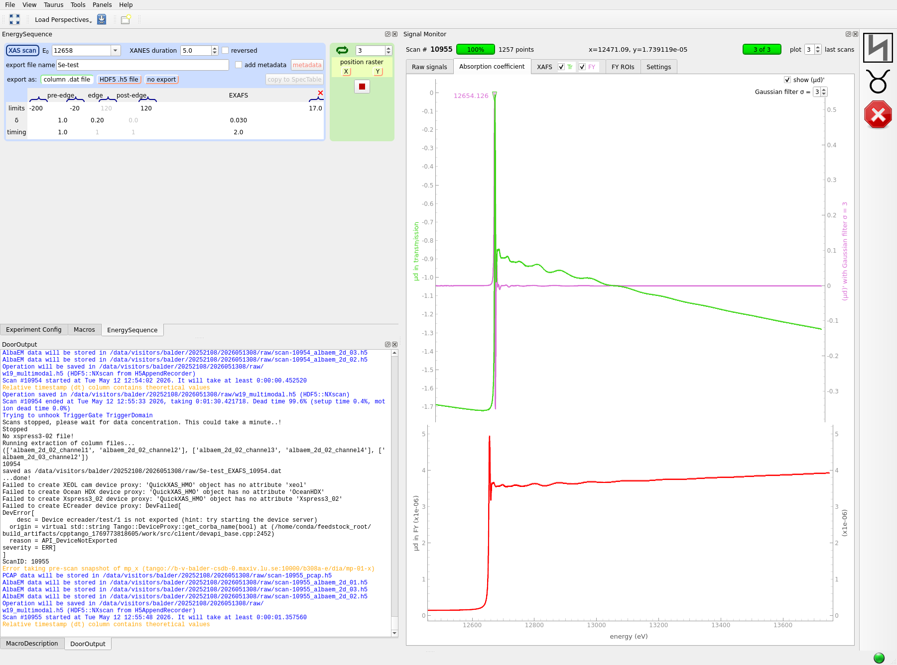
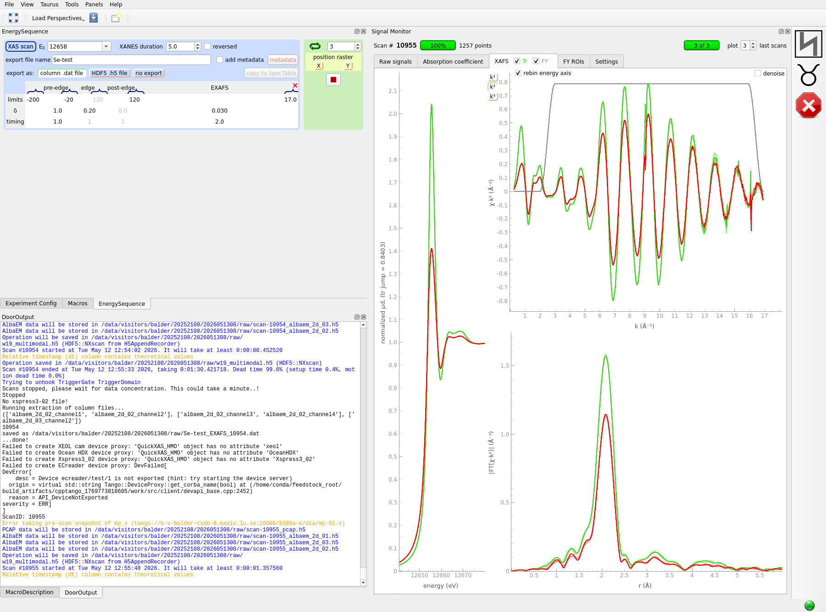
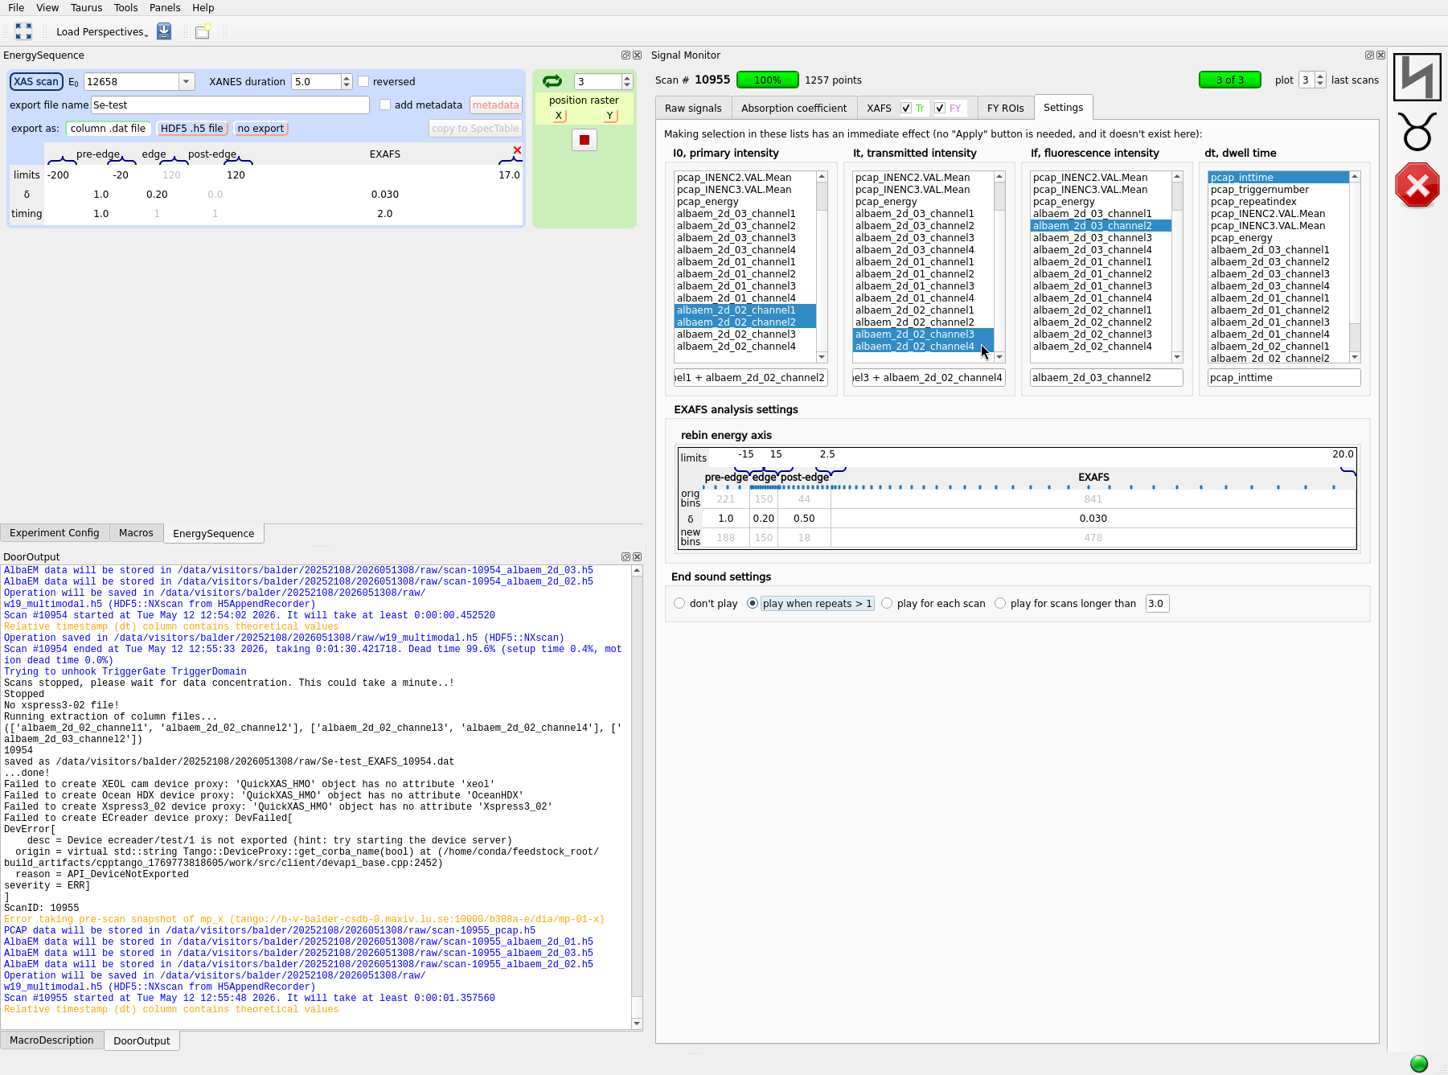
GUI BalderScans

Slide 9
Conclusions
Taurus does serve its purpose. It is usable by beamline staff. It is getting faster in time (great!).
Usability is sometimes questionable from my and users’ perspective, probably not so from the developers’ perspective. Tooltips are under-used; and there is no tooltip role.
The standard widgets (e.g. PoolMotorTV) are hardly tunable. Even the top-most Jorg’s bar is not (!)
A few common tasks/widgets are missing: store/restore motor groups, signal definitions, beam loss sound notification, beam presence check before scan start.
Thank you for your attention!

