Slide 1
Taurus @ SOLEIL
Project status & a beamline perspective
Arnaud HEMMERLE
Beamline scientist & Co-responsible of Taurus project @ SOLEIL

Slide 2
Outline
Taurus @ SOLEIL: why and how?
A beamline perspective
Taurus and PyQt-Tango GUIs for machine control → Alexandre Moutardier (Accelerators group)
Development of a fly-scan visualization GUI using Taurus → Raphaël Girardot (IT Engineer)

Slide 3
Taurus @ SOLEIL: why and how?
Since SOLEIL exists...
Requests for customizable Graphical User Interfaces (GUIs) on the control system,
But challenging in terms of resources, maintenance, and not a priority.
Take the opportunity of SOLEIL’s upgrade
2022-2024: Working group on Human Machine Interfaces (HMI) for the TDR phase
2023: Big survey on HMIs needs & usages in SOLEIL
→ 20 groups requested the possibility to build their own GUIs, in addition to the tools provided by IT
→ For automation, user-friendly interfaces, and combining data analysis with acquisition
→ In some cases, as a replacement for other softwares (LabView, IGOR, Matlab ...)
→ Decision made to evaluate Taurus as a candidate

Slide 4
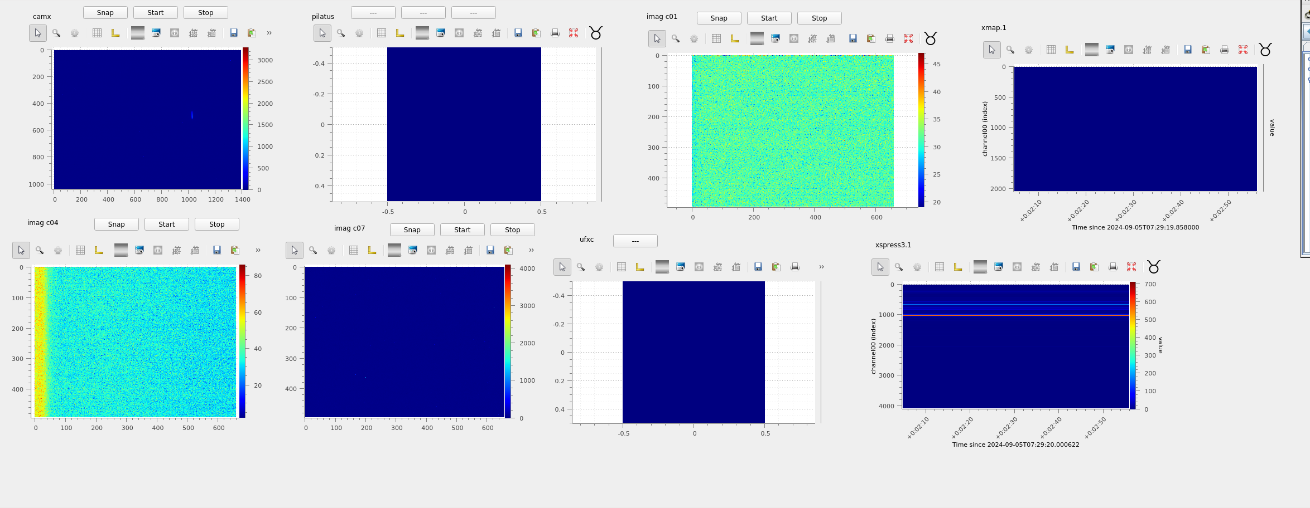
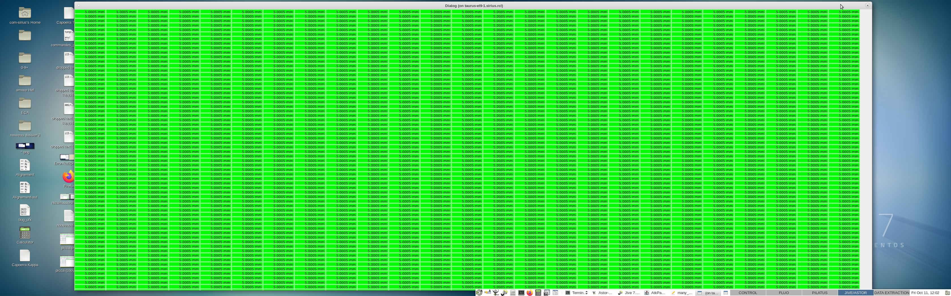
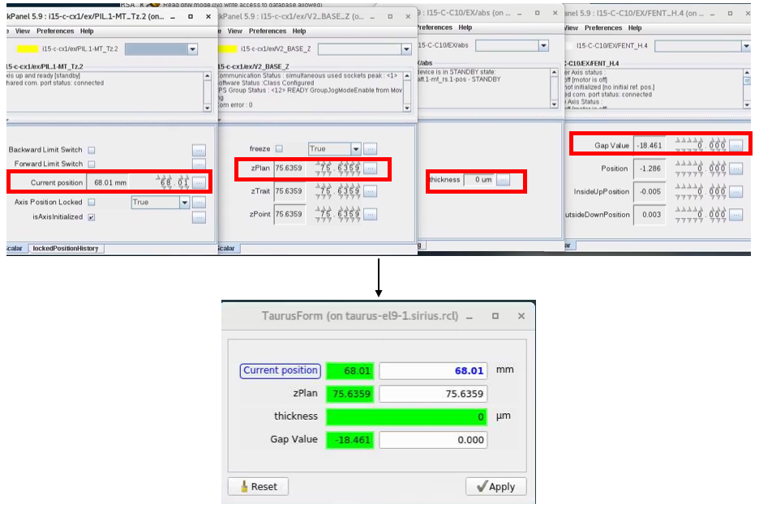
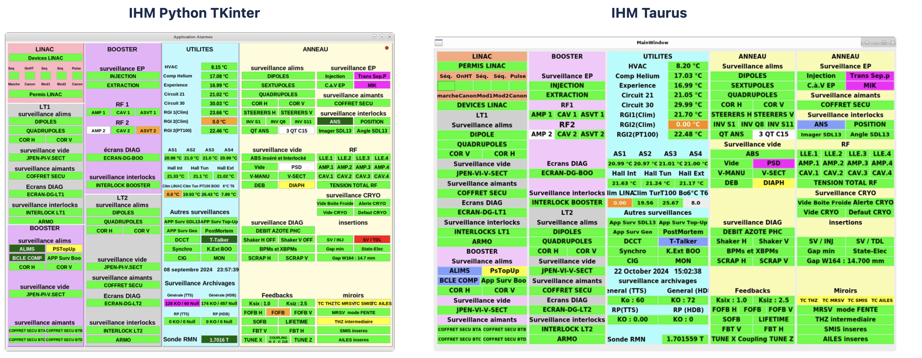
Taurus @ SOLEIL: why and how?
2024: Extensive testing of Taurus : IT + Beamline + Machine
Explore the different possibilities and compare them with existing tools,
Proof of concept for autonomous GUI development without support from IT teams,
Identify bugs and evaluate whether they are blocking,
Test performance limits.
8 detectors in the same GUI
10000 taurus labels in the same GUI
Testing Taurus forms
Going from TKinter to taurus

Slide 5
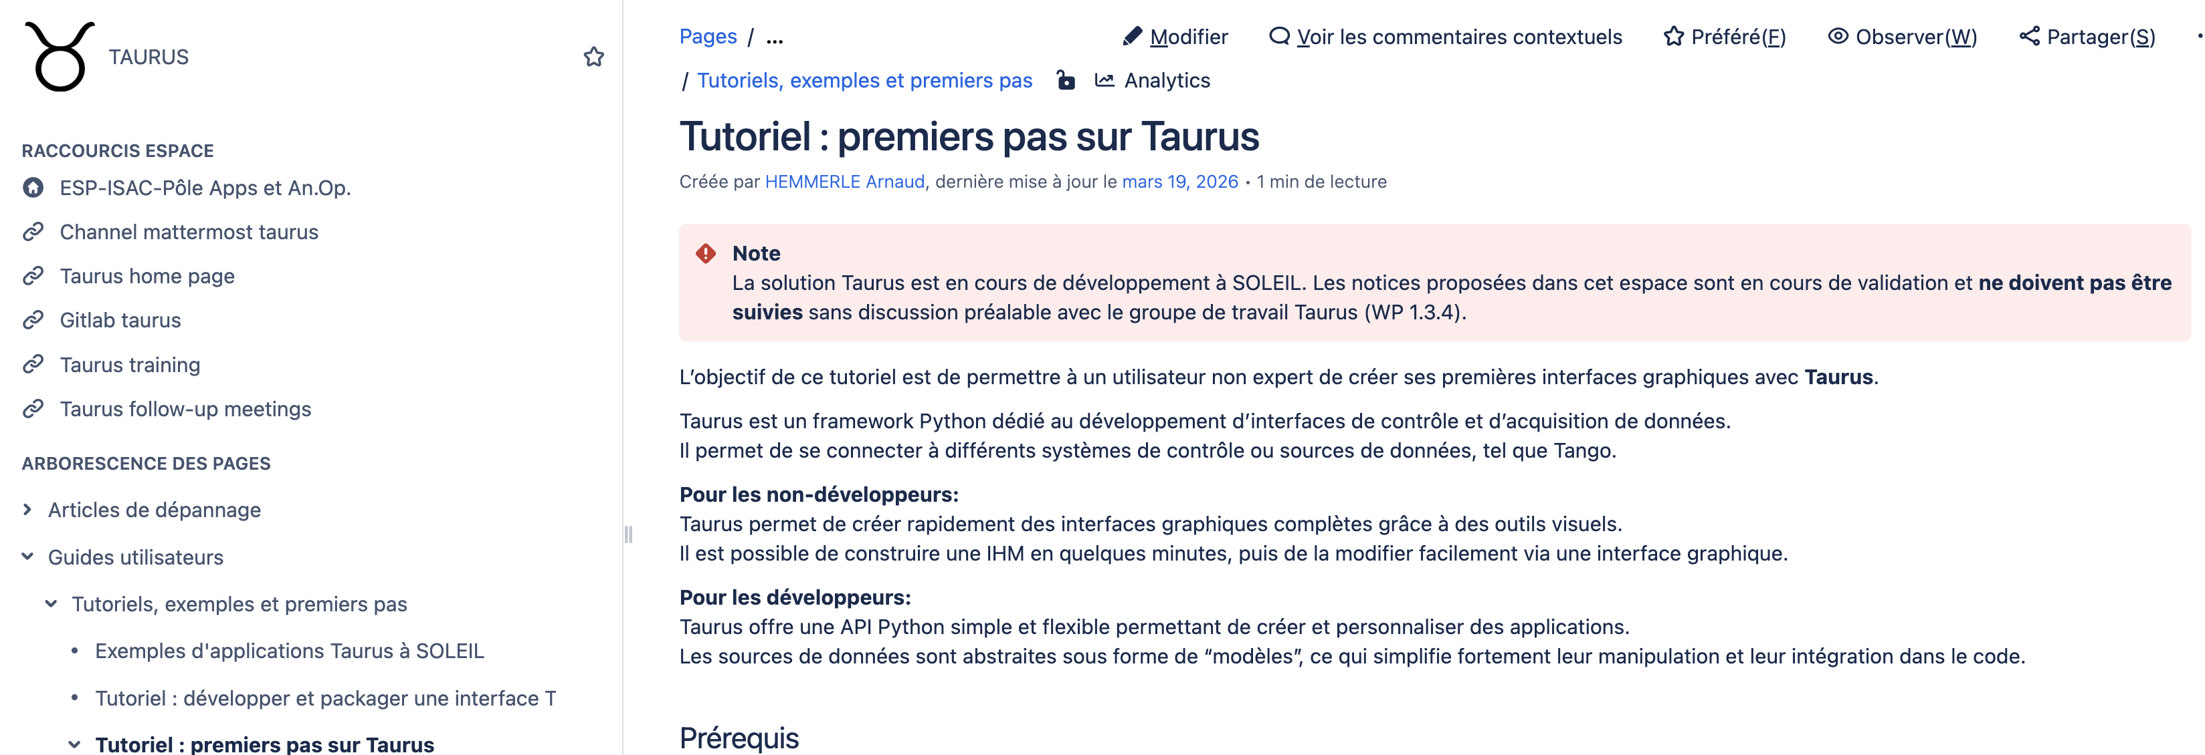
Taurus @ SOLEIL: why and how?
2025 - now : Taurus as one of the project for the IT upgrade of SOLEIL
Part of a larger project on applications and CI/CD (deploying Conda on the control system, tools for collaborative work, dev/prod platforms ...),
Definition of a strategy for deployment, training, and maintenance,
Building documentation,
A small working group that will progressively expand.
Building documentation
Still in test phase with positive feedback. Hopefully available for interested groups this year (?)
→ training?

Slide 6
A beamline perspective

Slide 7
A beamline perspective
Interesting native tools (no-code/low-code)
Taurus form: instead of 20 ATK panels, a single form adapted to each experimental configuration.

Slide 8
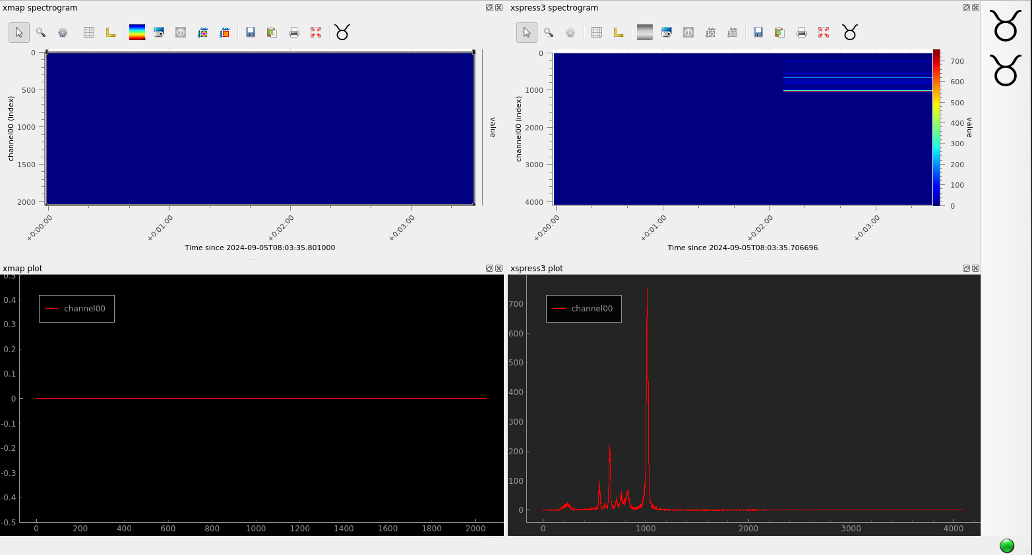
A beamline perspective
Interesting native tools (no-code/low-code)
Taurus gui: create a GUI with several detectors in a few minutes.

Slide 9
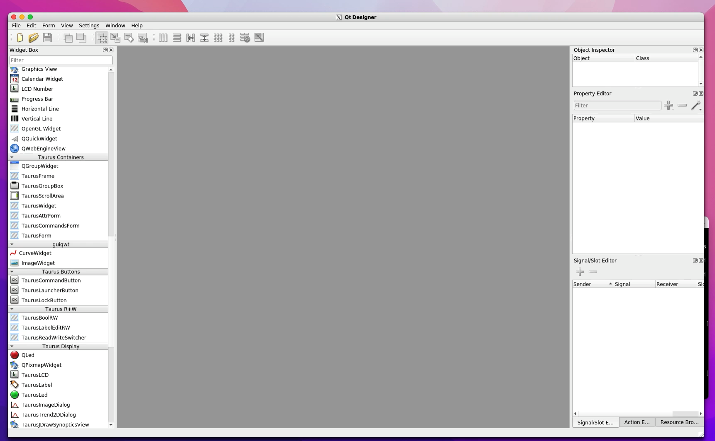
A beamline perspective
Interesting native tools (no-code/low-code)
Taurus designer: advanced GUI without coding.

Slide 10
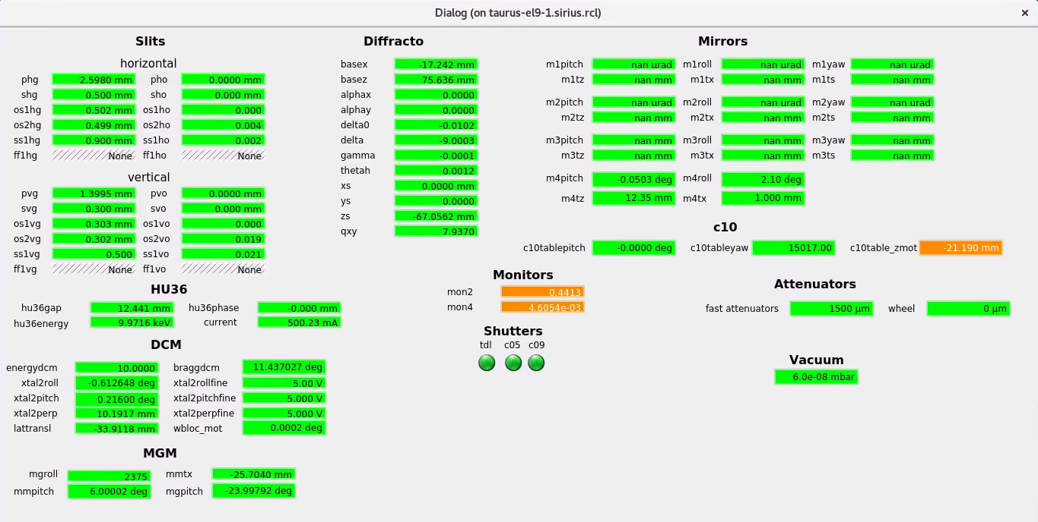
A beamline perspective
Interesting native tools (no-code/low-code)
Taurus designer: advanced GUI without coding.
Beamline dashboard

Slide 11
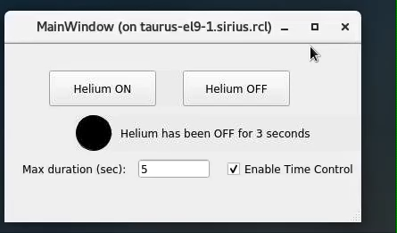
A beamline perspective
Going further with taurus in python scripts
Example: controlling helium flow in a sample environment.
Previously, users had to type SpyC (IPython) command lines:
→ No visualization of the current status,
→ Users often forgot to switch it off.
Starting from scratch, a Taurus GUI was developed in 2 hours and is now used for every experiment.

Slide 12
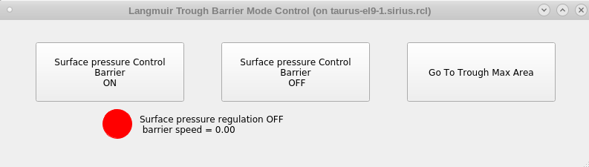
A beamline perspective
Going further with taurus in python scripts
Example: controlling helium flow in a sample environment.
Previously, users had to type SpyC (IPython) command lines:
→ No visualization of the current status,
→ Users often forgot to switch it off.
Starting from scratch, a Taurus GUI was developed in 2 hours and is now used for every experiment.
A colleague copied the code and, after a few trials and errors (with no prior Taurus knowledge):

Slide 13
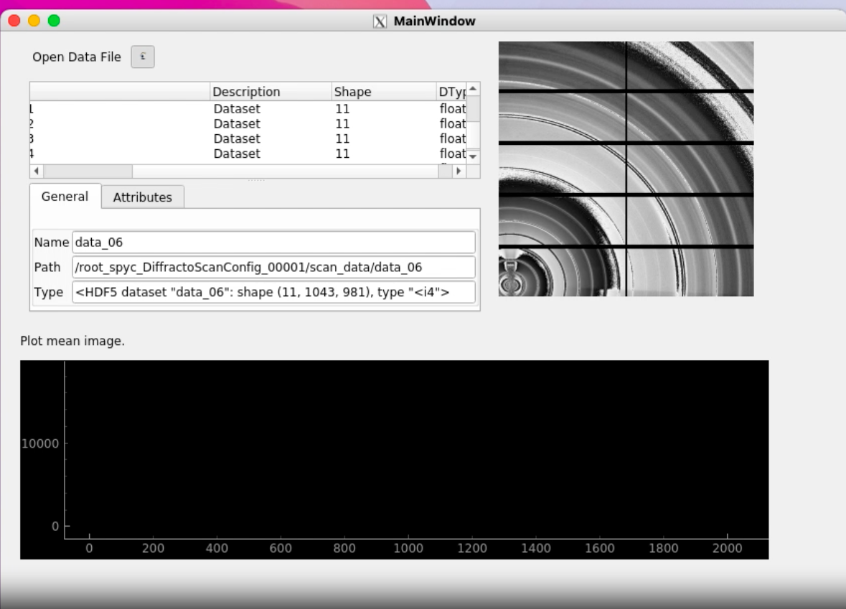
A beamline perspective
Proof-of-principle: control & data analysis on control system
Request of some beamlines: bringing control & data analysis on the same interface.
→ For example: measure-analyze-correct position-measure-analyze...
Here, using TaurusNexusBrowser widget, on the control system.
Only a proof-of-principle.
But raise the question: analysis on hardware that was not designed for it?

Slide 14
Conclusion

Slide 15
Conclusion
Taurus is an appropriate complementary tool for groups that want to develop their own GUIs,
It provides no-code, low-code, and full-code approaches adapted to a wide range of user profiles,
Python is the main programming language used by scientists,
No major performance issues were observed, although debugging Python applications can be challenging,
It is still unclear whether Taurus can replace existing HMIs or should mainly complement them.
Many thanks to everyone involved on the project @ SOLEIL
Patrick Madela
Raphaël Girardot
Yves-Marie Abiven
Alexandre Moutardier
Samuel Garnier
All SOLEIL II WPs, support teams, and colleagues who are more-than-ready to test Taurus.

