Slide 1







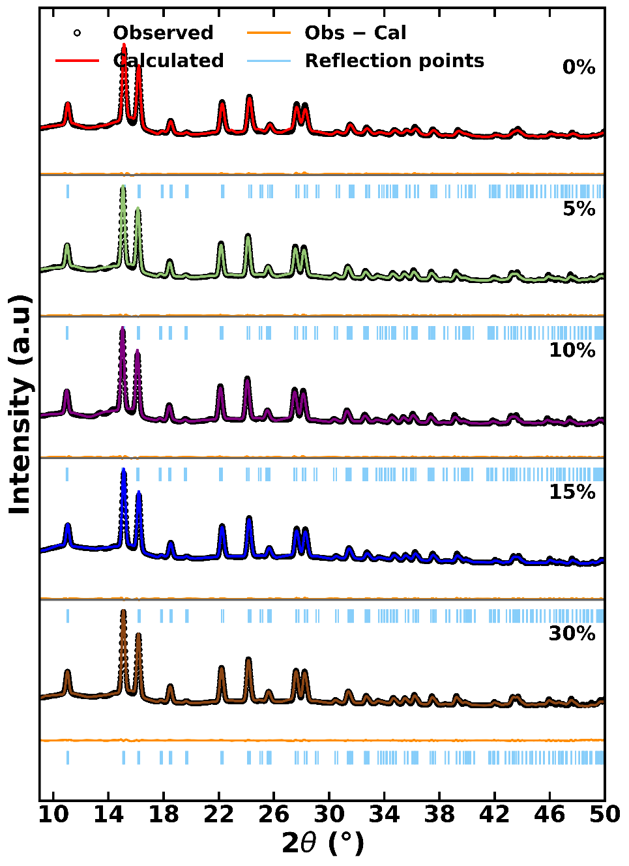
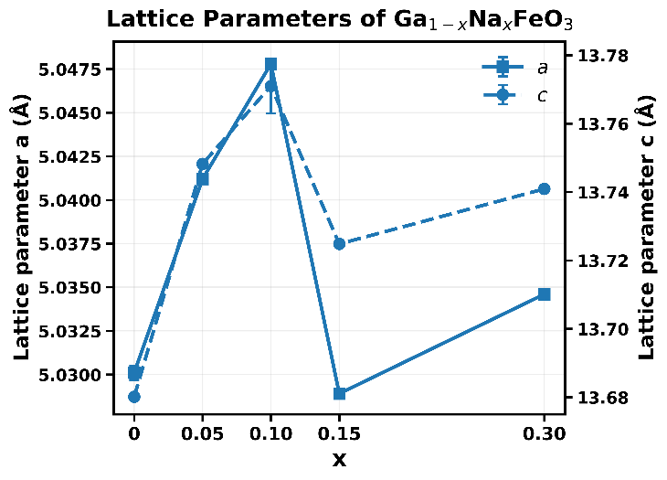
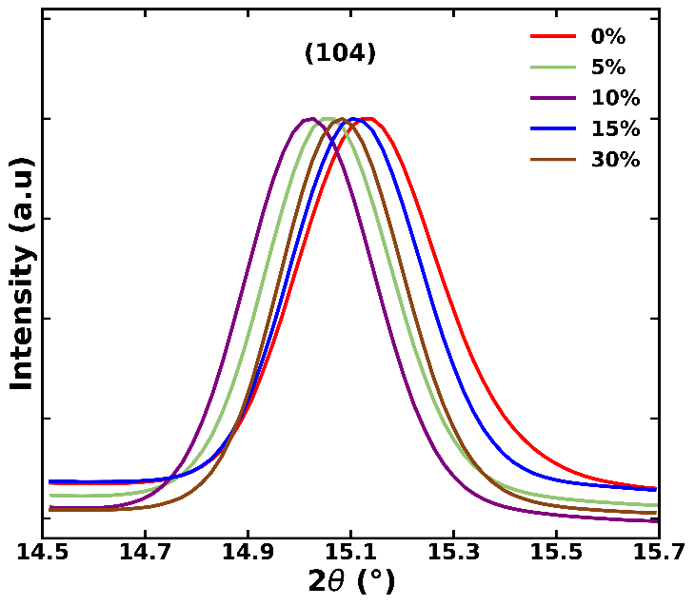
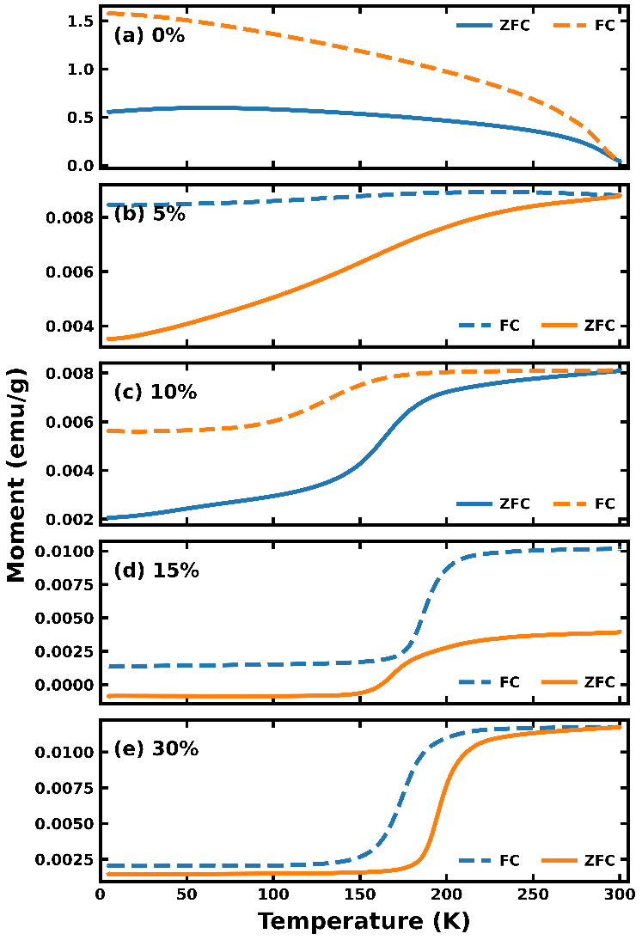
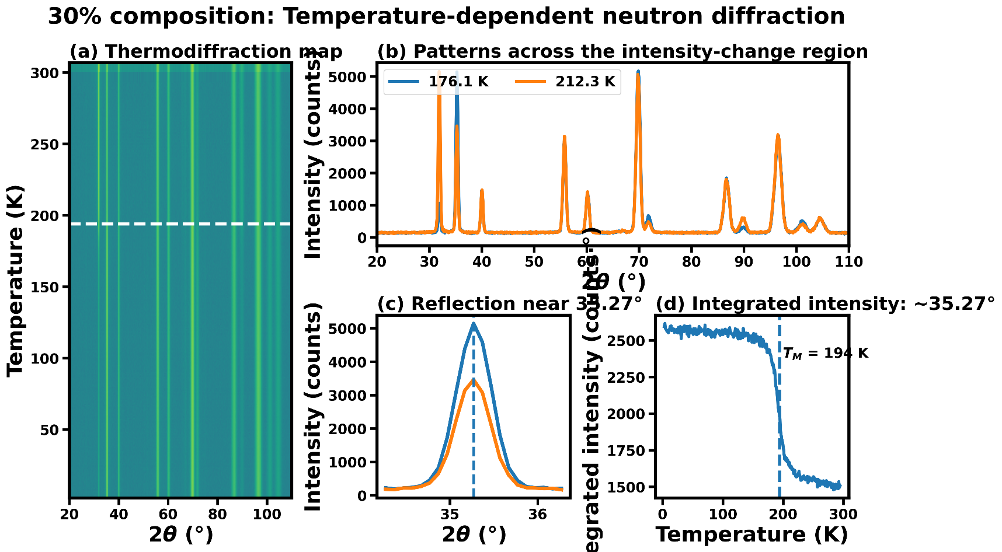
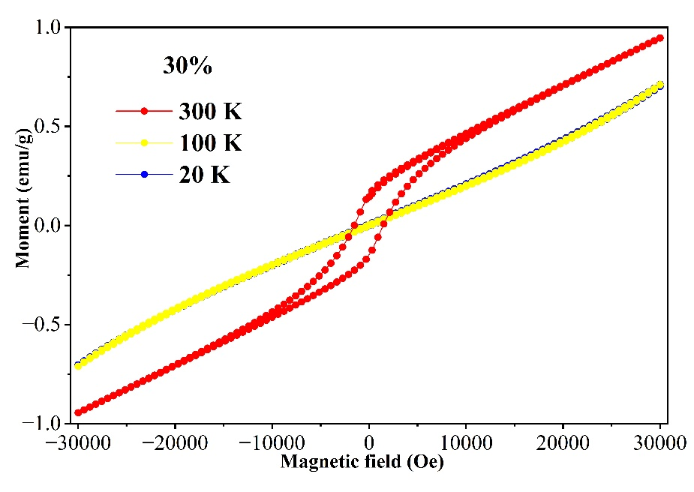
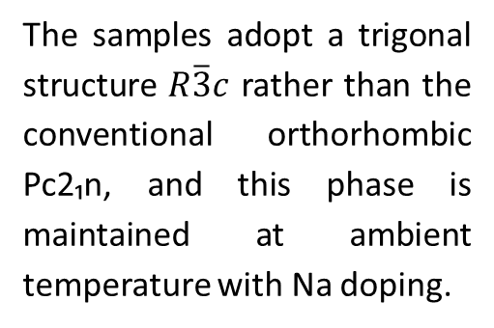
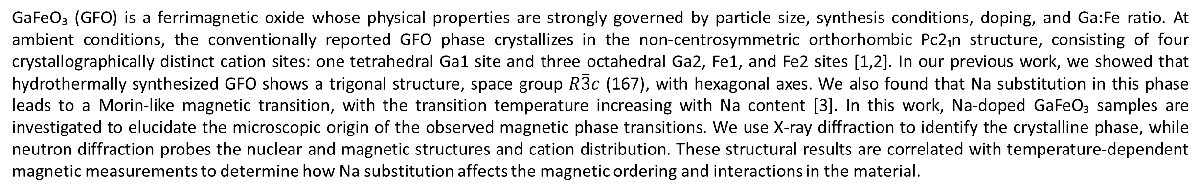
Effect of Na Doping on Magnetic Ordering in GaFeO₃
Z. Rahmany¹, N. Dhami^{1,2}, V. Balédent^{1,3}
1-Université Paris-Saclay, CNRS, Laboratoire de Physique des Solides, 91405 Orsay, France
2-Synchrotron SOLEIL, L’Orme des Merisiers, Départementale 128, 91190 Saint-Aubin, France
3-Institut Universitaire de France, Paris, France
Context
GaFeO₃ (GFO) is a ferrimagnetic oxide whose physical properties are strongly governed by particle size, synthesis conditions, doping, and Ga:Fe ratio. At ambient conditions, the conventionally reported GFO phase crystallizes in the non-centrosymmetric orthorhombic Pc2₁n structure, consisting of four crystallographically distinct cation sites: one tetrahedral Ga1 site and three octahedral Ga2, Fe1, and Fe2 sites [1,2]. In our previous work, we showed that hydrothermally synthesized GFO shows a trigonal structure, space group $R\overline{3}c$ (167), with hexagonal axes. We also found that Na substitution in this phase leads to a Morin-like magnetic transition, with the transition temperature increasing with Na content [3]. In this work, Na-doped GaFeO₃ samples are investigated to elucidate the microscopic origin of the observed magnetic phase transitions. We use X-ray diffraction to identify the crystalline phase, while neutron diffraction probes the nuclear and magnetic structures and cation distribution. These structural results are correlated with temperature-dependent magnetic measurements to determine how Na substitution affects the magnetic ordering and interactions in the material.
Synthesis
Rietveld refinement of XRD data
Ga₁₋ₓNaₓFeO₃ | $R\overline{3}c$ | λ = 0.71 Å | Rwp ≈ 11| χ² ≈ 2
Crystallographic structure
The samples adopt a trigonal structure $R\overline{3}c$ rather than the conventional orthorhombic Pc2₁n, and this phase is maintained at ambient temperature with Na doping.
Magnetometry study
Magnetic structure
M(T) and M(H) results confirm a strong temperature and composition-dependent magnetic response.
Applied magnetic field: 100 Oe.
The temperature evolution of the neutron diffraction pattern shows clear intensity changes near T ≈ 194 K, in agreement with magnetization measurements. The refinements of the neutron diffraction data are in progress.
Perspectives
References
Determine the magnetic structure from neutron diffraction data at low and high temperatures.
Perform temperature-dependent X-ray diffraction (XRD) measurements to investigate possible magnetoelastic coupling.
Mohamed, M. Bakr, et al. "Structural, magnetic, dielectric properties of multiferroic GaFeO3 prepared by solid state reaction and sol–gel methods." Journal of alloys and compounds 492.1-2 (2010): L20-L27.
Kang, Kun Uk, et al. "Magnetic properties of GaFeO3 prepared by slow cooling and quenched heat treatment method." Journal of Magnetism and Magnetic Materials 304.2 (2006): e769-e771.
Rahmany, Zamzama, and Savitha Pillai S. "Magnetoelectric properties and Morin type spin transitions of Na-doped GaFeO3." Journal of Physics: Condensed Matter 37.11 (2025): 115801.

