Slide 1

Installing a robot mounted detector on DIAD beamline
2021 MOCRAF Workshop,
ICALEPCS conference
Brian Nutter
Head of Motion Controls

Slide 2
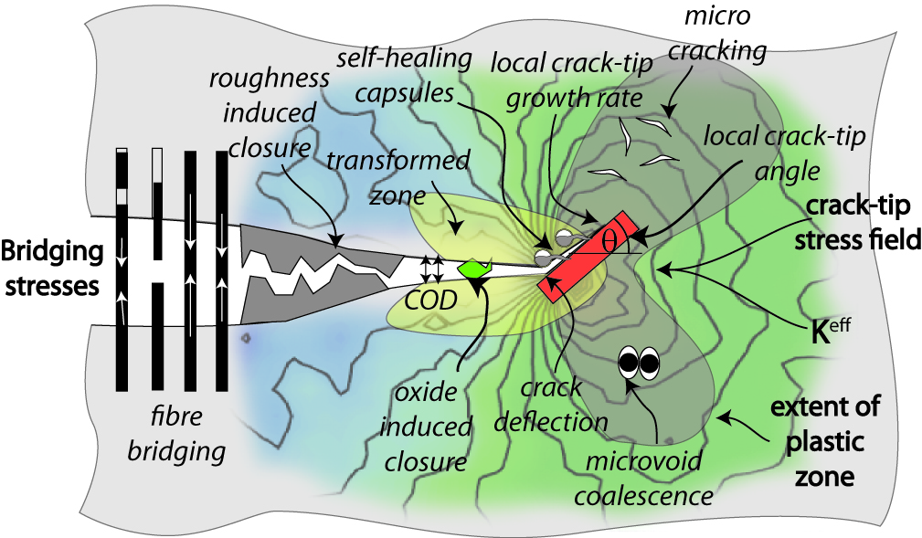
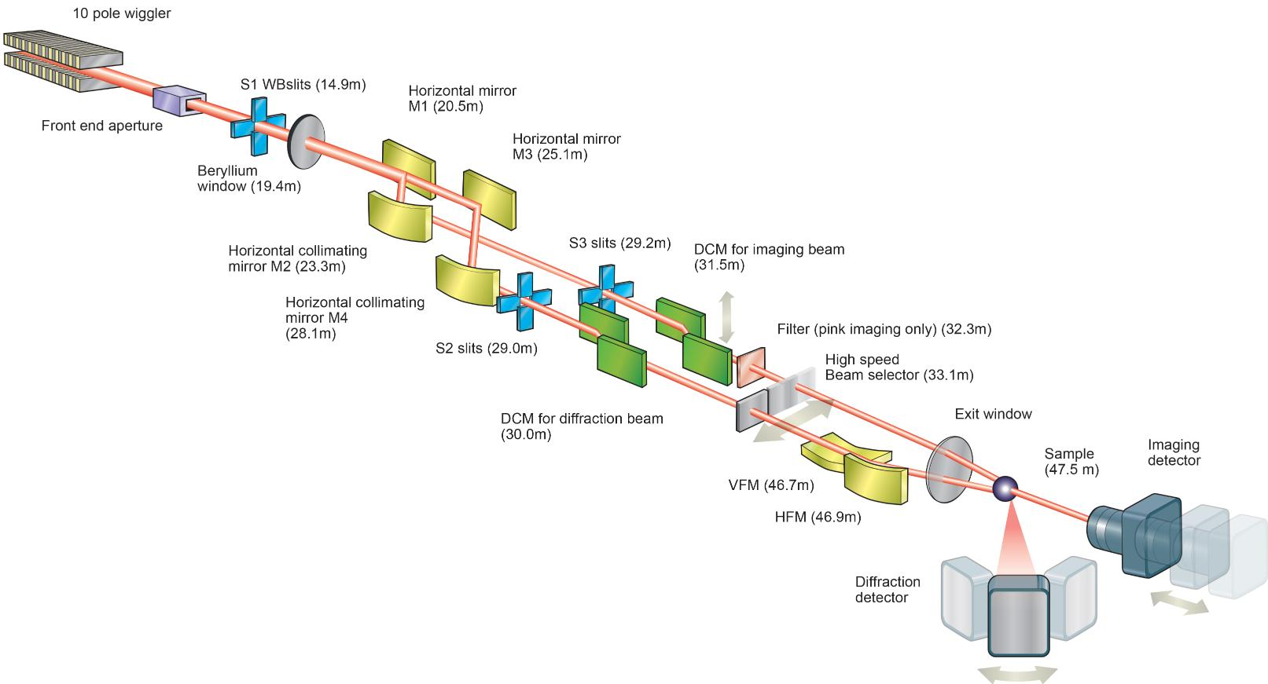
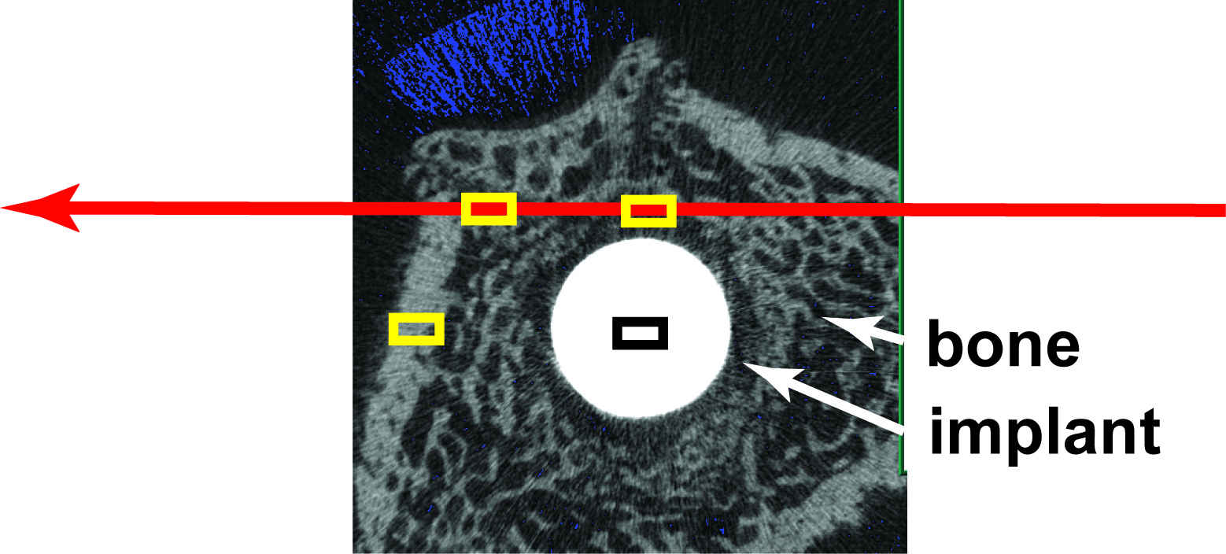
DIAD: Two beamlines combined at the sample: micro-tomography and micro-diffraction.
All to be done in-situ
Notes:
The main drive for building DIAD is that many scientific questions can only be answered by obtaining information of microstructure and crystalline structure at the same time.
Applied material science deals with heterogeneous samples under dynamic processes.
Top right: Crack growth, plastic deformation, strain fields
Bottom left: Implant, local structure and mineralisation of bone around implant.

Slide 3
RAHDD – Robot Arm Holds a Diffraction Detector
DIAD beamline Dual Imaging and Diffraction
Imaging camera plus 2D diffraction detector
Robot to be moved to ‘any?’ position around sample
Robot must NOT be a risk to personnel
Robot must NOT be a risk to the detector
Robot must NOT be a risk to external equipment
Robot must NOT be at risk from external equipment
Robot must be integrated into EPICS and GDA
Safety rated PLC for Machinery Protection not PSS

Slide 4
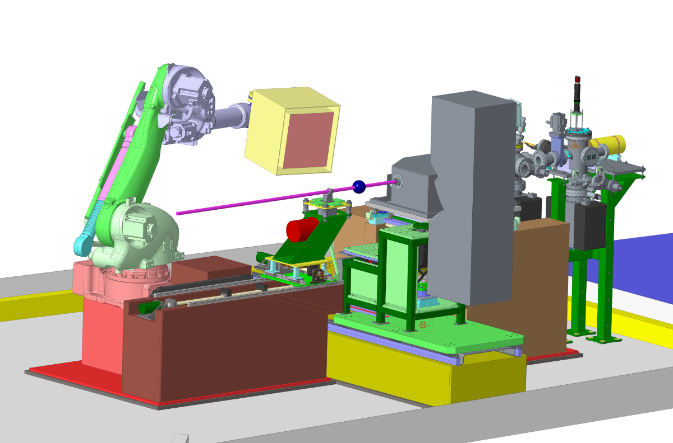
Experimental Hutch – under design In Use
3 sample positions:
  General tomography stage
  Mechanical test rig
  3rd position for user setup
Robot carries the Diffraction detector
Custom built table carries the imaging detector

Slide 5
Functionality Summary
The robot will position a detector within an area of the DIAD experiments hutch.
This area is part of a sphere, the positions are all referenced to the centre of the sample:
The sphere is 300 – 600mm radius.
The closest detector position is 300mm from the sample.
The furthest detector position is 600mm from the sample
The detectors angular range is 0° - 155°
When seen from the side; the detector will be positioned above the XZ plane (the origin of this coordinate system is the sample position).

Slide 6
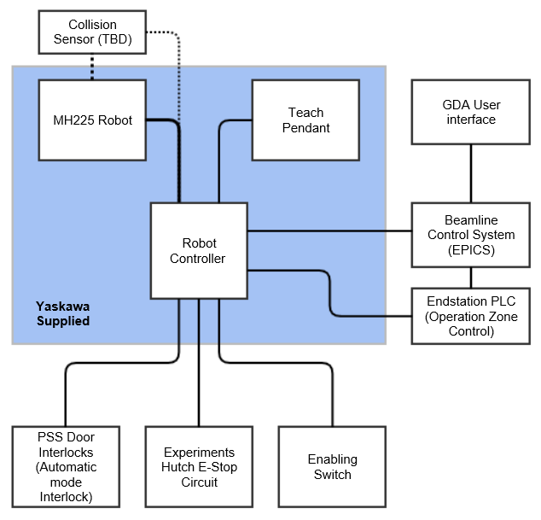
System description
Yaskawa MH225 Robot
DX200 Yaskawa Robot Controller
Teach pendant
End station PLC Omron NX series with safety CPU
Interlocks to the PSS system
Connection to Beamline E-Stop system
Connection to EPICS and GDA
Collision Sensor

Slide 7
DX200 Yaskawa Robot Controller
The controller contains all equipment needed to move the robot in a safe, coordinated manner. This includes 2 specific optional items relating to the safety of the robot system
1 Machine Safety board (MSB) - certified to Category 4/PLe according to EN ISO 13849-1 and SIL 3 according to EN 62061/IEC61508. The MSB is responsible for all standard safety functions including, but not limited to:
  Connection of emergency stop signals to external systems
  Supervision of operating modes, ensuring compliance to ISO 10218, e.g. ensuring teach mode is limited to 250mm/s
  Connection to the robot cell guarding

Slide 8
DX200 Yaskawa Robot Controller
The controller contains all equipment needed to move the robot in a safe, coordinated manner. This includes 2 specific optional items relating to the safety of the robot system
2) Functional Safety Board (FSB) - certified to Category 3/PL d according to EN ISO 13849-1 and SIL 2 according to EN 62061/IEC61508. The FSB has been added to this system to make the following functionality available:
  Axis Range limitation
  Axis speed limitation
  Safety range limits
  Tool change monitoring
  Speed limitation of the tool
  Tool angle monitoring

Slide 9
DX 200 Yaskawa Robot Controller
Functional safety unit
The FSB allows the Functional Safety Unit (FSU) to be used by the Robot system, the above named functionality is contained in the FSU.
The safety range function for the FSU allows keep-in and keep-out areas to be defined, these areas use a 3D model of the robot and tool to limit the motion of the robot. The robot is unable to move either into or out of a defined ‘box’. Each of these zones can be either permanently activated or switched using a safety input; each active zone also has a CPU utilisation overhead value, all active zones combined must not use more than 100% of the available CPU utilisation overhead or the Robot system will stop.
15 digit numeric password to enter FSU programming mode.
Notes:
Also wont allow the crossing of a plane

Slide 10
DX 200 Yaskawa Robot Controller
Functional safety unit- 32 conditional ‘files’
Must not leave
Must not enter
Tool Shape defined by up to 5 envelope curves-cylinders & hemispheres
Cannot cross

Slide 11
Things to miss, and be missed by!
Static Equipment- cable trays, Sample X translation base, Imaging camera base
Moving equipment – 3 movable sample environments
  Mechanical rig ( 500mm x 2300mm x 550mm)
  Tomography stage (400mm x 1250mm x 550mm)
  User plinth (400mm x 900mm x 550mm)
Imaging camera

Slide 12
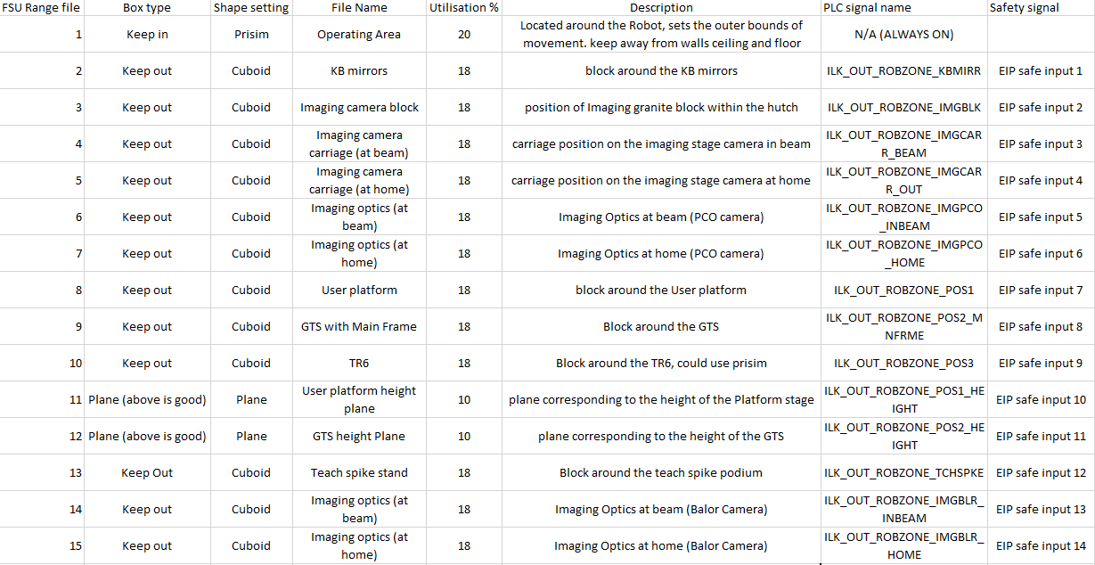
DX 200 Yaskawa Robot Controller
Functional safety unit- Currently uses 15 files, Active files are selected by safe input signals. Too many to al be active at once

Slide 13
DX 200 Yaskawa Robot Controller
And Don’t get hit by
The Robot will provide digital outputs to the end station PLC for interlocking other machinery.
Interference zones should be setup to indicate when the Detector is within certain zones:
    When the detector is within the main translation stage envelope.
    When the detector is within the imaging camera stage space envelope.
    When the detector is home.

Slide 14
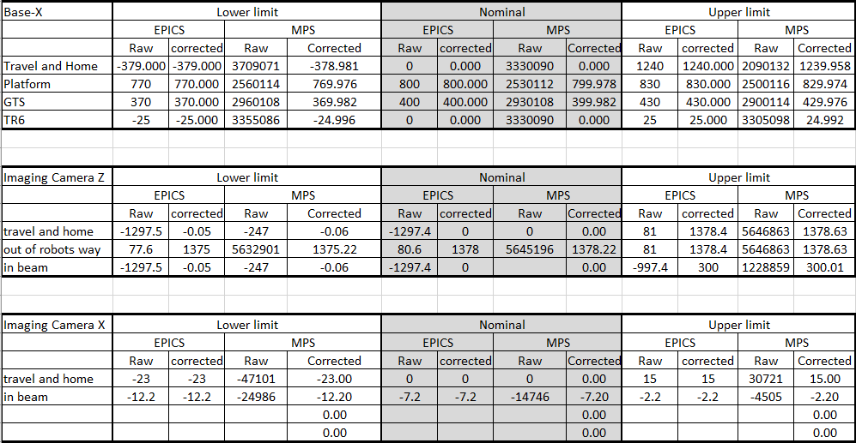
DX 200 Yaskawa Robot Controller
And Don’t get hit by.. The axes which must not occupy the same space as the detector are separately monitored by absolute encoders (SSI). Depending upon ranges Safety i/o interact with the safety unit of the robot

Slide 15
Functionality Summary
There will be 3 modes of operation
1 Automatic Full Speed.
ONLY when hutch searched and locked. Position requests via EPICS. 2 radii 600mm and 300mm in 5degree increments. Detector face rotation +/-45 degree. Robot operates at programmed speed.
2 Automatic safe speed. For doing set up checks
Position requests via EPICS. Movement ONLY if the end station PLC allow it. Robot can only operate a safe speed or slower. Key controlled access from PBS. Trained Diamond personnel only
3 Teach Mode. For programming and recovery of the robot system
Pendant controlled. Pendant in locked ‘safe’ key controlled by PBS. Trained Diamond staff only
Notes:
1. Automatic full speed – the hutch will be searched and locked, the robot will be controlled from EPICS. When a position request is made via the EPICS interface, and the End-station PLC allows it, the robot will move the detector to the requested position at the programmed speed.
2. Automatic safe speed – the hutch may be open, the robot will be controlled from EPICS. When a position request is made via the EPICS interface, and if the End-station PLC allows it, the robot will move the detector to the requested position with a restricted maximum speed.
In this mode an enabling switch will be used within Experiments hutch to override the hutch door interlock. This will allow the robot to be moved while being observed by one of the Beamline team. This mode will only be used by trained Diamond personnel or Yaskawa Engineers.
Teach mode – the hutch may be open, the robot will be controlled from the teach pendant. This mode will only be used by trained Diamond personnel or Yaskawa Engineers (Endsation PLC protection may be disabled via keyswitch that is tightly controlled)
Programmes to be written by Yaskawa personnel

Slide 16
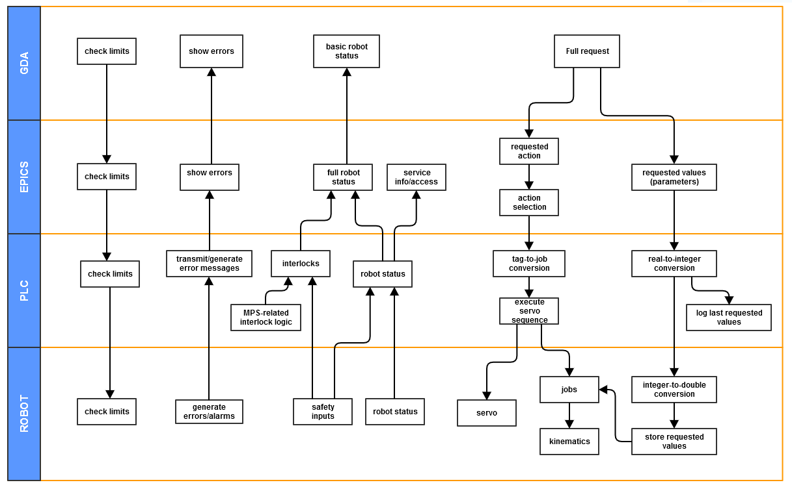
Robot Control layers
Notes:
This is the description of the interfacing between K11 DIAD's Robot Arm and EPICS.
The interaction of beamline staff with the robot arm for the Detector is expected to be done in 2 ways:
Using the teach pendant, where EPICS access is restricted.
Through EPICS control, where the robot arm can be operated safely from the control room.
Note that users are expected to control the robot positions through GDA, that in turn interacts with EPICS.
Here is a diagram of the layers of robot controls and their main areas of operation:

Slide 17
Implementation - Control System
FSU needs more than 7 settings for keep out zones
DX200 Can’t support EPICS Comms and Safety Fieldbus (needs another LAN port)
New plan to send data via the PLC
PLC used as intermediary to send and receive position request data.
PLC communicates using Ethernet I/P
PLC is Omron NX series with a Safety CPU
PLC can limit the values for position requests.

Slide 18
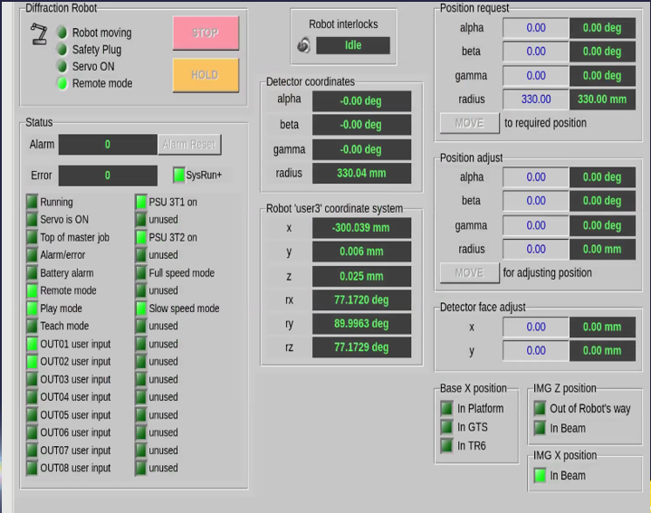
User EPICS Interface
DISPLAY CURRENT STATUS
Position feedback of the arm: gives the current position of the robot, both in:
  Cartesian coordinates (x,y,z,rx,ry,rz)
  Detector coordinates (Alpha, Beta, Gamma, Radius)
Current status: Status of the system, including related beamline components
  Robot arm status, such as servo status, movement, and errors.
  Interlocks, including Base X and Imaging Table.
Notes:
The user interface at EPICS level allows control of the robot through the use of EPICS PVs, as well as from the Synoptic. Is expected to have the following components:
Please note some error details may not be available through EPICS and will need to be checked/resolved directly on the pendant.

Slide 19
^{User EPICS Interface}
Commands for operating the robot: These are the commands to operate the robot arm, such as:Requests:
Position request (Alpha, Beta, Gamma, Radius): after setting a position, moves the robot to that position. A move might trigger a safe home position automatically.
  Position adjust (Alpha, Beta, Gamma, Radius): Once the robot is in position, finer adjustments are allowed for correction. If the corrections go out of the tolerance allowed, this may trigger a full re-positioning.
  Sample position adjust (X,Y,Z): Allows adjustment of the sample center, so the detector can focus on an specific part of the sample.
  Detector face adjust (X,Y): Allows adjustment of the face of the detector.
  Offset (offset): Finer adjustment of the distance between the sample and the face of the detector.
Notes:
These are commands that are requesting the robot to process some parameters given by the user. It consists on some fields being filled in (e.g. setting the desired position), and then an action (e.g. a button) to send the request to the robot. A request may be accepted, starting up the movement, or refused; a request may be refused on the spot or later on through an error indication/message.

Slide 20
^{User EPICS Interface}
Commands for operating the robot: These are the commands to operate the robot arm, such as:DIRECT COMMANDS:
Safe home: robot goes to a known safe position.
Factory home: This commands the robot to go to a factory-defined position when its encoders need to re-calibrate. This may be needed if the power to the robot is cut while it is moving. .
Maintenance home: This drives the robot to a known position where the detector can be safely serviced.
Stop: This soft stop is a non-emergency abort of a requested movement, stopping the robot and cancelling the movement command.
Hold: This pauses the robot action without cancelling the action, so it can be resumed later.
Recovery to safe: Function to try to recover from an error state of the robot, usually by returning to its safe home position.
Notes:
Direct commands: These don't require parameters, so they can be directly requested – e.g. a button
SAFE HOME Warning: when encoders need re-calibration, a full detailed procedure should be followed before calling this factory home, and must be supervised

Slide 21
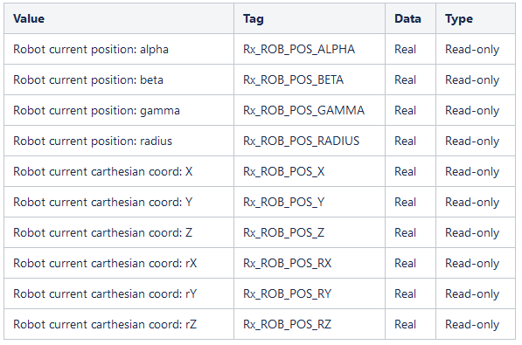
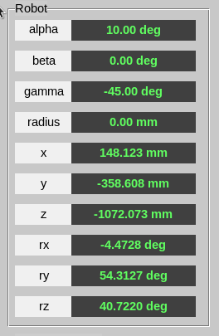
PLC – EPICS interface
EPICS communicates with the PLC using the tag-based EtherNet/IP (Industrial protocol) that the NX PLC provides. Tags are names defined on the PLC as entry points, similar to addresses, but easier to understand.
Notes:
Position and status feedback is provided to EPICS through read-only analogue and digital tags. Analogue values are converted at the PLC, so the end user just interacts with human-level values. This is also valuable for safety and debug purposes.

Slide 22
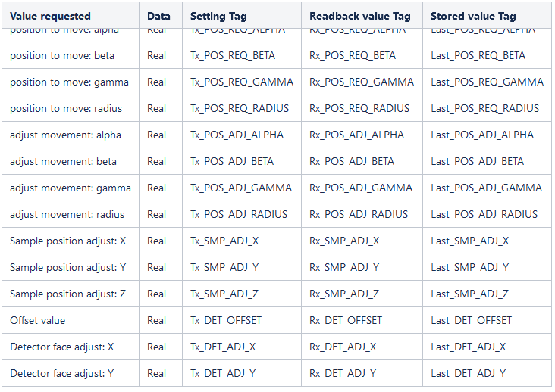
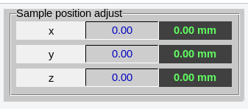
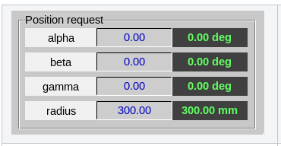
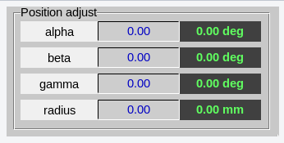
^{PLC – EPICS interface}
EPICS communicates with the PLC using the tag-based EtherNet/IP (Industrial protocol) that the NX PLC provides. Tags are names defined on the PLC as entry points, similar to addresses, but easier to understand
Position requests values are written into tags by EPICS, while the PLC offers readback values from the robot as well
Once all values are set the user can request to start the action
Notes:
Position requests values are written into tags by EPICS, while the PLC offers readback values from the robot as well. The PLC then checks again the validity of the values and stores them into non-volatile variables so can be recovered in case of IOC restart or failure. Once all values are set the user can request to start the action – in that case EPICS send a specific value to a tag for the PLC to process, in the same fashion as direct commands, triggering the conversion of the given values into robot interface values, and then communicated to the Robot arm. Note that changing these values once the robot starts moving, does not affect the commanded position as the robot stores these safely.

Slide 23
Implementation – Robot interface
PLC and Robot communicate over Ethernet I/P – 100 bytes
Robot uses system jobs to convert multiple bytes into one number
PLC does this much easier
Communication is key between programmers! ( Spreadsheet heaven!)
System Job functions:
Combine bytes from PLC for position data.
Separate bytes for transmission to PLC.
Convert Robot Coordinates into detector coordinates.
Transmit Robot position data.

Slide 24
System Functions – Position Robot
Position calculated using:
POS_REQ_ALPHA, POS_REQ_BETA, POS_REQ_GAMMA, POS_REQ_RADIUS
DET_OFFSET
DET_ADJ_X, DET_ADJ_Y
SMP_ADJ_X, SMP_ADJ_Y, SMP_ADJ_Z
N.B. The position calculation includes the detector face adjustment variables
Movement Sequence
1. Robot will check its position
2. Recover to stand off if not above equipment,
3. Move to the Requested Alpha, Beta and Radius.
4. Adjust position for the Detector face adjustment.
5. Apply Gamma Rotation.

Slide 25
System Functions – Adjust Position
Position calculated using:
Previous position variables
POS_ADJ_ALPHA, POS_ADJ_BETA, POS_ADJ_GAMMA, POS_ADJ_RADIUS
DET_OFFSET
DET_ADJ_X, DET_ADJ_Y
SMP_ADJ_X, SMP_ADJ_Y, SMP_ADJ_Z
N.B. The required position is recalculated from scratch, the adjustments are ABSOLUTE from the basic requested position
Movement Sequence
1. Robot moves to new position in one move. (MOVEL)

Slide 26
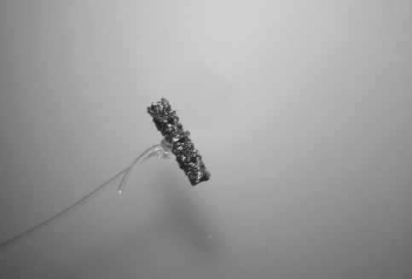
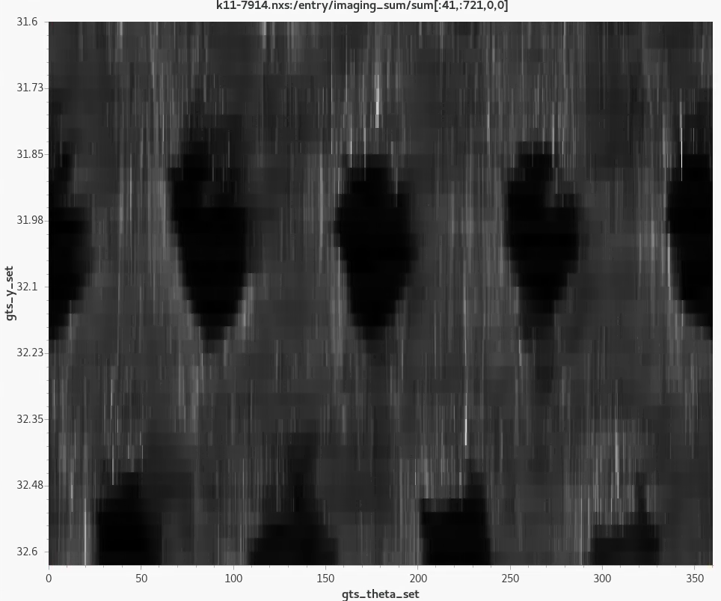
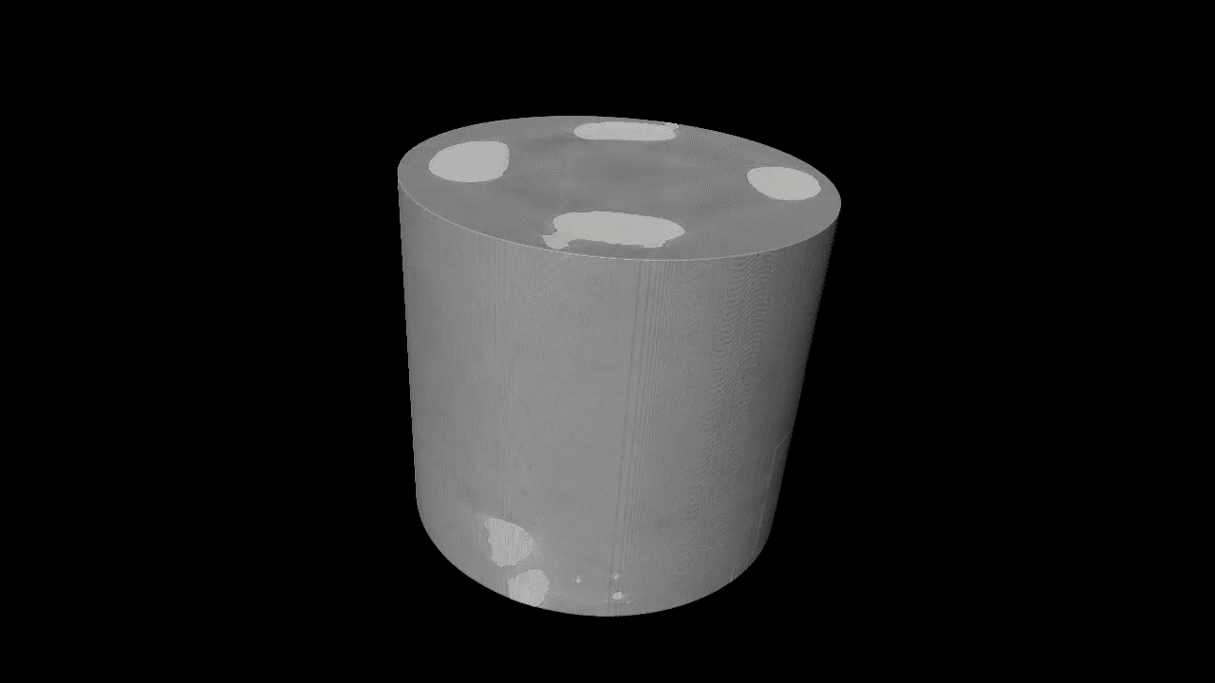
First User!!!!!!! (Validation) i.e. Does it actually Work?

Slide 27
Thank you for your attention
Questions
More hidden slides below

