Slide 1

Metrology of BL06-Xaira end station diffractometer
Author: Juan Luis Frieiro Castro, Nanomotion laboratory
Presenter: Xavier Serra-Gallifa, Electronics
Additional contributors: J. Nicolás, N. González, I. Sics, J. Centeno, X.Serra-Gallifa
08/10/2023

Slide 2
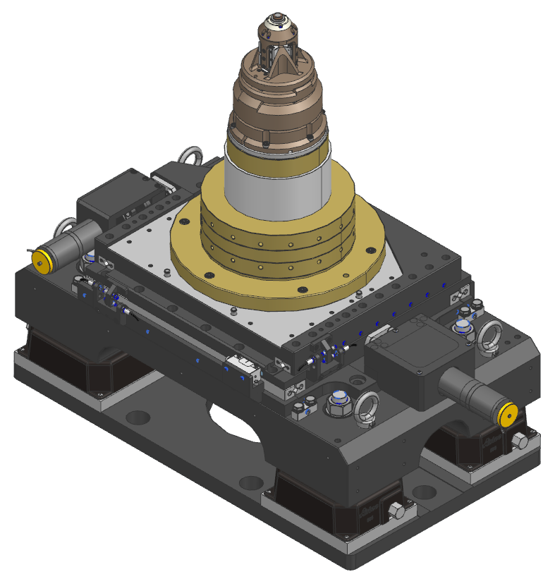
The BL06 XAIRA end station diffractometer: mechanical elements
XYZ
sample centering
Sample position
Requirements
Ω rotation
Speed up to 360 deg/s
Speed stability
Resolution: 2µdeg
Error: 10µdeg
Error in movement <500 µdeg @360 deg/s
Aerotech S-130-60 & Fluid Film Dynamics
XYZ
Stroke: 5 mm
Speed: 0.5 to 5 mm/s
Simultaneous movement
Resolution: 5 nm
Smaract SLC-1720
Goniometer
XY coarse

Slide 3
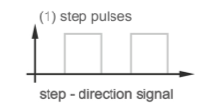
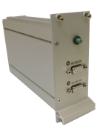

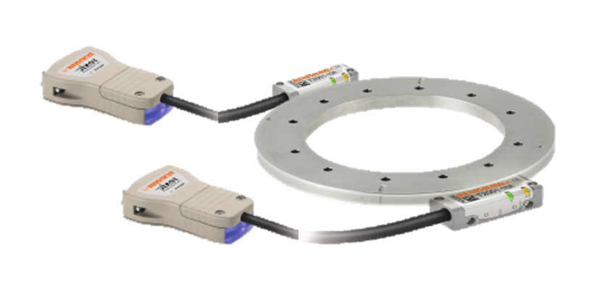
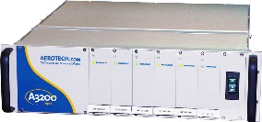

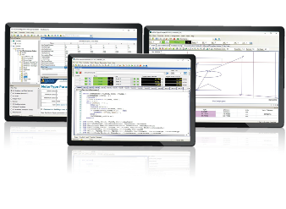
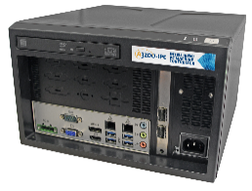
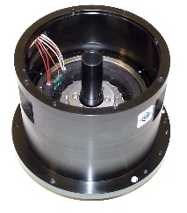
The BL06 XAIRA end station diffractometer: control system
Goniometer
Slipring for
header signals
2µdeg resolution @ 360deg/s
Encoder frequency = 180MHz
With double encoder to minimize eccentricity error

Slide 4
COMPONENTS DETAIL
ENCODER
ENCODER CONSTRAINS
  Angular Speed: up to 360 deg/s [60 rpm]
  Maximum Position Error ≤ 10 µdeg
  Resolution ≤ 2 µdeg
  Speed & Resolution requirements cannot be met with a digital output encoder
REXM 20U SA 115 (18000lines)
2x T2010-20A
Ti0000A 00A analog
Aerotech Interpolator
16384
+ quadrature (65536 total multiplication)
  ANALOG OUTPUT ANGULAR ENCODER
  2x Encoder reads required to eleminate excentricity errors and improve accuracy (1 arcsec = 0,27 mdeg)
Maximum analogue signal frequency
1rev/s * 18000 lines = Max frequency 18kHz
[Aerotech 2MHz]
Resolution
360deg/18000line/rev= 20mdeg
20mdeg/16384(interpolation) = Resolution 1,2µdeg
[Target resolution 2µdeg]
  Averaging of the two signals is done by the Aerotech Controller
  Encoder reading is used for the PSO (position trigger)

Slide 5

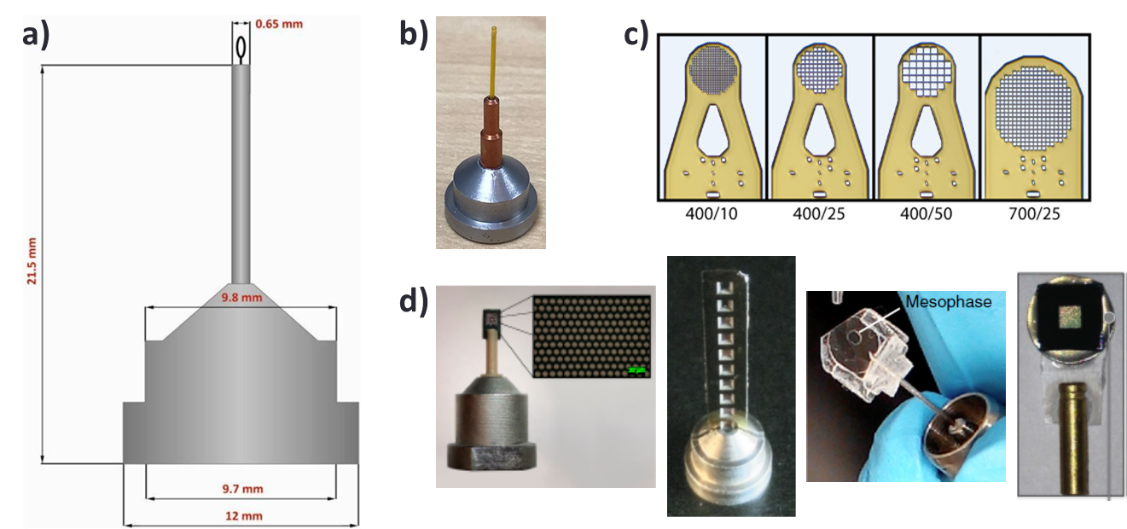
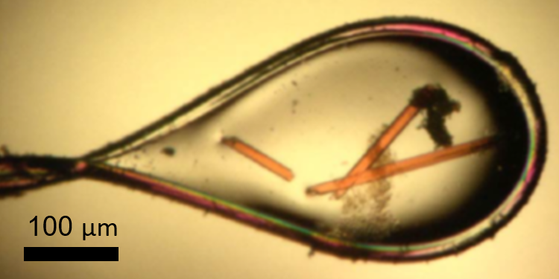
Typical experiment on the beamline: Helical scan
Helical scan

Slide 6
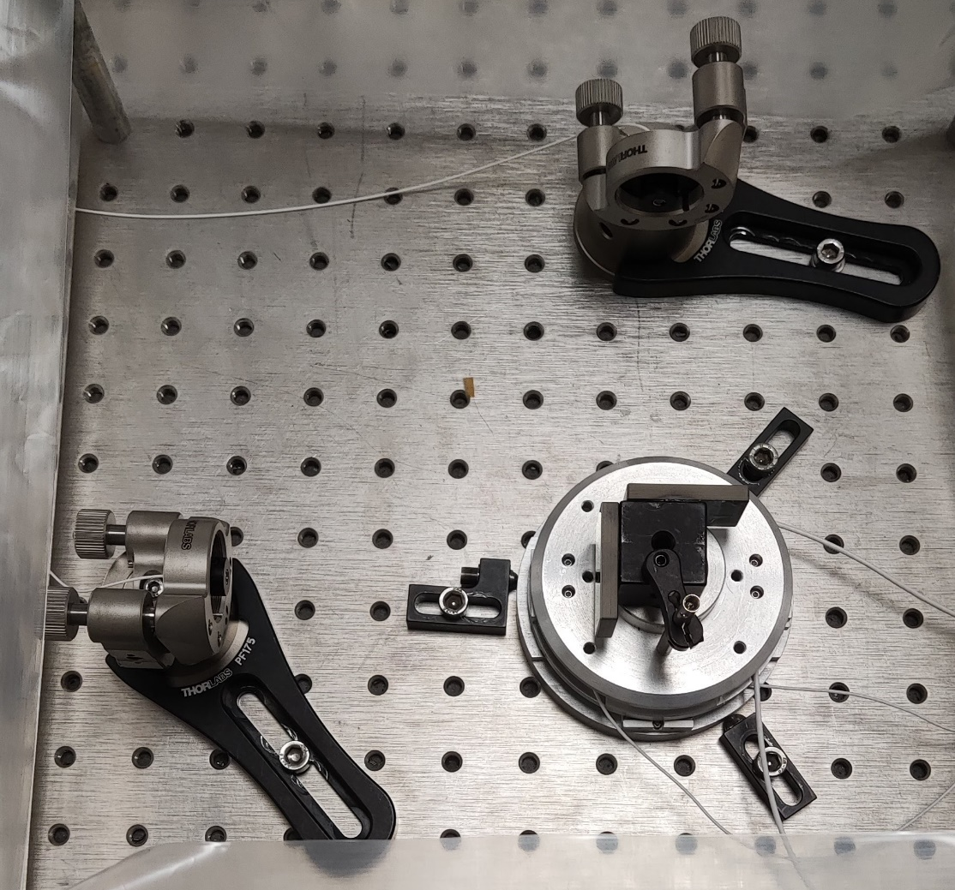
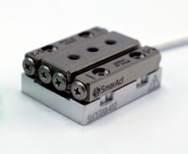
Metrology of the XY sample centering stages
Purpose:
Synchronize with other motions (Ω, Z) for trajectories
Metrology
Target resolution: 5 nm → Interferometry
Smaract SLC-1720
Linear piezo stage
Interferometer
sensor head
Target mirrors (90°)
(x4)
2 for X
2 for Y
XY stages

Slide 7
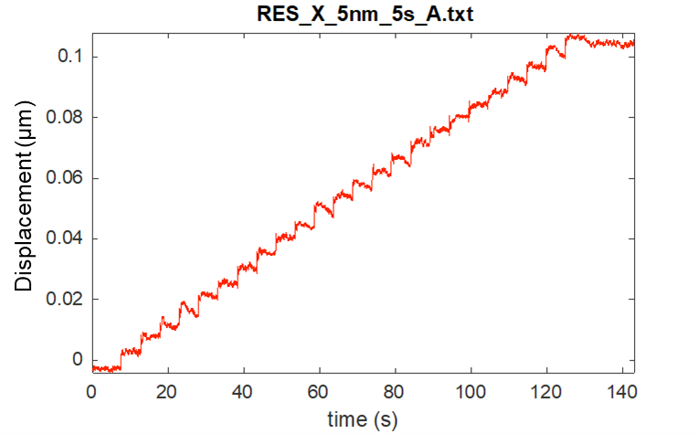
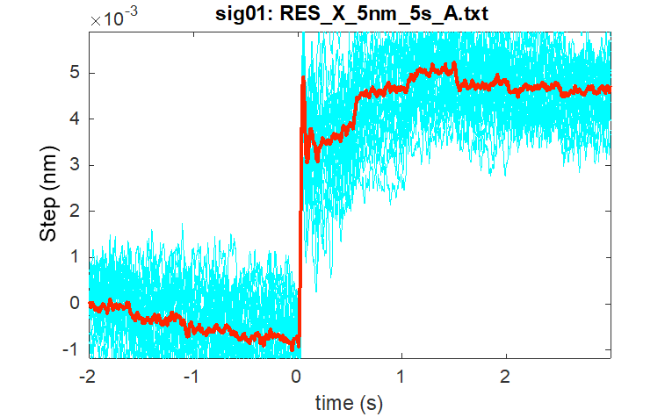
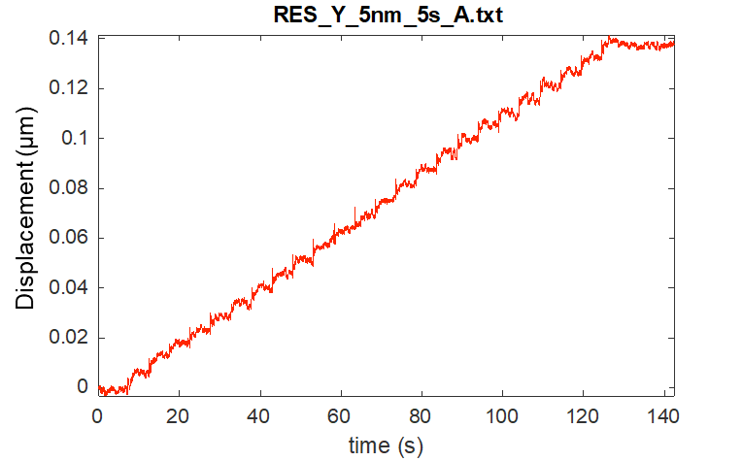
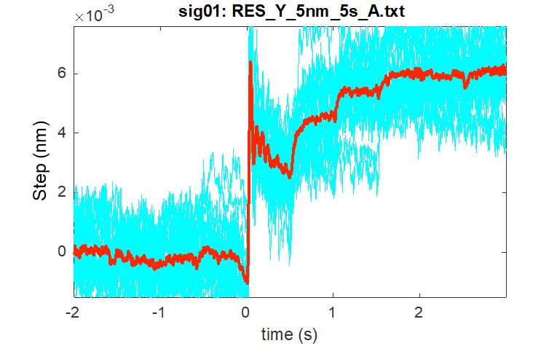
Metrology of the XY sample centering stages
Metrology
Measurement of step resolution: Commanded 25 steps of 5 nm, 5s between steps
Average step
4.711 nm
X
Y
Average step
6.075 nm

Slide 8
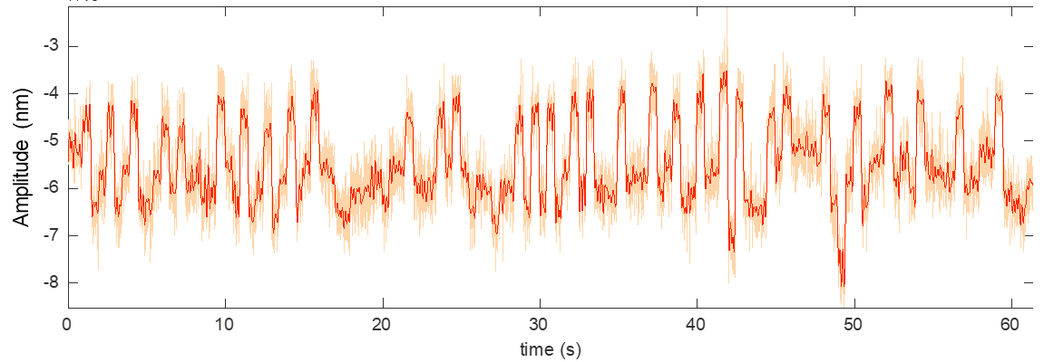
Metrology of the XY sample centering stages
Metrology
Stability: Peak-to-peak variation while
stationary in one position over a minute
  X-axis: 4.5 nm
  Y-axis: 7 nm
Following error: Position error in a motion at constant speed, respect to the expected position
  Both axis and directions of movement, less than 10 µm in acceleration phase
  Once at constant speed, error peak-to-peak below 5 µm

Slide 9
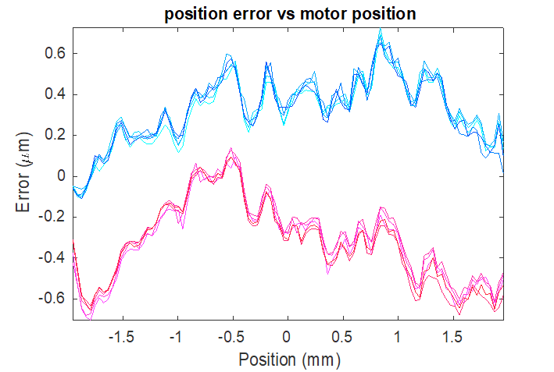
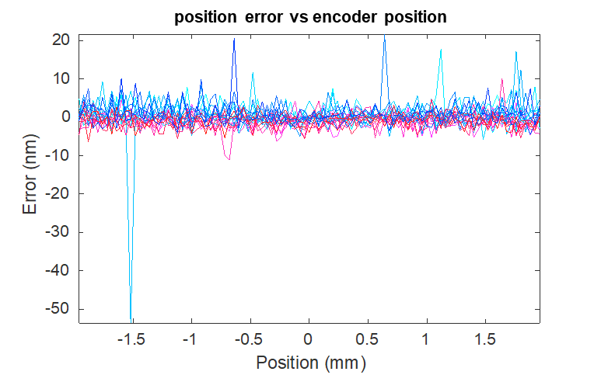
Metrology of the XY sample centering stages
Metrology
Repeatability: Difference in position for multiple consecutive cycles
Hysteresis: Difference between forward and backward motion in consecutive cycles
External metrology with interferometry shows errors in position
Position error based on the feedback loop of the encoder shows no error
Furthermore…

Slide 10
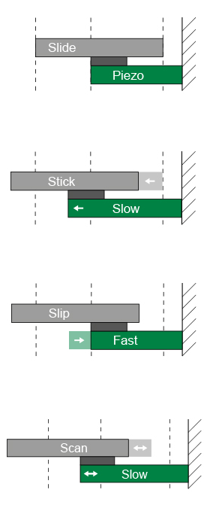
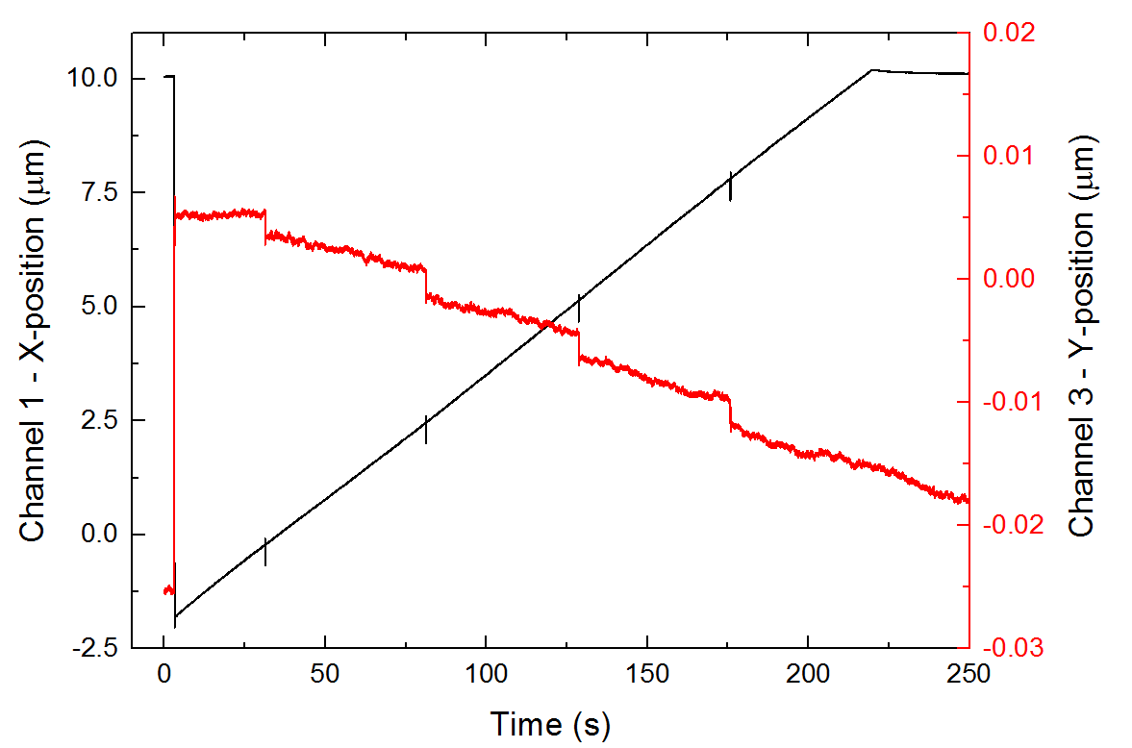
Metrology of the XY sample centering stages
Stick-slip motion error
Piezo stages use stick-slip motion to increase their range of displacement
Visible when moving slow or with small steps
When moving X:
periodic noise every ~2.6 µm
amplitude up to 130 nm measured
cross-talk with Y
(same happens when moving Y)
Adapted from Smaract
Not visible in encoder signal!

Slide 11
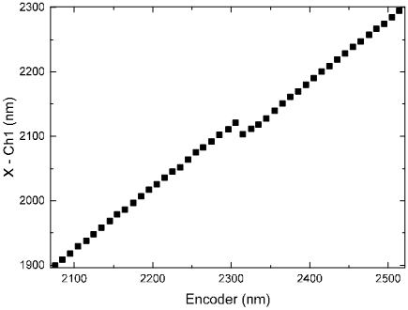
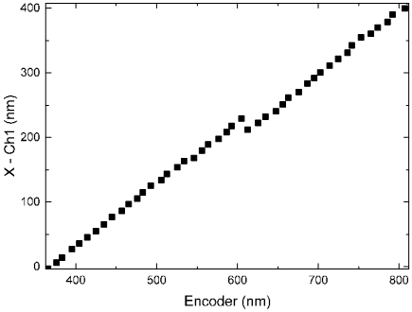
Metrology of the XY sample centering stages
Stick-slip motion error
Piezo stages use stick-slip motion to increase their range of displacement
Smaract is aware of the error. Solved by the close loop of the encoder:
continuing the displacement or just a matter of time?
Large steps or continuous motion avoids the error
Tested stop time after moving, before measurements:
Pause = 0s
Pause = 0.5s
Pause = 1s
A compromise should be made between time and small step motions

Slide 12
Runout of the end station goniometer
Metrology
Runout: Radial displacement of the center of rotation while the goniometer turns
Results at 5°/s:
rX = ± 42.2 nm
rY = ± 52.4 nm
Results at 55°/s:
  rX = ± 32.7 nm
  rY = ± 40.3 nm

Slide 13
Jitter of end station goniometer
Objective
Synchronization of goniometer motion, shutter and detector
JITTER
Target speed reached at goniometer
Shutter opens
Image acquisition starts
Acceleration
Target speed
Gonio speed
Shutter
Opened
Closed
Image acqusition
…
JITTER
How accurate is the trigger signal from the goniometer?
Detector
Time

Slide 14
Jitter of end station goniometer
Objective
Synchronization of goniometer motion, shutter and detector
Measurement setup
Compare the trigger from the gonio to an external refrence of rotation position
Instead of speed, knowing acceleration time → Trigger from goniometer at defined rotation position
PD signal (external reference)
Signal from goniometer (trigger)

Slide 15
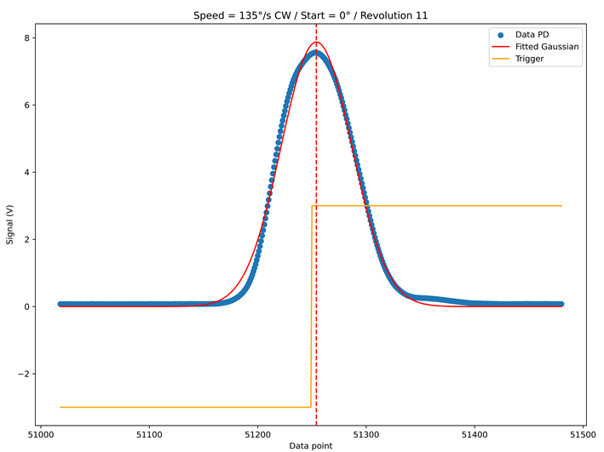
Jitter of end station goniometer
Objective
Synchronization of goniometer motion, shutter and detector
Sampling both signals with ADC at 200 – 500 kHz
PD output at 50 MHz
(expected Gaussian shape due to slit in front of PD)
Difference between both signals: How stable is it?
Jitter = standard deviation

Slide 16
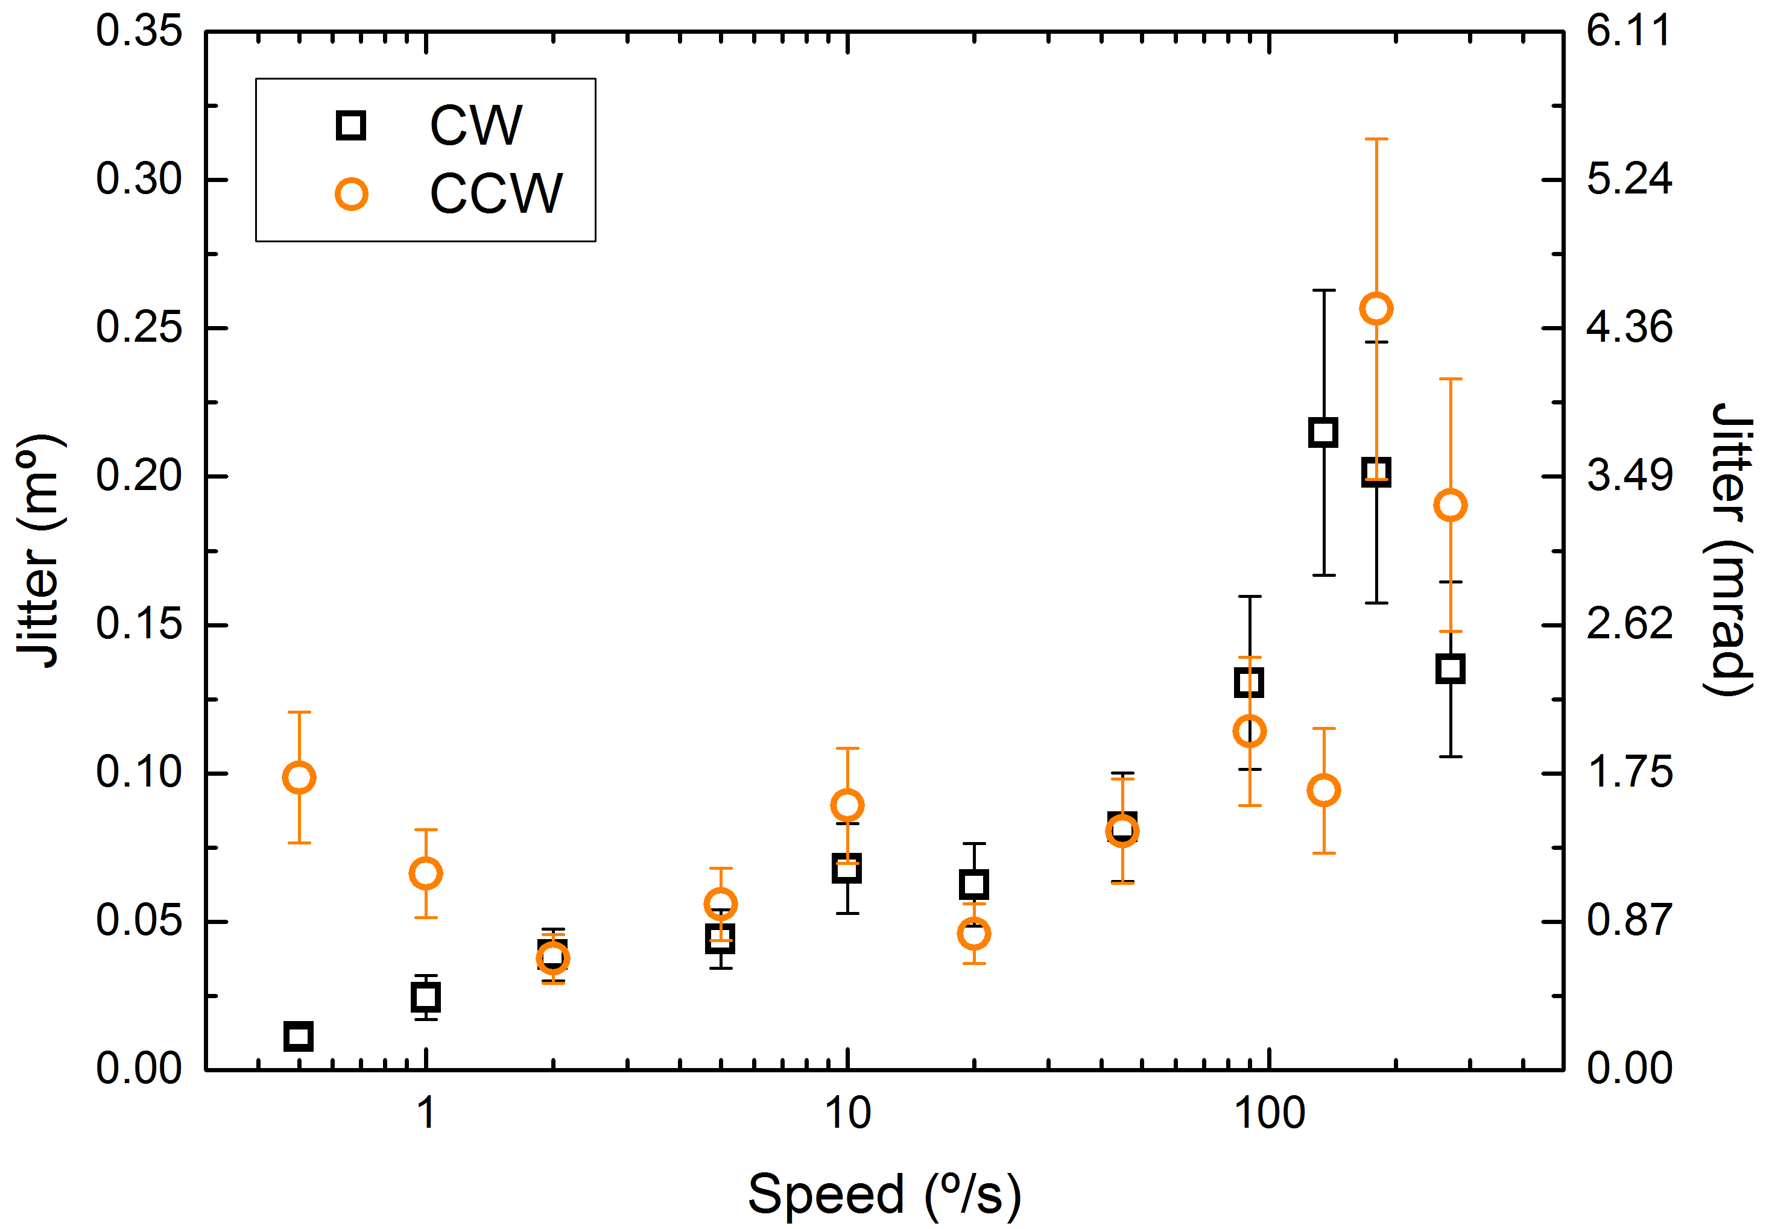
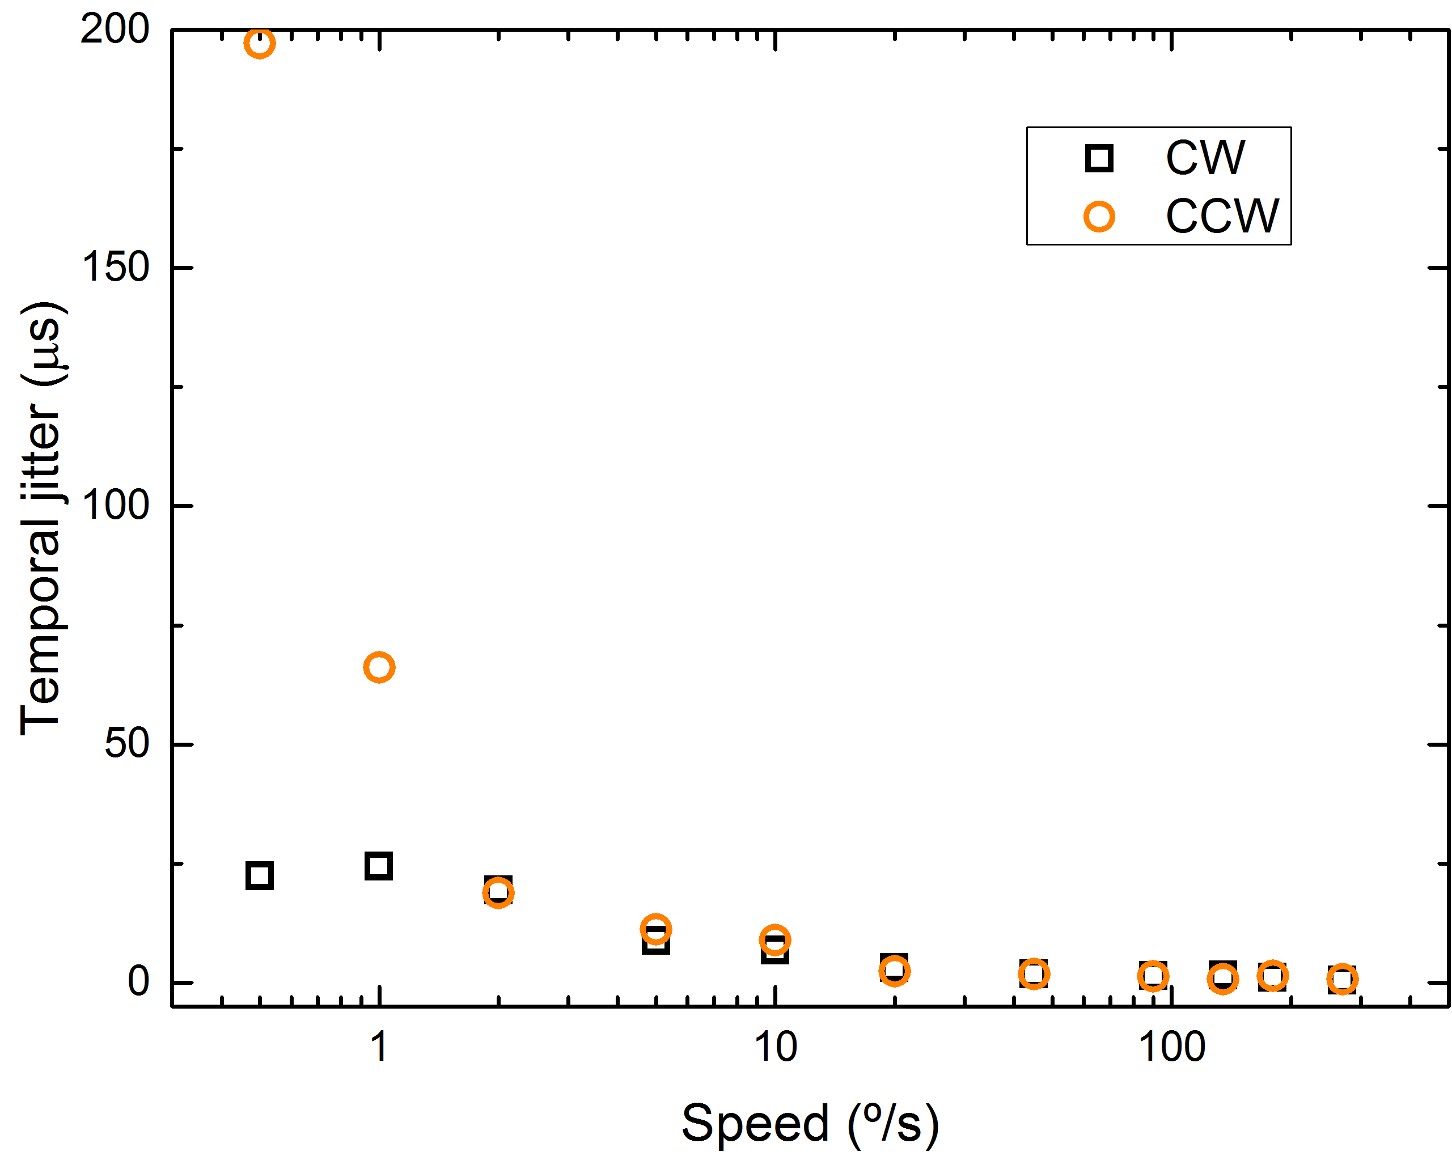
Jitter of end station goniometer
Jitter results
No effect when measuring continuous rotations or one-by-one
Clockwise (CW) and counter-clockwise (CCW): barely any difference
Jitter is smaller at lower speeds → Better control of the servo motor
Measurements at low speed subject to posible thermal drifts
As rotation elapsed
As time elapsed

Slide 17
Conclusions and next steps
XY stages
Characterized their individual linear motion: resolution, stability, following error, repeatability, hysteresis
Observed small cross-talk between axes
  mechanical connection
  not 90° of target mirrors for interferometry
Stick-slip error at small steps
  unavoidable
  corrected by encoder with time
Goniometer
Characterized the jitter of a trigger signal
Other motion parameters measured (not shown)
Future steps:
Slip-ring being installed to goniometer: re-measure jitter and motion
Mount XY stages on top and re-measure motions and crosstalk

