Slide 1
Frequency Response Functions with Power PMAC
2023 MOCRAF Workshop,
ICALEPCS conference
Brett Sing Gen
Diamond Light Source
Notes:
Hello everyone, I would like to present on our experience with obtaining a Frequency Response Function using a Power PMAC

Slide 2
Agenda
Power PMAC
Frequency Response Functions (FRF)
Process overview and results
Using an FRF: Controller
Future plans
Notes:
The agenda for today is as listed, where we will discuss these 5 sections in this order.

Slide 3
What is it?
Power PMAC

Slide 4
Power PMAC
Upgraded motion controller for Diamond Light Source
Previously used the Turbo PMAC
Meets most of our requirements
Missing frequency domain tools
Many more manuals
Notes:
This is the selected motion controller for Diamond Light Source. The current, standard Power PMAC satisfies most of our requirements but does not have the frequency domain tools we want, specifically with getting a Frequency Response Function. Which leads us to the Frequency Response Functions.

Slide 5
What is it and why use it?
Frequency Response Functions (FRF)

Slide 6
Frequency Response Functions (FRF)
Non-parametric description of the system's behaviour in the frequency domain
Yields more information about a system compared to the time domain tests
Offline design – Bode, Nyquist plots
System validation
Useful step in parametric identification
More difficult to get compared to time domain response
Nonlinearities, noise, numerical errors
Notes:
A Frequency Response Function is a non-parametric description of the system’s behaviour in the frequency domain. It yields more information about a system compared to time domain tests which is valuable as we move to tracking requirements. It can be used for offline design and validation. Furthermore, it is useful for parametric identification. However, there are obstacles with attaining a FRF and it is more difficult to get in our case.

Slide 7
How to obtain an FRF?
Process

Slide 8
Process Overview (System)
Plant = amplifier(drive) and translation stage
Stepper motor, lead screw, non-collocated optical encoder
Notes:
Firstly, our test system is a translation stage made of a stepper motor driving a lead screw via a belt and with a non-collocated, optical encoder shown here. The plant that we want to identify is the combined amplifier (or drive) with the translation stage.

Slide 9
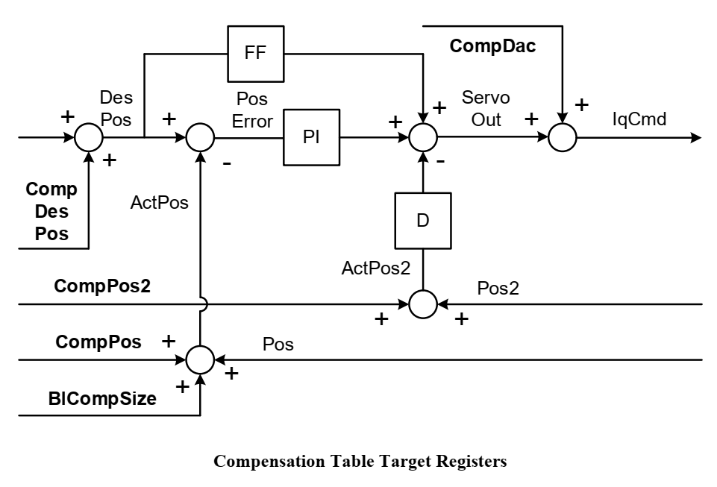
Process Overview (Injection Point)
Standard Servo Algorithm
Compensation Tables functionality
Works for both Open Loop (OL) and Closed Loop (CL) identification tests
Inject signal here
Notes:
In the Power PMAC, we used the compensation table functionality with the standard servo algorithm to inject the test signals. This injection point worked for both OL and CL identification tests.

Slide 10
Process (Steps)
Identify system constraints
1
Design identification test
2
Design excitation signal
3
Configure Power PMAC
4
Setup programs
5
Create reference signal
6
Identification test
7
Retrieve data and analyse
8
Notes:
The process of finding an FRF of the plant consisted of the following 8 actions. I shall only touch on the important aspects we encountered for actions 3, 4 and 5.

Slide 11
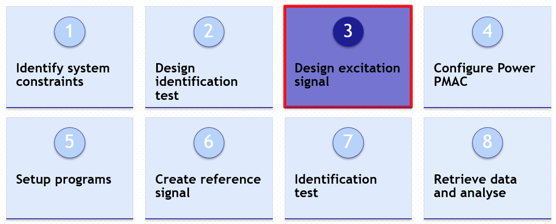
3.3) Design Excitation Signal
Linear approximation of overall system with nonlinearities and noise
Operating point –> normal operation motion; velocities and accelerations
RMS, DC bias, time constraints
Sampling frequency, computation and memory constraints
Random Phase, Multisine made of odd harmonic frequencies:
Periods, realisations, crest factor minimisation
Notes:
The design of the excitation signal is crucial as it determines the quality of the FRF. As this is a linear approximation of the plant during operation, the excitation signal must be at a similar RMS as the running signals during normal motion. Additionally, the hardware constraints must be considered.

Slide 12
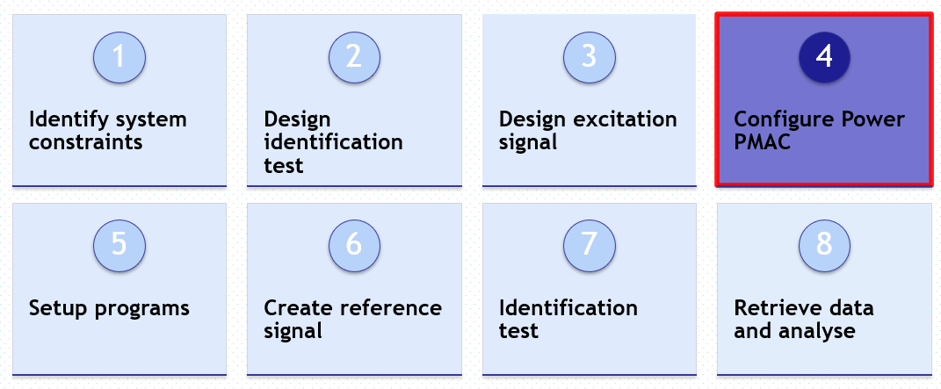
3.4) Configure Power PMAC
User-written servo C routine
Servo frequency of 5 KHz meant maximum frequency of 500 Hz
Configure for gathering and storing data
Notes:
After designing the excitation signal, the Power PMAC was configured for the test. We used a sampling frequency of 5 KHz which limited our FRF frequency range to 500 Hz.

Slide 13
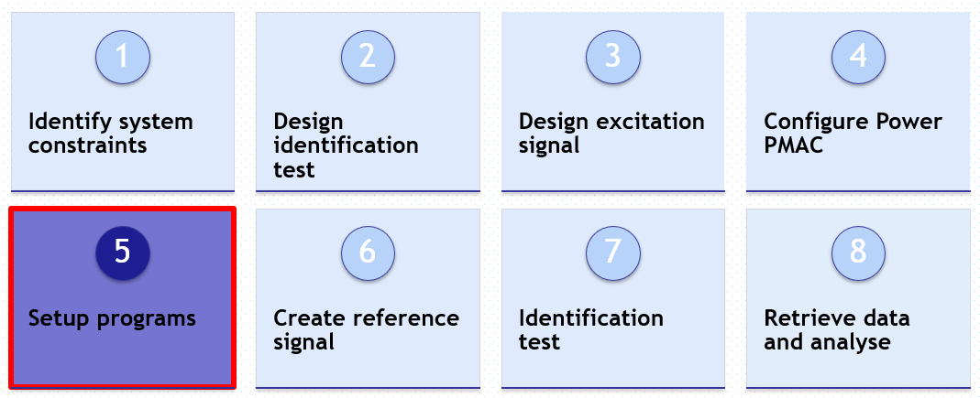
3.5) Setup Programs
Software PLC:
Motion program:
User-written servo C routine:
Background C routine:
Start of test
Setup and initialisation of gather utility
Implements the reference signal
Meets operating constraints
Virtual motor 0
Injects the excitation signal
Starts the gather utility
Streams the gathered data to external memory
Notes:
Four software programs were used in the Power PMAC to get an FRF. Notably, we used a virtual motor to generate the excitation signal which was then injected into the real system via the compensation table function.

Slide 14
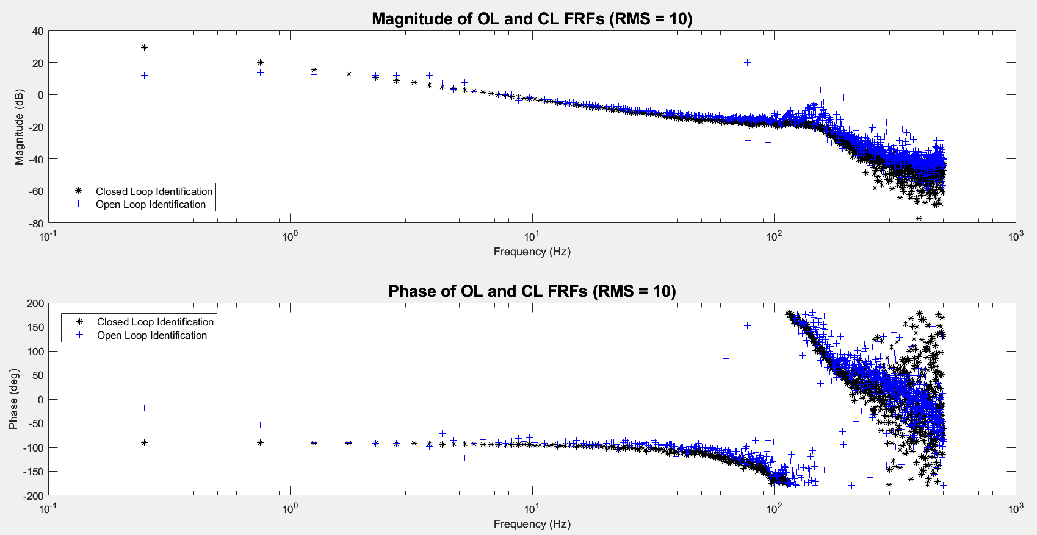
Notes:
Using this process, we acquired our main objective, a FRF of the plant. Here both the OL and CL FRFs are shown. Both FRFs are similar and show a peak at roughly 150 Hz. The phase plot wraps around 100 Hz and is quite jumpy. The magnitude and phase plots can be improved with different methods such as parametric identification.

Slide 15
Controller design, implementation and validation in the frequency domain
Using an FRF: Controller
Notes:
To note, we have obtained an FRF as seen in the previous slide and now this is an example of using an FRF.

Slide 16
Controller (Design)
Use FRF to design controller
Import FRF into ShapeIt© and design controller
Export the designed controller to Matlab©
Convert to the digital domain
Calculate the polynomial coefficients
ShapeIt©: 2005-2023 DJH Bruijnen, G Witvoet; Control Systems Technology, Eindhoven University of Technology
ShapeIt version: 0.16
Matlab©: 1994-2023 The MathWorks, Inc.
MATLAB version: 9.13.0.2105380 (R2022b) Update 2
Notes:
With this gained FRF of the plant, several controllers were designed, implemented and validated. We imported the FRF into the ShapeIt software and designed a controller.

Slide 17
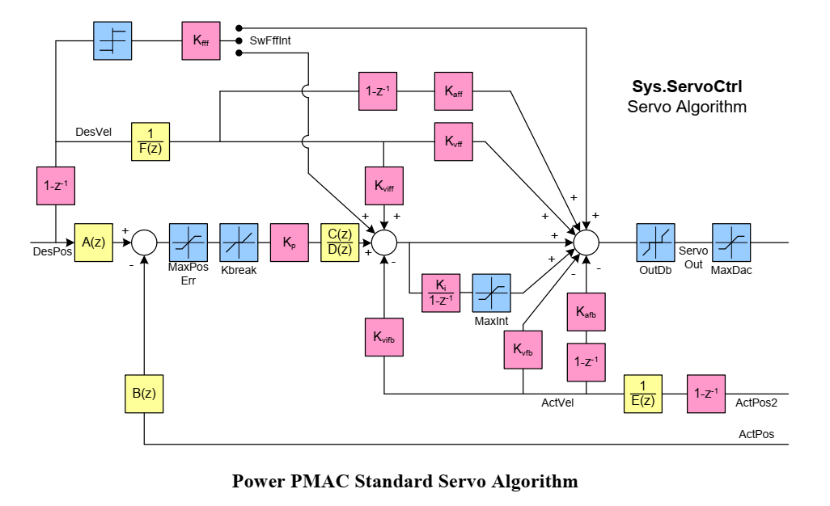
Controller (Implementation)
Digital controller - C(z)/D(z)
Enable higher order polynomials
Do not use other feedback terms
Implement controller here
Notes:
This controller was implemented in Power PMAC using the filter function with the proportional gain term and disregarding the other feedback terms.

Slide 18
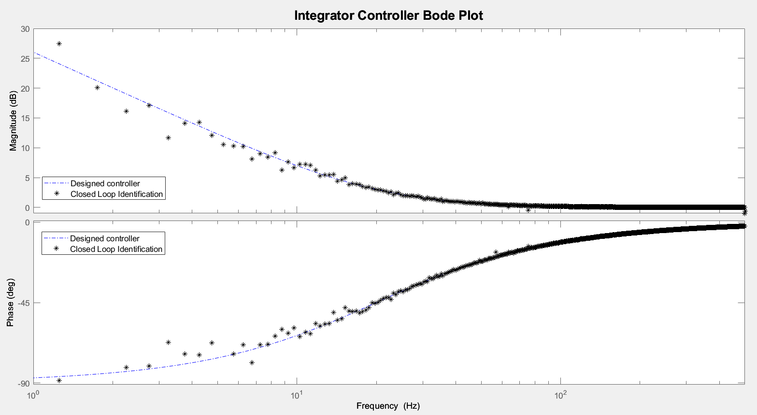
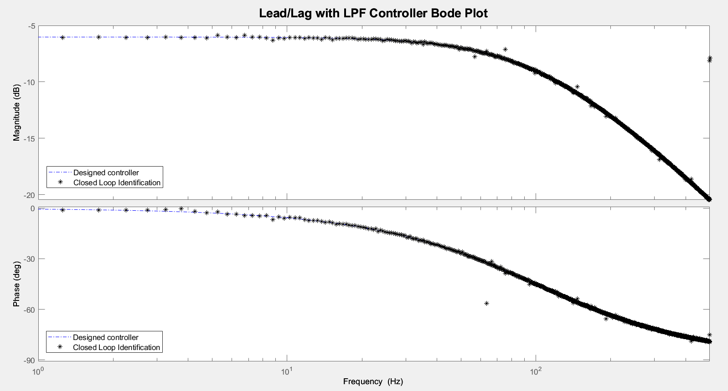
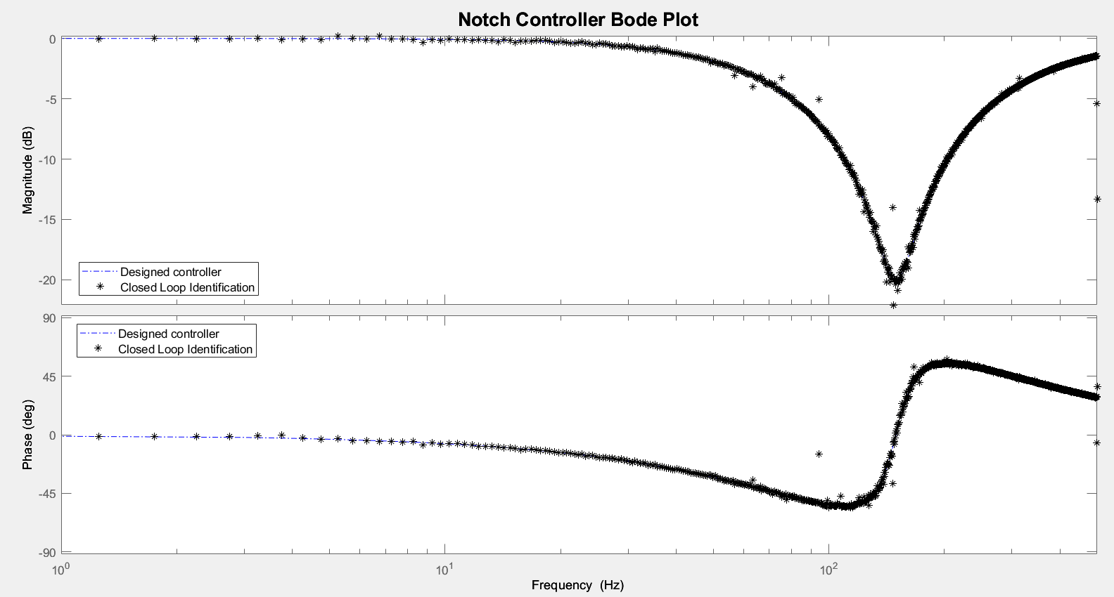
Controller (Validation)
Notes:
The controllers were validated using their FRFs.

Slide 19
Work in progress
Future plans

Slide 20
Work in Progress
FRF of other mechanical systems
Statistics – noise, total and nonlinear variances
Implementing other improved methods
Automating the process
Parametric identification
Nyquist plots
Notes:
Our next steps are to test other mechanical systems, calculate statistics that indicate the quality of the FRF and find routines to improve the FRF results.

Slide 21
Thank you
Brett Sing Gen
diammotioncontrol@diamond.ac.uk
brett.sing-gen@diamond.ac.uk
Diamond Light Source
Notes:
Thank you for your time and attention. This is an ongoing project, so any recommendations or advice is welcome as well as any questions.

Slide 22
Resources
System Identification: A Frequency Domain Approach (2nd Edition)
Mastering System Identification in 100 Exercises
System Identification and Control for the Sirius High-Dynamic DCM
Nonlinear System Identification: A User-Oriented Road Map
Advanced Data Gathering on Power PMAC
Power PMAC Software Reference Manual
Matlab (ShapeIt, System Identification App)

Slide 23
Frequency Response Functions (Application)
Magnetic Levitation (Maglev) project
Designed the system and built.
Validated using multiple FRFs and time domain responses.

Slide 24
Process (Steps)
Identify system constraints
1
Design identification test
2
Design excitation signal
3
Configure Power PMAC
4
Setup programs
5
Create reference signal
6
Identification test
7
Retrieve data and analyse
8

Slide 25
Parametric Fitting
Further approximation

Slide 26
Parametric Fitting
Many different frequency and time domain methods
System Identification App in Matlab
Import FRF as FRD
Fit using different models

Slide 28
