Slide 1
FPGA Power Brick LV
Tony Jacobs

Slide 2
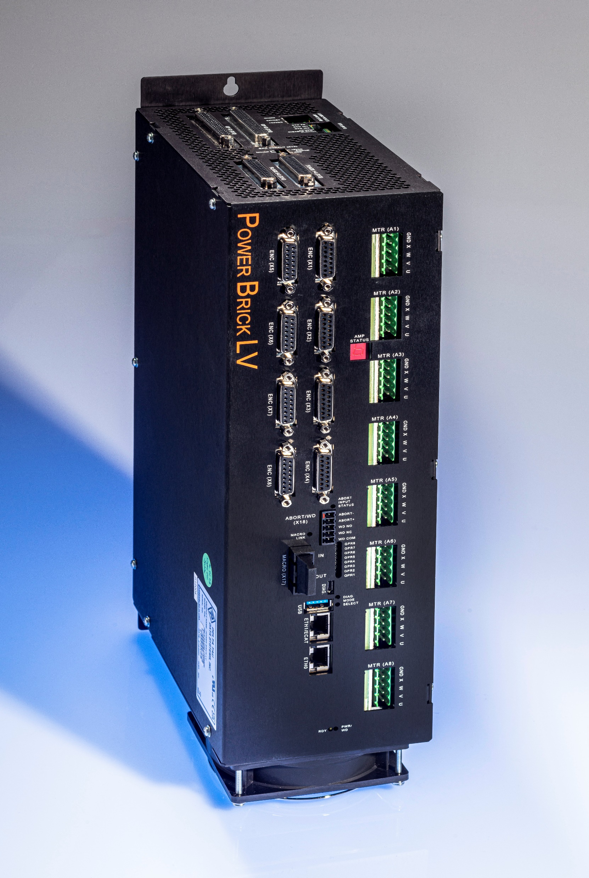
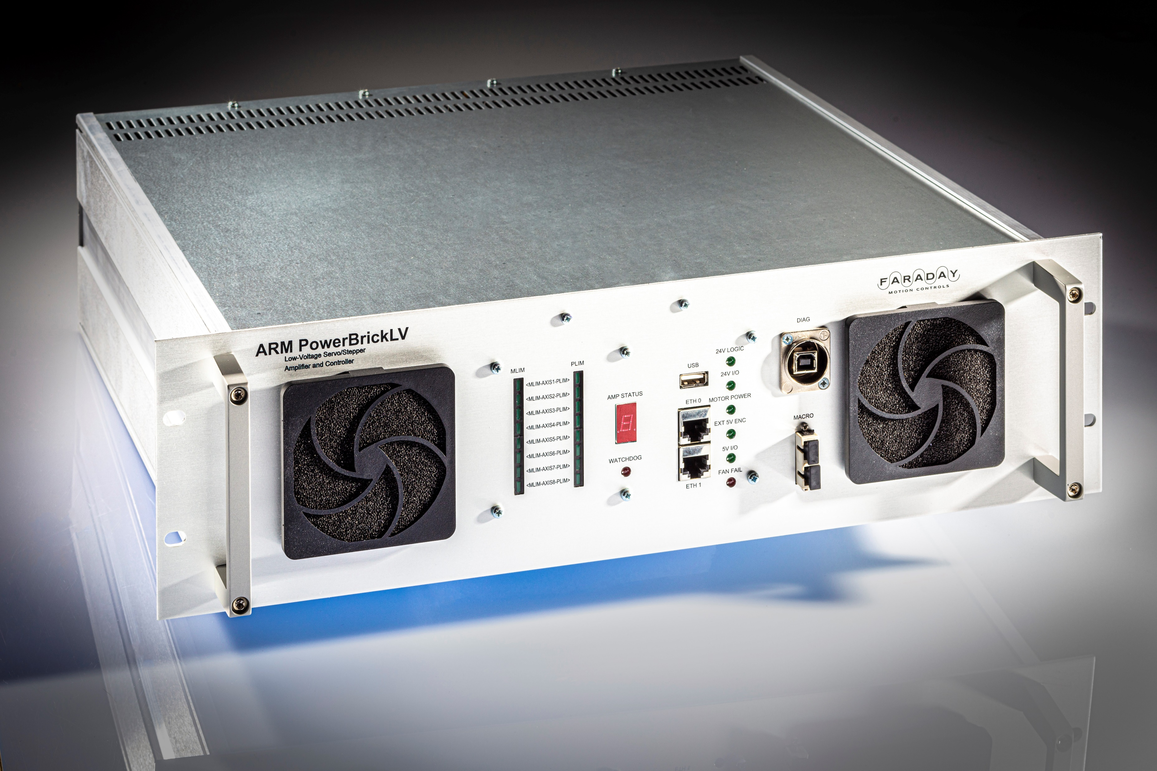
The Challenge…
To fit all of this:
+
+
Into the same space as one of these:

Slide 3
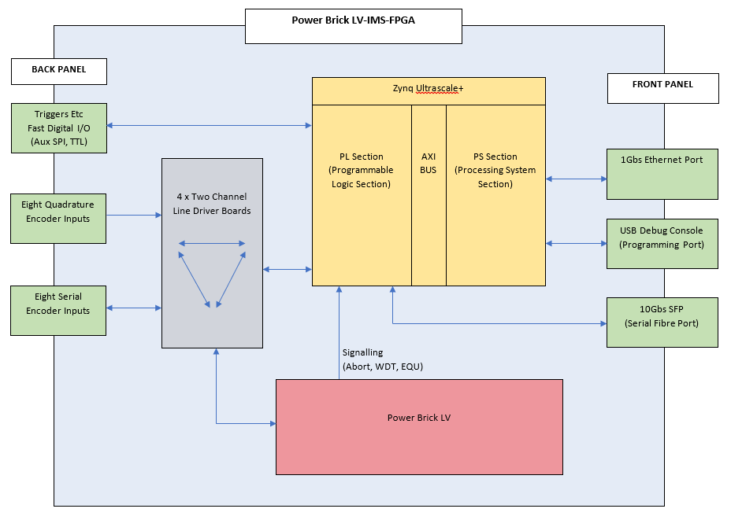
What it does

Slide 4
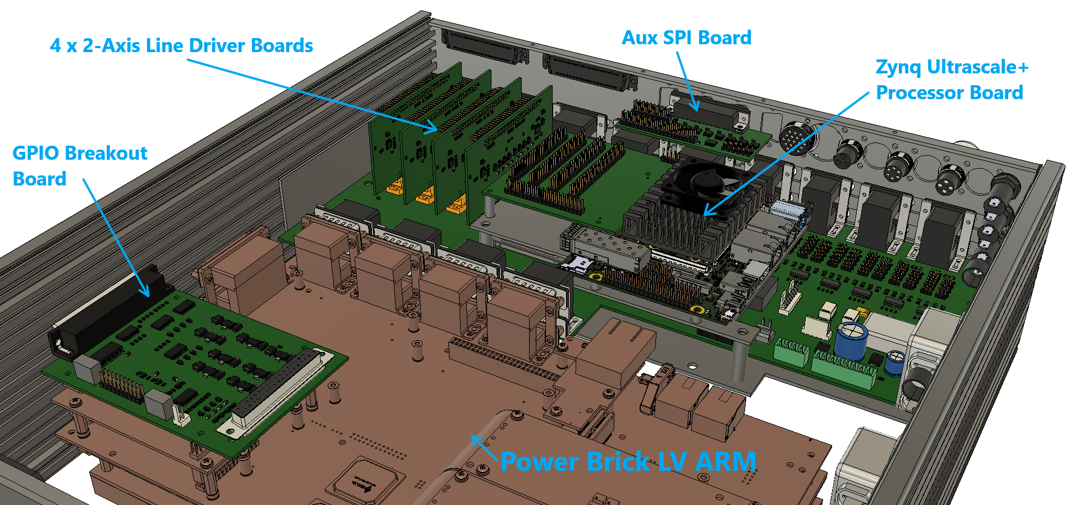
How we did it

Slide 5
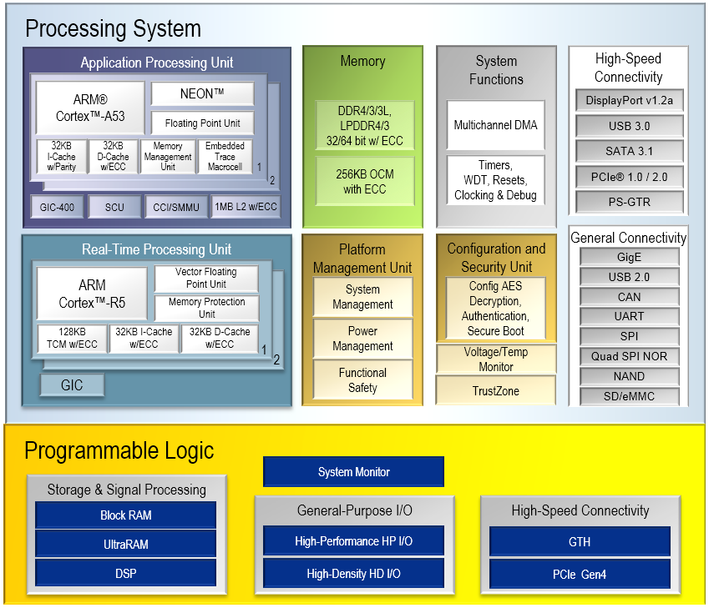
Encoder Co-Processor Features:
Zynq Ultrascale+ MPSoC - Combines CPU, FPGA and IO into a powerful module.
8 channels of TTL Quadrature encoders.
8 channels of Serial encoder input or output.
Digital IO – Customizable board with multi-way back panel connector.
MPSoC Module is an Enclustra Mercury+ XU6.
Generation of multiple triggers from combinations of multiple axes.
Triggers can be any format (serial, TTL).
FPGA is clocked at 125MHz giving up to 8nS resolution.
Encoder format conversion can be performed in real-time.
10 Gbps SFP+ fibre interface
Custom Fast IO Board:
Default board (Aux SPI) has 5 Bi-Directional RS-485 transceivers, 2x 5V Logic inputs and 2x 5V Logic outputs. Possible uses include: Driving an external DAC via SPI for potentially very fast control loops (e.g. vibration reduction with a multi-stage axis) Interfacing external RS422/RS485 devices.
- 24 ‘direct to the FPGA’ IO lines are available should a custom IO board be required.

Slide 6
Optional Boards:
GPIO Breakout Board:
4 GPIO lines from PMAC to FPGA
4 GPIO lines from FPGA to PMAC
4 GPIO lines from Back Panel to FPGA
4 GPIO lines from FPGA to Back Panel
EtherCAT Limits Override Board:
Allows external controllers (e.g. PLCs) to force Limit Flag conditions.
Saves the need to wire multiple limit switches in series.

Slide 7
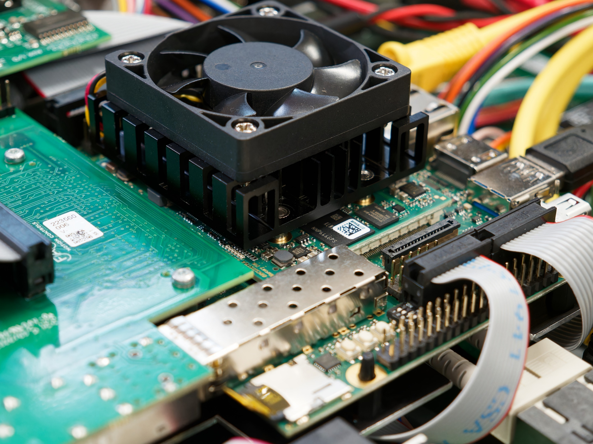
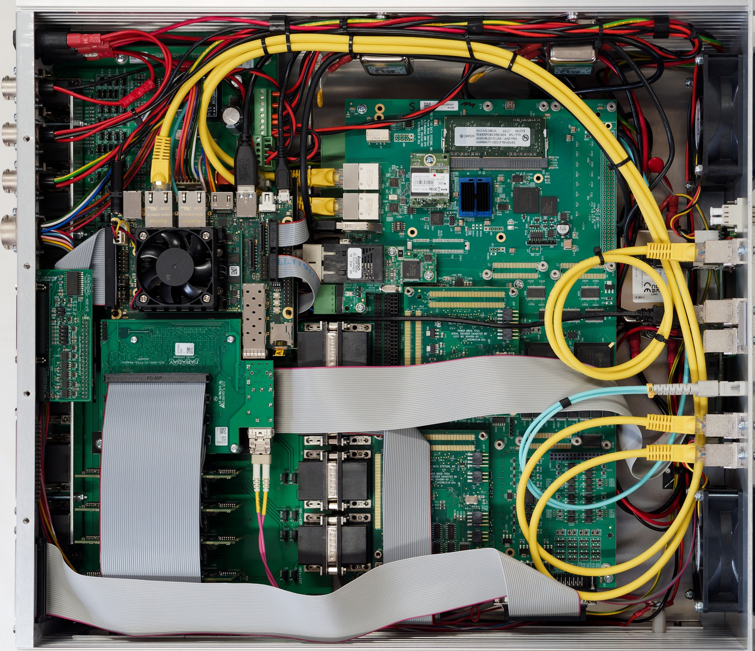
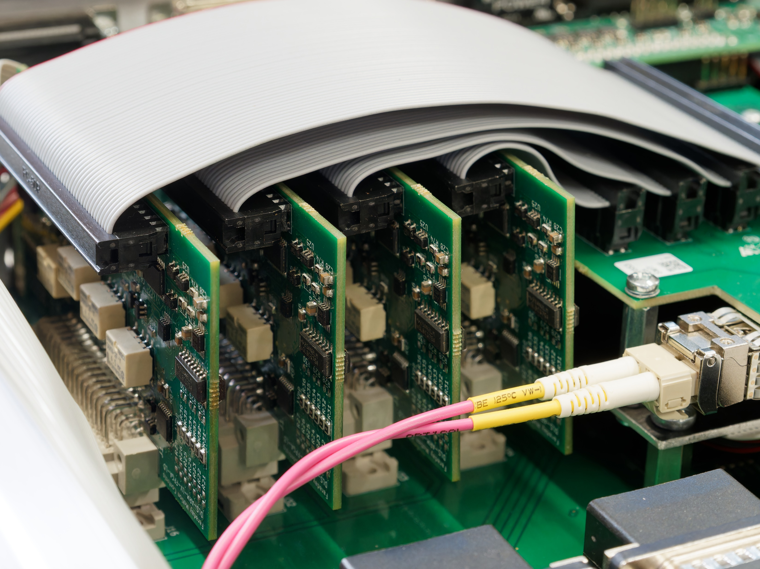
Inside the box

Slide 8
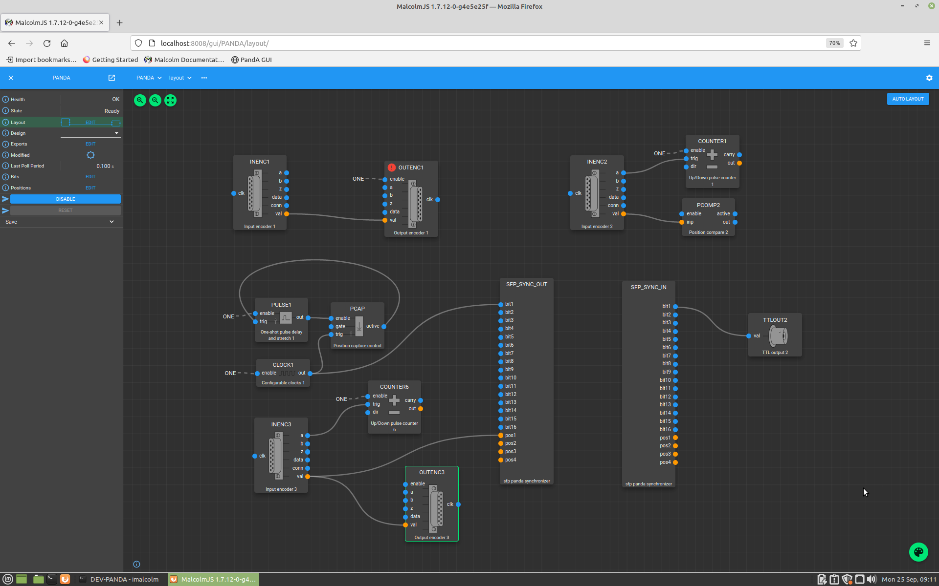
Running Diamond’s Malcolm GUI

Slide 9
FPGA Power Brick LV

