Slide 1
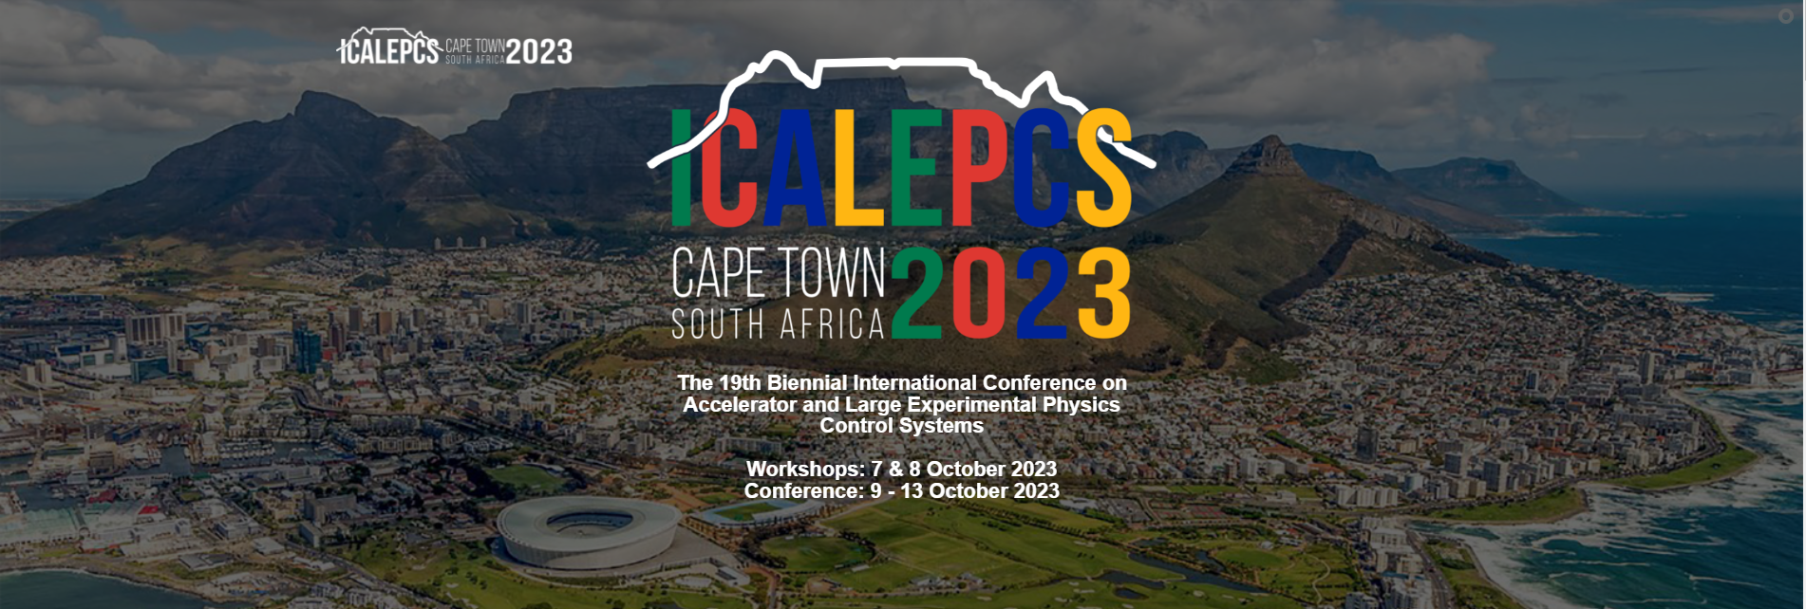
Round table organization
5 group for 45min discussion

Slide 2
Round table1
Frequency vs Time Domain Discover how we employ frequency vs time domains to enhance our mechatronic systems. Join the discussion on control loops, mechanics, metrology, and other relevant aspects.
How online metrology is included in your designs?
Which kind of additional sensors are needed (interferometers, …)?
Do you implement new process to implement ?
Robotic Frameworks Explore the implementation of robotic frameworks within different facilities. Share your experiences and insights on the various types of frameworks utilized in diverse contexts.
HW vs SW developments, going at different speeds?
What is nowadays preventing the discard and applications of new ideas?
Meet new colleagues working with motion control and robotics at large radiation facilities
Gain new understandings of related disciplines in robotics and metrology
Generic integration of robots\, Usage of robots for new applications Using the same robot in different experimental setups
Robotic frameworks used in other facilities or other business
What are our experiences in motion control safety and collaborative robots
How is automation addresses at each of the facilities
What are your main challenges in sample environment integration eg compactness, different controllers, other competencies ( temperature pressure?)

Slide 3
Round table1
Advanced Motion Control Algorithms Gain valuable knowledge about cutting-edge algorithms employed in motion control applications. Delve into topics such as Kalman filters, iterative learning control, model predictive control (MPC), applicative machine learning, and other advanced techniques.
Standardization across instruments / facilities / organizations
Is there a place for IA in scientific instrument control and what are the risks
How you chose the right motion feedback solution? (Reusability of existing ones? Based on in-house knowledge? Cost? )
Collection of recurrent and common failures across facilities on motion control devices
In-house developments vs industrial solutions, when is convenient and when not
How do you decide if an industrial equipment or in-house development is ready to be put in operation for critical missions (24/7 and high reliability required) ?
To learn about “special” motion control, implementations in other facilities, standardization in other facilities
Mechanical systems maintenance or close-loop re-tuning?
Experience with Electromagnetic Direct Drives?
Share experiences and engage with other Power PMAC users
Learn about different motion control methods/algorithms and technology
Trajectories with motor controllers of different suppliers
Motors for movements on the nanometer scale Deep reinforcement learning-based control algorithms
How have other facilities integrated the Advanced Motion Control Algorithm?
complex motion
continuous scans
timestamping and triggering
New motion control systems and methodologies

Slide 4
Guijarro, Mr Matias | Esrf | Group 1 | Xavier Serra Gallifa
LI, Dr ZHIYONG | Michigan State University
Sing Gen, Mr Brett | Diamond Light Source
Mashele, Mr Foster | Nrf Ithemba Labs
Smith, Mr Michael | European XFEL GmbH
Wegmann, Mr Peter | Helmholz-Zentrum Berlin
Smith, Mr William | Helmholtz-zentrum Berlin
Ramukosi, Mr Takalani | South African Radio Astronomy Observatory
Avila-Abellan, Mr Jose | Alba Synchrotron | Group 4 | Yves-Marie Abiven
Yazar, Mr Yekta | SLAC National Accelerator Laboratory
Mashayekh, Mr Navid | European X-ray Free-electron Laser Facility Gmbh
Steinbrück, Mr Reinhard | HZDR
Coppuck, Mr Jake | AWE PLC
He, Ms Huiling | Helmholtz-zentrum Berlin
Meyer, Mr Jens | Esrf
Vaher, Mrs Jessica | Lawrence Livermore National Laboratory
Colquhoun, Mr Guy | Awe Plc
Sjöblom, Dr Peter | MAX IV Laboratory | Group 2 | Laura Munoz
Masi, Dr Alessandro | CERN
Martínez Samblas, Mr Javier | CERN
Sukharnikov, Mr Konstantin | European XFEL
Werder, Dr Dominik Sebastian | Paul Scherrer Institut
Lyford, Mr Matthew | Awe
Jayaram, Ms Shaleena | South African Radio Astronomy Observatory
Kuiken, Mr Oscar | Umcg-partrec
Leihbecher, Mr Frank | Fmb Feinwerk Und Messtechnik Berlin Gmbh | Group 5 | Mario Di Castro
Geng, Ms Xiaosong | Oak Ridge National Lab
Wyman, Dr Max | Argonne National Laboratory
Samadli, Mr Ayaz | European Xfel Gmbh
Yakopov, Dr Mikhail | European XFEL GmbH
Celcer, Dr Tine | Paul Scherrer Institute
Karabekyan, Dr Suren | European XFEL
Marais, Dr Deon | Necsa SOC Limited
Afshar, Mr Nader | Australian Synchrotron - Ansto | Group 3 | Nicola Coppola
Gorgisyan, Dr Ishkhan | Max IV Laboratory
Blanco, Dr Enrique | CERN
Gofron, Dr Kazimierz | Oak Ridge National Laboratory
Danzeca, Dr Salvatore | CERN
Dodia, Mr Irshaad | South African Radio Astronomy Observatory
Kleines, Mr Harald | Forschungszentrum Jülich
Landré, Mr David | CERN

