Slide 1
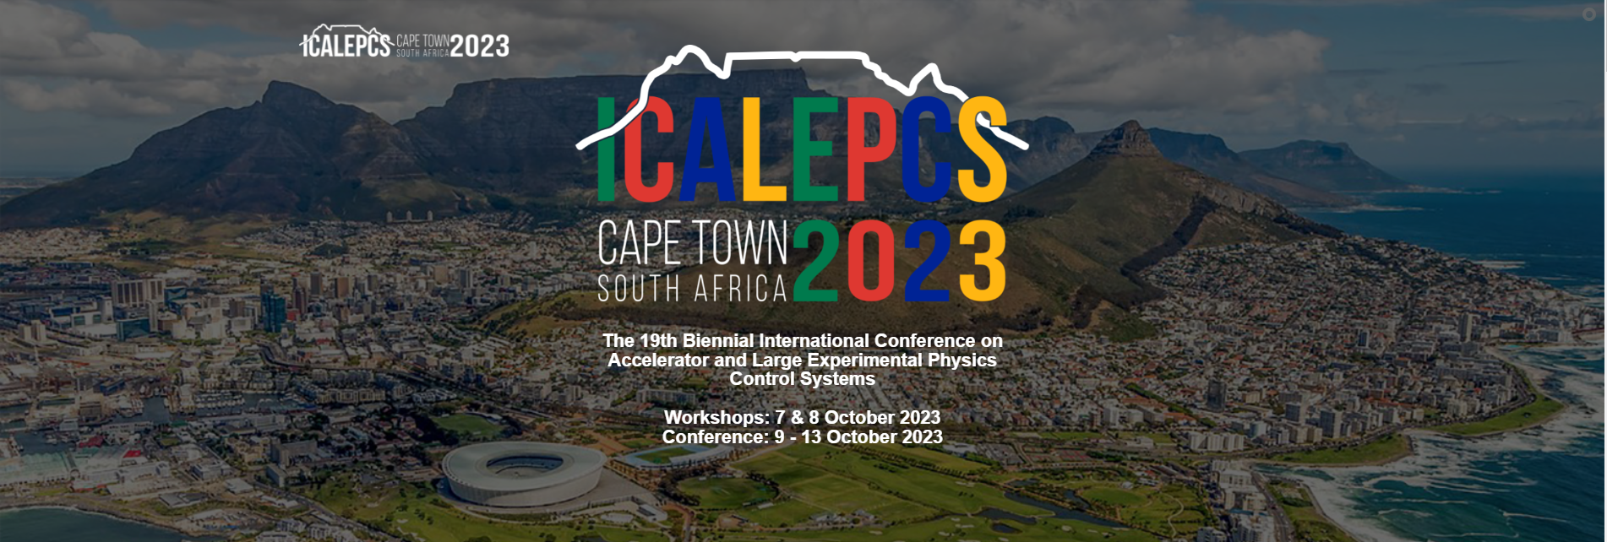
Round table organization
5 group for 1 hour discussion

Slide 2
Round table 2
Digital Twins Uncover how digital simulations can be used in optimizing and augmenting existing systems. Learn how digital twins contribute to anti-collision systems, hardware-in-the-loop setups, advanced sensor integrations, and more.
Integration of mechatronics applications in the control system
Instrument digital twins (McStas coupled) for training
Best practice for systems development
System modeling and validation with Hardware in the Loop (HIL) ?
Overcoming Existing System Limits Find out how we overcome limitations in motion control systems. Engage in conversations about handling obsolete controllers, improving motor resolutions, and other innovative solutions.
Formal design approaches
Nanopositioner integration in complex systems or beamline end-stations
AoB questions
Feedbacks on collaborations with university on R&D
Collaboration between institutes
Better understanding of state of the art.
Do other facilities share our challenges?
Exposure to “mechatronics” in industry and other applications
EtherCAT protocol use case (in operation)

Slide 3
Guijarro, Mr Matias | Esrf | Group 1 | Xavier Serra Gallifa
LI, Dr ZHIYONG | Michigan State University
Sing Gen, Mr Brett | Diamond Light Source
Mashele, Mr Foster | Nrf Ithemba Labs
Smith, Mr Michael | European XFEL GmbH
Wegmann, Mr Peter | Helmholz-Zentrum Berlin
Smith, Mr William | Helmholtz-zentrum Berlin
Ramukosi, Mr Takalani | South African Radio Astronomy Observatory
Avila-Abellan, Mr Jose | Alba Synchrotron | Group 4 | Yves-Marie Abiven
Yazar, Mr Yekta | SLAC National Accelerator Laboratory
Mashayekh, Mr Navid | European X-ray Free-electron Laser Facility Gmbh
Steinbrück, Mr Reinhard | HZDR
Coppuck, Mr Jake | AWE PLC
He, Ms Huiling | Helmholtz-zentrum Berlin
Meyer, Mr Jens | Esrf
Vaher, Mrs Jessica | Lawrence Livermore National Laboratory
Colquhoun, Mr Guy | Awe Plc
Sjöblom, Dr Peter | MAX IV Laboratory | Group 2 | Laura Munoz
Masi, Dr Alessandro | CERN
Martínez Samblas, Mr Javier | CERN
Sukharnikov, Mr Konstantin | European XFEL
Werder, Dr Dominik Sebastian | Paul Scherrer Institut
Lyford, Mr Matthew | Awe
Jayaram, Ms Shaleena | South African Radio Astronomy Observatory
Kuiken, Mr Oscar | Umcg-partrec
Leihbecher, Mr Frank | Fmb Feinwerk Und Messtechnik Berlin Gmbh | Group 5 | Mario Di Castro
Geng, Ms Xiaosong | Oak Ridge National Lab
Wyman, Dr Max | Argonne National Laboratory
Samadli, Mr Ayaz | European Xfel Gmbh
Yakopov, Dr Mikhail | European XFEL GmbH
Celcer, Dr Tine | Paul Scherrer Institute
Karabekyan, Dr Suren | European XFEL
Marais, Dr Deon | Necsa SOC Limited
Afshar, Mr Nader | Australian Synchrotron - Ansto | Group 3 | Nicola Coppola
Gorgisyan, Dr Ishkhan | Max IV Laboratory
Blanco, Dr Enrique | CERN
Gofron, Dr Kazimierz | Oak Ridge National Laboratory
Danzeca, Dr Salvatore | CERN
Dodia, Mr Irshaad | South African Radio Astronomy Observatory
Kleines, Mr Harald | Forschungszentrum Jülich
Landré, Mr David | CERN

