Slide 1

MOTION CONTROL WORKSHOP (MOCRAF)
8th of October 2023
Institutes introduction

Slide 2
ALBA SYNCHROTRON @MOCRAF 2023
José Ávila Abellán
8th October 2023

Slide 3
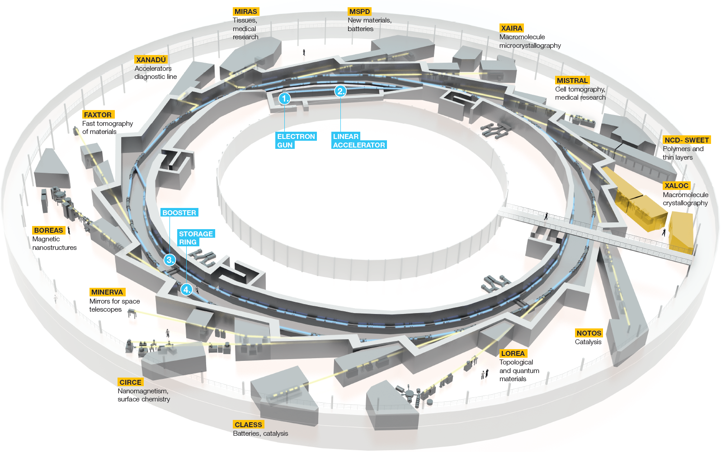
Introduction
ALBA is a 3rd generation synchrotron:
  LINAC: 100 MeV
  BOOSTER: 100 MeV – 3 GeV
  STORAGE RING: 3 GeV
Beamlines:
  10 operative
  (1 accelerator diagnostic)
  1 in commissioning (operation 2023)
  2 in installation phase (operation 2024)
  +1 in design phase (operation 2026)
  +1 beamline (ALBAII)
  +2 long-beamlines (ALBAII)
ALBA is facing the upgrade to a 4th generation synchrotron [TUPDP077]:
  Dark period 2030 & 2031
  Operation ALBAII 2032
MOCRAF 2023

Slide 4
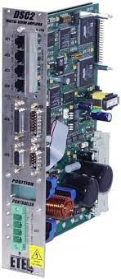

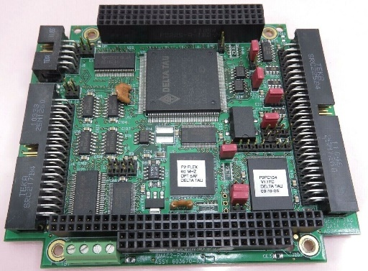
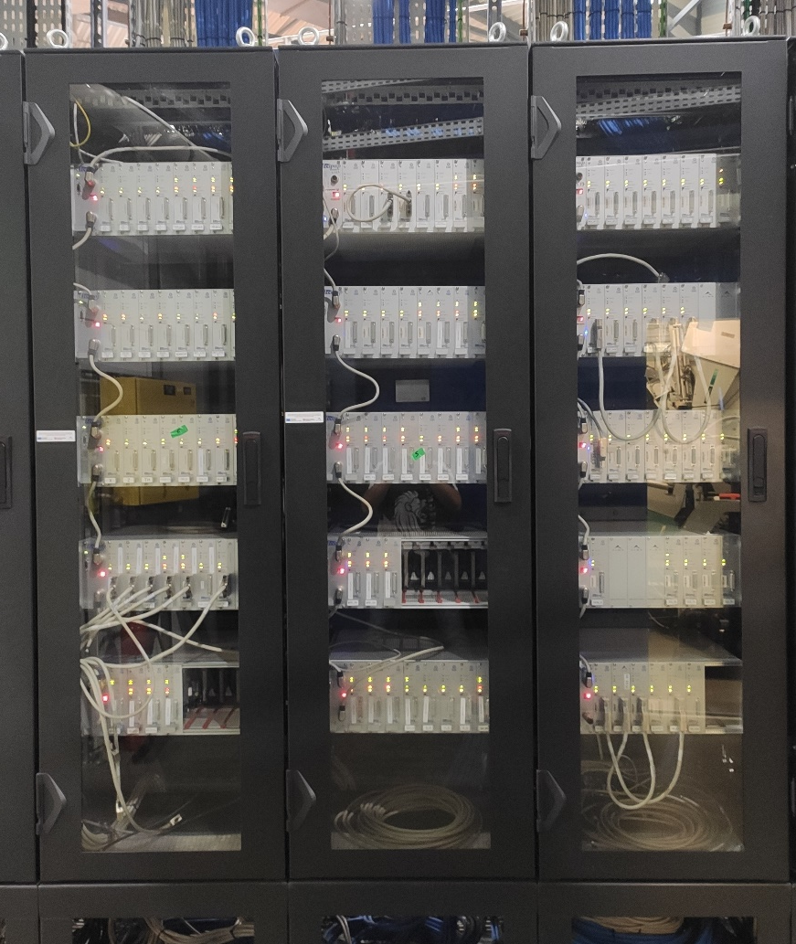
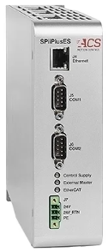
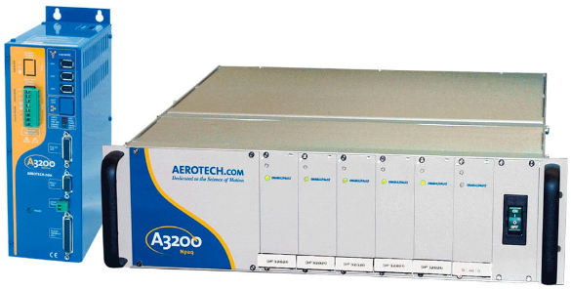
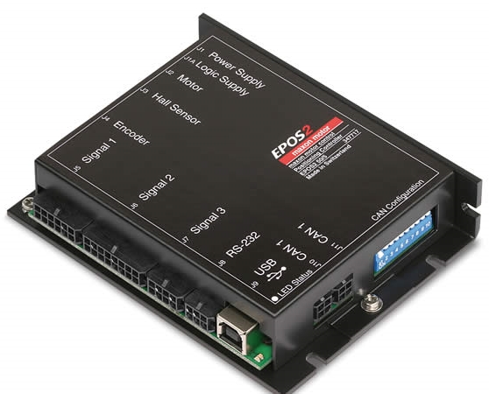
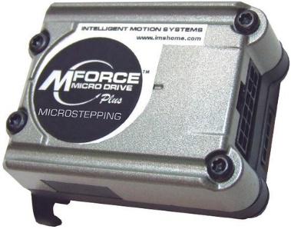
Motion Control Current Activities
One of the Electronics section main duties is the motion control:
  Participation in the design + Commissioning + Support to the operation (troubleshooting)
Stepper motors
  Accelerator (DI, RF, ID, FE): ~160 axis
  Operative/commissioning BLs: ~720 axis
  Under construction BLs: ~110 axis
  Future BLs: ~75 axis/BL
  Standard controller:
AC motors
  BLs: ~10 axis
  No standard motor/controller
  High speed and high stability:
    Sample environment -> Maxon EPOS2
    Goniometers -> ETEL DSC2P, Aerotech A3200
    Monochromator Bragg -> DeltaTau PMAC2-PC/104
    Tomography tower -> ACS SPiiPlusEs
+ some non-standard controllers (turn-key project)
  ~24 axis
  DeltaTau Power Pmac + IMS mForce
MOCRAF 2023

Slide 5
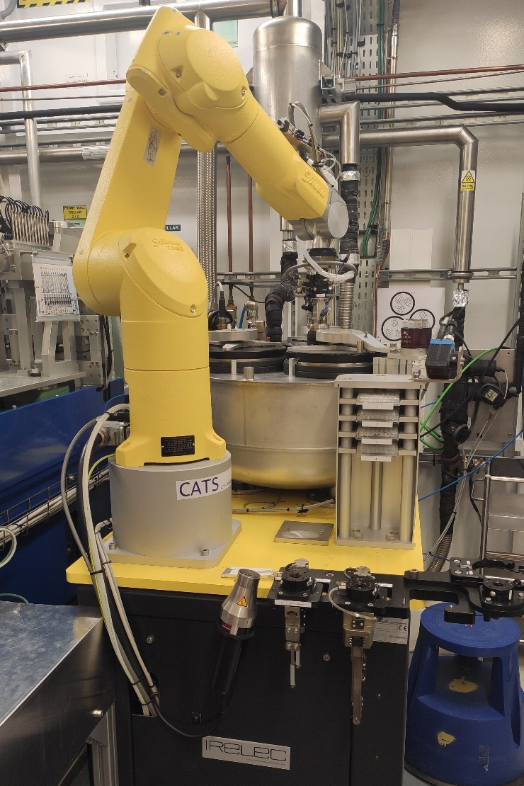
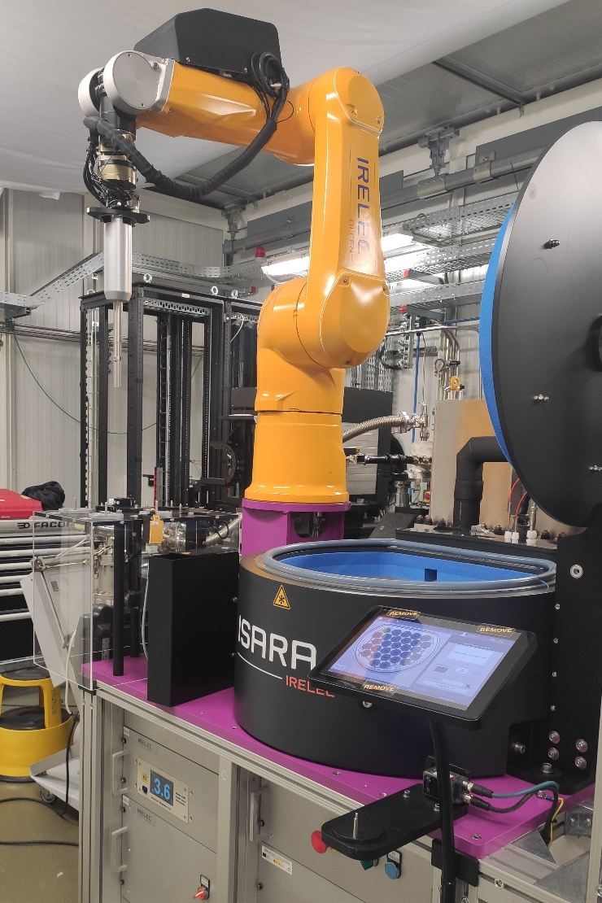
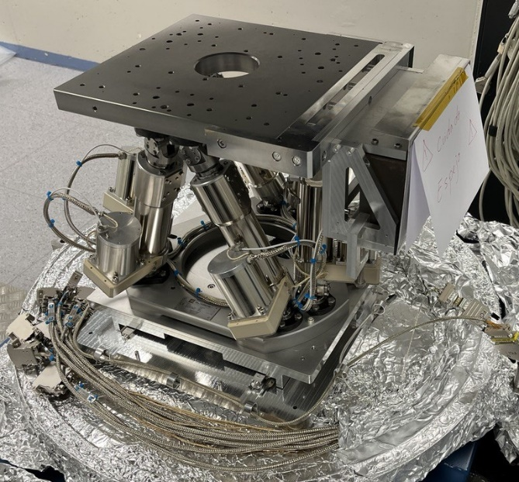
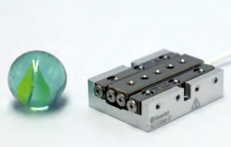
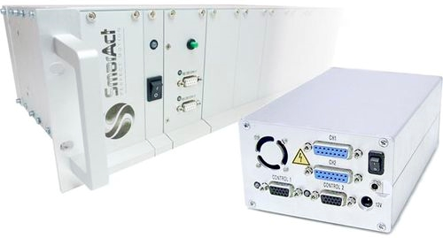
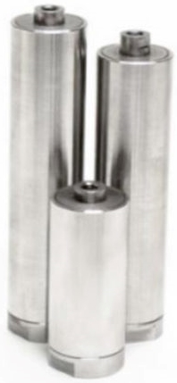
Motion Control Current Activities
Piezo stages
  BLs: ~30 axis
  SmarAct is our standard:
    MCS2 controller for unsynchronized axis
    SDC2 controller for synchronized axis (step/dir from IcePAP)
  Reduced space and/or high resolution
Robotics
  BLs: ~3 systems
  Turn-key solution (no-standard)
  Need for automation:
    Sample changer
    Hexapod
What would we like to accomplish at this workshop?
  To learn about “special” motion control implementations in other facilities
  Standardization in other facilities
  Mechanical systems maintenance or close-loop re-tuning?
  Experience with Electromagnetic Direct Drives?
Piezo actuators
  BLs: ~6 axis
  No standard actuator/controller
  Very high resolution:
    DCM mirrors adjustment -> Jenna
MOCRAF 2023

Slide 6
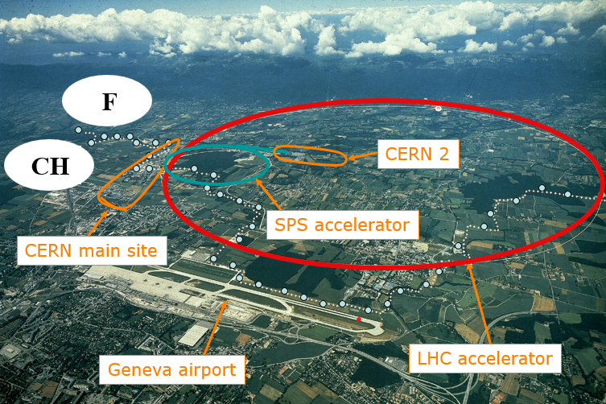
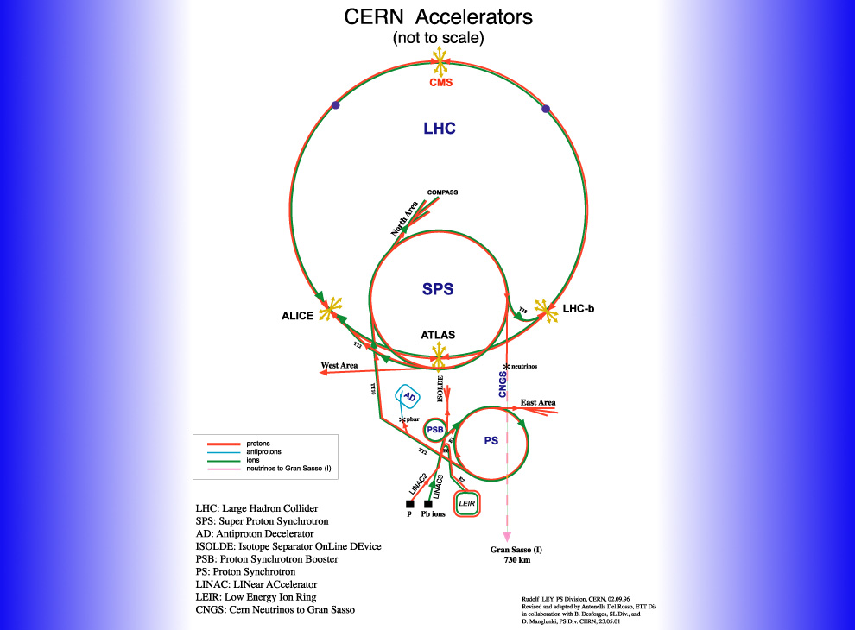

Slide 7
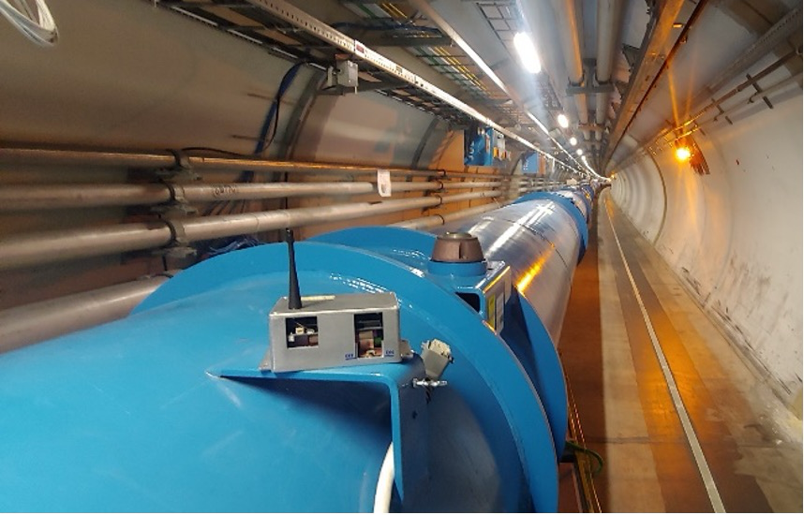
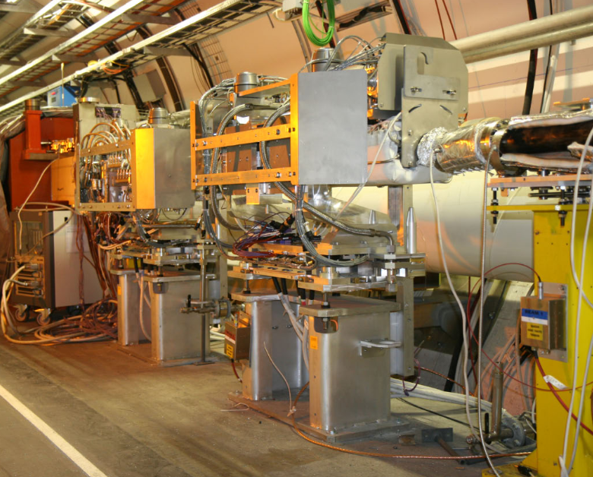
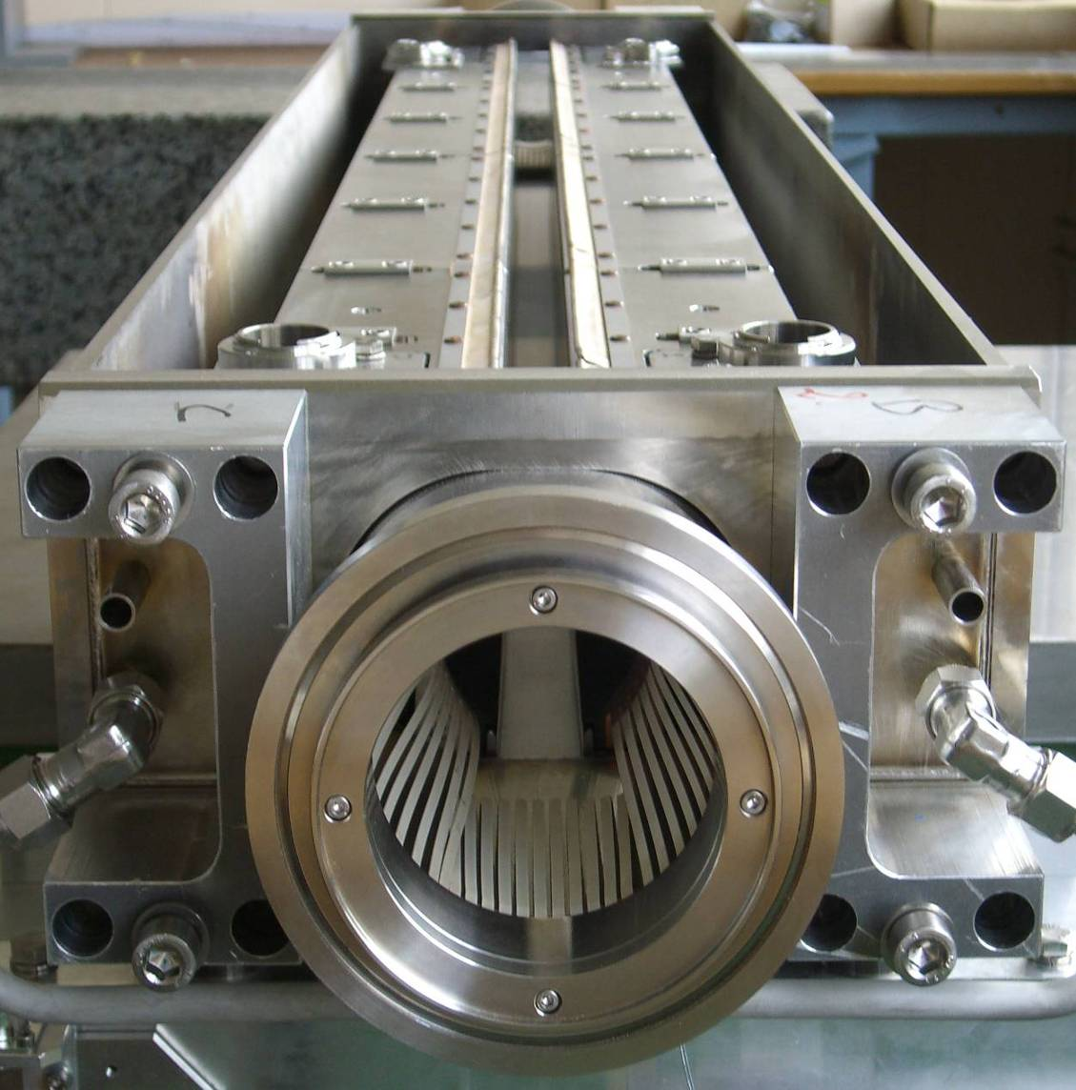
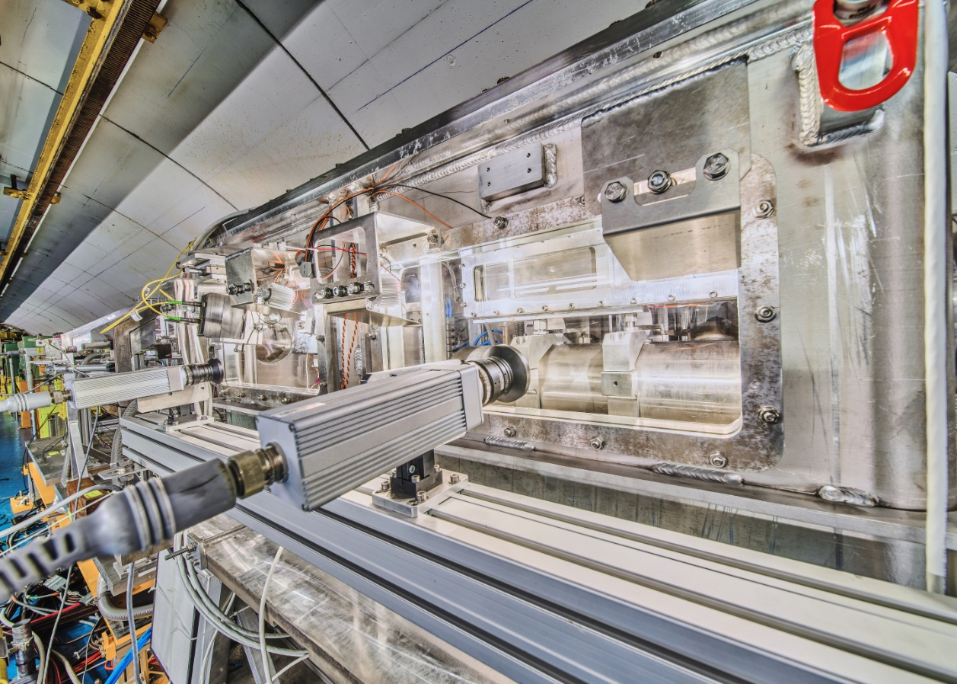
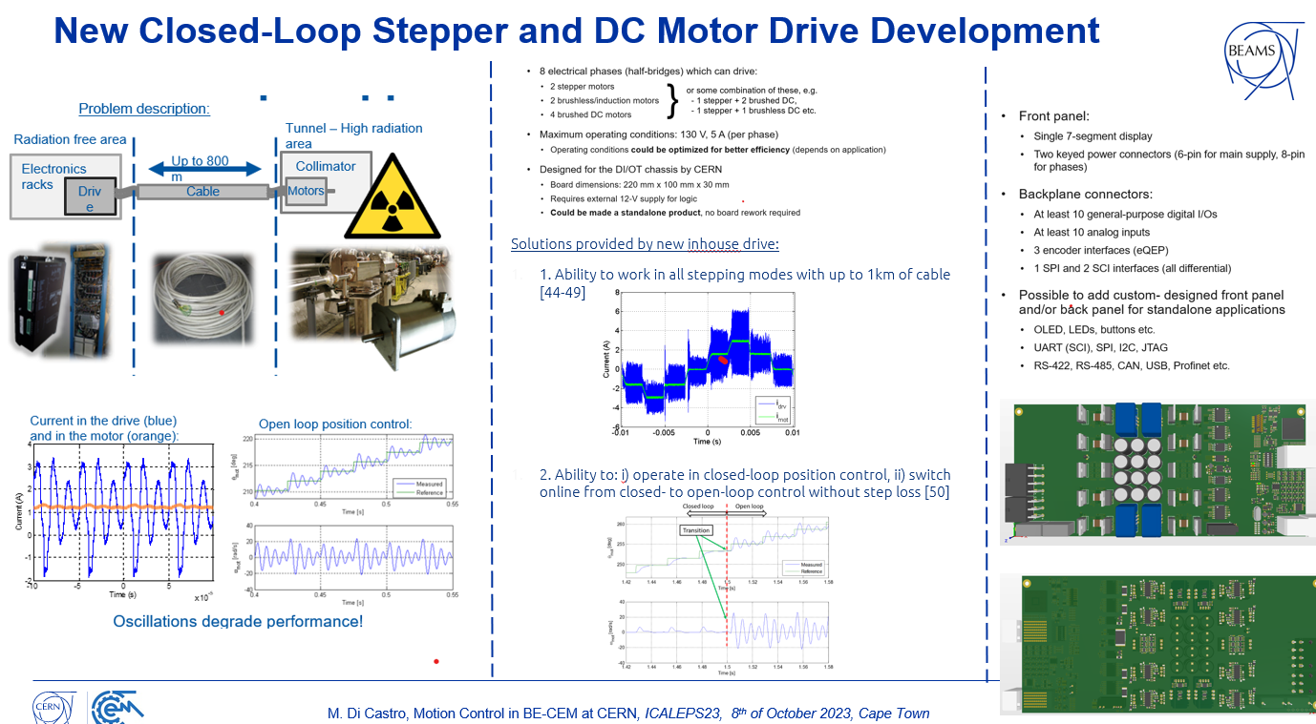
Advanced Controls for Beam Intercepting Devices (BIDs)
Main needs for BIDs controls
  Monitoring and actuation of several movable devices of the accelerator chain and experimental areas
    ~ 1000 motors and ~ 5000 transducers/sensors
  Collimators, beam dumps, beam stops, targets, slits, goniometers
    Position, temperature, vibration, close an open loop control etc.
    Main challenges for BIDs controls
  Real-time Controls with long cables (up to 1 km)
    No active electronics in the proximity of the device due to radiation damages to electronics and magnetic field interference
  Extremely high reliability and availability needed (~ 100%)
  Precision (~ 10 µm and/or 1 µrad)
Radiation tolerant wireless IoT
See S. Danzeca talk “Radiation-Tolerant Multi-Application Wireless IoT Platform for Harsh Environments”, WE3AO01 paper, Wednesday during Hardware technology WE3A session

Slide 8
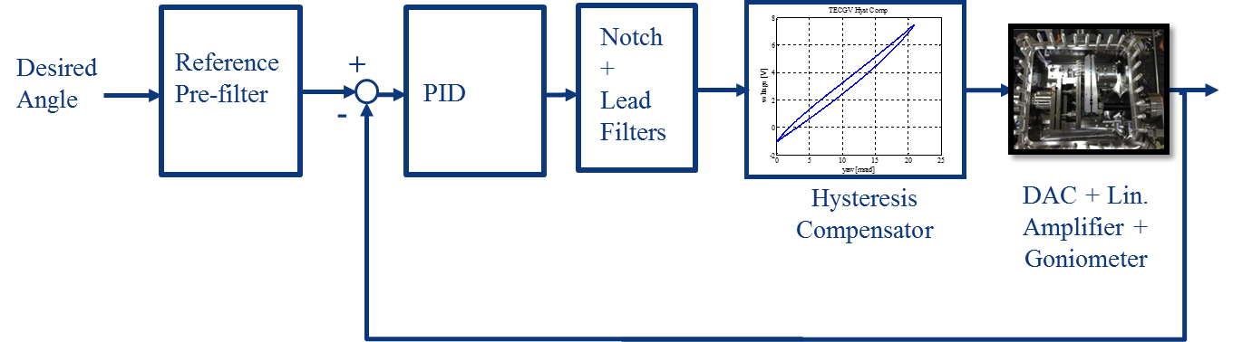
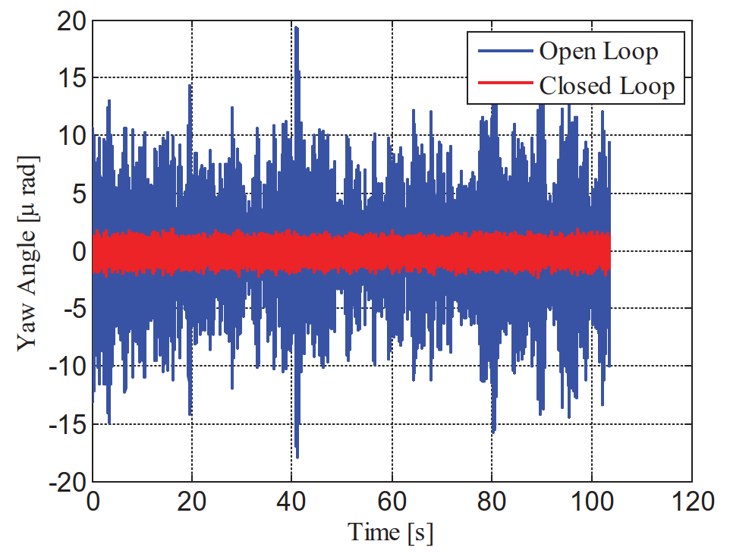
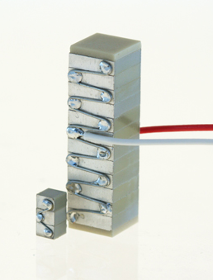
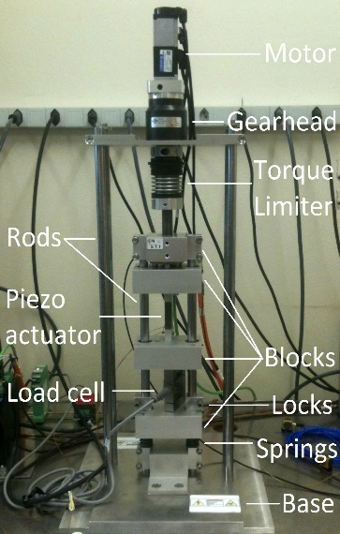
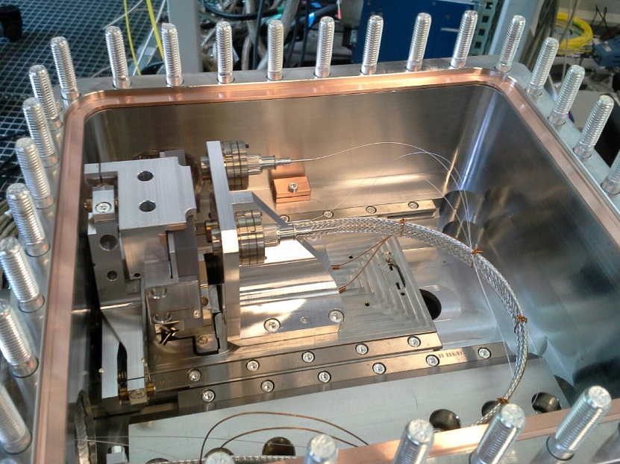
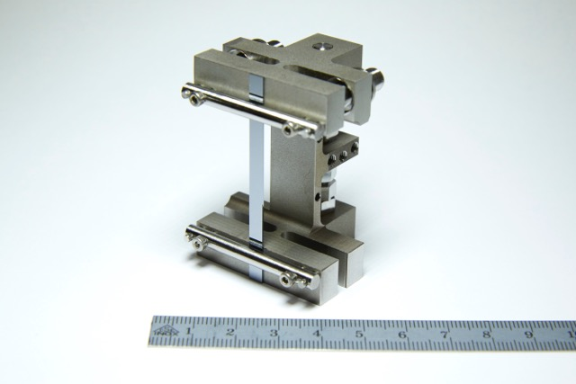
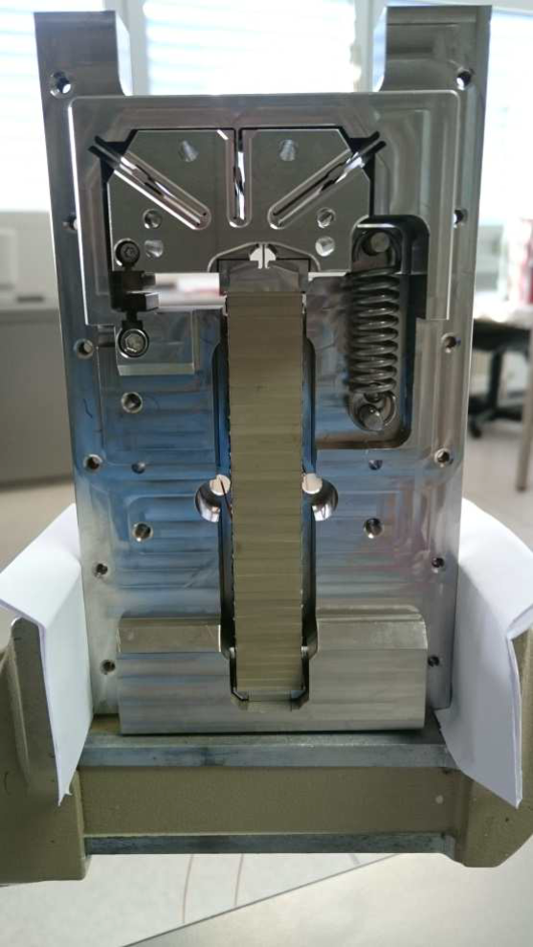
Piezo-based goniometer for beam collimation
Precise positioning (<1urad) in UHV of a sylicon crystal to stear particle beam
Feedback control loop for angular position tracking and disturbance rejection
New absolute angular position method and novel application of feedback method
Piezo
Inhouse developed electromechanical piezo characterisation testbench (measures stroke, blocked force, impedance, leakage current). µm position resolution, 4kN load capacity
Inside view of the LHC Goniometer
CERN-specific Piezo stack
(High temperature, radiation resistant, UHV compatible)
LHC Goniometer piezo based rotational stage

Slide 9
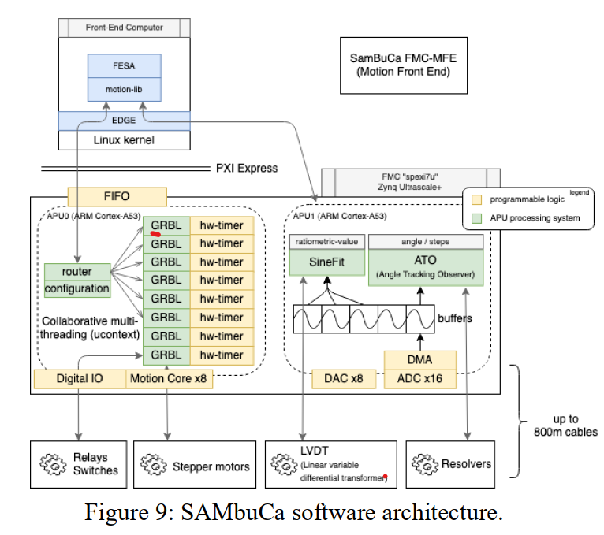
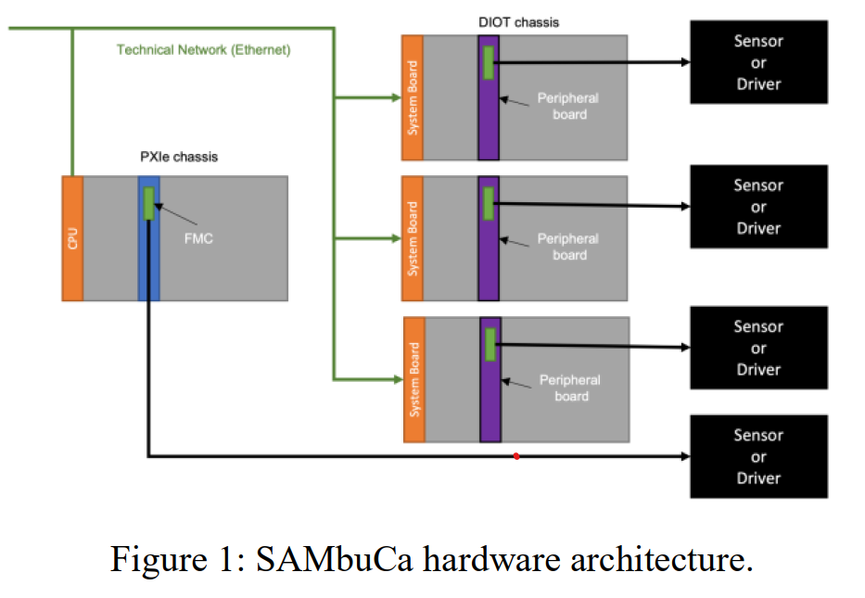
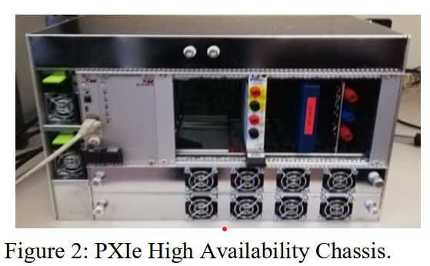
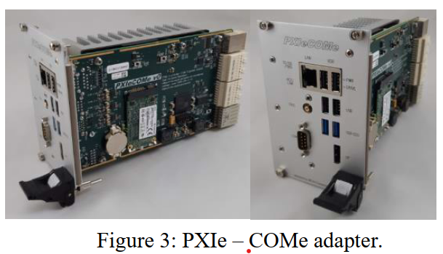
More info at the A. Masi talk: SAMbuCa: High-Precision Motion Control and Acquisition System, paper TH2BCO04, Thursday Mid-Morning session on Motion Control TH2BC
New Project for generic and modular motion control: SAMBUCA
Expectations and possible points for discussions
-Robotics: HW vs SW developments, going at different speed?
-In-house developments vs industrial solutions, when is convenient and when not?
-RELIABILITY: How you decide if an industrial equipment or in-house development is ready to be put in operation for critical missions (24/7 and high reliability required) ?
-Feedbacks on collaborations with university on R&D
-Clarify what is a digital twins ☺
-Collaboration between different institutes

Slide 10
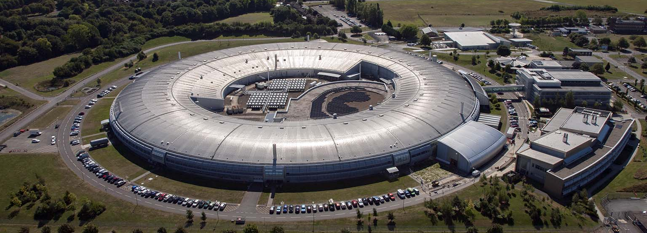
Introduction to Diamond light source
2023 MOCRAF Workshop,
ICALEPCS conference,
Brett Sing Gen and Oliver Copping

Slide 11
Diamond Light Source
A 3rd Generation Synchrotron in user operations since 2007 ( 7 beamlines).
Continuous upgrade programme in 3 phases up to 31(1/2) beamlines.
Designs well underway for storage ring upgrade to Multi Bend Achromat.
Funding approved by Government for upgrade and 2 new flagship beamlines.
Dark period expected 2027.
Motion team consists of 5 engineers and 2 technicians.
Supporting 31 beamlines, nearly 3000 axes.
Supporting Engineering led developments in new beamline equipment from monochromators to sample stations.

Slide 12
Motion control challenges at Diamond Light Source
Managing Obsolescence – many beamlines still have the original controller. All the rest are running on a now obsolete platform, but with a ‘form fit’ replacement.
Converting years of experience with the old controllers (Turbo PMAC) to deliver the same level of support for the new controller (Power PMAC)
EPICS and infrastructure support for the new controller
Keeping pace with science requirements for ever increasing accuracy and stability requirements for high precision, high resolution, fast data collection experiments.
Reconciling Robot safety necessity with science use case requirements.

Slide 13

What would I/we like from this workshop
Meet new colleagues working with motion control and robotics at large radiation facilities
Share experiences and engage with other Power PMAC users
Learn about different motion control methods/algorithms and technology
Gain new understandings of related disciplines in robotics and metrology

Slide 14
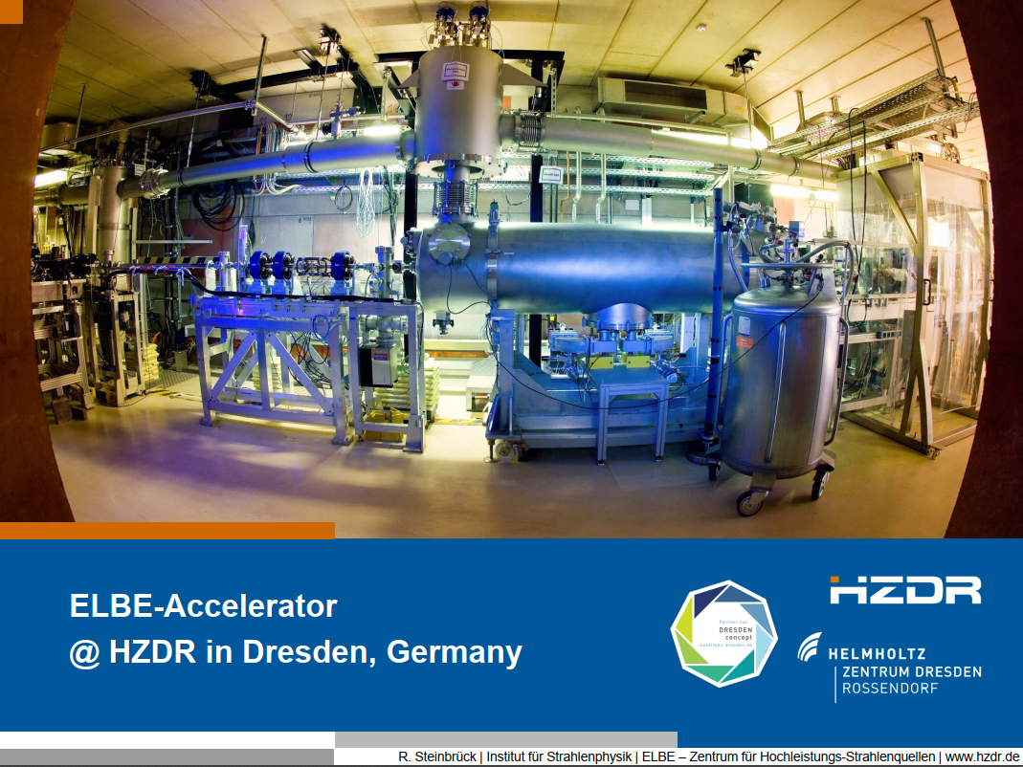

Slide 15
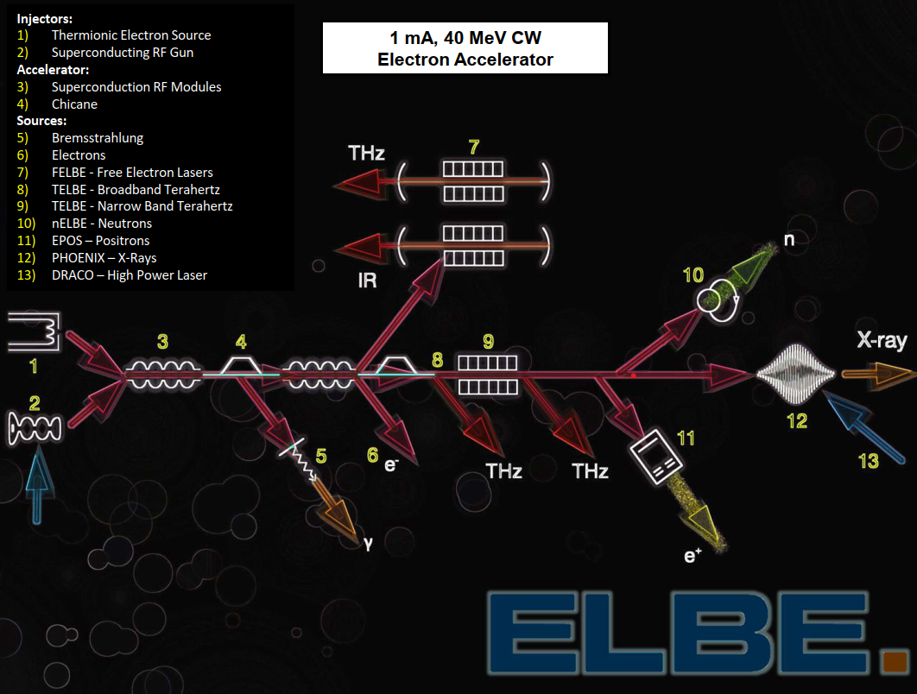

Slide 16
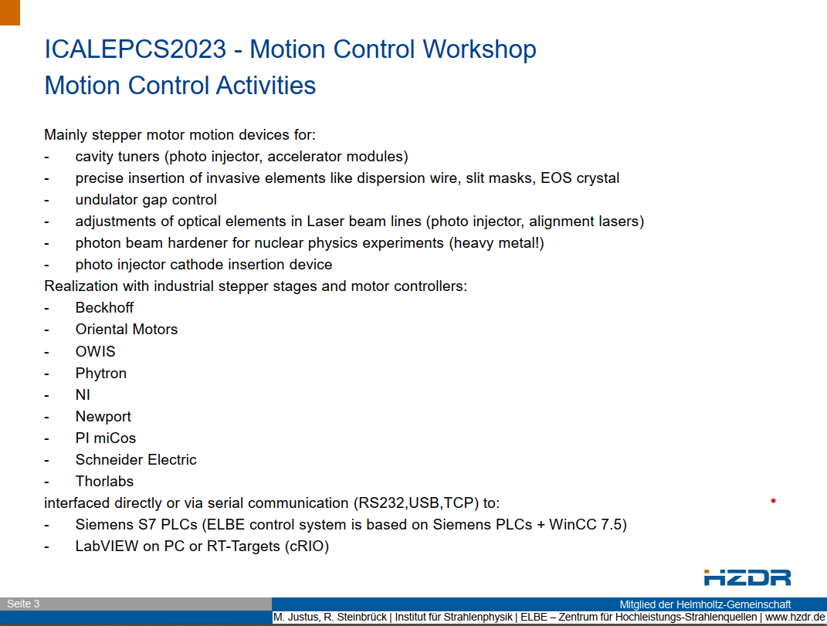

Slide 17
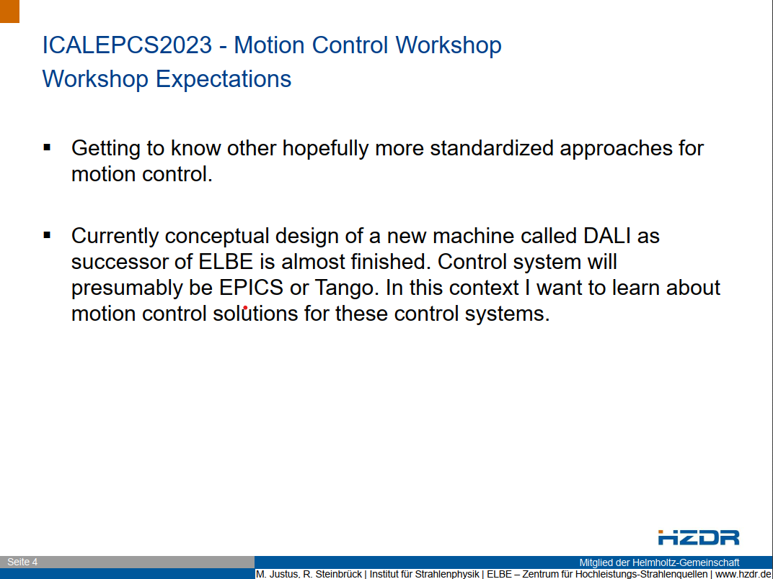

Slide 19
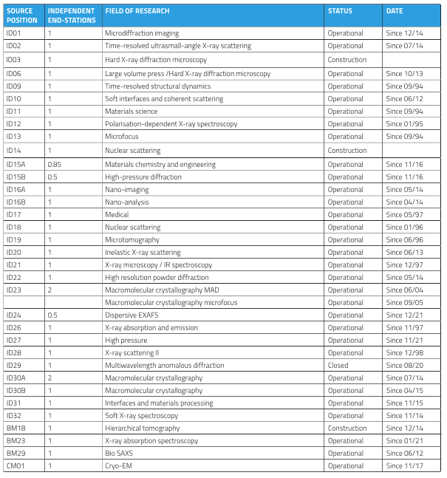
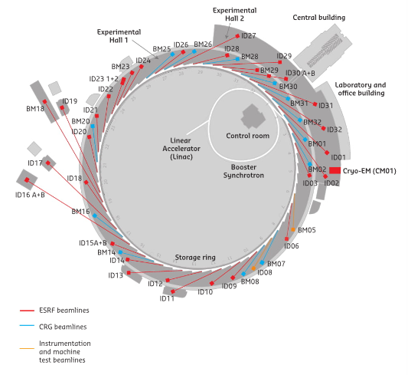
ESRF Beamline Control Unit
    33 ESRF beamlines and 13 CRG beamlines
46 Beamlines
More than 100 scientific techniques

Slide 20
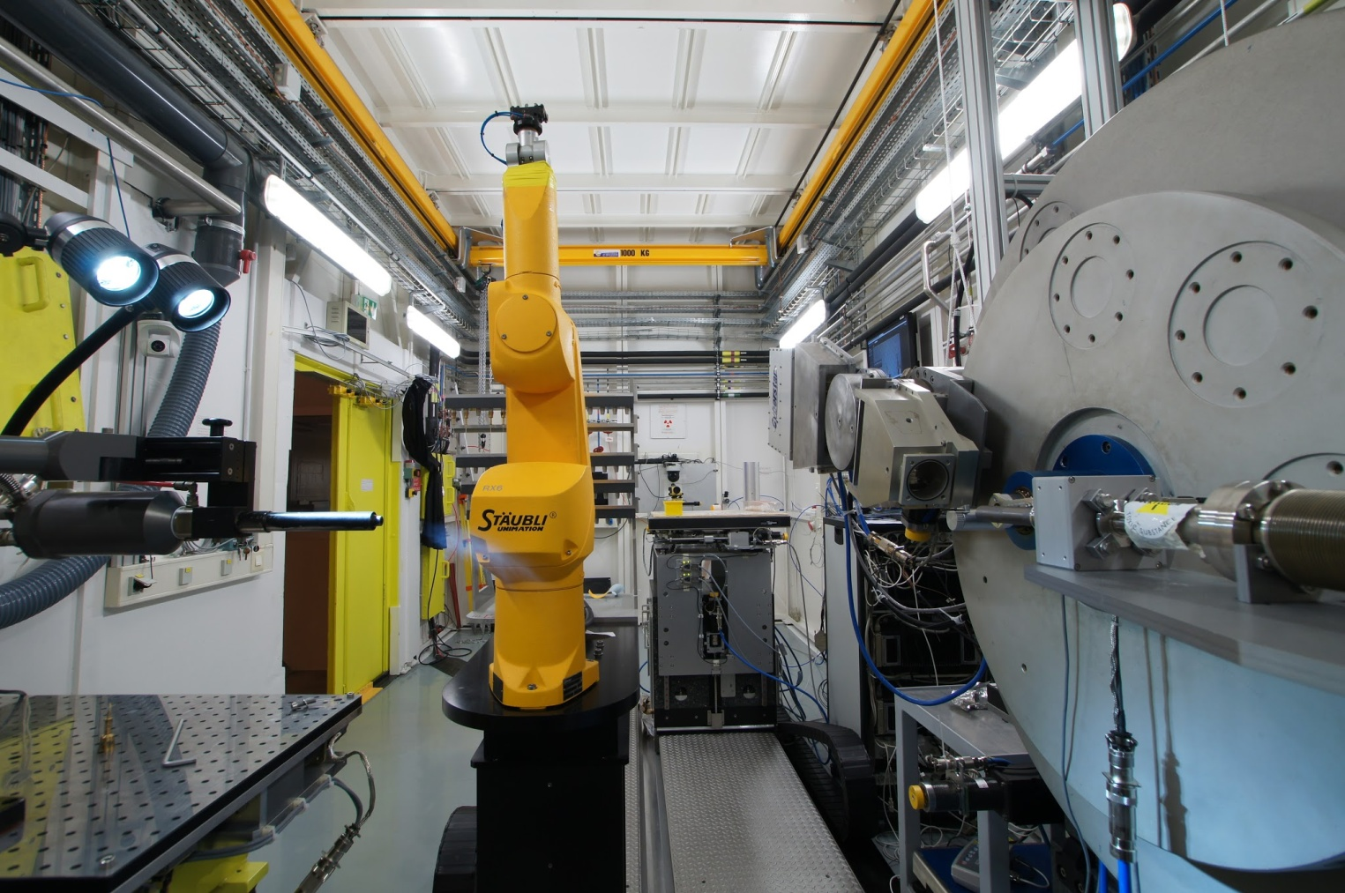
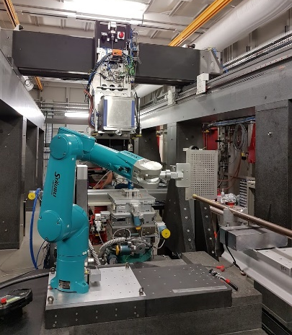
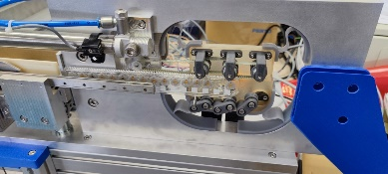
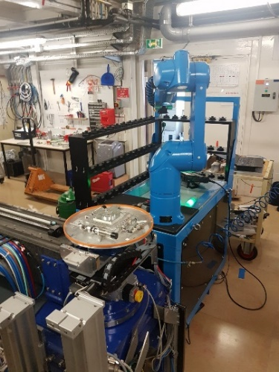
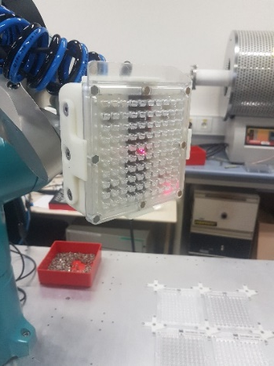
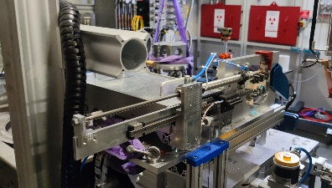
Automation projects (High Through Put)
Sample changer trends:
1) Increase in capacity without human intervention.
2) Clip on modules (robot out of beamline when not in use).
HR Tomography
XR Fluorescence
XRPD
XRPD
75 samples
~1 to 2 days autonomy
3500 samples
~ 2 days of autonomy
1056
~20 minutes autonomy
100 samples, upgradable to 3000.
~ 1h of autonomy
70 samples
~ 2 days of autonomy

Slide 21
Personal Interest
Overcoming Existing System Limits
  Trajectories with motor controllers of different suppliers
  Motors for movements on the nanometer scale
  Integration of mecatronics applications in the control system
Robotic Frameworks
  Generic integration of robots
  Usage of robots for new applications
  Using the same robot in different experimental setups

Slide 22
European X-Ray Free-Electron
Laser Facility
Ayaz Samadli
Michael Smith
Instrument Control Integration Group

Slide 23
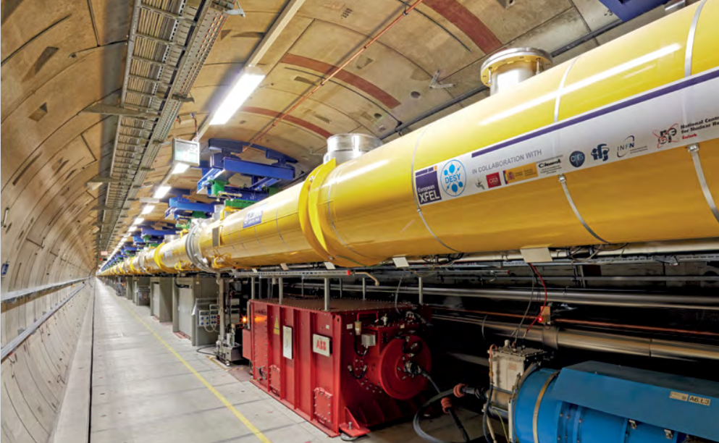
The European X-Ray Free-Electron Laser (European XFEL) generates 27 000 X-ray flashes per second at a brilliance that is a billion times higher than conventional X-ray sources
Research groups from around the world come to the facility to investigate nanometre-scale structures, fast processes, and extreme states
The facility is operated by the European XFEL GmbH, in partnership with Deutsches Elektronen-Synchrotron (DESY), and other organizations worldwide.

Slide 24
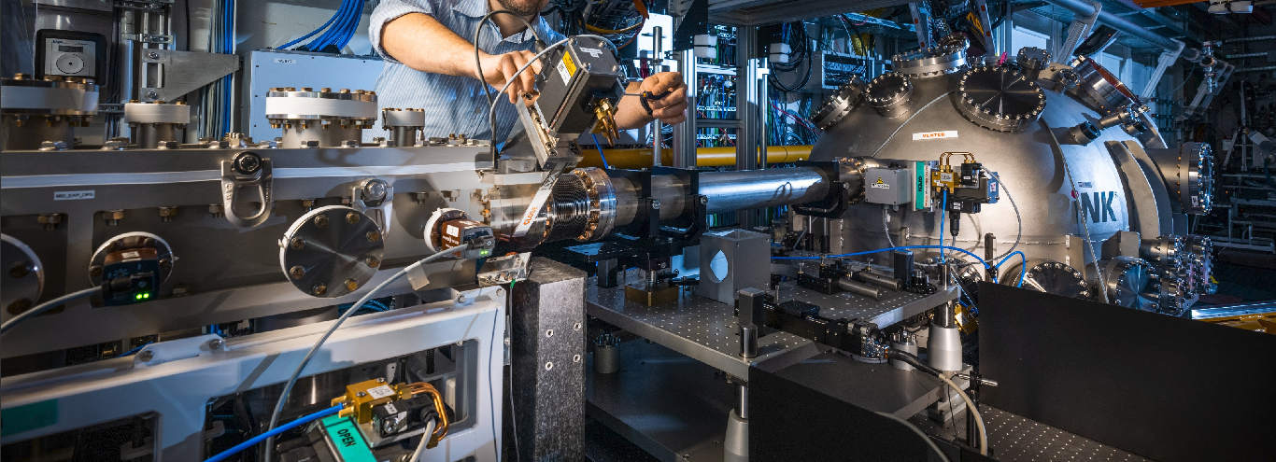
Uses the Karabo SCADA Framework for distributed software control of over 16 500 devices, monitoring 2.2 million properties
Many devices are based on Beckhoff PLCs, from digital switches to multi-axis motion systems
Interested in digital twins and applying more advanced motion/process control algorithms
Interested in application of Deep Reinforcement Learning-based control algorithms in other research facilities

Slide 25
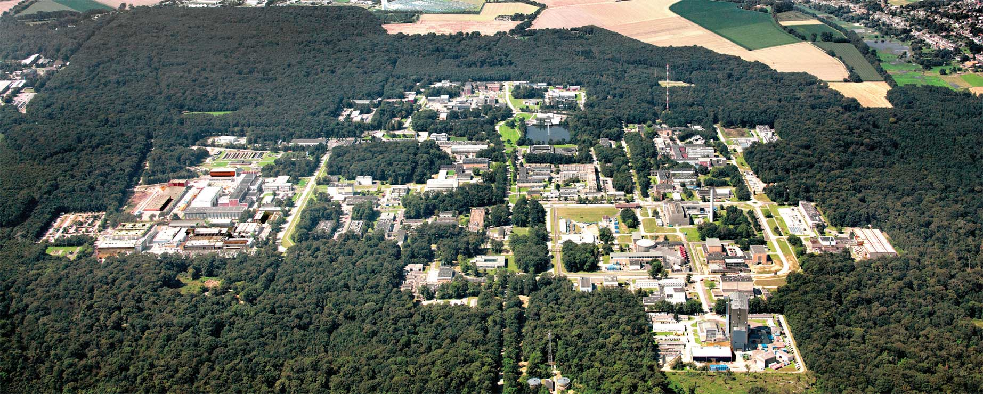
Forschungzentrum Jülich and JCNS
Forschungszentrum Jülich
  > 7000 Employees
  Multi-disciplinary: information, energy, bio-economics
  Several outstations
Jülich Centre for Neutron Science (JCNS)
  Neutron Scattering Department of Forschungszentum Jülich
  Operates neutron instruments at research reactors FRM-II and ILL
  Developing neutron instruments for SNS, ESS, NIST (Gaithersburg), FRM-II and ILL
  Robotics evaluation project for ESS
  Designed and manufactured all standard motion cabinet prototypes for ESS

Slide 26
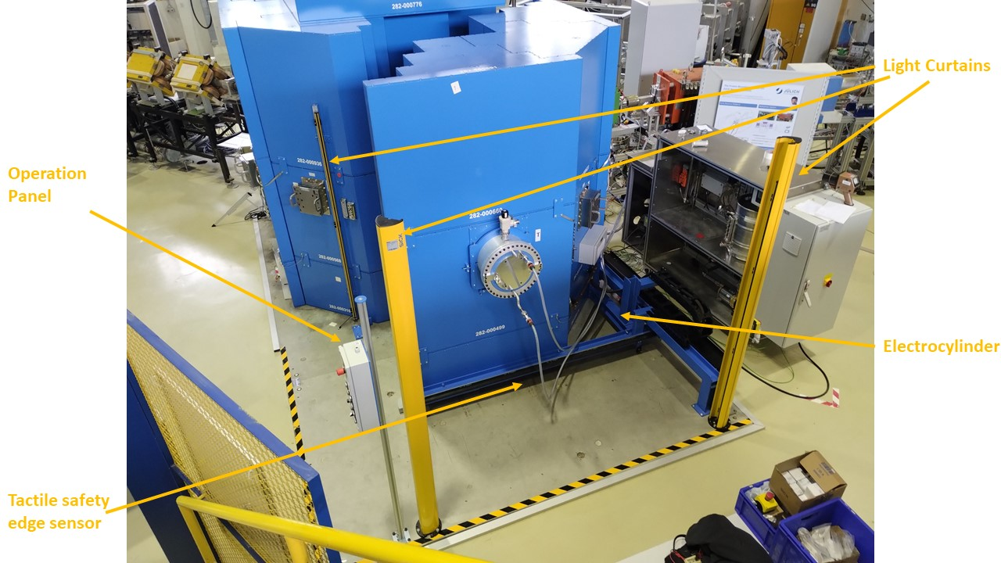
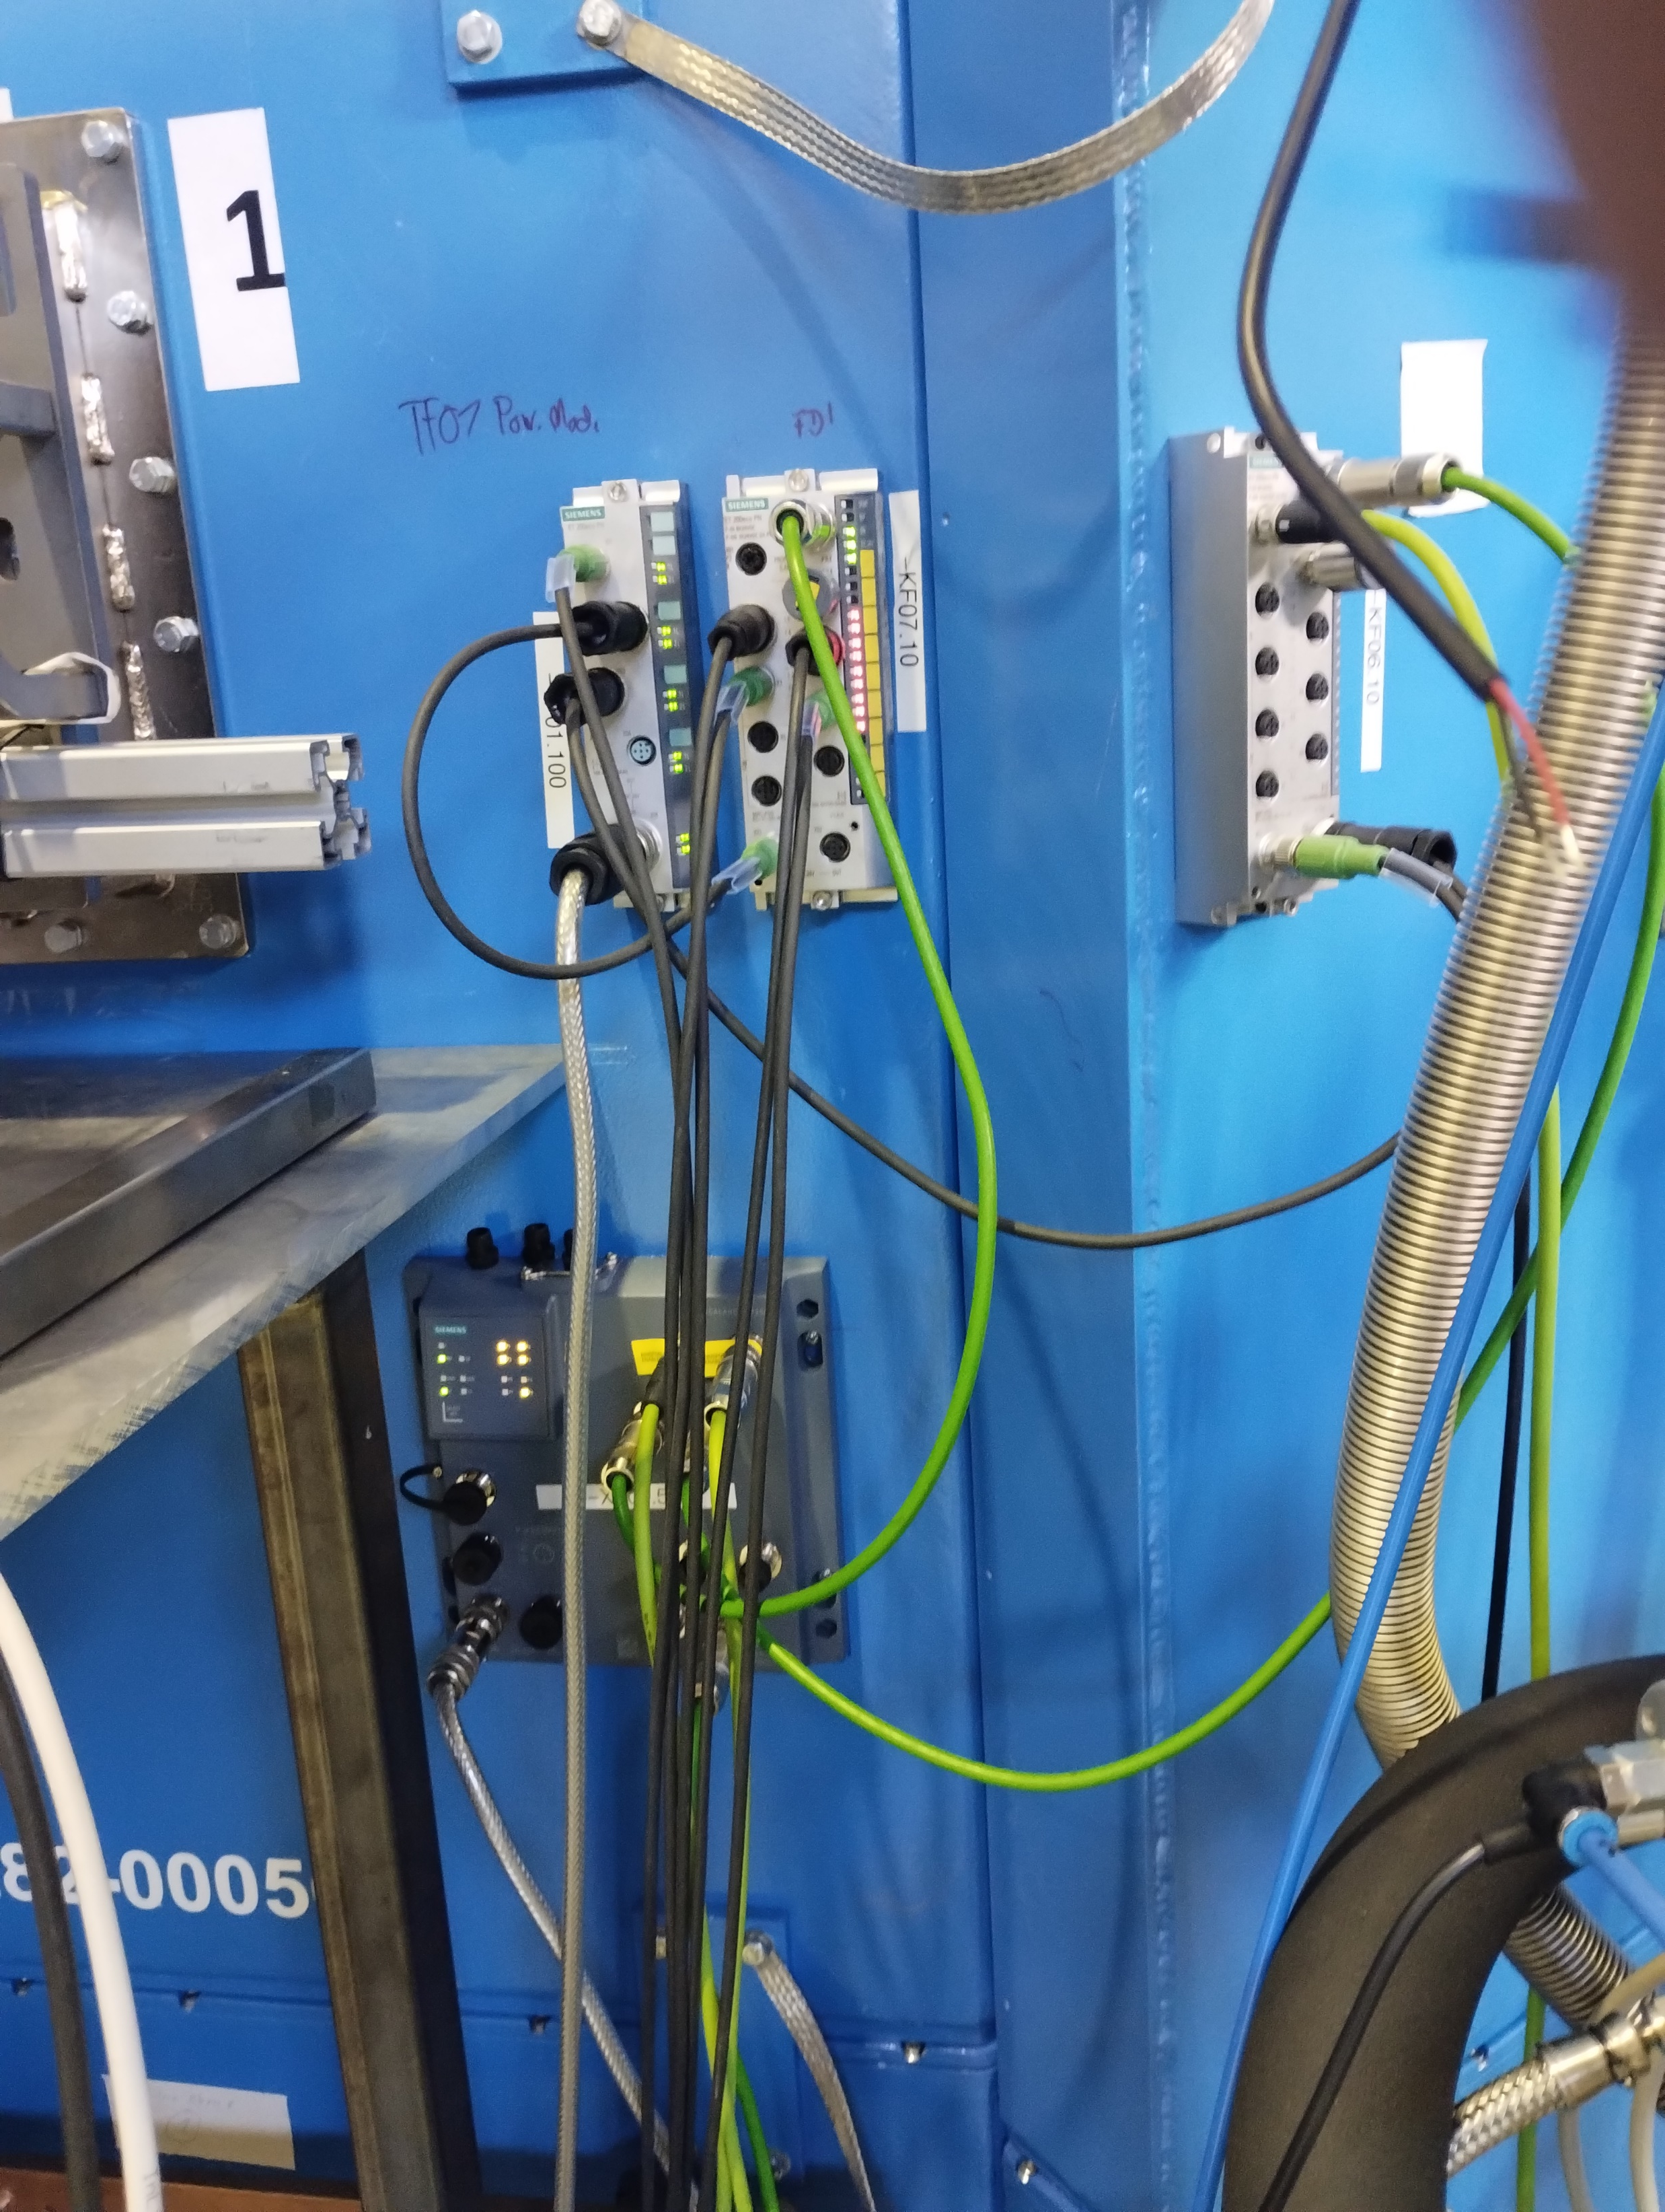


Recent Activities
High Brilliance Neutron Source Project (HBS)
  High Current Accelerator-driven Neutron Source
  Linac (70 MeV pulsed proton beam, 100 mA peak current)
  Tantalum target
  3 target stations, > 20 neutron instruments
JULIC neutron platform
  Target station prototype
  JULIC cyclotron (45 MeV, 8 µA)
  Serious motion safety issues

Slide 27
Expectations from the Workshop
Learn from the implementation approaches of other Labs
  Engineering process (software + hardware)
  Tools developed at other Labs
  Challenges and lessons learned
Get to know new technologies
Get to know new products

Slide 28


Slide 29


Slide 30


Slide 31


MAX IV
Lund University, Sweden
4th gen synchrotron
1.5 and 3.0 GeV storage rings
16 beamlines in operation
Favorite motion system: IcePAP
But run about everything…

Slide 32






Current struggle: time stamped, position triggered, continuous scans and trajectories
Continuous scans with position
based hardware triggers ICALEPCS 21
Complex trigger
THPDP054
Trajectory in arbitrary units
TH2BCO01

Slide 33
I want to accomplish
Better understanding of state of the art.
Does other facilities share our challenges?
How have other facilities integrated
  complex motion,
  continuous scans
  timestamping
  triggering

Slide 34
NECSA BEAM LINE CENTRE
Doc. No.
Presenter: Deon Marais
Event: Motion Control Workshop (MOCRAF 2023)
Venue: Room 10, Century City Convention Centre, Cape Town, SA
Date: 8 October 2023, 08:20 – 17:30

Slide 35






The South African Nuclear Energy Corporation (Necsa)
SAFARI-1 nuclear research reactor
  Medical isotopes
  In core Neutron Activation Analysis
  Neutron transmutation silicon doping
Beam Line Centre
  Commercial X-Ray instruments
      NIKON Micro-focus tomography facility
      Bruker D8 Advance (powder diffraction)
      Bruker D8 Discover (strain scanning)
  Neutron Strain scanner
  Neutron Powder diffractometer
  Neutron Imaging (under upgrade)
Kruger National Park - Limpopo and Mpumalanga provinces
Koeberg Nuclear Power Plant - Melkbosstrand, Western Cape
Necsa - Pelindaba, North West Province
SAFARI-1
Neutron Diffraction Facility (NDIFF)

Slide 36




































Necsa – NDIFF Control system
MPISI - Materials Probe for Internal Strain Investigations
Beam monitor
Dennex’s PSD
Android remote control
Galil DMC2280 motor controllers
19 stepper motors & limit switches
Mesytec MRS2000 Pre-amp
Dennex pre-amps
NI SCB-68E Junction Box
SICS >_
CF8000 CFD
NI6602 DAQ
ANSTO Histogram Server
Kowari’s Gumtree IC GUI
ScanManipulator
FAST ComTec P7888
PITSI - Powder Instrument for Transition in Structure Investigations
IA’s PSD
Beam monitor
Android remote control
Furnace
Cryostat
Cryo-furnace
Mesytec MRS2000 Pre-amp
Mesytec MPSD-8+
Galil DMC2280 motor controllers
NI SCB-68E Junction Box
West 4100
Lakeshore 360
NI6602 DAQ
Lakeshore 336
Mesytec MCPD-8
SICS >_
ANSTO Histogram Server
Kowari’s Gumtree IC GUI
ScanManipulator
TCP/IP

Slide 37

Necsa - Multi-Purpose Reactor Project
Envisaged Neutron Beam Line Centre at the MPR
  DMRE / Necsa initiative to replace SAFARI-1
  Various instrument options
Diffraction
  DSSS: Diffraction of Small Scale Structures
  HIPD: High Intensity neutron Powder Diffraction
  HRPD: High Resolution neutron Powder Diffraction
  NSS: Neutron Strain Scanning – engineering applications
  SCD-4C: Single Crystal Diffraction - 4 Circle
  SCD-QL: Single Crystal Diffraction: Quasi Laue
Small angle neutron scattering
  C-SANS: Conventional small angle neutron scattering
  ToF-SANS: Time-of-flight small angle neutron scattering
  USANS: Ultra Small Angle Neutron Scattering
Imaging
  NI-T: Thermal Neutron Imaging
  NI-F: Fast Neutron Imaging
  NI-C: Cold Neutron Imaging
Spectroscopy
  TOFS: Time of Flight Spectrometer
  TAS: Triple Axis Spectrometer
  SES: Spin Echo Spectrometer
Reflectometry
  NREF-H: Horizontal
  NREF-V: Vertical
  NREF-ToF: Time-of-Flight
Prompt Gamma Neutron Activation
  PGNA-C: Cold
  PGNA-H: Hot
  PGNA-T: Thermal
  PGNA-F: Fast
Other
  MARD: Medical Applications & Radiation Damage
  BCT: Boron capture therapy
  GAM: Gammametry
Workshop interest
  New motion control systems and methodologies
  Instrument digital twins (McStas coupled) for training
  Best practice for systems development
Necsa Neutron Beam Line Centre

Slide 38
MOTION CONTROLS FOR ORNL NEUTRON SCIENCE EXPERIMENTAL BEAMLINES
Xiaosong Geng
Control System Engineer for Instrument Systems
MOTION CONTROL WORKSHOP 2023
Oct. 9-13, 2023

Slide 39
Introduction
Two Facilities, Total of 35 neutron beam lines
  Spallation Neutron Source (SNS) : 19
  High Flux Isotope Reactor (HFIR): 12, plus 4 development
Control system
  EPICS/CSS (CS-Studio) based: SNS 19, HFIR 5
  SPICE (LabVIEW based): 7
DAQ Groups (Software and Hardware)
  Part of the ORNL Neutron Sciences Directorate
  Support all neutron data acquisition and control system including motion control

Slide 40




Motion control & Robotics
Senior software engineer, motion control software
New URs integration
Universal Robots
At SNS and HFIR, we integrated UR robots as standard robotics for sample changer
EPICS IOC communicates with robot controller via ModBus protocol
PolyScope UR

Slide 41
Would like to accomplish at the workshop
Isolate the primary issues of motion control
  Available hardware
  Software development
Coalesce common concerns and experiences with motion control systems
Robot experience and development
Ideas for further development
  Automation: benefits both staff and users
  Open source: EPICS model reduces developer burden

Slide 42



Particle Therapy Research Center (PARTREC), UMCG
Groningen, The Netherlands
Superconducting particle accelerator: AGOR (1997)
Previously: KVI (University of Groningen)
Transfer to UMCG with new name: PARTREC (2020)
Staff: ~25 technical, ~10 scientific

Slide 43
Motion control @ UMCG-PARTREC
DC motors:
  12 motors for the lenght adjustable resonators
  2 motor for the radial probe
Stepper motors:
  10 motors for extraction channels
  20 motors for slit systems
  3 motors for inflector
  3 motors for buncher adjustments
  1 motor for an adjustable gas valve

Slide 44
Goals for this workshop
We are redoing large parts of our control system over the coming years
Knowledge on the matter is sparce ➔ learning required

Slide 45

SOLEIL presentation for MOCRAF 2023
Yves-Marie Abiven – Laura Muñoz
ICALEPCS 2023, CAP TOWN, October 8th

Slide 46








SOLEIL in a nutshell,… towards SOLEIL II
in 2022
2472
single users
Storage ring 354m, 2.75GeV
29 beamlines
9 orders of magnitude in energy from far IR to hard X-rays
Open to external users in 2008
~ 450 staff members
More than
12 000
users since
2008
SOLEIL II
Better performances for Accelerator and photon sources
  Reaching an emittance < 100 pm.rad.
  Keeping the same electron beam energy : 2.75 GeV
  Preserving a maximum current of 500 mA
  in the multibunch mode.
New access mode with more efficient use of the SOLEIL Beamline
Green infrastructure
  Reduction in the facility environmental footprint
  Lower power and water consumption
  Reduce operational cost
Beam SIZES
Brightness

Slide 47

Robotic Activities
Works mainly driven by the enhancement of process automation
  Reliable positioning with highest precision
  Speed improvement
  Toward more autonomous systems
Robotic based on DeltaTau or Galil controllers
  Advanced kinematic models embedded in DeltaTau Controller such as Hexapods, Monochromators
  Enhanced trajectory management
    Better synchronization between multi-axis systems (Monochromator and Undulators)
    Collision avoidance
  EtherCAT-based communication between PLC, motion controllers and 6 axis arm robots
  Advanced control algorithms to improve Hexapod’s position*
Robotic based on 6 axis arm robots (Stäubli)
  Pick-and-Place type applications: Powder samples (XPRD), liquid samples (BioSAXS), radioactive samples (for Multi-technical experiments)*
  Handling detector for Bragg CDI experiments, exchange detectors for HAXPES experiments*
  Automatic test bench for magnets modules for insertions devices
Nanopositionning
  Improve Nanoprobe station
  Metrology of new nanopositioners

Slide 48
Workshop Expectations
Share experience in:
  System modelling and validation with Hardware in the Loop (HIL) ?
  Nanopositioner integration in complex systems or beamline end-stations
  Robotic frameworks used in other facilities or other business
  EtherCAT protocol use case (in operation)

Slide 49



SOUTH AFRICAN RADIO ASTRONOMY OBSERVATORY (SARAO)
NATIONAL RESEARCH FOUNDATION (NRF)
Notes:
SARAO is a National Facility managed by NRF.
Incorporates all national radio astronomy telescopes and programmes.
Best known for the MeerKAT Radio Telescope: a precursor instrument to the SKA, but also a powerful telescope in its own right.
Part of the Engineering Team at SARAO, more specifically the Electronics Team.

Slide 50


Current Activities
Background in Mechatronics
Currently MSc student at UCT
  “Modelling and Control of a MeerKAT Antenna”
  System ID, System Modelling, Control System Design, etc.
Work Related Activities
  Maser Room Temperature Control System
  “Control and Monitoring” systems

Slide 51
Objectives
Exposure to “mechatronics” in industry and other applications
Formal design approaches
Better appreciation of the domain
Learn something new (and preferably cool)!

