Slide 1
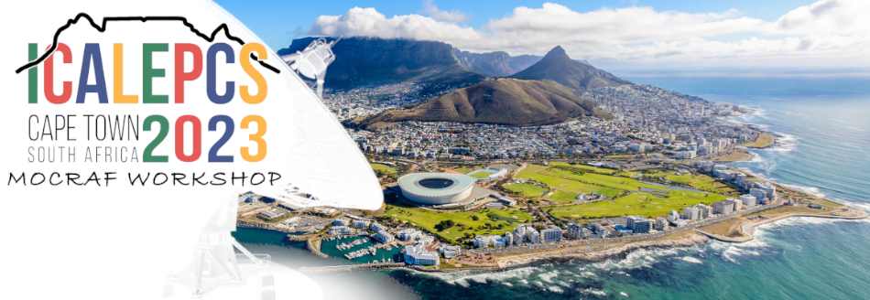
8th workshop dedicated to
Motion Control and Robotic Applications in large Facilities
Yves-Marie ABIVEN (SOLEIL), Mario Di Castro (CERN) , Nicola Coppola (EuXFEL), Christer Engblom (SOLEIL), Xavier Serra Gallifa (Alba), Laura Muñoz(SOLEIL), Brian Nutter( Diamond)

Slide 2
MOCRAF Workshop
Who?
How?
Why?
What?
Motion control and Robotics are key element ,which enable high level of performance at scientific facilities
A long tradition now with 7 previous MOCRAF Workshop
(2011 in SOLEIL, 2012 in Diamond, 2013 ICALEPCS San Francisco, 2015 ICALEPCS Melbourne, 2017 ICALEPCS Barcelona, 2019 ICALEPCS New York, 2021 ICALEPCS Shanghai)
ICALEPCS 2023 in CAP TOWN is an ideal place for the 8th WS, …
…meeting new friends
… Sharing expertise, methods, tools,
… Exchanging experience, solutions, lessons learned
…Initiating collaboration

Slide 3
MOCRAF Workshop
Who?
How?
Why?
What?
Frequency vs Time Domain Discover how we employ frequency vs time domains to enhance our mechatronic systems. Join the discussion on control loops, mechanics, metrology, and other relevant aspects.
Robotic Frameworks Explore the implementation of robotic frameworks within different facilities. Share your experiences and insights on the various types of frameworks utilized in diverse contexts.
Digital Twins Uncover how digital simulations can be used in optimizing and augmenting existing systems. Learn how digital twins contribute to anti-collision systems, hardware-in-the-loop setups, advanced sensor integrations, and more.
Overcoming Existing System Limits Find out how we overcome limitations in motion control systems. Engage in conversations about handling obsolete controllers, improving motor resolutions, and other innovative solutions.
Advanced Motion Control Algorithms Gain valuable knowledge about cutting-edge algorithms employed in motion control applications. Delve into topics such as Kalman filters, iterative learning control, model predictive control (MPC), applicative machine learning, and other advanced techniques.

Slide 4
Who?
How?
Why?
What?
MOCRAF Workshop
47 attendees
8 countries
21 Institutes
3 trading companies
https://www.google.com/maps/d/edit?hl=en&mid=1IJHQnihWT_Sk_-aLoR_gkVmAY2g&ll=5.108998801646877%2C0&z=2

Slide 5
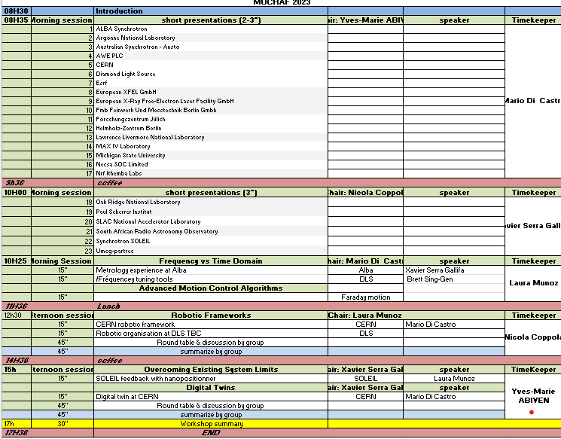
Who?
How?
Why?
What?
MOCRAF Workshop
Workshop sessions
Update of the status and challenges at each facilities
5 tracks related presentation feature talks followed by 45 min round table discussion in groups, with a 5 minutes summary from the groups

Slide 6
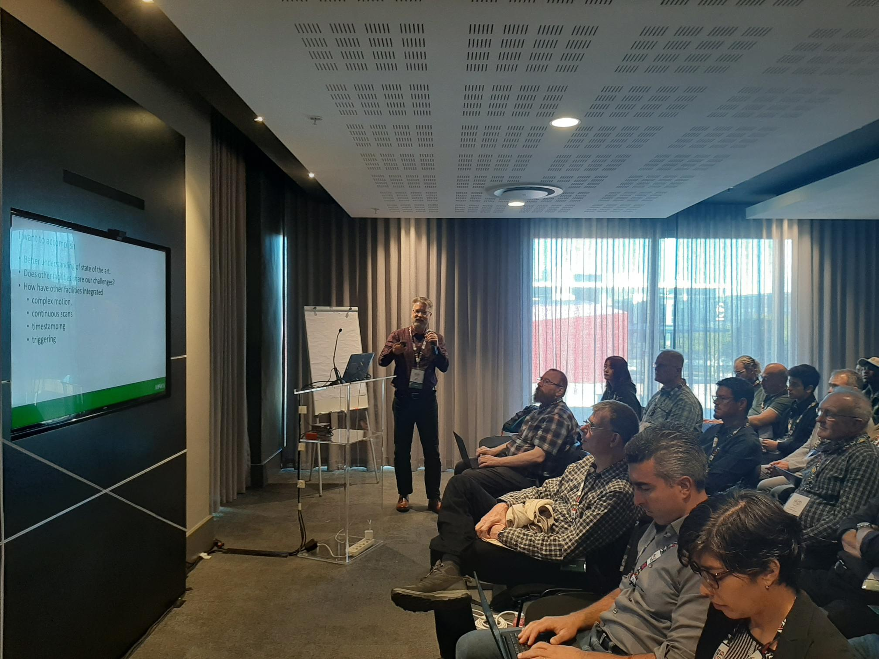
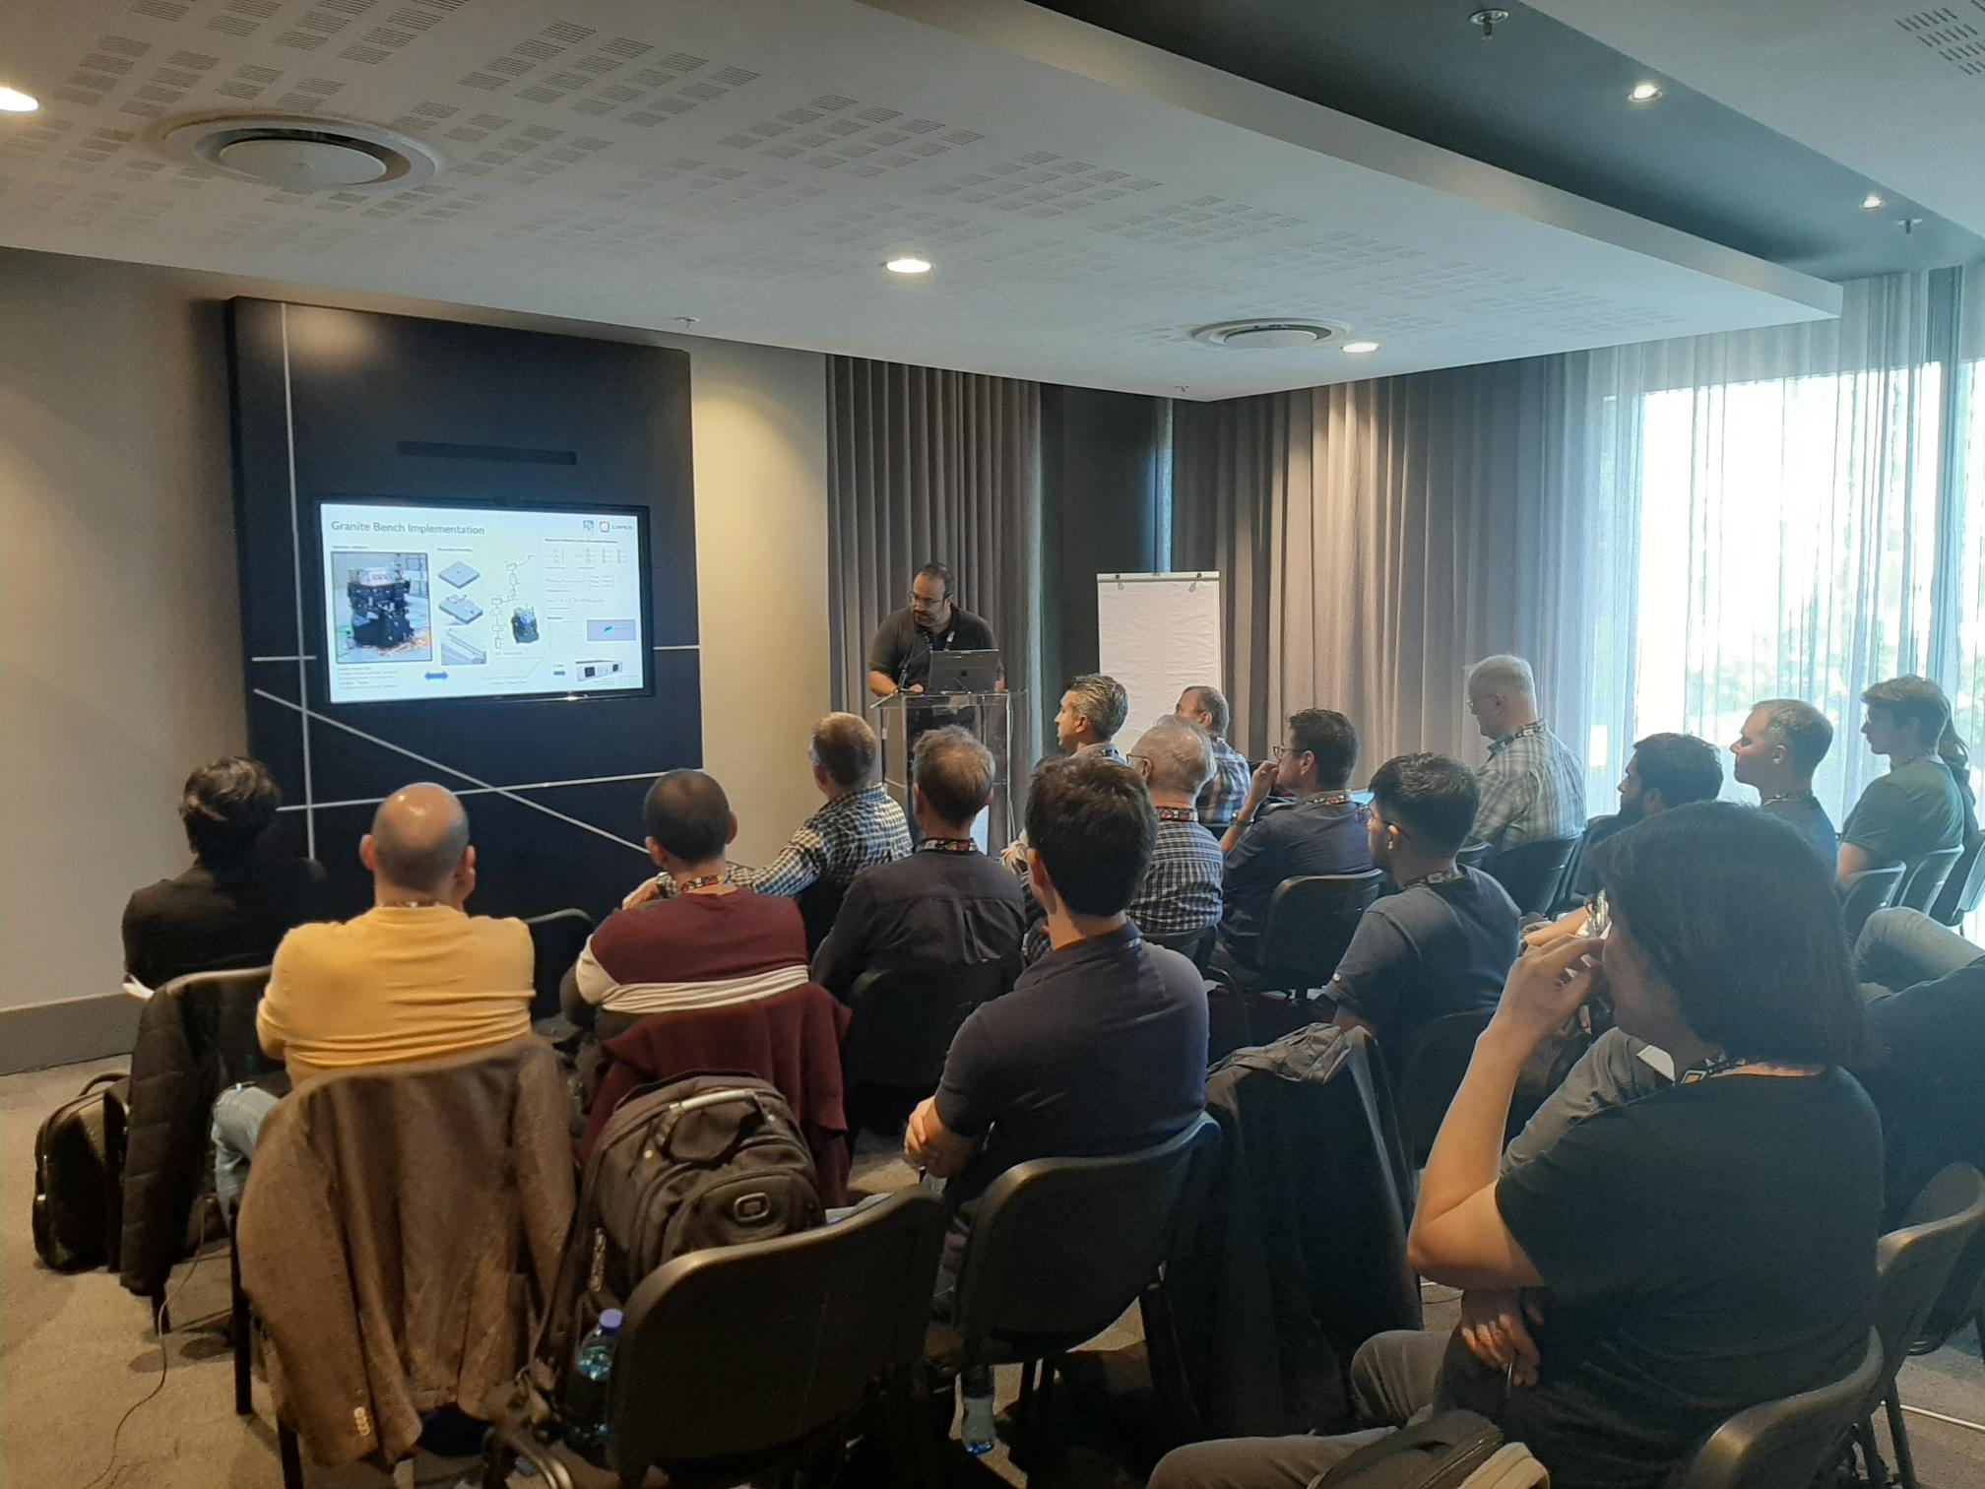
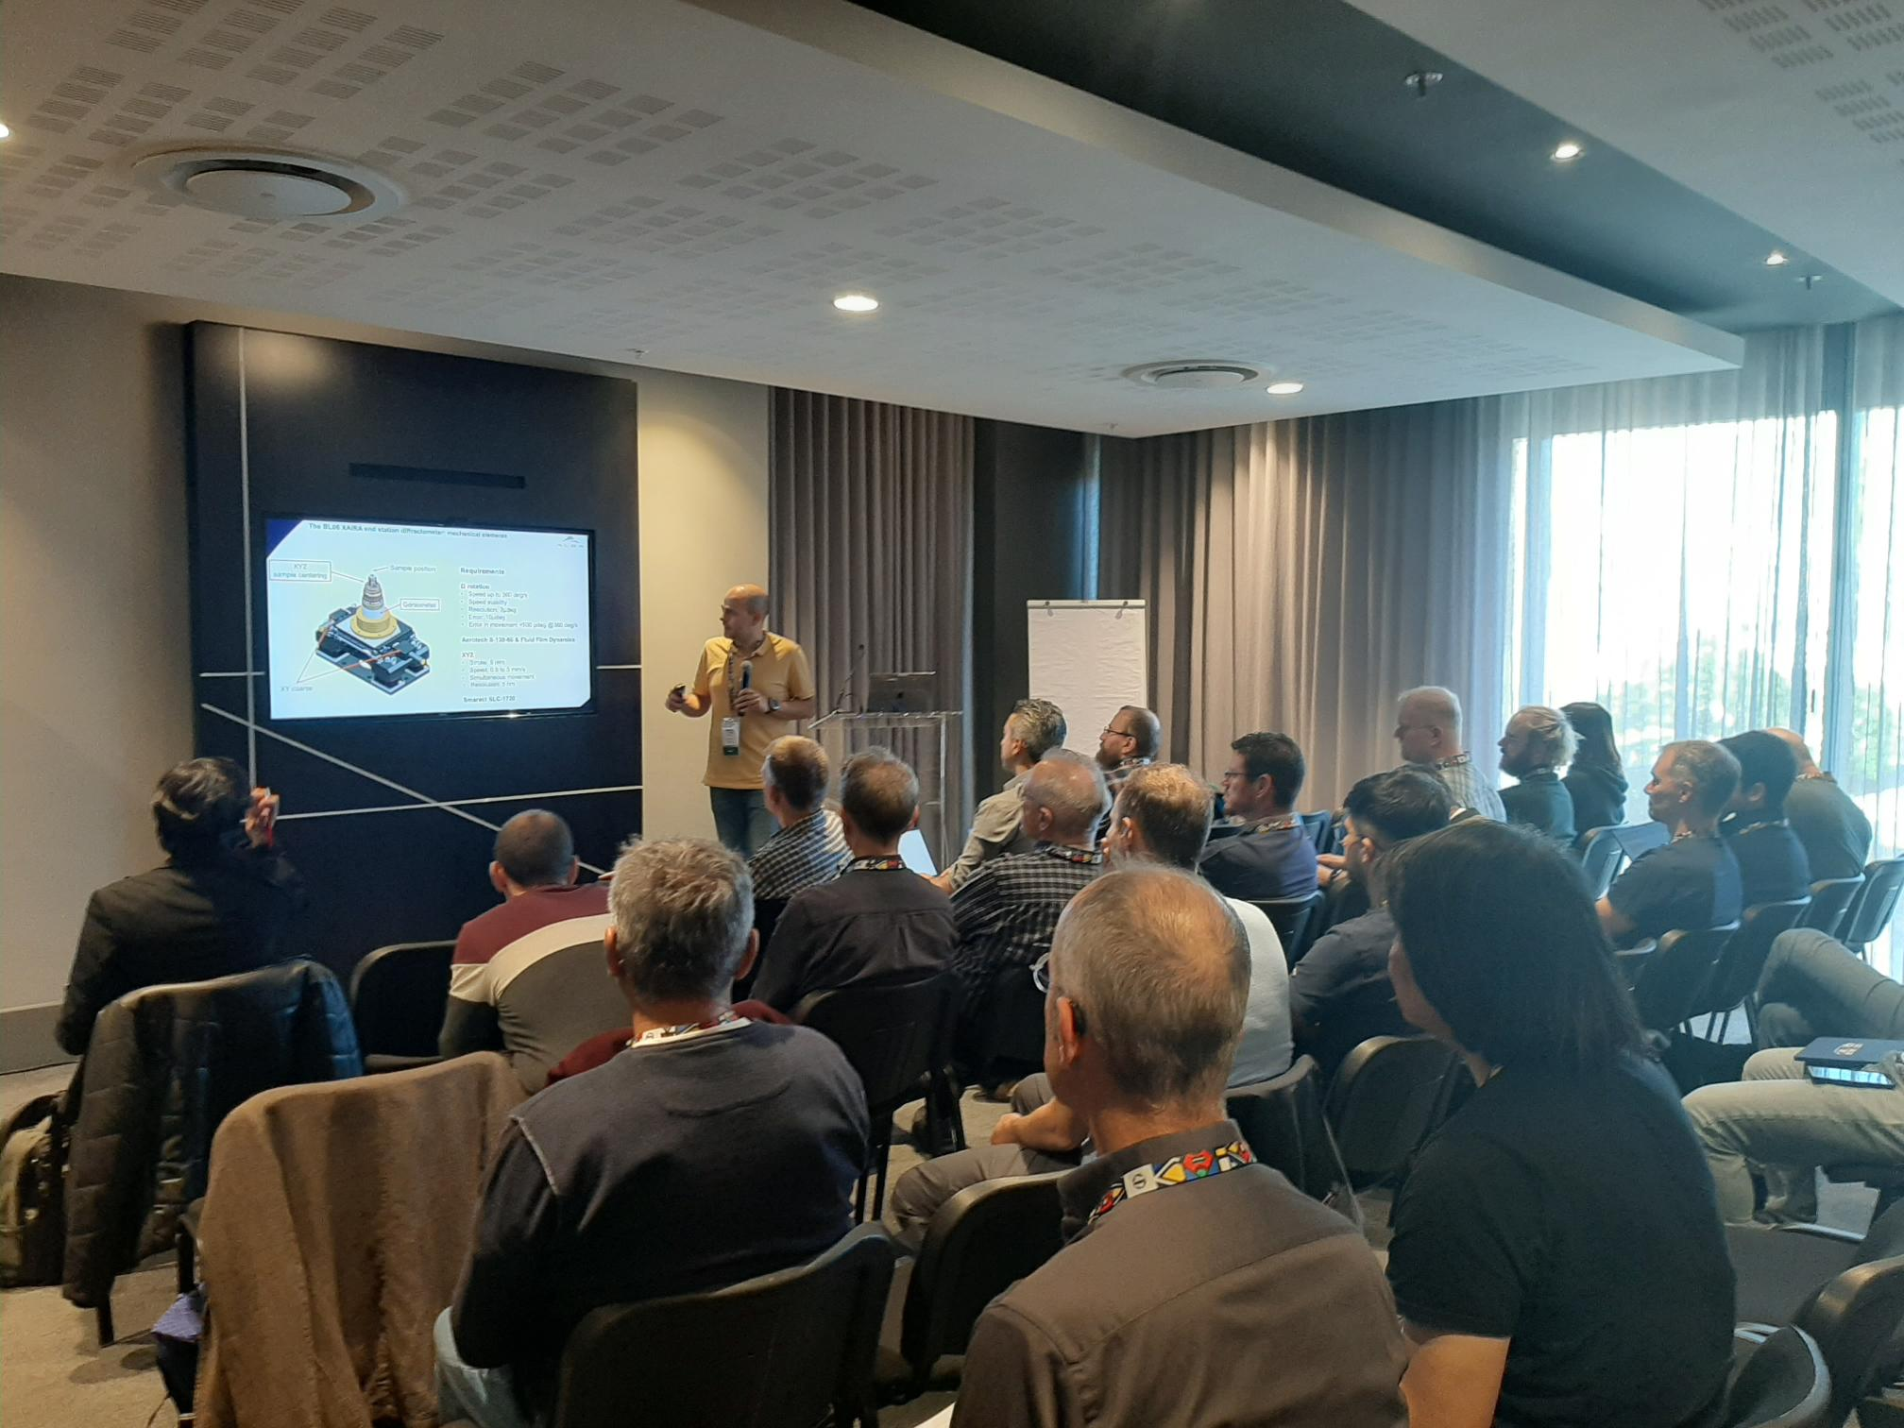
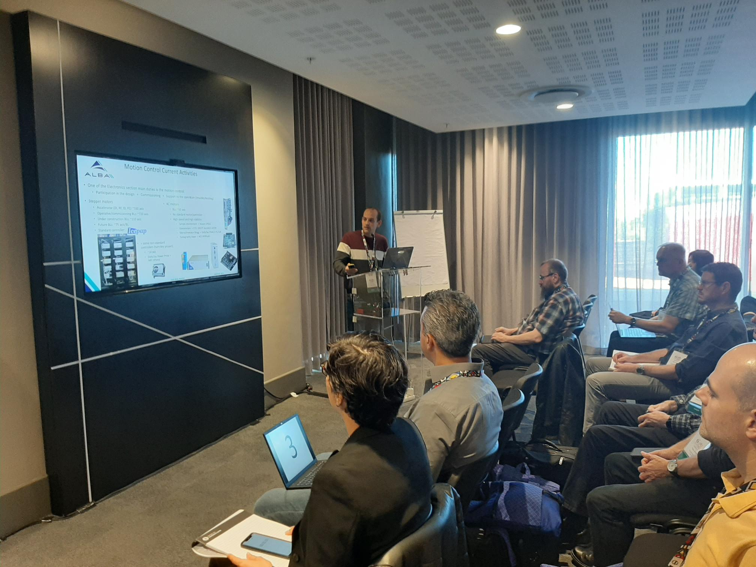
Workshop Summary
Dynamic and interactive day!

Slide 7
Workshop Summary
Main takeovers:
Interactive format has been appreciated by attendees
Standardisation of motion control solution should be strived for
For challenging motion control applications open solutions might give better understanding and ease integration
Collaboration among institutes should be highly encouraged, this type workshop/forum are suitable to build new partnership
Robotics: more and different types as previously foreseen have been shown. It is a optimal point in time to decide to have common and standard solutions
Digital twins: powerful engineering tool, not explored yet in motion control, started recently in robotics, tools and knowledge should be built and shared
Fruitful discussion with participants from industry who informed us that feedbacks from institutes on future developments and features are needed
Workshop will be followed up in future with topical discussions (~every 6 months)
Looking forward for the 9th workshop edition!

Slide 8
Thanks for all who contributed and participated!
Presentations from this workshop are available via Synchrotron Soleil web site along with those from previous workshops:
https://indico.synchrotron-soleil.fr/event/62/

