Slide 1
Introduction
Esther Ferrer Ribas, Paco Iguaz Gutiérrez, Fabienne Orsini
5th of February 2024

Slide 2
Welcome!
65 registrants with 15 students

Slide 3
Origin of this workshop
In 2019 funding request at the french national funding agency (ANR) for Detector Axion Like Particle Searches (DALPS) for the BabyIAXO experiment
DALPS: development and comparison of X-ray technologies (Micromegas, Gridpix, SDD, TES, MMC) for the BabyIAXO experiment
Project was funded. Kick-off meeting in 2020.
Idea of gathering together X-ray detector experts from different landscapes: dark matter, astrophysics, synchroton radiation, medical detectors and nuclear techniques ➔ 2-days transverse workshop @ SOLEIL
Thanks to SOLEIL for all the organisation and for hosting us!

Slide 4
Program of the workshop
Overview talks, specific talks, poster session, SOLEIL visit
Sessions:
Detection of rare events
Space applications
Medical and industrial applications
X-ray facilities

Slide 5
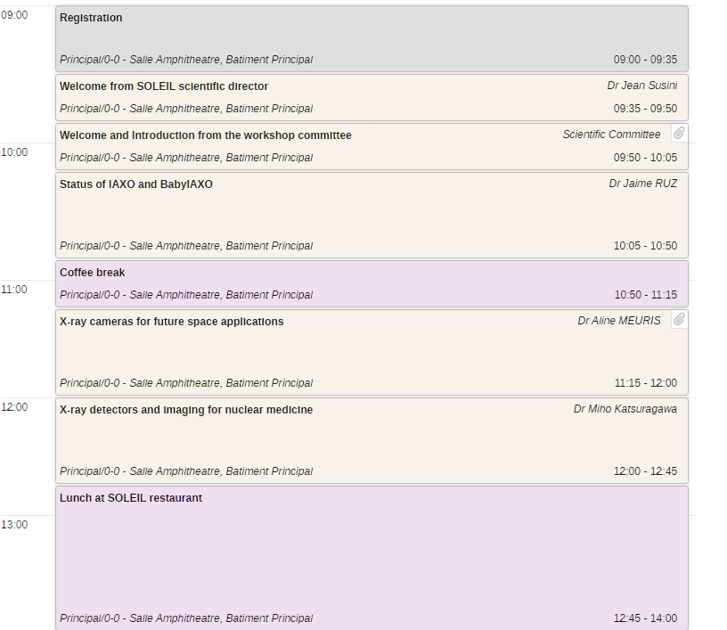
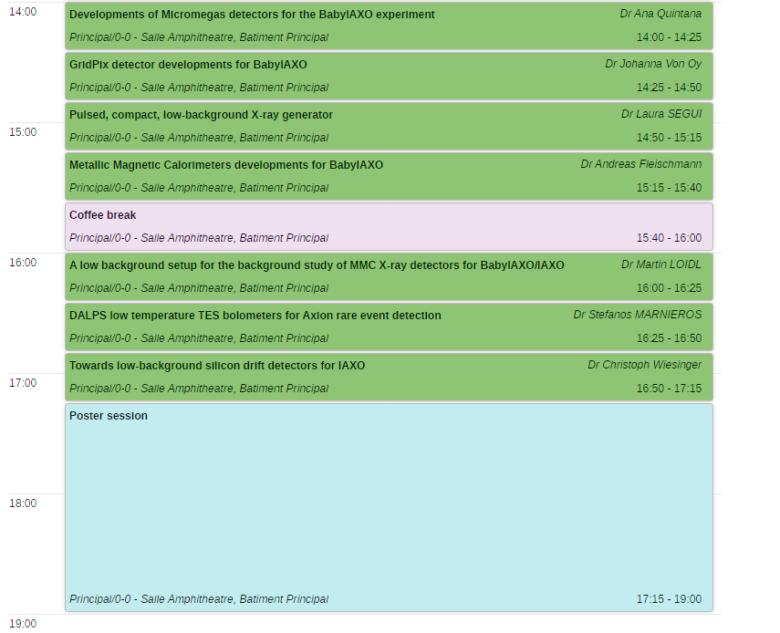
Monday 05th February morning
Monday 05th February afternoon
Dinner at SOLEIL at 19h00 (only registered people)

Slide 6
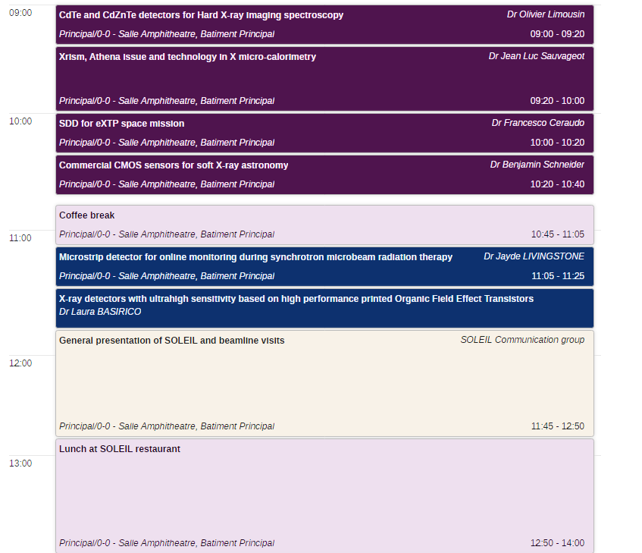
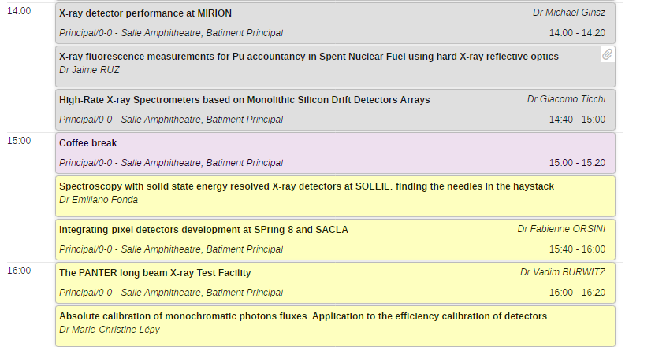
Tuesday 06th February morning
Tuesday 06th February afternoon
Visit of beamlines / group of ~15 persons max
16h45: End of the workshop

Slide 7
Poster session (Today 5th February, 17h15-19h00):
M. Andrae (SOLEIL): UFXC : A medium-sized photon counting pixel detector developed at SOLEIL
C. Forster (TUM): The TRISTAN Detector Upgrade for the KATRIN Experiment
H. Gomez Maluenda (CEA): Automated X-ray calibration system for high granularity Micromegas detectors
N. Goyal (SOLEIL): Development of MCP-based detection system for low energy beta decay experiment
F.J. Iguaz (SOLEIL): DANTE: A digital pulse processor for XAFS and XRF experiments
S. Kumar (GANIL): Development of an X-ray detection system for particle identification of Super Heavy nuclei
A. Meuris (CEA): Characterization of the focal plane of the microchannel X-ray telescope at the metrology beamline of SOLEIL synchrotron for the space astronomy mission SVOM
F. Orsini (SPring-8): Development of CITIUS-20.2M for SACLA
J. Schlegel (TUM): ComPol - A Compton polarimeter in a Nanosat
B. Singh (Punjab Univ): M X-ray Production Cross-Sections in 70Yb Induced by Nitrogen Ions
J.P. Ullo Betea (TUM): TAXO: Low-Background Silicon Drift Detectors for IAXO

Slide 8
Practical information:
Badge: Wear it all the time, please!
It will allow you to have access to SOLEIL site & to get your meal!
Meals: Lunchs & conference dinner will be held at the restaurant.
WIFI: The login & password are located behind your badge.
Amphitheatre: Please, no food, no liquids, no coffee.
Special requests: Please, contact us (the organizers), or Camille Enjommet, or send an email to conference email conf-xdep2024@synchrotron-soleil.fr

Slide 9
SOLEIL beamline visits:
Schedule: Tomorrow (Tuesday 6th Feb), before lunch (11h50 – 12h50)
Organized by SOLEIL communication group
General introduction (20 min) at SOLEIL Amphitheatre
Visit of 1 beamline: 4 groups (15 people/max)
One beamline per group: METROLOGIE, PUMA, PROXIMA-2 & SAMBA
Please, follow your group, not to get lost!

