Slide 1

Magnetic Micro-Calorimeters
for Baby-IAXO and
hi-res x-ray spectroscopy
Loredana Gastaldo, Andreas Fleischmann and a large team at
Heidelberg University

Slide 2
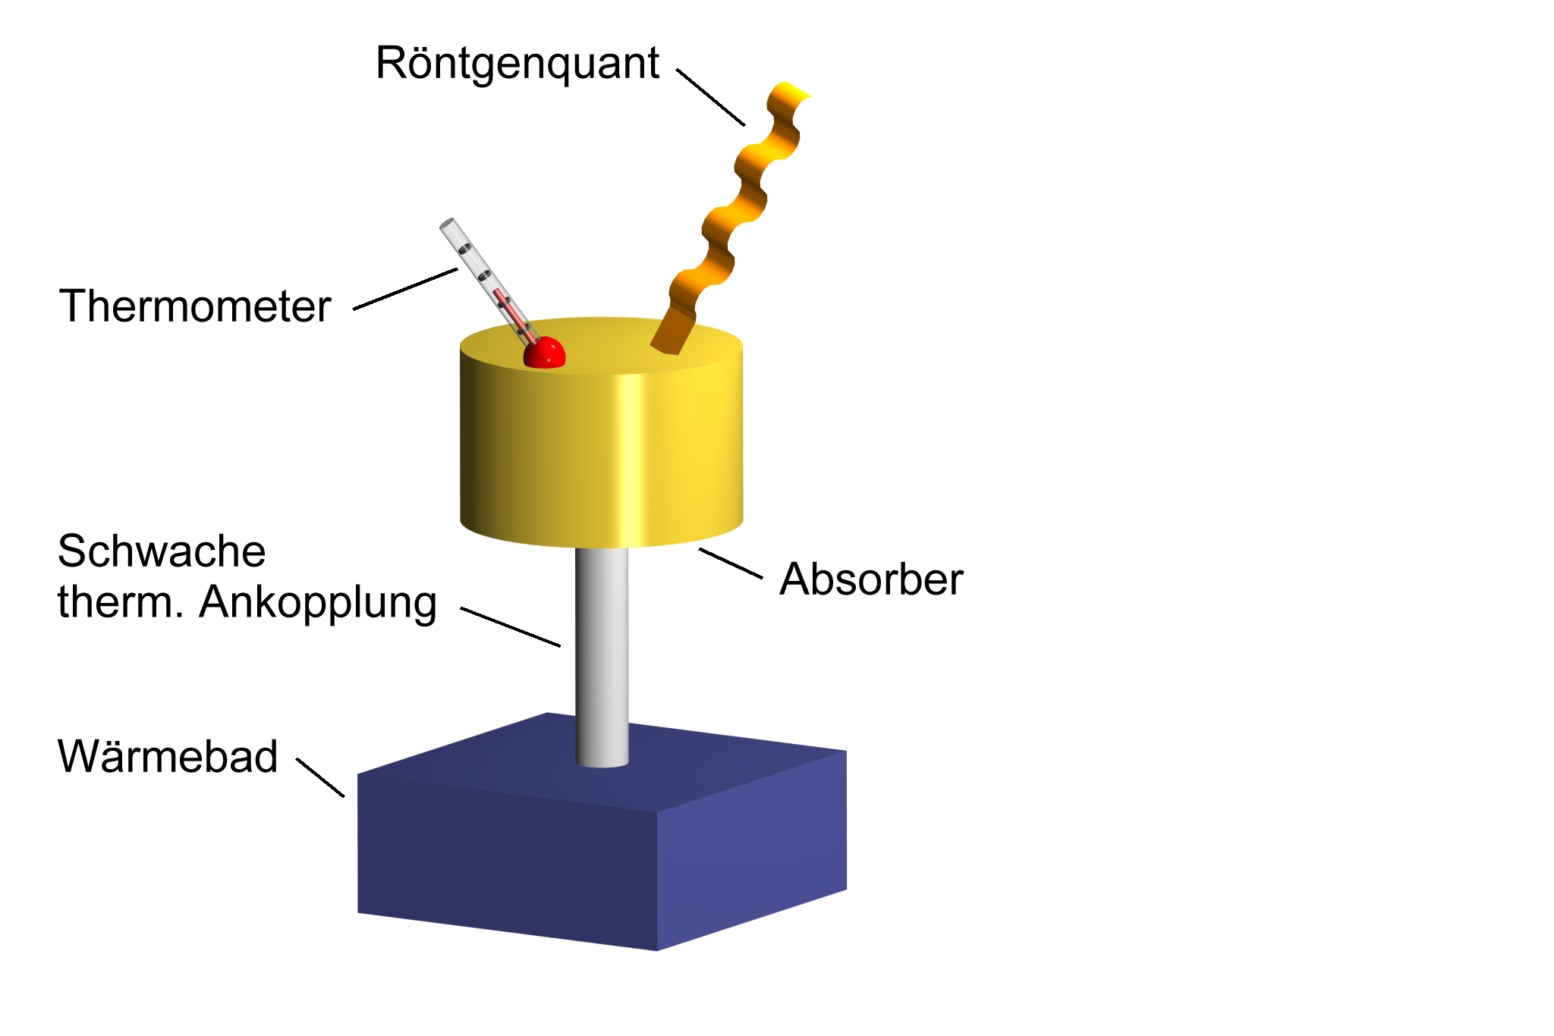
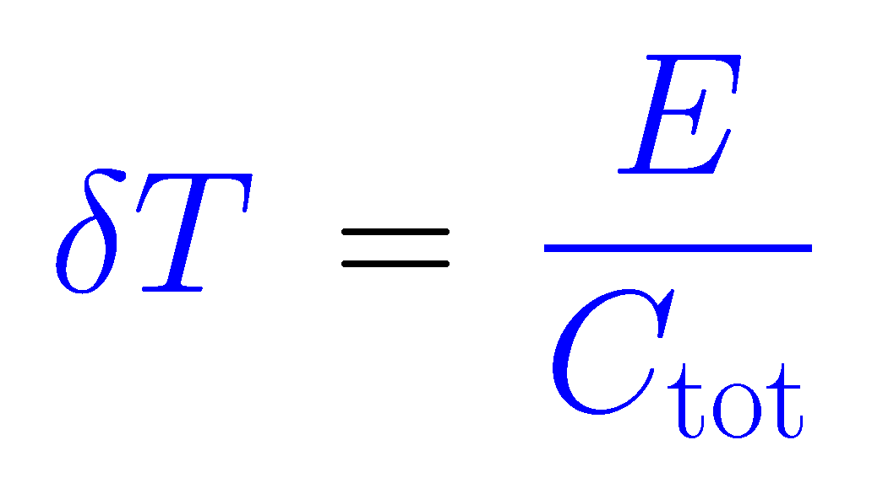
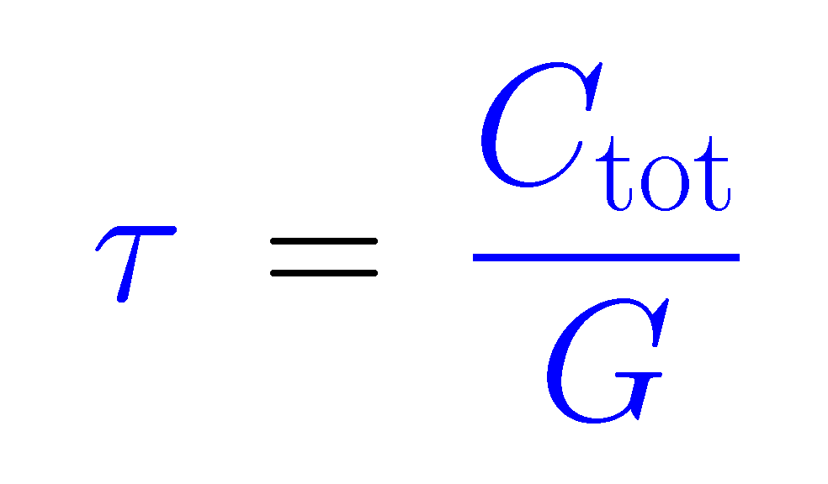
micro-calorimeters
X-ray photon or particle
Thermal detectors !
Somewhat numb:
Convert good form of energy to heat!
Thermometer
Temperature change
Weak thermal link G
Absorber C
Relaxation to bath temperature
Thermal bath
(T < 100mK)
Operation at low temperature (T < 0.1 K):
small specific heat
large temperature change
small thermal noise !

Slide 3
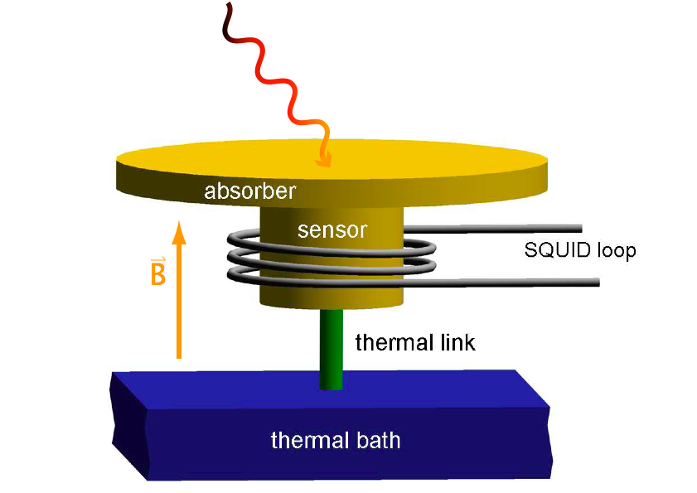
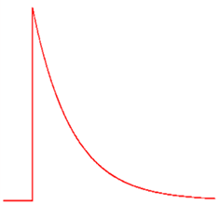
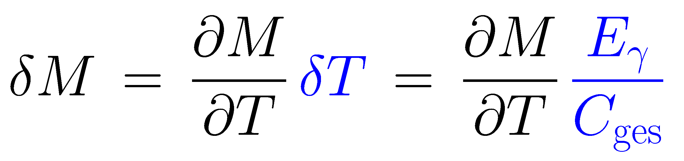
metallic magnetic calorimeters
paramagnetic sensor: Au:Er_{500ppm} , Ag:Er
T
M
T
~1 mK
signal size:
~1 ms
20 mK
t
main differences to resistive sensors like TES and thermistors
no dissipation in the sensor
no galvanic contact to the sensor
M and C of weakly interacting spins well understood
important for large arrays
numerical optimization
non-linearity: small & understood from thermodynamics

Slide 4
detector geometries
planar paramagnetic T-sensor
superconducting pickup loop with persistent current to generate bias B-field
meander-shaped pick-up coil
stripline (sandwich) design
250 μm
filling factor ≈ 0.4
filling factor ≈ 0.8

Slide 5
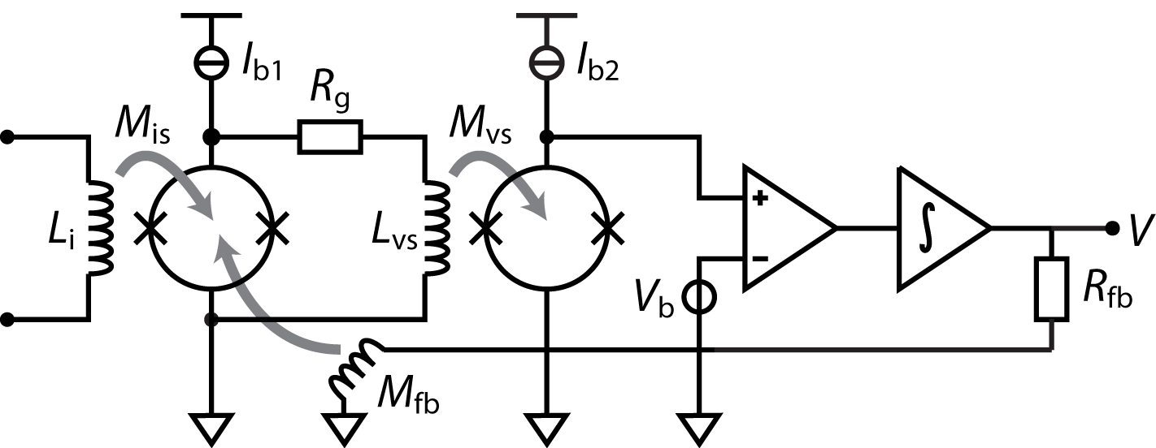
two-stage dc-SQUID setup
< 100 mK
300K
input coil should
match pickup coil
main advantages:
low readout noise
large system bandwidth (several MHz)
low power dissipation (close to the MMC)
linearization by flux locked loop

Slide 6
microwave SQUID multiplexer (µMUX)
readout 100s of pixels with only one HEMT amplifier and two coaxes

Slide 7
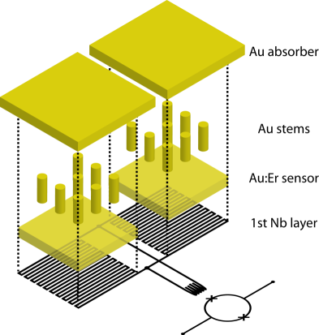
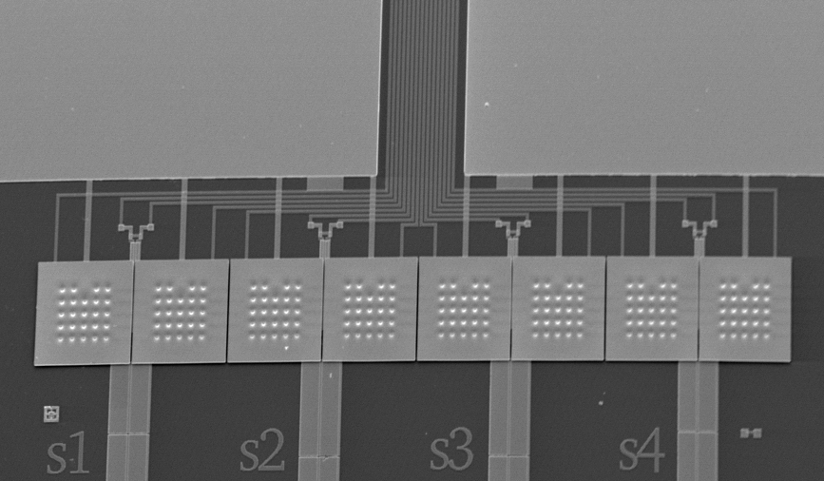
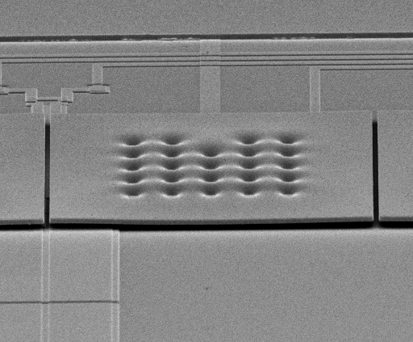
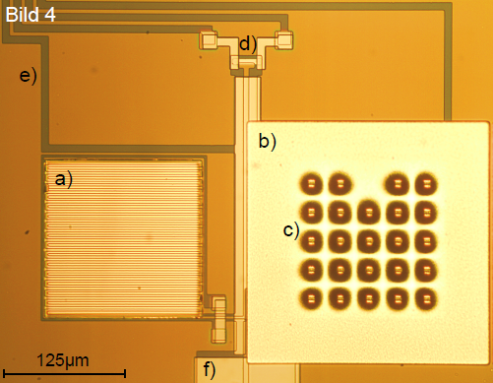
micro-fabricated devices: first 1×8 array for soft x-rays (a decade ago)
1×8 x-ray absorbers
  250μm×250 μm gold, 5 μm thick
  98% qu.-eff. @ 6 keV
  electroplated into photoresist mold
  mech/therm contact to sensor by stems
  to prevent loss of initially hot phonons
Au:¹⁶⁶Er_{300ppm} temperature sensors
Superconducting meander shaped pickup coils
  2.5 μm wide Nb lines
  I_{c} ≈ 100mA
On-chip persistent current switch (AuPd)
Au:Er
on
Nb meander
250 μm

Slide 8
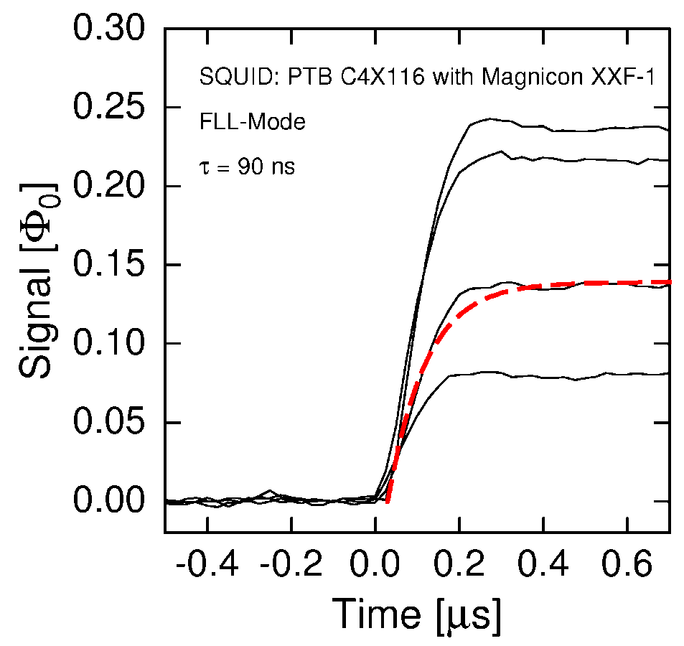
signal rise in compact x-ray detectors
rise time: 90 ns @ 30 mK, as expected for the electron-spin-relaxation of Er in Au

Slide 9
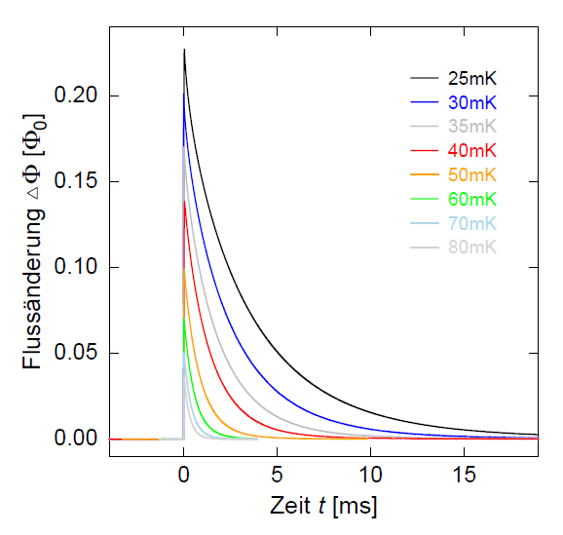
signal decay
decay time
adjusted by metallic thermal link (Au)
here: 3 ms @ 30 mK
On-chip thermal bath
magnetic flux
time

Slide 10
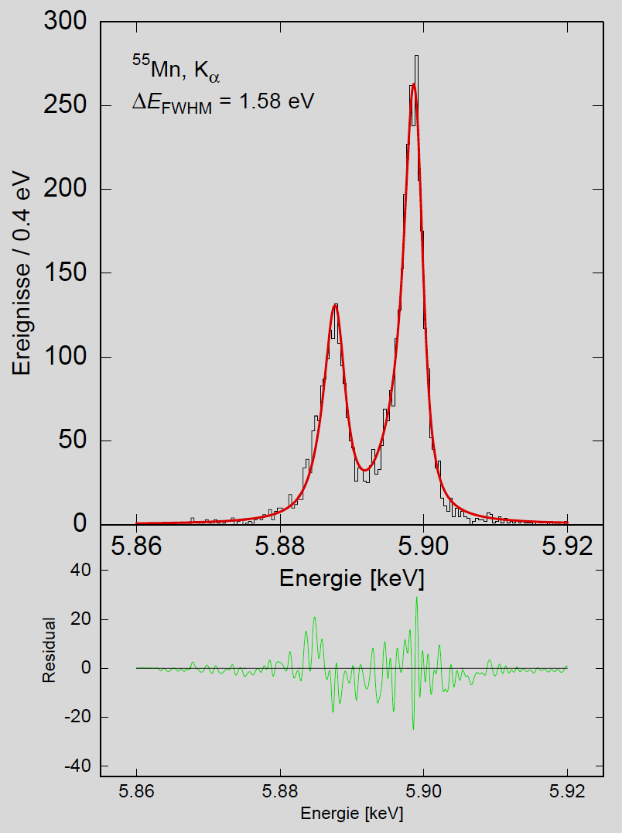
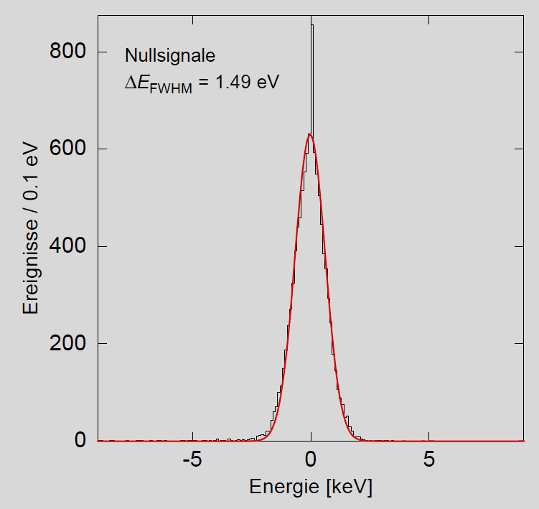
first 1×8 array for soft x-rays
⁵⁵Mn
ΔE_{FWHM} = 1.5 eV @ 0 keV
ΔE_{FWHM} = 1.6 eV @ 6 keV
Defines state-of-the-art together with TES from NIST and NASA

Slide 11
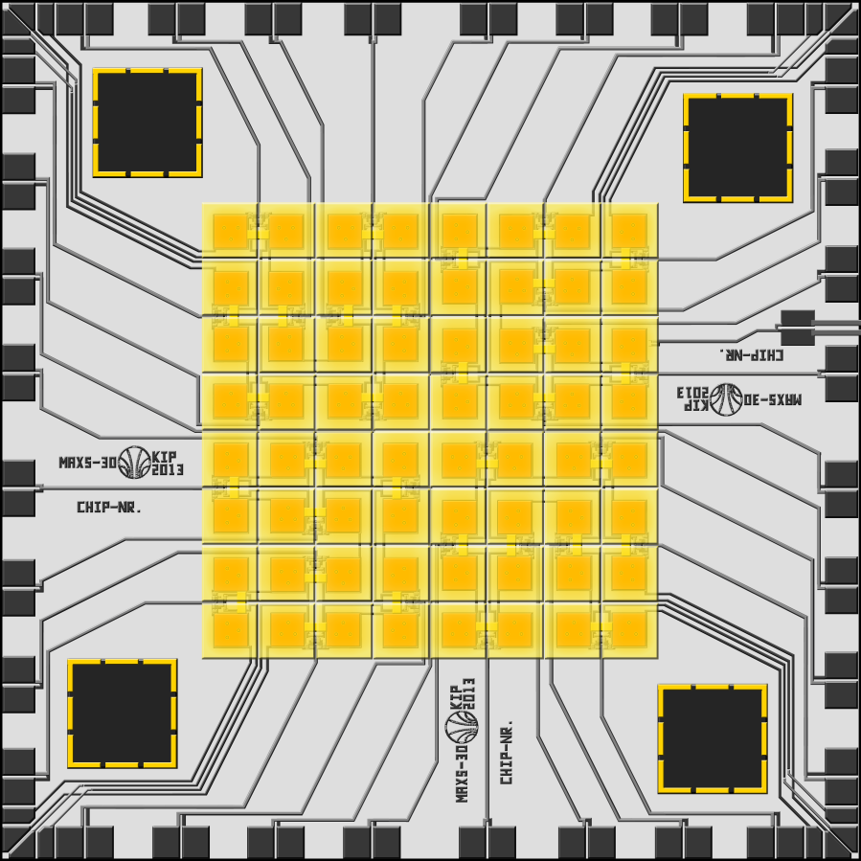
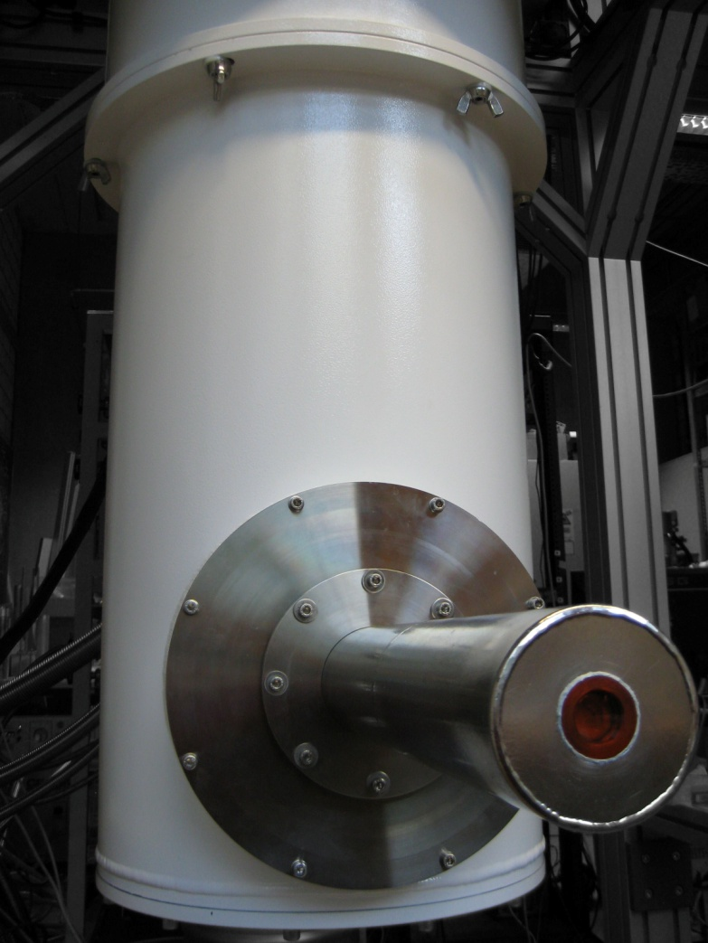
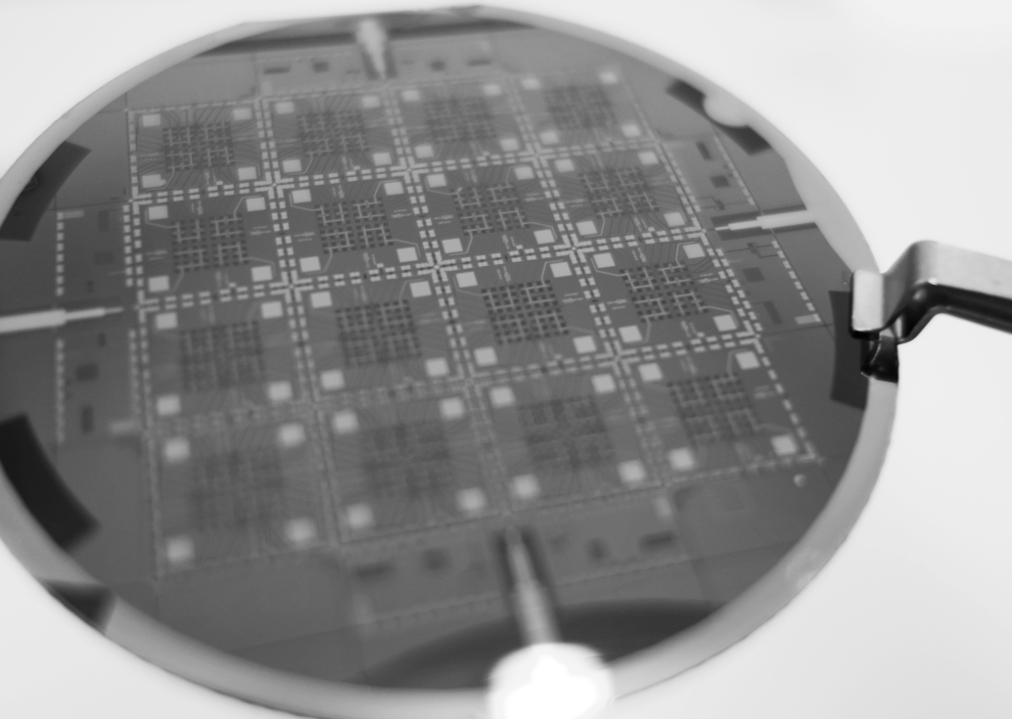
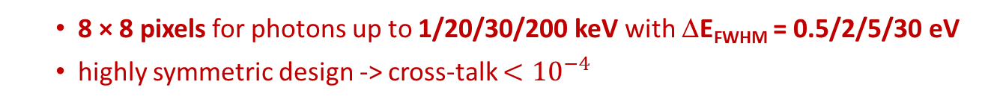
8×8 arrays of maXs-1/20/30/200
8 × 8 pixels for photons up to 1/20/30/200 keV with ΔE_{FWHM} = 0.5/2/5/30 eV
highly symmetric design -> cross-talk $<{10}^{−4}$
1.2/2/4/8 mm
Dry dilution fridge
(Bluefors, FI)

Slide 12
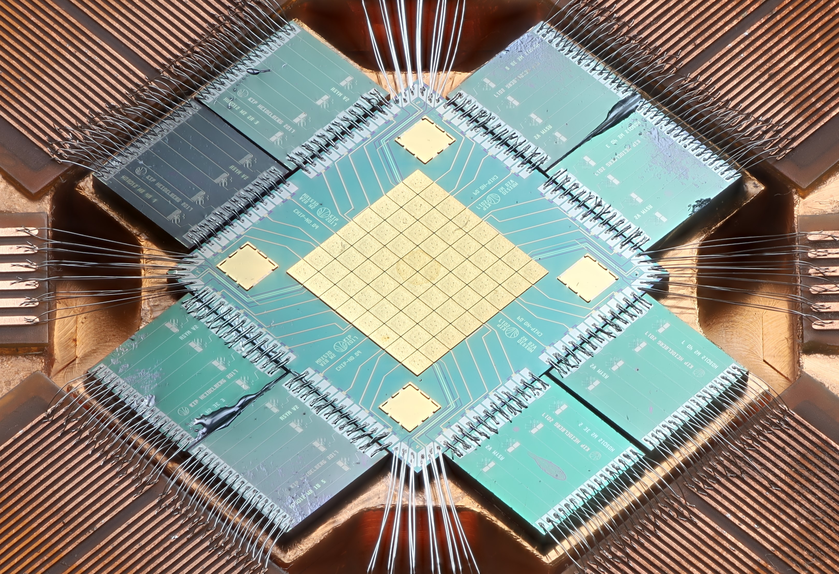
maXs-30 an 8×8 pixel array for x-rays up to 30 keV
Absorbers:
each 0.5mm × 0.5 mm
30-50 μm thick gold
9.8 eV
Energy resolution ΔE_{FWHM} = 9.8 eV @ 59 keV
Resolving power: 6000 (limited by gain drifts)

Slide 13
maXs-30: calibration
non-linearity
non-linearity as thermodynamically expected!

Slide 14
maXs-30: present calibration residuals
Most lines from literature have too large uncertainty.

Slide 15
maXs-30: present calibration residuals
Sub-eV agreement for carefully selected calibration lines.
Left-over residuals due to ADCs → sparse set of calib.-lines should allow for ppm-level (FS) calibration

Slide 16
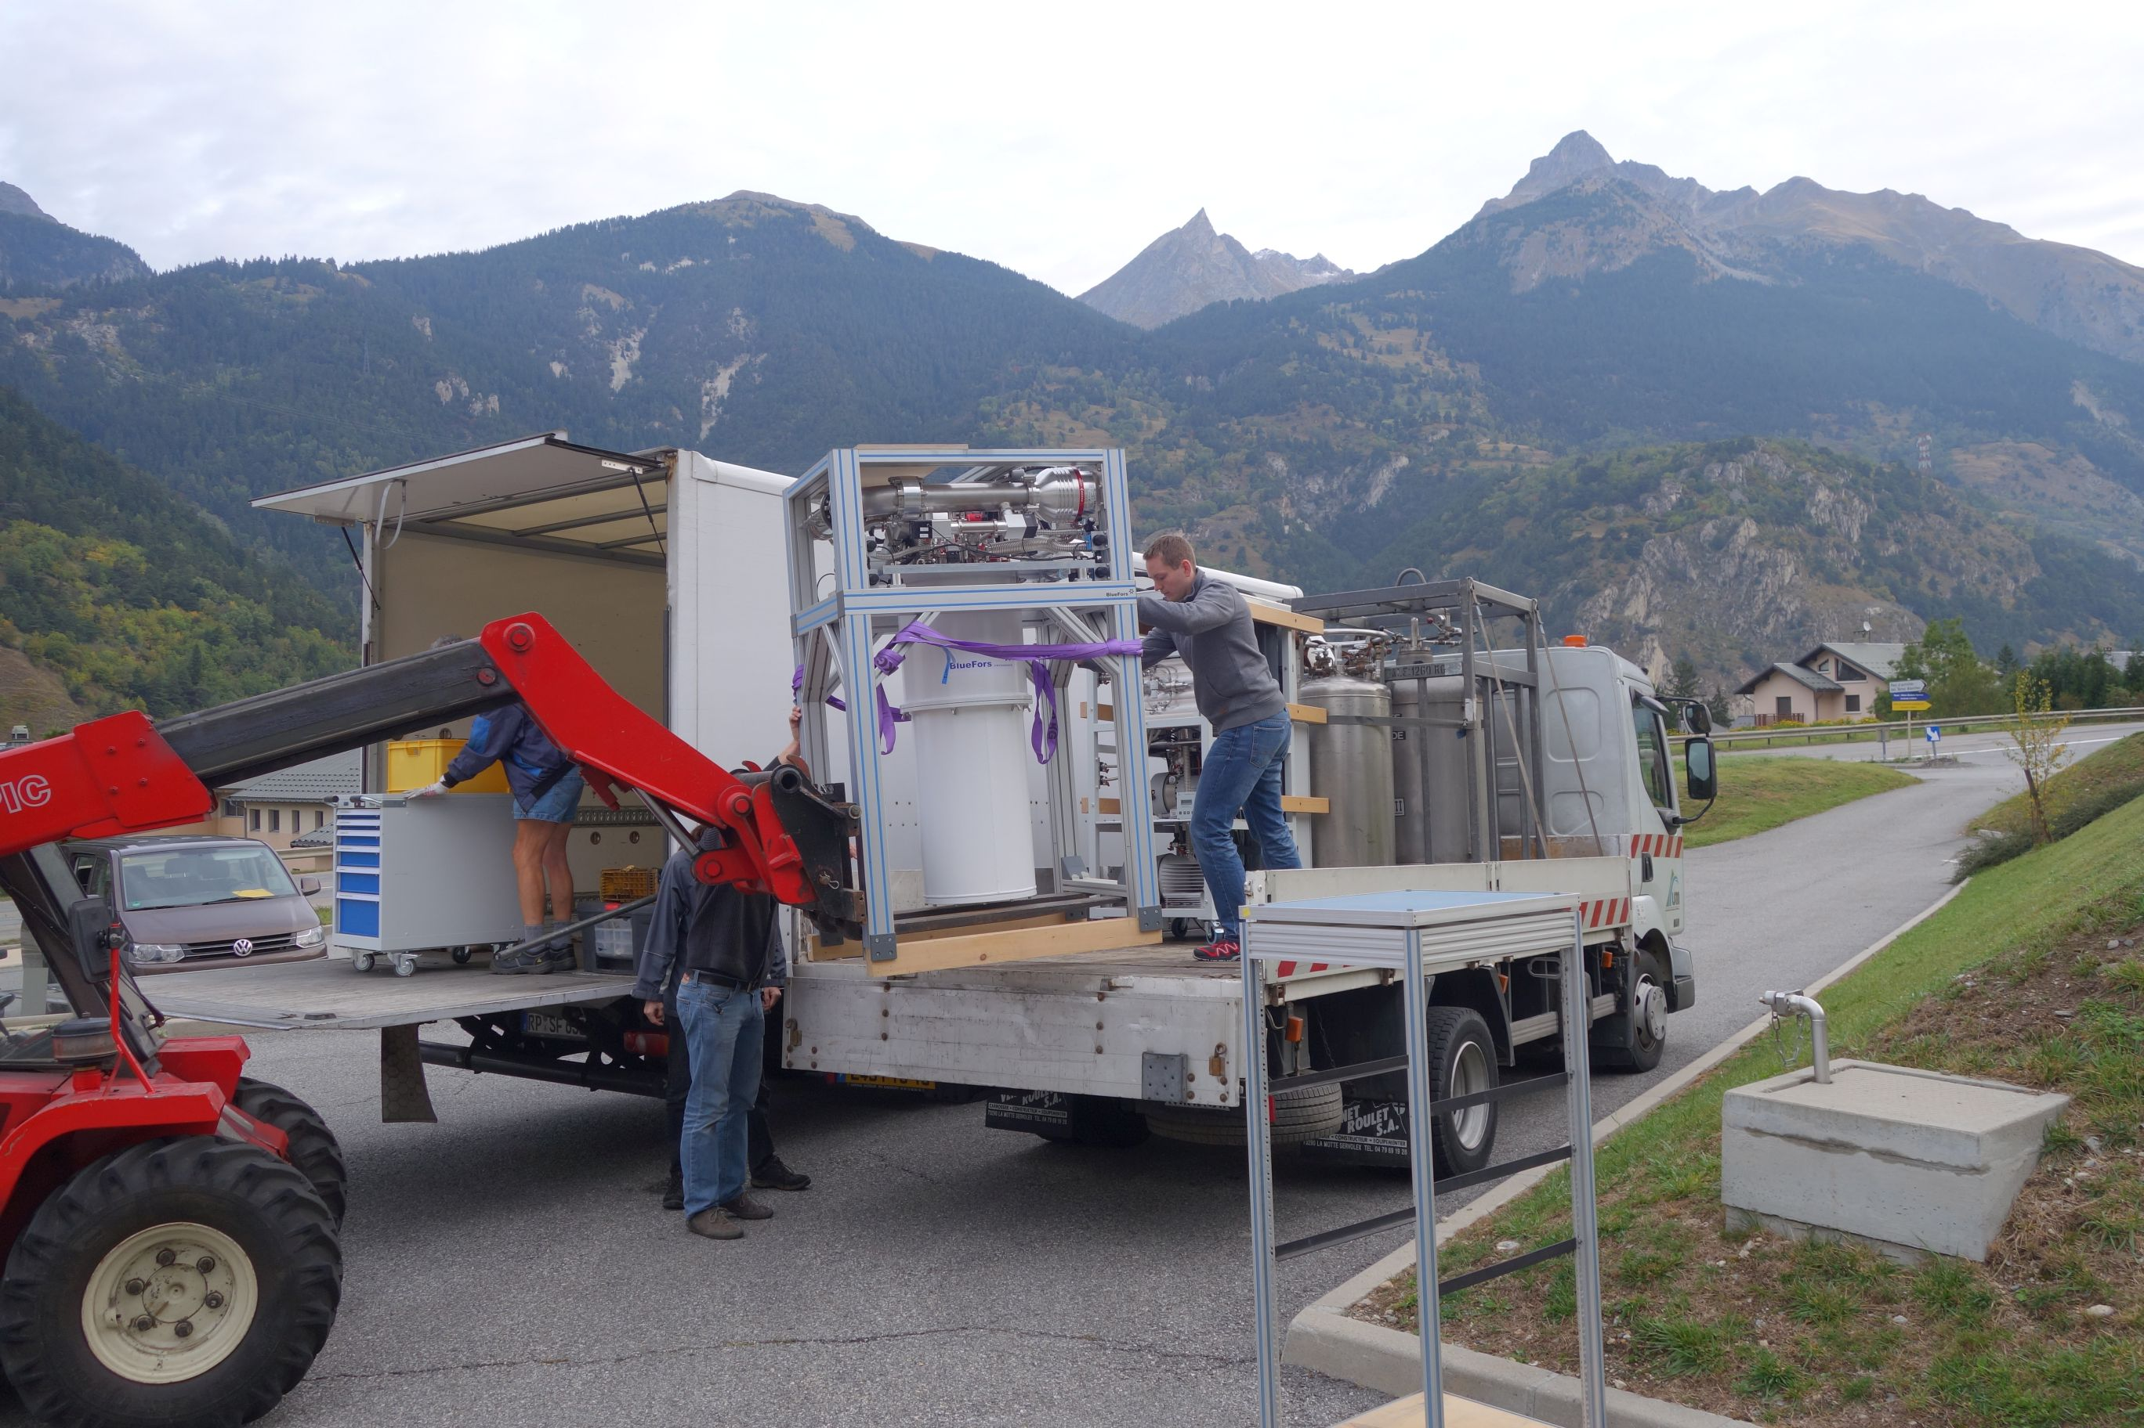
MMCs get more and more mobile
here @ entrance to Frejus tunnel between Italy and France

Slide 17
Two maXs-100 systems @ e-cooler of CRYRING @ GSI/FAIR: He-like Uranium

Slide 18
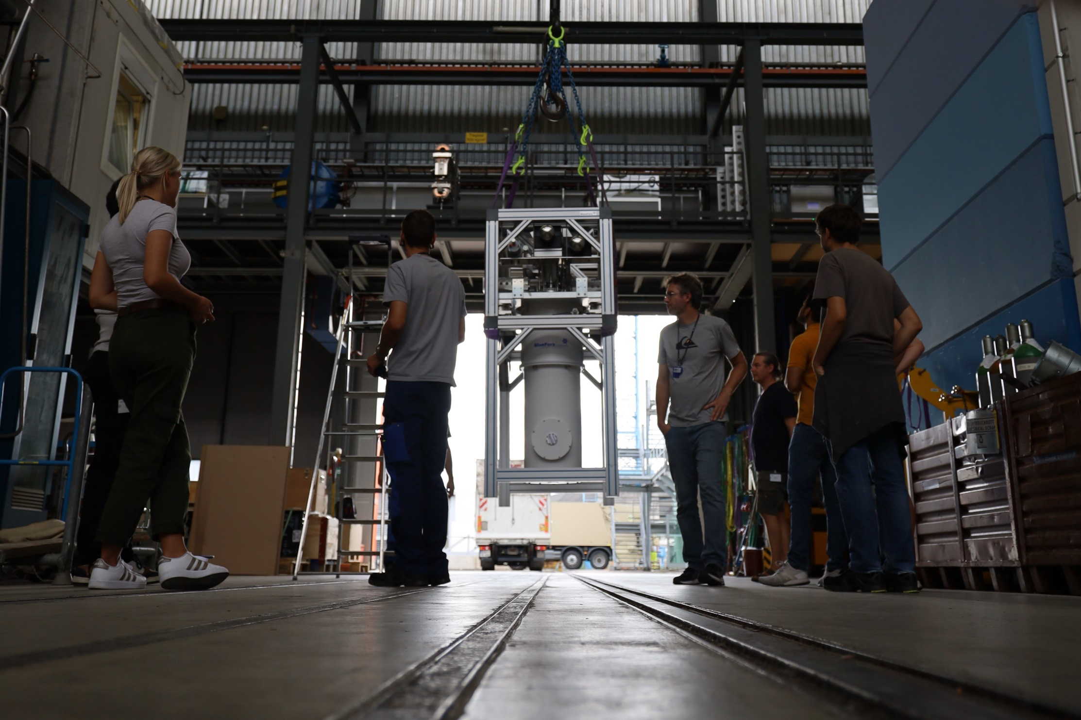
maXs-30 @ $μ$-beamline, PSI: muonic Li, B, C

Slide 19
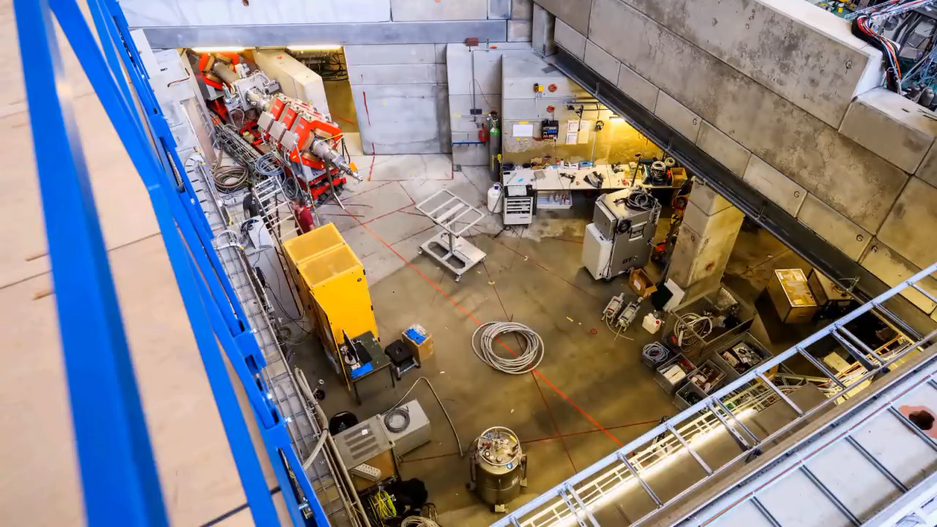
maXs-30 @ $μ$-beamline, PSI: muonic Li, B, C

Slide 20
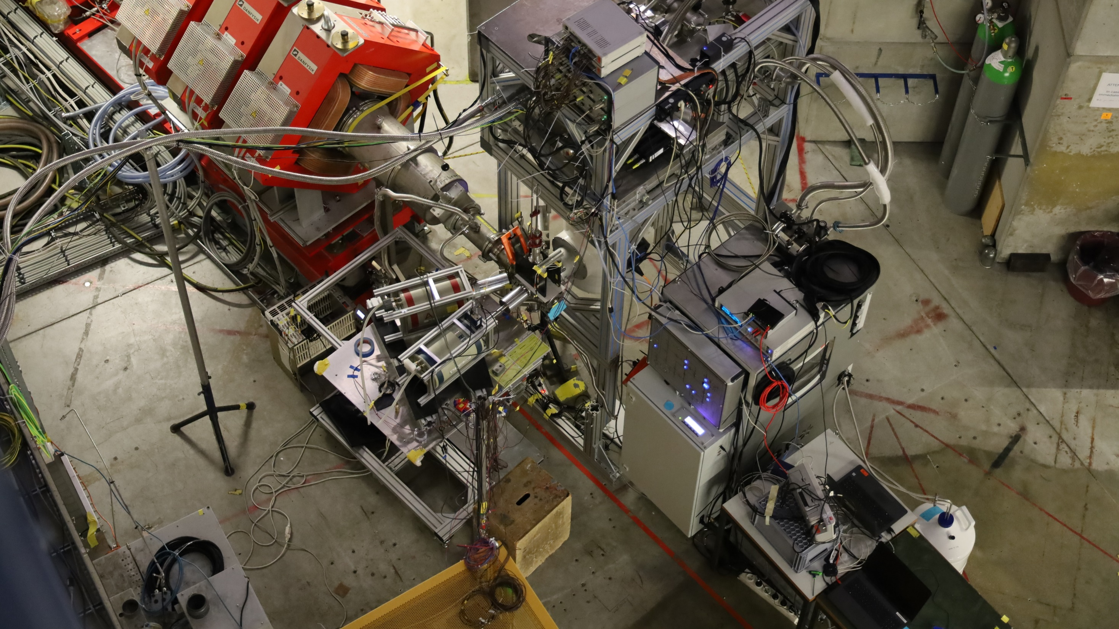
maXs-30 @ $μ$-beamline, PSI: muonic Li, B, C

Slide 21
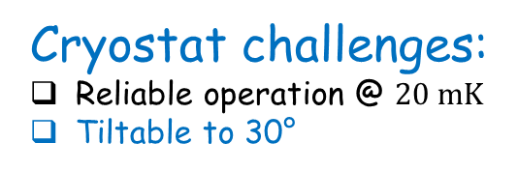
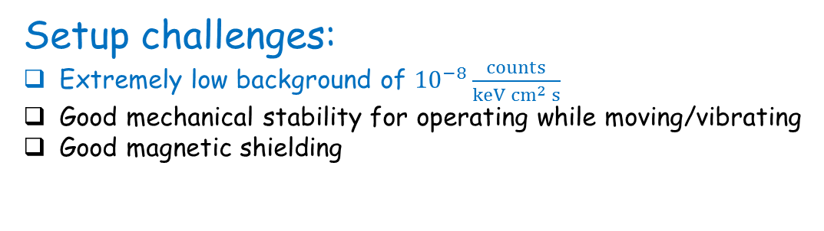
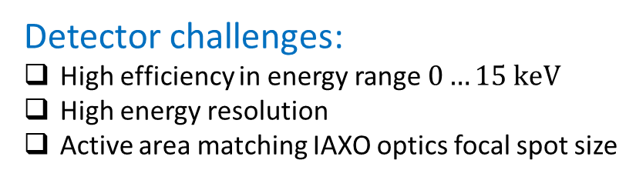
MMCs for IAXO: Challenges
Detector challenges:
High efficiency in energy range $0…15 keV$
High energy resolution
Active area matching IAXO optics focal spot size
ü
ü
ü
Setup challenges:
Extremely low background of ${10}^{−8}\frac{counts}{keV {cm}^{2} s}$
Good mechanical stability for operating while moving/vibrating
Good magnetic shielding
ü
ü
Cryostat challenges:
Reliable operation @ $20 mK$
Tiltable to 30°
ü

Slide 22
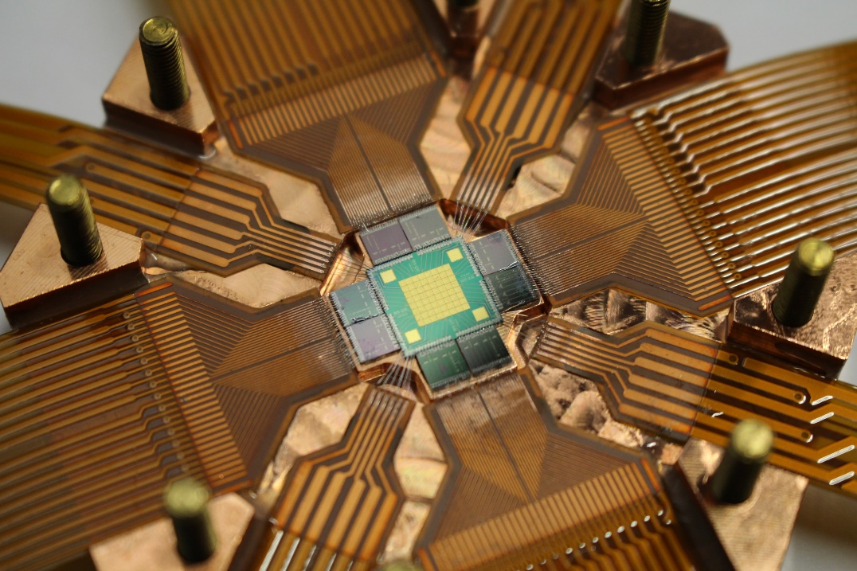
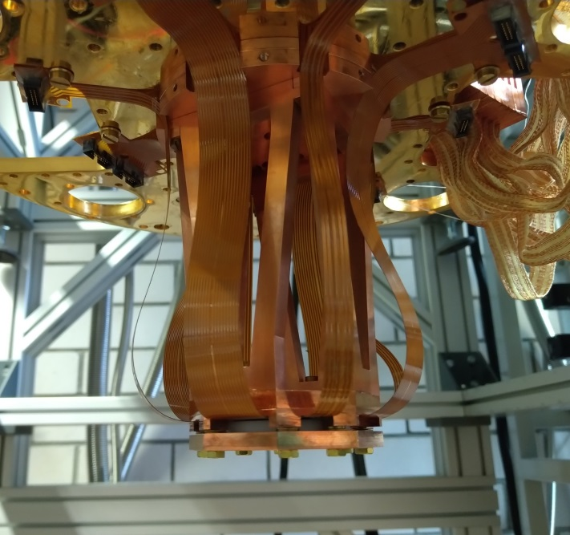
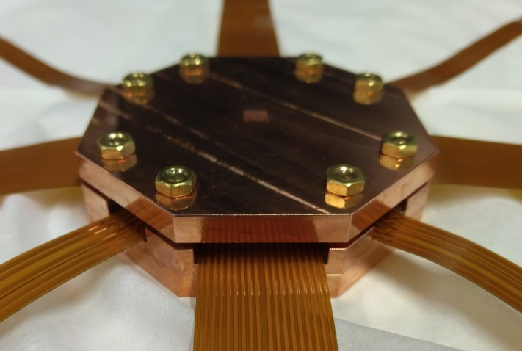
maXs-30 set-up for IAXO
Design suitable for IAXO telescope
High purity materials for background reduction
D. Unger et al., JINST 16 (2021) P06006, arXiv:2010.15348 [physics.ins-det]

Slide 23
maXs-30 set-up for IAXO
⁵⁵Fe calibration source
Stopping power @10 keV ~100%
Homogeneous performance over the array
Stable operation over 1 month
ΔE_{FWHM} ≅ 7 eV
D. Unger et al., JINST 16 (2021) P06006, arXiv:2010.15348 [physics.ins-det]

Slide 24
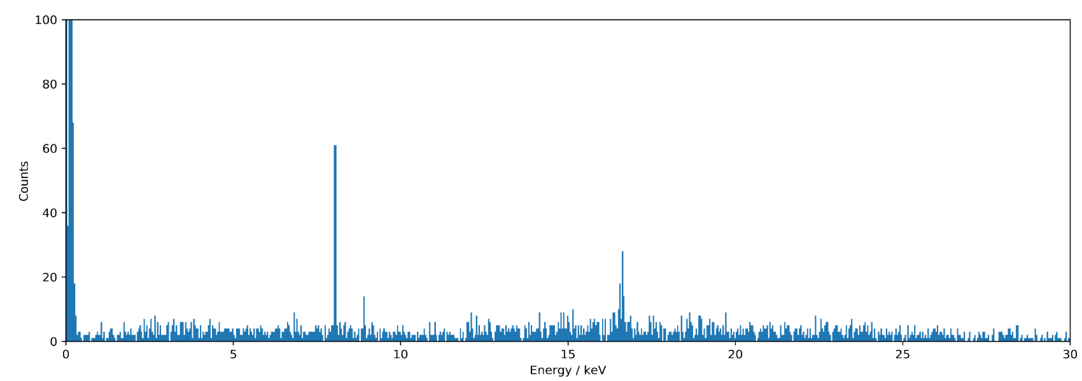
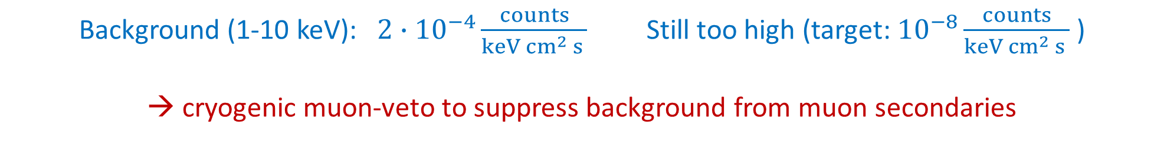
maXs-30 set-up for IAXO
Background spectrum (one month, overground, no special shielding, no muon veto)
$$\text{Cu} {\text{K}}_{α}$$
$$\text{N}\text{b} {\text{K}}_{α}$$
$$\text{Cu} {\text{K}}_{β}$$
Background (1-10 keV): $2∙{10}^{−4}\frac{counts}{keV {cm}^{2} s }$ Still too high (target: ${10}^{−8}\frac{counts}{keV {cm}^{2} s }$)
→ cryogenic muon-veto to suppress background from muon secondaries
D. Unger et al., JINST 16 (2021) P06006, arXiv:2010.15348 [physics.ins-det]

Slide 25
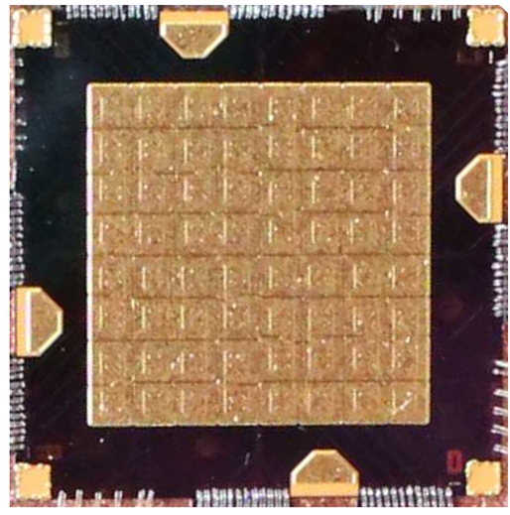
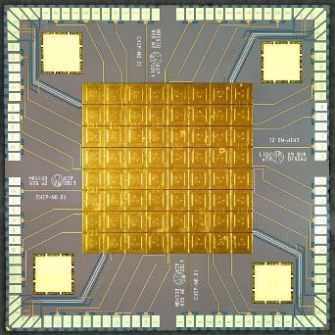


From maXs-30 to maXs-IAXO
active area4 × 4 mm² → 10 × 10 mm²
larger than focus spot
→ intrinsic background monitoring
thickness:30μm → 10μm to keep ΔE_{FWHM} < 10 eV
Axion production
Metallicity
14.4 keV iron line
30 µm
10 µm
maXs-IAXO
maXs-30
$$15 mm$$
$$8 mm$$
Same design, but scaled up!

Slide 26
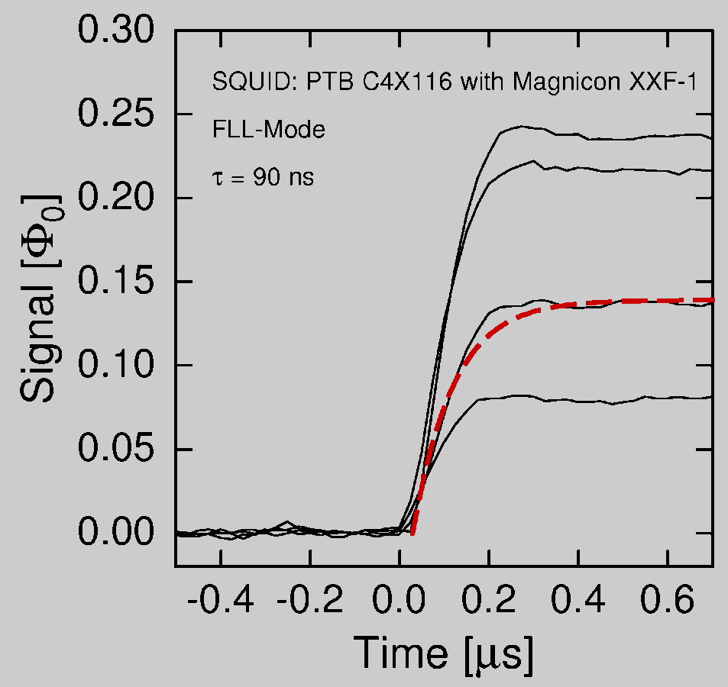
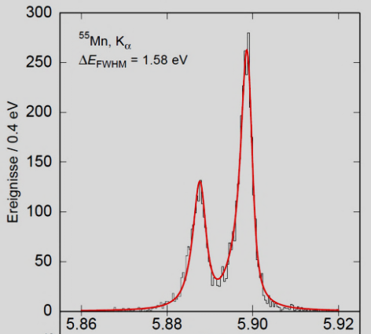
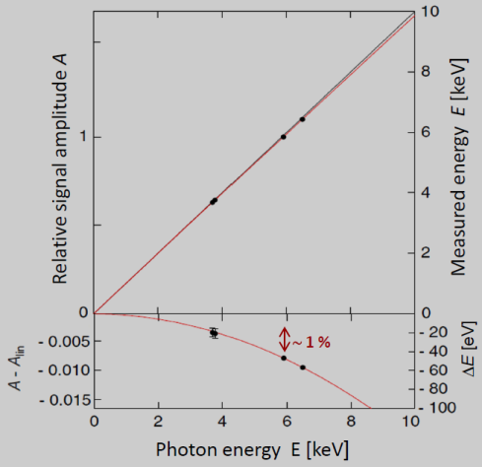
summary & outlook
metallic magnetic calorimeters combine in a unique way
energy calibration:
sparse set of calibration lines will allow for ppm-FS-accuracy for line-positions in fullrange
micro-fabrication works
scaling to pixelcounts > 100 in progress
large variety of sizes, stopping powers and resolutions
MMCs start to contribute to atomic, molecular, nuclear and astro-particle physics
time resolution
energy resolution
linearity

Slide 27
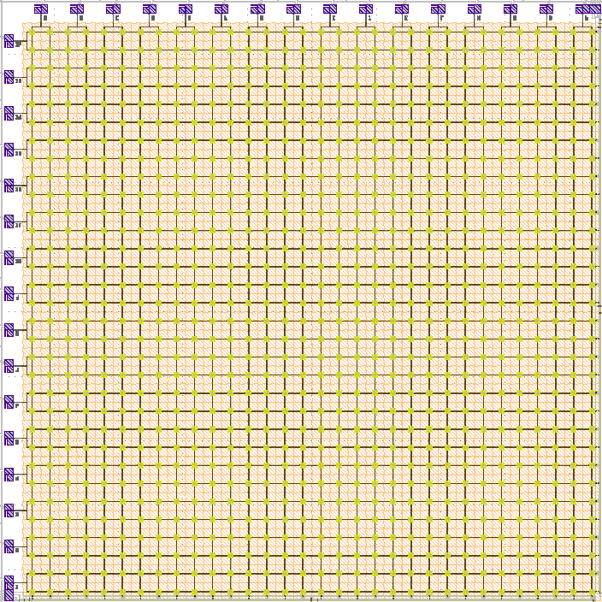
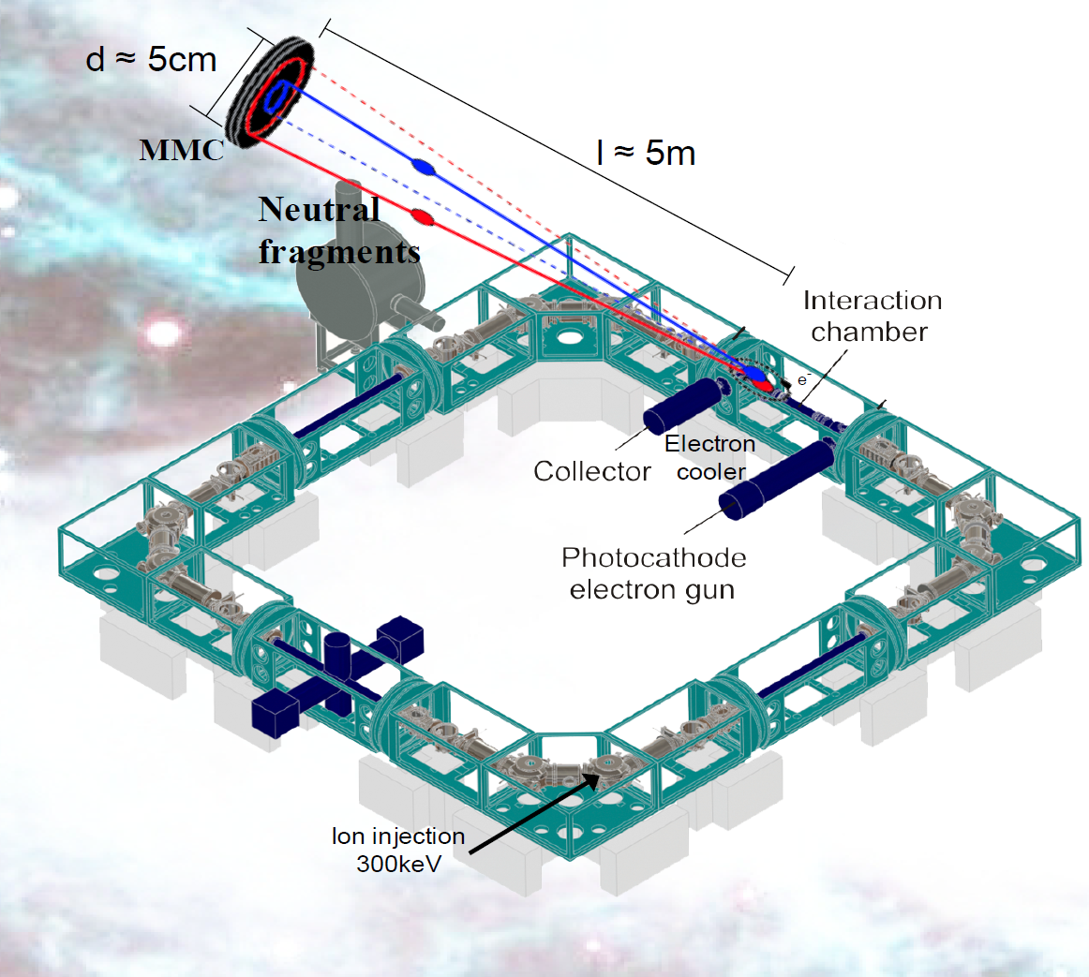
MOCCA: 4k-pixel molecule camera
to study reaction cross sections of molecular ions of cold interstellar plasmas
in the cryogenic storage ring CSR at MPI-K, HD
Position and energy resolved detection
of neutral molecular fragments
after neutralizing with an electron in the e-cooler
Heidelberg University, MPI-K Heidelberg, Columbia Astro Lab NY
MOCCA:
44.8mm × 44.8mm
64 × 64 pixels
resolution: ΔE = 250 eV (FWHM)
operated at T = 20 mK
16 two-stage SQUIDs to read-out 64 rows
16 two-stage SQUIDs to read-out 64 columns
T < 10K

Slide 28
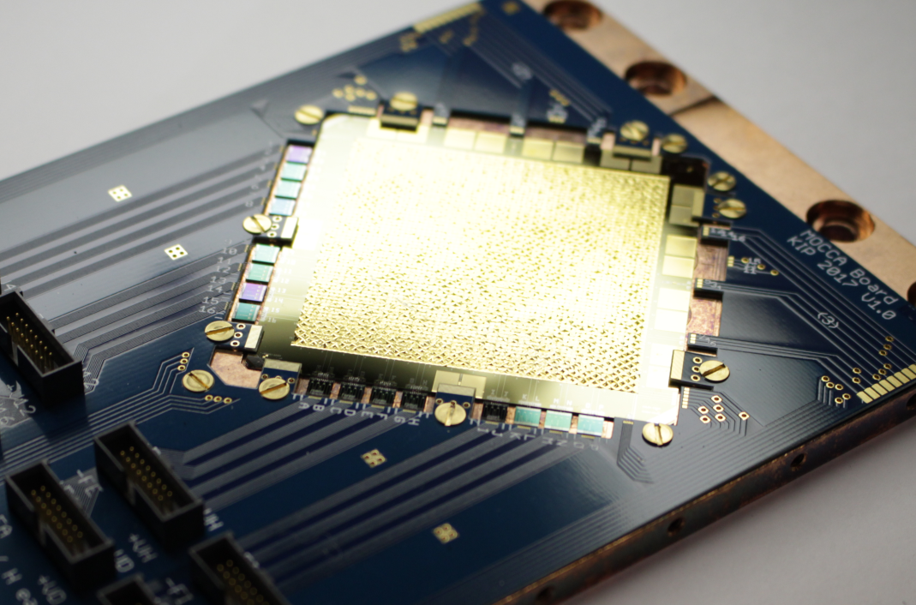
MOCCA: 4k-pixel molecule camera / hi-res alpha detector
45 mm
200 eV FWHM

Slide 29
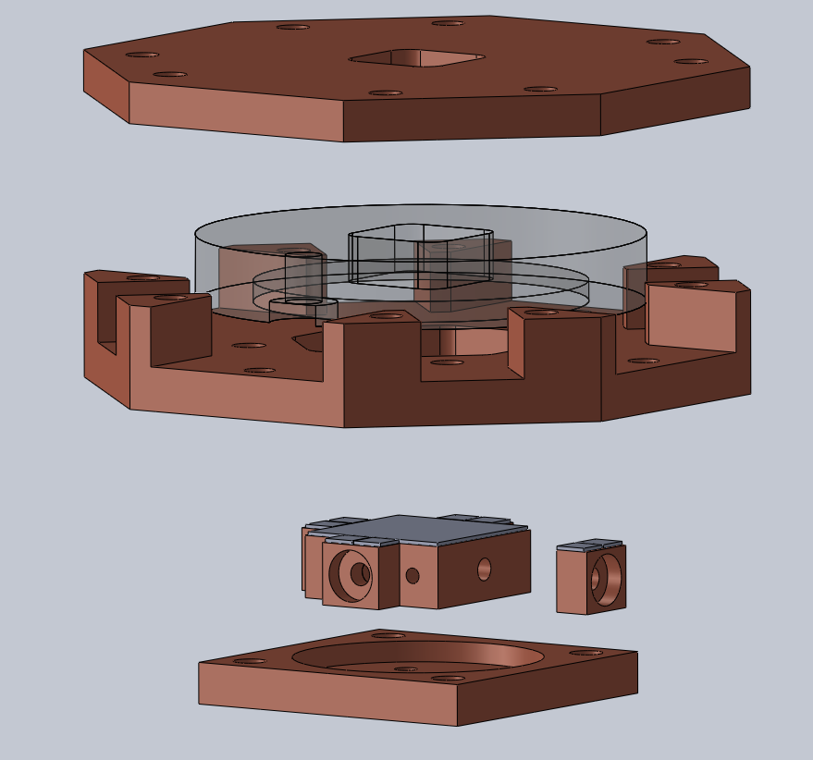
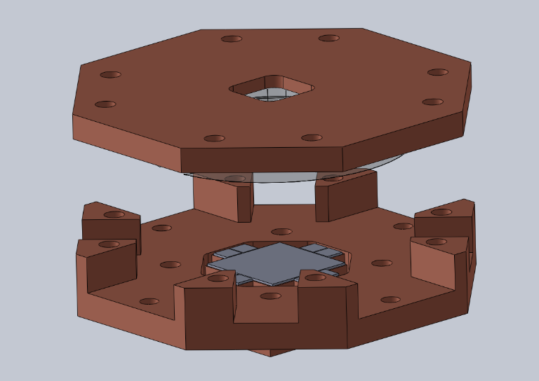
Detector setup V2
New features:
Modularized detector and SQUID holder
→ easy repair
Optimized for new detector
maXs-IAXO
Additional inner teflon shield to
reduce background

Slide 30
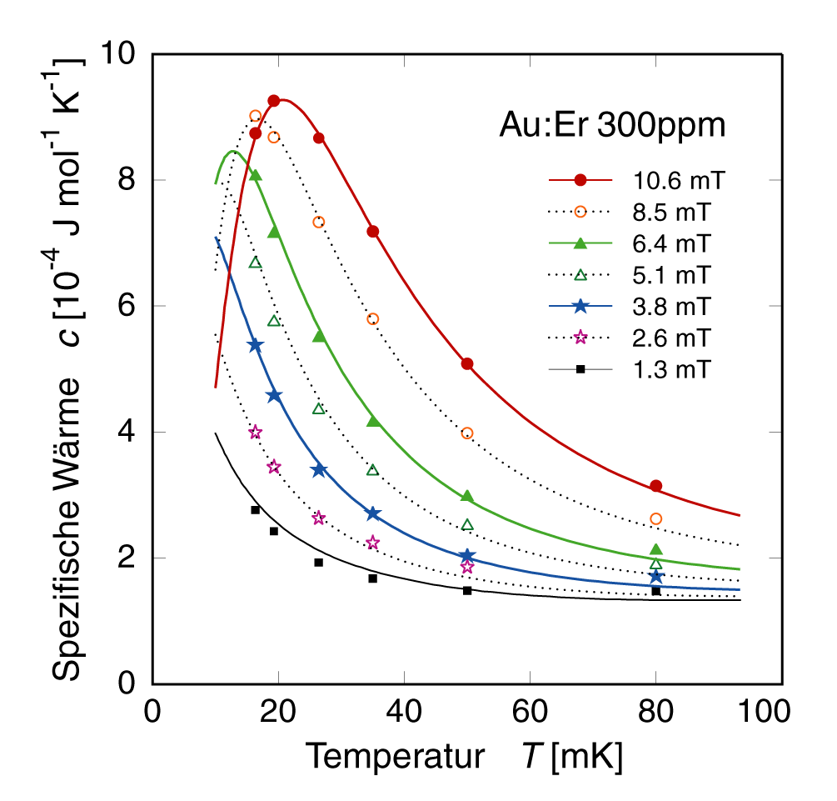
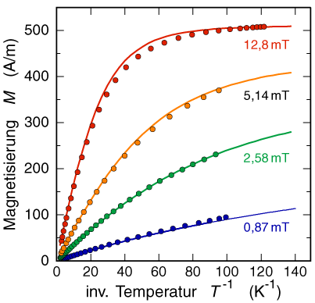
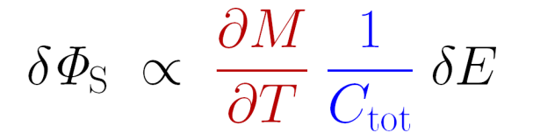
thermodynamical properties of Au:Er, Ag:Er
thermodynamic properties of interacting spins are well understood
Au:Er 300 ppm
Au:Er 300 ppm
Au:Er 300 ppm
typical range
of operation
Specific heat C [10⁻⁴ J mol⁻¹K⁻¹]
Magnetization M [A/m]
electrons
Inverse Temperature T⁻¹ [K ⁻¹]
Temperature T [mK]
signal size can be predicted with confidence
non-linearity as well !
RKKY-interaction between Er-spins ~ 3 times stronger in silver

Slide 31


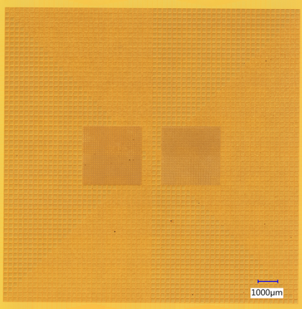
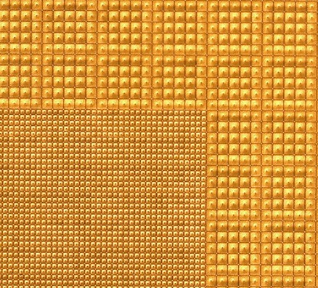
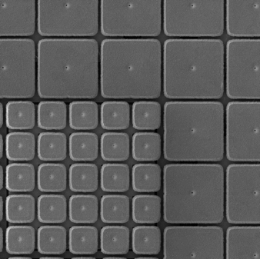
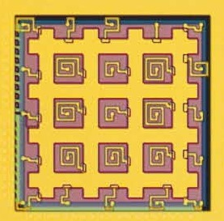
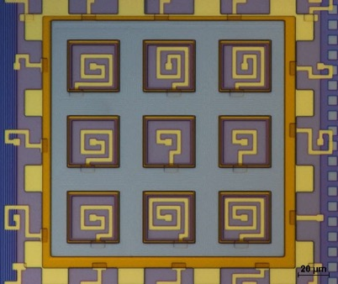

MMC-option for LynX: a 100k pixel X-ray camera for astro-physics
                read-out by 4000 μMUX-ed T-sensors (MMC)
“Large-scale metallic magnetic calorimeter arrays for the Lynx X-ray Microcalorimeter”, Devasia et al. ’22
4” wafer detector chip
Detector array
Main & UHR array absorbers
Main & Enhanced array
absorbers
Main array meander
hydra:
Main array sandwich hydra:
Enhanced array hydra:

Slide 32

maXs-30
maXs-30 mounted on coldfinger of a dry dilution fridge

Slide 33
maXs-30
T

Slide 34

maXs-30

