Slide 1
Microstrip detector for online monitoring during synchrotron microbeam radiation therapy: measurements with phantoms and veterinary patients
Jayde Livingstone
Equipe Physique Nucléaire et Applications Médicales, LPSC, Grenoble
Jean-François ADAM, Denis DAUVERGNE, Francesca DI FRANCO, Laurent GALLIN-MARTEL,
Marie-Laure GALLIN-MARTEL, Mostafa GHAFOORYAN-SANGCHOOLI, Mohamed IKHELIF, Sarvenaz KESHMIRI, Jayde LIVINGSTONE, Candice MILEWSKI, Jean-François MOTTE, Jean-François MURAZ, Paolo PELLICIOLI, Nicolas ROSUEL, Raphaël SERDUC
F. di Franco, et al., J. Synchrotron Rad., 2023.

Slide 2
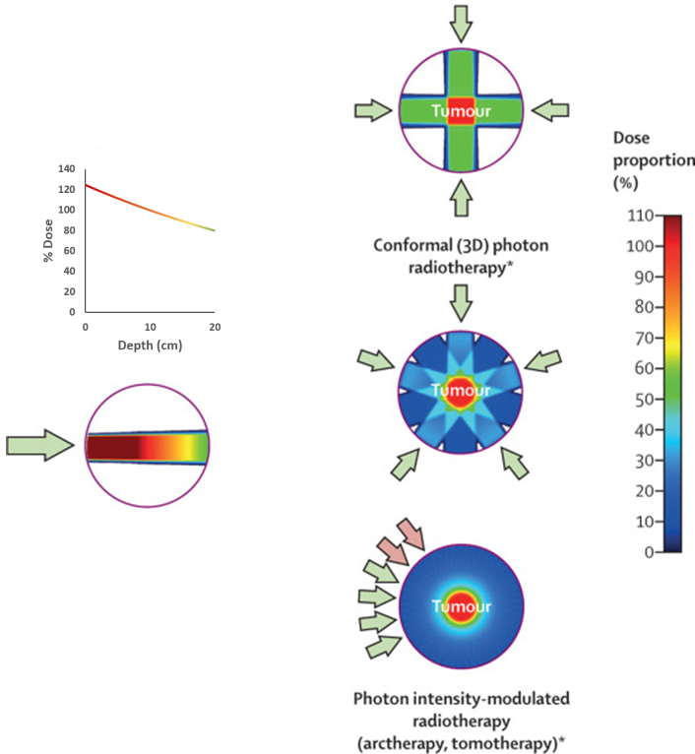
What is radiotherapy?
Adapted from Thariat J., et al., Lancet, 22(12), 2021
Use of radiation (e.g. x-rays, electrons, protons, etc.) to treat a disease, such as cancer
About half of all cancer patients will receive some form of radiotherapy during their treatment
The goal of radiotherapy is of course to kill cancer cells…But not at the expense of healthy cells!

Slide 3
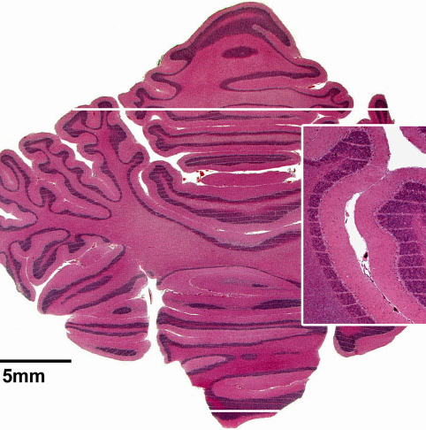
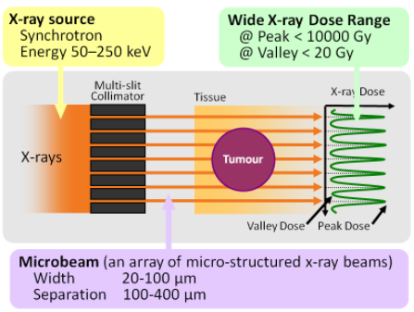
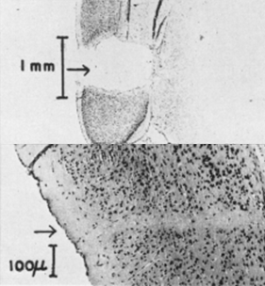
Microbeam radiotherapy: spatial fractionation of the dose
Dose volume effect
http://mswebs.naist.jp
www.esrf.eu
Up until now has been confined to synchrotron sources due to spectrum (kV) and high dose rates (10² – 10³ Gy/s) required
Dedicated beamlines:
ID17, ESRF (until mid-2023)
IMBL, Australian Synchrotron
Curtis, H. J., Radiat. Res., Suppl. 7., 1967

Slide 4
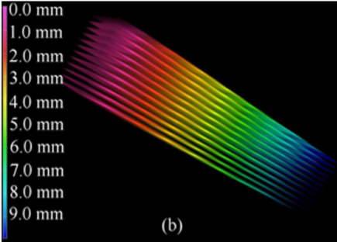
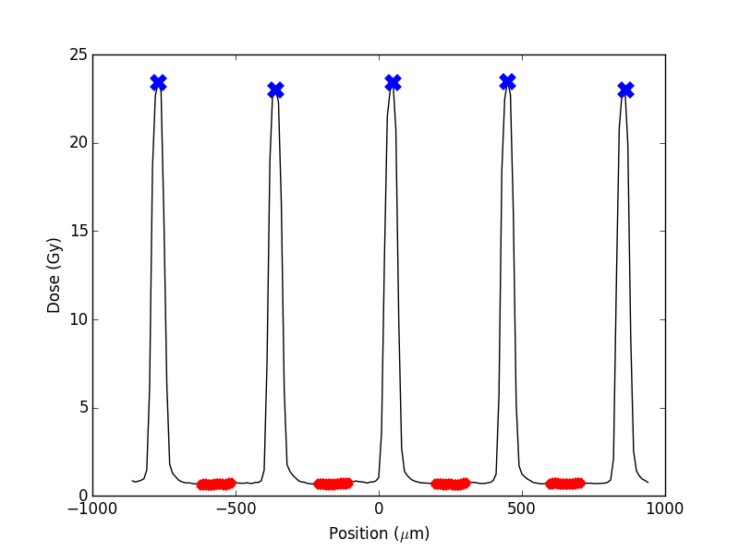
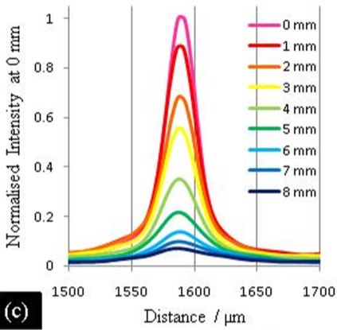
Experimental Mrt dosimetry
1D dose profile
Si strip detector (10 µm thick SV)
University of Wollongong, Australia
PTW microdiamond (1 µm thick SV)
J. Livingstone, et al., Med. Phys., 2016.
Optical fibres (10 µm thick scintillator)
J. Archer, et al., Sci. Rep., 2019.
2D dose distribution
Radiochromic film
J. Crosbie, et al., Phys. Med. Biol., 2008.
S. Bartzsch, et al., Med. Phys., 2015.
A. Ocadiz, et al., Phys. Med., 2019.
And others….
3D dose distribution
Gel dosimeters (PRESAGE)
S. Doran, et al., Phys. Med. Biol., 2013.
F. Gagliardi, et al., Med. Phys., 2015.
And others…
µm beamlets
high dose gradients
high dose rate
keV spectrum

Slide 5
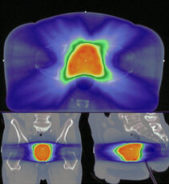
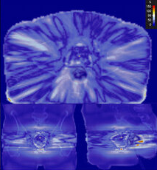
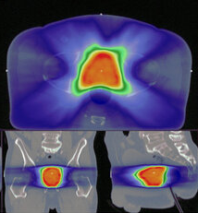
In Vivo Dosimetry: Portal imaging
Prescription
Dose
Agreement / Disagreement
Reconstructed dose

Slide 6
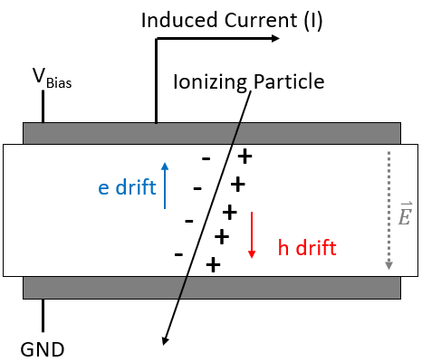
Diamond-based detectors
Diamond satisfies requirements (rapidity, tissue equivalence, radiation resistance)
Operated as a solid ionisation chamber
Front and back metal electrodes deposited via laser lithography
Induced current due to motion of charge carriers in vicinity of electrodes
Shockley-Ramo
$$I=q ⋅ \vec{v_{drift}}⋅\vec{E}$$
I. Zahradnik, PhD Thesis, 2021.
Notes:
Polarisation effects non-existant when photons traverse
€2000 monocristallin Element6
2x moins cher pour polycristallin DDK
Almax easylab Belgique – thinning, polishing
150 = 550 coupé en 2
Lithogragraphie laser metalisation (Al) 100 nm epaisseur
If less – risk of ripping it off during bonding
Higher precision compared to mask

Slide 7
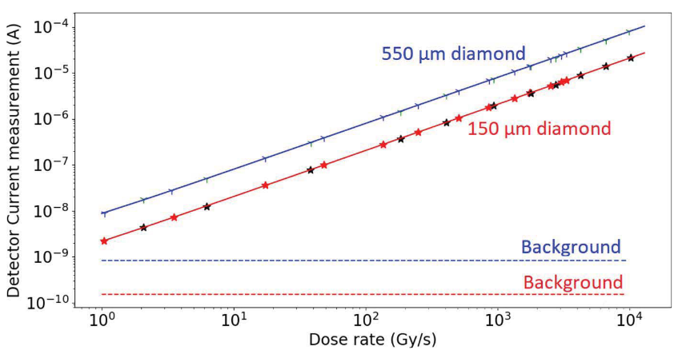
Preliminary tests: Dose rate response
2x monocrystalline CVD diamond detectors 4.5 x 4.5 mm² with Al metallisation
150 µm thick
550 µm thick
Irradiated at ID17 (ESRF) to investigate dose rate dependence in the range
1 – 10⁴ Gy/s
~100% charge collection efficiency measured using ²⁴¹Am 5.5 MeV alpha particles (M. L. Gallin-Martel, et al., Frontiers in Physics, 2021.)

Slide 8
Preliminary tests: Dose rate response
160 kV x-ray tube, 1 Gy/min
95 keV monochromatic x-rays, 0.5 Gy/s

Slide 9
LPSC microstrip diamond detector
8-strip prototype device
550 µm thick monocrystalline CVD diamond
8 strips: 3 mm high, 178 µm wide, 60 µm between adjacent strips
100 nm thick Al metallisation layers
1 V/µm electric field
Guard-ring surrounding strips
Simultaneous integrated charge readout
Aluminium housing with aluminised mylar beam window
LPSC 8-microstrip diamond detector prototype. All measurements in mm.

Slide 10
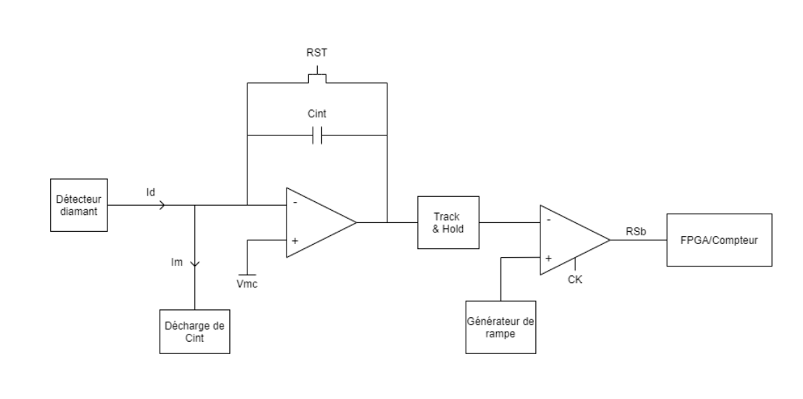
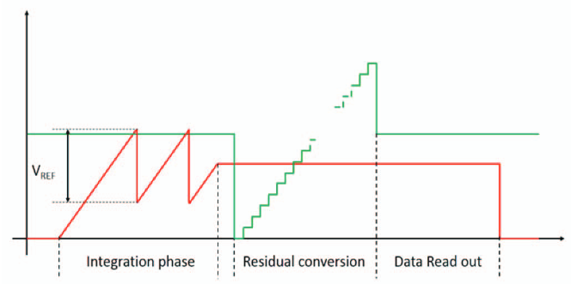
Detector readout
ASIC featuring a charge to digital converter (QDC)
Coarse measurement
DAC accounts for residual charge
Fine measurement
Integration time 1 ms – 100 ms
High dynamic range
10 nA – 100 µA
$$Q=β(CPT+αRES)$$
ASIC QDC
Vint
Vgr
L. Gallin-Martel, LPSC

Slide 11
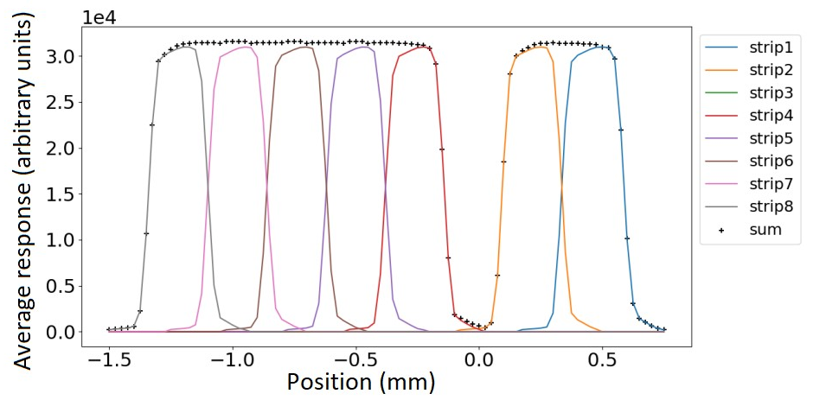
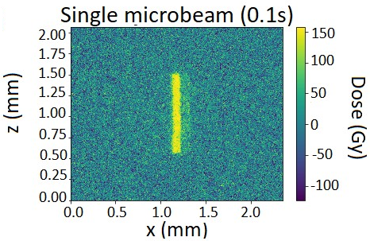
Detector response to single microbeam
A single microbeam (as visualised using Gafchromic ® film, left) was scanned horizontally across the microstrip detector.

Slide 12
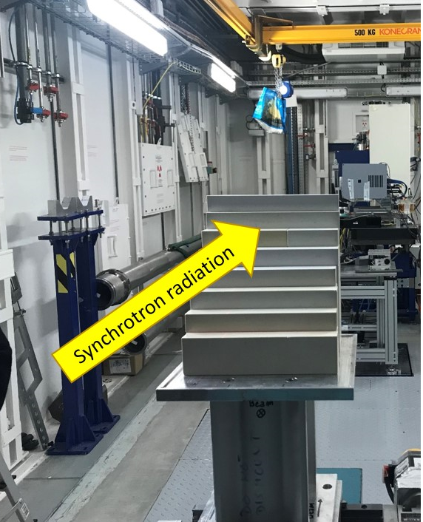
Step phantom: measurements vs Theory
In-beam (E_{ave} = 123.7 keV)
Inter-beam (E_{ave} = 308.0 keV)
$$μ=1.58 ×{10}^{−1} cm^{−1}$$
$$μ=1.22 ×{10}^{−1} cm^{−1}$$
$$μ_{NIST}=1.61 ×{10}^{−1} cm^{−1}$$
$$μ_{NIST}=1.19 ×{10}^{−1} cm^{−1}$$
$$I=I_{0}e^{−µx}$$

Slide 13
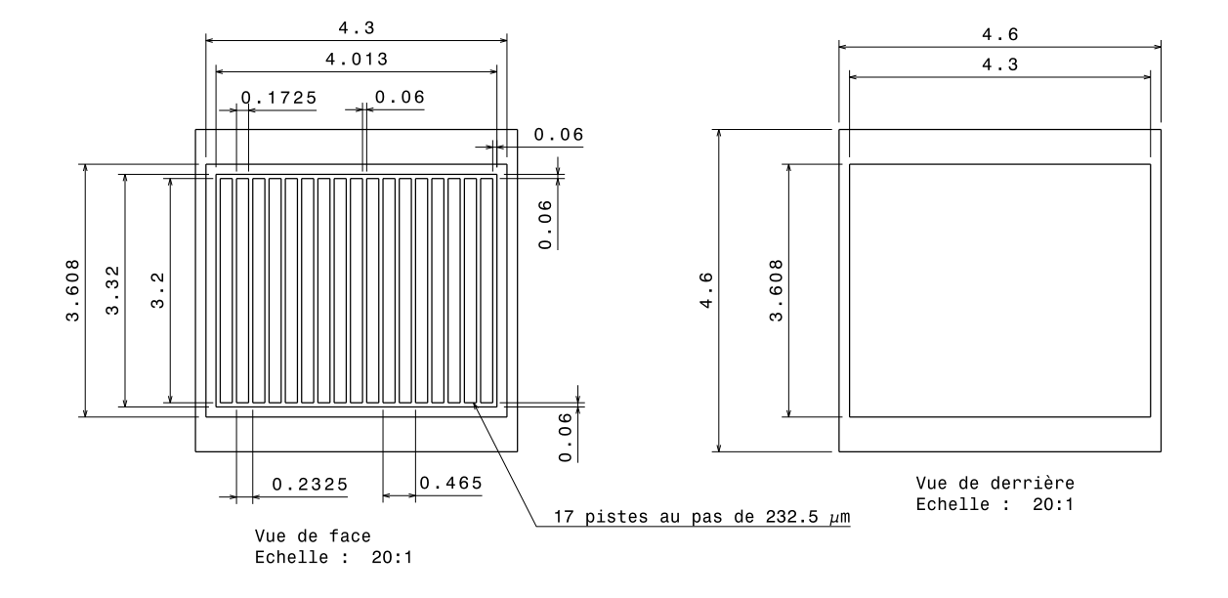
153-Strip detector

Slide 14
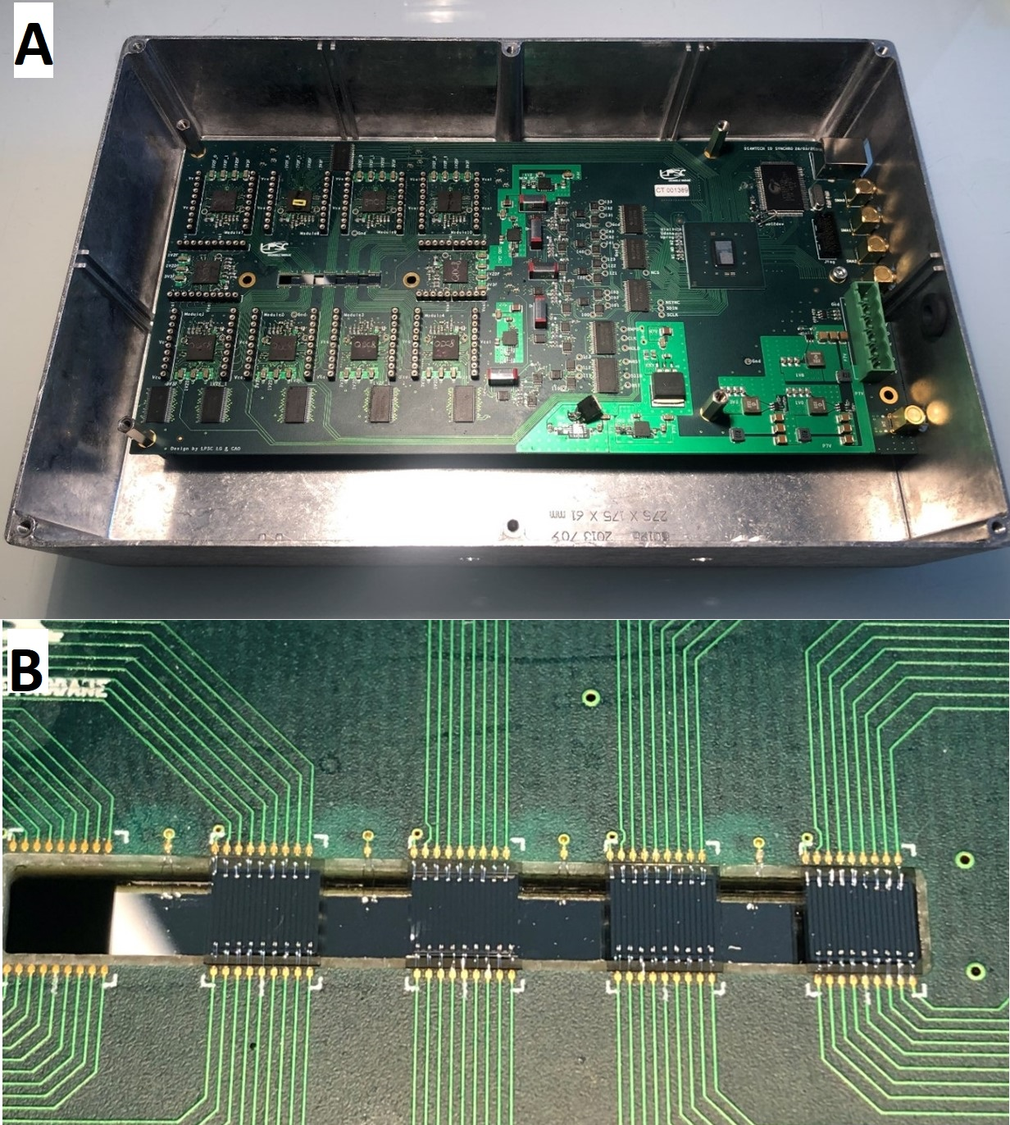
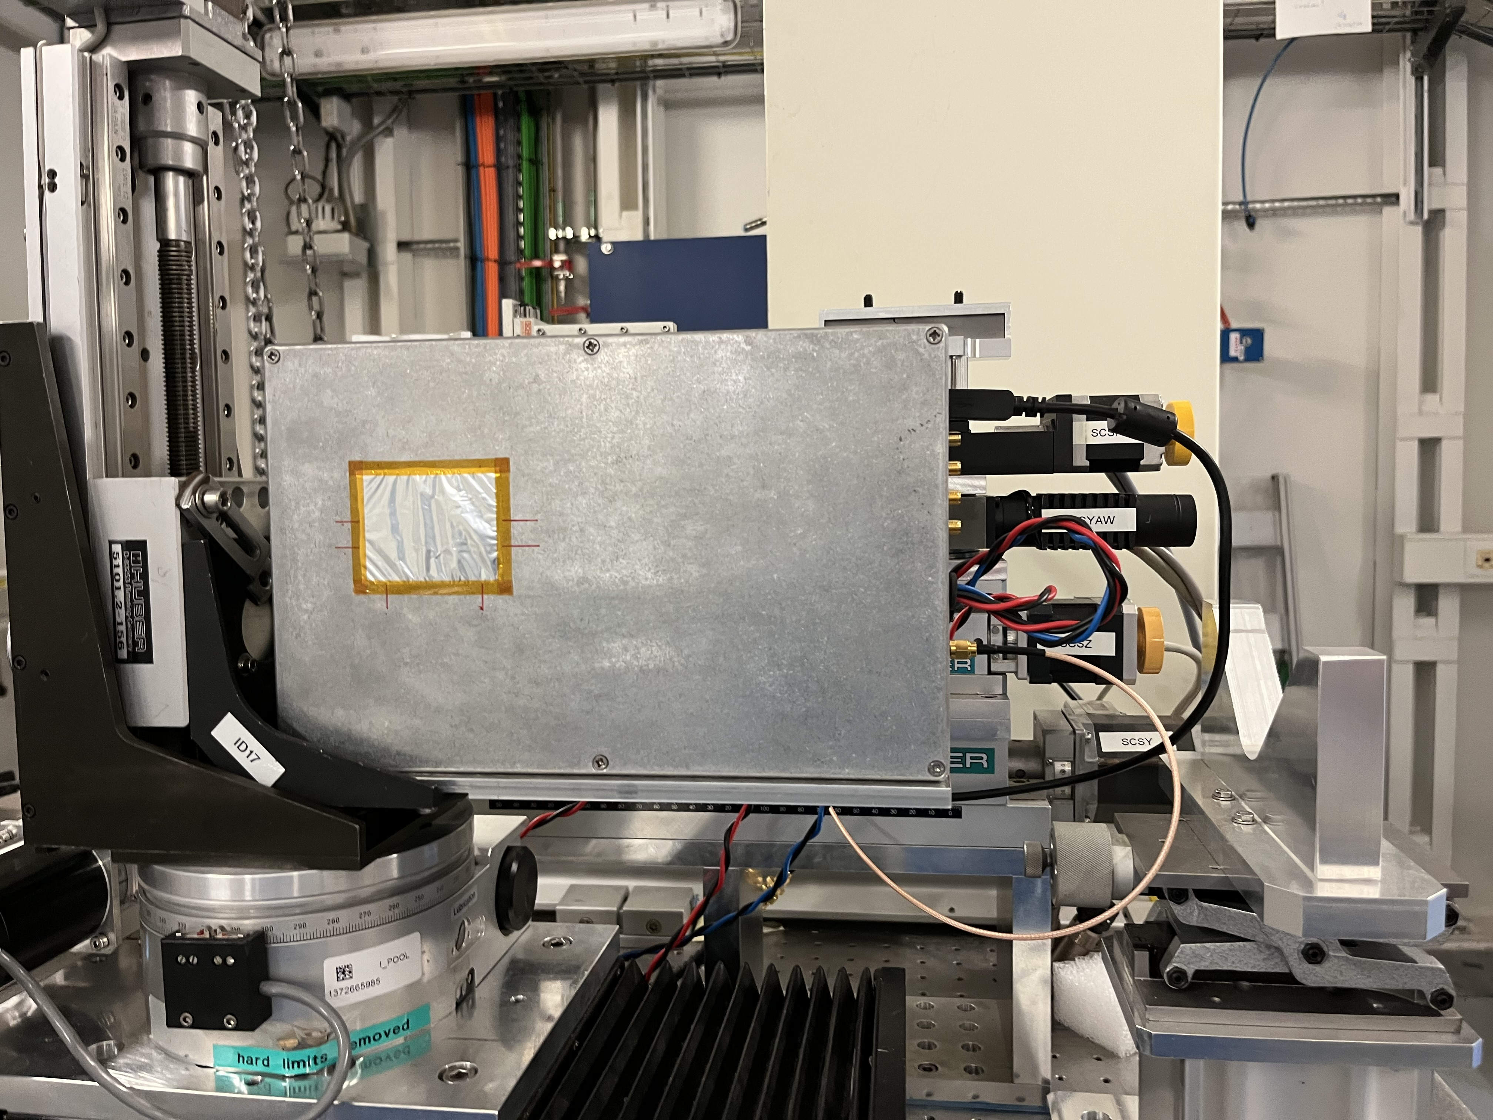
153-Strip detector
Juxtaposition of 9 x 17-strip diamond detectors:
150 µm thick monocrystalline diamond substrate

Slide 15
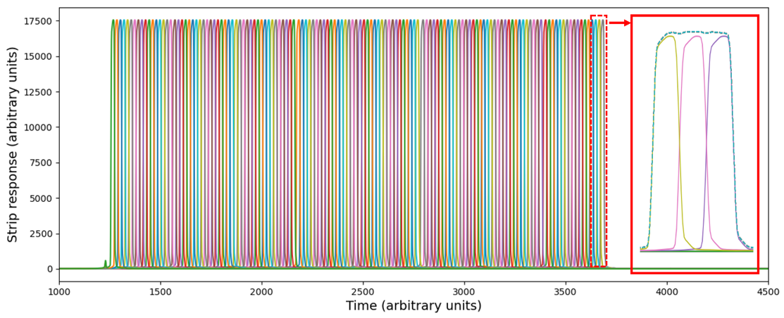
153-Strip detector response

Slide 16
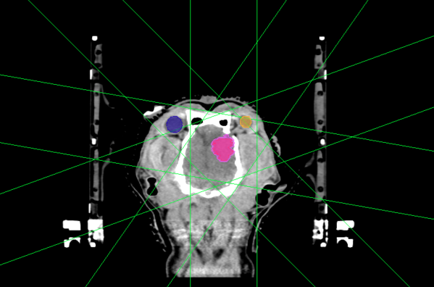
Preclinical and veterinary trials (MRT)
Detector
Preclinical trials (rodents):
Glioblastoma
Epilepsy
Veterinary trials (pet dogs):
Brain tumours

Slide 17
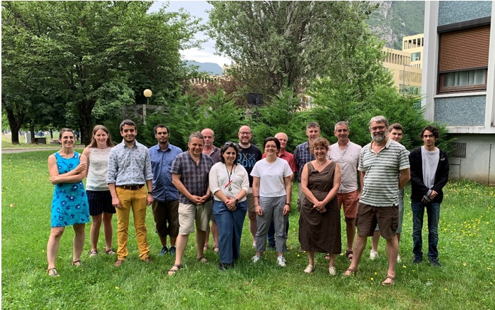
Conclusions
Dose rate linearity over 1 – 10⁴ Gy/s
Homogeneous strip response with no charge loss
Values of µ measured from transmitted beam in good agreement with theoretical values
Next steps:
Analysis of preclinical and veterinary trial data
Full characterisation of 153-strip detector at IMBL, Australian Synchrotron
Development of an upstream detector and dose reconstruction method

