Slide 1
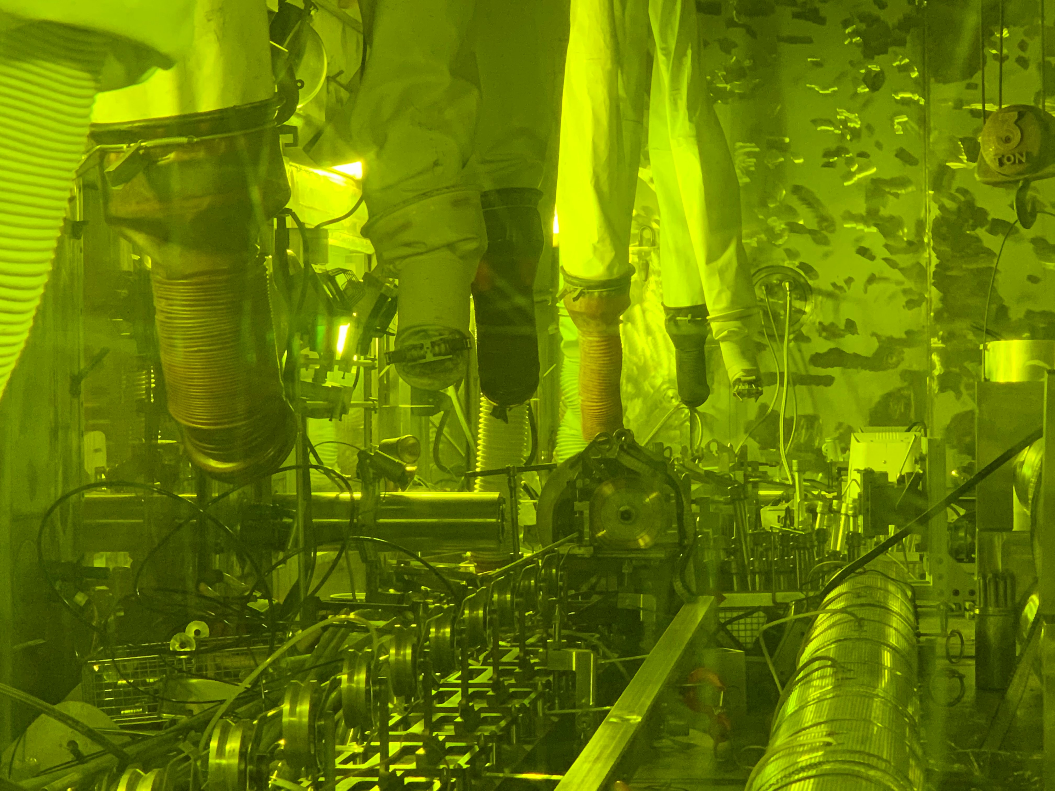



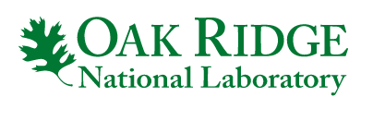
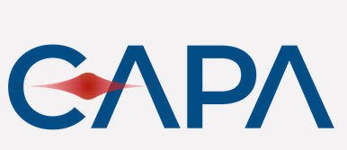
X-ray DEtector Technologies for Physics. XDEP 2024
X-ray fluorescence measurements for Pu accountancy in Spent Nuclear Fuel using hard X-ray reflective optics
  Jaime Ruz^{1,2}, M-A Descalle², K. Schmitt³, J.M. Sharp³ and K. Ziock³
  ¹Centro de Astropartículas y Física de Altas Energías, Zaragoza, Spain
  ²Lawrence Livermore National Laboratory, California, US
  ³Oak Ridge National Laboratory, Oak Ridge, Tennessee, US
LLNL-PRES-859795
This work was performed under the auspices of the U.S. Department of Energy by Lawrence Livermore National Laboratory under contract DE-AC52-07NA27344. Lawrence Livermore National Security, LLC

Slide 2
Outline
Introduction
Experimental Setup
  Facility
  Detector
  Reflective optics
Simulations
Measurements of Spent Nuclear Fuel
  GeGI detector
    MOX
  Point contact coaxial HPGe
    MOX
    Bonus run, WAD-125 (considerably younger fuel)
LLNL-PRES-859795
This work was performed under the auspices of the U.S. Department of Energy by Lawrence Livermore National Laboratory under contract DE-AC52-07NA27344. Lawrence Livermore National Security, LLC
XDEP 2024. J. Ruz, February 6th 2024
1/30

Slide 3
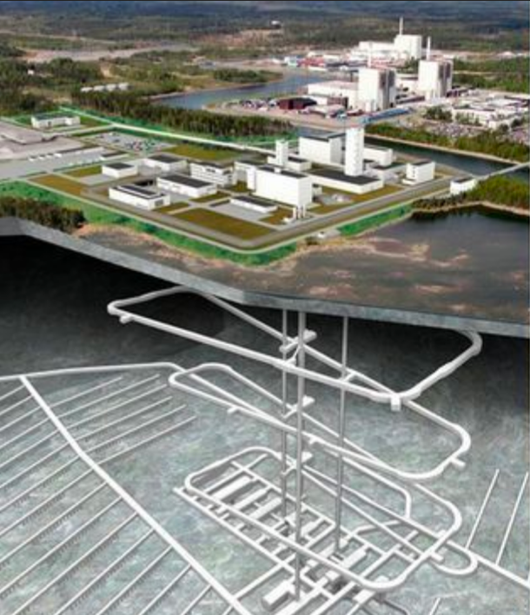
Spent nuclear fuel represents a global challenge
Introduction
Motivation
  It contains Pu which is of concern for safeguards
  It is highly radioactive, making traditional NDA analysis challenging
    Particularly true for weak lines
    Pu content inferred from burnup and model calculations
  Reprocessing Plants
    Receiver-operator differences occur on changing from item accountancy and model-inferred mass to destructive analysis of actual material present
For ‘permanent’ disposal facilities (e.g. Onkalo, Finland)
  Desirable to measure content before closing MC&A books
We are exploring x-ray fluorescence measurements to determine Pu/U ratios
LLNL-PRES-859795
This work was performed under the auspices of the U.S. Department of Energy by Lawrence Livermore National Laboratory under contract DE-AC52-07NA27344. Lawrence Livermore National Security, LLC
XDEP 2024. J. Ruz, February 6th 2024
2/30

Slide 4
K-shell, X-ray fluorescence, we want Pu Ka1:U Ka1
Introduction
Motivation
  The Good:
    X-ray emissions are stimulated by high-energy radiation ejecting a K-shell electron
      > 90% of the time one gets K-shell X-ray emission
      These sit on top of the background continuum
  The Bad
    Pu:U ratio determined by elemental abundances ~ 1%
      High background means very tight collimation and long dwell times
  The Ugly
    Pu Ka1 line (103.7 keV) is just 1.6 keV from ¹⁵⁵Eu nuclear line (105.3 keV)
      Requires excellent energy resolution
      Incommensurate with high event rates
LLNL-PRES-859795
This work was performed under the auspices of the U.S. Department of Energy by Lawrence Livermore National Laboratory under contract DE-AC52-07NA27344. Lawrence Livermore National Security, LLC
XDEP 2024. J. Ruz, February 6th 2024
3/30

Slide 5
Introduction
Research objective
Our ultimate goal: Directly and non-destructively measuring of Uranium and Plutonium content in spent fuel rods.
  Light water reactor spent fuel contains approximately 1% Plutonium and 3% fission products with the remainder Uranium.
  Fission products produce an intense gamma-ray field that obscures the Plutonium gamma rays
    High count rates
    Low intensity of nuclear lines with respect to other radioisotopes
Isotope | Line Energy [keV] | Activity [γ g⁻¹s⁻¹] |  | Isotope | Line Energy [keV] | Activity [γ g⁻¹s⁻¹]
²³⁵U | 143.8 | 8.4 x 10³ |  | ²³⁹Pu | 413.7 | 3.42 x 10⁴
²³⁵U | 185.7 | 4.32 x 10⁴ |  | ²⁴⁰Pu | 160.3 | 3.37 x 10⁴
²³⁹Pu | 129.3 | 1.44 x 10⁵ |  | ²⁴¹Pu | 148.6 | 7.15 x 10⁶
²³⁹Pu | 375.0 | 3.61 x 10⁴ |  | ²⁴¹Pu | 208.0 | 2.04 x 10⁷
LLNL-PRES-859795
This work was performed under the auspices of the U.S. Department of Energy by Lawrence Livermore National Laboratory under contract DE-AC52-07NA27344. Lawrence Livermore National Security, LLC
J. Ruz, February 6th 2024
4/30

Slide 6
Introduction
Research objective
The radioactive decay of the spent fuel also induces fluorescence in the Uranium and Plutonium and produce x-rays ranging from about 94 to 120 keV.
    These x-rays might prove to be useful NDA signature of the Plutonium to Uranium ratio in the spent fuel.
    The Uranium and Plutonium fluorescence have only rarely been measured in solid spent fuel. Need of optimized and collimated detector system
Element U | Line Energy [keV] | Relative Intensity |  | Element Pu | Line Energy [keV] | Relative Intensity
K_{α1} | 98.44 | 100 |  | K_{α1} | 103.76 | 100
K_{α2} | 94.67 | 61.9 |  | K_{α2} | 99.55 | 62.5
K_{β1} | 111.30 | 22.0 |  | K_{β1} | 117.26 | 22.2
K_{β2} | 114.50 | 12.3 |  | K_{β2} | 120.60 | 12.5
K_{β3} | 110.41 | 11.6 |  | K_{β3} | 116.27 | 11.7
LLNL-PRES-859795
This work was performed under the auspices of the U.S. Department of Energy by Lawrence Livermore National Laboratory under contract DE-AC52-07NA27344. Lawrence Livermore National Security, LLC
J. Ruz, February 6th 2024
5/30

Slide 7
Light-water reactor sample spectrum
Introduction
Candy Slide
  30.4 MWd/KgU, 21 months since discharge
  250 mm slit, point contact HPGe, Pu Ka1 is visible, but. . .
U Kα2
U Kα1
¹⁵⁵Eu
U Kβ1
Pu Kα1
U Kβ3
U Kβ2
DIRECT @ 54% deadtime, 2 hours realtime
MIRROR @ 3.8% deadtime, 2 hours livetime
LLNL-PRES-859795
This work was performed under the auspices of the U.S. Department of Energy by Lawrence Livermore National Laboratory under contract DE-AC52-07NA27344. Lawrence Livermore National Security, LLC
J. Ruz, February 6th 2024
6/30

Slide 8
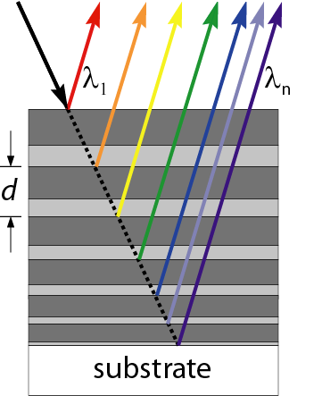

The tool
X-ray mirror
Use multilayer mirrors to selectively pass emission lines unique to Uranium and Plutonium (and filter out most of the other radiation)
Alternating layers of high- and low-Z materials act as reflecting interfaces, following Bragg’s law
For proof of concept we have deposit multilayers coatings of WC/SiC using constant-d spacing (N=300 , d=1.51 nm) on flat surface of 150x150 mm²
θ
Mirror assembly after collimator in a cell wall
Compton-imaging HP Germanium detector (PHDS GeGI) and shielding
Different fluorescence lines will appear at different locations of the detector
Tilting the optic will displace the image of the fluorescence over the face of the detector
θ
m$λ=2∙d sinθ$
Substrate representation
LLNL-PRES-859795
This work was performed under the auspices of the U.S. Department of Energy by Lawrence Livermore National Laboratory under contract DE-AC52-07NA27344. Lawrence Livermore National Security, LLC
J. Ruz, February 6th 2024
7/30

Slide 9
Experimental Setup
Configuration 1
Tungsten
Slit
First Mirror [ε,A]
Collimator
Lead
Direct
beam stopper
Fuel Rod
Collimator
Lead
Detector
Plane
1.5 m
15 cm
7.5 cm
15 cm
Detailed laboratory-based campaign conducted at the Irradiated Fuels Examination Laboratory (IFEL) at Oak Ridge National Laboratory.
The reflective optics were mounted downstream from the 30-inch-long lead collimator with an opening of 5mm x 69.85mm centered on the fuel rod. The 76-cm-long lead collimator was installed in the hot-cell port. An extra collimator with variable aperture was set between the optics and the lead collimation to minimize flux reaching the experimental setup. We also made use of a direct beam stop just in front of our detector.
Several spent fuel rod samples were investigated.
Φ_{Det}≃ Φ_{Rod}·ε·A
Hot Cell Port
lead collimator
LLNL-PRES-859795
This work was performed under the auspices of the U.S. Department of Energy by Lawrence Livermore National Laboratory under contract DE-AC52-07NA27344. Lawrence Livermore National Security, LLC
J. Ruz, February 6th 2024
8/30

Slide 10
Experimental Setup
Configuration 2
Tungsten
Slit
Second Mirror [ε,A]
First Mirror [ε,A]
Collimator
Lead
Direct
beam stopper
Fuel Rod
Collimator
Lead
Detector
Plane
1.5 m
15 cm
7.5 cm
15 cm
Detailed laboratory-based campaign conducted at the Irradiated Fuels Examination Laboratory (IFEL) at Oak Ridge National Laboratory.
The reflective optics were mounted downstream from the 30-inch-long lead collimator with an opening of 5mm x 69.85mm centered on the fuel rod. The 76-cm-long lead collimator was installed in the hot-cell port. An extra collimator with variable aperture was set between the optics and the lead collimation to minimize flux reaching the experimental setup. We also made use of a direct beam stop just in front of our detector.
Several spent fuel rod samples were investigated.
Φ_{Det}≃ Φ_{Rod}·ε²·A
Hot Cell Port
lead collimator
LLNL-PRES-859795
This work was performed under the auspices of the U.S. Department of Energy by Lawrence Livermore National Laboratory under contract DE-AC52-07NA27344. Lawrence Livermore National Security, LLC
J. Ruz, February 6th 2024
9/30

Slide 11
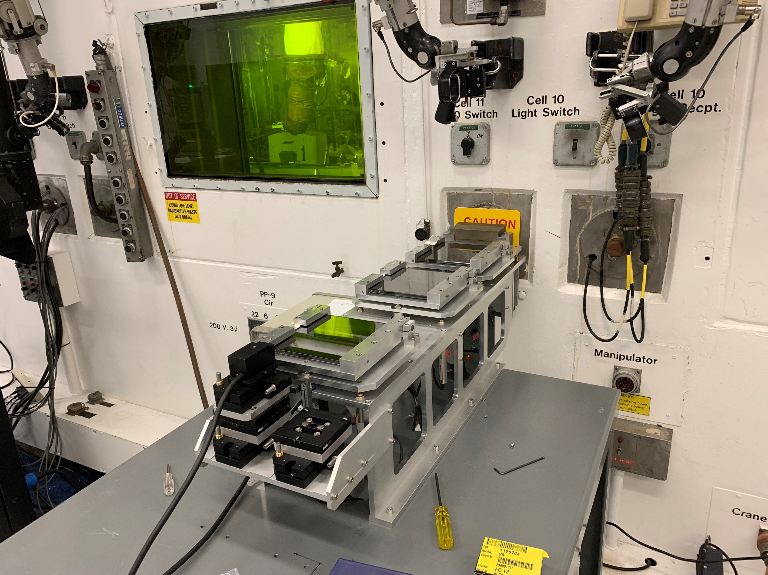
Experimental Setup
LLNL-PRES-859795
This work was performed under the auspices of the U.S. Department of Energy by Lawrence Livermore National Laboratory under contract DE-AC52-07NA27344. Lawrence Livermore National Security, LLC
J. Ruz, February 6th 2024
10/30

Slide 12
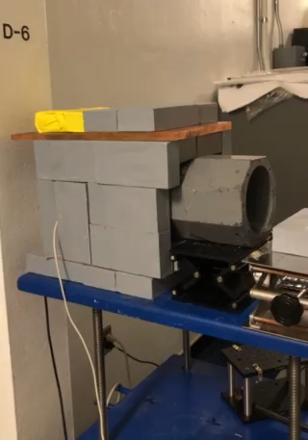

Experimental setup
To locate the reflected beam from the two-mirror reflective optic a GeGI detector was used. Unfortunately, its energy resolution did not allow for Pu to U ratio estimates due to a nearby Eu line.
A 5kg cryogenically cooled point contact coaxial High Purity Germanium (HPGe) was used for the purpose of the measurements.
To minimize background in the detector and improve the signal-to-noise ratio, the detectors were enclosed in ~ 5 cm of lead. Sn and Cu layers were included to reduce lead fluorescence.
Coaxial Germanium
GeGi Detector
LLNL-PRES-859795
This work was performed under the auspices of the U.S. Department of Energy by Lawrence Livermore National Laboratory under contract DE-AC52-07NA27344. Lawrence Livermore National Security, LLC
J. Ruz, February 6th 2024
11/30

Slide 13
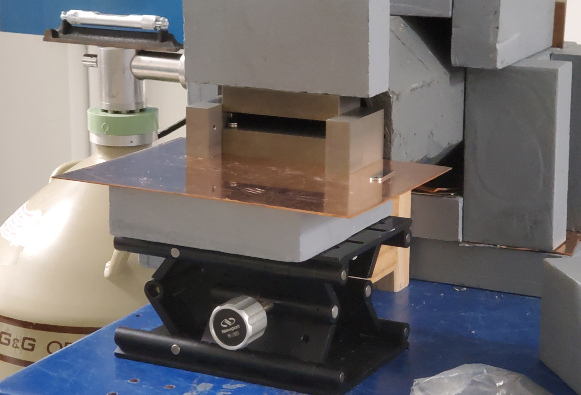
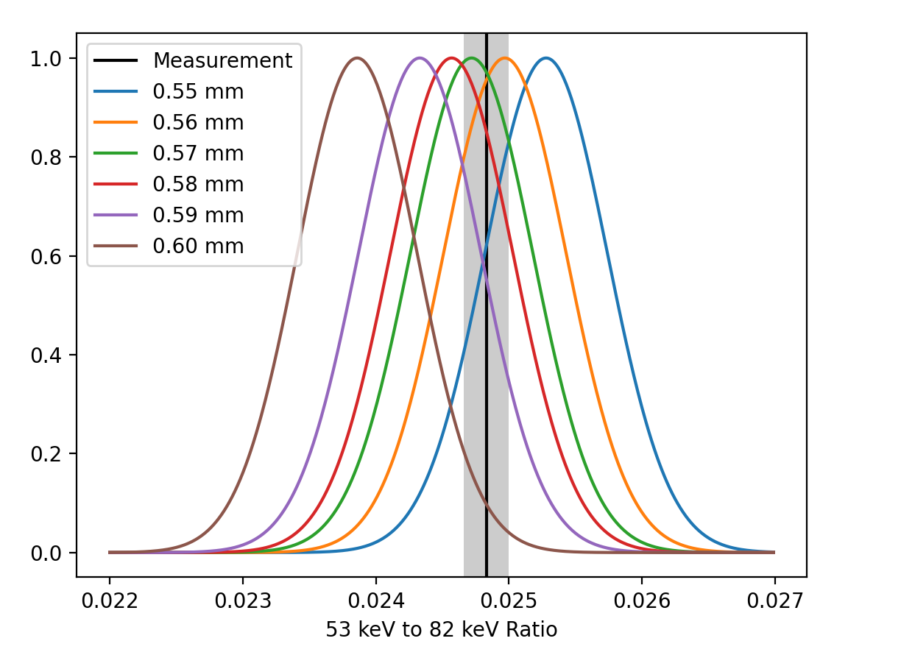
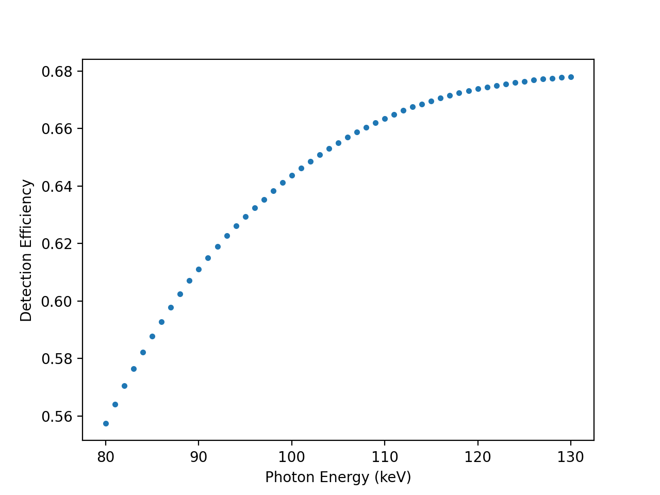
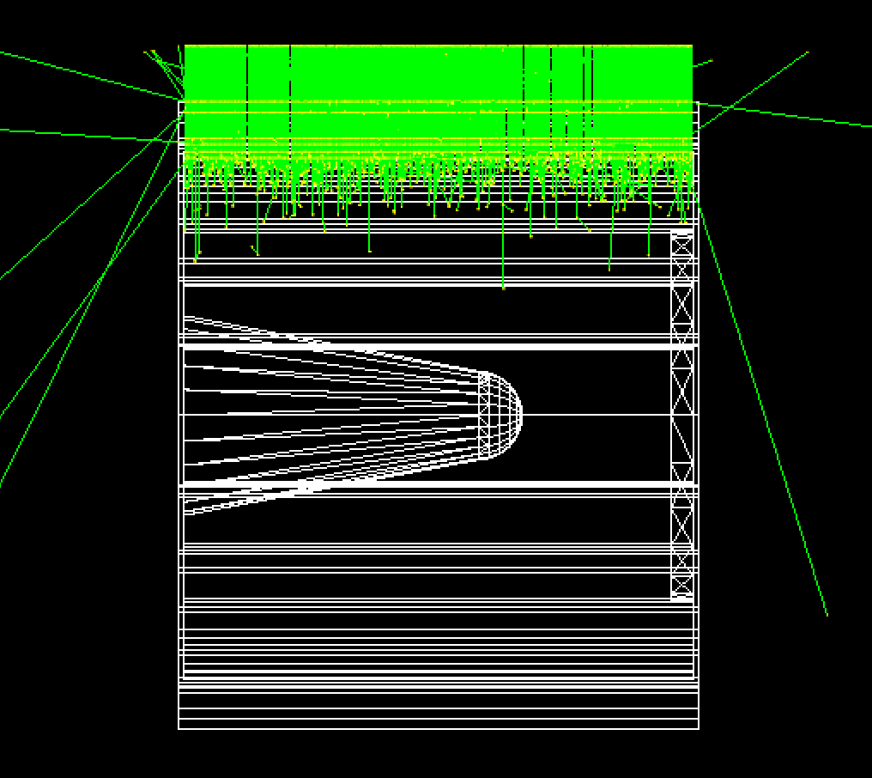
Experimental setup
Detectors
A cryogenically cooled point contact coaxial Hyper pure Germanium with rated FWHM of 700eV at 100keV was used for the purpose of the measurements.
Collimated ¹³³Ba source
623 eV FWHM @ 81 keV
Coaxial Germanium
Efficiency simulations were carried out for the inverted coaxial detector using Geant4. We took measurements with a Ba-133 source to constrain the simulations. We characterize a dead layer of 0.565 ± 0.02 mm thick and efficiency curves for the coaxial germanium detector.
Coax dead layer (top) and efficiency curve (bottom)
LLNL-PRES-859795
This work was performed under the auspices of the U.S. Department of Energy by Lawrence Livermore National Laboratory under contract DE-AC52-07NA27344. Lawrence Livermore National Security, LLC
J. Ruz, February 6th 2024
12/30

Slide 14
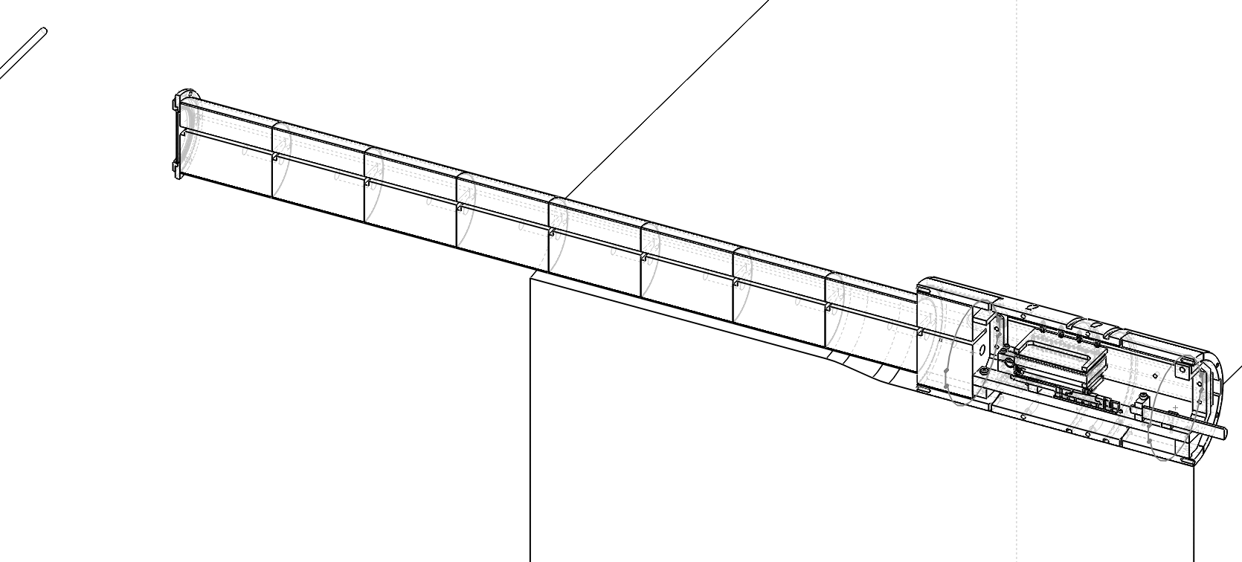
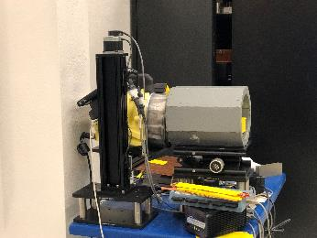
Measurement campaign
Experimental bay
Ray-trace simulations
Measurements
  Direct beam
  Single reflection using M1(θ)
    MOX Center
    Improving s/n ratio by means of shielding
  Two reflections using M1 (θ) & M2 (3θ)
    MOX Center
    Ukα1 and Ukα2 rock
  Single reflection using M1(θ) & M2 (θ)
    MOX Center
MOX fuel rod
Detector
In-wall Collimator
LLNL-PRES-859795
This work was performed under the auspices of the U.S. Department of Energy by Lawrence Livermore National Laboratory under contract DE-AC52-07NA27344. Lawrence Livermore National Security, LLC
J. Ruz, February 6th 2024
13/30

Slide 15
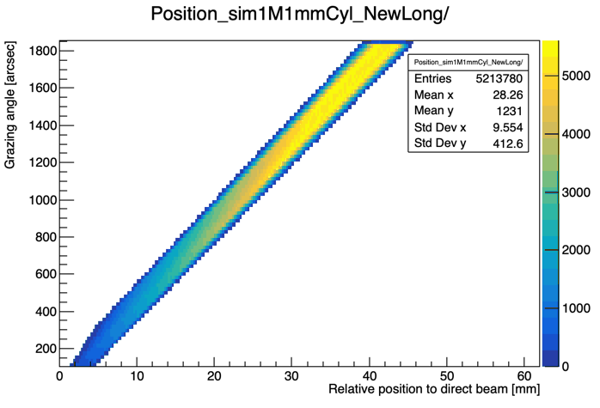
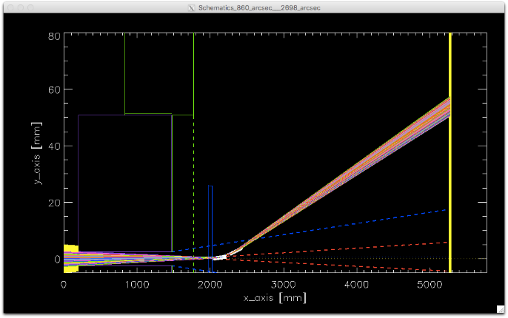
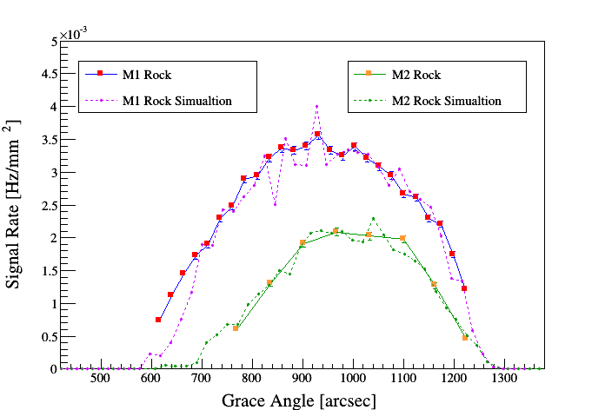
2D ray-tracing simulations enabled cross-checking of observables and guided adjustments in real-time
Ray-trace simulations
Single bounce
Emission spectra
Geometry
Reflectivity
Figure of error
footprint
LLNL-PRES-859795
This work was performed under the auspices of the U.S. Department of Energy by Lawrence Livermore National Laboratory under contract DE-AC52-07NA27344. Lawrence Livermore National Security, LLC
J. Ruz, February 6th 2024
14/30

Slide 16
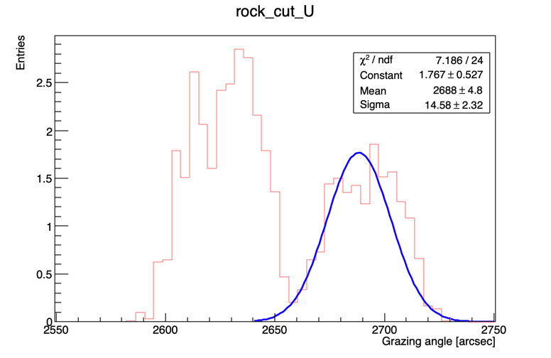
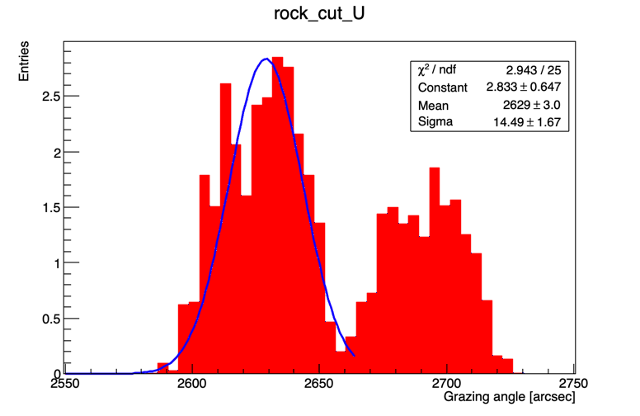
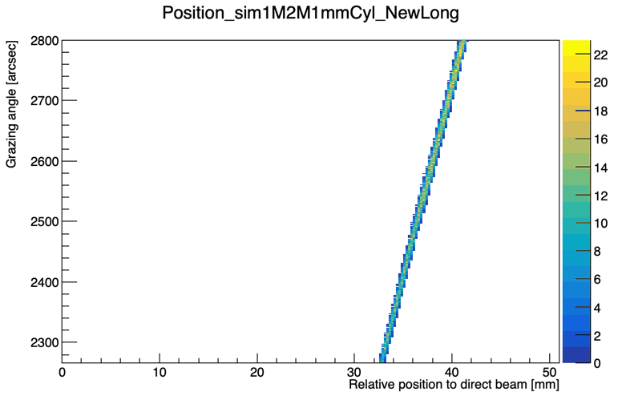


Ray-trace simulations
Double bounce
Simulation M1@860arcsec & M2rock. Energy cut 91-100 keV
Kα1
Lower angle because higher energy
Kα2
Higher angle because lower energy
With M1 fix @ θ, tilting M2 @ 3 θ works as a spectrometer. We can select the energy of the throughput beam.
$$\left(θ_{kα2}−θ_{kα1}\right)\sim 60 arcsec$$
Just 0.016° !!
$$FWHM≅30 arcsec$$
LLNL-PRES-859795
This work was performed under the auspices of the U.S. Department of Energy by Lawrence Livermore National Laboratory under contract DE-AC52-07NA27344. Lawrence Livermore National Security, LLC
J. Ruz, February 6th 2024
15/30

Slide 17

Characterize mirror performance
Measurement campaign
  Align system with position-sensitive, HPGe detector
  Generate “rocking curve”:
  flux vs mirror angle
    For Kα and Kβ
LLNL-PRES-859795
This work was performed under the auspices of the U.S. Department of Energy by Lawrence Livermore National Laboratory under contract DE-AC52-07NA27344. Lawrence Livermore National Security, LLC
J. Ruz, February 6th 2024
16/30

Slide 18
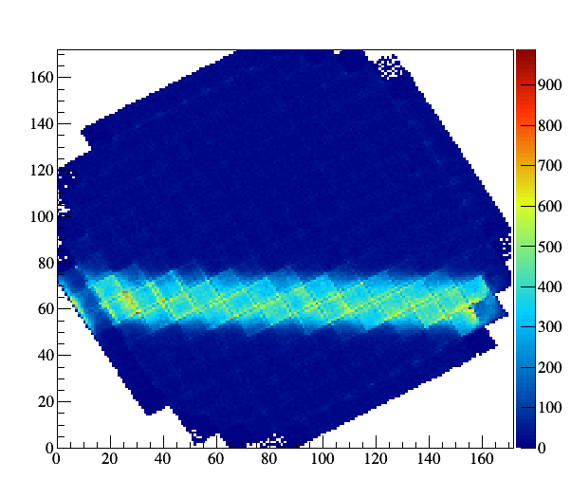
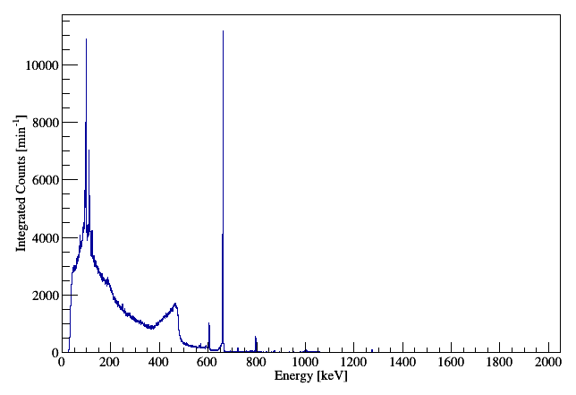
GeGI measurements
Direct Beam Exposure
dwell 500s
Slit @ 500μm
MOX is a very old fuel rod but still compromises the dead time of the detector
¹³⁷Cs
Cumulative plot full energy range
Spectra
LLNL-PRES-859795
This work was performed under the auspices of the U.S. Department of Energy by Lawrence Livermore National Laboratory under contract DE-AC52-07NA27344. Lawrence Livermore National Security, LLC
J. Ruz, February 6th 2024
17/30

Slide 19
GeGI measurements
Direct Beam Exposure
dwell 500s
Slit @ 500μm
MOX is a very old fuel rod but still compromises the dead time of the detector
Fluorescence Complex
¹³⁷Cs
Cumulative plot full energy range
Spectra
LLNL-PRES-859795
This work was performed under the auspices of the U.S. Department of Energy by Lawrence Livermore National Laboratory under contract DE-AC52-07NA27344. Lawrence Livermore National Security, LLC
J. Ruz, February 6th 2024
18/30

Slide 20
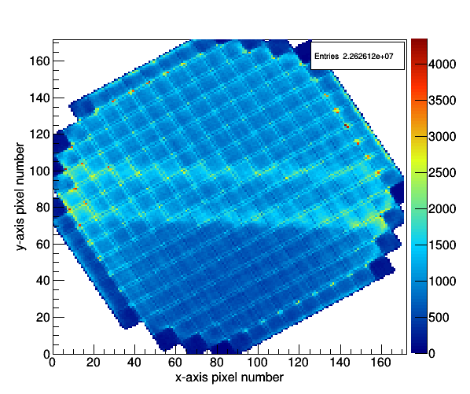
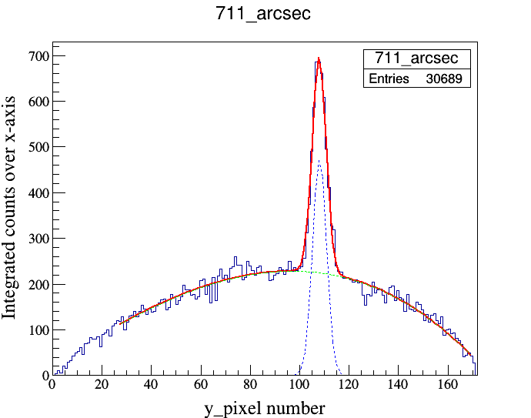
GeGI measurements
M1 at 711 arcsec
dwell 1800s
Slit @ 700μm
We can see at first glance a single reflection
Signal from reflection
Image full energy range
Cumulative events applying Energy cut for events between 91.5 and 103.0 keV
LLNL-PRES-859795
This work was performed under the auspices of the U.S. Department of Energy by Lawrence Livermore National Laboratory under contract DE-AC52-07NA27344. Lawrence Livermore National Security, LLC
J. Ruz, February 6th 2024
19/30

Slide 21
GeGI measurements
M1 at 711 arcsec
dwell 1800s
Slit @ 700μm
We can see at first glance a single reflection
Signal from reflection
Reflected signal
Direct Beam
Image full energy range
Cumulative events applying Energy cut for events between 91.5 and 103.0 keV
LLNL-PRES-859795
This work was performed under the auspices of the U.S. Department of Energy by Lawrence Livermore National Laboratory under contract DE-AC52-07NA27344. Lawrence Livermore National Security, LLC
J. Ruz, February 6th 2024
20/30

Slide 22
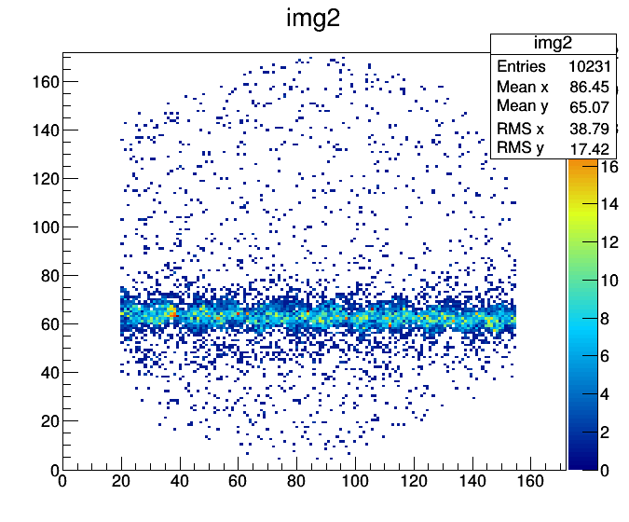
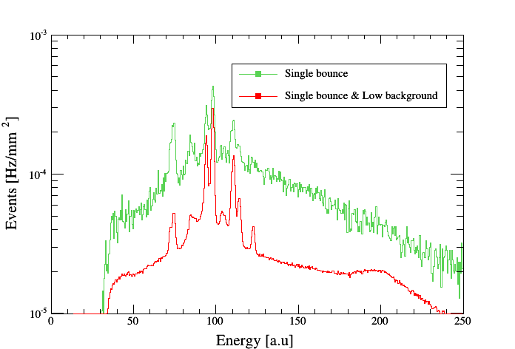

GeGI measurements
M1 at 711 arcsec
dwell xxx
Slit @ 1000μm
$$\left(s/n\right)×3$$
Pu and Eu
Signal in the 90-102 keV energy range
Spectra comparison
θ=711 arcsec θ_{low background}=711 arcsec
T=7200s T_{low background}>24h
LLNL-PRES-859795
This work was performed under the auspices of the U.S. Department of Energy by Lawrence Livermore National Laboratory under contract DE-AC52-07NA27344. Lawrence Livermore National Security, LLC
J. Ruz, February 6th 2024
21/30

Slide 23
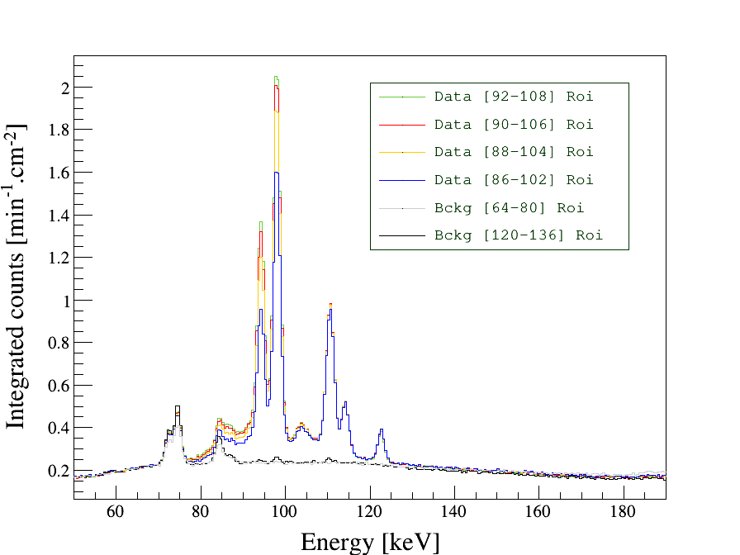
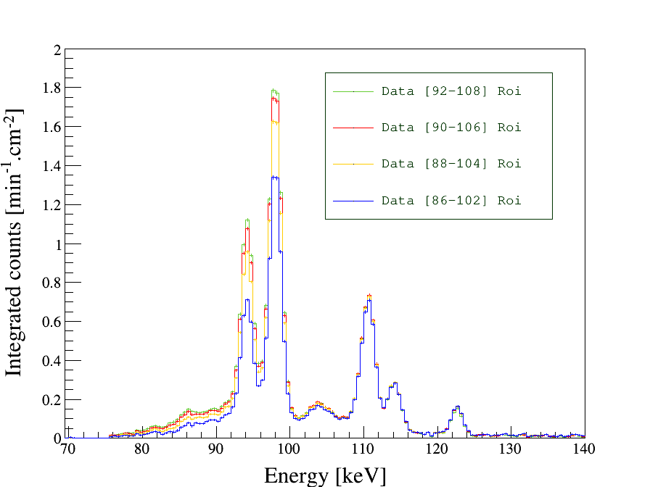
GeGI measurements
M1 at 711 arcsec
dwell >24hs
Slit @ 1000μm
Eu emission 105.30 keV
Pu-kα1 103.76 keV
∆E = 1.54 keV
LLNL-PRES-859795
This work was performed under the auspices of the U.S. Department of Energy by Lawrence Livermore National Laboratory under contract DE-AC52-07NA27344. Lawrence Livermore National Security, LLC
J. Ruz, February 6th 2024
22/30

Slide 24
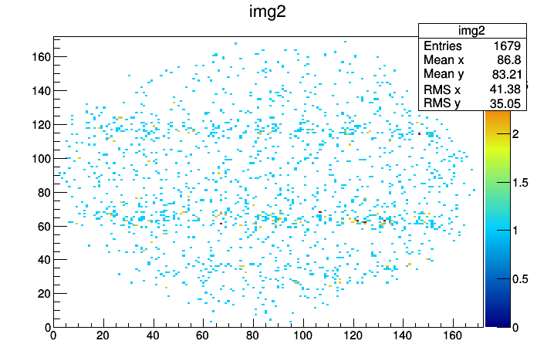
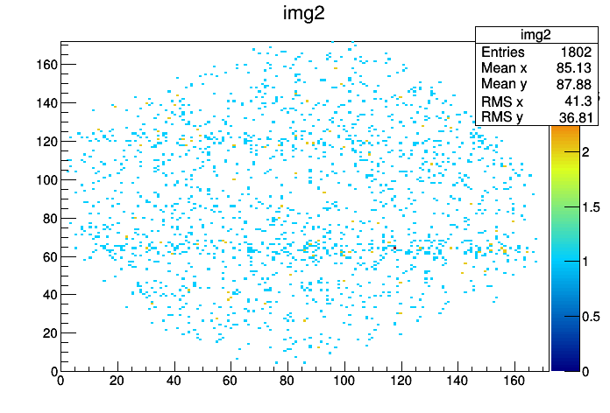
GeGI measurements
M1 at θ and M2 @ 3θ arcsec
dwell 1600s
Slit @ 1000μm
M1&M2 Double Bounce
M1&M2 Double Bounce
M1 Single Bounce Leak
M1 Single Bounce Leak
Image U-kalpha1 Double Bounce
Image U-kalpha2 Double Bounce
LLNL-PRES-859795
This work was performed under the auspices of the U.S. Department of Energy by Lawrence Livermore National Laboratory under contract DE-AC52-07NA27344. Lawrence Livermore National Security, LLC
J. Ruz, February 6th 2024
23/30

Slide 25
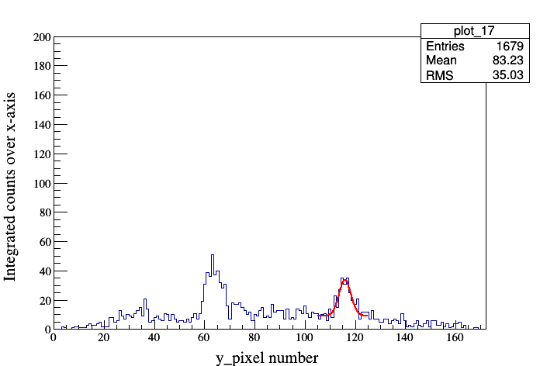
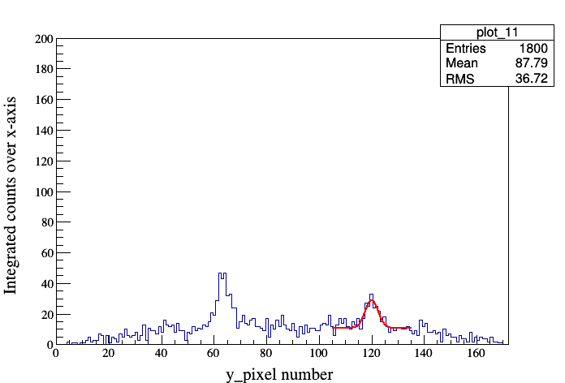
GeGI measurements
M1 at θ and M2 @ 3θ arcsec
dwell 1600s
Slit @ 1000μm
M1 Single Bounce
U-kalpha1
Double Bounce
M1 Single Bounce
U-kalpha2
Double Bounce
Cumulative plot U-kalpha1
Cumulative plot U-kalpha2
LLNL-PRES-859795
This work was performed under the auspices of the U.S. Department of Energy by Lawrence Livermore National Laboratory under contract DE-AC52-07NA27344. Lawrence Livermore National Security, LLC
J. Ruz, February 6th 2024
24/30

Slide 26
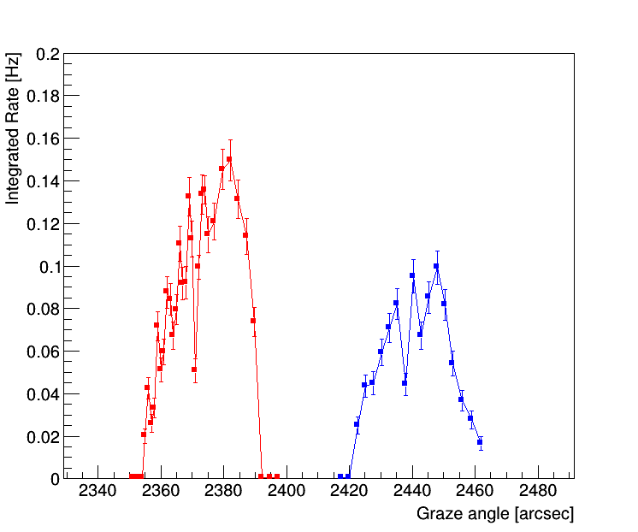
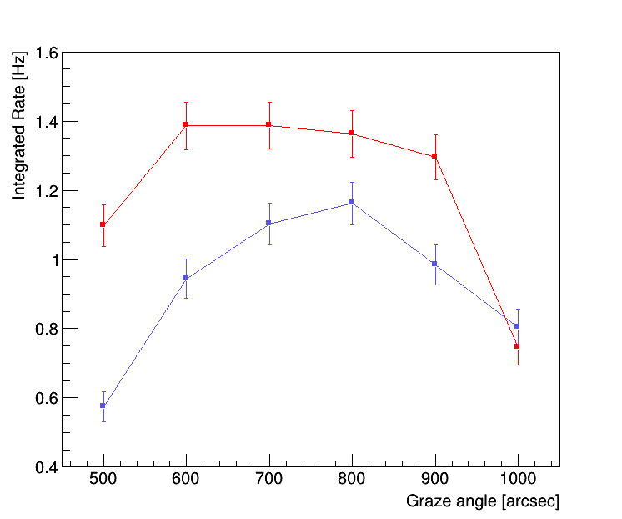
GeGI measurements
M1 at θ and M2 @ 3θ arcsec
dwell 1600s
dwell 300s
U-kalpha1
Double Bounce
Mean @2372 arcsec
U-kalpha2
Double Bounce
Mean @2446 arcsec
Equivalent to a prism mechanism to select different wavelengths
Δµ=74 arcsec
U-kalpha1 Single Bounce
U-kalpha2 Single Bounce
Rate 10%
of Single
Rate 9%
of Single
2 reflections
Rocking plot U-kalpha1 and Ukalpha2
1 reflection
Rocking U-kalpha1 and U-kalpha2
The two mirrors positioned at θ /3θ act as a fine spectrometer.
However, the rates for the stronger K_{α} lines are decreased by a factor of 10.
LLNL-PRES-859795
This work was performed under the auspices of the U.S. Department of Energy by Lawrence Livermore National Laboratory under contract DE-AC52-07NA27344. Lawrence Livermore National Security, LLC
J. Ruz, February 6th 2024
25/30

Slide 27
GeGI measurements
M1 and M2 at 711 arcsec
dwell 1800
Slit @ 1000μm
The GeGI is an imaging detector useful to see the location of the beam
However, the energy resolution is insufficient to resolve the Pu K_{a1} and Eu-155 peaks
It looks like the best strategy is to increase flux in a single reflection configuration while using a high energy resolution co-axial HPGe
Reflected image 90-102 keV energy range for the GeGI detector
Replace the GeGI detector by point contact coax
LLNL-PRES-859795
This work was performed under the auspices of the U.S. Department of Energy by Lawrence Livermore National Laboratory under contract DE-AC52-07NA27344. Lawrence Livermore National Security, LLC
J. Ruz, February 6th 2024
26/30

Slide 28
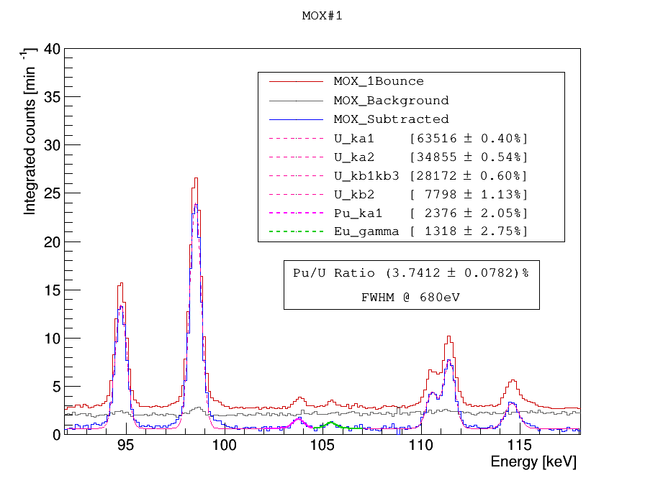
Measurements COAX. MOX Center
Single Bounce with double surface
dwell 28800s
We observe a discrepancy of up to a 50%
dead time in the direct beam measurement as well as skewness of the fluorescence peaks
(not shown)
Eu emission 105.30 keV
Pu-kα1 103.76 keV
∆E = 1.54 keV
Spectra of reflected beam and background run
LLNL-PRES-859795
This work was performed under the auspices of the U.S. Department of Energy by Lawrence Livermore National Laboratory under contract DE-AC52-07NA27344. Lawrence Livermore National Security, LLC
J. Ruz, February 6th 2024
27/30

Slide 29
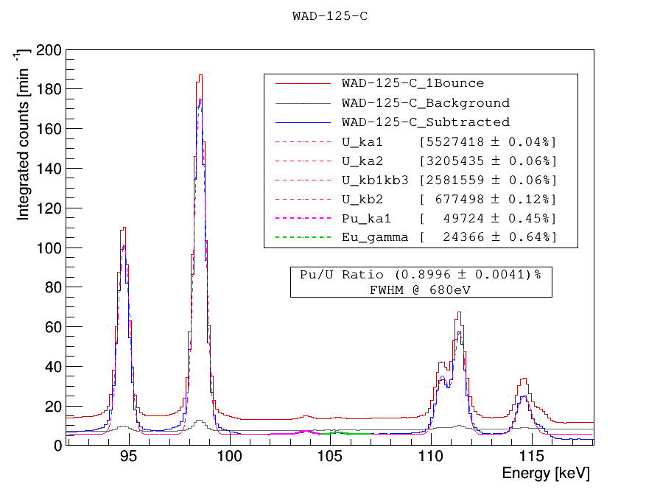
Bonus!! WAD-125 Center
Single Bounce with double surface
  Considerably younger fuel
We observe a discrepancy of up to a 60%
dead time in the direct beam measurement as well as skewness of the fluorescence peaks
(not shown)
Eu emission 105.30 keV
Pu-kα1 103.76 keV
∆E = 1.54 keV
Spectra of reflected beam and background run
LLNL-PRES-859795
This work was performed under the auspices of the U.S. Department of Energy by Lawrence Livermore National Laboratory under contract DE-AC52-07NA27344. Lawrence Livermore National Security, LLC
J. Ruz, February 6th 2024
28/30

Slide 30
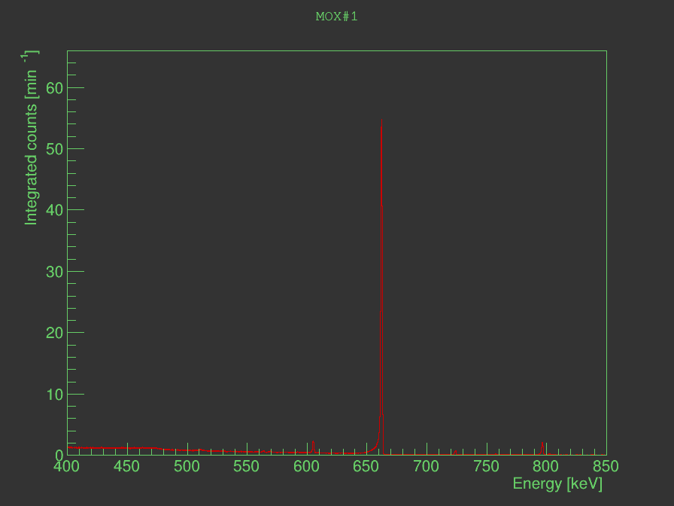
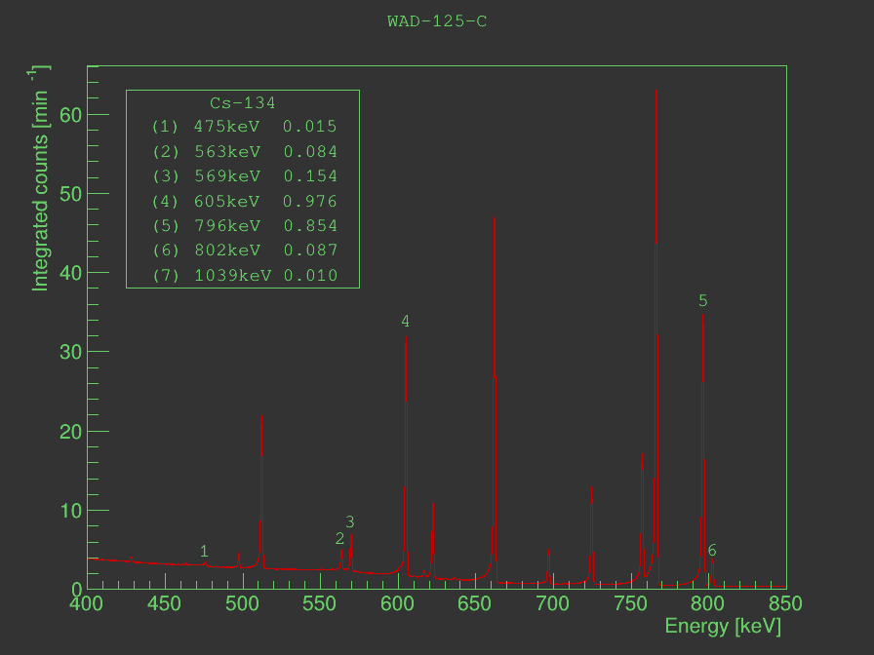
Bonus!! WAD-125 Center vs. MOX
There is ¹³⁴Cs in WAD-125
Half-life ¹³⁴Cs is 2 years
LLNL-PRES-859795
This work was performed under the auspices of the U.S. Department of Energy by Lawrence Livermore National Laboratory under contract DE-AC52-07NA27344. Lawrence Livermore National Security, LLC
J. Ruz, February 6th 2024
29/30

Slide 31
Conclusions
The GeGI is an imaging detector useful to see the location of the beam but, the energy resolution is insufficient to resolve the Pu K_{a1} and ¹⁵⁵Eu peaks
Simulations and data agree that with two reflections we can to scan K_{a1} and K_{a2} but, the measured rate for two reflection is not sufficient to distinguish between Pu and ¹⁵⁵Eu
Placing a coaxial point contact HPGe in the reflected beam (same location and shielding as for the GeGI) allows for much better energy resolution.
We are able to determine Pu/U ratio with very low statistical uncertainty. We could set the dwell based on the statistical uncertainty goal. For instance, with the MOX fuel a 0.5% statistical uncertainty will need of 600s dwell time.
LLNL-PRES-859795
This work was performed under the auspices of the U.S. Department of Energy by Lawrence Livermore National Laboratory under contract DE-AC52-07NA27344. Lawrence Livermore National Security, LLC
J. Ruz, February 6th 2024
30/30

