Slide 1
Absolute calibration of monochromatic photons fluxes Application to the efficiency calibration of detectors
Marie-Christine Lépy, Yves Ménesguen, Víctor H. Elvíra
Laboratoire national Henri Becquerel (LNHB)
CEA Saclay - DRT/LIST/DIN/SIMRI/LNHB-MA

Slide 2
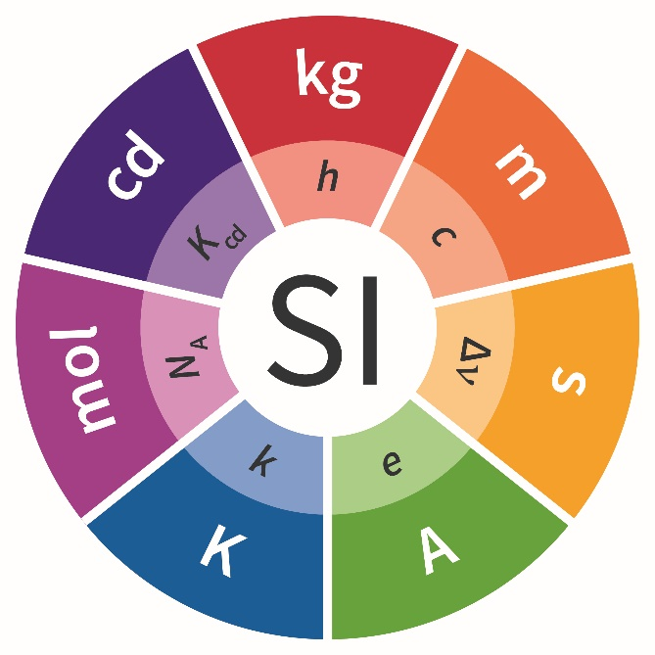
Context - Metrology
To ensure quality, every measurement must be traceable to the International System of Units (SI) via reference standards.
The BIPM is the international organization established by the Metre Convention (1875), through which Member States act together on matters related to measurement science and measurement standards.
https://www.bipm.org/en/
Mission: international and impartial status to promote and advance the global comparability of measurements for:
scientific discovery and innovation,
industrial manufacturing and international trade,
improving the quality of life and sustaining the global environment.

Slide 3
Context - Metrology
National Metrology Institutes (NMI) – intercomparisons - redundancy
LNE (Laboratoire National de métrologie et d’Essais): pilot of the French metrology
- several designated institutes for the different units
LNHB (Laboratoire national Henri Becquerel): in charge of ionising radiation
- radioactivity measurements (environment, nuclear power plants, radon, etc.)
- dosimetry (medical applications)
- caracterisation of radioactive and X-ray sources (X-ray tubes, electron beams, etc.)
- calibration of detectors (efficiency, response function)

Slide 4
Outline
Goal: determine the absolute photon flux intensity (s⁻¹)
(independently from atomic or nuclear data)
Cryogenic detector
BOLUX
Electrical substitution principle
Calibration setup
Measurement procedure
Correction factors
Results
Efficiency calibration of photodiodes
Efficiency calibration of energy-dispersive spectrometers
Application to the measurement of fluorescence yields
Conclusion & perspectives

Slide 5
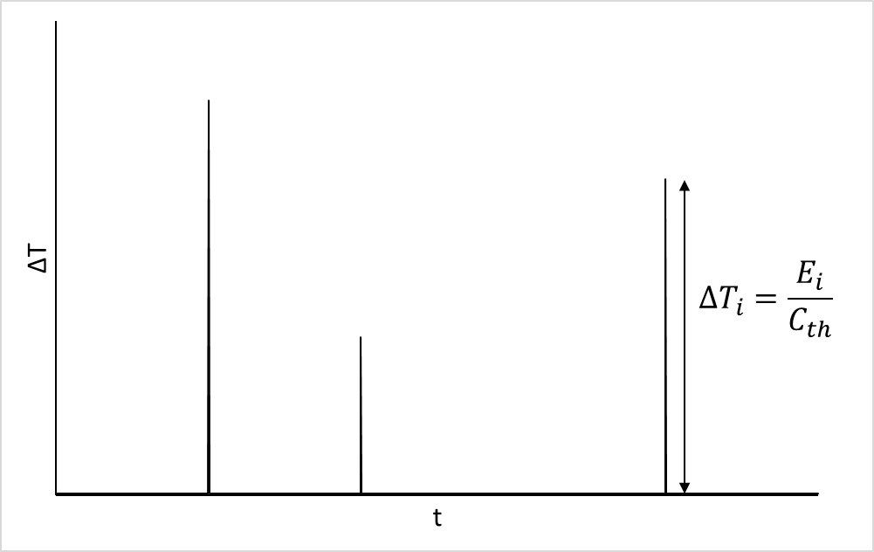
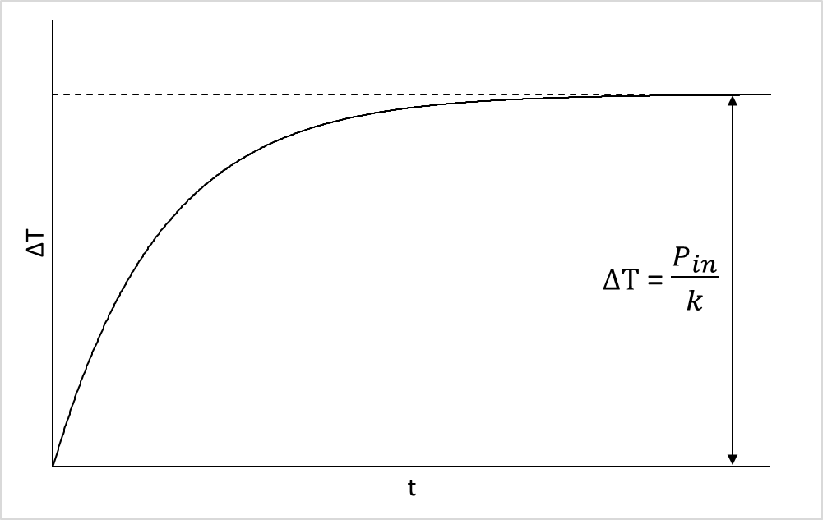
Cryogenic detectors
The incident x-ray beam in the absorber induces a temperature increase, ΔT, proportionnal to the incident energy
Pulse mode
Continuous mode
T = ~ mK
T = 4K
Application: spectroscopy
Application: bolometry
high-intensity flux measurement

Slide 6
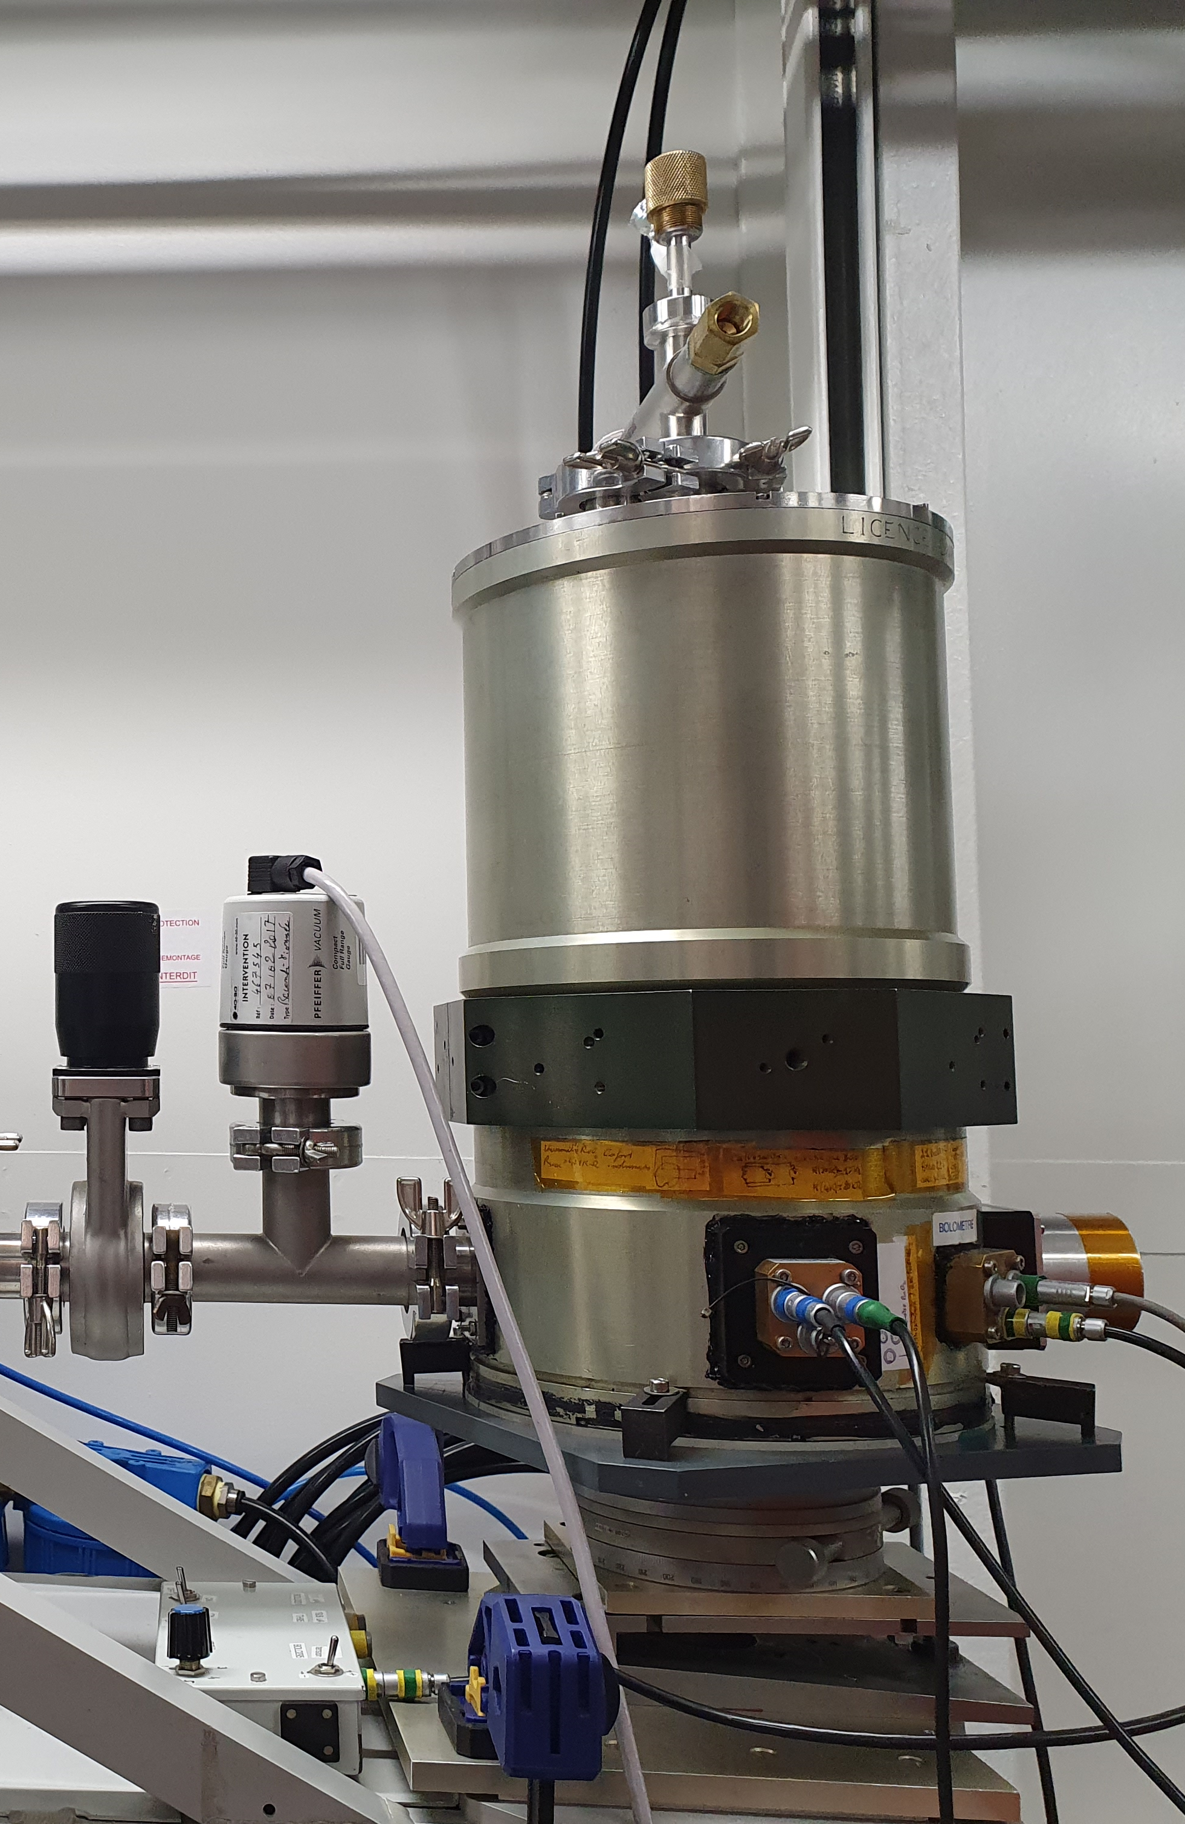
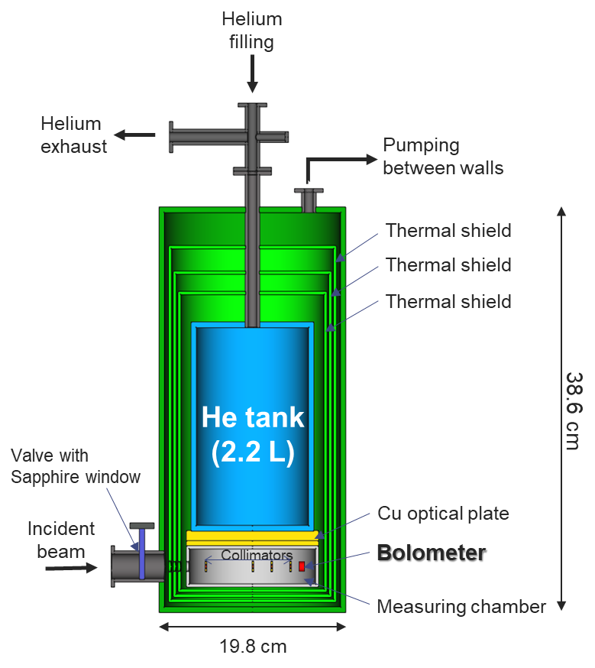
BOLUX - BOLometer for Use in the range of X-rays

Slide 7
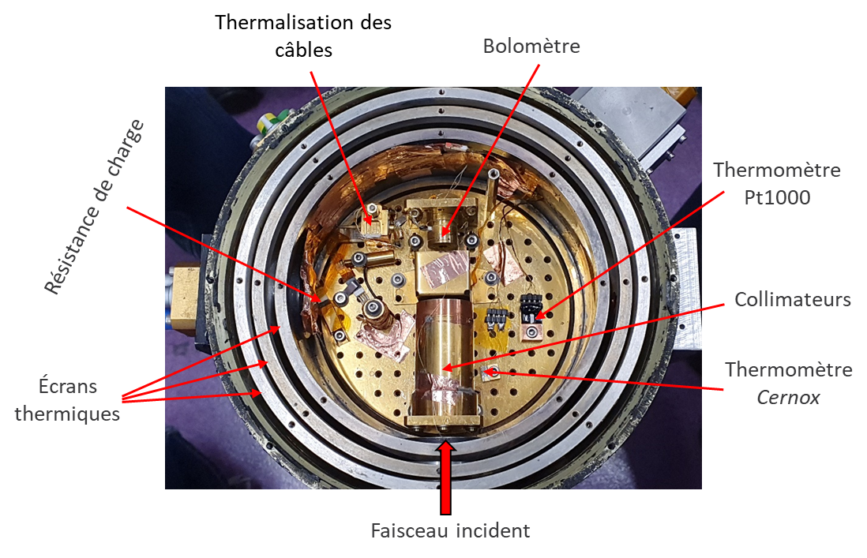
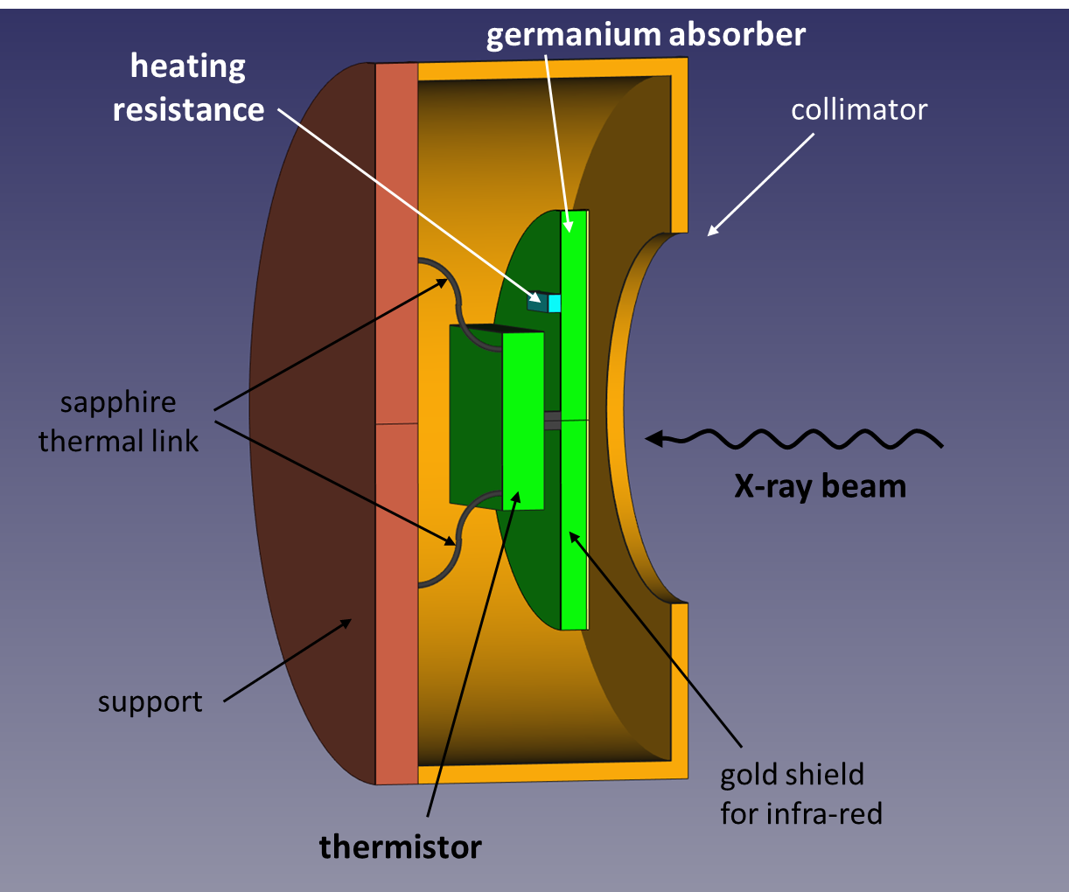
BOLUX - BOLometer for Use in the range of X-rays
Cryostat
Measurement chamber
Bolometer
Wires thermalisation
bolometer
Thermometer Pt1000
Load resistor
Collimators
Thermal screens
Thermometer cernox
Incoming flux

Slide 8
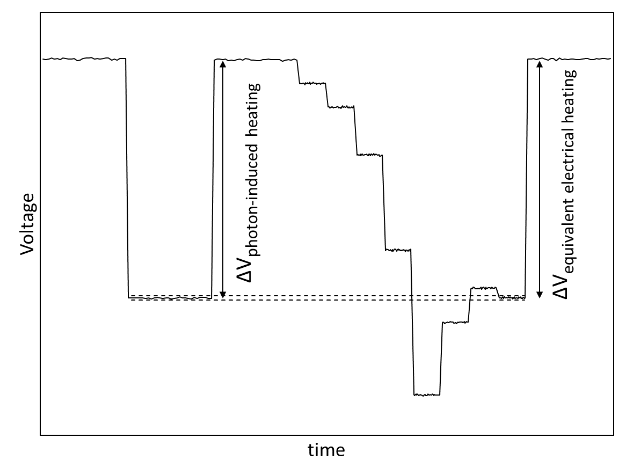
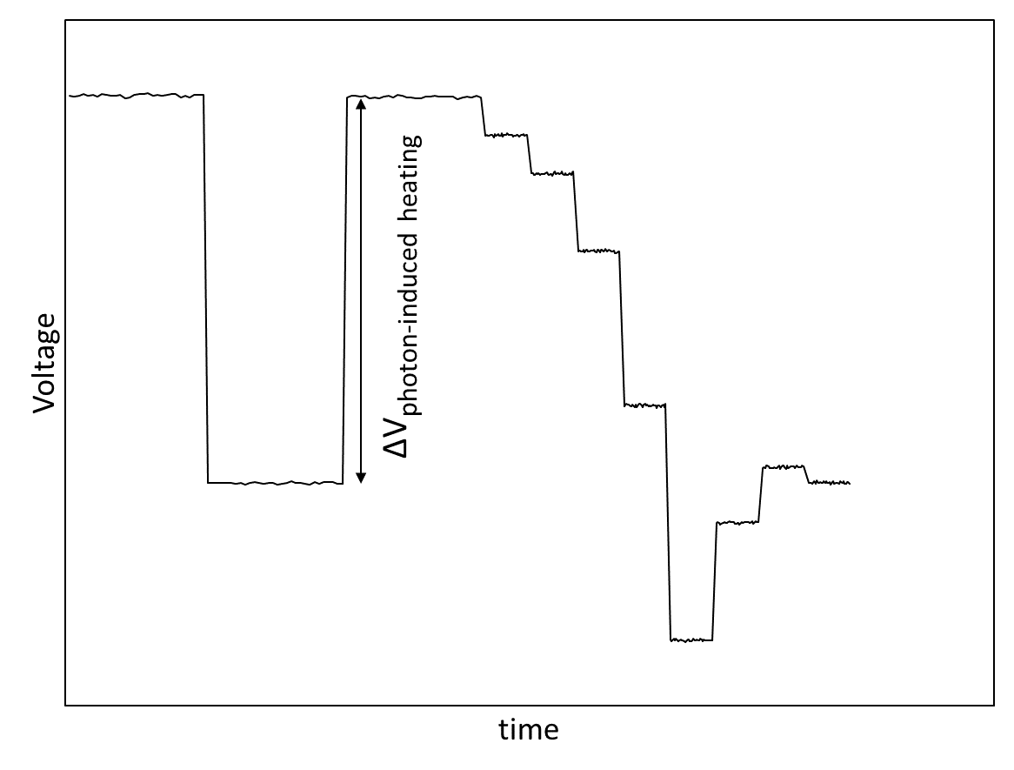
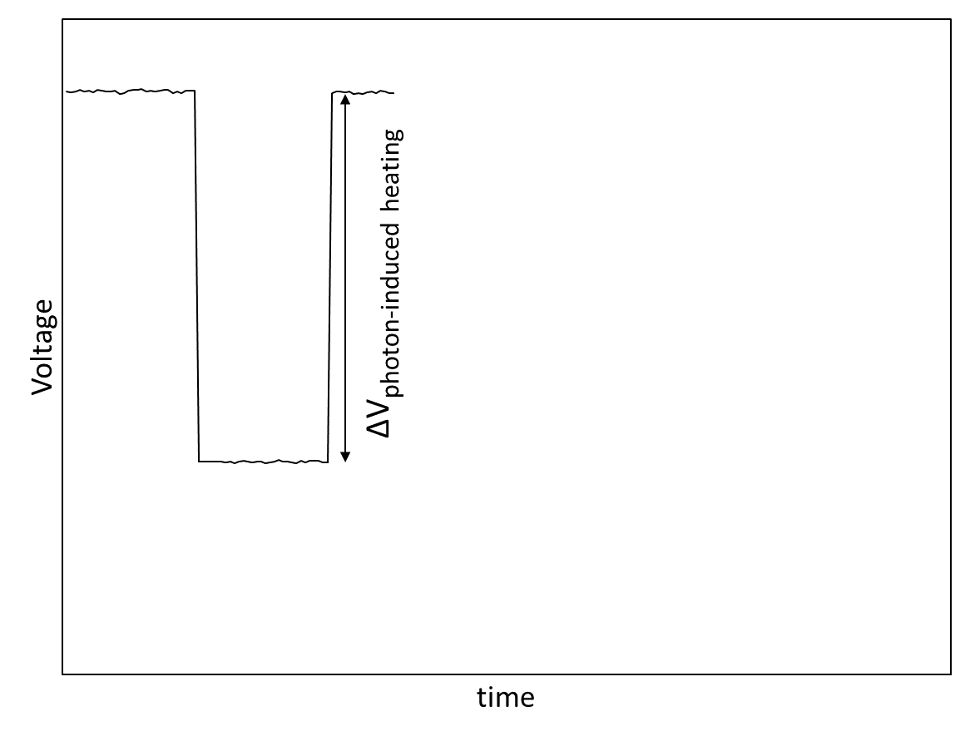
Electrical substitution principle
A thermistor with thermal link to the absorber is polarized (constant current)
The heating process (due to the radiant power) reduces the thermistor electrical resistance thus decreasing voltage.
The energy deposited by the radiation is known by finding the electrical power that needs to be transferred to the absorber in order to obtain the same temperature change (voltage).
Chauffage induit par rayonnement
Voltage
Voltage
Voltage
Tension
Radiant power matched by electrical power
Beam open
Beam stopped
η$P_{rad}=RI^{2}$

Slide 9
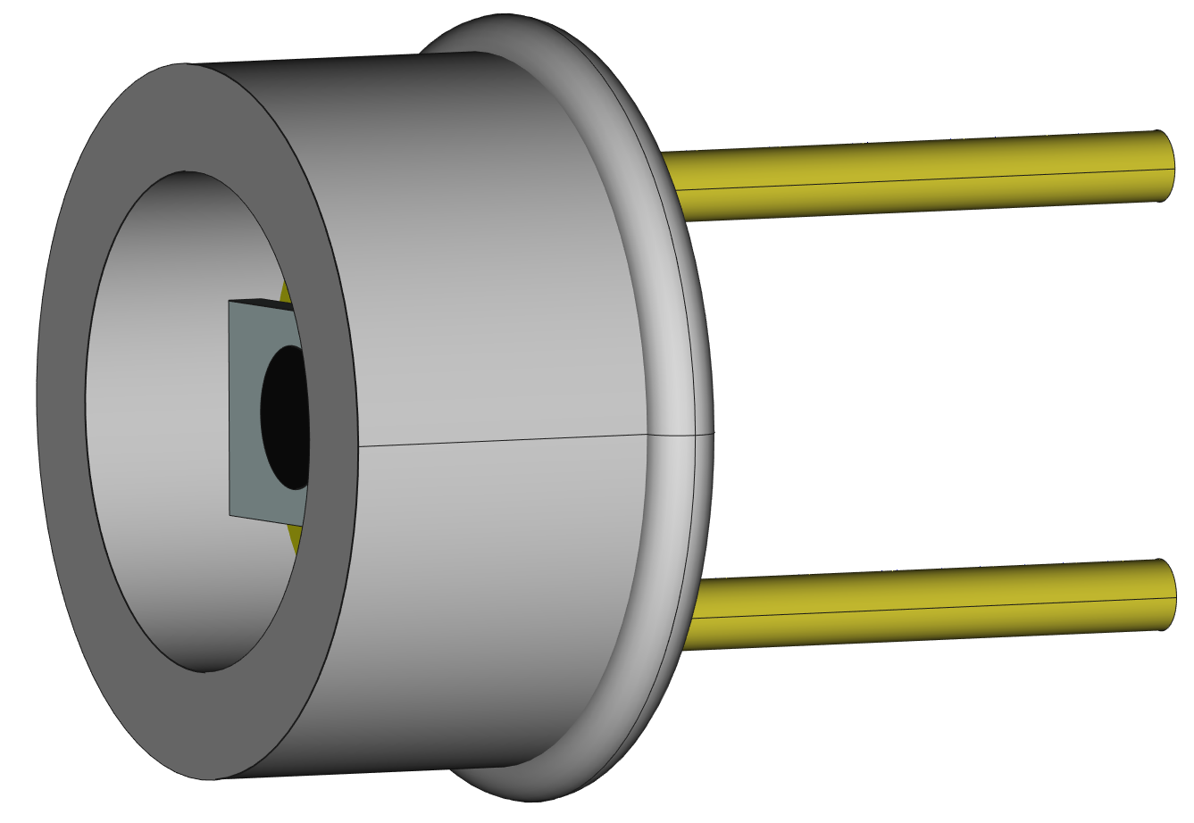
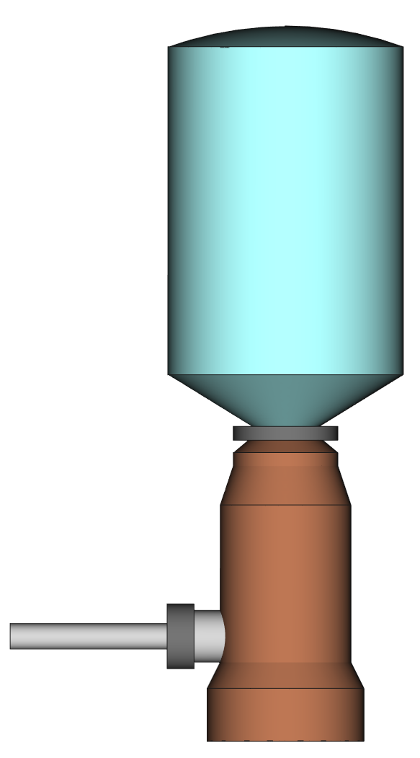
Calibrating detectors
1st step, with a high photon flux (~ 10⁹ s⁻¹)
BOLUX
Measurement of the beam power $P(W)$
Efficiency (responsivity)
of the photodiode
The efficiency of both BOLUX and the photodiode depend on the photon energy
but neither of them are able to discriminate photons by energy
Photodiode
Measurement of the current induced
BOLUX
Measurement of the beam power
+
$${Ef}_{diode}\left(A∙W^{−1}\right)= \frac{I_{diode}(A)}{P(W)}$$
Photodiode
Measurement of the current induced $I_{diode}(A)$
Incident X-ray beam
Incident X-ray beam
2nd step, with a lower photon flux (~ 10⁴ s⁻¹)
Photodiode
Measurement of incident photons rate, $N_{i}(E)$
Photodiode
Measurement of the incident photons count rate
Detection efficiency of the energy-dispersive spectrometer
+
Semiconductor detector
Measurement of the detected count rate
$$N_{s }(E)$$
Monochromatic radiation
Semiconductor detector
Measurement of detected count rate, $N_{S}(E)$
$${Ef}_{S}(E)=\frac{N_{S}(E)}{N_{i}(E)}$$
$$N_{i}\left(E\right)= \frac{I_{diode}}{{Ef}_{diode}{∙E}_{photon} }$$

Slide 10
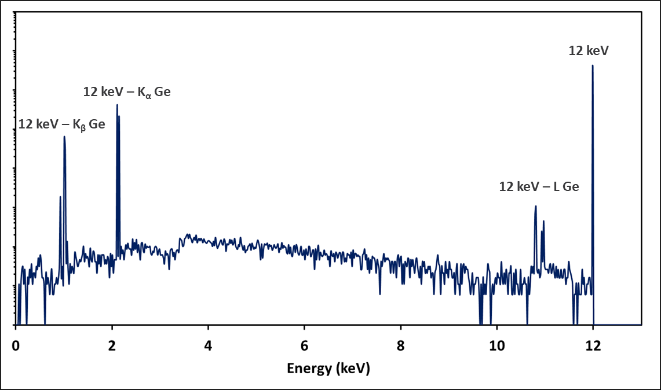
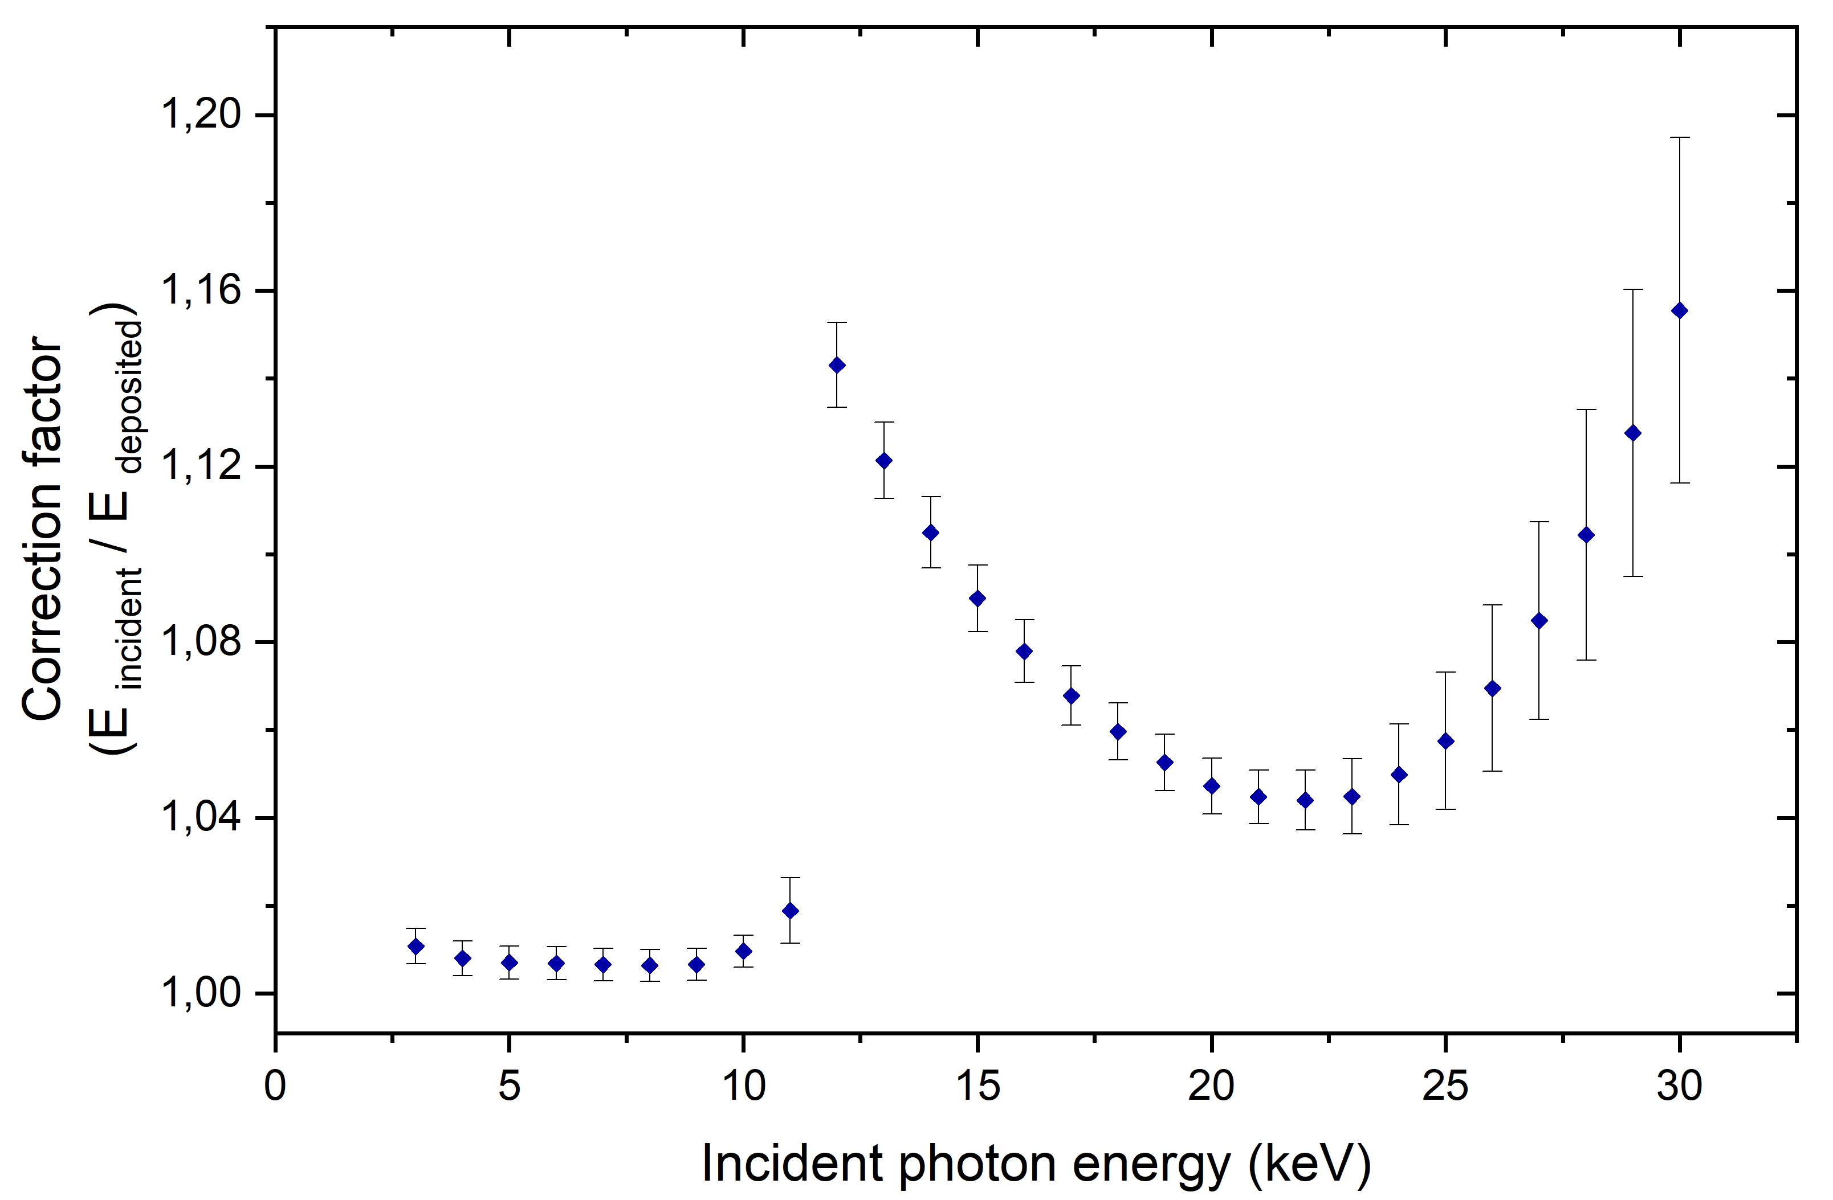
BOLUX : correction factor
Average energy deposited in the absorber per incident photon < 100 % due to:
Photons that do not interact with the absorber (transmission)
Photons that do interact but do not deposit all of their energy
Characteristic X-ray escape
Scattering
Energy (keV)
Énergie/keV
Monte-Carlo simulations
PENELOPE
PENetration and ENergy LOss of Positrons and Electrons *
* F. Salvat, OECD/NEA Data Bank (2015)

Slide 11
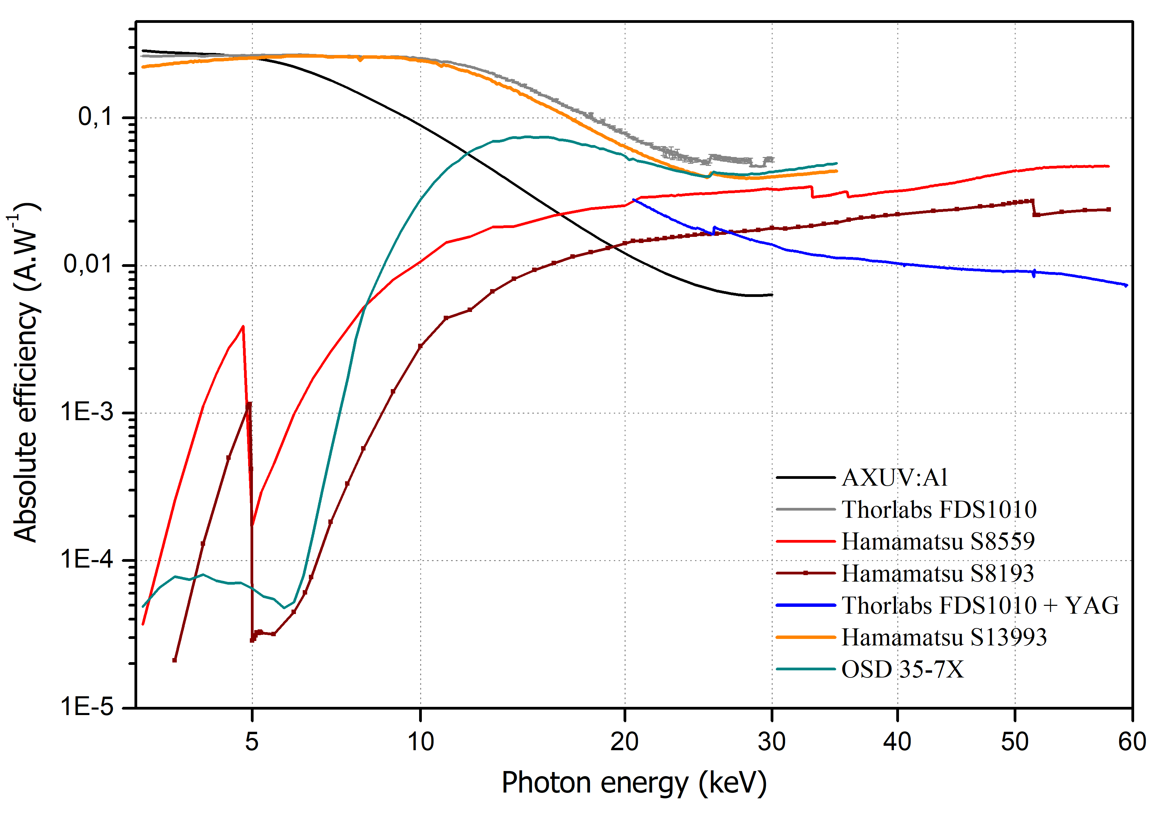
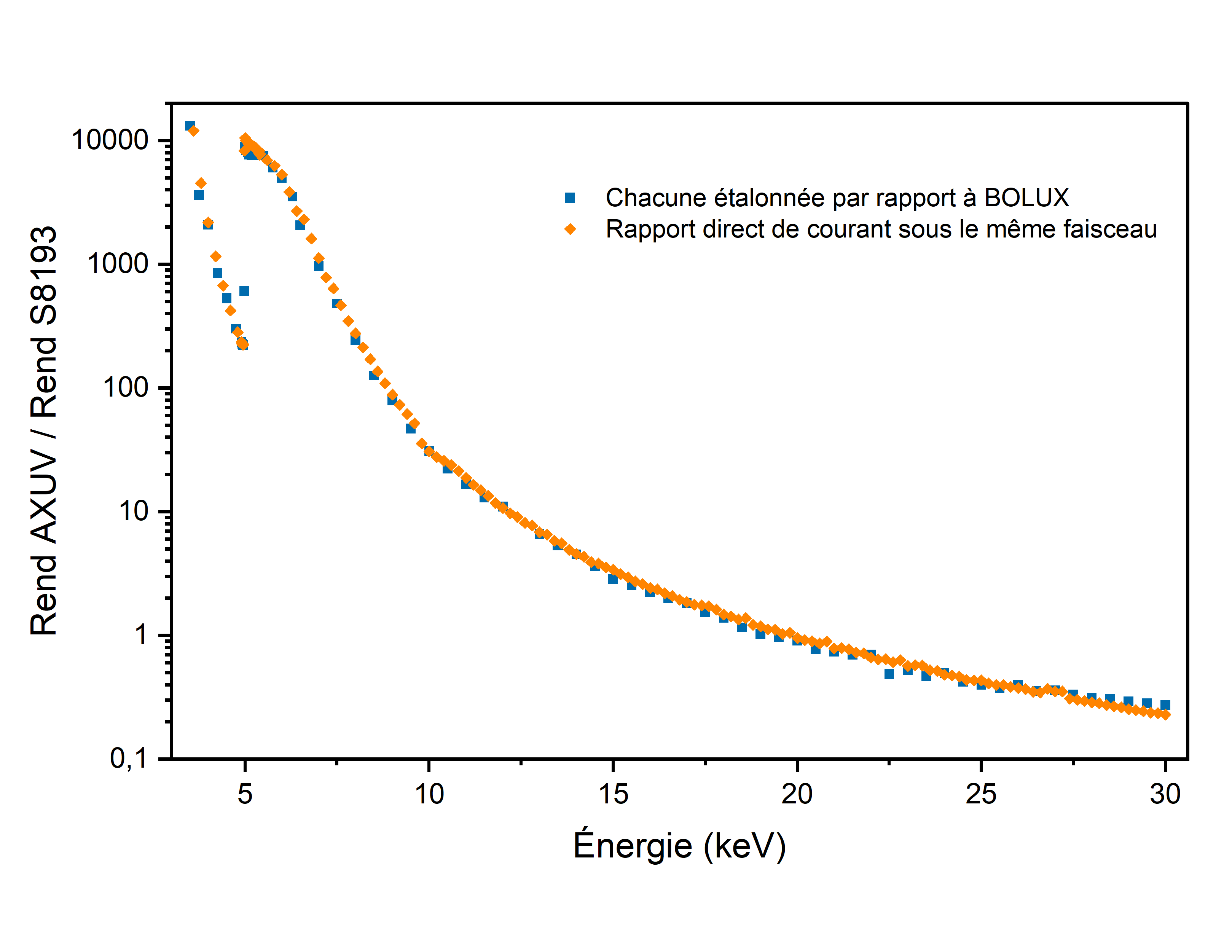
Measurement results
Efficiency calibration of photodiodes
Calibration of the photodiodes vs BOLUX
Calibration of S8193 vs AXUV
Energy (keV)

Slide 12
Measurement results
Efficiency calibration of energy-dispersive X-ray spectrometers - 1. SDD

Slide 13
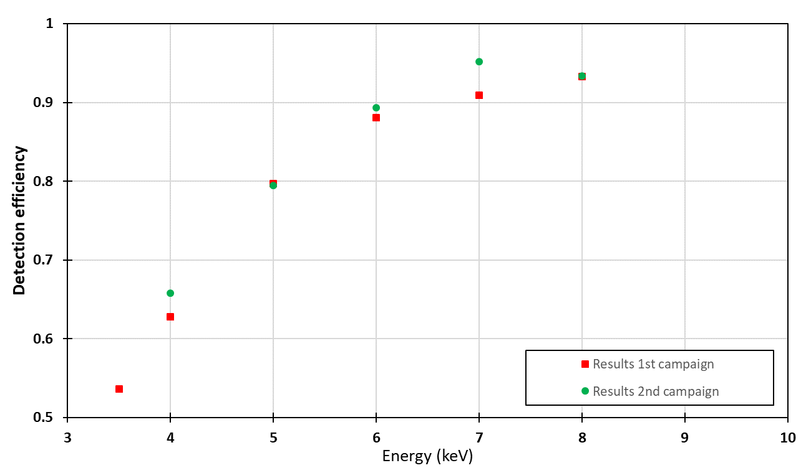
Measurement results
Efficiency calibration of energy-dispersive X-ray spectrometers - 2. HPGe
Experimental results in the range 3.5 keV – 8 keV
Efficiency
1st campaign
2nd campaign
Energy (keV)

Slide 14
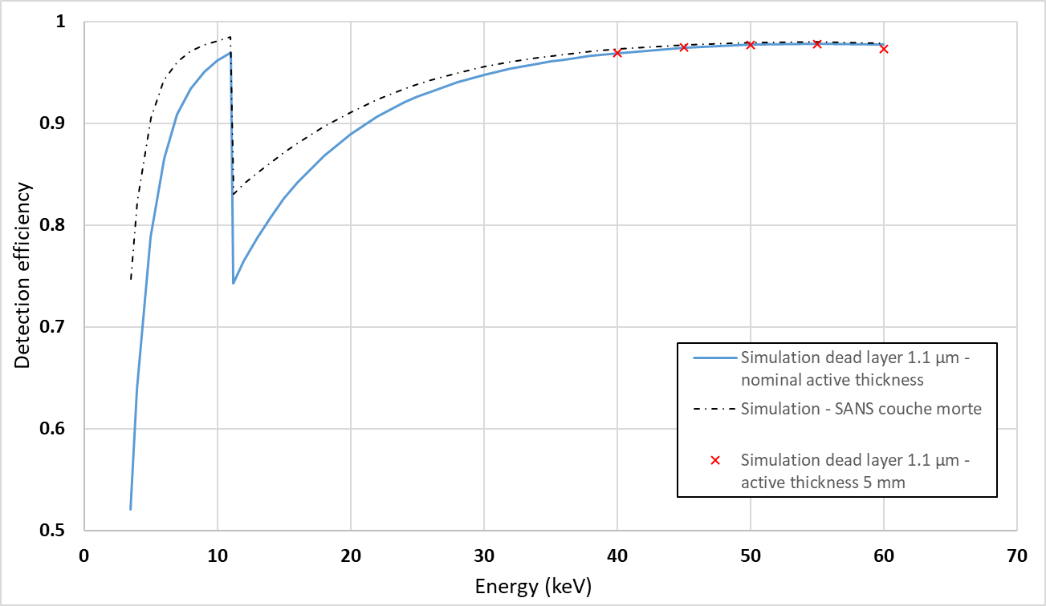
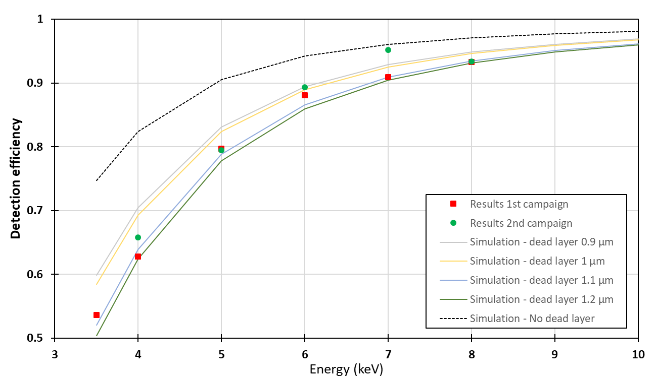
Measurement results
Efficiency calibration of energy-dispersive X-ray spectrometers - 2. HPGe
Monte Carlo simulations with different dead-layer thicknesses
Simulation – without dead layer

Slide 15
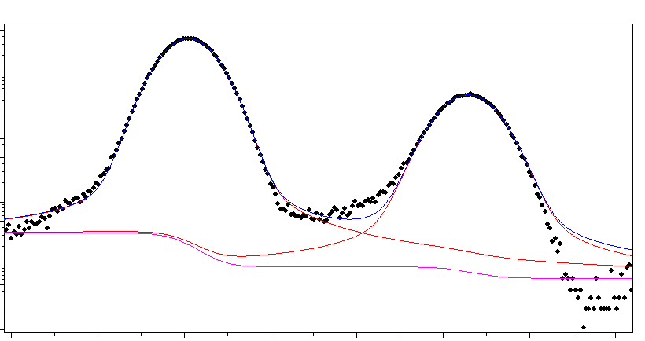
Application
Measurement of fluorescence yields
Reflection geometry: target at 45° both from the incident beam and the detector (SDD)
Sherman equation
$\frac{I_{i}}{η_{i}}=\int_{0}^{1}{I_{0}∙\frac{Ω}{4π}}∙{ω }_{i}∙τ_{0}\frac{M}{A}∙\exp\left(−μ_{0}∙\frac{M}{A}∙\frac{x}{\sin\left(β\right)}\right)∙⁡\exp\left(−μ_{i}∙\frac{M}{A}∙\frac{x}{\sin\left(θ\right)}\right)∙\frac{dx}{\sin{(β)}}$
SDD
Incident monochromatic X-ray beam
Fluorescence
I₀
I_{t}
$I_{0}=I_{t}∙e^{μ_{0}∙\frac{M}{A}∙\frac{1}{\sin\left(θ\right)}}$
Photodiode
Target
${ω }_{i}=\frac{Ω}{4π}∙\frac{I_{i}}{η_{i}}∙I_{t}∙\frac{1}{τ_{0}}∙(μ_{0}+μ_{i})∙\frac{e^{−μ_{0}∙\frac{M}{A}∙\frac{1}{\sin\left(45\right)}}}{1−e^{−\frac{M}{A}∙\frac{1}{\sin\left(45\right)}∙(μ_{0}+μ_{i})}}$

Slide 16
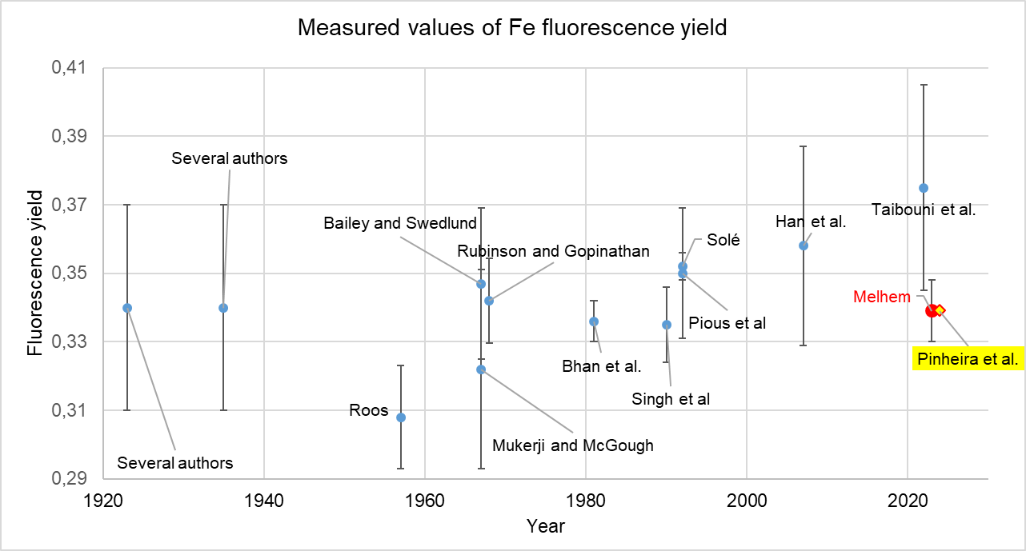
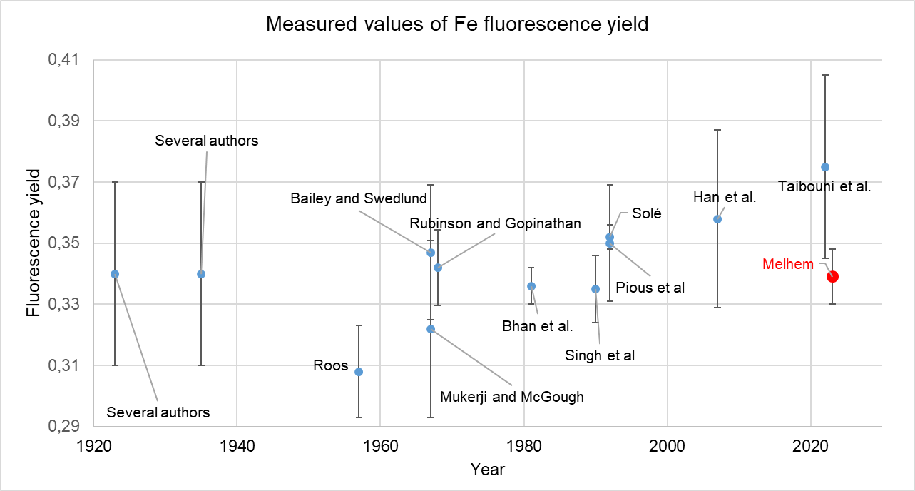
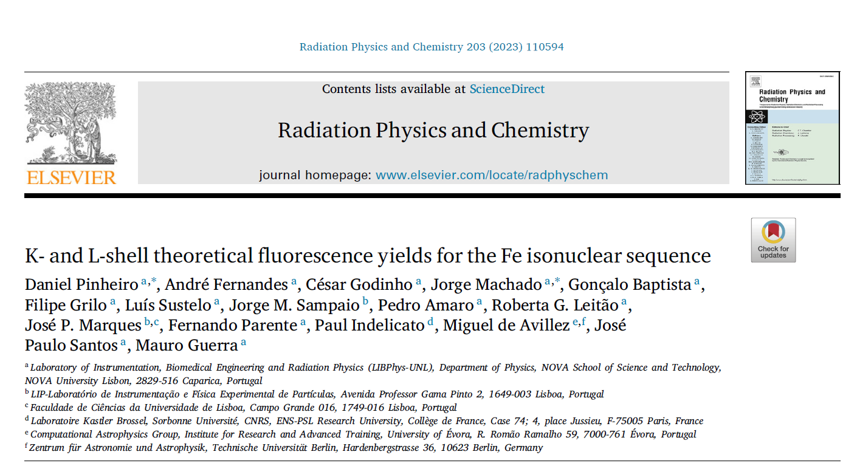
Application
Example of measurement of K fluorescence yield: Fe

Slide 17
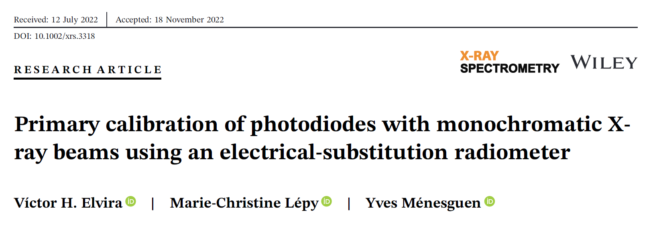
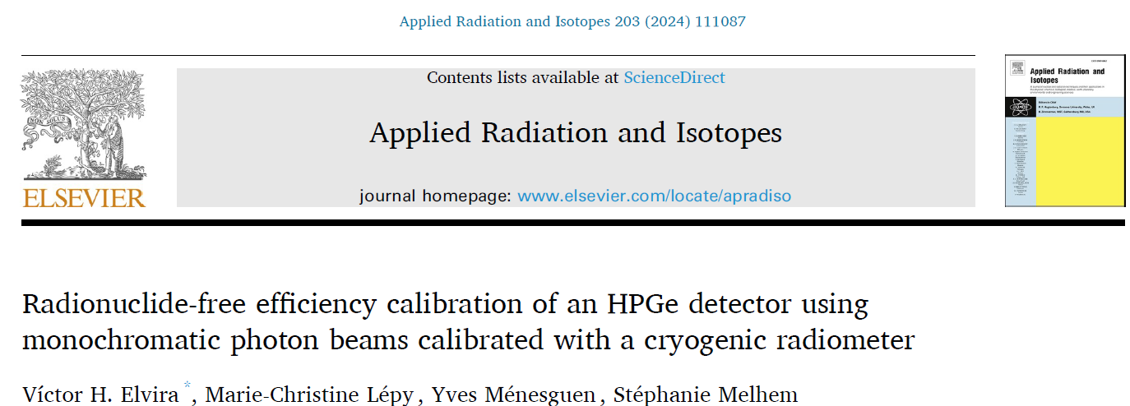
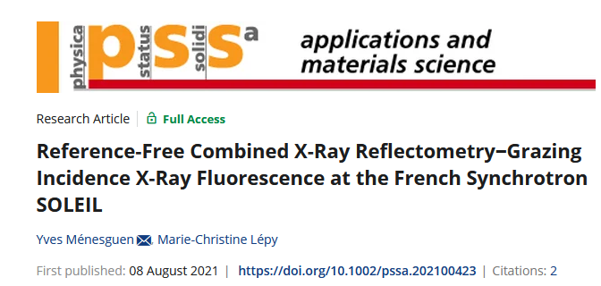
Conclusion and perspectives
Absolute calibration of photon fluxes using an electrical-substitution cryogenic detector
Calibration (responsivity) of transfer photodiodes
Efficiency calibration of energy-dispersive spectrometers
Application to the measurement of fundamental parameters
International Initiative on Fundamental Parameters
https://www.exsa.hu/?inh=635
Application to the caracterisation of innovative materials
XRR-GIXRF reference–free combined analysis
Extend the energy range of BOLUX with a thicker absorber (to reduce correction factors)

Slide 18
Thank you for your attention
Acknowledgment:
SOLEIL and the staff of the METROLOGIE and PUMA beamlines
LNE for funding via project 258

