Slide 1

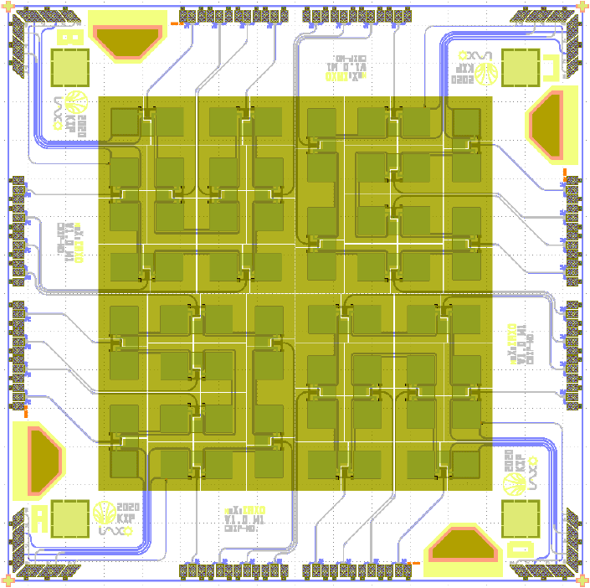
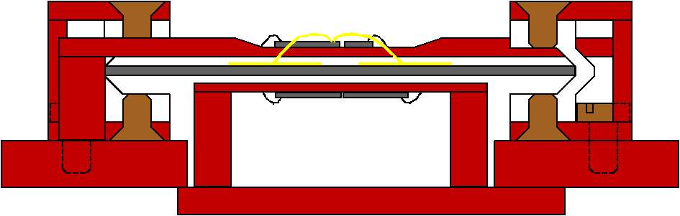
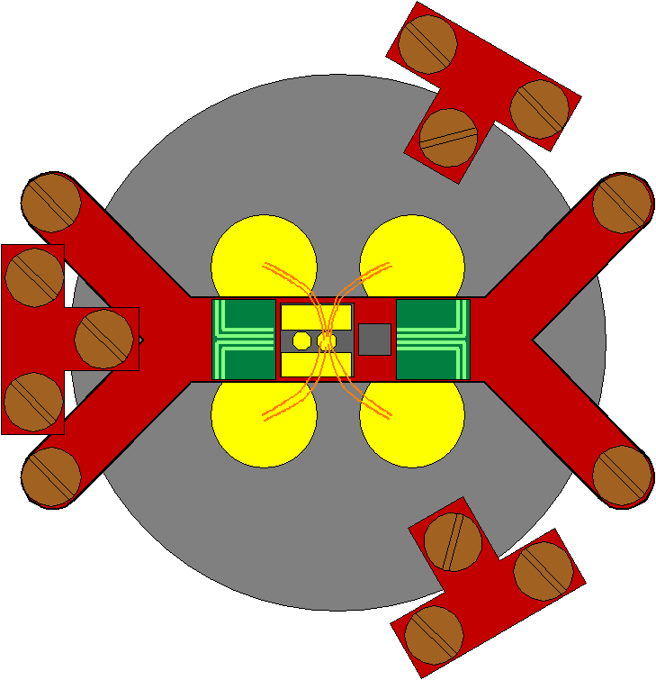
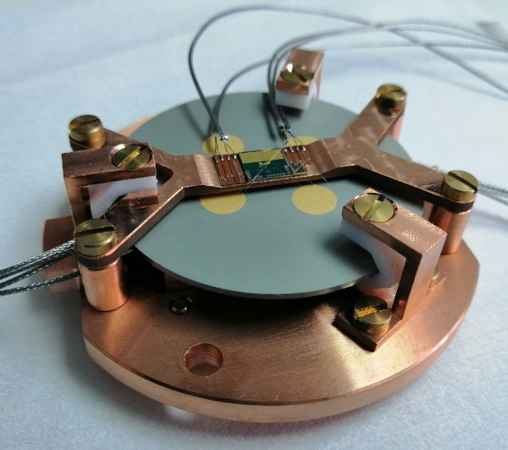
A low background setup for low energy X-ray detection
in the context of the BabyIAXO / IAXO axion searches
XDEP – X-ray DEtector
Technologies for Physics
5-6 February 2024 @ SOLEIL
M. Loidl, M. Rodrigues, M. Zahir, Q. Drenne

Slide 2
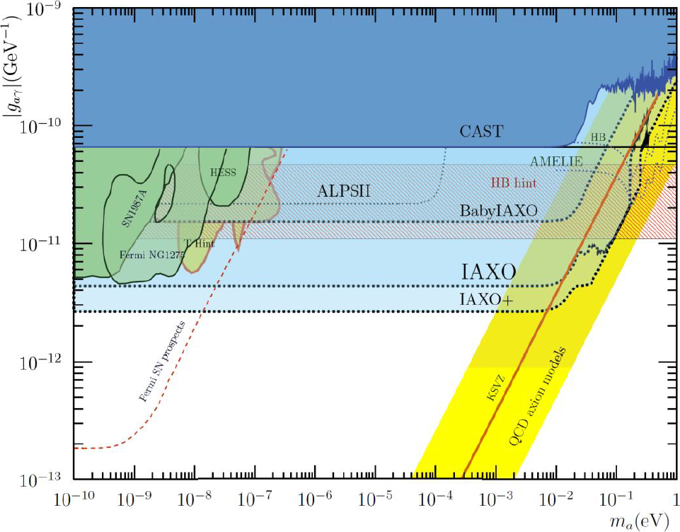
The BabyIAXO / IAXO solar axion searches (1/2)
Axions:
Proposed as a solution of the strong CP problem of the standard model
Primordial axions would be a natural dark matter candidate
Search (in tunable microwave
cavities) extremely challenging
Axions should be copiously
produced in stellar cores,
e. g. in the sun
Discovery of axions
within a substantial
part of the relevant
parameter space
in reach for IAXO

Slide 3
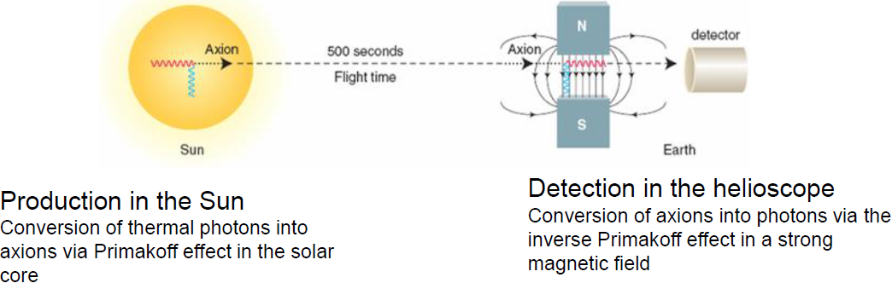
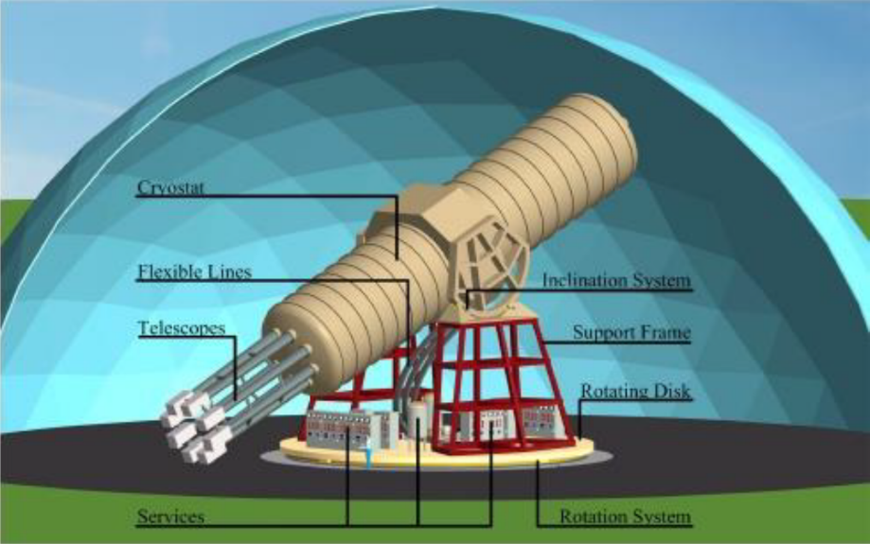
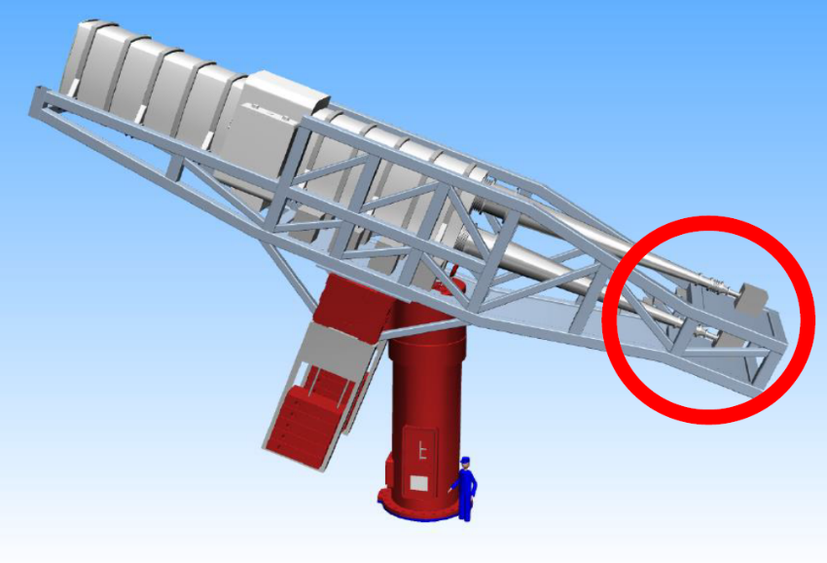
The BabyIAXO / IAXO solar axion searches (2/2)
IAXO:
Full-scale experiment with 8-bore magnet
Will be hosted at DESY
BabyIAXO:
Smaller 2-bore magnet
Fully funded, under construction
Experimental challenge: Low energy threshold (~ 0,5 keV), very low back-ground X-ray detectors

Slide 4
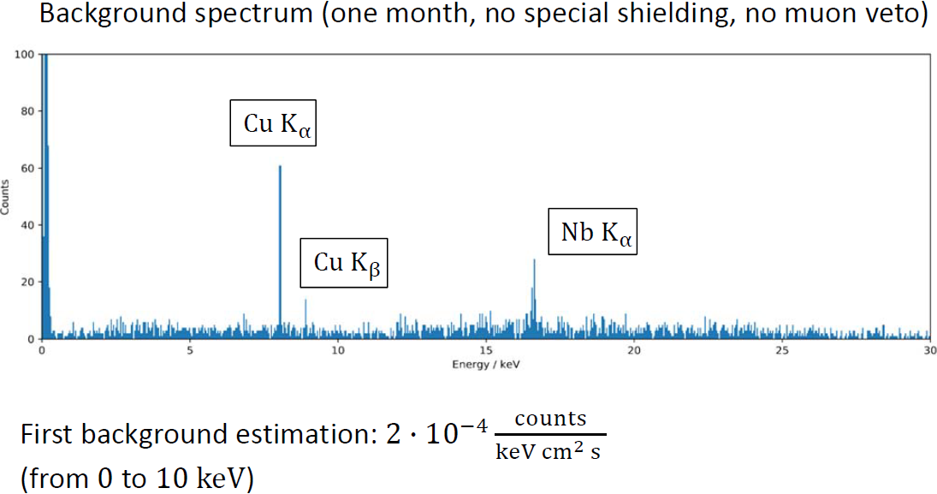

Aim of the MMC test programme
Determine the intrinsic background of an MMC based X-ray detector array
Requirement: ~ 10⁻⁷ counts/keV/cm²/s (BabyIAXO)
~ 10⁻⁸ counts/keV/cm²/s (IAXO)
Actual level:
Measured at KIP,
University of Heidelberg
Shielding
Muon veto

Slide 5
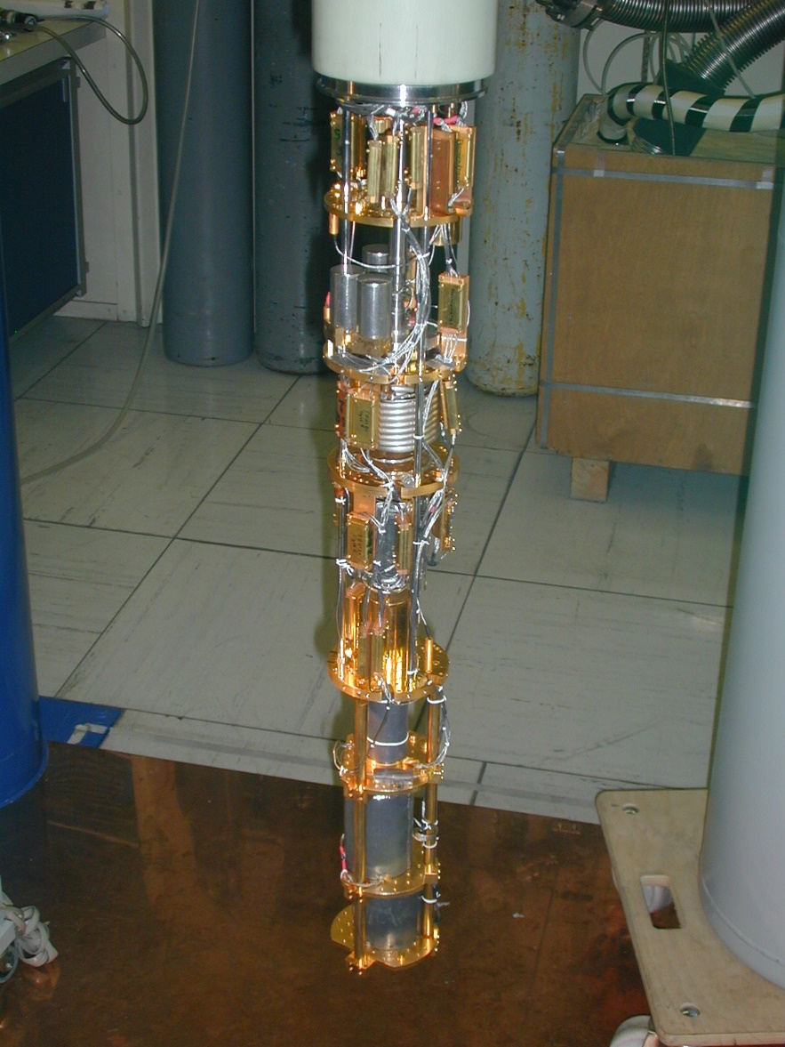
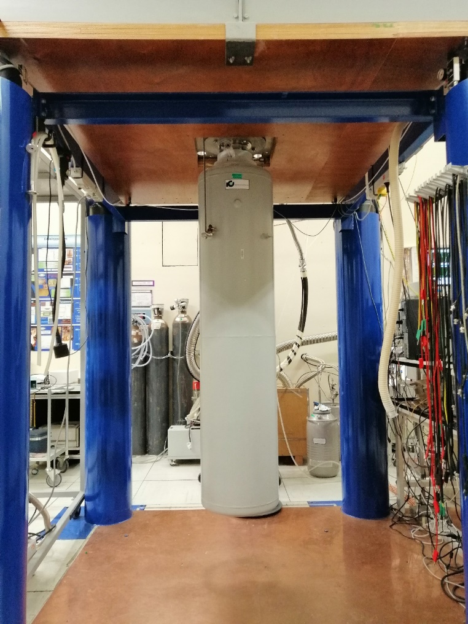
Dilution refrigerator @ LNHB (1/5)
Wired for 10 MMC & SQUID channels
Base temperature ~ 13 mK
inside
outside
Dilution unit
Experimen-
tal space:
Φ = 92 mm
h = 300 mm
Liquid helium dewar

Slide 6
Dilution refrigerator @ LNHB (2/5)
External lead shielding
Flexible lead mattes
40 cm
10 cm Pb shield
324 lead bricks
~ 3.5 tons
98.8% solid angle coverage
Top: flexible lead mattes available
150 cm
Experimental space
60 cm

Slide 7
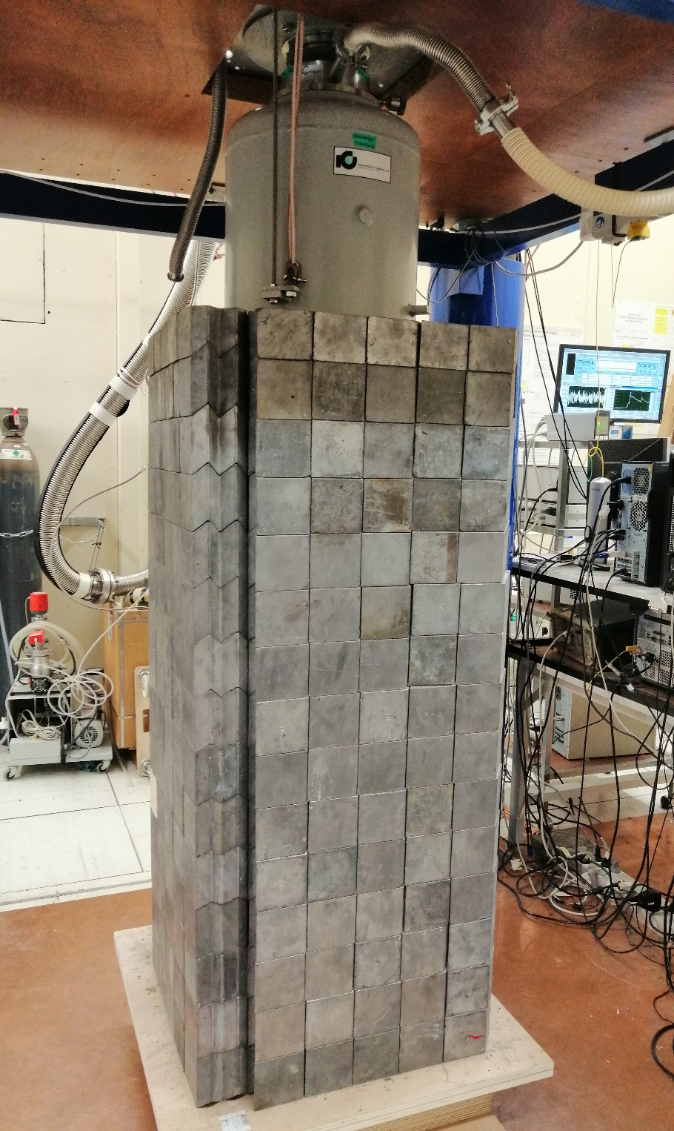

Slide 8
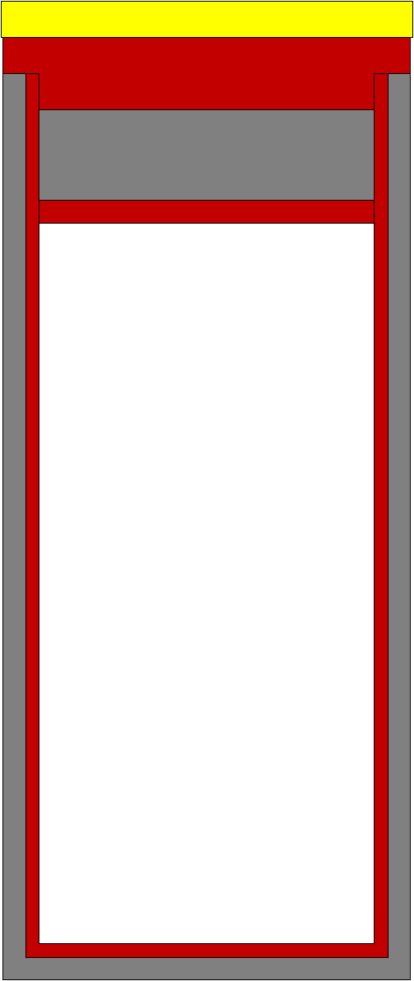
Dilution refrigerator @ LNHB (4/5)
Internal lead + copper shielding
Mixing chamber plate
Top internal lead
shielding: 2 cm
Top internal
copper mounting
& shielding plate:
5 mm
90 mm
200 mm
74 mm
Side and bottom
internal copper
shielding: 3 mm
Side and bottom
internal lead
shielding: 5 mm

Slide 9
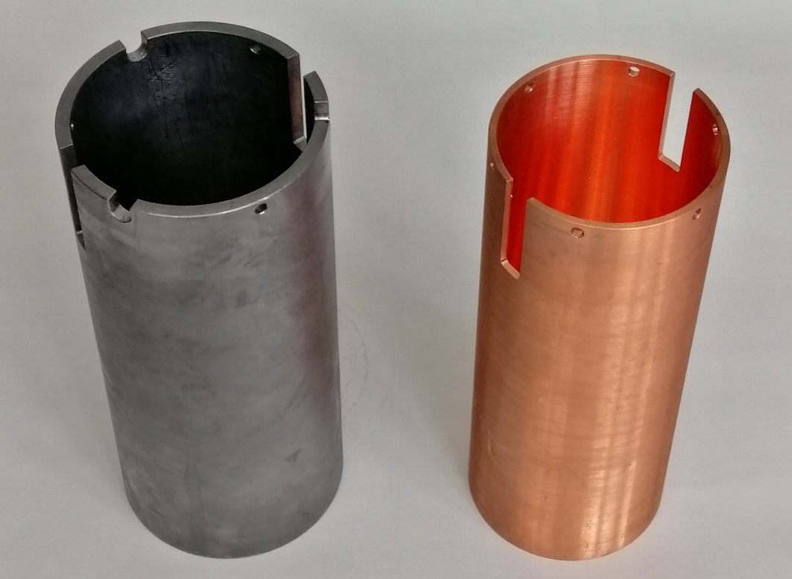
Dilution refrigerator @ LNHB (5/5)
Internal lead + copper shielding
~ 100 yrs old lead
²¹⁰Pb: (2.27 ± 0.69) Bq/kg
CuC2 copper

Slide 10
Internal muon veto (1/2)
Ge wafer, 50.8 mm (2″) diam.,
1 mm thick
Atmospheric muons:
E deposit few 10s of keV
C_{Ge} = 48.5 pJ/K @ 20 mK;
Gold phonon collector films
4 x φ 7 mm
C_{Au} ≈ 41.4 pJ/K @ 20 mK
Gold wire bonds to MMC sensor
C_{wires} ≈ 4.0 pJ/K @ 20 mK
C_{veto} ≈ 94 pJ/K @ 20 mK
Expected count rate: ~ 0.5 s⁻¹
One MMC, one SQUID channel
Copper
>
~
PTFE
Ge wafer
SQUID
MMC
Gold phonon
collector films

Slide 11

Internal muon veto (2/2)
Muon veto
MMC + SQUID
PTFE wafer holder pieces
Muon veto Ge wafer w/ Au phonon collector films

Slide 12
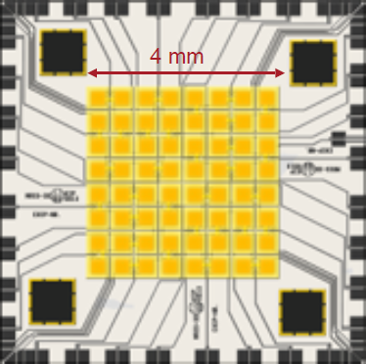
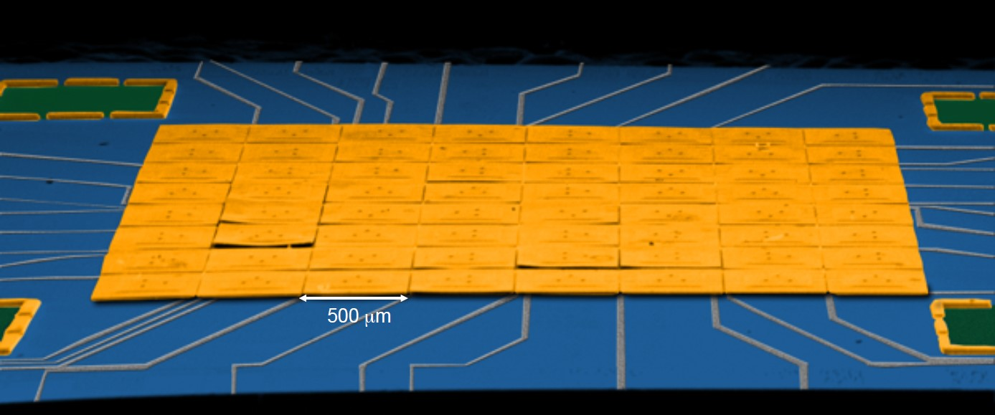
X-ray detector: MMC chip options (1/5)
maXs-30 X-ray array
8 x 8 array, Au absorbers 500 x 500 µm² each, 30 µm thickness
Full array surface area: 4 x 4 mm²
32 MMCs 32 SQUID channels required for full array readout
Expected ΔE ≈ 6 eV (FWHM)
Actual LNHB wiring: 1 quadrant can be read out 2 x 2 mm²
One chip received from KIP, Heidelberg University

Slide 13
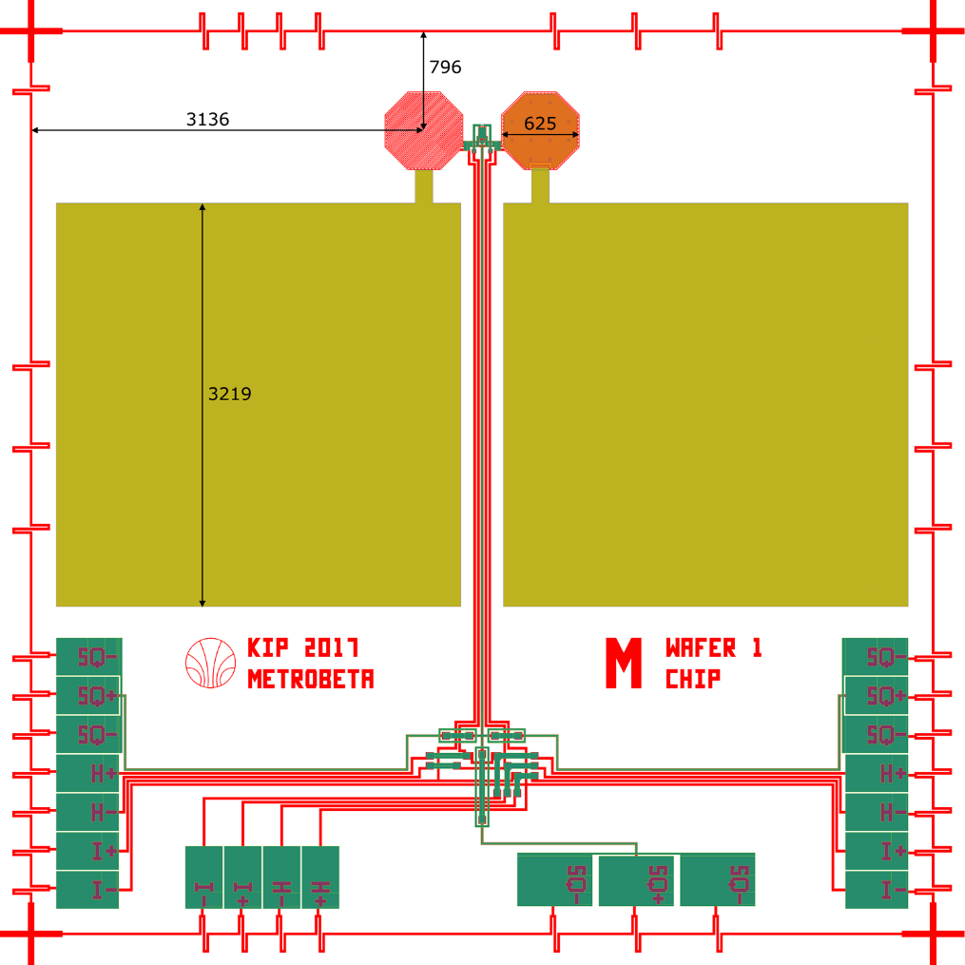
X-ray detector: MMC chip options (2/5)
MetroBeta/MetroMMC chips
heat
switch
meander shaped
pick-up coil
sensor
Octagonal design to optimize match with cylindric absorbers, best suited for MetroBeta
Slight difference (5 %) in sensor area to create a net magnetization signal for temperature information
On-chip heat bath for sensor thermalization
Electroplated Au layer with high RRR on top of each sensor for fast heat diffusion over the entire sensor area, to avoid position dependences
Three sets of bondpads to match different experimental setups
thermal
link
on-chip
heat bath
bond pads

Slide 14
X-ray detector: MMC chip options (3/5)
MetroBeta/MetroMMC chips
Designed for nuclear decay data measurements within a wide energy range,
e. g. beta spectra with Q_{β} ranging from few keV to ~ 1 MeV
5 sensor sizes to span a wide range of absorber heat capacities
Chip designation | XS | S | M | L | XL
Heat capacity C_{abs} @ 20mK | 8 pJ/K | 28 pJ/K | 110 pJ/K | 400 pJ/K | 1,7 nJ/K
SQUID type | PTB X1 | PTB X1 | PTB X1 | PTB XS | PTB S
Sensor area A_{sens} (square) | (249 µm)² | (335 µm)² | (538 µm)² | (1427 µm)² | (2663 µm)²
Sensor height h_{sens} | 3 µm | 3 µm | 3 µm | 3 µm | 3 µm
Energy resolution ΔE_{FWHM} | 5.2 eV | 9.5 eV | 19.1 eV | 37.5 eV | 74.4 eV

Slide 15
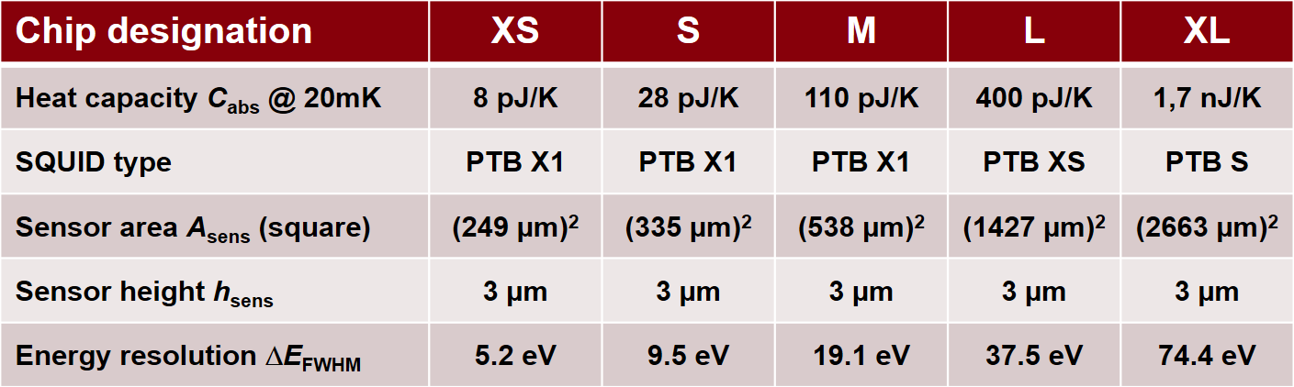
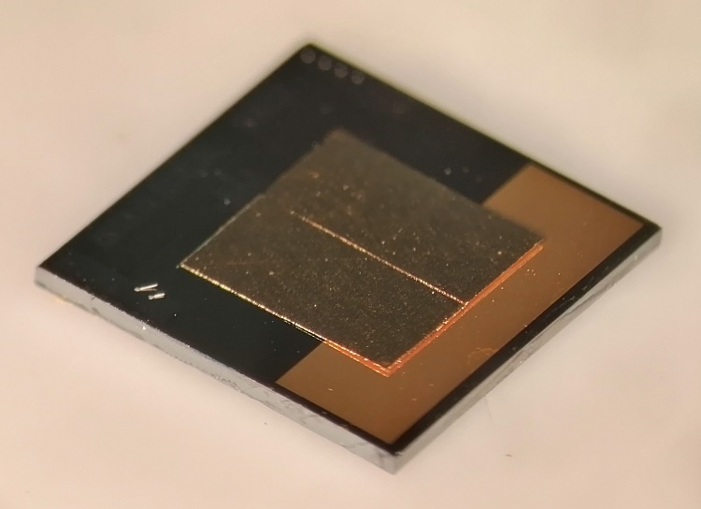
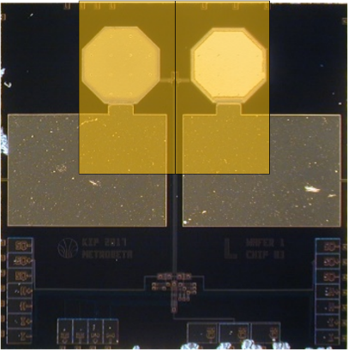
X-ray detector: MMC chip options (4/5)
MetroBeta/MetroMMC chips
Actual choice
Two absorbers 4.08 mm x 2.04 mm x 10 µm each
x 2 MMC chips 33.3 mm² active area
400 pJ/K @ 10 mK
L size MMC

Slide 16
X-ray detector: MMC chip options (5/5)
maXsIAXO
8 x 8 Au absorbers 1.25 x 1.25 mm²
Full array surface area: 1 cm²
10 µm thickness
Detection efficiency:
  > 99% up to 8 keV
  > 90% up to 10 keV
  Expected ΔE ≈ 11 eV (FWHM)
32 MMCs for full array
32 SQUID channels required
Actual LNHB wiring:
1 quadrant can be read out
5 x 5 mm²
Fabrication still pending …

Slide 17
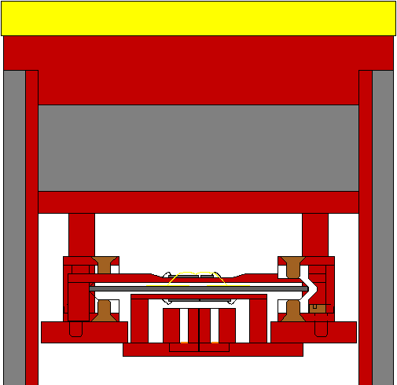
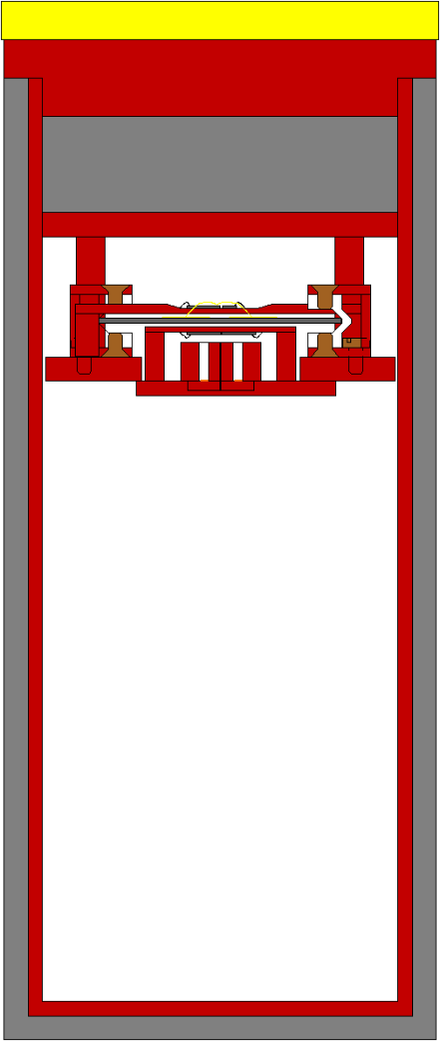
Configuration for background measurement (1/3)
muon veto
MMC & SQUID
muon veto wafer
X-ray MMCs
& SQUIDs
Collimators
⁵⁵Fe sources

Slide 18

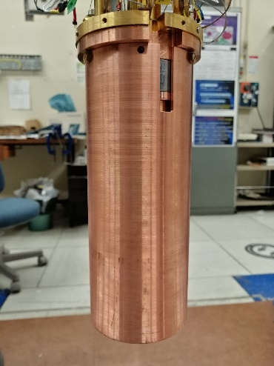
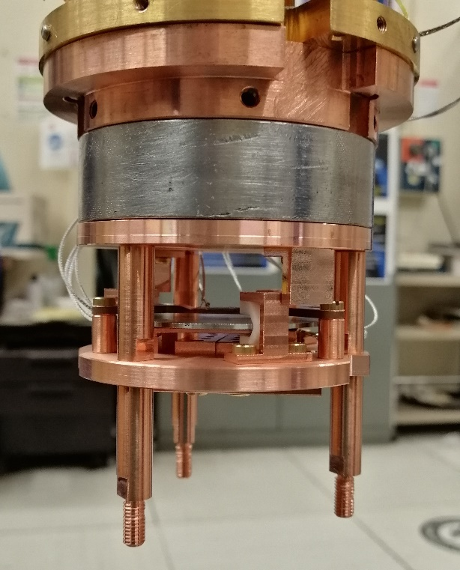
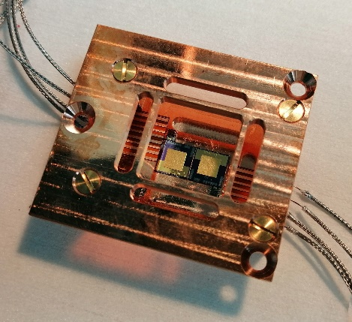
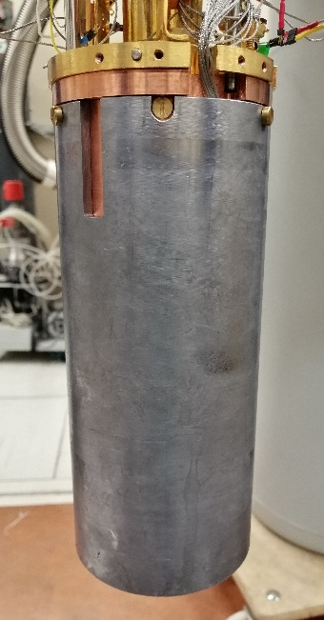
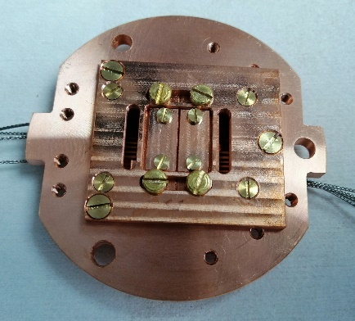
Configuration for background measurement (2/3)
Muon veto
X-ray MMCs
⁵⁵Fe sources & collimators

Slide 19
First test results (1/2)
One X-ray MMC (or its immediate surrounding) is contaminated: > 1 c/s
Second X-ray MMC: ~ 1 count / absorber / 5 min
Muon veto works: most pulses in the “clean” X-ray MMC are in coincidence with the veto.
Veto only count rate: ~ 1 count / 3 s
A few very low energy pulses in the X-ray MMC are not in coincidence with the veto
⁵⁵Fe X-rays not identifiable no energy scale
Various problems with data acquisition
no exploitable spectra, no background rate

Slide 20
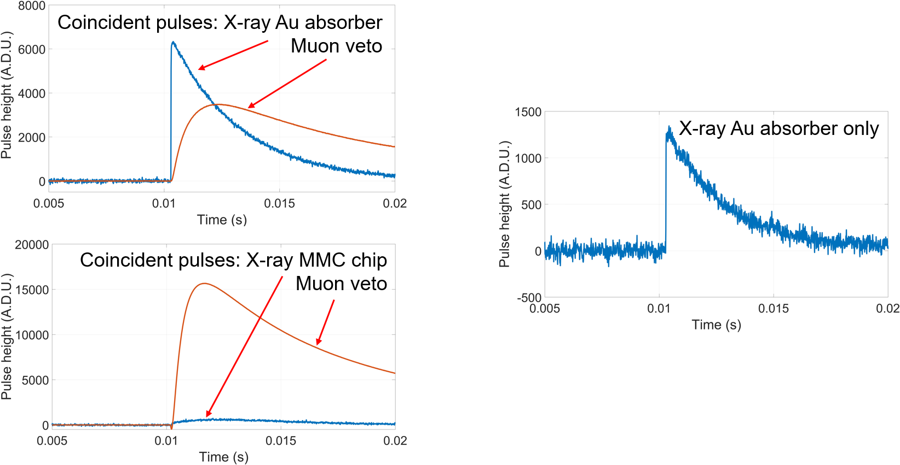
First test results (1/2)

Slide 21
Summary and outlook
External and internal shielding of the LNHB dilution refrigerator
  10 cm standard lead (external)
  5 mm low background lead (internal)
  3 mm low background copper (internal)
Muon veto: Ge wafer + Au films + Au bonding wires + MMC
Problems with
  Contamination (1/2 MMCs)
  ⁵⁵Fe sources
  Data acquisition
Next steps:
Replace brass screws by copper screws & standard solder by bonding from ribbon cables to MMC + SQUID chips
First figure of background level
Upgrade to 1 cm² X-ray detector area

Slide 22
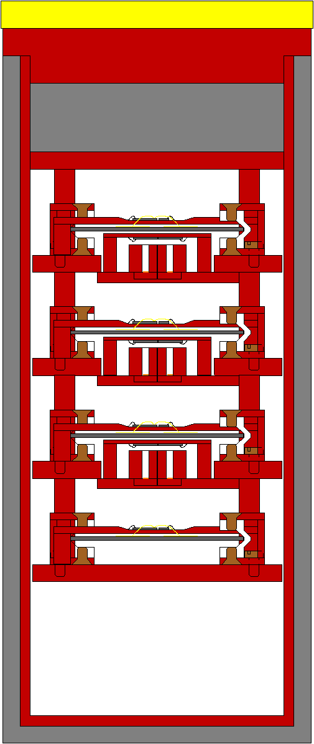
Configuration for background measurement (3/3)
Increase X-ray
detection area
3 X-ray detector layers
1 cm² active area
3-4 veto layers
in total
9-10 MMC
& SQUID channels

Slide 23
Thank you for
your attention!

