Slide 1
What is the Synchrotron SOLEIL

Slide 2

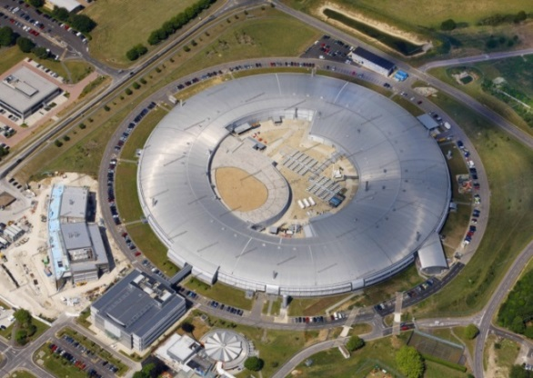
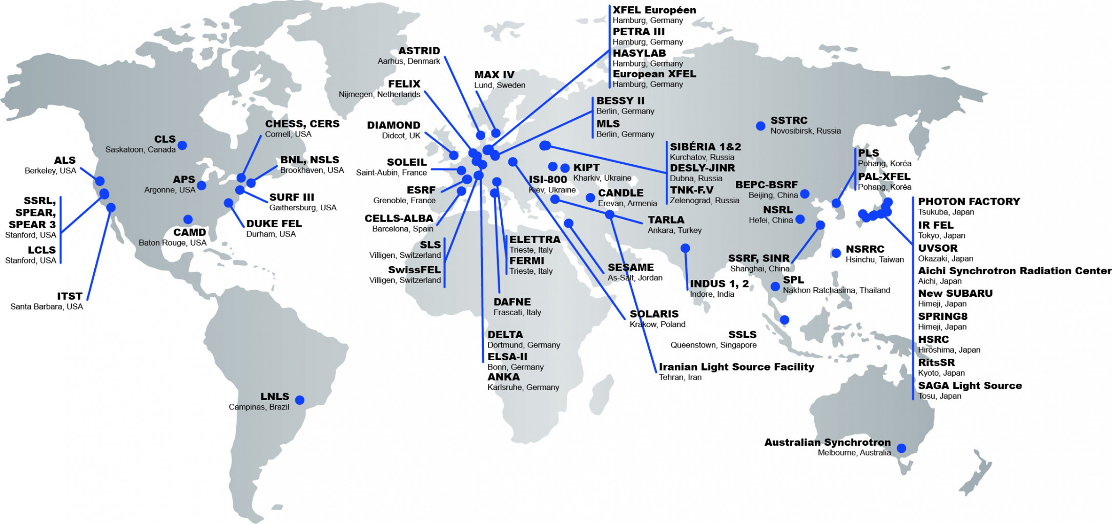


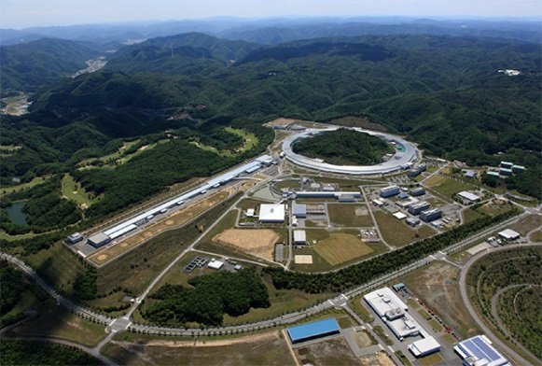
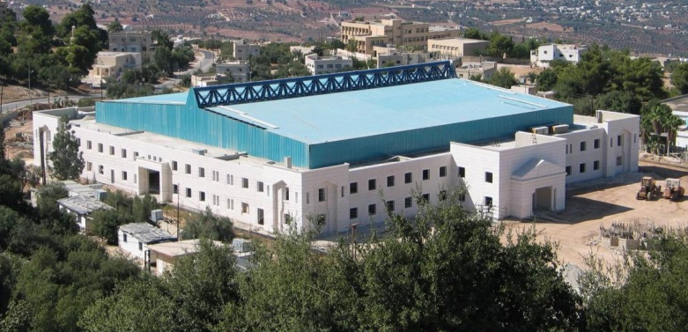
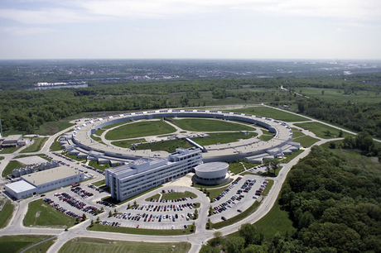


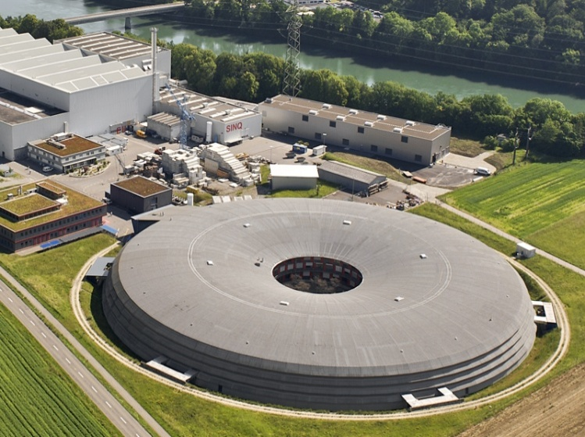
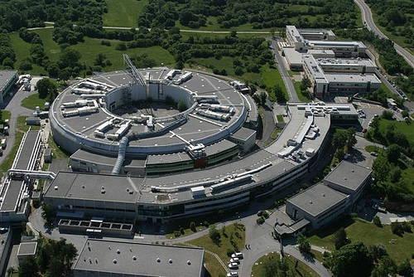

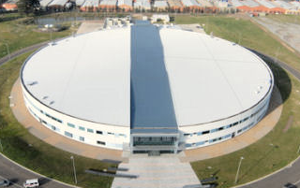


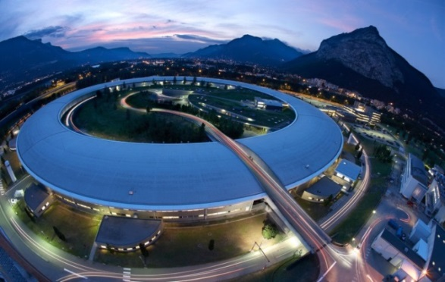
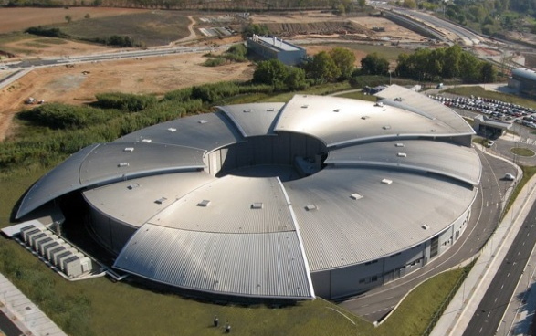

Synchrotrons around the world

Slide 3
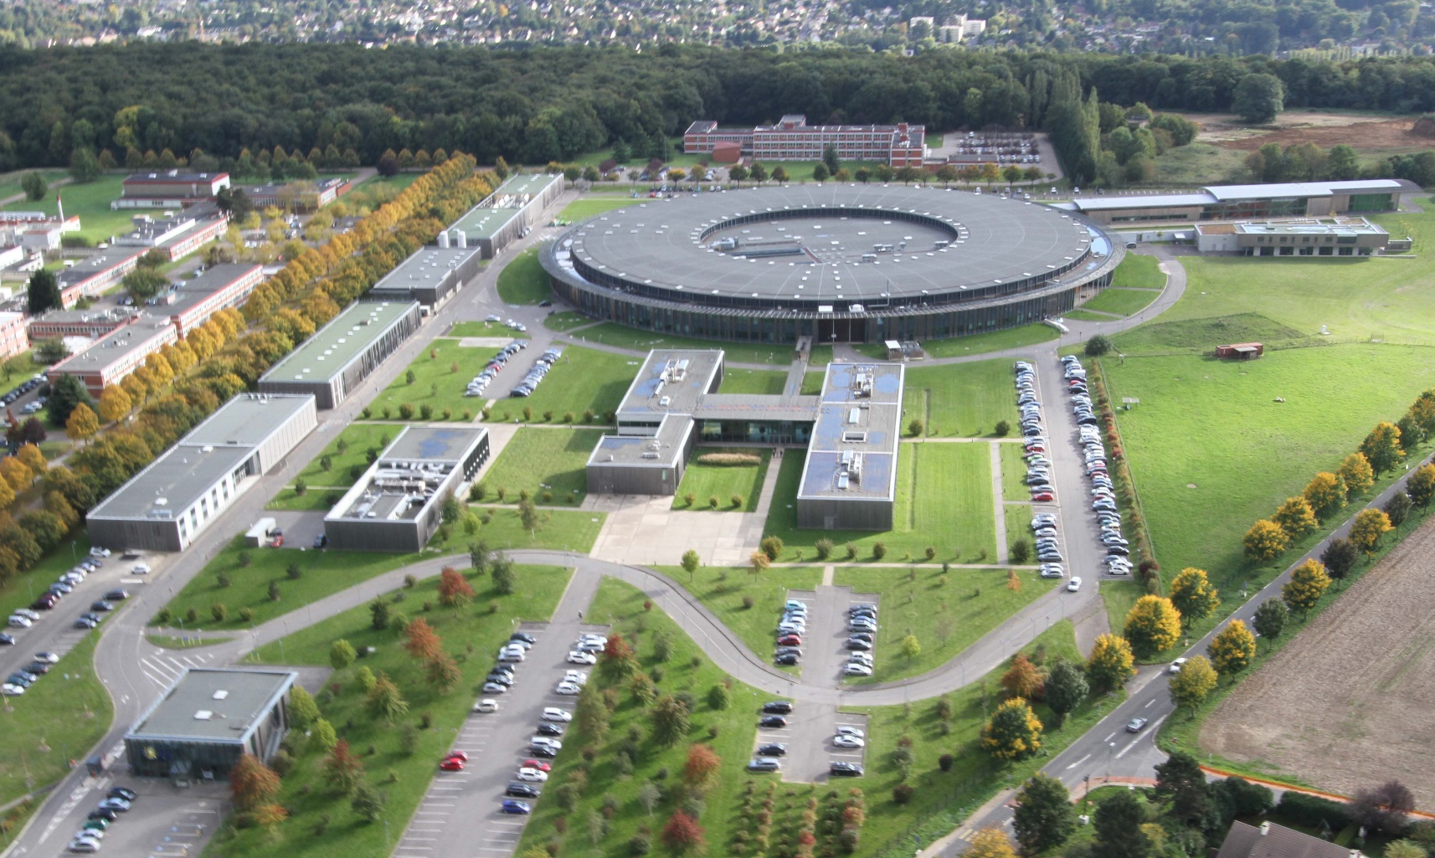


What is SOLEIL ?
Source Optimisée de Lumière d’Energie Intermédiaire du LURE (Laboratoire d’Utilisation de Rayonnement Electromagnétique)
Optimized Light Source of Intermediate Energy for LURE
(Laboratory of the Use of Electromagnetic Radiation)
72%
28%

Slide 4

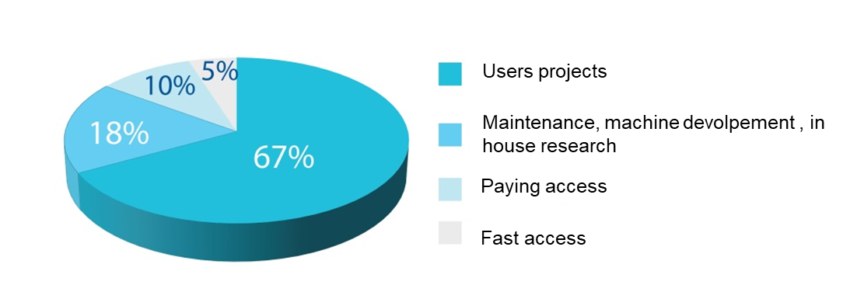
A tool for the scientific community
Free access : researchers
67% of beamtime
Conditions : publication of results and mention of SOLEIL in publications
Two call for projects per year
Submission of a project
Peer review by an external expert committee (about 58% acceptance rate)
Scheduling of the beamtime
Experiments between 4 to 6 days
About 6 month to 1 year wait
Paying access : industrials
About 5000 euros
10% of beamtime
Conditions : paying beamtime, confidentiality of results

Slide 5
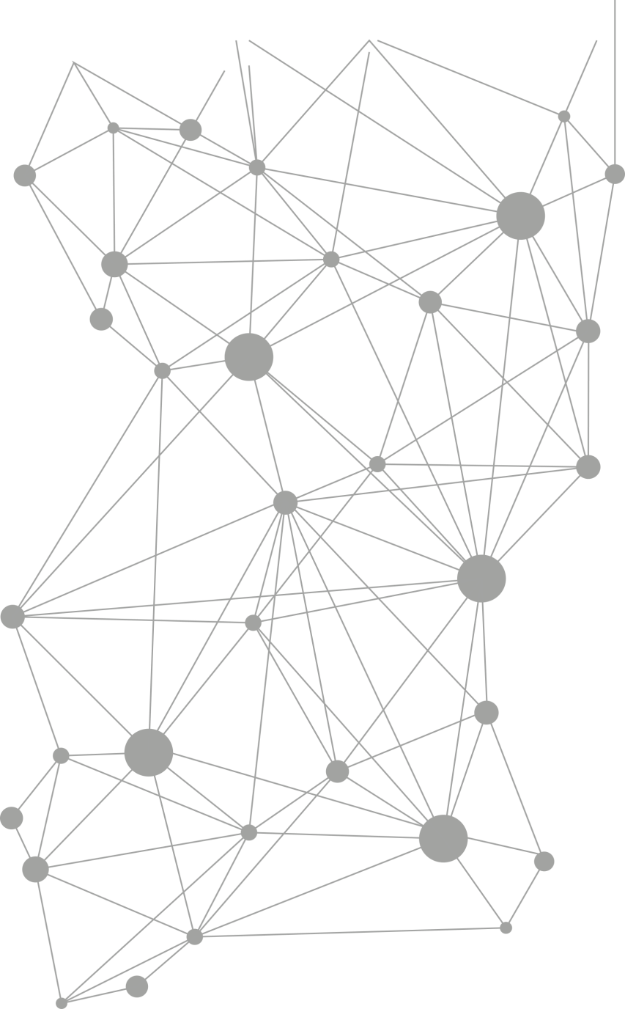
Few numbers
Beam availability
~5000 h / year
Availability 98,95%
Medium team between Beam Failure (MTBF) 139 hours 30
706
Scientific publication in 2022
546 by the users
More than 7900 publications since 2008
1 054
submitted projects
613 accepted
1208
Thesis with SOLEIL
(79 in 2022)
14 961
shifts asked
8481 given
2 620
users
per year coming from ~1000 laboratories
More than 29000
Users since 2008
668
remote users
(*3 / 2019)
Users come from
65% labs in France
26% labs in Europe
9% labs in the rest of the world

Slide 6
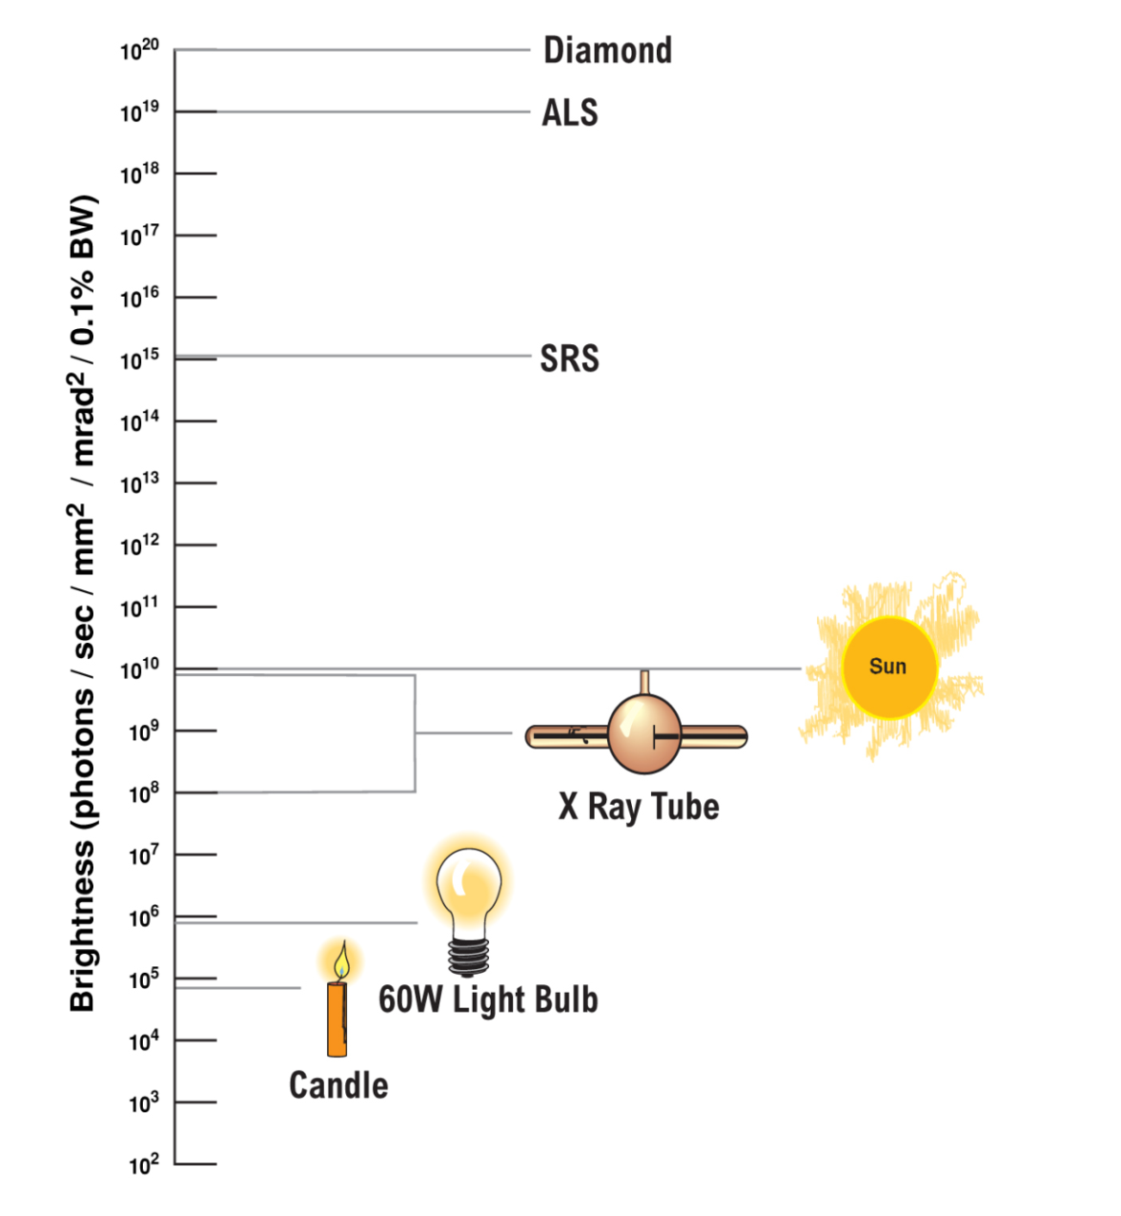
Light source
SOLEIL
SOLEIL photon beam :
Very bright
Pulsatility (50 ps every 3 ns)
Polarization
Adjustable wavelength (broad spectrum)
Stability (position and intensity)
Size of the beam : 15µm height and 150 µm width (brush of light)
Low divergence (microfocusing)
Notes:
Brightness : concentration de photon par temps par surface
Pulsatility : permet de faire la dynamique, cinétique
Polarisation : garder une direction de propagation, polarisation circulairement

Slide 7
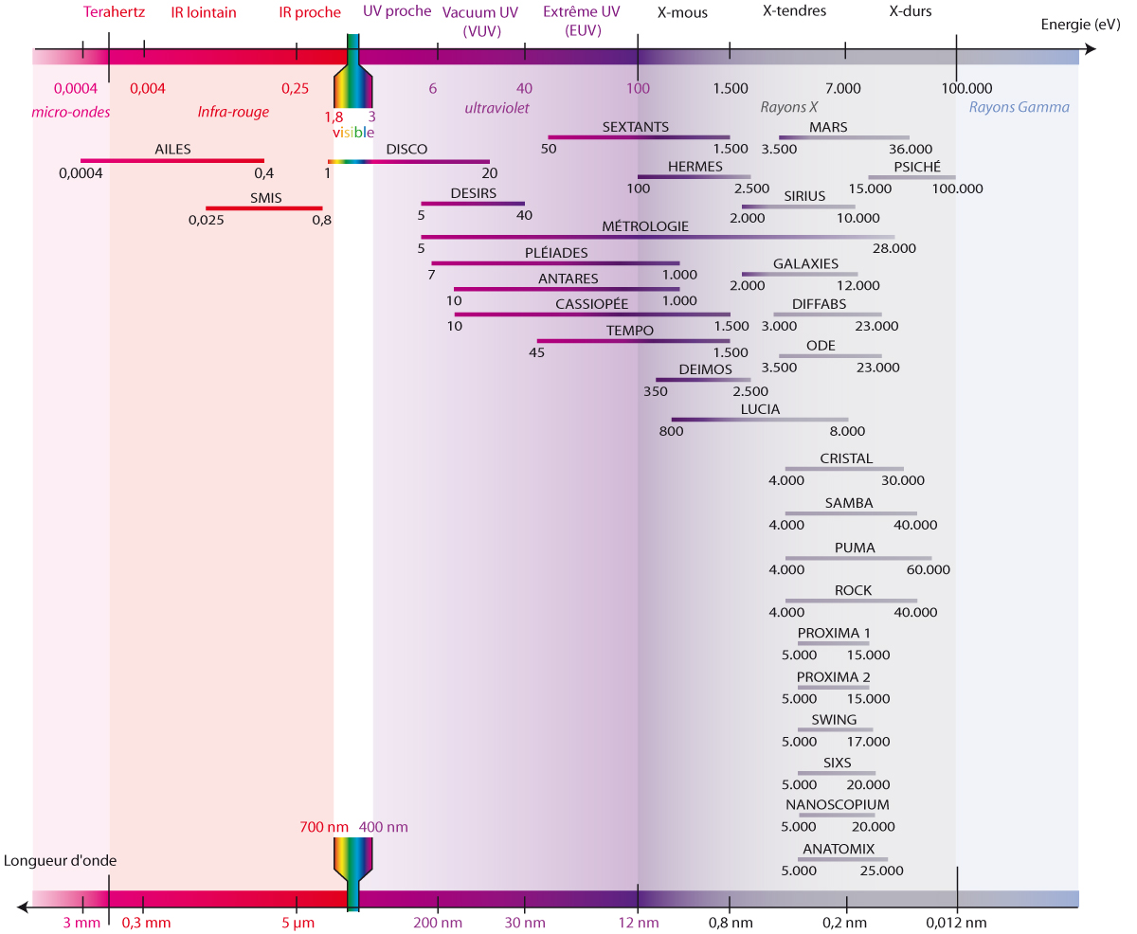
What do we use the light for ?
Notes:
From 0.1µEV to 100KeV

Slide 8
Complementary to the ESRF

Slide 9
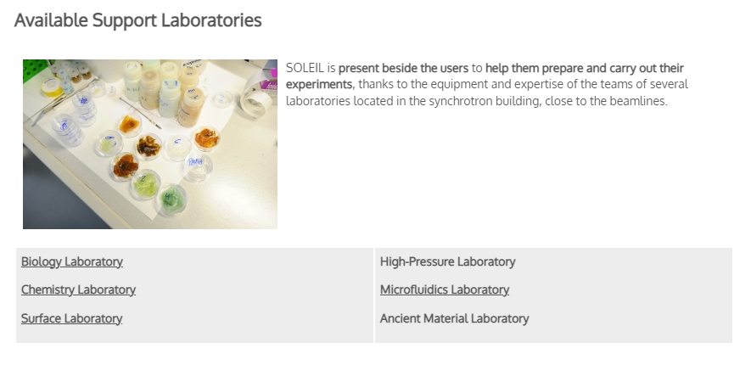
A tool for the scientific community

Slide 10
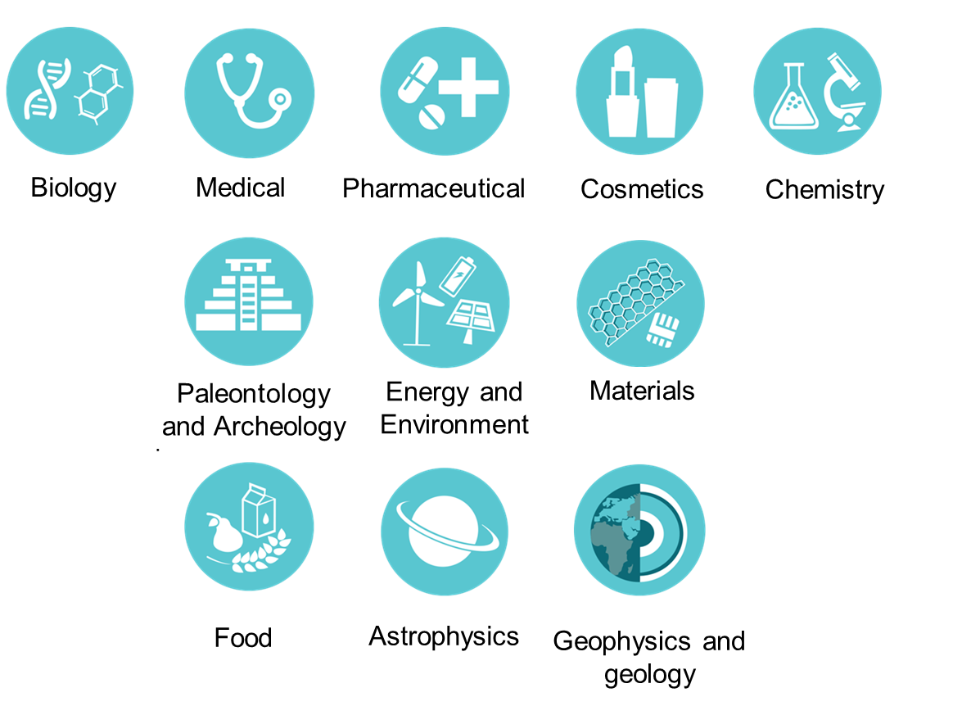
What do we use the light for ?

Slide 11
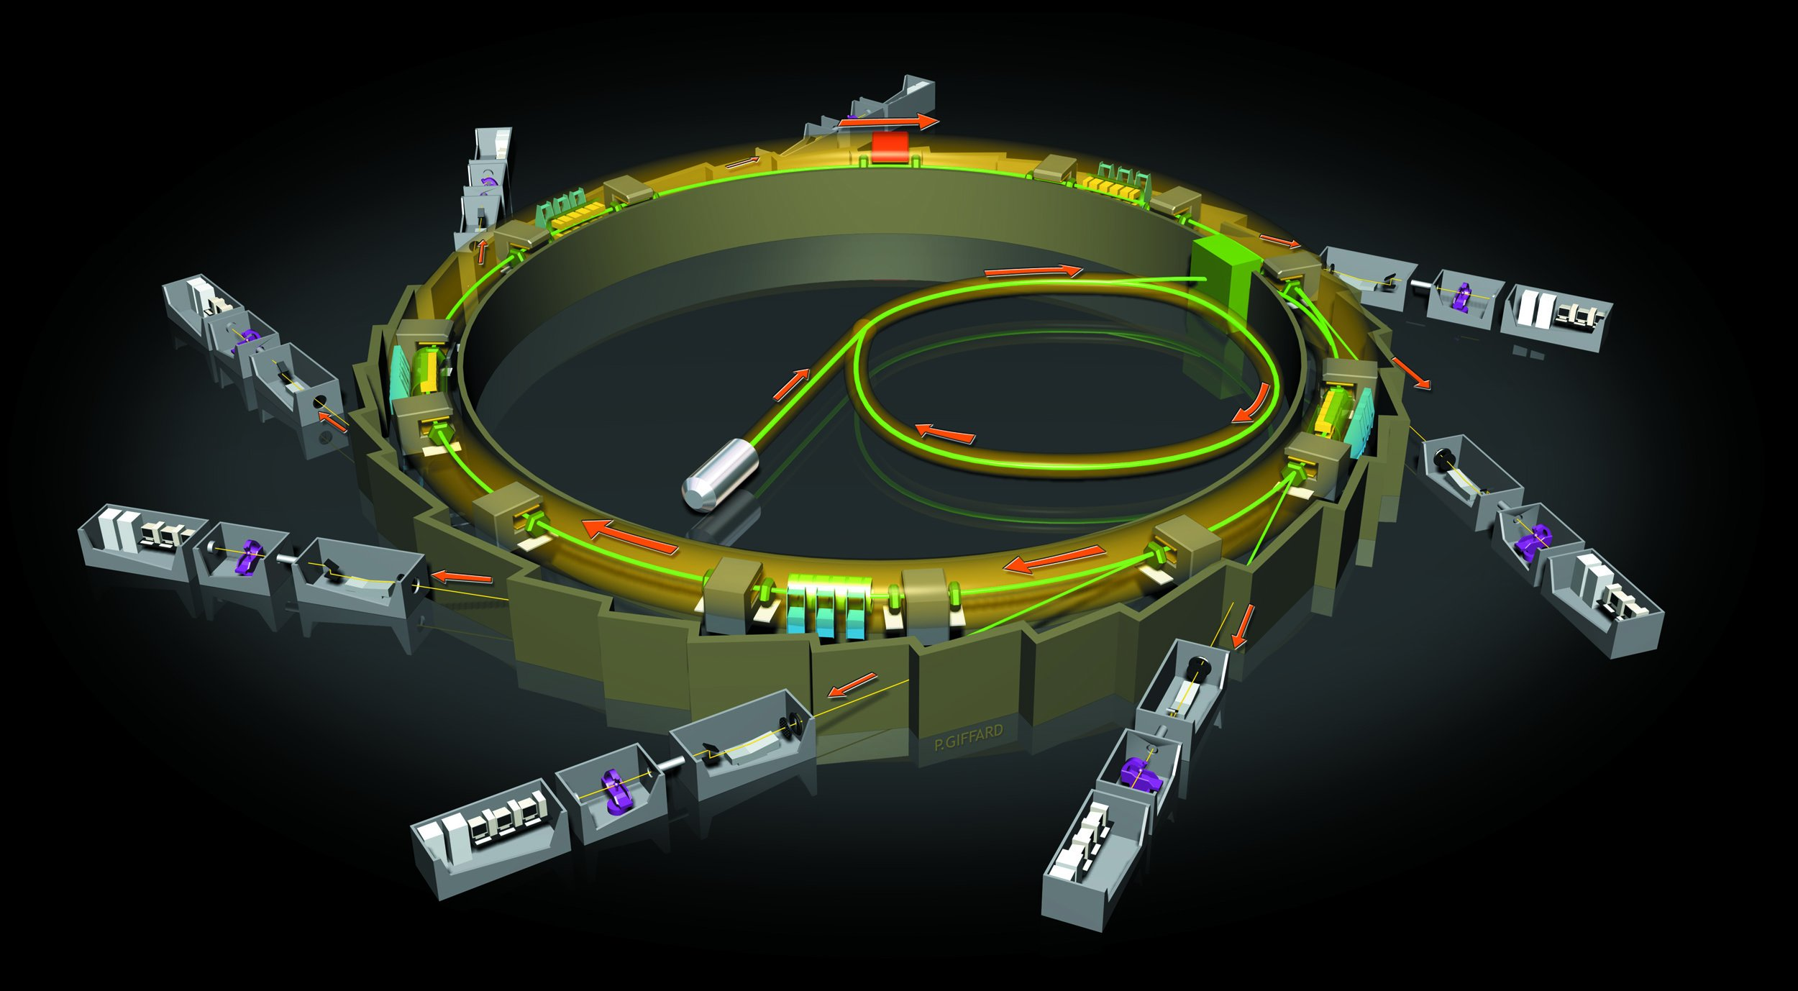
How does SOLEIL produce light ?
Storage ring
Beamlines
LINAC
Booster
Electron gun
Notes:
2.75GeV ; few µm in size
Different fill up mode :
Uniforme : 500mA
Hybrid : 445mA
8 bunches : 100mA
1 bunch : 16mA
Low alpha : 17mA
For the Uniforme mode, 416 bunches = 22 million electrons/bunch = 8.2 billion electrons total
Each bunch = 4nm length

Slide 12
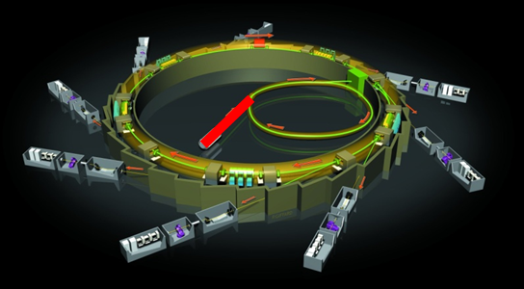
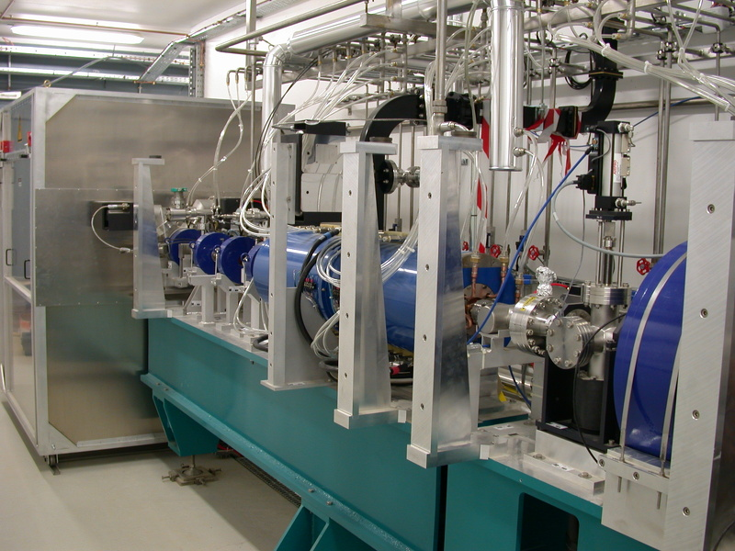
LINAC

Slide 13
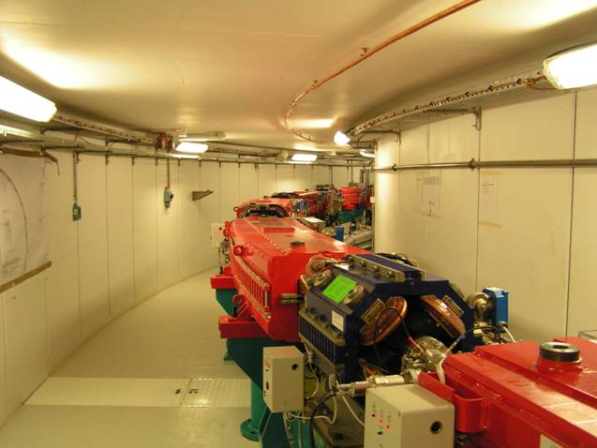

Booster

Slide 14
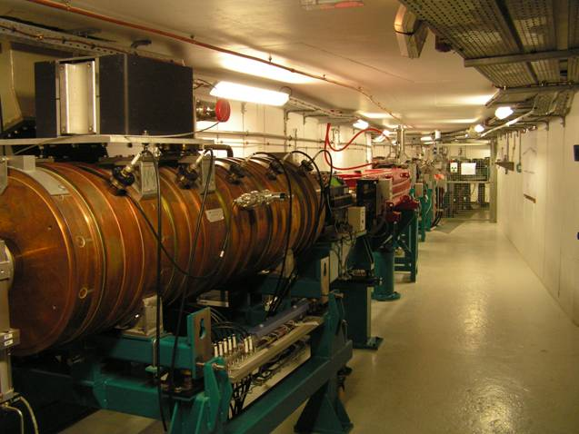
Booster

Slide 15
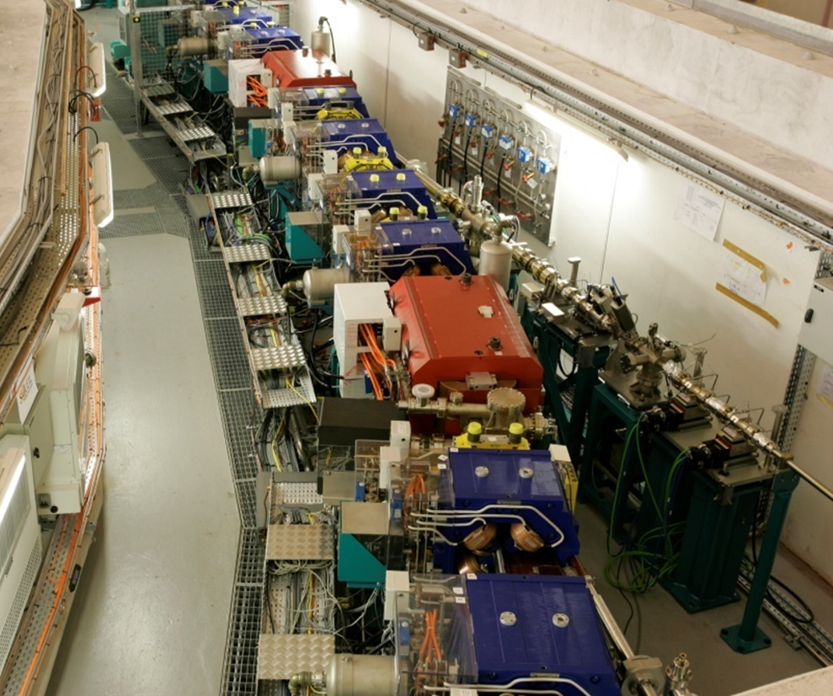
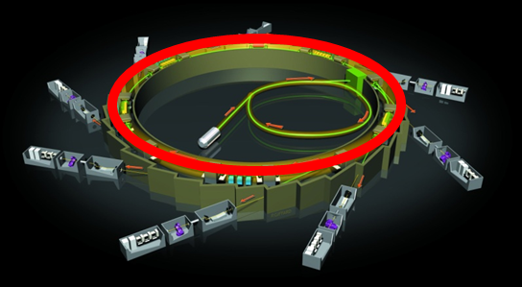
Storage ring
32 bending magnets : 600A power each : 1.7 Telsa

Slide 16
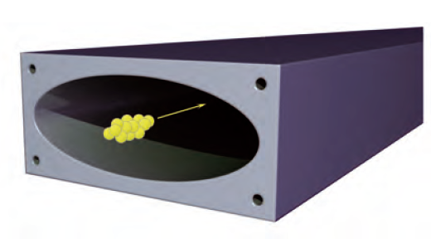
Storage ring
Vacuum Pump
Vacuum chamber for photons
Bending magnet
32 bending magnets : 600A power each : 1.7 Telsa
Hexapole
Quadrupole

Slide 17
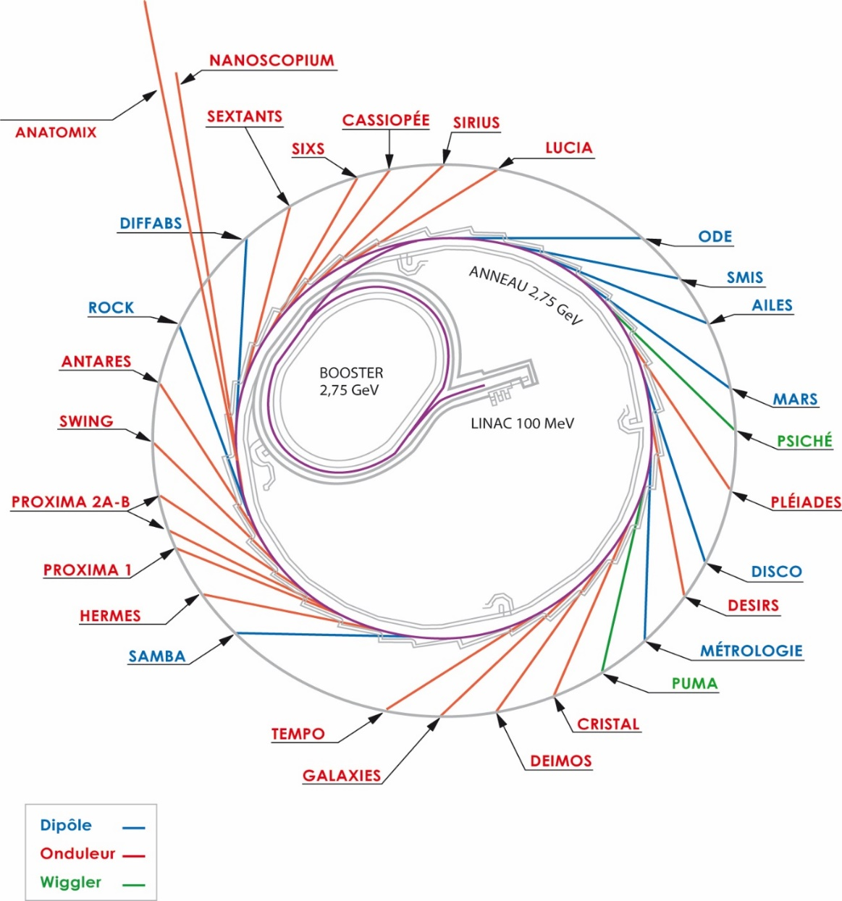
Odulators and wigglers

Slide 18
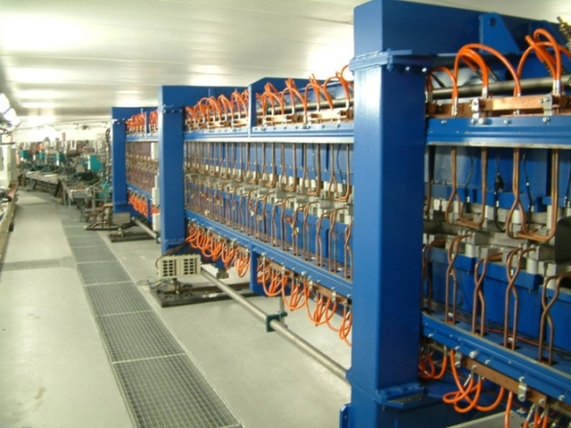
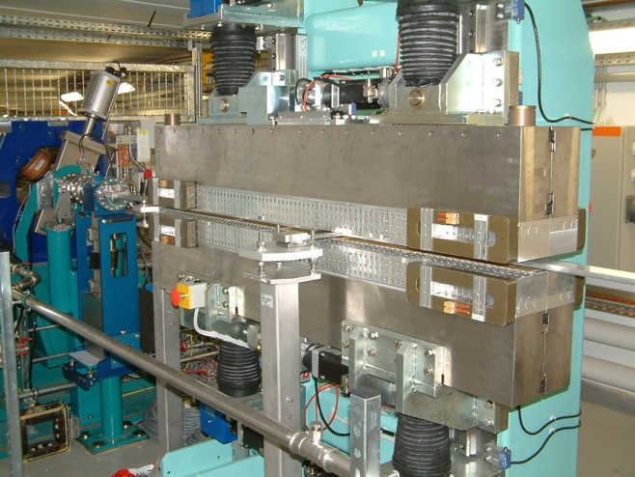
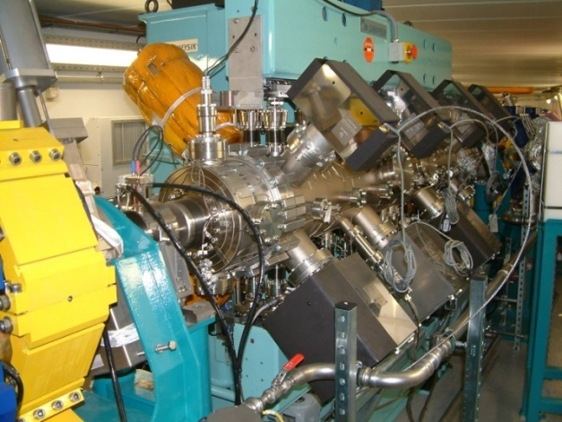
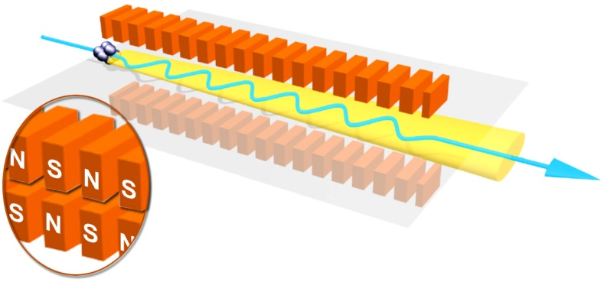
Odulators and wigglers
HU 640 : ligne DESIRS
(5 eV – 50 eV : Ultra Violet)
HU 80 : TEMPO
(100 eV - 3 keV : Soft X rays)
U 20 : ligne PROXIMA
(4 keV - 30 keV : Hard X rays)

Slide 19
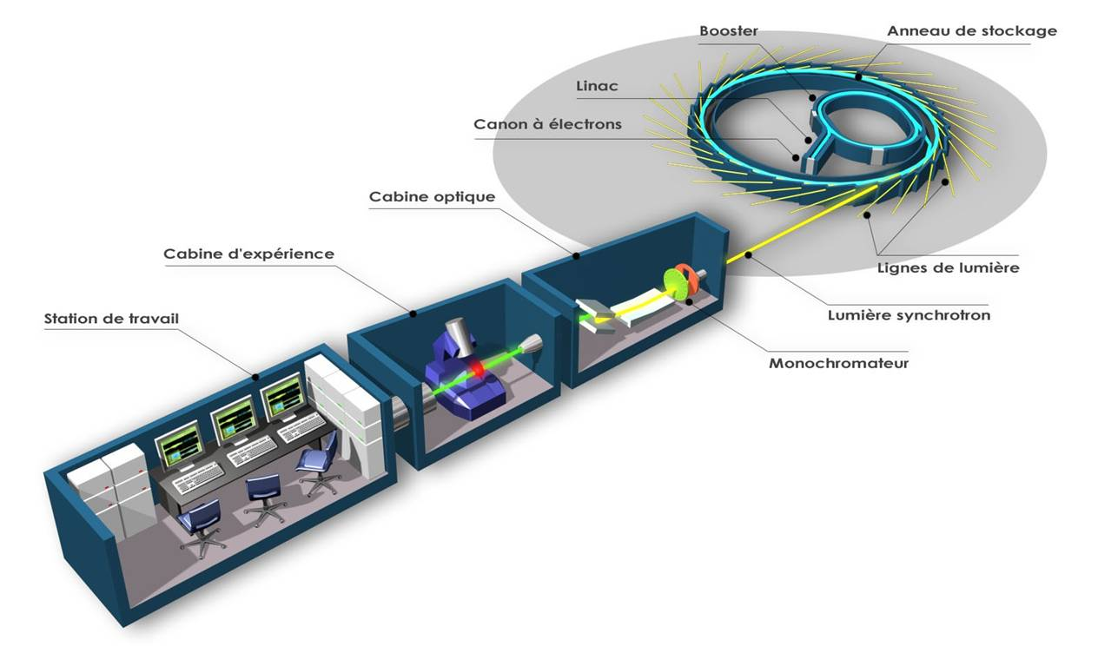
Beamline organisation
Booster
Storage ring
LINAC
Electron gun
Optical hutch
Experimental Hutch
Beamlines
Life station
Synchrotron radiation
Monochromator

Slide 20



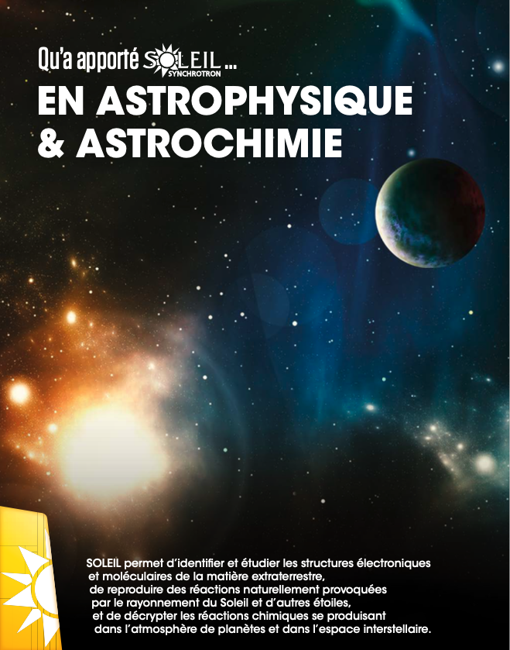

Impact of SOLEIL in different fields
To be continued …

Slide 21
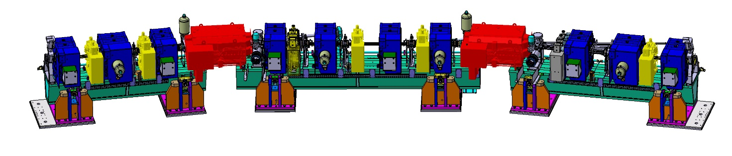
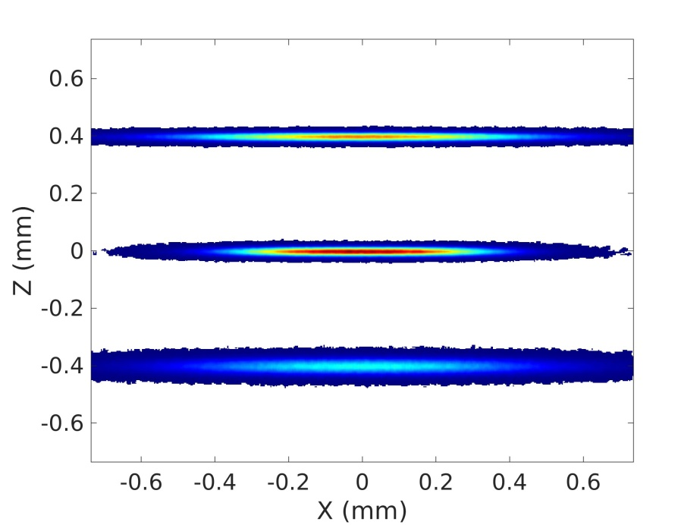
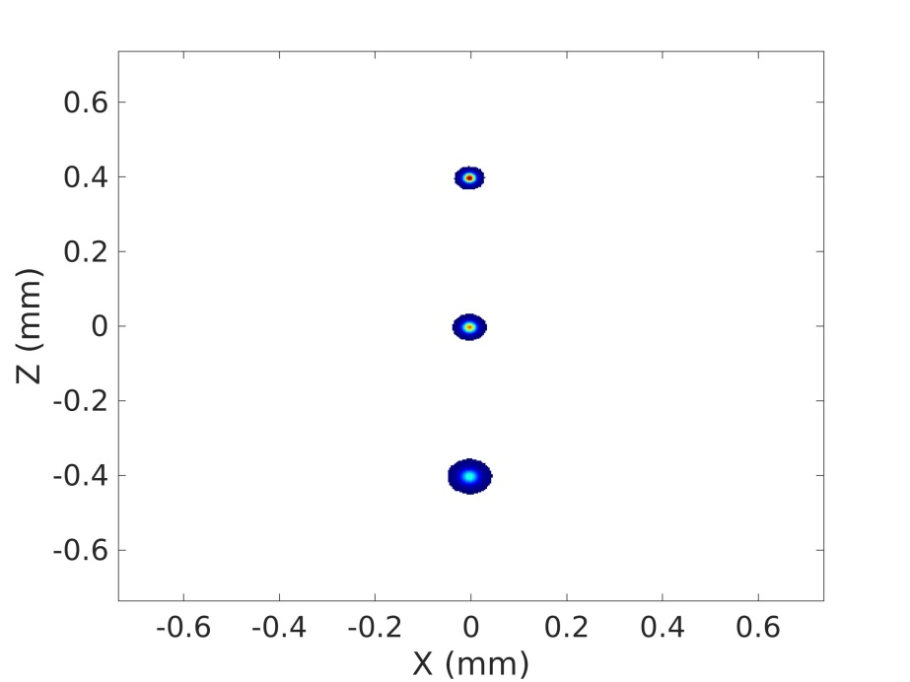
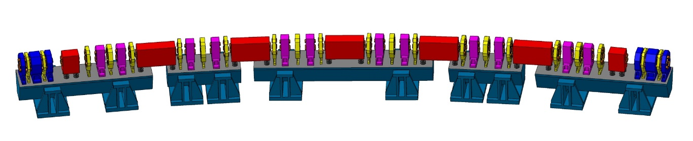
In the futur..
SOLEIL II : an upgrade of the accelerators, the beamlines and their environment
SOLEIL
SOLEIL II
< 10 μm x 10 μm
SOLEIL
Size of the electron beam
Modification of the storage ring
SOLEIL II

Slide 22
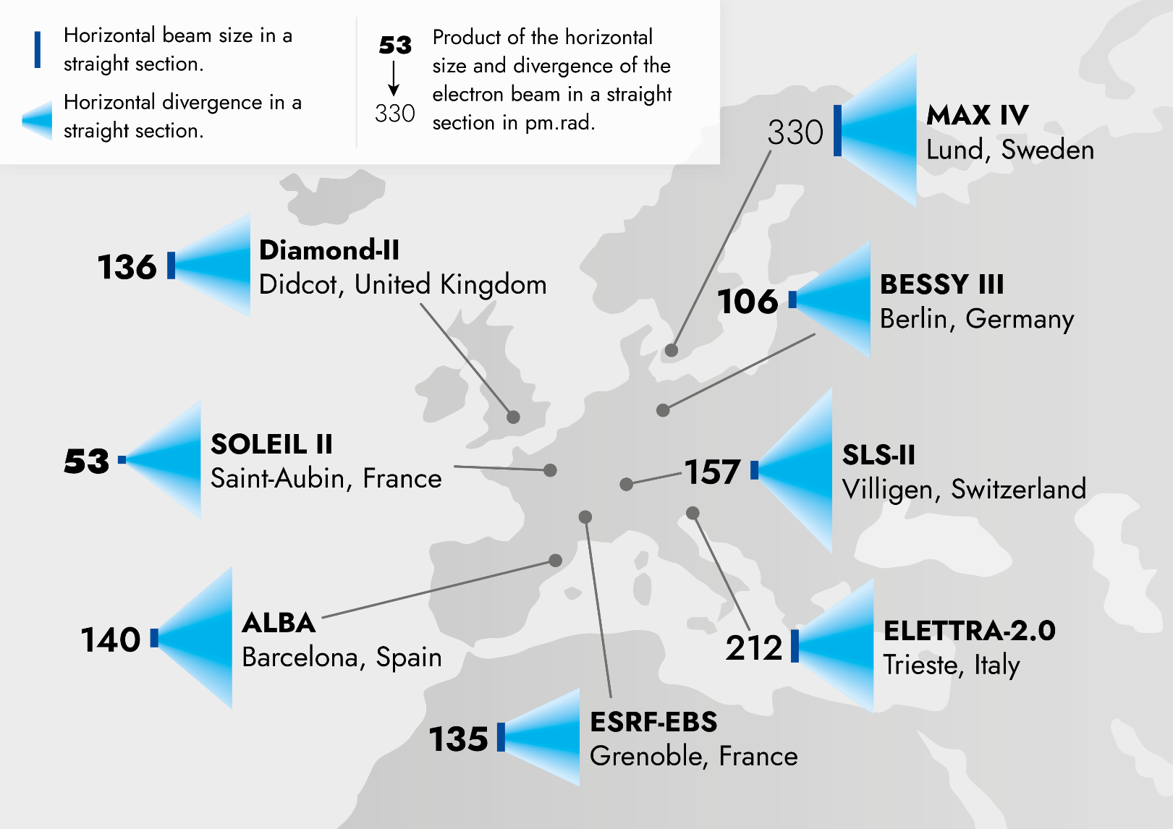
Et dans le futur …
SOLEIL II : an upgrade of the accelerators, the beamlines and their environment

Slide 23
Contact on the beamline
METROLOGIE : Pascal MERCERE
PUMA : Sebastian SCHOEDER & Laurent TRANCHANT
SAMBA : Emiliano FONDA
Proxima 2 : William SHEPARD

Slide 24
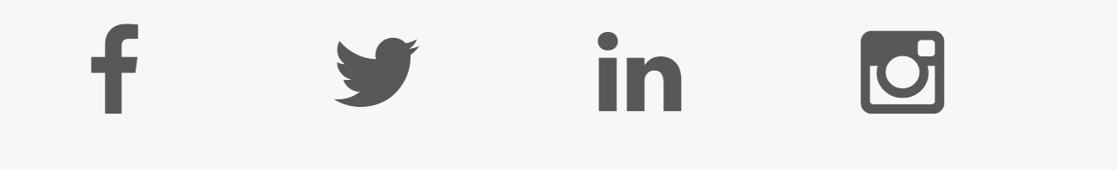
Follow us ☺
@synchroSOLEIL

Slide 25
Thank you

