Slide 1
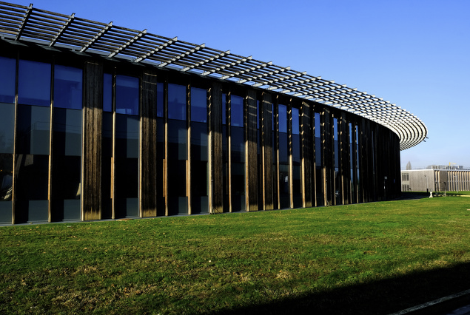
Recent progress in PETRA IV orbit feedback design
11th "Diagnostics Experts of European Light Sources" (DEELS) workshop
Sven Pfeiffer for the WP2.08 team
Burak Dursun, Szymon Jablonski, Sajjad Hussain Mirza, Holger Schlarb, Jan Magnus Christmann (TU Darmstadt), …
Saint-Aubin, 10.06.2024

Slide 2

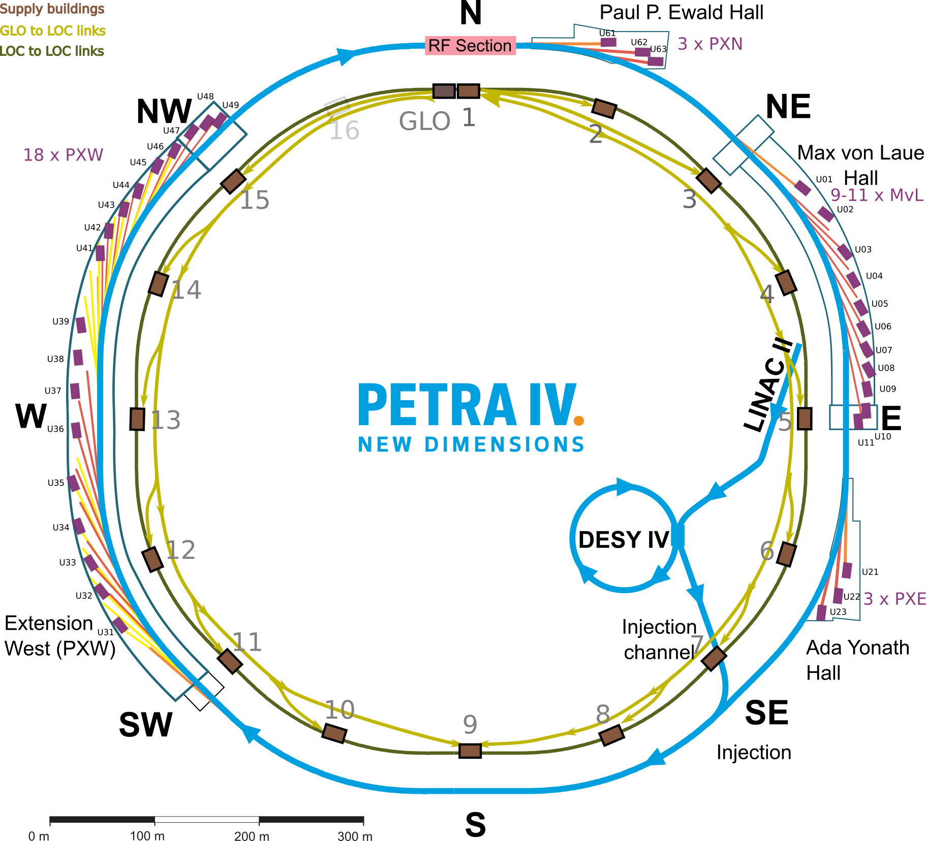
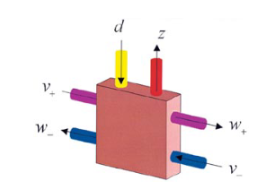
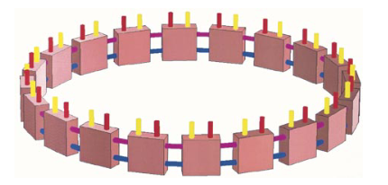
FOFB system topology
Ring: 2.3km, 789 BPMs, 560 fast correctors, FOFB: 10% (5%, 3%) beam stability, DC to 1kHz
Latency optimized topology
1 central control unit (GLO)
  Close to RF system / timing system
  Short path from GLO to LOC in experimental halls
15 distributed local sections (LOC)
  BPM collector
  Transmitter to power supplies
Optical fiber communication links
  Global to all local systems → classical regulation
  Local to local system
    For local control scheme integrating experiments
    Redundant system mode as future upgrade

Slide 3
FOFB System Design

Slide 4


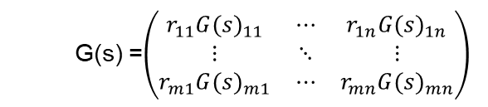
FOFB system: a cross-directional problem
A two dimensional control problem
The goal is to maintain the beam position throughout the ring → Spatial domain
Over time → Temporal domain
All corrector channels should have identical temporal response
  G(s) =$\left(\begin{matrix}r_{11}{G(s)}_{11} & ⋯ & r_{1n}{G(s)}_{1n} \\ ⋮ & ⋱ & ⋮ \\ r_{m1}{G(s)}_{m1} & ⋯ & r_{mn}{G(s)}_{mn}\end{matrix}\right)$
with
$$r_{mn}= \frac{\sqrt{β_{m}{\left(z\right)β}_{n}\left(z\right)}}{2πQ} cos⁡(πQ−|φ_{m}(z)−φ_{n}(z)|)$$
G(s) = G(s)R
C(s) = C(s)$R^{+}$
2 step simulation
Dynamical system at 1 location with all TFs
  Worst case scenario → best case for MIMO
Spatial (MIMO) system with main dynamics

Slide 5
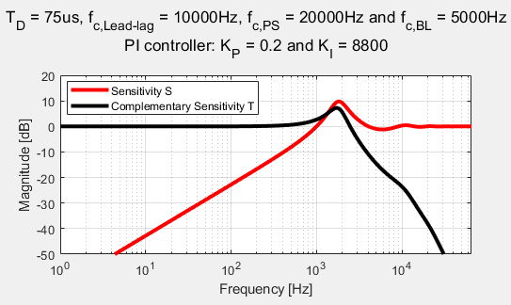
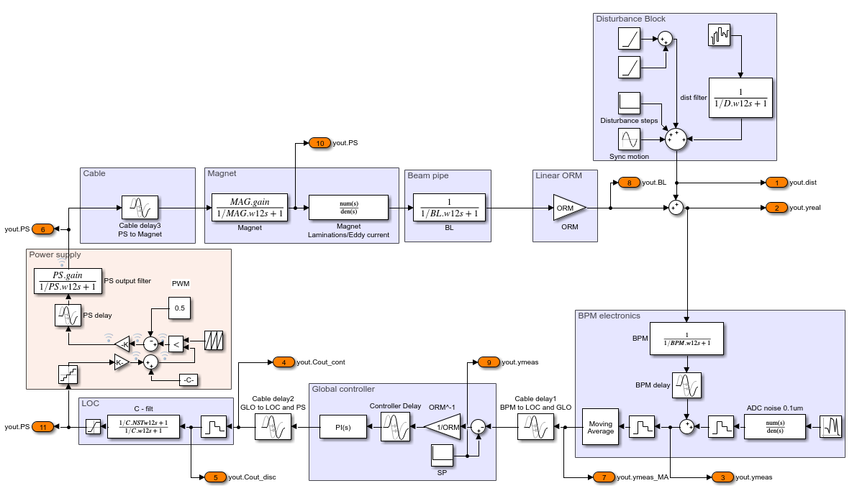
FOFB system
SISO simulation
Disturbance
(based on PIII)
Subsystems based on PETRA IV design
Disturbance spectra approximated with measurement at PIII
PI controller optimized for 1kHz disturbance rejection
Sensitivity function for disturbance rejection
Complementary S for reference tracking
1Hz for 23mH
Plant: Magnet, vacuum chamber and ORM element
Orbit in vacuum chamber
1.5us
60kHz
7kHz
0.167mm/A
V_{D}
I_{D}
Magnet Power Supply
(PWM as noise)
30kHz
Loop delay ~ 75µs
15us
BPM
(noise)
65kHz
PI controller
20.4us
7.5us
23.1us
V_{SP}
zoh
40 & 50kHz
I_{SP}
0.1um

Slide 6

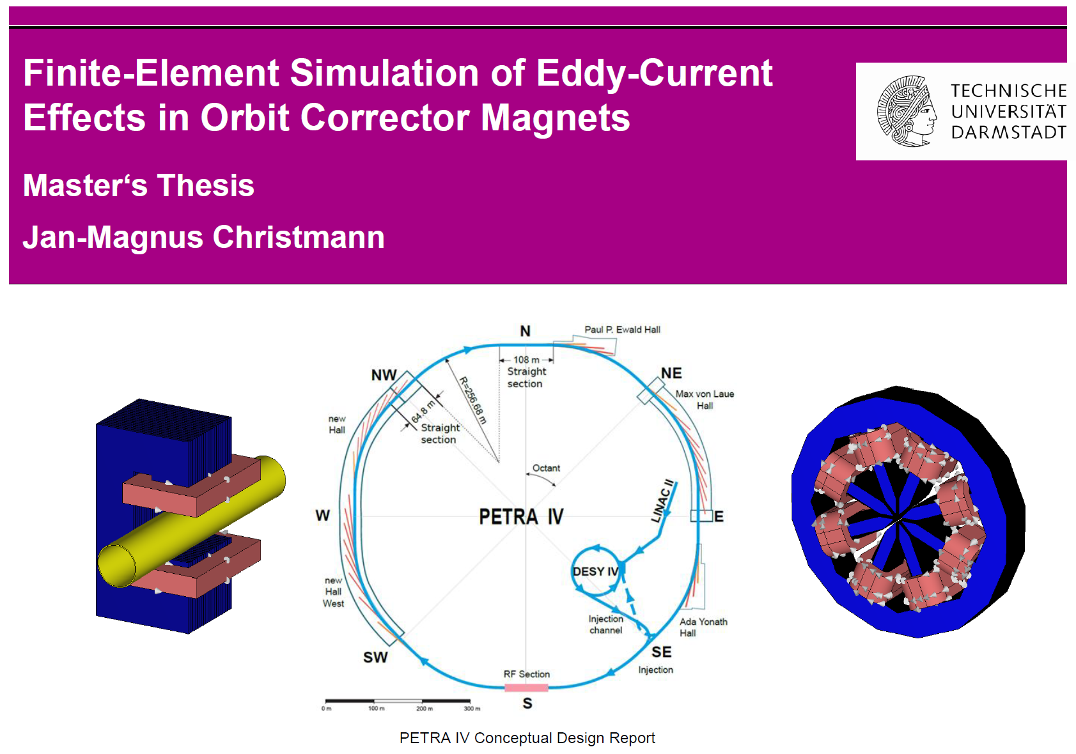
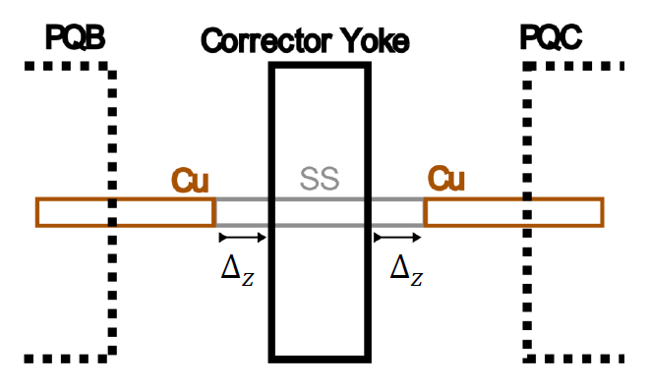
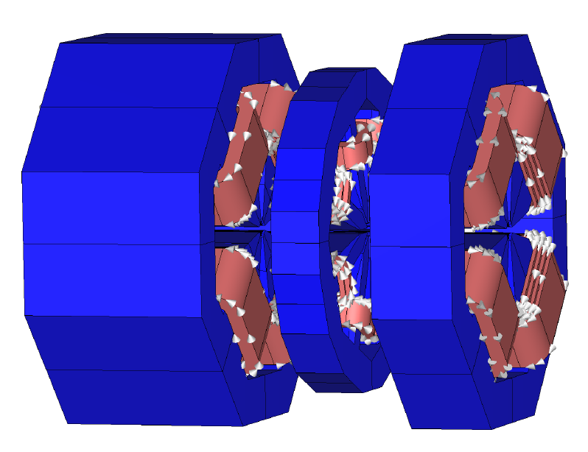
PIV - FOFB system
Institute for Accelerator Science and Electromagnetic Fields (TEMF)
Fast corrector magnet and vacuum chamber
Dynamic transfer functions
  Fast corrector magnet
    G = 1/(R + sL) (~Hz BW)
    Lamination thickness (30kHz - fractional order)
  Vacuum chamber (7kHz BW)
  Magnet power supply
    Output filter (30kHz)
  BPM electronics
Delays
  Processing delay
  Signal propagation
  Communication (time between sending and receiving)
Noise
  PS Quantization noise
  Pulse width modulation of the magnet power supply
  BPM electronic / sensor noise
Disturbances
  Incoherent: DC … kHz
Spatial disturbances
  Coherent: <1Hz (ocean waves)
  Transition: 1…10Hz (traffic noise)
2 step procedure
Simulation for optimization
  Started as Master thesis, now PhD thesis
Validation on test bench
  Corrector magnet including VC (and quads)

Slide 7
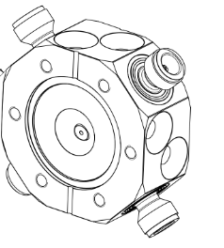
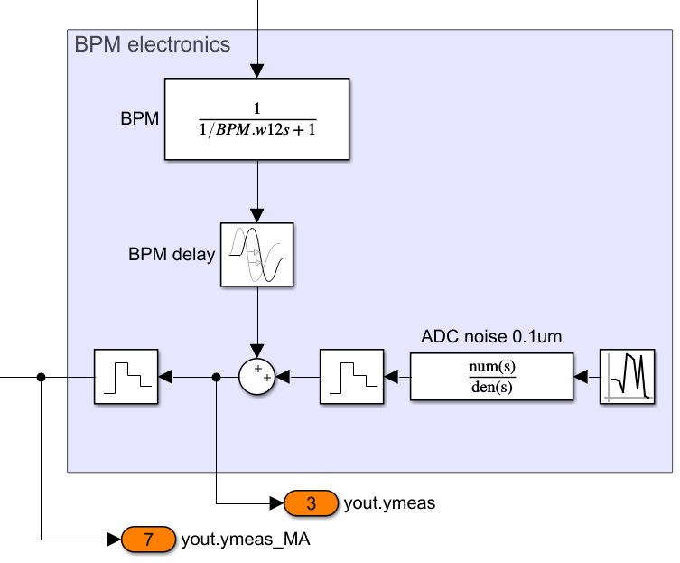

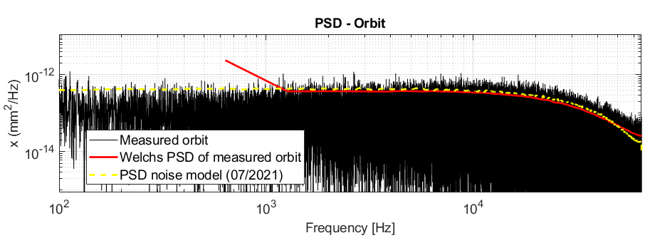
PIV - FOFB system
BPM electronics
IN
Dynamic transfer functions
  Fast corrector magnet
    G = 1/(R + sL) (~Hz BW)
    Lamination thickness (30kHz - fractional order)
  Vacuum chamber (7kHz BW)
  Magnet power supply
    Output filter (30kHz)
  BPM electronics
Delays
  Processing delay
  Signal propagation
  Communication (time between sending and receiving)
Noise
  PS Quantization noise
  Pulse width modulation of the magnet power supply
  BPM electronic / sensor noise
Disturbances
  Incoherent: DC … kHz
Spatial disturbances
  Coherent: <1Hz (ocean waves)
  Transition: 1…10Hz (traffic noise)
Model for DDC (digital down conversion)
OUT
Noise measured at PIII
Adapted for PIV simulation
BPM noise as function of bunch pattern, … ?

Slide 8
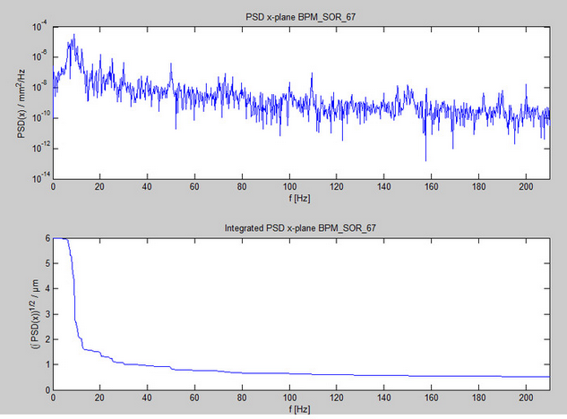
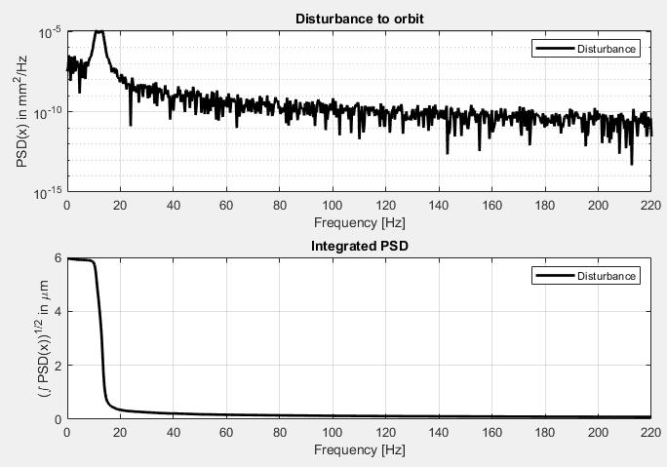
PIV - FOFB system
Disturbance integration - SISO
Dynamic transfer functions
  Fast corrector magnet
    G = 1/(R + sL) (~Hz BW)
    Lamination thickness (30kHz - fractional order)
  Vacuum chamber (7kHz BW)
  Magnet power supply
    Output filter (30kHz)
  BPM electronics
Delays
  Processing delay
  Signal propagation
  Communication (time between sending and receiving)
Noise
  PS Quantization noise
  Pulse width modulation of the magnet power supply
  BPM electronic / sensor noise
Disturbances
  Incoherent: DC … kHz
Spatial disturbances
  Coherent: <1Hz (ocean waves)
  Transition: 1…10Hz (traffic noise)
BPM Measurement at PIII
Start with PIII disturbance model to check PIV system simulations
→ Expect reduced distortions at PIV by optimization of girder eigenfrequencies
Approximation for simulation

Slide 9
PIV - FOFB system
Blocks for simulation
Dynamic transfer functions
  Fast corrector magnet
    G = 1/(R + sL) (~Hz BW)
    Lamination thickness (30kHz - fractional order)
  Vacuum chamber (7kHz BW)
  Magnet power supply
    Output filter (30kHz)
  BPM electronics
Delays
  Processing delay
  Signal propagation
  Communication (time between sending and receiving)
Noise
  PS Quantization noise
  Pulse width modulation of the magnet power supply
  BPM electronic / sensor noise
Disturbances
  Incoherent: DC … kHz
Spatial disturbances
  Coherent: <1Hz (ocean waves)
  Transition: 1…10Hz (traffic noise)
MIMO simulation and mode space analysis

Slide 10
SISO simulation

Slide 11
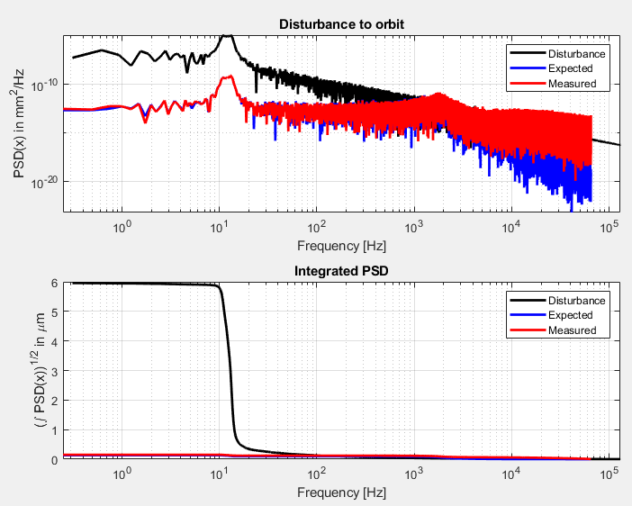
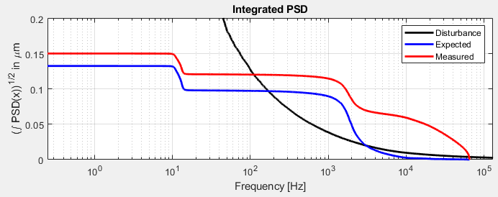
FOFB system
SISO simulation
Disturbance spectra approximated with measurement at PIII
Subsystems based on PETRA IV design
PI controller optimized for 1kHz disturbance rejection
150nm measured
132nm expected
→ 4…5% beam size
Factor 40 (32dB)
reduction by feedback;
Limited to FB controller and BPM noise
Red: measured with BPM noise
Blue: simulated without BPM noise
Zoom in y
Waterbed effect increasing orbit jitter
(latency and dynamics dependent)

Slide 12
Fractional order systems and it’s modelling

Slide 13
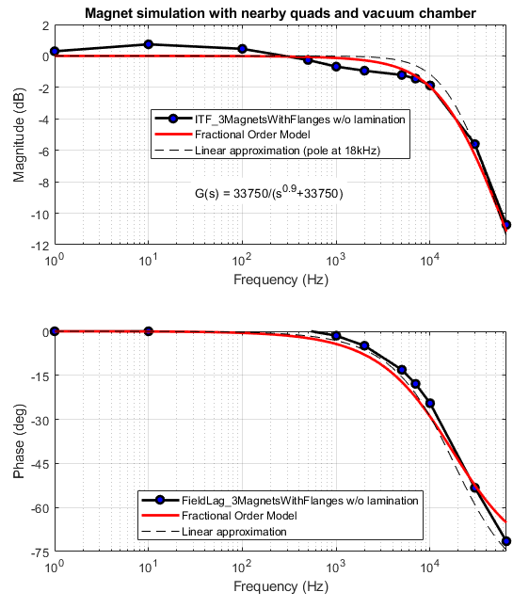
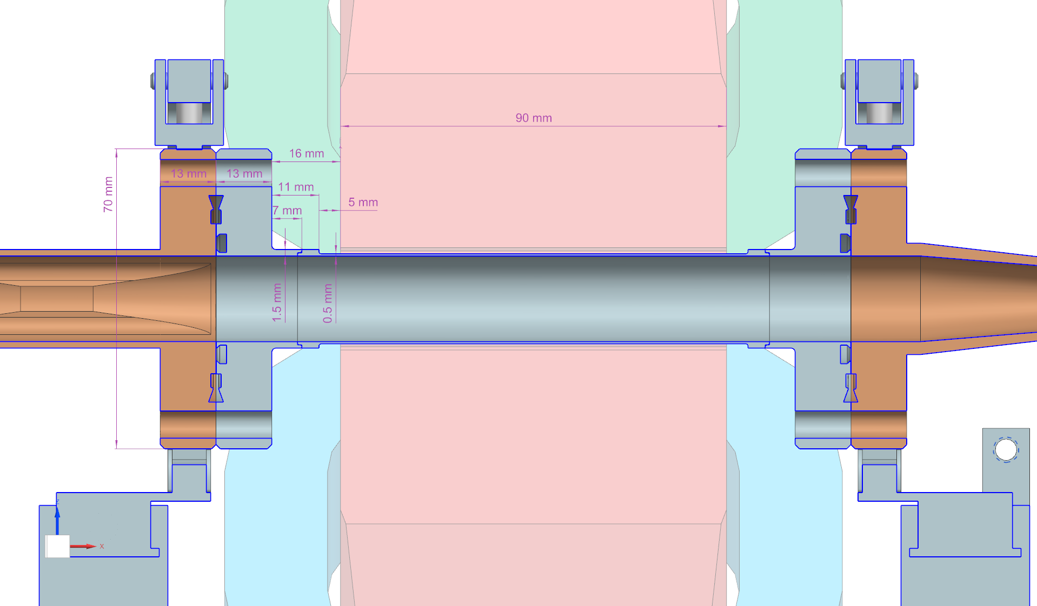
Fractional order systems and it’s modelling
Two potential system with fractional order characteristic
SS vacuum chamber with CU transition
Yoke → next slides
SS vacuum chamber with symmetric CU transitions
First order approximation seems sufficient

Slide 14
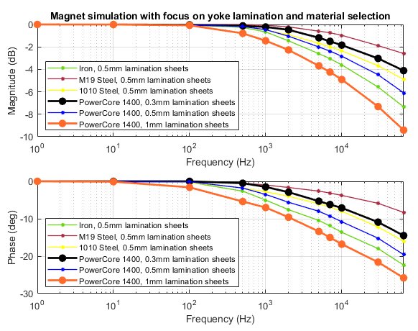
TEMF simulations
Yoke variations
1st prototype magnet with PowerCore 1400 and 1mm lamination
  3kHz with -10deg.
2nd prototype magnet with PowerCore 1400 and 0.3mm lamination
  30kHz with -10deg.

Slide 15
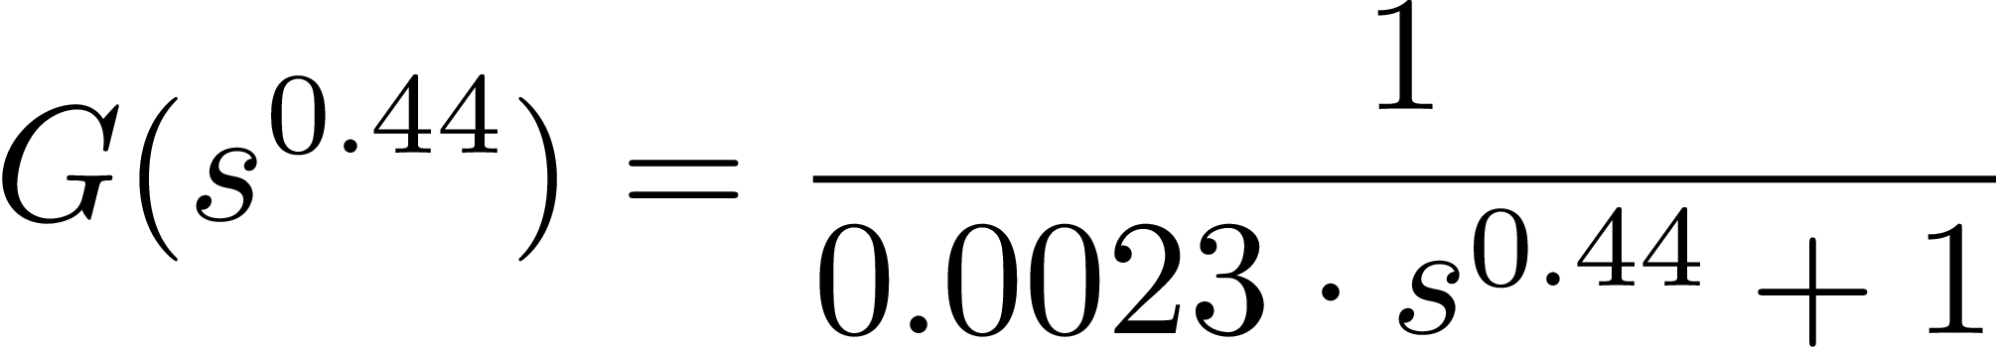
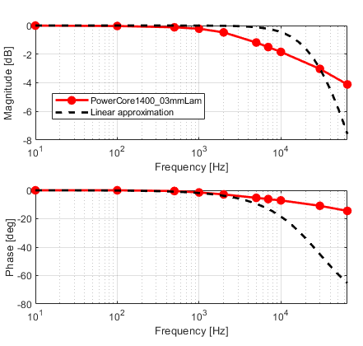
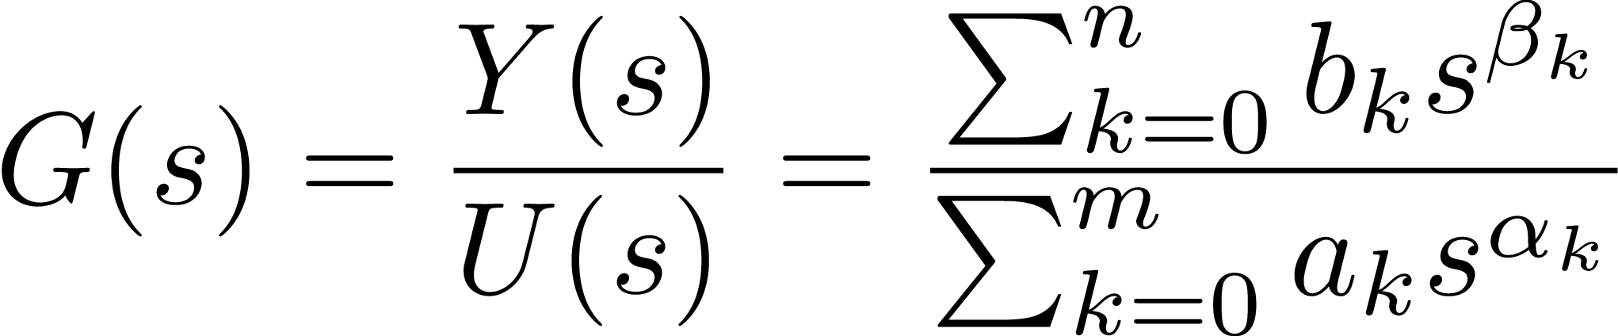
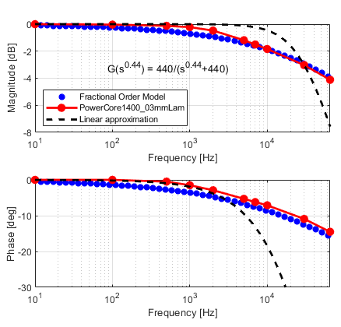
Fractional order characteristics
Modelling
First order system
All subsystems in full simulation approximated by first or higher order
  Assumption: worst case scenario with minimum phase margin in feedback
Fractional order systems
… is a dynamical system that can be modeled by a fractional differential equation containing derivatives of non-integer order (Wiki).
Fractional order characteristics
First order fractional system

Slide 16
SISO Fractional Order System Simulation

Slide 17
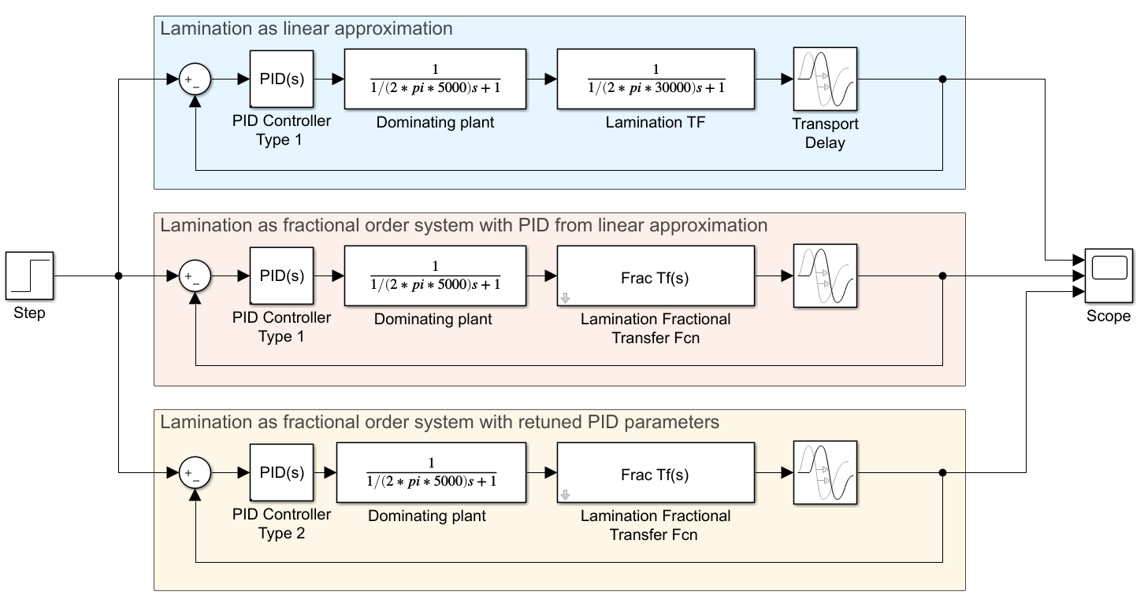
Fractional order characteristics
PI controller with linear system → 1st order modelling
PI controller with fractional order system → reality
PI controller adapted with fractional order system
PI controller for yoke lamination
Simulation
Dominating pole as approximation of the main plant characteristics (5kHz)
Feedback delay ~75us
Magnet laminations as
  Linear approximation
  Fractional order system
PI Feedback controller
  Designed with linear approximation
  Matched with fractional characteristics

Slide 18
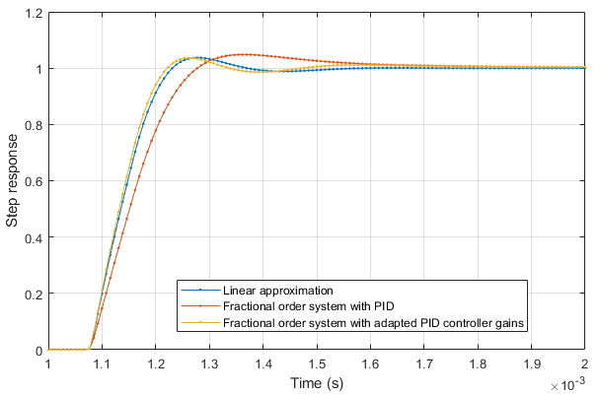
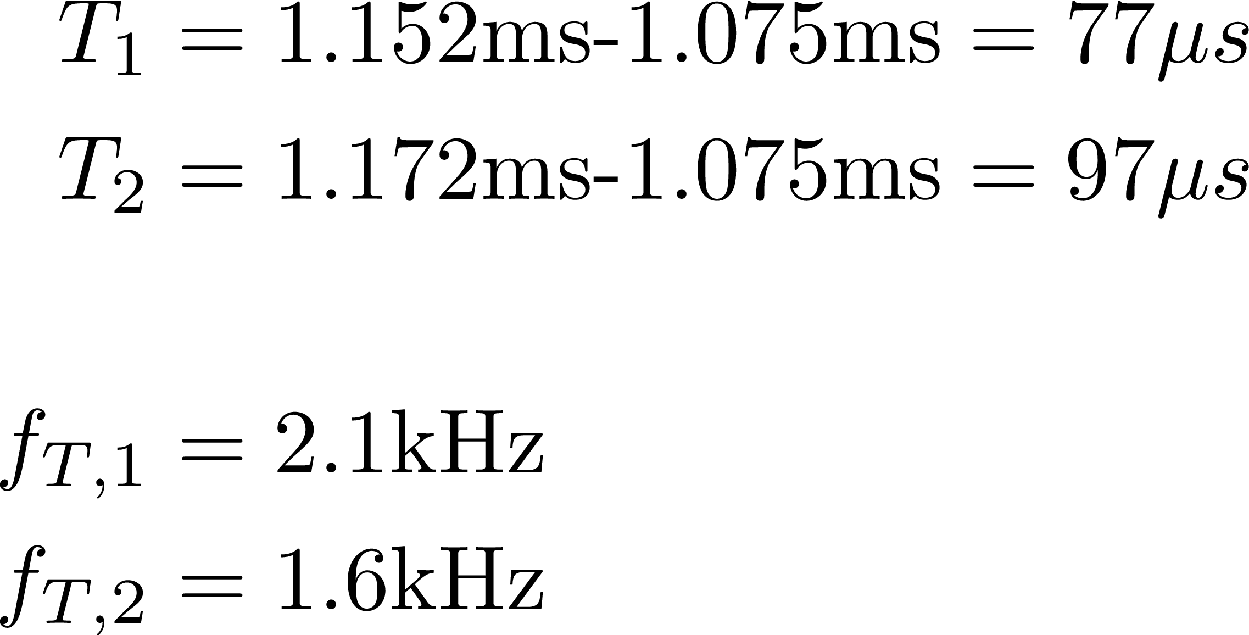
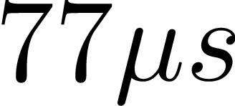

Fractional order characteristics
500Hz mismatch in closed loop.
BUT with adopted PID settings similar reference tracking characteristic achieved.
PID controller for yoke lamination
Simulation
Dominating pole as approximation of the main plant characteristics (5kHz)
Feedback delay ~75us
Magnet laminations as
  Linear approximation
  Fractional order system
PI Feedback controller
  Designed with linear approximation
  Matched with fractional characteristics
63% SS
I gain +10%
P gain +50%

Slide 19
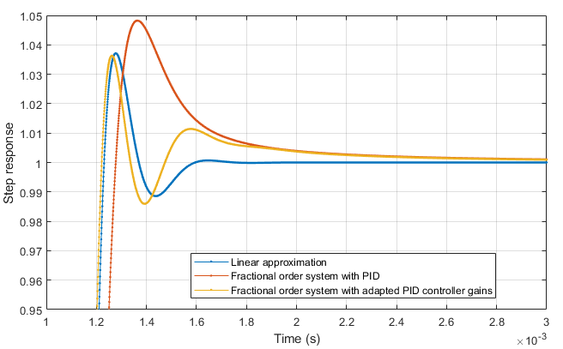
Fractional order characteristics
Linear vs fractional order system:
>1ms to reach convergence
PID controller for yoke lamination
Simulation
Adapted PID settings for faster reference tracking at the beginning (first 0.1ms)
Mismatch of the low frequency tracking
Might not be relevant for disturbance suppression feedback
BUT, might be of importance for integration of photon diagnostics using reference tracking → longer settling time

Slide 20
Conclusion & Outlook
Models (few) derived for (most) PIV systems
Simulations of fast/slow corrector magnet, vacuum chamber by TEMF
BPM noise characteristics measured at PETRA III
  Partly open for charge/bunch pattern/ … variations
Disturbance spectra of PETRA III for PIV simulations
Fractional order modelling of laminations and effect to feedback regulation with adapted PI settings
  Observed larger convergence time for reference tracking
Outlook
Next: Validation of first prototype corrector on magnet test bench
MIMO simulations with disturbance models
  Coherence length, PSD, girder transfer characteristic…
…
Thank you

Slide 21
Sven Pfeiffer
DESY - MSK
sven.pfeiffer@desy.de
+49 40 8998 2744

