Slide 1
DCCT Noise and Beam Lifetime Measurement
11th DEELS workshop SOLEIL, June 10-11 2024
Gero Kube
Saint-Aubin, 11.6.2024

Slide 2
Motivation
How it started…
in one (of many) meetings, question popped up
how fast does it take to measure a reliable beam lifetime?
searching in literature
topic of beam lifetime seldom treated
had to scratch my head and do it by myself…

Slide 3
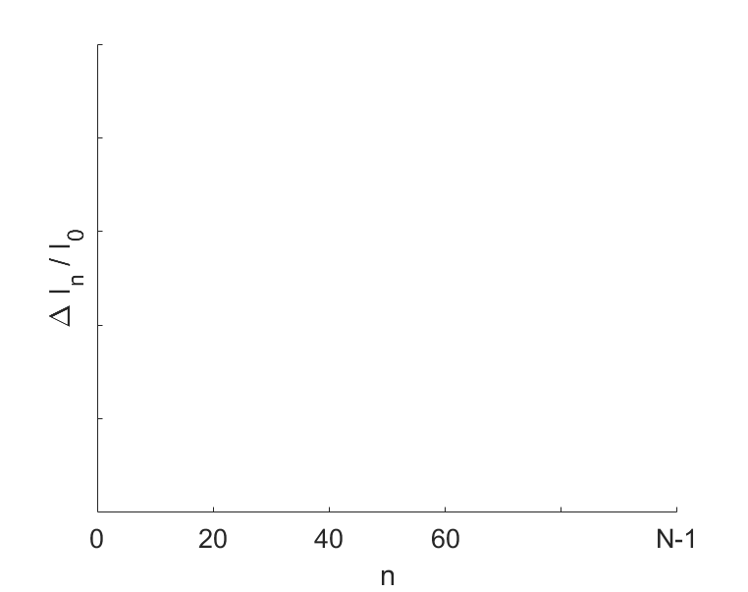
Lifetime Determination
Recapitulation
Principle
$$I\left(t\right)=I_{0}e^{−t/τ}$$
exponential decay of lifetime
measurement with fixed sample rate
e.g. via DVM: fixed Number of Power Line Cycles (NPLC)
$$I_{n}=I\left(nT_{s}\right)=I_{0}e^{−{nT_{s}}/τ}$$
$$t=n T_{s}$$
$${nT}_{s}≪τ$$
standard assumption:
$${→ I}_{n}≈I_{0}\left(1−\frac{T_{s}}{τ}n\right)$$
$\frac{∆I}{I_{0}}$ = $\frac{T_{s}}{τ}n$
lifetime determination
information about τ: in slope
access to slope (and error) → χ ² minimization

Slide 4
χ² Minimization
Parameter Estimation
Task
$$f\left(x_{n}\right)=m{∙x}_{n}+b$$
determine slope with error from data set (x_{n} , y_{n}), assuming linear relationship
standard method: χ ² minimization → for simple cases: analytical expression
$$χ^{2}=\sum_{n=0}^{N−1}{\frac{{\left[y_{n}−f\left(x_{n}\right)\right]}^{2}}{σ_{n}^{2}}=\sum_{n=0}^{N−1}{\frac{1}{σ_{n}^{2}}}}\left[y_{n}^{2}−2{mx}_{n}y_{n}−2by_{n}+m^{2}x_{n}^{2}+2mbx_{n}+b^{2}\right]=F−2mE−2bC+m^{2}D+2mbA+b^{2}B$$
$$A≔\sum_{n=0}^{N−1}{\frac{x_{n}}{σ_{n}^{2}}, B} ≔\sum_{n=0}^{N−1}{\frac{1}{σ_{n}^{2}}, C≔\sum_{n=0}^{N−1}{\frac{y_{n}}{σ_{n}^{2}}}}$$
find (m₀ ,b₀) which minimize χ ²
with
$$\frac{∂χ^{2}}{∂m}=−2E+2m_{0}D+2b_{0}A≝0$$
$$\frac{∂χ^{2}}{∂b}=−2C+2m_{0}A+2b_{0}B≝0$$
$$D≔\sum_{n=0}^{N−1}{\frac{x_{n}^{2}}{σ_{n}^{2}}, E} ≔\sum_{n=0}^{N−1}{\frac{x_{n}y_{n}}{σ_{n}^{2}}, F≔\sum_{n=0}^{N−1}{\frac{y_{n}^{2}}{σ_{n}^{2}}}}$$
$$m_{0}=\frac{EB−AC}{BD−A^{2}}$$
result (consider only slope because of τ-dependency)

Slide 5
χ² Minimization (2)
Parameter Error
Covariance or Error Matrix
$$C= \left(\begin{matrix}σ_{1}^{2} & & Cov(σ_{m},σ_{l}) \\ & ⋱ & \\ Cov(σ_{l},σ_{m}) & & σ_{r}^{2}\end{matrix}\right)=A^{−1}$$
$$A_{l,m}={\left.\frac{1}{2}\frac{∂^{2}χ^{2}}{∂c_{l}∂c_{m}}\right|}_{c_{l,0}c_{m,0}}$$
reminder
with
application
form matrix A
$$χ^{2}=F−2mE−2bC+m^{2}D+2mbA+b^{2}B$$
$$A_{1,1}={\left.\frac{1}{2}\frac{∂^{2}χ^{2}}{∂m^{2}}\right|}_{m_{0},b_{0}}=D$$
$$A_{1,2}= A_{2,1}={\left.\frac{1}{2}\frac{∂^{2}χ^{2}}{∂m∂b}\right|}_{m_{0},b_{0}}=A$$
$$A_{2,2}={\left.\frac{1}{2}\frac{∂^{2}χ^{2}}{∂b^{2}}\right|}_{m_{0},b_{0}}=B$$
$$⇒ A=\left(\begin{matrix}D & A \\ A & B\end{matrix}\right)$$
matrix inversion
$$C=A^{−1}=\frac{1}{BD−A^{2}}\left(\begin{matrix}B & −A \\ −A & D\end{matrix}\right) = \left(\begin{matrix}σ_{m_{0}}^{2} & σ_{m_{0,}b_{0}} \\ σ_{m_{0,}b_{0}} & σ_{b_{0}}^{2}\end{matrix}\right)$$
$$σ_{m_{0}}=\sqrt{\frac{B}{BD−A^{2}}}$$
result (consider only slope error because of τ-dependency)

Slide 6
Parameter Estimate and Error
Appliction to specific Example
Data Sampling with constant Rate
assignment:
$$x_{n}→n$$
$$σ_{n}→σ \left(constant for all sample points\right)$$
simplification
$$A=\sum_{n=0}^{N−1}{\frac{x_{n}}{σ_{n}^{2}}=\frac{1}{σ^{2}} \frac{N\left(N−1\right)}{2}, B}=\sum_{n=0}^{N−1}{\frac{1}{σ_{n}^{2}}=\frac{N}{σ^{2}}, D=\sum_{n=0}^{N−1}{\frac{x_{n}^{2}}{σ_{n}^{2}}=\frac{1}{σ^{2}}}}\frac{\left(N−1\right)N\left(2N−1\right)}{6}$$
result
$$m_{0}=\frac{6}{\left(N+1\right)N\left(N−1\right)}\sum_{n=0}^{N−1}{y_{n}}\left\{2n−N+1\right\}$$
$$σ_{m_{0}}=2σ\sqrt{\frac{3}{\left(N+1\right)N\left(N−1\right)}}$$

Slide 7
Lifetime and Lifetime Error
Transfer
Lifetime
$$\underbrace{∆I_{n}}=\underbrace{I_{0}\frac{T_{s}}{τ}}∙\underbrace{n}$$
$$τ=\frac{T_{s}}{6}∙\frac{\left(N+1\right)N\left(N−1\right)}{\sum_{n=0}^{N−1}{\frac{I_{0}−I_{n}}{I_{0}}}\left\{2n−N+1\right\}}$$
recap:
$$y_{n}$$
$$x_{n}$$
$$m_{0}$$
Lifetime Error
error propagation
$τ=$ $I_{0}\frac{T_{s}}{m_{0}}$
${⇒ σ}_{τ}=$ $I_{0}\frac{T_{s}}{m_{0}^{2}}σ_{m_{0}}=\frac{τ^{2}}{I_{0}T_{s}}$ $σ_{m_{0}}$
insert
$\frac{σ_{τ}}{τ}=2\sqrt{3}$ $\frac{τ}{T_{s}}$ $\frac{σ_{I}}{I_{0}}\frac{1}{\sqrt{\left(N−1\right)N\left(N+1\right)}} ≈ 2\sqrt{3} \frac{τ}{T_{s}} \frac{σ_{I}}{I_{0}}\frac{1}{\sqrt{N^{3}}}$
introduce current loss in data acquisition period: $∆I_{N}=I_{0}N\frac{T_{s}}{τ}$
$$\frac{σ_{τ}}{τ}=2\sqrt{3} \frac{σ_{I}}{{∆I}_{N}}\frac{1}{\sqrt{N}}$$
in accordance with
X. Huang, J. Corbett, NIM A629 (2011) 31

Slide 8
Data Acquisition Time
Transfer
Number of Samples and Acquisition Time
$$N=\sqrt[3]{12{\left(\frac{τ}{T_{s}} \frac{σ_{I}}{I_{0}}\frac{1}{{σ_{τ}}/τ}\right)}^{2}}$$
$$t_{acq}=\sqrt[3]{12{ T}_{s}τ^{2}{\left( \frac{σ_{I}}{I_{0}}\frac{1}{{σ_{τ}}/τ}\right)}^{2}}$$
rearrangement
Examples
PETRA IV high brightness mode:
I₀ = 200 mA
σ_{I} = 0.5 µA
τ = 10 h
σ_{τ}/τ = 1%
T_{s} = 0.2 s${ t}_{acq}=5.8 s$
example X. Huang, J. Corbett, NIM A629 (2011) 31
I₀ = 100 mA
σ_{I} = 1 µA
τ = 50 h
σ_{τ}/τ = 1%
T_{s} = 1 s${ t}_{acq}=73 s$

Slide 9
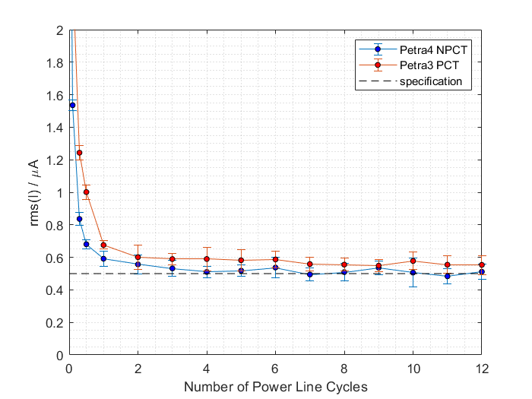
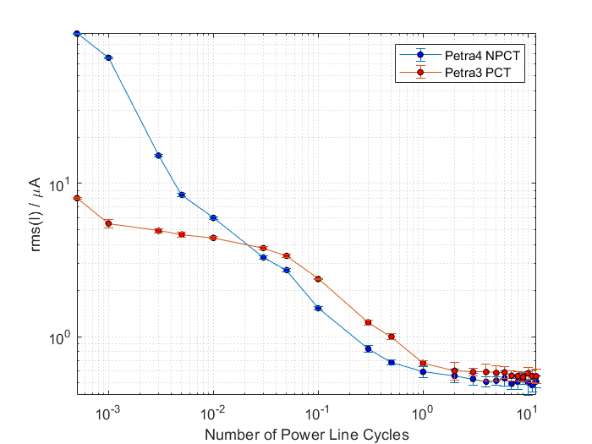
DCCT Studies at PETRA III
Performance Studies in view of PETRA IV
Resolution Studies: P3 PCT vs. P4 NPCT installed at P3
requirement
ability to detect each tranferred bunch with DC monitor
minimum transferred current (200 mA, 1920 bunches, 1% top-up)
I_{min} = 1 µA
minimum detectable current: factor 2 above noise level
maximum noise level: rms(I) ≤ 0.5 µA
NPCT fulfils specifications
measurement: monitor resolution as function of NPLC
natural time unit: Number of Power Line Cycles (NPLC)
readout based on 7.5 digit DVM (Keithley DMM 7510)
resolution dominated by (N)PCT noise, not by DVM
interesting observation: PCT better than NPCT (NPLC « 1)

Slide 10
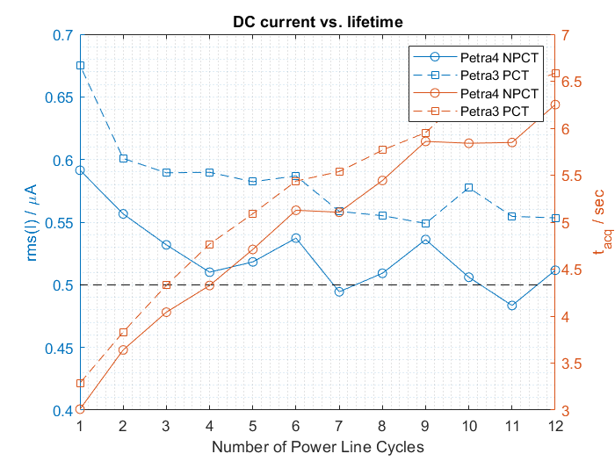
Lifetime versus Monitor Resolution
Performance Studies in view of PETRA IV
Lifetime Determination
lifetime determination based (usually) on measurement of DC current
machine physics: fast lifetime determination → short measurement time, NPLC small
user stability: precise intensity measurement → long measurement time, NPLC large
balancing both requirements
assumptions:
I₀ = 200 mA
τ = 10 h
Δτ/τ = 1%
T_{s} = sampling time
lifetime determination to level of 1% should be possible within 5-6 s

Slide 11
Extension to multiple Devices
Qunatifying the Benefit
Proposal
instead of single DCCT → M intensity measurements available (e.g. BPM sum signal)
proposal and realization at ESRF (and others):
B.K. Scheidt, F. Ewald and B. Joly, Proc. DIPAC 2011, p .194
Modification
$$σ_{τ}=2\sqrt{3} \frac{τ^{2}}{T_{s}} \frac{σ_{I}}{I_{0}}\frac{1}{\sqrt{N^{3}}}$$
single device lifetime error
M devices, each with same error σ_{I}
$${\overline{σ}}_{τ}=\frac{σ_{τ}}{\sqrt{M}} =2\sqrt{3} \frac{τ^{2}}{T_{s}} \frac{σ_{I}}{I_{0}}\frac{1}{\sqrt{{MN}^{3}}}$$
modified data acquisition time:
$$t_{acq}^{M}=\sqrt[3]{\frac{12}{M}{ T}_{s}τ^{2}{\left( \frac{σ_{I}}{I_{0}}\frac{1}{{σ_{τ}}/τ}\right)}^{2}}$$

Slide 12
Data Acquisition Time for multiple Devices
Example
PETRA IV High Brightness Mode
parameters
σ_{I} / I₀ ≙ σ_{SUM} / SUM_{max} ≈ 2.23 x 10⁻⁵
τ = 10 h
σ_{τ}/τ = 1%
T_{s} = 0.1 s
M = 800
measured with Libera Brilliance @ 100 mA (max. ADC ≈ 20000)
SA data path
$$t_{acq}^{M}=2.1 s$$
number of BPMs for PETRA IV
( factor ≈ 2.7)

Slide 13
Question / Comment
Implementation on BPM Electronics
Χ² Minimization Result
$$τ=\frac{T_{s}}{6}∙\frac{\left(N+1\right)N\left(N−1\right)}{\sum_{n=0}^{N−1}{\frac{{SUM}_{0}−{SUM}_{n}}{{SUM}_{0}}}\left\{2n−N+1\right\}}$$
could it be of interest to implement it directly on Libera?
first attempt:
A. Kosicek, P. Leban, B.K. Scheidt, Proc. BIW 2010, p .311
fit result for exponential decay
exact formula without linearization
$$I_{n}=I\left(nT_{s}\right)=I_{0}e^{−{nT_{s}}/τ} ⇒ \underset{y_{n}}{\underbrace{ln\left(\frac{I_{0}}{I_{n}}\right)}}=\underset{m_{0}}{\underbrace{\frac{T_{s}}{τ}}} \underset{x_{n}}{\underbrace{n}}$$
$$τ=\frac{T_{s}}{6}∙\frac{\left(N+1\right)N\left(N−1\right)}{\sum_{n=0}^{N−1}{ln\left(\frac{{SUM}_{0}}{{SUM}_{n}}\right)}\left\{2n−N+1\right\}}$$

