Slide 1
Notes:
Slide 1: Company Logo Full Page
Before you start editing the slides of your talk change to the Master Slide view:
Microsoft Office :Menu: View > Slide Master;
Macintosh – View > Master > Slide Master
Edit the following items:
On the Slide Master (first master slide) – lower area
a) On the left Delete the text and write the title of the event/Conference, Location
b) On the right delete the text and write the name and surname of the speaker and the date (day, month , year)
Close Master View

Slide 2
Elettra 2.0 eBPM system architecture and its implementation in a complete Elettra section
R. De Monte, G. Brajnik, G. Gaio
Notes:
Slide 2: Title of the Presentation
Before you start editing the slides of your talk change to the Master Slide view:
Microsoft Office :Menu: View > Slide Master;
Macintosh – View > Master > Slide Master
Edit the following items:
On the Slide Master (first master slide) – lower area
a) On the left Delete the text and write the title of the event/Conference, Location
b) On the right delete the text and write the name and surname of the speaker and the date (day, month , year)
Close Master View
To start adding slides insert a new slide and select a Layout:
For Title & Subtitle
For text with bullet points
For Text
For Picture, graphs, visuals
Two columns
Blank

Slide 3
The current phase of eBPM for Elettra 2.0 project
The Elettra eBPM project is a partnership between Elettra Sincrotrone Trieste and Instrumentation Technologies.
The status of the project is on time and in particular we are in the final phase.
The eBPM electronics for two BPM is composed by:
Two units of a PilotTone RF Front End, which represents the analogue RF core of the signal processing which :
  Generates a pilot tone.
  Mixes the pilot tone to each of the 4 channels.
  Manages the gain of the RF chain.
  Manages the signal bandwidth with different filters.
  Is managed by an MCU that performs all the communication tasks.
One unit of a digital part that is a 2U aluminium box called DAQ10SX that contains:
  Two 4 channel ADC@210Msps FMC cards managed by a digital board with a high performance FPGA with SoC.
  In the FPGA the signals from the ADC are demodulated and processed to obtain a high resolution beam position, with nanometers resolution and with very high stability (<500nm in 8h).
  The SoC, running Linux OS, manages all the control system and housing tasks.

Slide 4
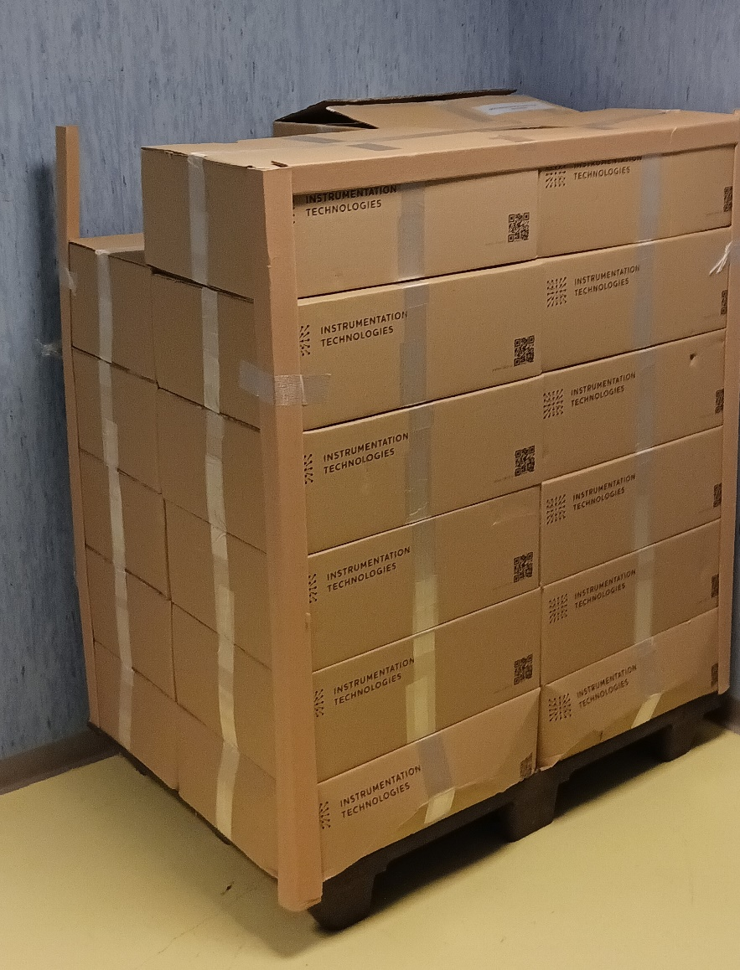
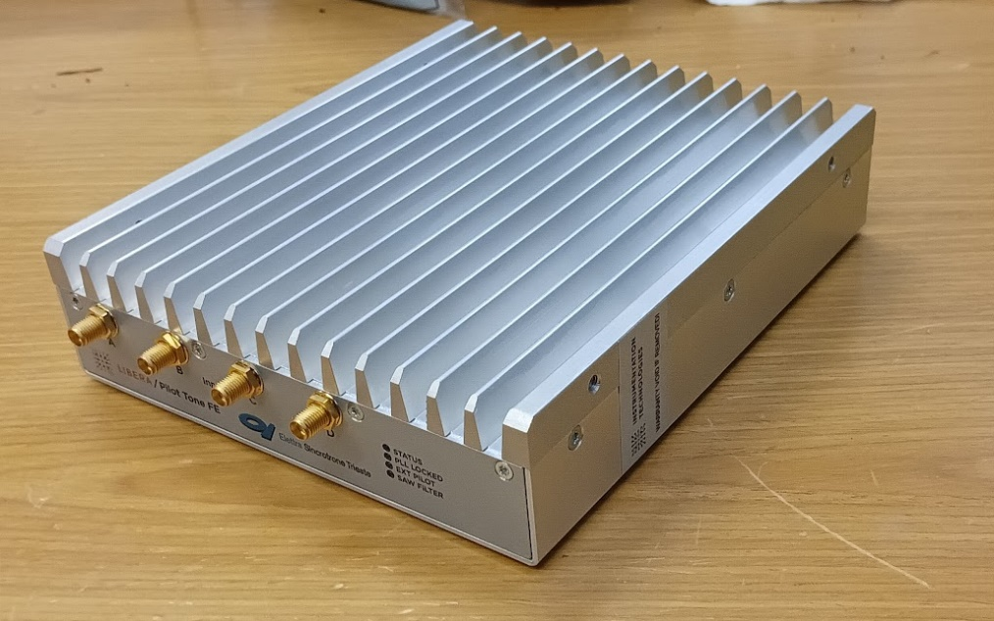
The current phase of eBPM for Elettra 2.0 project
Therefore, the following parts have been supplied:
No. 200 (two hundred) PilotTone RFFE (PTFE) version B, i.e. the final complete version with FAT documentation, certifying its performances. The FAT was prepared and executed in close contact with Elettra in order to maintain a high level of control over what was delivered. 10 random-chosen units were tested and their parameters were equal to what was declared and measured.

Slide 5
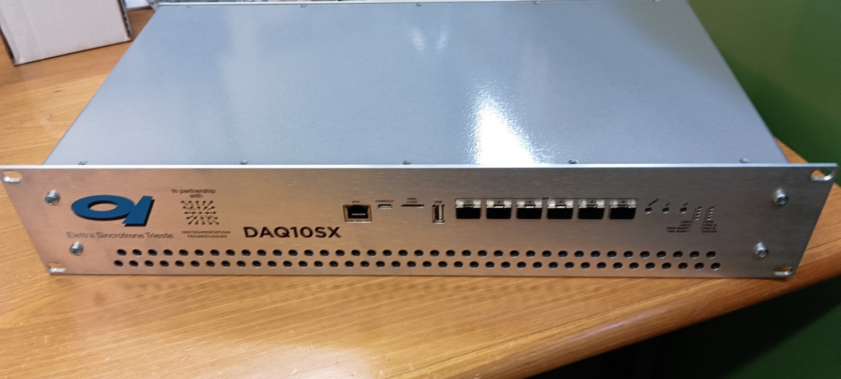
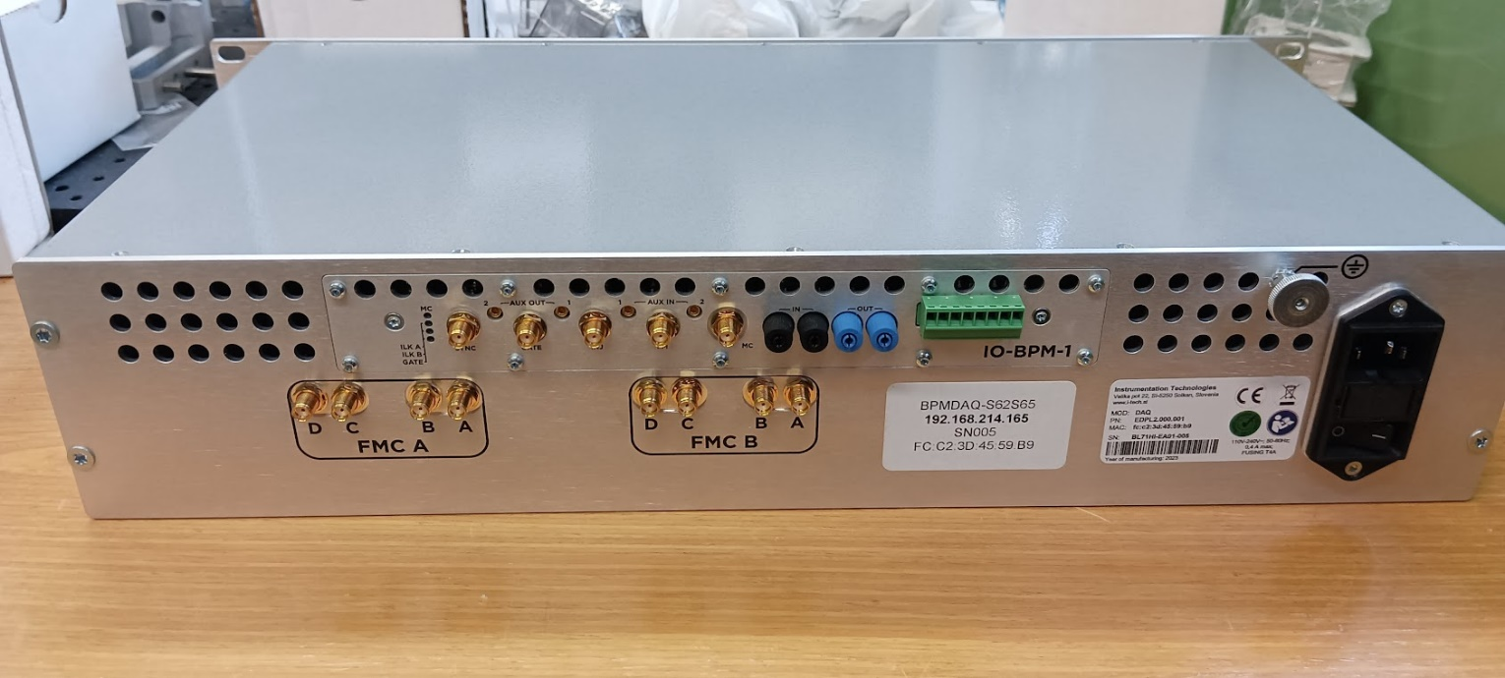
The current phase of eBPM for
Elettra 2.0 project
No. 7 (seven) complete digital platforms (DAQ10SX ) with FMC cards. The FAT was created and executed in close contact with Elettra to maintain a high level of control over the delivered samples. The functionality and performances of the entire system were tested in laboratory with positive results. The tests were particularly exhaustive under “unspecified” conditions (clock, voltages, signals) in order to verify the absence of criticalities in the pre-series.

Slide 6
eBPM field tests with Elettra
In April ‘24 with the restart of Elettra, the integration of 4 DIGIDAQ units and 8 PTFE units for a total of 8 eBPM was carried out by replacing all the Libera units in Elettra section #6.
In a series of machine physics shifts, the PTFE units were inserted into Elettra's tunnel between the short cables from the pickups and the long cables going to service area racks.
In the service area rack, the Libera BPM units were disconnected and the DAQ10SX units were connected: the new units were connected to the control network using 10Gbit optical ethernet interfaces alongside standard 1Gbit copper interfaces.

Slide 7
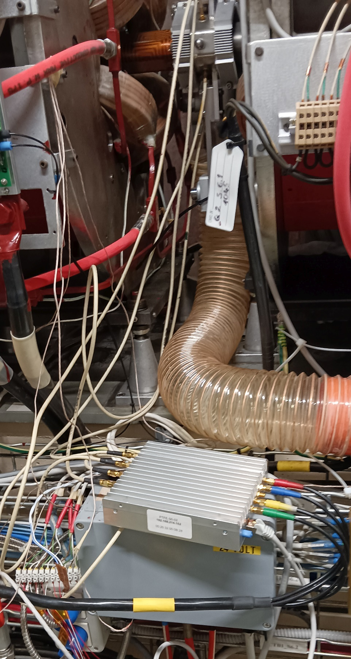
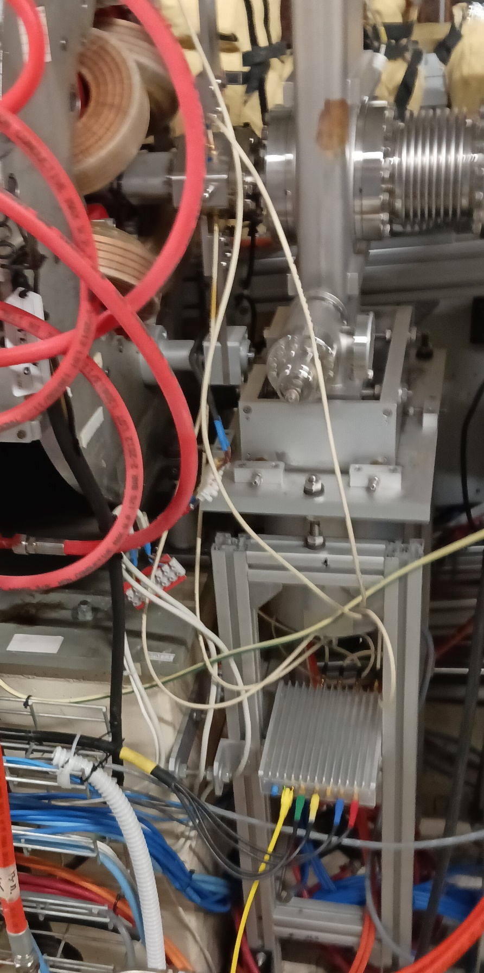
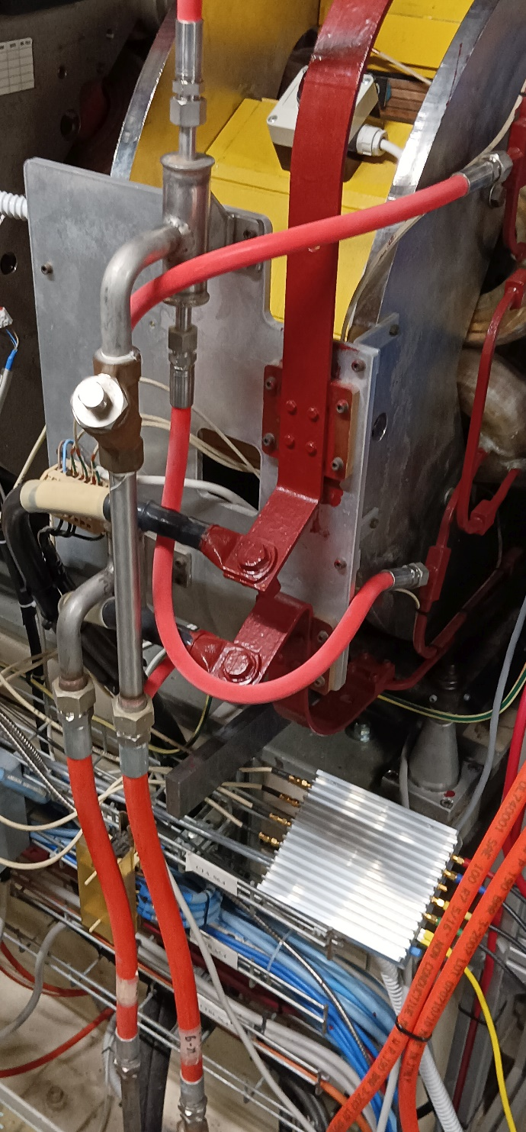
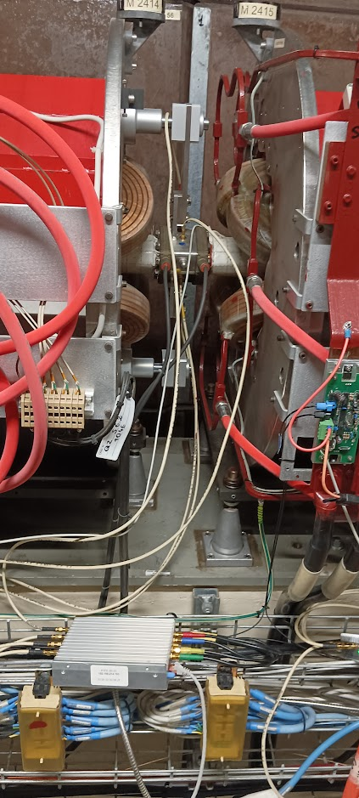
PTFE in Elettra tunnel

Slide 8
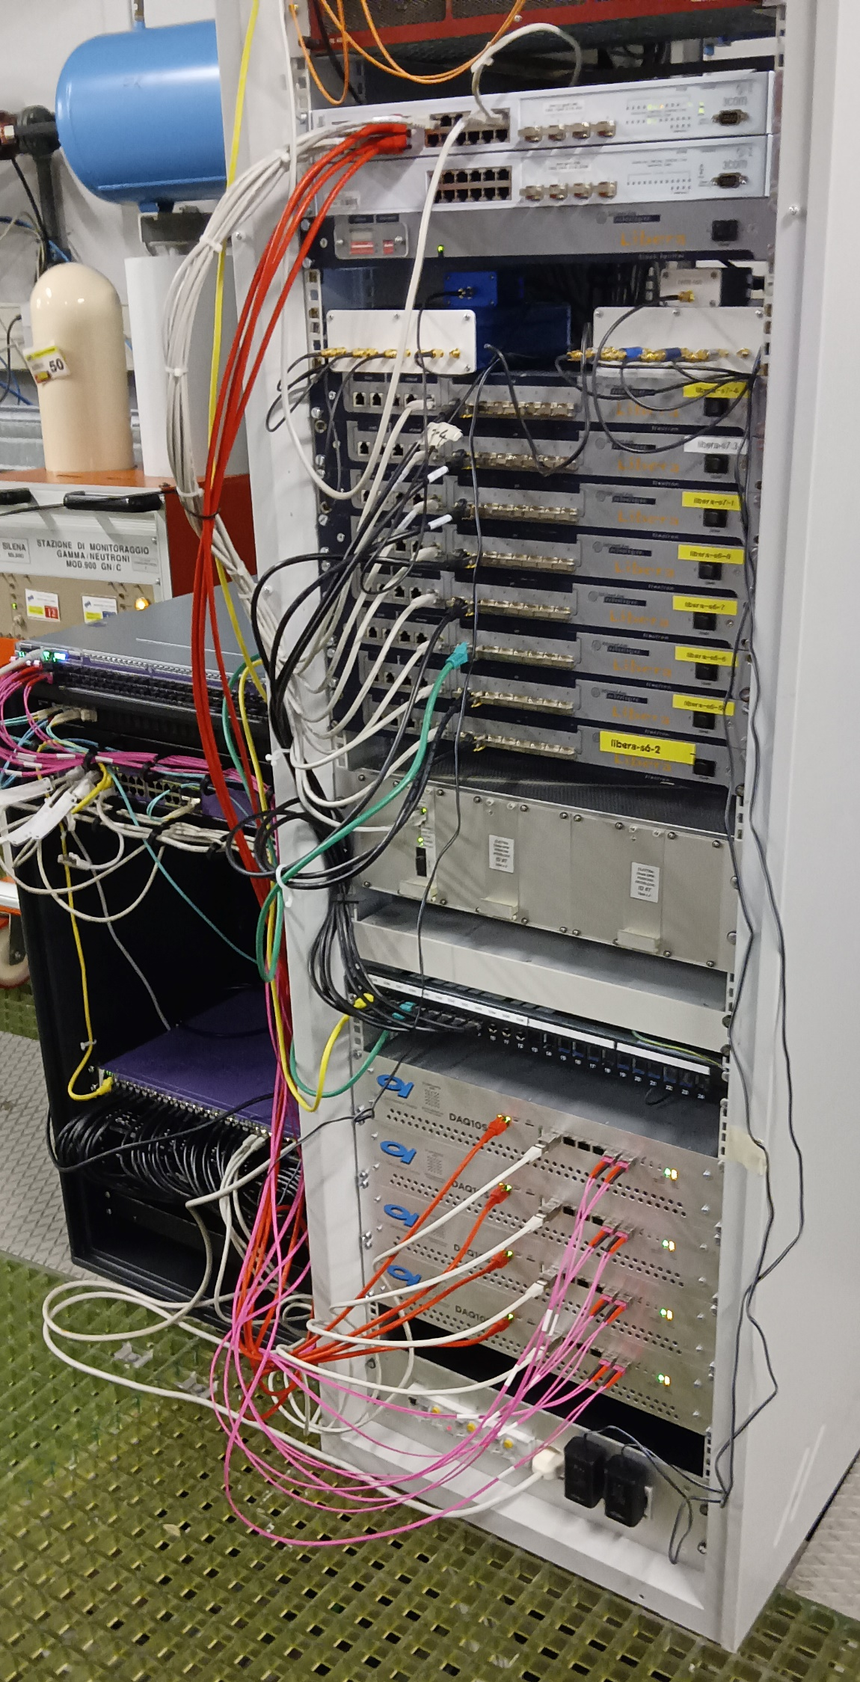
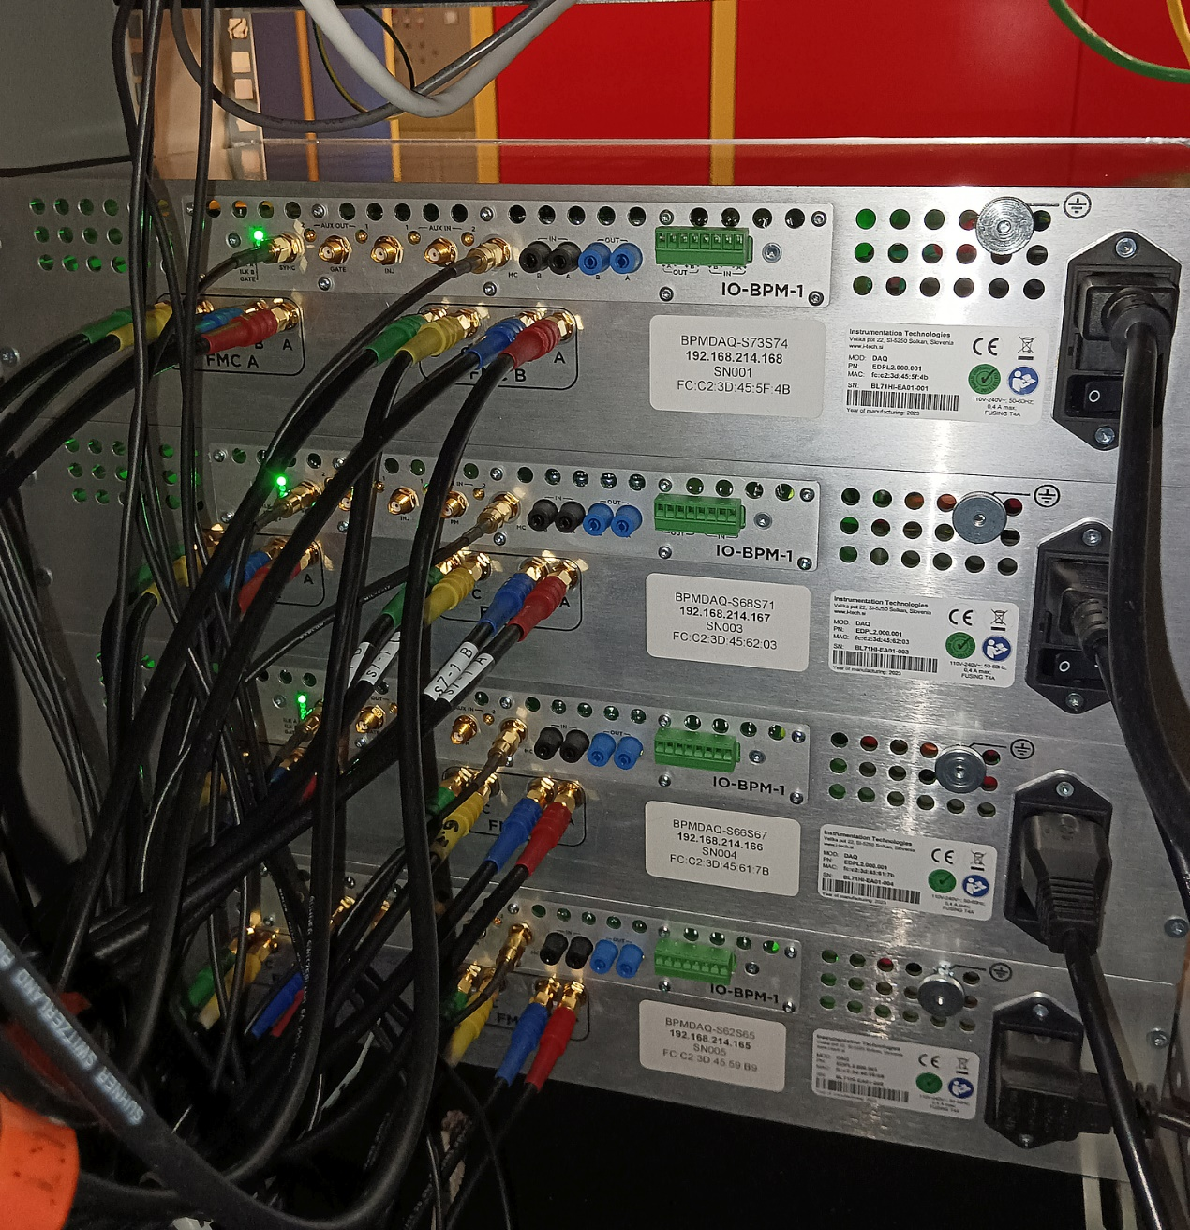
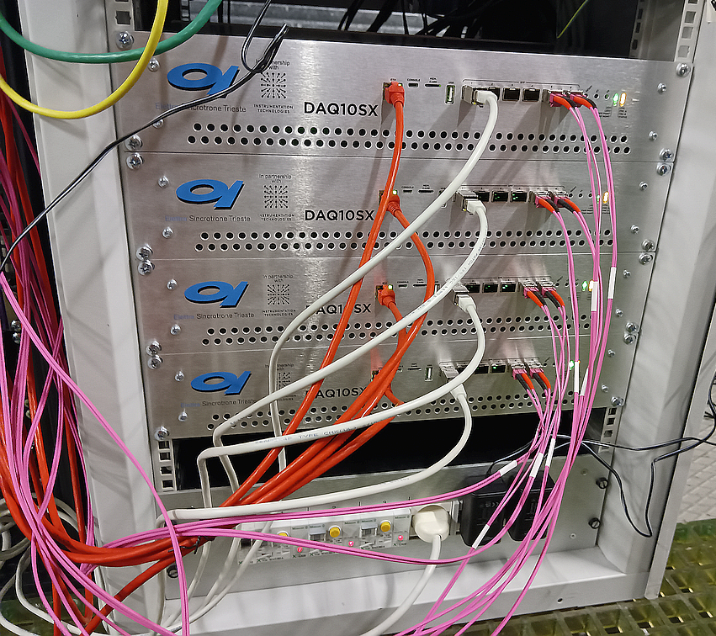
DAQ10SX acquisition modules in Elettra Service Area

Slide 9
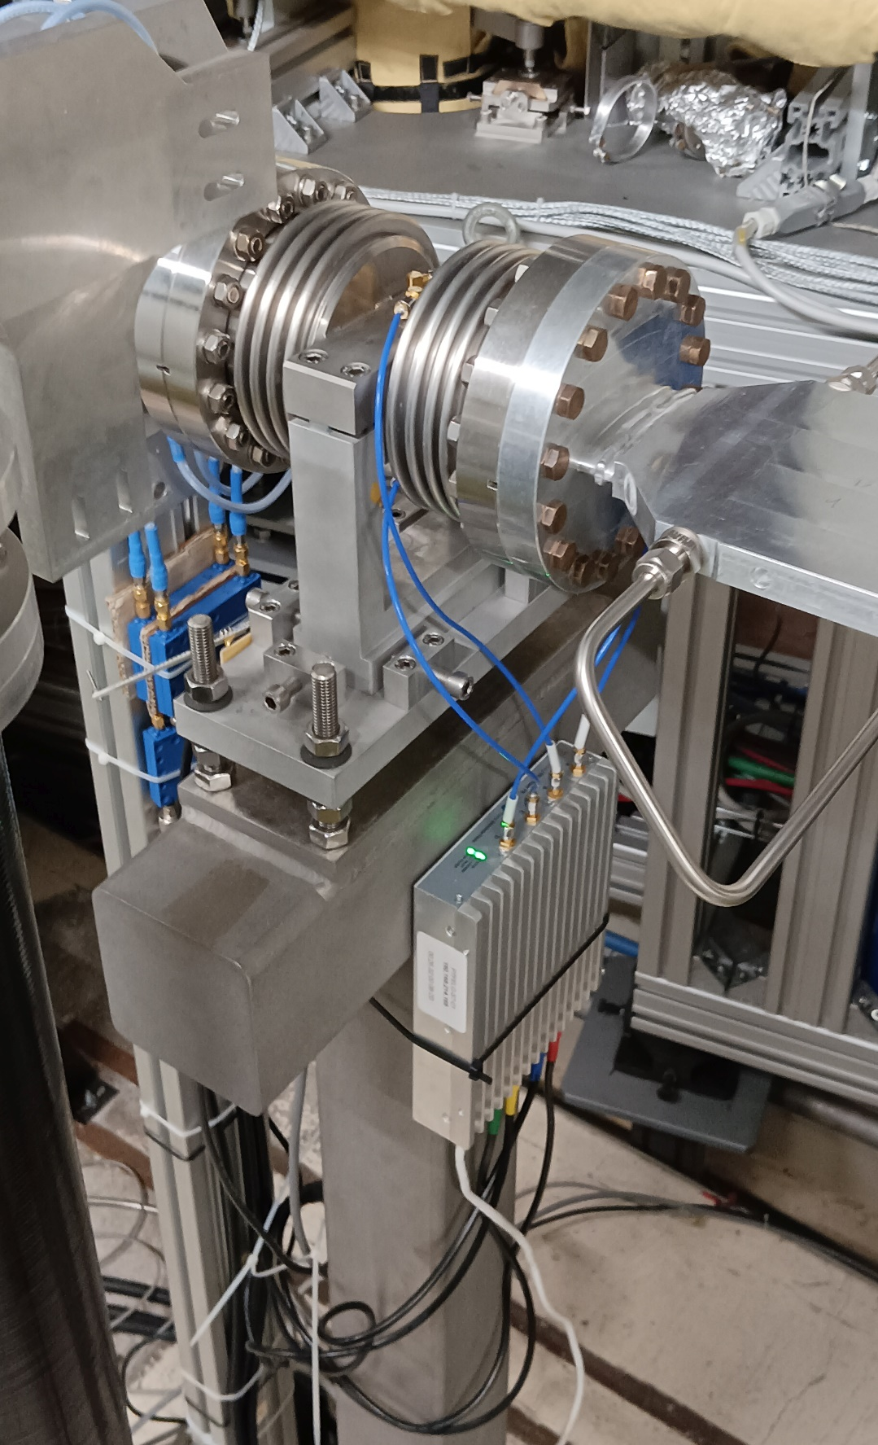
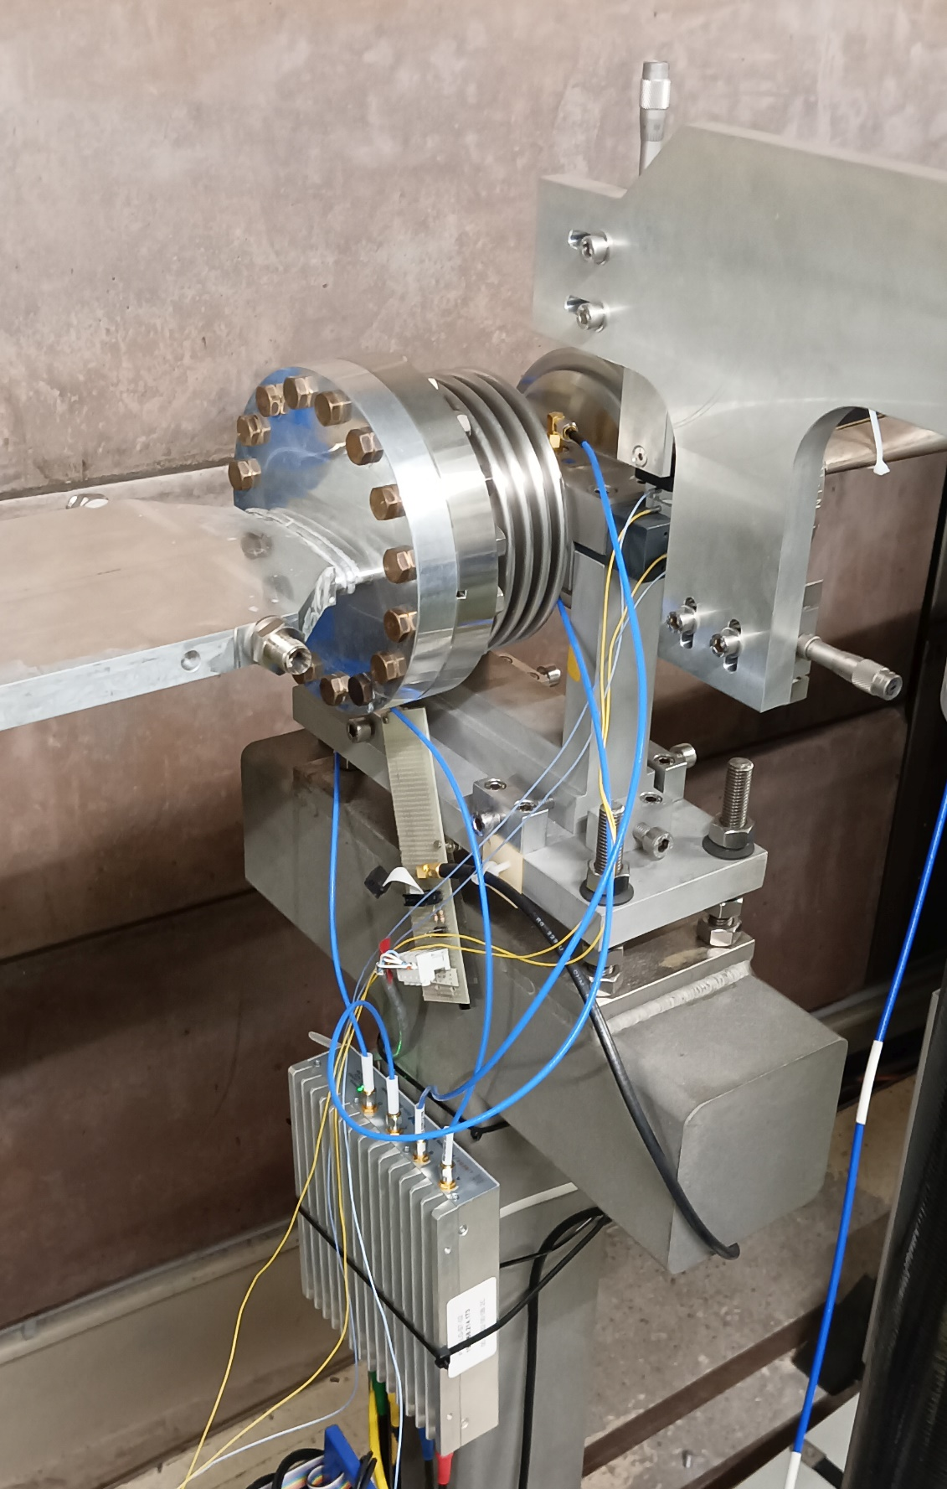
LOW GAP BPMs
In Sect. #7 an additional unit with two PTFEs has been installed on the ‘LOW GAP’ BPM pair. This unit is always online and data is always available to the Elettra Control System.

Slide 10
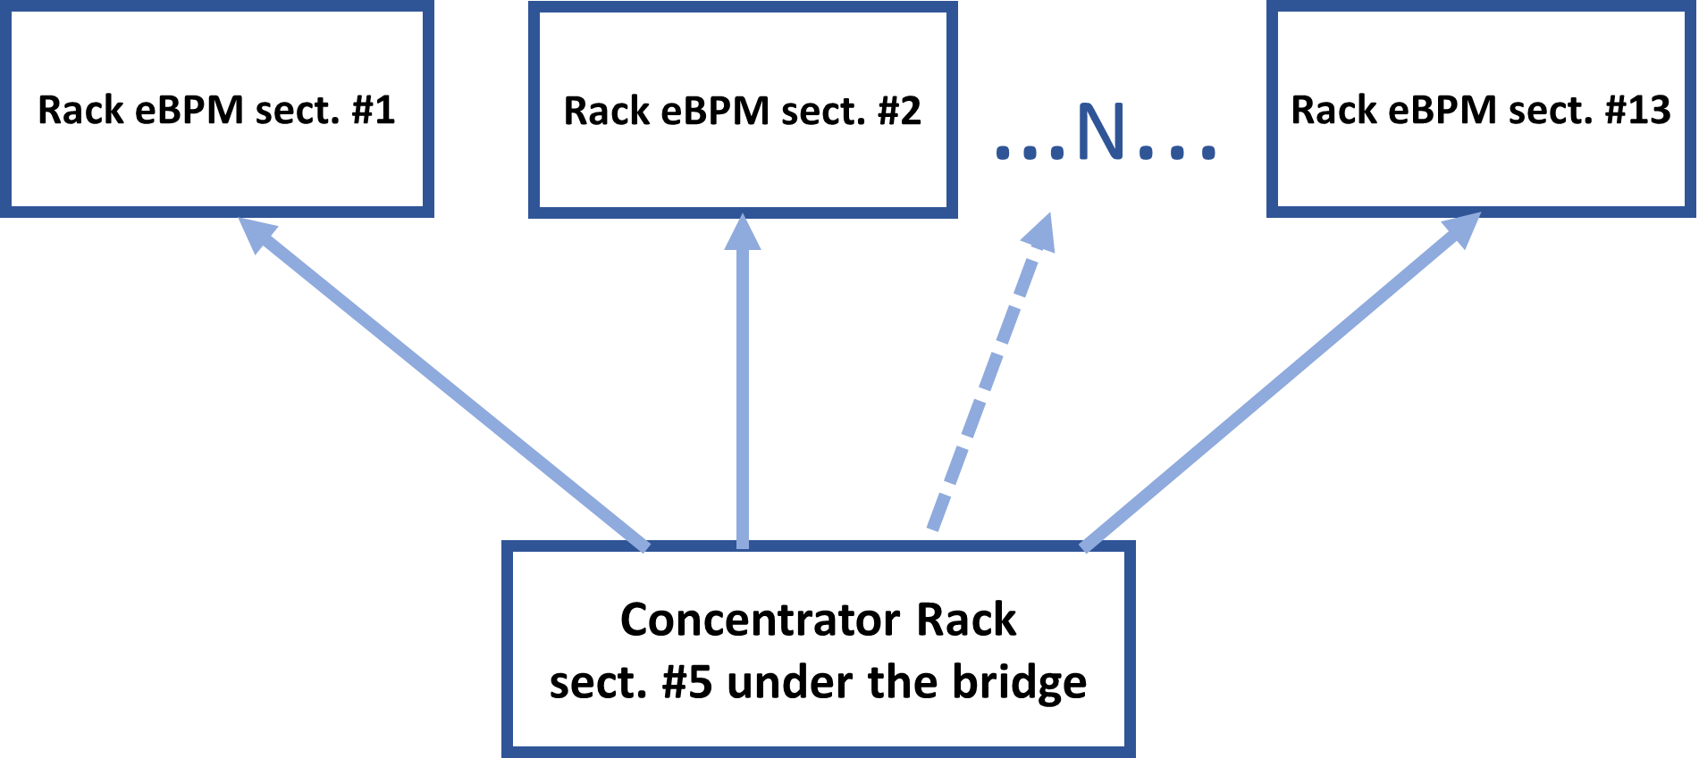
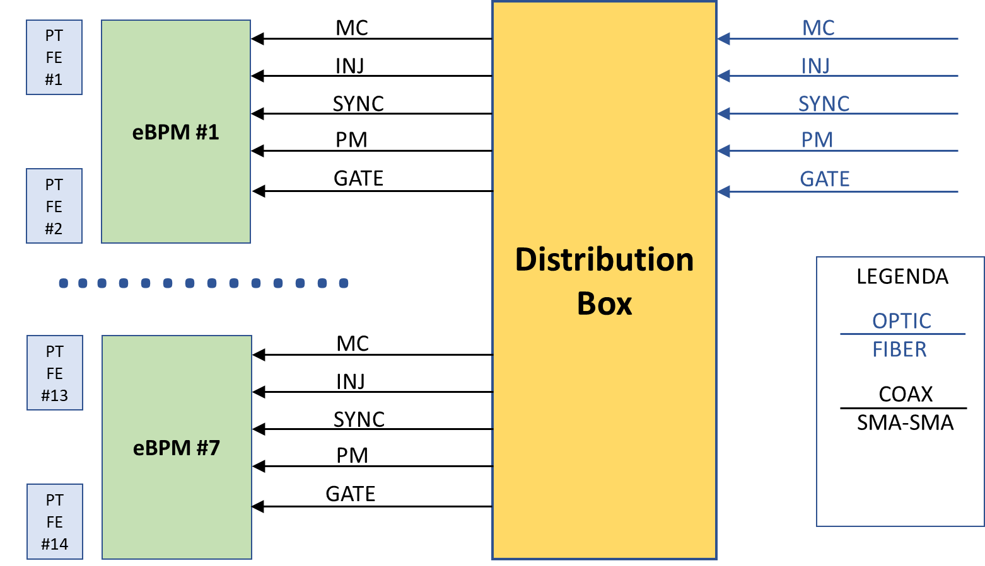
eBPM timing signal distribution model
Signal distribution model inside the racks
MC = Master Clock ( TbT clock)
INJ = Injection trigger
SYNC = Turn number sync
PM = Post Mortem trigger
GATE = for gated acquisitions

Slide 11
System integration
Integration into the Elettra Control System was made easier by the presence of the DPDK-based GOF2 (Global Orbit Feedback2) architecture.
In this way, the high-speed, low-latency data output from the FPGA using UDP packets is processed by the GOF2 unit, which then makes the data acquired in the various modes available to the entire control system.
All the Tango servers use the data acquired in real time by the GOF2 which collects the data from the DAQ10SX boxes at different and programmable rates.
The rates that are currently implemented and in use are:
ADC RAW @150 MHz
Turn by Turn (1.1566 MHz)
100KHz
10KHz
10Hz
Raw data from the ADC is collected and processed as required and, if necessary, triggered with the machine injection.

Slide 12


DPDK, an industrial grade platform to accelerate Ethernet packet processing for Elettra 2.0 real-time platform
DPDK is a network stack bypass technique
Application running in userspace on CPU-isolated cores
  without interaction with Linux, coded in C
Initially used by telecom companies (latency < 20μs)
Available in cloud solutions from hyperscalers such as:
  Microsoft Azure
  Amazon AWS
  Google Cloud

Slide 13
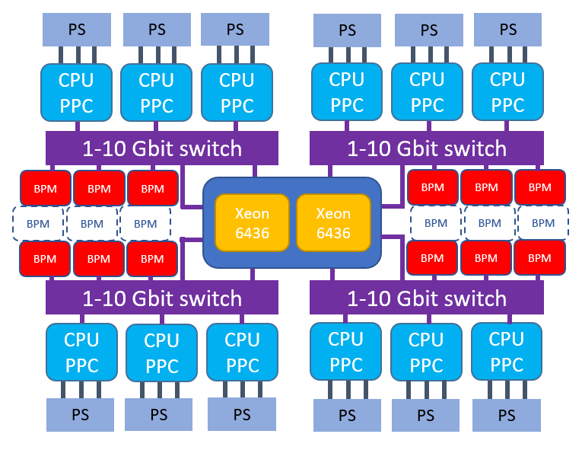
DPDK based Fast Orbit Feedback upgrade (Elettra)
Test Elettra 2.0 central processing architecture
(Dell PowerEdge, 64 HT cores 3.1 GHz)
The central server acquires data from 95 BPMs and processes feedback code at 10 kHz. This server is connected to the BPM network via four 10GbE links (1-10Gbit switch)
The server transmits current settings to 12 VME CPUs (CPU PPC), which control power converters (PS), via another set of four 10GbE links.
13

Slide 14
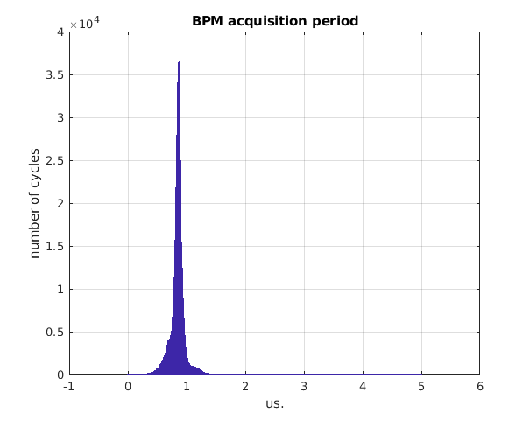
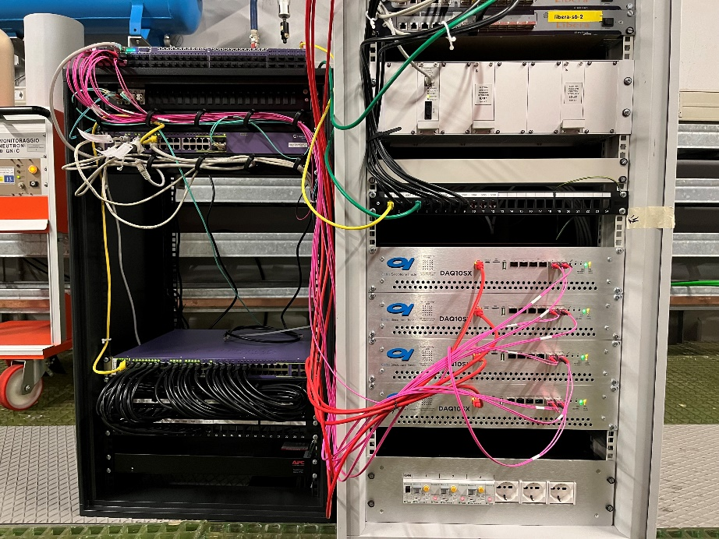
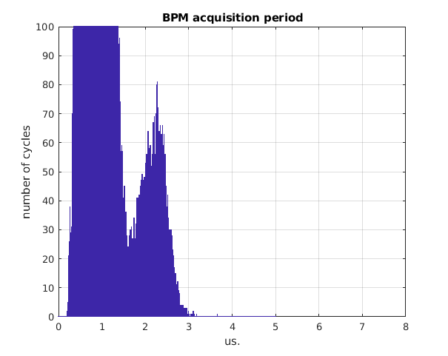
eBPM turn by turn real-time acquisition and processing
864ns
8 new-BPMs at 1.15 MHz + 24 Libera at 10 kHz over one 10 GbE link (sectors 5,6,7) -> main server
new-BPM S6.2
at TbT freq.
main server acquiring 9.5 Mpss, no pkt loss
99.8% pkts processed in less than 1 μs
Worst case 3.5 μs
100 GbE mandatory
BPM
BPM
BPM
BPM
BPM
10 GbE
network
jitter
BPM
BPM
BPM
BPM
BPM
BPM
BPM
BPM
BPM
BPM
BPM
BPM
BPM
BPM
BPM
BPM
BPM
BPM
BPM
BPM
BPM
BPM
BPM
BPM
BPM
BPM
BPM
BPM
BPM
10 GbE
BPM
1 GbE
Xeon
6436
Tango
Shared memory
Xeon
6436
isolated
BPM
10 GbE
Switch 1-10 GbE

Slide 15
Fast Orbit Feedback (Elettra) algorithms
Feedback calculations (95bpm x 82corr x 2planes) performed by a single core using AVX512 vector instructions.
InvRM product + PID calculation time: 2.6 μs
13 harmonic suppressors at: 50 Hz, 100 Hz, 150 Hz, 200 Hz, 250Hz, 300 Hz, 350Hz, 400 Hz, 500 Hz, 600 Hz, 700 Hz, 800 Hz, 900 Hz
Harmonic suppressors calculation time: 4.6 μs (no vector instructions)
Total processing time: 7.2 μs (10 kHz rep-rate)
Processing time scale linearly with the number of CPU cores used for the feedback calculations

Slide 16
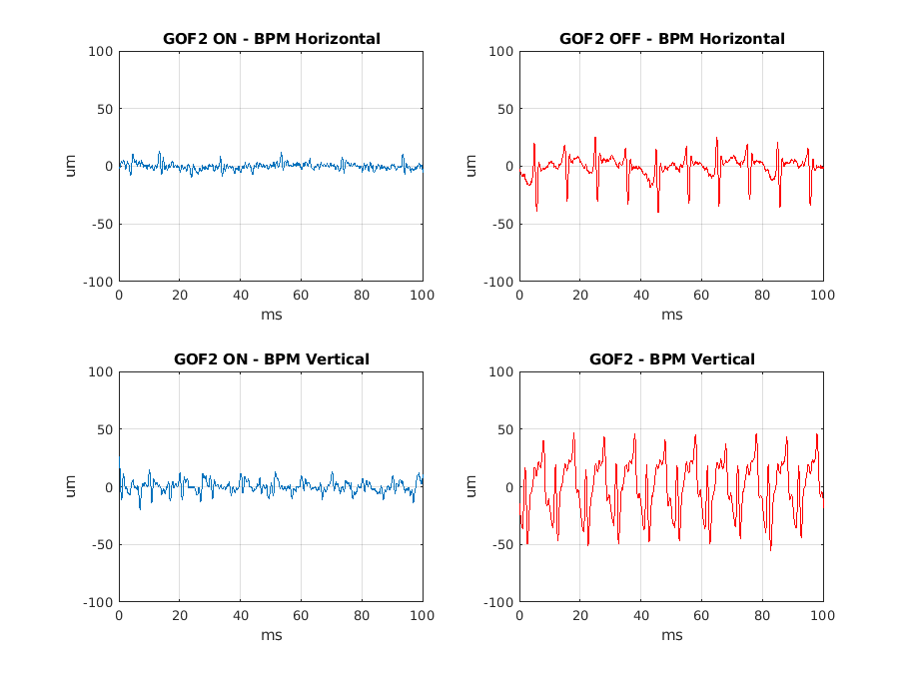
Fast Orbit Feedback performance
Out of the loop LG BPM data

Slide 17
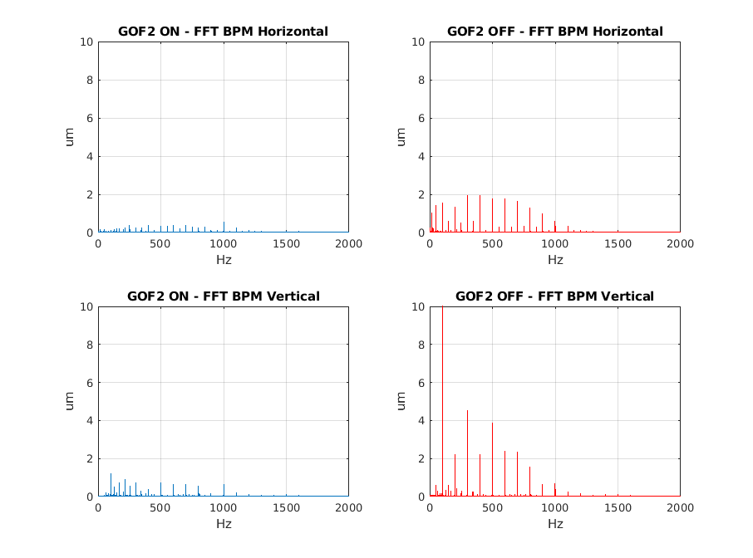
Fast Orbit Feedback performance
Out of the loop LG BPM data

Slide 18
Elettra 2.0 Fast Orbit Feedback numbers
DPDK based framework, coding in C
Dual Xeon 6 6960P Granite Rapids, 288 HT cores at 2.7-3.8 GHz
Six 100 GbE links (Intel E810)
168 BPMs and >500 correctors: fast (5.6 kHz bw), pure (~1 kHz bw) and embedded (190 Hz bw)
Repetition rate: 100 kHz
Control (read/write) of all PS, bendings, quads , sexts, corrs, trim coils, at 100kHz
Real-time response matrix measure: 100ms (fast correctors)
Acquiring at TbT rate (1.156 MHz): 8-12 BPMs, 4 LLRF, 96 Fast BLM
  Ingress: 40 Mpps (Million of Packets Per Second)
  Egress: 10 Mpps
Real-time centralized system designed for:
  Orbit Feedback
  Fast optics measurement (BBA, LOCO…)…during user beamtimes?
  Machine learning at high speed

Slide 19
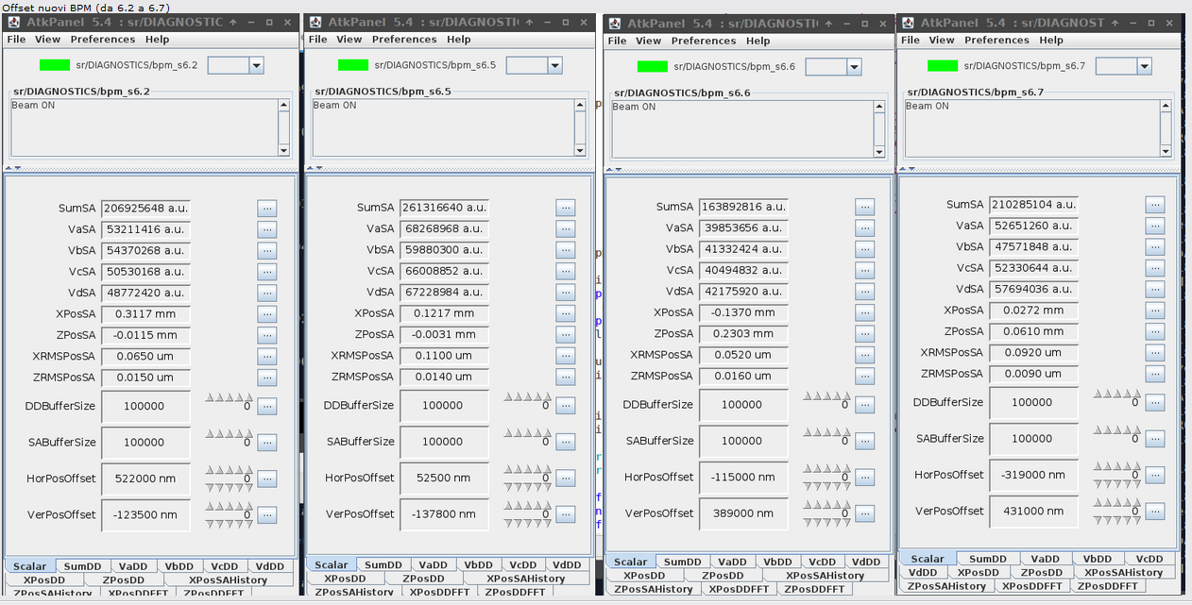
ATK Panels of the new devices (Tango Control System)

Slide 20
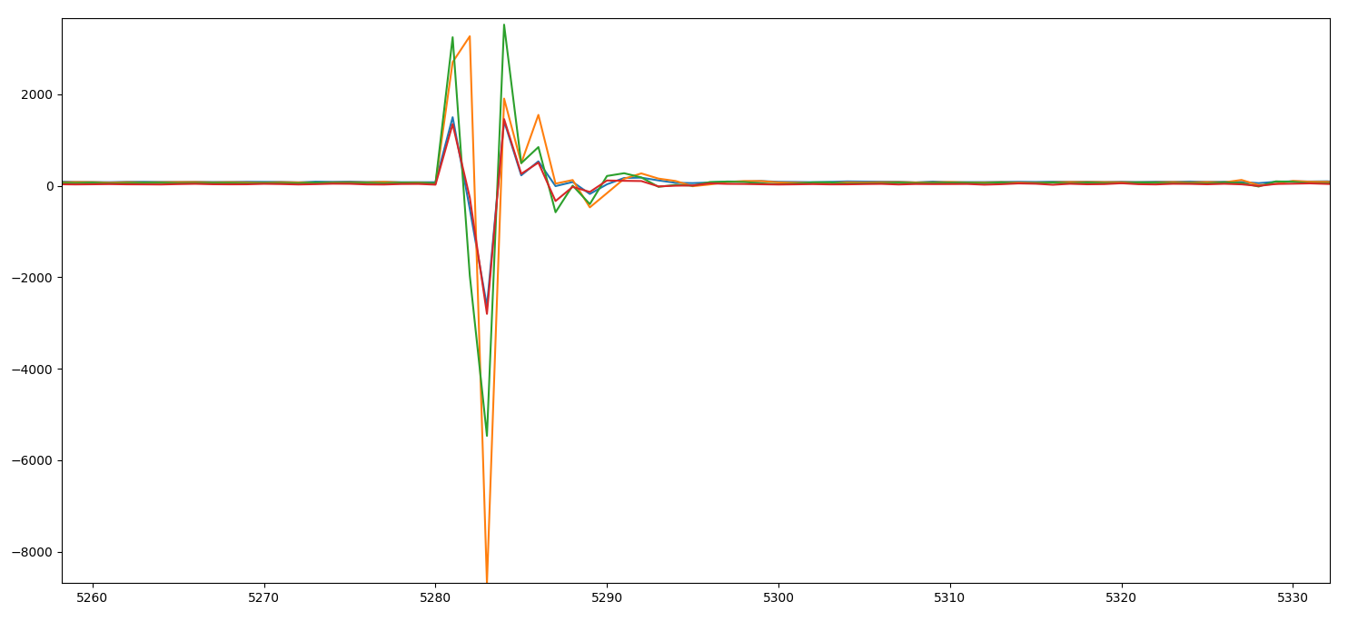
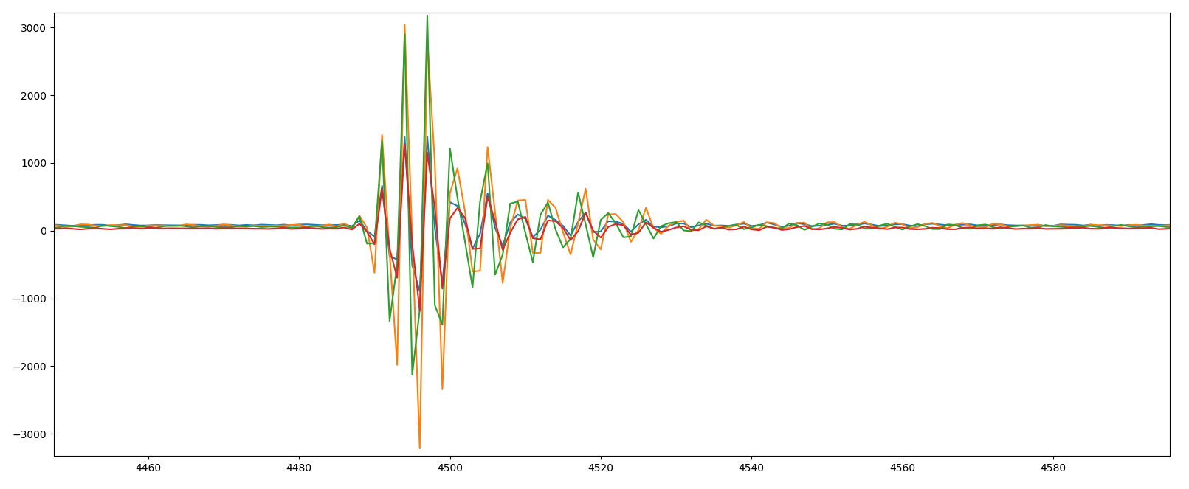
Single Bunch response BPM #6.2
3000
1,5 mA Single bunch
LC filter on PTFE
-8000
3000
1,5 mA Single bunch
SAW filter on PTFE
-3000

Slide 21
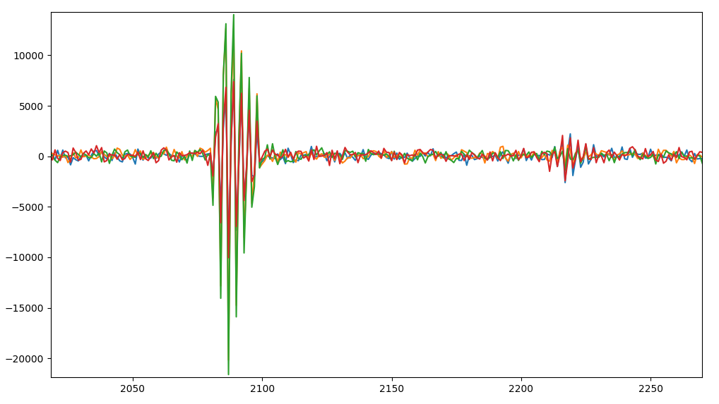
First turn mode tests
Raw data ADC on BPM #6.2 with previous PTFE settings, scale in samples (6.6 ns per sample).
Booster current 0.75 mA
note the second turn given by the electrons passing over the FLSC 12.1
The duration is about 20 samples (132 ns).
Amplitude in bin ADC 32000 pk-pk

Slide 22
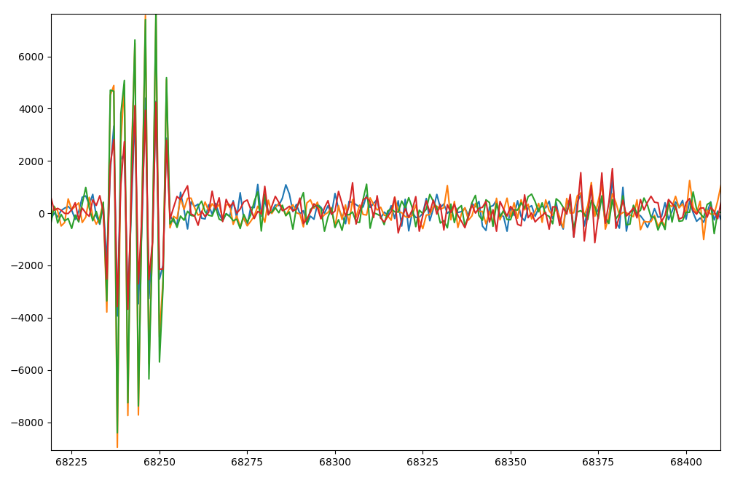
First turn mode tests
Raw data ADC on BPM #6.2 as above, booster current at 0.35 mA
Amplitude approximately halved (from 32000 pp to 16000 pk-pk)

Slide 23
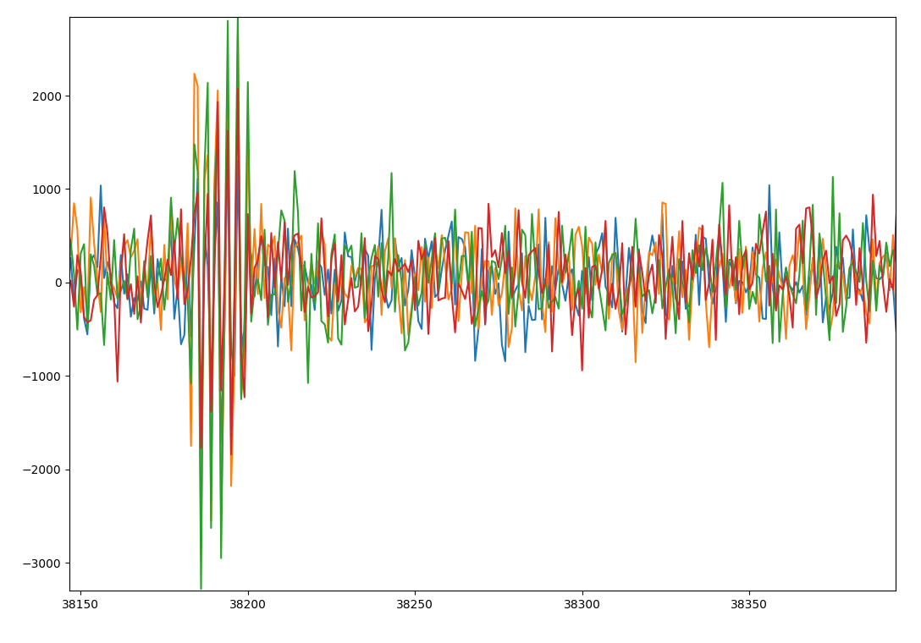
First turn mode tests
Raw data ADC on BPM #6.2 as above, booster current at 0.15 mA.
Amplitude at approx. 6000 pk-pk

Slide 24
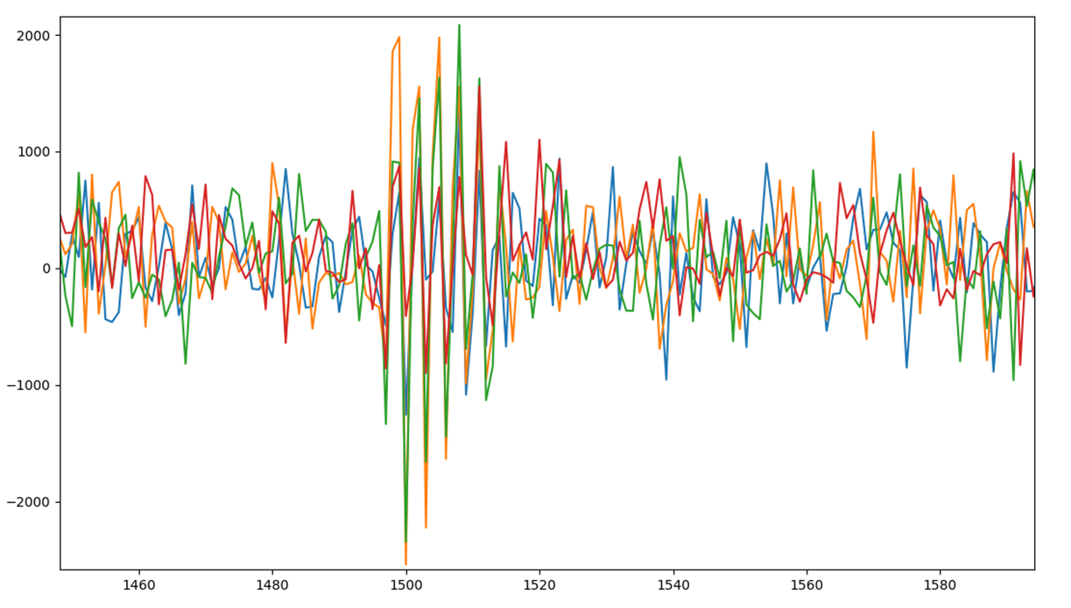
First turn mode tests
Raw data ADC on BPM #6.2 as above, booster current at 0.08 mA.
Amplitude at approx. 3500 pk-pk

Slide 25
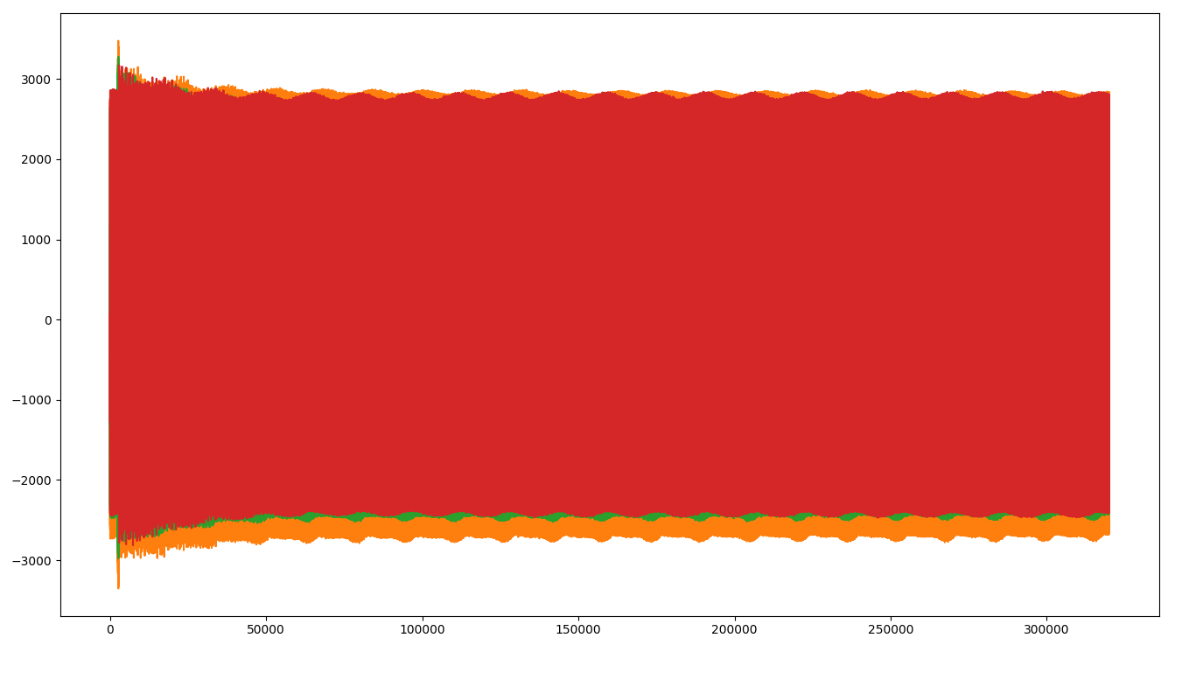
Raw ADC mode (150MHz)
Injection effects on stored beam
300.000 samples buffer (approx 2 ms)

Slide 26
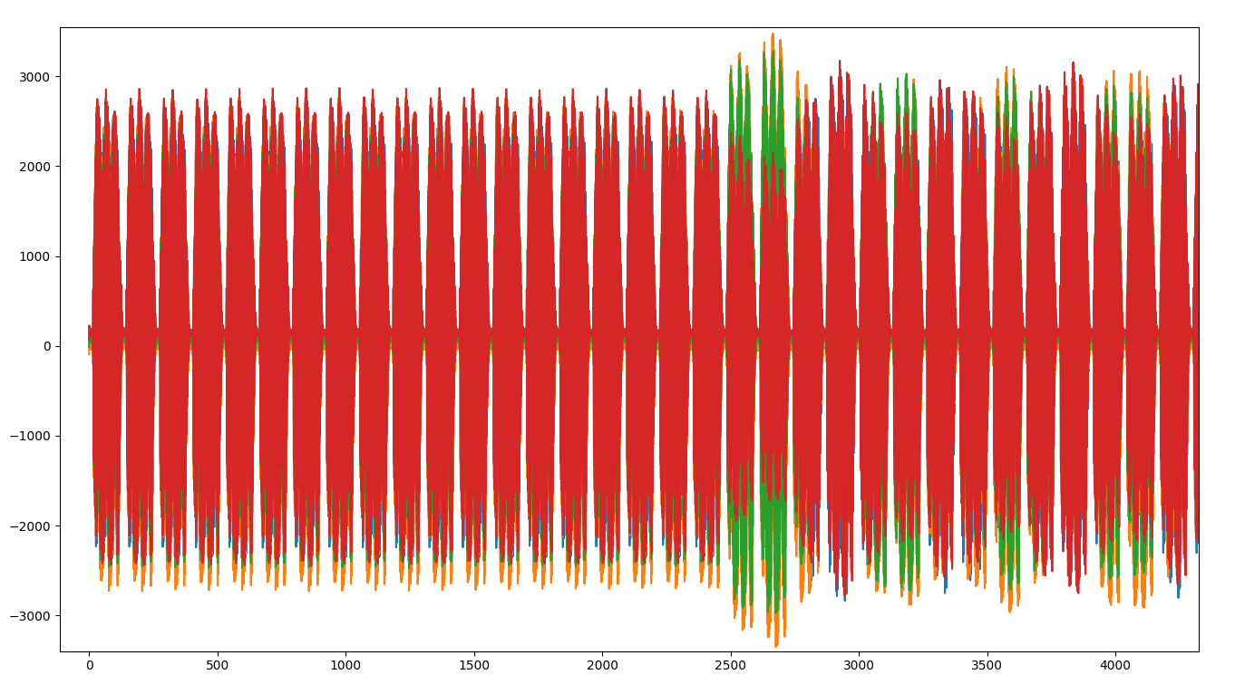
Raw ADC mode (150MHz)
Previous slide zoom

Slide 27
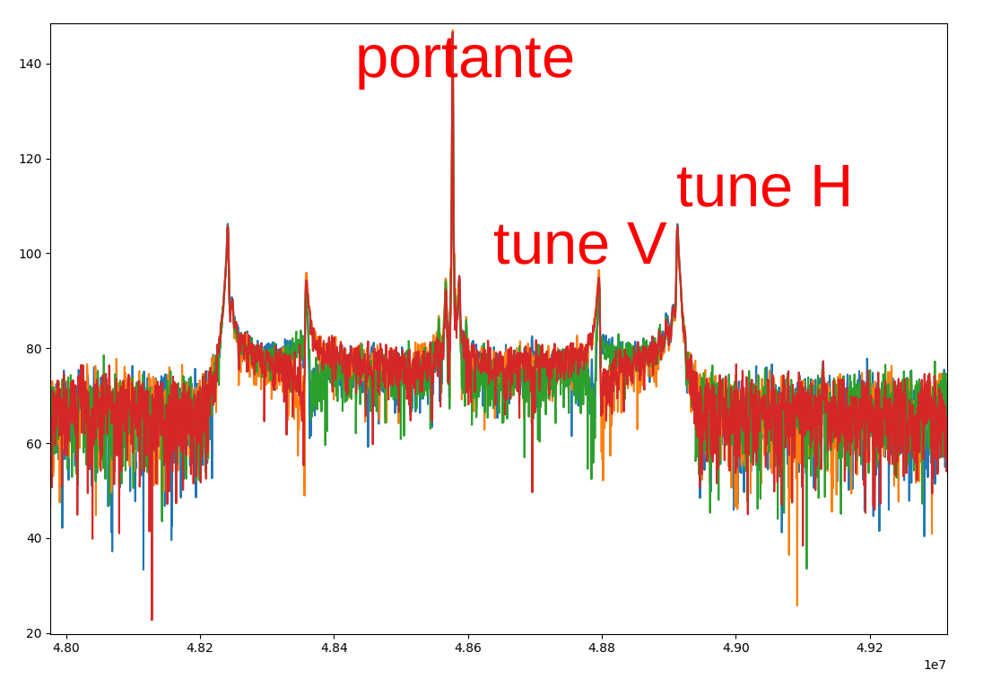
Raw ADC mode
FFT of the previous data.
Note the sideband of the two tune frequency

Slide 28
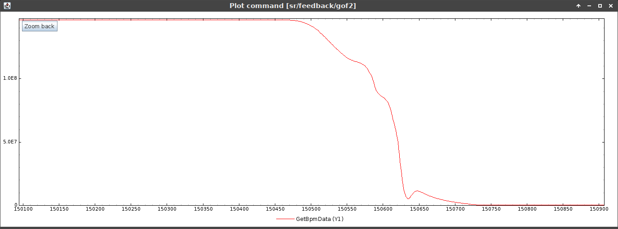
Beam Dump Tests
Sum signal of BPM #6.2 acquired at TbT during a beamdump (real time view)

Slide 29
SoC Architecture
The FPGA firmware communicates with the SoC processor in 3 ways:
A set of registers that allow the FPGA eBPM operations to be configured.
A set of registers that report the current readings at 10Hz rate of the two eBPM channels. The readings include the positions, the amplitude of the carrier and the pilot.
A shared memory mapped in a rolling 256MB window, to transfer large amounts of data from/to the FPGA side such as post-mortem data. Total FPGA ram is 8GB (3s of RAW ADC data for both BPM).

Slide 30
SoC Architecture
Dual core ARM 64 with Linux O.S
The Linux system is derived from Yocto, customized in house. The different functionalities are done by specific processes that communicate with each other using shared memory techniques.
All processes are written in ansi C, without using third party libraries.
The main tasks are:
Socket server for direct access to FPGA registers.
Socket server to perform specific tasks: such as firmware upgrade, AGC parameter configuration, turn number synchronization, etc.
Hardware monitoring process, interrupt driven by FPGA firmware, managing PLL unlock, temperature alarms, fan status, etc.
AGC manager to maintain the desired signal parameters (carrier/pilot amplitude, pilot frequency, filter switch) via TCP/IP with the two remote PTFE units.
Socket server for reporting interlock status to the Elettra Control System.
Temporary position interlock manager (to be replaced by specific FPGA functions).

Slide 31
Conclusions
All tests have been successful, but are still ongoing due to the complexity of the system.
The system is proving to be fully capable of supporting all Elettra2 operating modes and specifications.
Next steps:
Permanent replacement of sect. #6, and, when the network infrastructure can support it, (availability of 100 Gb network switches), permanent replacement of sect. #7.
Elettra Injection Booster eBPM replacement.

Slide 32
Notes:
Last Slide 1: Thanks to the audience

Slide 33
Notes:
Last Slide 2: Aerial Photo of Elettra

Slide 34
Clipboard – for copy and paste
Text Box
Text Text Text
Text Text Text
Text Text Text
Text Box
Text Text Text
  Text Text Text
    Text Text Text
Text Box
Text Text Text
Text Text Text
Text Text Text
Text Box
Text Text Text
  Text Text Text
    Text Text Text
Rectangle
Text Text Text
Text Text Text
Text Text Text
Text Text Text
Rectangle
Text Text Text
  Text Text Text
    Text Text Text
Notes:
Clipboard Slide: working slide to be kept at the end of the presentation
Copy & paste an element from the Clip Board to the particular slide:
1. Click on a box to mark it.
2. Position the mouse pointer on the box frame: Copy!
3. Click on the particular slide: Paste!
How you intend to use the elements is your choice.
You can combine the text block style with the background colour in different manner.

Slide 35
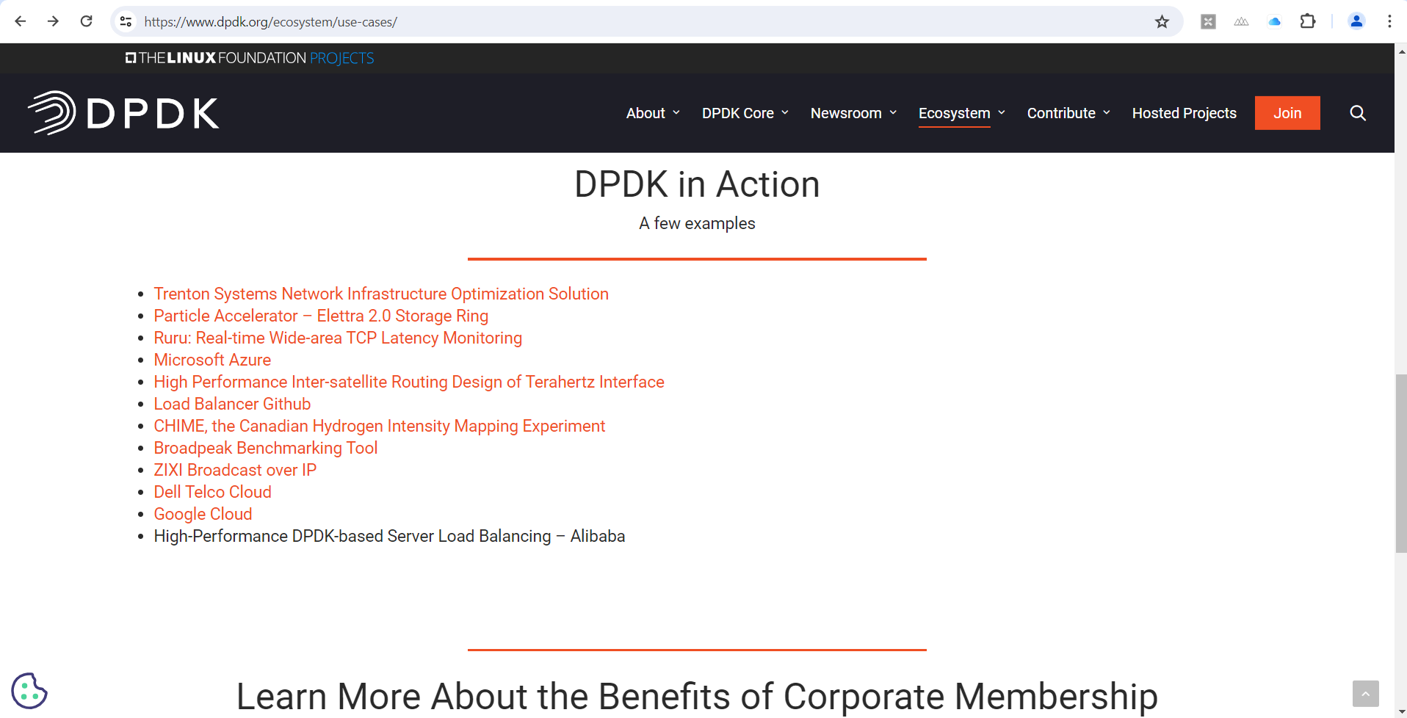

Accelerating Elettra 2.0 with DPDK
https://www.dpdk.org/ecosystem/use-cases/

