Slide 1
DEELS 2024: Welcome and Introduction
10-11 June 2024 Nicolas HUBERT

Slide 2
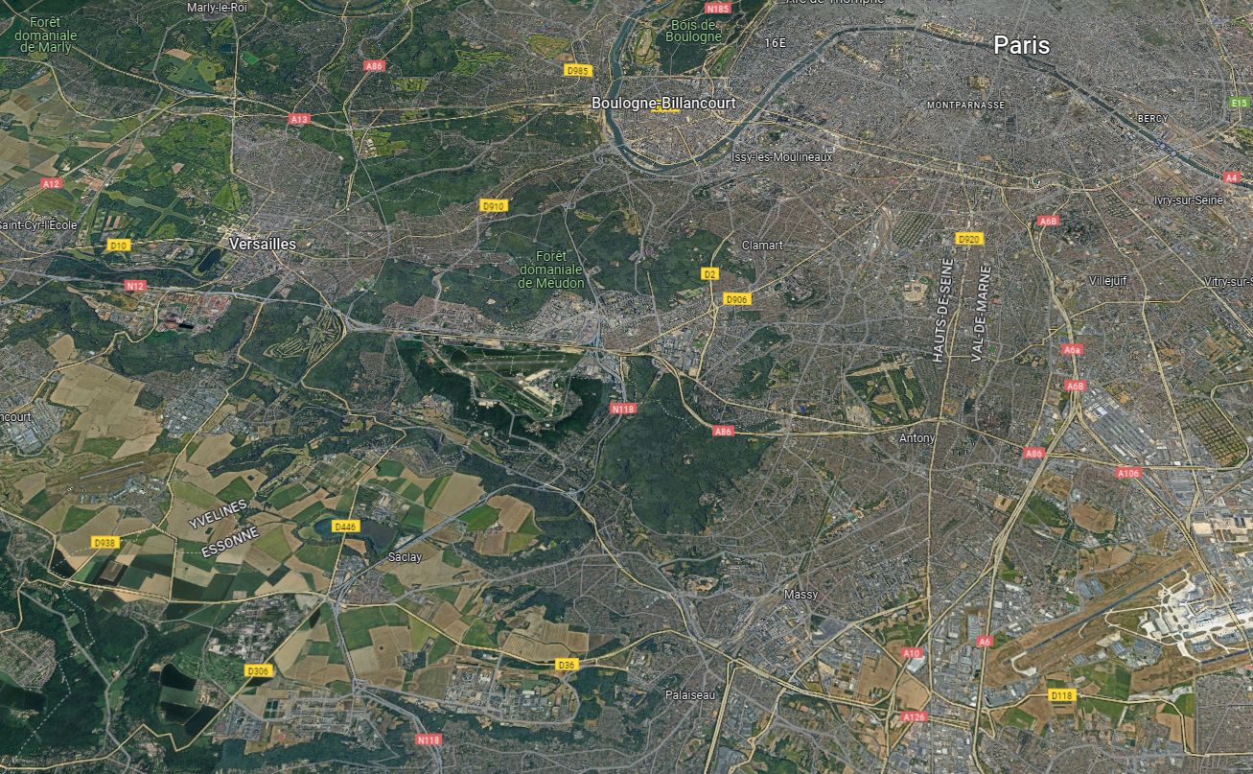
Where we are
Saclay Plateau:
  20 km south of Paris
  Fertile soil well suited for farming
  First farming research activities at the beginning of the 20th century.
  Installation of public research institutes (other domains) since the 60s., mainly in the south of the plateau.

Slide 3
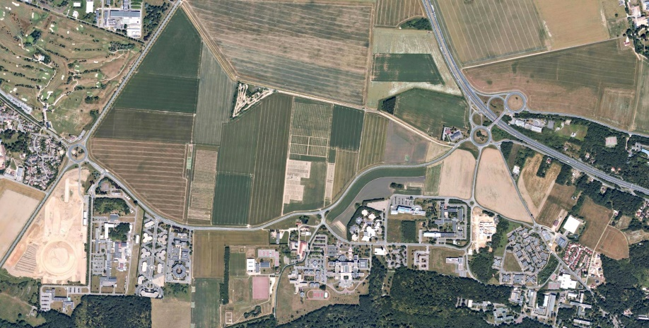
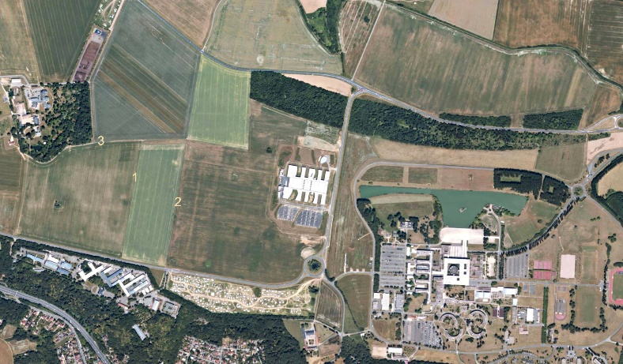
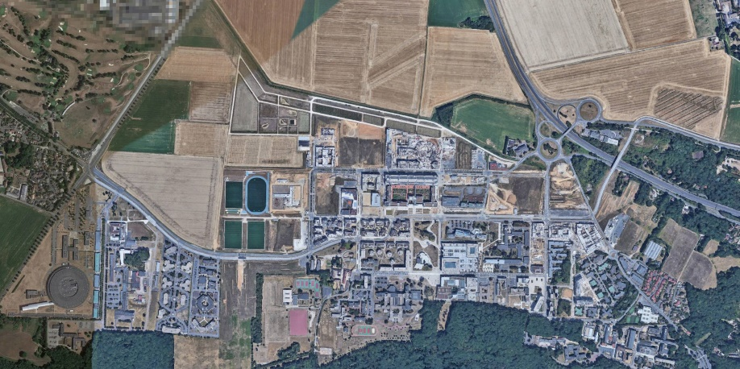
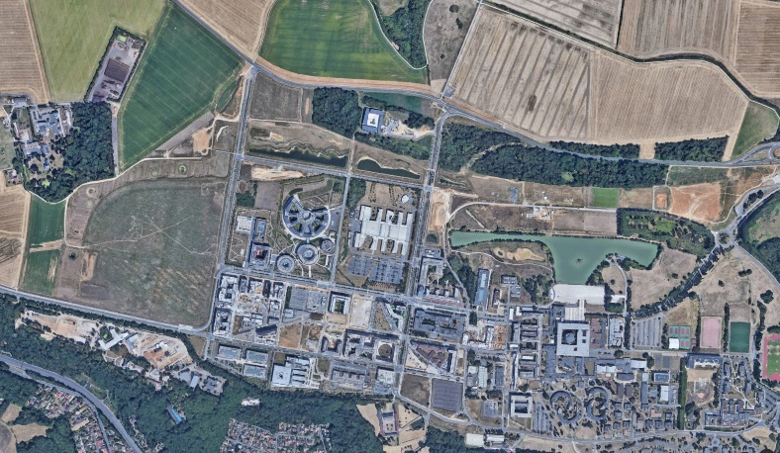
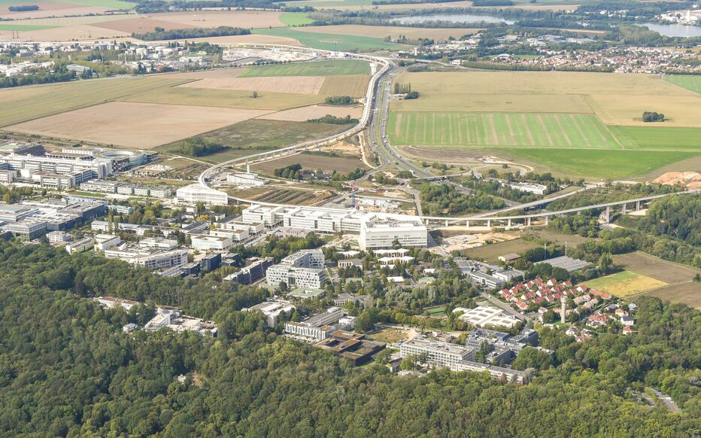
Where we are
2005
Paris-Saclay cluster:
  Scientific and technologic cluster initiated in 2006 and localized on the Saclay Plateau
  Initially public research (CEA and CNRS) and academic institutes.
  Many industries have now settled their development laboratories and headquarters here (EDF, Danone, Thales, Sanofi…).
  Will aggregate 20 to 25 % of French research.
    65 000 students
    360 research laboratories
  Metro connexion to Massy in 2026 and to Orly airport in 2027.
2019
2024

Slide 4
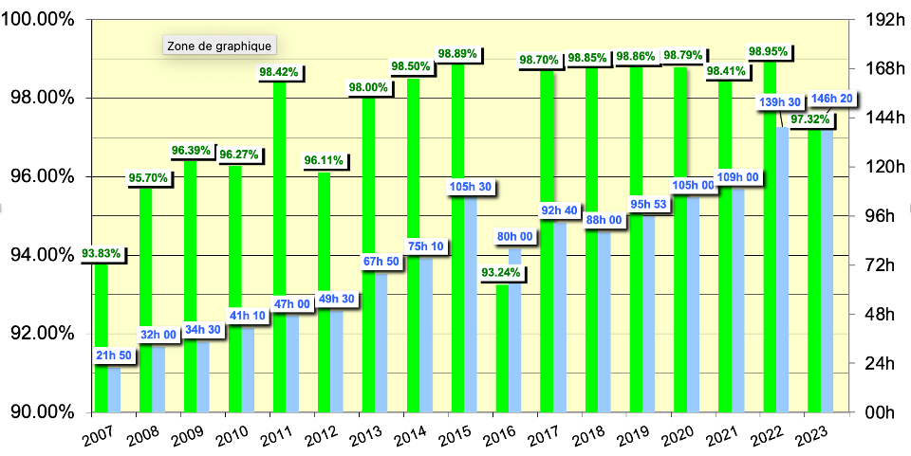
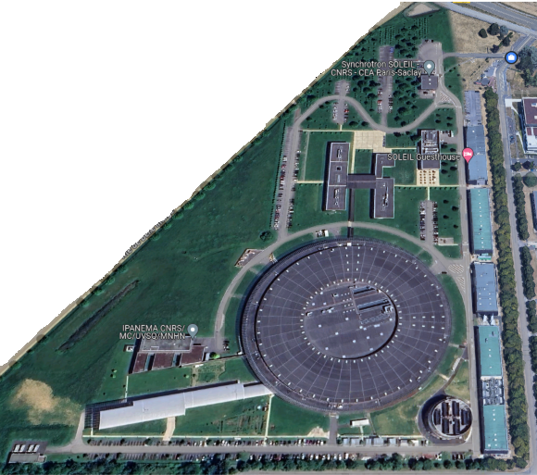
SOLEIL
SOLEIL Synchrotron:
  3rd gen. light source in operation since 2006
  29 beamlines
  4 modes of operation (uniform 500 mA, hybrid, 8 and 1 bunches)
  2023 operation:
    97.3% of beam availability
    146 h MTBF (best year).
  Recent construction and commissioning of a new cooling station:
    Chilled water production station
    Connection to accelerator and beamlines in January 2024.
    Drastic reduction of the operation and maintenance constraints identified with the old station.
    80% water savings
    2 MWh/year electricity savings
    Fatal heat to be reused for future Paris-Saclay swimming center heating and housings.

Slide 5
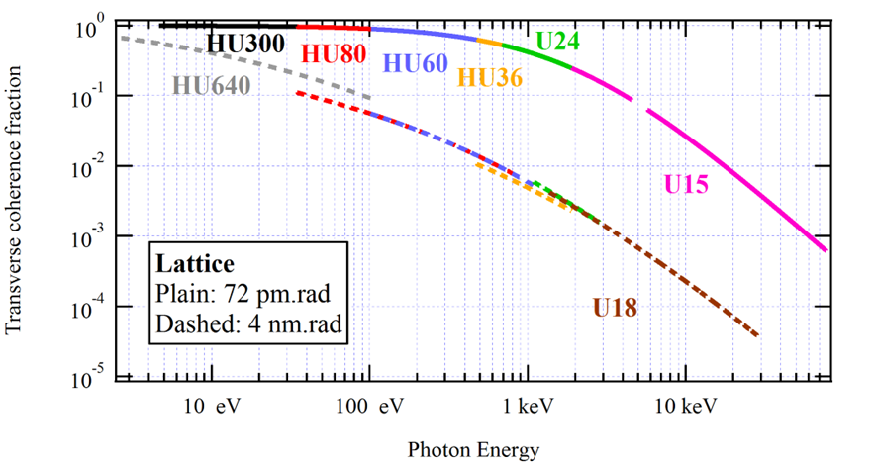
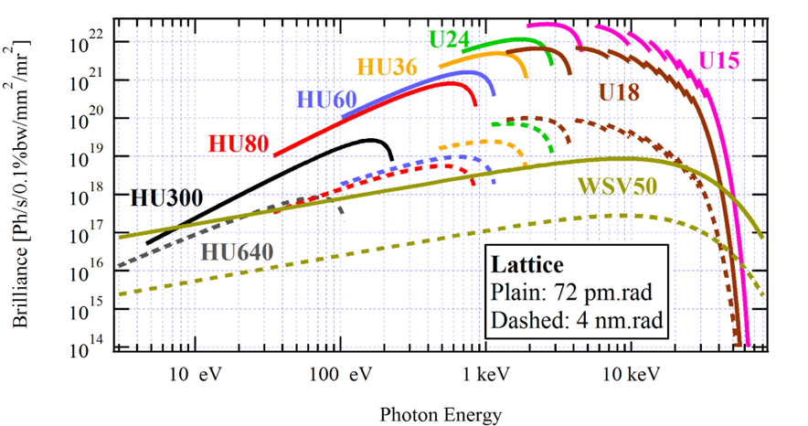
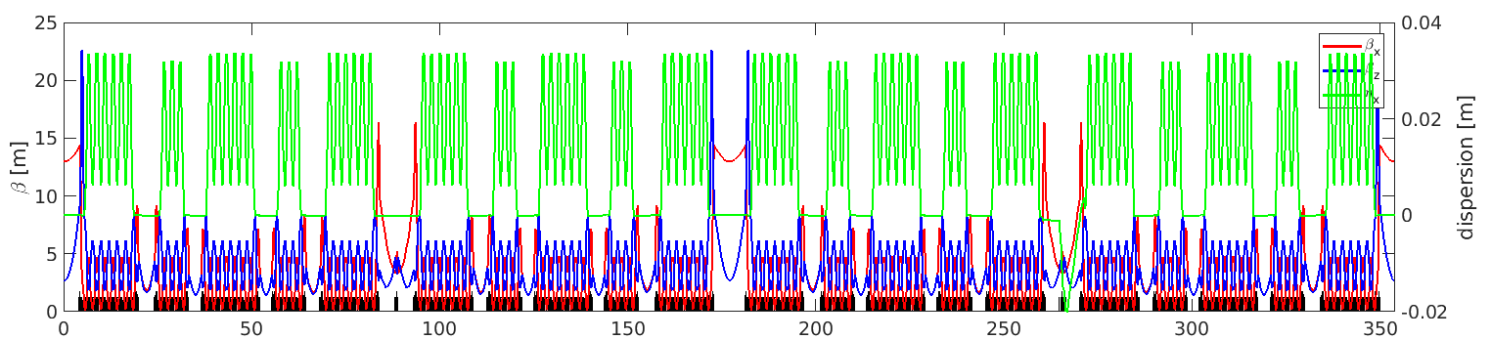
SOLEIL
SOLEIL II project:
  Approved in Dec. 2023, and fundings delivered for the 2 first years.
  ~83 pm.rad emittance (~53 pm.rad round beam as ultimate goal)
  22 straight sections, 19 for IDs
  Large photon spectrum (far IR to hard X-rays)
  NEG coated very small vacuum chamber (12 mm)
  Extensive use of permanent magnets (all dipoles, RB and main QP)
  High performance Multipole Injection Kicker (MIK)
  LINAC upgrade and new low-emittance Booster
Expected gain in coherence and brilliance with SOLEIL II.
Non-standard MBA lattice: 12 x 7BA + 8 x 4BA / 2.75 GeV / 354 m / 500 mA.

Slide 6
DEELS Workshop
11th DEELS workshop
  European annual meeting dedicated to diagnostics for light sources.
    Bring the diagnostics community together
    Enhance synergies between facilities
    Small format to stimulate discussions and share common problematics and solutions.
  28 participants from 11 institutes
  Very rich scientific program with 25 contributions:
    20 standard talks: 15 + 10 min.
    5 discussion triggers: 5 + 15 min.
DEELS 2024: Synchrotron SOLEIL
DEELS 2023 DESY
DEELS 2022 HZB
DEELS 2021 SESAME Virtual Event
DEELS 2020 Elettra Virtual Event
DELLS 2019 ESRF
DEELS 2018 Diamond Light Source
DEELS 2017 Synchrotron SOLEIL
DEELS 2016 DESY
DEELS 2015 Alba
DEELS 2014 ESRF

Slide 7
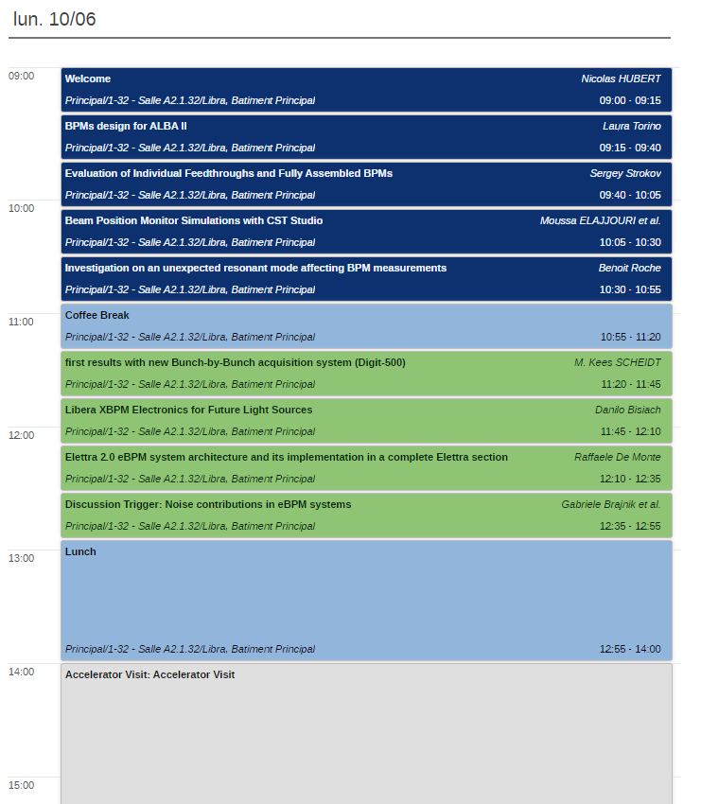
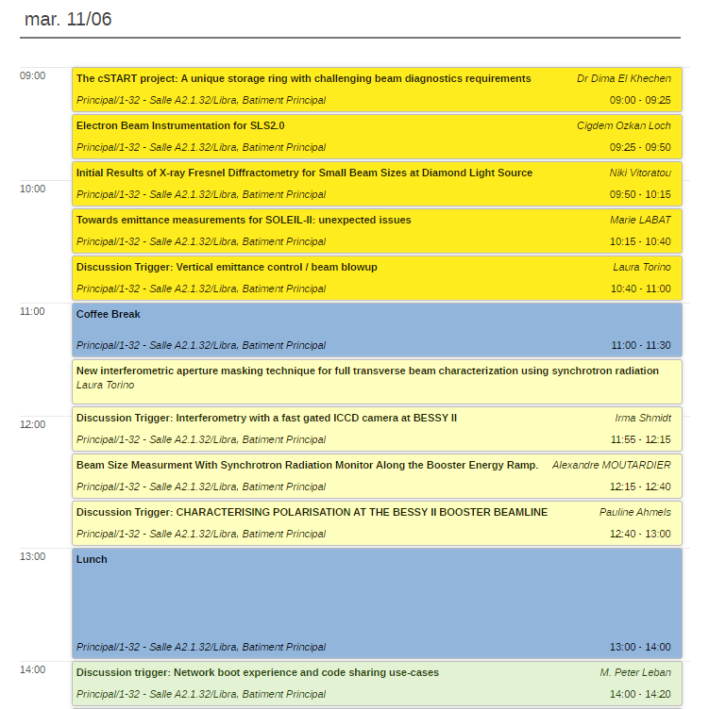
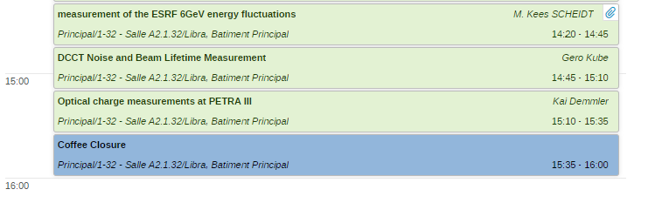
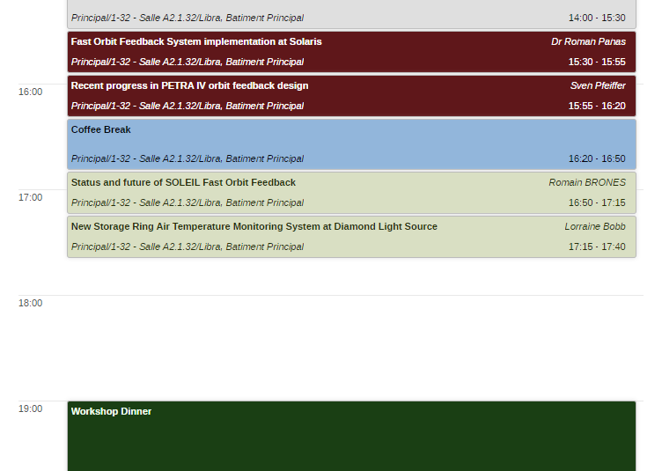
Scientific Program

Slide 8
General announcements
WLAN:
  GUEST with ID and password given to you at the entrance
  eduroam
Lunches:
  In SOLEIL canteen (inside or terrace)
Coffee breaks:
  Downstair in the ‘cafeteria’ area
Group photo:
  Tuesday, beginning of morning coffee break @ 11:00
  In front of the main building
Contacts
  Nicolas HUBERT: +33 7 86 73 71 61
  Deborah IORIO: +33 1 69 35 93 21

Slide 9
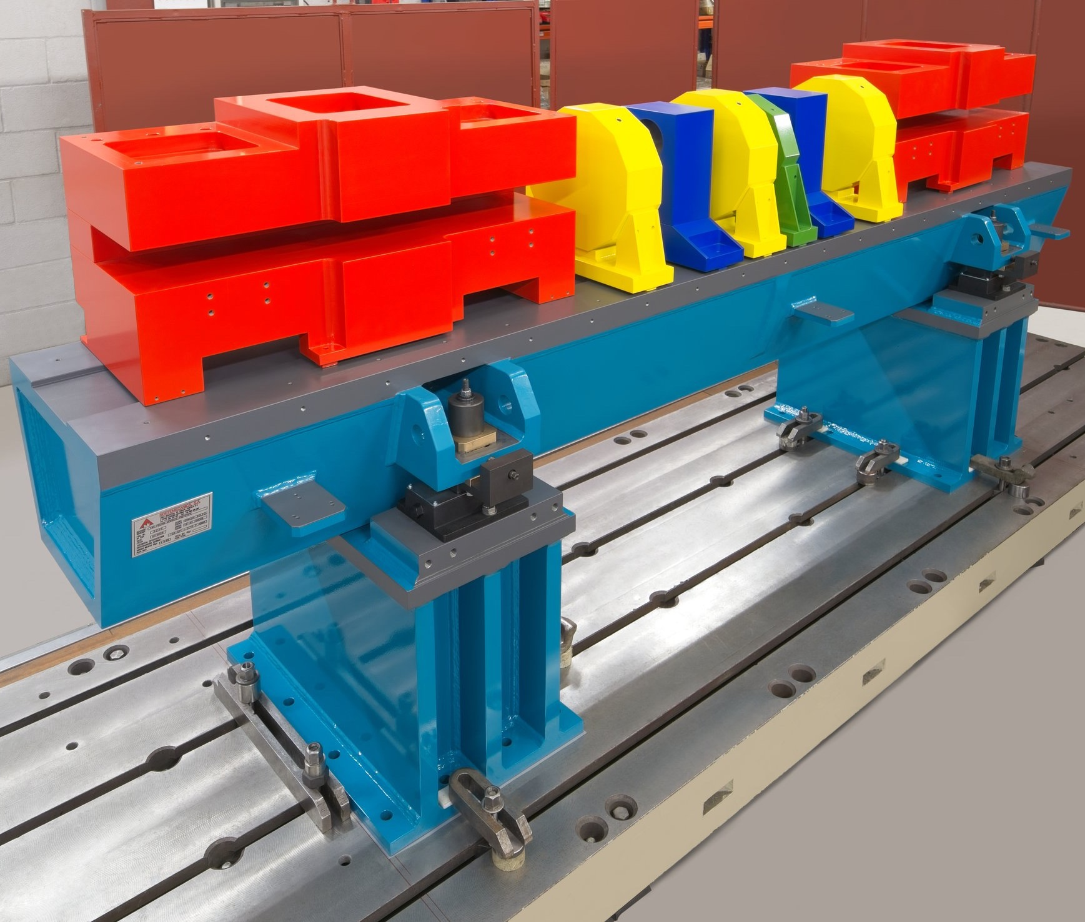
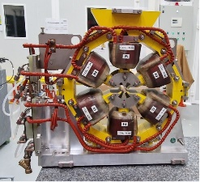
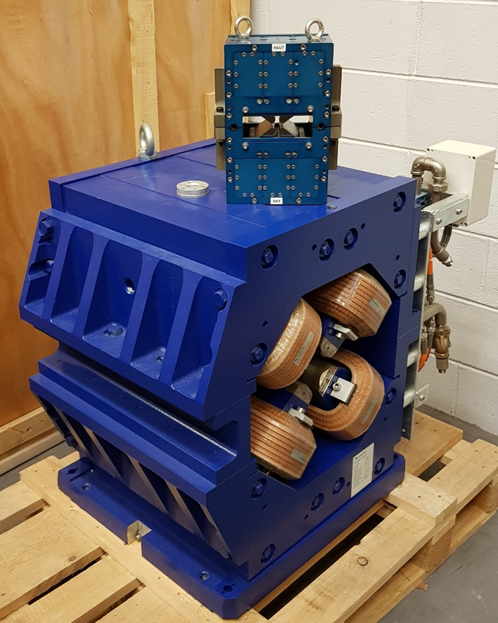
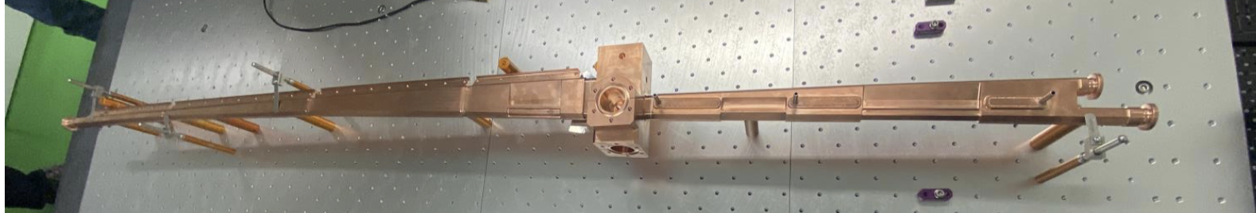
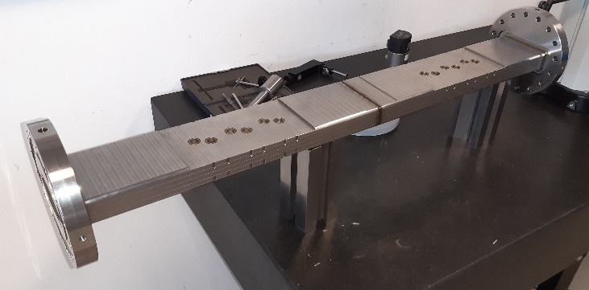
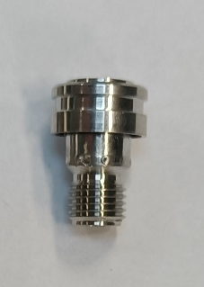
Visit
SOLEIL tour today:
  3 groups
  Meeting point here in Libra room at 13:50 for grouping (please don’t be late)
  Entrance in the tunnel is not allowed in case of pregnancy or for people with pacemaker or defibrillator implant.
  Content:
    Diagnostics hutch
    1 section of the tunnel
    RF room
    Control room
    Vacuum and magnets & IDs labs
Notch sextupole prototype
Quadrupoles
1- SOLEIL (electro-mag.)
2- Prototype SOLEIL II (permanent mag.)
Girder prototype
Bending magnet CUCrZr vacuum chamber prototype
Vacuum chamber to test the BPM button prototypes

Slide 10
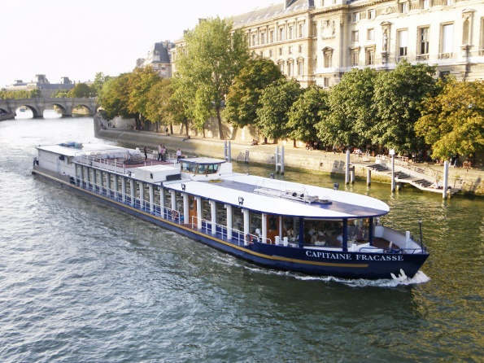
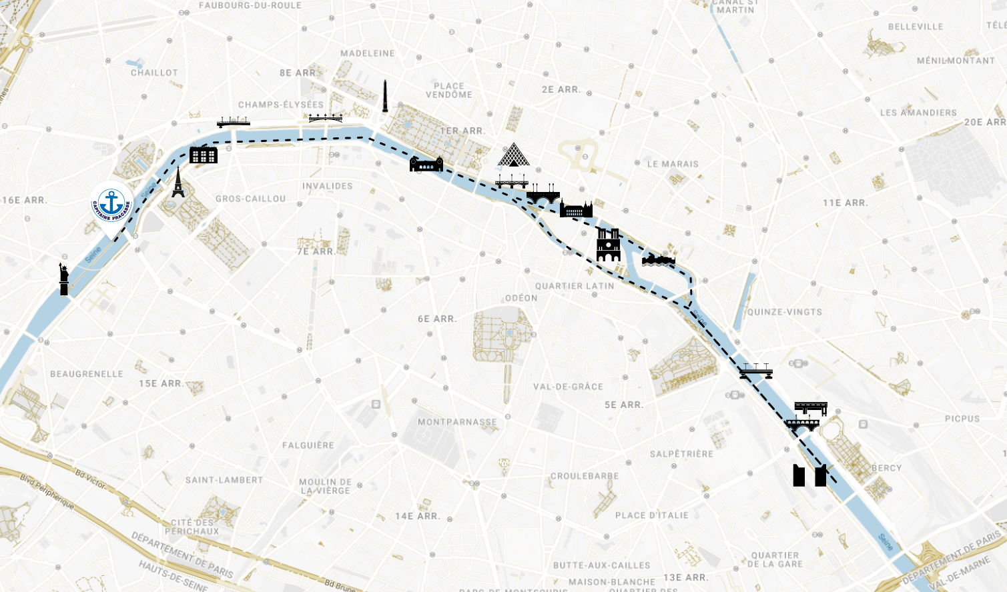
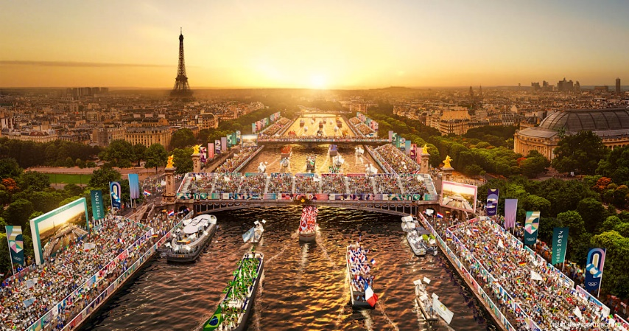
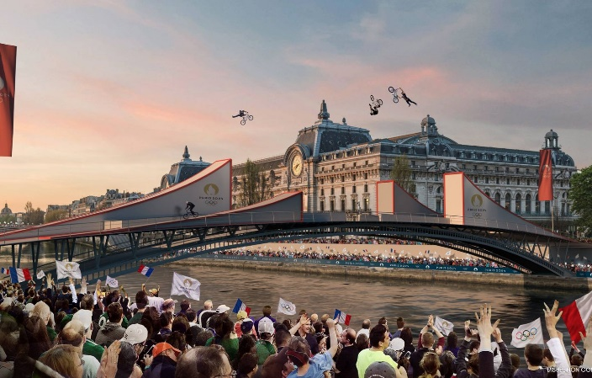
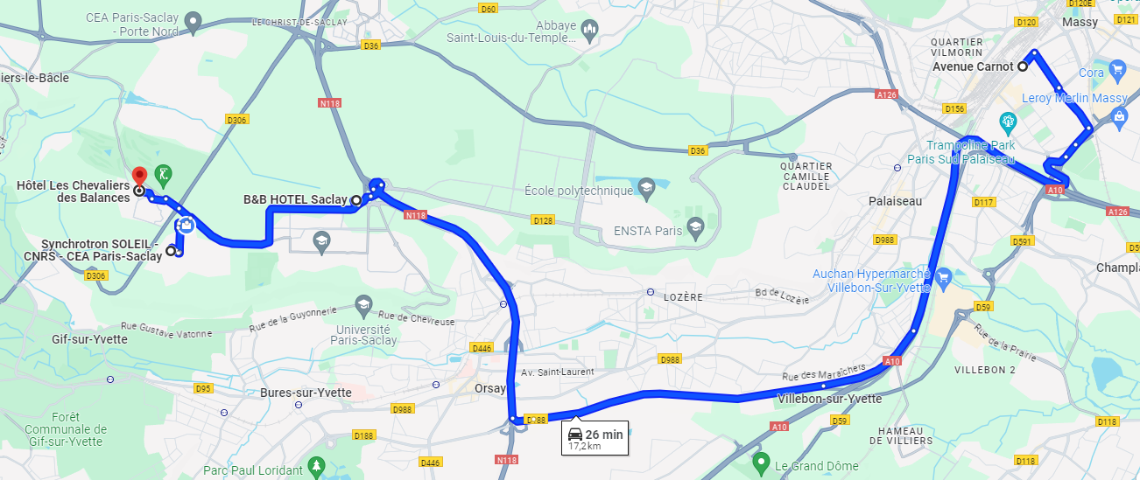
Dinner
Come on board Capitaine Fracasse!
Cruising dinner on the Seine:
  Rehearsal for the Olympics opening ceremony
  Fixed schedule:
    Boarding: 20:15
    Departure: 20:45
    Return: 23:00
Bus will leave SOLEIL at 19:00:
  Meeting point on the parking at the entrance of SOLEIL
Bus will be back at SOLEIL around 00:00, dropping before at Massy and B&B Hotel Saclay.
1st Massy
4th Chevalier des Balances
2nd B&B Paris Saclay
3rd SOLEIL

Slide 11
Acknowledgement
We are very happy to host the workshop.
Thanks to all the participants for coming and for your participation.
Special thanks to Deborah Iorio for the organization!

